Slide 1
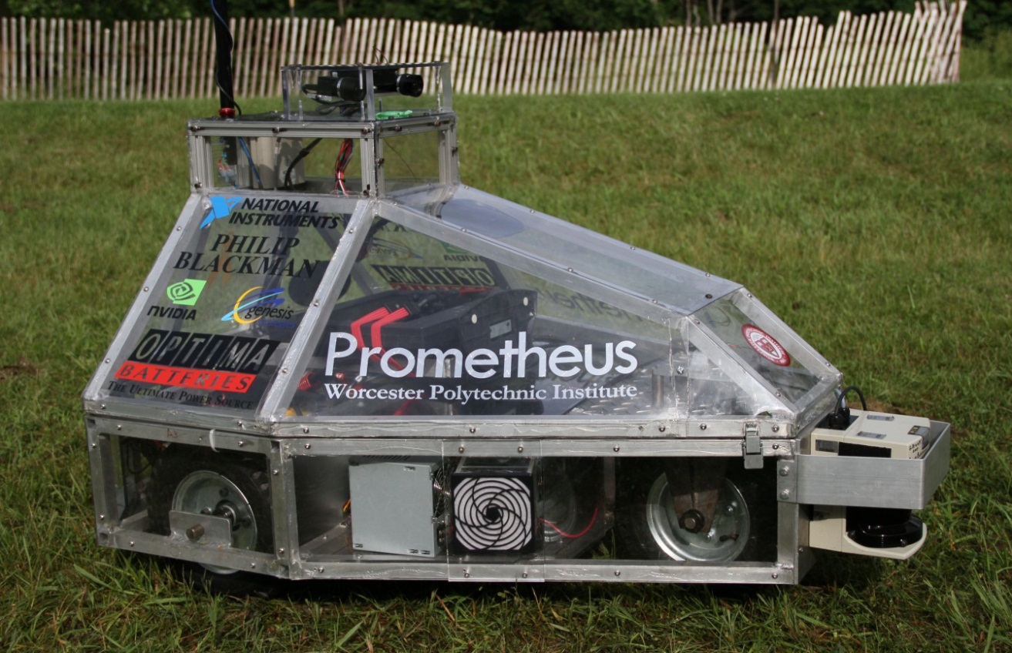
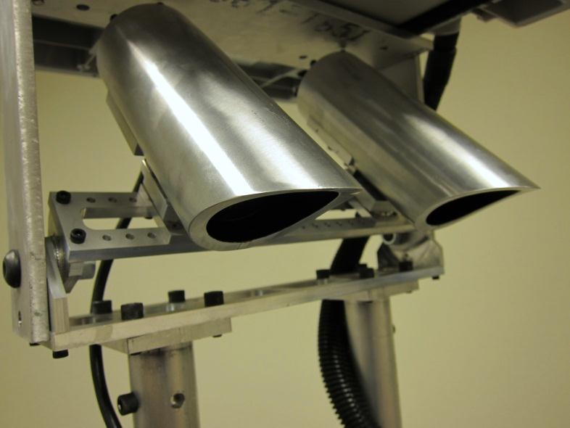
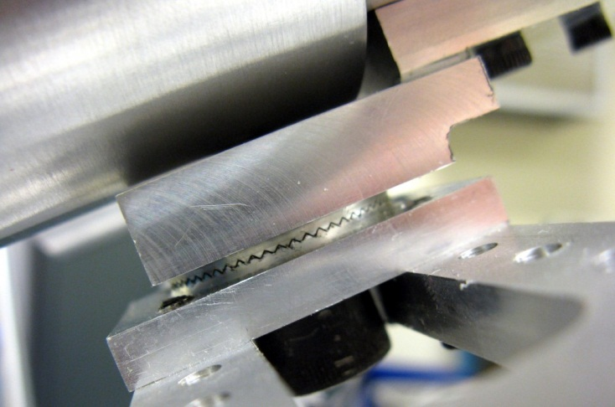
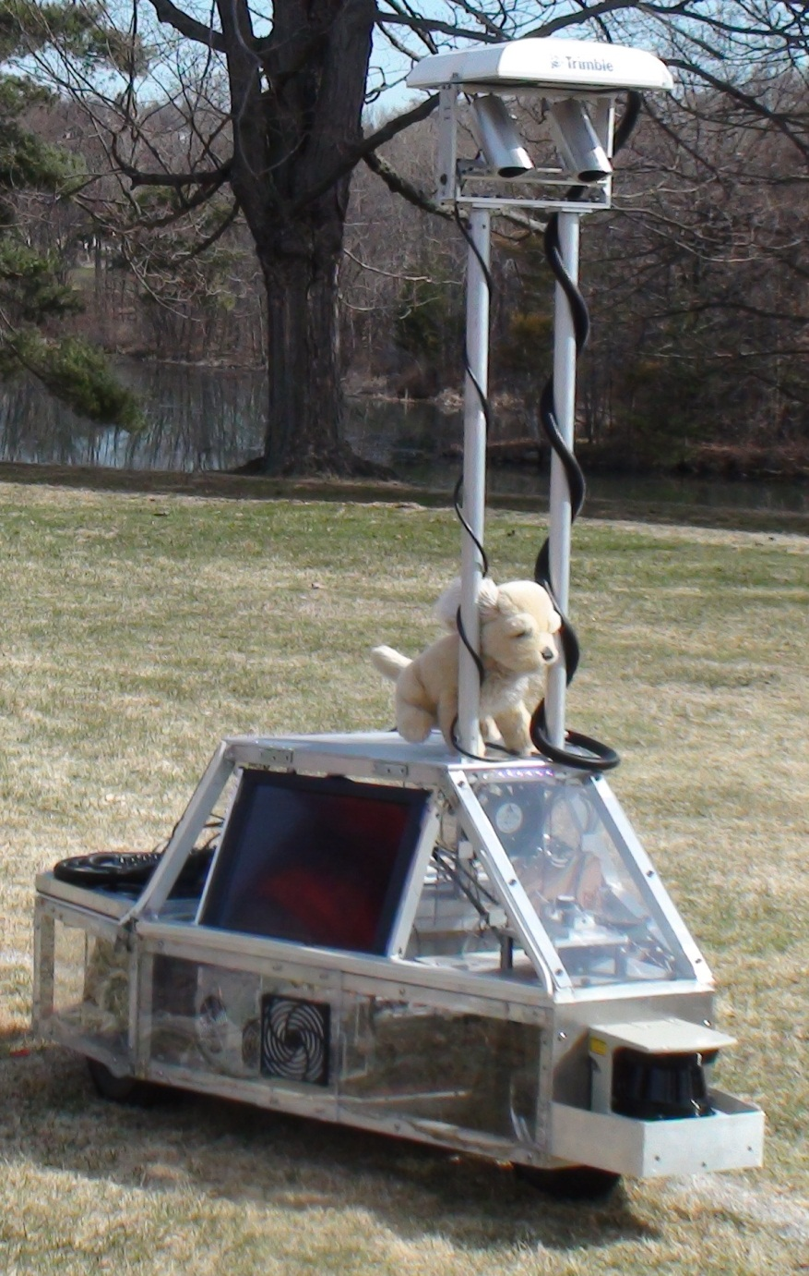
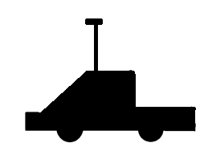
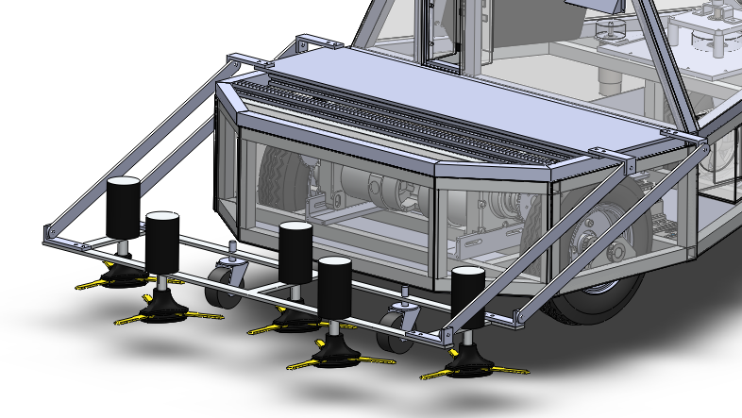
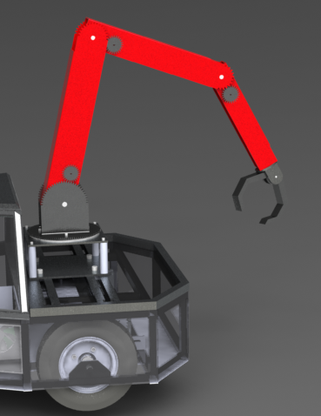
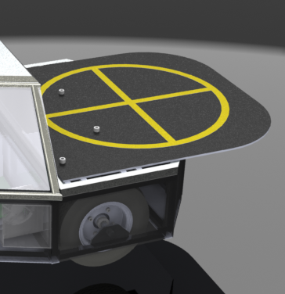
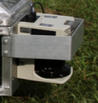
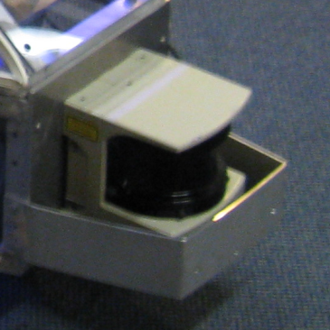
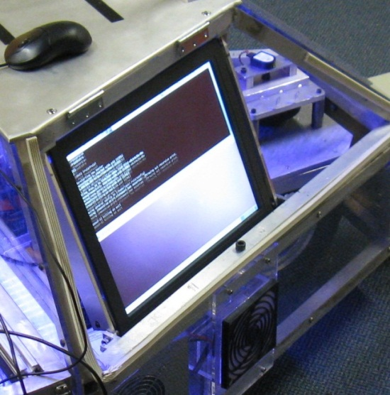
Realization of Performance Advancements for WPI’s UGV- Prometheus Mali Akmanalp, Ryan Doherty, Jeffrey Gorges, Peter Kalauskas, Ellen Peterson, Felipe Polido Robotics Engineering, http://robot.wpi.edu Advisors: Professors Taskin Padir, Stephen Nestinger, Michael Ciaraldi, William Michalson, Ken Stafford
Abstract
The objective of this project is to design and implement performance improvements for WPI’s intelligent ground vehicle, Prometheus, leading to a more competitive entry at the Intelligent Ground Vehicle Competition. Performance enhancements implemented by the project team include a new upper chassis design, a reconfigurable camera mount, extended Kalman filter-based localization with a GPS receiver and a compass module, a lane detection algorithm, and a modular software framework. As a result, Prometheus has improved autonomy, accessibility, robustness, reliability, and usability.
Mechanical Improvements
The top cover of Prometheus was reconstructed to address a number of areas where there was room for improvement. Debugging and modifications to the software required opening the cover and plugging in a mouse, keyboard and monitor. The robot didn’t give any feedback in real time. The cameras often had difficulty detecting lines, especially in low angle light conditions. Also the field of view began more than two feet ahead of the robot, which proved to be a problem in confined operating spaces. The position and orientation of the LIDAR was too low for obstacle avoidance in thick grass.
Camera Mounts
Better Location – decrease minimum field of view distance
Reconfigurable – adjustable yaw, pitch, height and baseline
Light Isolation – less glare, polarized lenses
Repeatability – no-slip, planar knurling for yaw and pitch
Baseline
2010 Prometheus Design
Pitch
Yaw
Reconfigurable
Height
Planar knurling
Universal Mounting Platform
Allows for expansion of robot capabilities and instrumentation.
$$x$$
$$x$$
$$l$$
$$l$$
$$y$$
Current expansion:
Lawnmower attachment for ION Autonomous Lawnmower competition.
Future expansion:
Robotic arm
Quad rotor landing pad
$$h$$
$$y$$
$$h$$
$$L$$
$$L$$
Old
New
$x=$ camera to back wheel
$l=$ camera to obstacle
$h=$ ground to obstacle
$y=$ ground to camera
$L=$ front to back wheel
Changing the elevation and position of the cameras decreased the minimum field of view distance.
Lawnmower attachment design
LIDAR Reconfiguration
User Interface
Old
Detects thick grass as obstacles
New
Increased elevation and better protection by the bumper.
Touchscreen
Allows for direct feedback during operation as well as easier in field debugging
Background
Prometheus is a contender in the Intelligent Ground Vehicle Competition (IGVC). The competition requires project teams to design a small outdoor vehicle that will autonomously travel from a starting point to a number of target destinations, while avoiding obstacles. The entries are judged based on a number of criteria including design innovation, a written report, an oral presentation, and overall performance during the competition.
Prometheus was the creation of a 2010 WPI MQP group which built it from the ground up. The vehicle uses an array of sensors which constantly collect and process information about its environment. This information aids in the robot’s localization and autonomous navigation.
Visual Cues
RGB LEDs on the front and back indicate the status of the robot during run time. Battery voltage display allows for monitoring status
Reconstructed Steering Mechanism
Sponsors
External Interface
Components can be attached without opening the cover. Individual power switches allow for specific components to be reset.
Keyed shaft replaced set screw eliminates slipping.
Thicker shaft reduces shear stress where the shaft is welded to the yoke.
Thrust bearing at the end of the shaft to reduce friction while turning under loads.
cRIO and LIDAR power
Computer power
12 Volt
VGA
CAT6
USB
Touchscreen with LEDs indicating manual control

