Slide 1
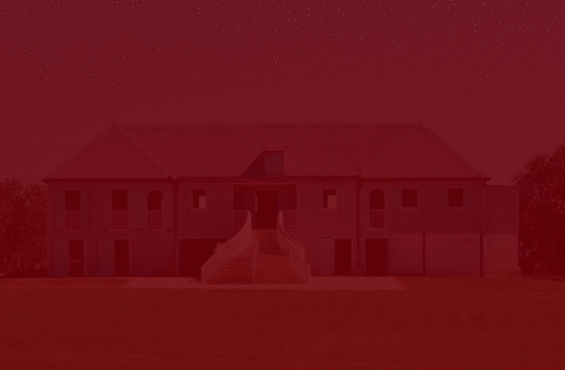


Historic Bridge Preservation
Harry Chartoff
Steven D’Agostino
Maggie LaRoche
Travis Rossen
Notes:
Maggie: Hi my name is Maggie LaRoche………→ and our project is entitled Historic Bridge Preservation
Mention what we’re studying

Slide 2
Presentation Overview
Introduction
Our Project
Assessments
Solutions
Recommendations
Notes:
Introduction: overview of the conservation issue in Puerto Rico and the groups that have formed to combat it.
Our Project: why we are working with Para La Naturaleza to solve this issue.
Assessments: We will give an in depth look at the current state of the two bridges and the actions our team took to work on solve these issues
Solutions: This section will alllow us to present to you all of the ideas that we to re-create access over these two bridges
Recommendations: We will show you the final bridge designs and materials that we recommend PLN use when reconstructing the bridges

Slide 3
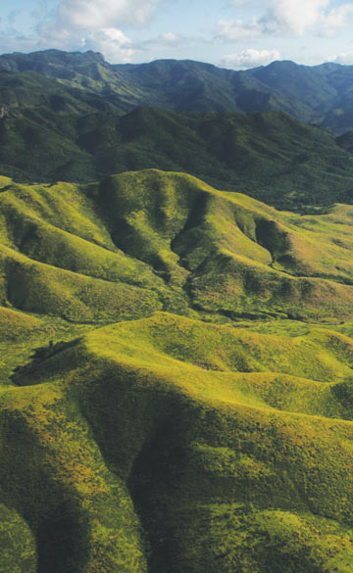
The Issue
“Urban sprawl and deforestation...began to take a huge toll on the island’s natural resources”
-Fideicomiso de Conservación de Puerto Rico
Notes:
Maggie: Because Puerto Rico is a small island, lack of space is a constant issue. Land developers often capitalize on open land to turn into new, urban developments. This problem became relevant in 1968 when Puerto Rico began to face an industrialization period to modernize the economy. Although the modernization would help the economy, land developers failed to realize the huge threat of deforestation that they brought to the island.

Slide 4
Organizations
involved in Conservation
Caborrojeños Pro Salud y Ambiente
Departamento de Recursos Naturales y Ambientales (DRNA)
Para La Naturaleza
Notes:
Maggie: To combat this issue many groups formed to conserve Puerto Rico’s natural lands. All of the groups have a similar goal to conserve the island’s lands and educate the public on the importance of conservation. Specifically, Para La Naturaleza has a goal to protect 33% of Puerto Rico’s land by 2033. Since their formation in 2011, the group has protected over 24,000 acres and have made great advancements towards conservation and historical restoration. I will now hand it of to Travis to give you a more in depth look at specific conservation efforts by Para La Naturaleza.
Conservation trust and PLN are the same, just include PLN and take out conservation trust

Slide 5
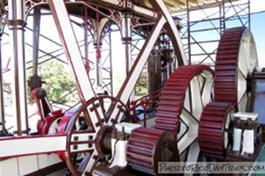
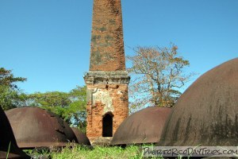
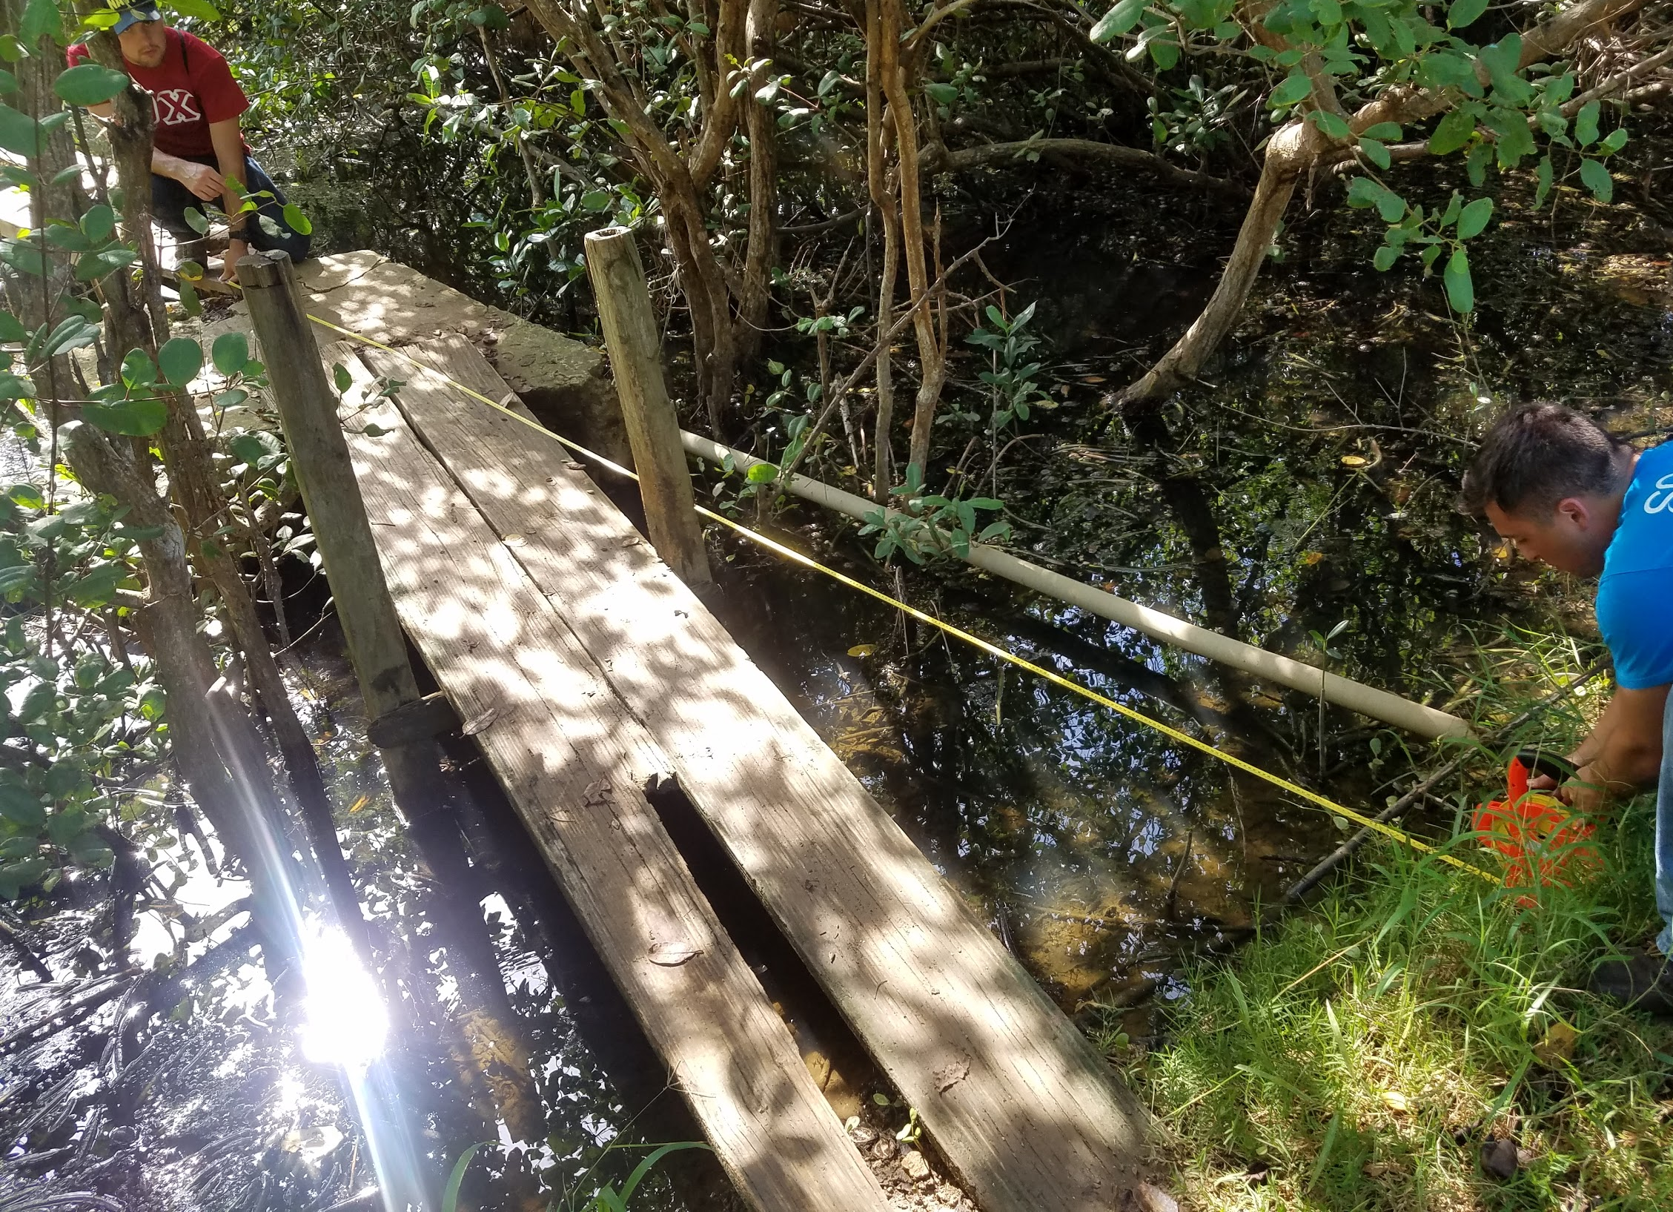
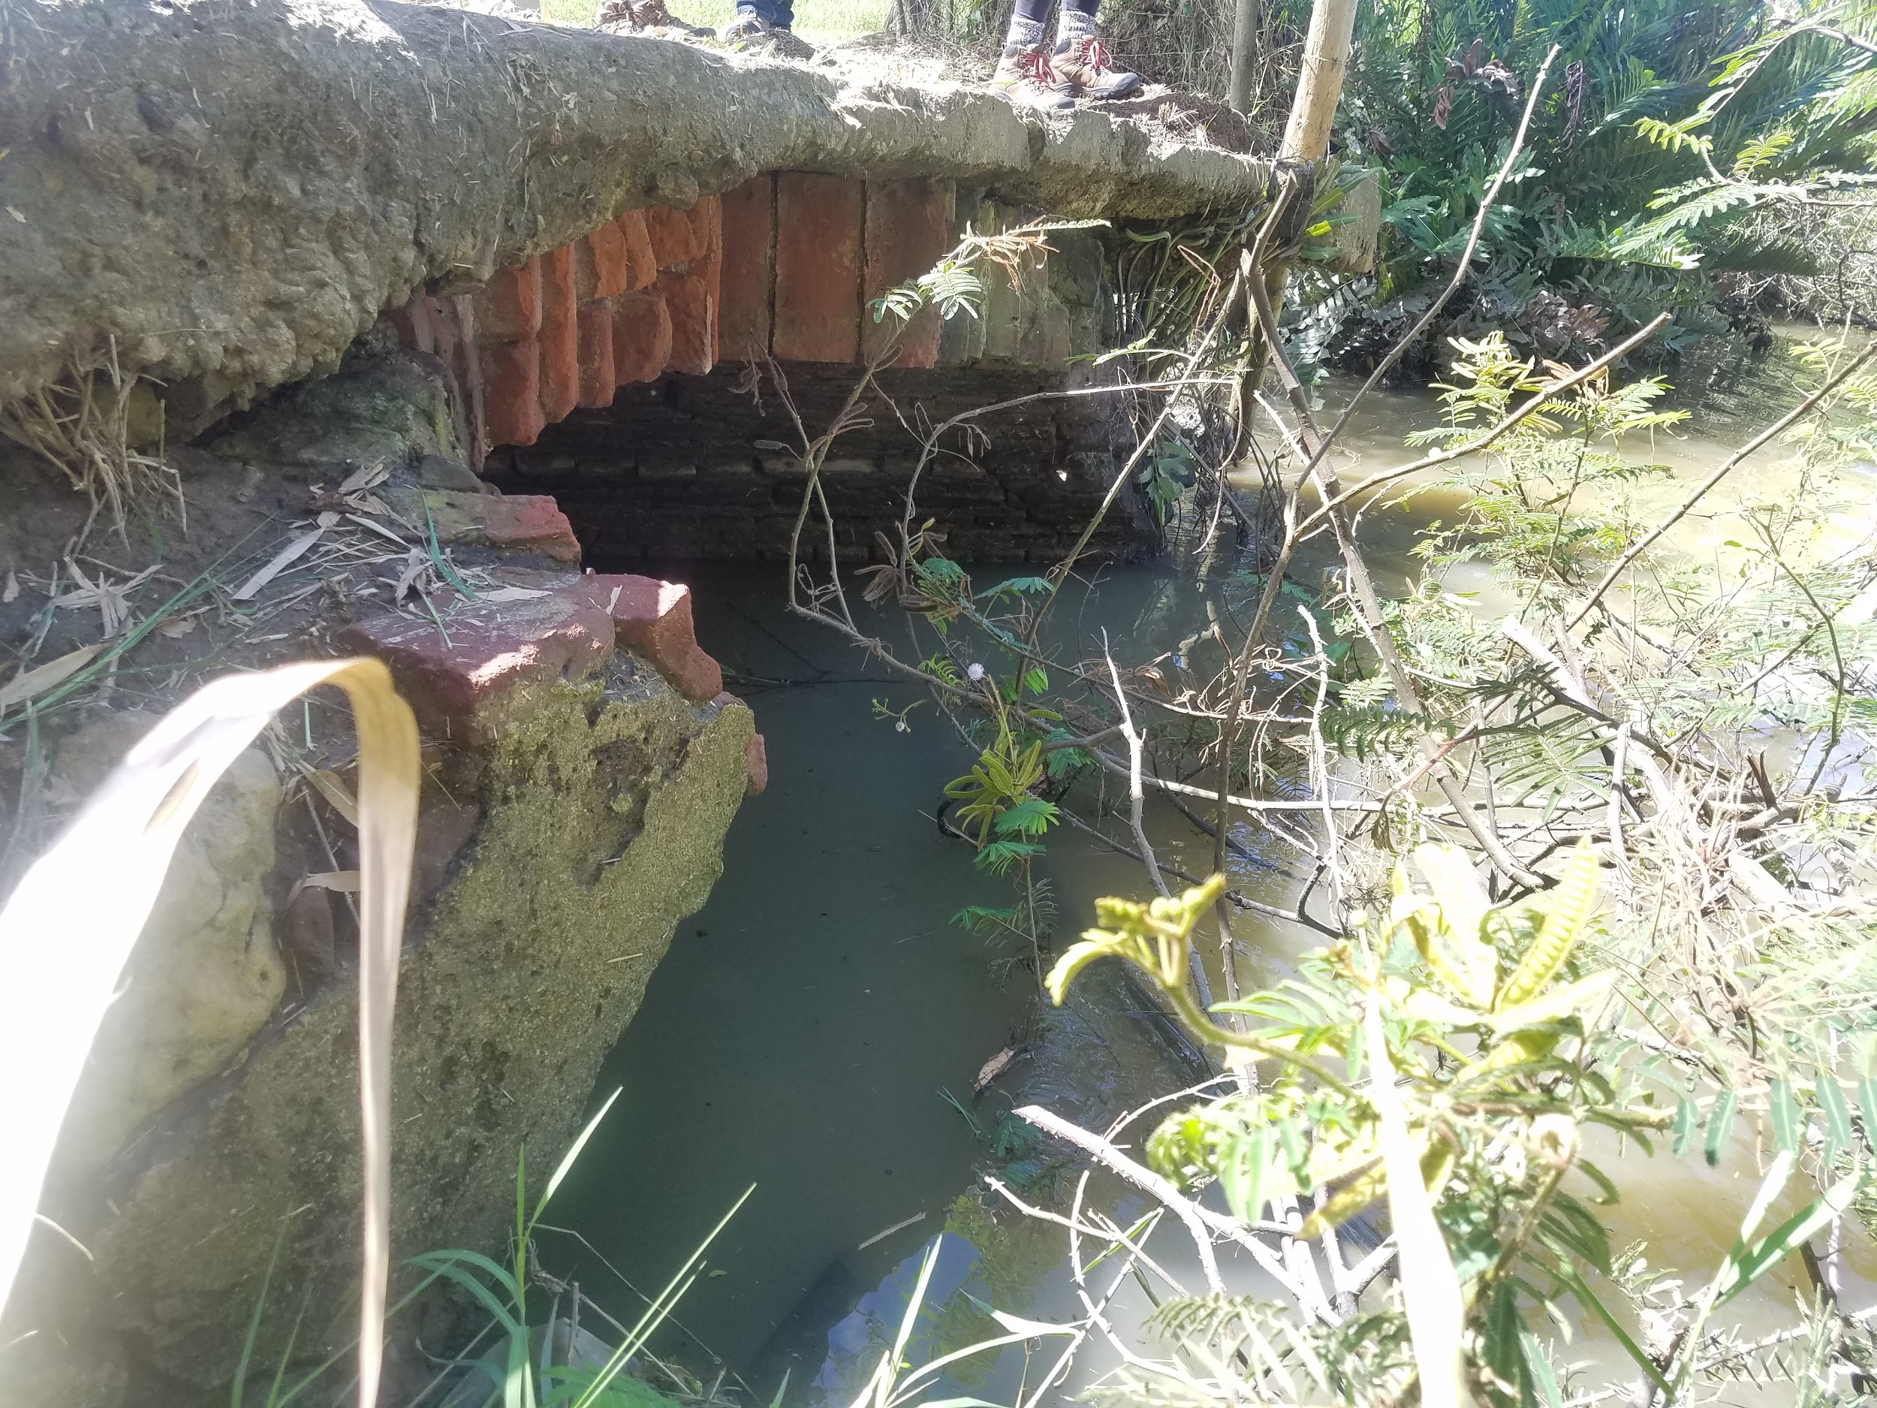
Conservation Efforts at Hacienda La Esperanza
Steam Engine Sugar Mill
Drying House
La Boquilla Bridge
María Hernández Bridge
Notes:
Travis: Multiple conservation efforts can be seen at Hacienda La Esperanza. On-site, Para La Naturaleza has successfully restored the steam powered sugar mill and the drying house seen above along with a number of other projects. Our project is to move forward with their conservation efforts to propose restoration plans for both La Boquilla Bridge and the Maria Hernandez Bridge.

Slide 6
Primary Objective
To develop structurally sound designs for both the María Hernández and La Boquilla bridges while utilizing the pre-existing historic structures to ensure public safety while minimizing ecological impact.
Notes:
Travis: Specifically, our primary objective is to (read above).

Slide 7
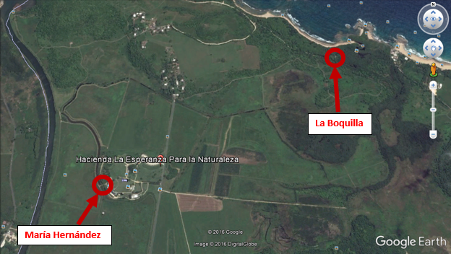
Location of the Two Bridges
Notes:
In the bottom Left we have the Maria Hernandez Bridge and to the Top Right we have the La Boquilla Bridge.

Slide 8
ASSESSMENTS
Notes:
I will now hand it off to Steven and Harry to give you a look at our on-site assessments of the bridges.

Slide 9
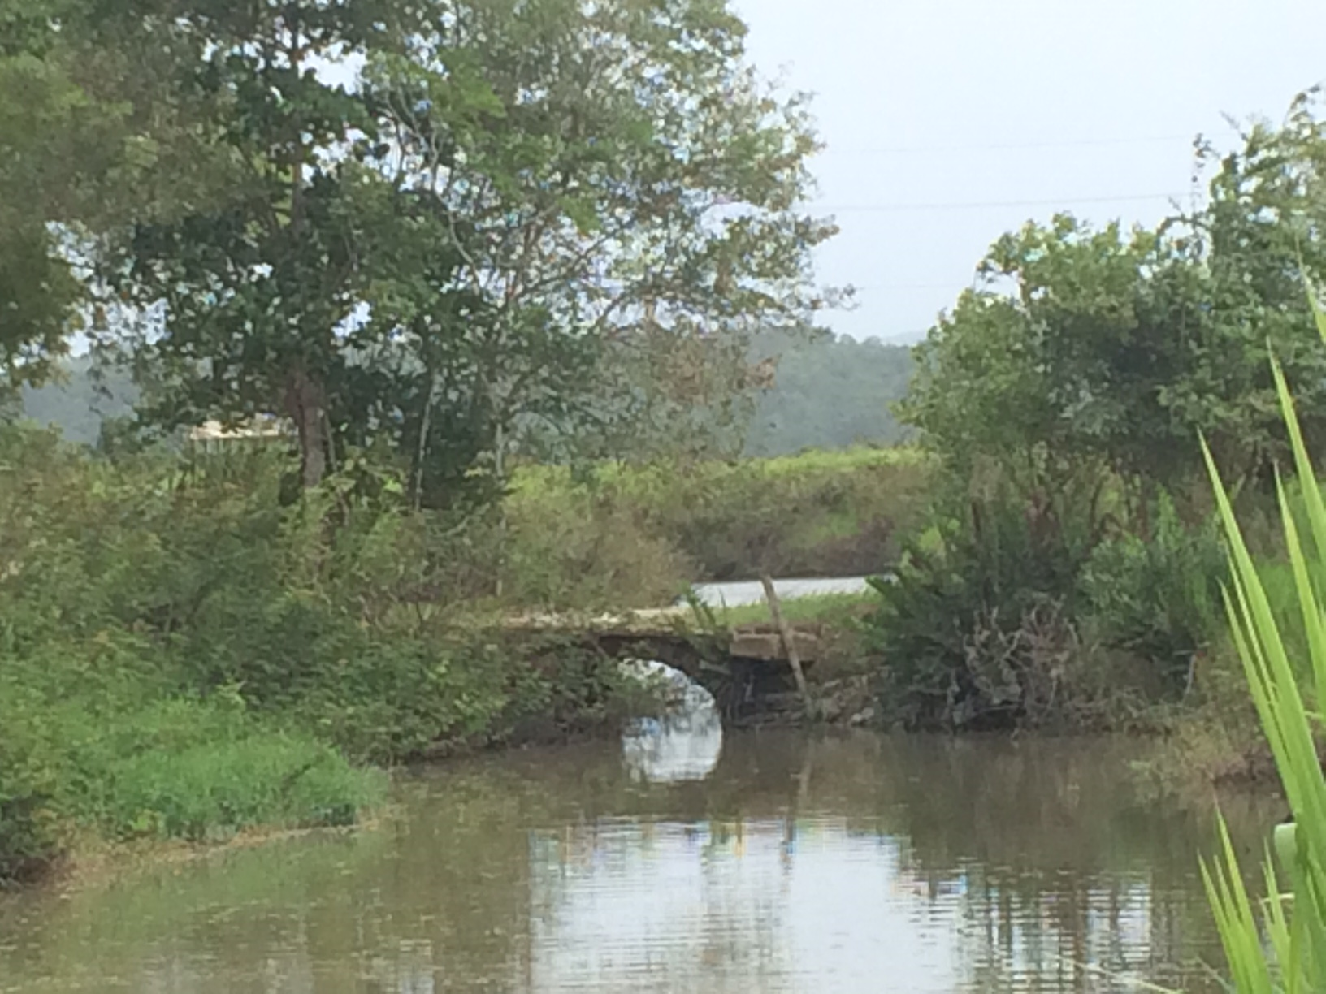
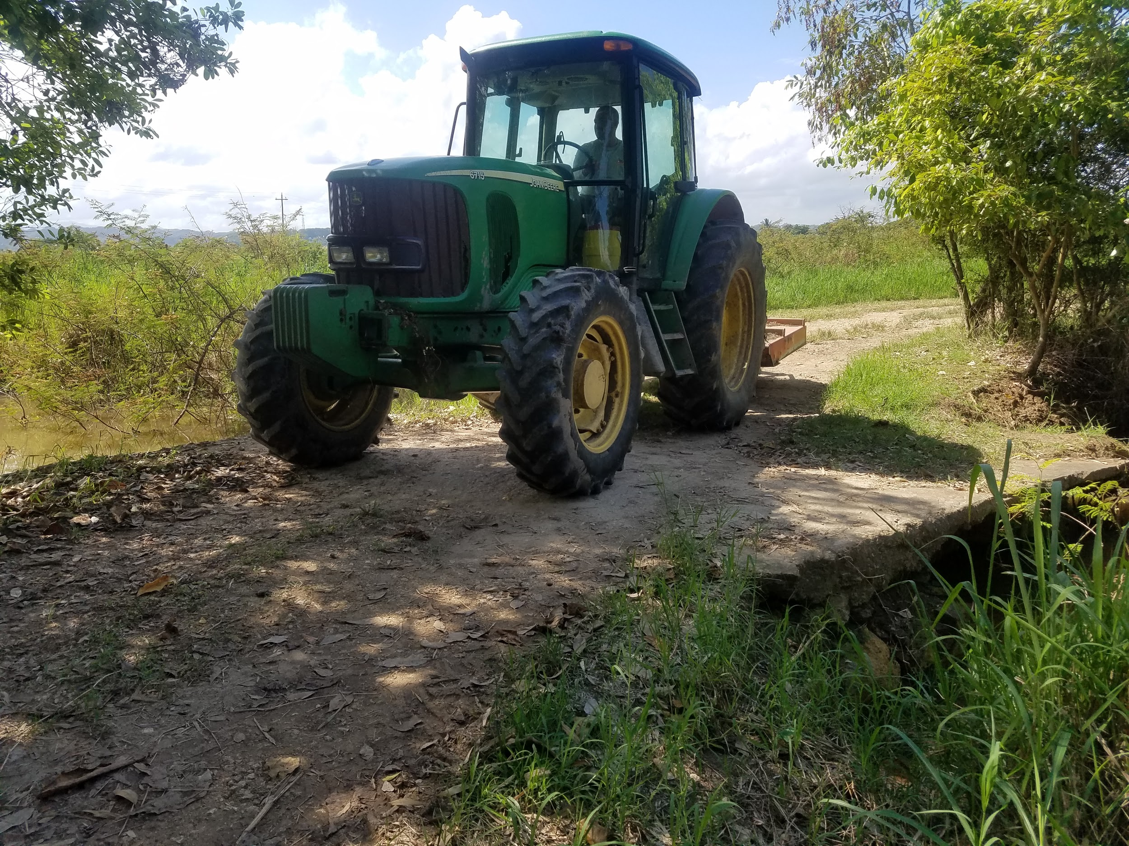
María Hernández Bridge
Notes:
These are a few pictures of the current bridge at Hacienda La Esperanza. As you can see from the photo on the left, there is an arch below the flat concrete slab. This arch is part of the original bridge. On the right you can see a large John Deer tractor safely traversing over the bridge.

Slide 10
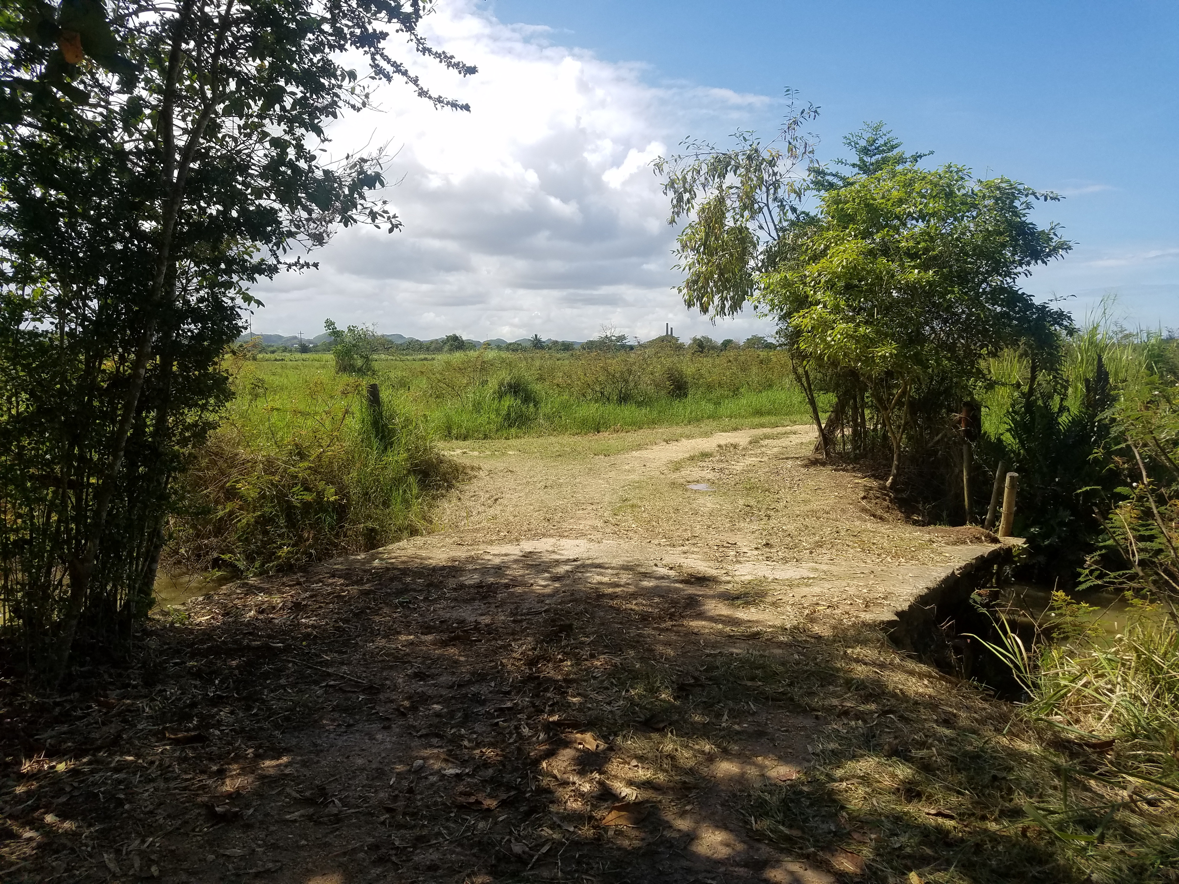
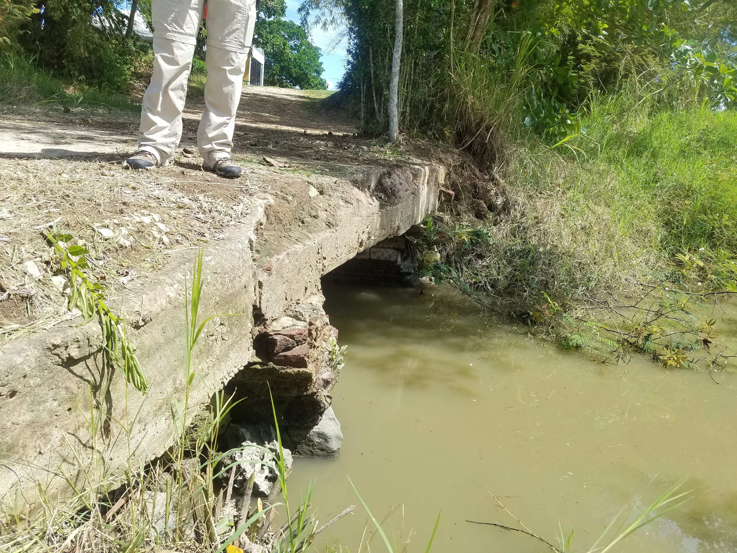
María Hernández Bridge
Notes:
While we were on site, we took alot of pictures and measurements, talked with Elizabeth and Carlos about the use of the bridge, and looked for cracks, erosion, and deformations. As you can see from the photo on the left, the bridge juts out towards the right. And here (point to the right) you can see erosion of the banks and deformation in the concrete.

Slide 11
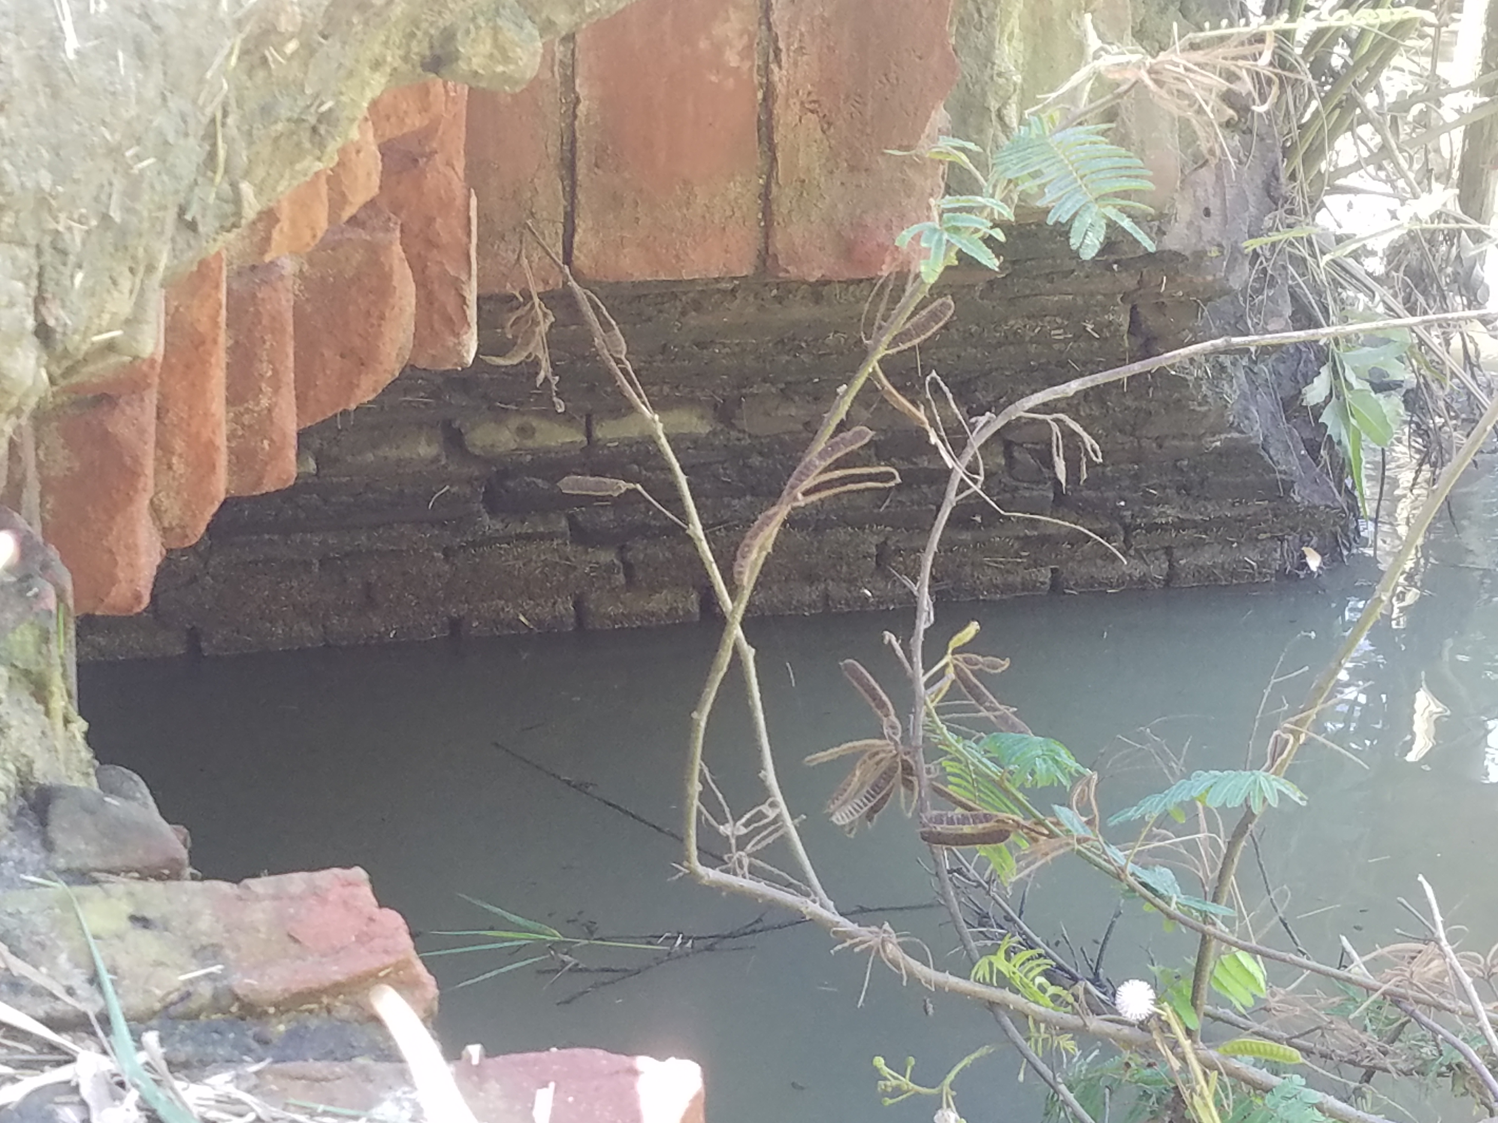
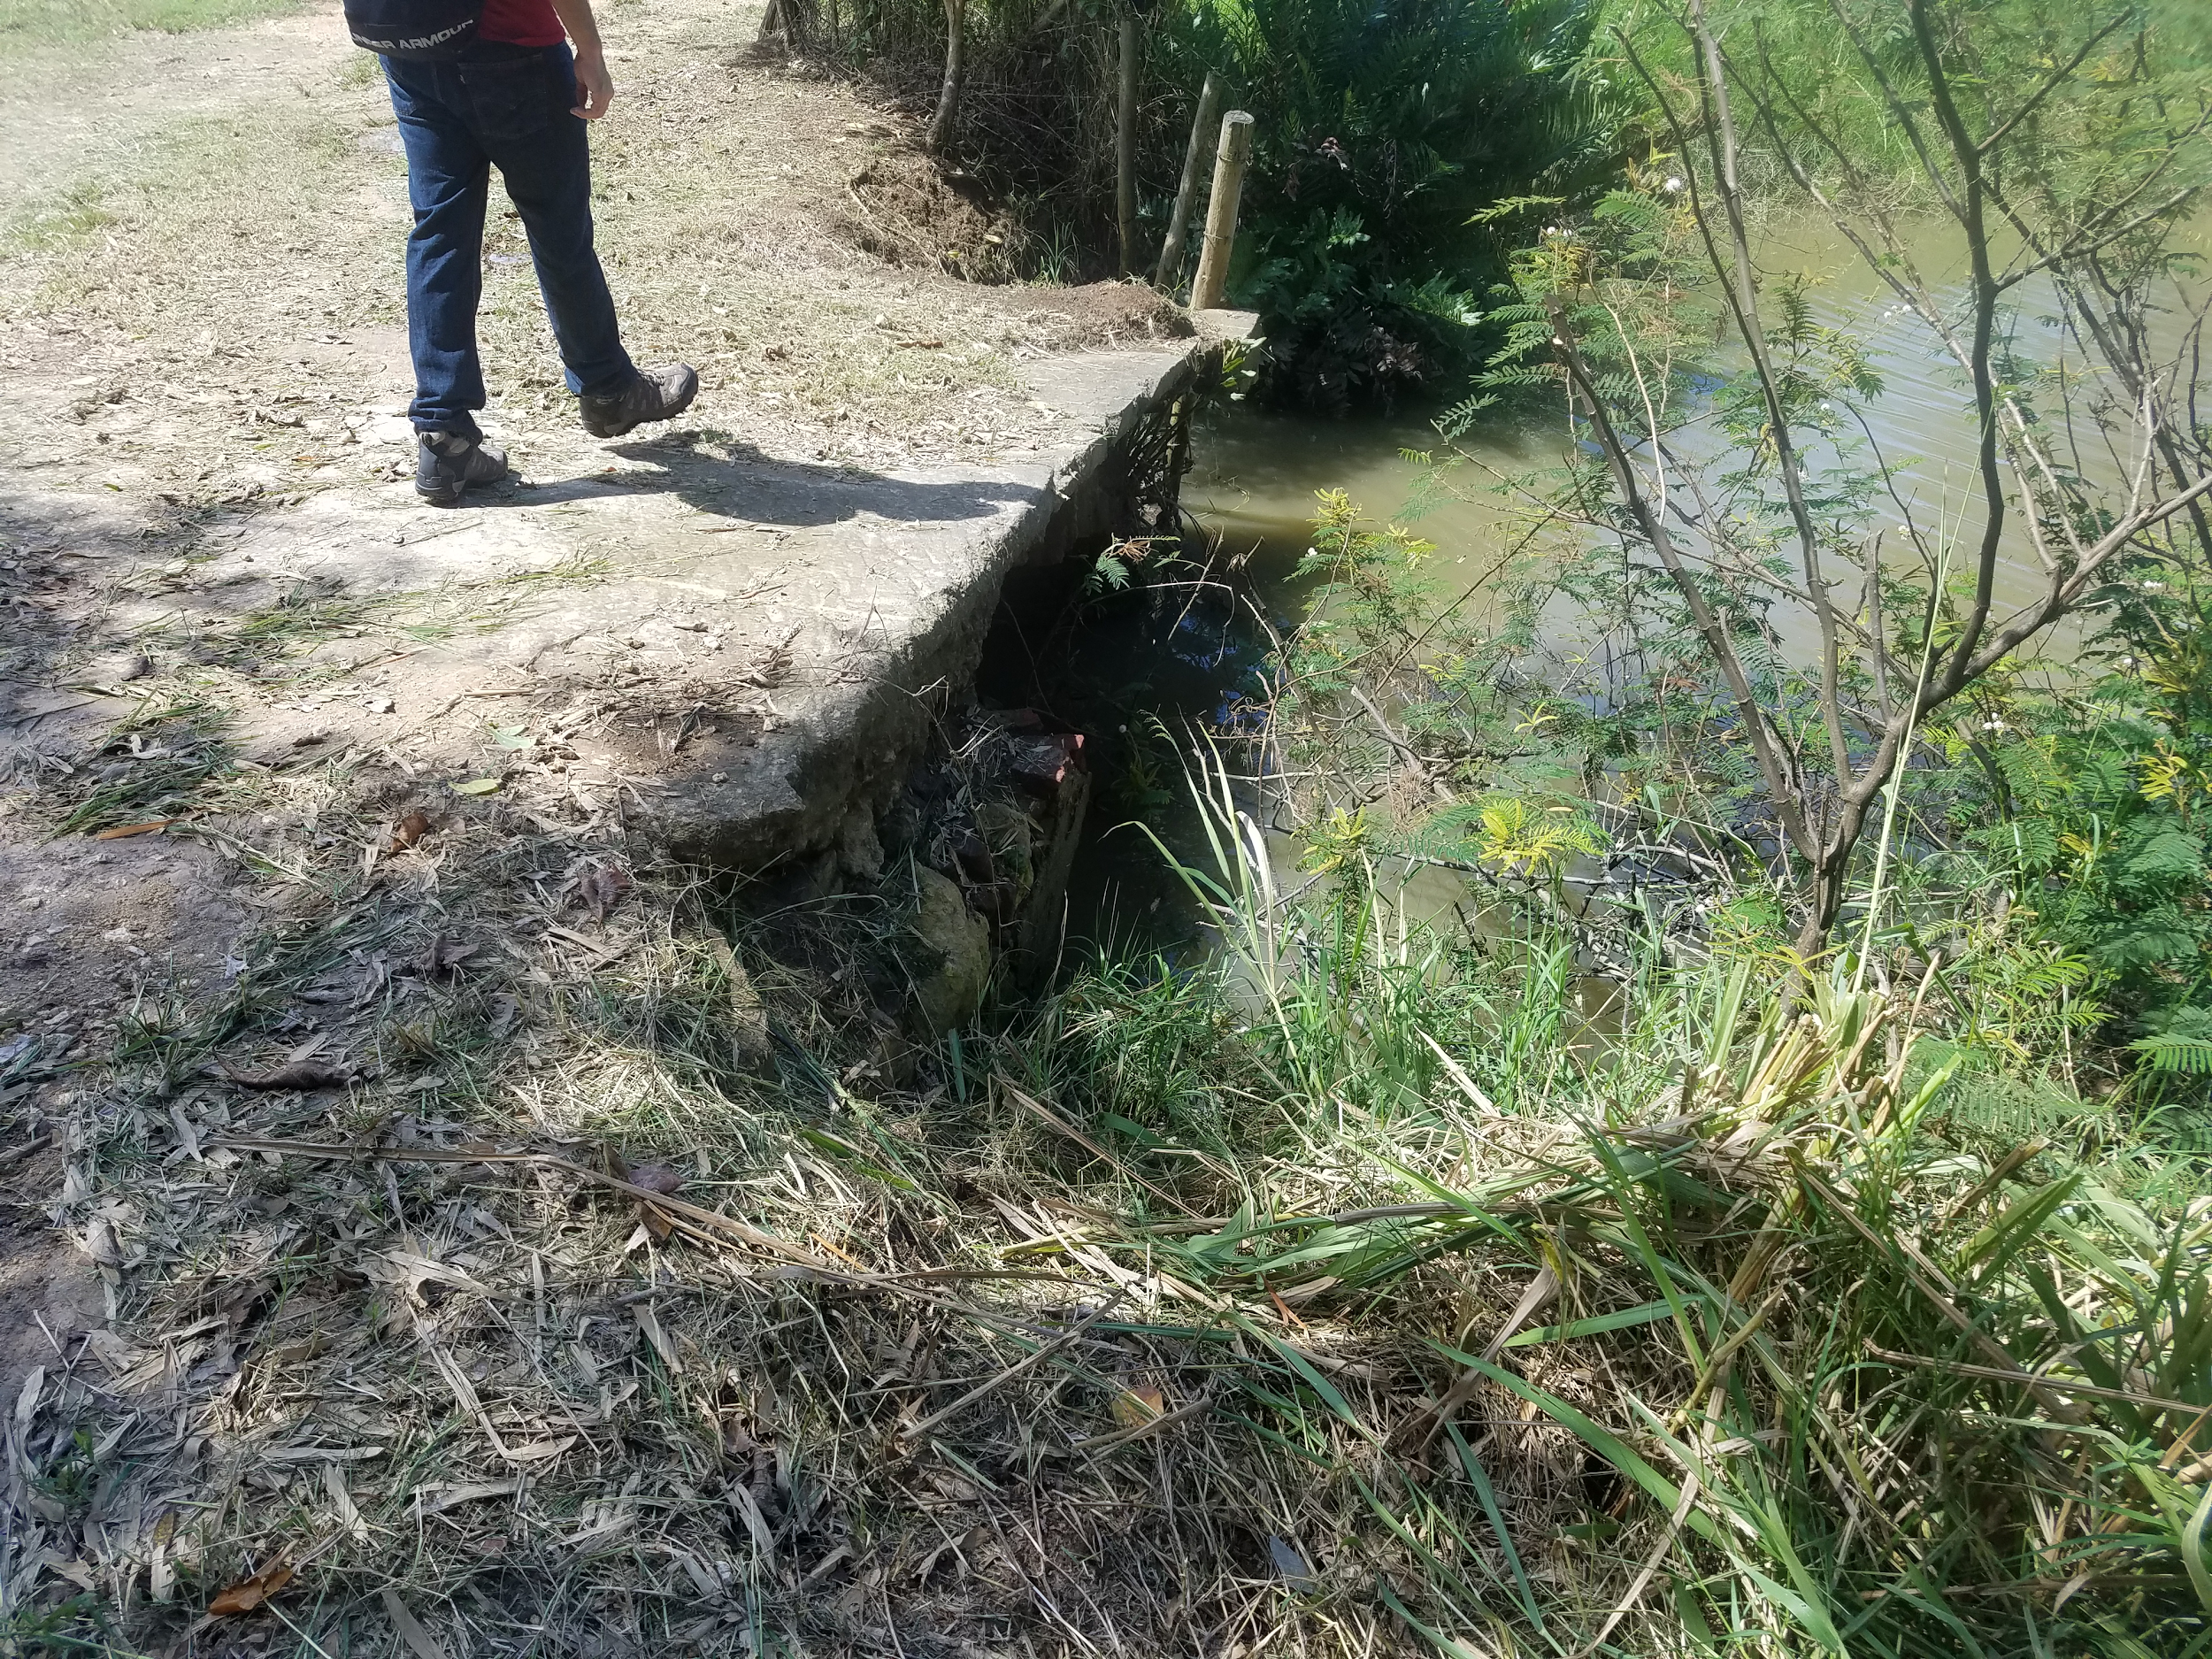
María Hernández Bridge
Notes:
On the left, shows a zoomed in picture of the underside arch and the right shows a better picture of the bridge shiting to the right and more erosion.

Slide 12
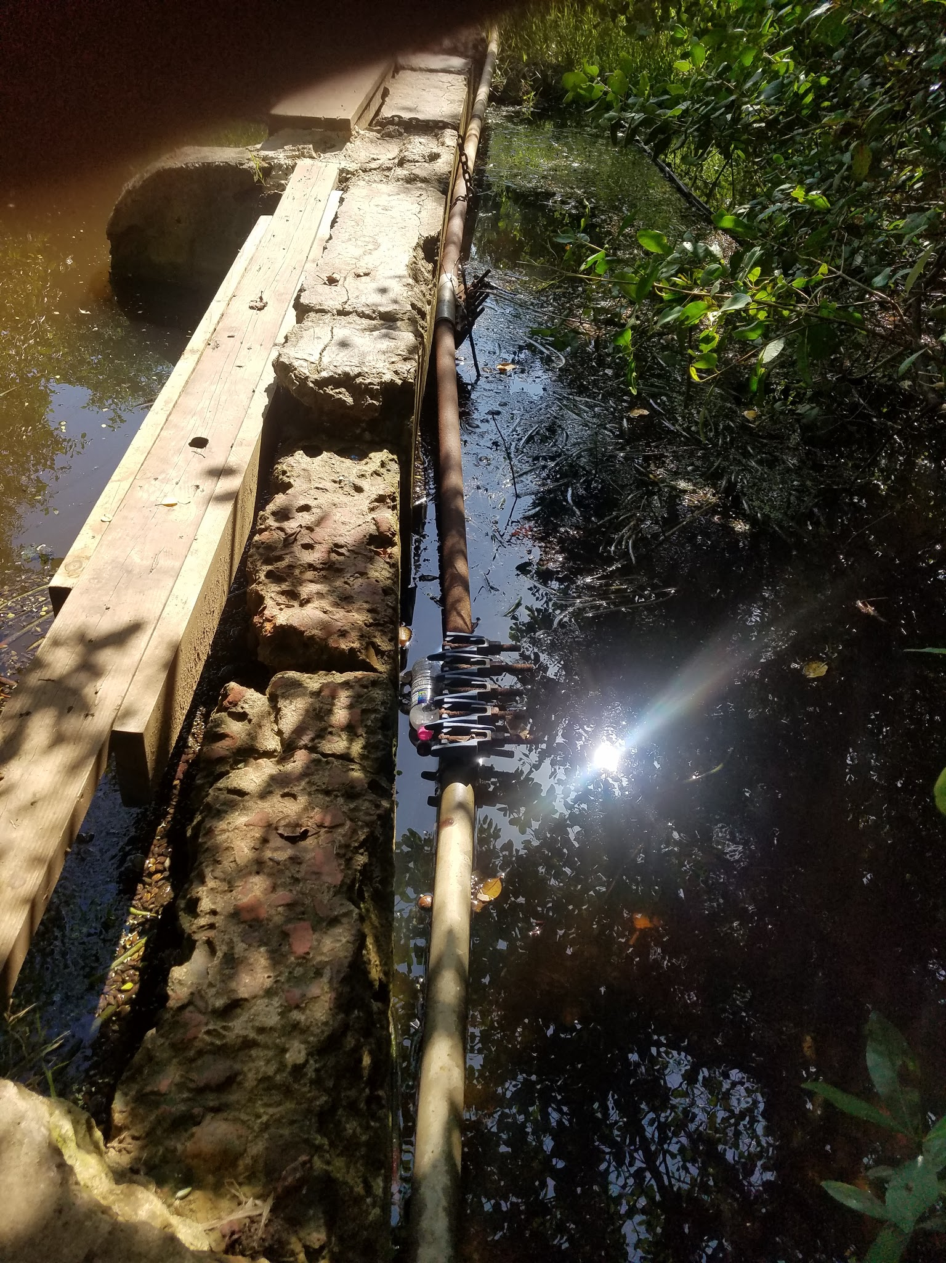
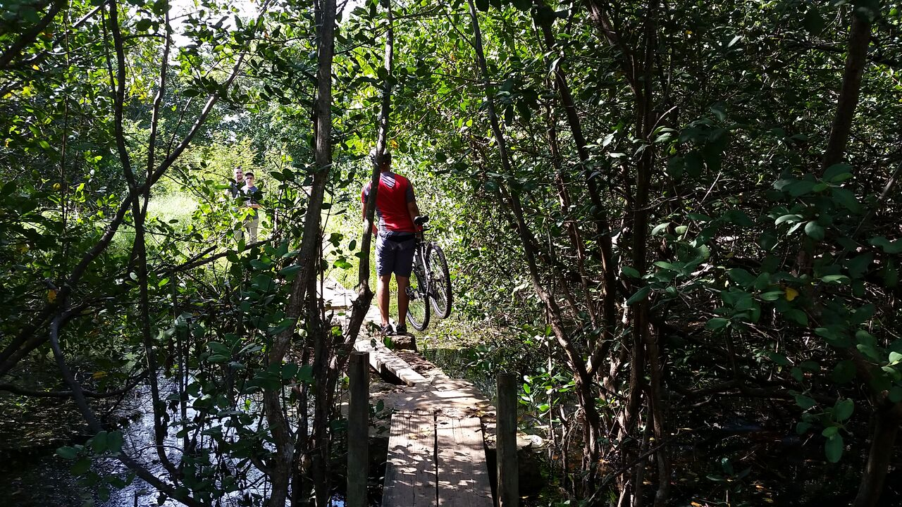
La Boquilla Bridge
Notes:
Harry: The initial state of the bridge was quite a sight to behold. There were literally just planks strewn across the abutments that were starting to wither away due to erosion, and it was very difficult to cross safely. It was also very inconvenient for bikers to cross, since they had to carry their bikes across, as you can see in the picture.

Slide 13
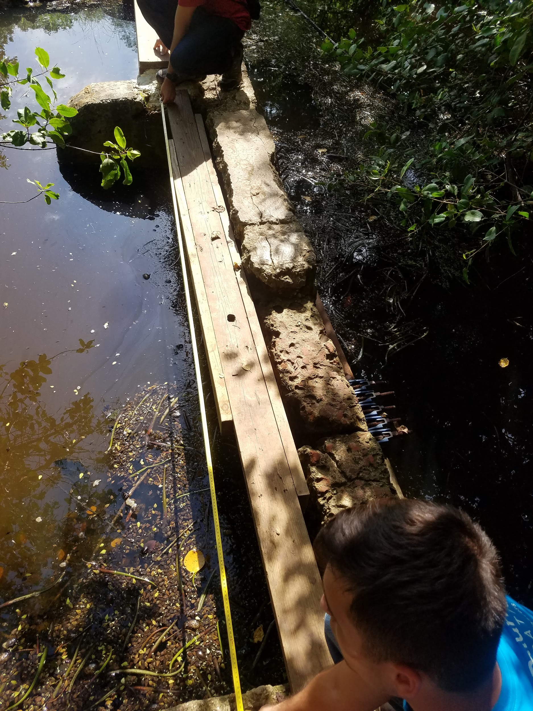
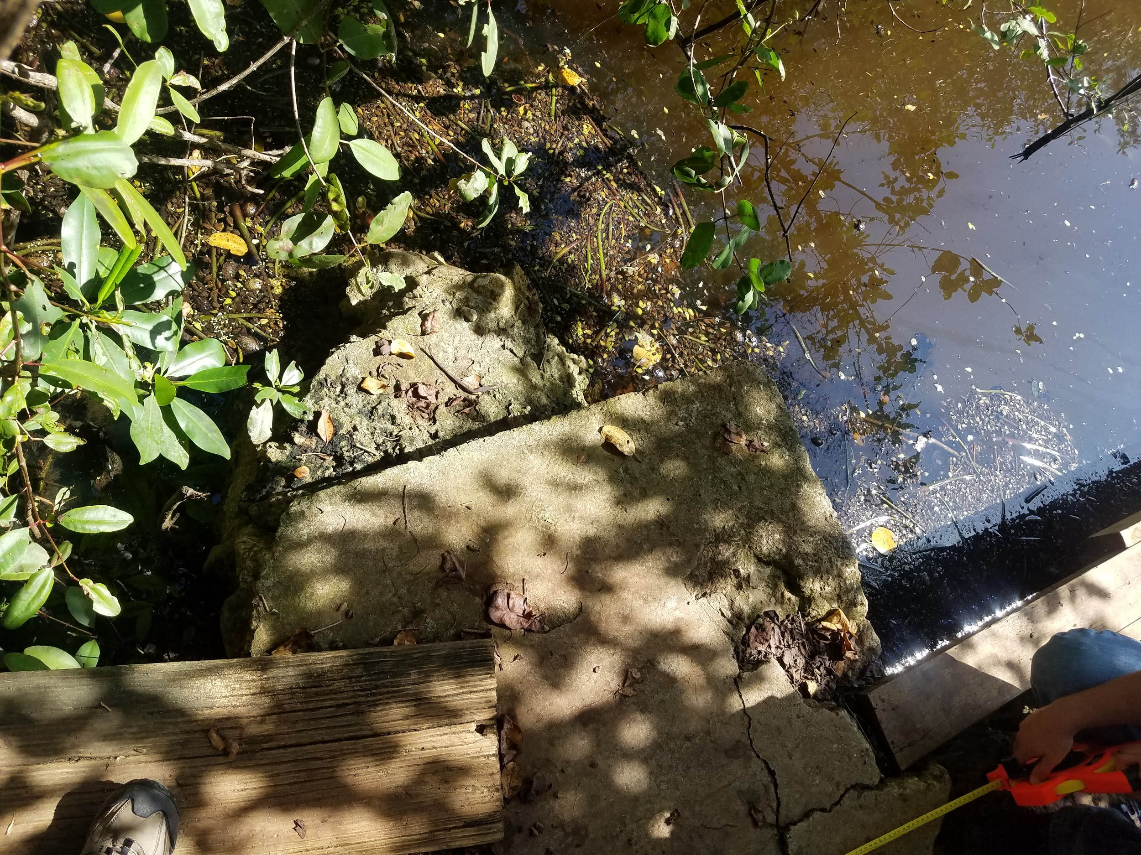
La Boquilla Bridge
Notes:
Harry: Here you can see us taking some of the measurements between the different abutments on the left, and you can see the angle that the bridge makes when it turns on the right.

Slide 14
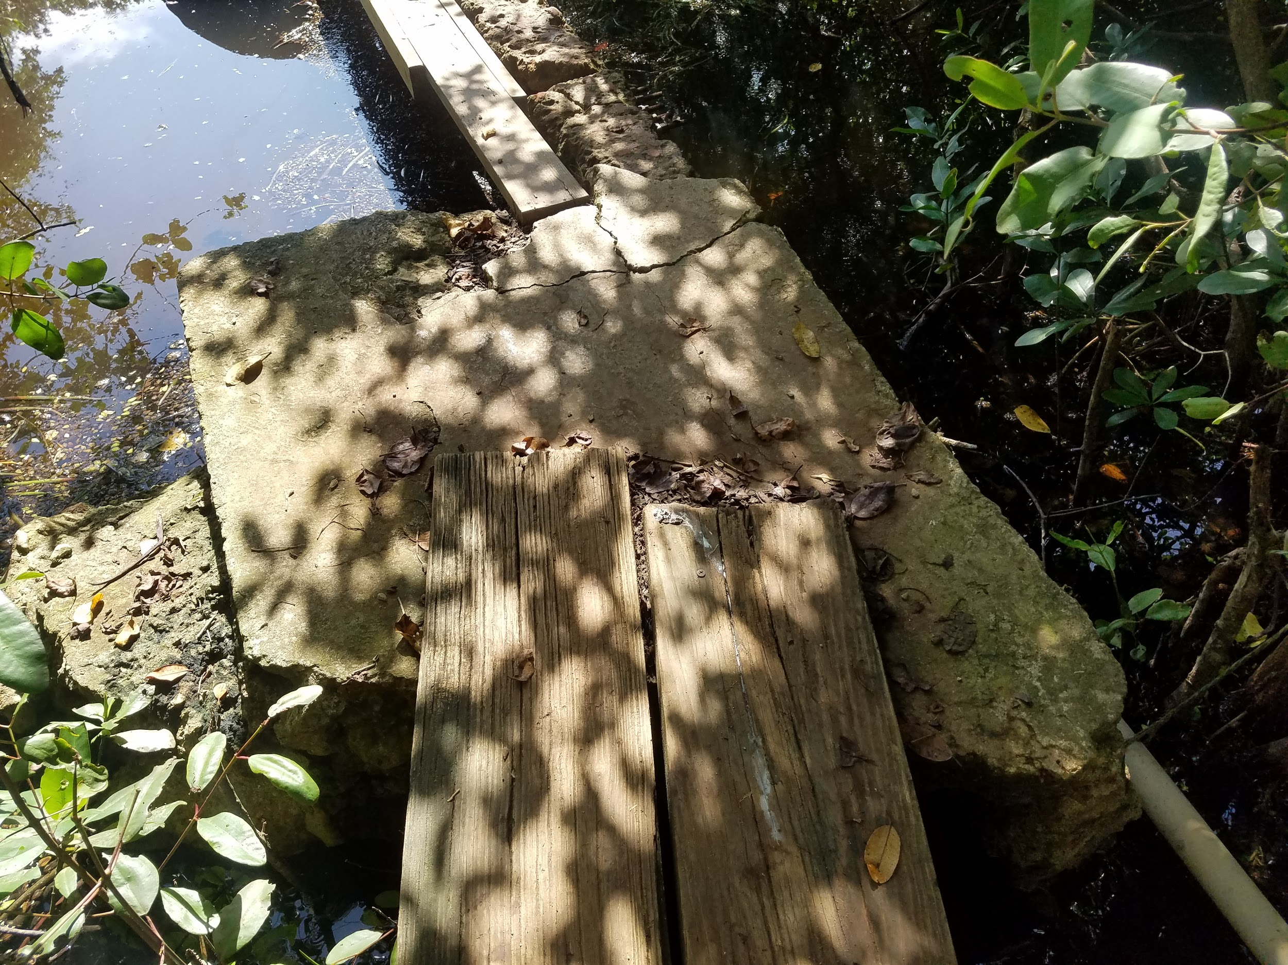
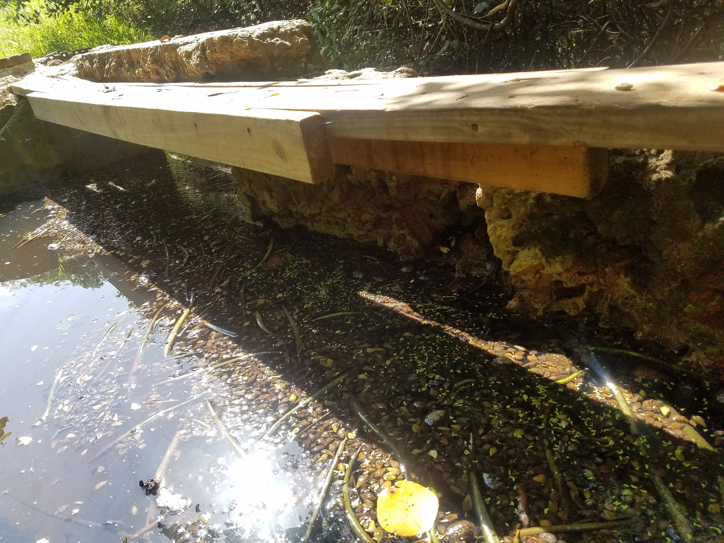
La Boquilla Bridge
Notes:
Harry: On the right hand side is another image of the angle that the bridge makes when you get to one side of it, and on the right you can see one of the weaker planks that really bows when you walk on it. It is very thin and they tried to compensate for that by attaching more wood to it, but as you can see, it isn’t the safest by any means.

Slide 15
SOLUTIONS
Notes:
When developing our solutions for the Maria Hernandez bridge, we decided to have two methods. Method one is a restoration approach that will keep the original bridge and foundation. Method two is the design of a completely new bridge to go over the existing one.

Slide 16
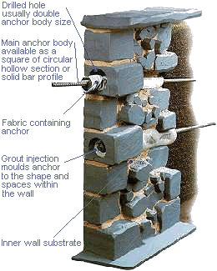

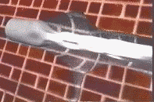
María Hernández- Initial Restoration Plan
Notes:
For the restoration plan of this bridge we did research on a company named Cintec.The method they use for restoration, stabilizes and strengthens the bridge from within, by pumping Presstec™grout into a hollow steel tube which is surrounded by a fabric sock. As seen with the animation and pictures above. These steel tubes are inserted after holes are drilled into the original foundation. This method would preserve the original brick and concrete foundation of the bridge.
We reached out to this company via email and were referred to Eric Jokinen, who is owner of Jokinen Engineering. He is an independent engineer helping Cintec on a number of projects throughout North America. He is also very familiar with construction in Puerto Rico, particularly historic bridges and buildings.

Slide 17
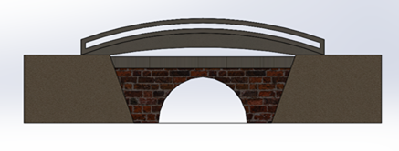
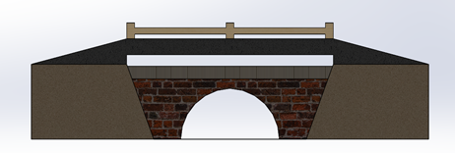
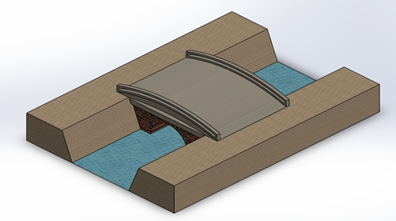
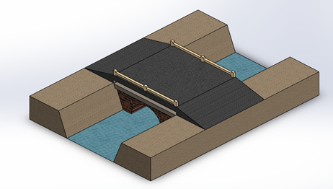
María Hernández- Initial Bridge Design
Notes:
Before we began drafting our final design for the maria hernandez bridge, we had to make preliminary models. These consisted of an arch and ramps with a flat slab that would go over the pre-existing bridge. We ended up further developing the model on the right because the arch design hindered the driver of tall tractors to be able to see over the top while driving. This not only puts the driver at risk, but also fellow workers at Hacienda La Esperanza. The ramp design takes out the arch and replaces it with a flat slab. This new bridge would take off all future loads from the original bridge and would be made out of reinforced concrete.

Slide 18
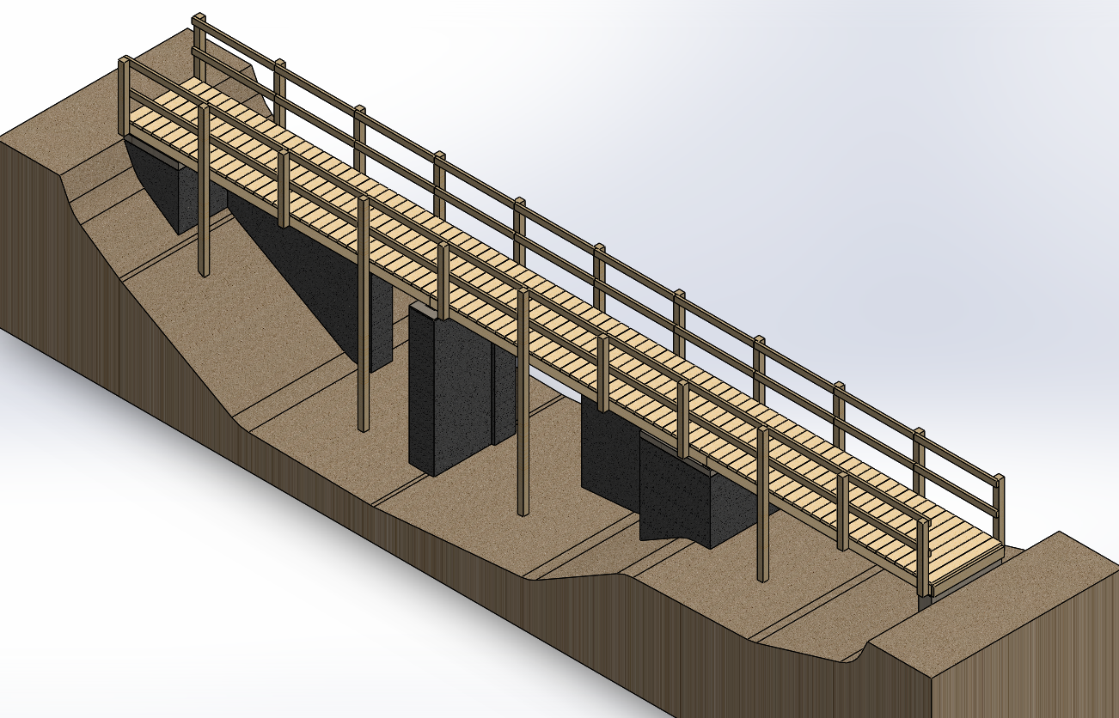
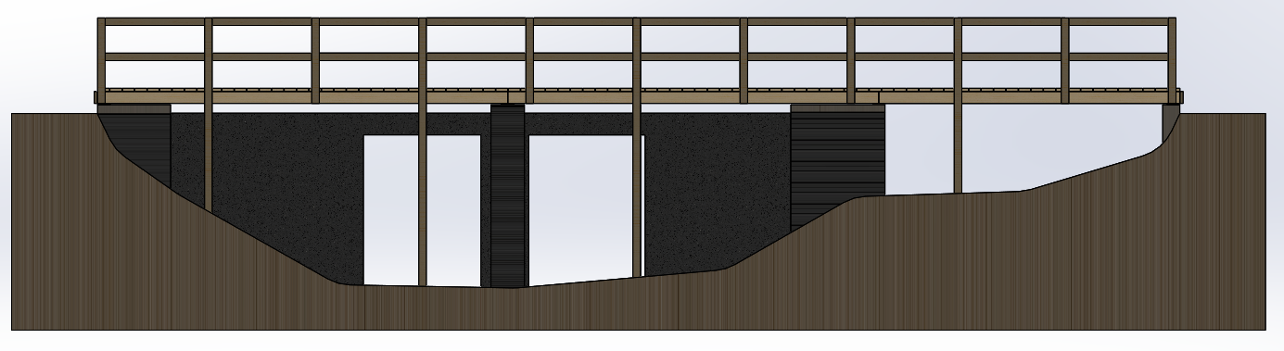
La Boquilla-Main Design
Notes:
Harry: We have 4 different designs, but this is the main idea for what the bridge would look like

Slide 19
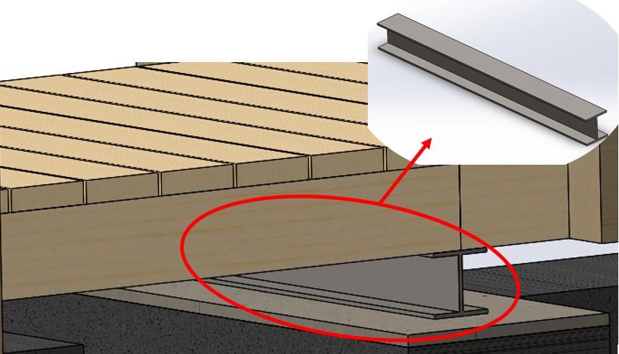
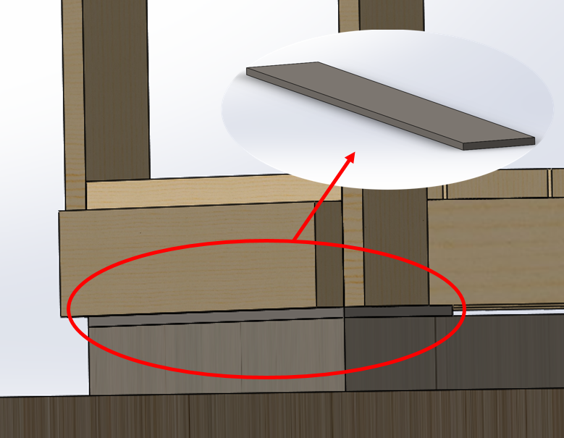
La Boquilla-Design Differences
H-Beam
Steel Plate
Notes:
Harry: One of the main differences between the bridges is whether or not it will have a steel H-beam or a steel plate separating the bridge from the concrete. Both serve as protection for the bridge to increase its longevity, but the H-beam provides a bit more protection by lifting the bridge up higher so that it is less likely to be damaged from the river.

Slide 20
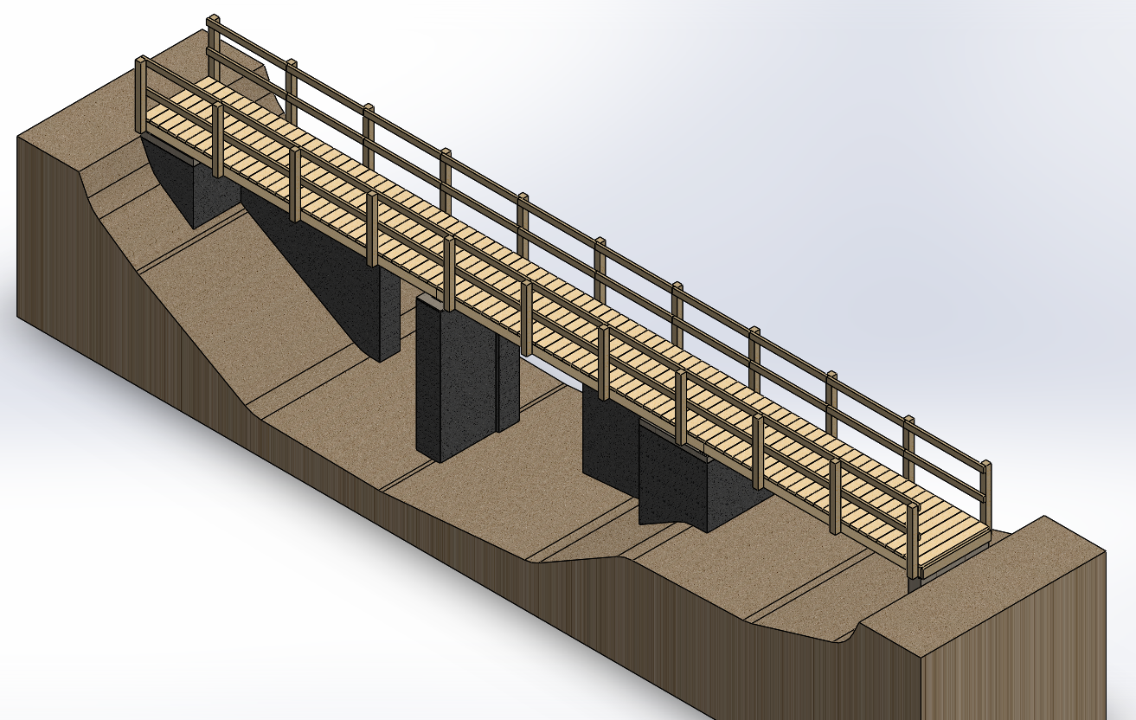
La Boquilla-Design Differences
No Pylons
Pylons
Notes:
Harry: The second main difference between the different designs is whether or not pylons will go into the ground or just extend above the deck. Having the pylons go into the ground ends up costing a bit more, but it ends up being much safer, since the pylons going into the ground provide increased support for the bridge.
Label pylons

Slide 21
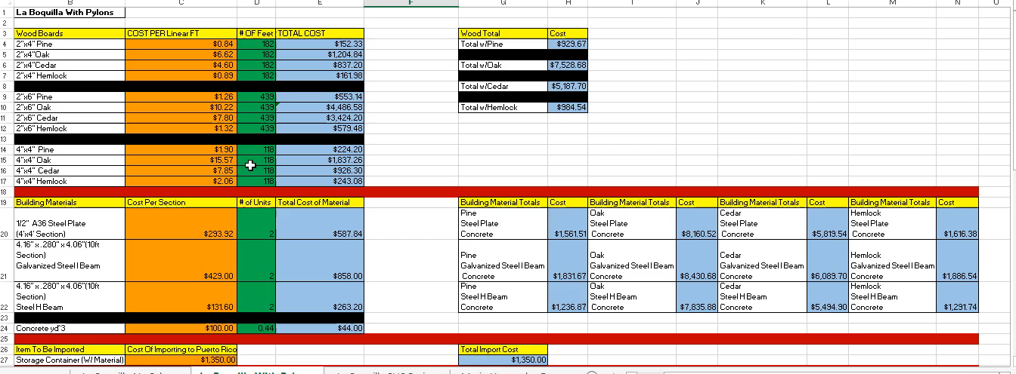
Notes:
This is our interactive excel sheet that show material costs for these beidges. This is an example of our excel spreadsheet we made to estimate total the total cost associated with these builds. Starting in the first section we have the wood types and sizes. There is Pine, Oak, Cedar, and Hemlock, and they’re made in 2x4s, 2x6s, and 4x4s. Based on my research from wholesalers I found prices per linear feet of each type and size. In the next column we have the number of feet estimated that will be needed to complete the build. Then in following column the total price for that specific type, size, and amount is automatically calculated when you change any value in the previous two columns. This is the same for all the rows in this section. Then off to the right we can see the total costs for each type of wood if chosen.
In the next section we analyse the different materials for the spacers in the same fashion as the wood. In this section we also calculate the amount of other materials needed like rebar and concrete. Then off to the side each possible combination with the different types of wood and spacer is automatically calculated.
After that the next two sections show the estimated costs of importing materials to Puerto Rico as well as estimated labor costs associated with the build. Again as different values are added in, different totals are calculated.
The last section then calculates the overall total cost for the build based of each combination of wood and spacers, and the addition of other material and labor costs.
La Boquilla With Pylons shows the same thing however there is more wood in the first section creating a slightly higher cost in the end. Then for the Maria Hernandez Bridge we have a simplified sheet because no wood is invovled and the only other difference is that the number of workers need is different than with La Boquilla.
This entire sheet is an interactive model that will be shared with Para La Naturaleza.

Slide 22
RECOMMENDATIONS

Slide 23
Notes:
We are not recommending Cintec due to our conversations with Eric Jokinen. After sending Mr. Jokinen pictures and dimensions of the bridge, he said“The Cintec costs, including advanced engineering analysis, will certainly exceed the replacement cost for a new bridge deck with modern materials on the existing foundations” In a way, what he said validates our Final Design as being a prime recommendation for this bridge.

Slide 24
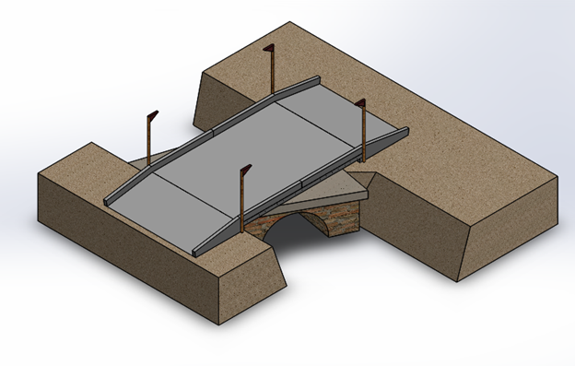
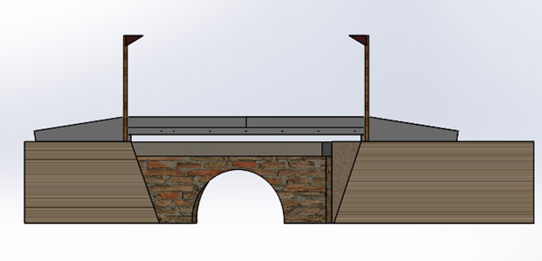
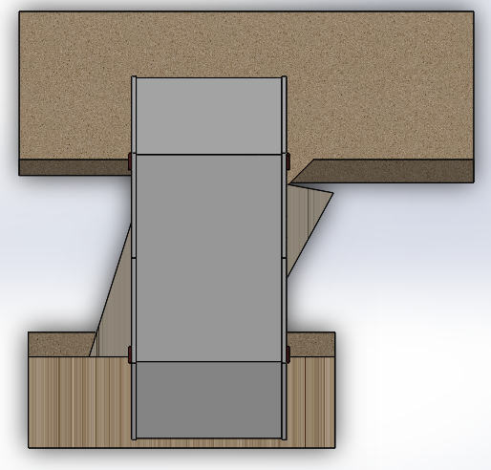
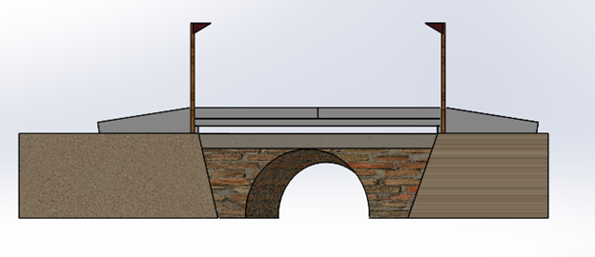
María Hernández Recommendation
Notes:
Our final recommendation for the maria hernandez bridge is a further developed model from the one previously shown.This model features a scale makeup of the original bridge as well as the new one placed over it. The gap between the old and new bridge is .21 meters (more than 8 inches). The whole new structure, including the railings, is made of reinforced concrete. The addition of flag poles came from a suggestion by Senora Padilla and were added in so that a tractor driver can see where the ramps begin and end, maximizing safety. The next slide shows a more in depth look at the bridge and its dimensions.
Replace flags with reflectors

Slide 25
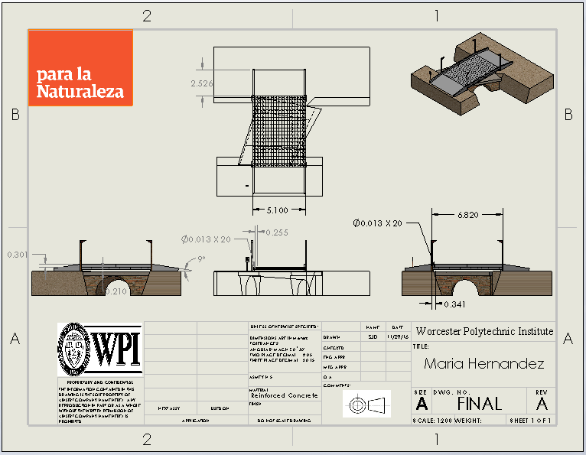
Notes:
This is a professional drawing made in SolidWorks, showing the dimensions in meters of the bridge.

Slide 26

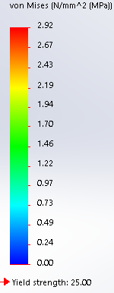
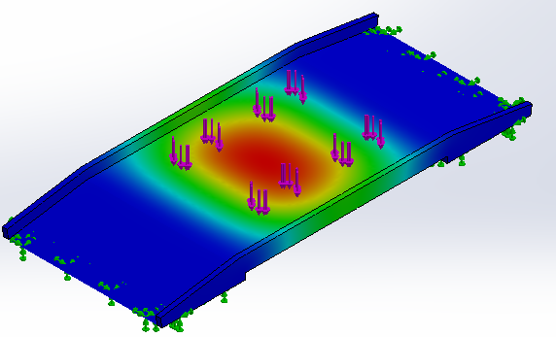
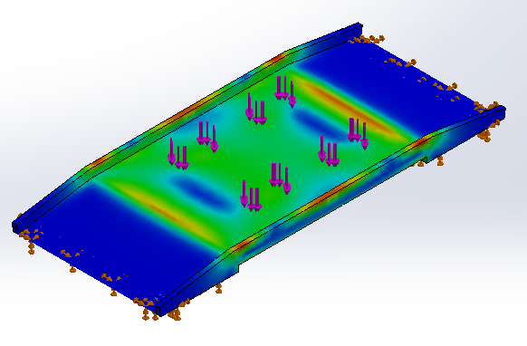
Simulation Results for María Hernández
Displacement
Stress
This bridge can
support up to 50,000 lbs
Notes:
After full completion of the bridge we decided to run weight bearing Simulations in SolidWorks. The John deer tractor located at hacienda la esperanza at most weighs 22,000 lbs, so to include a factor of safety, we more than doubled this number in the simulation to 50,000 lbs and it still didnt fail. Max displacement was only 1.87 mm which very minimal.

Slide 27
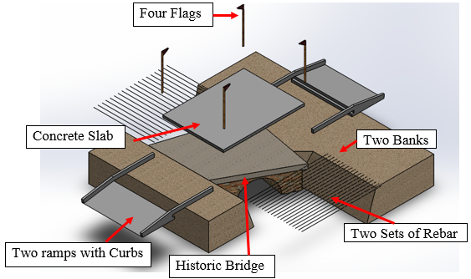
Step by Step Build for María Hernández Bridge
Notes:
This is a full assembly of the bridge except for the false frame. A false frame is a frame that would be built underneath future bridge. It serves as a type of mold for the concrete to settle and harden. So assuming the frame is already built, the first step would be to step up the rebar mesh. The next step would be to pour the concrete slab, making sure everything is level. Then you would make the curbs and ramps. Finally you would add the flagpoles and the bridge is complete. The next slide shows a video of this

Slide 28

Assembly of María Hernández Recommendation
Notes:
Here is the video showing the step by step process of building the bridge.

Slide 29
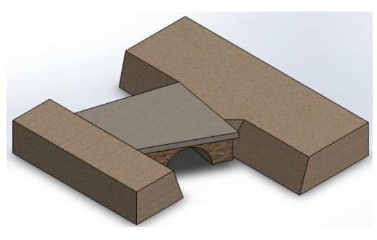
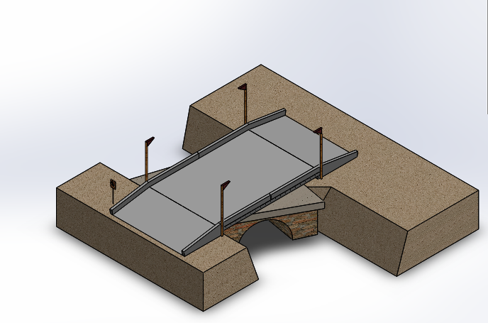
Before
After
Notes:
This is a general before and after picture of the final bridge. The picture to the left is the original structure that is currently as hacienda la esperanza, while on right shows our fully developed mode going over it.

Slide 30
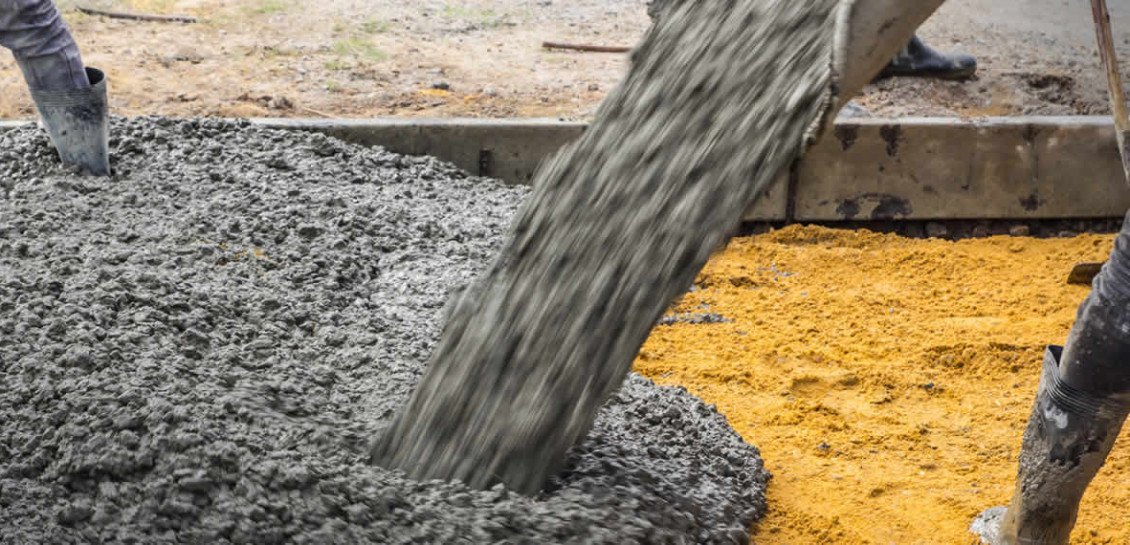
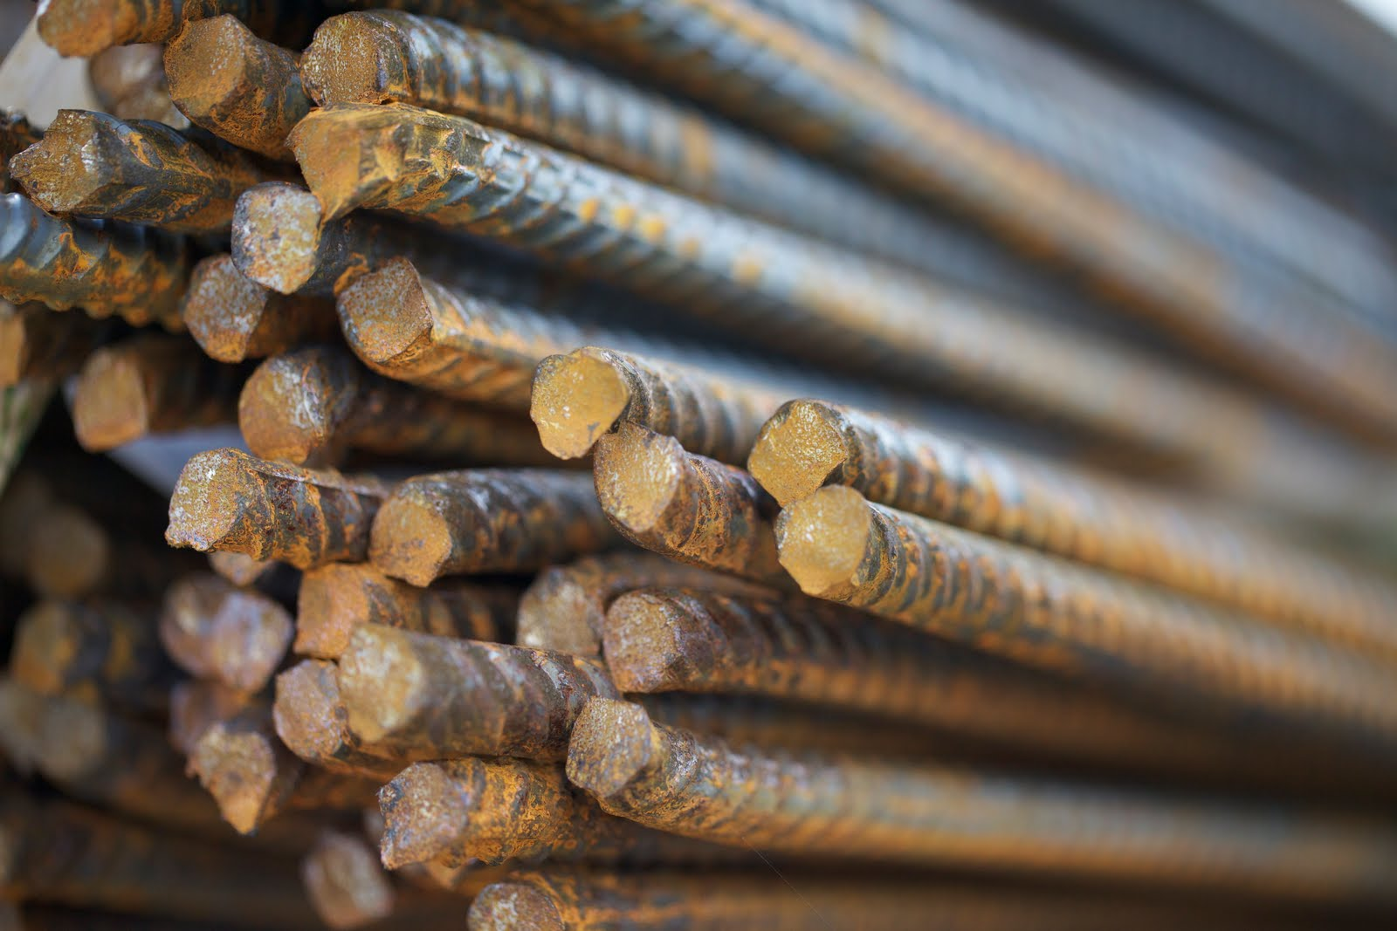
María Hernández Material Recommendation
Notes:
Travis: For the Maria Hernandez bridge we recommend that the bridge be mainly constructed of concrete then reinforced with ½ ” steel rebar throughout the structure..

Slide 31
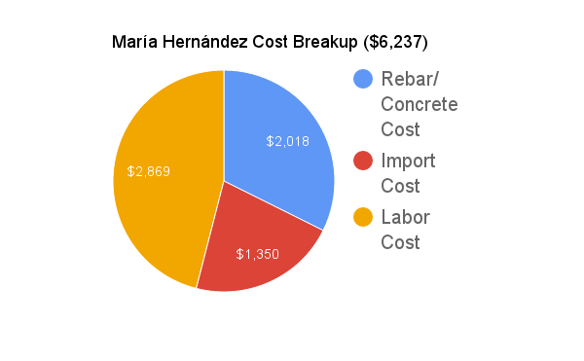
Cost Analysis
Notes:
For the Maria Hernandez Bridge, the majority of the costs are associated with the labor of building the bridge which is %. The next largest part is the cost of the rebar and concrete for the bridge itself which is %. Lastly is the price for importing the materials to Puerto Rico which is %.

Slide 32
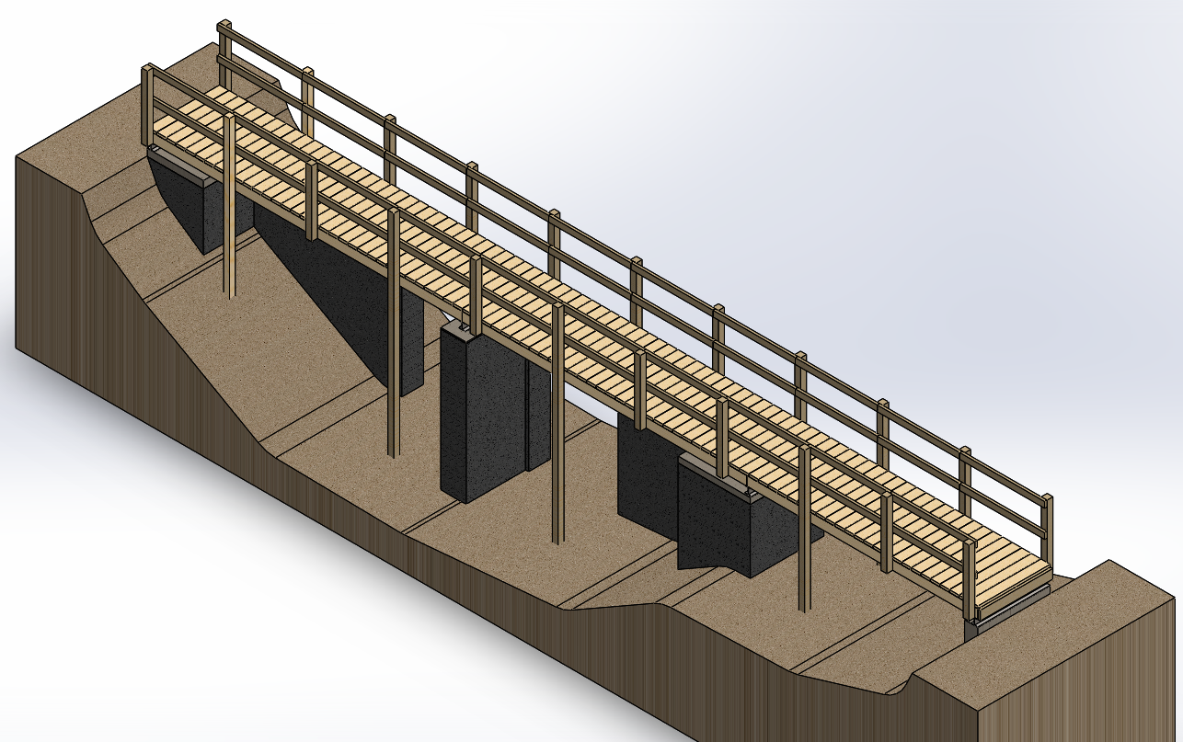
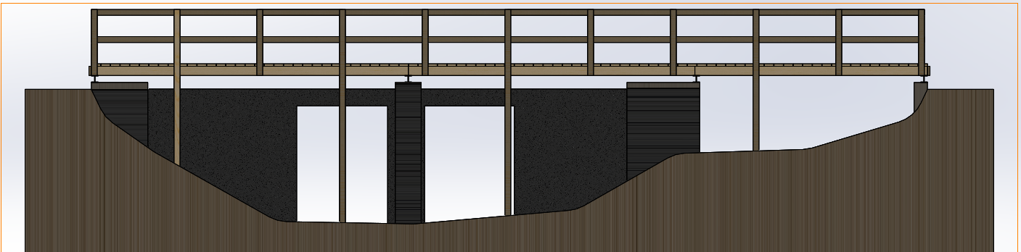
La Boquilla Bridge Recommendation
Notes:
Harry: For our recommendation, we suggest using Design 3 for La Boquilla Bridge. This design has the best balance of both price and structural stability. It satisfies all of Para La Naturaleza’s requirements, and will certainly be able to withstand numerous uses.

Slide 33
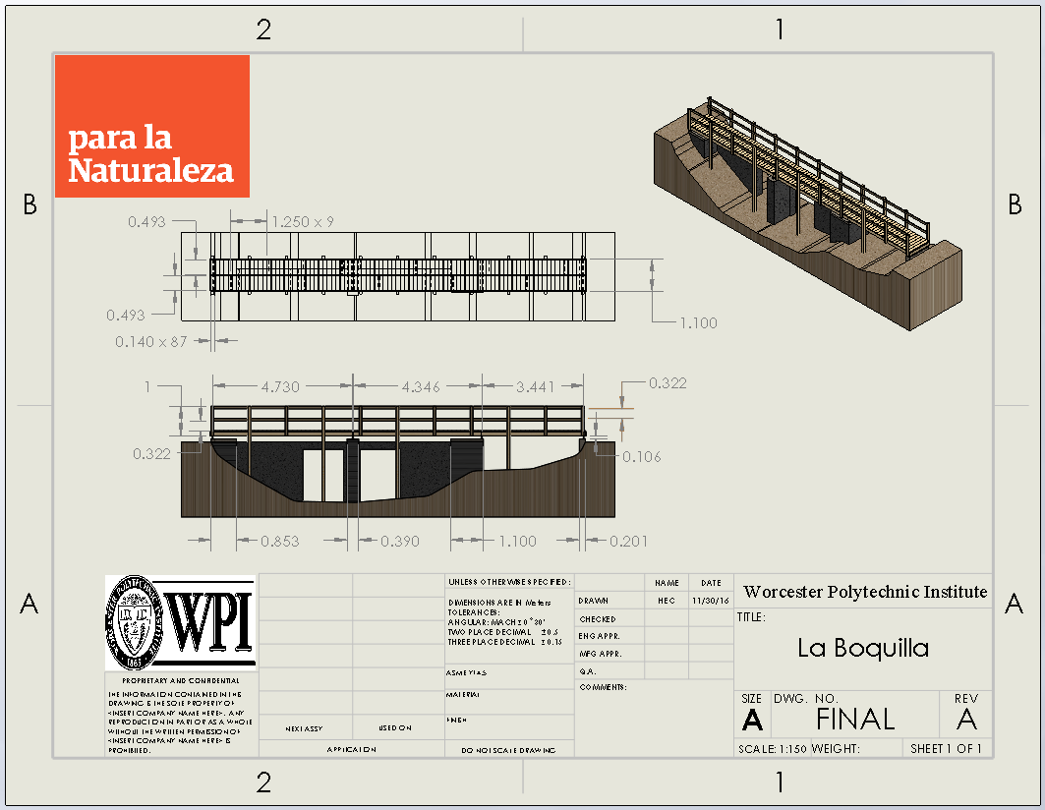
Notes:
Harry: Here we have a drawing of our final design for La Boquilla. From this you will have all of the dimensions needed in order to build the bridge.

Slide 34
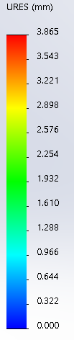
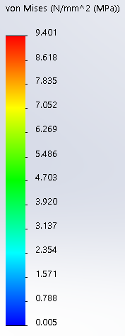


Simulation Results for La Boquilla Bridge Recommendation
Displacement
Stress
Notes:
Harry: Upon testing the bridge, it was able to withstand 1000 pounds of force and under that amount of force it only deformed 4 mm. This simulation was done with the assumption that the bridge is made of pine. This model only shows a portion of the bridge, however, the bridge is essentially made up of three of these sections, so it is still a valid test.

Slide 35

Step by Step Build for La Boquilla Bridge
Notes:
Harry: In order to build the bridge, new concrete will need to be poured on top of the old concrete abutments in order to resurface them so that they are completely flat. Next, steel H-beams will be lain on top of the resurfaced concrete and attached the concrete with concrete screws. Next, the stringers will be attached to the H-beams and the stringer supports will be connected between them. The deck will then be placed on top of the stringers and the pylons will be bolted to the stringers and placed into the ground where necessary. Finally, the handrails will be attached to the insides of the pylons. This will all be depicted on a video in the next slide.

Slide 36

Assembly of La Boquilla Final Design
Notes:
Harry: Here is a video showing the bridge building steps.

Slide 37


Before
After
Notes:
Not touching***
Harry: Here we have a before and after rendering of La Boquilla Bridge. As you can see, much has changed. We have gotten rid of all of the planks that were previously placed by locals, and we made it so that the bridge would be straight for both ease of building and ease of traversing by the bikers and hikers. It’s also important to note that the new bridge will not be touching the old one, which will increase the lifespan of the original brickwork of the original bridge.

Slide 38



La Boquilla Material Recommendation
Notes:
Travis: We recommend the structure be mainly built of either pine or cedar. Pine because it is the cheapest wood to work with, Or Cedar because even though its very expensive, it can last 3 times as long as Pine. Another option we recommend as a possibility is a fusion between real wood and a composite trex decking. Trex decking is extremely long lasting and durable however the creation of the boards is not very eco friendly. For the spacers, we recommend that steel H beams be used because it helps get the wooden structure up and away from the water, and it also is the cheapest of the three spacer options which included the H beam, and galvanized steel I beam. The tops of the abutments also need to be resurfaced with concrete to create flat and flush surfaces.
Talk about plastic wood option

Slide 39


Cost Analysis
Pine
Cedar
Notes:
Travis: This Pie chart shows the breakup for costs associated with the La Boquilla build. Again you see the majority of costs are coming from labor costs. Next are the prices for importing. Then the costs for the H Beam, and lastly are the costs associated with the cost of wood. While Treated Pine can last around 15 years with ordinary matienence, Cedar with ordinary maintenance can last 25 years more.

Slide 40


Cost Analysis
Pine With Composite Decking
Cedar With Composite Decking

Slide 41

Informational Sign Design-María Hernández
Notes:
Maggie: A final part to our bridge designs would be the instillation of informational signs that would be placed at the opening to each bridge. These designs were developed using Para La Naturaleza’s current color scheme and design aesthetics. As you can see the sign would be placed here (point) on the bridge. The sign will include the name of the bridge, the date it was constructed and the date it was redesigned. The signs are in both English and Spanish

Slide 42


Informational Sign Design-La Boquilla
Notes:
Maggie: A similar sign was designed to go at the entrance to La boquilla bridge. This sign also includes both spanish and english translations and will be located here (point) on the footbridge.

Slide 43


Our Experience in Puerto Rico
Notes:
Maggie: We just wanted to say how great our experience has been while in Puerto Rico. My favorite part of being here was that we were able to experience the rich culture and try great food.
Travis: I would just like to just say how thankful I am for the hospitality of the Puerto Rican People during our time here. In most settings here, no matter the language barrier we faced, people always met me with a smile and kindness. I’m really going to miss that, as well as the amazing food and the beautiful landscapes. Thank you.
Steven: I thought the best part of puerto rico was the breath taking views of the beaches, rain forests, and historical sites. I'll never forget the puerto rican culture and will truly miss the food and night life.
Harry: I would say the best part of puerto rico for me was all of the different experiences i was able to partake in, the food I was able to eat, and the people i met along the way. If i could do it all again, i wouldn’t have done it any other way.

Slide 44
Acknowledgements
Para La Naturaleza
  Elizabeth Padilla
  Carlos Torres
WPI
  Professor Frederick Bianchi
  Professor Sarah Crowne
  Professor Lauren Mathews
  Professor Karen Troy

Slide 45
Thank you
Questions? Comments?
Notes:
Maggie: Before we ask for any questions, we’d like to give a big thanks to our sponsor, Para La Naturaleza - especially Señora Padilla and Señor Torres. You guidance, help, and positivity throughout our time in Puerto Rico has made the experience amazing.
We’d also like to thank our project advisors: Professor Troy and Professor Bianchi, for their feedback and help that was crucial to making this project a success. We could not have done this without all of your help!

