Slide 1
Design of an Implantable Reparative Device for Ulnar Collateral Ligament Tears in Overhead Throwing Athletes
Maria Decelles, Evan Hallberg, Brooklynn Paris,
and Meagan Smith
Notes:
Maria (20 sec)
Hi Everyone. Our MQP team will be presenting our design of an implantable reparative device for ulnar collateral ligament tears in overhead throwing athletes. My name is Evan Hallberg and my team members are Maria Decelles, Brooklynn Paris, and Meagan Smith.

Slide 2
Clinical Need
Youth ages 15 to 19 account for 56.8% of all UCL reconstruction surgeries. [1]
25% of all active MLB pitchers have had UCL reconstruction surgery [2]
9-12 month recovery time [3]
Notes:
Maria 40 sec
Ulnar collateral ligament reconstructive surgery is the most common treatment ulnar collateral ligament tears which many overhead throwing athletes experience due to repetitive motions.
Youth between the ages of 15 and 19 account for more than half of all reconstruction surgeries which can be detrimental to their development
Additionally, 25% of all active MLB pitchers have undergone this procedure
which has a 9 to 12 month recovery time
There is a clinical need for repairtive treatment with a shorter recovery time for partial tears

Slide 3
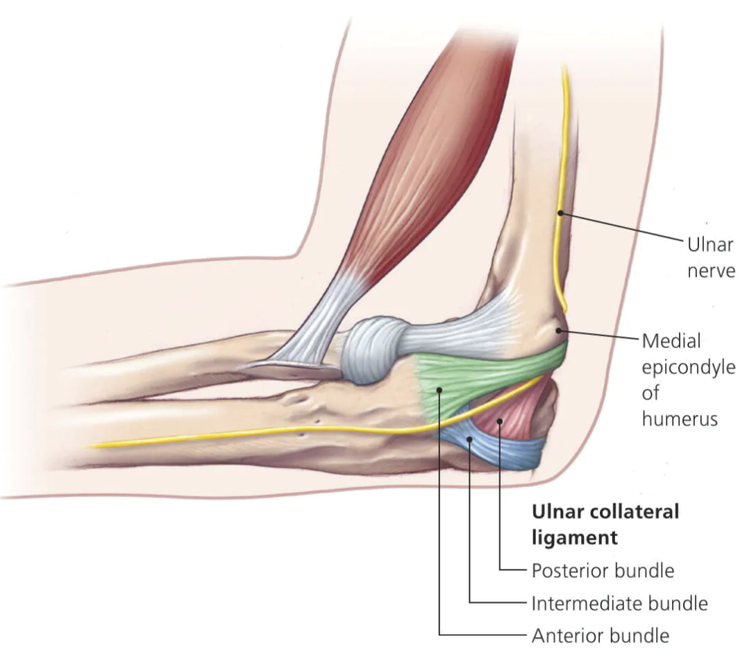
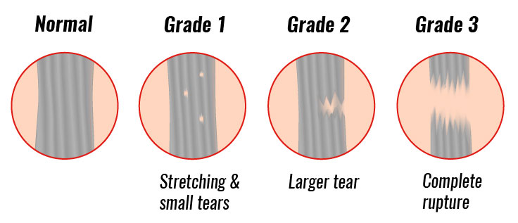
Anatomy of the UCL
Posterior Bundle
Transverse Bundle
Anterior Bundle
Notes:
Meagan 30 seconds
Here you can see the UCL consists of three parts: the anterior bundle, the posterior bundle, and the transverse bundle. Tears most commonly occur in the anterior bundle as it is the primary contributor to resisting valgus stress.
Tears may occur in different levels: grade 1, 2 or 3 tears. Grade one tears tend to heal on there own while grade 2 and 3 are more difficult to treat and often require surgical intervention. We were focused on healing grade 2 tears, as these are the ones that are most commonly operated on that may not need full reconstruction surgeries.

Slide 4
Natural Ligament Healing
Inflammation
Days 0 - 7
Clear debris
Repair/proliferation
Week 1 – Week 6
Growth factors and more
Remodeling
Week 6 – 18 Months
Tissue remodeling
Notes:
Brooklynn: 35 sec
Natural ligament healing process needs to be understood so we can assist it’
Three phases
Inflammation: days 0-7, cells clear debris from area
Repair/proliferation: Week 1-6, growth factors and other cells are present to facilitate protein synthesis and angiogenesis, and increase cell proliferation
Remodeling: week 6- 18 months, collagen fibers get thicker and more dense
We are primarily focused on the second phase of healing to assist lower grade tears in the natural healing process
To understand more about ligament healing, we researched each phase. It was important to understand the healing process as we looked for ways to speed it up through our design.
Ligament wound healing occurs over three stages: inflammation, repair/proliferation, and remodeling.
Inflammation occurs immediately after injury for up to a week and the area is cleared of debris.
The repair or proliferative stage occurs three or four days after injury for up to six weeks. Growth factors are released that support vascular ingrowth, protein synthesis, and cell proliferation.
Finally, the remodeling stage occurs from week 6 until 18 months after injury in which tissues are remodeled to help collagen fibers become denser and increase in diameter.
We are aiming to assist the healing process, mainly in the repair phase. Grade 2 tears will not completely heal on their own or with physical therapy, but they are typically not severe enough to warrant full surgery. Our method should assist in the healing process to heal the ligament in a shorter time than physical therapy would.
Extra:
Growth factors showed promise as they are associated with collagen formation, protein synthesis, angiogenesis, vascular ingrowth and increased cell proliferation.
Cell integration and migration, cell proliferation, talk about what the reader will need to know to understand our design process et
Extra: leukocytes release growth factors and cytokines to attract repairing cells, and macrophages release VEGF-2 to support vascular growth in the area. Fibroblasts aid in the formation of new collagen. Platelets and neutrophils release TGF-B which deposits new ECM material.

Slide 5
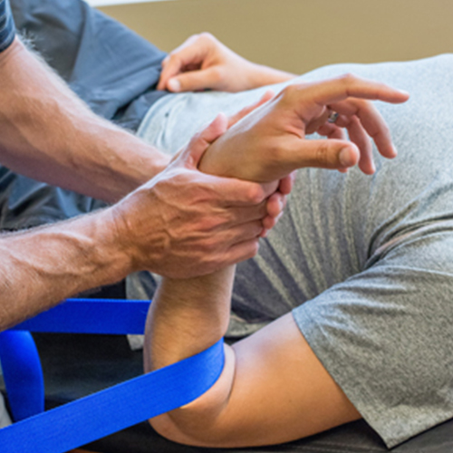
Current Clinical Treatments
Rest and
Physical Therapy
Tommy John Surgery
Internal Brace
by Arthrex
Tendon threaded through drilled holes
Collagen Coated Tape Fastened to the Ligament
Unmet Need
A device that supplements the natural healing of all types of partial UCL tears
Repair technique:
does not replace existing anatomy
Reconstruction method:
uses autografted tissue to function as new UCL
irreversible
Notes:
Meagan 1 min
Rest and Physical therapy is typically the first step in the treatment process of UCL injuries. This is effective in healing grade one tears and occasionally grade two tears. For injuries that cannot be treated by PT, there are surgical methods available like the implantation of the internal brace device. This device heals the native ligament and does not replace the existing anatomy. Not all patients with grade 2 tears qualify for this surgery. The gold standard of care is tommy john surgery as this works for all grades of tears. This is a full reconstruction, where an autografted tendon will function as the new UCL. This is an irreversible procedure and has a long and intense recovery process. Our goal is to repair the UCL because this will keep the native anatomy present and reduce post-operative stress. There is an unmet need of a device that supplements the natural ligament healing process for all types of second grade tears, that may not need full reconstructive surgery.

Slide 6
Objectives
Delivers a Therapeutic Agent
Surgically Compatible
Reproducible
Healing Promotion
Mechanically Sound
Cost Effective
Notes:
Evan (10 sec) 20 sec
In collaboration with our client and our advisors, we identified the Objectives that will serve as the basis of our design requirements.
We determined that the design needs to deliver a therapeutic agent, is surgically compatible, is reproducible, promotes healing to the native ligament, is mechanically sound and is cost effective.
Based on the scope of this project we will be focusing on these four objectives.

Slide 7
Client Statement
Design, develop and test an implantable scaffold that assists in the healing of a torn ulnar collateral ligament (UCL). The design should be biocompatible and should degrade in 4-6 weeks. The scaffold must significantly increase cell proliferation by releasing a therapeutic agent over a period of at least 2 weeks. The scaffold should have a stiffness between 3 and 17 N/mm and a failure load of at least 13 N. The scaffold should be implantable in a 10 cm window and within the dimensions of 15 mm by 40 mm by 3 mm. The design must be reproducible such that it can be used as an alternative gold standard of care for UCL repair treatments.
biocompatible
degrade in 4-6 weeks
increase cell proliferation
releasing a therapeutic agent
least 2 weeks
stiffness
3 and 17 N/mm​
failure load
13 N
dimensions of 15 mm by 40
mm by 3 mm​
Notes:
Brooklynn 35 sec
Based on our background research, unmet need and conversations with our client, we developed the following statement.

Slide 8
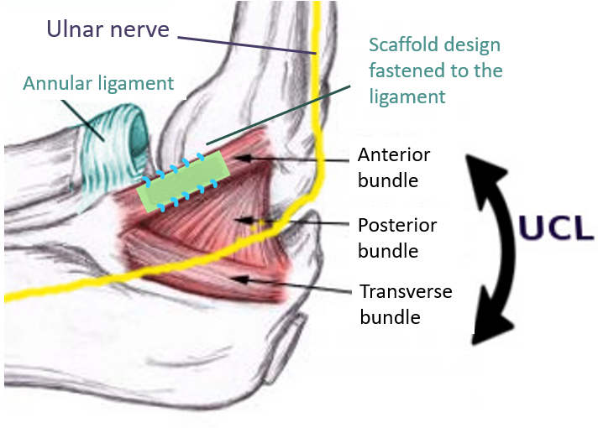
Conceptual Design
Notes:
Evan 20 sec
Our concept was to design a degradable device that delivers a therapeutic agent to assist in the healing of the UCL.
A previous MQP team attempted a similar idea but were unable to load enough therapeutic agent and their product was too stiff for the client's needs.

Slide 9
Conceptual Designs
Notes:
Meagan 45 sec
40 seconds
Now that we have establish the functions and specifications of our project, we moved to our design process phase and began brainstorming ideas.
One design we produced was a sponge scaffold that would absorb in a hydrogel loaded with a therapeutic agent that was then encased in a material that would act as a membrane to elongate the drug release profile.
Our next design was a sponge-therapeutic agent composite that would have threads running through it to suture it down to the ligament
Our third design was electrospun mats that would be layers together to release a therapeutic agent over time.

Slide 10
Design Considerations
Contains Therapeutic Agent
Physical Absorption
Physical Encapsulation
Controlled Release of GFs
PDGF-BB
Increases Cell Proliferation
Withstands Surgical Manipulation
Acellular Dermal Matrix
Silk Hydrogels
Collagen Sponges
hello
1.00 µg/mL
0.167 µg/mL
0.417 µg/mL
0.667 µg/mL
Notes:
Brooklynn: 1:10 sec
We conducted research on our design functions in the context of each of our conceptual designs.

Slide 11
Design Considerations
Contains Therapeutic Agent
Mesenchymal Stem Cells
Bone Marrow Aspirtate
PRP
Isolated Growth Factors
Platelet-like Particles
Controlled Release of Growth Factors
Collagen Sponges
Keratin Films
Chitosan Sponges
Silk Hydrogels
Electrospun Zein Mats
Reproducible
Electrospinning
Lyophilizing sponges
Hydrogels
Manufacturing Method
Withstands Surgical Manipulation
Collagen Sponges
Acellular Dermal Matrix
Collagen Threads
Keratin Films
Contains Therapeutic Agent
Collagen Sponges
Controlled Release of GFs
Mesenchymal Stem Cells
Reproducible
Electrospinning
Lyophilizing sponges
Hydrogels
Manufacturing Method
Withstands Surgical Manipulation
Collagen Sponges
Acellular Dermal Matrix
Collagen Threads
Keratin Films
Bone Marrow Aspirtate
Platelet-like Particles
PRP
Isolated Growth Factors
Keratin Films
Chitosan Sponges
Silk Hydrogels
Electrospun Zein Mats
Contains Therapeutic Agent
PDGF-BB
FGF-2
Reproducible
Withstands Surgical Manipulation
Electrospinning
Collagen Sponges
VEGF
TGF
GF
Acellular Dermal Matrix
Collagen Threads
Keratin Films
Manufacturing Method
Lyophilizing sponges
Hydrogels
Controlled Release of Growth Factors
Collagen Sponges
Keratin Films
Chitosan Sponges
Silk Hydrogels
Electrospun Zein Mats
Notes:
Brooklynn
We prioritized the therapeutic agent choice first and considered the following options. Growth factors have a large role in the healing process as I mentioned earlier, so we decided to use isolated growth factors for the low volume required and healing properties.

Slide 12
Design Considerations
Contains Therapeutic Agent
Collagen Sponges
Controlled Release of GFs
PDGF-BB
Reproducible
Electrospinning
Lyophilizing sponges
Hydrogels
Manufacturing Method
Withstands Surgical Manipulation
Collagen Sponges
Acellular Dermal Matrix
Collagen Threads
Keratin Films
FGF-2
VEGF
TGF-β1
IGF-1
Keratin Films
Chitosan Sponges
Silk Hydrogels
Electrospun Zein Mats
Notes:
From there, we considered the five growth factors that are the most prevalent in the healing process, which you can see here. We chose PDGF-BB through a Pugh analysis of each growth factor’s properties.

Slide 13
Design Considerations
Contains Therapeutic Agent
Collagen Sponges
Controlled Release of GFs
PDGF-BB
Increases Cell Proliferation
Withstands Surgical Manipulation
Collagen Sponges
Acellular Dermal Matrix
Collagen Threads
Keratin Films
Keratin Films
Chitosan Sponges
Silk Hydrogels
Electrospun Zein Mats
0.167 µg/mL
0.417 µg/mL
0.667 µg/mL
1.00 µg/mL
Notes:
To control the release of growth factors, we considered different modalities. Ultimately we decided to use collagen sponges and silk hydrogels due to their drug loading capacity and accessibility.

Slide 14
Design Considerations
Contains Therapeutic Agent
Physical Absorption
Encapsulation
Layer-by-Layer
Chitosan Binding
Heparin Binding
Controlled Release of GFs
PDGF-BB
Increases Cell Proliferation
Withstands Surgical Manipulation
Collagen Sponges
Acellular Dermal Matrix
Collagen Threads
Keratin Films
0.167 µg/mL
0.417 µg/mL
0.667 µg/mL
1.00 µg/mL
Notes:
To ensure that the growth factors would be released over an extended period, we considered different methods of containing them. We chose physical absorption and encapsulation because those methods worked best with our chosen materials.

Slide 15
Design Considerations
Contains Therapeutic Agent
Controlled Release of GFs
PDGF-BB
Increases Cell Proliferation
Withstands Surgical Manipulation
Collagen Sponges
Acellular Dermal Matrix
Collagen Threads
Keratin Films
Silk Hydrogels
0.417 µg/mL
0.667 µg/mL
1.00 µg/mL
Collagen Sponges
Physical Absorption
Physical Encapsulation
hello
0.167 µg/mL
Notes:
To ensure that the scaffold would increase cell proliferation, we determined different concentrations of PDGF-BB for future testing based on literature which can be seen here.

Slide 16
Design Considerations
Contains Therapeutic Agent
Controlled Release of GFs
PDGF-BB
Increases Cell Proliferation
Withstands Surgical Manipulation
Collagen Sponges
Acellular Dermal Matrix
Collagen Threads
Keratin Films
Silk Hydrogels
1.00 µg/mL
0.167 µg/mL
0.417 µg/mL
0.667 µg/mL
Collagen Sponges
Physical Absorption
Physical Encapsulation
hello
Notes:
Finally, we needed to ensure that our scaffold would withstand manipulation for implantation. We believed these materials would be used in a casing for the drug eluding component of the design. We chose acellular dermal matrix or ADM to provide mechanical support to the device.

Slide 17
Design Considerations
Contains Therapeutic Agent
Physical Absorption
Physical Encapsulation
Controlled Release of GFs
PDGF-BB
Increases Cell Proliferation
Withstands Surgical Manipulation
Acellular Dermal Matrix
Silk Hydrogels
Collagen Sponges
1.00 µg/mL
0.167 µg/mL
0.417 µg/mL
0.667 µg/mL
Notes:
Brooklynn: 1 min

Slide 18
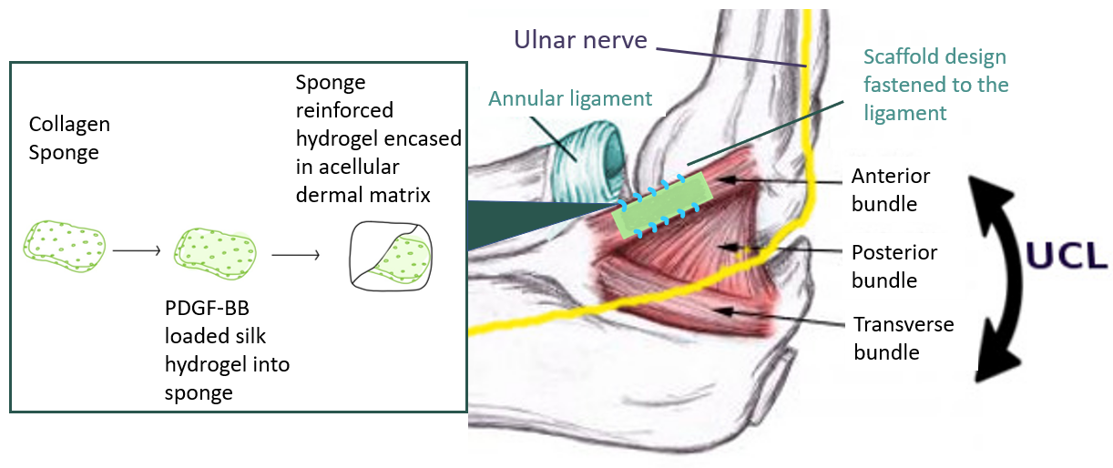
Final Design
Notes:
Meagan – 20 sec
From these design consideration, we selected the following design which includes a collagen sponge that absorbs a silk hydrogel loaded with PDGF-BB. This scaffold is then enclosed in an acellular dermal matrix that will help control the release of PDGF-BB over a longer period of time. This scaffold would then surgically implanted to heal the UCL.

Slide 19
PDGF-BB Concentration Study
Increases Cell Proliferation
Goal: Determine concentration of PDGF-BB with the highest cell proliferation
Setup: 30,000 NIH 3T3 cells seeded in 10% FBS media
n = 3
Conclusion
1.00 µg/mL to be used in final design validation
* Denotes statistical significance
(p < 0.05)
Notes:
Brooklynn 26 sec
- To begin our verification testing, we assessed the cell proliferation of 3T3 mouse fibroblast cells in 10% FBS culture media in the presence of different concentrations of growth factors, which are shown on the slide.
We counted the cells using a hemocytometer on days three and five after seeding cells and found that there was a statistical significance between many different concentrations, which is denoted by an asterisk.
Concluded that 1.0 ug/mL had the highest rate of proliferation and therefore would be used in the final design.
- Wanted to measure the effect of different concentrations of PDGF-BB (add box)
- Cells were counted in each well (n=3) and the count was averaged
- An ANOVA was conducted using the count from each individual well. there was a statistically significant difference within the groups according to the ANOVA
- ANOVA Single Factor was conducted, and the main effect was significant. Individual post-hoc comparisons with bonferroni corrections can be shown by asterisks
- Individual comparisons were conducted with bonferroni corrections and anything with p < 0.005 was considered statistically significant. These are depicted on the graph.
Limitations: Human error, would have been better to use a cell proliferation assay, low number of repetitions due to budgeting

Slide 20
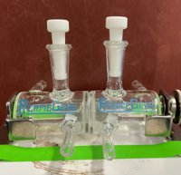
Permeability Testing of Acellular Dermal Matrix with Albumin
Controlled Elution
Goal: Determine the diffusion coefficient of Albumin across the ADM
n = 1
Diffusion coefficient = 9.07 ± 7.38 ×10⁻⁸ cm²/s
8.28% of the Albumin diffused by day 7
Conclusion
Acellular dermal matrix helps to slow down protein diffusion
Notes:
Maria: 35 sec
To understand how the ADM could help reduce burst release, we modeled diffusion using Albumin in an ussing chamber system. Over a seven day period we found that the diffusion coefficient to be around 9 *10 ^-8 cm2/s and about 8% of the albumin diffused through the matrix by day 7.

Slide 21
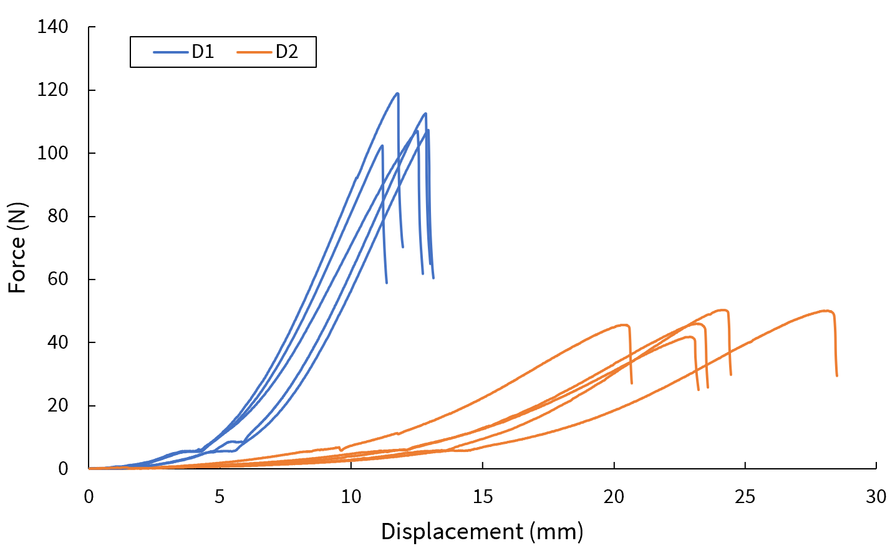
Tensile Testing of Anisotropic Acellular Dermal Matrix
Withstands Manipulation
Goal: Determine mechanical properties of acellular dermal matrix
Direction 1
Stiffness: 18.33 ± 1.35 N/mm
Failure Load: 109.91 ± 6.24 N
n = 5
Direction 2
Stiffness: 4.59 ± 0.63 N/mm
Failure Load: 45.05 ± 5.83 N
Conclusion
Device will not be compromised during surgical manipulation
Notes:
Evan (35 sec)
A crucial element of our design was to ensure that the casing would not be compromised due to surgical manipulation so we conducted tensile tests to determine the stiffness and failure load of the acellular dermal matrix in two directions. We tested 10 hydrated samples, 5 in each direction with a strain rate of 25%/min and found that the average stiffness for both directions were in or close to the stiffness range of 3-17 N/mm and the average failure load for both directions were both greater than 13 N.
So we can conclude that the device will not be compromised during surgical manipulation

Slide 22
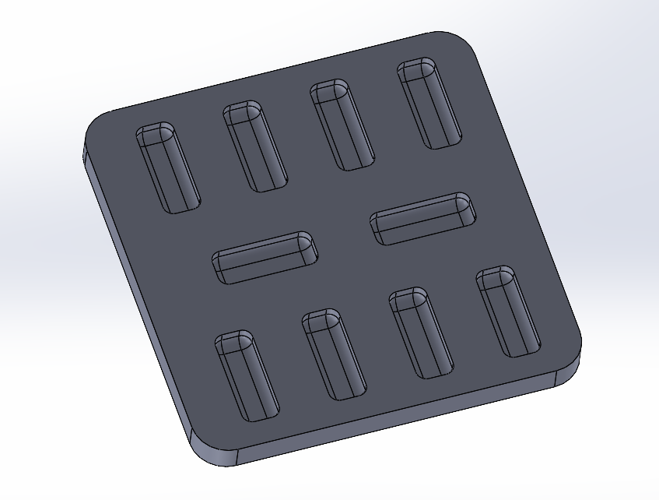
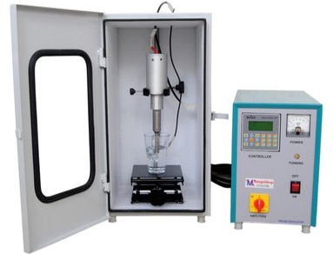
Fabrication of the Final Design
Controlled Release of GFs
Model of PDMS Mold
Sponge Reinforced Hydrogel
Contains
Therapeutic Agent
Sonicator
Increases Cell Proliferation
Collagen Sponges
Hydrogel on ADM
Withstands Manipulation
Notes:
Brooklynn: 30 seconds
Based on this verification data, we moved forward with final design fabrication using sterile technique. We sonicated 5% silk for 60 seconds and dispensed about 150 uL into each well of the mold before adding a collagen sponge, and then adding another 150 uL of silk on top to create the sponge reinforced hydrogel you see on the slide. Due to the time and budget constraints of this project, we were unable to test the hydrogel inside the ADM, but there is an image of the hydrogel so you can get an idea of what we intend. The ADM would be folded over to create a pocket with the reinforced hydrogel inside.

Slide 23
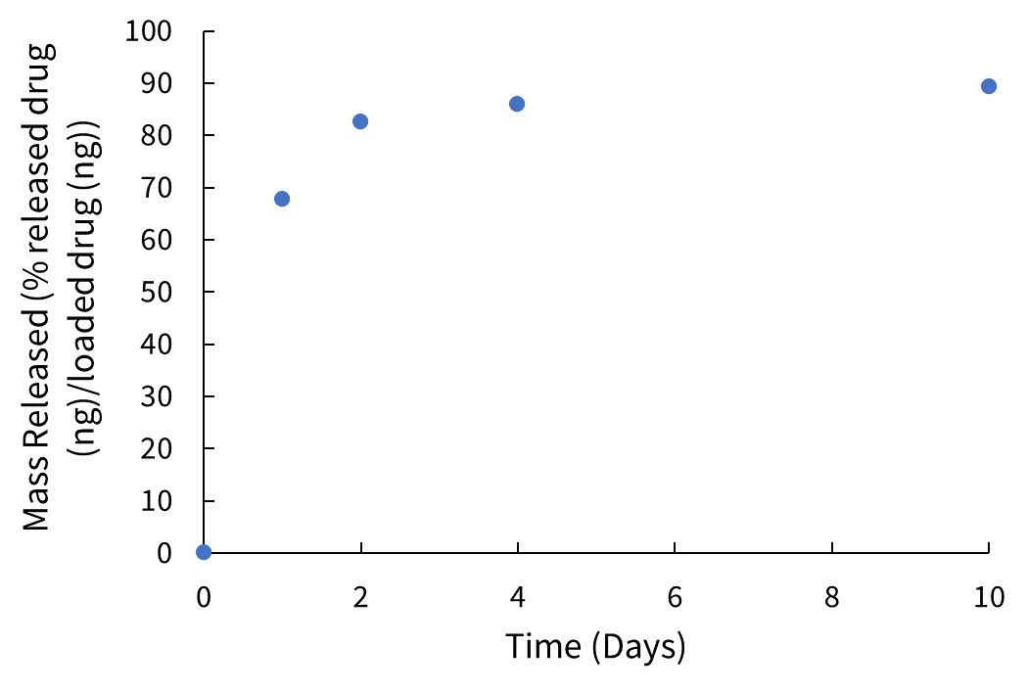
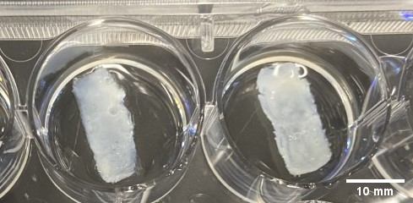
Drug Elution Testing with PDGF-BB
Controlled Release of GFs
Goal: Determine elution rate of PDGF-BB from final sponge reinforced hydrogel
89.3% of PDGF-BB released by day 10
Conclusion
We would want to encase the scaffold in the acellular dermal matrix to optimize drug release over a longer period of time
Notes:
Meagan 30 sec
Finally, we validated our design by first performing final drug elution testing. We suspended our PDGF-bb loaded sponge reinforced hydrogels in 1 mL of dPBS- and pulled supernatant samples at the time points shown on the graph. We then used an ELISA assay to determine the amount of PDGF-BB released at each time point. The graph shows the cumulative drug release of PDGF-bb over 10 days. It is important to note that most of the protein was eluded in the first two days. This further suggested the need to encase the scaffold in the acellular dermal matrix to optimize drug elution.

Slide 24
Cell Proliferation Testing with Eluded PDGF-BB
Increases Cell Proliferation
Goal: Determine bioactivity of scaffold loaded with final PDGF-BB concentration
Setup: 150 µl of supernatant, 20K CRL 2097 cells in 10% FBS media
Time 7 BrdU
Conclusion
Higher concentrations of PDGF-BB should be tested
Notes:
Brooklynn: 30 seconds
Wanted to test the affect of our eluded PDGF-BB on cell proliferation
seeded CRL 2097 human fibroblast cells in 10% fbs media
Used a BrdU assay to assess how the rate of cell proliferation had changed in the presence of the eluded drug over a 3 and 5 day time period
Found that there was a higher percentage of BrdU positive cells on Day 5, but further testing with higher PDGF-BB concentrations is needed to really assess the design’s affect on cell proliferation
Purpose: determine the bioactivity of our scaffold after PDGF-BB has been loaded and eluded
Set up: Deliver 150 µL of eluted supernatant from design to cell proliferation set up. Complete BrdU Cell Proliferation Assay three and five days after eluant is added. We did four trials for each day of drug elution along with controls. Seed CRL 2097 cells cultured in 10% FBS Media 24 hrs before adding eluant, then add 150ul of the sample to its respective well. Incubate for 3 or 5 days before analysis with BrdU assay.

Slide 25
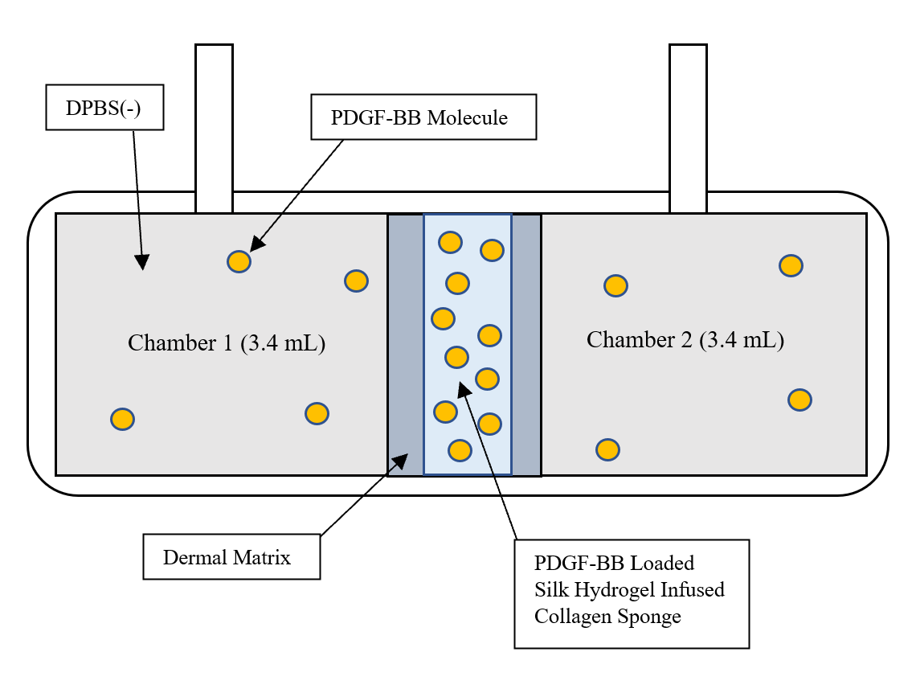
Permeability Testing of Acellular Dermal Matrix with PDGF-BB
Controlled Release of GFs
Goal: Determine the diffusion coefficient of PDGF-BB across the ADM from the scaffold device
n = 1
Diffusion coefficient = 9.14 ± 0.11 ×10⁻⁸ cm²/s
18.3% of the PDGF-BB diffused by day 12
Conclusion
The acellular dermal matrix is an appropriate material to reduce burst release of PDGF-BB and elongate the elution period
Notes:
Maria: 30 seconds
To understand how the ADM could help reduce burst release of PDGF-BB from our device, we used another ussing chamber system. After 12 days we found that... and ..this is comprable to values found in literature for bsa diffusion throuhg a cornea membrane (same magnitude, 3*10^-8)

Slide 26
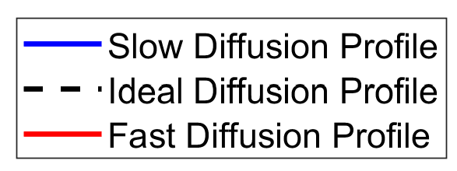
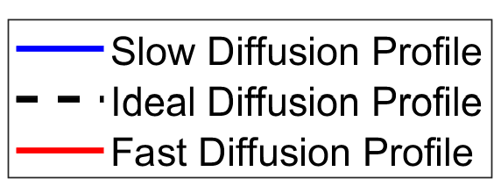
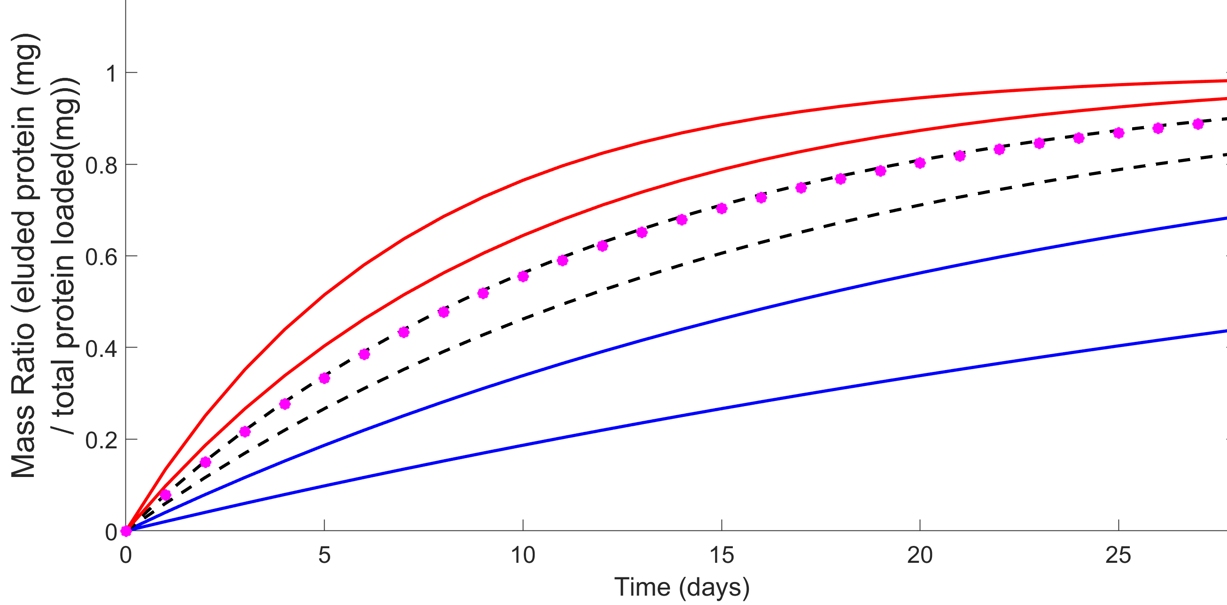
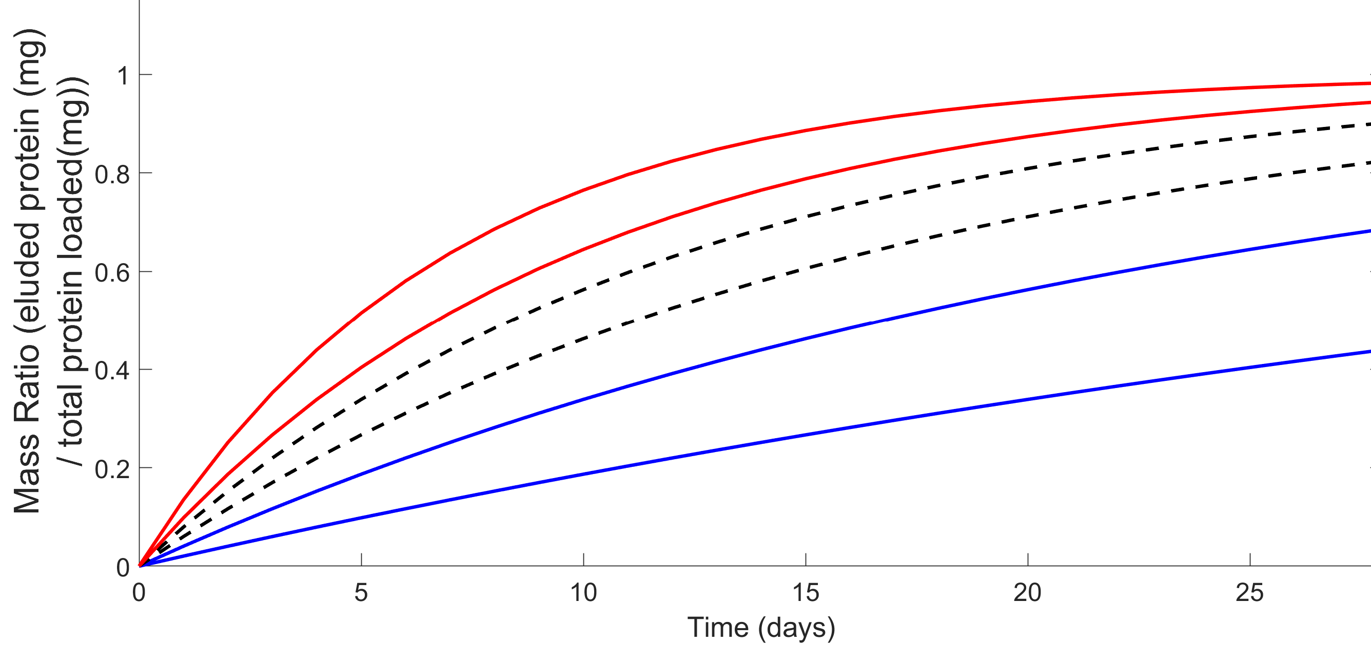
Diffusion Model of PDGF-BB Through Acellular Dermal Matrix Over 4 weeks​
Controlled Release of GFs
Goal: Compare experimental diffusion profile of PDGF-BB through the acellular dermal matrix with our diffusion model
Method: Generate theoretical curves with varying diffusion profiles and determine our "ideal" range of curves
Conclusion
The acellular dermal matrix is modeled to be an ideal material for the diffusion of PDGF-BB
Notes:
1 min 20 sec
To validate our diffusion results of PDGF-BB through the casing... a mathematical model derived from Fick's law was applied to generate plots to predict the diffusion profile of our design.
CLICK
As you can see from the model... the curves represent diffusion profiles by iterating diffusion coefficients.
We then identified a range of ideal diffusion profiles as denoted by the black dashed line that reduced burst release and elongated elution
We then plotted our experimental data based on its diffusion coefficient which can be seen by the pink dotted line.
As you can see this diffusion profile lies between our ideal curves so we can conclude that the dermal matrix is modeled to be an ideal material for the diffusion of PDGF-BB.

Slide 27
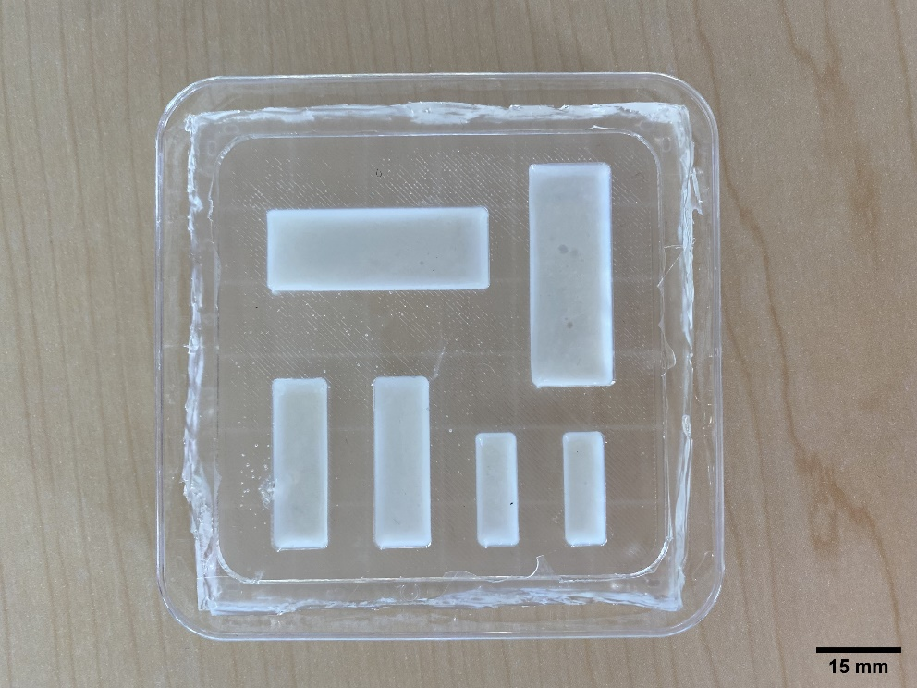
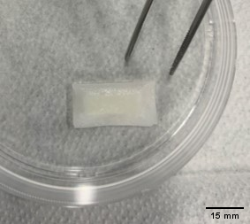
Client Feedback
Collagen Sponge Reinforced Hydrogels
Collagen Sponge Reinforced Hydrogel
Acellular Dermal Matrix
"This is something that is very practical and would be easily implemented in the operating room" ~ David P. Magit, MD
Notes:
Maria 20 s
We presented the final product our client in various sizes and with and without the casing as shown. We discussed that the smallest size would be the most ideal and suggestions for next steps.

Slide 28
Conclusion
Delivers a Therapeutic Agent
Healing Promotion
¿
Surgically Compatible
Mechanically Sound
Notes:
Evan 20 sec
In conclusion to this project we were able to successfully deliver a sustained release of our therapeutic as determined by our drug elution and diffusion testing
As for healing promotion Further cell proliferation testing is required to assess how well the scaffold promotes healing of the UCL
we proved that the design is surgically compatible as our client confirmed it could be easily implemented in an operating room
and we proved the design is mechanically sound as determined by our tensile testing results.

Slide 29
Future Recommendations
Growth Factor Portfolio & Higher Concentrations
Animal Testing
Application to Additional Ligaments
Collagen + Growth Factor Composite Sponge
Sealing and Fixation Methods
Notes:
Maria: 20 seconds
Moving forward, we would recommend using a variety of growth factors, loading the collagen sponge with growth factor, developing the dealing and fixation methods, perform animal testing, apply the design to other ligaments, and develop an operating room kit for the product.
Other GF: FGF-2, Production of collagenase, proliferation of capillary endothelial cells, angiogenesis, formation of granulation tissue
Load more with collagen sponge is possible during fabrication
Fibrin glue is standard, suture net/figure 8
Animal models: rabbit
Additional ligaments: acl, rotator cuff
Rabit studies done in FCL in knee,
non human primates and specific breeds of rats (long evans) have elbows similar to humans and can supinate and pronate
file:///C:/Users/Maria%20Decelles/Downloads/aoj-06-12.pdf

Slide 30
Acknowledgements
Professor Karen Troy, PhD
Professor George Pins, PhD
David Magit, MD
Kevin Cornwell, PhD
Professor Jeannine Coburn, PhD
Professor Sakthikumar Ambady, PhD

Slide 31
Thank you!
Any questions?

Slide 32
References
[1] Fleisig, G. S., Barrentine, S. W., Zheng, N., Escamilla, R. F., & Andrews, J. R. (1999). Kinematic and kinetic comparison of baseball pitching among various levels of development. Journal of Biomechanics, 32(12), 1371–1375. https://doi.org/10.1016/s0021-9290(99)00127-x
[2]Davis, C. (n.d.). Teen Tommy John surgeries, youth sports injuries reach epidemic proportions. Sun-Sentinel.Com. Retrieved April 14, 2022, from https://www.sun-sentinel.com/sports/fl-sp-tommy-john-youth-injuries-20180618-story.html
[3] David, M. (2021, September 24). Objectives Meeting [Personal communication].

Slide 33
Appendices

Slide 34
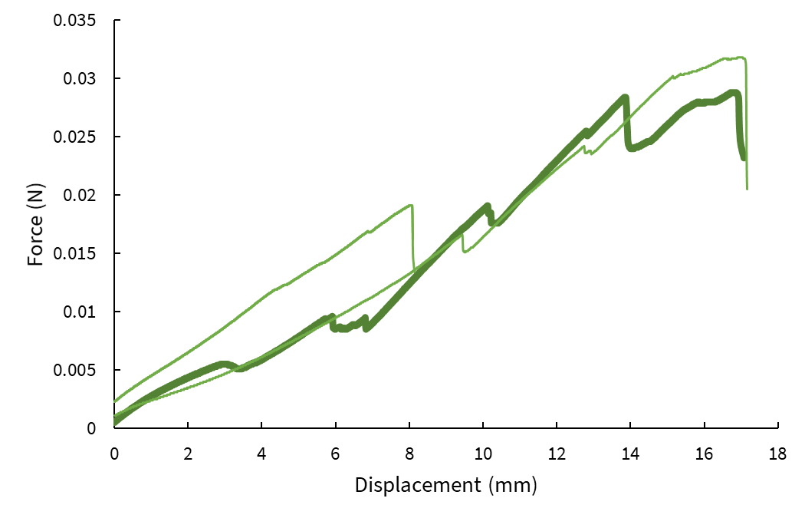
Chicken Skin Mechanical Testing
Stiffness: 3.1 ± 1.6 N/mm
Failure Load: 31 ± 13 N

Slide 35
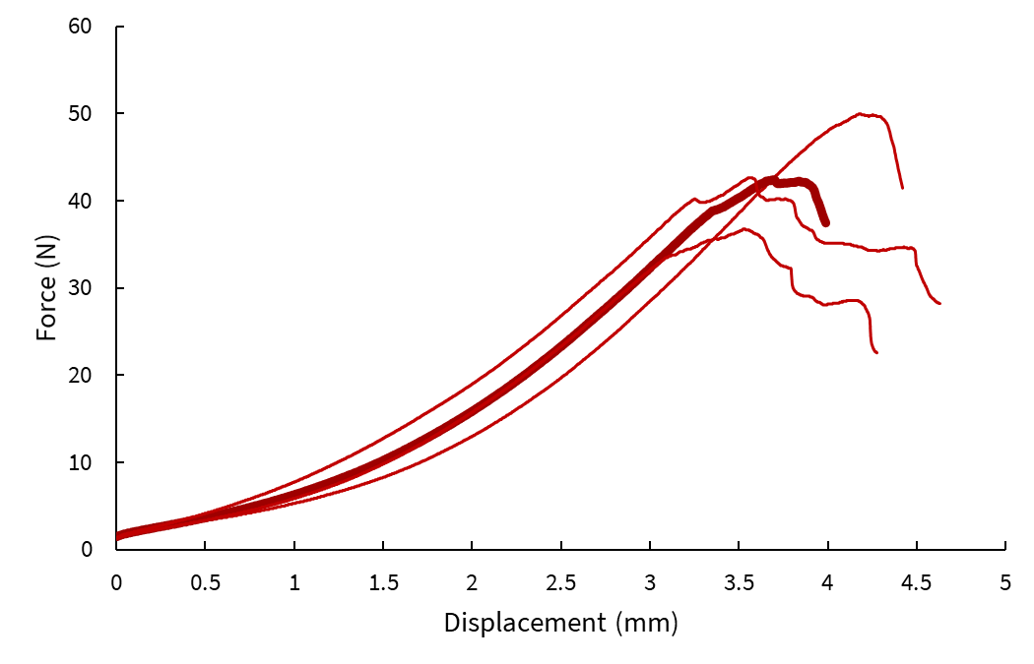
Band-Aid Mechanical Testing
Stiffness: 15.3 ± 1.1 N/mm
Failure Load: 43.3 ± 4.7 N

Slide 36
Material for Drug Loading Pugh Analysis
Evaluation Criteria | Weight | Baseline | Collagen Sponge | Silk Hydrogel | Zein Electrospun Mats | Chitosan Sponge | Keratin Films
Ease of Drug Attachment/Loading Capacity | 5 | 0 | 1 | 1 | 1 | 1 | 1
Has it been used with PDGF-BB? | 3 | 0 | 1 | 1 | -1 | 1 | -1
Controlled Release | 4 | 0 | 1 | 1 | 0 | 1 | 0
4-6 week Degradation Duration | 3 | 0 | 1 | -1 | -1 | -1 | 1
Biological Response | 5 | 0 | 1 | 0 | 1 | 0 | 1
Constraints
Cost | 5 | 0 | -1 | 1 | 1 | 1 | -1
Material Availability | 3 | 0 | 1 | 1 | 0 | -1 | -1
Equipment Availability | 5 | 0 | 1 | 1 | 0 | 0 | -1
Total |  |  | 23 | 22 | 13 | 11 | 1

Slide 37
Material for Structural Support Pugh Analysis
Evaluation Criteria | Weight | Baseline | Collagen Sponge | Collagen Threads | Silk Hydrogel | Zein Electro- spun Mats | Keratin Films | Acellular Dermal Matrix
Stiffness > 3 and < 17 N/mm | 5 | 0 | 1 | -1 | 0 | 1 | 1 | 1
Failure Load > 13 N | 5 | 0 | -1 | 0 | 0 | 0 | 0 | 1
4-6 week Degradation | 3 | 0 | 1 | -1 | -1 | -1 | 1 | -1
Biological Response | 5 | 0 | 1 | 1 | 0 | 1 | 0 | 1
Constraints
Cost | 5 | 0 | -1 | -1 | 1 | 1 | 1 | 0
Material Availability | 3 | 0 | 1 | 1 | 1 | 0 | -1 | 1
Equipment Availability | 5 | 0 | 1 | 1 | 1 | 0 | -1 | 1
Total |  |  | 1 | 0 | 10 | 12 | 5 | 20

Slide 38
Degradation Rates Researched
Material | Degradation Rate (weeks) | Sources
Collagen Sponge | 1 to 4 | (Noah et al., 2002; Ueda et al., 2002)
Collagen Thread | 4 to 26 | (Ge et al., 2006)
Silk Hydrogel | 15 | (Leng et al., 2017; Hopkins et al., 2013)
Zein Electrospun Mats | 10 to 35 | (Yao et al., 2009; Wang et al., 2013)
Chitosan Sponge | 0.25 to 4 | (Stinner et al., 2010; Han et al., 2014)
Keratin Films | 0.5 to 6 | (Borrelli et al., 2015; Vasconcelos et al., 2008)
Dermal Matrices | - | -

Slide 39
Growth Factor Functions
Growth Factors | Function (s)
Platelet-Derived Growth Factor (PDGF-BB) | Collagen production, protein production, DNA synthesis, increased cell proliferation, generation of other growth factors
Transforming Growth Factor- β1 (TGF-β1) | Increased production of collagen I and III, improved mechanical properties
Vascular Endothelial Growth Factor (VEGF-2) | High angiogenic effect, cell proliferation, vascular growth towards the site of repair, can be upregulated through biological and mechanical stimuli
Basic Fibroblast Growth Factor (FGF-2) | Production of collagenase, proliferation of capillary endothelial cells, angiogenesis, formation of granulation tissue
Insulin-Like Growth Factor- I (IGF-1) | Protein synthesis, cell proliferation, collagen synthesis, decrease swelling, migration of fibroblasts

Slide 40
Growth Factor Pugh Analysis
Growth Factor Functions | Weight | PDGF-BB | FGF-2 | TGFβ-1 | VEGF-2 | IGF-1
College Production | 1 | 1 | 1 | 1 | 0 | 1
Cell Proliferation | 1 | 1 | 0 | 0 | 1 | 1
Protein Production | 1 | 1 | 0 | 0 | 0 | 1
DNA Synthesis | 1 | 1 | 0 | 0 | 0 | 0
Generation of Other Growth Factors | 1 | 1 | 0 | 0 | 0 | 0
Improved mechanical properties | 1 | 0 | 0 | 1 | 0 | 0
Migration of fibroblasts | 1 | 0 | 0 | 0 | 0 | 1
Angiogenesis | 1 | 1 | 1 | 0 | 1 | 0
Vascular Growth | 1 | 0 | 1 | 0 | 1 | 0
Formation of granulation tissue | 1 | 0 | 1 | 0 | 0 | 0
Total |  | 6 | 4 | 2 | 3 | 4

Slide 41
PDGF-BB Concentration Results
Concentration (μg/mL) | 0.167 | 0.417 | 0.667 | 1 | 0
Day 3 Count | 405,000 | 420,000 | 617,500 | 555,000 | 267,500
 | 437,500 | 492,500 | 572,500 | 655,000 | 352,500
 | 340,000 | 507,500 | 530,000 | 825,000 | 295,000
 |  |  |  |  | 325,000
Avg | 394,167 | 473,333 | 573,333 | 678,333 | 310,000
% Increase | 127% | 153% | 185% | 219% | 100%
Day 5 Count | 1,495,000 | 2,065,000 | 1,850,000 | 2,980,000 | 825,000
 | 2,100,000 | 2,355,000 | 2,615,000 | 2,712,500 | 662,500
 | 2,060,000 | 2,145,000 | 2,917,500 | 2,527,500 | 710,000
 |  |  |  |  | 610,000
Avg | 1,885,000 | 2,188,333 | 2,460,833 | 2,740,000 | 701,875
% Increase | 269% | 312% | 351% | 390% | 100%

Slide 42
Drug Elution Testing with Albumin
Controlled Release of GFs
Goal: Characterize the release profile of albumin from various scaffold conditions
n = 5
Conclusion
Collagen sponge reinforced hydrogels to be used for final scaffold
Notes:
Meagan 7:45 40 sec
We then began to verify our final design by testing how to best release from various scaffold designs: a silk hydrogel and a collagen sponge reinforced silk hydrogel. we loaded each scaffold with model protein, Albumin, and suspended 5 conditions of each scaffold in dPBS (-). We pulled supernant samples at the time points shown on the graph. WE then used a BCA Assay to measure the release of albumin and found the cumulative release over 14 days. You can see that the sponge reinforced gel showed a more sustained release of growth factor Thus, for our final design we chose to move forward with this structure.

Slide 43
Drug Elution Testing with Albumin
Controlled Elution
Goal: Characterize the release profile of albumin from various scaffold conditions
Number of Trials: 5
Notes:
Meagan
To determine how to best release PDGF we initially tested the drug elution from a few scaffold designs: a silk hydrogel and a collagen sponge reinforced silk hydrogel. we made each scaffold, loaded it with Albumin, a model protein, and suspended them in dPBS (-).

Slide 44
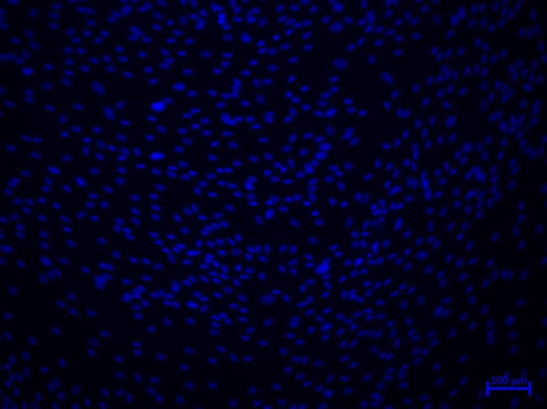
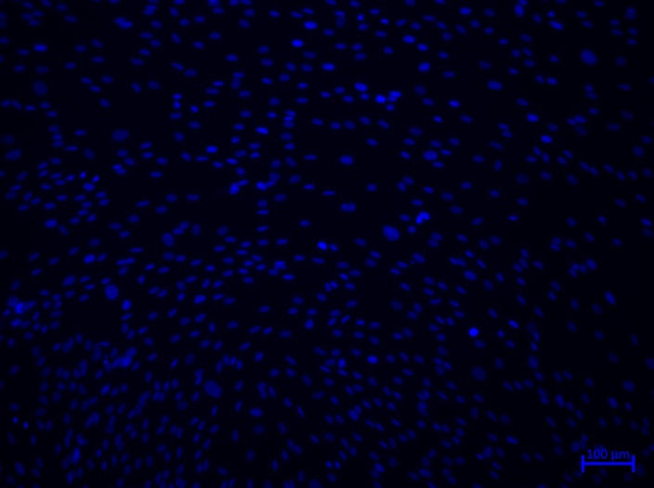
Representative BrdU Assay Photos
Day 5
DAPI Time 1
BrdU Time 1
Day 3
DAPI Time 1
BrdU Time 1

Slide 45
Permeability Testing of Casing
Goal: Determine diffusion coefficient of PDGF-BB though the decellularized bovine dermis casing
Set up: scaffold and dermis "sandwiched" between chambers, samples collected every 48 hrs, PDGF-BB concentrations measured
Calculations: compare diffusion coefficient of experimental system to ideal diffusion coefficient
N: total solute mass in system
V: total volume, D is the diffusion coefficient
C₂ : protein concentration in the top chamber at a given time
h: thickness of the barrier to diffusion
t: time
A: surface area of the barrier
τ: scaling factor(accounts for volume change)
Notes:
-compare to theoretical models (evan)
-compare to sandwich testing
-compare to lit values
Make sure to add what we have!
Assume plannar surface

Slide 46
Silk Fibroin
Bombyx Mori
Silk II – beta sheets that form a crystalline structure after spinning
Physically gelled through sonication methods
Helps initiate the formation of β-sheets by altering the physical crosslinks. This helps the gel solidify into a stable gel.

Slide 47
Functions and Specifications
Functions
Specifications
Contains Therapeutic Agent
Contains 300 ng of PDGF-BB
Controlled Release of GFs
At least 2-week release
Increases Cell Proliferation
Statistically significant increase in cell proliferation with the use of growth factors as compared to control
Implanted in 10 cm incision window
Scaffold must not exceed 10 mm X 25 mm X 3 mm
Stiffness is 3-17 N/mm
Failure load > 13 N
Withstands Surgical Manipulation
Scaffold Degrades
Degradation over 4-6 weeks
Withstands Anchoring
Sutures must withstand 78.3N
Fixation method degrades slower than the scaffold
Notes:
Evan (30 sec)
In collaboration with our client and our advisors, we identified the following functions and specifications that will serve as the basis of our design requirements.
We determined that the design needs to contain a therapeutic agent to aid in the healing process, exhibit a controlled release of growth factors, increase cell proliferation, withstand surgical manipulation, degrade within the body and withstand anchoring to the ligament. However, we were unable to test the degradation of the materials and perform tests on ligament fixation due to time and resource constraints.

Slide 48
Specifications
Scaffold must...
Contain 300 ng of PDGF-BB
Release PDGF-BB over a period of at least 2 weeks
Significantly increase cell proliferation
Be implantable in a 10 cm window
Be within the dimensions of 10 mm X 25 mm X 3 mm
Not be stiffer than 20 N/mm
Have a failure load great than 13 N
Degrades in 6 weeks
Notes:
Evan (30 sec)
In collaboration with our client and our advisors, we identified the following functions and specifications that will serve as the basis of our design requirements.
We determined that the design needs to contain a therapeutic agent to aid in the healing process, exhibit a controlled release of growth factors, increase cell proliferation, withstand surgical manipulation, degrade within the body and withstand anchoring to the ligament. However, we were unable to test the degradation of the materials and perform tests on ligament fixation due to time and resource constraints.

Slide 49
BADM Values
Bovine versus Porcine Acellular Dermal Matrix: A Comparison of Mechanical Properties
**1x6 cm with 4mm narrow dog bone section**
BADM (1.6 mm thickness)
Failure Load = 108.08 +/- 39.43 N
Suture Retention: 112.36 +/- 11.56 N
BADM (2.95 mm thickness)
Failure load = 130.24 +/- 64.25 N
Suture Retention = 153.02 +/- 25.64
Is more than 20 N
Notes:
https://www.ncbi.nlm.nih.gov/pmc/articles/PMC4174084/
https://journals.lww.com/annalsofsurgery/Abstract/2012/03000/Differentiation_of_Biologic_Scaffold_Materials.30.aspx

Slide 50
ADMN Testing Criteria

