Slide 1
Logic For Exploit Detection: Utilizing Proof Search for Exploitability Detection in Compact Software Systems
Presenter: Kaveh Eskandari Miandoab
Advisor: Professor Rose Bohrer
Reader: Professor Xiaoyan Sherry Sun

Slide 2
Motivation
Compact, yet intricate software systems are imperative to society.
Voting Software
Moderation Software
Scheduler Systems
These systems can be prone to exploits and bugs.
Design Flaw
Data Flaw
Programmer Bias

Slide 3
Motivation
Software Characteristics
Simple in Design
Important in Task Performance
Many (Direct or Indirect) Users
Can be Modeled Manually Quickly (Not Blackbox)
Current Tools
Language Specific Tools (C/C++)
Poor Domain Specific Performance

Slide 4
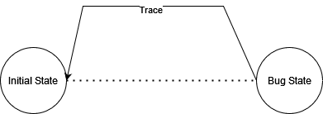
Main Idea
Model implementation level behavior as a declarative set of states.
Consider a bug/exploit as an unwanted state.
Search for states that can lead to the bug.

Slide 5
Key Takeaway
Backward Proof Search can be Used to Detect Bugs in a Staged Linear Logic Programming Model of a Compact Software.

Slide 6
Key Takeaway
Backward Proof Search can be Used to Detect Bugs in a Staged Linear Logic Programming Model of a Compact Software.

Slide 7
Linear Logic Programming

Slide 8
Logic Programming
Declarative Paradigm of Programming
Single Formalism
Logic
Computation
Great Description Level Tool
Behavior Level Definition
Abstraction Over Procedural Implementation
$H:−B_{1},B_{2},B_{3},…,B_{k}$
Classical State Definition
$ReturnWinner\left(x\right):−CountVotes\left(x\right),Function_{2},…Function_{k}$

Slide 9
Issues with Logic Programming
Strong Mathematical Toolset for Domain Declaration
Knowledge Base
Databases
Unable to Define Stateful Domains
Mutability of Program World Through Execution
Cat(Matt)
OnMat(Matt)
Moves(Matt)
How to handle the negation of OnMat(Mat)?
Linear Logic Programming is the Solution

Slide 10
Linear Logic Programming
Subset of Logic Programming
Allows for the Utilization of Statfulness and Concurrency
Emphasize Formulas as Resources
A Resource can be Generated and Consumed
$Moves\left(Matt\right)⊗OnMat\left(Matt\right) −o Moves(Matt)$
Transformations Applied to Statements as Proofs
Models the General Behavior of the Program

Slide 11
Key Takeaway
Backward Proof Search can be Used to Detect Bugs in a Staged Linear Logic Programming Model of a Compact Software.

Slide 12
Staged Linear Logic Programming
Linear Logic Programming Does not Allow for Ordering
Must Search the Program Space to Find the Correct Ordering
Rules Might Nondeterministically interfere
red-to-blue: ball red –o ball blue
blue-to-red: ball blue –o ball red
count Color Number * ball Color –o count Color (Successor Number)
3 Blue, 4 Red
7 Red?
7 Blue?
4 Blue 3 Red?

Slide 13
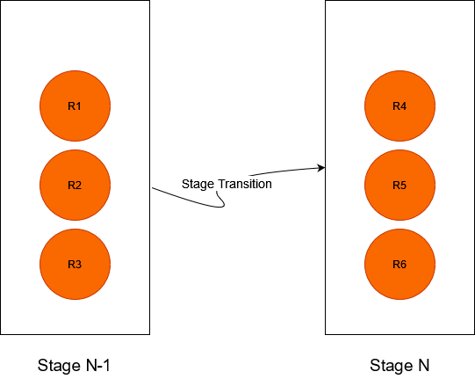
Staged Linear Logic Programming
Staged Linear Logic Programming Allows for Programs with Quiescence
Structure the Program to Consecutive Stages
Stage $N$ is only Used when Stage $N−1$ is Quiescent

Slide 14
Staged Linear Logic Programming
red-to-temp: ball red –o ball temp
blue-to-red: ball blue –o ball red
temp-to-blue: ball temp –o ball blue
count Color Number * ball Color –o count Color (Successor Number)
By introducing stages, we provide ordering to the program structure.

Slide 15
Key Takeaway
Backward Proof Search can be Used to Detect Bugs in a Staged Linear Logic Programming Model of a Compact Software.

Slide 16
Conversion to a Linear Logic Program

Slide 17
Motivating Example
Alice, Bob, John, and Sophia are People
Sophia and Bob are Candidates
Each Person Votes for a Candidate
A Person who is a Candidate can not Vote for Themselves
A Person can Only Vote Once
The Character with the Highest Number of Votes Wins

Slide 18
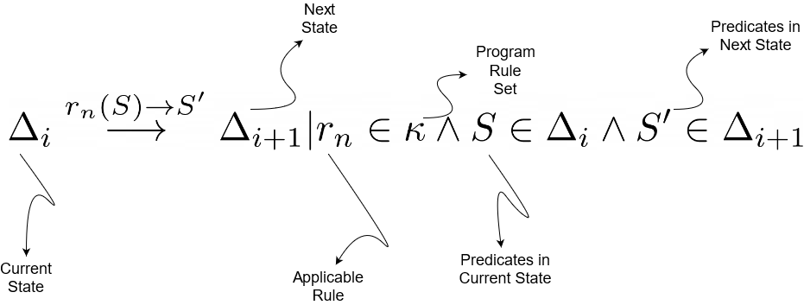
Conversion Criteria
Rule Based
Initial State → Starting Point
Subsequent States → Rule Application
Each State is a Program Configuration
Rule Application Results in Configuration Change

Slide 19
Conversion Criteria
Stage Based
Apply Rules in Stage $N$ Only if $N−1$ is Quiescent
Does not Limit the Usage of Stageless Logic Modeling

Slide 20
Motivating Example
Alice, Bob, John, and Sophia are People
Sophia and Bob are Candidates
Each Person Votes for a Candidate
A Person who is a Candidate can not Vote for Themselves
A Person can Only Vote Once
The Character with the Highest Number of Votes Wins

Slide 21
Conversion to Staged Linear Logic
$Person ∈Type$
$\left(\text{Alice} ∈Person\right)⊗\left(Bob ∈Person\right)⊗\left(John ∈Person\right)⊗\left(Sophia ∈Person\right)$
$Candidate\left(Person\right):Predicate$
$Voter\left(Person\right):Predicate$
$Votes\left(Person, Person\right):Predicate$
$HasNotVoted\left(Person\right):Predicate$
$Voter\left(P_{1}\right)⊗HasNotVoted\left(P_{1}\right)⊗Candidate\left(P_{2}\right)−o Votes\left(P_{1},P_{2}\right)⊗HasNotVoted\left(P_{1}\right)$
$Δ_{0}=Candidate\left(Bob\right),Candidate\left(Sophia\right),Voter\left(Bob\right),Voter\left(Sophia\right),Voter\left(Alice\right),Voter\left(John\right),$
$$HasNotVoted\left(Alice\right),HasNotVoted\left(John\right),HasNotVoted\left(Sophia\right),HasNotVoted(Bob)$$
Intentional Bug

Slide 22
Key Takeaway
Backward Proof Search can be Used to Detect Bugs in a Staged Linear Logic Programming Model of a Compact Software.

Slide 23
Proof Search

Slide 24
Proof Search
Concurrent Computing
Searching for Possible Computations
Logic Programming
Basic Paradigm of Computation
Functional Programming
Searching for a Program Satisfying a Constraint

Slide 25
Proof Search
Given a Query Q, is There a Feasible Computation Trace Such that Q is Produced?

Slide 26
Proving a Bug
$Person ∈Type$
$\left(\text{Alice} ∈Person\right)⊗\left(Bob ∈Person\right)⊗\left(John ∈Person\right)⊗\left(Sophia ∈Person\right)$
$Candidate\left(Person\right):Predicate$
$Voter\left(Person\right):Predicate$
$Votes\left(Person, Person\right):Predicate$
$HasNotVoted\left(Person\right):Predicate$
$Voter\left(P_{1}\right)⊗HasNotVoted\left(P_{1}\right)⊗Candidate\left(P_{2}\right)−o Votes\left(P_{1},P_{2}\right)⊗HasNotVoted\left(P_{1}\right)$
$Δ_{0}=Candidate\left(Bob\right),Candidate\left(Sophia\right),Voter\left(Bob\right),Voter\left(Sophia\right),Voter\left(Alice\right),Voter\left(John\right),$
$$HasNotVoted\left(Alice\right),HasNotVoted\left(John\right),HasNotVoted\left(Sophia\right),HasNotVoted(Bob)$$
Prove: $\left\{Votes\left(C_{i},C_{j}\right), Votes\left(C_{i},C_{j}\right)\right\}$ Holds.
Intentional Bug

Slide 27
Proof Search Process
Identify the initial configuration of the linear logic system.
Identify a linear logic statement that is an undesirable system behavior.
Apply backward proof search with the undesirable statement as the goal state and the linear logic program as the set of rules.
Identify the inference rules such that their application leads to the generation of the goal statement.
Temporarily eliminate the bottom stage inference rule from the sequent and replace the current target with one of the states that are able to generate the current target via inference rules.
Repeat the process.

Slide 28
Key Takeaway
Backward Proof Search can be Used to Detect Bugs in a Staged Linear Logic Programming Model of a Compact Software.

Slide 29
Proving a Bug
$Δ_{0}=Candidate\left(Bob\right),Candidate\left(Sophia\right),Voter\left(Bob\right),Voter\left(Sophia\right),Voter\left(Alice\right),Voter\left(John\right),$
$$HasNotVoted\left(Alice\right),HasNotVoted\left(John\right),HasNotVoted\left(Sophia\right),HasNotVoted(Bob)$$
(1) Identify the initial configuration of the linear logic system.

Slide 30
Proving a Bug
$\left\{Votes\left(C_{i},C_{j}\right), Votes\left(C_{i},C_{j}\right)\right\}$
(2) Identify a linear logic statement that is an undesirable system behavior.

Slide 31
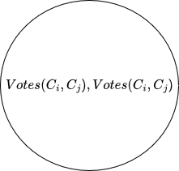
Proving a Bug
(3) Goal Statement

Slide 32
Proving a Bug
(4), (5) Goal Statement

Slide 33
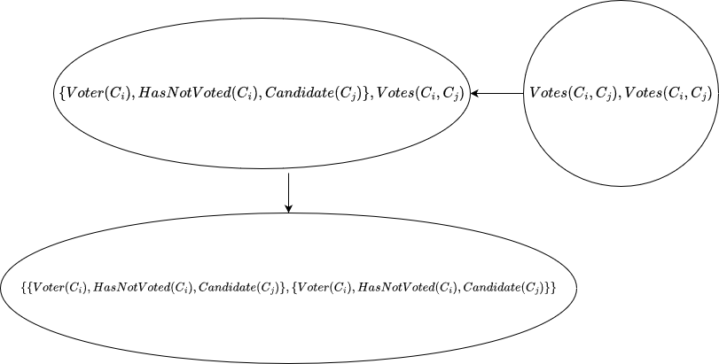
Proving a Bug
(4), (5), (6) Goal Statement

Slide 34
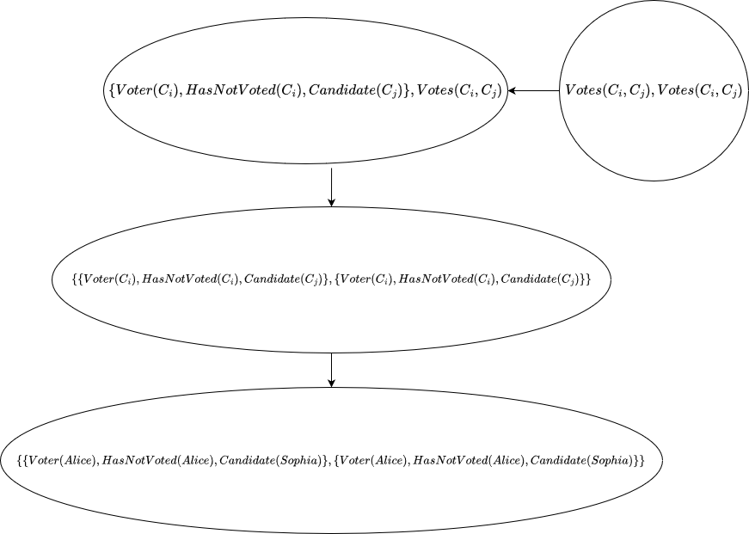
Proving a Bug
(4), (5), (6) Goal Statement

Slide 35
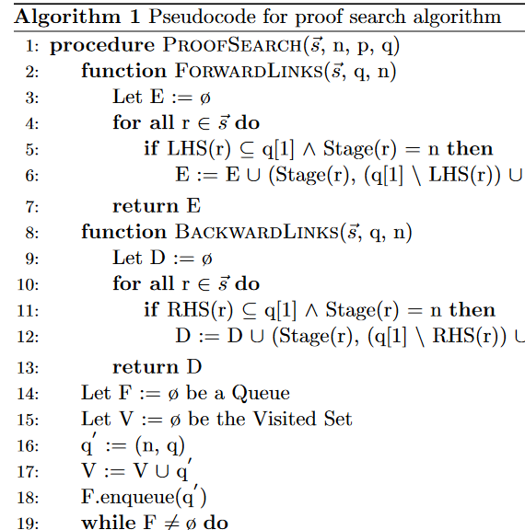
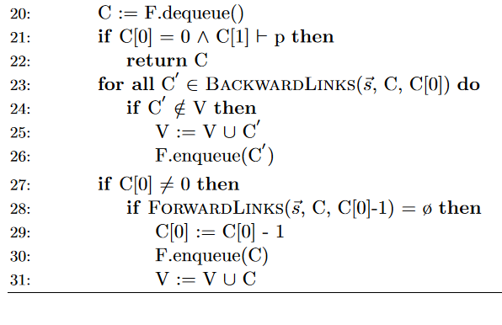
The Algorithm

Slide 36
Algorithm Properties
Breadth-First-Search Approach
Depth-First-Search is Problematic
Cyclic Resources are not Properly Handled (A –o B and B –o A)
Backward Search
Forward Search is also Problematic
No Easy Way of Goal Based Approach for Bug Detection

Slide 37
Algorithm Properties
Breadth-First-Search Approach
Depth-First-Search is Problematic
Cyclic Resources are not Properly Handled (A –o B and B –o A)
Backward Search
Forward Search is also Problematic
No Easy Way of Goal Based Approach for Bug Detection
Sound
A Found Trace is Guaranteed to be Correct with Respect to the Query
Complete
All Correct Traces Can be Found that Result in the Query

Slide 38
Algorithm Properties
Breadth-First-Search Approach
Depth-First-Search is Problematic
Cyclic Resources are not Properly Handled (A –o B and B –o A)
Backward Search
Forward Search is also Problematic
No Easy Way of Goal Based Approach for Bug Detection
Sound
A Found Trace is Guaranteed to be Correct with Respect to the Query
Complete
All Correct Traces Can be Found that Result in the Query
In Each Step
Iteratively Generate States in Current Stage N Such that they Produce the Goal State and Until Quiescence is Reached in Stage N.
If Goal is Quiescent in Stage N-1, also Check for States in Stage N-1
Keep Generating States Until Stage 0 is Reached, Return True if the Initial Predicate or Configuration is Satisfied.
Return False if Space is Fully Explored (Semi-Decidable Procedure)

Slide 39
Key Takeaway
Backward Proof Search can be Used to Detect Bugs in a Staged Linear Logic Programming Model of a Compact Software.

Slide 40
Evaluation and Implementation

Slide 41
Implementation
Pure Python Implementation
Version 3.10
Freely Available
Open Source

Slide 42
Evaluation – Corpus Selection
Toy Examples
Functional Correctness of the Algorithm
6 Programs
27 Rules
Larger, Manually Constructed Examples (PolicyKit [Zhang, 2020])
Real Life Feasibility of the Algorithm
2 Programs
10 Rules
Randomized, Artificially Created Examples
Efficiency of the Algorithm
3502 Programs
89884 Rules

Slide 43
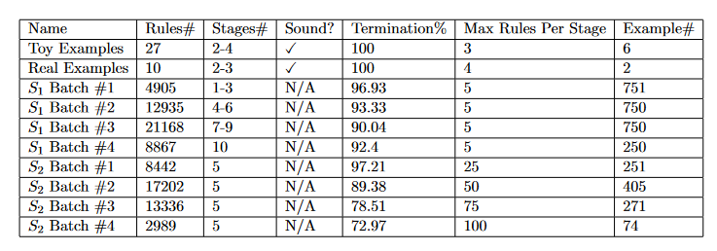
Evaluation – Experimental Results

Slide 44
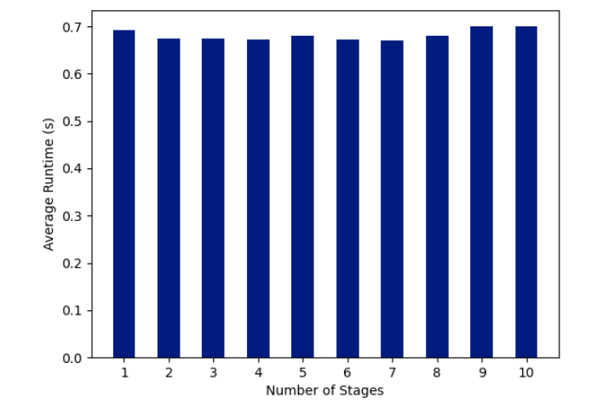
Evaluation – Average Runtime – Stage Bound

Slide 45
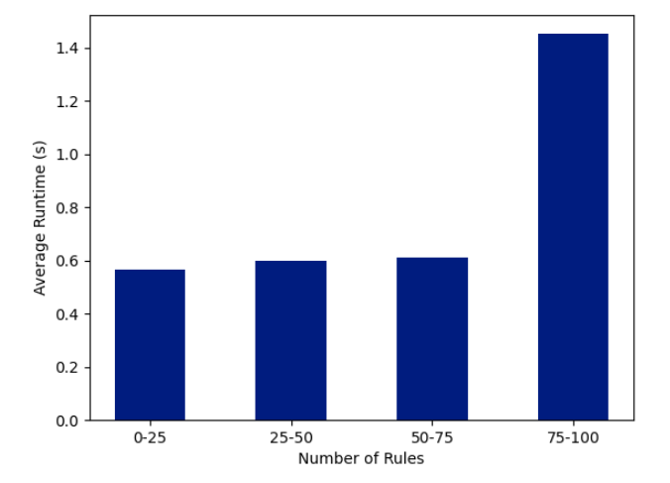
Evaluation – Average Runtime – Rule Bound

Slide 46
Conclusion

Slide 47
Conclusion
First Backward Proof Search for Staged Linear Logic Programs
Complete and Sound
Bug Detection from a Target Query
Comprehensive Evaluation of Python Implementation
90.04% Termination Rate when Bound by Stage
72.97% Termination Rate when Bound by Rules
Future Work
Algorithm Optimization
Automata Learning
Automatic Staged Linear Logic Program Generation
Domain Specific Application

Slide 48
THANK YOU ☺

