Slide 1
Sponsored by
Exploring Anycast Stability in IPv4 and IPv6
Jack Campanale, Jasper Meggitt,
Yash Patel, Cindy Trac
Notes:
Yash
Hi everyone, thank you for taking the time to join us. Today, we will be presenting our Major Qualifying Project - PATHly Visualizer: Exploring Anycast Stability in IPv4 and IPv6.
This project was done in collaboration with both Fastly and WPI.

Slide 2
Team PATHly
Yash Patel BS/MS in CS ‘23
Jack Campanale
BS in CS
IMGD Minor ‘23
Jasper Meggitt
BS/MS in CS ‘23
Cindy Trac
BS in CS/DS
Teacher Prep ‘23
Notes:
Yash
I’d like to start introducing the team. My name is Yash Patel a 5th year student doing my BS/MS in Computer Science.

Slide 3
Cloud Service
Provider
Edge Cloud
Platform
Content Delivery Network
(CDN)
Notes:
Cindy (for MQP talk)
A little more about Fastly, our sponsor, before we get into our project.
Fastly is a cloud computing service provider. Some of their services include content caching, image optimization, and load balancing. CLICK
Fastly describes its network as an edge cloud platform. This means it is designed to help developers extend their core cloud infrastructure to the edge of the network, closer to users. The closer to the user, the faster the service. CLICK
The Fastly edge cloud platform includes their content delivery network (CDN), a network of interconnected servers that can help speed up webpage loading for data-heavy applications. This is crucial for Fastly customers, some of which include The New York Times and Reddit.

Slide 4
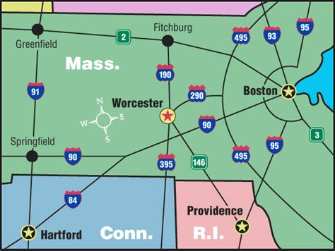
Notes:
Cindy (for Fastly talk)
A little bit more about WPI before we get into things.
WPI stands for Worcester Polytechnic Institute.
We’re located in Worcester, which for those of you outside of MA, is about an hour away from Boston.
This project is considered our MQP, which stands for Major Qualifying Project (idk if you can tell but we really like our acronyms)
Think og it as a senior capstone project related to your major. Fastly has been sponsoring MQP projects for a few years now and it’s a great opportunity to get handson experience before we graduate.

Slide 5
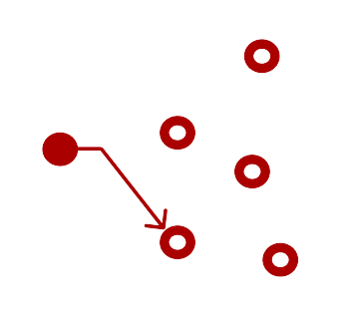
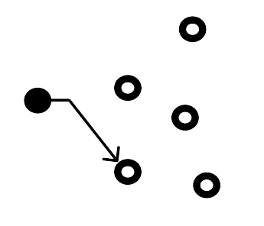
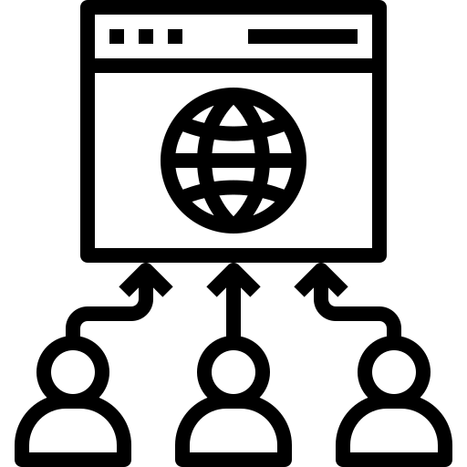
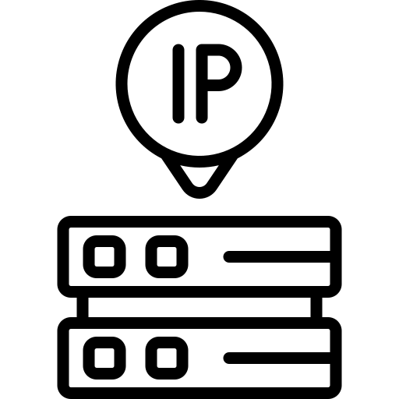
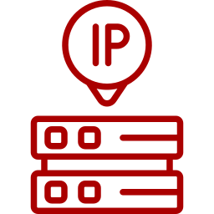
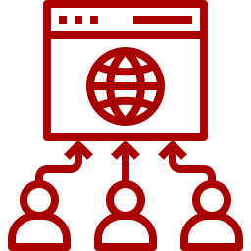
Problem Statement
Modern Internet relies on Anycast
Anycast Traffic Management
IPv4 vs. IPv6
Notes:
Going into the problem statement for our project. IP Anycast is a packet routing delivery scheme where there is one source, and multiple destinations defined under the same IP range. From those destinations, only one is chosen to receive the packet. Modern internet services rely on IP Anycast, especially CDNs like Fastly, where Anycast is utilized to process and cache data at the closest endpoint. Anycast enables CDNs to bolster system performance, security, and load balancing. CLICK The issue lies with Anycast traffic management, as it is difficult to understand and analyze. Routing packets is asymmetric, meaning packets can take several path variations going from a source to a destination. It’s never wholly evident what direction a packet is going to take in Anycast, or for what reason a sudden path change is made. So this seemed to be a natural course for our project. Create a tool to visualize Anycast routing to allow network engineers to analyze routes. However, CLICK a problem lies with IPv6 Anycast variations due to their lack of maturity in comparison to their IPv4 counterparts. IPv6 is a far more new protocol than IPv4, and for that reason is less fully integrated in modern routing services than IPv4. IPv6 paths for packets could be completely different from IPv4 paths. To address this, this project’s aim was to create a tool that utilizes public measurement data in order to identify and analyze differences in IPv4 and IPv6 Anycast routing. In response to this, we created CLICK Pathly.
Before we go into project implementation, we’re going to go over a little background information.

Slide 6
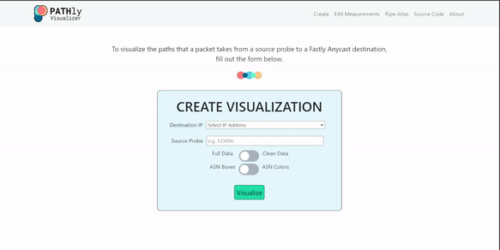
PATHly (Probe ASN Traffic Highway) Visualizer
Notes:
The PATH in PATHly stands for Probe Autonomous System Number Traffic Highway because as you can see in this sneak peek, we have created a tool to actually visualize the path a packet takes from a source probe to its destination. Our team’s approach to the challenge of anycast traffic management is to visualize it in order to draw insight.
Before we go into project implementation and our demo, we’re going to go over a little background information.

Slide 7
Background - IPv4 vs. IPv6
IPv4
XXX.XXX.XXX.XXX
32 Bits
IPv6
XXXX:XXXX:XXXX:XXXX:XXXX:XXXX:XXXX:XXXX
128 Bits
Notes:
Cindy
IP (Internet Protocol) addresses have standardized the way computers are able to communicate with one another.
Computers identify and differentiate themselves through IP addresses.
Under IPv4, there are 4.3 billion unique addresses because of its 32-bit limit. CLICK
When IPv4 was created
In order to support the rise in number of network-capable devices, IPv6 was created.
Under IPv6, addresses have a 128-bit size limit, allowing for 3.4 x 10^38 unique addresses. CLICK
This will allow every device in the world to have its own unique IPv6 address.
Now, on the surface it might seem like we are simply renaming IP addresses and referring to them by a longer name. But IPv4 and IPv6 are, in fact, very different. They are two completely different protocols. The chance of IPv4 and IPv6 returning the same route is very slim. You can see this in the graphic where the color of the line correspond to the protocol. Each protocol takes different
By comparing IPv4 and IPv6, we can gain insight on how networks behave from how the routes diverge.

Slide 8
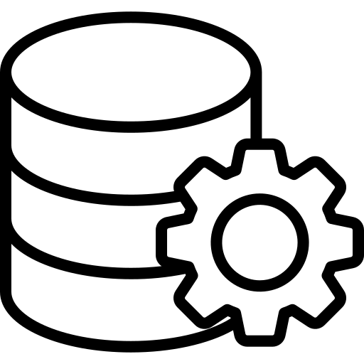
Methodology
Evaluating Anycast
Public Data Sources
Project Management
Security Concerns
Understanding inbound paths
Measuring externally gives more information
RIPE Atlas
Obtaining Traceroute Measurements
Agile Methodology Framework
Week Long Sprints
Hosted on Google Cloud Platform VM
Data Sources are public
Little to no security concerns
Notes:
Yash
The evaluation of anycast is a difficult task. A CDN such as Fastly can know its own policies and network configuration but they rely on thousands of other actors who each have their own policies and configurations. Fastly wants to understand the paths that inbound connections take because routes are often asymmetric so measuring out of Fastly will yield possible entire different AS paths. Measuring externally will give Fastly more information about how the network is actually behaving. CLICK
So what public measurements should we use? We focused on using RIPE Atlas. RIPE Atlas is an open, global network of Internet connectivity measurement probes, providing a better understand of the Internet as a whole. This means that RIPE Atlas uses probes that are located across the world for their own measurements such as Traceroute. CLICK
With the problem statement made and data sources identified, we need to decide on what project management system for the MQP. We utilized the agile methodology framework where the project was broken into one week sprints. Each sprint was broken into sprint planning, stand-ups, and retrospective. CLICK
Furthermore, we need to ensure our project doesn’t have any security concerns. Our application is hosted on a Google Cloud Platform VM managed by Fastly. In addition all data sources we use are public. This conveys that our project has little to no security concerns.

Slide 9
Tools
Programming
Languages / Frameworks
Data
Sources
Notes:
Yash
With our plan laid out, we needed to plan what tools we are going to use for our project.
We decided to use Golang and React JS for the backend and frontend of our project. Our team had little experience with Go but with it being one of the company’s primary languages and a huge learning opportunity, we decided to take on the challenge of learning and utilizing Go.
CLICK
We also used RIPE Atlas for our public measurements on Traceroute Data. We used Go libraries to be able to get properly formatted Traceroute data without having to manually parse the data ourselves.

Slide 10
Background - Traceroute
TTL: 1
TTL: 1
TTL: 2
Source
Hop 1
Hop 2
Hop 3
Destination
Time Exceeded
Time Exceeded
Notes:
Jasper
Points to touch on:
Attempt to get path from source to destination
Traceroute makes use of the Time-To-Live of packets
Normally the TTL is used to ensure packets do not persist in routing loops and other routing misconfigurations
When the TTL does expire, the convention is to send a new packet to the sender telling them that their packet was dropped
We perform 3 samples at each hop level
However, this strategy has some flaws
Not all servers will propagate these TTL expiration packets. Under heavy network load, some servers may also drop these packets to reduce network bandwidth
We can not guarantee that the response takes the same route back to us so the round trip times may not reflect the time between individual hops
By default, traceroute performs 3 samples at each TTL until it reaches the destination. However, we can not guarantee that all responses on a single traceroute measurement only reflect a single path.
We can adjust for this using the knowledge that network routing is usually cached so when comparing with additional messages, most will only contain a single route.

Slide 11
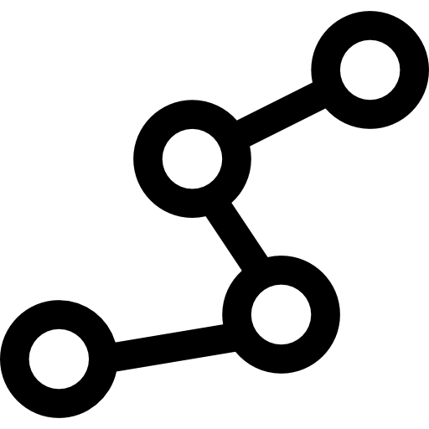
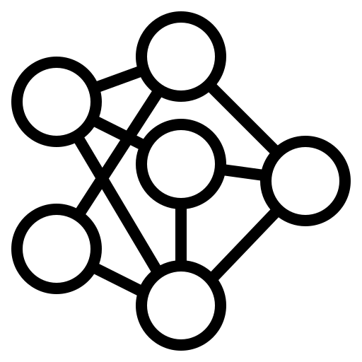
Traceroute Data Processing
Moving Statistic
Full vs. Clean Paths
ASN Mapping
Store data that does not consume all of our memory
Measurements that are close together fall in the same bin
Build paths where Nodes are IP addresses and edges are hops
Clean paths remove the timeouts and rarely taken paths
Use public CAIDA data to map IP addresses to ASNs
Gives a high level routing overview of routing changes
Notes:
Click to the next section when I say the name of the section (Full vs. Clean Paths, ASN Mapping)
How we store data in a way that does not consume all of our memory (using the moving statistics)
We also drop edges and nodes that were last used outside of the statistics period
Full
Refer to indexing model for nodes
Clean
We pretend timeouts do not exist
Empty layers are left in
We connect adjacent hops with edges between each occurring node
Before sending the data, we remove edges that cover less than k/N of the source node’s outbound edges

Slide 12
Live Demo
Notes:
We’re now going to go over a demonstration of Pathly
Select probe/destination to visualize
Here we are on the homepage of Pathly. In this main form, users are able to select a destination address, being a fastly anycast device, a source probe, being a Ripe Atlas probe number, and they’re able to toggle a few selections
Select full/clean - talk about them
To start, users can select between representing the full or clean traceroute data, as discussed before.
Select boxes/colors - talk about them
Users can then select how they want ASNs to be represented, as either boxes or node colors.
Visualize and move nodes, highlight edges, click on nodes - SELECT 10755
After hitting visualize we can scroll down and see the data represented as a flow chart. The graph title shows what our source IP addresses are, and what destinations they’re going towards. Here we see our source’s IPv4 and IPv6 addresses. If we scroll over we can see the IPv4 and IPv6 addresses of our destination. Any node in between is a node that was traversed by a packet at some point on its way from the source to the destination. We can see here that the IPv4 and IPv6 paths are separate from one another. If users want to change how the graph is layouted, they may move nodes around, highlight edges between nodes, and view a nodes metadata.
Download raw traceroute
These graphs are a helpful method of visualizing this data, however, it can always be helpful for a network engineer to see the data. We included a download traceroute data button here to let users download and analyze the raw data side by side with the visualizations. Looking at the raw data, it is evident how much more readable our program makes this data.
Edit measurements -WHEN STARTING, SELECT START LIVE COLLECTION NOT HISTORICAL
That’s all for the home page, moving on, a network engineer might want to see a specific ripe atlas measurement they started rather than the default options. We implemented a page here to start and stop measurements on the backend, and see what measurements are currently running. We can start a measurement, then select if we want to fetch previously saved data, start live collection of data, or both. I’ll start live collection. It succeeds, then if I list the measurements, we can see its been added to the list. We can stop the previous measurement, and get rid of any cached data from the backend. T
That wraps up the live demonstration

Slide 13
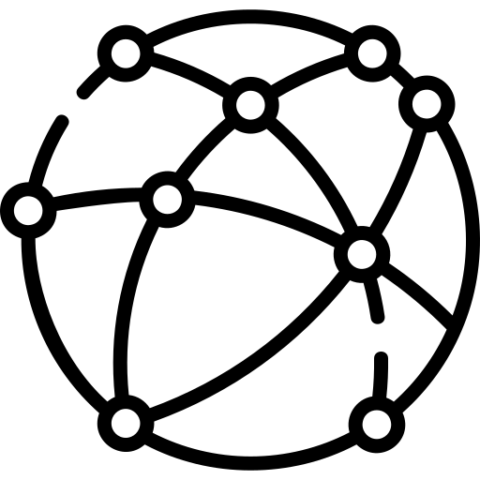
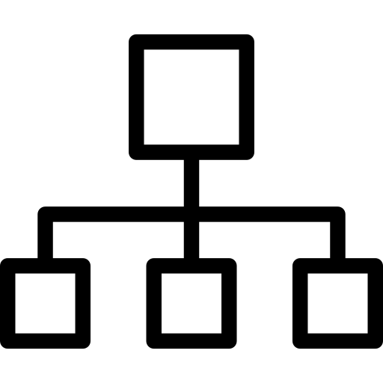
Future Work
BGP Data Implementation
Better Comparison Between IPv4 and IPv6
Identify and Prioritize Frequently Changing Paths
Notes:
Cindy
As you may know, a term here at WPI can fly by. We really had to prioritize what we wanted to tackle this term, a lot of which jack just showed us. Here are ideas that could be implemented in future iterations of this project.
First, We would implement support for BGP data into our application. As of right now, we are grabbing traceroute data from RIPE Atlas. Looking into more sources of data would expand the reach and application of PATHly.
PATHly’s goal as an application is to allow for network engineers to ascertain differences between IPv4 and IPv6 Anycast forwarding. As PATHly is now, engineers are left to do that at an surface eye level as IPv4 and IPv6 paths are rendered separately on the visualized graphs.
Similarly, we would focus on being about to identify frequently changing paths. This involves more autonomous work on our application’s part as opposed to leaving insight discovery up to the user.
SOME CONCLUSION
Now, these are just some of the features that can add to our application. As PATHly stands now, network engineers at Fastly will be able to utilize PATHly as a tool to quickly visualize paths from source to destination.

Slide 14
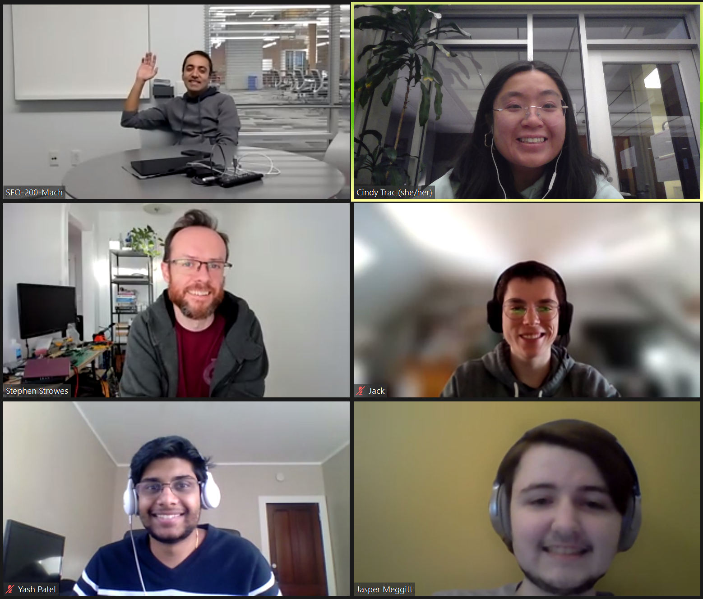
Special Acknowledgements
Fastly Mentors
Salman Saghafi
Stephen Strowes
Fastlyans
Patrick McManus
Glitch Team
… and many more!
Advisor
Professor Claypool
Notes:
Cindy
We’d like to extend special thanks to a few people who were integral to our project. First, Salman and Stephen, who not only served as our sponsors but also our mentors.
They met with us each day during stand-up, paired programmed with us, and even hopped on to have a meal in three different time zones.
In addition, a big part of our term has been getting to know Fastly as a company. We loved meeting with WPI alum and other Fastlyans.
And of course, a big thank you to our advisor Professor Claypool for setting this experience up and guiding us along the way.
With that we’d love to open the floor to any questions

Slide 15
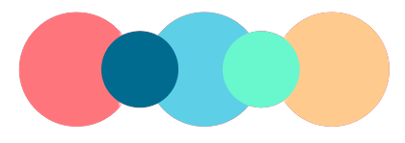
Thank you!
Any questions?
Notes:
Cindy

Slide 16
Extra Slides - Demo Video

Slide 17
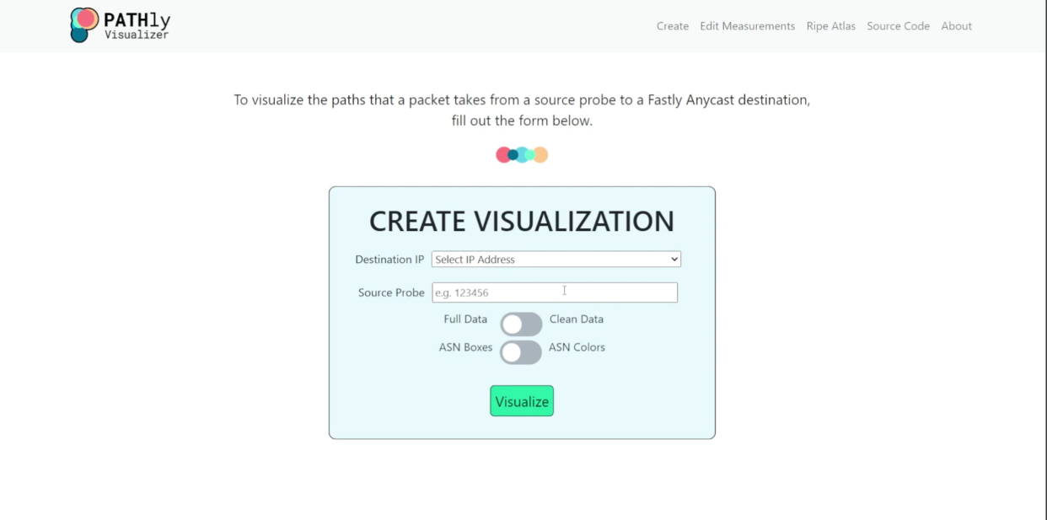
Extra Slides - Demo Screenshot Home Page

Slide 18
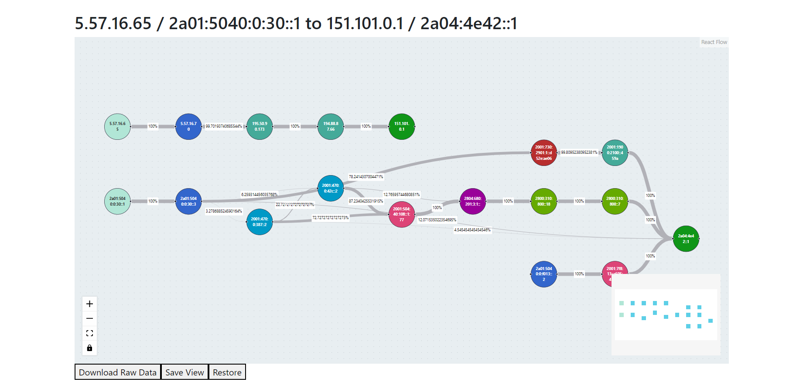
Extra Slides - Demo Screenshot Graph

Slide 19
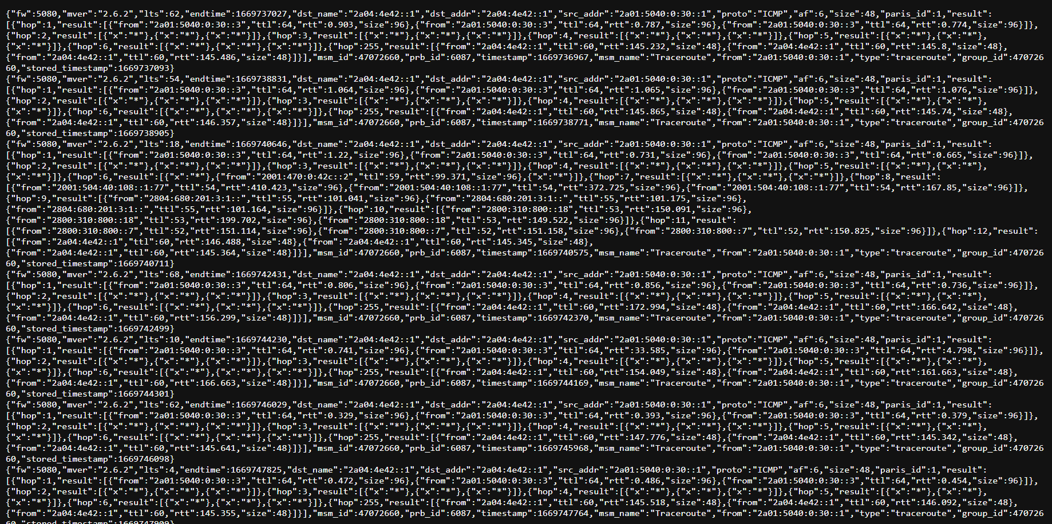
Extra Slides - Demo Screenshot Raw Data

Slide 20
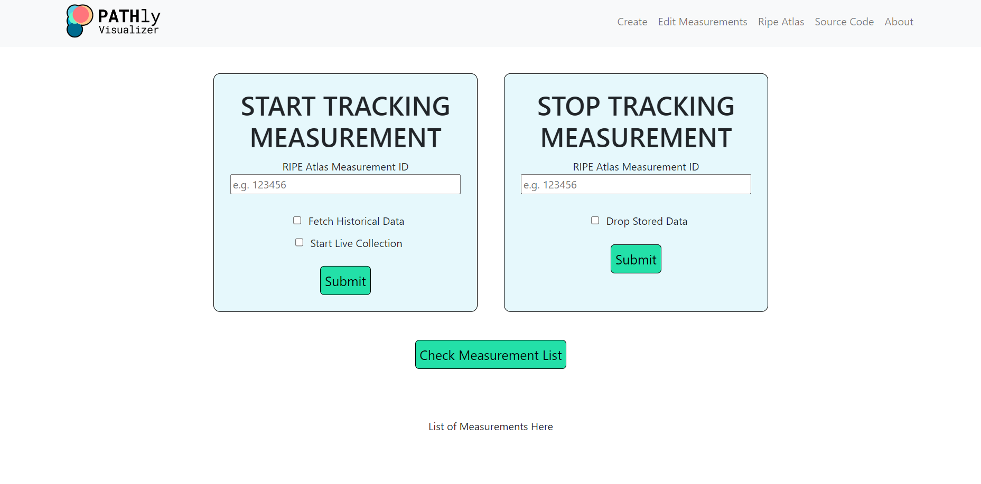
Extra Slides - Demo Screenshot Edit Measurements

Slide 21
Extra Slides - Demo Screenshot List Measurements

Slide 22
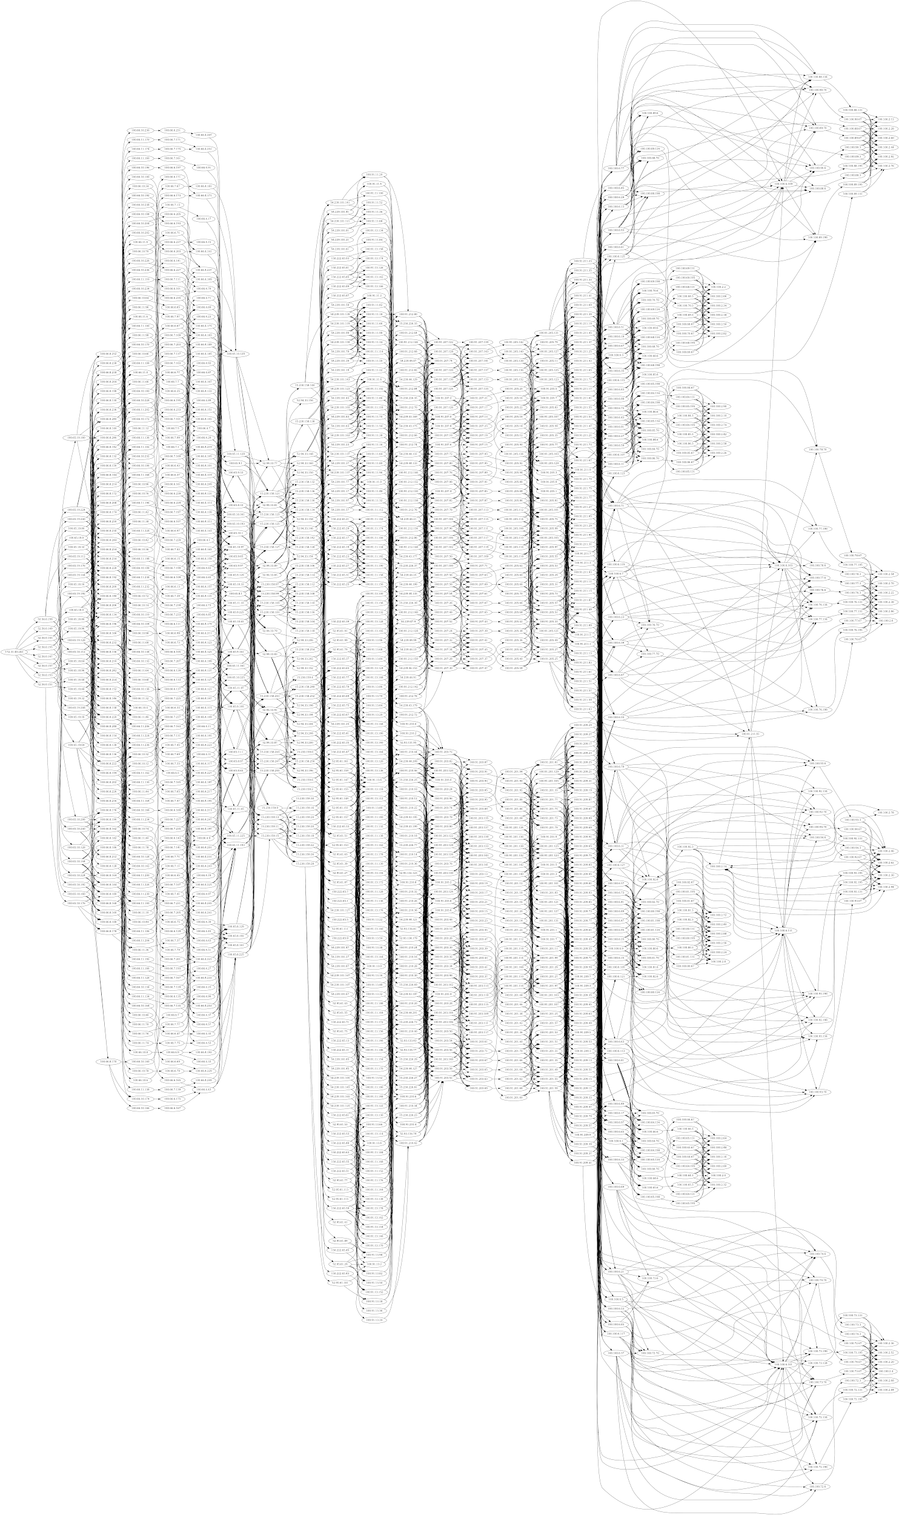
Extra Slides - Without Collection Limits

Slide 23
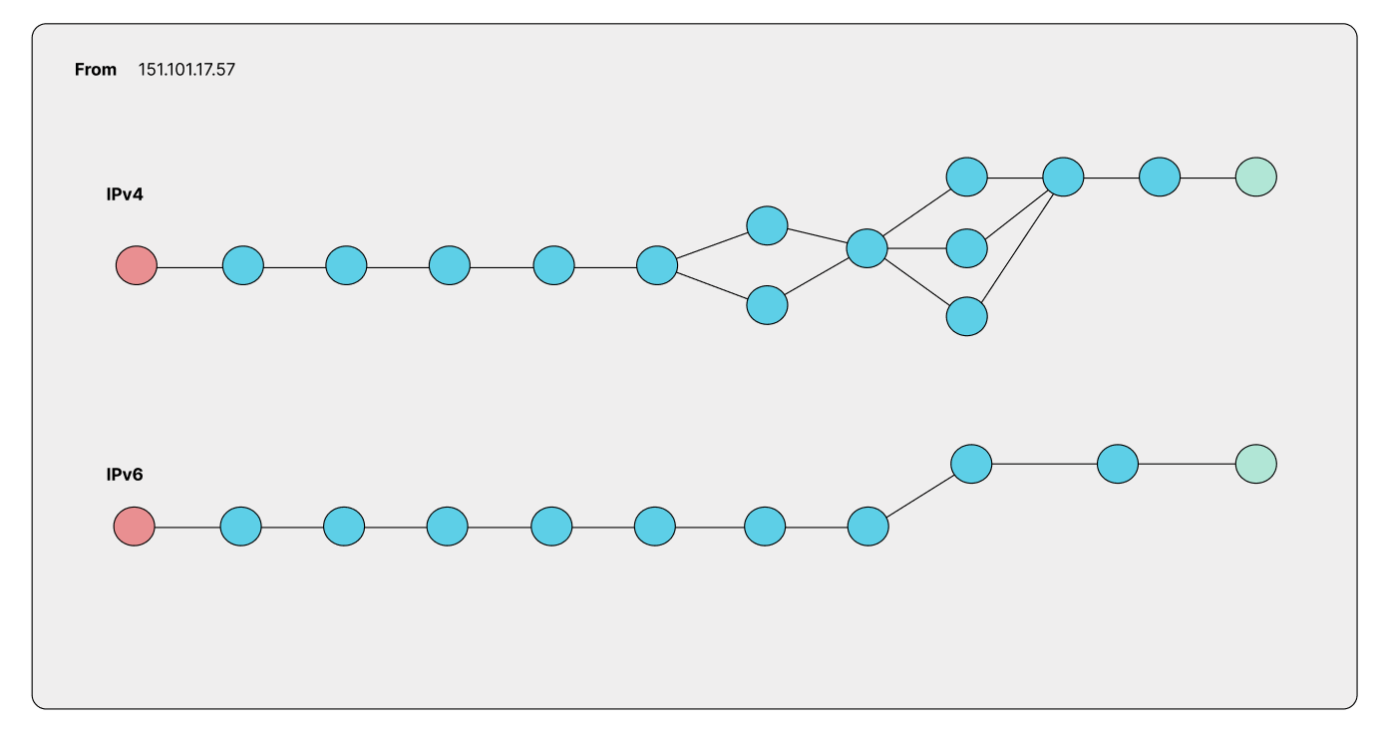
UI Mockups - IPv4 vs. IPv6 Side-by-Side

Slide 24
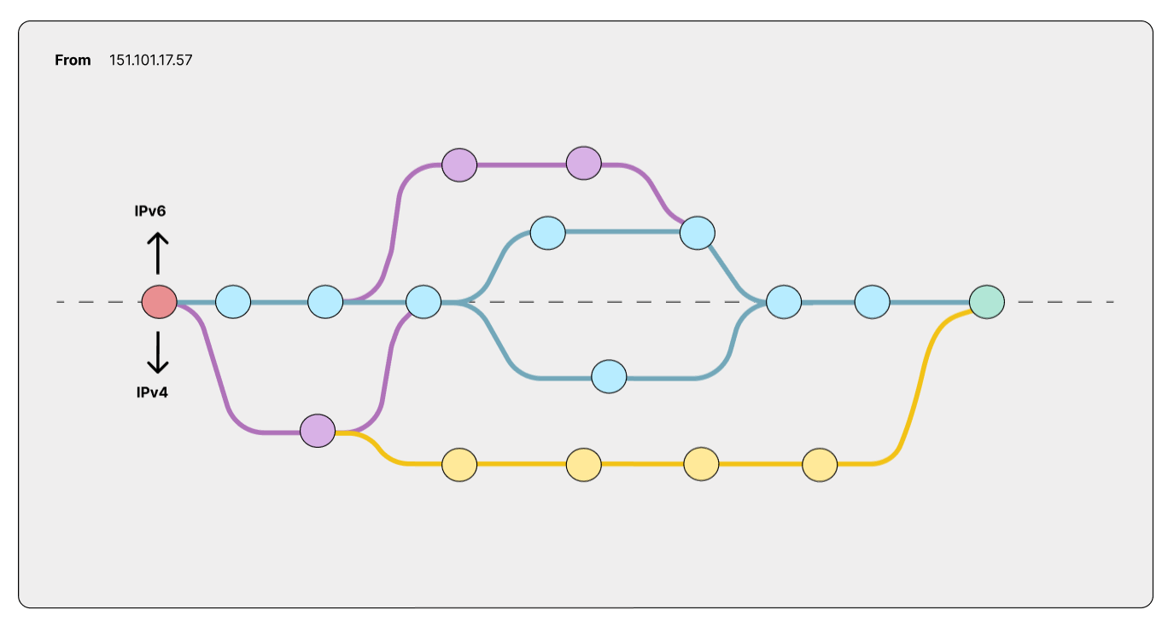
UI Mockups - IPv4 vs. IPv6 Branching

Slide 25
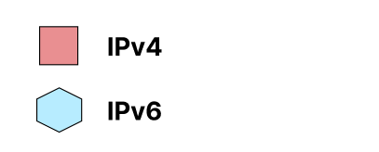
UI Mockups - IPv4 vs. IPv6 Together

