Slide 1
Analysis of Cool Routes Climate Adaptation Tool
By Jack Charpentier, Zaq Humphrey, Jackie Nicoletti, Abbigail Poland, Cassidy Williams
1
Notes:
Good afternoon and thank you all for joining us tonight, my name is…..
And we will be discussing the analysis of the Cool Routes Climate Adaptation Tool
Which was developed for the city of Melbourne
Jack

Slide 2
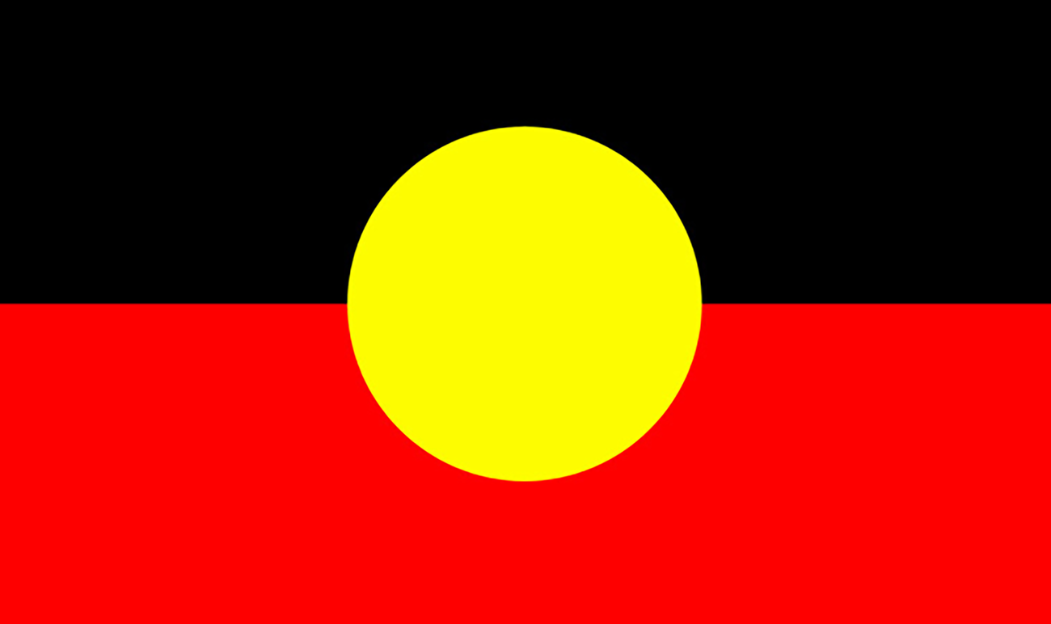
Acknowledgements
The City of Melbourne respectfully acknowledges the Traditional Owners of the land we govern, the Wurundjeri Woi-wurrung and Bunurong Boon Wurrung peoples of the Eastern Kulin and pays respect to their Elders past, present and emerging.
We acknowledge and honour the unbroken spiritual, cultural and political connection the Wurundjeri, Bunurong, Dja Dja Wurrung, Taungurung and Wadawurrung peoples of the Eastern Kulin have to this unique place for more than 2000 generations.
We are committed to our reconciliation journey, because at its heart, reconciliation is about strengthening relationships between Aboriginal and non-Aboriginal peoples, for the benefit of all Victorians.
2
Notes:
Cassidy

Slide 3
Road Map
1
2
3
Climate Emergency
Climate Adaptation
Cool Routes
6
4
5
Results
Recommendations
Research Objectives
3
Notes:
-We will be discussing the prominent Climate Emergency happening around the world but for the sake of our presentation we will be focusing on the Melbourne area
-Next we will be elaborating on how the city of Melbourne has taken the initiative to adapt the city and its citizens to help mitigate the effects of this climate issue
-In focusing on our project, the city of Melbourne has developed the cool routes tool which has seen some issues with overall uptake within the city population. We will be discussing various
aspects of the tool as well as the issues associated with it
-finally, we have developed some avenues to explore these issues and provide some possible solutions which can be reflected in our preliminary results and recommendations
Jack

Slide 4
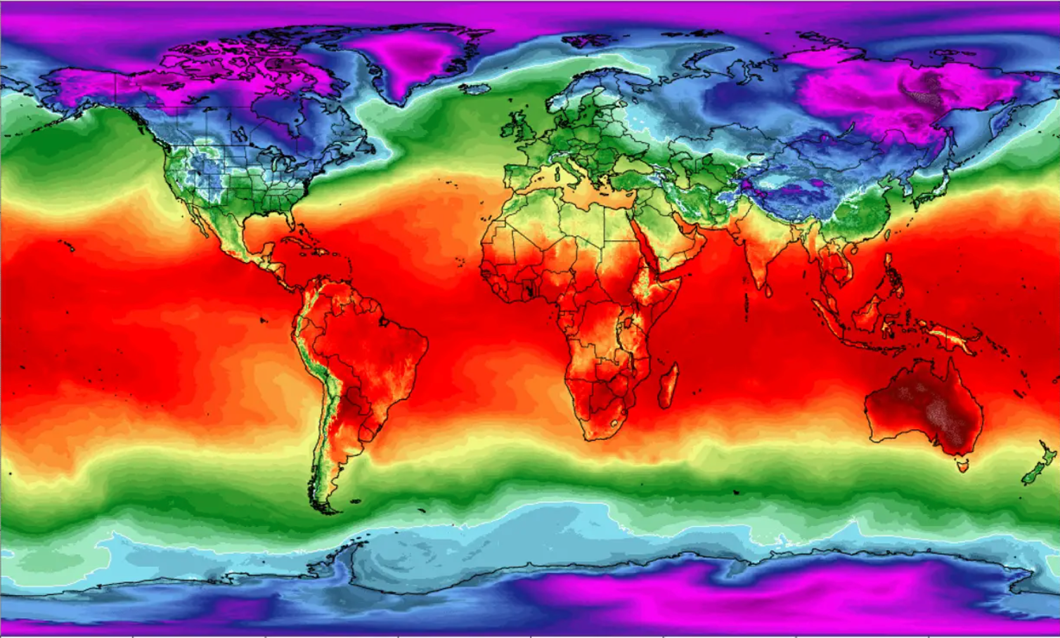
4
Notes:
This is a heat map of the world and if you direct your attention to the lower right quadrant, you will notice Australia has a dark red presence. As you all probably already know Australia has a very strong sun as well as inconsistent heat waves in the summer. As a result of this intense sun, Australia sees the largest number of skin cancer cases in the world. In fact, 2/3 of the population will develop some form of skin cancer before the age of 70. Therefore, there is a premiant need for citizens to stay out of direct sunlight whenever possible.

Slide 5
Climate Change Adaptation Initiative:
“Process of planning, preparing, responding, and driving adjustments in the city to ensure that people can survive and thrive no matter the change.”
- City of Melbourne Climate Change Adaptation Strategy Refresh (2017)
5
Notes:
In proactive response to this climate emergency, our community partner, the City of Melbourne, has enacted policies for governing which enable citizens to survive and thrive in any given climate.
Since this Climate change adaptation initiative was put into place in 2017, many specific strategies have been implemented since then to help citizens live despite the heat
- Abbi

Slide 6
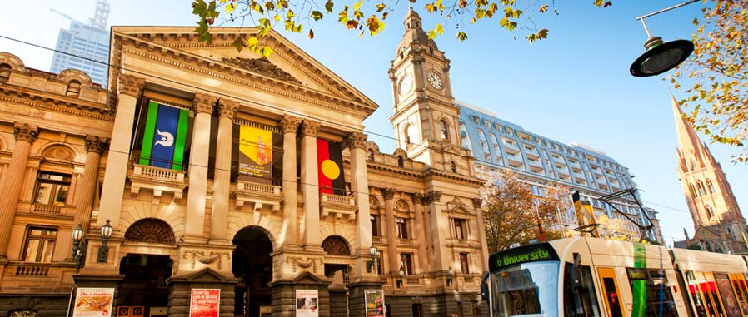
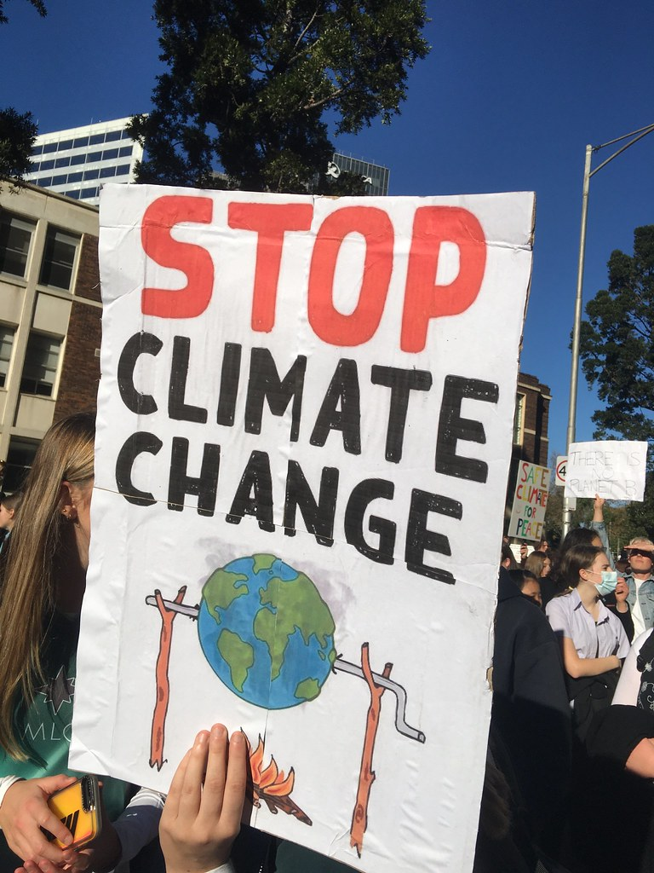
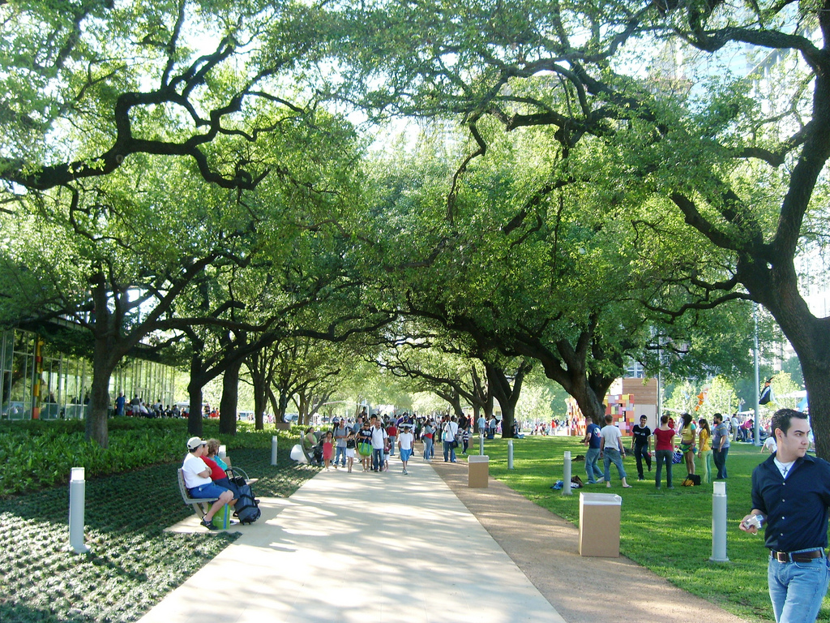
City of Melbourne’s Progressive Mindset
Climate Change & City Resilience
Chief Heat Officers (x2)
Parks & City Greening
6
Notes:
Zaq
Melbourne Is being very progressive in its approach to dealing with this extreme heat
Some of the policies in place to help their citizens include:
Appointed two chief heat officers to help manage extreme heat risk
increase plants and biodiversity projects through out city
There are also projects increasing greenery throughout parks and the city to help reduce the effects of extreme heat
Focusing on how can we help to adapt both the city and the people:
* Green blue infrastructure, physically change the city
Help the people adapt through tools and giving them information they need to prepare for climate change
Englart, J. (2021, May 22). Stop climate change - climate strike Melbourne 21 May 2021. Flickr. Retrieved February 7, 2023, from https://www.flickr.com/photos/takver/51194849093
Shehaj, E. (2008, April 15). Discovery Green Park. Flickr. Retrieved February 7, 2023, from https://www.flickr.com/photos/25409330@N05/2415213184
City of Melbourne. (2023, February 7). About Council - City of Melbourne. City of Melbourne. Retrieved February 7, 2023, from https://www.melbourne.vic.gov.au/about-council/Pages/about-council.aspx
City of Melbourne. (2023). Green Infrastructure - City of Melbourne. City of Melbourne. Retrieved February 6, 2023, from https://www.melbourne.vic.gov.au/community/greening-the-city/green-infrastructure/Pages/green-infrastructure.aspx

Slide 7
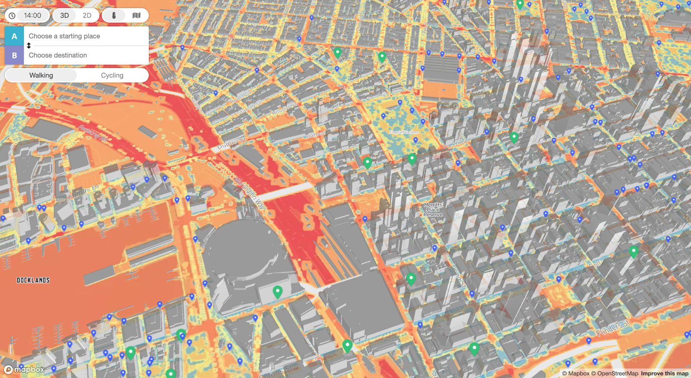
Cool Routes
Climate adaptation tool for Melbourne’s pedestrians
Using Data from:
Temperature
Time of day
Landscape
Surface of pathways
City infrastructure
Shade cover
7
Notes:
In addition to these projects which help reduce heat in the city, CoM has tools to help citizens live despite the extreme heat and therefore developed Cool Routes.
Cool Routes is a heat-based navigation website that can route people by foot or bike through the city taking the path best protected from the sun and the heat.
In order to determine cool pathways, Cool Routes collects data about
the website interface uses a 3D thermal comfort map of the city with colored pathways representing hot or cool routes

Slide 8
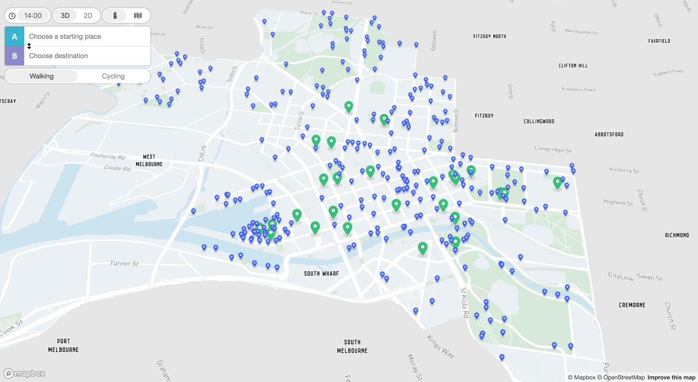
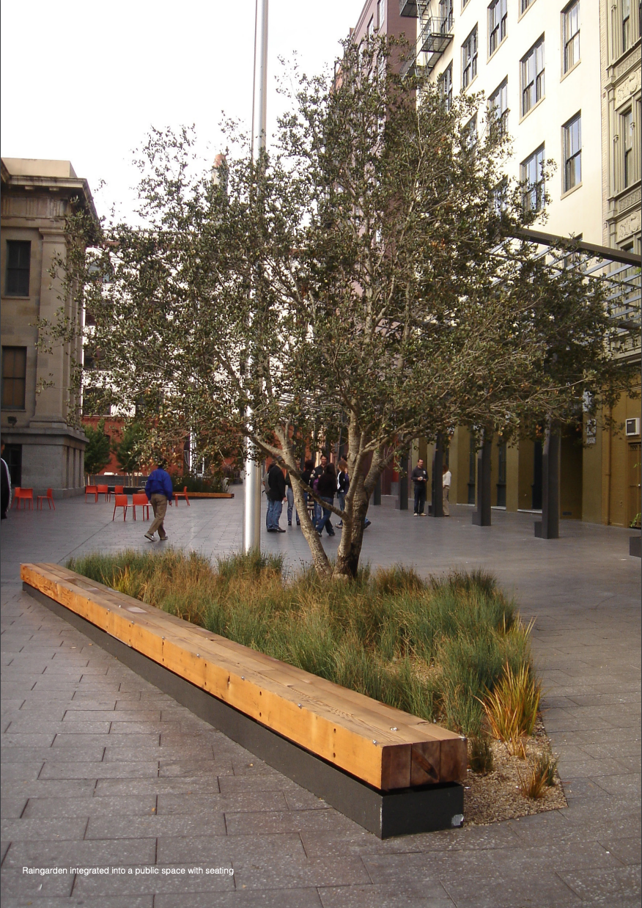
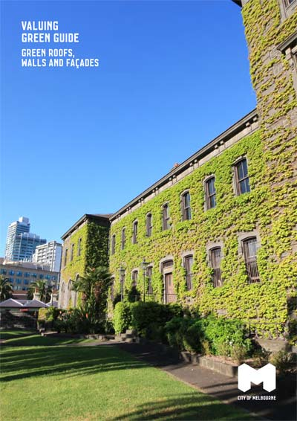
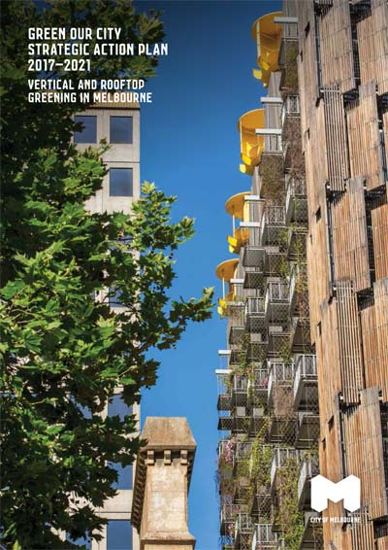
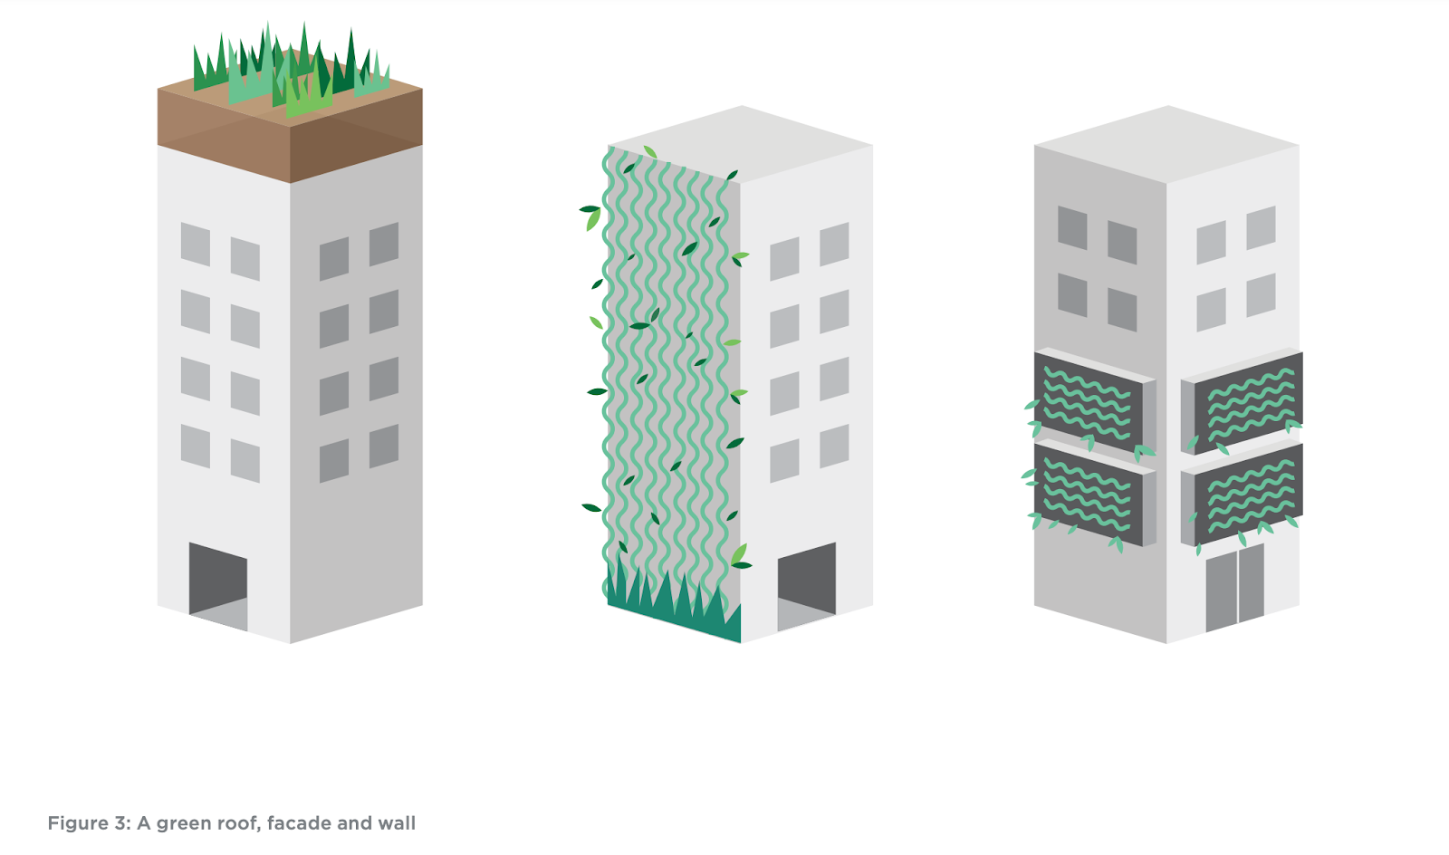
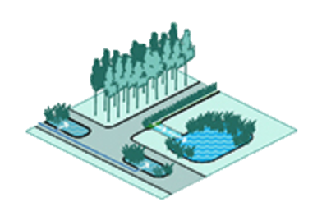
Examples of blue infrastructure include bodies of water, tree pits, and rain gardens
The website also pinpoints the location of water fountains and green and blue infrastructures throughout the city
8
Notes:
The website also locates drinking fountains as well as green and blue infrastructures for users to seek out.
Green infrastructure is defined as increased vegetation, which reduces heat and filters air in urban spaces.
Blue infrastructure is added vegetation that is passively irrigated with stormwater, specifically implemented to assist with water management.
Examples of real green and blue infrastructure found throughout Melbourne

Slide 9
How can we improve the uptake of the Cool Routes Climate tool within the city of Melbourne?
Growth Timeline
Public needs shift after infection rates skyrocket
April 2020
Australia opens borders with restrictions
Nov. 2021
Covid-19 Pandemic
March 2020
Cool Routes launched
Dec. 2020
Cool Routes Project
Jan. 2023
9
Notes:
- First launched in December 2020 (innovative)
- This was during the global pandemic
People weren’t traveling around the city
Most were working and living from home
Subsequently this project got little attention and ultimately got moved to the “back burner”
Its hard to allocate resources to a project which is not relevant in the current situations
Since the scope of public needs changed, the city has had trouble in providing a plan for the future of the tool
This leads us to the research question we have identified
Jack

Slide 10
Website Design
Community Needs
City Resources
Understanding
Adoption
Adoption
10
Notes:
Zaq Adoption is not only increasing usage of the app more, but understating how users can integrate this website into their daily lives.
To understand the concept of adoption, we identified three main objectives which we sought to understand, being web design, community needs, and city resources.
The research we completed in each of these disciplines helped us to create accurate and feasible recommendations

Slide 11
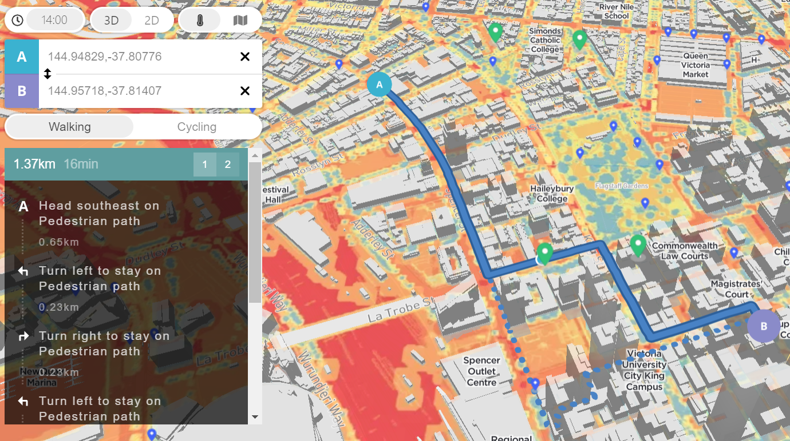
Website Design
Alex Therrien, UCD Expert
Dani Bramante, Business Manager
Jack Barrett, Software Engineer
11
Notes:
To understand the Website Design and User-Centered Design, we first interviewed Alex Therrien, a UCD expert. He originally explained that we needed to prioritize adoption. Once in Melbourne, we met with NOVA Systems to understand how Cool Routes was created and the feasibility of different website changes.

Slide 12
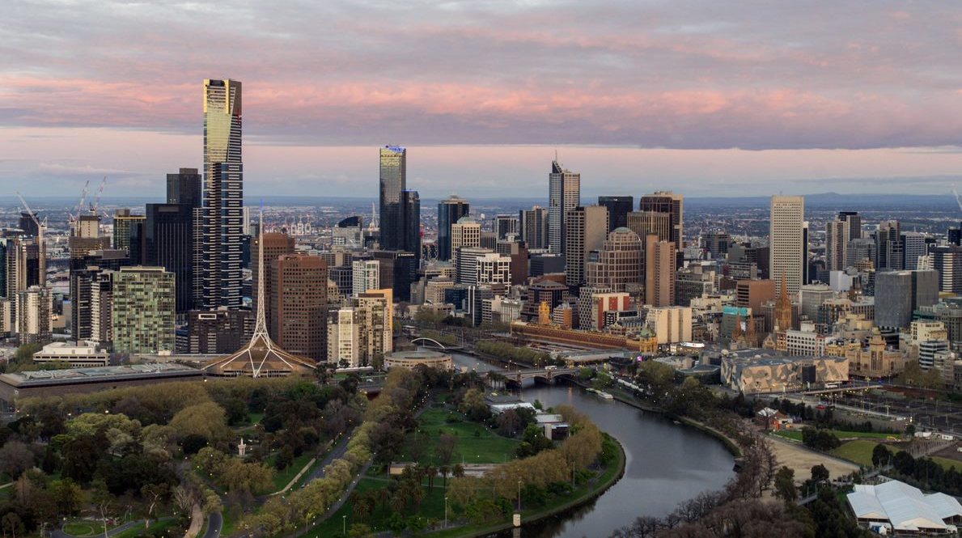
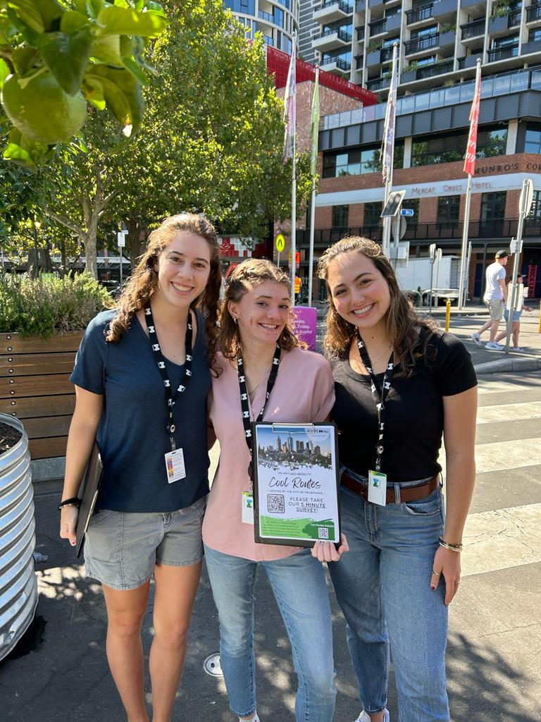
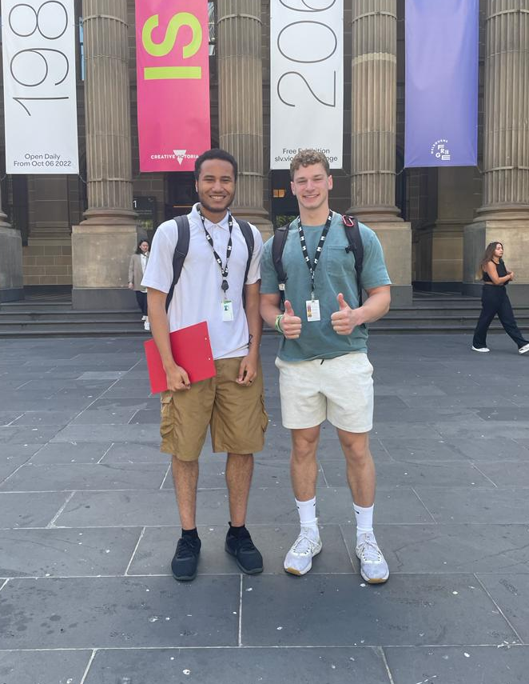
Community Needs
12
Notes:
Another priority for our team was understanding Melbourne’s community needs. Our goal was to understand how people prefer to travel, where they get their CoM information from, if they know/care about the CoM blue/green infrastructure projects around the city. We tackled this by creating an online survey and spread it both in person and digitally. We got over 200 responses that gave us valuable results.

Slide 13
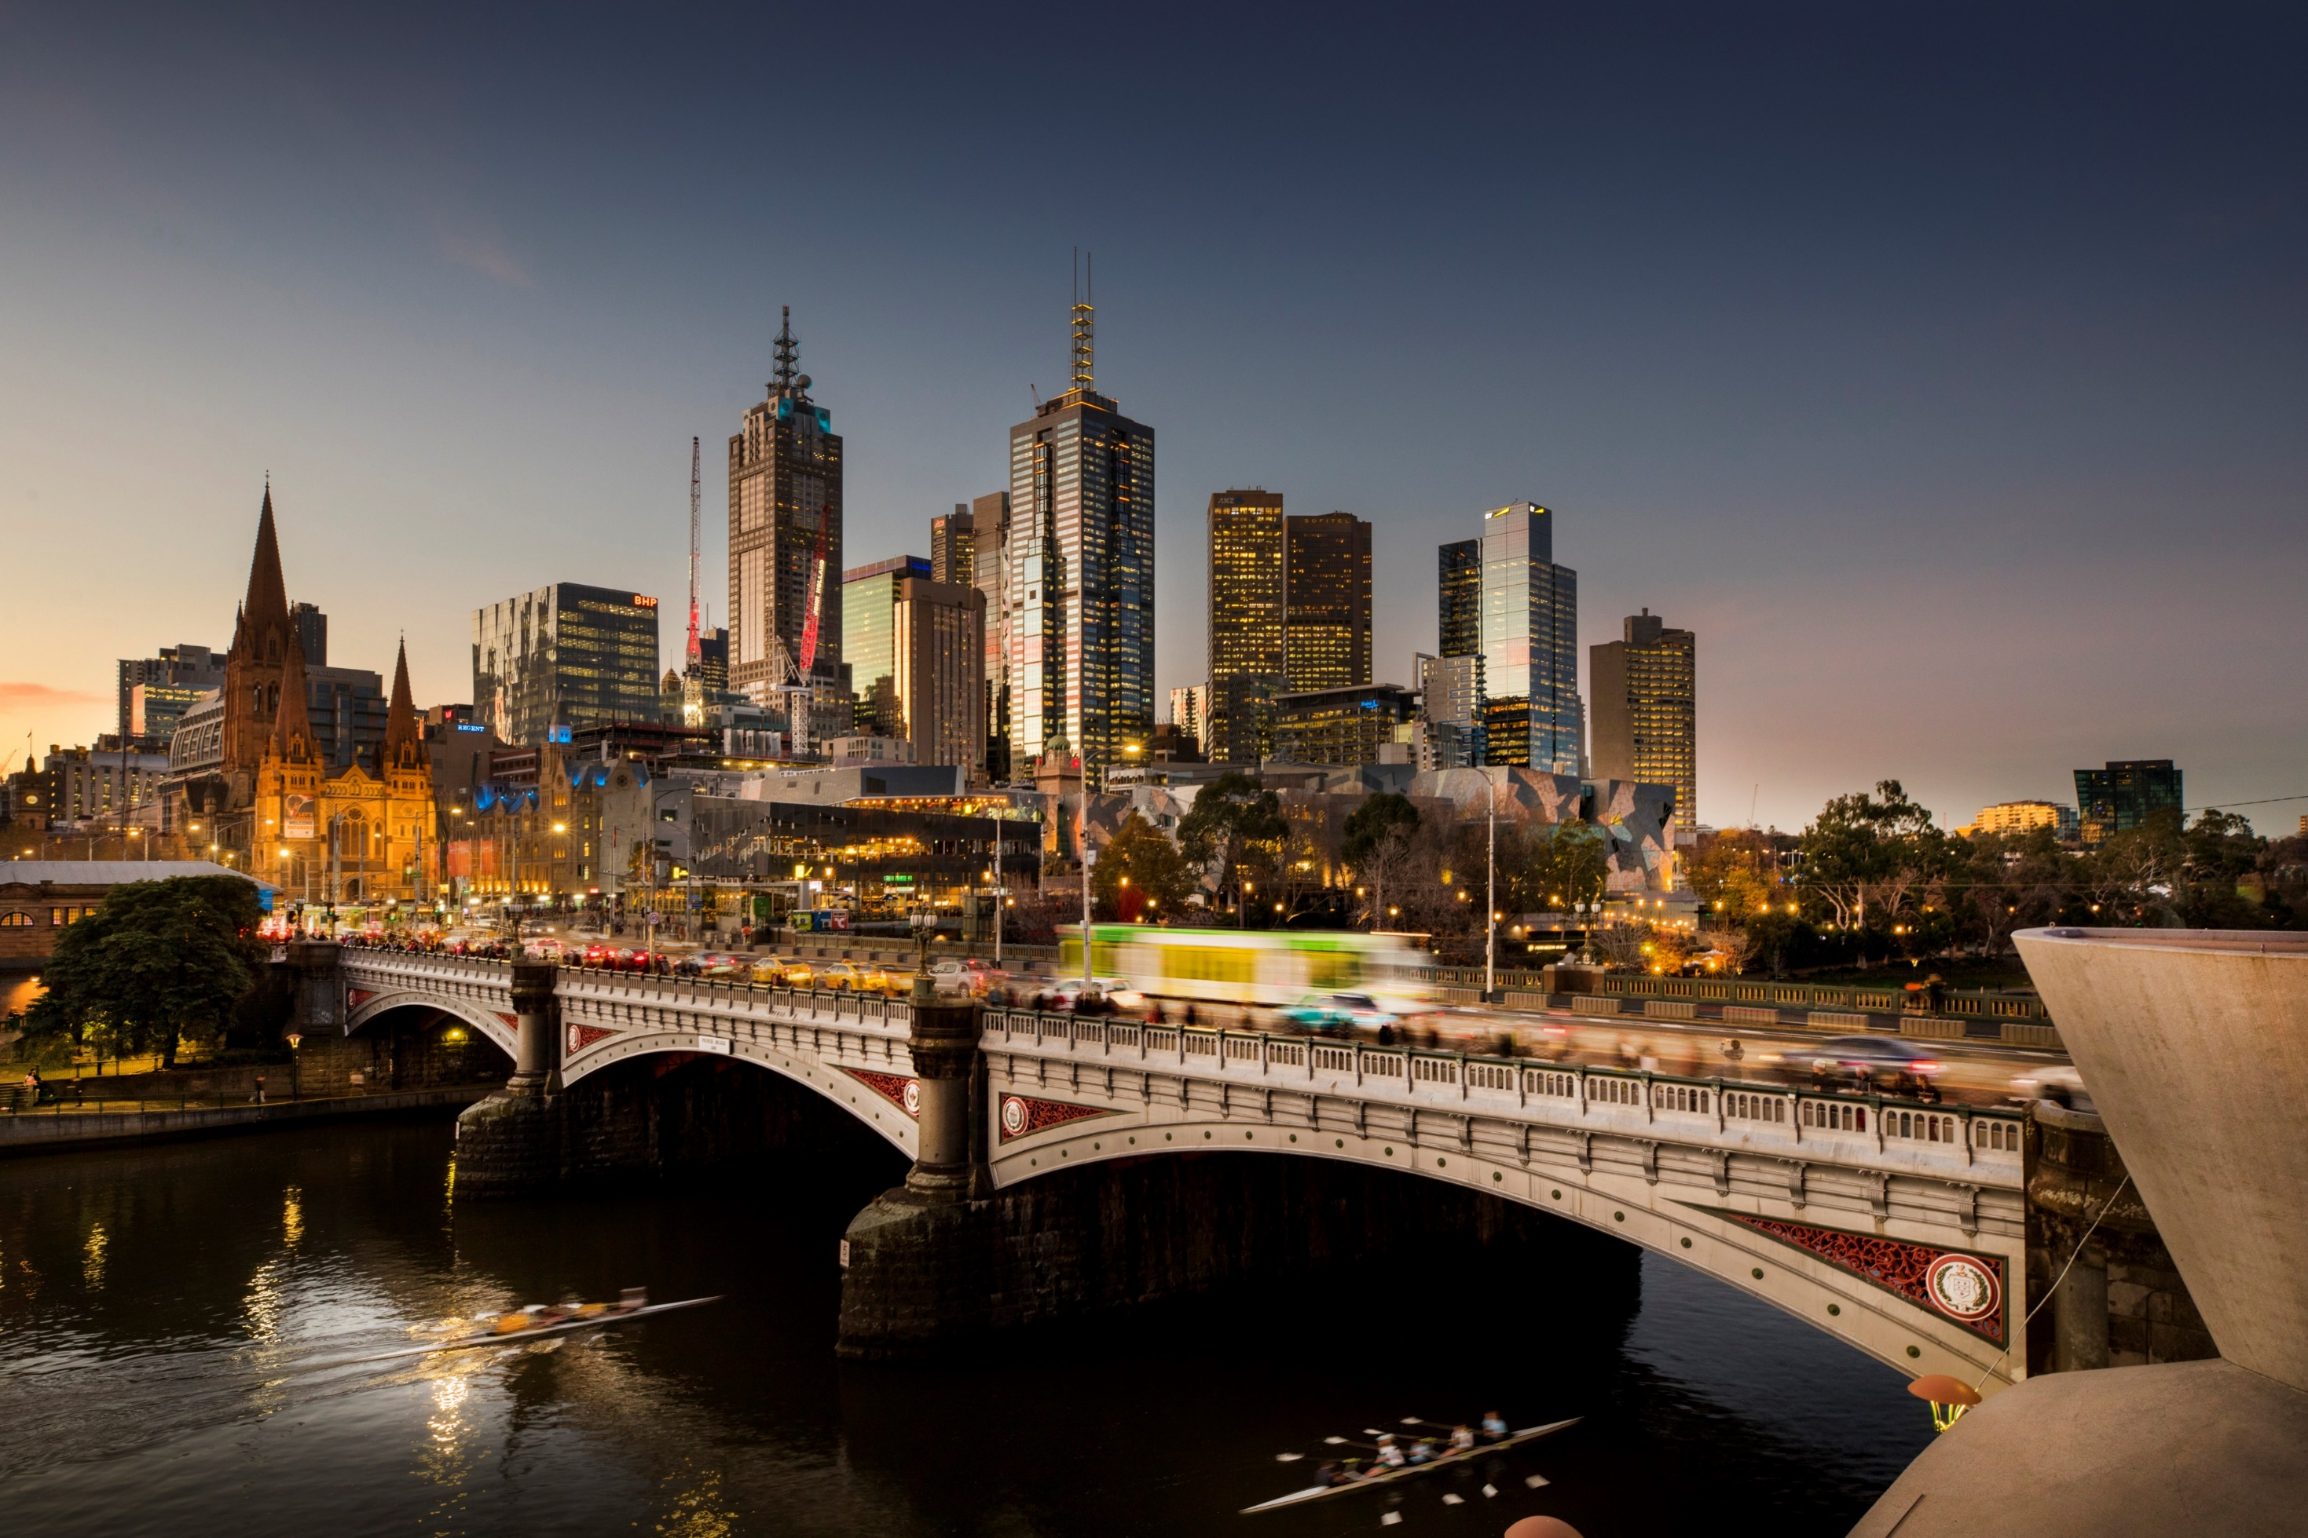
Pre-existing Initiatives
Candace Jordan, Climate Change Adaptation Lead
Nicki Colls, Climate Change Partnership and Advocacy Lead
Emma Bacon, Founder and Executive Director
13
Notes:
Lastly, we explored many resources and pre-existing initiatives in Melbourne to understand how and where the Cool Routes could be marketed. We conducted interviews with Candace Jordan, our community partner, and nicki colls, a climate change partnership and advocacy lead with CoM. As well as Emma Bacon, the founder and executive director of sweltering cities. We gained great insight into the resources of the CoM to market Cool Routes, and resources available to Melbourne’s citizens and pedestrians.
Through all of our research we were able to discover highlight opportunities for improvement in the uptake of Cool Routes - Jackie

Slide 14
Key Findings:
Why Cool Routes is important
14
Notes:
Through all of our research we were able to identify why Cool Routes is so important and how it can best reach the target audience.
These are some of our key findings we collected through our survey that show why there is a need for cool routes

Slide 15
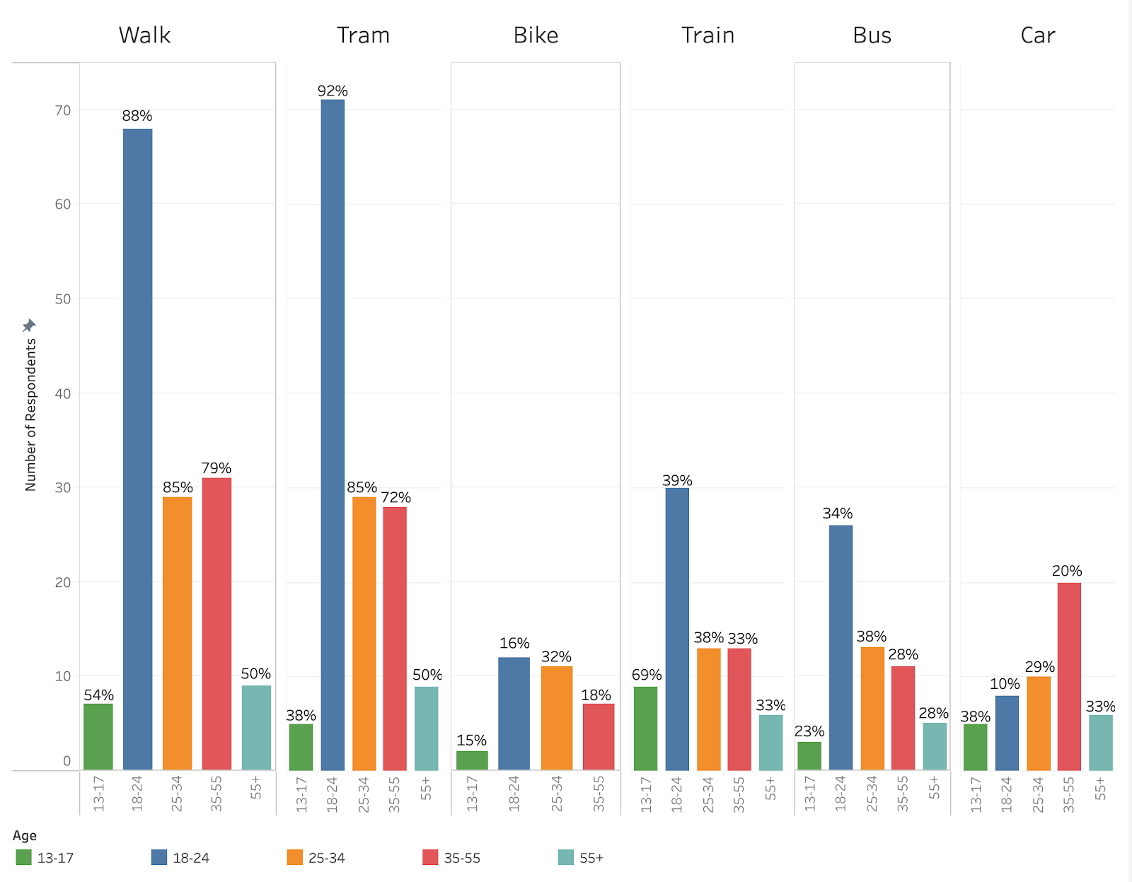
Walking and tramming are the most popular modes of transportation in the city
15
Notes:
Zaq
There is a large audience that this tool could be readily available to.

Slide 16
People 18-55 are negatively affected by heat when they walk or bike
16
Notes:
Jackie – We asked our survey respondents who regularly walk or bike through the city how the heat impacts their travel. The majority of respondents in four of the five age groups told us they are negatively affected by heat. This demonstrates a need for a tool to protect travelers in during heatwaves.
Jackie

Slide 17
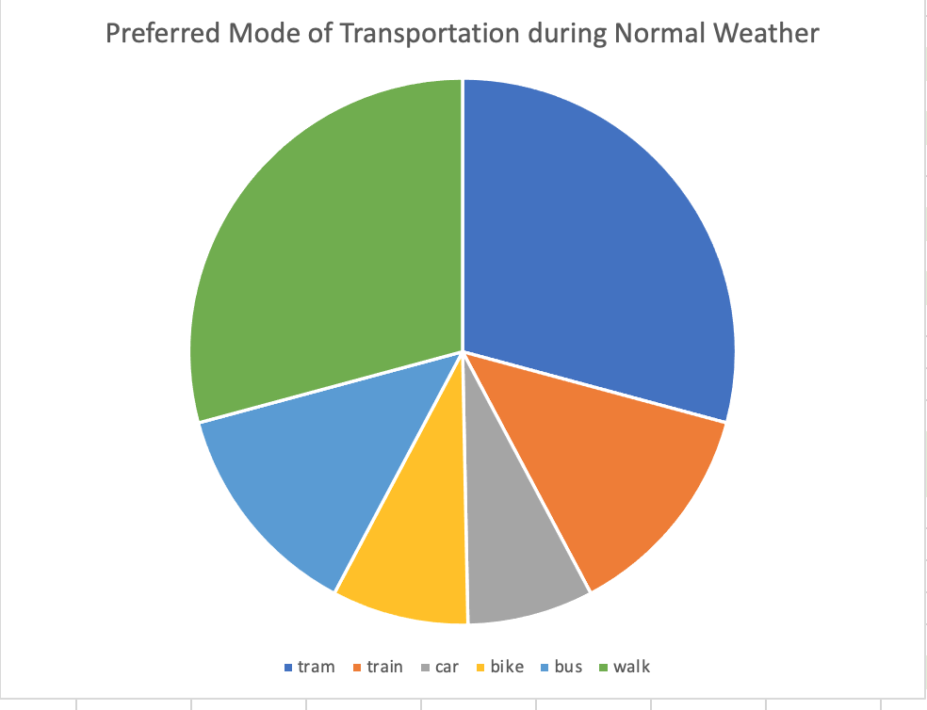
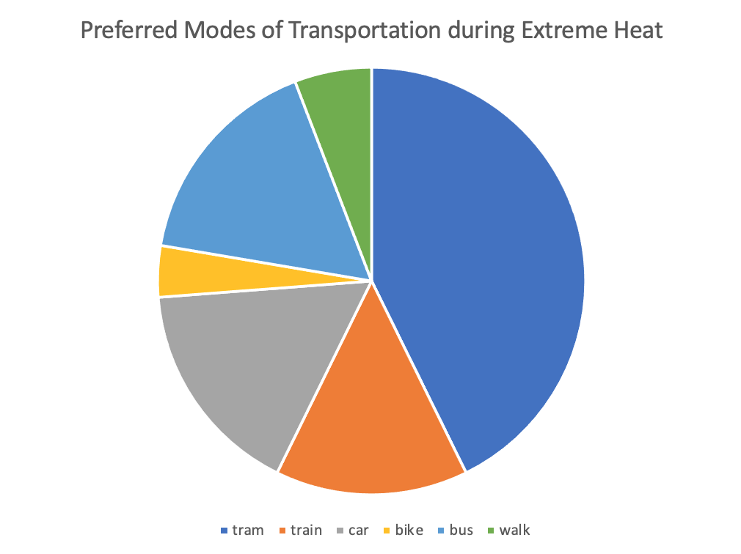
Citizens and tourists change their transportation during extreme heat
Walk
Bus
Walk
Tram
Tram
Bike
Bus
Train
Car
Train
Bike
Car
17
Notes:
Jackie – Looking further, 49% of respondents change their travel plans for extreme heat. Of these respondents, 31% changed their mode of transportation. There are significantly fewer people who chose to walk during this extreme weather with people instead choosing to take the tram or drive. Because people are changing their travel plans for the heat it shows there is an audience of people who could use Cool Routes to alter their travel during extreme heat.
Jackie

Slide 18
However,
Cool Routes can be improved
18
Notes:
Even though this is an important tools we found many areas that could be improved. Through our research through surveying, conducting focus groups, and hosting interviews we found opportunities for growth in the website’s development

Slide 19
Difficulty With Navigation
66%
"It's like reading a map, which I think everyone’s really out of the habit of doing, so you're used to the functionality of someone knowing where you are”
of focus group participants
got lost on their journey
​​”I was trying to follow the map and came to a dead end. So, I ended up not following the path, and… came out to the scorching heat on the North side of Melbourne Central.”
19
Notes:
- Many focus group respondents had a very difficult time navigating with Cool Routes. Cool Routes doesn’t use any street names in its directions, and uses terms such as pedestrian path, and footpath instead.66% of our participants got lost on their journey through Melbourne with Cool Routes. This is been a reoccurring problem when navigating with Cool Routes, and therefore it has helped our team brainstorm helpful recommendations.
Abbi

Slide 20
Featured locations that users may not be interested in
How interested are you in learning about the locations & purpose of blue infrastructure around Melbourne?
How interested are you in learning about the locations & purpose of green infrastructure around Melbourne?
2.59
0
5
Not Interested
2.34
Very Interested
20
Notes:
Through both our survey and focus group, our team discovered that Cool Routes may not highlight locations that people find the most interesting. In our survey, we asked how interested people would be in learning more about the locations & purpose of green and blue infrastructure. As you can see, not many people felt strongly about either of these projects around the city. The focus group participants mimicked our survey results. Therefore, we have noted this as a problem with the tool.
- Abbi

Slide 21
12 of 202
survey respondents had heard of Cool Routes
21
Notes:
Cassidy
Looking past technical design, from our survey we also wanted to understand who cool routes is reaching
We found that only 12 out of 202 survey respondents knew about cool routes
We discovered a gap between the CoM’s work and the number of people cool routes has been able to reach, so we then researched the resources available for marketing

Slide 22
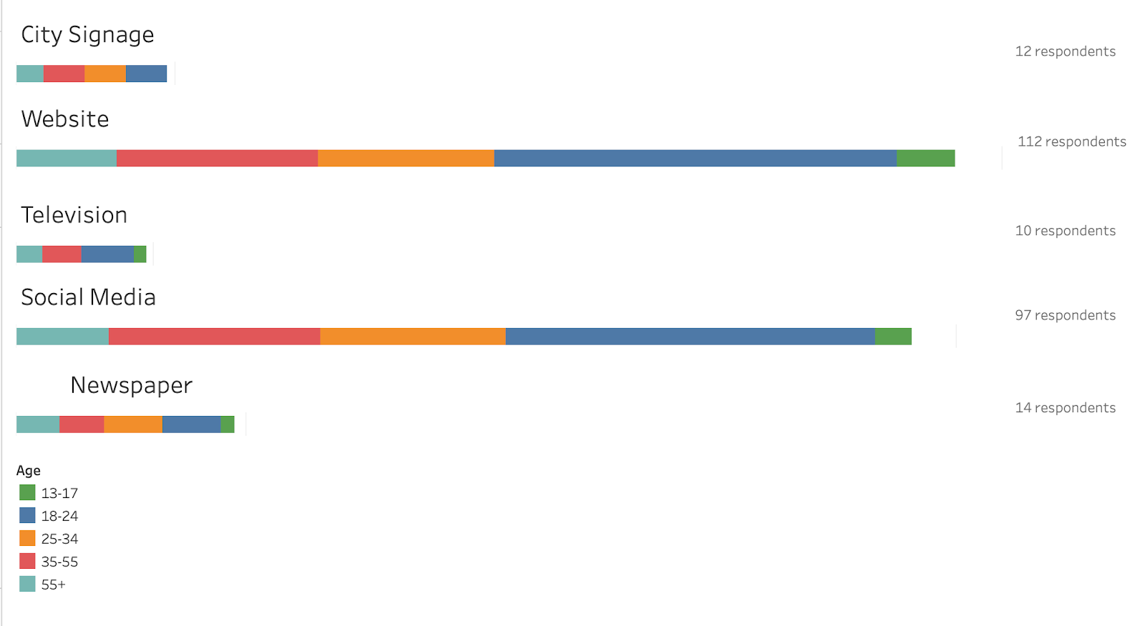
City Signage
Website
Television
Social Media
Newspaper
Websites and social media are the most popular sources for all ages to receive CoM information
22
Notes:
Cassidy
through our survey we found that the com website and social medias are the most popular platform for citizens and tourists

Slide 23
23
Notes:
- Jack

Slide 24
Technical Design
24
Notes:
Zaq first 2
We have categorized our recommendations into three sections, the first being Web Design
Our first suggestion is improving a user’s navigation experience with changes such as adding live location and making clearer direction
The next recommendation we created was improving the accessibility of Cool Routes. This would involve adding audio directions and more clear street labels to make accessible to a wider audience.
Jackie last 2
We also found it would be beneficial to allow users to customize their experience by highlighting new, cool places and allowing users to filter which locations they would like to see marked.
Lastly, we created recommendations to improve the user interface of the website, allowing users to more easily interact with the website. This includes added visual elements, such as buttons or switches, to make using the website’s features easier.

Slide 25
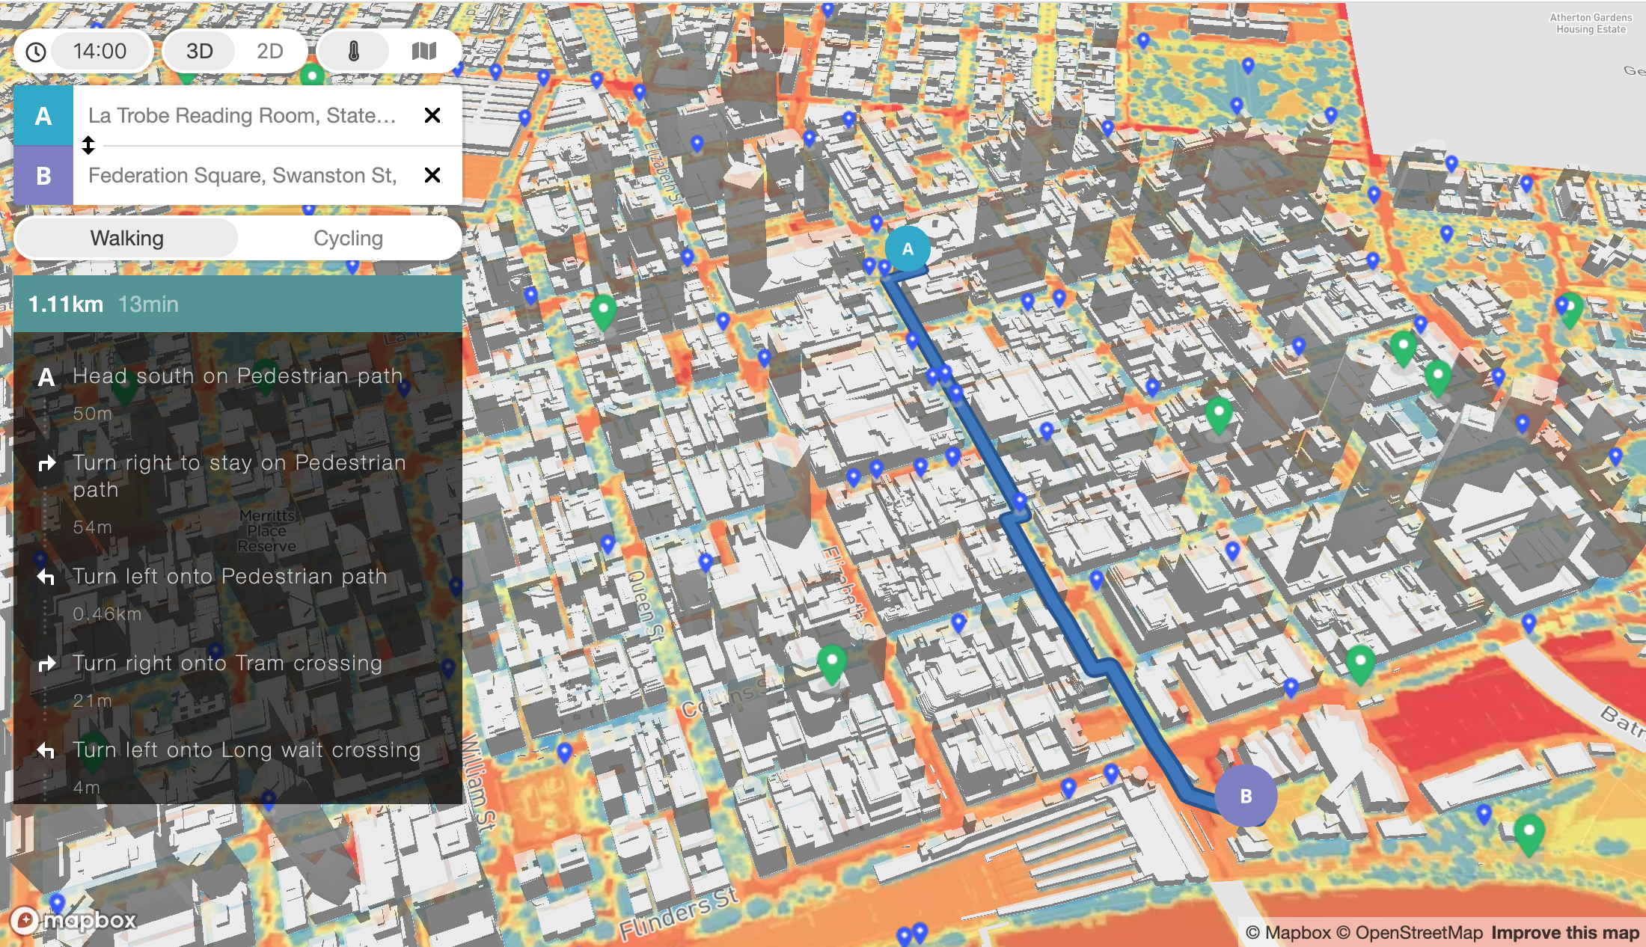
Add features critical to navigation
Audio Instructions
25
Notes:
First we looked at adding features that are critical

Slide 26
Refine featured locations
26

Slide 27
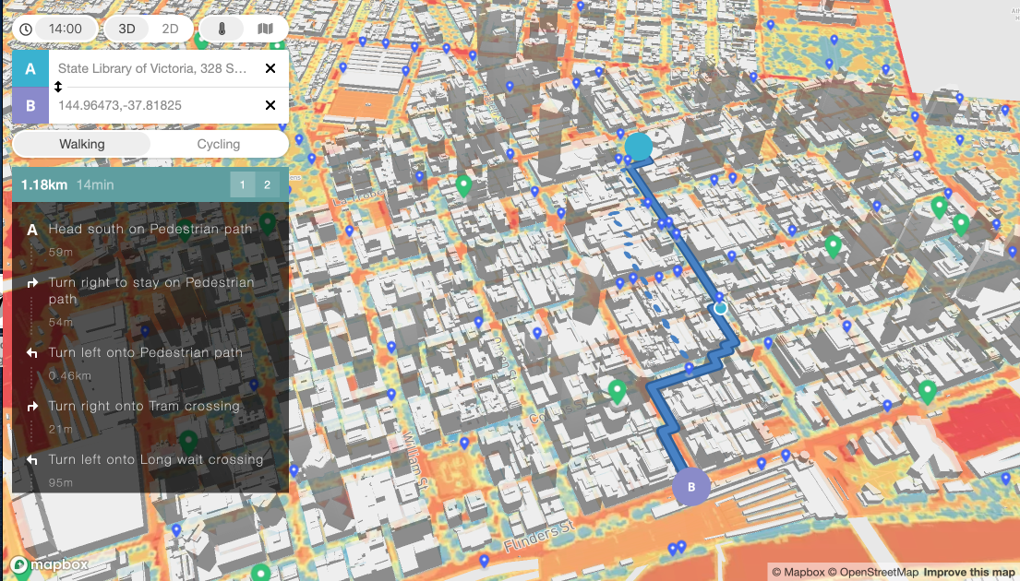
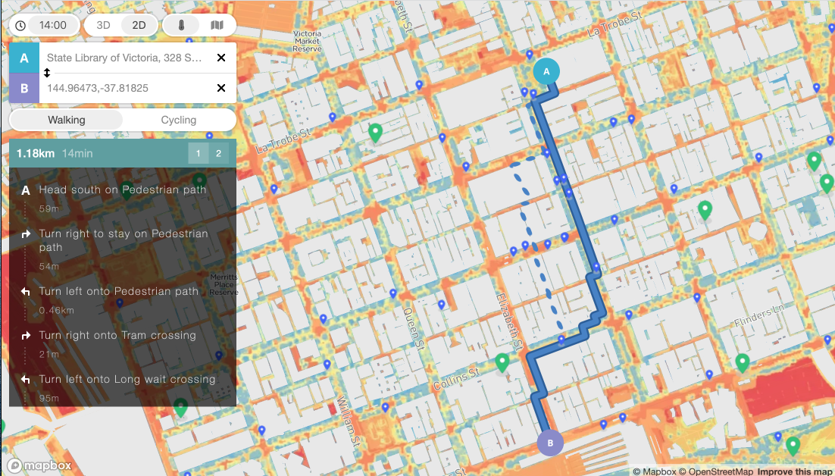
Improving user interface
GO
27
Notes:
There are also some features we think would help users interact with the website.
Especially on the mobile version, it is easy to misclick and change the route. A go button to lock the

Slide 28
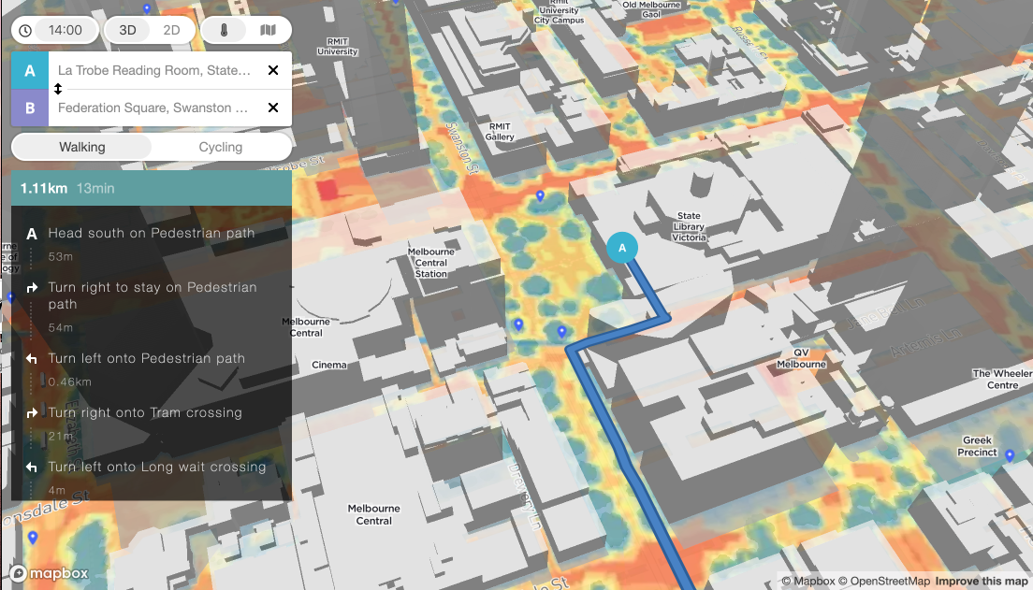
Audio Instructions
28

Slide 29
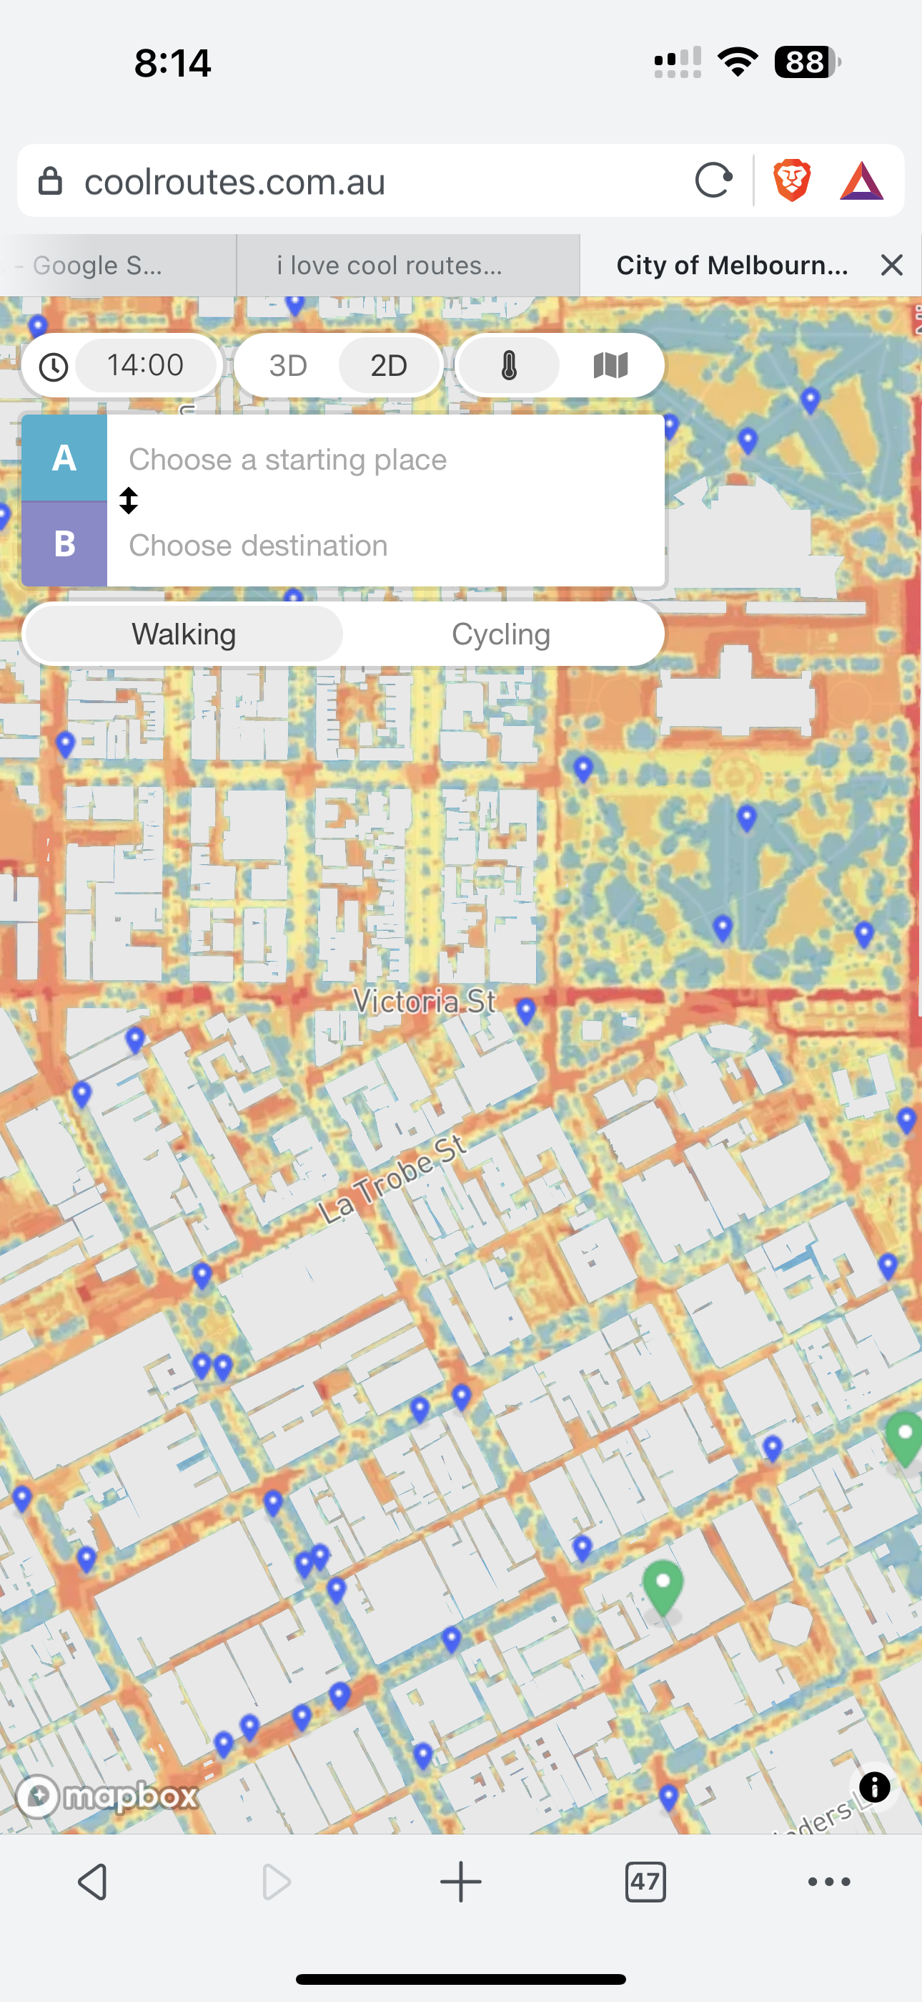
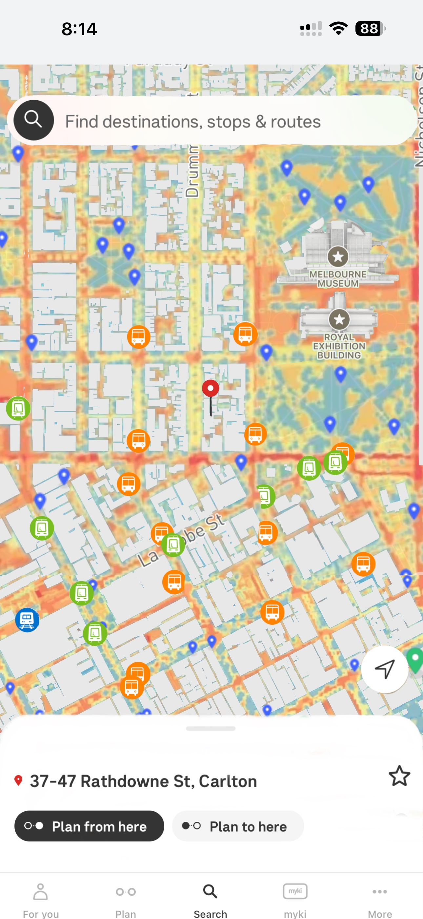
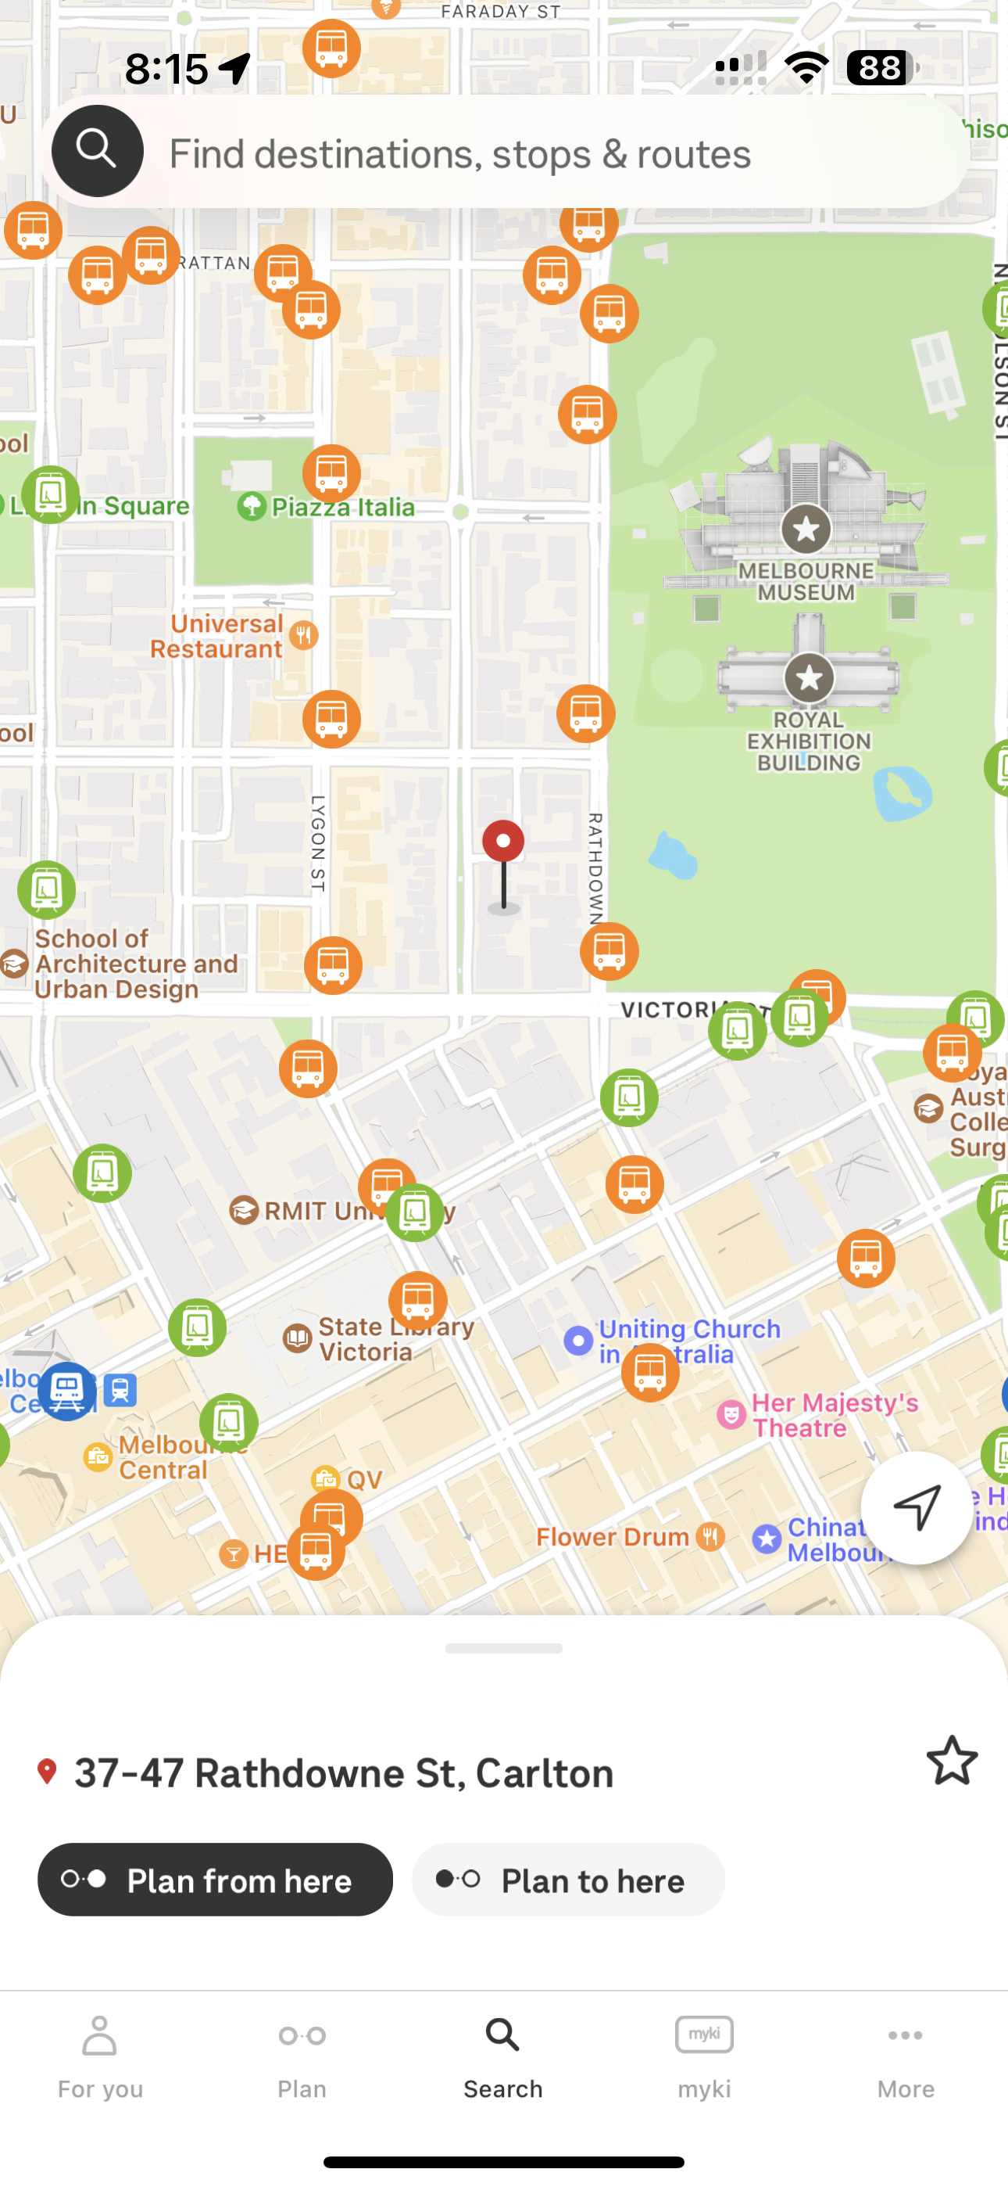
Integrate Into Other Resources
Cool Routes
PTV
29

Slide 30
Marketing Opportunities
30
Notes:
Another avenue we explored was CoM’s marketing
CoM provides vast resources to their citizens in preparation for heatwaves, and we suggest integrating Cool Routes into these resources. This can include making Cool Routes more visible on their Heatwaves web page and adding to existing social media content. ;;;;;;;;;;;;
In addition, we recommend an increase of marketing throughout the city. This can be in the form of physical signs, so that users can gain access to the tool while they are traveling through extreme heat, or by briefing City Ambassadors or other employees about cool routes. This can be especially useful with librarian trainings, as they can provide public access to digital resources, allowing the tool to reach vulnerable communities.
We also recommend CoM integrated cool routes into their existing resources

Slide 31
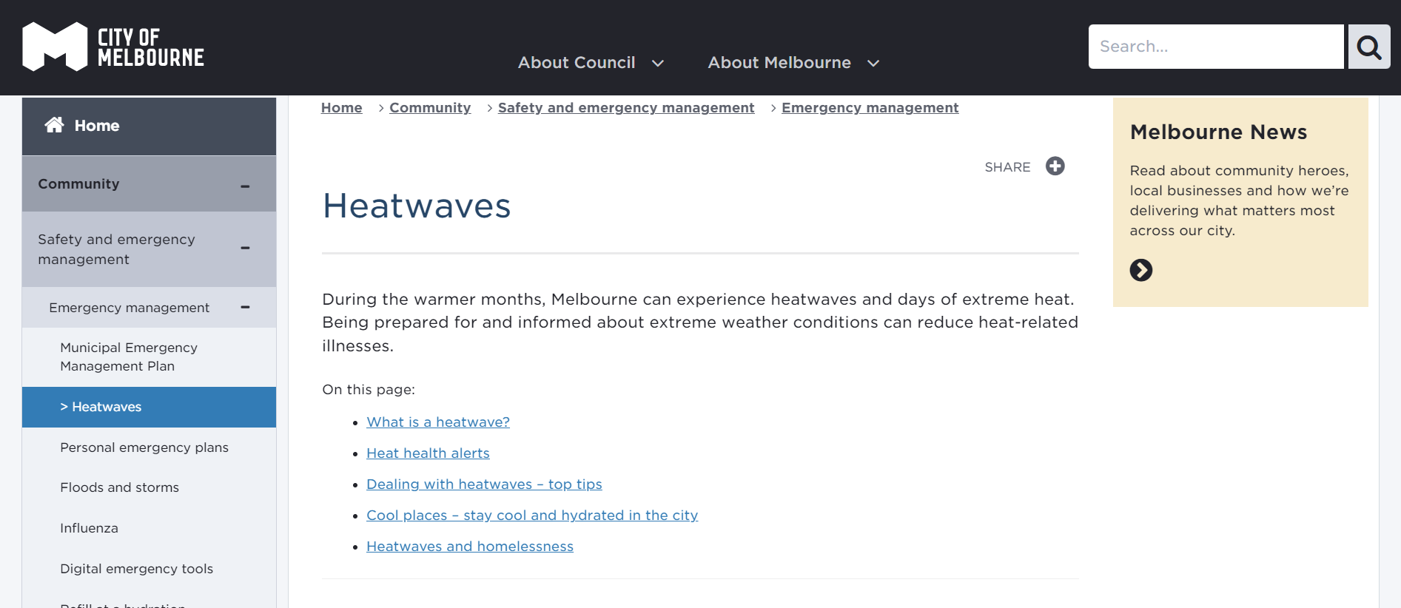
Marketing in Preparation for Heat Waves
Cool Routes – navigate Melbourne protected from the sun
31
Notes:
We recommend that the CoM market Cool Routes prior to heat waves. This would include increasing the accessibility of the Cool Routes link on the heat waves website that goes out with the heat health alerts and showcasing Cool Routes in the social media posts that appear before and during heat waves.

Slide 32
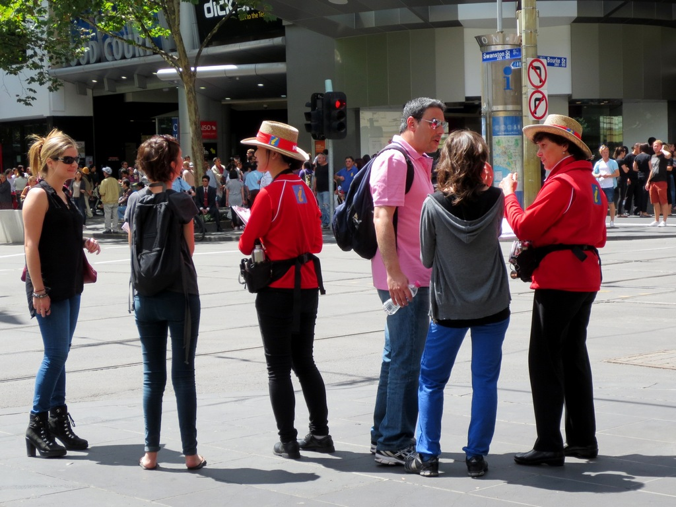
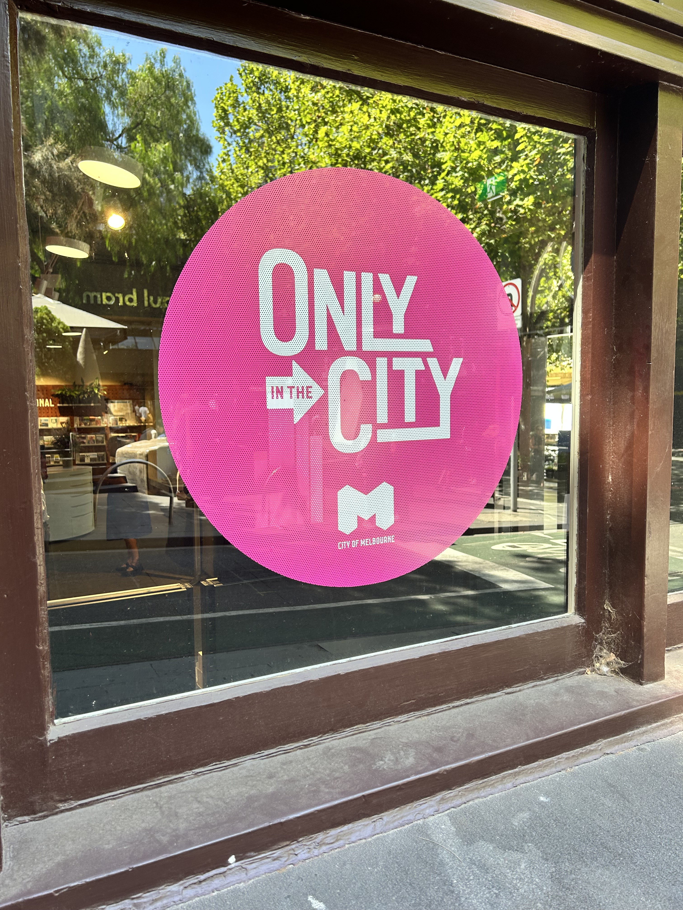
Increase Physical Marketing Within the City
Creative signage throughout the city
City Ambassador and librarian training
32
Notes:
Additionally we see an opportunity to expand marketing by increasing the physical marketing within the city. the city could implement creative signage so people can find cool Routes while they travel through the heat. To this end it would also be beneficial to train the city ambassadors and librarians about Cool Routes so they can spread information about the website librarians specifically could allow people to benefit from cool routes who don’t usually have access to the digital resources needed to use the website on their own

Slide 33
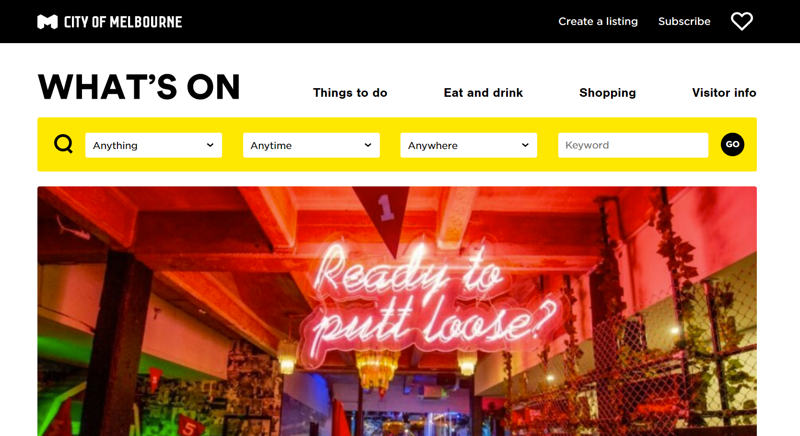
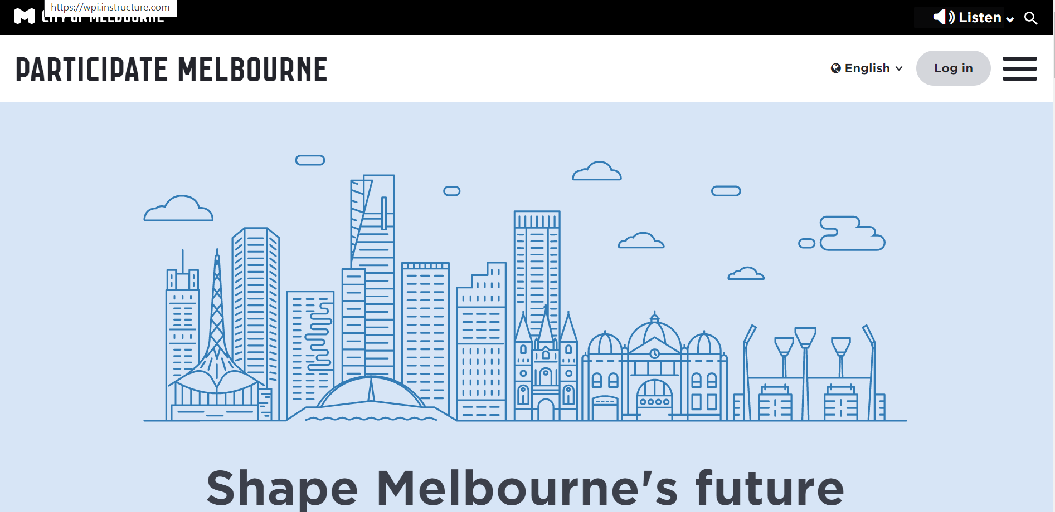
Utilize the existing CoM marketing resources
Green Leaflet
What'sOnMelbourne
Neighbourhood Portals
ParticipateMelbourne
33

Slide 34
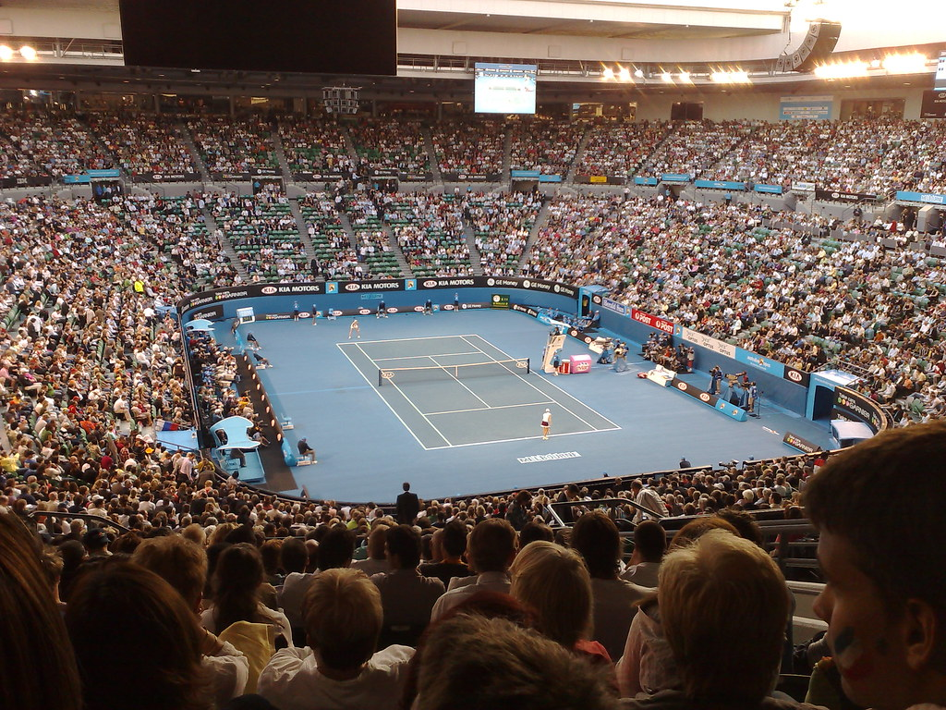
Market at Summer Events
34

Slide 35
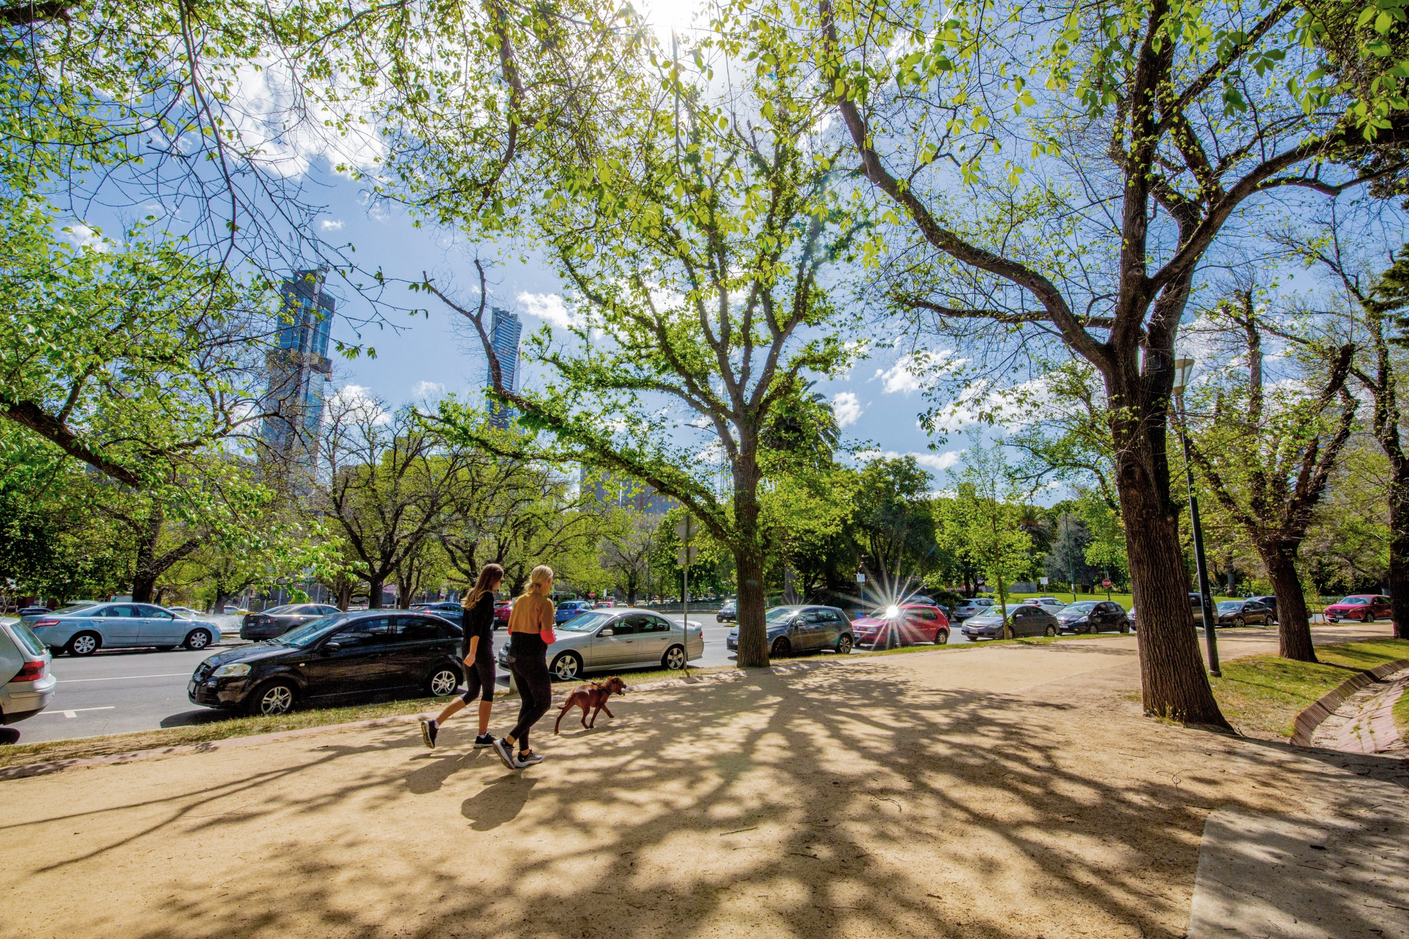
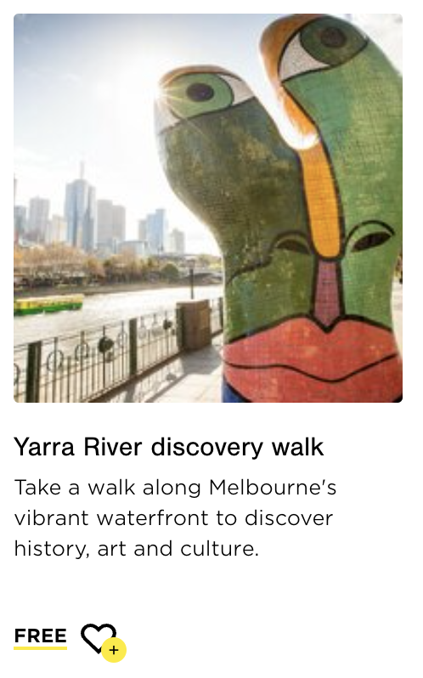
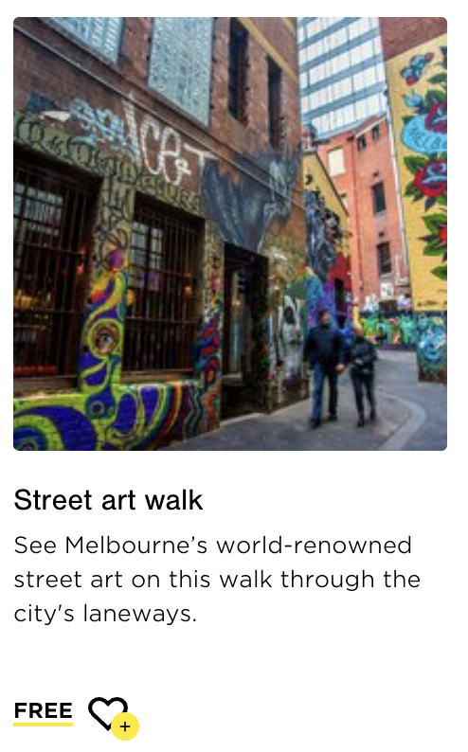
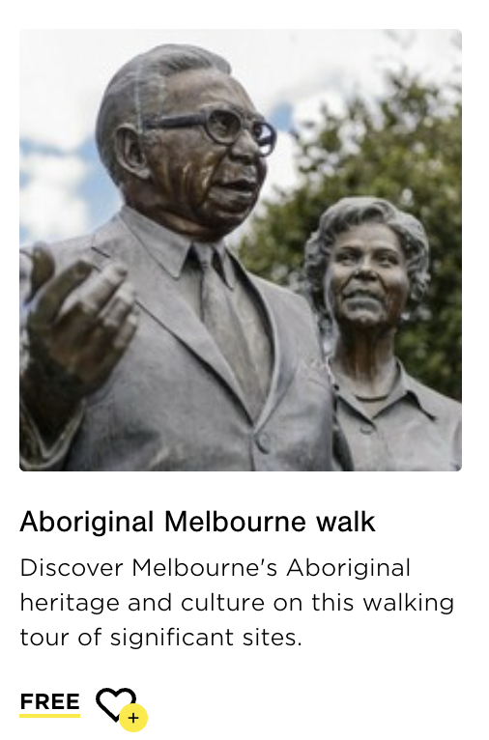
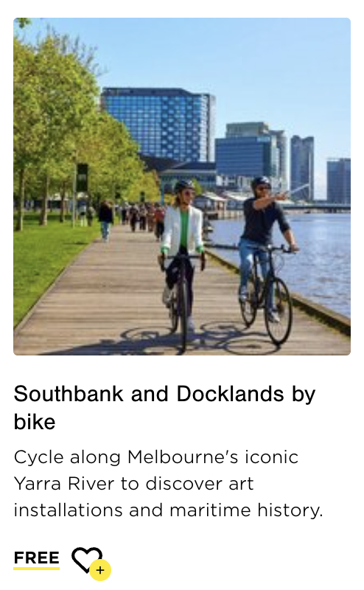
Merge With Self-Guided Tours
35
Notes:
Our team believes that the CoM can integrate Cool Routes into existing resources. Melbourne has many different activities such as Melbourne walks and sustainability walks, and Cool Routes would merge perfectly with these resources. In addition, merging with PTV and Arevo are also two practical suggestions for the CoM. It is also important to highlight that the technology Cool Routes has can impact the greater community. If the CoM were to release this technology into other cities or countries, more places could utilize and reap the benefits that Cool Routes will being to their community.
- Abbi and add impact

Slide 36
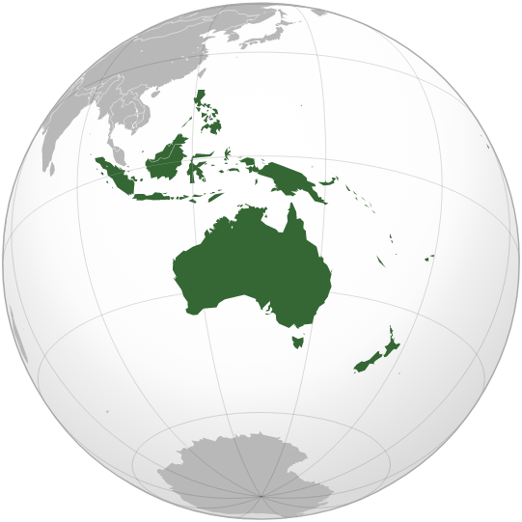
36

Slide 37
Thank You
Any questions?
Special thanks to:
Candace Jordan, City of Melbourne
Nicki Colls, City of Melbourne
Jack Barrett & Dani Bramante, Nova Systems
Emma Bacon, Sweltering Cities
CoM Focus Group Participants
Aarti & Ryan Madan, WPI
37
Notes:
Jack

