Slide 1
Desarrollar un
Sistema de
Gestión de
Voluntarios
para el Caño 3.7
Notes:
Gabo

Slide 2
Notes:
All

Slide 3
¿COMO LLEGAMOS AQUI?
50+ project centers across 6 continents
WPI
Notes:
Gabo
Title : how we got here

Slide 4
¿Porque estamos aqui?
Improve Volunteer Management System
Create a lasting relationship between ENLACE and WPI
Notes:
Gabo
Title Why we are here?
just have Cano3.7

Slide 5
Orden del Día
VMS definition
Commercial VMS options
Demo Top Option
Questions
Custom Solution
Demo VMD
Compare both options
Questions
Cano Video
Notes:
Gabo

Slide 6
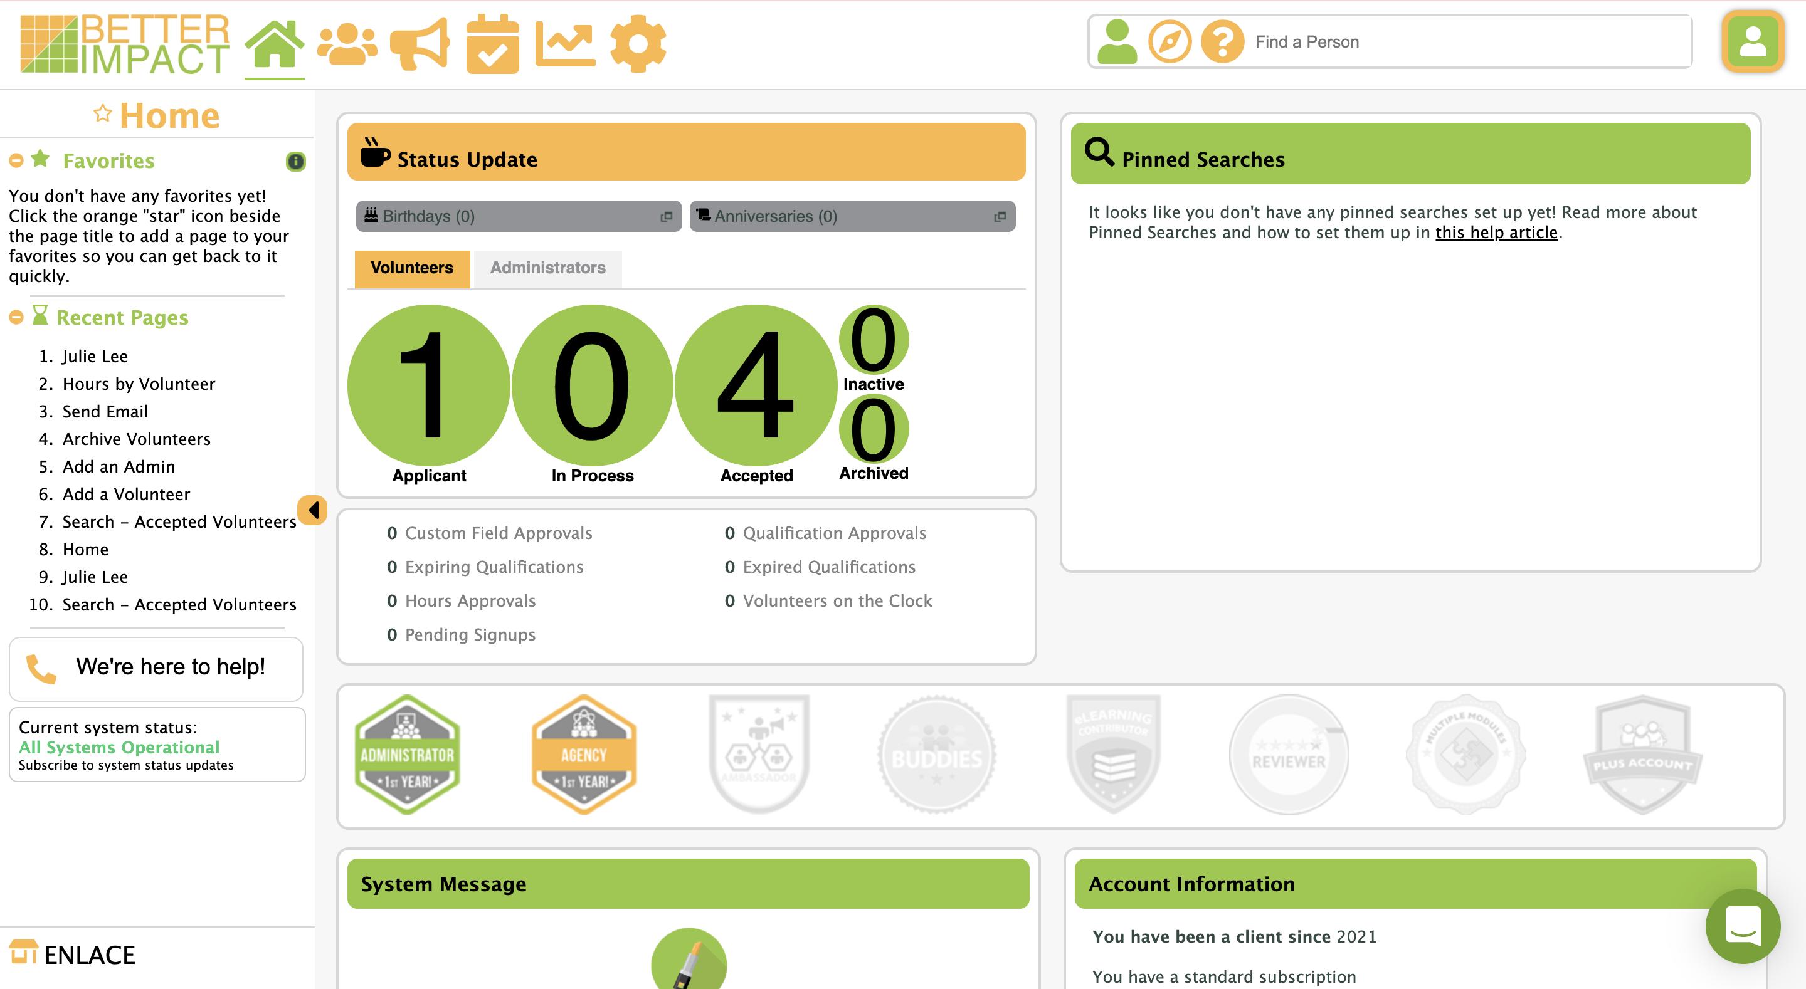
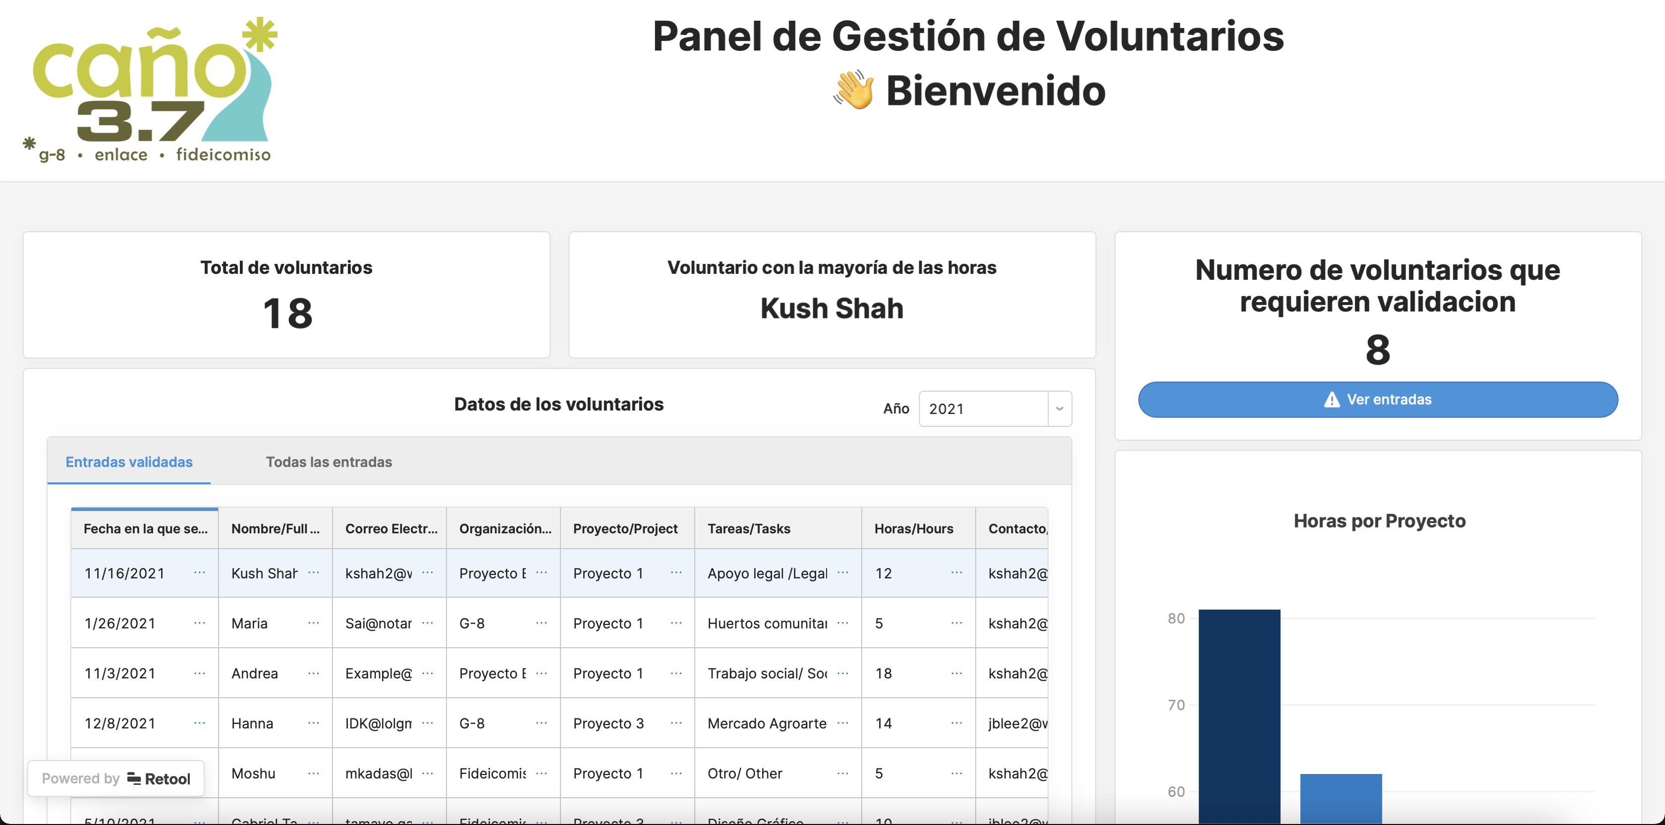
¿Que es un VMS? (Volunteer Management System) (Sistema de Manejo de Voluntarios)
Notes:
Danny
Volunteer Management Systems (VMSs) are software packages that are meant to help nonprofits manage volunteer relationships by increasing productivity of the organization, providing coordination of different tasks with volunteers, and administering volunteer programs, events and initiatives.
It has features that aren’t necessarily useful, and has limitations thus we created our VMD
We will be showing you the major features of each in the upcoming slides

Slide 7
Sistema de gestión de voluntarios comerciales
Notes:
Give a feel for commerical VMS

Slide 8
REQUISITOS PARA EL VMS
Available in Spanish and English
Register volunteer information and store it in a database
Quantify volunteer hours and generate reports in PDF format
Generate summaries for scheduled events
platform type: cloud
Notes:
That enlace requested and would benefit the organization

Slide 9
TOP 3 VMS
 | Volunteer Hub | Hands on Connect | BetterImpact
Volunteer Registration Capacity | Plus Plan: up to 1000 Pro Plan: up to 2000 Enterprise: 2500+ | Unlimited | Unlimited
Platform Type | Cloud | Cloud | Cloud
Technical Support | Yes | Yes | Yes
Language Change | Yes, google translate | Yes | Yes
Statistical Report | Yes | Yes | Yes
Cost | Depends on # of volunteers | Depends on # of volunteers | Enterprise Version: $5,104 Standard Version: $2,036
Demo | No | No | Yes
9

Slide 10
BetterImpact Demo
Notes:
Mention
Group sign up
Qualifications
Modules
Badges
FEEL
Log into hours- julie
Show calendar- Julie
Log hours- Hannah
Volunteer can generate report-hannah
Switch to admin mode
Applicant/in process/accepted on home page- Julie
Manage admins and manage volunteers for example by inputting hours on the behalf of volunteers- Hannah
Communicate tab: send an email- hannah
Generate report (hours by activity) -Hannah
Configuration tab- julie
SHOW HOW IT CAN BE IN SPANISH-julie
Switch to volunteer mode-Julie

Slide 11
¿Preguntas?
Notes:
Document commercial vms selection process and aid in potential future commercial vms selection for enlace

Slide 12
Panel de control para la gestión de los voluntarios Personalizado
Notes:
Custom Volunteer Management Dashboard
Change the image
Start selling VMD

Slide 13
VMD DEMO
Notes:
Custom Volunteer Management Dashboard

Slide 14
Tabla comparativa entre BetterImpact y VMD
 | BetterImpact VMS | Volunteer Management Dashboard
No need to sign into VMS for use | No, sign in required | Yes
Calendar to organize events | Yes | No, can be added
Generate Certificates | Yes | Yes
Generates Reports | Yes | Yes
Support | Live Chat | Written Guides
Associate monetary value to volunteer’s task that can quantified in the reports | Yes | Yes
Annual Cost | Enterprise: $5,104 Standard: $2,036 | $120 per administrator
Notes:
Say the pinch points
Say whats not great about betterimpact
All volunteers need an account and must sign in
Most critical difference point

Slide 15
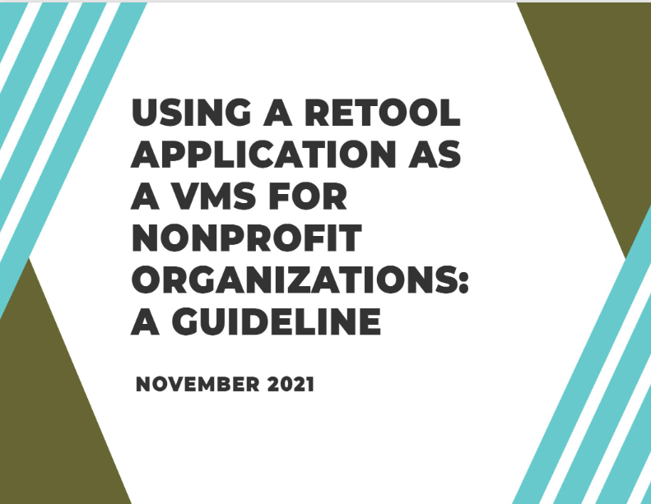
¿Preguntas?

Slide 16
Gracias
Scott Jiusto
Gbeton Somasse
John-Michael Davis
Paige Anderson
Caño3.7
Mario Núñez
Maria Inirio
Kimberley Pérez Rodríguez
Carlos Pérez Muñiz
Miguel Angel

Slide 17
Cano Video
Notes:
* If anyone wants to see it, we will be playing it, but it will be on the website

