Slide 1
Mean-Value Method of Lateral Force Calibration
A Major Qualifying Project
By
Derek Eggiman

Slide 2
Introduction

Slide 3
Acknowledgments
We would like to thank Sigma-Xi for generously funding this project.
We would also like to thank Professor Nancy Burnham and Dr. Deli Liu.

Slide 4
Atomic Force Microscope
Focused laser is reflected off cantilever.
Changes in cantilever orientation result in a change of laser position
Laser position is detected by the photo diode.
Cantilever position is interpolated from photo diode signal.

Slide 5
Current Problems in LFM Calibration
Many studies assume a functional form for friction, f=μ(N+A).
Other methods calibrate as a function of load.
Repeated scans
Excess tip wear.
Other methods require special equipment or are far to complicated and time consuming.
Want quick, in-situ method.

Slide 6
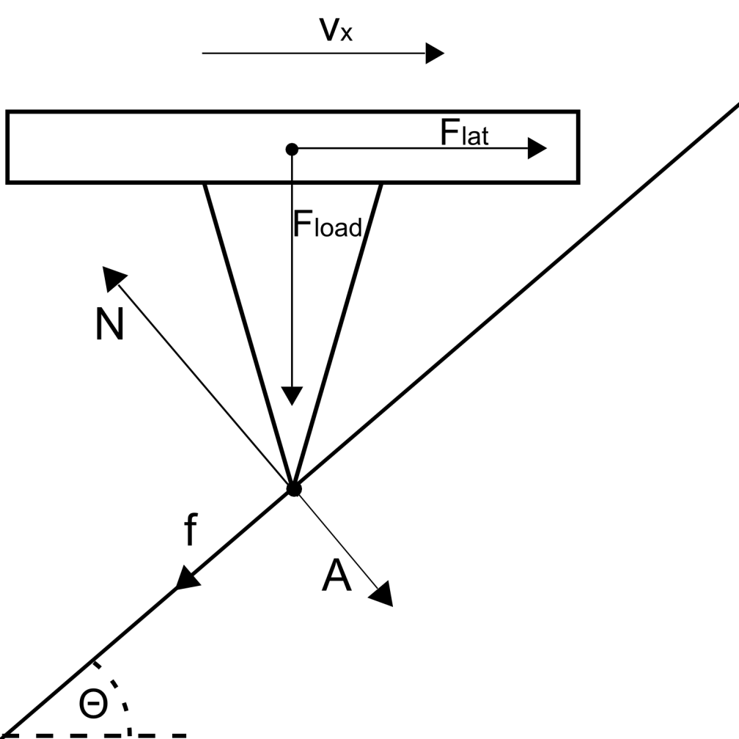
MethoDology
Equilibrium equations depend on direction of motion (V_{x}) and angle (θ).
Taking the average value of scans in opposite directions over the same surface results in cancelations.
F_{lat-avg}= F_{load}tan(θ) or
V_{lat-avg}= αF_{load}tan(θ)

Slide 7
Results & Discussion

Slide 8
Samples:Tested
Piano wire
Steel rod
Solder spheres
1.588 mm diameter Si₃N₄ ball bearings
http://www.satotekkou.co.jp/en/product/img/ceramic-p04.jpg

Slide 9
Single ScaN: Topography & LFM

Slide 10
Single Scan: Re-plot

Slide 11
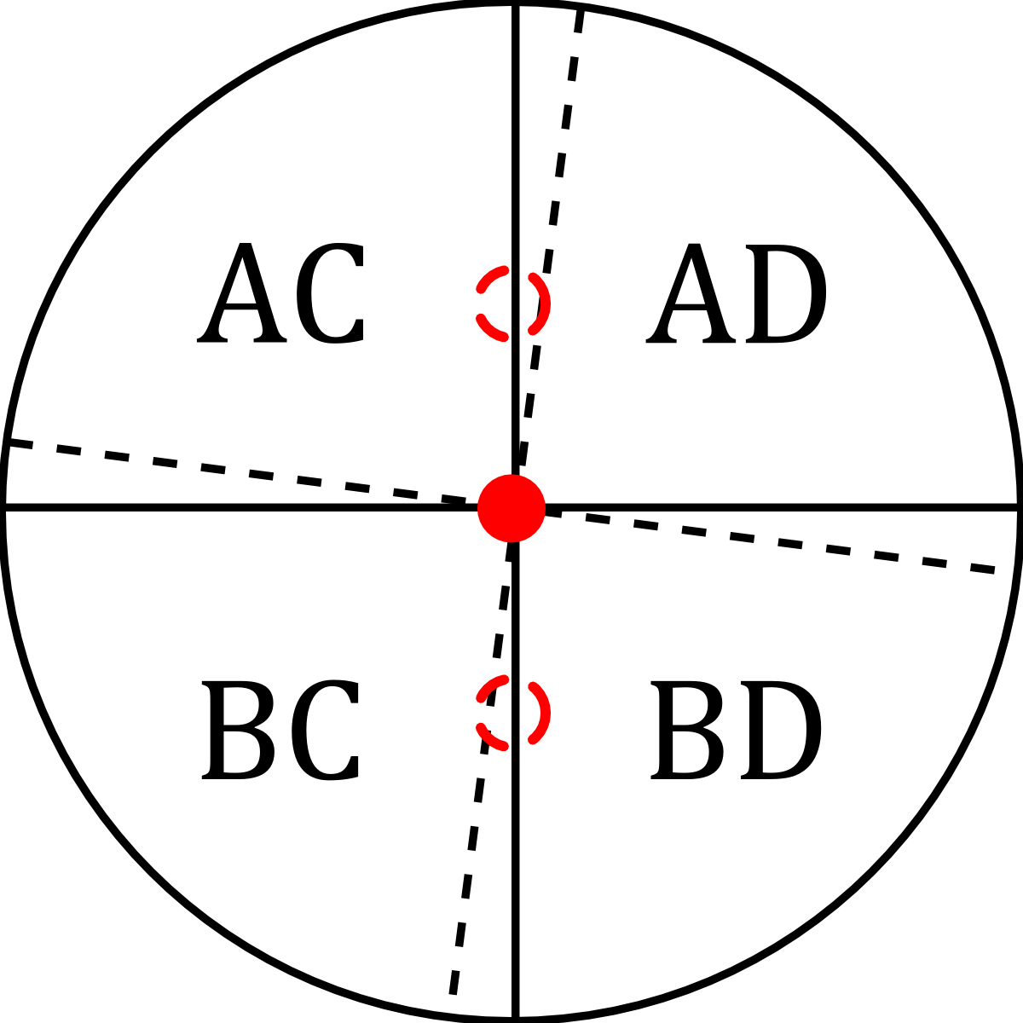
Experimental Difficulties
Finding a sufficiently smooth surface
Lack of lateral force sensitivity
Crosstalk of lateral and normal force signals

Slide 12
Crosstalk

Slide 13
Full scan Mean-value analysis
Obtained by taking a complete image of 256X256 data points in a 27 X 27 (μm) scan range.
Then taking the mean value along the y axis and using this data to perform our analysis.
Plotted the mean value of:
Topography (μm)
LFM Forward
LFM Reverse

Slide 14
Full Scan: Topography

Slide 15
Full Scan: LFM

Slide 16
Full Scan: Re-plot

Slide 17
Conclusions
Mean value of 256 X 256 point scan shows high degree of linearity. R²=0.961.
Successfully derived proof of concept.
Work will be continued by Saonti Chakraborty and published in a peer reviewed journal.

Slide 18
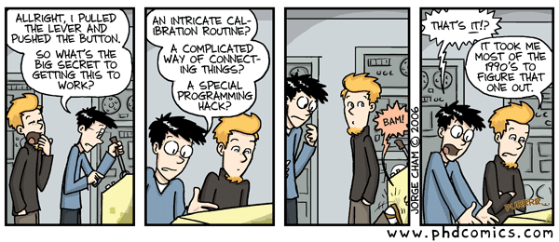
Questions?
http://www.phdcomics.com/comics/archive.php?comicid=771

