Slide 1
Teaching Greener: Climate Education in Worcestershire UK
Ethan Knight | Caleb Powell
Logan Frandsen | Noah Mester
Faculty Advisors:
Professor Fred J. Looft
Professor Linda Carre Looft
Sponsors:
SOS UK
University of Worcester
Notes:
Caleb

Slide 2
What is Climate Education?
Sustainability
Global Warming
Everyday Actions
Greenhouse Gas Emissions
Human Impact
Climate Change
2

Slide 3
School Level | Number of Responses | Percentage of Total Respondents
Primary | 10 | 23%
Secondary | 38 | 88%
Further Education (Ages 16-18) | 19 | 44%
Higher education | 16 | 37%
Most Students Learn About Climate in Secondary School
3

Slide 4
Project Goal
Report on the implementation status of the climate education curriculum in Worcestershire from the perspective of secondary school faculty.
4

Slide 5
Objective 1:
Developed a database of headteachers, teachers, and curriculum heads for every secondary school in Worcestershire.
Project Objectives
Objective 2:
Documented the climate education policies of England at the secondary school level and the climate change policies of the UK.
Objective 3:
Identified barriers and successes to the implementation of climate education in secondary schools.
Objective 4:
Identified opportunities for the improvement of climate education in secondary schools.
5

Slide 6
Project Methods
Objective 1: Database
Excel Sheet
Objective 2: Policies
Literature Review
Objective 3: Barriers
Semi-structured interview and Survey
Objective 4: Opportunities
Analyze Data
6

Slide 7
Teacher Interview Results
7

Slide 8
Barriers of Climate Change Implementation
Time
Lack of Infrastructure
School Geography Requirements
8

Slide 9
Successes of Climate Change Implementation
Sustainability Activities
Connection to World Events
Climate Assignments in Different Subjects
9

Slide 10
Teacher Trainee Results
10

Slide 11
39% - No Climate Education
37% - Helpful
"How helpful was the education you received about the human effects on climate change?"
N = 71
6% - Unhelpful
18% - Neutral
11

Slide 12
23% of 31 Respondents Replied “Impact”
“What, if anything, did you find most memorable about the climate change education you received?”​
​
12

Slide 13
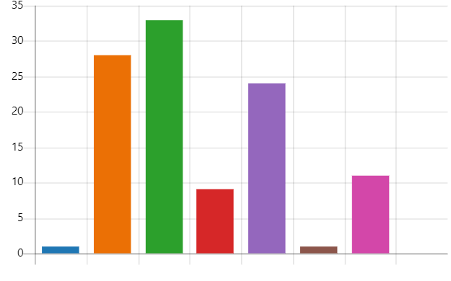
"How do you feel about your role as a teacher in relation to the climate and ecological emergency?"
33
28
24
Responses
11
9
1
1
Not Responsible
Partially Responsible
Responsible
Guilty
Anxious
Indifferent
Hopeful
13

Slide 14
7%
Very Prepared
38%
Somewhat Prepared
14%
Nether Prepared Nor Unprepared
18%
Somewhat Unprepared
23%
Very Unprepared
"How prepared do you feel to teach about the climate and ecological crisis?"
14

Slide 15
Recommendations
15

Slide 16
Recommendation
Add Climate Change Topics to the National Curriculum
1
2
3
4
Review Curriculum
Remove Outdated Topics
Formulate Climate Change Curriculum
Implement Revised Curriculum
16

Slide 17
Recommendation
Improve Teacher Training and Resources
Provide Sharing Spaces
Online Curriculum Training
Provide Climate Change Materials
Carbon Literacy Training
Creative Integrations
17

Slide 18
Recommendation
Improve outdoor and environmental activities
Local Education
Access to Nature
Establish Eco-clubs
18

Slide 19
Acknowledgments
Executive Director Jamie Agombar, SOS-UK
Director of Education (interim) Meg Baker, SOS-UK
Senior Lecturer of Teacher Education Elena Lengthorn, University of Worcester
Project Advisor Fred J. Looft, WPI
Project Advisor Linda Carre Looft, WPI

Slide 20
Thank You

