Slide 1
Waste Collection Optimization for the Amager Resource Center
Johann Bradley, Robert Connor, Makayla D’Amore, Rory Sullivan
Notes:
Makayla

Slide 2
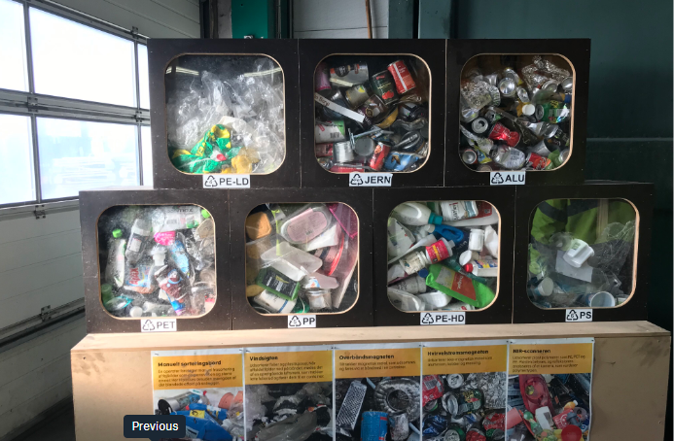
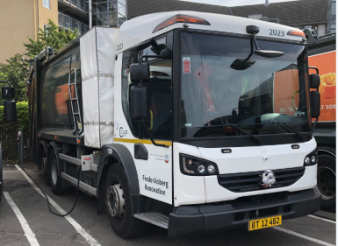
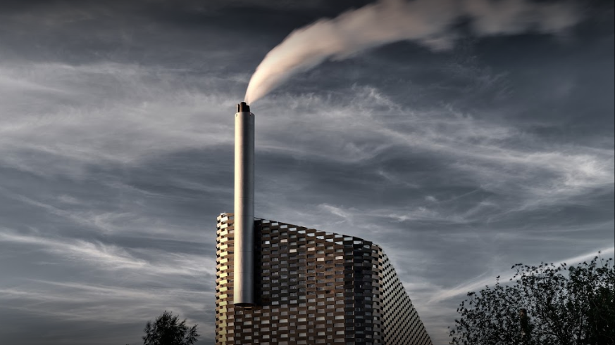
Project Statement
This project explored waste collection optimization in the City of Copenhagen and developed various recommendations for ARC as they transition for the impending E-truck upscale in 2022.
Notes:
Johann

Slide 3

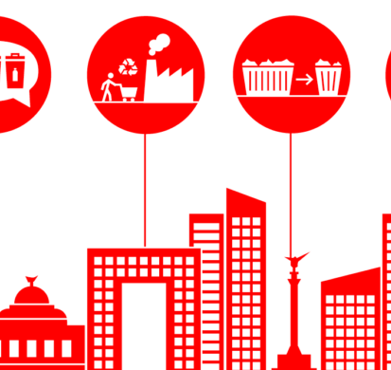


Methodology
Objective 1:
Investigate
inefficiencies
Objective 2:
Develop processes
Objective 3:
Formulate recommendations
Notes:
Rory
Objective 1: Understand the process and procedures of the European waste industry (particularly within the Copenhagen Municipality) and identify opportunities to improve the waste collection processes.
Objective 2: Develop a method to optimize route planning for household waste collection in Copenhagen and conduct a pilot study using the districts of Vesterbro and Amager East, taking into account the areas of improvement and current waste collection practices that were identified in objective 1.
Objective 3: Formulate recommendations on how to replicate the optimization process created in objective 2.

Slide 4
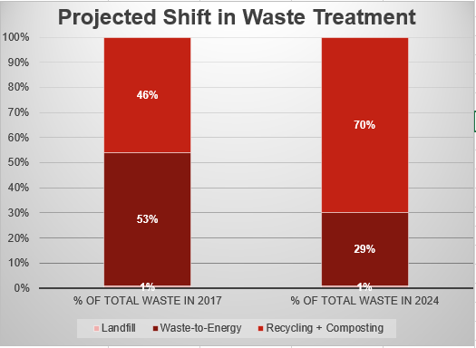
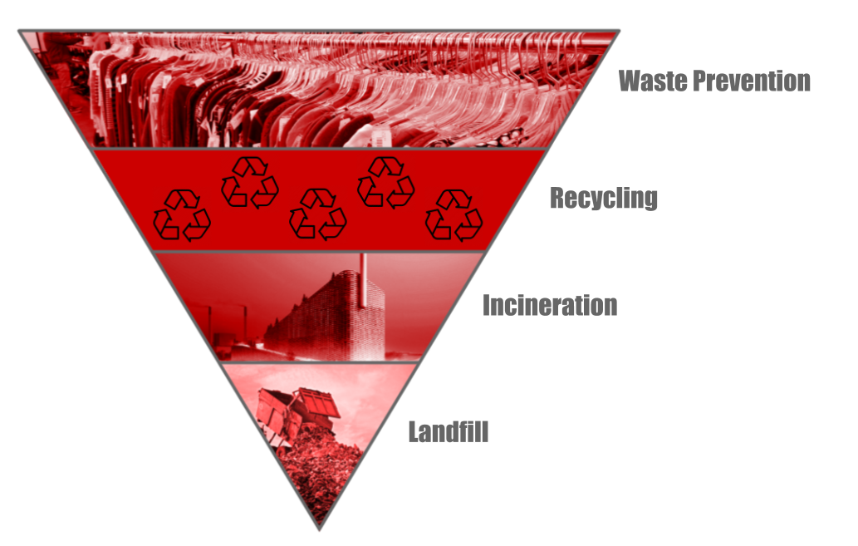
The waste collection industry is changing and adapting to represent a more sustainable model
Waste Hierarchy
Notes:
Makayla
“Now the waste collection industry is changing for Copenhagen. A large part of this coincides with the Municipality’s 70% recycling goal by 2024 as well as their carbon neutrality goal by 2025. The Municipality of Copenhagen is attempting to edge closer and closer to the Waste Hierarchy model seen to the right (*explain waste hierarchy model).Currently, Copenhagen primarily incinerates most of their waste with little landfill, however the goal is to move to recycling, and then thereby waste prevention as a whole.”

Slide 5
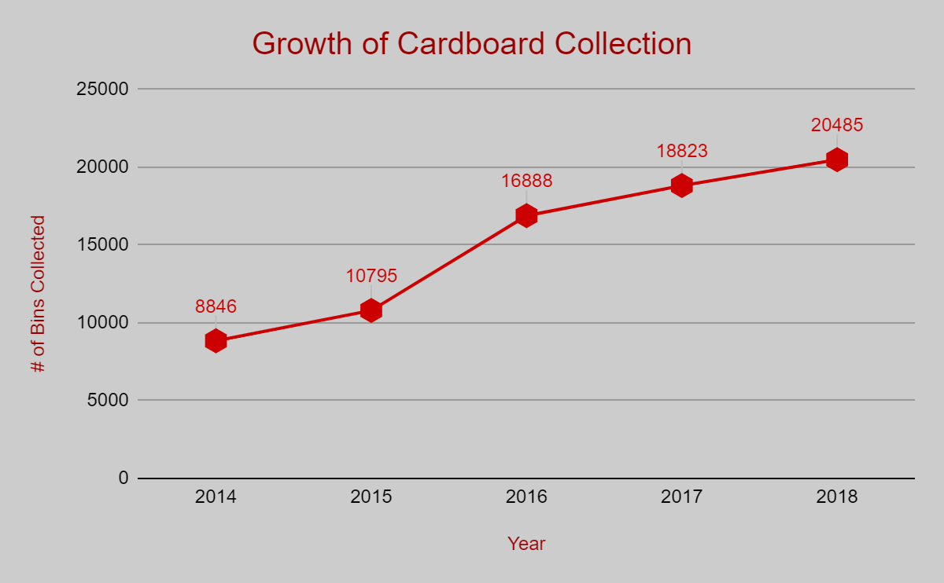
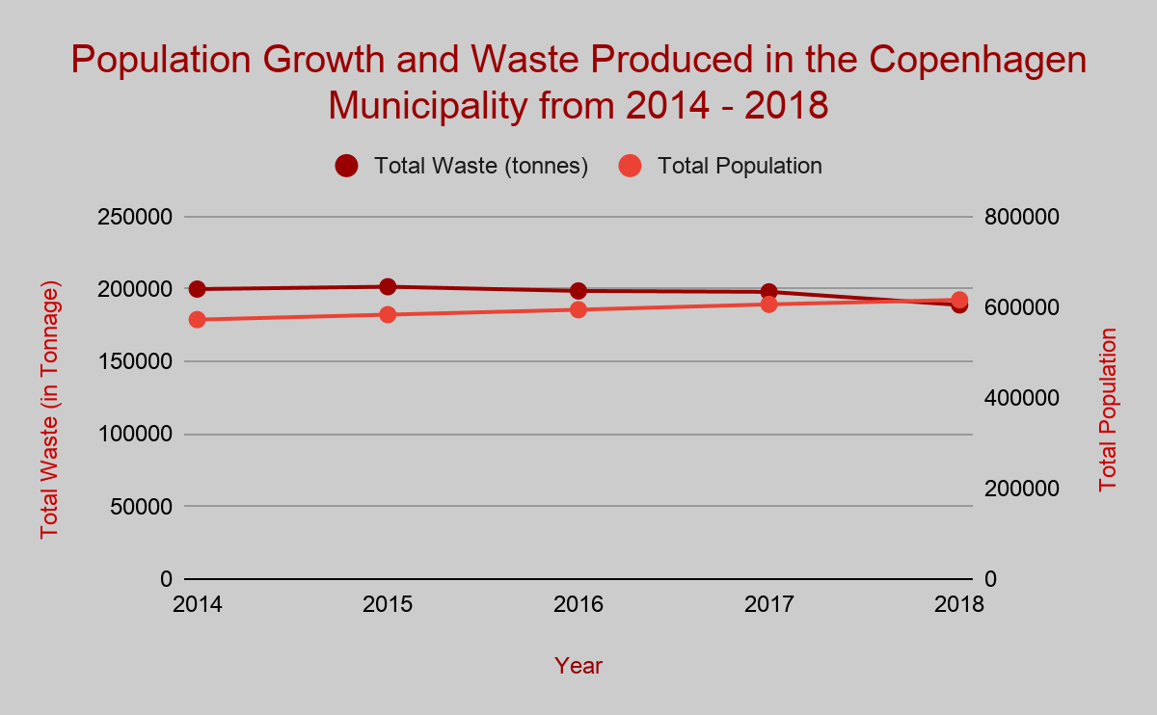
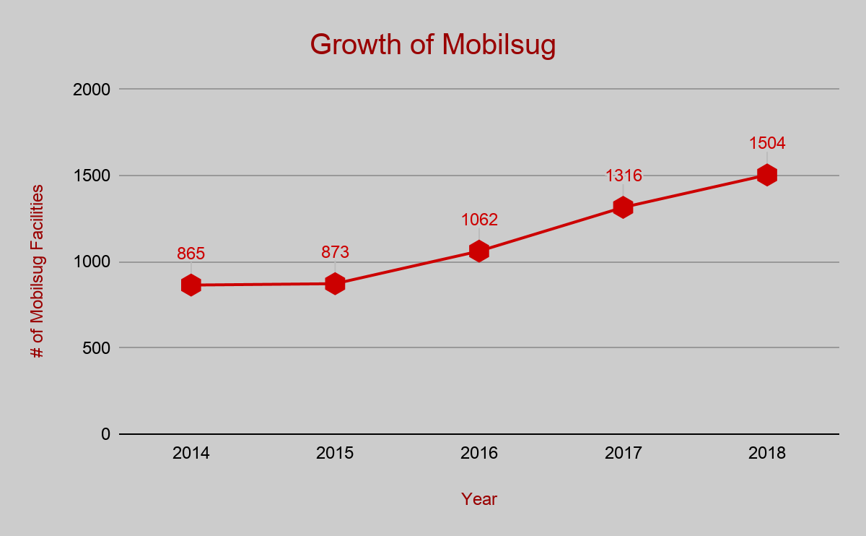
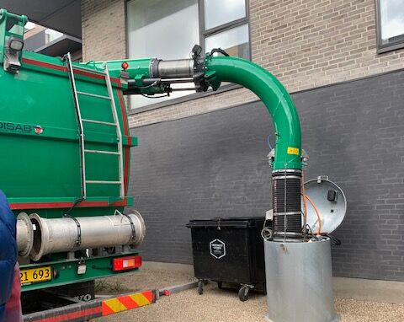
The waste collection industry is changing and adapting to represent a more sustainable model
Notes:
Makayla
“But these changes don’t only come from directives by the Municipality. For example, the collection of cardboard waste has more than doubled in the past 5 years. On the other end (*cue next graphic), a growing popular form of waste collection is Mobilsug (*explain Mobilsug). Mobilsug does not coincide with the carbon neutrality goal as currently, the only way to collect waste using Mobilsug is through LNG/diesel vehicles. E-trucks are not capable of the power requirements to run the vacuum for Mobilsug collection. However, one thing that is not necessarily changing, is the overall volume of waste in Copenhagen, now we assumed that as the Copenhagen population increases (at an estimated 40,000 per year), the waste would as well. However, we have found that Copenhagen has done a great job through recycling and reusing their waste they were able actually lower the overall volume of waste over the years.”

Slide 6
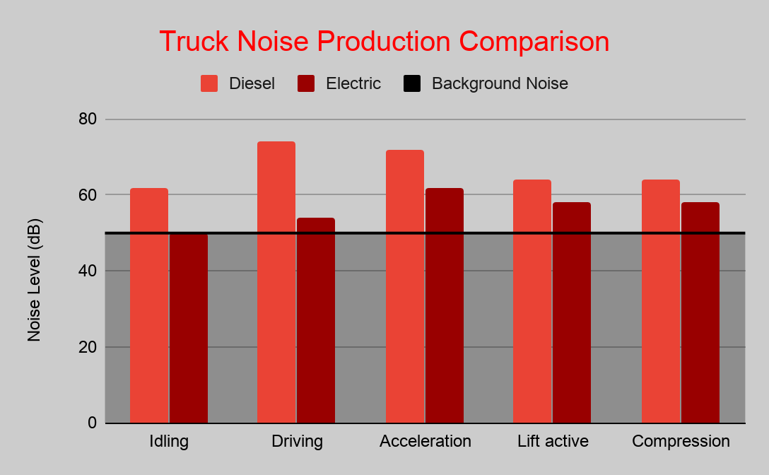
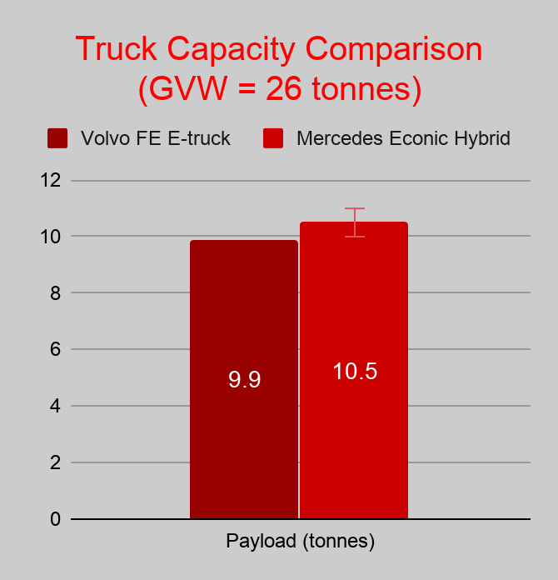
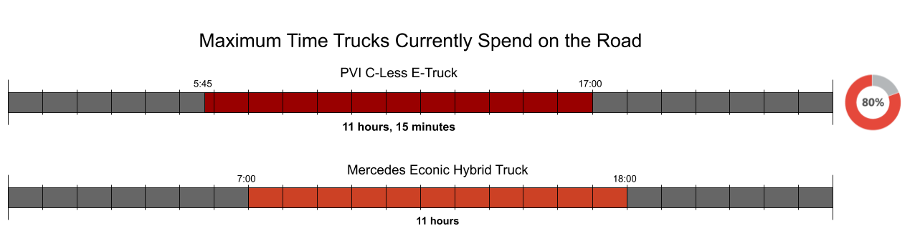
Performance of E-Trucks is similar to that of diesel and biogas trucks
Notes:
Reuben
“In regards to E-trucks, as this is primarily what ARC will be using to collect waste, the overall performance between both vehicles is similar. (* show and explain data as well as the better noise.” It is important to note as well that the overall maintenance according to our source at Frederiksberg, is relatively the same between the batteries on the E-truck and the engine on the regular diesel trucks.”

Slide 7
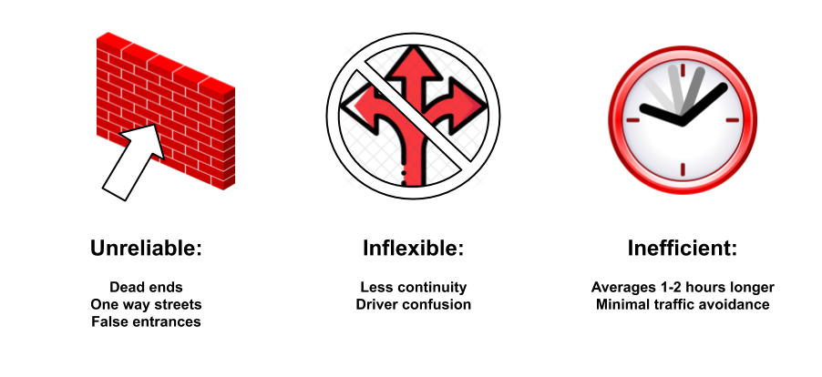
Automated route planning software has not been effective
Notes:
Reuben
Where we felt we could leave the biggest impact on for ARC would be through waste routing. At first glance, the best way we felt to do this would be through automated routing software. However, based on all of our experiences and interviews, we found that allowing the driver’s the freedom to navigate their routes on their own actually proved for them to finish earlier (* explain graphic).

Slide 8
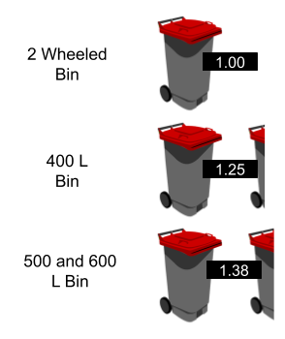
Cost of collection is dependent upon the number of bins collected per shift
Notes:
Rory
Explain how different sized bins are weighted differently
Explain how number of bins collected accounts for different levels of union agreement - and therefore larger shift premium
Specific example of Amager East - ‘Capacity Calculator’ will originally show how many trucks are needed if all trucks run at same union level

Slide 9
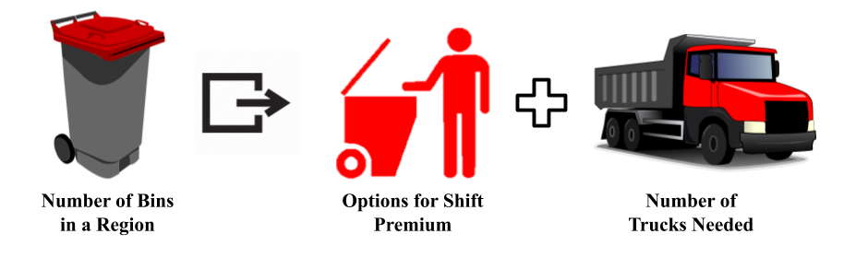
ARC can decrease their projected fleet size by optimizing collection capacity
Notes:
Makayla
Team created a ‘Capacity Calculator’ to help ARC identify number of trucks needed for each city district
Input of number of bins/types of bins
Output of various union agreement levels various

Slide 10
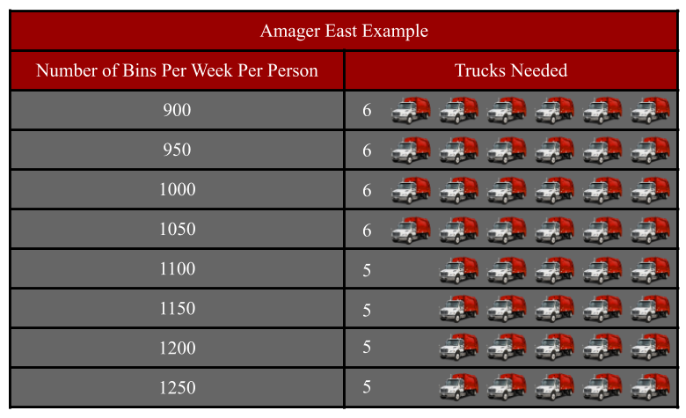
Waste collection can be conducted with fewer trucks than currently utilized
Notes:
Rory
Explain how different sized bins are weighted differently
Explain how number of bins collected accounts for different levels of union agreement - and therefore larger shift premium
Specific example of Amager East - ‘Capacity Calculator’ will originally show how many trucks are needed if all trucks run at same union level

Slide 11
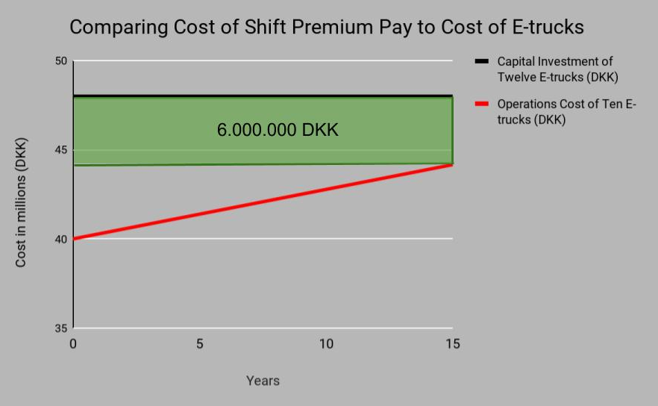
ARC should utilize this process to present an opportunity for savings in the E-truck fleet
Amager East
Vesterbro
Union Weekly Collection Bracket (2 collectors per truck) | Number of trucks
1150 | 2
1100 | 2
1050 | 1
Union Weekly Collection Bracket (2 collectors per truck) | Number of trucks
1100 | 3
1050 | 2
Notes:
Johann
‘Capacity Calculator’ also offers opportunity to mix and match various collection brackets
Our specific areas of study (Vesterbro and Amager East can be seen)

Slide 12
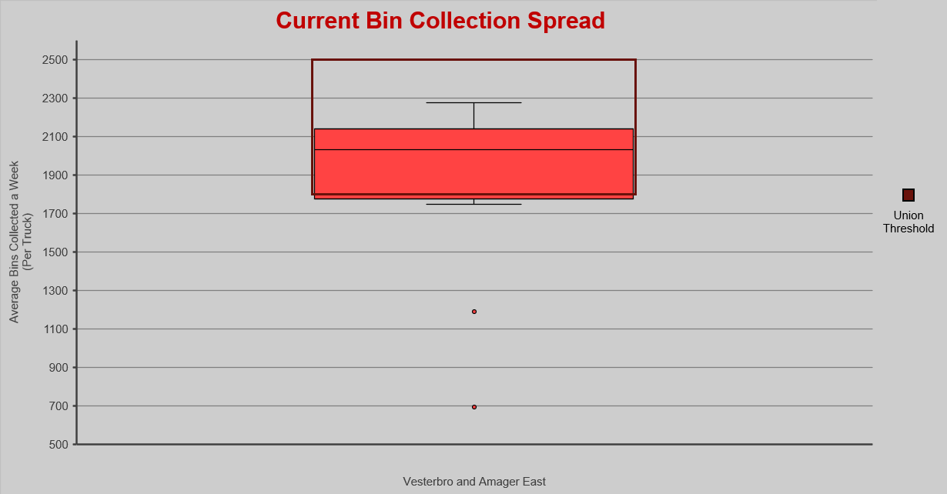
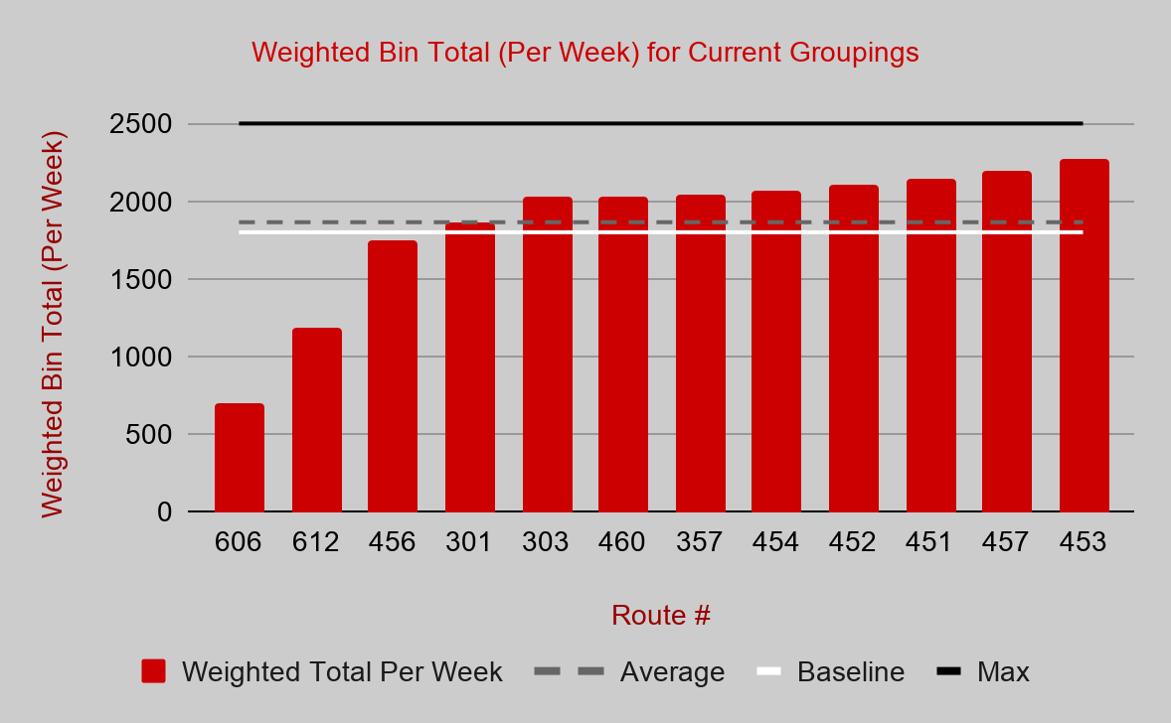
Inconsistencies in the current waste collection process can be reduced
Notes:
Reuben
“One of our key findings was that current shifts are not organized consistently across the board. This was not to go against the current practices as the current collections did not have to put upfront a heavy capital investment so it made more sense for them to spread the collection out among a group. However, in the case for ARC, we found that standardizing collection between trucks as well as increasing the overall vlume collected per truck by a fraction could prove to demonstrate the most savings for ARC.”

Slide 13
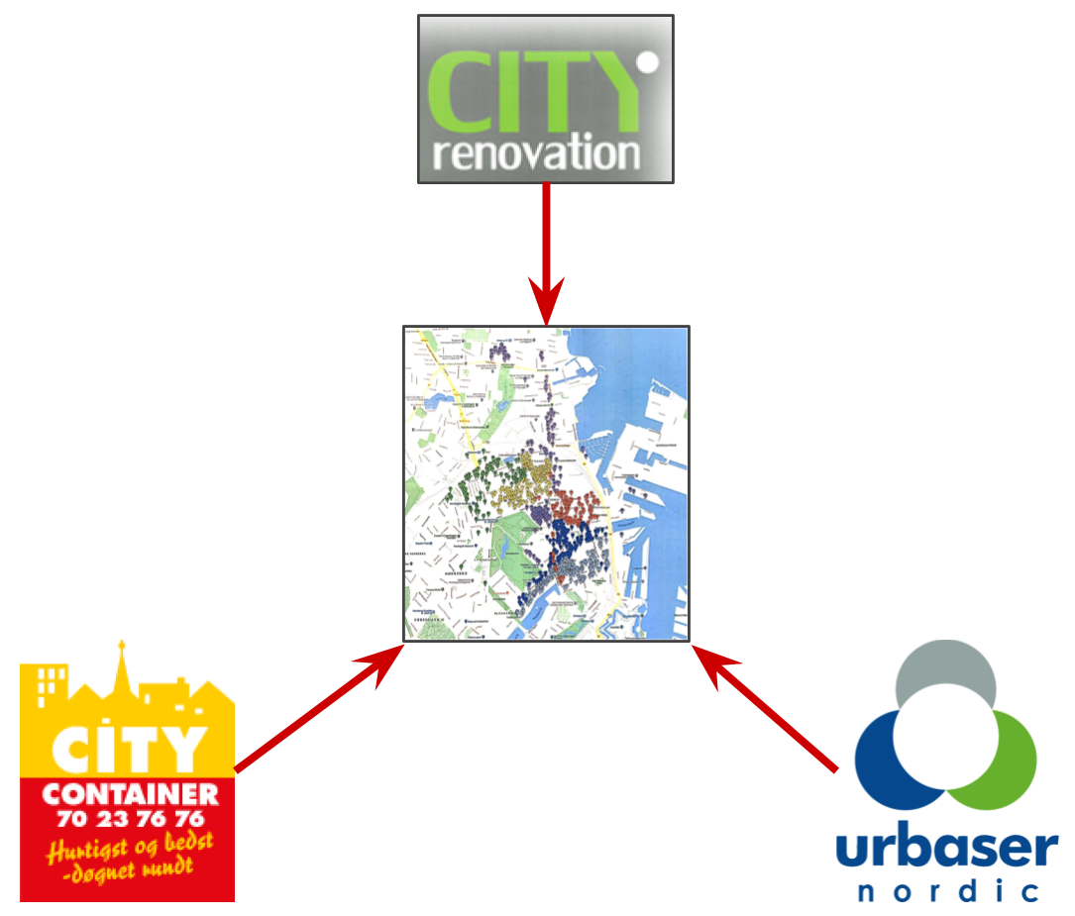
A combination of mapping software and manual routing is an effective option for route planning
Notes:
Johann
Based on our analysis, we found the best way to assemble routes was through a combination of mapping software and manual routing. Essentially, this is a process where drivers are given a specific area to collect waste in and are given the freedom to navigate their way between points. This encourages worker efficiency as the driver’s like the freedom to be able to go where they want.

Slide 14
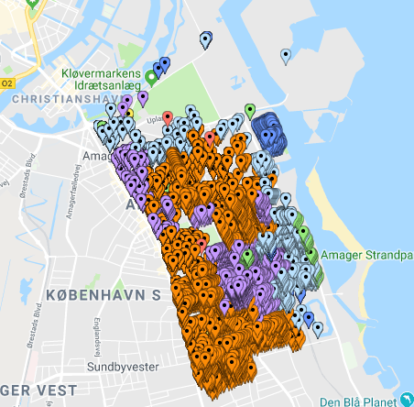
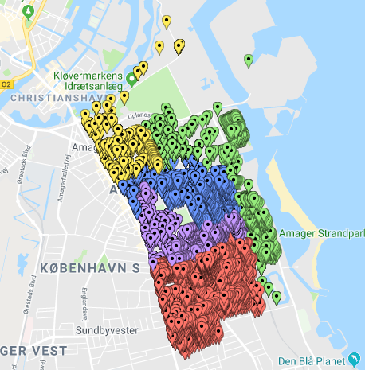
The optimized process creates less geographically dispersed groupings than current practice
Current Routes | Recommended Route
Notes:
Reuben
Comparison of less geographically dispersed areas. 1 fewer route is used. Process Explained:
Start in bottom corner. Select area of close to target bin collection bracket.
Must pay attention to areas inaccessible due to objects such as train tracks
Add/Subtract one road at a time to get desired bin count
Small roads - must select both sides of street for ease of collection.
Larger roads - must be collected in 2 sweeps, can be split up between routes if needed

Slide 15
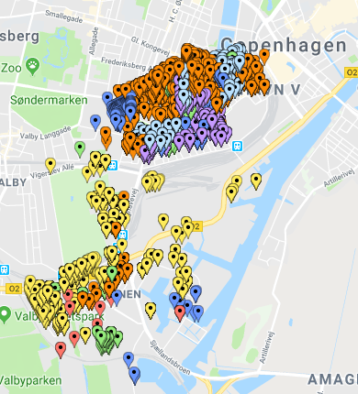
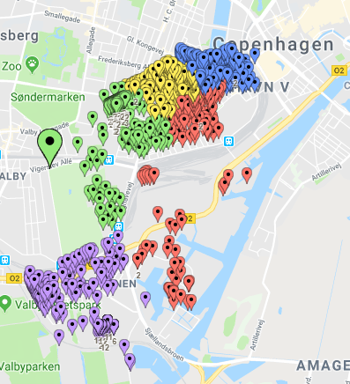
The optimized process creates less geographically dispersed groupings than current practice
Current Routes | Recommended Route
Notes:
Makayla
In order for routes to be successfully implemented - Communication is Key
Work with drivers to know best possible routes. They will know city layout specifics the best.
With their input, routes will make more sense, and will have cooperation of collectors in changing routes.

Slide 16
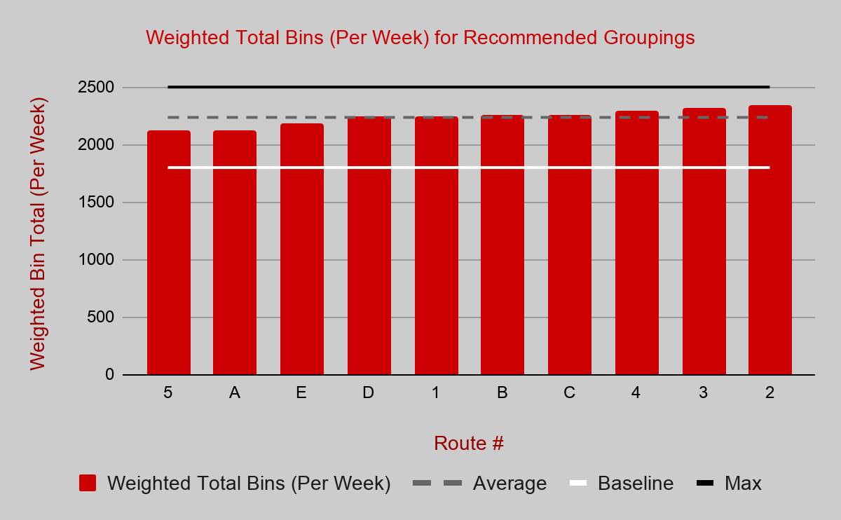
The optimized process uses fewer routes than current practice
Notes:
Reuben
“Comparing physical numbers for these current routes, on the left, and recommended routes, it is clear the current routes differ greatly in their spread while the recommended routes on the right have a more even distribution while still operating within the union agreement threshold.

Slide 17
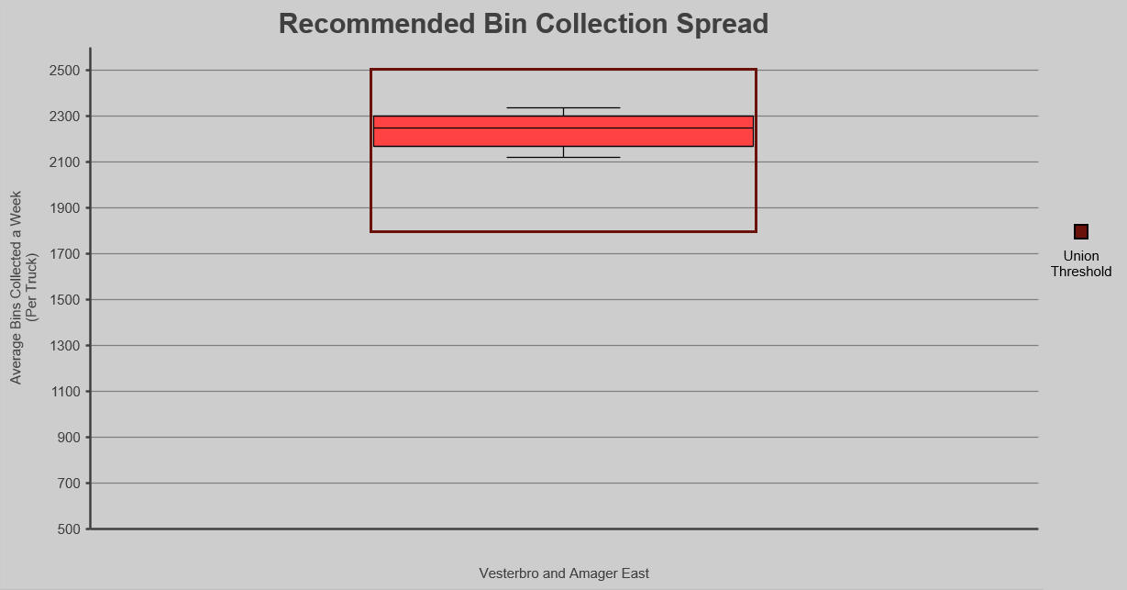
The optimized process uses fewer routes than current practice
Notes:
Rory
“These box and whisker charts serve to show where most of the data sits within the union threshold. The chart on the left shows the current routes and how fifty percent of the data falls within the larger redbox towards the lower half of the union agreement. Additionally, the black brackets serve to show the outliers of the data and how far they spread. On the right, are the recommended route spreads and as you can see they represent larger numbers in each route while still substantially remaining in the threshold. Additionally, the outliers of the black brackets and spread are much more compact.

Slide 18
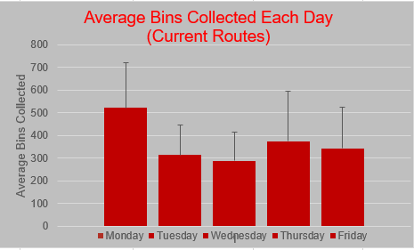
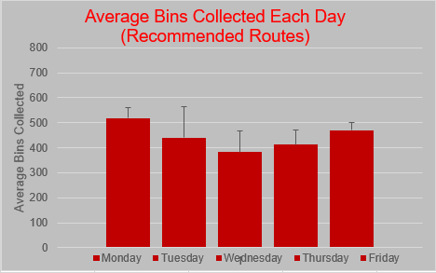
The optimized process creates a more even distribution throughout the week
Notes:
Reuben
Columns show average, bars on top show the maximum from sample
Certain frequencies have set days of collection (6 x or 3x)
Other frequencies were spread throughout smaller days to even out collection
Originally, Monday was extremely large collection day (avg - 578, max - 718) and Wednesday was extremely small (avg - 318, max - 415)
Recommended routes even out collection much more, Monday now (avg - 519, max - 559) and Wednesday now (avg - 382, max - 461)

Slide 19

Summary
Addressed Changing Industry
Optimized Fleet Size
Developed Grouping Strategy
Developed Frequency Distribution Strategy
Notes:
Johann

Slide 20
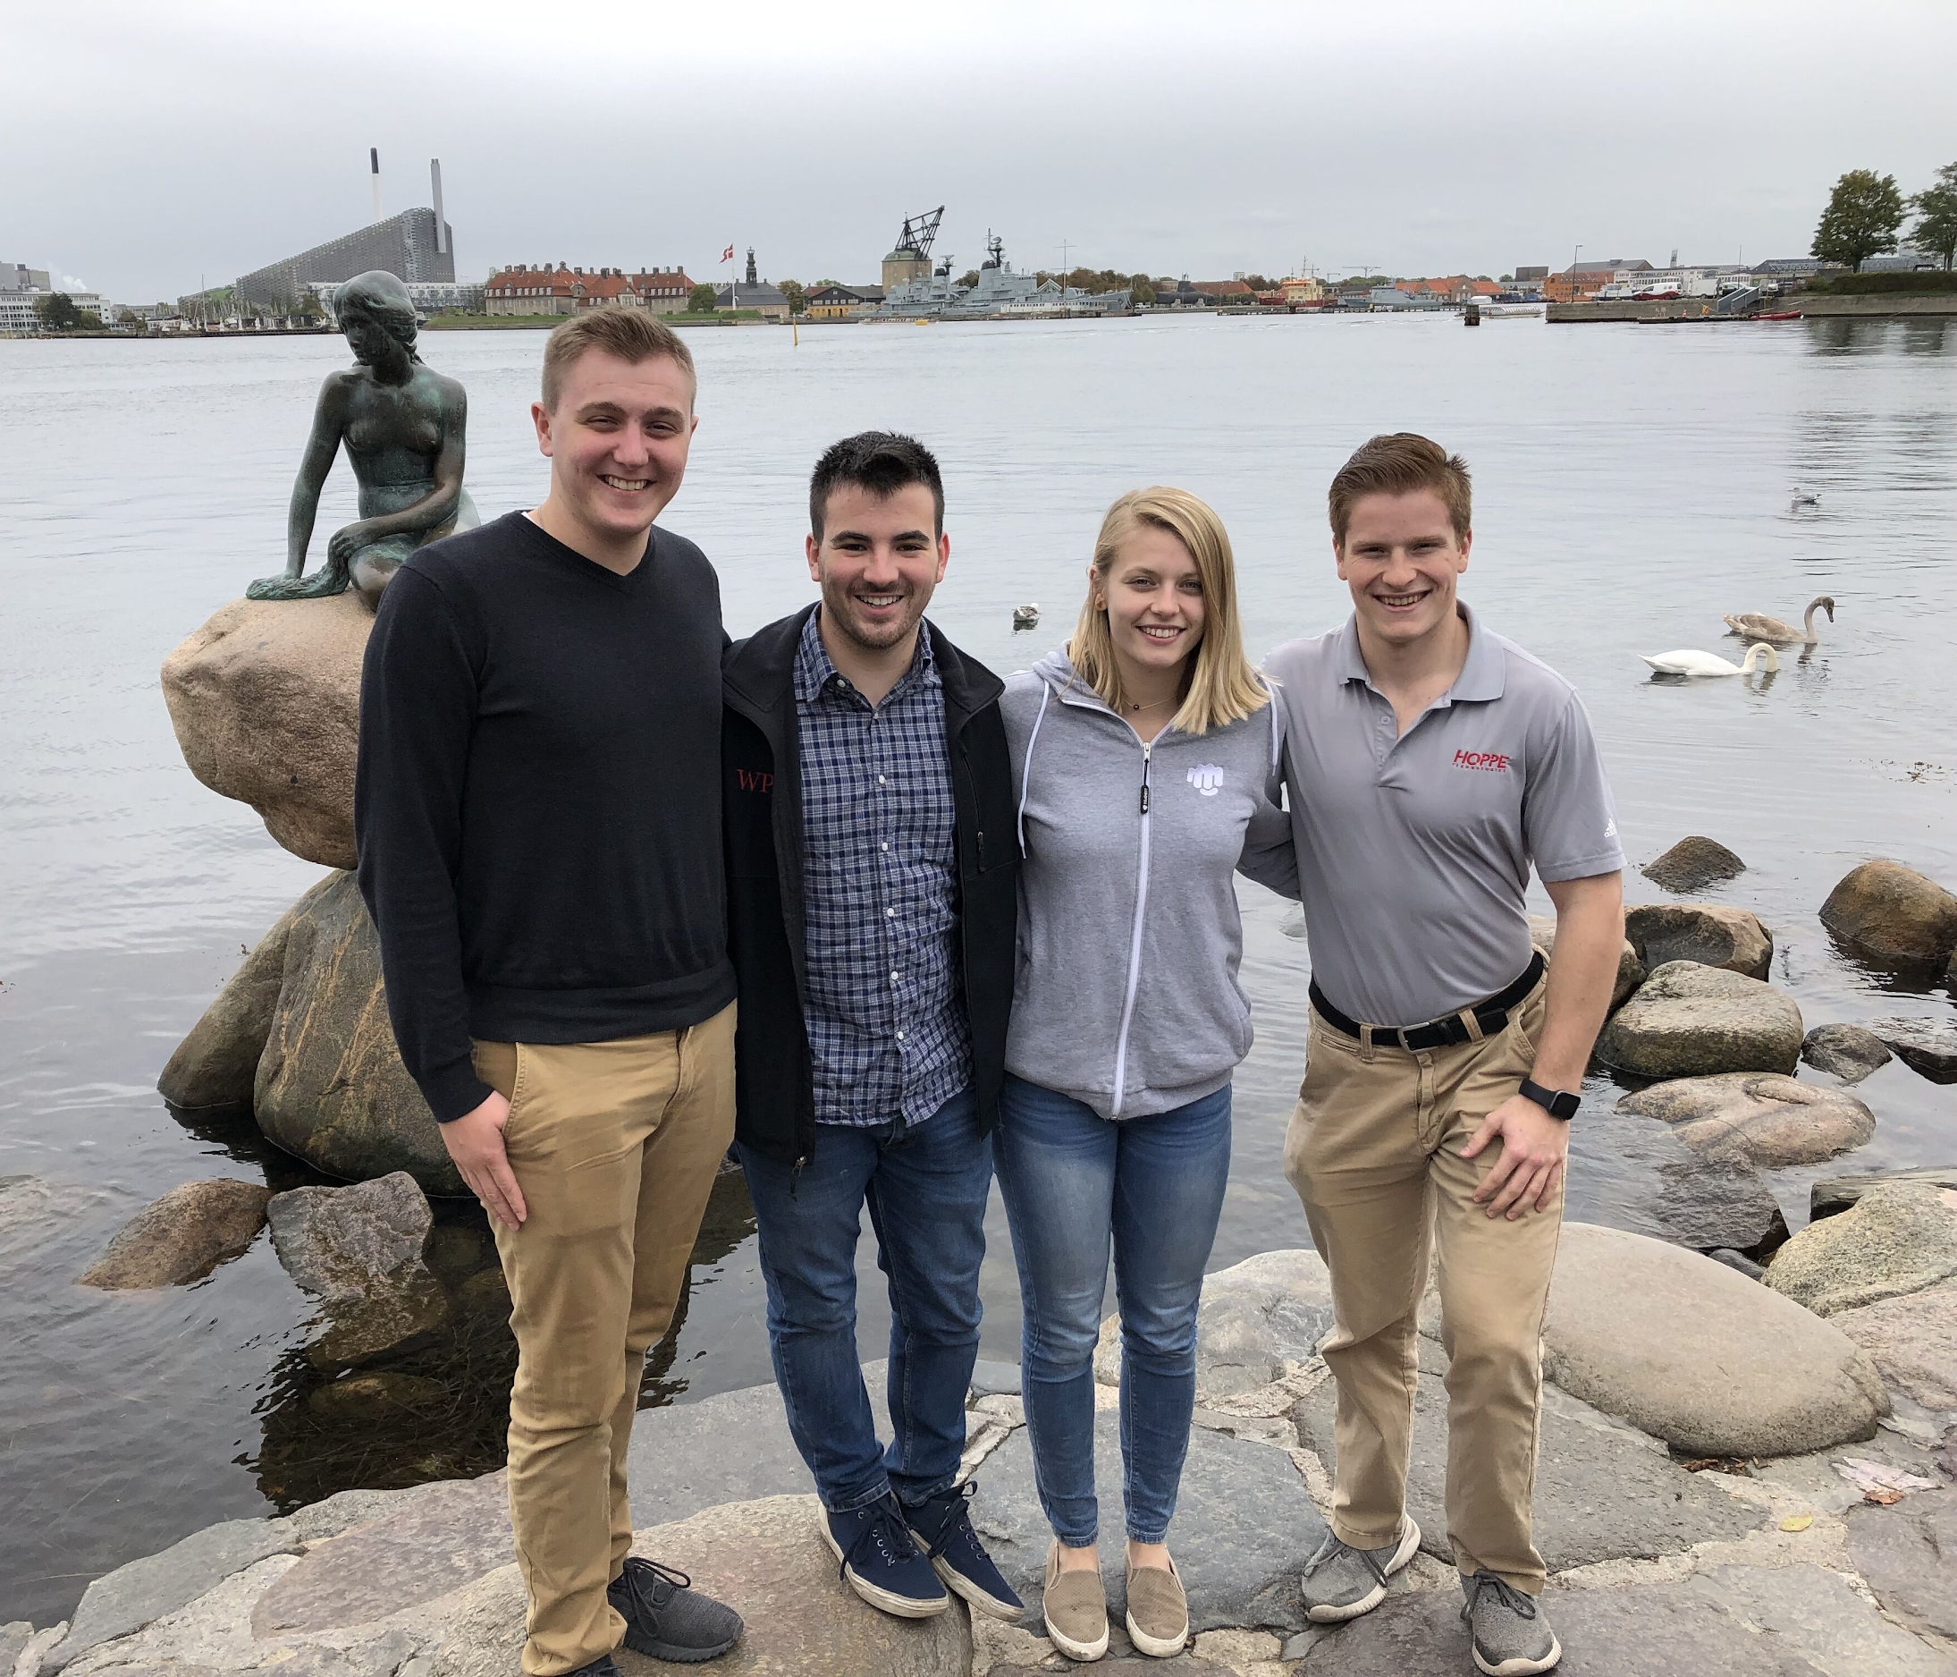
Tak!
Notes:
TAK

