Slide 1


ETHNOGRAPHIC FILM STUDY OF INDONESIAN CULTURE & CLIMATE
A SERIES OF DOCUMENTARIES BY
TAHVORN GEORGE, MOLLY O’CONNOR, JAROD ROMANKIW, MICHELLE ZHANG
Figure 1
Notes:
MOLLY
https://ceres.org.au/wp-content/uploads/2016/02/CERES_logo_2015_300_glyph_GREEN.png

Slide 2
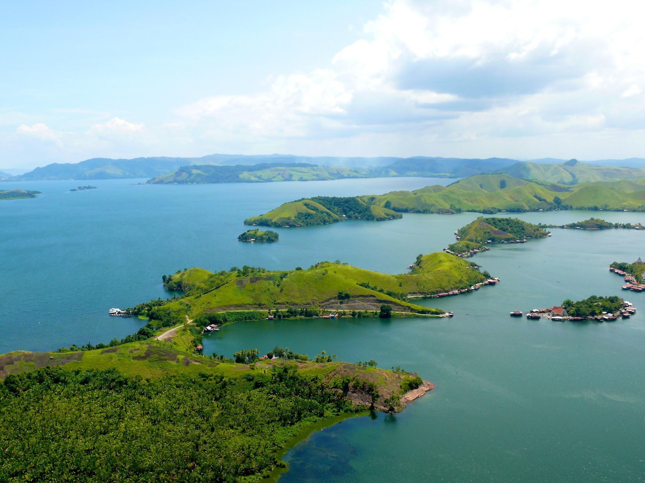
Brief Overview
CERES Introduction
Project Goal
Video Presentation
Q & A
Figure 2
Notes:
MOLLY
- the structure for today’s presentation is as follows
- research throughout the term, our mission and objectives and how we hope to achieve them in the upcoming project term

Slide 3
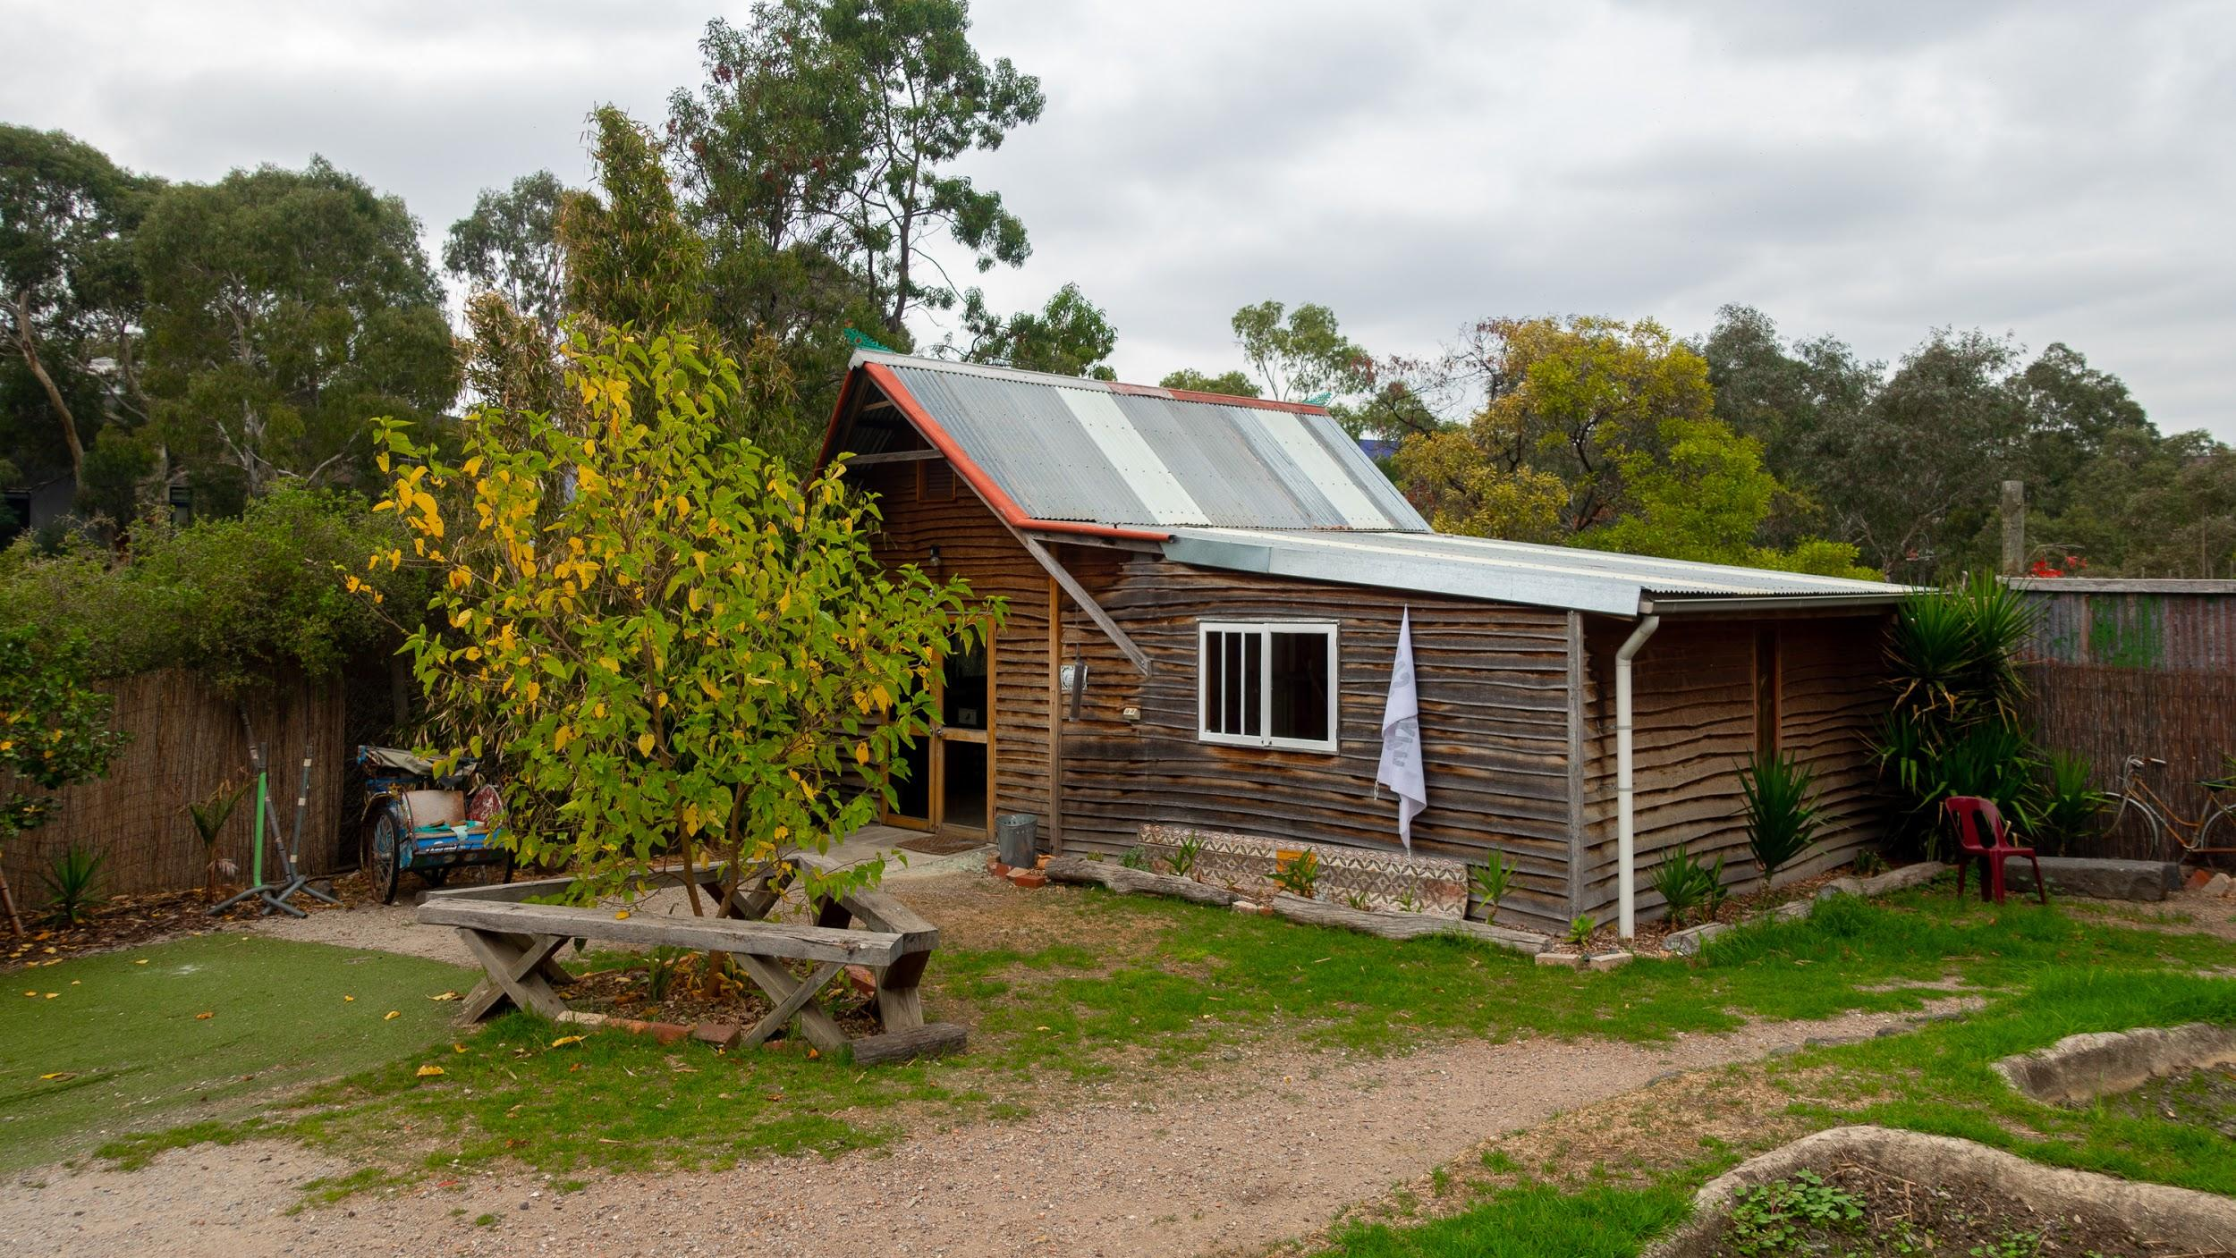
CERES Environment Park
Indonesian Village
Notes:
MOLLY
Cultural villages help educate visitors on a specific region.
Community-based learning focusing on environmental education programs.

Slide 4
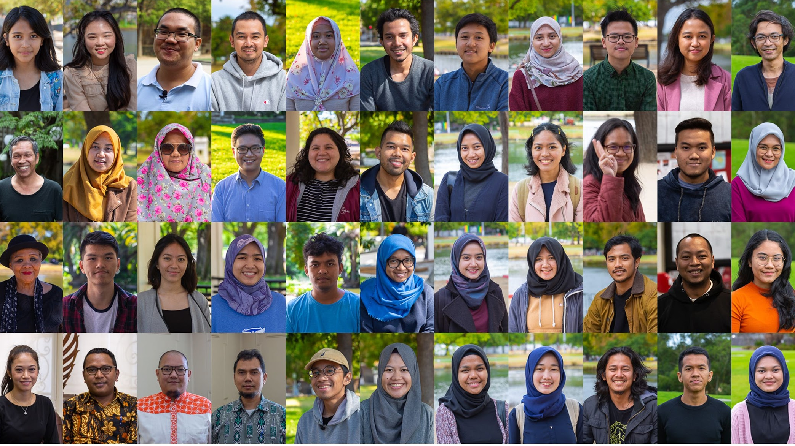
Project Goal
To enrich the learning experience at CERES with positive climate stories from Indonesians.
Notes:
JAROD

Slide 5
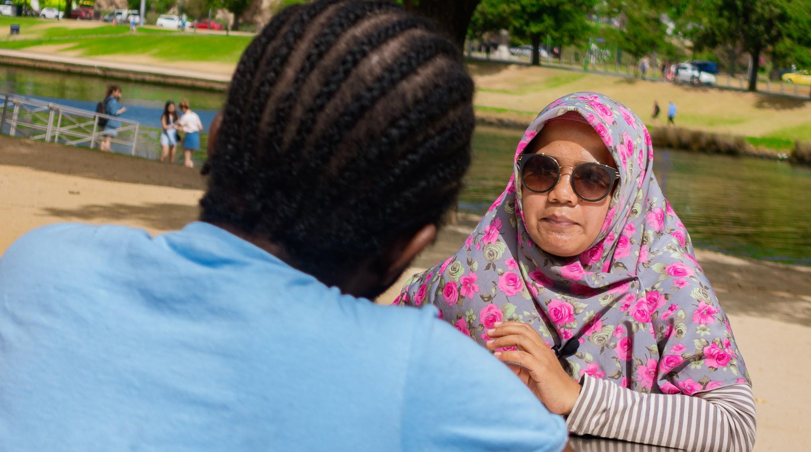
People
Place
Culture
What is an “Ethnographic Film Study”?
Notes:
JAROD
People, Place, Culture

Slide 6
Objectives
Devise an Effective Inquiry Approach
Develop Groundwork
Compile Stories
Share Stories to Global Platform
Notes:
MICHELLE
Engage with experts in ethnographic filmmaking to refine project scope, establish applicable communication skills, and devise an effective inquiry approach.
Identify candidates to interview, and develop a production schedule.
Compile stories utilizing ethnographic interviews with Indonesian nationals residing in Melbourne that document perceptions of ecological phenomena and support an ethnographic representation of climate change impact.
Produce a series of focused topic videos, infographics, and a broader documentary-style narrative to augment the educational experience at the Indonesian village and encourage sustainable environmental behaviors.

Slide 7

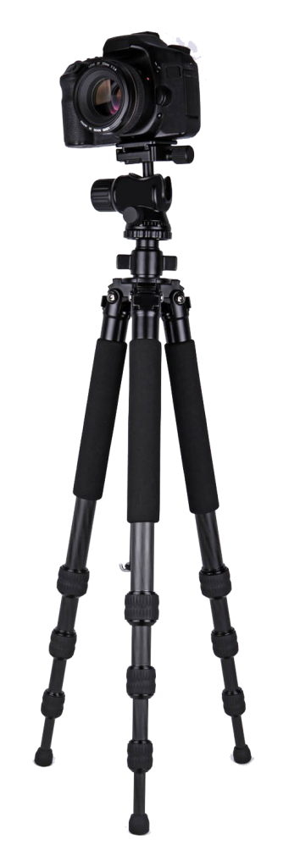

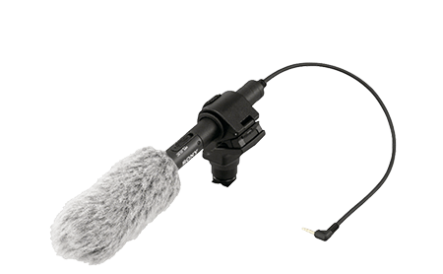
Devise an Effective Inquiry Approach
OBJECTIVE
1
University Training
Technical Skills
Interview Skills
Professionals
Experienced in Ethnographic Filmmaking
Notes:
MICHELLE
http://www.pngmart.com/files/2/Digital-SLR-Camera-PNG-HD.png
https://s3.amazonaws.com/peoplepng/wp-content/uploads/2018/06/03113720/Video-Camera-Tripod-PNG-Image-1024x1024.png
https://png.pngtree.com/element_origin_min_pic/16/09/28/2057ebbc5e91216.jpg

Slide 8
Develop Groundwork
OBJECTIVE
2
Identify participants
Establish interview schedule
Determine film locations
Notes:
MICHELLE

Slide 9
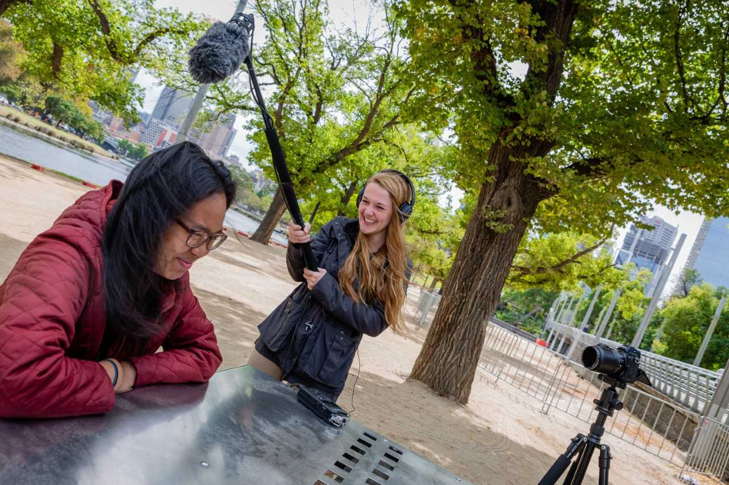
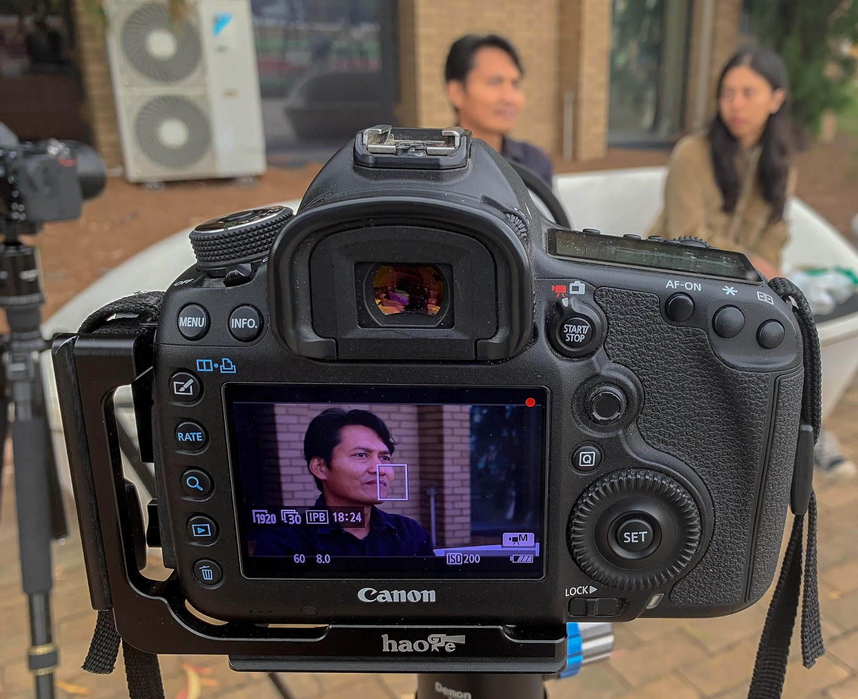
Compile Stories
OBJECTIVE
3
Notes:
TAHVORN
Deforestation, Air pollution, Flooding, General climate change, Rubbish disposal
Storytelling, capture all angles: wide medium tight tight tight
Edit adobe premiere

Slide 10
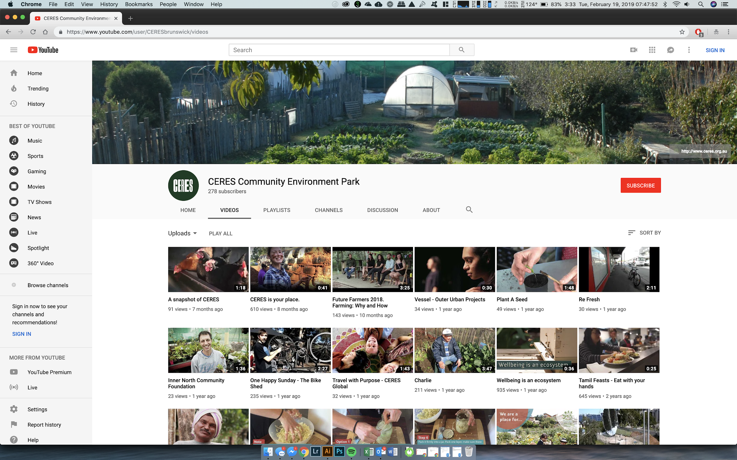
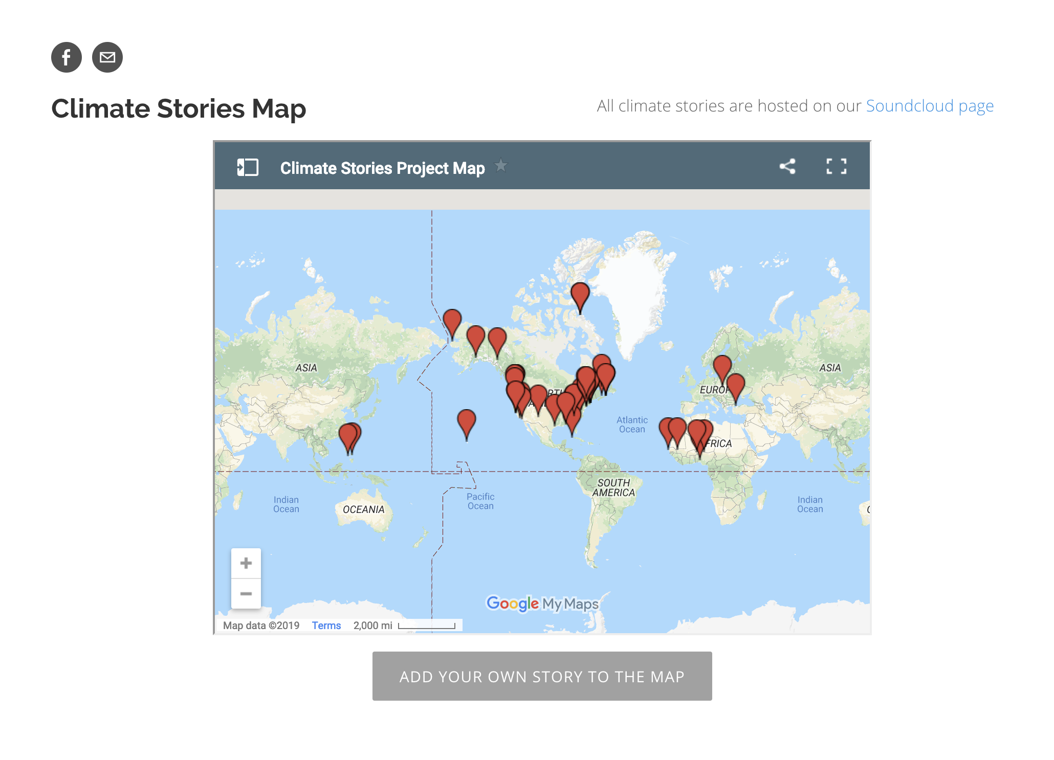

Share Stories to Global Platform
OBJECTIVE
4
Notes:
TAHVORN
After each video goes through its final export, these videos will then be made available to different platforms
Platforms include CERES’ youtube page where will compile these 4 videos into a longer format video of approximately 28 minutes
CERES’ chook app which is an interactive app that visitors can use to view these videos while touring the park
And Climatestoriesproject.org which is a forum used to share personal and community responses to climate change. WPI has partnered with this site to distribute climate stories from different projects all around the world.

Slide 11
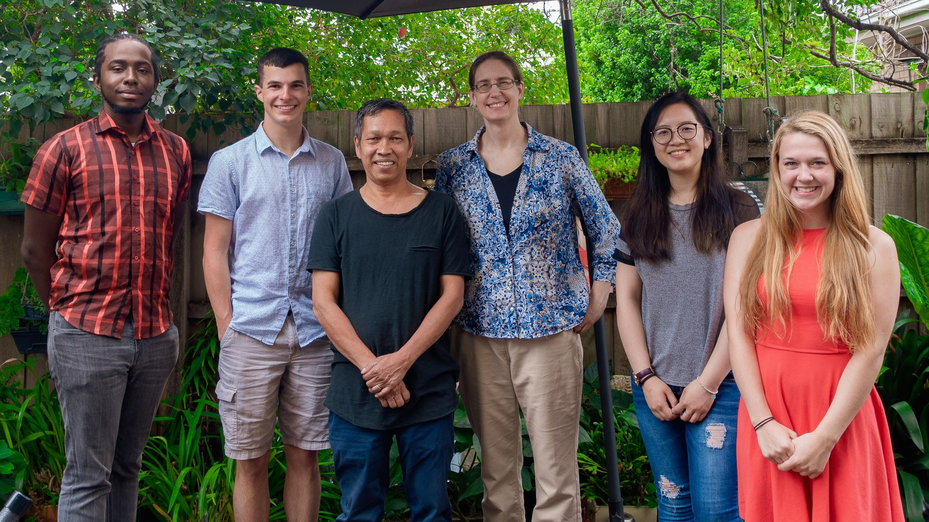
FINAL VIDEOS
Notes:
TAHVORN

Slide 12

Air Pollution
VIDEO
1
Edited By
Tahvorn George
“People need to change from themselves, and then they can inspire others to do the same”
-Brahmantyo Putra
Synopsis
In the city of Jakarta, air quality has been of major concern to the residents of Indonesia. Indonesian residents of Melbourne speak on their experiences with the traffic in Jakarta, investigate why the issue exists, and the efforts by the government and people to alleviate the traffic issue.
Notes:
JR

Slide 13

Rubbish
VIDEO
2
Edited By
Michelle Zhang
“A community who lives together,
helps each other.”
-Toto Suprapto
Synopsis
The growth of unmanaged waste has affected the quality of life of many in Indonesia. Indonesians share their experience with rubbish and how their communities are taking action to implement sustainable changes. Several non-profit organizations and local communities have developed innovative methods to encourage people to reduce waste, eliminate plastic, and clean the environment.
Notes:
JR

Slide 14

Flooding
VIDEO
3
Edited By
Molly O’Connor
“The environment is our mother; it’s where we get food, where we get cover, where we get safe.”
-Alfons Sroyer
Synopsis
Flooding is a major issue in Indonesia, particularly in the capital city of Jakarta, where flooding affects the largest population. Indonesians share the perspectives and stories regarding their experiences with flooding issues and efforts, including causes, changing flood patterns, and related challenges. This is followed by a discussion of community and government action to improve these conditions.
Notes:
JR

Slide 15
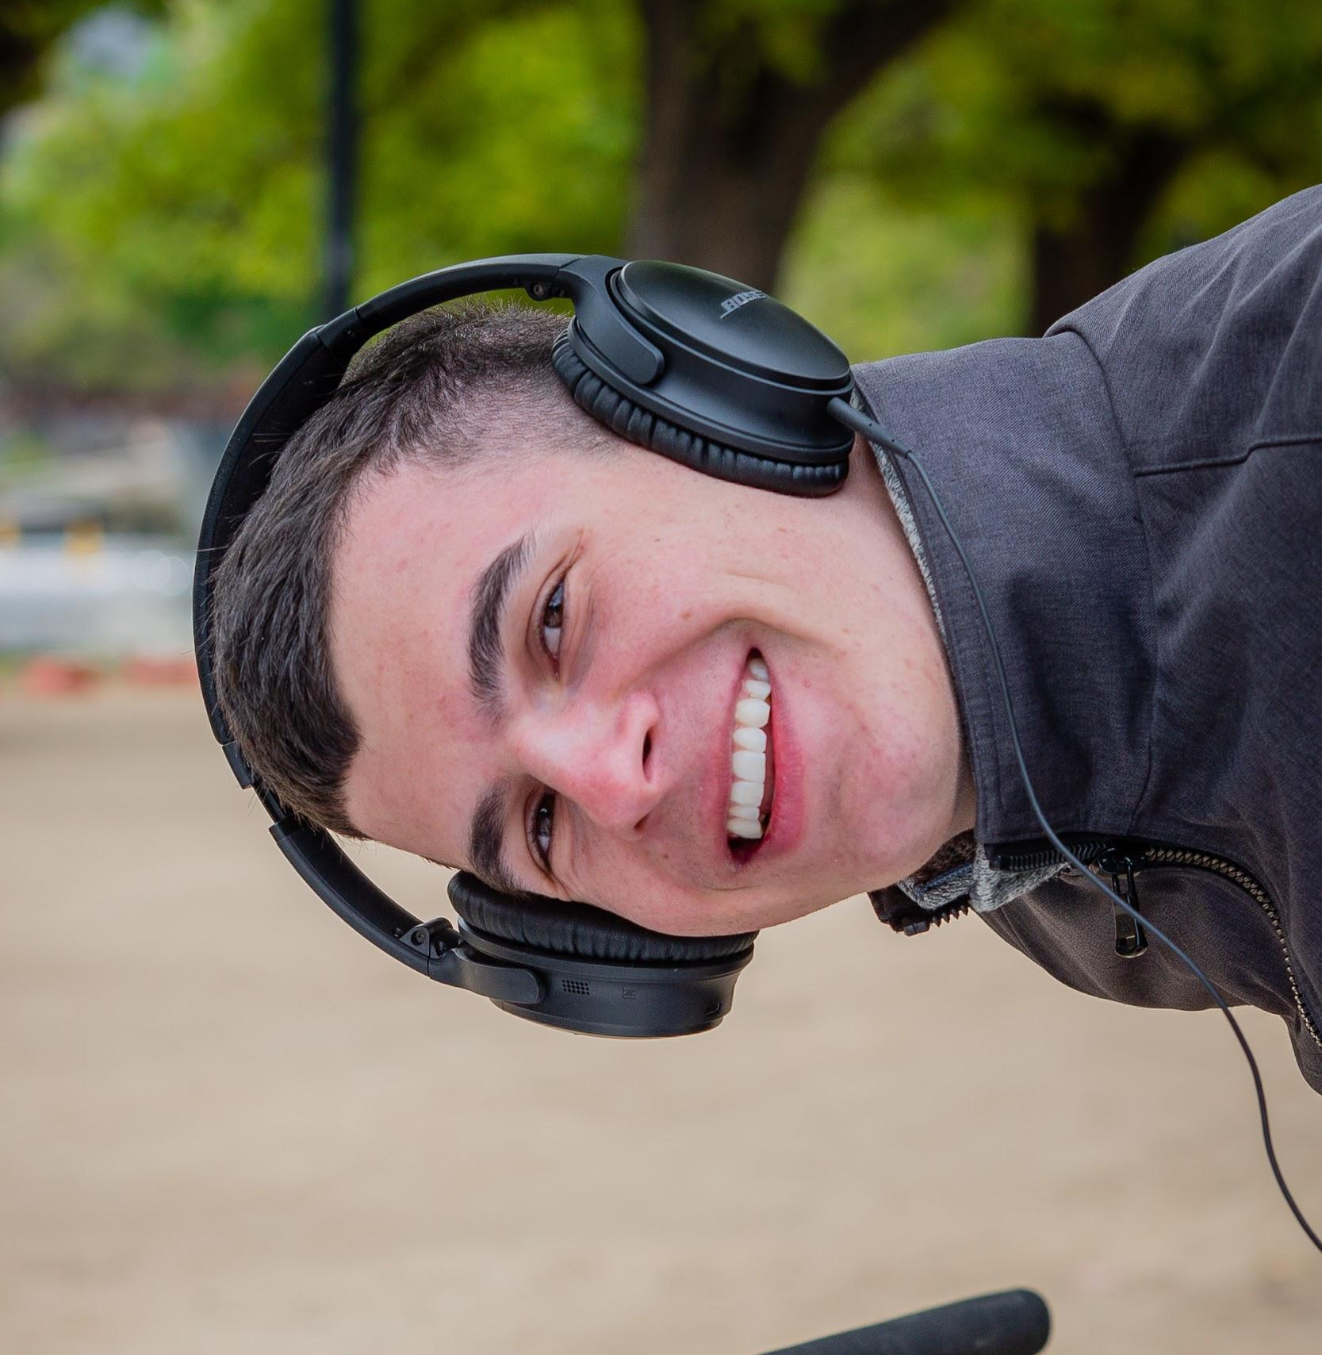
General Climate Change
VIDEO
4
Edited By
Jarod Romankiw
“You think about your environment, and you think not just for your own benefit but also for others...”
-Sri Dean
Synopsis
This documentary studies the general climate changes happening in Indonesia, and relief efforts to help combat with those issues. Topics mentioned in this video include general awareness of climate change by Indonesians, the responsibility that people need to act to reduce climate change, sustainability efforts, and how the environment and spirit are one.
Notes:
JR

Slide 16
Link to Open Videos: https://www.youtube.com/playlist?list=PLKGhrroLIuwDlS5XrC-BxepHGZCHL9KtT

Slide 17
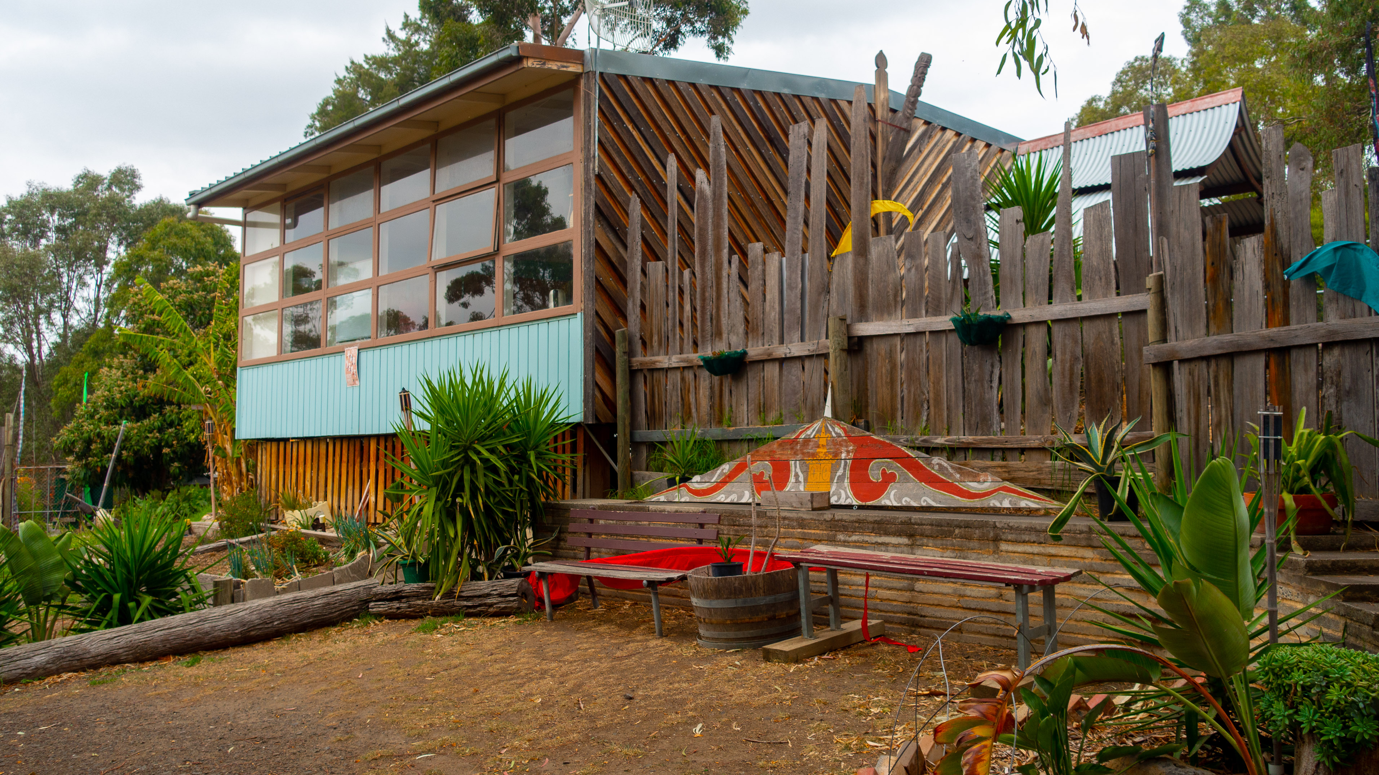
Future Plans & Takeaways
Implementation
Physical Displays
Online Presence
Indonesian Community
Strong Culture
Care for Environment
Notes:
MOLLY
Cultural villages help educate visitors on a specific region.
Community-based learning focusing on environmental education programs.

Slide 18
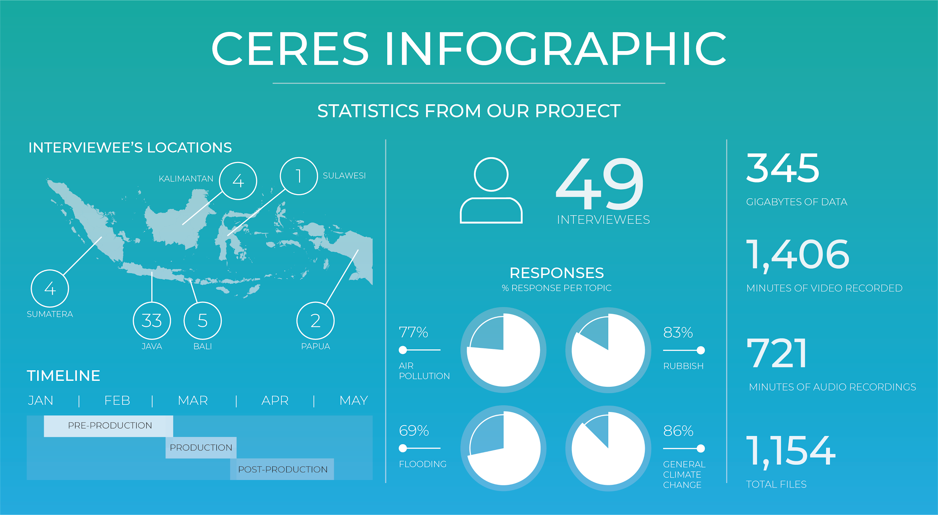
Notes:
JAROD

Slide 19

Thank you!
Q&A
Figure 3
Notes:
JAROD

Slide 20
References
01
https://besthqwallpapers.com/Uploads/17-3-2018/44527/bali-4k-sunset-volcano-rice-fields.jpg
02
https://wriorg.s3.amazonaws.com/s3fs-public/uploads/6240292838_e520003898_o.jpg
03
https://lonelyplanetwp.imgix.net/2017/07/GettyImages-185404913_super-b6174f8fe89a.jpg?fit=min&q=40&sharp=10&vib=20&w=1470

