Slide 1




WPI and Community Learning
Alvaro Soares | Julia Zheng | Ken Stein | Michele Perry | Vincent Milano | David Keck
City of Boston
MIS
Notes:
Good Morning everyone, thanks for being here…
USE FIRST AND LAST NAMES

Slide 2
The Big Picture
Notes:
Our project deals with metropolitan school system and the various organizations that also contribute to the development of the youth. What these youth organizations attempt to do is provide the students with an after-school experience.

Slide 3
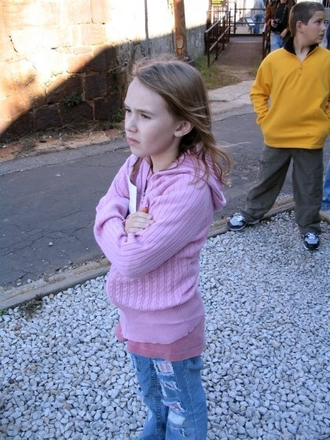
Interesting Facts
Our background research shows that:
Students with no available Out-of-School programs miss valuable chances for growth and development
(McLaughlin, 2000)
More than half of the country’s teenagers wish there were more community-based programs available
(Penn, Schoen & Berland Associates, 2001)
As many as 15 million children with no after-school activities to attend nationwide
(Miller, 1999)
Notes:
We have seen that these programs cause a significant I mpact on youth. In our research we came across a few interesting facts that really emphasize this statement. Students with no after-school programs miss important chances for development. More than half of the country’s teenagers wish there were more community-based programs available. 15 million children leave school with no after-school activities to attend.
This leads us to the current situation in Boston.

Slide 4
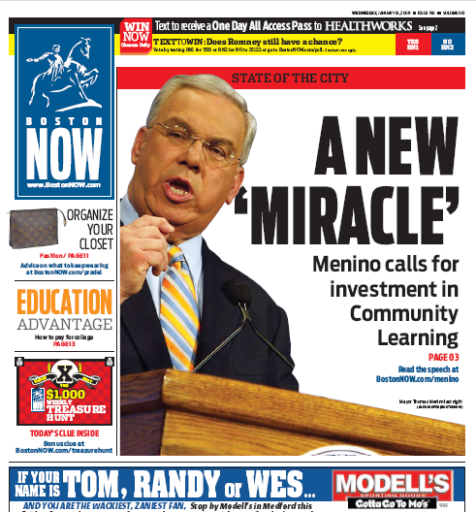
The Community Learning Initiative
“A new miracle…” – Mayor Thomas Menino
A new push for a well-rounded education
More after-school participation
Institutionalize Boston’s main youth resources
Notes:
At the beginning of this year the mayor declared his state of the city address. This speech focused around a “new miracle” as seen in the image above which was from the cover of a Boston Paper. The “miracle” the mayor talks of developed the community learning initiative which our project is focused. The goals of this initiative include; creating a well-rounded education; improving after-school participation; and institutionalizing Boston's main youth resources. According to Menino, this means students are not only enrolled in school, but also a library and the after-school centers.

Slide 5

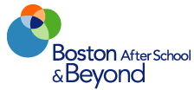
The Youth Organizations
BOSTON PUBLIC SCHOOLS
BOSTON AFTER SCHOOL AND BEYOND
BOSTON PUBLIC LIBRARIES
BOSTON PUBLIC HEALTH COMMISSION
BOSTON YOUTH LINE
BOSTON CENTER FOR YOUTH AND FAMILIES
Notes:
This is a sample of the organizations that contribute to the youth of the City.

Slide 6
Out-of-School-Time Domains
Student
Character
Education
Arts
Sports and Recreation
An after school program provides students with activities that will enhance the student’s proficiency in various domains
Most important domains outlined in ACES framework adopted by BCYF
Notes:
The organizations involved in the after school system focus on developing the youth in 4 key domains. This domain framework is referred to as ACES standing for Arts, Character, Education and sports.

Slide 7
WPI Involvement

Slide 8

Programs: Goals
Make youth information accessible
Connect current databases
Gather data from other programs
Utilize data by preventing duplication

Slide 9
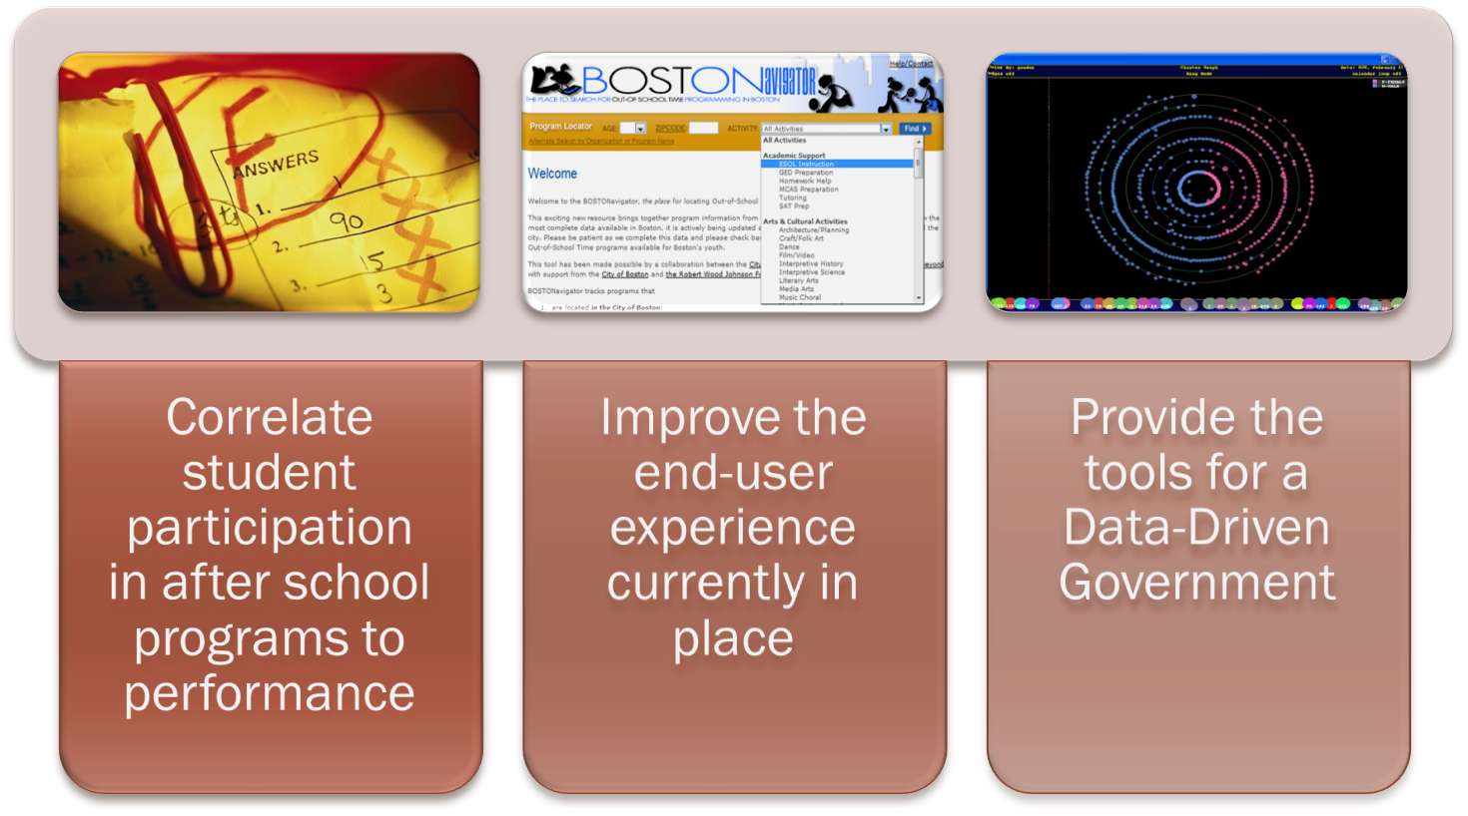
Youth: Goals
Correlate student participation in after school programs to performance
Improve the end-user experience currently in place
Provide the tools for a Data-Driven Government

Slide 10
Methodology
Analyze
Study
Map
Compile
Recommend
Identify
Analyzed:
  Current after-school information systems
  Investigated organization’s expectations
  current system in place used to measure program efficiency
Developed:
  A potential solution for a data model and devised a recommendation for the most feasible solution for a new system
  A recommendation system for different use cases
Compiled a list of existing systems that could be implemented and determined which software systems fulfill the requirements
Identified potential links among the systems and determined the efficiency of the current systems
Studied the possibility of finding a correlation between after-school involvement and academic performance
Mapped the geographical involvement of students in after-school programs

Slide 11

Discussing Difficulties
Multi-level data privacy
System compatibility
Monetary investment
Social/behavioral correlations difficult to be considered valid, because of too many external factors
Notes:
Problems that may arise:
Data privacy – some systems have confidential information about youth
system compatibility – since these systems were created separately, some may include newer technologies that may not mesh well
monetary investment – Organizations run a tight budget

Slide 12
Findings
Notes:
[Enter Michele] Now that we’ve looked at the organizations’ perspective of the after-school scenario, our group will focus on the social behavior and implications of these programs in comparison to the students.

Slide 13
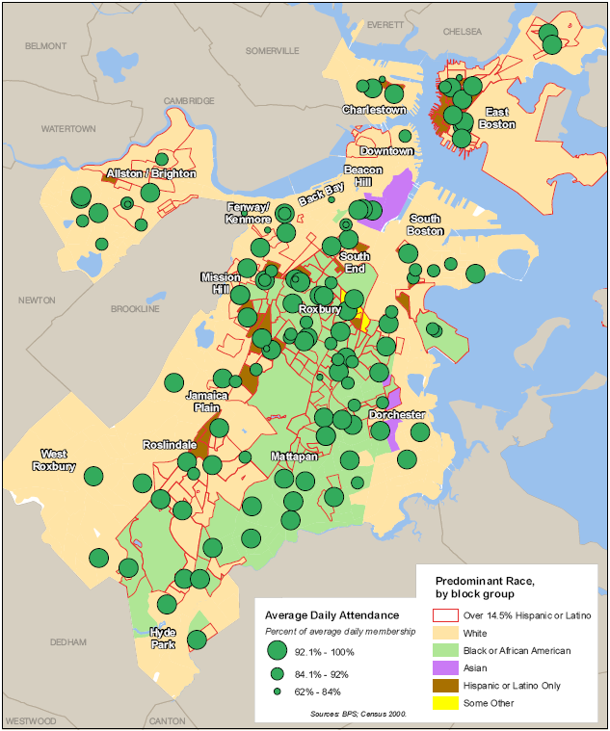
GIS Maps
GIS maps inconclusive due to lack of programmatic data that is not being collected or is incomplete

Slide 14
Findings
Students who participate in after-school programs are
  less likely to drop out
  more likely to have higher academic achievement
(Theory Into Practice, 2004; ERIC Digest, 2001 )
Delinquency in students can be decreased when after-school programs are regularly attended.
(Prevention Science, 2004; Theory and Practice, 2004; ERIC Digest, 2001)

Slide 15
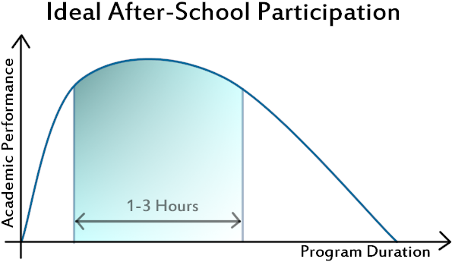
Findings
Programs that encourage achievement and build self esteem are more likely to increase grades than ones that give extended homework time
(ERIC Digest, 2001; Prevention Science, 2004; Theory and Practice 2004)
Activities that take up too much of the students’ time can detract from homework and cause a decrease in grades
(Theory Into Practice, 2004; ERIC Digest, 2001)
Notes:
MULTIPLE REGRESSION ANALYSIS!

Slide 16


Findings
Each organization has different use for the data collected
Some databases are not being updated
Performance metrics poorly recorded

Slide 17
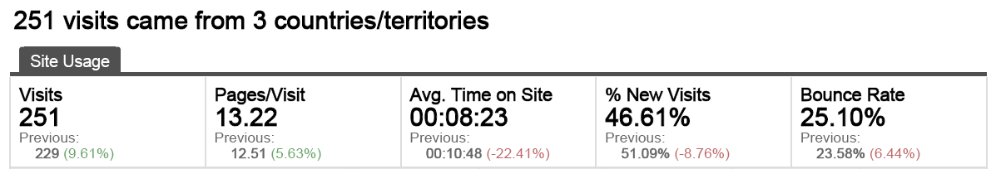
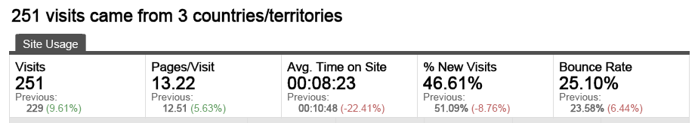
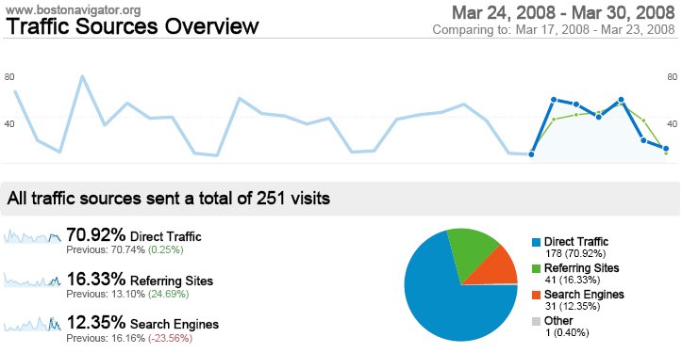
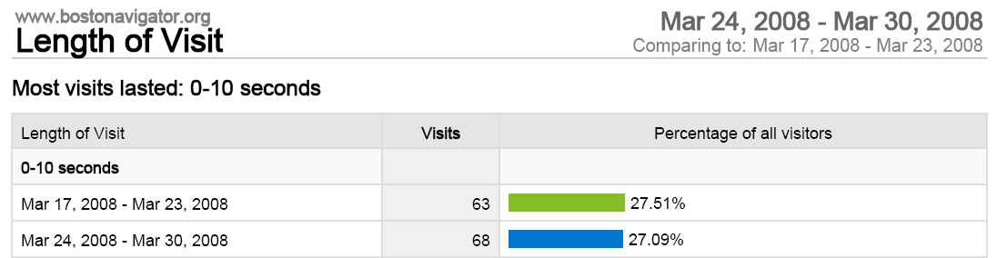
Findings
Website reports that average user spends 6-9 seconds on the website
Updating system is complicated and organizations are not updating the system often enough, if at all

Slide 18
Mapping the Future

Slide 19

Analysis: The Ideal Solution
Our system needs to:
  Be accessible to all organizations
  Track performance metrics
  Be flexible and easily customizable
  Be user friendly
  Cost-effective

Slide 20
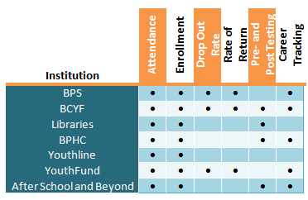
Analysis: Performance Metrics
The system needs to accommodate different key metrics for different organizations

Slide 21

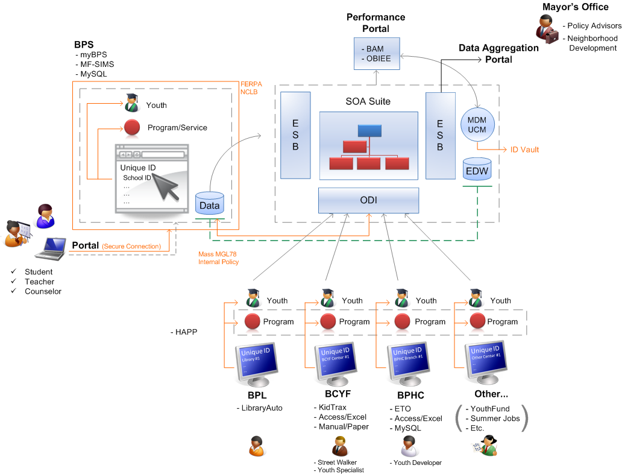
A Vision of the Future

Slide 22
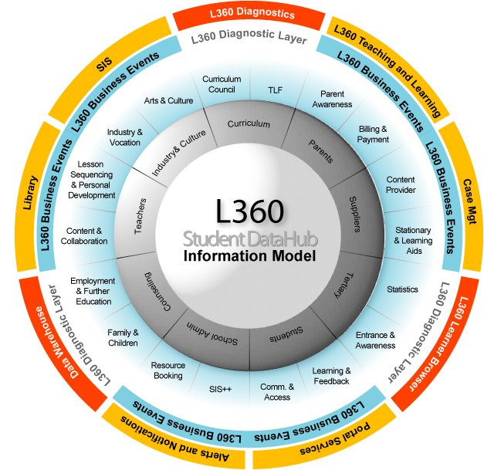
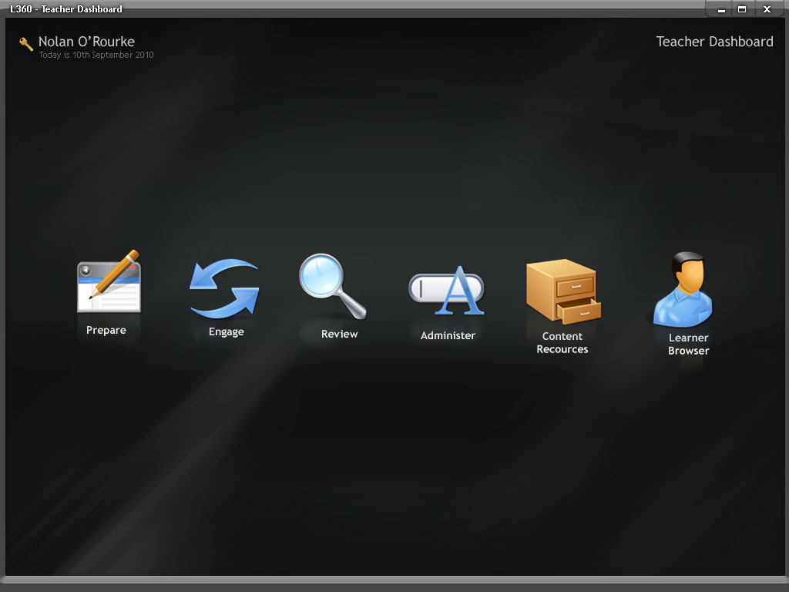
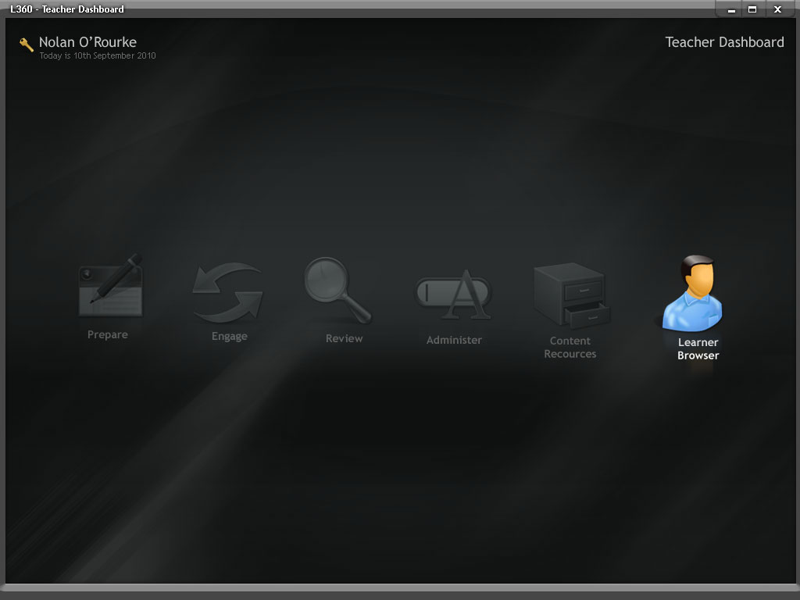
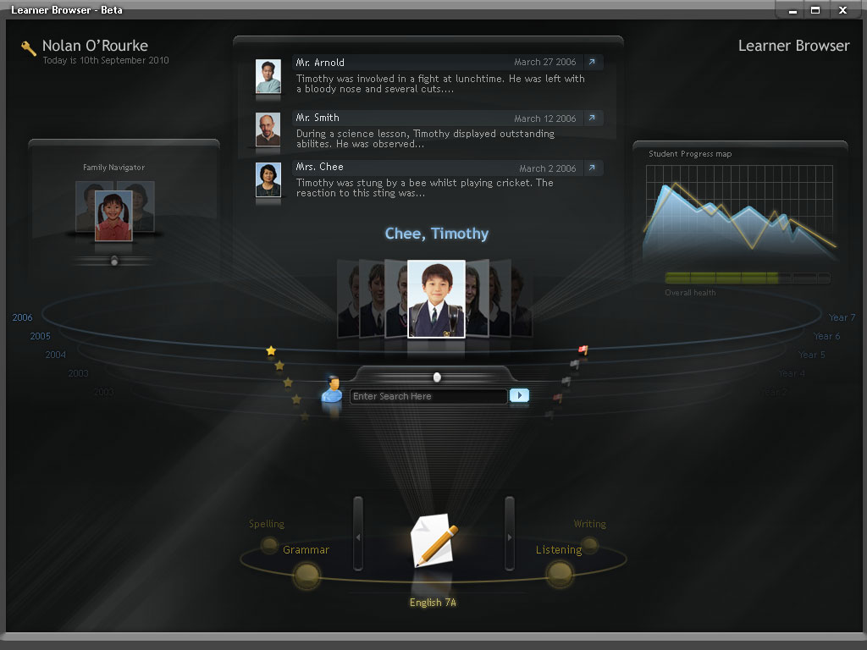
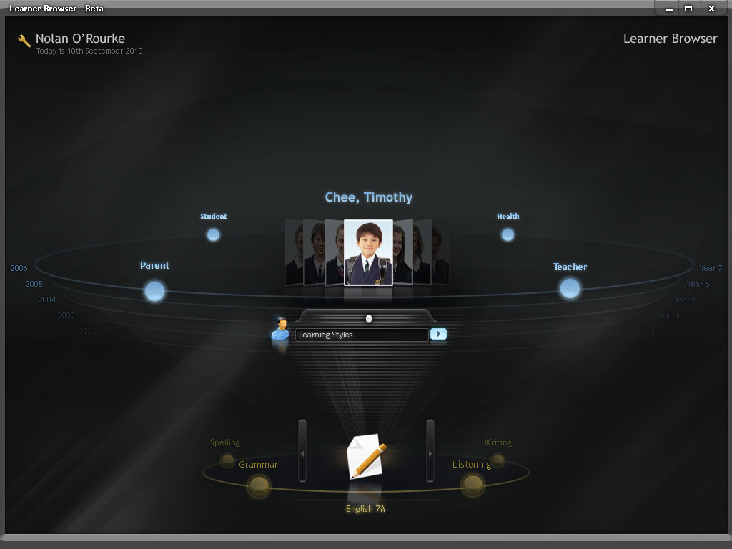
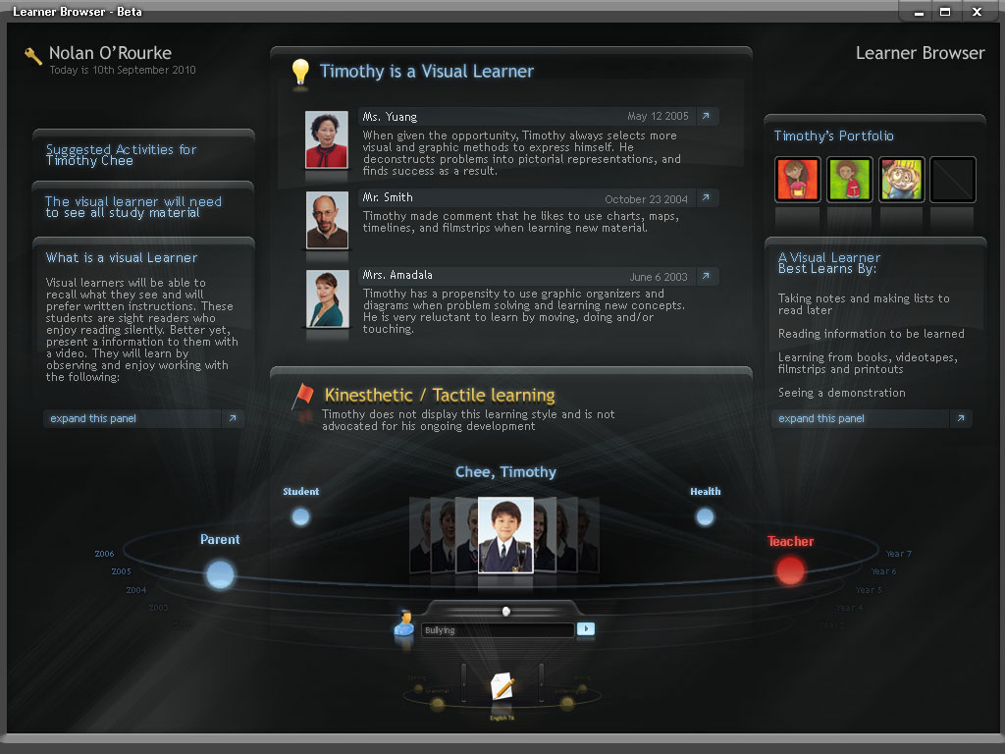
The Learning Platform

Slide 23

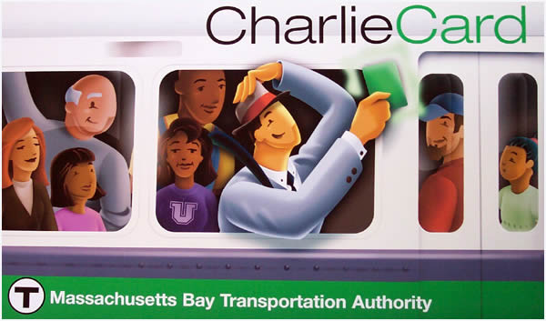
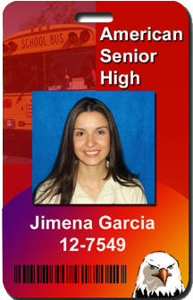
Findings: One-Card implementation
In the future the after-school card systems could be integrated with the MBTA, Community Change, and BPS.
BPS is piloting a program with MBTA in the near future
Boston Main Streets has implemented a card that gives cardholders discounts in local businesses.
Community Change is eager to co-brand with other organizations in Boston.

Slide 24
Comparing Alternatives

Slide 25
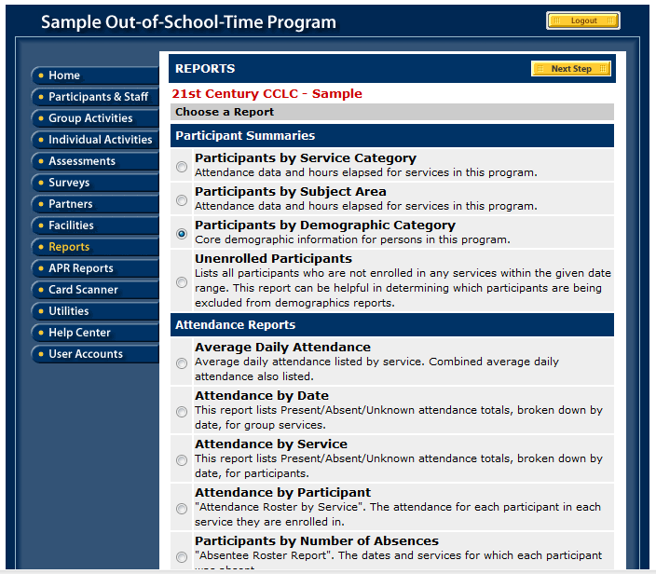

Findings: Possible Alternatives
CitySpan
  Successfully in use by several other cities which BPS would like to emulate, such as:
    Providence
    Chicago

Slide 26
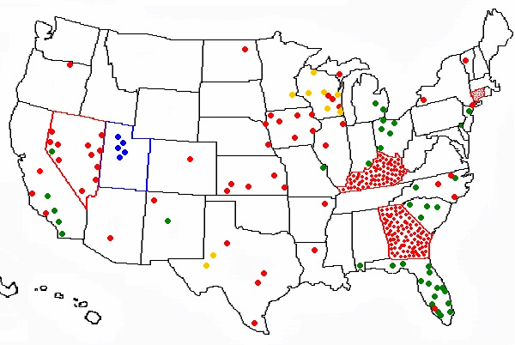
Findings: Possible Alternatives
Cayen
  Used in 10 PSS Schools in Boston
  Finger scanning software
  Used in:
    South Carolina
    Kentucky
  Integrate qualitative and quantitative metrics
  Customizable within city’s organizations
  Data warehousing

Slide 27
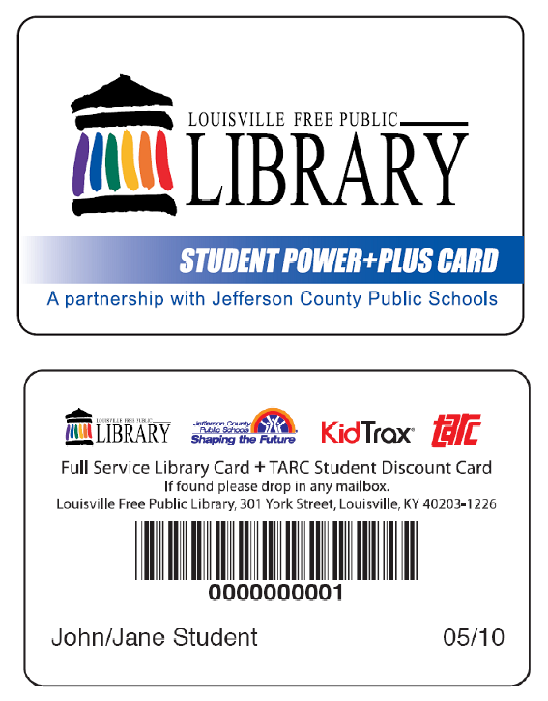

Findings: Possible Alternatives
KidTrax
  In use by 16 high schools and 22 organizations in the City of Boston already
  Has an integrated card system
  Flexible system, capable of generating reports

Slide 28
Comparing systems

Slide 29
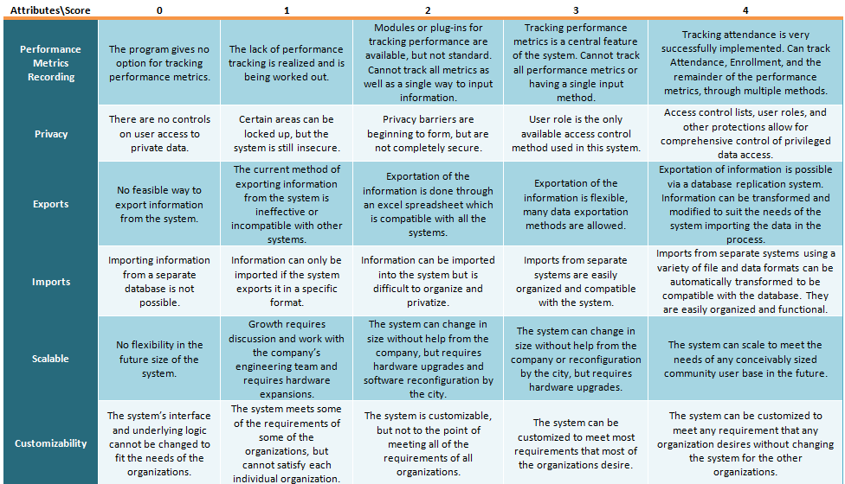
Analysis: Rubric Sample
Notes:
We created a rubric with a scoring system for each program, in a scale of 0 to 4. 0 is when a system does meet any requirements within that attribute. A 4 is when all expectations are met. This is an example.

Slide 30
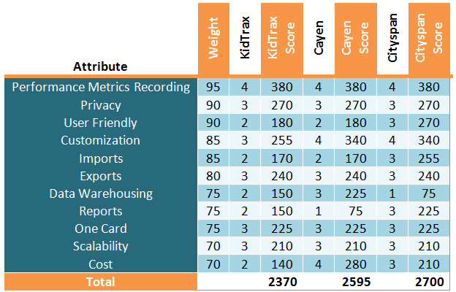
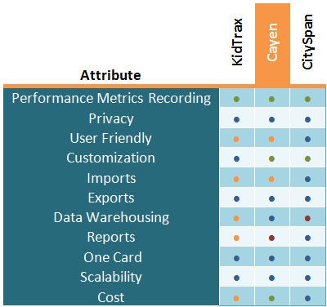
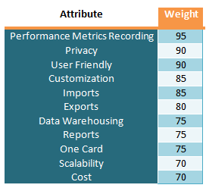
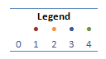
Analysis: Comparing Programs
We weighted and compared each alternative to rank them according to their attributes.
Notes:
We then assigned the scores to each program, as the table on the left shows. And multiplied those scores by an assigned weight to each attribute.
The scores are shown below.
As we can see, the programs are very close in scores, which also led us to rate each system qualitatively.
Therefore we tested each system from the user’s perspective.

Slide 31
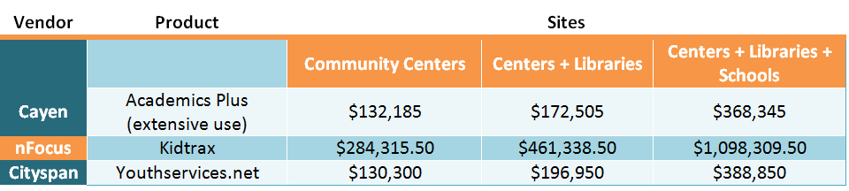
Cost Comparison
We requested a high-level basic quote from nFocus, Cityspan, and Cayen.
The following are 3 year cost estimates
Notes:
Another step was to ask each of the three after-school management software companies to give us a basic quote. These quotes are not very accurate, because they were given to us only two days after we requested them. However, they give us an approximate measure of how expensive each system is.
Cayen gave us their licensing prices by the three software packages they offer.
All of the prices listed are for a three year period.

Slide 32
Choosing A Solution for Boston

Slide 33

Recommendation: Cityspan
We feel that Cityspan’s Youthservices.net is the most feasible information system for Boston’s Community Learning Initiative
Key attributes
  Quickest learning curve
  Comparatively Inexpensive
  Thorough reports
  Fastest system

Slide 34

Recommendation: Cityspan
The following issues need to be addressed:
Period of installation
Security and privacy
Data storage
Compatibility with organizations that already use a different system

Slide 35
Cataloguing Programs

Slide 36
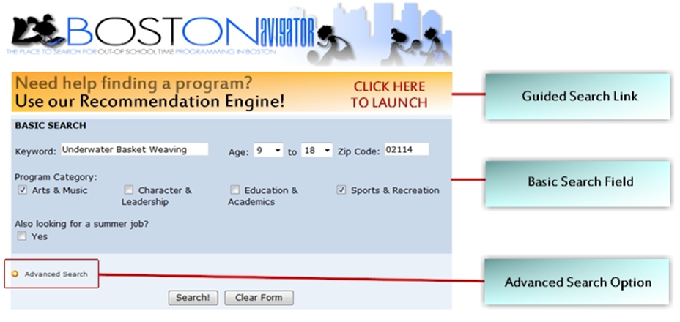
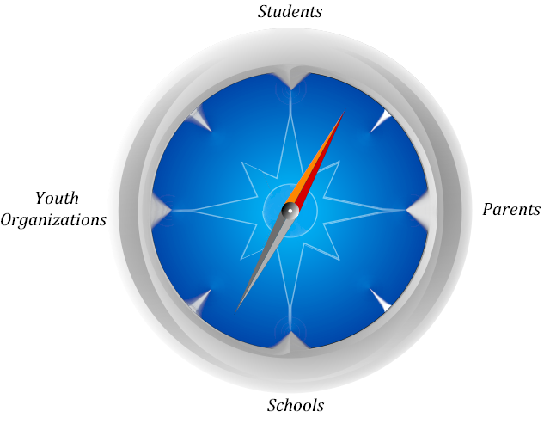
Recommendation 2: Navigator Structure
After gathering data, we have developed several use cases
We developed a recommendation that is tailored to each use case
www.BOSTONavigator.com

Slide 37

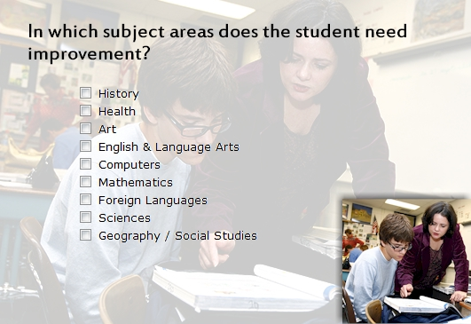

Recommendation 3: Search CRITERIA
Sports
Soccer
Basketball
Education
Reading
Math
Volleyball
Football
Test Scores
Location
Neighborhood
T-Stops
Leadership
Forums
Conferences
Etc...

Slide 38
Recommendation 4:
Introducing a Community Learning Role
Policy Advisor
Mayor
Community Learning Administrator
Chief Information Officer
Boston After-School and Beyond Representative
Boston Centers for Youth and Families Representative
Boston Public Schools Representative
Boston Public Schools Athletic Director
Boston Public Libraries Representative
Boston Youthline Representative
Boston Youth Services Network Representative
Notes:
Mention Darrell and Devaney

Slide 39
Project Impact

Slide 40
Summary
A unified back-end system will allow for Boston Youthline to function to its full potential.
Government will shift its policy making strategy from process-driven to data-driven.
WPI’s involvement has created awareness and visibility into Community Learning
The front-end user and organizations will have direct interaction by improving BOSTONavigator.
Trends and correlations will be more easily made than ever, with performance tracks being measured immediately and constantly.

Slide 41

Solution: A Seamless interaction
BOSTON AFTER SCHOOL AND BEYOND
BOSTON PUBLIC SCHOOLS
BOSTON PUBLIC LIBRARIES
BOSTON PUBLIC HEALTH COMMISSION
BOSTON CENTER FOR YOUTH AND FAMILIES
BOSTON YOUTHLINE
Notes:
Conceptually, this is what we desire – a centralized information systems

Slide 42
Acknowledgements
We would like to express our gratitude towards the following collaborators and their respective organizations
    Nigel Jacob – Senior Advisor for Emerging Technologies, City of Boston
    Chris Breining – Insight Program Director, Oracle Corporation
Boston MIS Department
Bill Oates
Boston Youthline
Patty McMahon
Boston Public Libraries
Ruth Kowal
Koren Stembridge
Scot Colford
John Dorsey
Ken Peterson
BCYF
Amy Reid
Daphne Griffin
Boston’s GIS Group
Claire Lane
Jim Alberque
Carolyn Bennet
PASA (Providence After-school Alliance)
Elizabeth Devaney
Boston After School and Beyond
Vickie Stringfellow
Patricia McGuiness
Oracle Corporation
Paul Laurent
Boston Public Health Commission
Michelle Urbano
Jeanne Cannata
Boston Youth Services Network
Heidi Hall
BPS
Shamil Mohammed
Kenneth Still
Wallace Johnson
Alice Santiago
Kim Rice

Slide 43
Questions?

