Slide 1

ANF Virtual Visibility
This document was created by Alison Collard de Beaufort, Emily Minch, Nathan Hyde, and Speros Perakis as a record-keeping tool for the virtual visibility outcomes of their Angels-Net Foundation (ANF) project team, during the B’20 Cape Town Project Center. This is to ensure their project’s work is saved, in case of any upcoming changes or updates to ANF’s virtual presence (such as a website domain change, website redesign, etc...)
It is part of the “Enhancing Angels-Net Foundation’s STEAM Program and Visibility” Interactive Qualifying Project submitted to the faculty of Worcester Polytechnic Institute in partial fulfillment of the requirements for the Degree of Bachelor of Science.
To view the full project: https://wp.wpi.edu/southafrica/projects/2020-projects/anf/

Slide 2
Website (Wix)

Slide 3

Home page

Slide 4
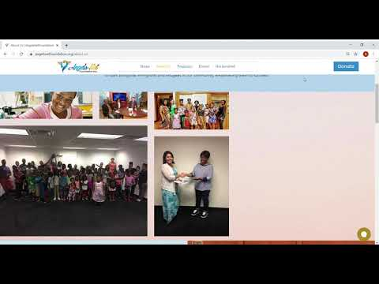
About Us

Slide 5
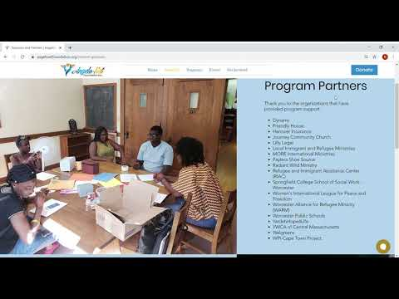
Sponsors and Partners

Slide 6
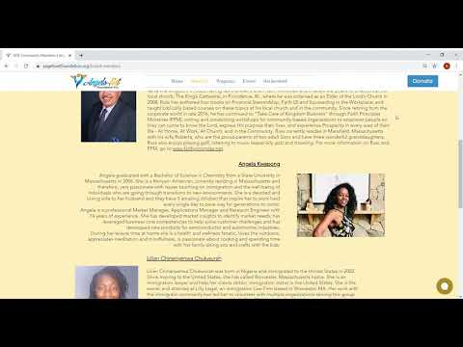
ANF Community Members

Slide 7
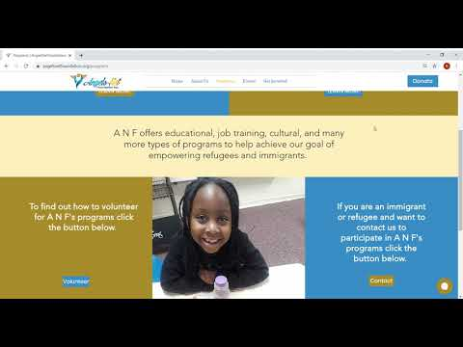
Programs

Slide 8
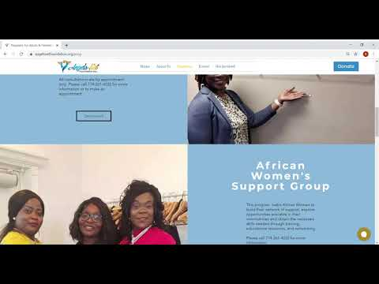
Programs for Adults & Families

Slide 9
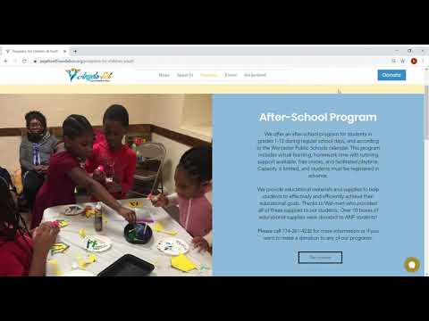
Programs for Children & Youth

Slide 10
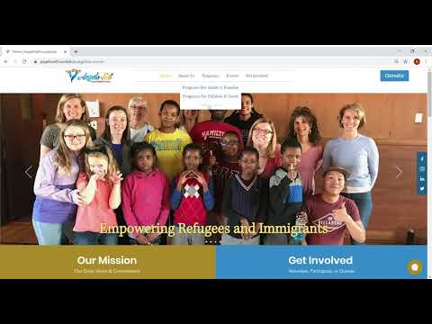
Kids Corner

Slide 11
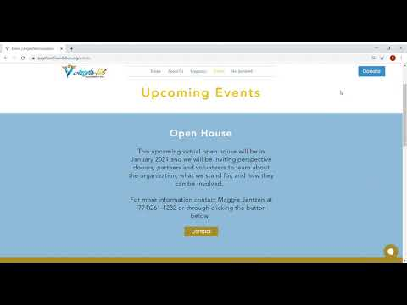
Events

Slide 12
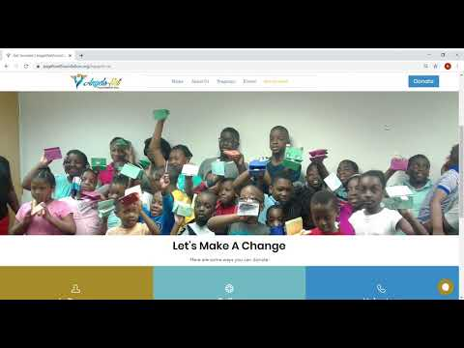
Get Involved

Slide 13
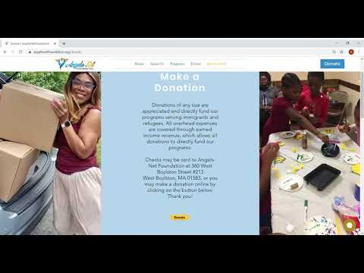
Volunteer, Donate, and Contact

Slide 14
Social Media Pages

Slide 15
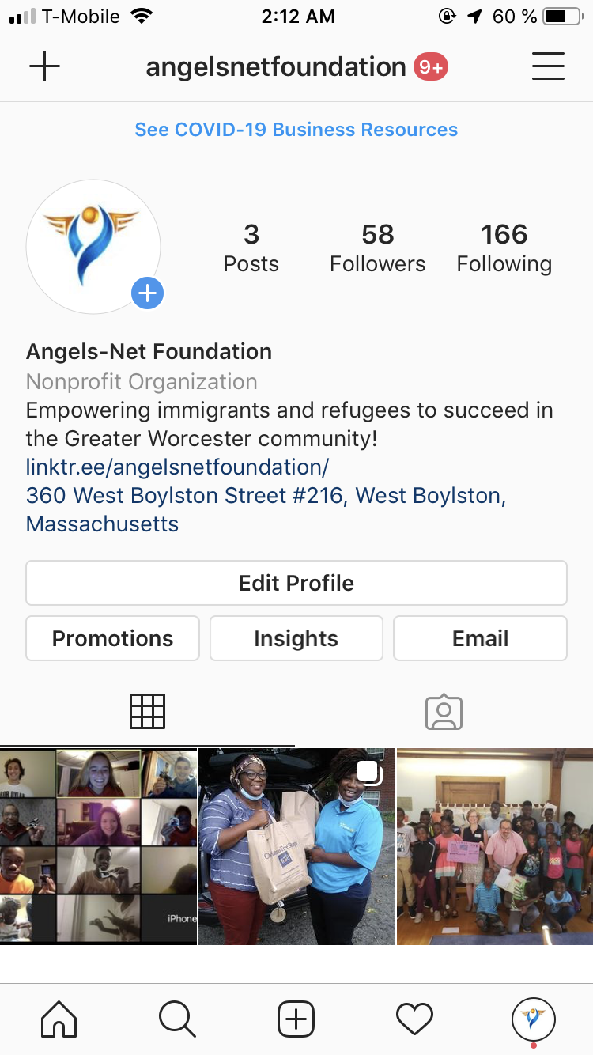
Instagram

Slide 16
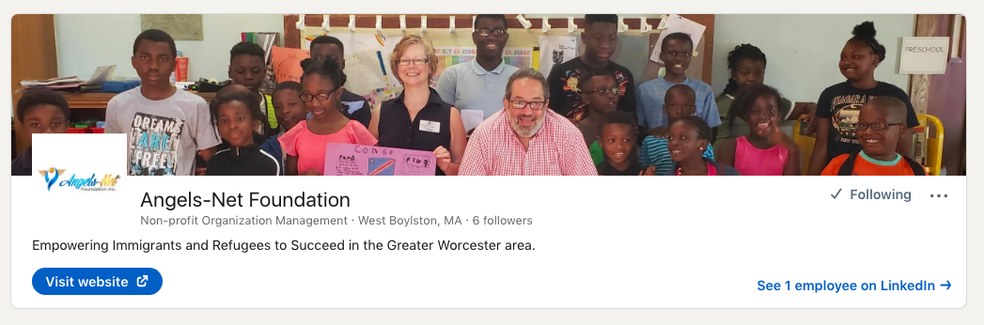
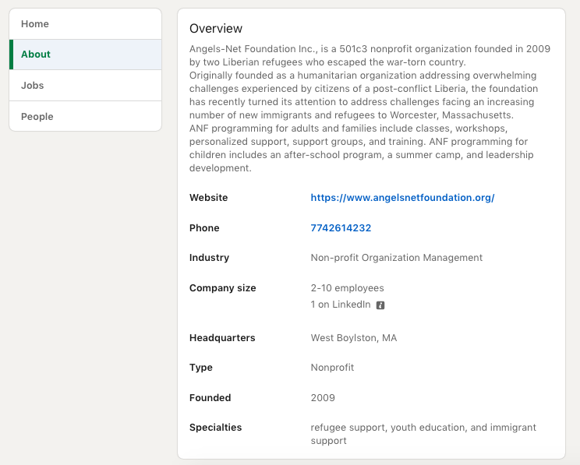
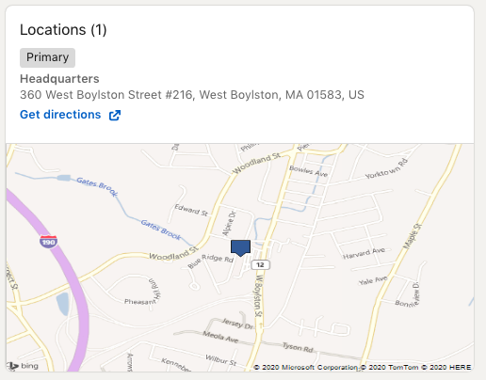
LinkedIn

Slide 17
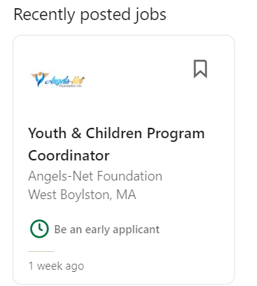
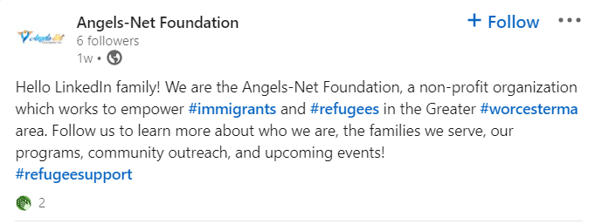
LinkedIn

Slide 18
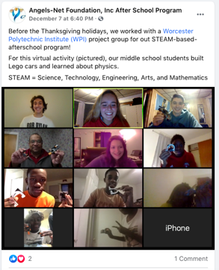
Facebook

