Slide 1
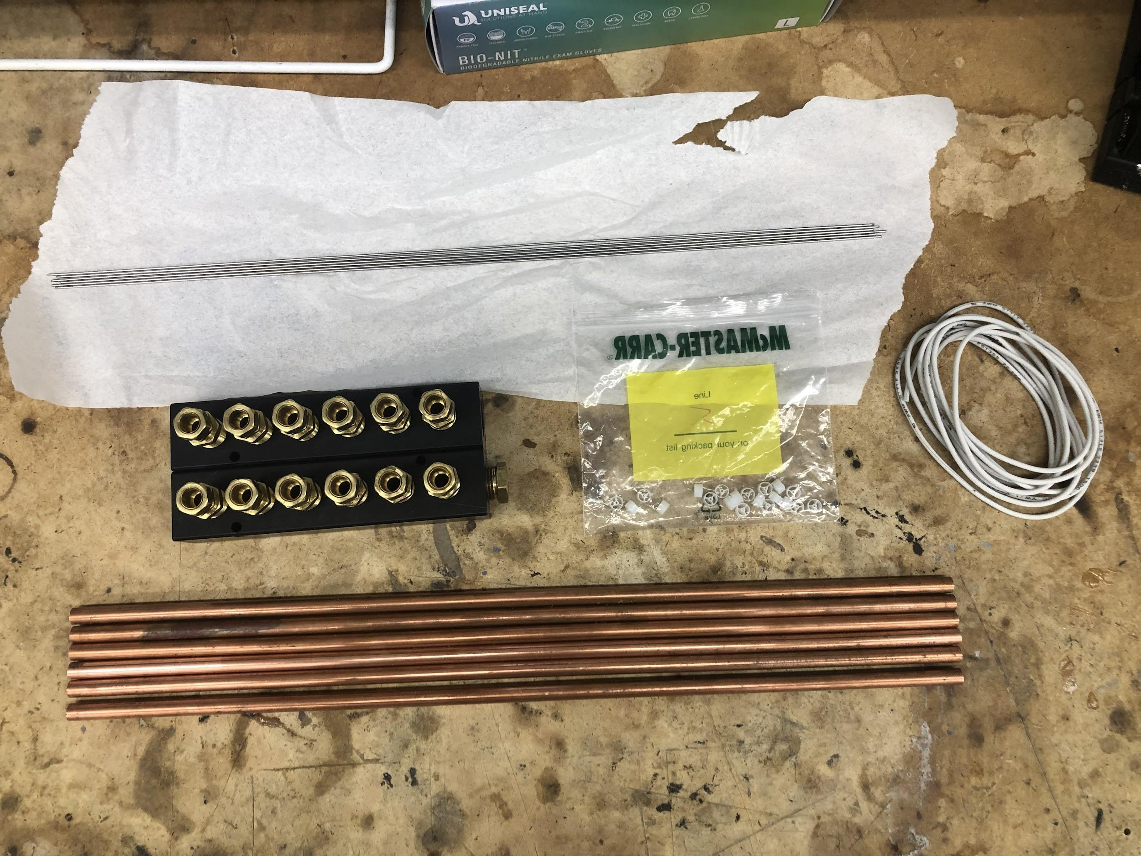
EHD VCC Fabrication Process
The first part of our system to be built was the evaporator, in which EHD would eventually be implemented.

Slide 2
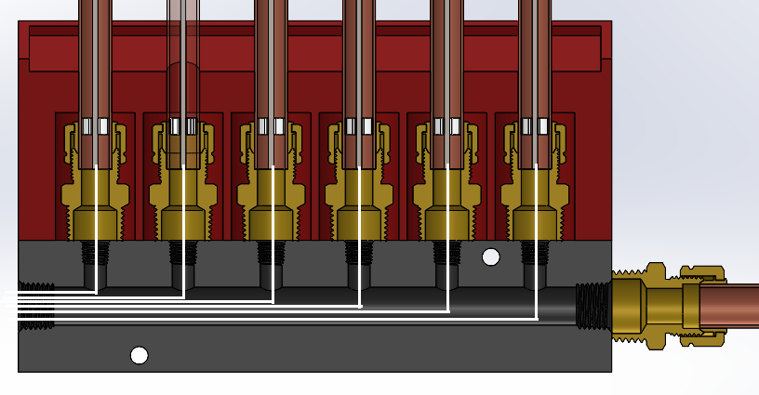
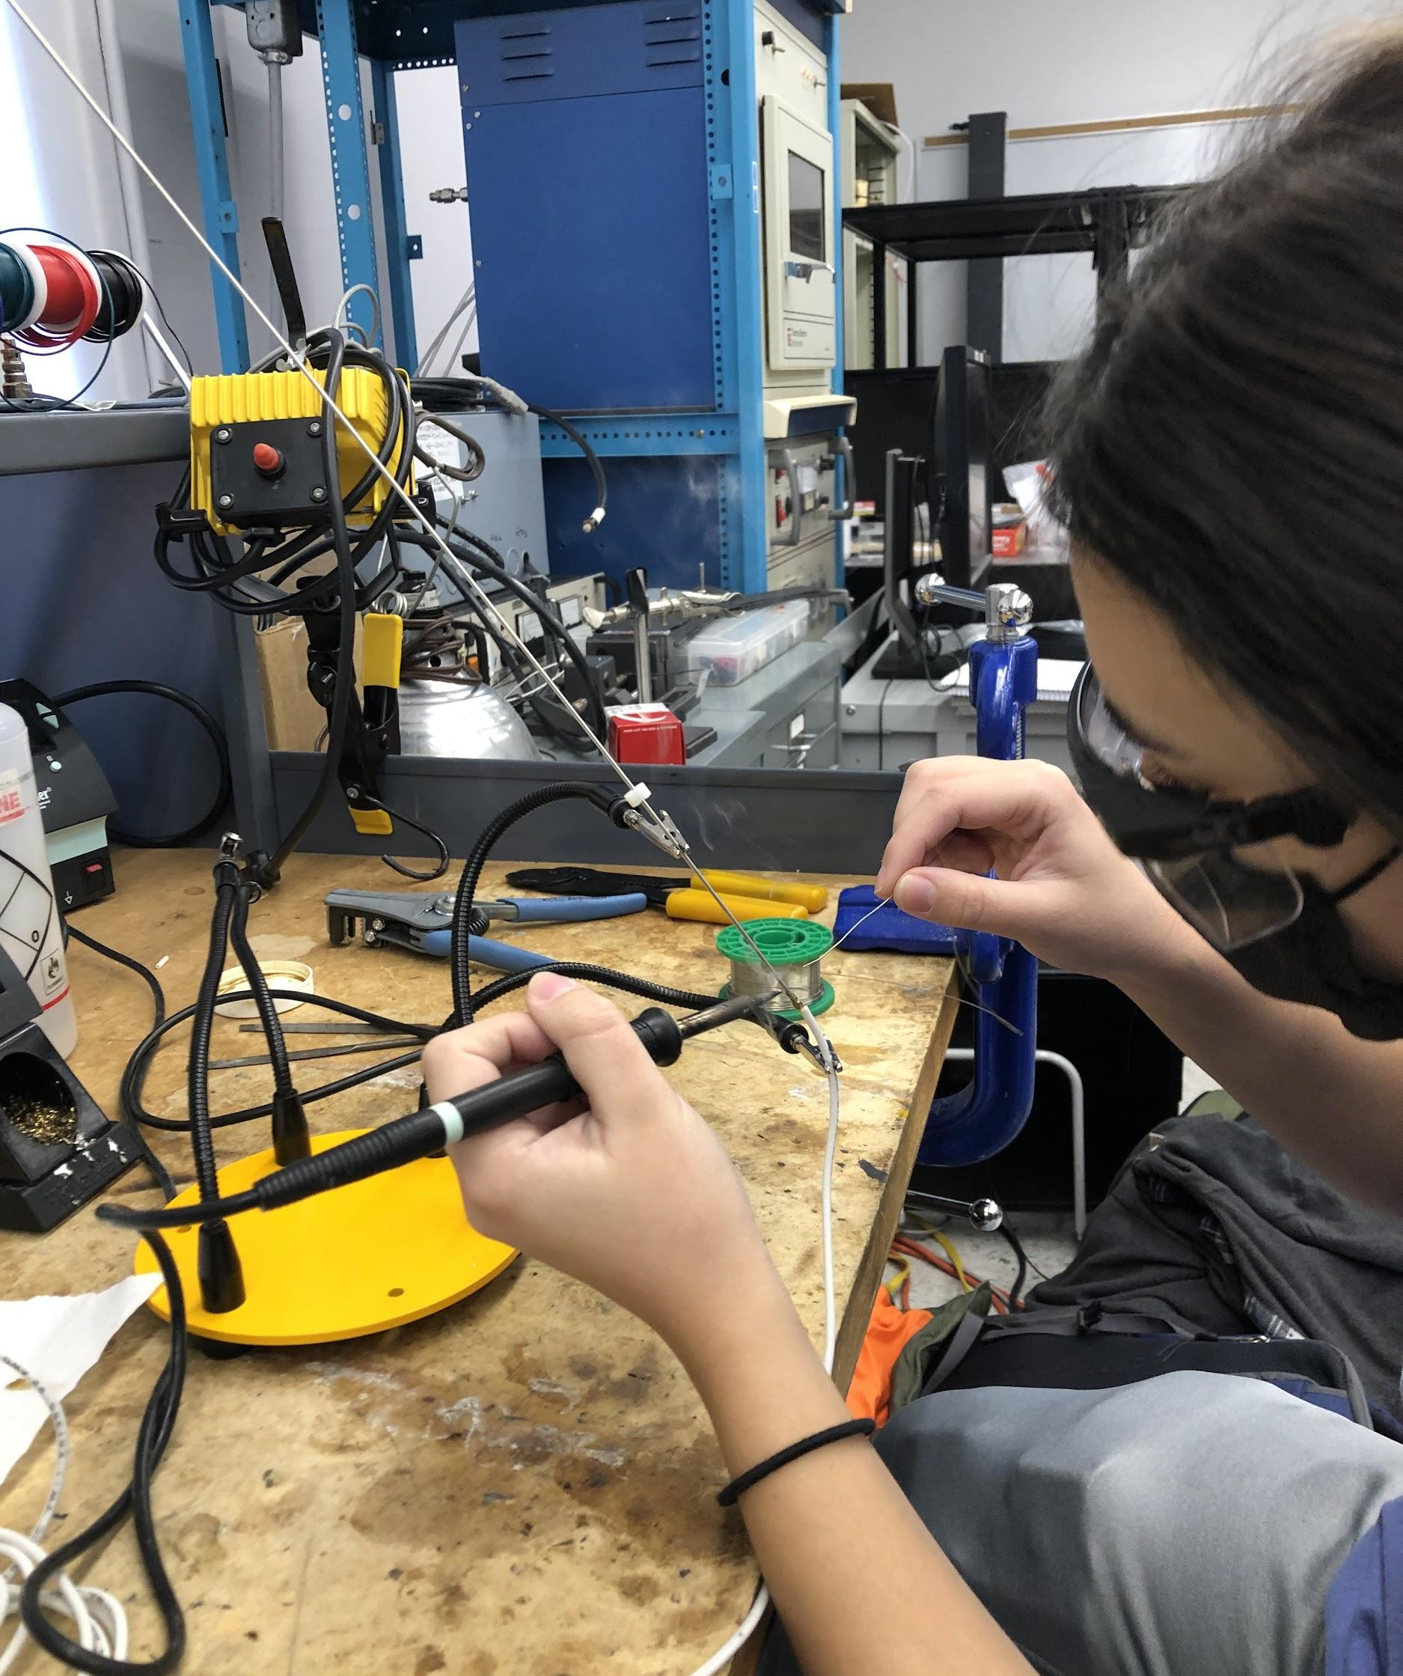
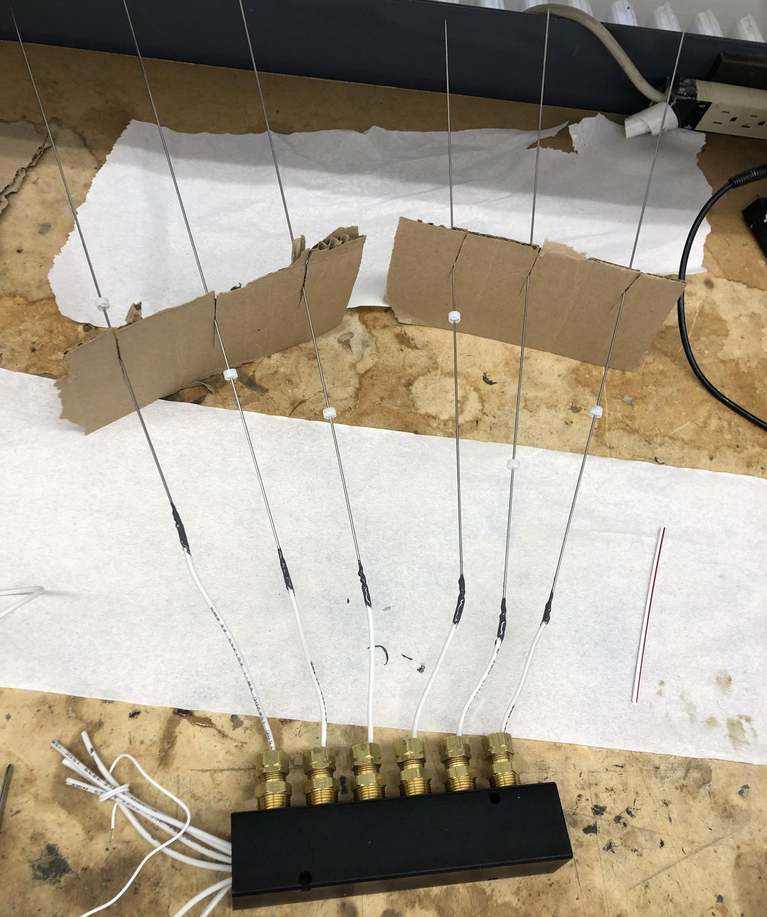
EHD VCC Fabrication Process
After we cut the copper pipes and stainless steel electrodes to length, the electrodes were soldered to wires running through the bottom manifold of the evaporator. This connected our electrodes to the high voltage power source, and the soldering was epoxied to prevent the connections from touching any other part of the system.
Wires not to scale

Slide 3
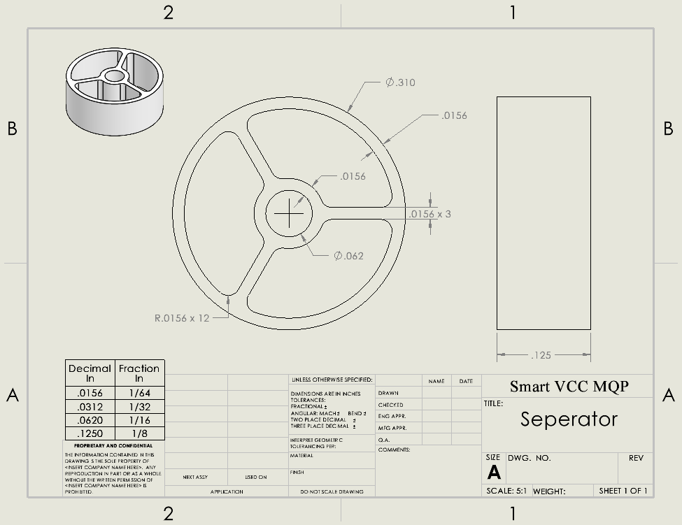
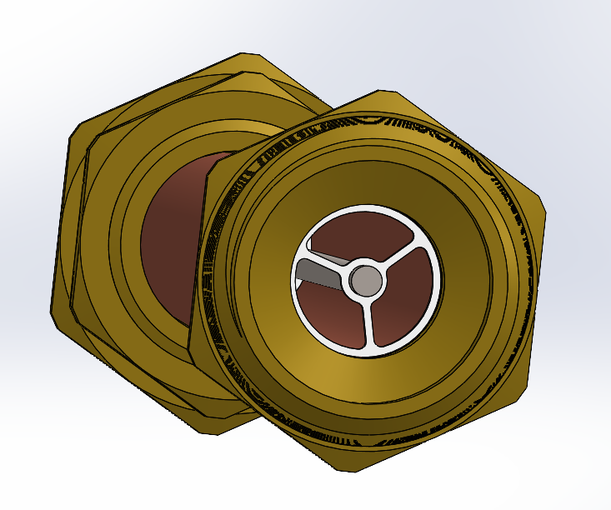
EHD VCC Fabrication Process
We used 3D-printed Teflon spacers to separate our electrodes from the walls of the copper pipes - one at the bottom, top, and middle of each electrode, all attached with Loctite 411 adhesive.

Slide 4
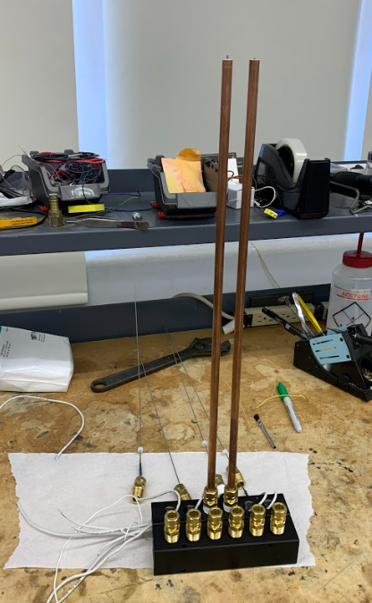
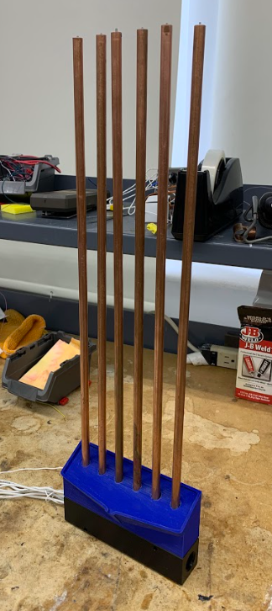
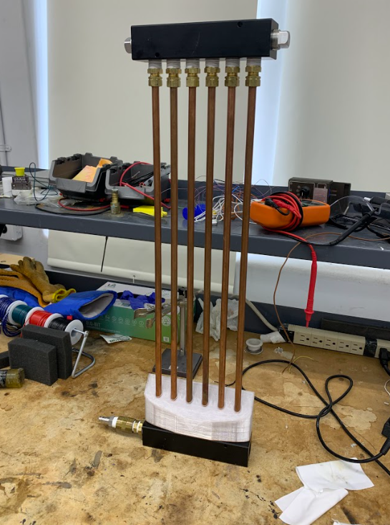
EHD VCC Fabrication Process
We were then able to attach our electrodes to the interior of our pipes, which allowed us to move onto our full evaporator assembly.

Slide 5
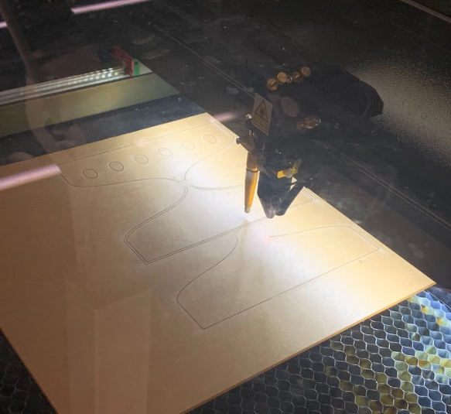
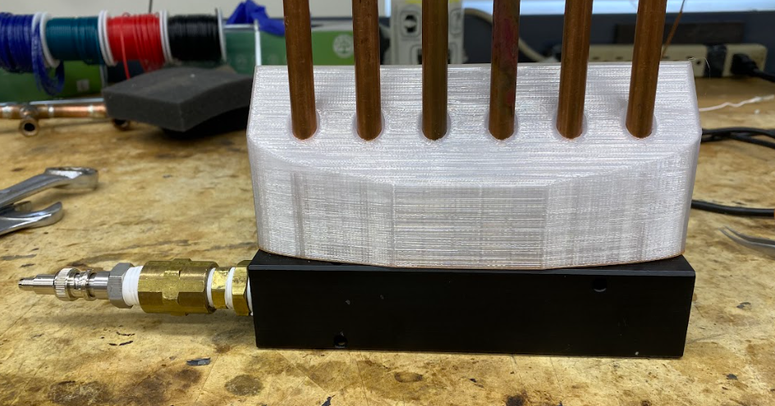
EHD VCC Fabrication Process
The base of the drainage slope was 3D printed to fit over the evaporator tubes. The top of the slope was laser cut and treated with Rain-X to promote drainage. Later on, we applied silicone to the connections of the pipe to the slope to prevent water from slipping into the slope.

Slide 6
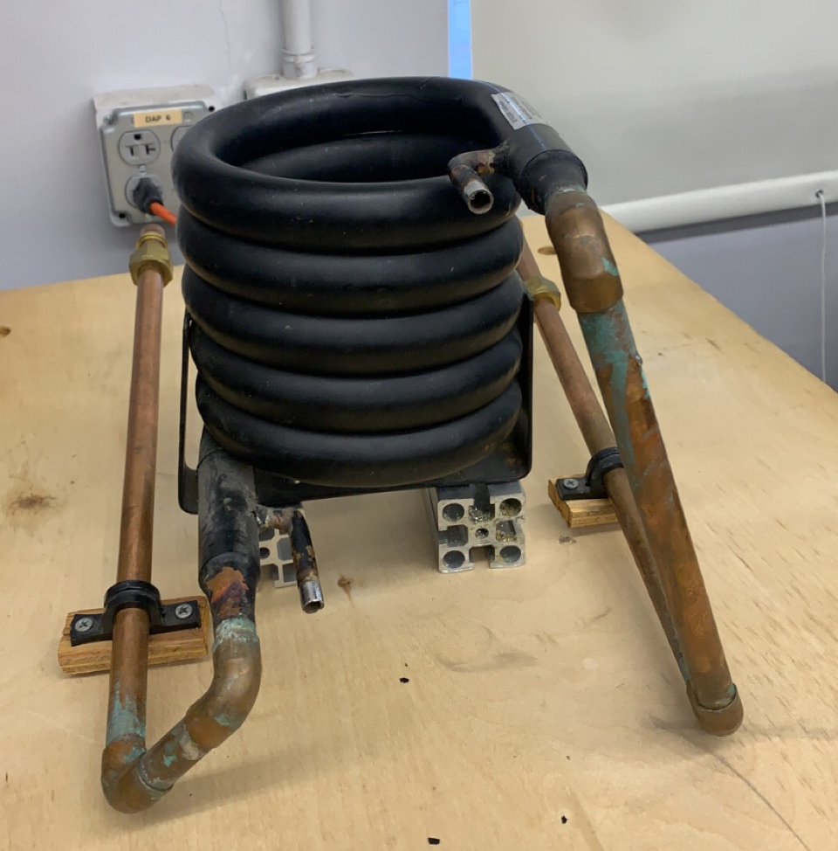
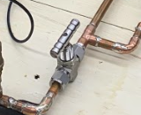
EHD VCC Fabrication Process
The compressor, condenser, and expansion valve the group used are shown here. The counterflow, water-cooled condenser was especially useful, as it was connected to a chiller that allowed us to easily alter the refrigerant exit temperature.

Slide 7
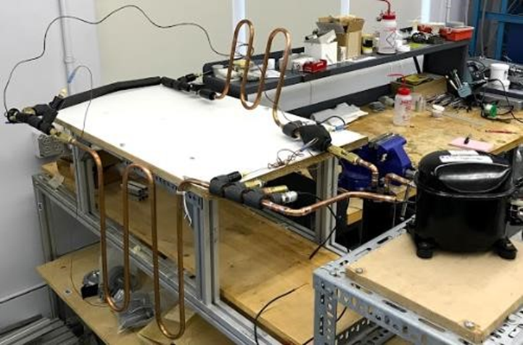
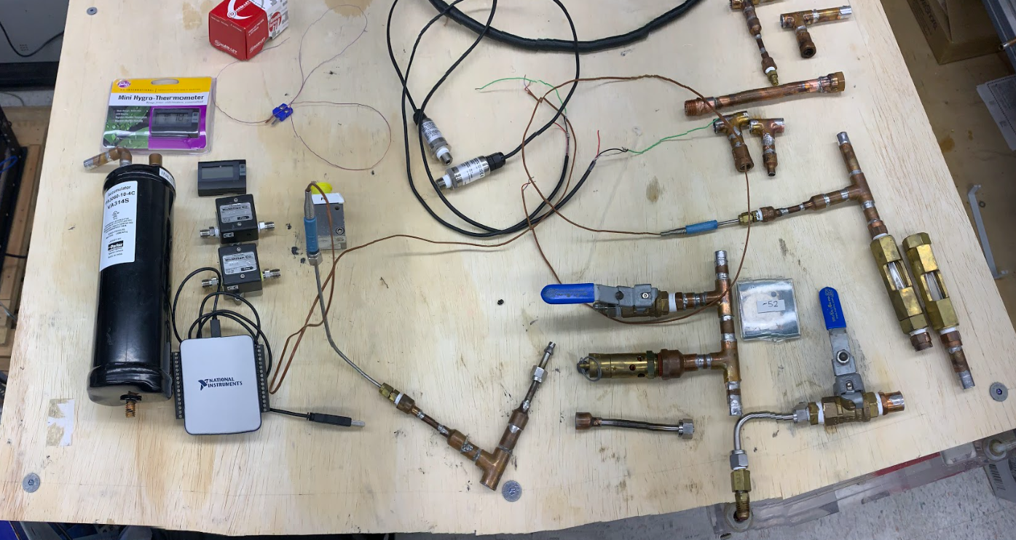
EHD VCC Fabrication Process
We were able to salvage many of these from a disassembly of a previous MQP.
In addition to 4 main VCC components, our complete system assembly included the following:
6 thermocouples
2 absolute pressure transducers
1 differential pressure transducer
1 pressure relief valve
2 charge ports
1 flowmeter
1 accumulator
2 sight glasses

Slide 8
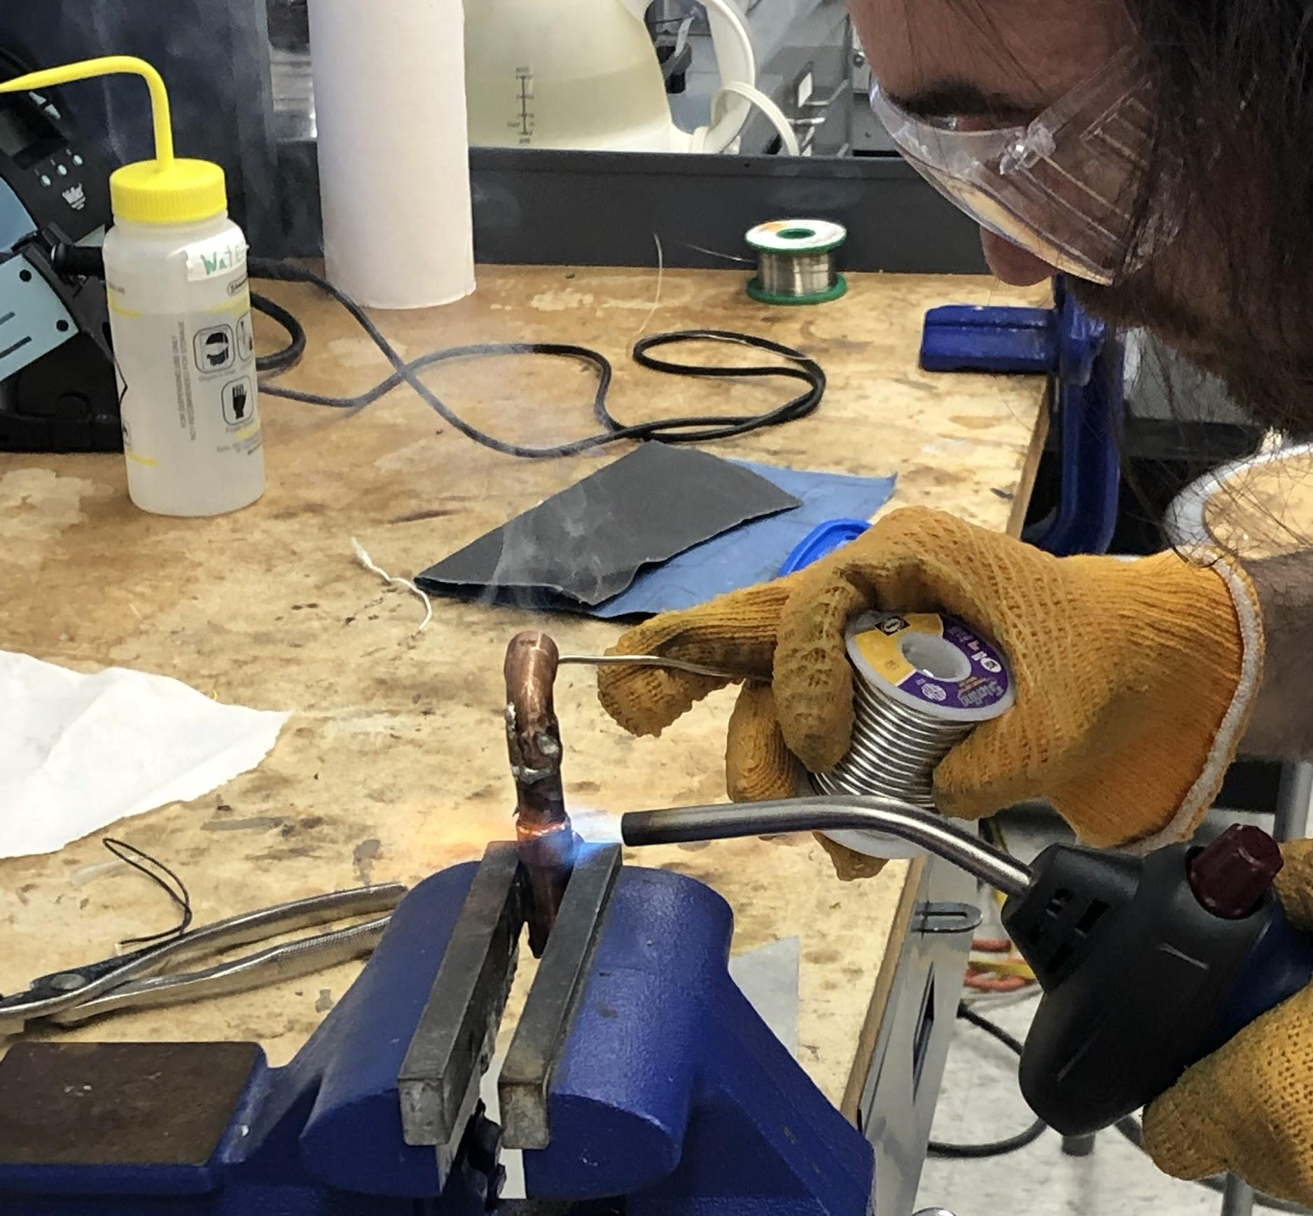
EHD VCC Fabrication Process
Many of the piping connections in our system were connected by brazing. This process is very similar to soldering, but at a hotter temperature. As such, it required the use of a propane torch. The brazed areas of our system can easily be identified by the silver-colored solder, made up of copper, selenium, and tin.

Slide 9
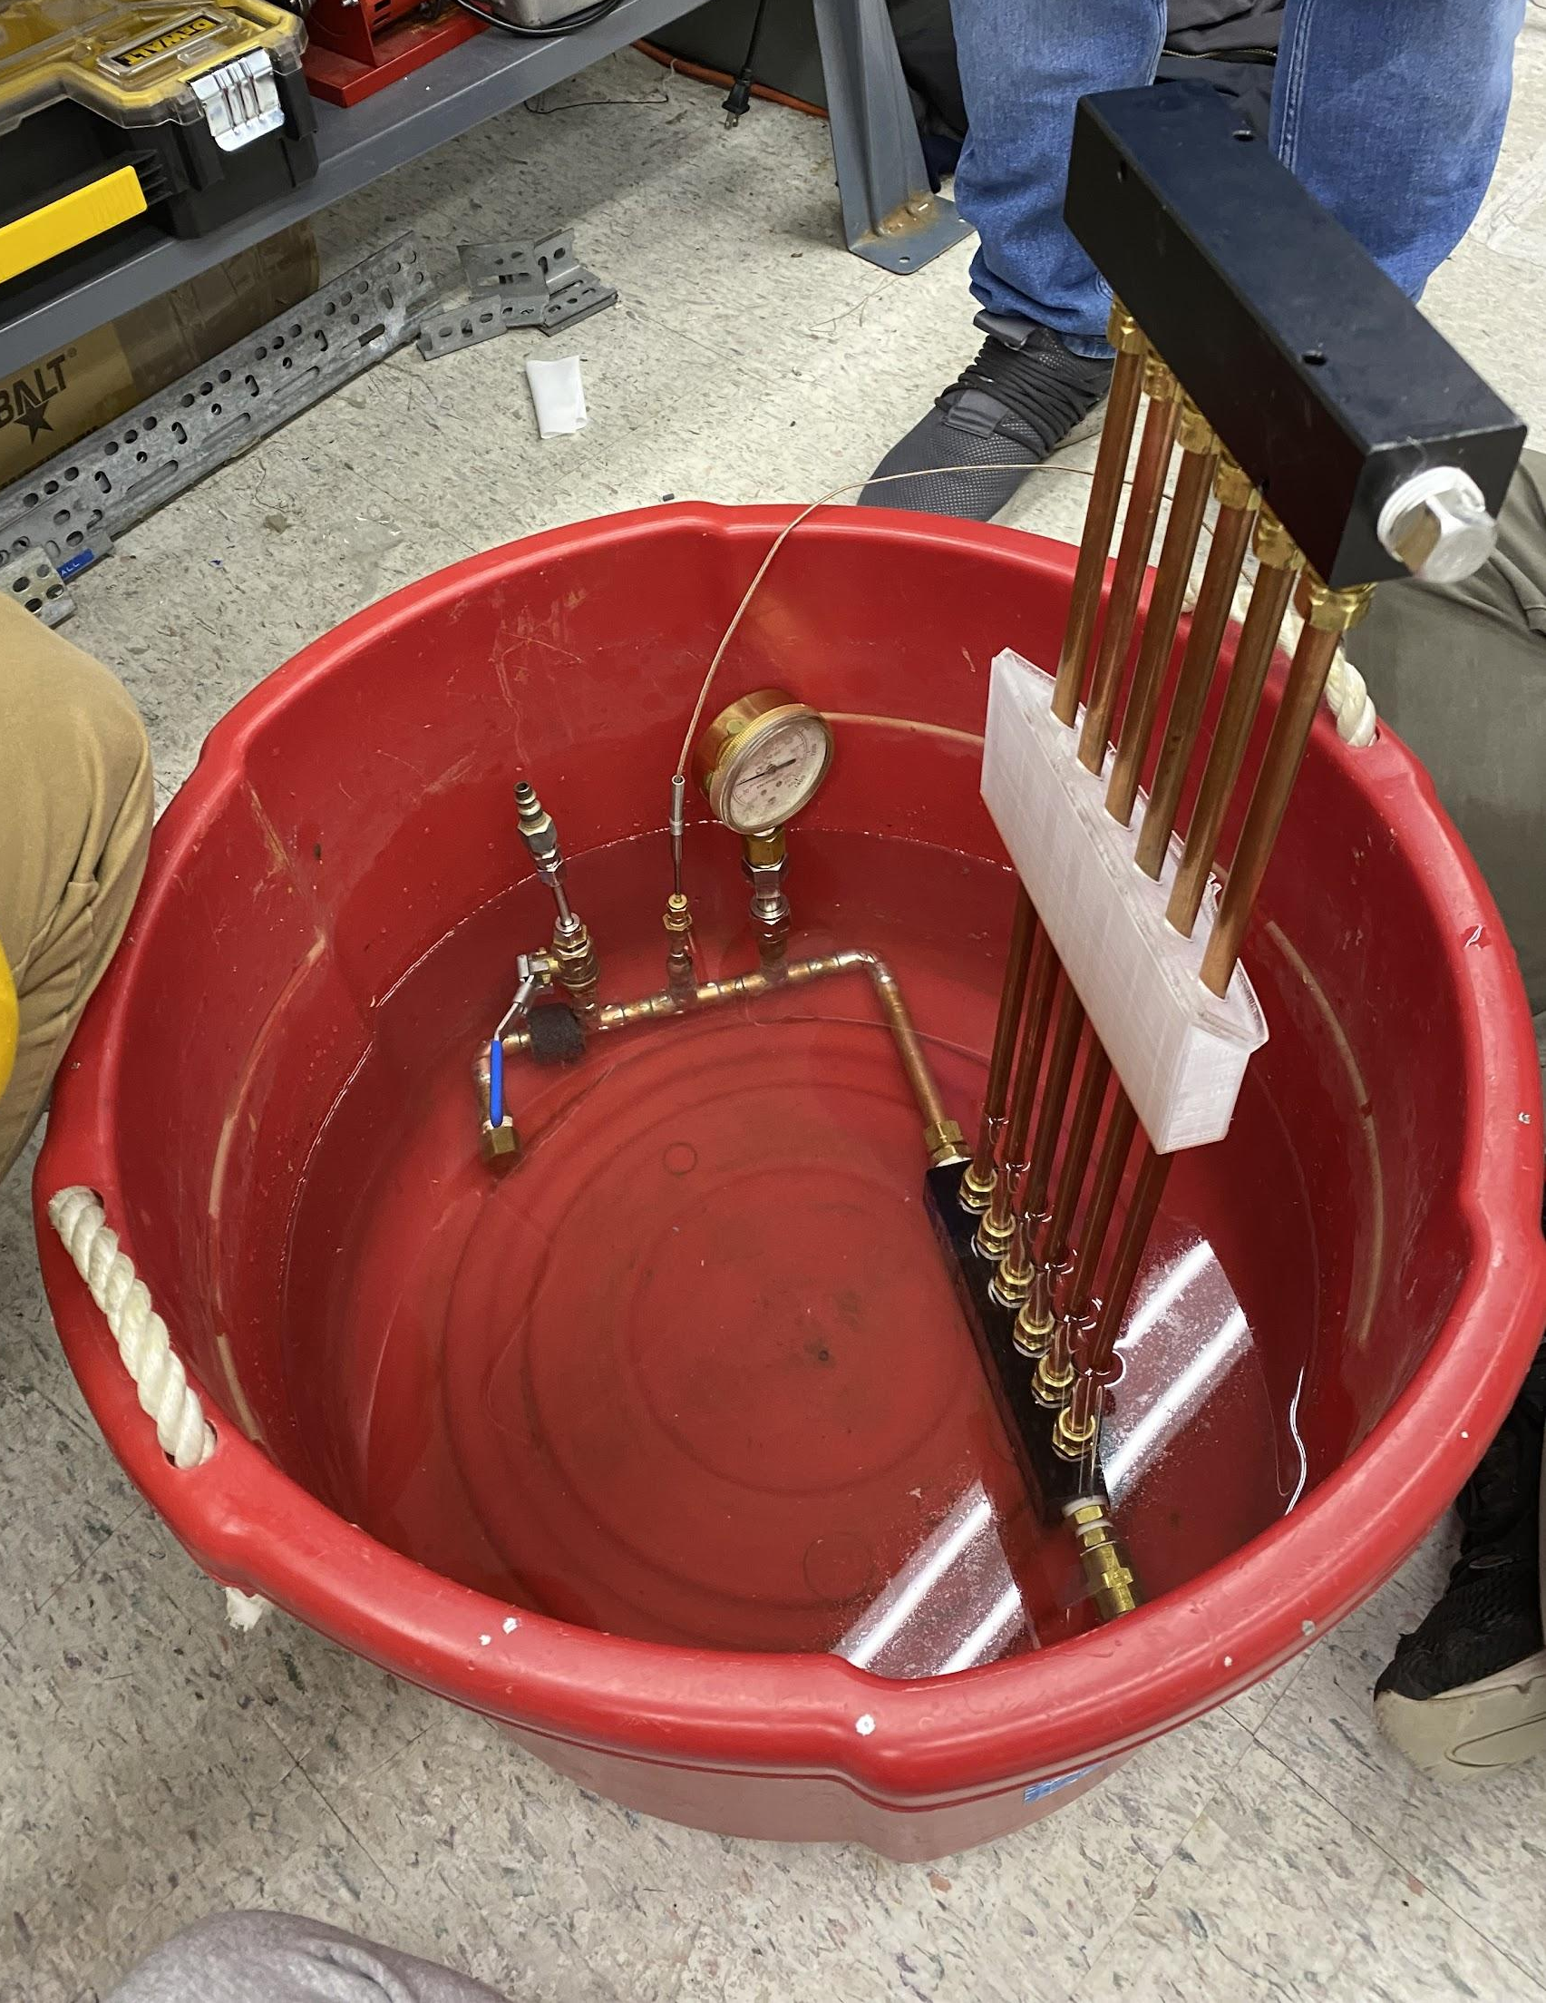
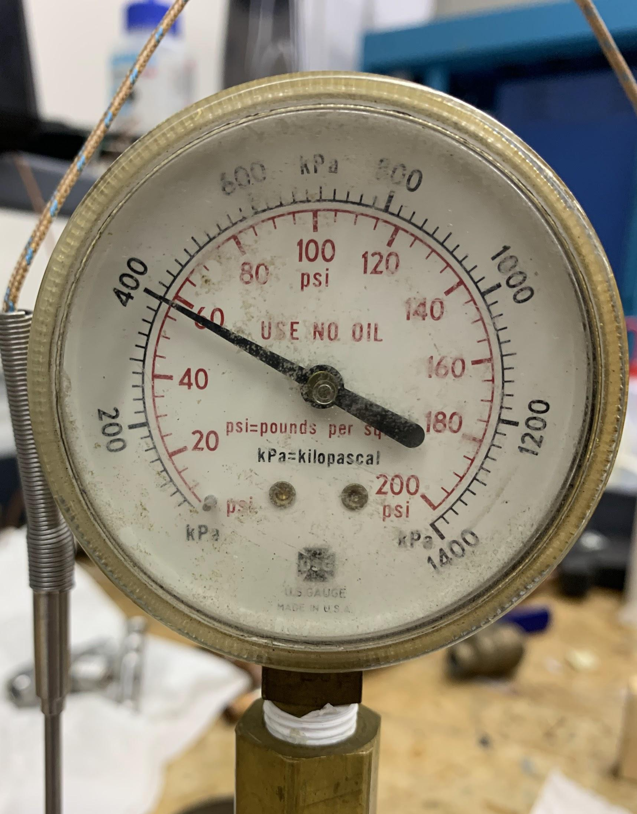
EHD VCC Fabrication Process
We leak tested the evaporator alone, the low side, and high side individually before leak testing the entire system. Each loop was closed off, pressurized with air, then either submerged in water or sprayed with soap water so that any leak would produce bubbles. This was repeated until the system could hold pressure overnight.

Slide 10
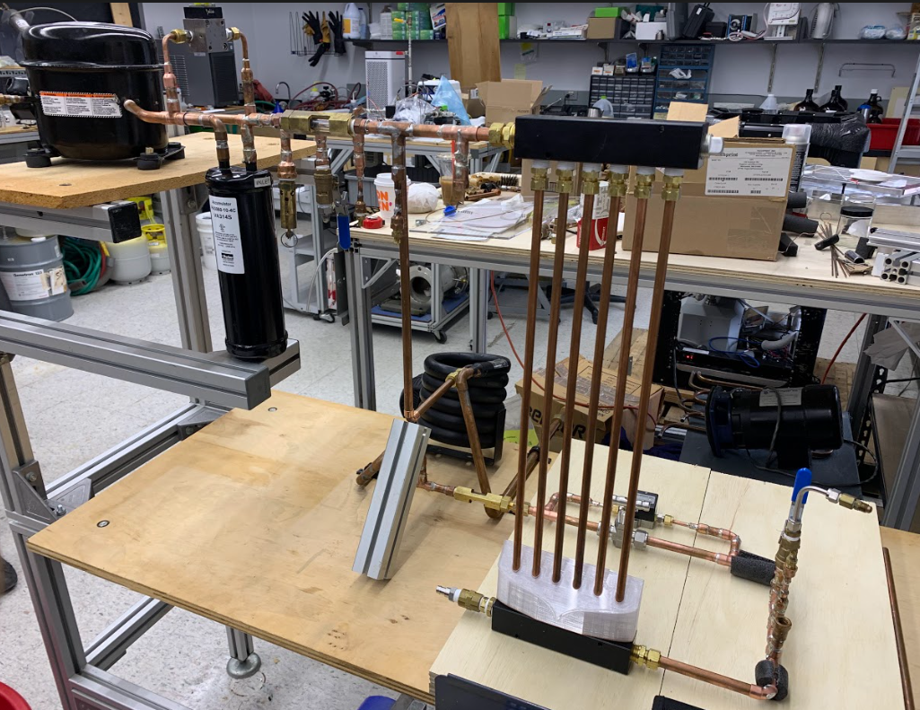
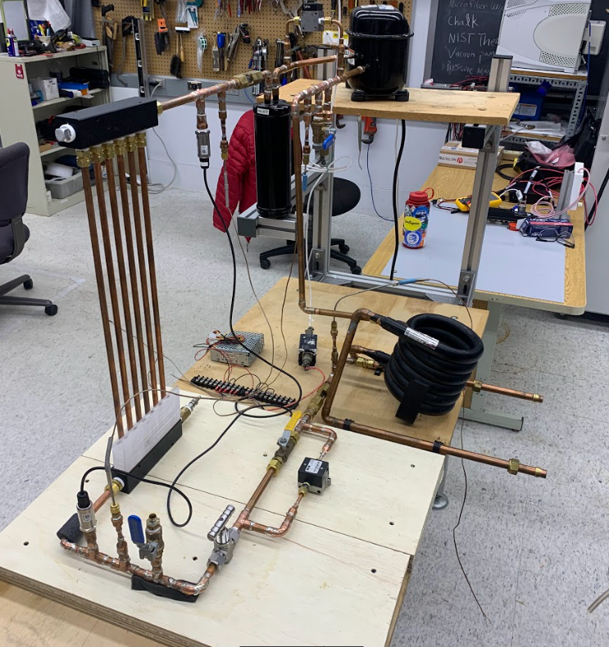
EHD VCC Fabrication Process
With leak testing completed, the group moved onto full system assembly. This brought the VCC to look much more similar to what you see on the table today. Shortly after assembly, exposed pipes outside of the evaporator were covered with insulation to promote heat loss and gain to the environment only at the evaporator.

Slide 11
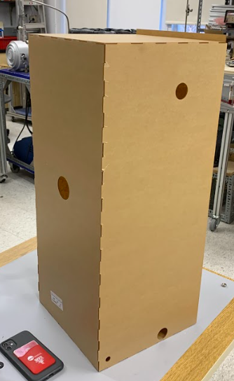
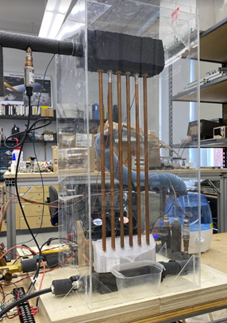
EHD VCC Fabrication Process
To create a greenhouse-like environment for the evaporator, an enclosure was built to simulate a humidity greater than that achievable in the lab along with a consistent air velocity (~2 m/s). This enclosure was laser cut in six parts, and allowed for an easy slide-off front panel as well as accommodated attachment to the rest of the system and a vent for our humidifier.

Slide 12
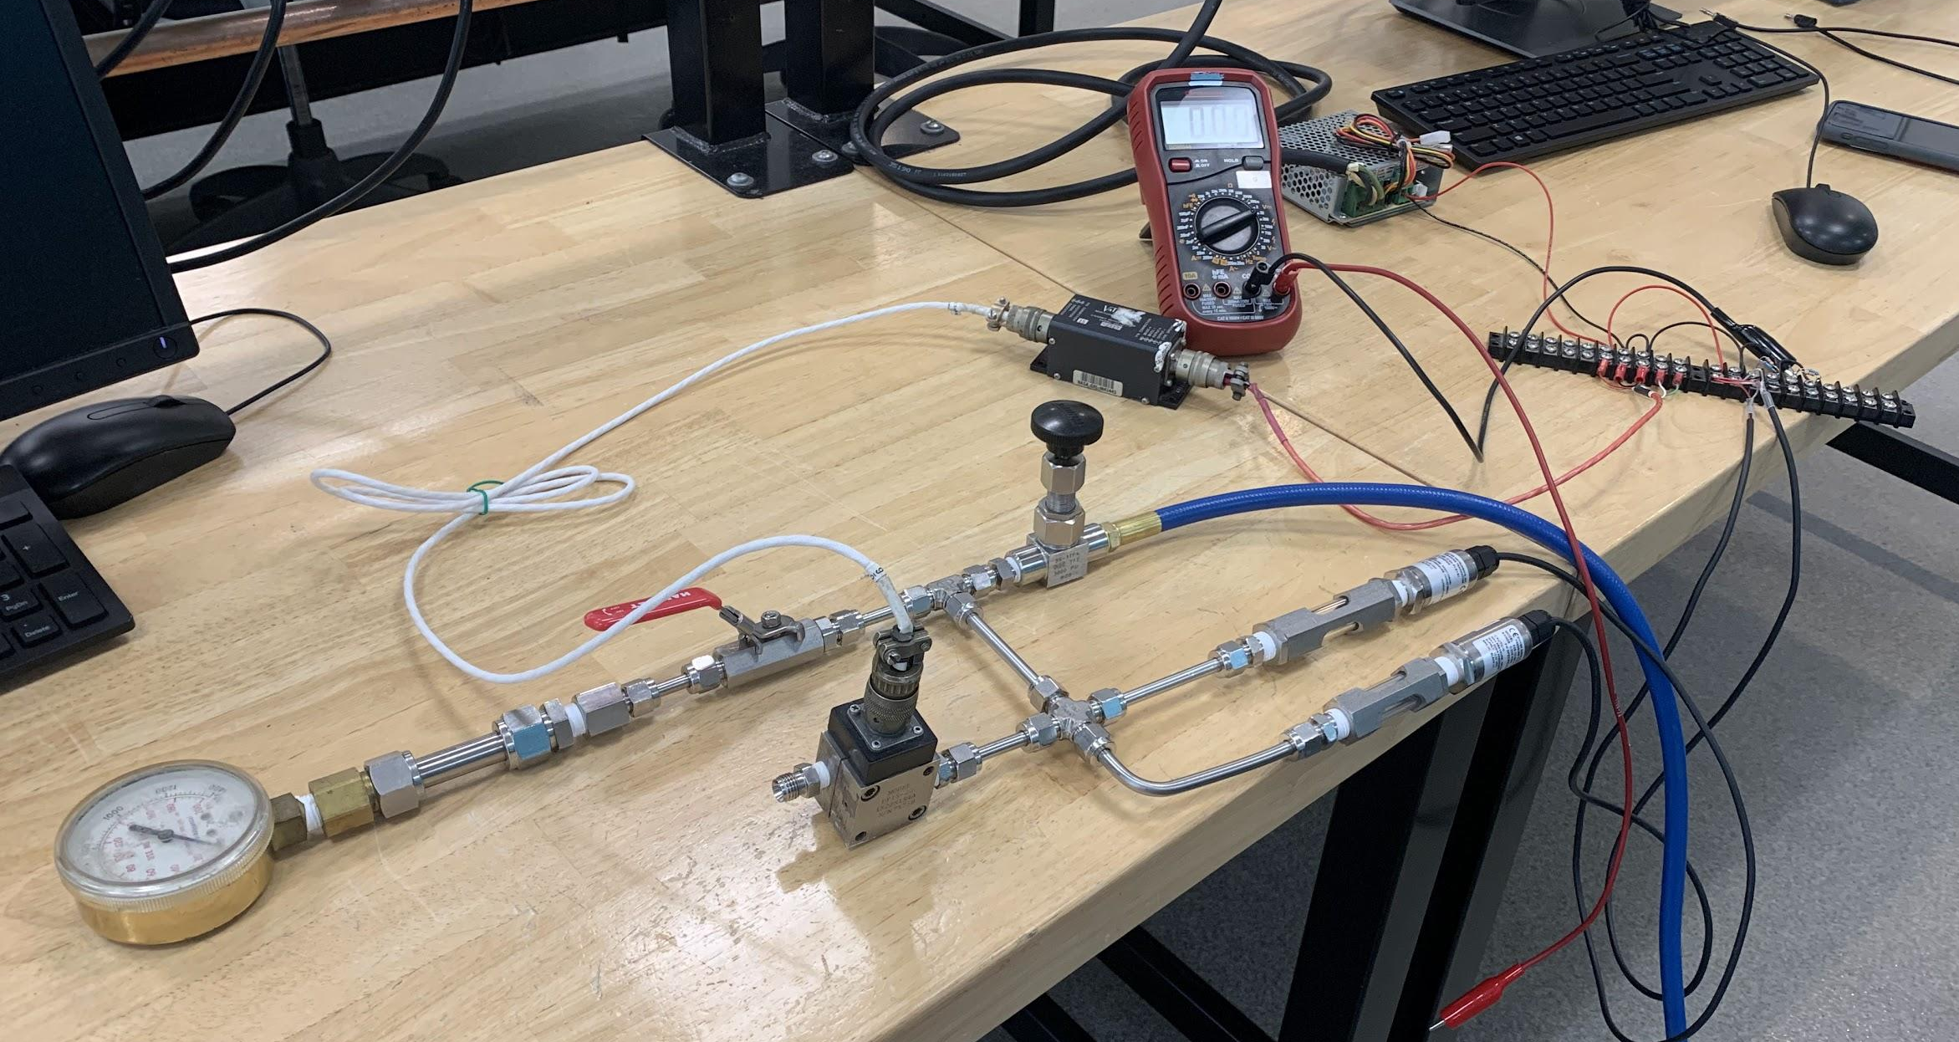
EHD VCC Fabrication Process
Both pressure transducers and the differential pressure sensor were all calibrated together. This process consisted of pressurizing the test loop and comparing the voltage output of each sensor to the pressure gage reading. These readings were used to create a linear regression equation for our LabVIEW program to use.
A similar test configuration was used to check the limit on our pressure relief valve.

Slide 13
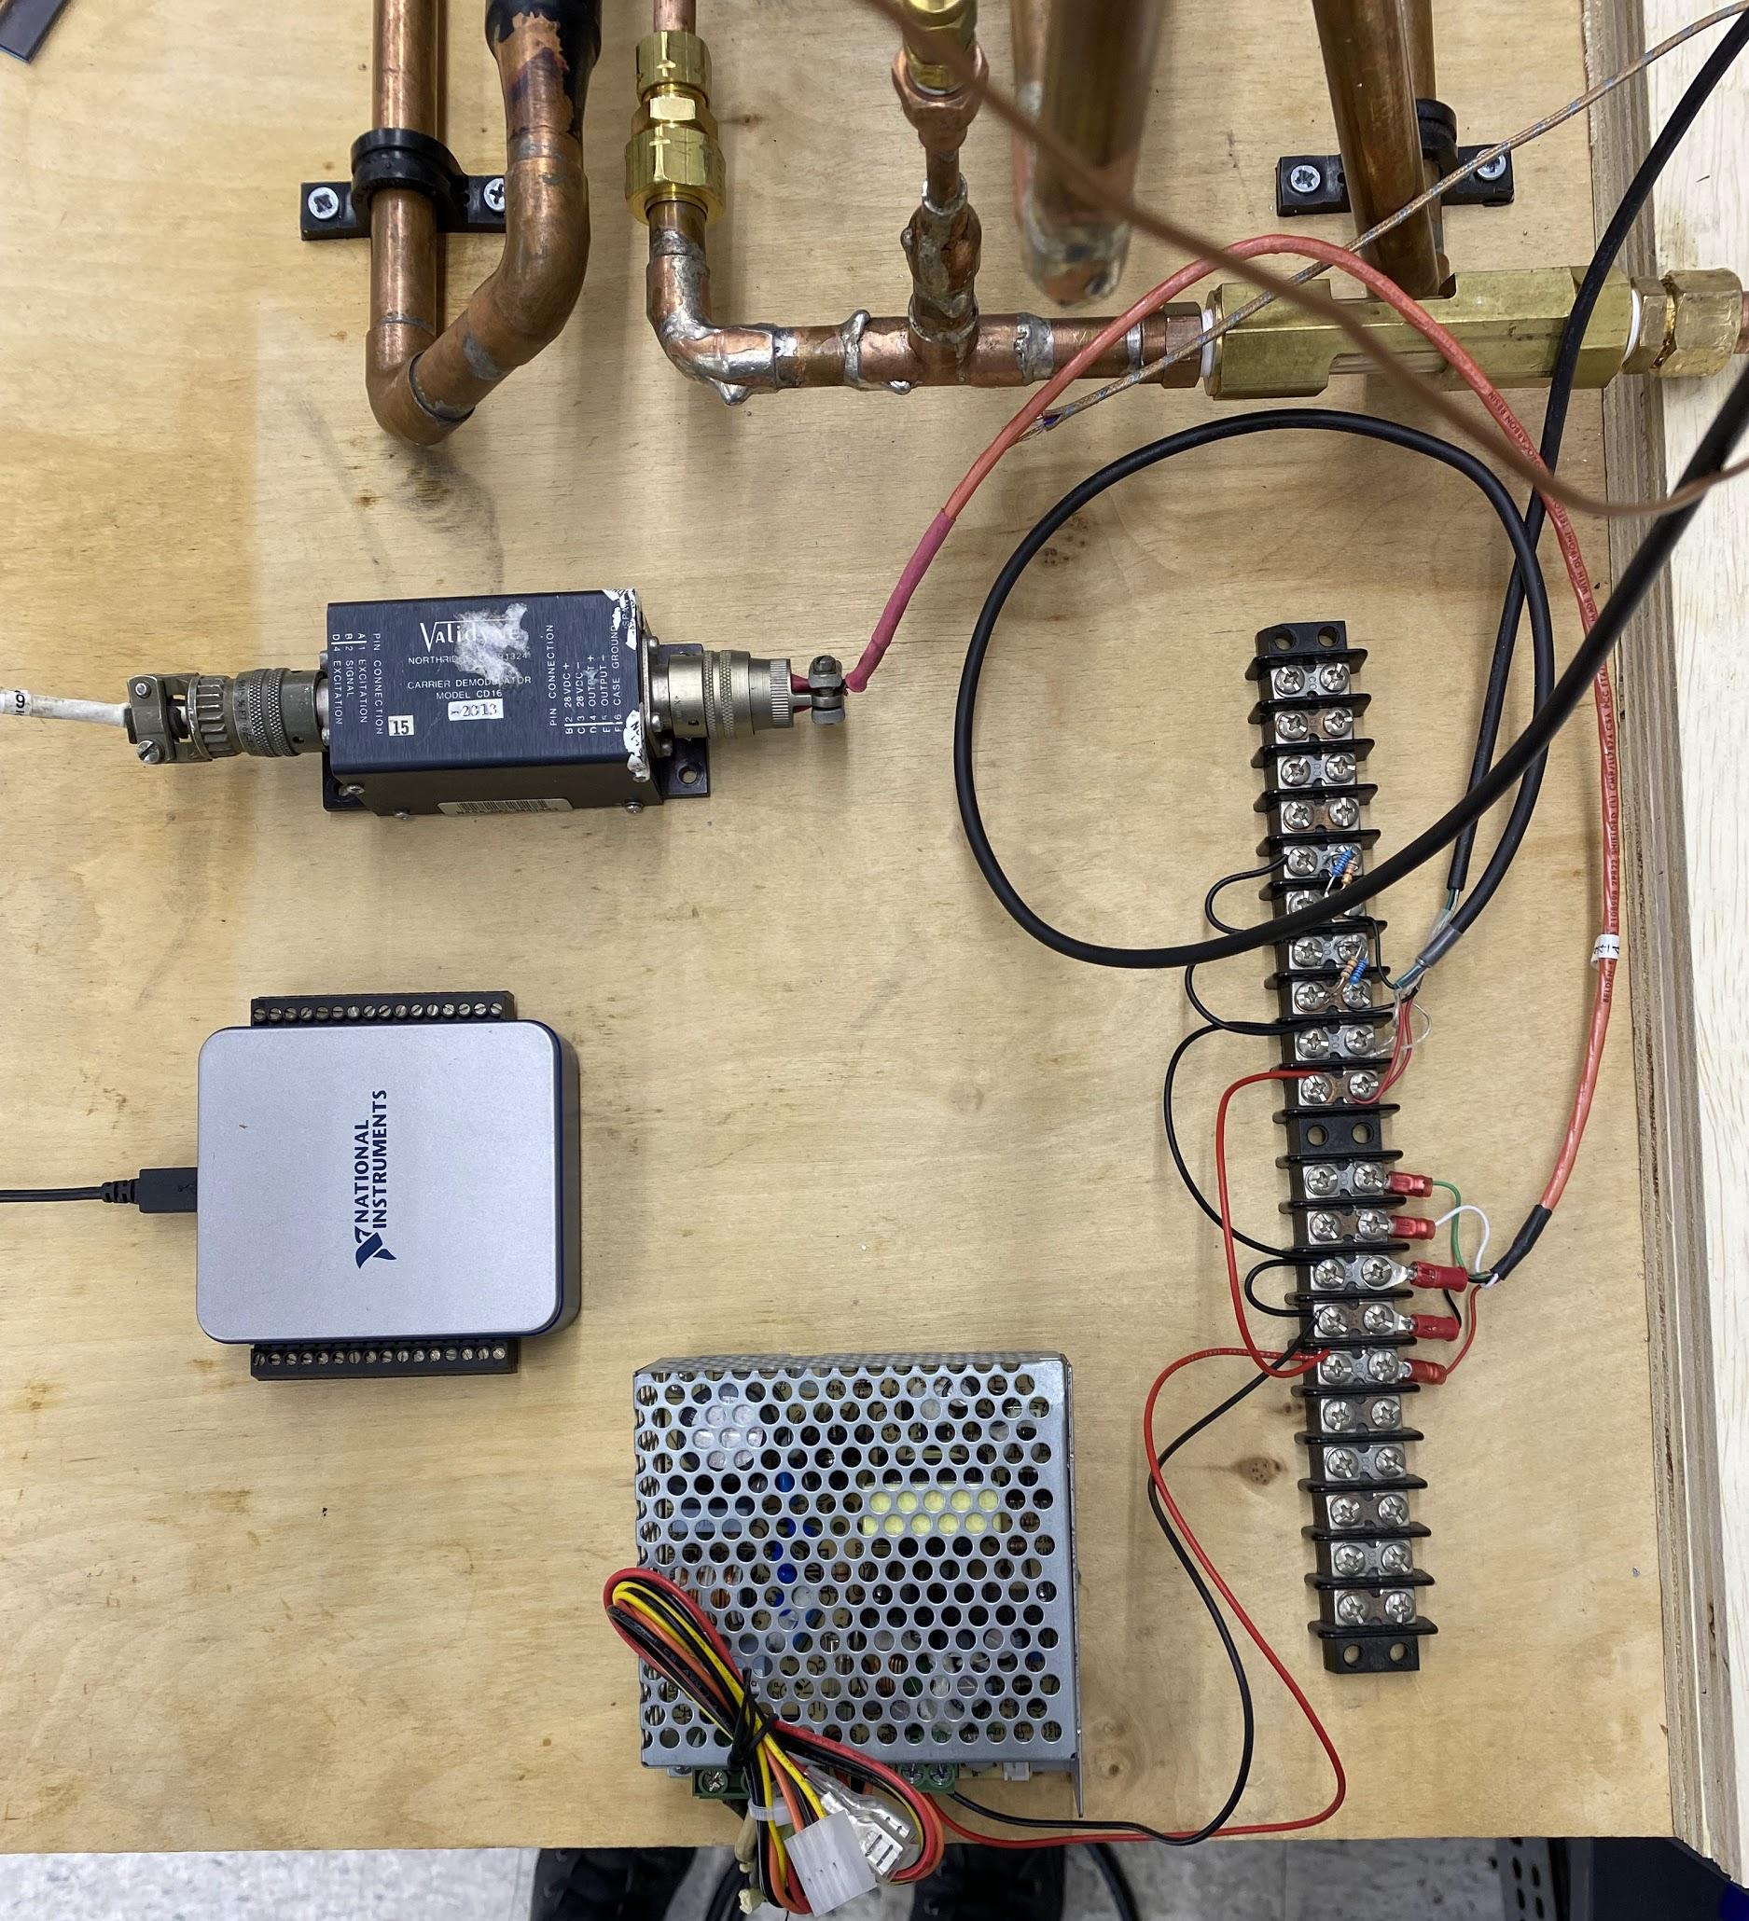
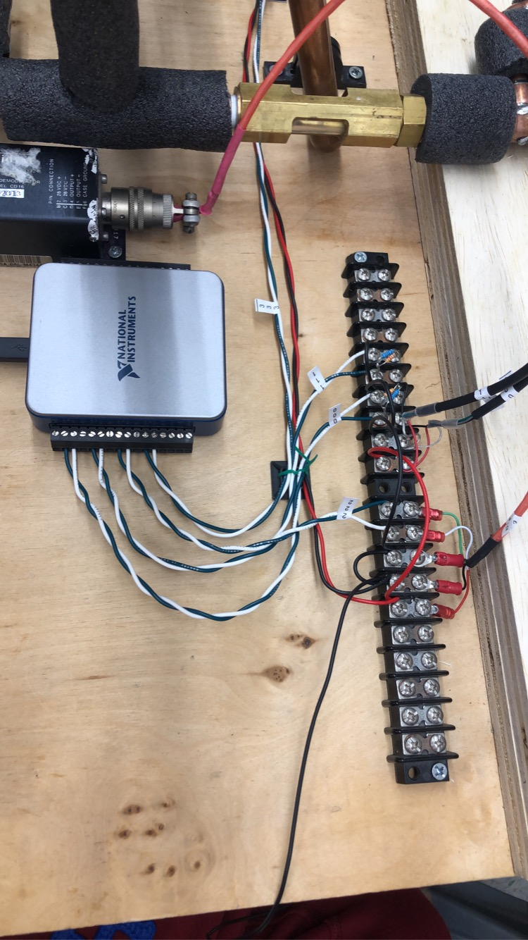
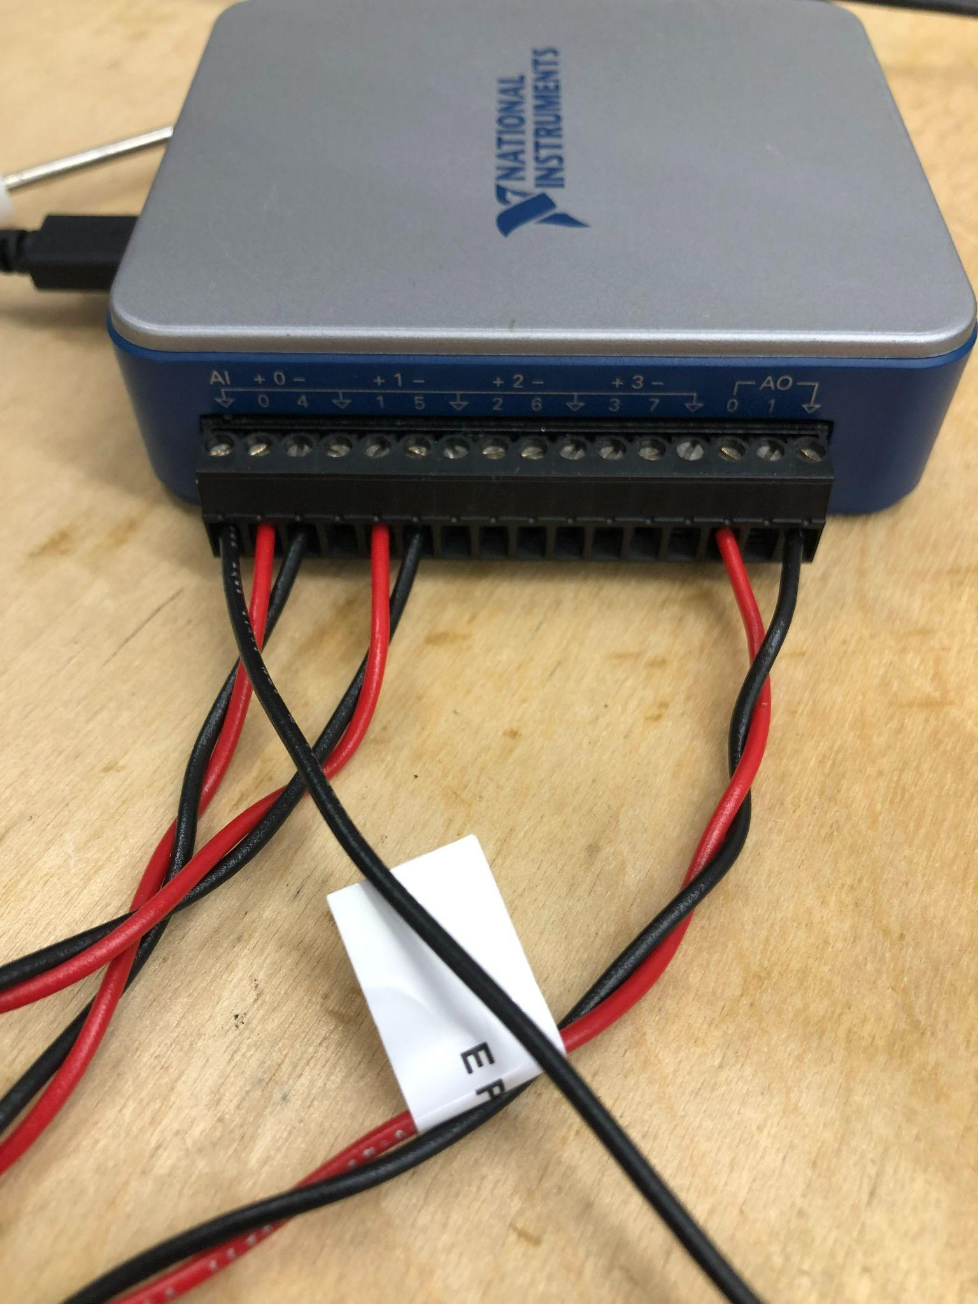
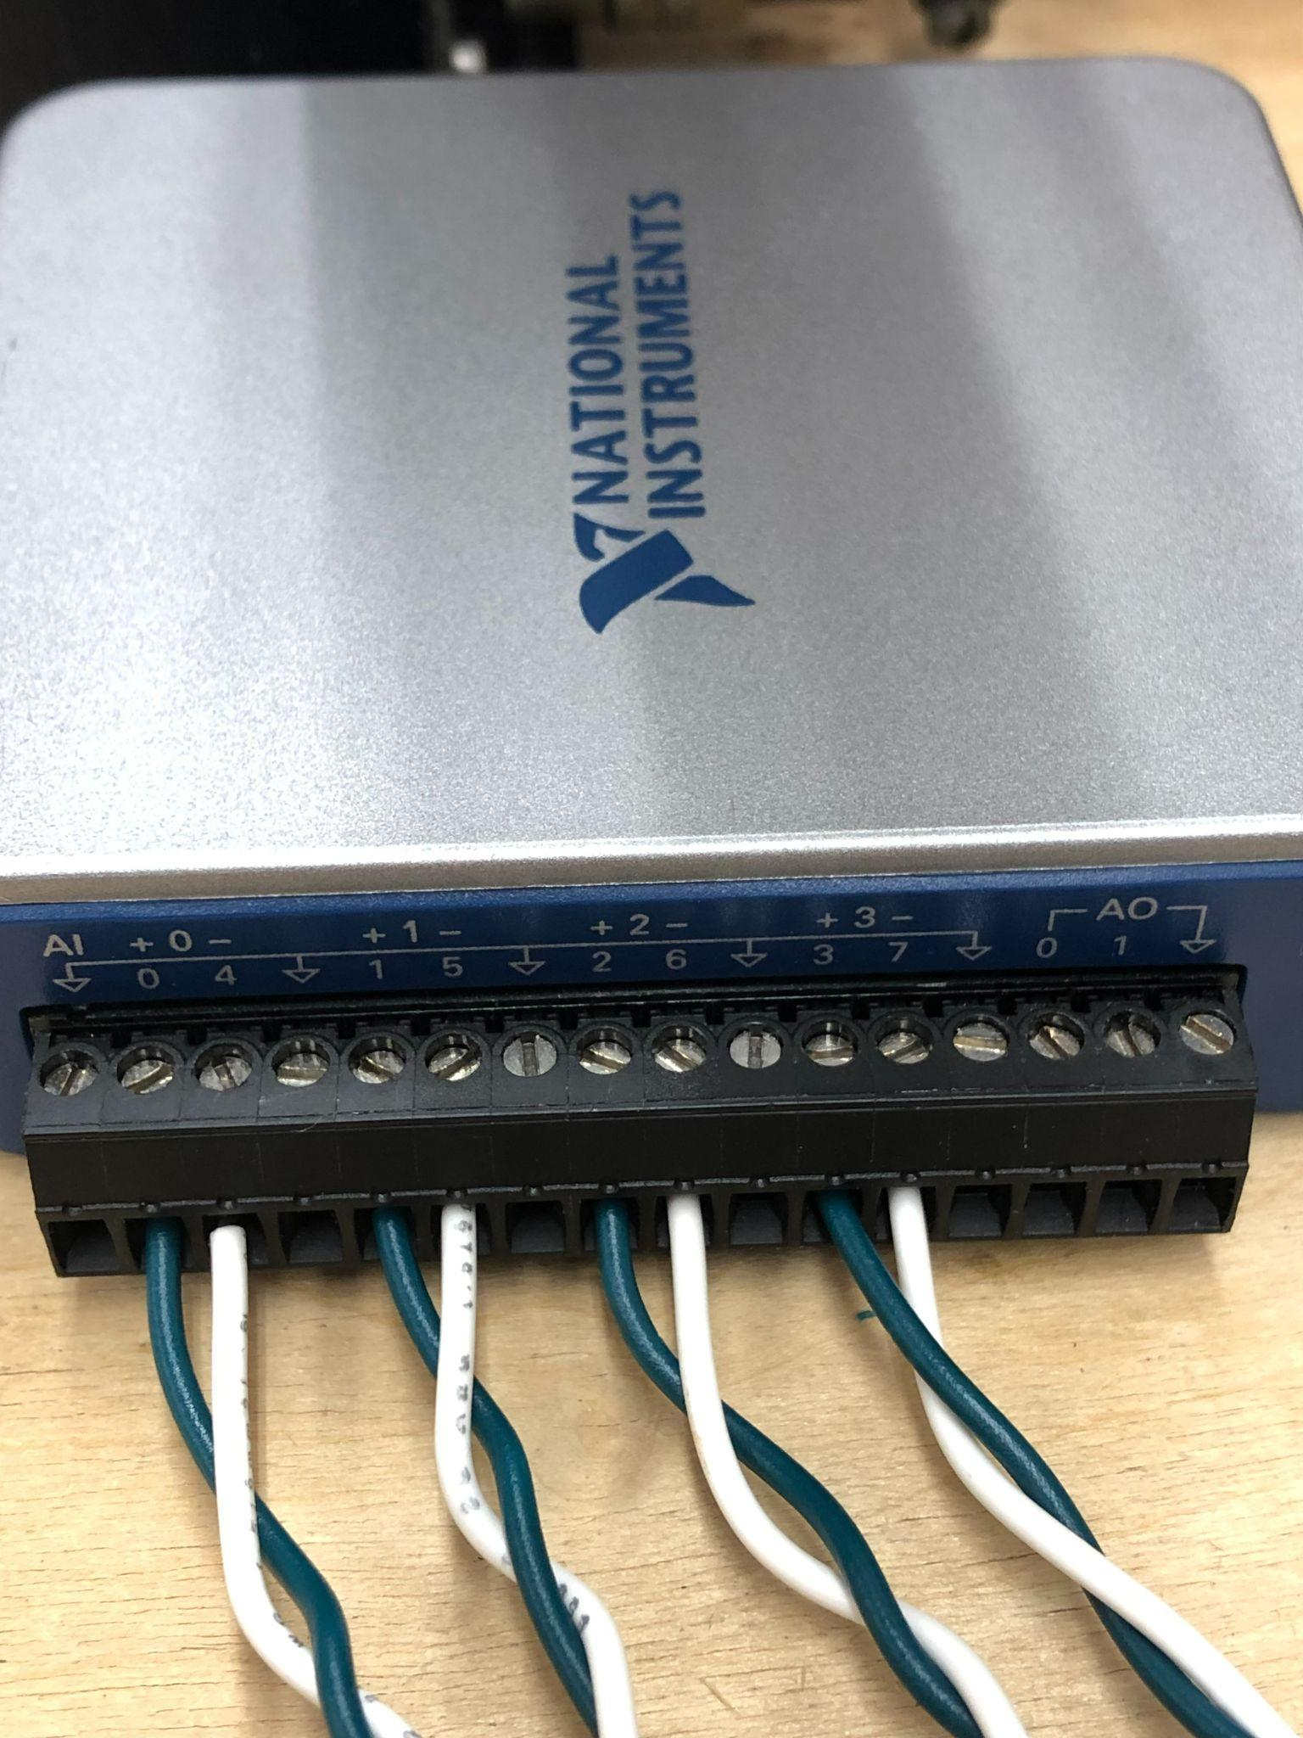
EHD VCC Fabrication Process
The various sensors in our system produced different output signals. We wired the signals accordingly to 3 separate Data Acquisition (DAQ) Boxes which then connect to a Laptop running LabVIEW.

Slide 14
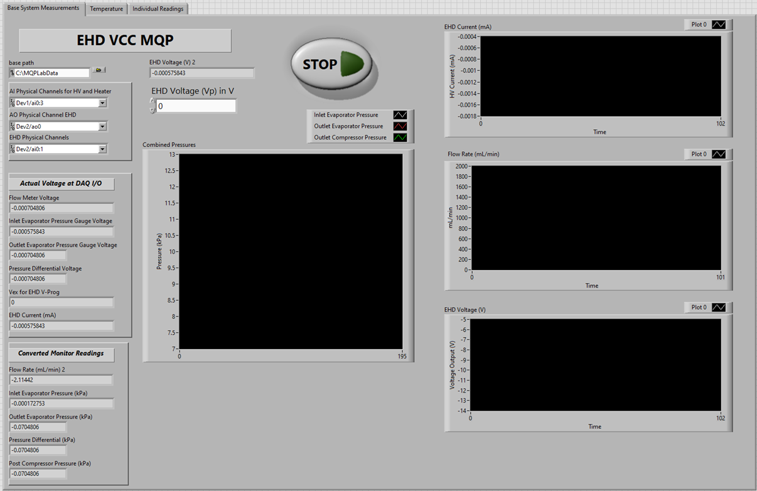
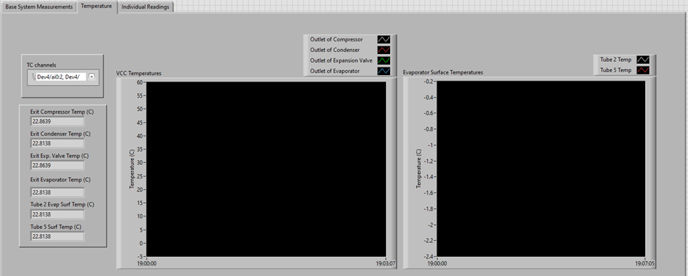
EHD VCC Fabrication Process
LabView was our main means of monitoring the system throughout testing and preparing the system, as well as supply an input EHD voltage. The front panel, where we saw summaries of our key system parameters, is shown here.

Slide 15
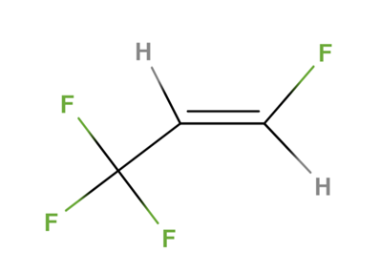
EHD VCC Fabrication Process
Refrigerant Selection: HFOs vs. HFCs
In recent years, refrigerant use has pushed away from using hydrofluorocarbons (HFCs). Although they do not degrade the ozone layer like refrigerants similar to Freon, due to their extremely stable natures they can become greenhouse gases if released into the atmosphere. Hydrofluoroolefins (HFOs) are able to degrade over time and have virtually zero global warming potential (GWP). Due to this factor, it was chosen to perform our project with an HFO.

Slide 16
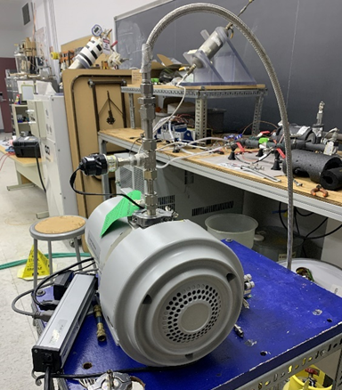
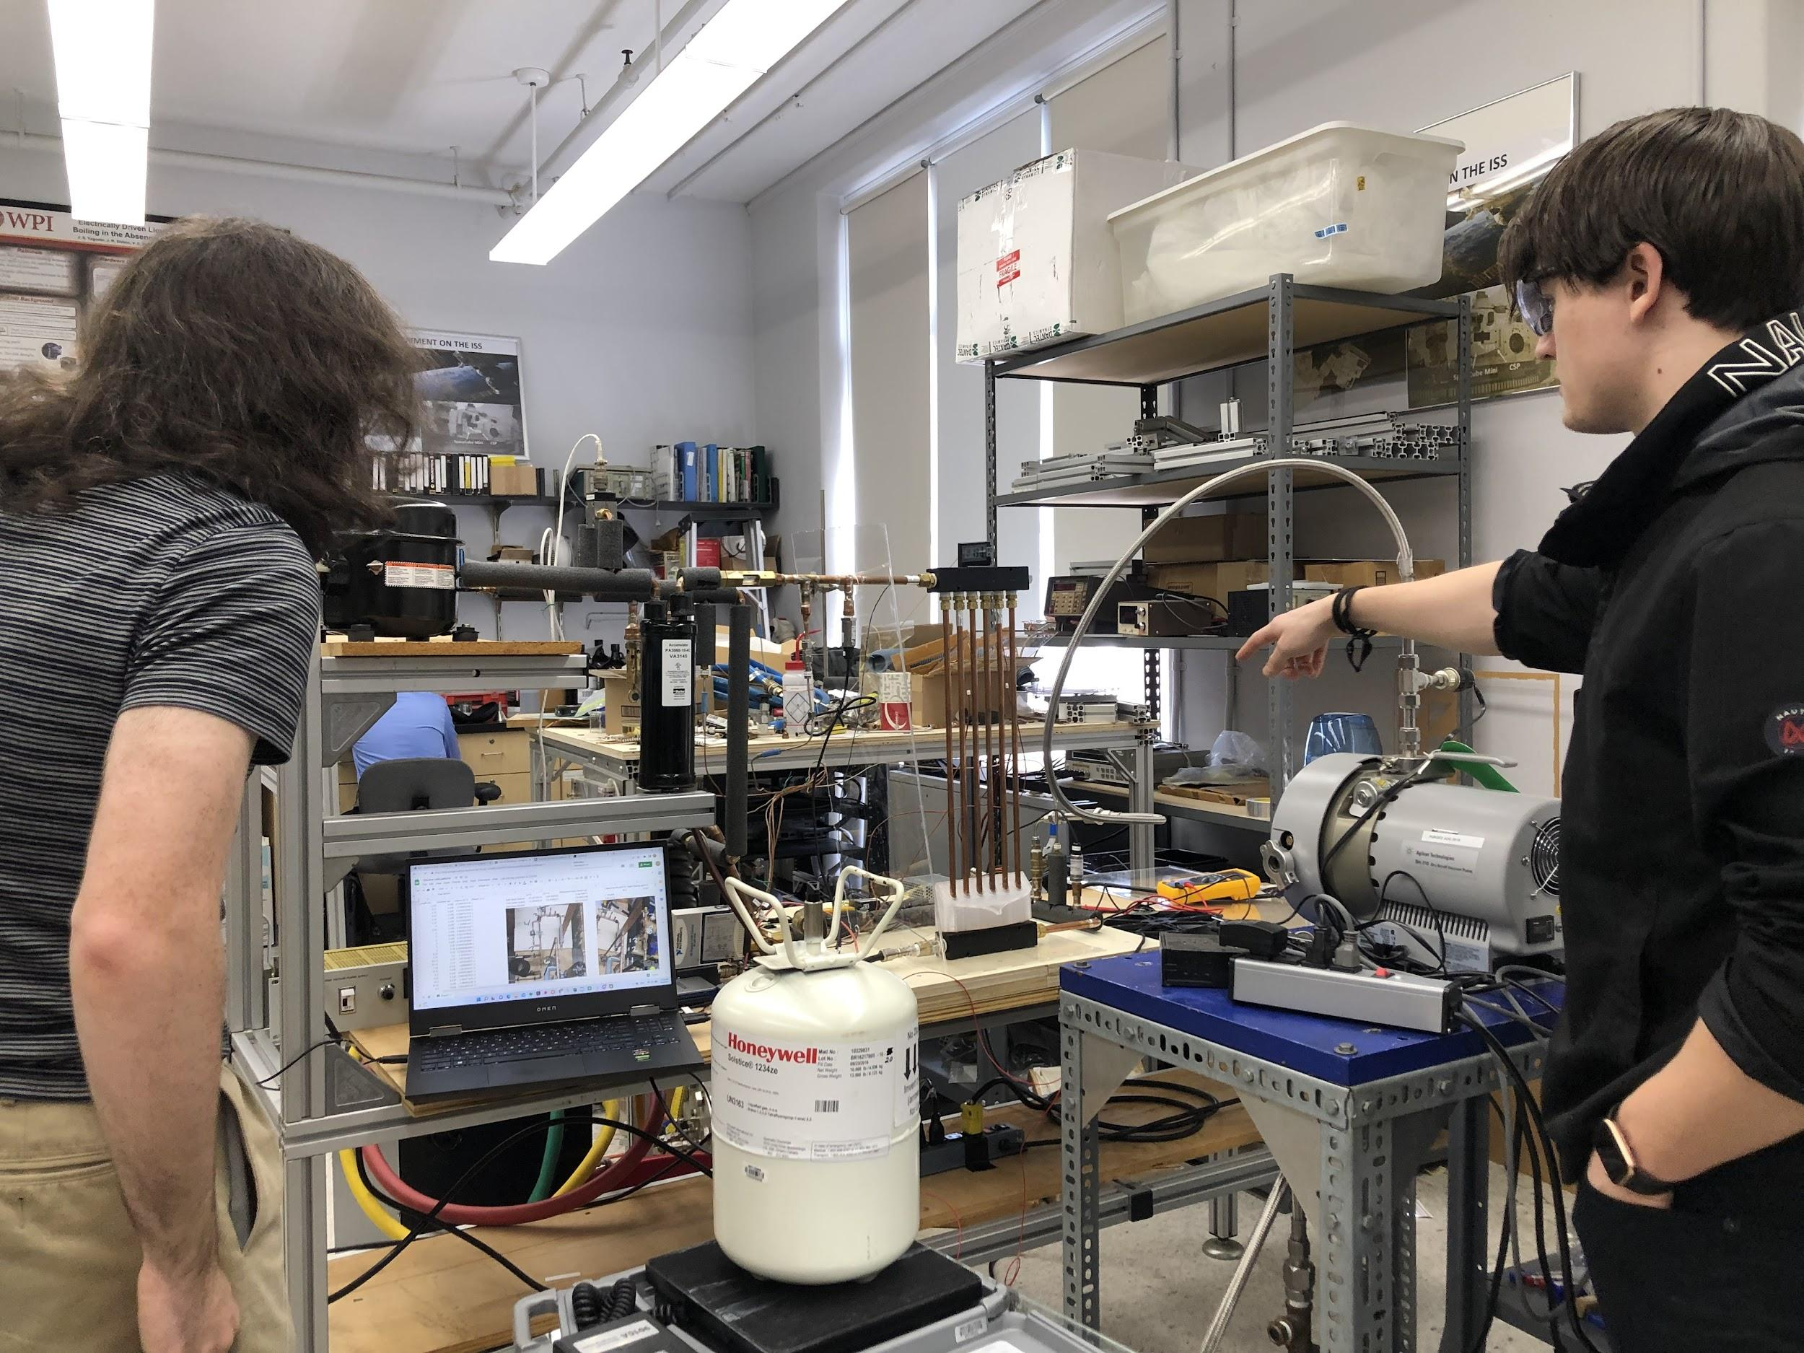
EHD VCC Fabrication Process
With the system fully prepared, we were able to charge it with our refrigerant (R1234ze(E)). The system was first vacuumed to 150 μmHg (0.02% of atmospheric pressure), then 288 g of R1234ze was added according to our system volume calculations). Although this did not quite reach saturation pressure within the system (~5 bar), this mass was used to prevent excess liquid coming out of the evaporator.

Slide 17
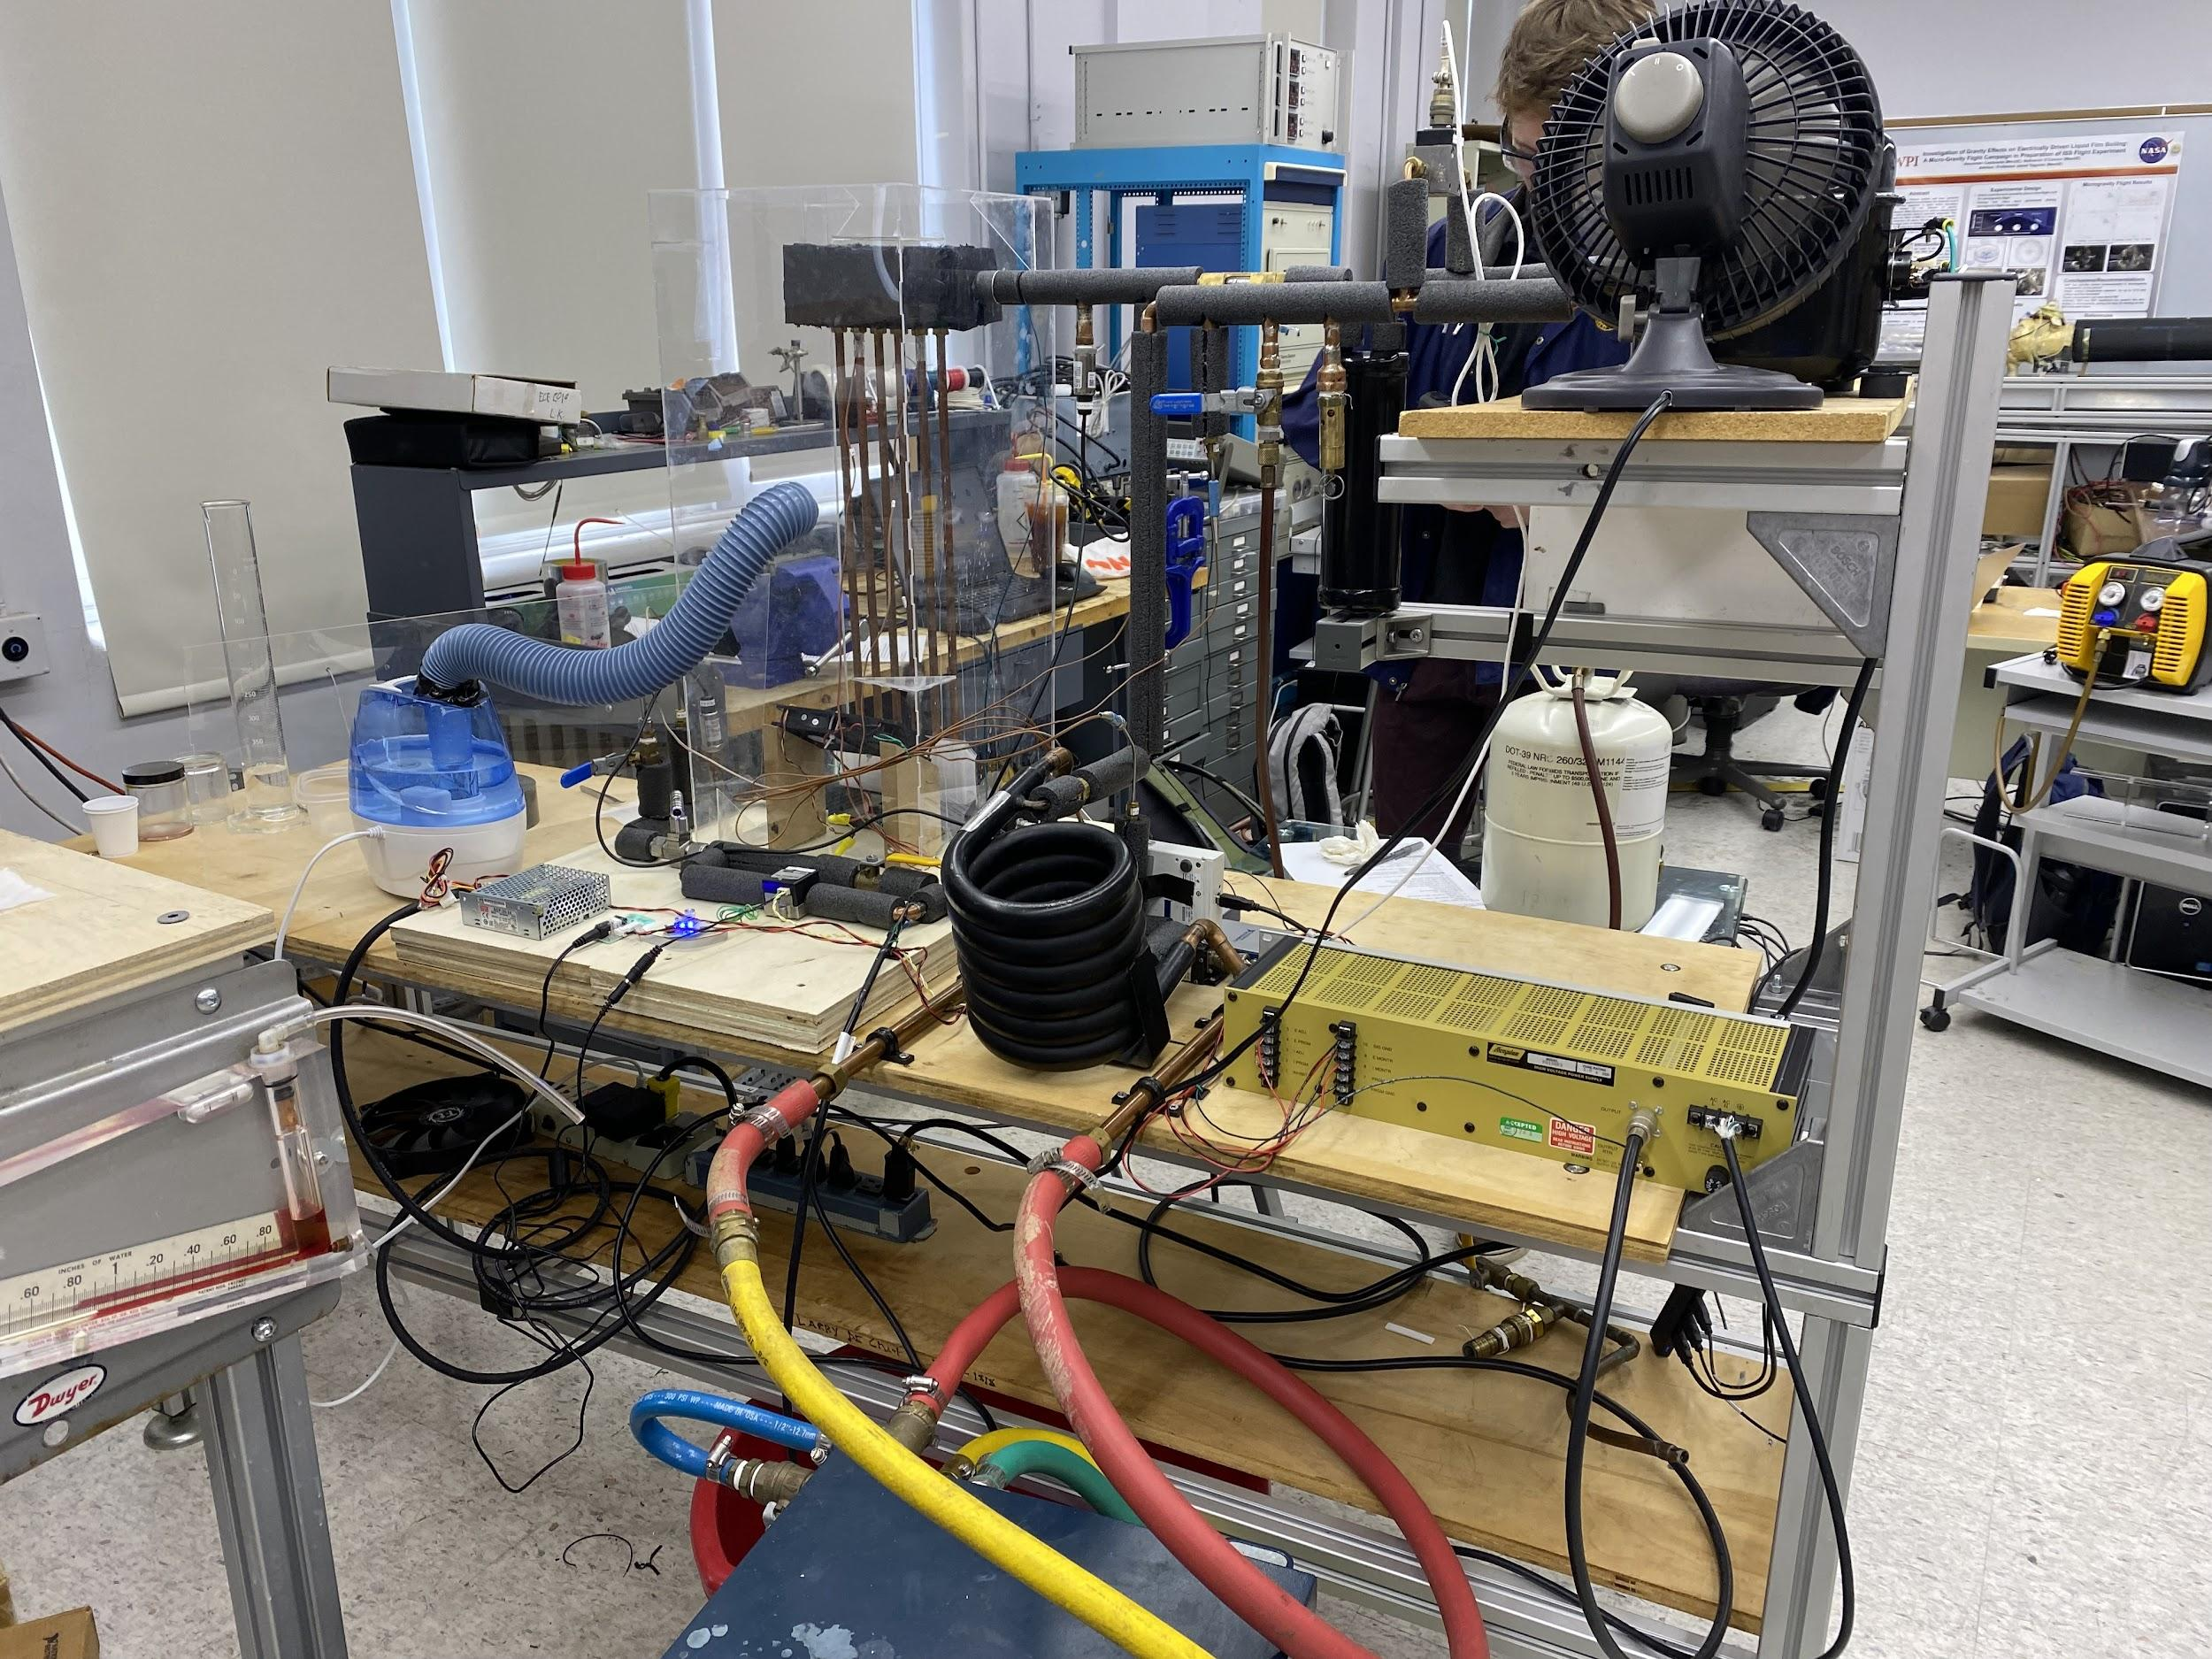
EHD VCC Fabrication Process
This is our final experimental configuration, with the humidifier, chiller, and high voltage power supply set up.

Slide 18
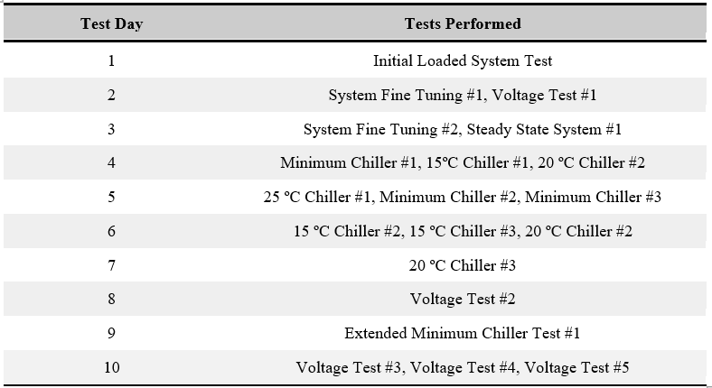
EHD VCC Fabrication Process
With this, our fabrication process was complete! See the table below for our testing schedule, and our supplementary materials for our collected data.

