Slide 1
Software Defined Radar
Group 33 – Ranges and Test Beds
MQP Final Presentation
Shahil Kantesaria
Nathan Olivarez
13 October 2011
This work is sponsored by the Department of the Air Force under Air Force Contract #FA8721-05-C-0002. Opinions, interpretations, conclusions, and recommendations are those of the author and not necessarily endorsed by the United States Government
Notes:
1
1

Slide 2
Overview
Project Introduction & Deliverables
Radar Background
Radar System Design
Time Synchronization
Radar Processing
Summary

Slide 3
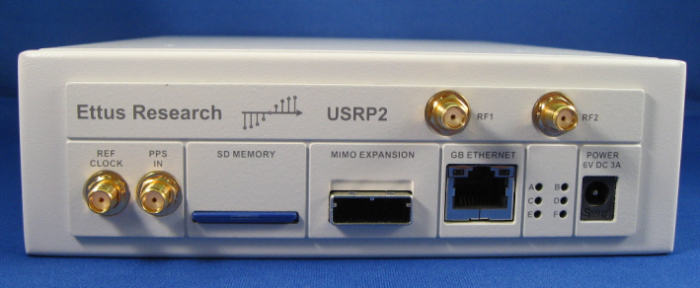
Project Introduction
Project objective: build an inexpensive multistatic radar receive system using Ettus Universal Software Radio Peripheral (USRP2)
Deliverables:
Time Synchronization
Radar Processing
Range
Doppler
Direction
Software Defined Radio
Radio whose typical hardware components are implemented in software
Digital filters & mixers, modulators/demodulators
http://cwnlab.ece.okstate.edu/images/facilitiesimg/usrp2.jpg
Notes:
Two main deliverables: time synchronized 6 channel receiver array to within a 5 ns tolerance
implement existing radar algorithms in matlab post processing script including range, doppler and direction
Brief background on SDR: is a radio whose hardware compoents are inplemented in software on an FPGA rather than being fixed

Slide 4
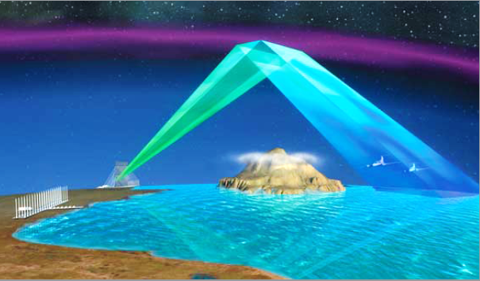
Radar Background
Radar, short for Radio Detection and Ranging, is a method of detecting targets using electromagnetic waves
Two different types of Radar:
Pulse Radar
Continuous Wave Radar
Over the Horizon Radar:
Continuous Wave
3-30 MHz Frequency
Multistatic configuration
Large antenna arrays (~2-3 km)
¹http://www.raytheon.com/capabilities/products/stellent/groups/public/documents/legacy_site/cms01_049201.pdf
Notes:
Pulse alternative between transmit and receive
Continous: continously and simulatanously transmits and receives
OTH is continous wave which allows for higher average transmit power allowing detection of objects 1000 km away
3-30 mhz allows for bouncing of signals off of the atmosphere
Large antenna arrays comprise this multistatic system to receive the reflections
Multistatic: point to picture
Multistatic configuration can be broken down into two major subsystems

Slide 5
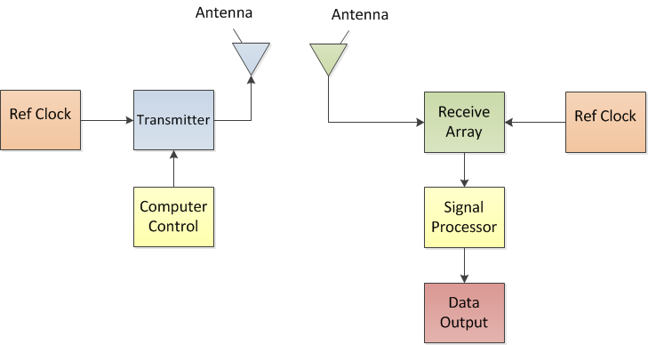
Multistatic Radar System
Transmitter
Receiver
Notes:
On the left is the transmitter that transmits the signal, in our project the transmitter has been given to us by Group 33
Right: primary focus of our project the receiver which samples the signal from an antenna, processes the sampled data and provides a data output
In our system there are 6 receive channels which need to be insyc with each other

Slide 6
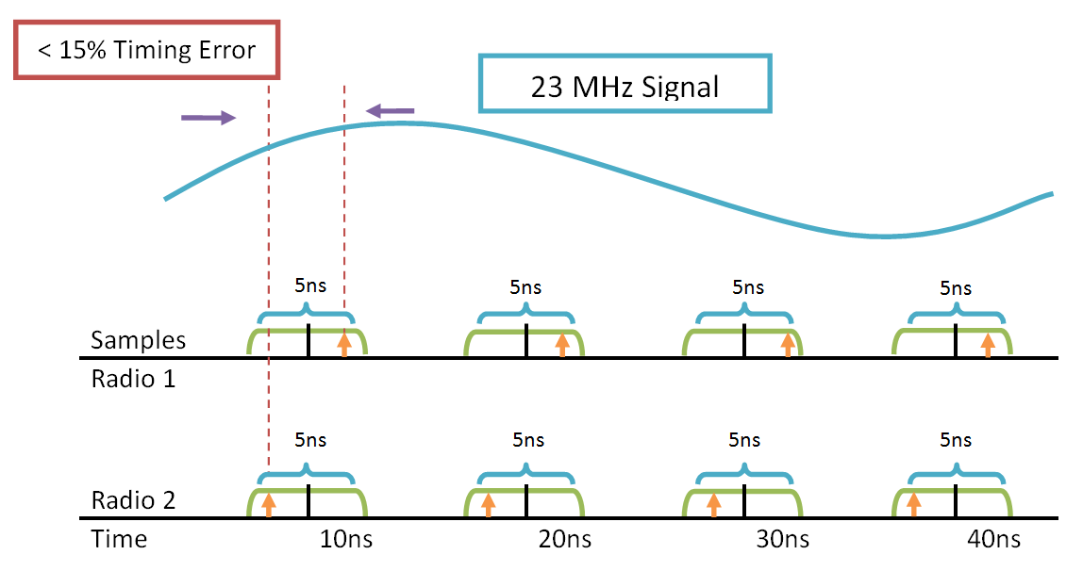
Clock Synchronization
Sampling rate of the system is 100 MHz
Our radar system operates in HF (3-30 MHz)
Tolerance of 5 ns minimizes the error to less than 15% for the HF band
Notes:
Each radio receiver samples the incoming signal at 100 MHz
Since our system operates in the HF band having a tolerance of 5 ns between all of the receivers in the array would result in less than a 15% timing error.
As seen in the picture is a incoming signal, ideally we would like all the radios to sample at the black line, but in reality each radio will sample at a different point in time, but synchonizing the radios to within a 5 ns window we can minize the error to 15 percent
To provide an example of this clock drift

Slide 7
Clock Stability
Current Performance
Target Performance
3 Synchronized, 1 Not
4 Synchronized Radios
Notes:
A oscilloscope plot showing the adc clock waveforms of 3 sync radios with one radio drifting in PINK, does not meet the 5 ns requirement
Our target performance is shown in the right plot where all the adc waveforms are in phase with each other to a certain tolerance

Slide 8
USRP2 Clock Synchronization
Synchronizing USRP2 ADC Clock
100 MHz Internal Oscillator controlled by a Phased Locked Loop
Inputs to Phase Locked Loop
10 MHz Reference Clock
1 pulse per second (PPS )
Input Power/Level Requirements
10 MHz Ref. Clock Power: 5-15 dBm
1 PPS: 5V Peak-to-Peak

Slide 9
Receiver System Design

Slide 10
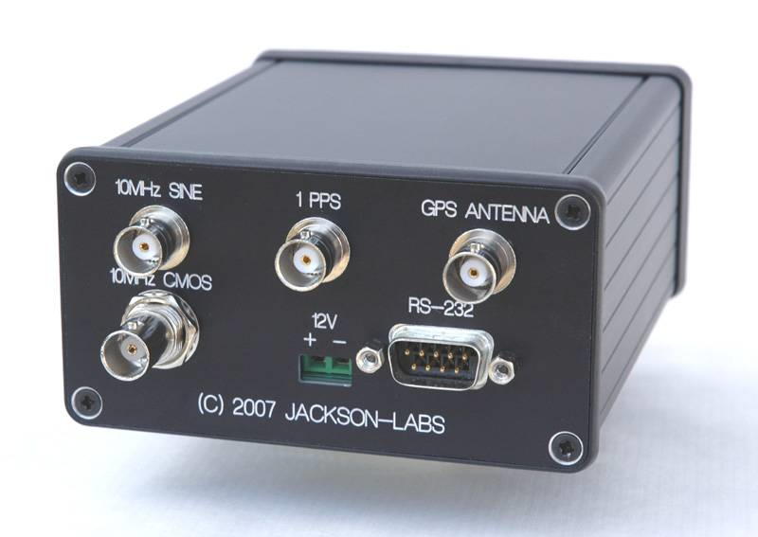
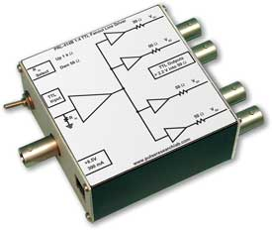
Radar System Design
Selected the following Components:
Jackson Labs GPS Disciplined Oscillator
10 MHz output
1 PPS output
Pulse Research Labs 1:4 Fanout Buffer
Clock/PPS Signal Distribution
Freq < 100 MHz
Four in-phase 50Ω TTL Outputs
¹http://media.marketwire.com/attachments/200706/MOD-346700_Fury_bezel_small.jpg
²http://www.pulseresearchlab.com/products/fanout/prl-414B/images/PRL-414B_small.jpg

Slide 11
Our Implementation

Slide 12
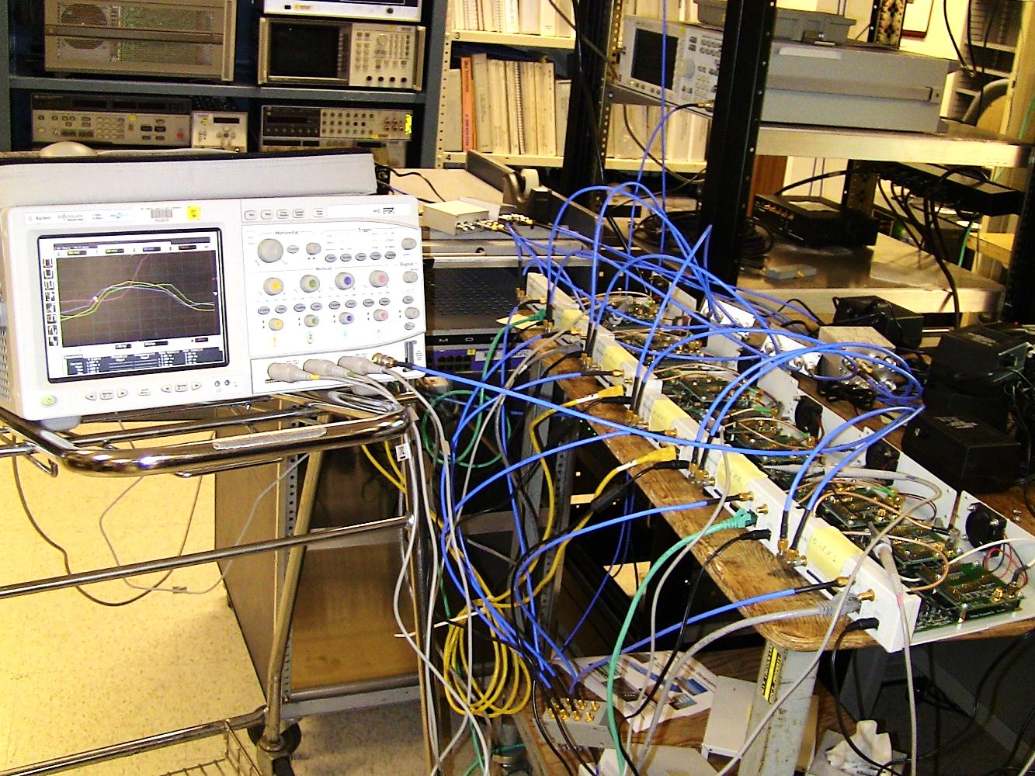
Synchronization Testing
We used an oscilloscope and the USRP2 clock debug pins to record the ADC clock drift

Slide 13
PPS Trigger Test
The purpose of this test was to determine whether the radios could consistently trigger off the 1 PPS
Channels 1-3 were connected to USRP2s and Channel 4 was connected to the GPSDO PPS output
The PPS signal served as a reference for measuring drift
30 Minute Persistence Plot
Voltage
< 2ns
Time (ns)

Slide 14
Radar Receiver
GNU Radio provides the means to interface the USRP2 array and record data
Radar processing implemented in Matlab
Range
Doppler
Direction
Notes:
The ability to achieve time synchronization showed that it is possible to use the USRP2 to build a radar receive array.
We used the program GNU Radio to interface with and record data from the USRP2. This raw data was then ported to Matlab for post processing.
All of our radar processing was conducted in Matlab in 3 main steps: range processing, doppler, calculation and direction finding

Slide 15
Radar Receive Array
One Dimensional Line Array:
6 Elements
23 MHz Signal: λ = 13 m
Spacing: = 6.5 m
Antenna Height: = 3 m

Slide 16
Range Processing
Range is determined by the time delay between the transmitted and the received signals
Assuming the transmitter and receiver are synchronized, the delay equals the travel time
R
R ≈ c τ/2
Tx
Rx
t=0
Time delay
t=τ
Notes:
The first step is range processing which is used to determine the distance of a target from the receiver.
<PLAY> Range can be calculated by measuring the amount of time it takes a transmission to reach a target and return to the receiver

Slide 17
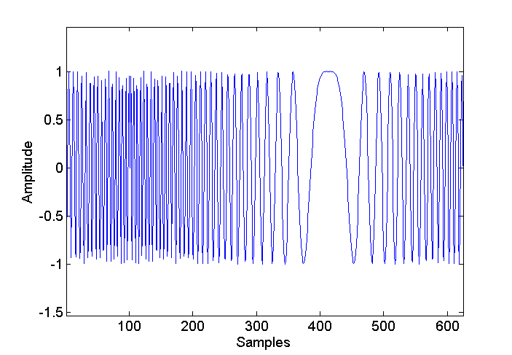
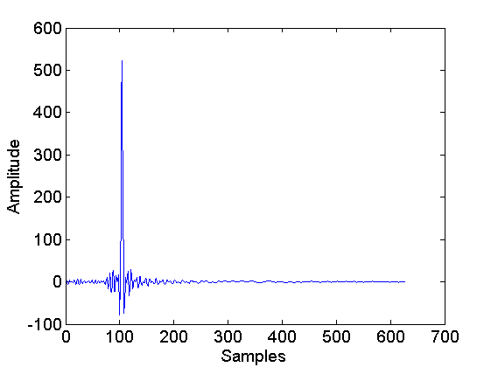
Range Processing (cont.)
The delay can be computed by determining when the chirp was received via correlation
Correlating the received signal with the transmitted chirp is known as pulse compression
Received Chirp
Peak index denotes delay
Single Sweep
Amplitude
CORR
Amplitude
Transmitted Chirp
Time
Range bins
Notes:
The signal radar system transmits is called a chirp, a narrowband frequency sweep
The time delay can be computed by correlating the transmitted chirp with the received chirp.
Correlation of a single sweep creates a distinct peak which represents the range

Slide 18
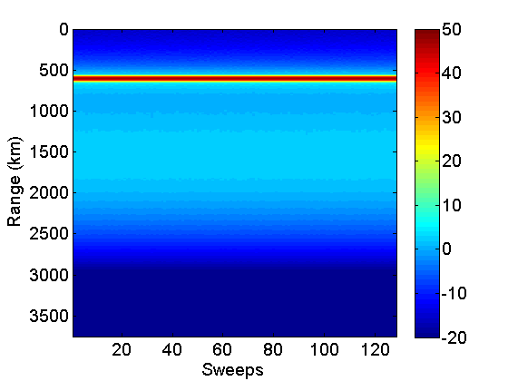
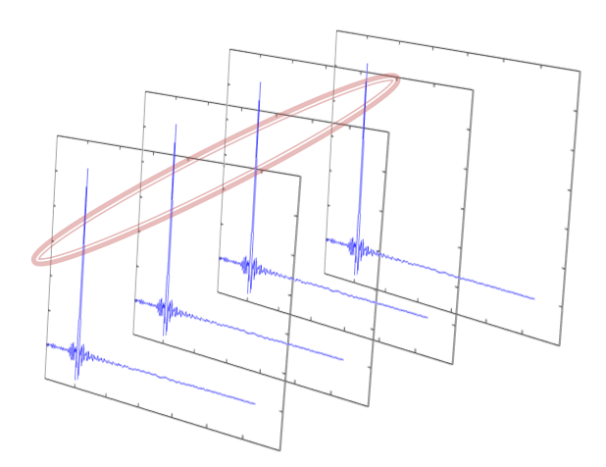
Range Plot
Multiple sweeps over time
Range vs. Time
Time
Notes:
We can generate a range vs. time plot by taking the correlation of multiple sweeps over time.
The range of a target is denoted by the high intensity ridge, as shown in red.
This figure shows a target at about 600 km.

Slide 19
Doppler Processing
By computing the difference between transmitted and received waveform repetition frequency (WRF), we can use the Doppler effect to determine a target’s velocity
Changes in WRF are characterized by a periodic phase change between received chirps
This frequency can be determined by taking the Fourier transform of the pulse-compressed data
Target 1: +F
Target 2: -F

Slide 20
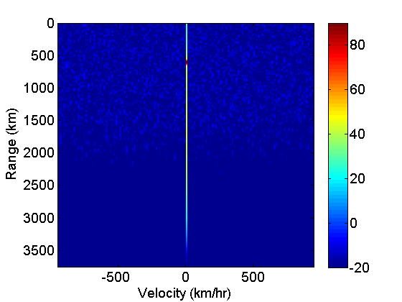
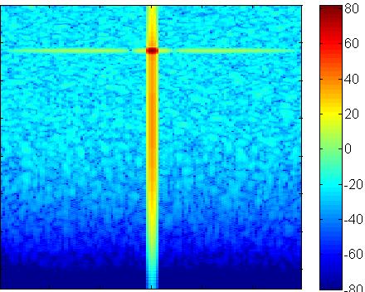
Doppler Processing
Used to identify target velocity
Doppler is a phase progression from sweep to sweep
The Fourier Transform of a periodic function produces an impulse function at the center frequency
Taking the FFT of the range cells creates a peak at the intersection of the target’s range and Doppler Frequency
Range vs. Time
Range vs. Speed
FFT
FFT
Range (km)
Range (km)
FFT
FFT
Time
Velocity (km/hr)
Notes:
Doppler processing is used to determine a target’s velocity.
As a target moves relative to the receiver, it creates a Doppler shift frequency characterized by a phase progression of the received signal from sweep to sweep.
This frequency can be calculated by taking the fourier transform across each of the range cells.
As shown in the range vs. speed plot, a target is located at the peak created by the intersection of the range and doppler axes.
This figure shows a target located at 600 km moving at 0 km/hr. Note that this plot is generated from a single antenna.

Slide 21
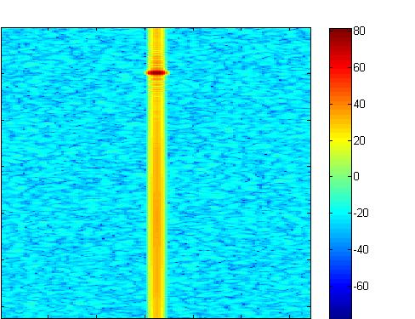
Range-Doppler Comparison
Our Results
Sponsor’s Results
Range (km)
Range (km)
Velocity (km/hr)
Velocity (km/hr)
Both plots show the target at approximately 600 km and 0 km/hr

Slide 22
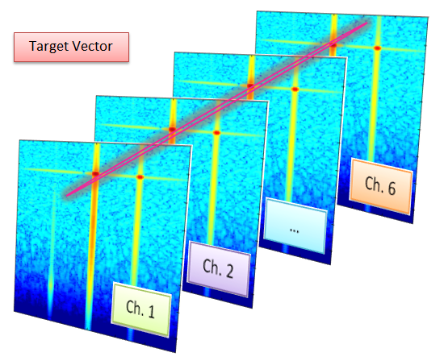
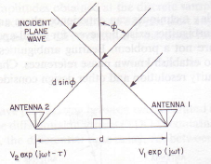
Direction Finding
Direction finding requires a vector of the complex samples from each channel’s Range-Doppler plot
Assuming a flat wave front (far field transmission), each sample has magnitude M and phase Φ:
ϴ
ϴ
Notes:
By taking the range-doppler plots from each antenna, it is possible to find the direction of a target.
The range-doppler bin from each of the 6 antennas, which represents a specific target, has a magnitude M and phase phi.
The target’s direction can be related to the phase difference across these 6 points.
This diagram shows a simplified case with just 2 antennas. This relationship assumes the transmitter is far away from the receiver (far field)
As the incident angle changes, the time difference of arrival, and hence the phase difference, between antennas also changes

Slide 23
Direction Finding (cont.)
Each point is multiplied by a candidate ‘zeroing vector’ defined for different theta values
The value theta that optimizes the sum is the incident angle
Complex samples from receivers at one Range-Doppler cell
Optimum ϴ
ϴ
180°
0°
x₁
x₂
x₃
Maximum magnitude sum
Notes:
An efficient method of calculating the angle is by finding an optimum angle (theta) that “zeroes” the angle of each of the 6 vectors.
The magnitude of each vector, M, can be determined by multiplying Me^jphi by a vector with negative phase.
By calculating the phase at different values of theta, we can determine the magnitude of each of the 6 points at different “candidate” angles.
The “candidate” value of theta that maximizes the magnitude sum indicates the incident angle of the transmission.

Slide 24
Our Receive Array
Six, 10 ft antennas arranged in a linear array outside Katahdin Hill

Slide 25
Direction Finding Demonstration
Notes:
This short video shows the direction plot generated by our receive array as a mobile transmitter drove through the health center parking lot parallel to our array.
The x axis of the plot shows the angle of the transmission’s incident angle (which is denoted by the signal’s peak)
The y axis shows the magnitude of the signal.
<PLAY> The angle theta from direction plot follows the transmitter as it moves. Based on our calculations, our angle had an error of about 10-15 degrees. This could be due to the close proximity of the transmitter and inaccurate calibration.

Slide 26
Summary
Purpose: Develop an inexpensive phased receive array using the USRP2 SDR
Deliverables:
Synchronized array
Array form factor
Radar processing code
Future Works
Setup larger line array
Improve synchronization by modifying FPGA firmware
Implement Real-time Processing

Slide 27
Acknowledgements
Vito Mecca
Kyle Pearson
Matthew Morris
James Montgomery
Jeffrey McHarg
Walter Dicarlo
Robert Piccola
Special Thanks to:
Group 33

Slide 28
Questions?

