Slide 1
RBH Photovoltaic System: Performance Review and Future Recommendations
Presented by:
Charles Dewitt
Casey Arpin
Drew Gelinas
Maryann O’Connell

Slide 2
Project Goals
Evaluate the performance of the photovoltaic (PV) system at Río Bayamón Housing Complex.
Examine the benefits of signing a net metering agreement.
Determine backup battery options for use during power outages.
Notes:
Add emphasis to first goal

Slide 3

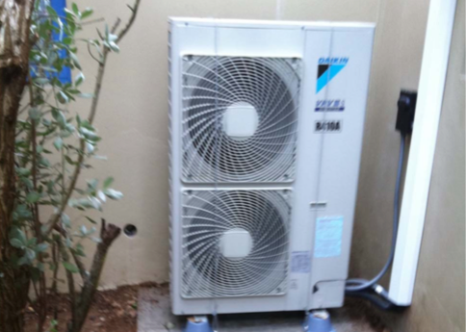
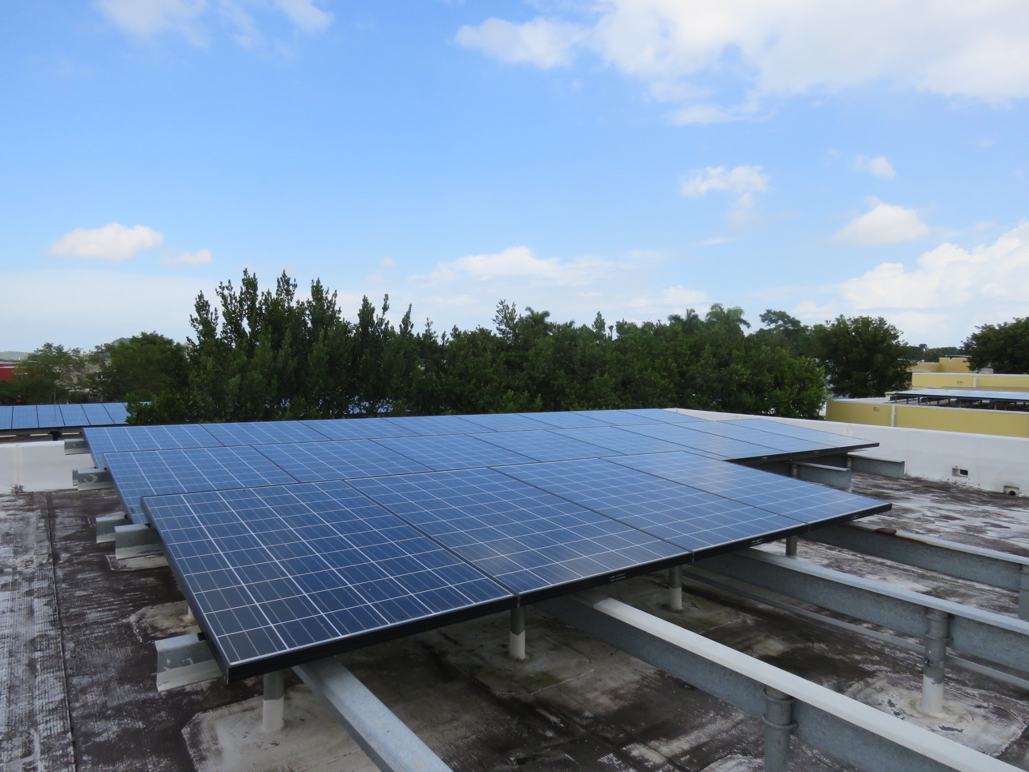
Quick History
December 2010
Phase 1 Initiated
June 2011
Phase 2 Initiated
September 2016
Completion of Contract Year 5
Notes:
Do we really need this slide? I think if we just had a slide about phase one it would be better.
Then another slide about the contract years. We don’t need to mention phase 2.

Slide 4
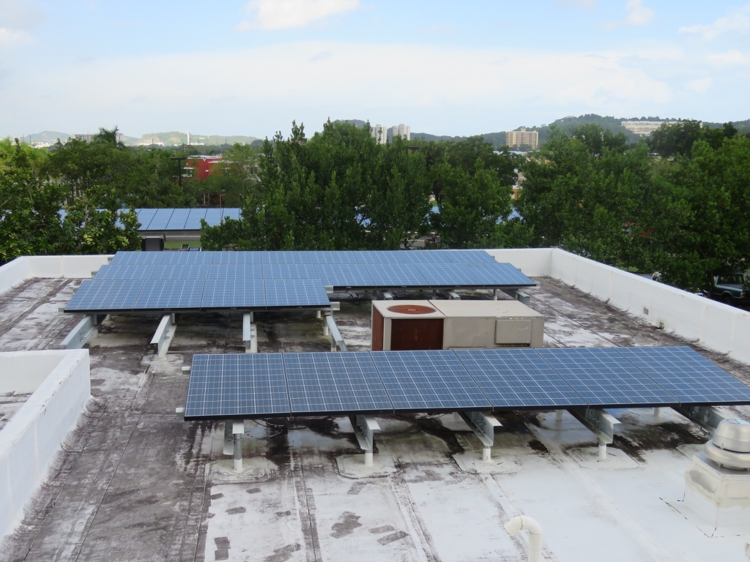
RBH PV System Overview
576 kW of solar PV capacity in total
2,451 PV Modules
85 Inverters
Enterprise Grade Monitoring System

Slide 5
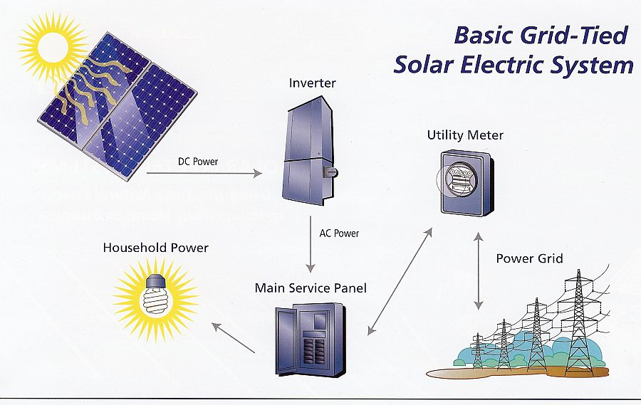
Photovoltaic (PV) Systems

Slide 6
Net Metering Overview
Electricity Consumed
Electricity Produced
Net Consumption

Slide 7

3 months
Electricity used at RBH in 2013 produced by the photovoltaic arrays

Slide 8
Performance
Savings and Costs
Back-up Batteries
Contracts
Project Overview

Slide 9
Performance
Savings and Costs
Back-up Batteries
Contracts

Slide 10
Common Terminology
Documents
IGA
RESA
Other
PREPA
M&V
ESPC

Slide 11
USCG Puerto Rico
Energy Savings Performance Contract (ESPC)
Schneider Electric
US Coast Guard
Hannon Armstrong PR Solar LLC

Slide 12
ESPC Overview
RESA
Price Proposal
M&V Reports
Completed annually by ESCO
23-year contract
Investment Grade Audit
Technical Assessment
Saving and performance verification
Financing method
Establishes third party ownership
Notes:
Need to add bullets to RESA

Slide 13
Puerto Rico ESPC Net Metering Timeline
Revisions and comments made by Coast Guard legal team.
2012
Updated net metering agreement to include revisions.
2015
2011
PREPA proposed agreement.
2014
Revisions and comments continued.
2016
Draft still awaiting final review by Coast Guard legal team.
Notes:
net-metering contract, 10-18-2011, provided by PREPA
reviewed by USCG Legal Services, comments made, 5-18-2012.
Additional comments, Sector San Juan Logistics Department Head, 12-17-2014.
Resource efficiency manager worked with the Sector San Juan Legal Detachment, June 2015, draft net metering contract, addresses revisions
draft awaiting final review by USCG Legal Services

Slide 14
Summary of Contracts
The ESPC is the contract that describes the finances, technical specifications, and performance of the PV system.
The Coast Guard does not have a net metering agreement and is still waiting for final reviews by the Coast Guard Legal services.

Slide 15
Performance
Savings and Costs
Back-up Batteries
Contracts

Slide 16
Actual Vs. Estimated Production for RBH
Year 1 | Year 2 | Year 3 | Year 4
626 MWh | 770 MWh | 756 MWh | 769 MWh
642 MWh | 852 MWh | 847 MWh | 843 MWh
2.5% | 9.5% | 10.8% | 8.8%
Actual
Estimated
PV System at RBH is Underperforming
Notes:
The estimated production values
Note Contract Year 1 was a partial year
Explain estimated annual production corresponds to the USCG’s expectations of the system

Slide 17
Adjustments to Production
shading
utility grid outage
maintenance activities undertaken by the USCG

Slide 18
Adjusted Vs. Estimated Production for RBH
Year 1 | Year 2 | Year 3 | Year 4
665 MWh | 845 MWh | 767 MWh | 769 MWh
642 MWh | 852 MWh | 847 MWh | 843 MWh
3.7% | 0.8% | 10.6% | 8.8%
Adjusted
Estimated
Notes:
Explain estimated annual production corresponds to the USCG’s expectations of the system

Slide 19
Summary of Performance
Overall, the PV System at RBH is performing well.
Actual production has been within 10% of the estimated production for contract Year 1 through Year 4.
Future M&V reports will provide additional insight regarding the system’s performance.

Slide 20
Performance
Savings and Costs
Back-up Batteries
Contracts

Slide 21
Annual Cost to USCG
Notes:
Regular Performance Expenses = Measurement and Verification ($) + Management/ Administration ($) + Maintenance ($)

Slide 22
Regular Performance Period Expenses ($)
Management and Administration
Measurement and Verification
Maintenance

Slide 23
Actual Production (kWh)
Adjustments to Production
(kWh)
total kWh of Services
Adjustments to Production
(kWh)
$145 K
total kWh of Services
RESA rate per kWh
RESA Services ($)
Costs Incurred from Year 1-4 Adjustments
(for RBH and ASB)
Notes:
Actual term: Production Outside of Owner Control / term used: Adjustments to Production
RESA Services Payment is referred to as total kWh of Services in RESA
RESA Services Payment is Task Order terminology

Slide 24
ESPC Expenses Allocation with Net Metering Agreement

Slide 25
ESPC Expenses Allocation without Net Metering Agreement

Slide 26
Lost at RBH by not having a net metering agreement for Years 1 and 2 Alone
$450 K

Slide 27
RESA Rate Determination
Electricity prices rely heavily on crude oil (FCA)
US historical crude oil prices
Calculate US crude oil with inflation
Use final oil costs to calculate inflation rate
Use current PREPA electricity costs with inflation rate

Slide 28
Summary of Savings and Costs
Since there is no net metering contract in place, the Coast Guard is yet to see any true savings.
Adjustments to production at RBH and ASB during contract Year 1 through Year 4 cost the Coast Guard $145 K.
During contract Year 1 and Year 2 alone, the Coast Guard lost
at least $450 K from the absence of net metering agreement.

Slide 29
Performance
Savings and Costs
Back-up Batteries
Contracts

Slide 30

Problem Overview
Frequent Power Outages
Current Electricity Backup Process
Grid Tied PV System
Four Hour Gap

Slide 31
Battery Types
Battery Types
Sealed Lead Acid
AGM
Gel
Lithium Ion
Flooded Lead Acid
Battery Needs:
Deep cycle
Long cycle-life
Low maintenance
No/low environmental impact

Slide 32
Lithium ion vs. Lead acid
Battery Types | Lithium Ion | AGM Lead Acid
Cycle Life | 2,000 @ 100% DoD | 1,000 @ 50+% DoD
Temperature Sensitivity | Degrades @ > 115F | Degrades @ > 77F
Discharge Efficiency | 100% @ 20hr rate 99% @ 4hr rate | 100% @ 20hr rate 80% @ 4hr rate
Natural Self-Discharge | 8% in 24 hrs with an additional 1.5% per month | 5% per month
Safety Rating | High | High
Maintenance Required | None | None
Environmental Impact | Low (depends on disposal) | Low (depends on disposal)

Slide 33
Cost-benefit analysis
Providing power for: refrigerators and lighting
Categories | 4hr Outage Per Week Li |  | 4hr Outage Per Week L-A
Voltage | 12V | 48V | 12V | 48V
Cost of Single Battery | $290 | $1300 | $110 | $525
Cost of Batteries/Block | $8120 | $9100 | $3075 | $3,675
Estimated Total RBH Cost | $235,475 | $263,700 | $89,325 | $106,575
Providing power for: refrigerators, lighting and air conditioning
Categories | 4hr Outage Per Week Li |  | 4hr Outage Per Week L-A
Voltage | 12V | 48V | 12V | 48V
Cost of Single Battery | $575 | $2,850 | $135 | $625
Cost of Batteries/Block | $15,975 | $19,975 | $3,775 | $4,375
Estimated Total RBH Cost | $462,850 | $579,375 | $109,625 | $126,875

Slide 34
Final Cost Comparison
Installation Cost of Cheapest Battery:
Estimated Cost of Using Generators:
Batteries: | $106,600
Balance of Systems: | $168,800
Labor: | $3,350
Total: | $278,750
US Diesel Cost/Gallon: | $2.42
Avg Inflation Rate(10yrs): | 12.94%
Max Generator Prod: | 15kWh
Total 20 Year Cost: | $23,500
VS
Cost Difference:
$255,000

Slide 35

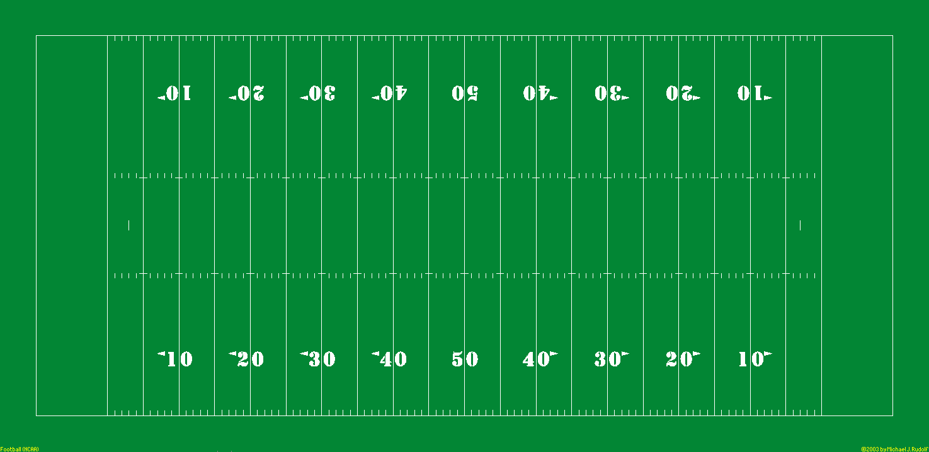
Battery Issues
Size of Total Batteries
Future Replacement of Batteries
Disposal Complications
Environmental Impact
X 4
X 2
Notes:
- Height was off, omit
Check weight! Typical SUV is ~4500 lbs

Slide 36
Summary of Batteries
48V Lead Acid is the best battery option for this scenario
Batteries aren’t plausible due to size
Continuing to use a generator would save $255,000

Slide 37
Project Recommendations
Push for Net Metering Contract
Given current battery options, continue to use diesel generators during power outages

Slide 38
We would like to thank the following people and organizations for assisting us with our project:
US Coast Guard
Lt. Cetrulo
Professor Bianchi
Professor Troy
Richard Evers

Slide 39

Questions?

Slide 40
ESPC Expenses Allocation without Net Metering Agreement
Notes:
In this chart, Savings corresponds to money paid for buying the system

Slide 41
ESPC Expenses Allocation with Net Metering Agreement
Notes:
Meaning of savings varies during and after

Slide 42
Annual Production Summary for RBH
Year 1 | Year 2 | Year 3 | Year 4
2.5% | 9.5% | 10.8% | 8.8%
3.7% | 0.8% | 10.6% | 8.8%
Actual
Adjusted
Potential to Exceed Expectations
Potential to Meet Expectations
Expected to Continue Underperforming
Notes:
Explain estimated annual production corresponds to the USCG’s expectations of the system

