Slide 1
Stantec Structural MQP
Structural Bridge Design and Construction Traffic Management Plan for the Route 24/140 Interchange
By: Anjali Kuchibhatla, Carolina Leguizamón and Maitane Sesma
February 27, 2017
Notes:
ANJALI
Title of the project, talk about how project is all encompassing, preliminary so 3 general ideas

Slide 2
Site Conditions
Interchange at Route 24/140
Project First Light
Casino Development
Roadway Improvements
Major link with the Greater Boston Area
Located at a Wetland Region
Photo description
Notes:
MAITANE
Taunton, MA, interchange at 24/140
The interchange redesign is part of a larger project in Taunton, known as Project First Light.
Project First Light consists of a casino development, as well as roadway improvements at surrounding intersections along Route 24 and Route 140 in order to alleviate potential traffic congestion.
Talk about wetland region

Slide 3
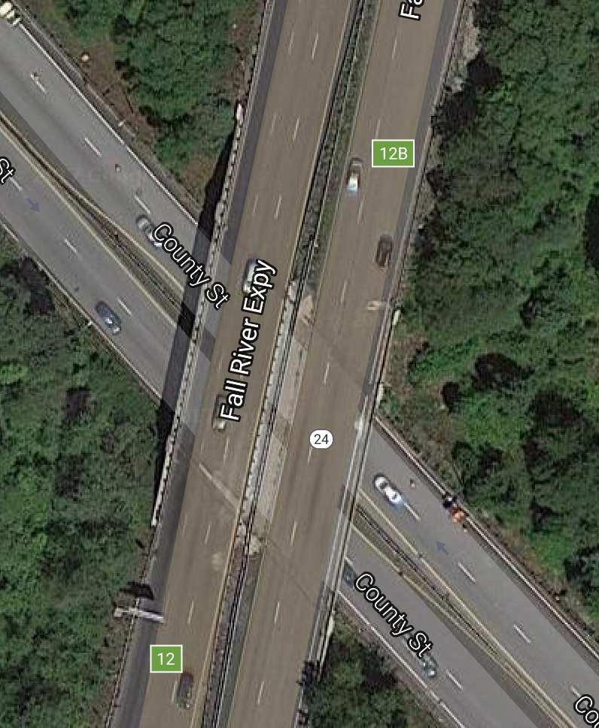
Current Bridge Geometry
115 ft. span
88 ft. width
14.5 ft. vertical clearance
2 lanes each direction
Improvements need to be done on the bridge and intersection
Notes:
MAITANE
Talk about vertical clearance, width, length,
2 lanes each direction
In order to accommodate PFL, improvements need to be done on the bridge
Signaling
Many stakeholders
Route 24 has four operating lanes, and provides a major link between the greater Boston area and communities to the Southeast of Taunton. Route 140 is a state highway that passes through parts of southeastern and central Massachusetts.

Slide 4
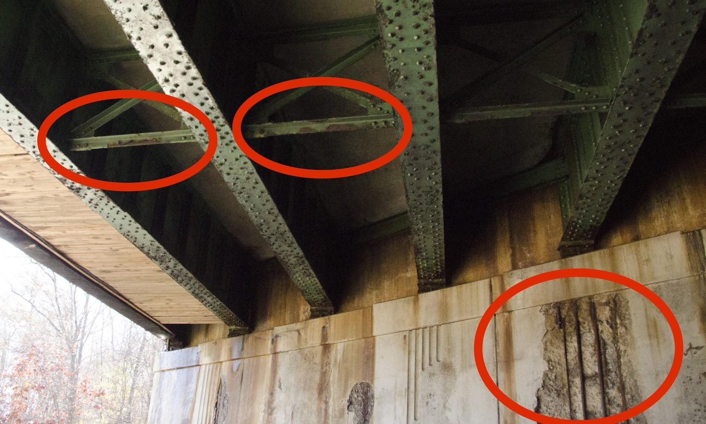
Site Visit
Traffic Congestions
Structurally Deficient Bridge
Exposed Rebar, Corrosion, deterioration
Notes:
MAITANE
Route 24 has four operating lanes, and provides a major link between the greater Boston area and communities to the Southeast of Taunton.
Traffic congestion (generally, classified as crash cluster)
Exposed rebar, corrosion, deterioration, bridge is in of replacement (structurally deficient), chunks falling off
Although the bridge can remain in service, it does require immediate attention

Slide 5
“The purpose of this project was to provide a preliminary structural design, construction schedule, and traffic management plan for the bridge replacement.”
Notes:
MAITANE

Slide 6
Proposed Bridge Extensions
Proposed widening
88 ft. to 135 ft.
New lane configuration
12 ft. lanes
18 ft. deceleration lane on Rte. 24 SB
Vertical clearance 14 ft. to 16.5 ft.
Notes:
CAROLINA
NEW LAYOUT W STREET MIX
Based on 25% development plans from Stantec
Bridge widened around 50 ft
To meet MassDOT standards
Casino Traffic

Slide 7
Proposed Bridge Extensions
Proposed widening
115 ft. to 141 ft.
New lane configuration
12 ft. lanes
18 ft. deceleration lane and 10 ft. shared use path on Rte. 140 NB
Notes:
CAROLINA

Slide 8
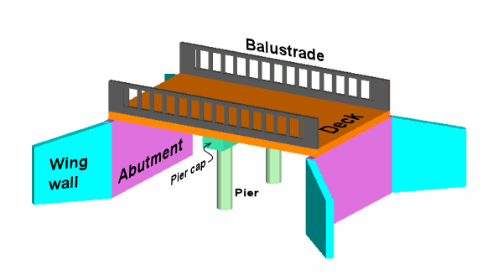
Background
Structural components considered:
Superstructure
Beam/Girder system
Deck
Substructure
Piers
Abutments
Foundations
Notes:
CAROLINA
Based on the needs and requirements for this bridge, we thought about different options for design
These would be the elements considered in our preliminary design because we found that they would vary the most between options
From MassDOT, FHWA, and AASHTO, developed the 6 bridge options: 3 1-span, and 3 2-span

Slide 9
Preliminary Bridge Design
Single Span
Plate Girder Steel
Single Span
Box Girder Steel
Cases
Double Span
Stringer Steel
Double Span
Spread Box Beam Prestressed Concrete
Notes:
ANJALI
From those 6, we analyzed overall wt of superstructure and section depth (to minimize the amt of work necessary for height increase) to get 4 final Cases
All options used composite concrete decks, reinforced concrete footings, etc.
We ended up with 2 single span and 2 double span options

Slide 10
Evaluation Criteria
Simplicity of Construction
Project Cost
Traffic Management
Beam Height
Maintenance and Inspection of Structure
Inspection Requirements
Possibility for future Improvements
Aesthetics
Minimize Environmental Impacts
Labor Cost
Time of Construction
Minimize Safety Hazards During Construction
Notes:
ANJ
In order to get the option, used these factors
Stantec, MassDOT, us
Qualitative and quantitative analyses
Talk about the 3 bolded ones mainly
Identified scope of work for each criterion
These were three most determining factors in our evaluation, but we also wanted to consider all these other factors to develop a more well-rounded recommendation

Slide 11
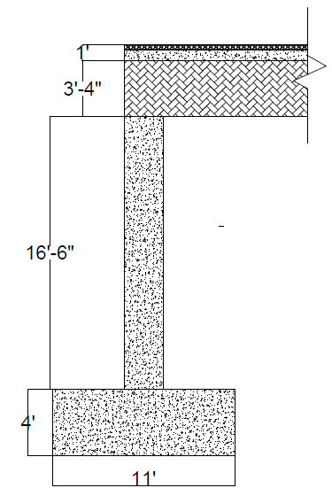
Final Bridge Design
Clear Span: 141 ft.
Width: 135 ft.
Component | Material
Footings | Reinforced Concrete
Retaining Walls | Reinforced Concrete
Beams | W40x235 Plate Girders
Deck | Composite Concrete Deck with 4” Asphalt
Notes:
ANJ
After evaluating all options, we found that the best design was a plate girder steel bridge with a 141’ single span length and 135’ width
Footings and retaining walls are made of reinforced concrete
with preliminary design of W40X235 plate girders and a composite concrete deck
Once we determined the structural design, we focused on how are we going to construct it

Slide 12
Slide-In Bridge Construction (SIBC)
Pros | Cons
Accelerated schedule Reduced temporary construction costs Reduced required labor Increases safety Minimized traffic delays and vehicular accidents during construction | Requires complete closure Requires technical experience with SIBC methods
Notes:
MAITANE
We considered several construction methods and found benefits on SIBC
FHWA promotes this method

Slide 13
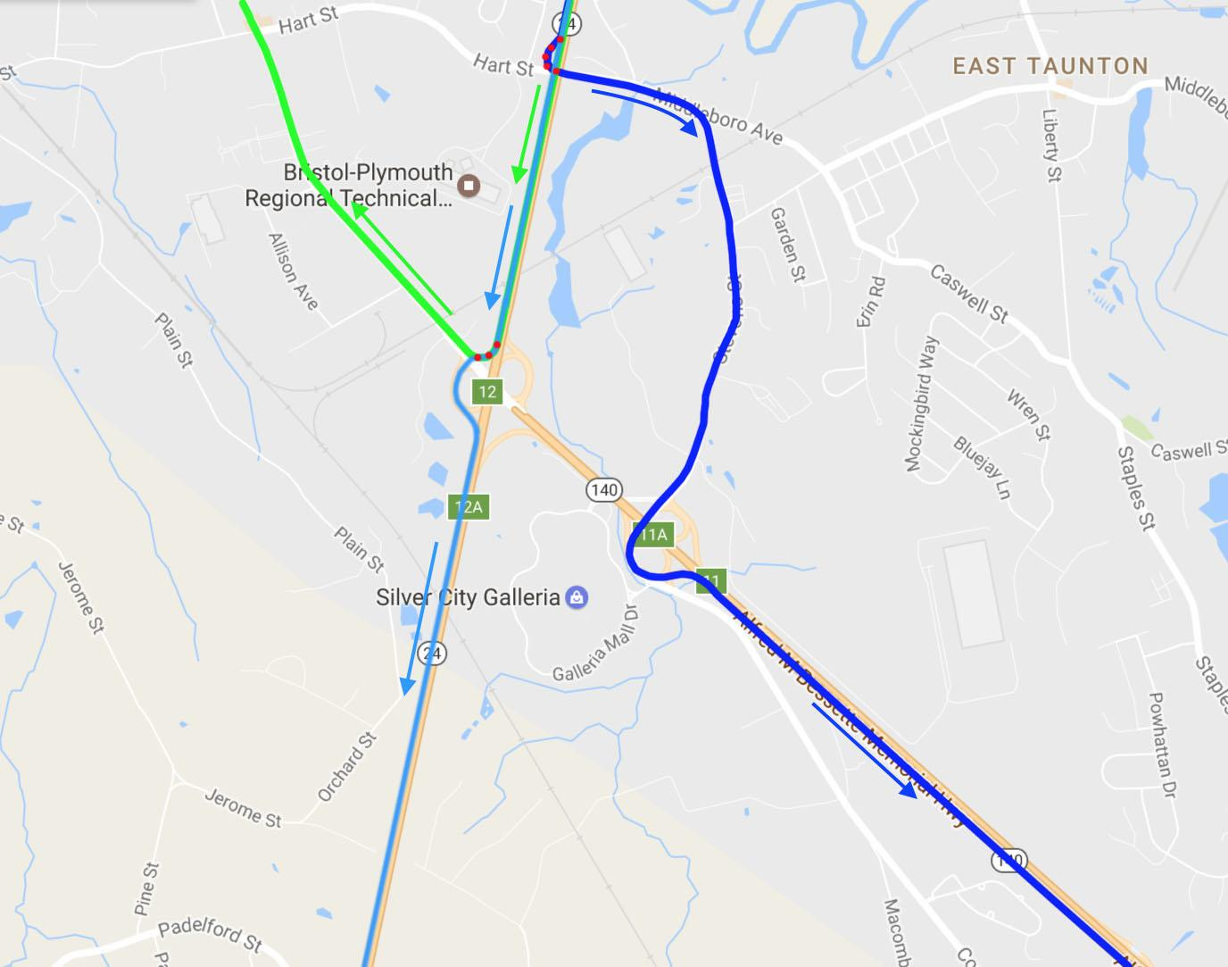
SIBC - Traffic Detour
*Bridge is completely closed
Notes:
MAITANE
We looked at the feasibility of closing the bridge for a couple of days.
We considered nearby roads that could serve as detour paths
Some we were able to route on existing roads and others we considered the construction of temporary ramps.
This is an example of some paths
Once we realized it was feasible we began to look at the construction management of SIBC method

Slide 14
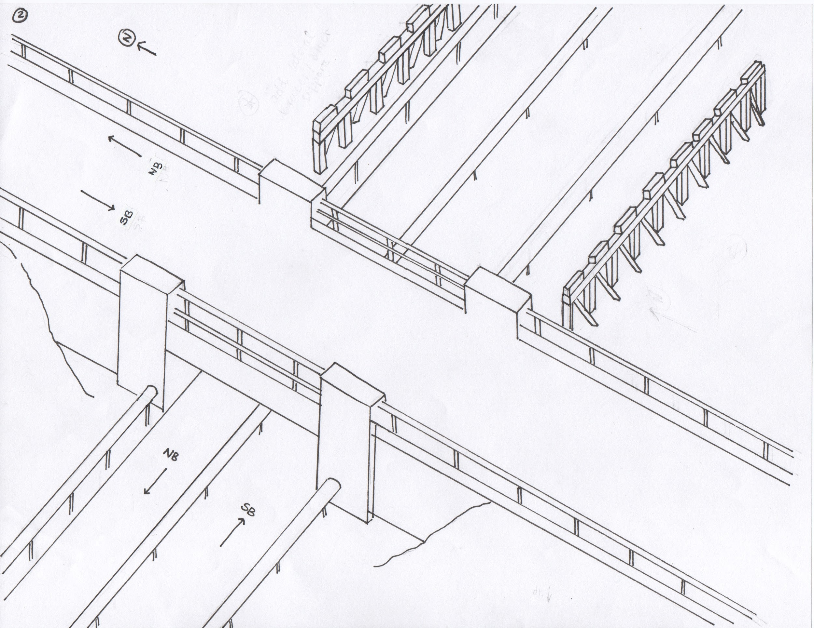
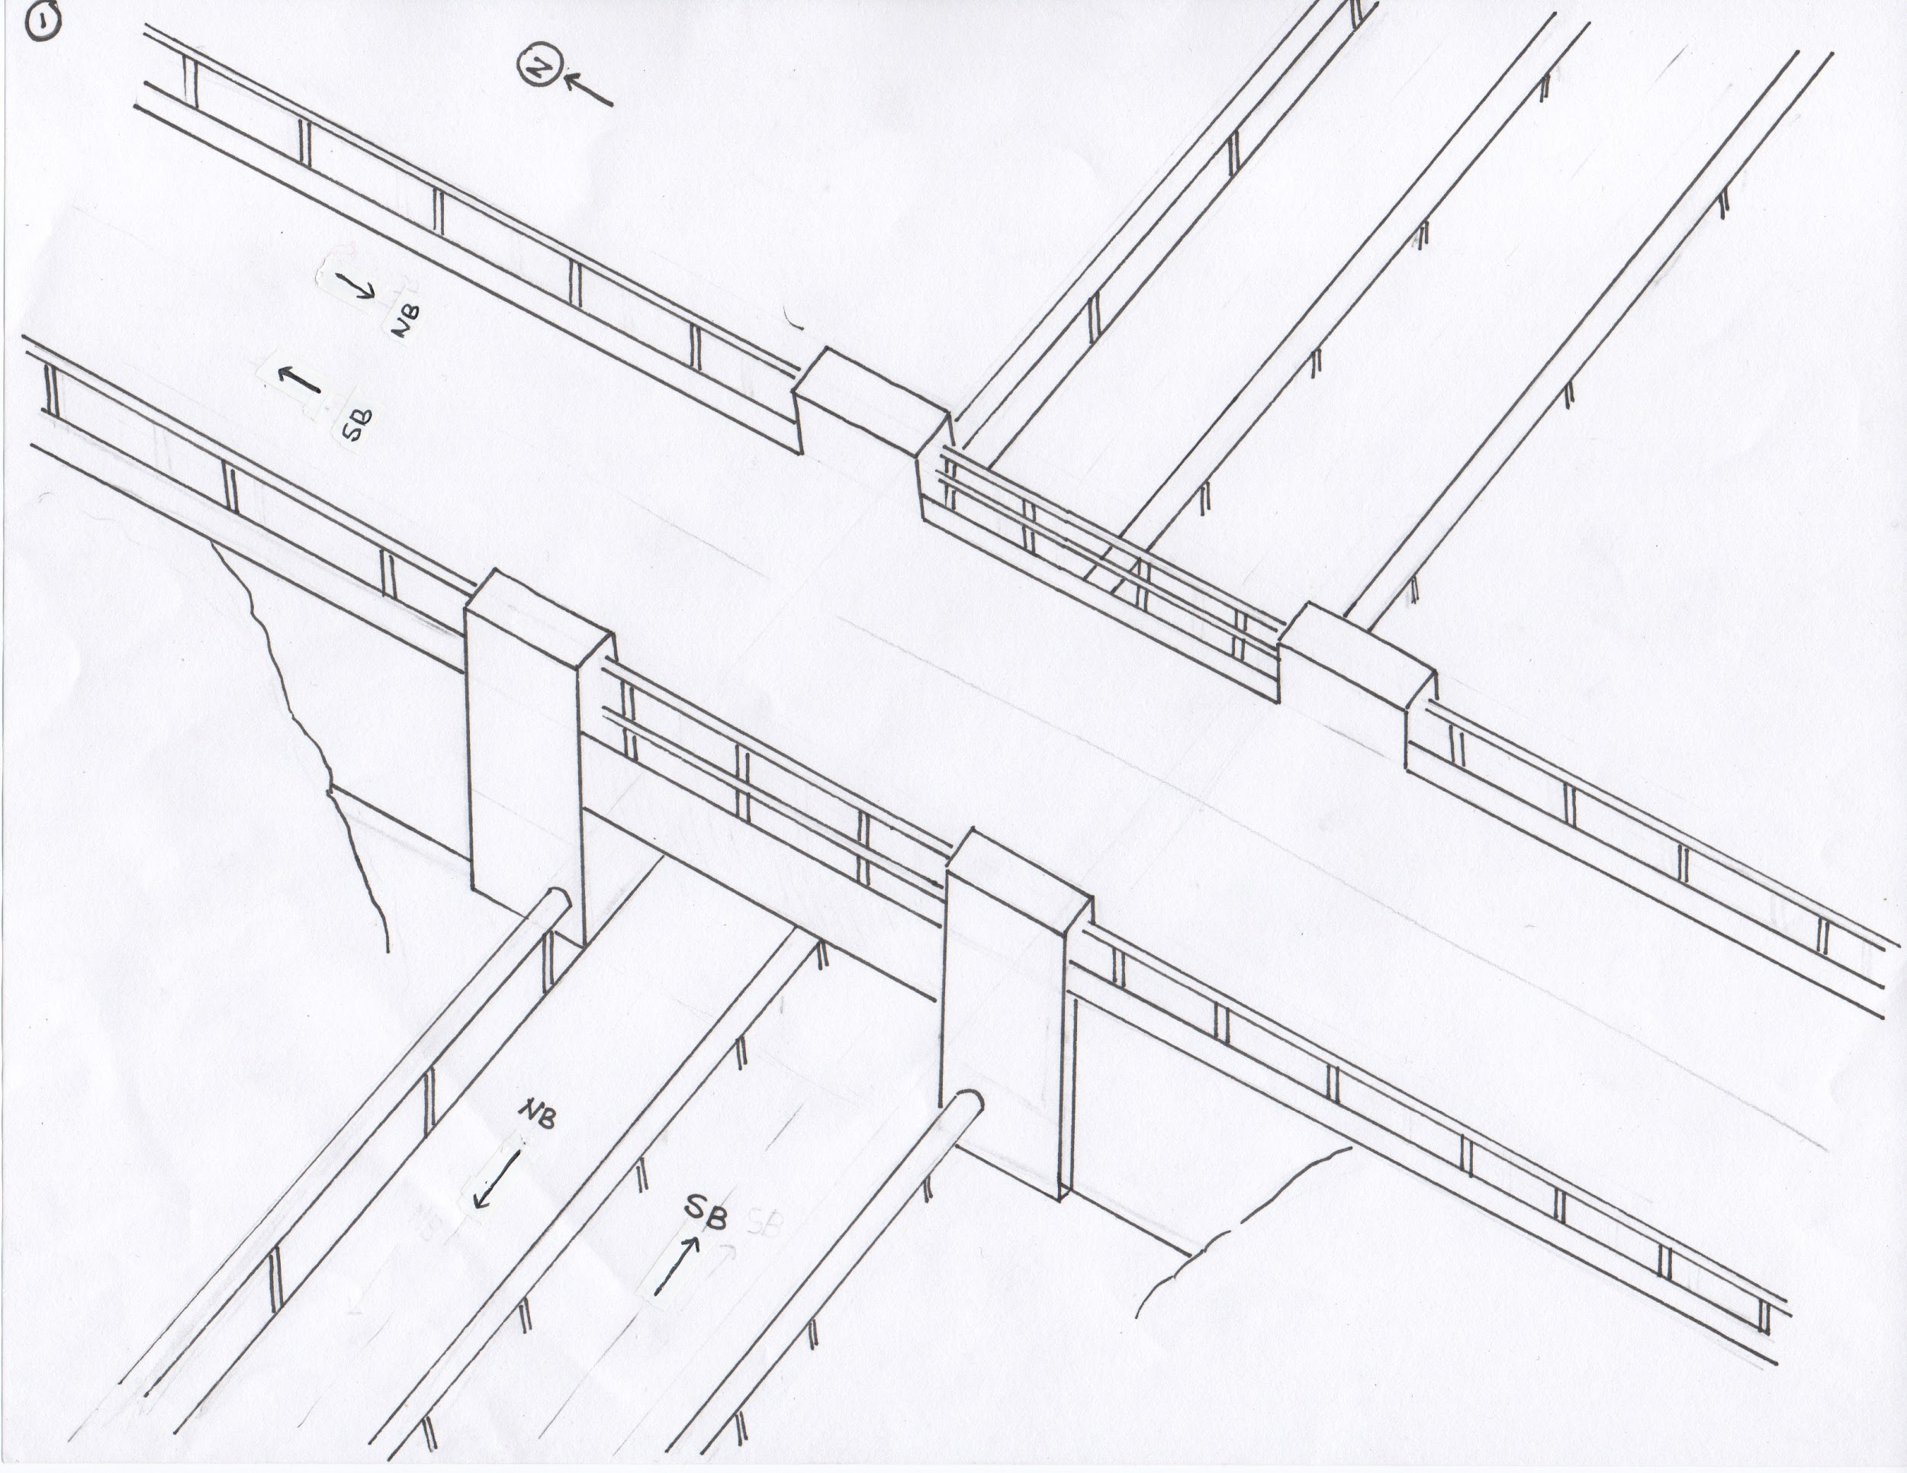
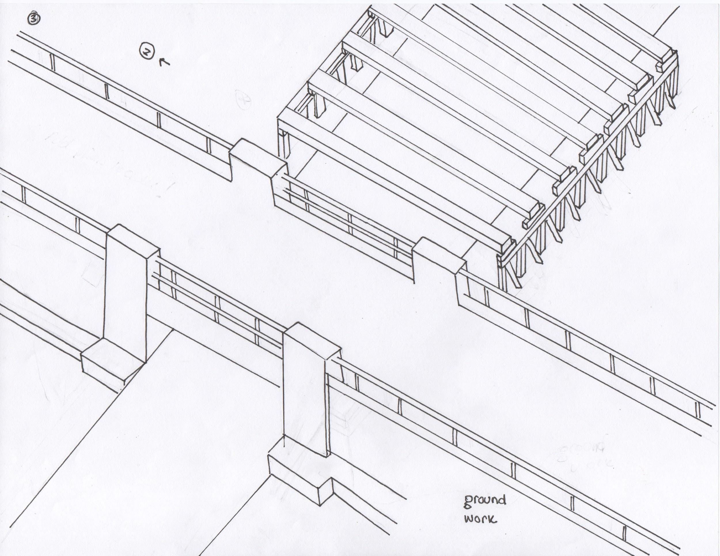
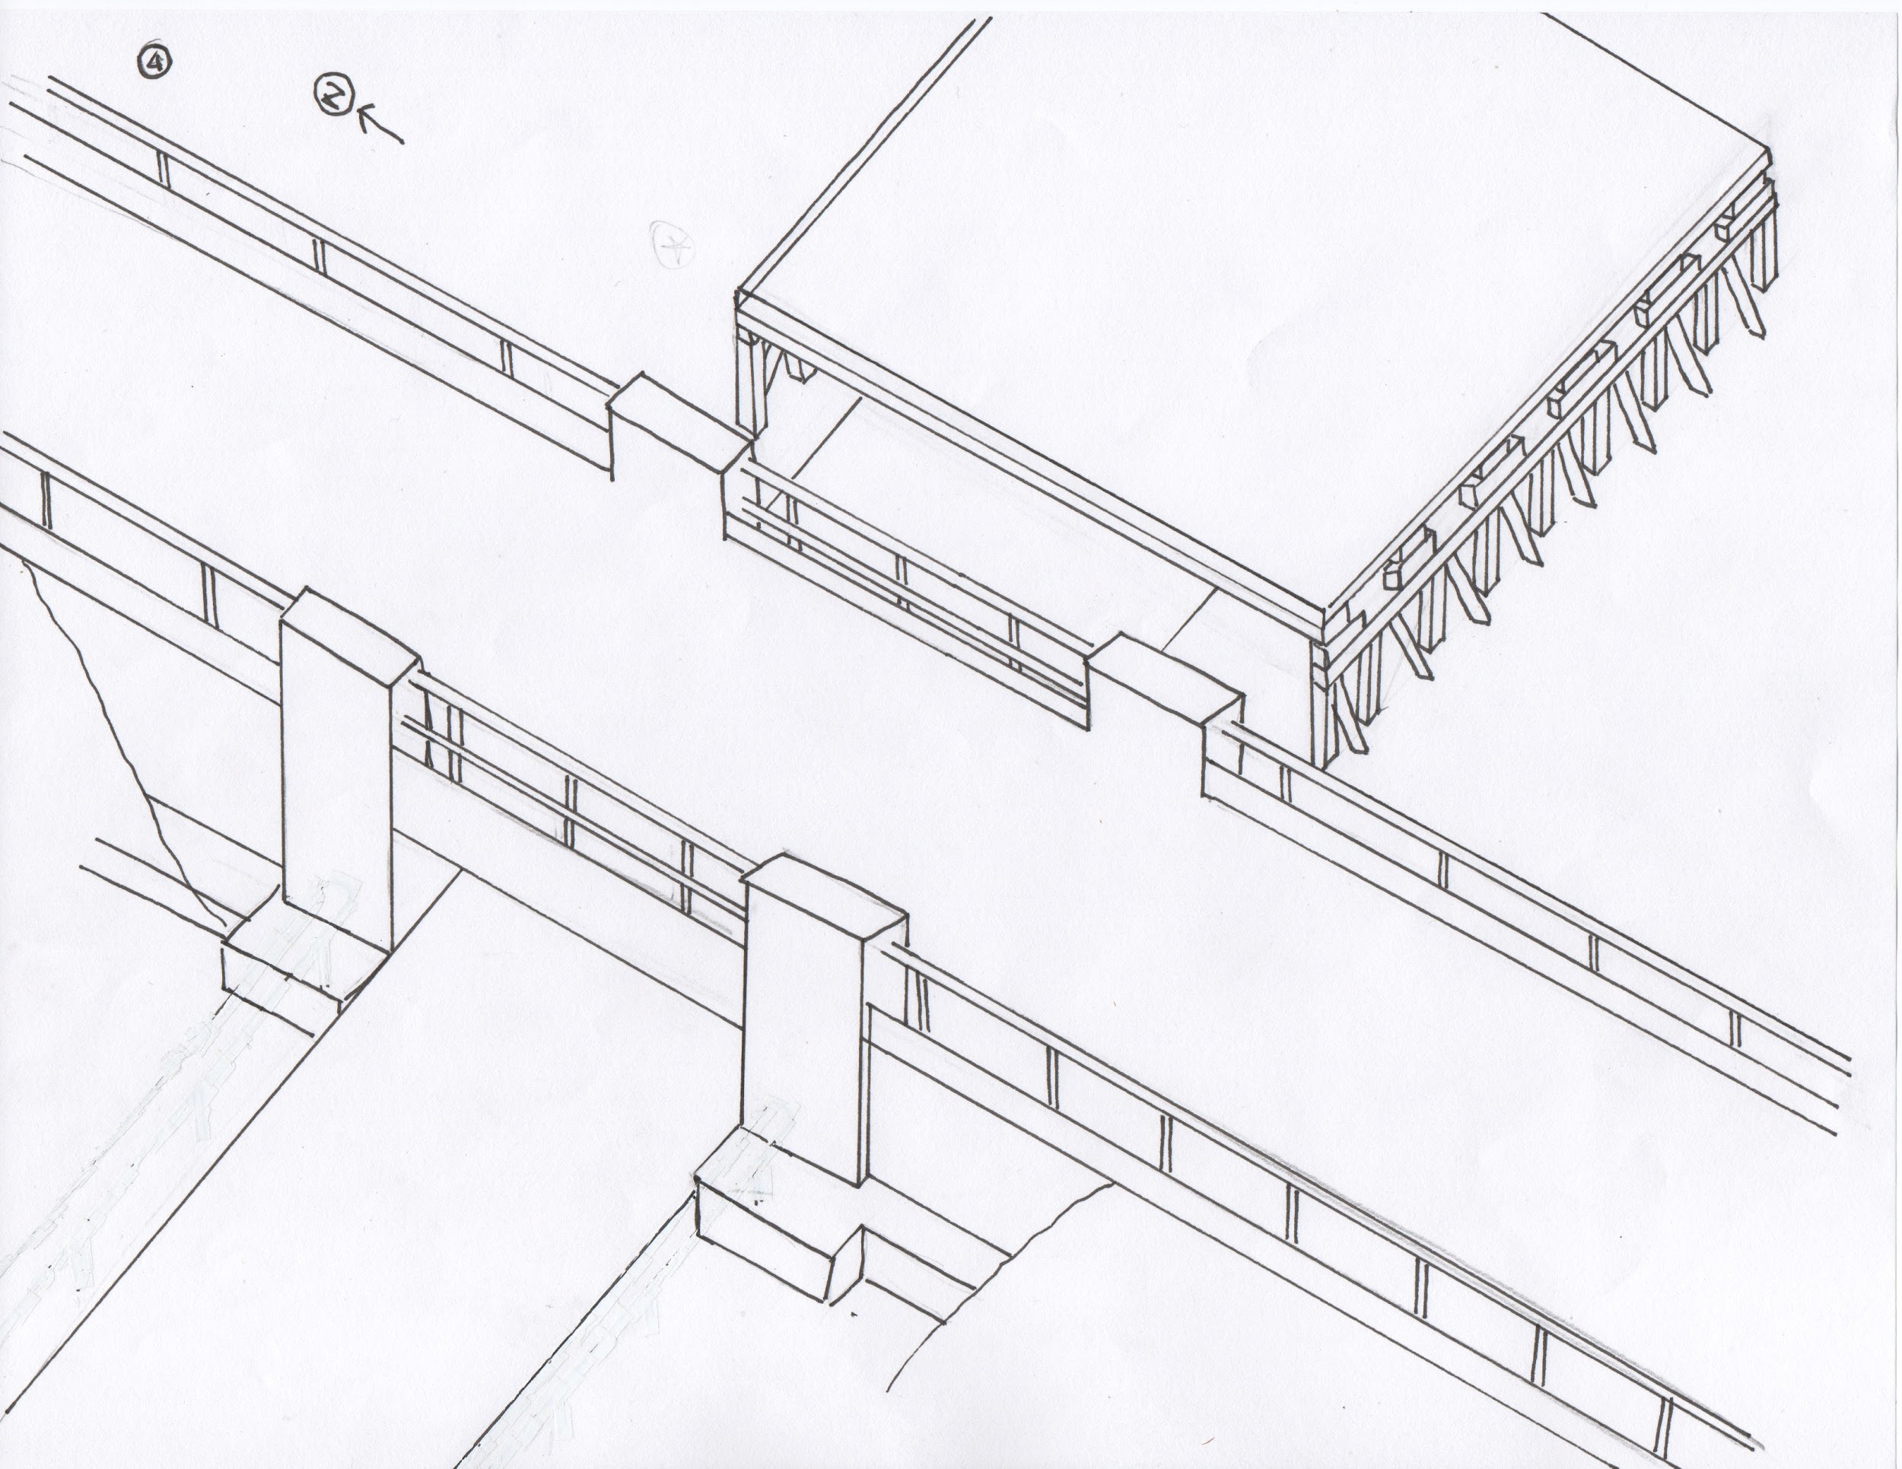
SIBC - Construction Management
Stage 1 ~ 1 week
Necessary signs indicating dates of completion and partial shutdown
Transportation of required machinery
Temporary supports for the construction of the new structure are built adjacent to current structure
Stage 2 ~ 1 week
Groundwork to expose foundation
Installation of foundations
Beams are placed, followed by the precast concrete slab
Notes:
CAROLINA
OSHA regulations for: excavation, appropriate signaling and assist vehicle control
STAGE 1
In this stage necessary signs would be posted to let motorists know about the partial shutdown of the intersection
Machinery would be transported to the site
also Temporary supports would be built next to the existing bridge to begin new construction
In Stage 2, groundwork would begin in order to install parts of the new foundation and the beams and deck system would be placed onto the supports

Slide 15
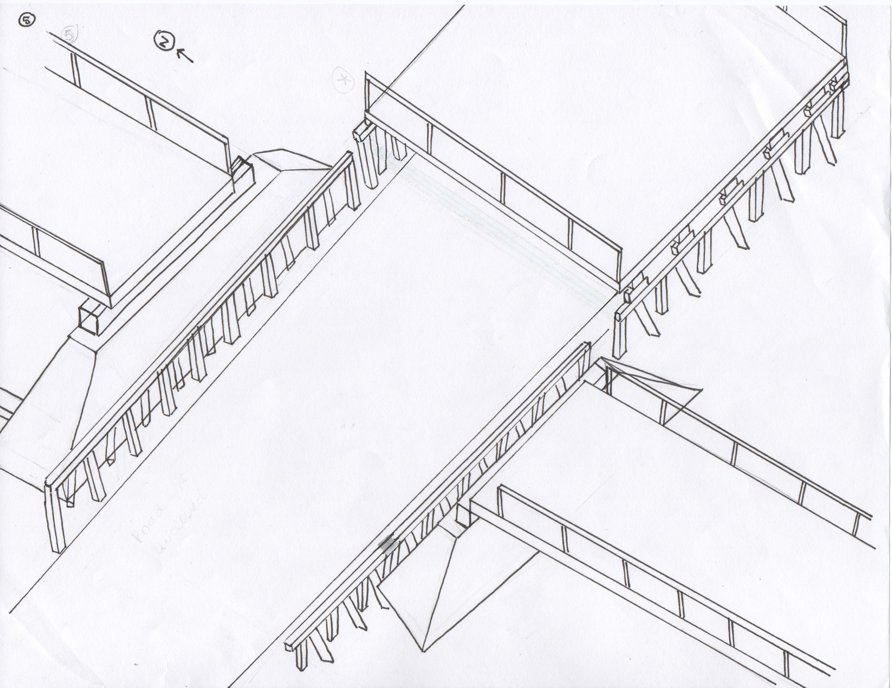
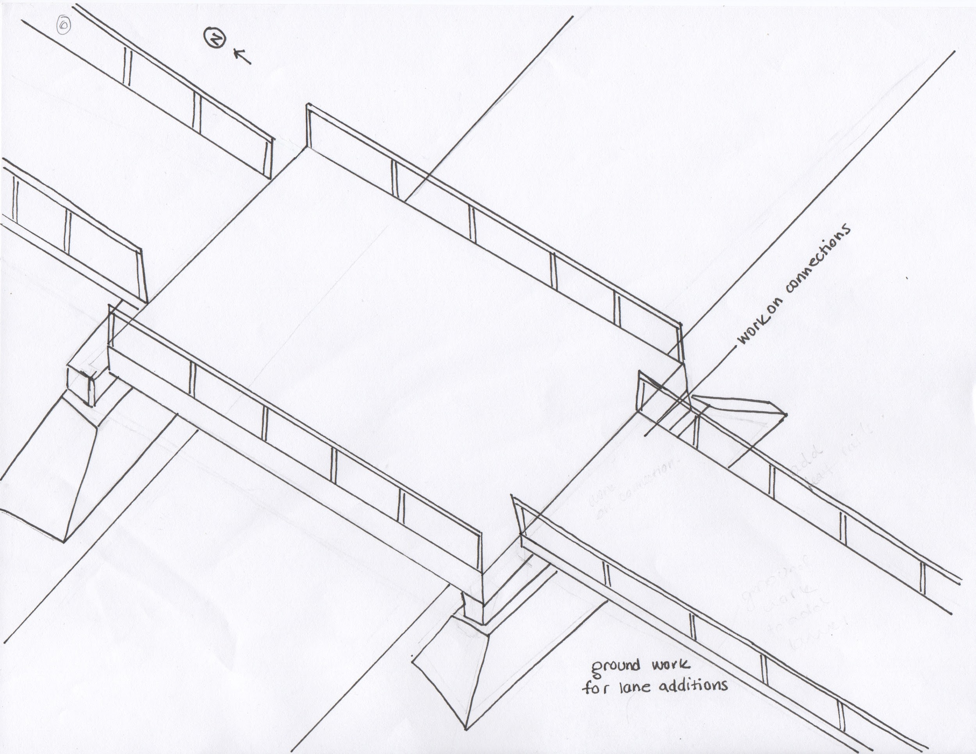
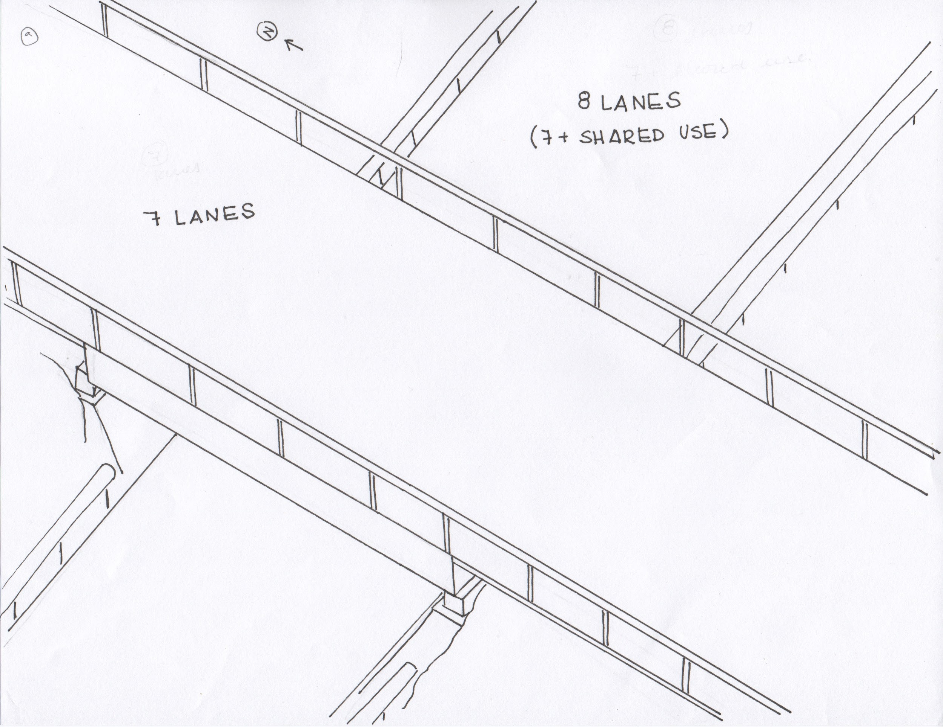
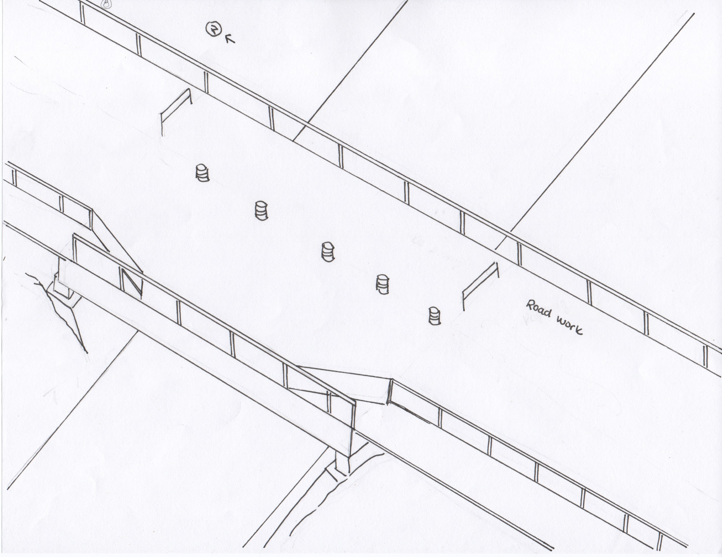
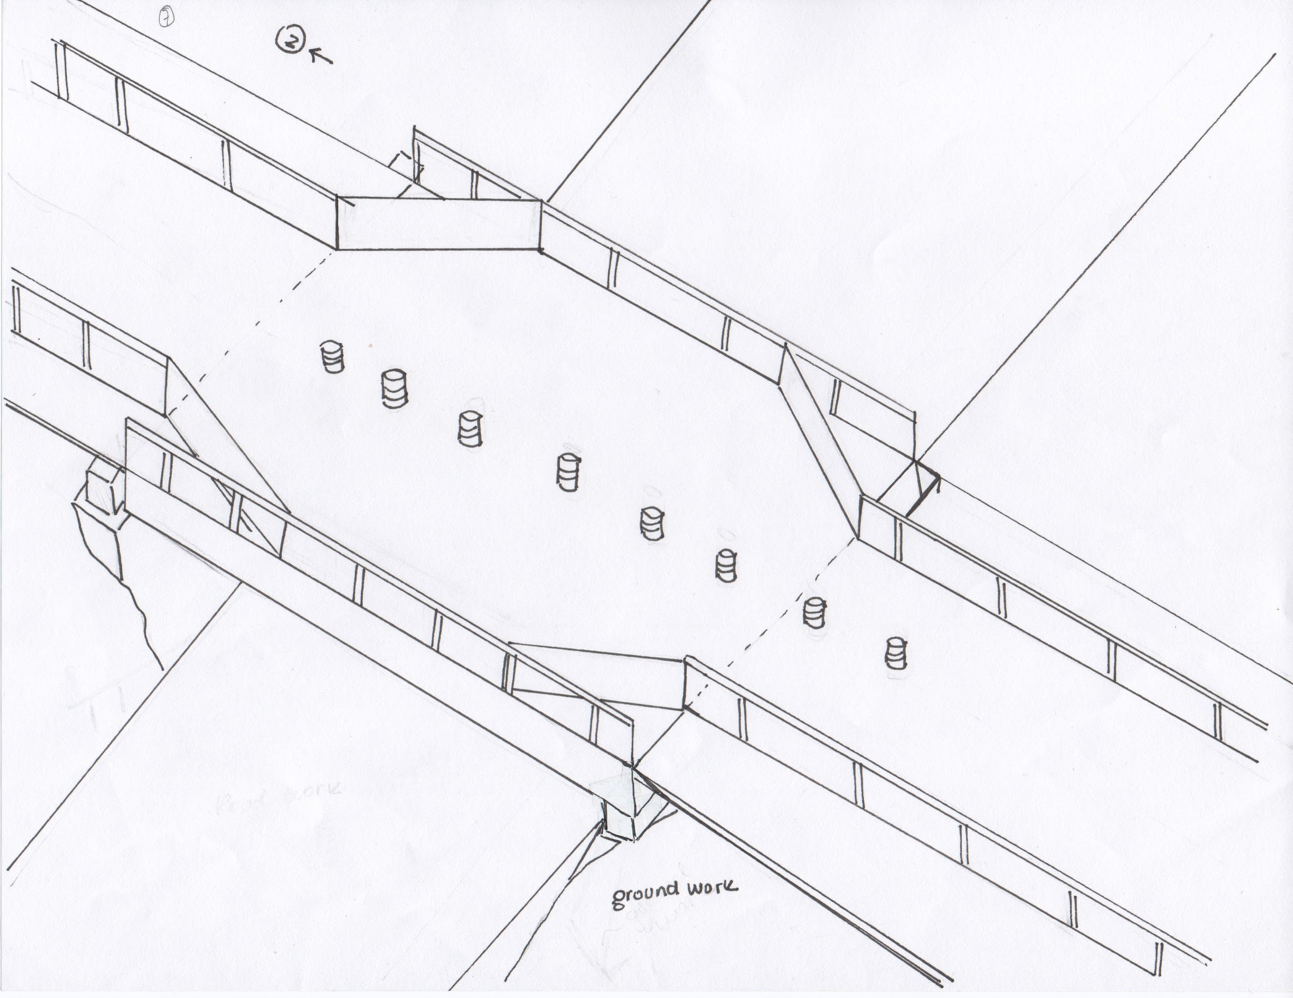
SIBC - Construction Management
Stage 3 ~ 3-4 days
New bridge structure is complete
Interchange is shut down
Demolition of old structure
New bridge is slid into place
Stage 4 ~ 2-3 days
Work on connections is completed
Grading and backfill is completed to allow for the new vertical clearance and lane layout
Pavement markings are added with minimal traffic management
Notes:
they would finish up with grading and backfill to allow for the new vertical clearance and the new lane configuration with traffic control
finally lane demarcations are added

Slide 16
Final Cost Estimate
 | Case #1
Bridge Cost | $8,000,000
Temporary Bridge Cost | $3,100,000
TOTAL (25% Contingency) | $14,000,000
 | Case #1
Bridge Cost | $8,000,000
SIBC Cost | $2,210,000
TOTAL (25% Contingency) | $13,000,000
~$1,000,000 reduction in overall project cost
Notes:
ANJ
From this plan, we determined a SIBC construction cost of about 2.2 million dollars
The total project cost with SIBC methods was about $13 million
This can be compared to “traditional temporary bridge methods,” which was calculated to be about $14 million, indicating a $1 million reduction in construction costs using SIBC methods
Using this new method, you can 1.: reduce the cost of bridge replacements in MA, and 2.: minimize impacts to the city of Taunton as a whole.

Slide 17
Thank You to:
Professor Leonard Albano
Professor Suzanne LePage
Fred Moseley
Christie Dennesen
Walt Woo
Erica Lotz
Alex Simpson
Briana Weisgerber
Notes:
ANJALI

Slide 18
Questions?
Notes:
ANJALI

Slide 20
Total Cost Summaries

Slide 21
HL-93 Loading Analysis

Slide 22
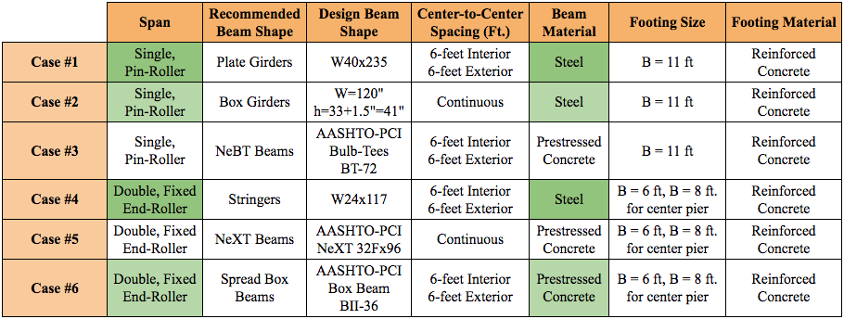
6 Preliminary Cases

Slide 23
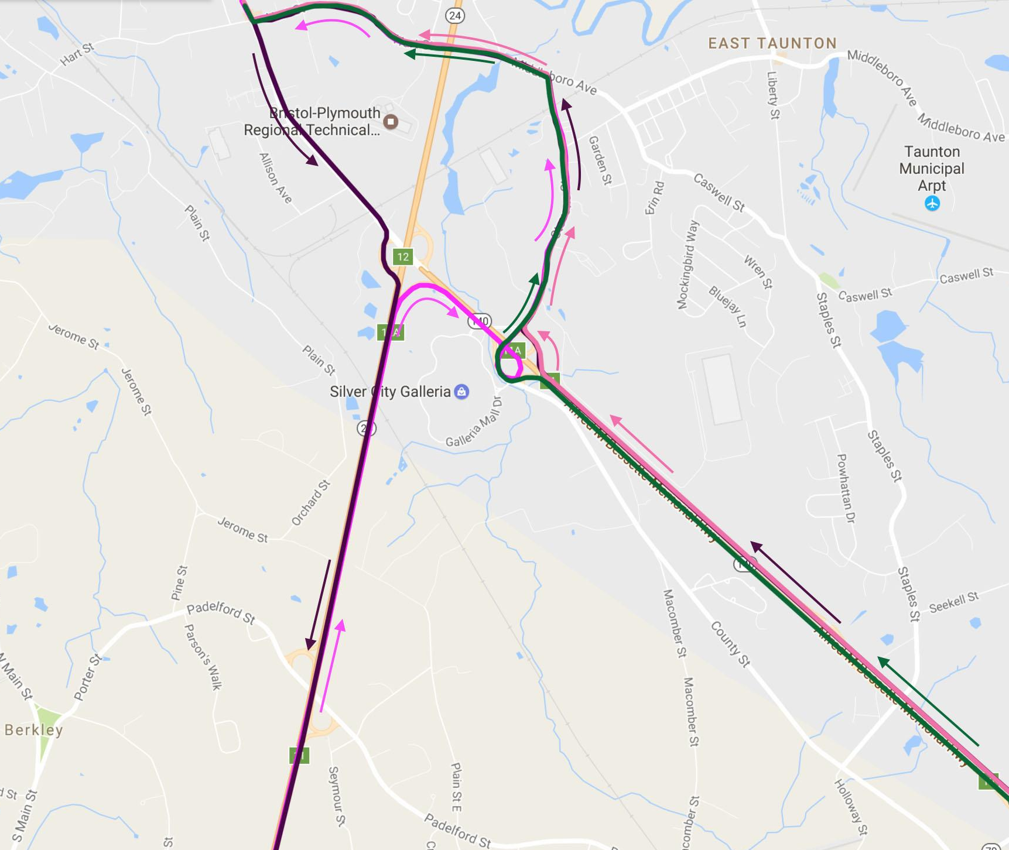
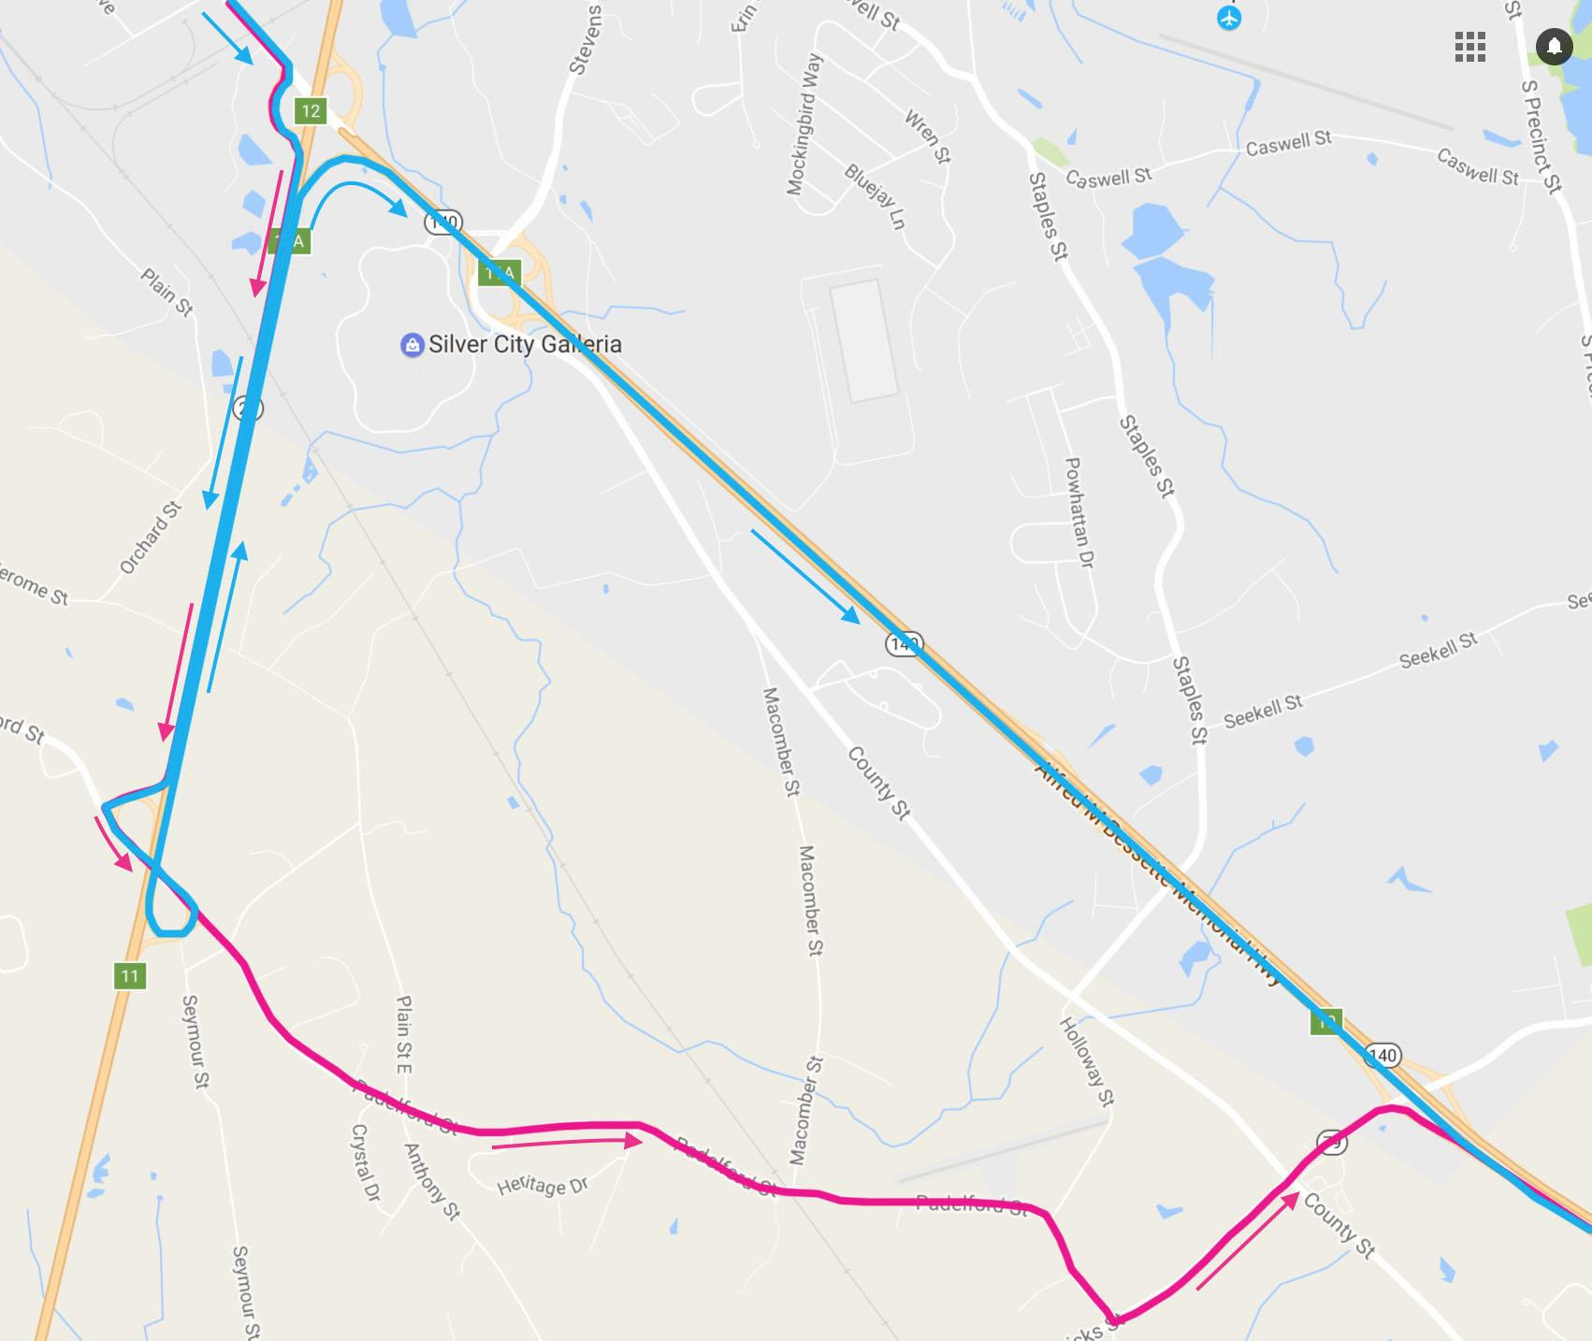
SIBC - Traffic Detour
Notes:
MAITANE

Slide 24
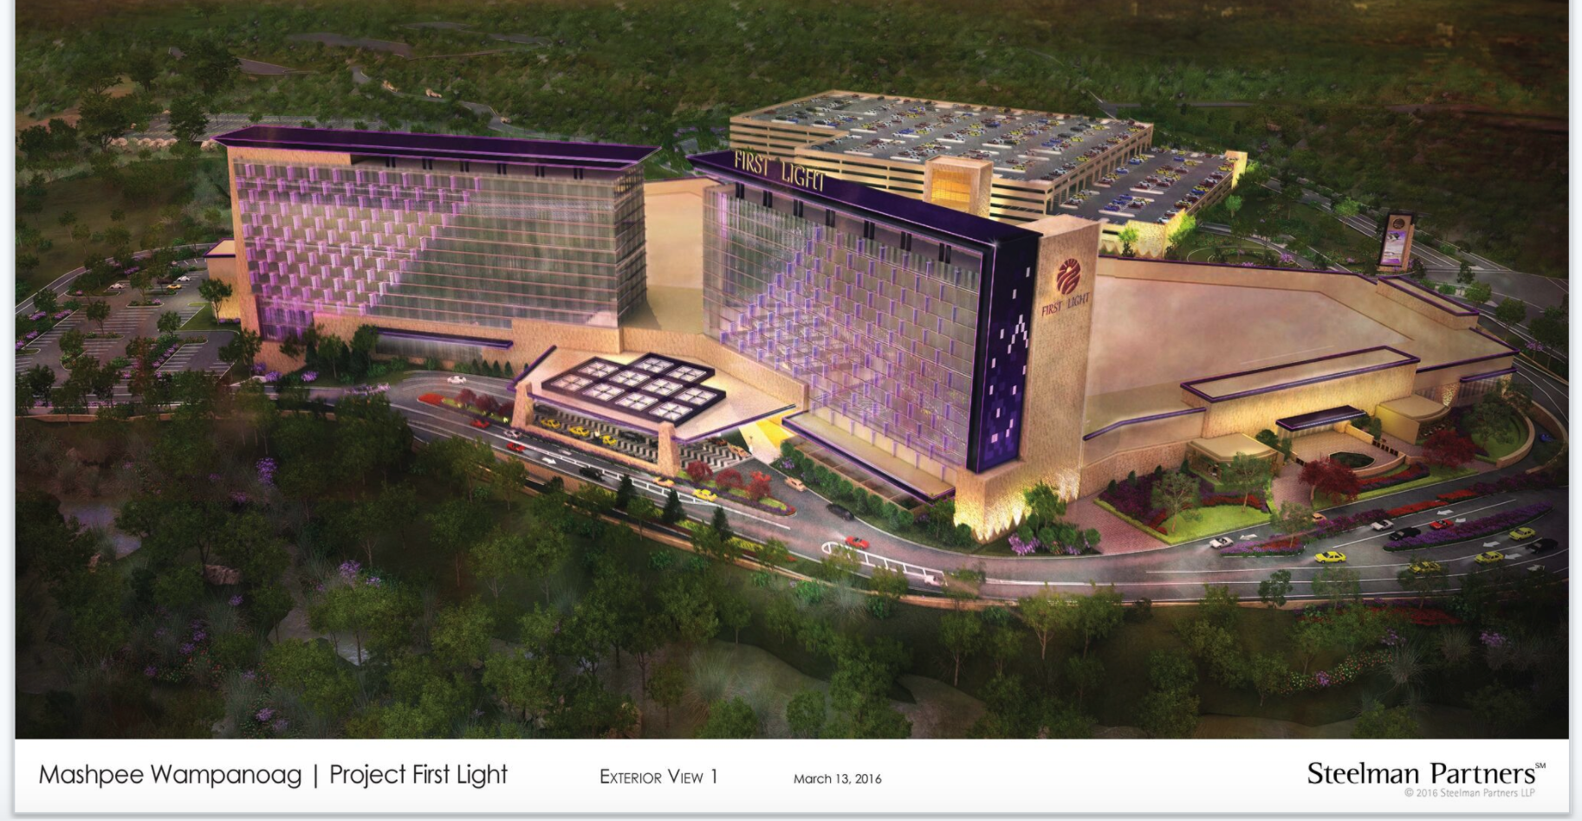
Project First Light

