Slide 1

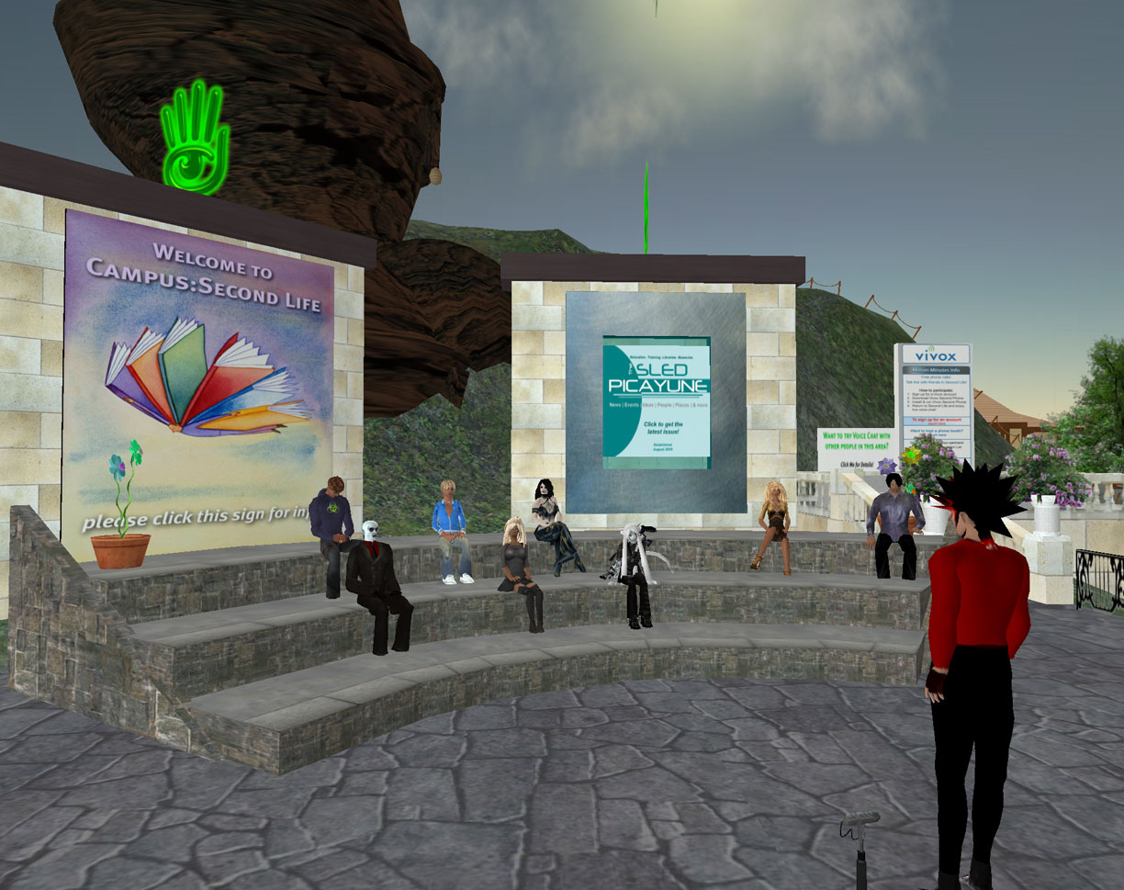
Job Recruiting in Virtual Worlds (Second Life)
Cosmin Tudor (Management Information Systems)
Advisor: Professor Loiacono, Eleanor
Abstract
This project analyzes the potential of job recruiting in Second Life, a 3D virtual world. A survey was developed to explore the users’ acceptance of Second Life as a job search tool and their perception about potential virtual career fairs or virtual interviews. It focuses on both current users of virtual worlds as well as on non-users. Preliminary results show that while users are not yet ready to make virtual worlds their primary job search tool, they are willing to try Second Life in addition to other conventional job search techniques.
Methodology
  A top-down approach was used to write the methodology. It includes the following:
    Research Area – Virtual worlds, in particular Second Life.
    Literature Review – Existing research on virtual worlds, in particular Second Life, was reviewed.
    Topic – Job recruiting in Second Life was identified as an interesting and timely topic of research.
    Research Questions – Does Second Life have the potential to be an efficient tool for job seekers?
    Survey Design – Developed survey questions using existing research items.
    Data Collection – The survey was administered to both Second Life users as well as non-users of Second Life.
    Data Analysis – Survey responses were analyzed using aggregate data.
Preliminary Results
Preliminary results show the following:
    Job recruiting in Second Life has the potential to attract new employees to businesses.
    Job-seekers are willing to add Second Life as an addition to other conventional job search methods. However, they do not view Second Life as a primary job search tool yet.
    A monetary incentive is the most effective way of attracting users to company recruiting events.
    The majority of the participants are comfortable with virtual interviews. However, they believe real job fairs to be more efficient than virtual job fairs.
What data are required to answer the questions?
Research Area
Literature
Context
Topic
Research Questions
Design
Data Collection
Data Analysis
Answer Questions
+
Background
Multi-User Virtual Environments (MUVES) refer to 3D virtual world environments where users interact with others through their avatars and form a complex and vibrant community.
Second Life is the most popular 3D virtual world created by Linden Labs. The current number of users is estimated to be around 12 million, with around a hundred thousand premium accounts. Second Life has its own economy, culminating with a floating exchange rate between real US dollars and a virtual currency called Linden dollars.
Second Life has had staggering growth over the past years and as a result many businesses have established a presence in the world to get benefits such as increased market exposure or improved team collaboration. Despite the advantages, some companies are still hesitant about joining Second Life because of management resistance (Cutter, 2007).
Pre-empirical Stage
Empirical Stage
Conclusions/Recommendations
Second Life has the potential to increase companies’ pool of potential employees and assist them in job recruitment. However, in order for the potential to be realized, job-seekers who are not actively using a virtual world must be made aware of the connection Second Life creates between employers and potential new hires. As a recommendation, companies with a presence in Second Life should consider redirecting applicants on their website to the virtual world.
Project Objectives
The main objective is to investigate whether Second Life is a viable job search tool for users. In particular, answers were sought for the following questions:
    How does Second Life compare to other more conventional recruiting means?
    Can Second Life become the premier Internet recruitment tool?
    Does Second Life’s recruiting appeal have the potential to attract new users to virtual worlds?
    Would potential Second Life users be comfortable with having a virtual interview?
    How important is appearance and behavior in Second Life for doing well in a virtual interview?
Acknowledgments
I would like to thank Professors Eleanor Loiacono, Susan Djamasbi and Bengisu Tulu for their guidance throughout the project. Also, I would like to acknowledge Mrs. Christine Drew’s help with the literature research for the project.
References
Cutter Benchmark. MUVEs: Not Just Games People Play. Cutter Benchmark Review, Vol.7, No.5 (May 2007).
Groves, Robert. (2004), Survey Methodology, 1st edition, Wiley InterScience, USA
Punch, Keith. (2003), Survey Research – The Basics, 1st edition, SAGE Publications, USA.

