Slide 1
The E.W. Tipping Foundation
eric
Finding Technologies to Improve the Quality of Life and Independence of Clients
Thomas deRito, Eric Lacroix, and Victor Vazquez

Slide 2
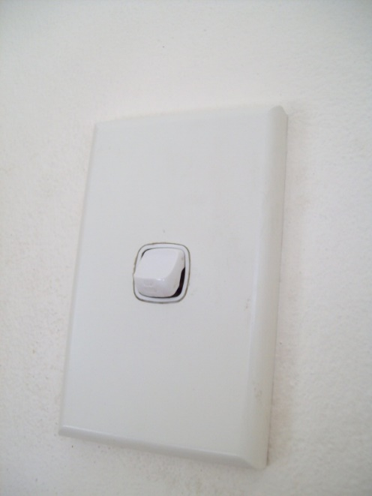
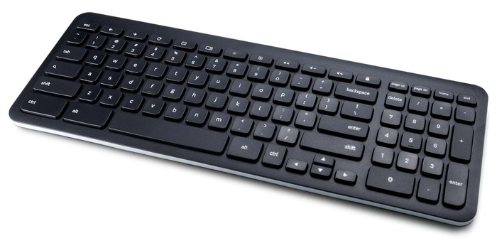
Example Client
Tom
Notes:
Provide an example of how a clients needs affect their quality of life and independence. Being unable to reach the light switch, cannot send emails to family and friends, or (insert something to do with communication)

Slide 3
Tom
Notes:
Talk about how technology might be able to help?

Slide 4
Our Research
Tom
The E.W. Tipping Foundation (EWTF) is beginning to incorporate assistive technology
What types of technologies exist that can improve the independence of the EWTF’s clients?
Notes:
Flows into what we are researching. The example provides a good explanation as to WHY we are working with the EWTF to develop this list of assistive technologies

Slide 5
Our Project
Tom
Provide the E.W. Tipping Foundation with a range of technology options that could improve the quality of life and the independence of their clients
Notes:
What we are going to do to help the EWTF

Slide 6
victor
One of the largest disability service providers in Victoria
Provide individualised services to their clients
Needs and Goals
Moving Forward: using technology to benefit their clients
Notes:
Probably won’t need this slide when we talk to the Executive Board

Slide 7
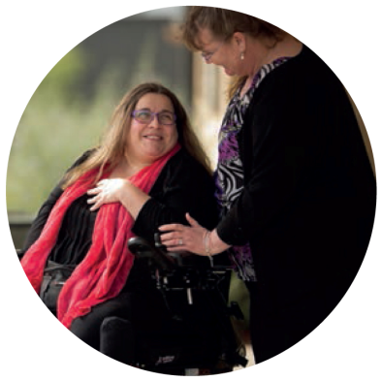
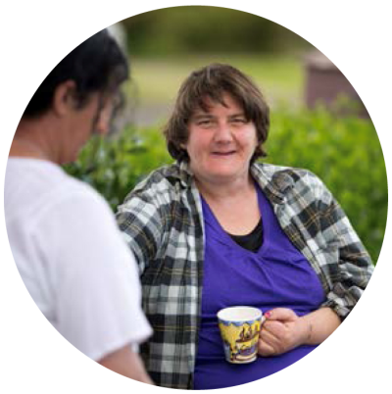
Wide Range of Disabilities
victor
Many Clients with a Range of Disabilities
Focused on 4 Categories most common among E.W. Tipping clients
Intellectual
Physical
Acquired Brain Injury (ABI)
Autism
Different Ways Technology Can Help
Notes:
In order to find such technology options, we first had to understand the clients of the EWTF. As you know the foundations works with many clients with a wide range of disabilities. For this reason, we focused on four of the most common disabilities among EWTF clients. The four categories were: Intellectual disabilities - including cognitive disabilities like down syndrome, Physical disabilities - including hearing and vision impairments in addition to other physical impairments, Acquired Brain Injury - which included both cognitive and physical changes such as paralysis and memory loss, and lastly clients on the Autism spectrum which varies with each individual and could affect skills such as communication and social interaction skills. With a better on understanding of these kinds of disabilities, we were able to begin to look at different ways that technology can help.

Slide 8
Myriad of Technology
victor
Many Different Suppliers
Continuous Development of Technologies
Notes:
In doing so, we were able to find many technology suppliers both here in Australia and internationally. All of which are continuously developing more technologies and improving upon their functionalities and cost effectiveness.

Slide 9
Objectives
victor
Determine areas where technology could be used to improve the lives of clients
Research appropriate technology options based on common needs that the clients have
Notes:
With so many technologies out there, we identified two objectives to help guide our research in a way that would best suit the needs of the EWTF and clients. First, to determine the areas where technology could be used to improve the lives of clients. And second, to research appropriate technology options based on common needs amongst clients.

Slide 10
Determine Areas Where Technology Can Benefit
victor
Clients
Carers
INTERVIEWS
Staff of the EWTF
Occupational Therapist
Notes:
To work towards our first objective, determining areas where technologies can benefit clients, we conducted interviews with Clients, carers, staff of the EWTF, and occupational therapists who works with clients with disabilities and assistive technologies.

Slide 11
Carers, Staff, and Occupational Therapist Interviews
victor
Semi-Structured Interviews
Interviewed 2 carers, 8 staff members, and 1 occupational therapist
Understanding EWTF Services
www.tipping.org.au
Notes:
We conducted interviews with carers staff members, and occupational therapists using a semi-structured method. This allowed for us to ask additional follow up questions with respect to participant responses and allowed participants to provide comments, concerns, and advise. Using this method we were able to interview 2 carers, 8 staff members, and one occupational therapist. Whom were essential in understanding how the EWTF operates, how services are delivered to clients, and what common needs exist amongst clients and how could technology can help clients.
Talk about how these interviews were geared towards understanding areas of common need for clients. By identifying areas where technology can help the clients, it allowed us to narrow down our research for more general needs.
What did we ask about?

Slide 12
Client Interviews
victor
Scenery
Motivational Interviews
C.O.S.I. Review
Interviewed 3 clients
How can technology help?
Interests
Notes:
When interviewing clients we used a motivational interview method. A motivational interview is a conversational style of interviewing that allows us to get the information we are looking for by conversing with clients rather than directly asking questions. To begin client interviews we first engaged them in casual conversation by discussing general topics such as the scenery in Australia and what the best sites to visit are, as well as their hobbies and interests such as gardening and sports. To ensure we conducted these in the most respectful manner and in a way clients would best understand what we are asking, we reviewed our proposed questions with a staff member of the Client Outcomes and Service Improvement department.
who helped us get in touch with and interview 3 clients who were able to provide us with a better understanding on how technology would help them as well as gain further information on common areas where technology would benefit a wider range of clients.

Slide 13
Research Appropriate Technologies
victor
Technology based on specific parameters
Cost
Ease of Use
Safety
Durability
Personalisation
Contacted Technology Suppliers
Notes:
Using the information gathered from client and staff interviews, we were able to work towards our second objective and research appropriate technologies using parameters deemed important clients and staff members when looking at assistive technologies. Such as the cost of the technology, how easy the technology is to use, its safety, durability and its ability to be personalised to fit the needs of individual clients. Additionally, we also contacted technology suppliers to better understand the technologies they supply.
We contacted technology suppliers to understand the type of technology that they supply.
We researched specific technologies based on the common areas of needs that we got from interviews

Slide 14
Results
tom
Lists of assistive technologies
Including technology suppliers
Recommendations on:
What to do with the lists
How to keep them up to date

Slide 15
List of Technology Suppliers
tom
Provided a list of technology suppliers
In the future, E.W. Tipping staff will know where to research assistive technology

Slide 16
Example List of Suppliers
tom

Slide 17
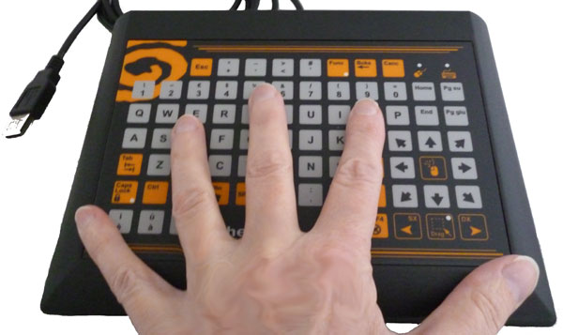
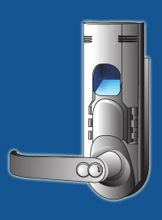
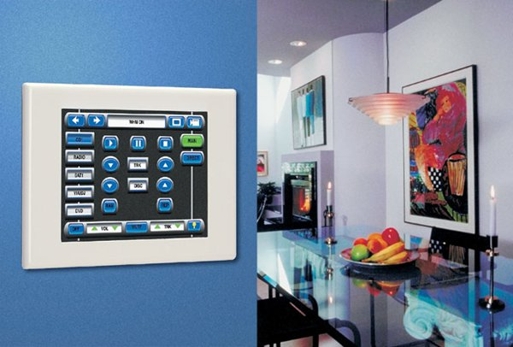
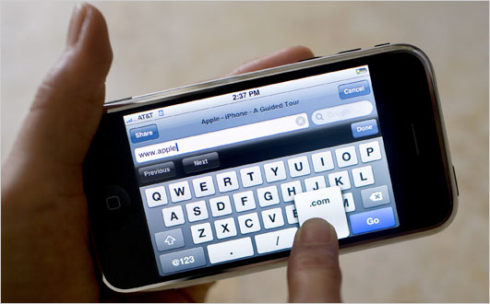
Lists of Technology
tom
Health
Computer Access
Security
Home Automation
Communication

Slide 18
Computer Access
tom

Slide 19
Example List of Technology
tom
Notes:
Can sort by supplier

Slide 20
Computer Access Technology
tom

Slide 21
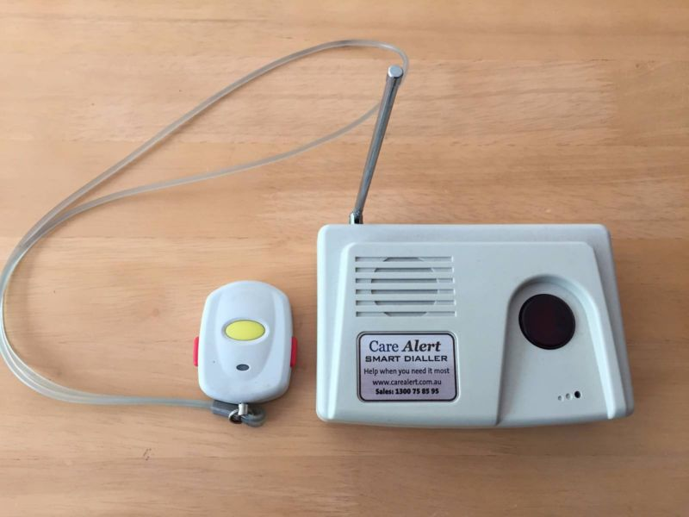
Health Technology
tom

Slide 22
Client Communication Technology
victor

Slide 23
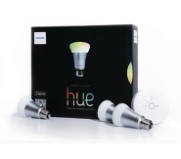
Home Automation Technology
eric
Notes:
What else should go on the technology slides? Cost? Retrofitability? Durability? Interesting facts?

Slide 24
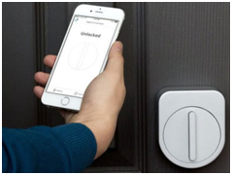
Security Technology
eric
Sesame Smart Lock
Locking and Unlocking Doors

Slide 25
What We Have Found
eric
Not all assistive technologies are designed to help people with disabilities
Lack of consistency in finding the parameters
There is not a "one size fits all" technology
Notes:
Finding #1: home automation is designed to help people live more comfortably within their home. Home Automation technologies can be modified to help people with disabilities.
Finding #2: Suppliers mention the parameters, but they do not mention exactly HOW or WHAT makes it easy to use. Don't mention the specifics on the parameters.
Finding #3: There are technologies that help a wide range of clients with different disabilities, but not one that can be used by ALL clients. Use of iPad example.

Slide 26
Client Accessible List
eric
User friendly for clients, carers, and staff
Online database or App
Technology newsletter

Slide 27
Updating the List
eric
Two to three EWTF staff members
Technology Supplier Questionnaire
Using Systematic Research Process

Slide 28
Technology Supplier Questionnaire
eric

Slide 29
Using Systematic Research Process
eric

Slide 30
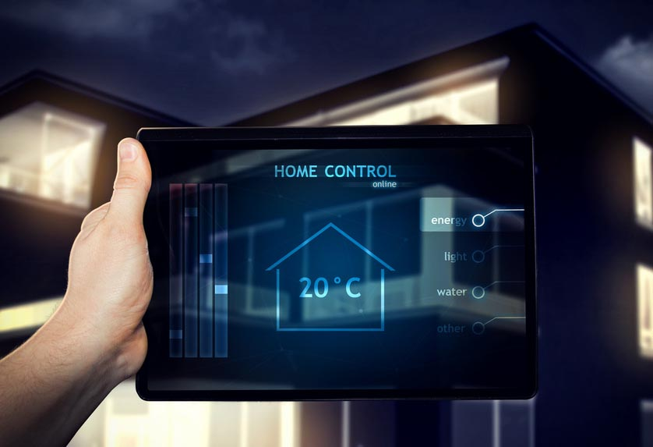
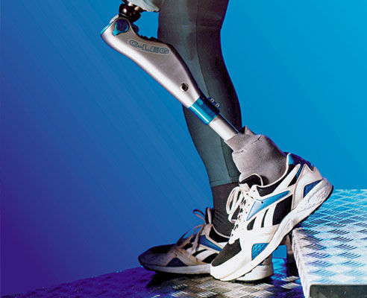
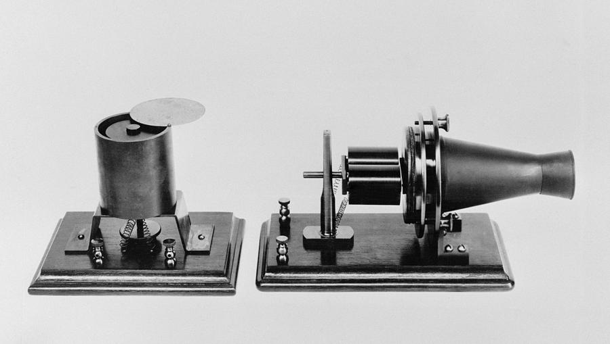
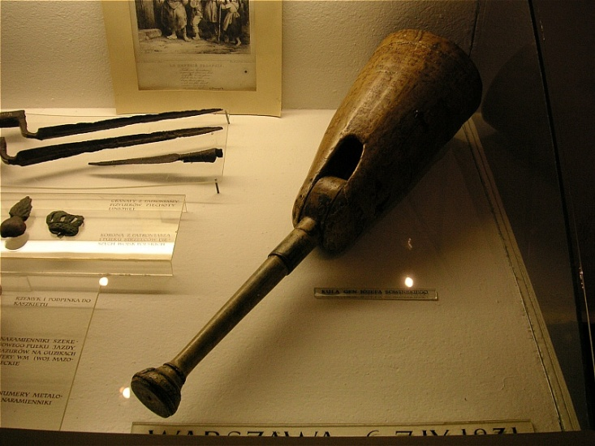
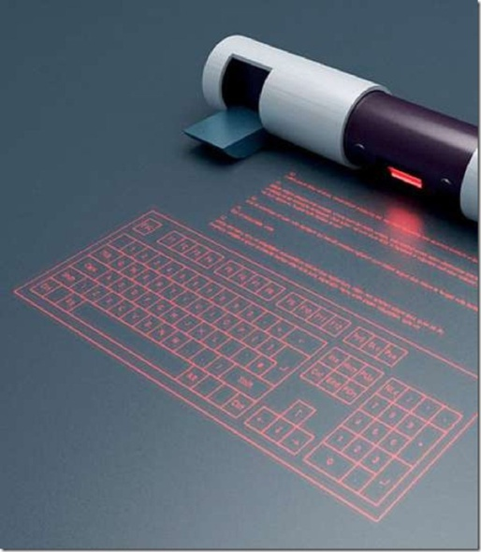
Who Would Have Thought…
eric

Slide 31
Tom

Slide 32
Technology Can Help!
Tom
Notes:
Describe the importance of technology for everyone, especially individuals with disabilities
Don’t try to sell specific technologies (Say “Voice recognition software” instead of “Dragon NaturallySpeaking”)

Slide 33
Acknowledgements
tom
Mr. James Digby, CFO of the E.W. Tipping Foundation
The staff and clients of the E.W. Tipping Foundation
Professor Jeanine Skorinko and Professor Reinhold Ludwig

Slide 34
References
https://www.tipping.org.au/
http://harmanradio.com/
http://www.bayfm.com.au/bay-lifestyle/gardening/54573-beginner-s-guide-to-backyard-gardening

