Slide 1
Improving MCTS and Neural Network Communication in Computer Go
Joshua Keller
Oscar Perez

Slide 2
Outline
Overview
The Game of Go
Computer Go Techniques
AlphaGo Match
Our Project
Future Work

Slide 3
Overview
Learned about Go, and the aspects of computer Go
Worked to implement new ideas on existing Go Programs.
Ran tests to evaluate our implementations

Slide 4
What is Go?
Possibly the world’s oldest strategy board game
Goal is to surround the most territory
Ranking system:
30 kyu - 1 kyu
1 dan - 7 dan (amateur)
1 dan - 9 dan (professional)
Best humans (9 dan p) used to be better than the best computers (amateur dan level)
https://upload.wikimedia.org/wikipedia/commons/2/2a/FloorGoban.JPG
Notes:
-credit to Wikipedia for the picture

Slide 5
Rules of Go
Two colors, black and white
Players take turns placing stones on the board
Stones have liberties
Groups of stones can be captured when they lose their liberties
At the end of the game, surrounded territory and captured stones are added up
Notes:
Liberties at “a” points
Ladder at bottom left “a”
White cannot play at “c”
Ko at “d”
Points marked “w” are white’s territory, points marked “b” are black’s, points marked “n” are no one’s

Slide 6
Go: Difficult for AI
Go:
200 possible moves per turn
average game length is 300 turns
moves have long-term influence more often
positions are hard to evaluate formulaically
Chess:
about 37 possible moves per turn
average game length is 57 turns
moves have long-term influence less often
positions can be judged based on material count

Slide 7
Computer Go Techniques

Slide 8
Mini Max
Black’s best first move is a1
White’s best reply is b2
Black’s best response is a2
Gelly S et al.: "The Grand Challenge of Computer Go: Monte Carlo Tree Search and Extensions", CACM 2012.
But this is impractical for most games
Notes:
-thanks to “The Grand Challenge of Computer Go” paper for this diagram

Slide 9
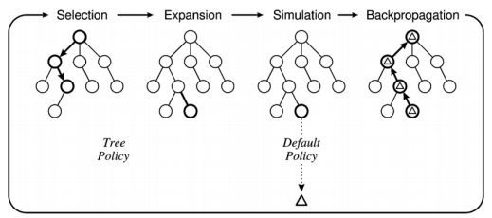
MCTS
Browne, Cameron B., et al. "A Survey of Monte Carlo Tree Search Methods." IEEE Transactions on Computational Intelligence and AI in Games 4.1 (2012): 1-43. Print.

Slide 10
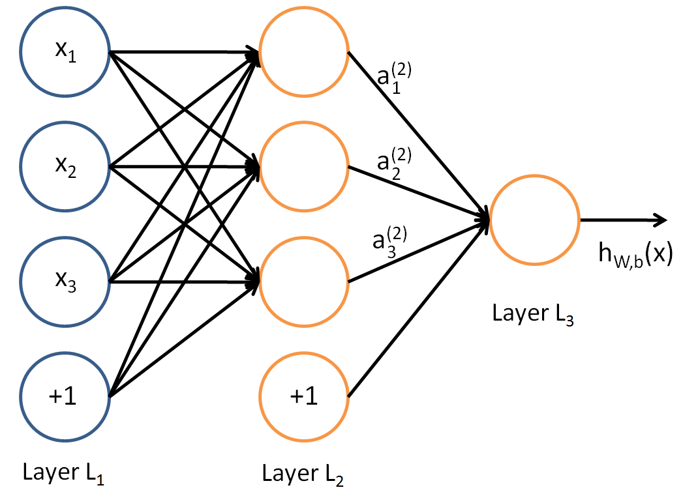
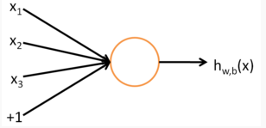
Artificial Neural Network
Used for making decisions based on training data
http://ufldl.stanford.edu/tutorial/supervised/MultiLayerNeuralNetworks/
http://ufldl.stanford.edu/tutorial/supervised/MultiLayerNeuralNetworks/
Notes:
How it works
Takes in input, multiplies this input by a certain weight, and then outputs a classification

Slide 11
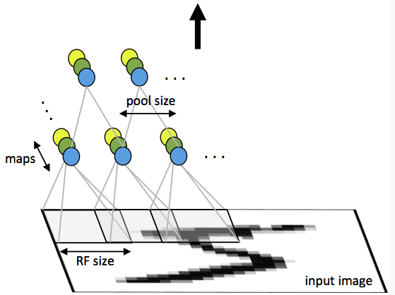
Convolutional Neural Network
A type of neural network inspired by the visual cortex
A key idea is the use of small filters that emphasize local connections & areas
http://ufldl.stanford.edu/tutorial/supervised/ConvolutionalNeuralNetwork/

Slide 12
The AlphaGo Match

Slide 13
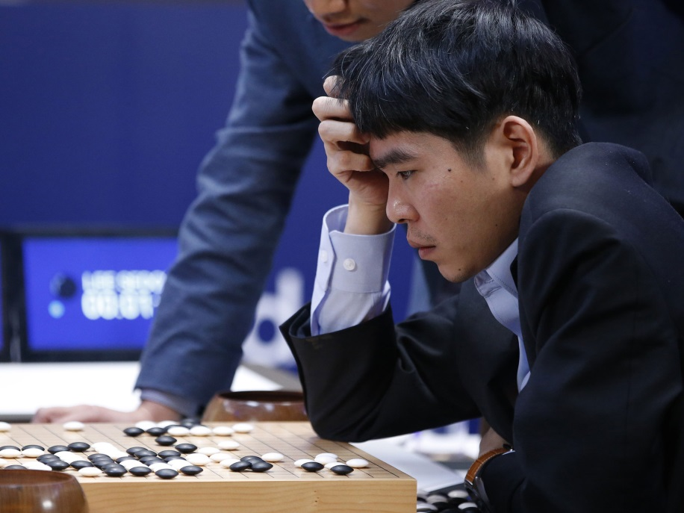
AlphaGo vs. Lee Sedol
AlphaGo: program designed by Google DeepMind
Hybrid: used both MCTS and neural networks
Lee Sedol, best Go player in the world
https://deepmind.com/css/images/alphago-logo.png
http://static.independent.co.uk/s3fs-public/thumbnails/image/2016/03/12/11/alphago-AP.jpg
Notes:
This was a huge match, widely publicized
Televised throughout South Korea
60 million viewers in China
International array of commentators analyzing each game live

Slide 14
The “Computer-Style” Move
Game 2, move 37
AlphaGo deliberately went against its initial bias toward human-style play
Commentators thought it was a typo in the move relay
Notes:
David Silver commented that AlphaGo estimated a human’s chances of playing this move to be 1 in 10000
But as it searched and used its reinforcement-learning trained neural network, it found this move to be more effective than human-style moves

Slide 15
The Divine Move
Game 4, move 78
Lee Sedol found a powerful move that AlphaGo had not considered
It just barely worked (possibly a weakness in the nature of MCTS)
Notes:
Some claim AlphaGo discounted this move because the variations it considered in the playouts all led to a loss for Lee Sedol (as White)
AlphaGo started playing “crazy” moves after this, moves in which it hoped Lee Sedol would overlook something, instead of moves which were objectively better given the best response.

Slide 16
There is Still Much to be Done
AlphaGo ran on a huge distributed system of 1920 CPUs and 280 GPUs
This kind of computing power is not available to the majority of computer users today
Different ways of combining neural networks with MCTS have yet to be explored
The communication between MCTS and neural networks can be improved
Notes:
… and this improvement can go in both directions

Slide 17
Our Project
Developed four ways to combine neural networks with MCTS
Modified existing open-source Go program Pachi
Fuego was used as a reference opponent for testing
Last year’s neural network implementation was also used as a starting point

Slide 18
First Approach
Give neural network the ability to influence which nodes to expand
Hopefully makes the program expand moves which are better

Slide 19
How We Tested It
We tested this by giving the neural network different amounts of influence, and seeing how that improves play.
The influences we gave the neural network were:
0.1
0.25
0.5
0.75
0.9
1

Slide 20
Results
Performance by win rate out of 100 games:
0.1- 46%
0.25- 44%
0.5 – 50%
0.75 – 50%
0.9 – 50%
1 – 50%
The addition of the neural network certainly made Pachi play better when it had more influence

Slide 21
Second Approach
Use more than one Neural Network to influence which move to expand.
Use the different neural networks at different layers in the tree.

Slide 22
How We Tested It
Measured the frequency in which MCTS visited each layer.
Tested it by using different layer cutoffs for the neural networks

Slide 23
Results
Performance by win-rate:

Slide 24
Third Approach
Train the neural network as part of Pachi instead of by itself
This is natural because the neural network is ultimately going to be used with Pachi, not in isolation
Requires a radically different training method

Slide 25
How We Tested It
Used simultaneous perturbation stochastic approximation with different values of the perturbation constant
Tested Pachi’s predictions on game data from KGS
We only perturbed the weights in the last layer of an existing neural network

Slide 26
Results

Slide 27
Fourth Approach
Change the neural network so MCTS can communicate with it
Added a search-based feature: who owns a given point at the end of the game (as in last year’s project)

Slide 28
How We Tested It
Generated search-based pattern features from 100,000+ KGS games
Trained for 12,000,000 iterations on those patterns

Slide 29
Results

Slide 30
Conclusions
The ideal neural network influence appears to be 0.5
When using more than one neural network
If the games are timed, must focus on either number of iterations or the effectiveness of each iteration
SPSA is promising, but would be better if measured with win-rate than with predictions
Our search-based feature appears to only marginally improve accuracy

Slide 31
Future Work
Train a neural network using SPSA to improve win-rate rather than predictive accuracy
Experiment with other search-based features
Train a neural network using unsupervised learning only (could take a very long time)

Slide 32
Acknowledgements
Levente Kocsis, Project Advisor and SZTAKI liaison
Gabor Sarkozy, MQP Advisor
Worcester Polytechnic Institute
MTA-SZTAKI
Pachi and Fuego Development Team

Slide 33
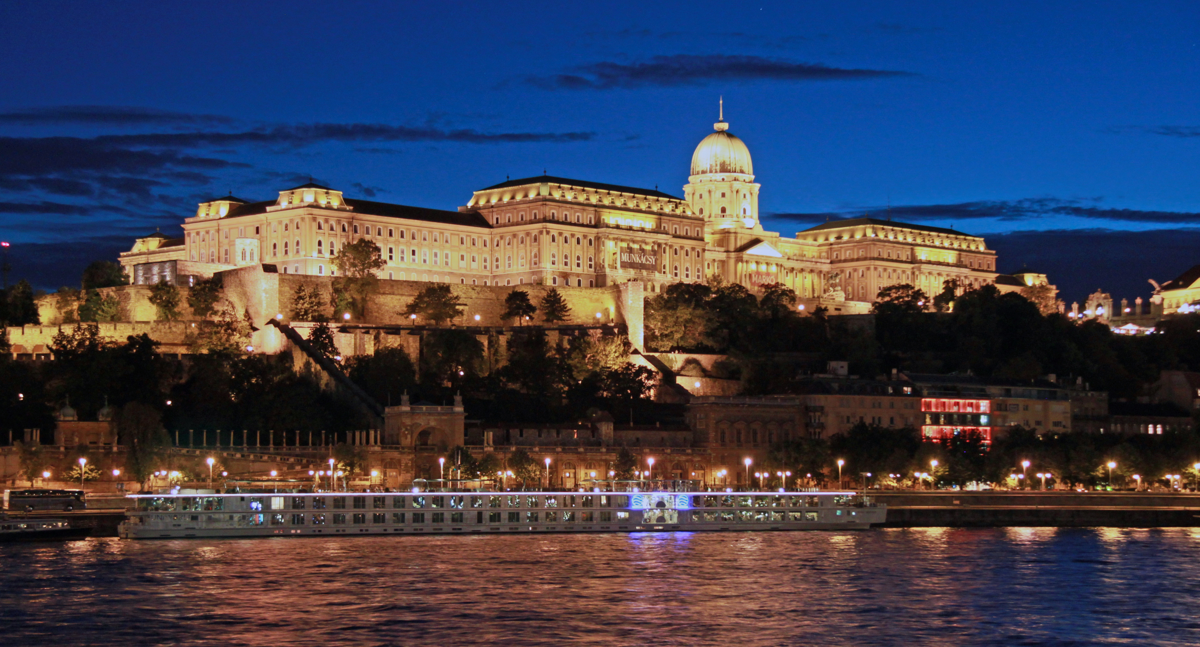
Questions?

Slide 34
Thank You!

