Slide 1
Warm-up: Simplify
53²⁵ · 53⁷⁵ (w⁶)⁵ y⁹ · y⁻⁹
8⁴⁹
8¹⁵
Notes:
🍐 This is a Pear Deck Drawing Slide
🍐 To edit the type of question, go back to the "Ask Students a Question" in the Pear Deck sidebar.

Slide 2
Warm-up: Simplify
53²⁵ · 53⁷⁵ (w⁶)⁵ y⁹ · y⁻⁹
53²⁵ ⁺ ⁷⁵ w^{6 · 5} 8⁴⁹ ⁻ ¹⁵ y⁹ ⁺ ⁻⁹
53¹⁰⁰ w³⁰ 8³⁴ y⁰
8⁴⁹
8¹⁵

Slide 3
Warm-up: Simplify
53²⁵ · 53⁷⁵ (w⁶)⁵ y⁹ · y⁻⁹
53²⁵ ⁺ ⁷⁵ w^{6 · 5} 8⁴⁹ ⁻ ¹⁵ y⁹ ⁺ ⁻⁹
53¹⁰⁰ w³⁰ 8³⁴ y⁰
8⁴⁹
8¹⁵

Slide 4
Warm-up: Simplify
53²⁵ · 53⁷⁵ (w⁶)⁵ y⁹ · y⁻⁹
53²⁵ ⁺ ⁷⁵ w^{6 · 5} 8⁴⁹ ⁻ ¹⁵ y⁹ ⁺ ⁻⁹
53¹⁰⁰ w³⁰ 8³⁴ y⁰
8⁴⁹
8¹⁵

Slide 5
Warm-up: Simplify
53²⁵ · 53⁷⁵ (w⁶)⁵ y⁹ · y⁻⁹
53²⁵ ⁺ ⁷⁵ w^{6 · 5} 8⁴⁹ ⁻ ¹⁵ y⁹ ⁺ ⁻⁹
53¹⁰⁰ w³⁰ 8³⁴ y⁰
8⁴⁹
8¹⁵

Slide 6
How many solutions will the following equation have?
-10x - 4 = 26
Notes:
🍐 This is a Pear Deck Multiple Choice Slide. Your current options are: A: one solution, B: no solution, C: infinite solutions,
🍐 To edit the type of question or choices, go back to the "Ask Students a Question" in the Pear Deck sidebar.

Slide 7
How many solutions will the following equation have?
-10x - 4 = 26
Variable on one side of the equation.
One solution

Slide 8
How many solutions will the following equation have?
-10x - 4 = 26
Variable on one side of the equation.
One solution

Slide 9
How many solutions will the following equation have?
-10x - 4 = 26
+4 +4
-10x = 30
-10 -10
x = -3
One solution
0
Check:
-10(-3) - 4 = 26
30 - 4 = 26
26 = 26 :)
1

Slide 10
How many solutions will the following equation have?
-10x - 4 = 26
+4 +4
-10x = 30
-10 -10
x = -3
One solution
0
Check:
-10(-3) - 4 = 26
30 - 4 = 26
26 = 26 :)
1

Slide 11
How many solutions will the following equation have?
-10x - 4 = 26
+4 +4
-10x = 30
-10 -10
x = -3
One solution
0
Check:
-10(-3) - 4 = 26
30 - 4 = 26
26 = 26 :)
1

Slide 12
How many solutions will the following equation have?
-10x - 4 = 26
+4 +4
-10x = 30
-10 -10
x = -3
One solution
0
Check:
-10(-3) - 4 = 26
30 - 4 = 26
26 = 26 :)
1

Slide 13
How many solutions will the following equation have?
-10x - 4 = 26
+4 +4
-10x = 30
-10 -10
x = -3
One solution
0
Check:
-10(-3) - 4 = 26
30 - 4 = 26
26 = 26 :)
1

Slide 14
Video -- Evaluate vs. Simplify

Slide 15
Evaluate vs. Simplify
Evaluate:
Simplify:
5⁶
5⁴
15625
625
5⁶
5⁴
Value
Simple
5⁶ ⁻ ⁴
5²
5 · 5
25
25
5⁶ ⁻ ⁴
5²

Slide 16
A)
Evaluate:
Simplify:
3⁴
3
3⁴
3
Notes:
🍐 This is a Pear Deck Drawing Slide
🍐 To edit the type of question, go back to the "Ask Students a Question" in the Pear Deck sidebar.

Slide 17
Evaluate:
Simplify:
3⁴
3
81
3
3⁴
3
27
3⁴ ⁻ ¹
3³
3 · 3 · 3
27
3⁴ ⁻ ¹
3³

Slide 18
Evaluate:
Simplify:
3⁴
3
81
3
3⁴
3
27
3⁴ ⁻ ¹
3³
3 · 3 · 3
27
3⁴ ⁻ ¹
3³

Slide 19
Evaluate:
Simplify:
3⁴
3
81
3
3⁴
3
27
3⁴ ⁻ ¹
3³
3 · 3 · 3
27
3⁴ ⁻ ¹
3³

Slide 20
B)
Evaluate:
Simplify:
2⁷
2³
2⁷
2³
Notes:
🍐 This is a Pear Deck Drawing Slide
🍐 To edit the type of question, go back to the "Ask Students a Question" in the Pear Deck sidebar.

Slide 21
Evaluate:
Simplify:
2⁷
2³
128
8
2⁷
2³
16
2⁷ ⁻ ³
2⁴
2 · 2 · 2 · 2
16
2⁷ ⁻ ³
2⁴

Slide 22
Evaluate:
Simplify:
2⁷
2³
128
8
2⁷
2³
16
2⁷ ⁻ ³
2⁴
2 · 2 · 2 · 2
16
2⁷ ⁻ ³
2⁴

Slide 23
Evaluate:
Simplify:
2⁷
2³
128
8
2⁷
2³
16
2⁷ ⁻ ³
2⁴
2 · 2 · 2 · 2
16
2⁷ ⁻ ³
2⁴

Slide 24
What is the coefficient of the 1st term?:
-y + 15 - 4y
Notes:
🍐 This is a Pear Deck Multiple Choice Slide. Your current options are: A: -4, B: -1, C: 1, D: 4, E: 15,
🍐 To edit the type of question or choices, go back to the "Ask Students a Question" in the Pear Deck sidebar.

Slide 25
What is the coefficient of the 1st term?:
-1y + 15 - 4y

Slide 26
Simplify by expanding:
A)
7⁴
7⁴
( · · · )
( · · · )
Answer:
Notes:
🍐 This is a Pear Deck Drawing Slide
🍐 To edit the type of question, go back to the "Ask Students a Question" in the Pear Deck sidebar.

Slide 27
Simplify by expanding:
7⁴
7⁴
( 7 · 7 · 7 · 7 )
( 7 · 7 · 7 · 7 )

Slide 28
Simplify by expanding:
7⁴
7⁴
1
1
1
1
( 7 · 7 · 7 · 7 )
( 7 · 7 · 7 · 7 )

Slide 29
Simplify by expanding:
7⁴
7⁴
1
1
1
1
( 7 · 7 · 7 · 7 )
( 7 · 7 · 7 · 7 )
1 · 1 · 1 · 1

Slide 30
Simplify by expanding:
7⁴
7⁴
1
1
1
1
( 7 · 7 · 7 · 7 )
( 7 · 7 · 7 · 7 )
1 · 1 · 1 · 1
1

Slide 31
Simplify by expanding:
B)
b³
b³
( · · )
( · · )
Answer:
Notes:
🍐 This is a Pear Deck Drawing Slide
🍐 To edit the type of question, go back to the "Ask Students a Question" in the Pear Deck sidebar.

Slide 32
Simplify by expanding:
b³
b³
( b · b · b )
( b · b · b )

Slide 33
Simplify by expanding:
b³
b³
1
1
1
( b · b · b )
( b · b · b )

Slide 34
Simplify by expanding:
b³
b³
1
1
1
( b · b · b )
( b · b · b )
1 · 1 · 1

Slide 35
Simplify by expanding:
b³
b³
1
1
1
( b · b · b )
( b · b · b )
1 · 1 · 1
1

Slide 36
The Zeroth Power
Expression:
a⁶
a⁶
1
1
1
1
1
1
Expand:
(a · a · a · a · a · a)
(a · a · a · a · a · a)
1
1 · 1 · 1 · 1 · 1 · 1
Quotient Rule for Exponents: a⁶ ⁻ ⁶
(subtract the exponents)
Rewrite: a⁰
= 1

Slide 37
The Zeroth Power
Expression:
Evaluate:
2³ = 8
=
2³
2³
2³
2³
8
8
1
1
1
Expand:
(2 · 2 · 2)
(2 · 2 · 2)
1
= 1
1 · 1 · 1
Quotient Rule for Exponents: 2³ ⁻ ³
(subtract the exponents)
Rewrite: 2⁰
= 1

Slide 38
The Zeroth Power -- Video

Slide 39
Simplify and Evaluate:
B)
16²⁹
16²⁹
k⁵¹
k⁵¹
100ª
100ª
Notes:
🍐 This is a Pear Deck Drawing Slide
🍐 To edit the type of question, go back to the "Ask Students a Question" in the Pear Deck sidebar.

Slide 40
Simplify and Evaluate:
16²⁹
16²⁹
k⁵¹
k⁵¹
100ª
100ª
16²⁹ ⁻ ²⁹ k⁵¹ ⁻ ⁵¹ 100⁸ ⁻ ⁸
16⁰ k⁰ 100⁰
1 1 1

Slide 41
Simplify and Evaluate:
16²⁹
16²⁹
k⁵¹
k⁵¹
100ª
100ª
16²⁹ ⁻ ²⁹ k⁵¹ ⁻ ⁵¹ 100⁸ ⁻ ⁸
16⁰ k⁰ 100⁰
1 1 1

Slide 42
Simplify and Evaluate:
16²⁹
16²⁹
k⁵¹
k⁵¹
100ª
100ª
16²⁹ ⁻ ²⁹ k⁵¹ ⁻ ⁵¹ 100^{a - a}
16⁰ k⁰ 100⁰
1 1 1

Slide 43
Simplify and Evaluate:
C)
y^{x} · y ^{-x} r ⁻²⁴⁹ · r²⁴⁹ 41²⁵ · 41⁻²⁵
Notes:
🍐 This is a Pear Deck Drawing Slide
🍐 To edit the type of question, go back to the "Ask Students a Question" in the Pear Deck sidebar.

Slide 44
Simplify and Evaluate:
y^{x} · y ^{-x} r ⁻²⁴⁹ · r²⁴⁹ 41²⁵ · 41⁻²⁵
y^{x + -x} r ⁻²⁴⁹ ⁺ ²⁴⁹ 41²⁵ ⁺ ⁻²⁵
y⁰ r⁰ 41⁰
1 1 1

Slide 45
Simplify and Evaluate:
y^{x} · y ^{-x} r ⁻²⁴⁹ · r²⁴⁹ 41²⁵ · 41⁻²⁵
y^{x + -x} r ⁻²⁴⁹ ⁺ ²⁴⁹ 41²⁵ ⁺ ⁻²⁵
y⁰ r⁰ 41⁰
1 1 1

Slide 46
Simplify and Evaluate:
y^{x} · y ^{-x} r ⁻²⁴⁹ · r²⁴⁹ 41²⁵ · 41⁻²⁵
y^{x + -x} r ⁻²⁴⁹ ⁺ ²⁴⁹ 41²⁵ ⁺ ⁻²⁵
y⁰ r⁰ 41⁰
1 1 1

Slide 47
How many solutions will the following equation have?
-6r - 11 = -6r + 11
Notes:
🍐 This is a Pear Deck Multiple Choice Slide. Your current options are: A: one solution, B: no solution, C: infinite solutions,
🍐 To edit the type of question or choices, go back to the "Ask Students a Question" in the Pear Deck sidebar.

Slide 48
How many solutions will the following equation have?
-6r - 11 = -6r + 11
+6r +6r____
-11 ≠ 11
No solution
0
0
Statement:
There is no solution, because -11 ≠ 11.

Slide 49
How many solutions will the following equation have?
-6r - 11 = -6r + 11
+6r +6r____
-11 ≠ 11
No solution
0
0
Statement:
There is no solution, because -11 ≠ 11.

Slide 50
How many solutions will the following equation have?
-6r - 11 = -6r + 11
+6r +6r____
-11 ≠ 11
No solution
0
0
Statement:
There is no solution, because -11 ≠ 11.

Slide 51
How to simplify exponents with the same base by using the Product Rule and Quotient Rule for Exponents
Expression:
3⁵ · 3⁴
3⁷
3⁵ ⁺ ⁴
3⁷
3⁹
3⁷
=
3⁹ ⁻ ⁷
Rewrite: 3²

Slide 52
How to simplify exponents with the same base by using the Product Rule and Quotient Rule for Exponents
Expression:
d¹⁵ · d⁶³
d²⁷ · d
1
d¹⁵ ⁺ ⁶³
d²⁷ ⁺ ¹
d⁷⁸
d²⁸
=
d⁷⁸ ⁻ ²⁸
Rewrite: d⁵⁰

Slide 53
Video - Simplify exponents with same base by Product and Quotient Rule for Exponents

Slide 54
Simplify:
B)
9¹³ · 9¹⁵
9¹¹
r⁶² · r¹²
r²⁷
Notes:
🍐 This is a Pear Deck Drawing Slide
🍐 To edit the type of question, go back to the "Ask Students a Question" in the Pear Deck sidebar.

Slide 55
Simplify:
9¹³ · 9¹⁵
9¹¹
r⁶² · r¹²
r²⁷
9¹³ ⁺ ¹⁵
9¹¹
9²⁸
9¹¹
r⁶² ⁺ ¹²
r²⁷
r⁷⁴
r²⁷
=
=
9²⁸ ⁻ ¹¹
9¹⁷
r⁷⁴ ⁻ ²⁷
r⁴⁷

Slide 56
Simplify:
9¹³ · 9¹⁵
9¹¹
r⁶² · r¹²
r²⁷
9¹³ ⁺ ¹⁵
9¹¹
9²⁸
9¹¹
r⁶² ⁺ ¹²
r²⁷
r⁷⁴
r²⁷
=
=
9²⁸ ⁻ ¹¹
9¹⁷
r⁷⁴ ⁻ ²⁷
r⁴⁷

Slide 57
Simplify:
9¹³ · 9¹⁵
9¹¹
r⁶² · r¹²
r²⁷
9¹³ ⁺ ¹⁵
9¹¹
9²⁸
9¹¹
r⁶² ⁺ ¹²
r²⁷
r⁷⁴
r²⁷
=
=
9²⁸ ⁻ ¹¹
9¹⁷
r⁷⁴ ⁻ ²⁷
r⁴⁷

Slide 58
Simplify:
9¹³ · 9¹⁵
9¹¹
r⁶² · r¹²
r²⁷
9¹³ ⁺ ¹⁵
9¹¹
9²⁸
9¹¹
r⁶² ⁺ ¹²
r²⁷
r⁷⁴
r²⁷
=
=
9²⁸ ⁻ ¹¹
9¹⁷
r⁷⁴ ⁻ ²⁷
r⁴⁷

Slide 59
Simplify:
C)
71¹⁰⁰
71¹⁵ · 71⁵²
w⁴⁸
w²⁷ · w²⁰
Notes:
🍐 This is a Pear Deck Drawing Slide
🍐 To edit the type of question, go back to the "Ask Students a Question" in the Pear Deck sidebar.

Slide 60
Simplify:
71¹⁰⁰
71¹⁵ · 71⁵²
w⁴⁸
w²⁷ · w²⁰
71¹⁰⁰
71¹⁵ ⁺ ⁵²
71¹⁰⁰
71⁶⁷
w⁴⁸
w²⁷ ⁺ ²⁰
w⁴⁸
w⁴⁷
=
=
71¹⁰⁰ ⁻ ⁶⁷
71³³
w⁴⁸ ⁻ ⁴⁷
w¹ = w

Slide 61
Simplify:
71¹⁰⁰
71¹⁵ · 71⁵²
w⁴⁸
w²⁷ · w²⁰
71¹⁰⁰
71¹⁵ ⁺ ⁵²
71¹⁰⁰
71⁶⁷
w⁴⁸
w²⁷ ⁺ ²⁰
w⁴⁸
w⁴⁷
=
=
71¹⁰⁰ ⁻ ⁶⁷
71³³
w⁴⁸ ⁻ ⁴⁷
w¹ = w

Slide 62
Simplify:
71¹⁰⁰
71¹⁵ · 71⁵²
w⁴⁸
w²⁷ · w²⁰
71¹⁰⁰
71¹⁵ ⁺ ⁵²
71¹⁰⁰
71⁶⁷
w⁴⁸
w²⁷ ⁺ ²⁰
w⁴⁸
w⁴⁷
=
=
71¹⁰⁰ ⁻ ⁶⁷
71³³
w⁴⁸ ⁻ ⁴⁷
w¹ = w

Slide 63
Simplify:
71¹⁰⁰
71¹⁵ · 71⁵²
w⁴⁸
w²⁷ · w²⁰
71¹⁰⁰
71¹⁵ ⁺ ⁵²
71¹⁰⁰
71⁶⁷
w⁴⁸
w²⁷ ⁺ ²⁰
w⁴⁸
w⁴⁷
=
=
71¹⁰⁰ ⁻ ⁶⁷
71³³
w⁴⁸ ⁻ ⁴⁷
w¹ = w

Slide 64
Simplify:
D)
x²⁴ · x³⁷
x¹⁶ · x¹⁷
762⁷² · 762⁸
762⁴⁴ · 762²²
Notes:
🍐 This is a Pear Deck Drawing Slide
🍐 To edit the type of question, go back to the "Ask Students a Question" in the Pear Deck sidebar.

Slide 65
Simplify:
x²⁴ · x³⁷
x¹⁶ · x¹⁷
762⁷² · 762⁸
762⁴⁴ · 762²²
x²⁴ ⁺ ³⁷
x¹⁶ ⁺ ¹⁷
x⁶¹
x³³
762⁷² ⁺ ⁸
762⁴⁴ ⁺ ²²
762⁸⁰
762⁶⁶
=
=
x⁶¹ ⁻ ³³
x²⁸
762⁸⁰ ⁻ ⁶⁶
762¹⁴

Slide 66
Simplify:
x²⁴ · x³⁷
x¹⁶ · x¹⁷
762⁷² · 762⁸
762⁴⁴ · 762²²
x²⁴ ⁺ ³⁷
x¹⁶ ⁺ ¹⁷
x⁶¹
x³³
762⁷² ⁺ ⁸
762⁴⁴ ⁺ ²²
762⁸⁰
762⁶⁶
=
=
x⁶¹ ⁻ ³³
x²⁸
762⁸⁰ ⁻ ⁶⁶
762¹⁴

Slide 67
Simplify:
x²⁴ · x³⁷
x¹⁶ · x¹⁷
762⁷² · 762⁸
762⁴⁴ · 762²²
x²⁴ ⁺ ³⁷
x¹⁶ ⁺ ¹⁷
x⁶¹
x³³
762⁷² ⁺ ⁸
762⁴⁴ ⁺ ²²
762⁸⁰
762⁶⁶
=
=
x⁶¹ ⁻ ³³
x²⁸
762⁸⁰ ⁻ ⁶⁶
762¹⁴

Slide 68
Simplify:
x²⁴ · x³⁷
x¹⁶ · x¹⁷
762⁷² · 762⁸
762⁴⁴ · 762²²
x²⁴ ⁺ ³⁷
x¹⁶ ⁺ ¹⁷
x⁶¹
x³³
762⁷² ⁺ ⁸
762⁴⁴ ⁺ ²²
762⁸⁰
762⁶⁶
=
=
x⁶¹ ⁻ ³³
x²⁸
762⁸⁰ ⁻ ⁶⁶
762¹⁴

Slide 69
Simplify (and Evaluate):
E)
n⁹³
n⁴¹ · n⁵²
5⁶² · 5³²
5⁹⁴
Notes:
🍐 This is a Pear Deck Drawing Slide
🍐 To edit the type of question, go back to the "Ask Students a Question" in the Pear Deck sidebar.

Slide 70
Simplify (and Evaluate):
n⁹³
n⁴¹ · n⁵²
5⁶² · 5³²
5⁹⁴
n⁹³
n⁴¹ ⁺ ⁵²
n⁹³
n⁹³
5⁶² ⁺ ³²
5⁹⁴
5⁹⁴
5⁹⁴
=
=
n⁹³ ⁻ ⁹³
n⁰ = 1
5⁹⁴ ⁻ ⁹⁴
5⁰ = 1

Slide 71
Simplify (and Evaluate):
n⁹³
n⁴¹ · n⁵²
5⁶² · 5³²
5⁹⁴
n⁹³
n⁴¹ ⁺ ⁵²
n⁹³
n⁹³
5⁶² ⁺ ³²
5⁹⁴
5⁹⁴
5⁹⁴
=
=
n⁹³ ⁻ ⁹³
n⁰ = 1
5⁹⁴ ⁻ ⁹⁴
5⁰ = 1

Slide 72
Simplify (and Evaluate):
n⁹³
n⁴¹ · n⁵²
5⁶² · 5³²
5⁹⁴
n⁹³
n⁴¹ ⁺ ⁵²
n⁹³
n⁹³
5⁶² ⁺ ³²
5⁹⁴
5⁹⁴
5⁹⁴
=
=
n⁹³ ⁻ ⁹³
n⁰ = 1
5⁹⁴ ⁻ ⁹⁴
5⁰ = 1

Slide 73
Simplify (and Evaluate):
n⁹³
n⁴¹ · n⁵²
5⁶² · 5³²
5⁹⁴
n⁹³
n⁴¹ ⁺ ⁵²
n⁹³
n⁹³
5⁶² ⁺ ³²
5⁹⁴
5⁹⁴
5⁹⁴
=
=
n⁹³ ⁻ ⁹³
n⁰ = 1
5⁹⁴ ⁻ ⁹⁴
5⁰ = 1

Slide 74
How many solutions will the following equation have?
5g + -13 = -13 + 5g
Notes:
🍐 This is a Pear Deck Multiple Choice Slide. Your current options are: A: one solution, B: no solution, C: infinite solutions,
🍐 To edit the type of question or choices, go back to the "Ask Students a Question" in the Pear Deck sidebar.

Slide 75
How many solutions will the following equation have?
5g - 13 = -13 + 5g
-5g -5g
-13 = -13
Infinite solutions
0
0
Statement:
There are infinite solutions, because -13 = -13.

Slide 76
How many solutions will the following equation have?
5g - 13 = -13 + 5g
-5g -5g
-13 = -13
Infinite solutions
0
0
Statement:
There are infinite solutions, because -13 = -13.

Slide 77
How many solutions will the following equation have?
5g - 13 = -13 + 5g
-5g -5g
-13 = -13
Infinite solutions
0
0
Statement:
There are infinite solutions, because -13 = -13.

Slide 78
Simplify:
A)
24c³⁹
6c²⁷
Answer:
Notes:
🍐 This is a Pear Deck Drawing Slide
🍐 To edit the type of question, go back to the "Ask Students a Question" in the Pear Deck sidebar.

Slide 79
Simplify:
24c³⁹
6c²⁷
24 · c³⁹
6 · c²⁷
4 · c³⁹ ⁻ ²⁷
4c¹²

Slide 80
Simplify:
24c³⁹
6c²⁷
24 · c³⁹
6 · c²⁷
4 · c³⁹ ⁻ ²⁷
4c¹²

Slide 81
Simplify:
24c³⁹
6c²⁷
24 · c³⁹
6 · c²⁷
4 · c³⁹ ⁻ ²⁷
4c¹²

Slide 82
Simplify:
B)
49r¹⁰⁴
7r²⁴
Answer:
Notes:
🍐 This is a Pear Deck Drawing Slide
🍐 To edit the type of question, go back to the "Ask Students a Question" in the Pear Deck sidebar.

Slide 83
Simplify:
49r¹⁰⁴
7r²⁴
49 · r¹⁰⁴
7 · r²⁴
7 · r¹⁰⁴ ⁻ ²⁴
7r⁸⁰

Slide 84
Simplify:
49r¹⁰⁴
7r²⁴
49 · r¹⁰⁴
7 · r²⁴
7 · r¹⁰⁴ ⁻ ²⁴
7r⁸⁰

Slide 85
Simplify:
49r¹⁰⁴
7r²⁴
49 · r¹⁰⁴
7 · r²⁴
7 · r¹⁰⁴ ⁻ ²⁴
7r⁸⁰

Slide 86
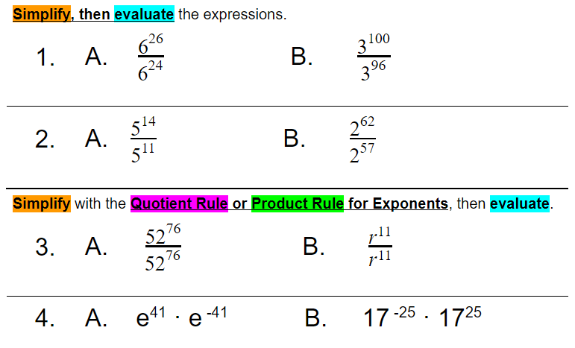
Homework:

Slide 87
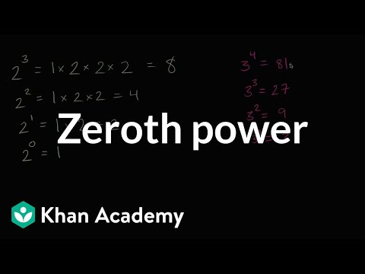
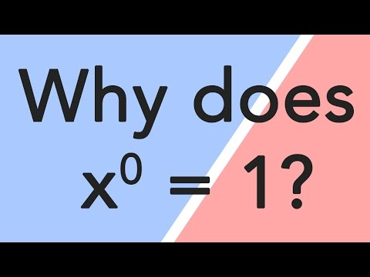
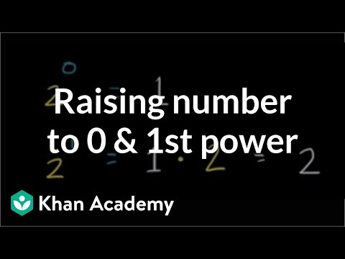
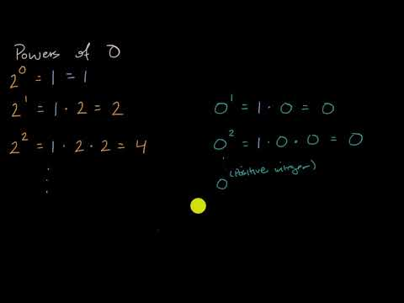
Additional help videos

