Slide 1
Cleaning up East Potomac Park
Kirsten Doyle Zhentian Ren Jarod Thompson Yuan Wang

Slide 2
04
02
03
01
OUTLINE
Methods
& Results
Deliverables & Recommendations
Introduction
Background

Slide 3
01
Introduction

Slide 4
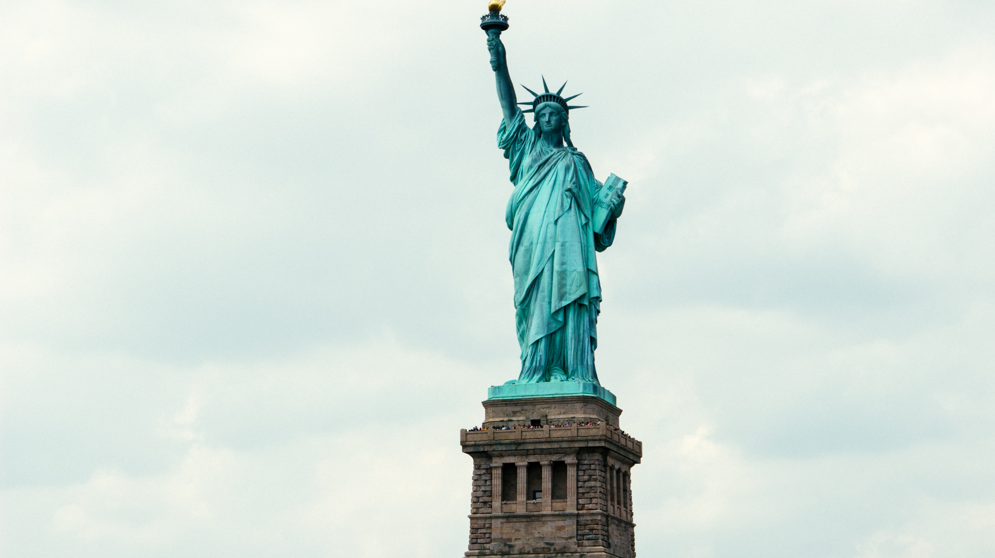
National Park visitors generate 50,000tons of trash every year
Notes:
National Park visitors generate 50,000 tons of trash every year. That's enough to fill the statue of liberty more than 1800 times.

Slide 5
National Park Service Budget is Decreasing Despite Rising Costs
Notes:
The National Park Service budget is decreasing. As shown here, in 2006 the budget for maintenance was 1 billion dollars. The budget jumped to 2 billion in 2009 but has been on a decline since, with the budget in 2014 being slightly more than ½ billion.
The budget cuts happen despite rising disposal costs. In 2006, the cost was $90 per ton of trash. In 2014, the cost rose to $140 per ton. At this rate, it costs around 7 million dollars to dispose of the trash brought into the national parks.
Both of these combined lead to an increase in deferred maintenance. In 2006, the total deferred maintenance of the NPS was 8 billion dollars. It has been on a steady incline and in 2014 the total deferred maintenance was 12 billion dollars.

Slide 6
National Park Service Staffing is Decreasing Despite Rising Visitation
Notes:
The declining budget also leads to a decrease in staffing. In 2013, the NPS had 22,500 staff, but the number has decreased and in 2017 the NPS had just over 19,000 staff.
This happens despite an increase in visitation from 28 million in 2011 to 32.5 million in 2017, which would usually require more staffing

Slide 7
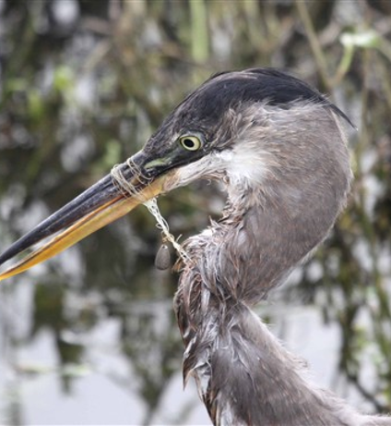
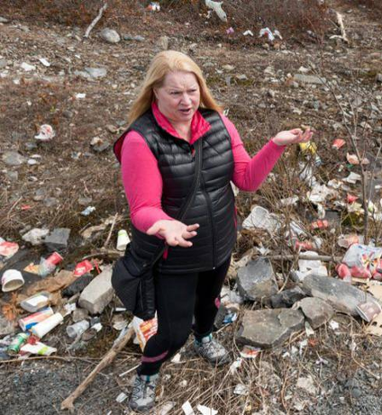
Adverse Effects on Wildlife
Adverse Effects on Visitor Experience
Notes:
The amount of trash brought into the parks has adverse affects on wildlife. Birds can get their beaks or limbs tangled in leftover fishing line and animals like rats and racoons can get into the trash and mistake wrappers or bottle caps for food, causing injury or death to the animals
The trash also has adverse effects on visitor experience. Visiting a park with a large amount of litter is not aesthetically pleasing and decreases visitation to that park.

Slide 8
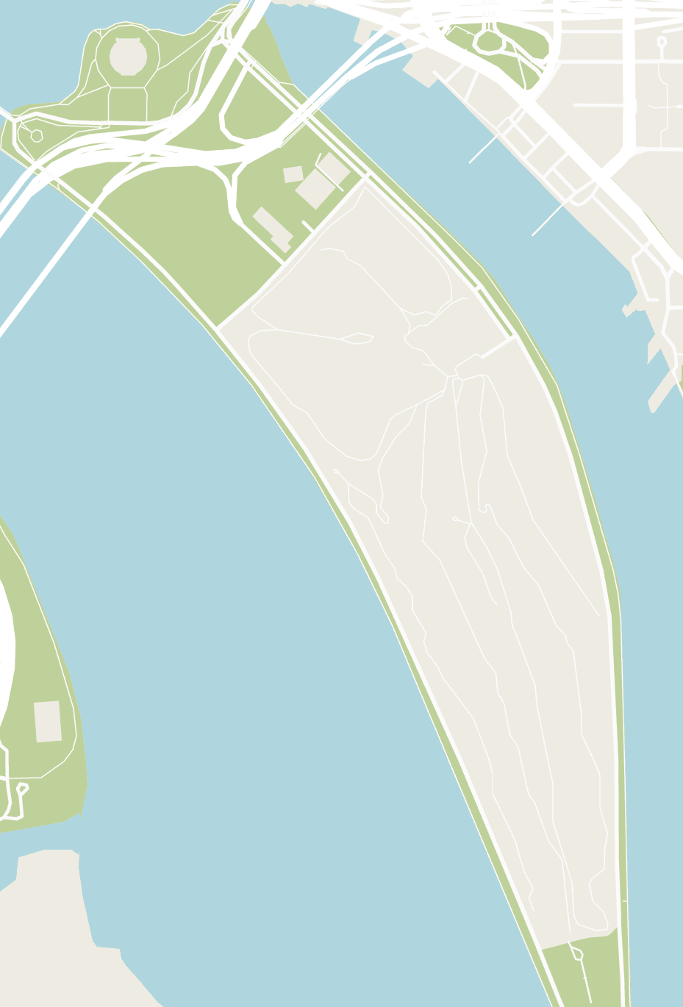
East Potomac Park
Notes:
Our project is located in East Potomac Park in Washington D.C.
Our project's area of concern is the perimeter road of the park and the picnic area at the southern end.
The park is frequented by runners, bikers and fisherman.

Slide 9
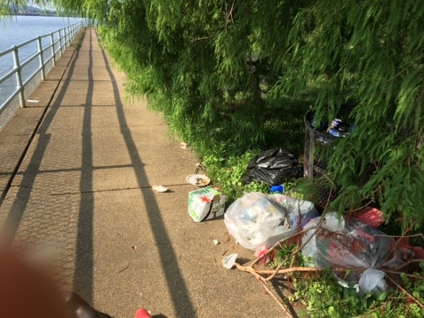
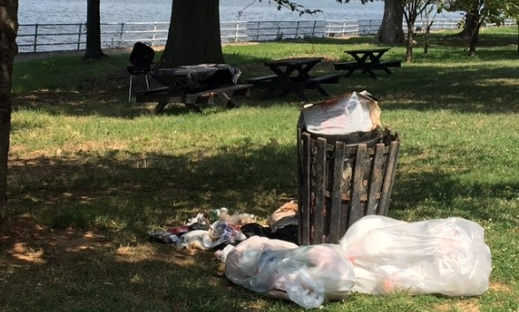
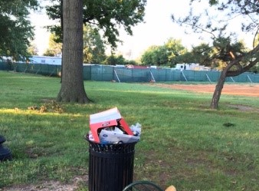
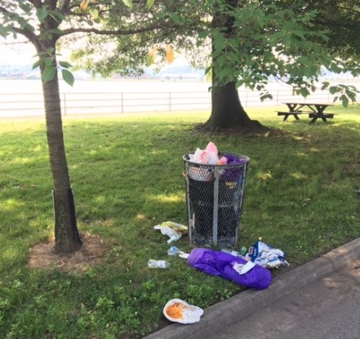
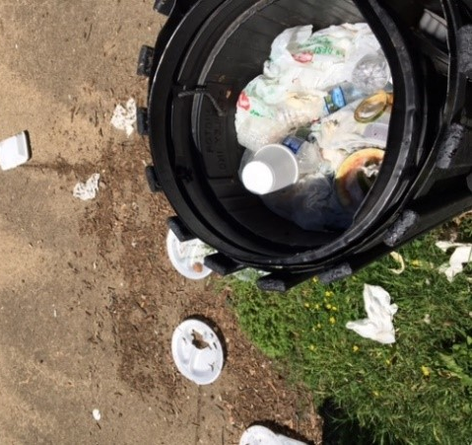
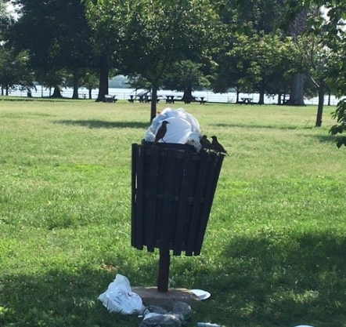
Notes:
Since East Potomac Park is a NPS park, it stands to reason that it is also suffering from these same trash problems that Kirsten just mentioned
As you can see here, we have pictures of overflowing trash cans in the park, pictures of bags of trash brought into the park by visitors, and cans knocked over by wildlife.

Slide 10
Overall Goal
Notes:
The overall goal of our project is to recommend...

Slide 11
OBJECTIVES
Evaluate trash problems and management practices at other parks
Characterize trash problems and management practices at East Potomac Park
Identify factors that affect littering behavior and visitor awareness
Notes:
We identified three key objectives to achieve this goal...

Slide 12
02
Background
Notes:
Moving onto the background section, our first bit of research focused on how to affect visitor behavior

Slide 13
Visitors are Influenced on Individual & Contextual Levels
Contextual
Distance between the trash bins
Amount of existing littering
Individual
Age
Gender
Notes:
A study conducted in 2013 called "Littering in Context" found that visitor behavior is mainly influenced by two different levels: individual and contextual
With 85% of littering behavior dependent on the individual level, the two factors that most affect visitor behavior are age and gender.

Slide 14
Individual Level
Young People
(18-29)
Older People
(29 >)
15%
26%
Notes:
The observed littering rate for people between ages 18-29 was 26%, while the observed littering rate for people older than 29 was only 15%.

Slide 15
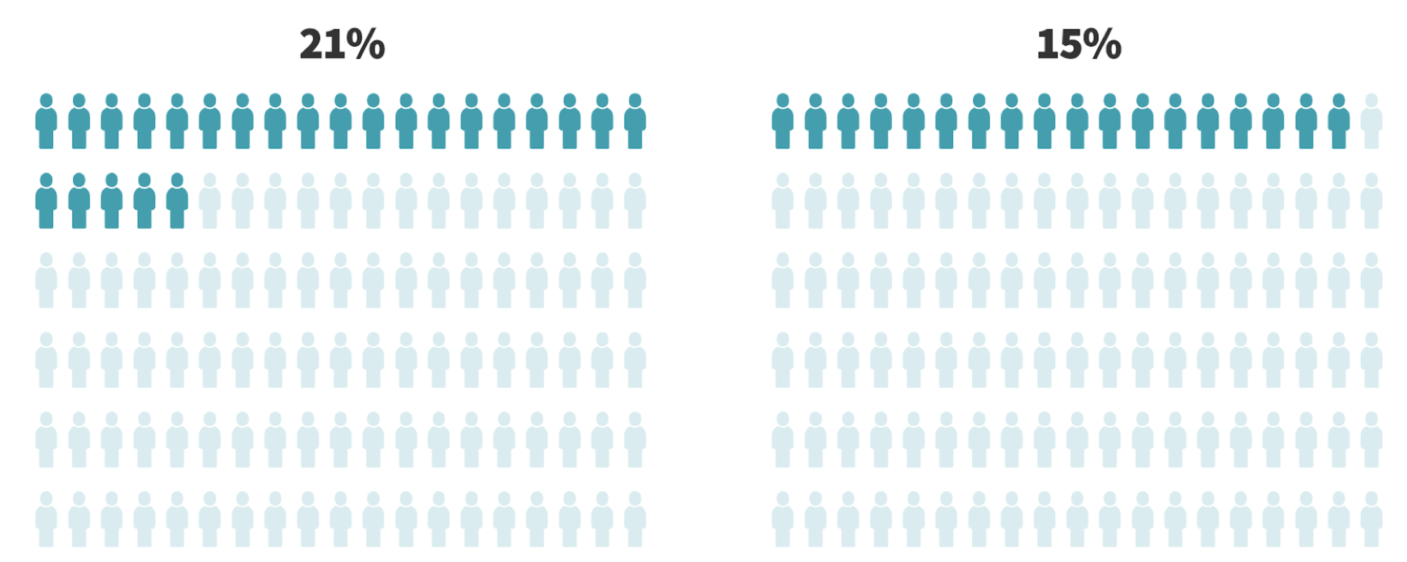
Individual Level
Male
Female
Notes:
In addition, the observed littering rate of males was 21% while only 15% of the observed females littered.

Slide 16
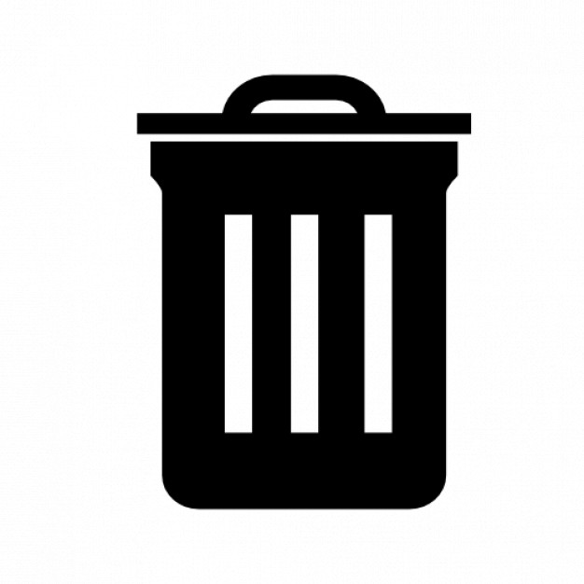
Contextual Level
20 ft
12%
60 ft
30%
Notes:
The contextual level is also a significant factor, specifically distance between trash cans and the amount of already existing litter.
When trash cans are only 20 feet apart, the observed littering rate was 12%, with that rate increasing linearly by 1% for every additional 10 feet.
Once that distance increased to 60 feet, that number jumps to 30%.

Slide 17
Contextual Level
Notes:
Visitors are more likely to litter if they already see a lot of trash in the park. The observed littering rate in every site the researchers observed went up by 2% the more trash that was at each site.

Slide 18
Four Types of Trash Management Approaches
Infrastructural
Informational
Educational
Enforcement

Slide 19
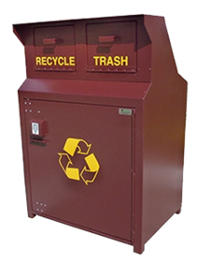
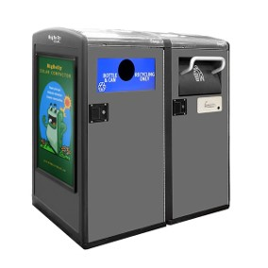
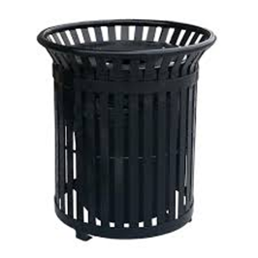
Infrastructural Approaches
Standard
Trash Bin
Wildlife Proof
Trash Bin
Big Belly Smart Bins
Notes:
Standard bins are designed to withstand damage from visitors and inclement weather. However, standard bins are not well suited for keeping wildlife out and it is not easy for maintenance crews to know when the bin needs emptying unless it is visibly overflowing. Because of this, new types of trash bins have been developed. Wildlife-proof bins serve the purpose of keeping wildlife out of the trash. This is beneficial to the health of animals, humans, and the environment. Big Belly bins are smart trash bins invented by Big Belly Solar, which compacts the trash and let the maintenance crews know when the cans are full

Slide 20
Infrastructural Approaches
Trash Free Park
Zero Landfill Initiative
Waste Diversion Rate
Notes:
The NPS is transitioning to new infrastructure removal practices. These practices mainly focus on the “Trash Free Park” or “Trash In, Trash Out” concepts that involve removing trash receptacles from an entire park or sections of a park. Visitors are expected to carry out the garbage they generate and dispose of it outside the park. Its purpose is that they can save money and use them for other important things. Another aspect is that decluttering the park for visitors’ experience. This concept reduces the amount of litter in the park, and has been successfully implemented Chesapeake and Ohio Canal Park.
The objective was to use “Subaru‘s expertise to identify, test, and promote practices that reduce the amount of trash the NPS sends to landfills.” This infrastructure involved providing public recycling bins for the national parks.

Slide 21
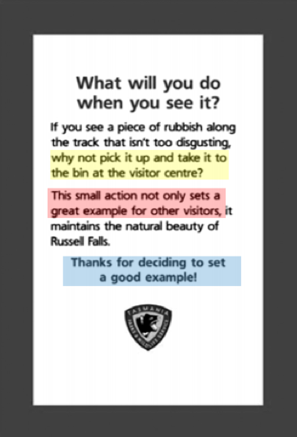
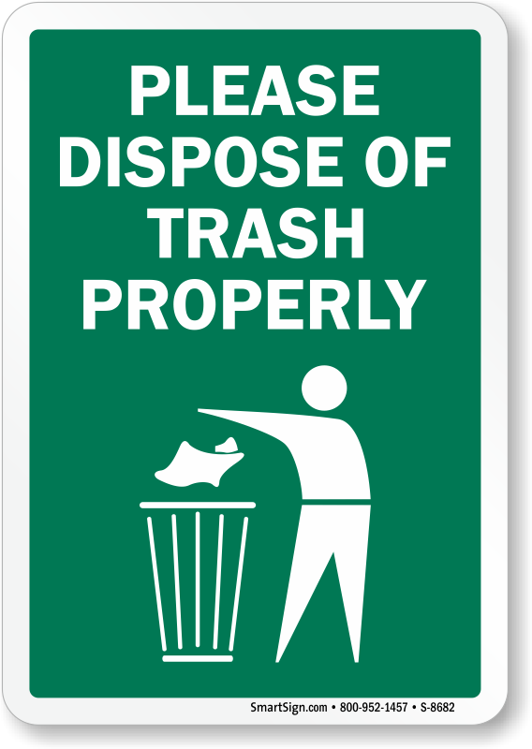
Informational Approaches
Typical Signage
Innovative Signage
Notes:
The left sign is the typical signage with simple picture and strong warning words. On the other side, it is an innovative signage from Russel Falls Park which is used for a research developing effective signage to change visitor littering behavior. This research used the theory of planned behavior which has identified three main types of cognitive beliefs that determine behavioral decisions. These are behavioral beliefs (i.e., a visitor’s attitude towards a behavior), normative beliefs (i.e., a visitor’s normative pressure to perform or not perform a behavior), and control beliefs (i.e., a visitor’s belief that he/she has the ability to perform a behavior). Visitors exposed to these signs showed a 15% - 20% increase in litter pickup.

Slide 22
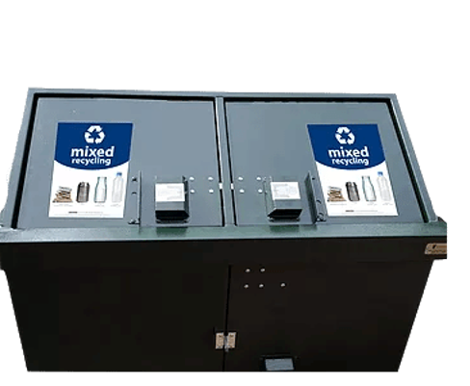
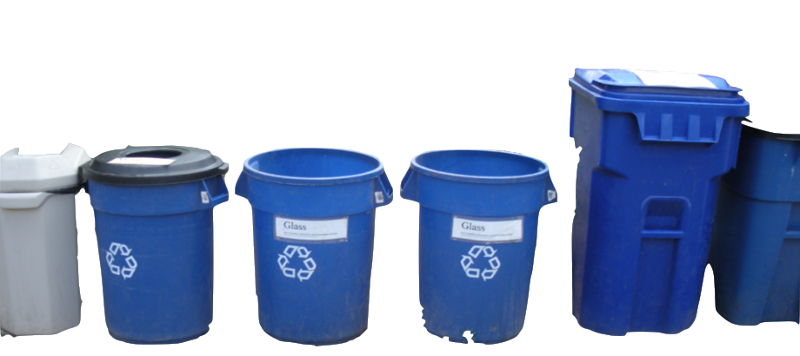
Information Approaches
Inconsistent Labelling
Consistent Labelling
Notes:
Variation in bin color, shape, terminology, and symbols within parks will lead to confusion with recycling. Therefore, in 2018, three national parks adopted the Recycle Across American label system to make it consistency in three national parks

Slide 23
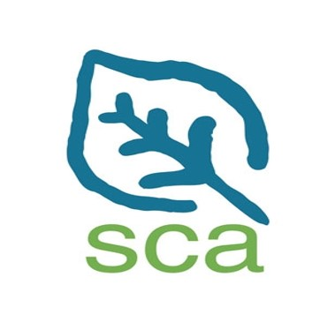
Educational Approaches
Student Conservation Association
Alice Ferguson Foundation
Notes:
Now, it comes education approach, first, national park service is partnering with student conservation association to offer national park based classes to raise people's awareness about the negative impact of trash. Another example we found is the Alice Ferguson Foundation (AFF) which is an education-based foundation in the D.C. area. It has a goal of connecting people to the natural spaces that they live around and recreate in through education. More importantly, it has partnered with many area schools and has provided students with curriculum opportunities to study nature. It has also partnered with the NPS to use national park land for field studies

Slide 24
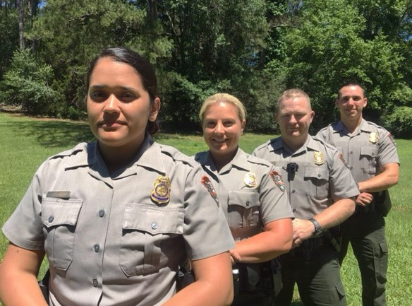
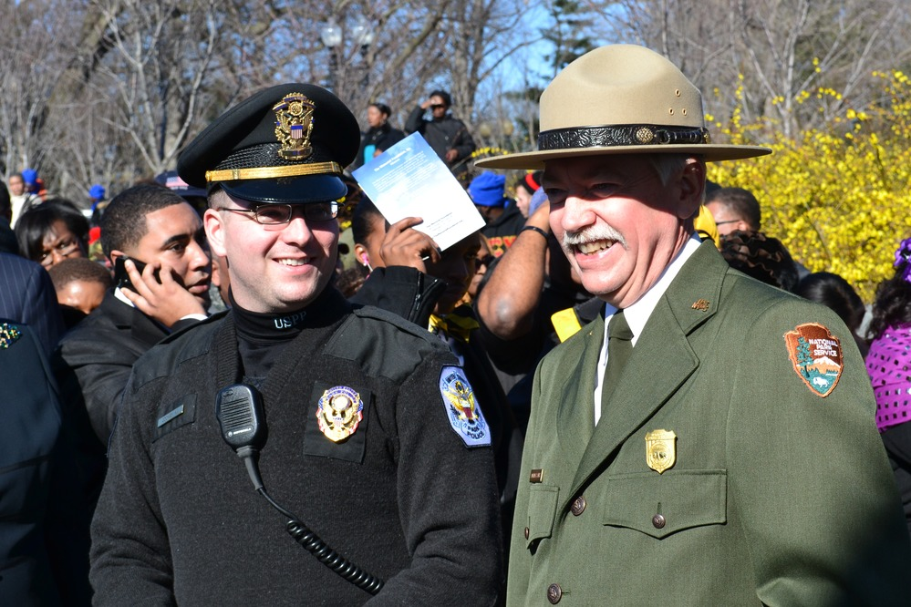
Enforcement Approaches
Law Enforcement Rangers
United States Park Police
Notes:
The NPS has its own law enforcement ranger team who are knowledgeable of the park system and regulations within the park at the local, state and federal levels. They patrol park grounds, enforcing rules and regulations and protecting park resources. The United States Park Police is another important part of the NPS's enforcement approaches. They have the rights to fine and arrest the people according to the federal and city regulations. For example, failure to use trash cans will result in a $100 fine.

Slide 25
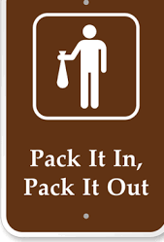
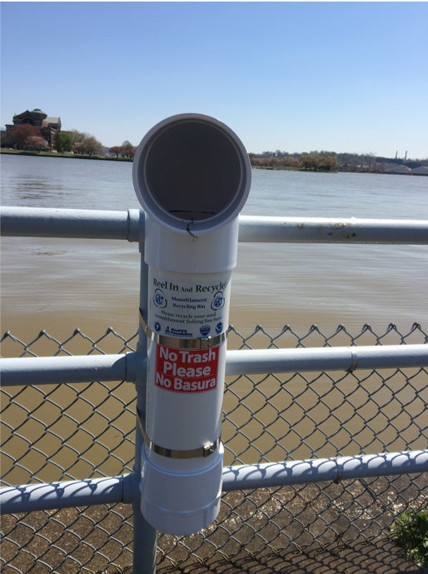
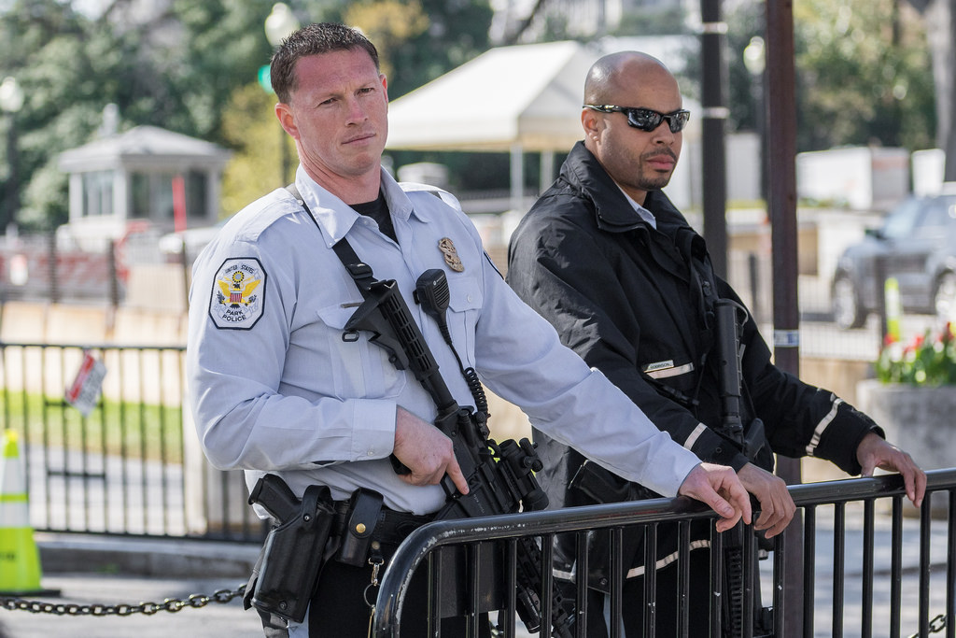
East Potomac Park Trash Management Approaches
Trash Free Policy
Monofilament Container
U.S. Park Police
Notes:
Based on our knowledge of the four management approaches, we identified the approaches that East Potomac Park is currently using.
Categorized into the infrastructural approaches, the picnic areas employ a trash free policy, where the users are meant to carry their trash out with them as they leave. However, this message conflicts with the provision of trash cans in that area. EPP also provides monofilament fishing line containers along the sea wall for fishermen.
EPP also uses an enforcement approach through the US Park Police who patrol the park. They have offices inside the park grounds as well.

Slide 26
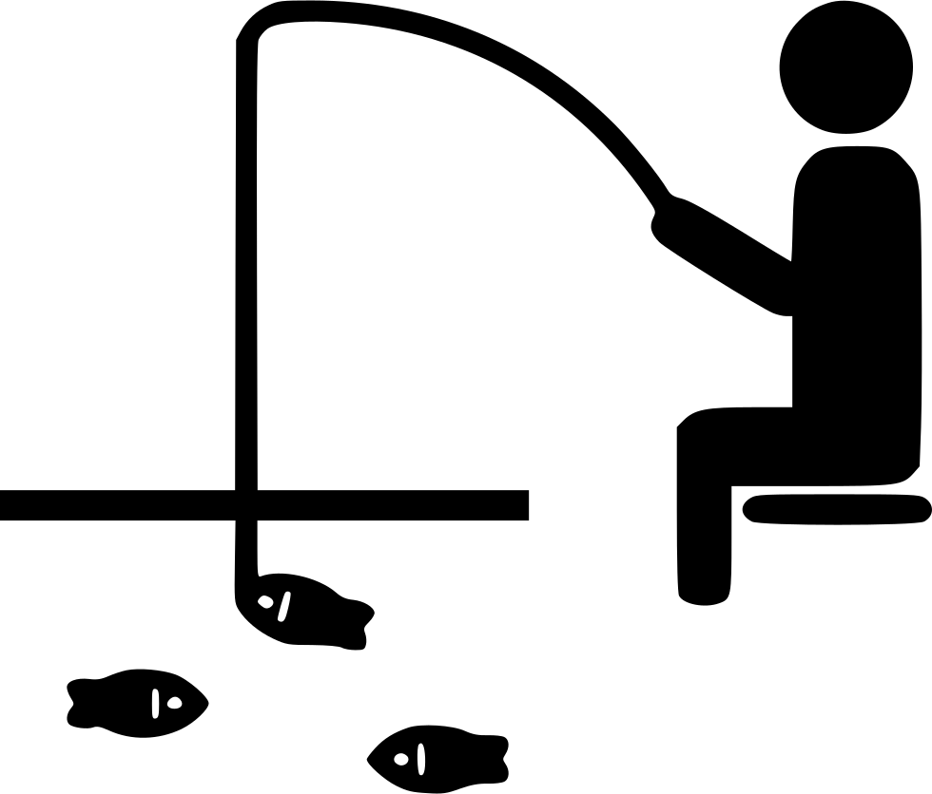
East Potomac Park has four types of trash problems
Visitors
Dumping
Fishing
River Flooding
Notes:
We also identified the four main sources of trash in East Potomac Park, with the four being
General litter and trash left behind by picnickers
Trash and fishing line left behind by fishermen
Debris from river flooding
Illegal dumping from park visitors
########## Reorder problems, mention general trash not just picnickers

Slide 27
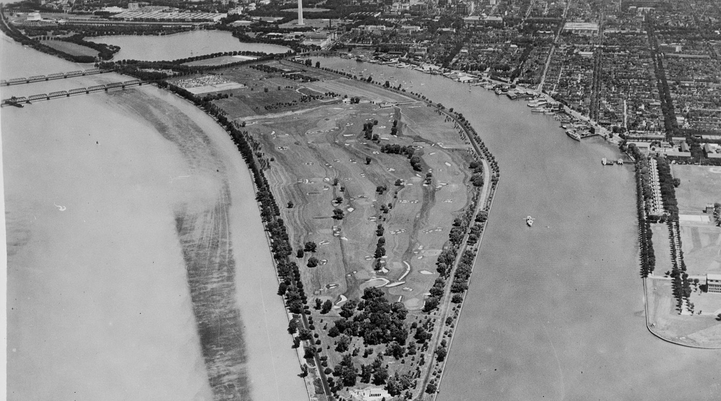
03
Methods & Results
Notes:
Now we move on to our method and result section.

Slide 28
Overview
Objective 1
Objective 2
Objective 3
- Literature Review
- Interviews
- Literature Review
- Site Assessment
- Interviews
- Literature Review
- Informal Conversations
Notes:
The 3 methods we are using are reviewing literature, site assessment and conducting interviews.

Slide 29
Evaluate trash problems and management practices at other parks
Methods - Literature Review
Infrastructure Approaches
Volunteer Groups
Education Approaches
Information Approaches
Enforcement Approaches
Notes:
Besides the 4 approaches that Yuan mentioned earlier, we continued our research into volunteer programs as another approach. Since our BG section has covered a lot of the lit review, here we’re focusing on distinct information from interviews.

Slide 30
Evaluate trash problems and management practices at other parks
Methods - Interviews
National Park Staff in DC
Outside Organizations
Notes:
Our interviewees are mainly NPS staff from other parks in DC and some people who work for outside organizations.

Slide 31
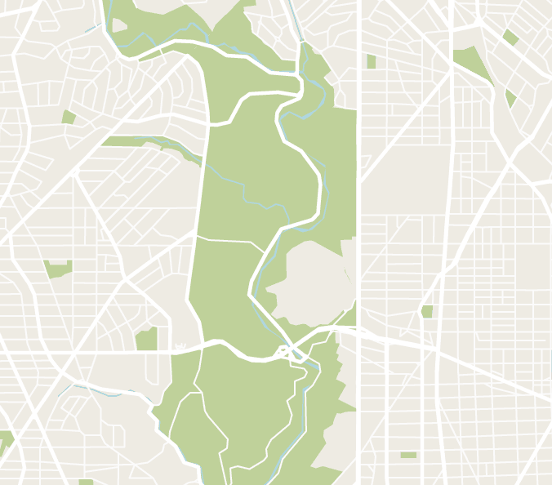
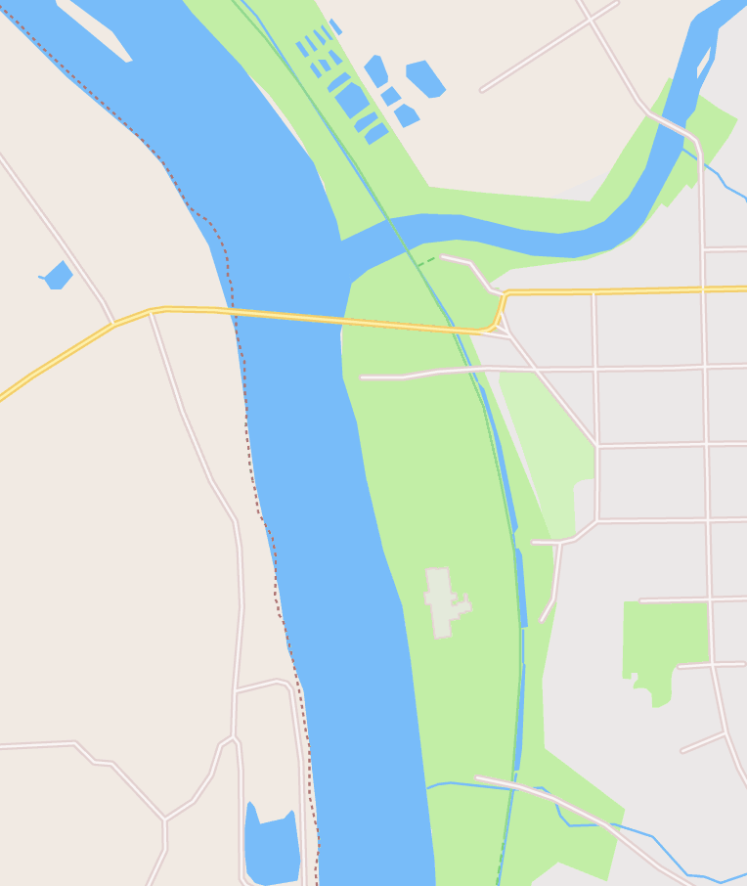
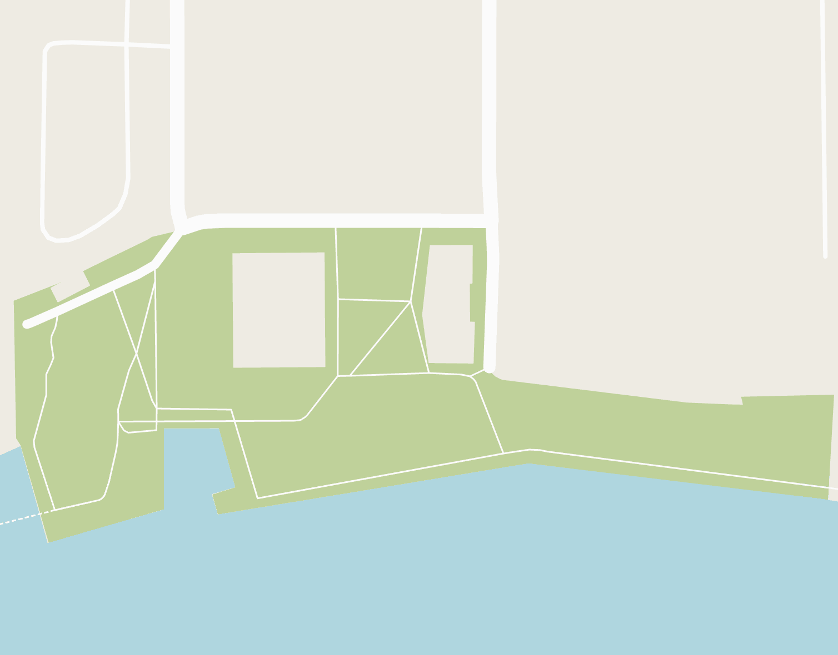
Evaluate trash problems and management practices at other parks
Results – Other parks are using a variety of different approaches to address trash problems
Rock Creek Park
Chesapeake & Ohio Canal Park
The Yards Park
Rubbermaid Trash Bins
Contract litter pickup
In-house maintenance operations
Trash Free Park
130 trash bag dispensers
Trash/ Recycle Bins
Managed by Capitol Riverfront BID
Notes:
From our interview with Don Kirk, the chief of maintenance at RCP, we learnt that RCP is using Rubbermaid trash bins that are wildlife-proof. However, visitors often don’t use them correctly, they leave their trash on top of the bin rather than putting it inside. He also mentioned that he is unhappy with the fact that they has to empty the trash bins so many times. So they tried reducing the number of trash bins, however, it didn’t work well.
Similar to what Don Kirk said, Robert Mocko, the environmental specialist of NACE has also mentioned that he heard the trash in trash out policy was attempted in Great Falls Park, Virginia, but it did not work well.
However, C&O Canal Park is doing well with the trash free park concept, they reduced 75% trash within the first year they started to be trash free. And the percentage has been kept low ever since. Rita Knox believes this program has been so successful because they installed 130 trash bag dispensers throughout the different access points and picnic areas in the park.
Don Kirk from RC also said that RC is so large that they have in house maintenance crews, contractors and volunteers to work on trash removal and maintenance.
But The Yards Park, unlike RC, is managed by the Capitol Riverfront BID. BIDS are areas that are chosen by property or business owners to be better developed economically. They are usually downtown or neighborhood commercial areas. The BID is funded by the self-imposed tax from the business property owners and is in charge of the Yards Park cleanliness, maintenance and beautification.

Slide 32
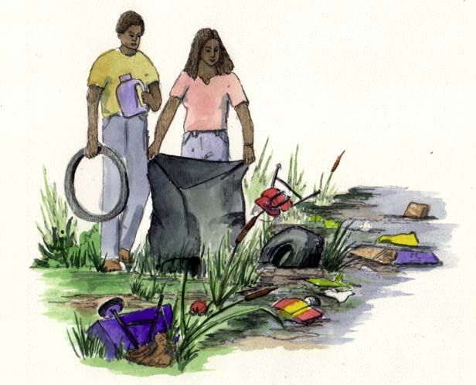
Evaluate trash problems and management practices at other parks
Results – Education programs give students perspective into the impacts that trash has on the environment
Talking Trash Program
Notes:
Many parks we interviewed are partners with the AFF, for example, the C&O Canal Park and ROCR.
“Talkin’ Trash” is an education program run by the AFF. It is a form of curriculum and field study for mainly high school students. We talked to Heather Zdobysz (Za-doe-bis), the program manager of education from the AFF, she told us that they partner with the NPS to use the parks and monuments for the Talkin Trash program. The students clean up trash in the park and identify how much of it is recyclable or plastic waste, among other categories. The program gives students perspective into the long lasting impacts trash has on the environment

Slide 33
Evaluate trash problems and management practices at other parks
Results – Volunteers play a large role in keeping D.C. parks clean
SOLVE Volunteer
Notes:
Through several of our interviews, we learned that AFF not only focuses on education programs, they also has a big volunteer program to clean up trash and is partner with RCP and C&O Canal parks. Every year they have a month long cleanup during April. This year they cleaned up over 300 sites and a million pounds of trash.
Through our interview with Don Kirk from RCP, Arielle Conti and John Maleri (Ma-ler-ee) from Rock Creek Conservancy, and Robert Mocko from NACE, we learned that volunteers in RCP and Anacostia Park are a big part of cleaning up trash. Rock Creek Park has SOLVE partners, one of which is the Rock Creek Conservancy, who are in charge of maintaining specific sites by cleaning up litter and reporting hazards.
Anacostia Park has a group called the Anacostia Watershed Society that performs similar tasks as groups in Rock Creek's SOLVE program, but the Anacostia group is also in charge of cleaning up trash and debris from the river.
Both Don Kirk and Robert Mocko feel the volunteer groups are doing a good job.

Slide 34
Evaluate trash problems and management practices at other parks
Results – Properly implemented signs are effective
Trash Free Park
Rock Creek Park
Anacostia Park
The Yards Park
Chesapeake & Ohio Canal Park
60-75 signs
Notes:
None of RCP, Anacostia and the Yards Park has any signage regarding trash.
But Robert Mocko said he thinks the trash free park policy in Great Falls Park could've used more outreach/information practices to be implemented more successfully.
Robert Mocko was correct, because the trash free park we interviewed, C&O Canal Park, has 60-75 signs in the park to inform visitors about the trash free park, and Rita Knox a ranger in that park, believes this was a factor in its successful implementation.

Slide 35
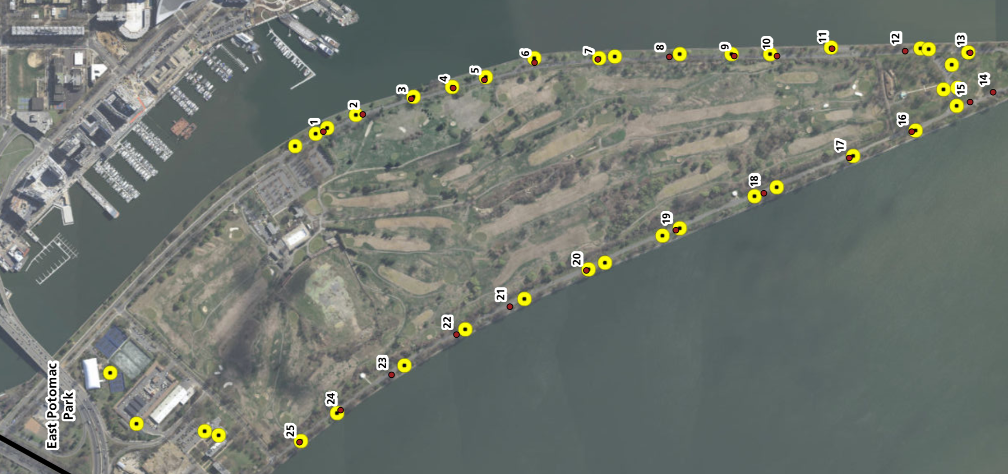
Characterize trash problems and management practices at East Potomac Park
Methods – Site Assessment
Amount/Types of Trash
Trash Bins Location/Accuracy
Distance Between Trash Bins
Notes:
Our 2nd objective was to characterize the trash problem and management practices at East Potomac Park.
We began this objective with a site assessment, where we observed the amount/types of trash, the locations of the trash bins and fishing line containers and the distance between the trash cans.

Slide 36
Characterize trash problems and management practices at East Potomac Park
Methods – Interviews
Facility Staff
Education Staff
Volunteer Coordinator
U.S. Park Police
Suggestions for Improvement
Standard Operating Procedure for Trash Removal
Education Programs
Approaches to Reduce Littering
Opinions on Different Approaches
Effectiveness of programs
How they Solicit Interest / Implement the programs
Park Police Regular route
Jurisdiction over littering
Notes:
We interviewed these 4 types of staff in EPP.
We asked facility staff about their standard operating procedure.
We asked education staff about what education programs they currently have.
We asked volunteer coordinators the effectiveness of their volunteer programs.
And we asked a US park police officer details about his jurisdiction over littering.

Slide 37
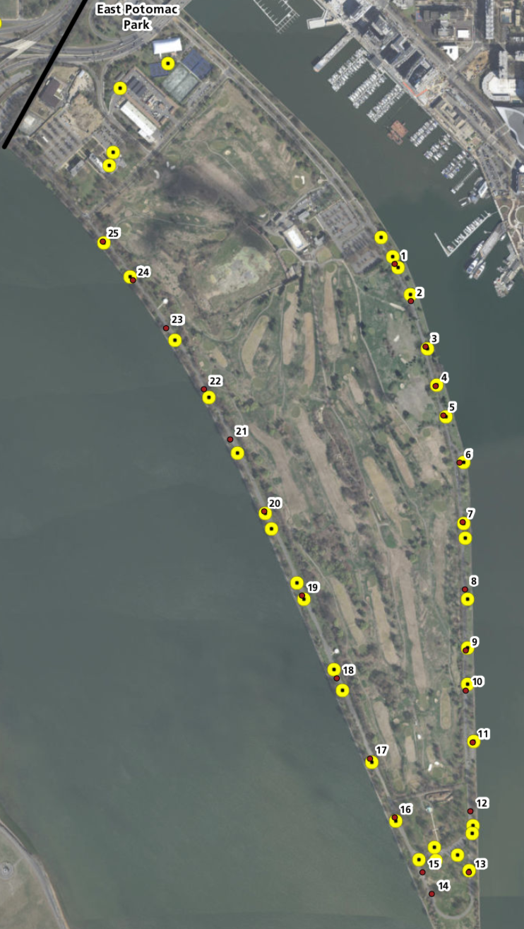
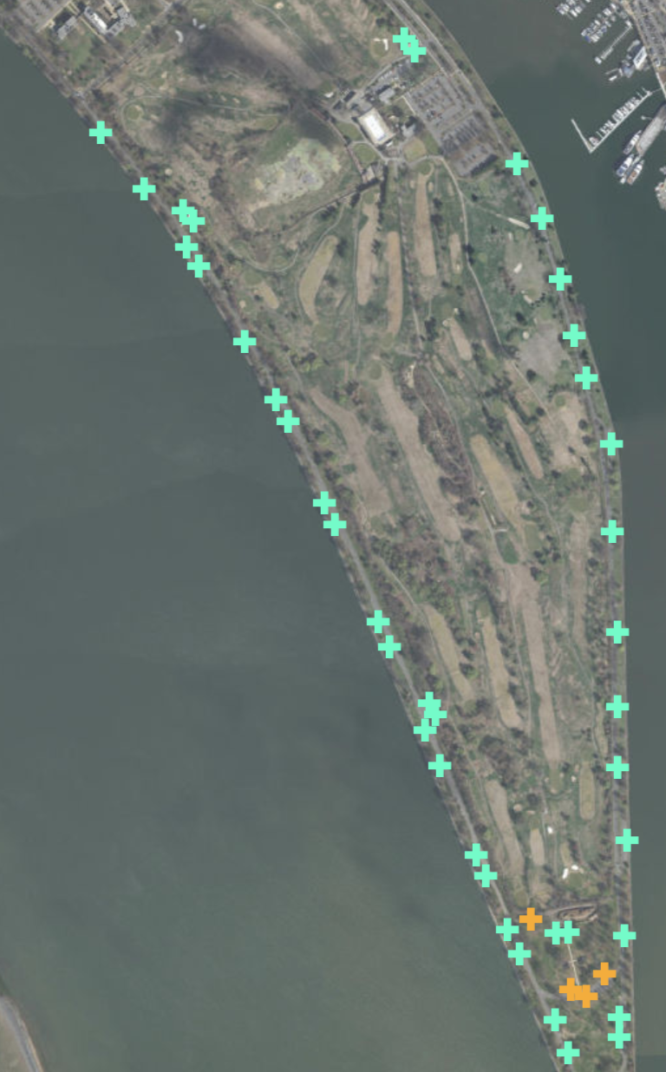
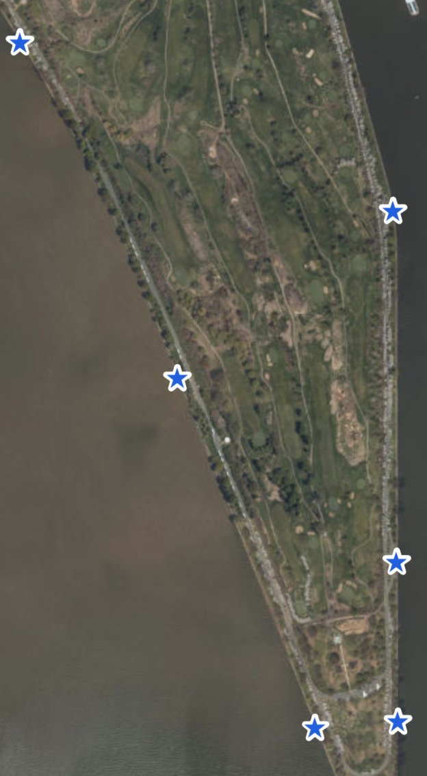
Characterize trash problems and management practices at East Potomac Park
Results – The design of the trash bins can be improved
Standard Trash Bins
Proposal to install wildlife-proof trash bins
Monofilament containers
Notes:
Through our interviews and literature reviews, we learned that animals going into trash bins and spreading trash around is a big problem for the park.
However, because of Leslie's proposal, they are in process of switching to wildlife proof trash bins which Jeffrey Hitchcock, an environmental compliance program manager at NAMA, thinks will have a big impact on their trash removal process.
Interestingly, this proposal also involved removing 103 trash bins from the park, which contradicts the research we conducted.
Also, the six fishing line containers are not being used properly as visitors will often put regular trash in them.

Slide 38
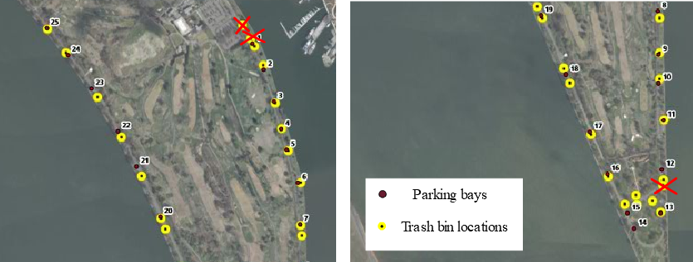
Characterize trash problems and management practices at East Potomac Park
Results – The trash bins are in the southern half of the park, while most of the trash is in the northern half
Notes:
Through our site assessment, we were able to confirm the locations of the trash bins with a few exceptions. The map of current trash bin locations has 34 trash bins, but after going out into the park, we had observed only 31 trash bins, with the missing bins marked with a red X. We also found that some bins are not shown on the map. These 6 bins were found in the picnic area.
We also found the most common litter in the park to be food wrappers, bottle caps, and illegal beer bottles. We found more litter in the northern area of the park where there are currently no trash cans, however there was consistent litter in the grass along the sea wall in the southern section of the park.

Slide 39
Characterize trash problems and management practices at East Potomac Park
Results – East Potomac Park uses a variety of resources for trash pickup
Notes:
From our interview with Jeffrey Hitchcock, we learned that the maintenance crews only have 2 trash trucks and 2 licensed drivers for all of NAMA. They do have 2 new trucks on the way and are in the slow process of hiring a new driver.
We also learned that litter pick up is contracted out to Ruppert Landscaping. However, their job performance is currently not meeting the stipulations of the contract and they are being withheld pay until these issues are addressed.
We learned that the Youth Conservation Corps is in charge of emptying the fishing line containers. The YCC is a summer program for high school students that lasts about 8-10 weeks during the summer, and they get paid to complete various tasks regarding environmental management and maintenance.

Slide 40
Characterize trash problems and management practices at East Potomac Park
Results – There are no educational programs in East Potomac Park
This Photo by Unknown Author is licensed under CC BY-SA
Notes:
From our interview with Jennifer Epstein, the education specialist at NAMA, we learned that there is currently no education programs in East Potomac Park but she would be willing to do one. Also, they are short staffed, so she can not run the variety of programs that she would like to.

Slide 41
Characterize trash problems and management practices at East Potomac Park
Results – There were three trash pickup projects in 2018
Notes:
This bar chart shows the total number of volunteers for projects in East Potomac Park over the past four years. During this year, they've had 66 total volunteers, with three projects involving picking up trash and one involving emptying the fishing line containers. This conflicted with our initial understanding of how volunteers operated within the park, as we thought that volunteers were not allowed to pick up trash according to the landscaping contract.

Slide 42
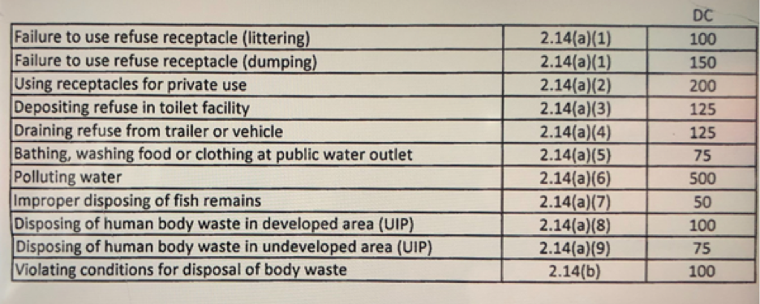
Characterize trash problems and management practices at East Potomac Park
Results – Officers rarely give out fines for littering
Notes:
From our interview with Officer Conn, a US park police officer in NAMA, we learned that police officers rarely give out fines for littering or dumping in the park because it is difficult to catch anyone in the act.

Slide 43
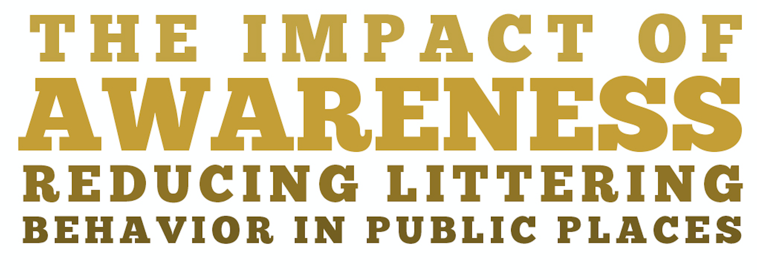
Identify factors that affect littering behavior and visitor awareness
Method - Literature Reviews
Notes:
Our 3rd objective is to identify factors that affect littering behavior and visitor awareness.
Our first method was literature review, which Jarod and I mentioned in the BG section. We got a lot of useful information from these 3 sources.

Slide 44
Identify factors that affect littering behavior and visitor awareness
Methods – Informal Conversations
Fishermen
Notes:
We also had informal conversations with some park users in EPP. They are 8 fishermen

Slide 45
Identify factors that affect littering behavior and visitor awareness
Results – Fishermen are unaware of the containers
Where is the container?
I don’t know what this is for.
Notes:
From our talk with the 8 fishermen, they complained that the fishing line container are too far away, and suggested having some back to the area before the Hains Point Gate.
6 out of 8 of them told us that they don’t know where the fishing line containers were, what they look like or what they were for.

Slide 46
Deliverables & Recommendations
04
Notes:
Moving on to our last section.
We have created 5 deliverables to supplement our recommendations.

Slide 47
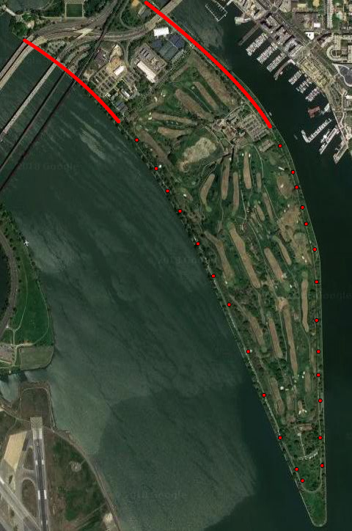
Recommendation – Install Trash Bins in Important Locations
Notes:
We wanted to create a recommendation based on our research that littering rates go up after the distance between trash cans exceeds 60 feet. With the length of the perimeter road of East Potomac Park being around 3.15 miles, the optimal amount of bins for the park would be 297. However, this is obviously unrealistic for a park to implement, therefore, after talking with Leslie and April, we recommend to add more trash bins in each parking bay following the 60 feet distance, for the part of road that is north of hains point gate, as highlighted, we also recommend to add more trash bin.

Slide 48
Recommendation – Implement Signage Regarding Trash/Littering
Proposed Signage Regarding
Trash/Littering
Notes:
We also recommend that the park implements signage regarding littering. Based on our literature reviews, we found that signs created using the tpb were effective in reducing littering by 15-20%.
We created a sample sign using a similar strategy. The text in blue box put moral pressure on the visitor to reinforce them to pick up litter. This is called normative belief.
The text in orange box is called control belief, it states the easiness of the action.
The text in purple box makes visitors feel good to perform the action by thanking them. This is called behavioral belief.
### Since there are often non-english speakers visiting the park, we think having spanish version of the signage is a good idea.
### We suggest to have the sign on picnic tables, in the picnic area, and in every couple parking bay.

Slide 49
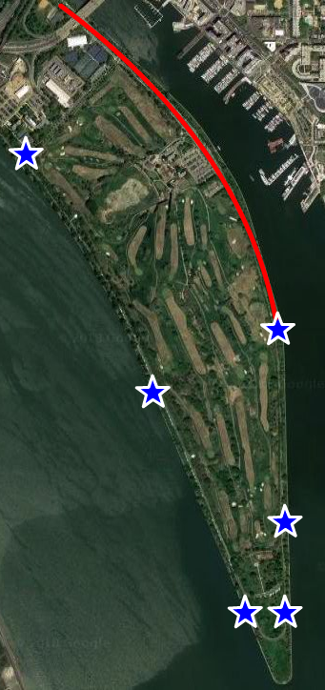
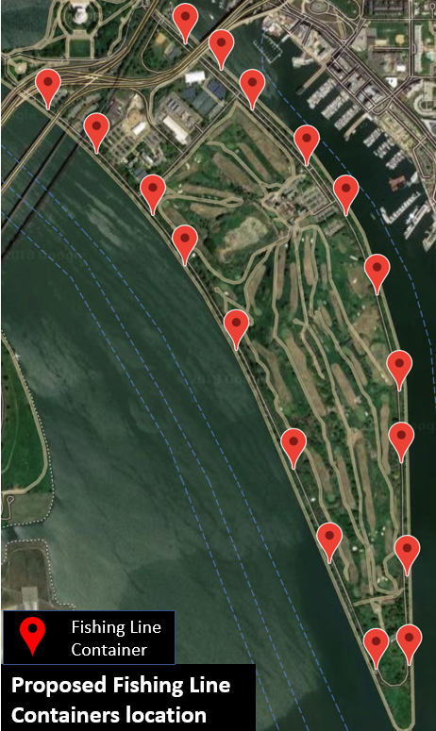
Recommendation - 12 More Fishing Line Containers
Observed Fishermen locations
Notes:
We also recommend East Potomac Park to have 12 more fishing line containers in addition to the 6 they currently have.
While we observed that more fishermen congregate in the north part of the park, we realized this could be because these are the slower months for visitation, so we recommend uniform distribution for the 18 fishing line containers.

Slide 50
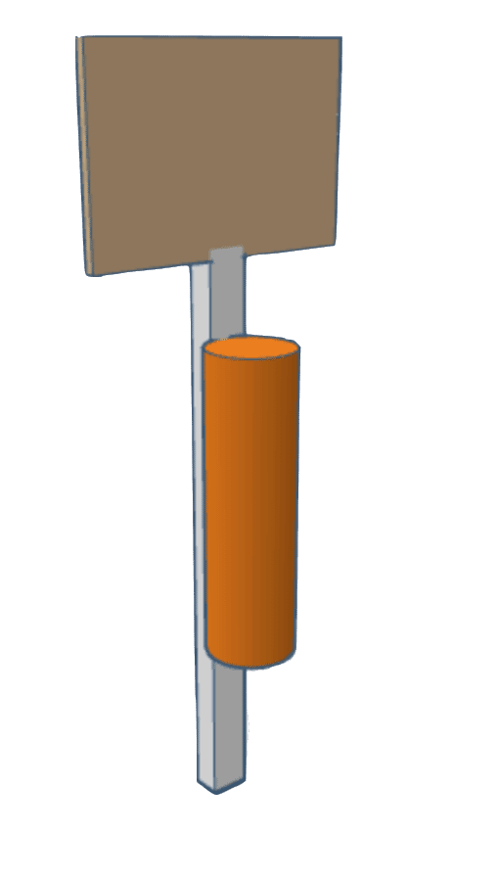
Recommendation – Redesign of Fishing Line Containers
Seawall
Seawall Walkway
Notes:
We also think redesigning the fishing line containers is a good idea because white containers on white fence are difficult to notice.
One possible solution is to redesign the containers, making them a different color to stand out from the fence and giving them a better label to express what they are for.
Another potential solution is to move the containers to the other side of the cement walkway in order to make them more visible, and attach them to a pole with a sign conveying their proper use.
However, we did realize there is limitation to this solution, since digging holes and putting up poles on the grass will make contractor's job more difficult.

Slide 51
Recommendation – Implement Signage Regarding Fishing Line Containers
Proposed Signage for the Monofilament Containers
Notes:
We recommend that the park implements signage for the redesign of the fishing line containers. The sign was created to inform the visitors of the purpose of the containers as well as their general locations around the park. It was created also based on the three beliefs identified in the tpb.
Text in blue pressure fishermen to use the containers correctly by emphasizing that proper disposal of fishing line can save life, this is nomative belief.
Text in orange states the accessability of the containers and it is an easy action to perform, this is control belief.

Slide 52
Recommendation – Run Education Programs in East Potomac Park
Pre-Visit
Visit
Post-Visit
Notes:
According to the study "Littering in Context" mentioned earlier by Jarod, younger people are more likely to litter than older people.
Therefor, we recommend that EPP connects with schools to run an education program to improve the students' awareness about the impacts of trash. Jennifer had mentioned that she was willing to run a program regarding trash, so we developed a lesson plan that could be used following the DC educatin standards for middle schoolers. We named this program "Trash Rangers" and it includes a pre-visit, open ended discussion where the students will answer questions posed by the teacher regarding the impacts of trash the strategies they think will help reduce them. The visit to the park includes observational studies where students split into groups to look for impacts and management strategies they see in the park. Post-visit, the students will write of a summary of their findings, and what they plan to do to reduce their impact on the environment. After consultation with Jen, we also recommend the teachers send these summaries to the park for the park to use and this gives students a chance to voice their opinion
### we also suggest this program is run regularly, because a one time experience is not enough to teach the students everything about trash.

Slide 53
Recommendation – Run an Education Program in East Potomac Park
Notes:
This is a an example of an observation table the students might fill out while they're in the park. The types of trash, its impacts, and the management strategies will change based on what the students identified as important in the pre-visit discussion.

Slide 54
Recommendation – Use Volunteers for Litter Pickup
Contractor
Volunteer
Notes:
We think EPP could benefit from volunteers cleaning up the park. We have received clarification that having volunteers pick up litter is not a breach of the contractor agreement. We also received concerns about volunteers not being committed enough to do a daily clean up job. Based on this information, we recommend a weekly volunteer group to complete trash pick up. The frequency of the group can be adapted as needed for the busier times of the year, especially in the late spring and summer months.

Slide 55
Recommendation – Hire More Staff
Interpretation/Education Department
Maintenance
Department
Notes:
From our interview with Jen we learned that because she is the only member of the education staff it can be difficult for her to keep up with the requests she receives from schools. And from our interview with Jeffrey Hitchcock, we learned that there are only 2 licensed truck drivers. Therefore, we recommend both departments look into hiring more staff and that the maintenance department continues the process they’ve already begun
If you'd like a more in-depth explanation on the creation of these deliverables, it can be found in the Deliverables and Recommendations Section of final report we will be delivering to Leslie and April.

Slide 56
Acknowledgements
Advisors
Dominic Golding
Lorraine Higgins
Sponsor Liaisons
Leslie Frattaroli
April Newman
NAMA Interviewees
Jennifer Epstein
Jeffrey Gowen
Jeffrey Hitchcock
Jacklyn Meyer
James Pierce
Other Interviewees
Officer Conn
Arielle Conti
Denise Coogan
Don Kirk
Rita Knox
John Maleri
Robert Mocko
Nick Soloman
Kathryn Tyler
Heather Zdobysz
Notes:
We’d like to thank our sponsors and advisors at this time for their help throughout our project, as well as our interviewees for helping us gather the information we needed. Thank you for listening and are there any questions?

