Slide 1
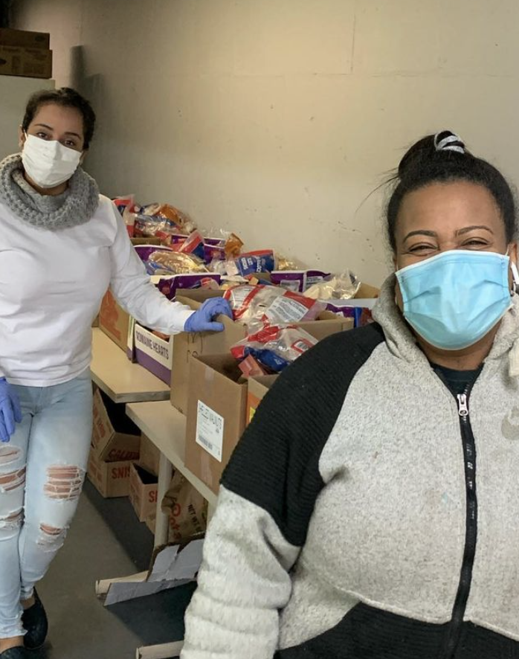
Addressing Food Insecurity in the African Community in Worcester
Camila Carvalho, Isabelle Chi, Lauren Guerrero & Mary Scrivanich
Notes:
Camila

Slide 2
AGENDA
01
03
02
04
BACKGROUND & INTRODUCTION
PROJECT OUTCOMES & DELIVERABLES
PROJECT OBJECTIVES & METHODOLOGY
CONCLUSION & RECOMMENDATIONS
Notes:
Isabelle
This is a brief overview of our presentation for today. First, we will be going over some background information and giving an introduction. Next, we will give a summary of our project objectives and the methods used to accomplish those objectives. Then, we will discuss the outcomes and deliverables of the project. And finally we will go over our conclusions and recommendations.

Slide 3
OUR SPONSOR
Sponsor: Massachusetts Organization of African Descendants (MOAD)
Coalition of members from diverse African nations living in Worcester
Working with UMass Memorial Medical Center to create a city-wide task force to address the barriers faced by the African community by implementing a food pantry
Notes:
Mary
We worked alongside our newly established sponsor Massachusetts organization of African Docents. MO AD is a coalition of volunteer members from diverse African nations living in Worcester, including African businesses, restaurants, churches and individuals. Since the start of COVID, MOAD has been working with UMass Memorial to establish two food pantries, a church-based pilot location and a longer-term community-based main pantry. UMASS memorial medical center assisted MOAD in creating a city wide task force to address he barriers and inequity faced by the African community. There is an overwhelming body of evidence to show that many families, particularly low-income African families, struggle to access food that is affordable, high-quality, and healthy.
With keeping the community background and interests in mind, we have designed an implementation plan for a successful long-term food pantry in the area.

Slide 4
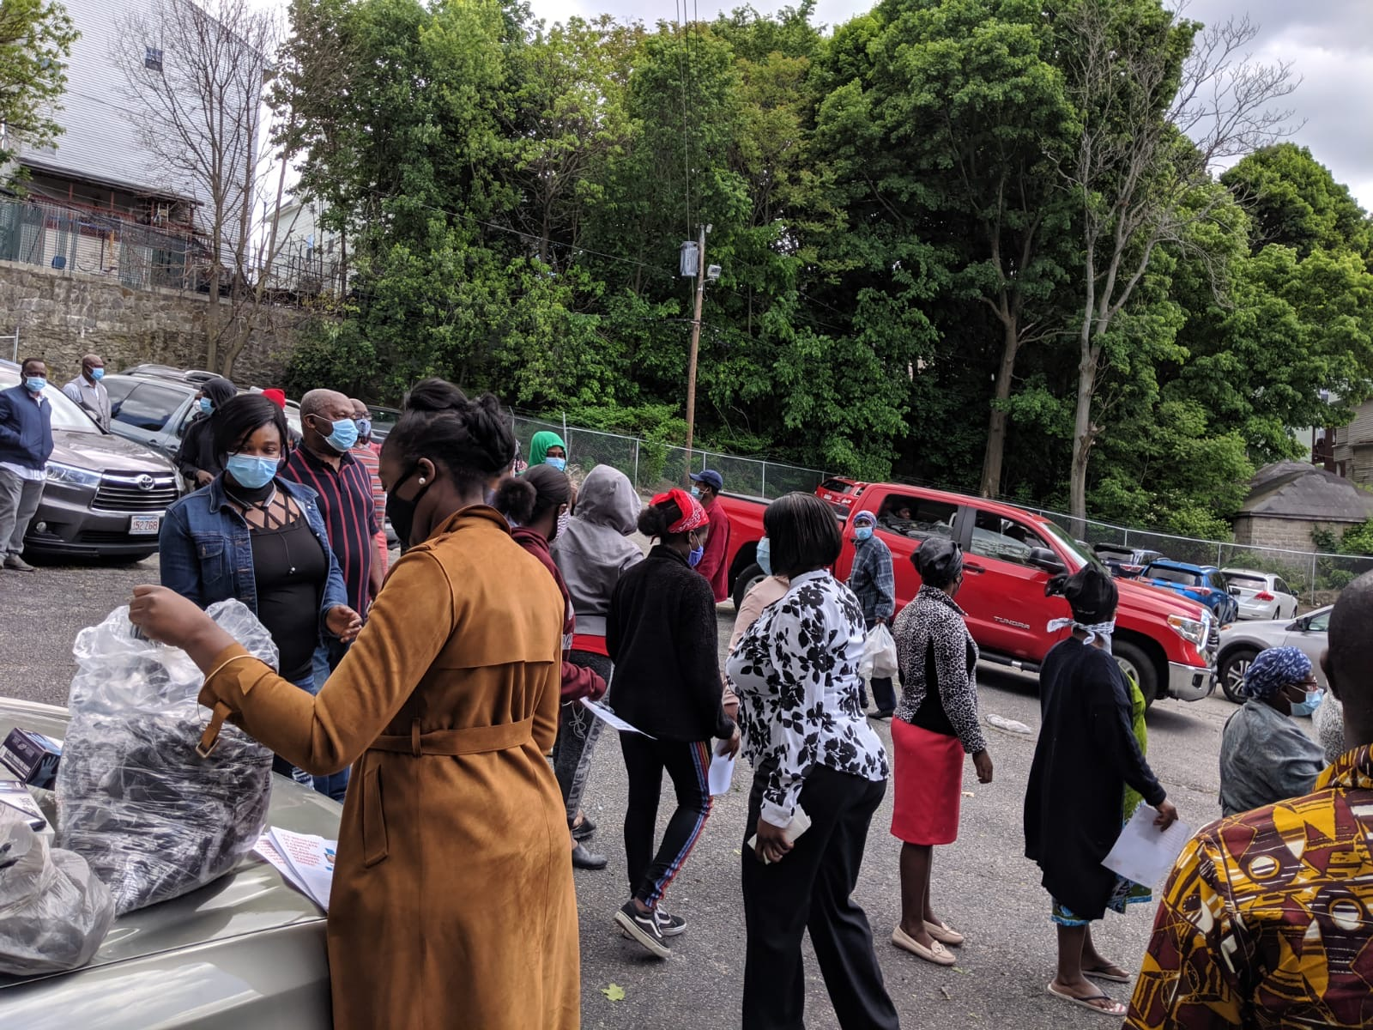
TARGETED COMMUNITY
Individuals of African origin (refugee, immigrant, documented or undocumented) living in Worcester
African countries represented in Worcester
Cape Town, South Africa
Notes:
Lauren
To provide the best experience for our audience, we first identified our targeted community. Based on the City of Worcester’s demographic data, Ghana was the country where most foreign born residents in Worcester were from with a total of 4019 of them. However, by going through African Community Education’s website, other prominent countries included Burundi, Cameroon, Central African Republic, Democratic Republic of Congo, and others seen on the map in gold which you can observe are mainly in central Africa. Therefore, MOAD’s food pantry will be catered to African immigrants and refugees from the countries just mentioned. Moreover, we will be mainly focusing on low income families and individuals who do not have the financial means to support themselves. These individuals and families are facing enough setbacks as it is with their adjustment to living in the United States because of cultural and linguistic barriers. And more now with COVID-19, it has created a bigger demand for a solution to achieve food security. We would also like to quickly highlight Cape Town, South Africa because of their presence in Worcester and it was our original IQP site.

Slide 5
UNDERSTANDING FOOD INSECURITY
DEFINITION
CAUSES
CONSEQUENCES
- “Household-level economic and social condition of limited or uncertain access to adequate food”
- With COVID-19, 54 million people will be food insecure
- Poverty
- Language and cultural barriers
- Lack of access to information
- Ineligibility for food assistance programs
- Cardiovascular disease, diabetes, overweight and obesity
- Depression and anxiety
Notes:
Change line spacing
Camila
To understand the motivation of our project, we need to explain the issue we are trying to address, which is food insecurity. According to the United States department of Agriculture, food insecurity is a “household-level economic and social condition of limited or uncertain access to adequate food”. This issue is especially prevalent in countries with economies closely related to inequality, such as the United States. With the consequences of COVID-19, Feeding America, a well known organization, states that the pandemic could push the number of food insecure Americans to 54 million by the end of 2020, which is 17 million more food insecure individuals than before the pandemic.
The main cause of food insecurity is poverty, because it prevents food insecure families from buying and accessing food. Other reasons, that apply directly to our targeted community, is language and cultural barriers, lack of access to information, and ineligibility for food assistance programs.
There are many consequences to food insecurity, but here we are going to focus on the health problems related to this issue. Food insecurity is associated specifically with diet sensitive chronic diseases, including cardiovascular disease, diabetes, overweight and obesity. However, food insecurity can also affect someone’s mental health, as food insecure individuals may suffer with depression and anxiety. Therefore, this issue is extremely critical and needs to be addressed.

Slide 6
OVERALL GOAL
Develop a plan for a successful long-term food pantry for the African Community in Worcester that will enable MOAD to inform the targeted community about the food pantry and healthy eating options and work towards achieving food security.
Notes:
Make less wordy
Isabelle
Now that we’ve given you some background information, we are going to go over the overall goal of our project. The goal is …

Slide 7
PROJECT OBJECTIVES
Obtain information on the impact of food insecurity in the African community in Worcester
Increase access to information on healthy eating and the food pantry
Educate MOAD on food pantry processes, use of the space, and number of human resources needed
Determine a convenient area for the location of the food pantry
Notes:
Lauren
Now that we have gone over the mission statement, i will go over the goals of our project that will allow MOAD’s food pantry to be accessible and provide healthy food options for the the African community. These are:obtain information on the impact of food insecurity in the African community in Worcester ,determine a convenient area for the location of the food pantry, Increase access to information on healthy eating and the food pantry, and educate MOAD on food pantry processes, use of the space, and number of human resources needed. These objectives have helped us develop different approaches on how to achieve food security for the local African community.

Slide 8
DELIVERABLES
Flyer, Web-Based and Paper Survey, and Preliminary Data
DELIVERABLES
Wish List, Pamphlet, and Website
Obtain information on the impact of food insecurity in the African community in Worcester
Increase access to information on healthy eating and the food pantry
Educate MOAD on food pantry processes, use of the space, and number of human resources needed
Determine a convenient area for the location of the food pantry
DELIVERABLE
Google Map
DELIVERABLE
Business Plan
Notes:
Mary
Going off the objectives Lauren has just mentioned, there are deliverables that were created based off of each one of them. For the first objective, we developed a survey, and our deliverables include a flyer promoting it, a web-based and paper-based version of the survey and preliminary data. For the second objective, through background research and a list given by our sponsor, we developed a map in Google Maps with the location of African-owned businesses in Worcester. For the third objective, through our background research, information provided by our sponsor and the Worcester Together group, we developed a food pantry wish list, healthy eating options pamphlet, and a website for MOAD. Lastly, for the fourth objective, with the information gathered from interviews and background research, we created a booklet version of our recommended plan for the food pantry. We’ll go into more detail about each of these deliverables in the next slides.

Slide 9
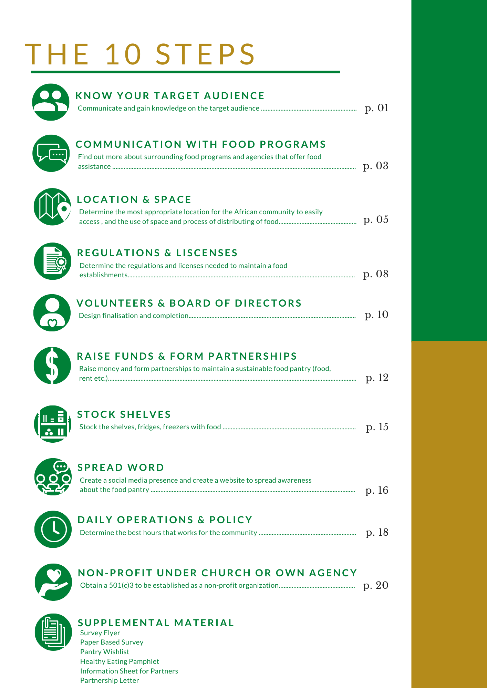
BUSINESS PLAN
THE PURPOSE
Provides the organization with an outline on how to proceed with establishing a food pantry
Notes:
Place emphasis on the business plan!!! even if we do not reorder the slides, make sure the audience knows that this is the most important one
Animate OR figure out how to really show the 10 steps
Mary
We developed a busniesss plan which provides the organization with an outline on how to proceed with establishing a food pantry. The plan breaks down the process of developing a food pantry into 10 key general steps and goes into further detail within each step. The plan includes choosing the best location in Worcester keeping in mind the locations of African businesses and locations the African community visits often in order to have the location in a spot that is accessible. It includes the process and certifications needed for volunteers and recommended positions that should be covered by a board of directors. It provides ways of spreading the word about the pantry using social media including the website we have developed. It has a daily operations page which includes recommendations on certain polices that should be in place for transportation, a suggested recall program and other polocies important for the success of the pantry. The plan combines all of our deliverables as it provides a clear path forward including what we have done and what to do next with the work we have already completed.

Slide 10
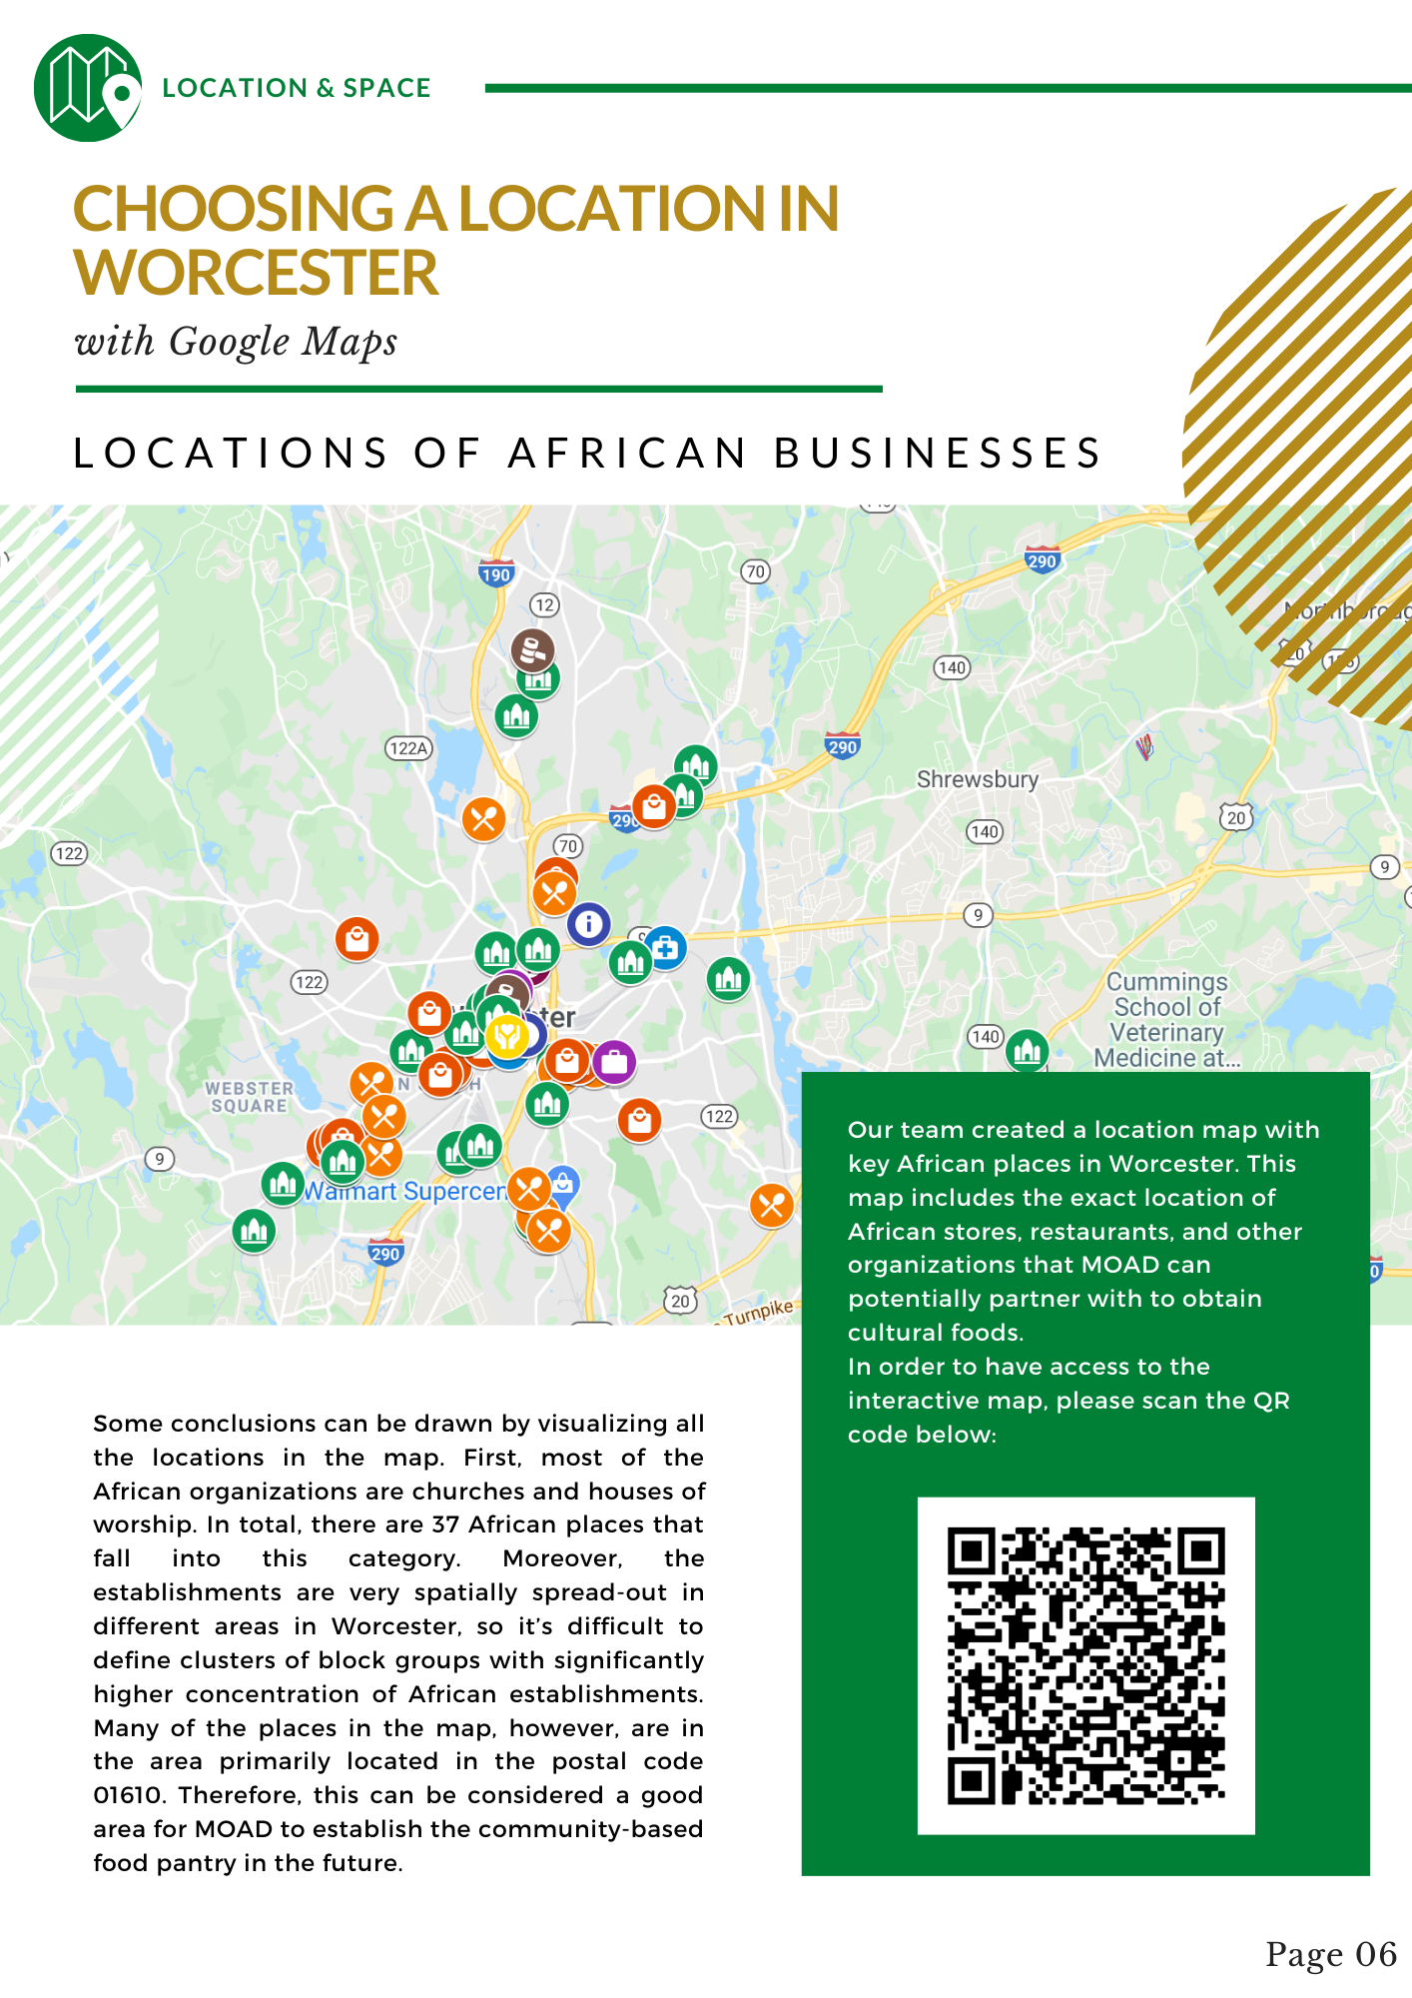
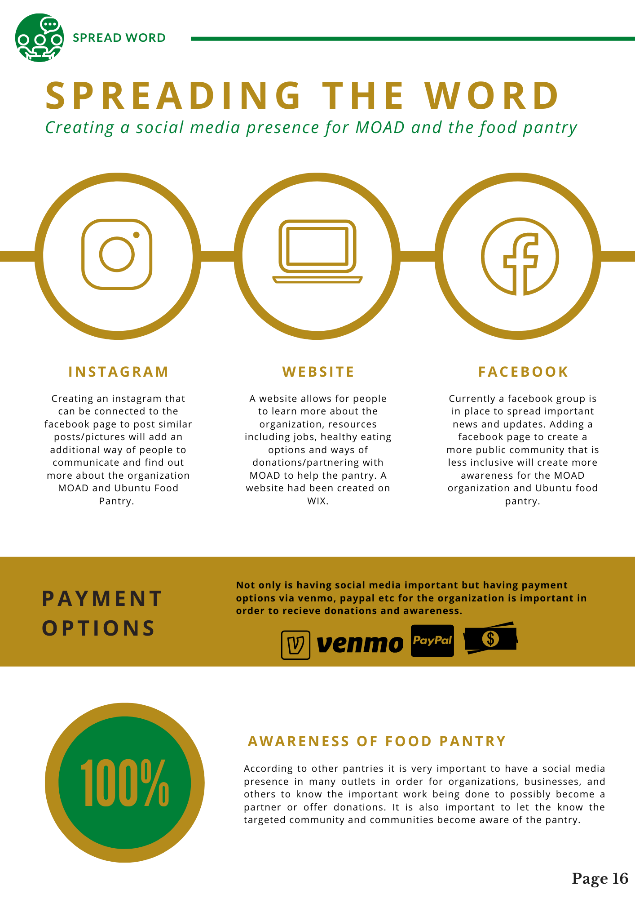
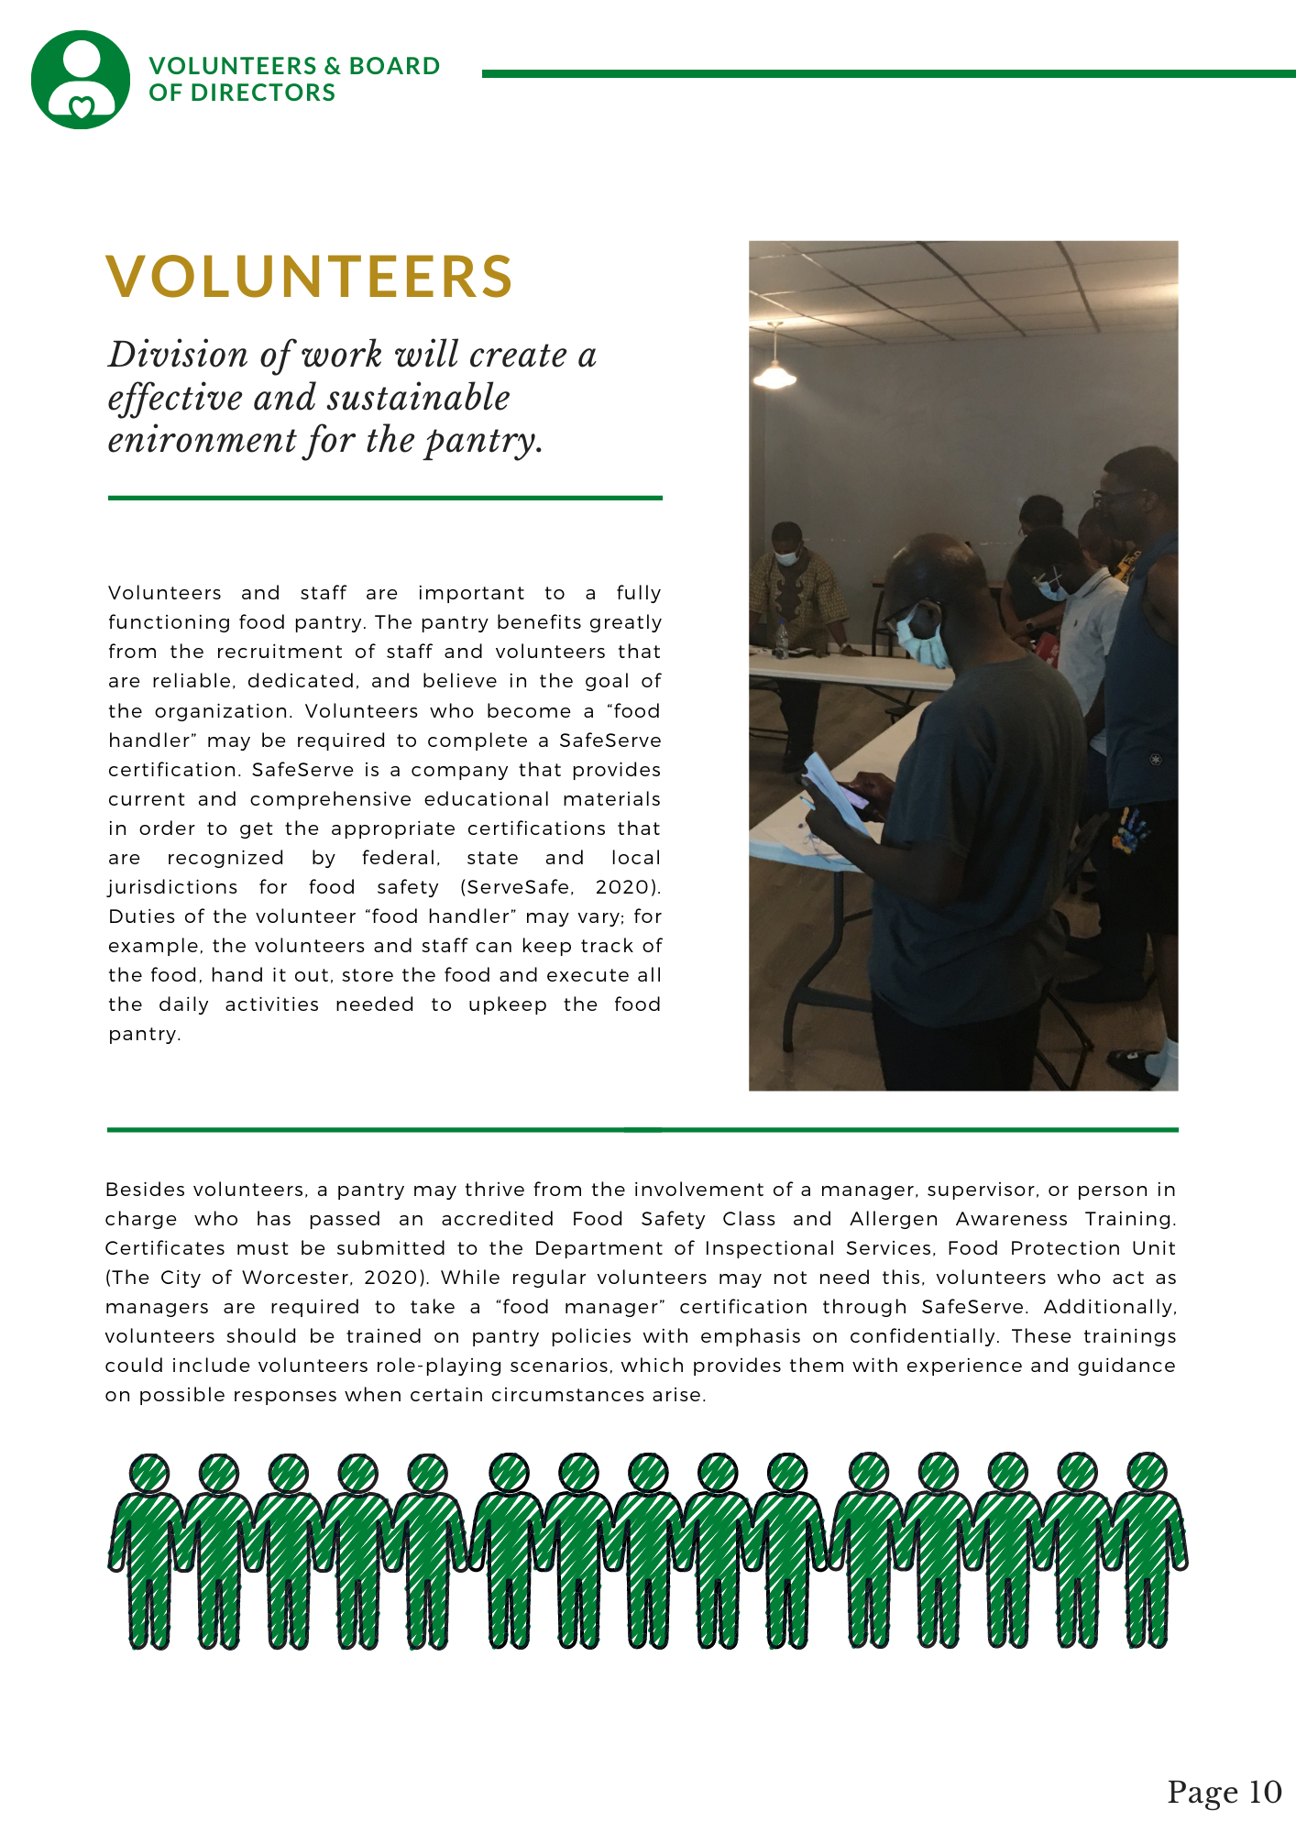
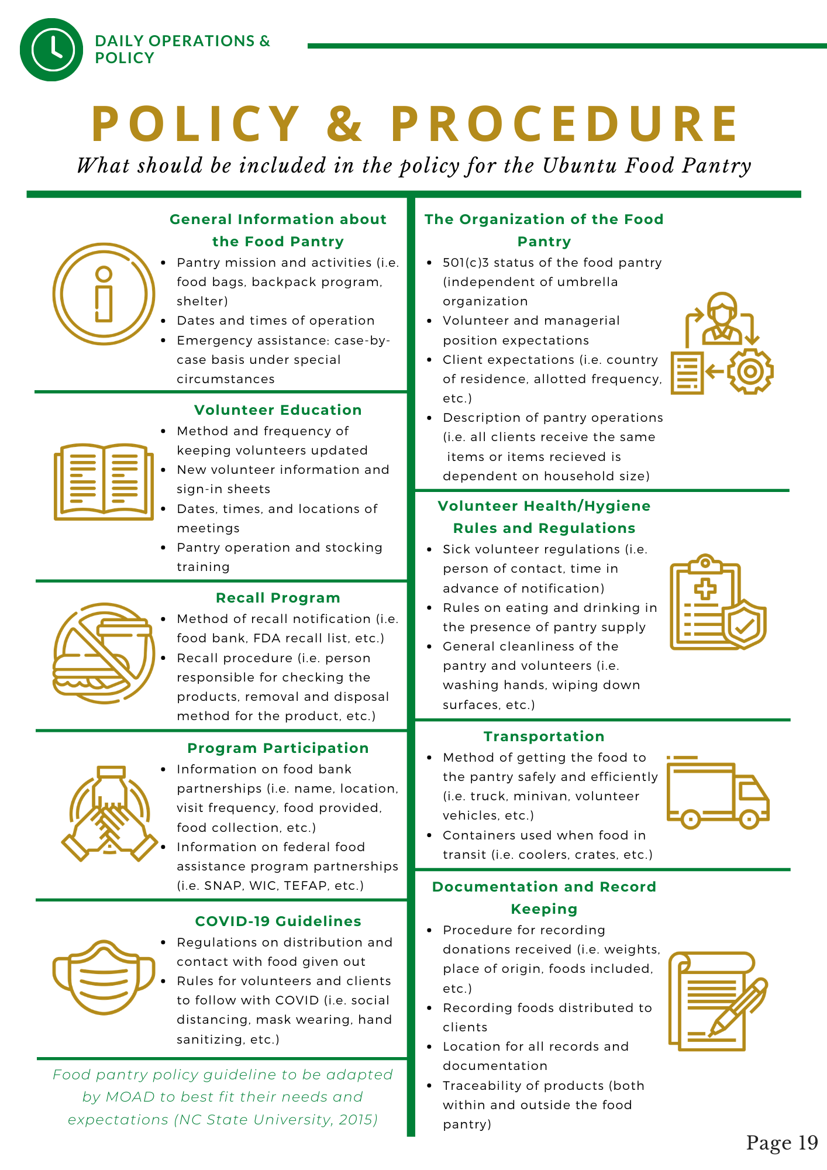
BUSINESS PLAN
THE PURPOSE
Provides the organization with an outline on how to proceed with establishing a food pantry
Notes:
Place emphasis on the business plan!!! even if we do not reorder the slides, make sure the audience knows that this is the most important one
Animate OR figure out how to really show the 10 steps
Mary
We developed a busniesss plan which provides the organization with an outline on how to proceed with establishing a food pantry. The plan breaks down the process of developing a food pantry into 10 key general steps and goes into further detail within each step. The plan includes choosing the best location in Worcester keeping in mind the locations of African businesses and locations the African community visits often in order to have the location in a spot that is accessible. It includes the process and certifications needed for volunteers and recommended positions that should be covered by a board of directors. It provides ways of spreading the word about the pantry using social media including the website we have developed. It has a daily operations page which includes recommendations on certain polices that should be in place for transportation, a suggested recall program and other polocies important for the success of the pantry. The plan combines all of our deliverables as it provides a clear path forward including what we have done and what to do next with the work we have already completed.

Slide 11
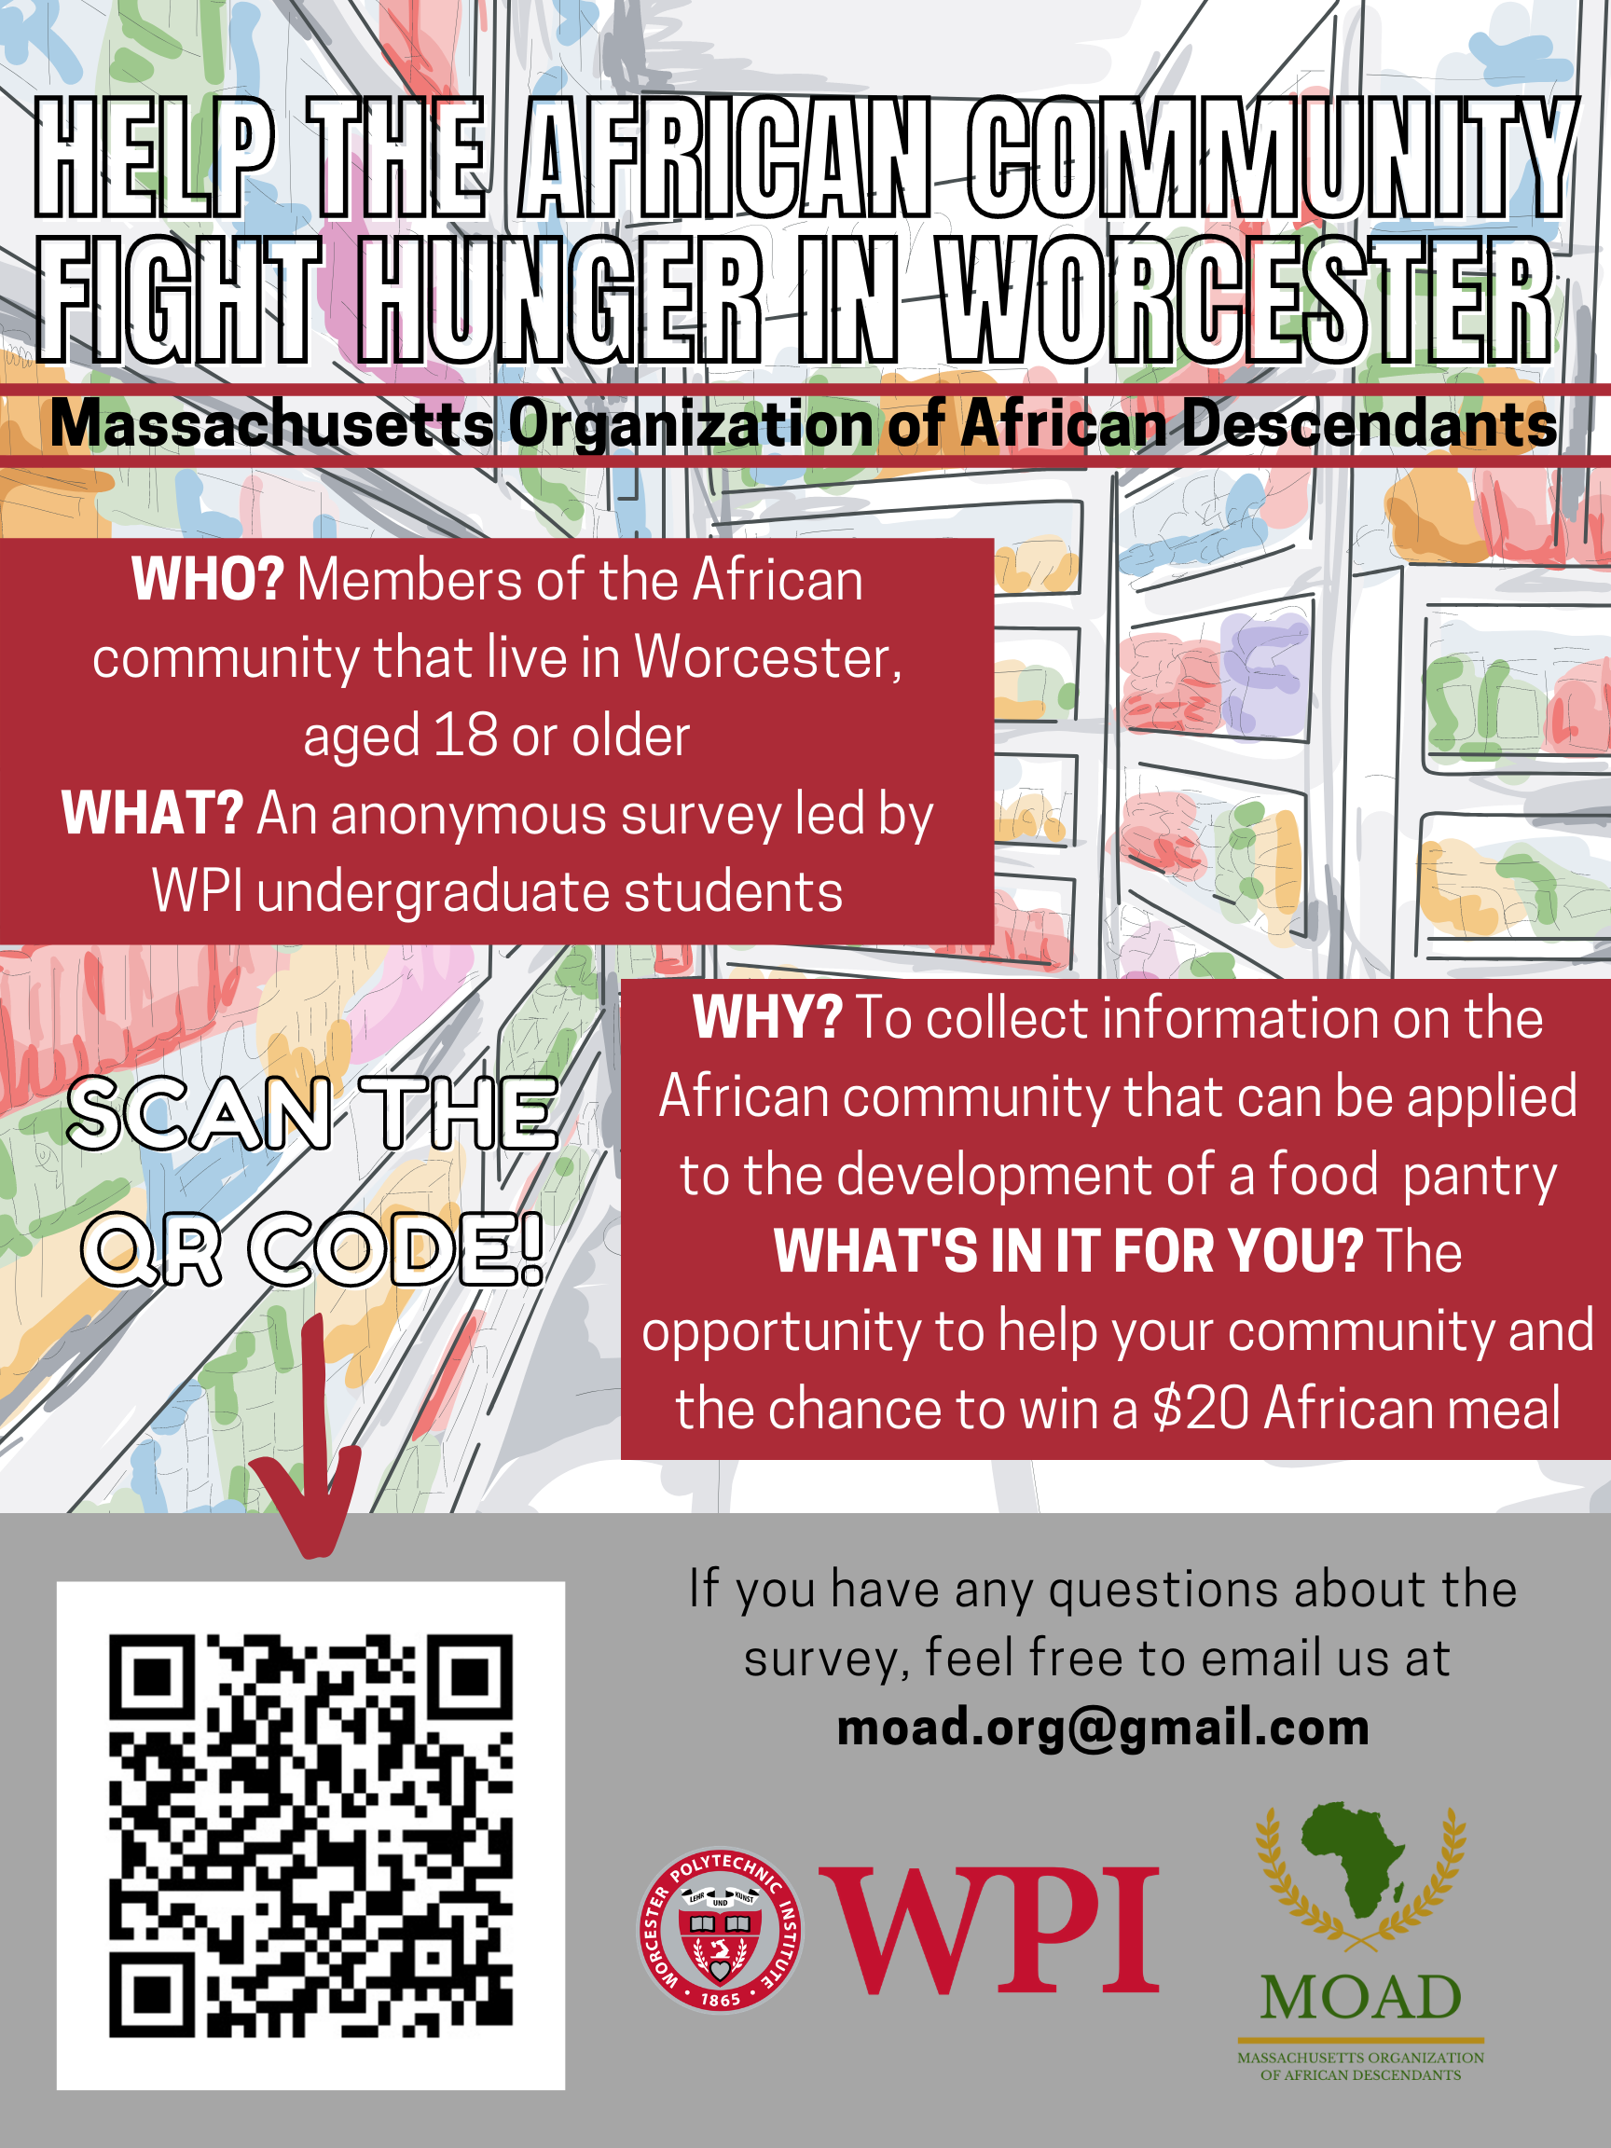
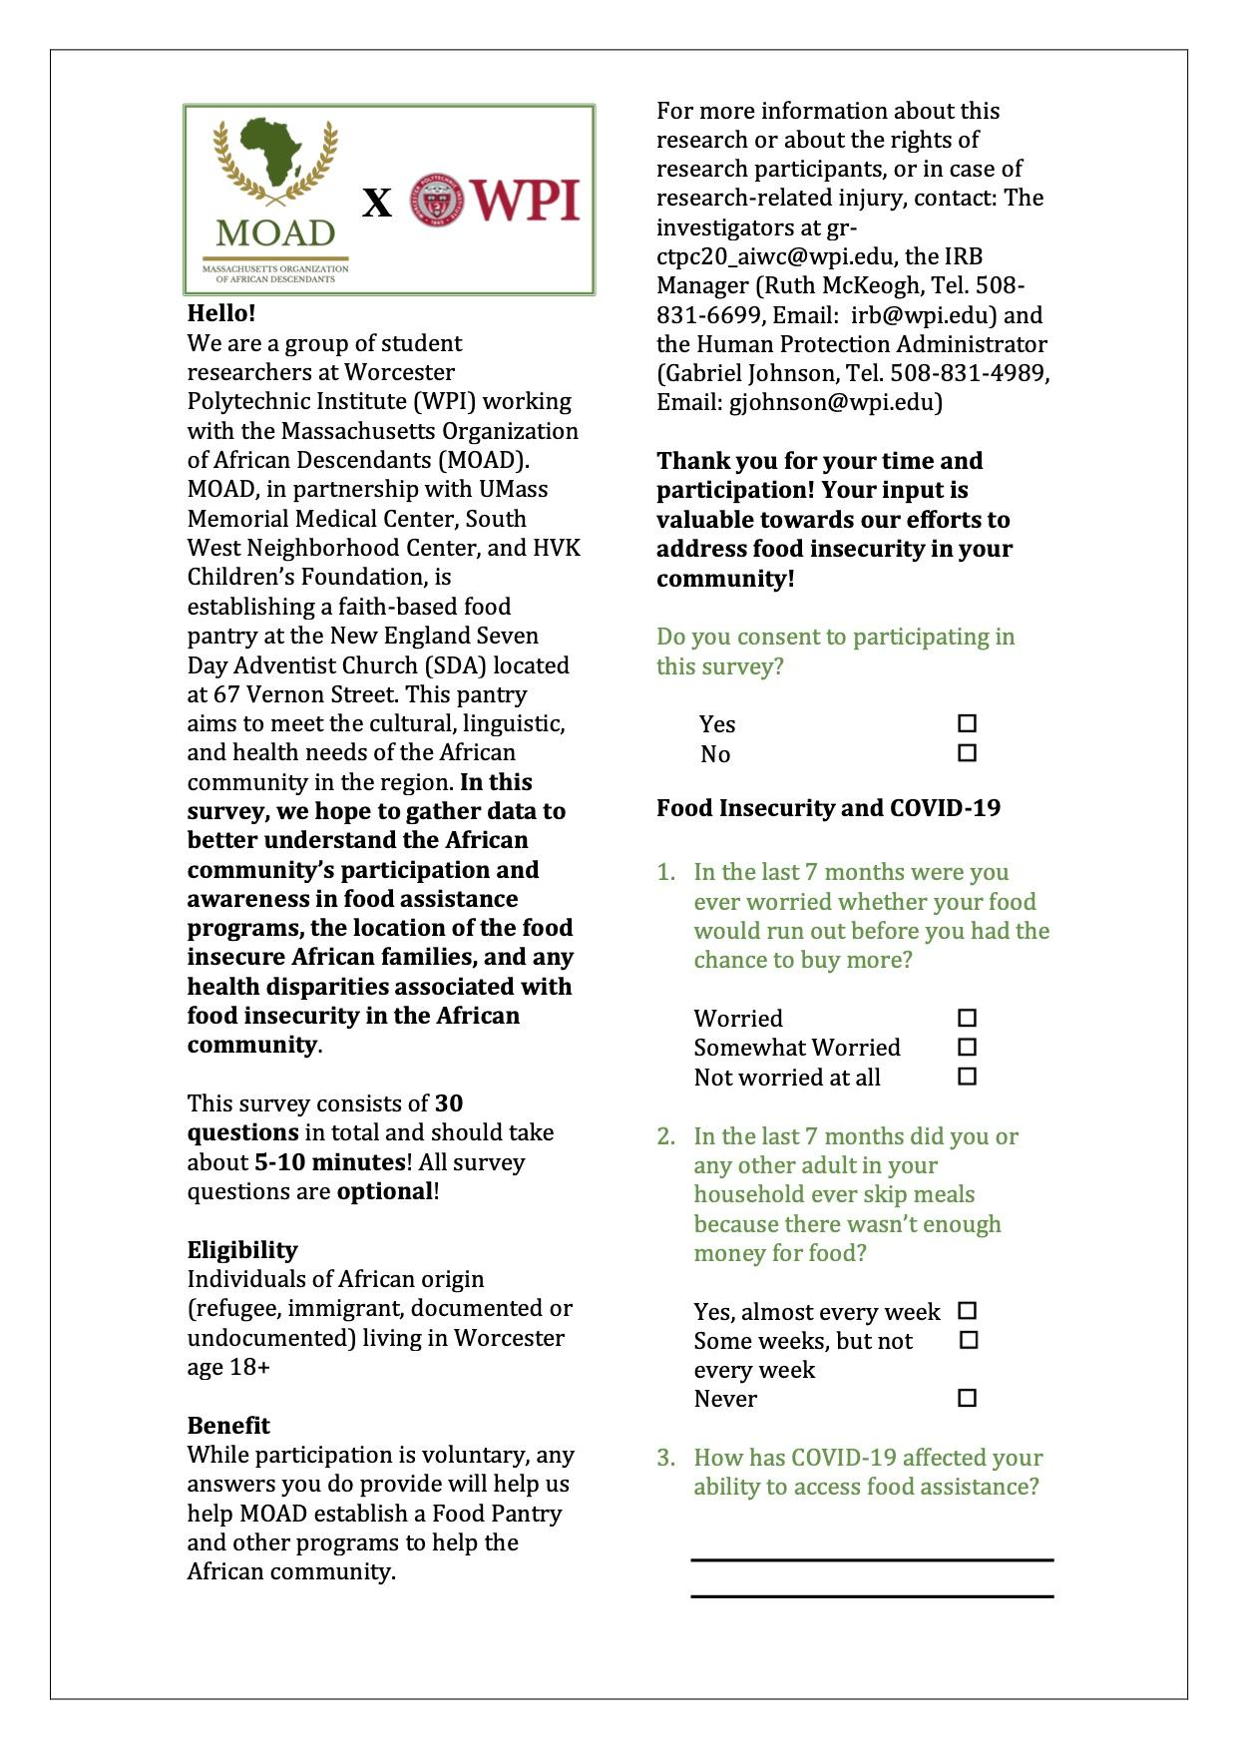
SURVEY
THE PURPOSE
KEY FINDINGS
Negative impacts of COVID-19: decrease access to food assistance, financial instability, fear
Presence of health problems: high blood pressure, iron deficiency, hypertension, diabetes,
Gain a better understanding of the African community
Apply knowledge to developing the food pantry
Notes:
Change?
Isabelle
As Mary stated, paper and web-based surveys were used to tackle the first objective of learning more about the impact of food insecurity on the African community in Worcester. On the right you can see the flyer we made to promote the web-based survey
as well as the first page of the paper survey we created. The survey contained questions on topics such as their access to food assistance programs, the effects COVID-19 has had on them, their health conditions, and many more.
And was designed to help us gain a better understanding of our targeted community,
so that knowledge can be applied when developing the food pantry and catering it to them.
Through a pilot distribution of the survey, we found a few prominent trends,
one of them being the negative impact COVID-19 has had on them. This pandemic has affected their access to food assistance, the financial stability, and has even made some of them afraid to leave their home to get food.
Another trend noticed from the survey was the presence of health problems among survey participants and their peers. These health problems include high blood pressure, iron deficiency, hypertension and diabetes.
From survey:
COVID-19 has had a significant negative impact on participant
less access to food assistance
financial instability
fear of going out and buying food
There is a large presence of health issues faces by the participants of the survey and their peers
most prominent is high blood pressure
followed by iron deficiency and hypertension
diabetes, overweight, and obesity also plays a role, based on the survey
high percentage has access to internet at home and a cell phone

Slide 12
NEXT STEPS FOR SURVEY
Analyze data collected from the surveys
Continue collecting data on African community through the web-based and paper survey
Apply learned information to cater food pantry and resources to targeted audience
Notes:
Isabelle
While we were able to get some valuable information from the pilot survey distribution, data collection is a vital part of the food pantry establishment process and should be continued. Fortunately, the web-based survey will stay open for MOAD to continue to use in their journey to establishing Ubuntu Food Pantry. In order to use this resource to its fullest potential, MOAD should continue collecting data on their targeted community through the surveys, continually analyze the data from the surveys as they recieve more participants, and apply that learned information to cater the food pantry and other resources to the African community in Worcester

Slide 13
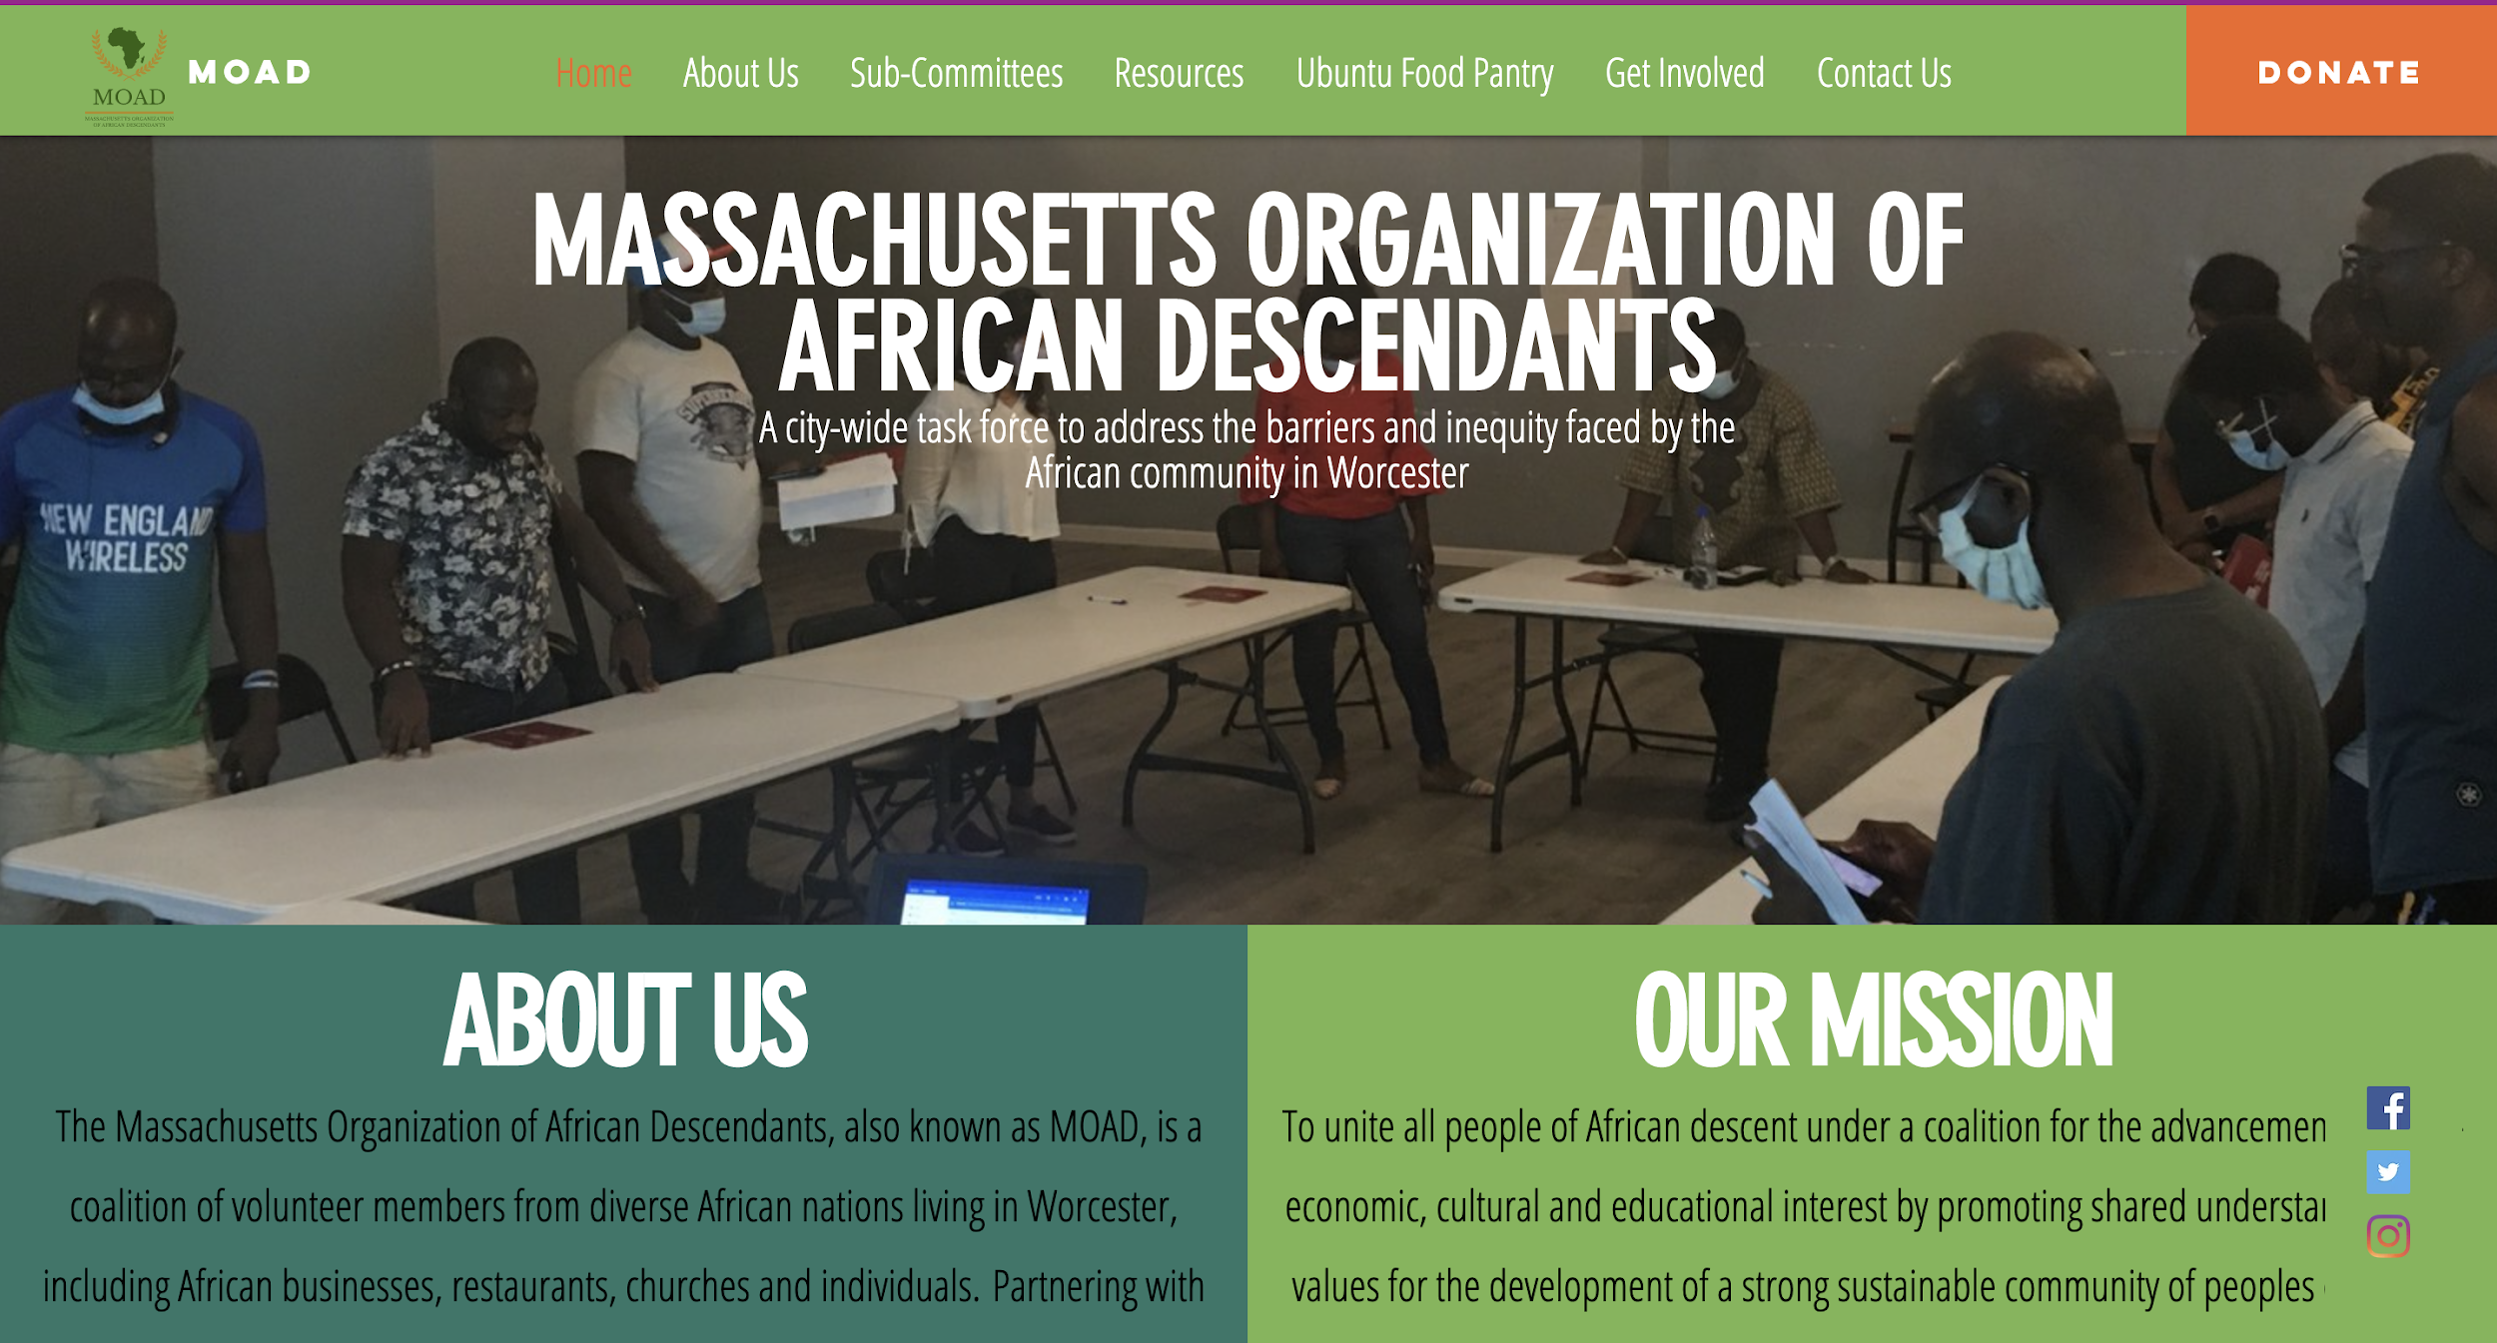
M0AD WEBSITE & LOGO
THE PURPOSE
Creates a social media presence and identity
Promotes MOAD and food pantry
Allows the African community to learn about different resources
Demonstrates how to get involved within the organization
Notes:
Mary
Our last deliverable from objective 3, we designed a website and logo. As seen here, the website has separate tabs including the homepage, a sub committes page, a resources page, an page for the food pantry, a getting involved page and a contact us page. Both the logo and website create a social media presence and identity for MO AD. The website provides information on MOADs purpose of uniting all people of African descent under a coalition for the advancement of economic cultueal and educational interest. Not only does the website promote MOAD but also promotes the food pantry. Other than promoting the organization and pantry the website provides other resources including healthy eating options, job opportunities and locations of local African busineeses. Finally, the website provides ways how to get involed within the organization and food pantry.

Slide 14
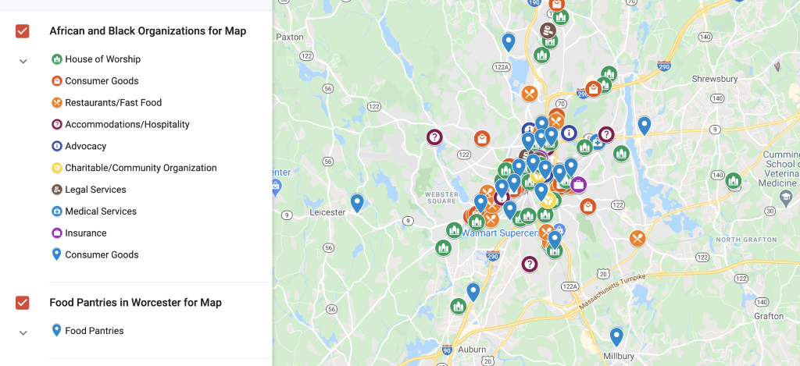
MAPPING
Utilizing background research provided by MOAD and searching local African sites
KEY FINDINGS
Higher concentration of African places: 01610, 01605 and 01606
5 established food pantries in the 01610 area, but only 2 and 1 in the 01605 and 01606 areas respectively
Notes:
Camila
For the second objective, we utilized background research and a list of African-owned businesses in Worcester to develop a map of key African places in the region. In this map, we also included the location of food pantries in the area served by the Worcester County Food Bank. This will help our sponsor when applying for a partnership with the food bank since there is a lower chance of obtaining it if the food pantry is located in an area with a high concentration of previously established food distribution programs. Some conclusions drawn from visualizing these locations are that the establishments are very spatially spread-out in different areas in Worcester, so it’s difficult to define clusters of block groups with significantly higher concentration of African establishments, but it’s possible to determine that the areas in postal codes 01610, 01605, and 01606 have a good amount of African places. On the other hand, by analyzing the location of the food pantries, there are 5 pantries already established in the 01610 zip code area, but only 2 and 1 in the 01605 and 01606 areas respectively. It’s important to notice that the map can also be used as a resource after MOAD has brainstormed possible locations for the community-based food pantry.

Slide 15
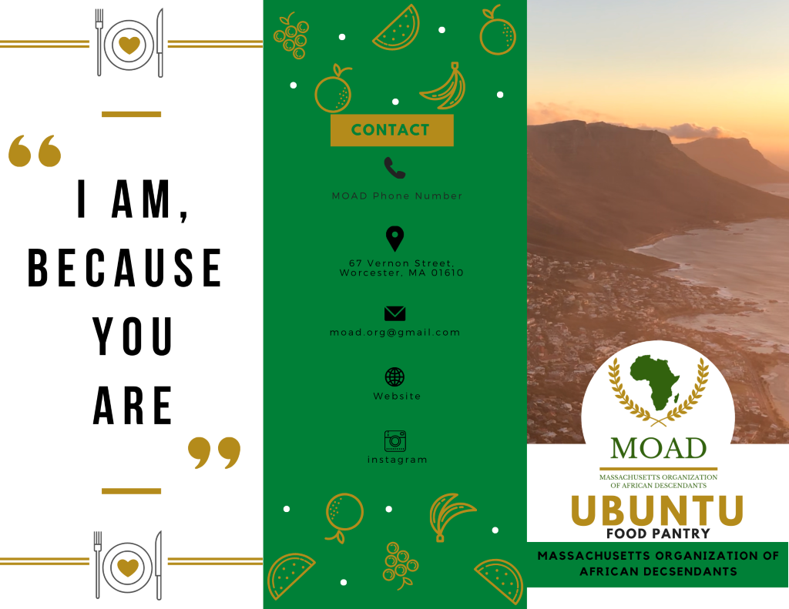
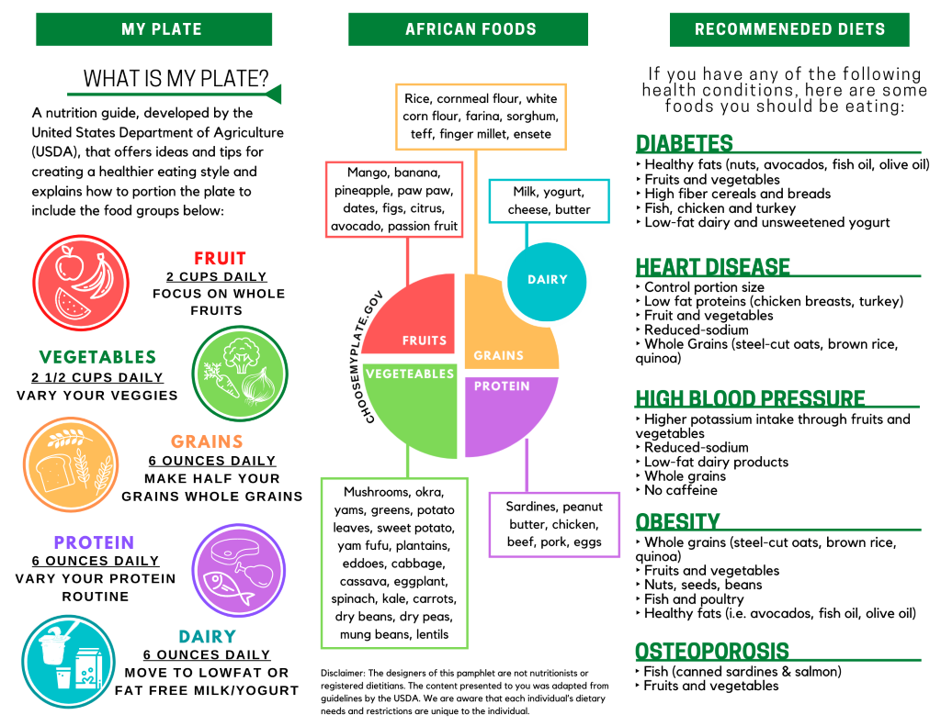
HEALTHY EATING OPTIONS PAMPHLET
THE PURPOSE
Clients will be able to adjust their diet according to MyPlate and their health conditions if applicable
Will be distributed in the food pantry
Notes:
Lauren
For the third objective, which was to increase access to information on healthy eating options, we created a healthy eating options pamphlet, that will provide information on what healthy foods the community should be eating according to common health disparities they experience. This will be based on MyPlate, which is nutritional guide developed by the United States department of agriculture which offers ideas and tips for creating a healthier eating style and explains how to portion your food plate to include all the food groups: vegetables, dairy, protein, fruits, and grains. We also utilized background research to see what common health conditions the African community has to search what foods are recommended based on their health condition. This pamphlet will be distributed in the food pantry for MOAD’s potential clients to make changes to their diet according to MyPlate and health condition.

Slide 16
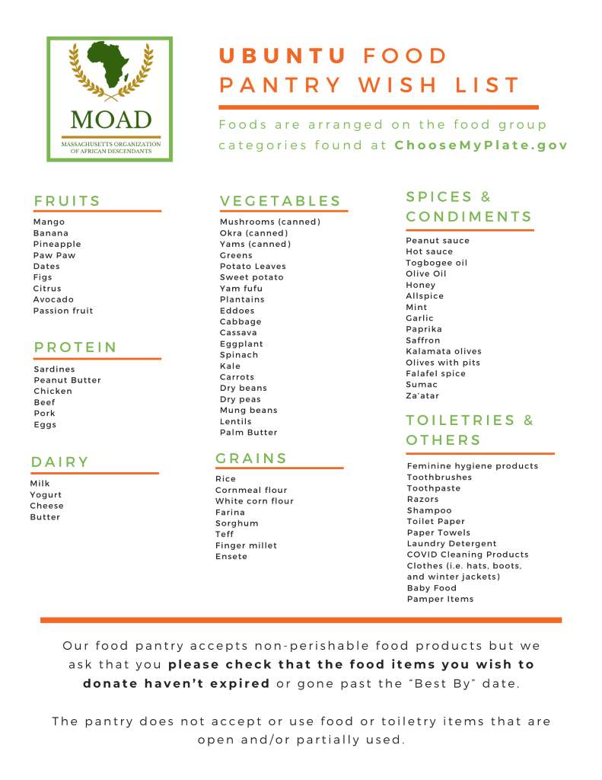
FOOD PANTRY
WISH LIST
THE PURPOSE
Donors will be able to know which foods and other products the food pantry will be accepting
Can be promoted in MOAD’s social media platforms and website
Notes:
Lauren
Also for the third objective we created a wishlist that will allow potential donors and organizations that we partner with to know which foods MOAD’s food pantry will be accepting, which will be called the Ubuntu food pantry. Ubuntu meaning ‘I am because you are’ . Through our Worcester Together meetings that focused on food insecurity and policies in the city of Worcester and the help of our sponsor, we created a list of foods that incorporates typical African healthy foods that our clients will be familiar with. These foods were separated by different sections: dairy, protein, vegetables, fruits and grains, which will allow our clients to easily and healthily cook their meals by following MyPlate Guidelines. We also included the option of donating toiletries and other necessities. The next steps for this wish list would be to place the list in the food pantry and MOAD’s future social media platforms and website.

Slide 17
NEXT STEPS FOR MOAD
Collect data of food pantry users when they obtain food
Create other social media & ways of payment
Hold food drives in local churches and schools, and collect monetary donations
Include translations in Ubuntu Food Pantry operations
Notes:
Camila
Lastly, we want to emphasize that the work for this food pantry is not done. Our team has some suggestions of steps that MOAD can take next to make sure this food pantry is as successful as it can be. First, we recommend including translations in Ubuntu Food Pantry operations to reach more people in the African community. This can be done by translating the survey or the pamphlet created by us to common African languages. We also encourage MOAD to collect data of food pantry users when they obtain food, including their zip code, number of family members, age group, household source of income, among others. This will help a lot in the future when applying for grants. We also suggest holding food drives in local churches and schools, and collecting monetary donations. This will be extremely important to stock shelves in the food pantry before obtaining a partnership with the food bank. Lastly, we emphasize the need to have a social media presence for MOAD and the pantry, so creating other forms of social media, such as Instagram and Linkedin, is important to spread awareness for the targeted community and to attract possible partnerships. Having multiple ways of receiving payment, such as Venmo and Paypal, can also help the pantry get more donations.

Slide 18
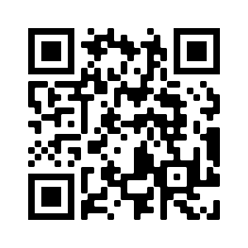
THANK YOU
SUMMARY OF DELIVERABLES
Do you have any questions/comments?
MOAD’s Website
Business Plan
Survey
Big Outcomes
Supplemental Outcomes
Food Pantry Wish List
Healthy Eating Options Pamphlet
Google Map
Please keep this slide for attribution
Notes:
Add QR code that links to website and plan, put the outcomes on the slide too
Make QR code smaller and add something more “interesting”
Camila
Thank you so much for listening to our presentation. We would like to specially thank our IQP advisors, Gbeton and Scott, for all the guidance throughout this term, and our sponsor liaison, Jermoh Kamara, for all the help and constant assistance she has provided. Please feel free to ask any questions.

