Slide 1
Analysis of Disinfection By-Products from Ballast Water Treatment Systems for USCG
Rachel Campbell, Demi Davis, Jadon Thomas
Notes:
Jadon
[Name, major, year]
Interns from WPI
15 weeks spent researching BWMS and Disinfection Byproducts
Goal of determining which Disinfection Byproducts need to be regulated and to what degree

Slide 2
OES-3
Office of Operating and Environmental Standards
Environmental Standards Division
Notes:
Rachel
Give intro to background

Slide 3
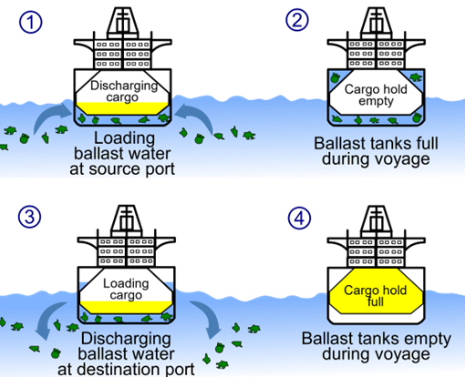
What is the issue?
Ballast water: seawater that sits in the hull of a vessel to provide stability and compensate for weight changes
Ballast water carries organisms
Release into new environment makes organisms invasive
Water needs to be treated
Ballast water management systems (BWMS): water treatment system onboard a vessel that neutralizes organisms in ballast water before it is discharged
Disinfection By-Products (DBP): harmful chemicals formed from the reaction between BWMS disinfectants and organic ocean matter
Sources:(Kim et al., 2022) (Shah et al., 2015)(Villanueva et al., 2015)
Notes:
Demi - To help understand why we are working with OES-3, we will go over some ballast water background information. Ballast water is the water that sits in the hull of a vessel to compensate for weight shifts due to cargo moving and fuel consumption. Looking at the diagram here you can see that ballast water enters the vessel’s hull. You will also notice that the organisms will also be drawn into the vessel with the water. The vessel then transports the ballast water containing the organisms to the next dock where cargo is exchanges and the ballast tanks are emptied. This process has effectively transported oceanic organisms from one ecosystem to another making them now invasive organisms which are very destructive to the ecosystem they are foreign to. Because of this, ballast water has to be treated to neutralize the organisms before it can be discharged from the vessel, or deballasted. This creates the need for ballast water management systems, but unfortunately that presents another issue. Some BWMS use chemical treatments that leave excess disinfection chemicals in the water. These chemicals react with organic oceanic matter to create disinfection by-products which can be very harmful to human and oceanic environment health.

Slide 4
How did we get here?
Origins of Ballast Water
Regulation D-2 Ballast Water Exchange Standard
Regulations are under development
International Maritime Organization (IMO) establishes D-1 standard to control invasive species
President signed the VIDA which includes a requirement for the EPA to make discharge standards and the USCG to enforce them.
1800s
2004
2017
2018
Present
Ballast water is used to provide stability and structure to the vessel’s hull and compensate for weight shifts due to cargo displacement and fuel consumption
IMO’s D-2 standard goes into effect which pushes vessels to install on-ship BWMS
OES-3 develops ballast water regulation, policy, and guidance which regulates DBPs by default but need to know which DBPs should be regulated and to what degree.
Regulation D-1 Ballast Water Exchange Standard
Vessel Incidental Discharge Act (VIDA)
Sources:
(Kim et al., 2022)
(Feng et al., 2023)
(US EPA, 2019)
Notes:
Rachel - As this is a relatively new issue, there are not currently DBP regulations for BWMS. Ballast water has been used since the 1800s, but the International Maritime Association only set the Regulation D-1 Ballast Water Exchange Standard in 2004. This was due to the emerging issue of invasive organisms transported through ballast water. The IMO set a stricter D-2 standard in 2017 which pushed vessels to use onboard BWMS in order to comply. In 2018 the Vessel Incidental Discharge Act was signed which requires the Environmental Protection Agency and the USCG to make and enforce new discharge standards. The standards and regulations for VIDA are still under development. This leads us to the present where OES-3 is researching the issue of DBPs from ballast water as there are currently no ballast water standards for DBPs.

Slide 5
Our Goal
Determine to what degree the concentrations of different disinfection by-products (DBP) created by ballast water management systems (BWMS) exceed Environmental Protection Agency (EPA) recommendations and suggest whether ballast water management regulations should be implemented.
Notes:
Jadon
Our research focused on determining to what degree certain DBPs exceeded EPA recommended limits, with the goal of suggesting where ballast water management regulations should be implemented.

Slide 6
Ballast Water Treatment Methods
BWMS
Pre-Treatment
Primary Treatment
Post- Treatment
Chemical
Non-Chemical
Filtration
Neutralization
Electrolysis, Chemical Injection
UV, Heat, Ozone
Sources:
(Bailey et al., 2022)
(Shah et al., 2015)
(Duan et al., 2023).
Notes:
Demi- This diagram displays the different ballast water management treatment steps and technologies. DBPs are produced from BWMS using chemical disinfectants for their water treatment such as electrolysis and chemical injection treatment systems. For the purposes of this project, we’ve focused solely on electrolysis and chemical injection-based treatment systems.
For both systems a disinfectant is introduced to the ballast water. In a chemical injection system the disinfectant is carried on the vessel along with the BWMS, and must be replenished. Electrolysis systems run a current through the seawater which creates disinfectants such as chlorine. The treated water is then deballasted, but excess disinfectants have the opportunity to react with organic matter in the water to produce DBPs.

Slide 7
Methodology
Research
Gather information about the health impacts of DBPs from archival research and compile and organize USCG BWMS testing results
Data Analysis
Analyze organized USCG data in reference to EPA standards and recommendations alongside opinions of subject matter experts
Social Analysis
Determine societal implications of DBP regulation through PESTEL and SWOT analysis
Findings
Determine to what degree the concentrations different DBPs created by BWMS exceed EPA recommendations
Notes:
Jadon
Our methodology consisted of three main stages.
- Research which involved gathering and organizing data from archival research, as well as organizing BWMS testing results, provided by the USCG
- Data Analysis, where we reviewed and analyzed our organized data with respect to EPA standards and recommendations as well as the opinions of SMEs
- Social Analysis determined the larger implications of DBP regulation using PESTEL and SWOT analyses, which will be discussed in more depth later.

Slide 8
Method 1: Research and Compilation
Data organization
Archival Research
USCG provided us with BWMS testing data that has been collected from independent labs for type approval
Data Includes:
BWMS system tested
Salinities for which the test was run
DBP concentrations produced
Data received in the form of 18 PDFs containing test results → converted to Excel
Excel sheets organized DBP results by BWMS treatment method and water salinity
Focusing on groups of chemicals that were included in at least 8/18 data sets:
Found independent studies through databases for insight into human and environmental impacts
Concluded that trihalomethanes (THM) and haloacetic acids (HAA) are appropriate chemicals to analyze due to:
Availability of data points in BWMS testing results
Documented human and wildlife impacts
Notes:
Demi
Explain how the tests were conducted (land based, smaller systems), representative of how systems run onboard vessels
Only includes data from 16 different chemical systems
Shows the BWMS type, salinity, DBP produced
The data was given to us in PDF form containing tables of data that we then converted into Excel spreadsheets. We used a feature in Excel that helps copy over the data, but we also made sure to spot check the spreadsheets to make sure the conversion was performed without any misprints.
We then organized the data in excel into tables for each of the 18 documents we received and then pulled out data points for each of the 14 chemicals we chose to analyze for fresh, marine, and brackish water salinities.
Archival Research: We looked at our compiled data in excel and found which chemicals had the most data across the data sets to narrow down the chemical groups that we wanted to analyze. We found that the group of four trihalomethanes and the group of nine haloacetic acids appeared in enough data sets for us conduct a data analysis on them. We then performed archival research on these two groups of chemicals to understand the human and environment health impacts of these DBPs. We did this by finding independent studies in databases showing the chronic effects of THMs and HAAs on human and aquatic life.

Slide 9
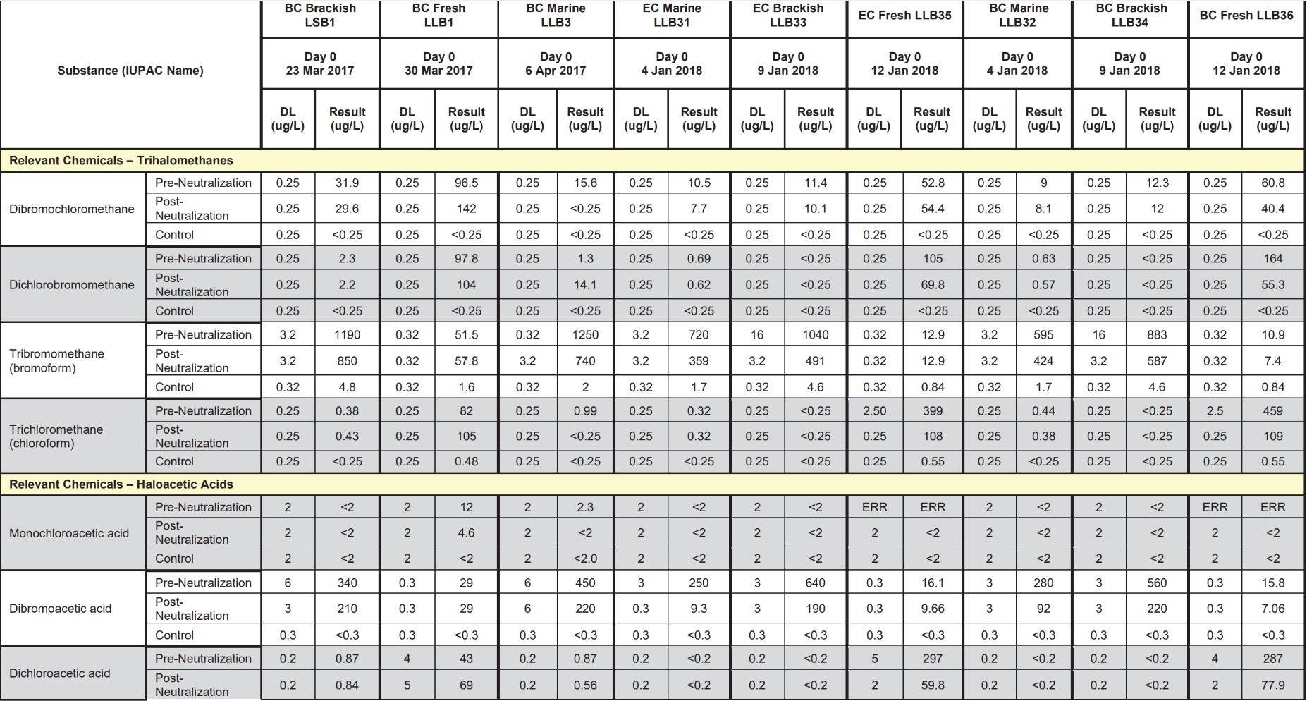
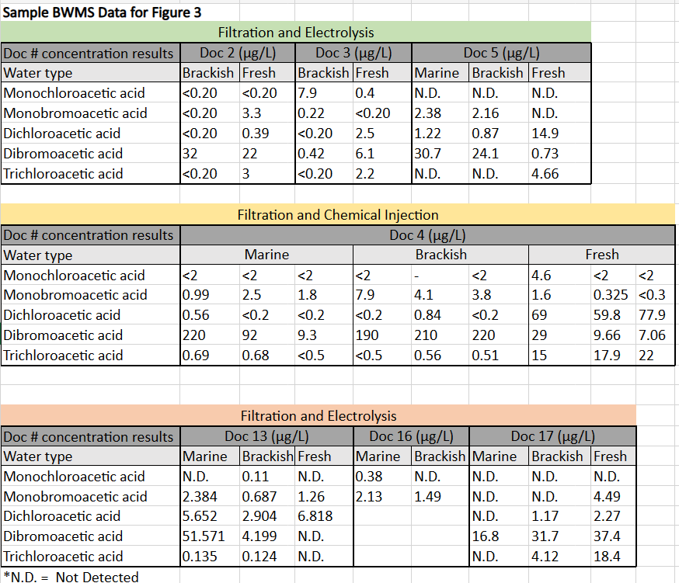
Data Conversion Example
Original Data
Converted Data
Notes:
Mention spot checking for errors in the conversion

Slide 10
DBPs for Analysis
Trihalomethanes (THM)
Chloroform
Dicholorobromomethane
Bromoform
Dibromochloromethane
Haloacetic Acids (HAA)
Monochloroacetic acid
​Monobromoacetic acid​​
Dichloroacetic acid​​
Dibromoacetic acid​​
Trichloroacetic acid​
HAA5
Tribromoacetic acid
Bromochloroacetic acid
Bibromochloroacetic acid
Dichlorobromoacetic acid
HAA9
Notes:
These are the two groups of DBPs we chose to analyze. The trihalomethanes comprise of…. The haloacetic acids can be analyzed by the sum of the concentrations of the first five chemicals….which are referred to as HAA5s, or the sum of all nine HAAs which are referred to as HAA9s. We will be analyzing th four THMs and the sum of the nine HAAs.

Slide 11
Results of Archival Research
Human Health Impacts
THMs
Bromoform and chlorodibromomethane can cause harm to the liver and kidneys (ATSDR, 2015)
Chronic exposure to THMs can have harmful effects on the human nervous system:
Depression and irritability (ATSDR, 2015)
Causing nausea, dizziness, headaches, and narcosis (PubChem, 2023)
Bromoform and chloroform can change hematological count
Indicative of developing medical conditions (Lodhi, 2017)
Environmental Impacts
HAAs
When placed under stress from low levels of HAAs:
Phytoplankton tends to bloom, or rapidly reproduce (Cui et al., 2022)
Depletes oxygen from the surrounding waters
Release toxins
Causes increased mortality and illness in larger ocean organisms
Detrimental effects on the balance of the food chain
Notes:
In our archival research we found that THMs have significant human health impacts including harm to the liver and kidneys and nervous system effects with chronic exposure. The damage to the nervous system can cause symptoms such as depression, iritability, nausea, and dizziness…
Bromofrm and chloroform can also
Mention how we got HAA9 EPA standard

Slide 12
Interviewees
Ann Kimrey
Dr. June Mire
General Engineer at the Marine Safety Center for U.S. Coast Guard
Director of Ecological Services at Tetra Tech, Inc., contractor for the Office of Operating and Environmental Standards
"So essentially, you're using electricity and the salt in saltwater like in the ocean to create chlorine, which is then your disinfectant and that is going to have disinfection by products" (Kimrey, Personal Communication).
"So disinfection by products are things we use on purpose to protect us from microbes generally, but at high enough concentrations, or in certain exposure pathways, they can hurt you" (Mire, Personal Communication).
Notes:
In our interviews we In this step we used a website from the EPA to find the standards of comparison for safe concentrations THMs to use in our statistical analysis in method 2. This website was provided by Ms. Kimery.

Slide 13
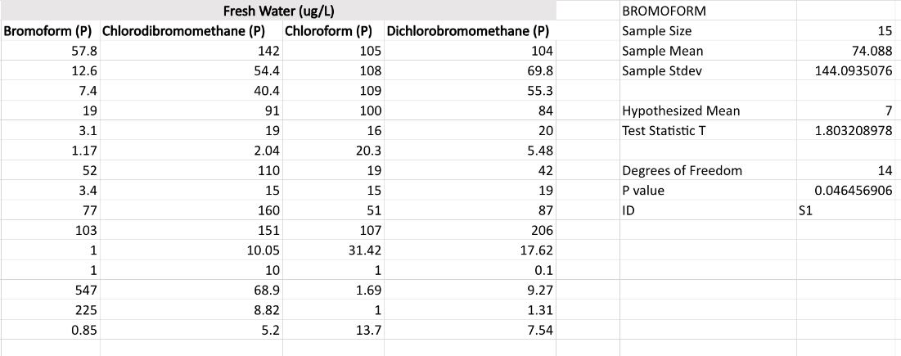
Method 2: Statistical Analysis
Right Tailed One Sample T Testing was done for every chemical/salinity combination.
Tests were done at a 95% confidence level, with α = 0.05
If Resulting P Value was below 0.05, the null hypothesis was rejected, and it could be concluded the data was significantly higher than the EPA limit
Notes:
Rachel - Once we had chosen what DBPs to focus on, we moved into our statistical analysis.
We were testing to conclude whether the chemical concentrations of the DBPs we chose to focus on were higher than the EPA recommended limit. To do this, we ran one sample t tests. A t test is a statistical test used to determine whether a difference in means is statistically significant. We took the averages of all the chemical concentration results for each specific chemical and water salinity combination, and compared each of those averages to the corresponding EPA recommendation for what is considered safe for human and aquatic life.

Slide 14
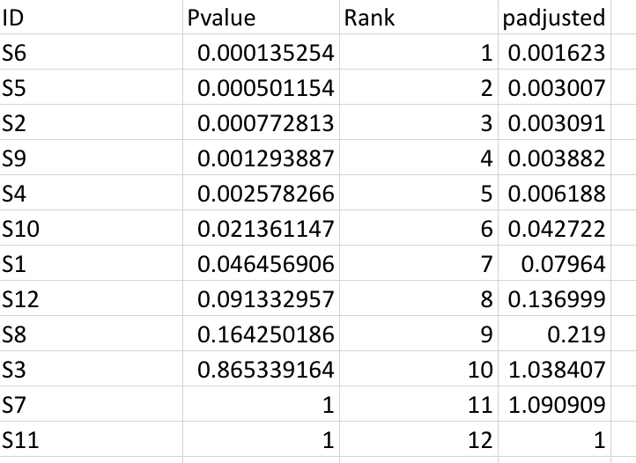
Statistical Analysis (cont.)
When many tests are conducted, possibility for Type 1 Error increases through multiple comparisons.
Type 1 Error is a false rejection of the null hypothesis.
To account for this, we adjusted the resulting p-values through the Benjamini-Hochberg adjustment method.
P values for each test run for THMs were sorted in ascending
order and given a rank 1-12. The following formula was used
to adjust the P values:
= (P value * 12)/Rank
Notes:
Explain Multiple Comparisons

Slide 15
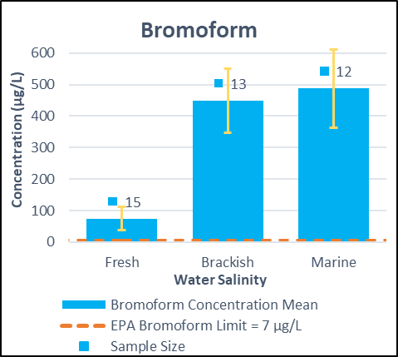
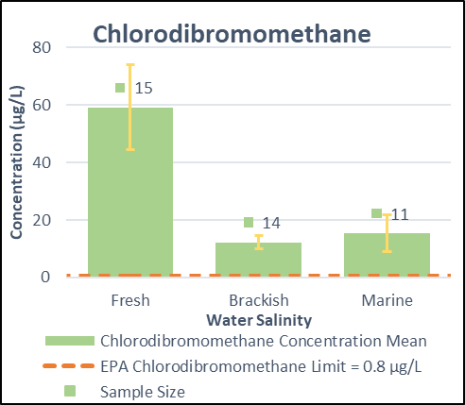
Results of Data Analysis
Notes:
This is the visual representation of the t-tests we ran for 5 different chemicals. The colored bars represent the concentration values of each chemical in the three different water salinities. The yellow error bars represent the variation, standard error, in each sample set, and the orange dotted line represents what the EPA recommends for safe concentrations of each DBP. The number above each bar shows the sample size for each of the 15 tests we ran. The further the error bars are above the dotted lines, the more significant the difference the concentration values from the BWMS data we were given and the EPA recommendation.

Slide 16
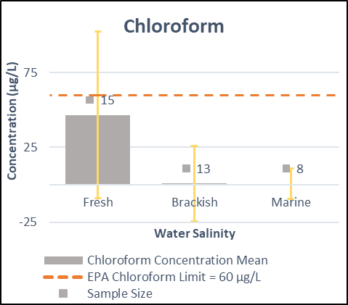
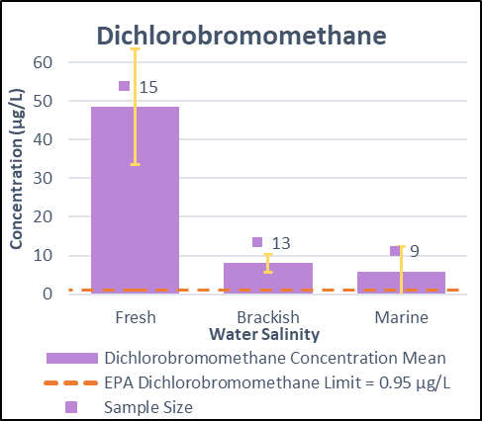
Results of Data Analysis

Slide 17
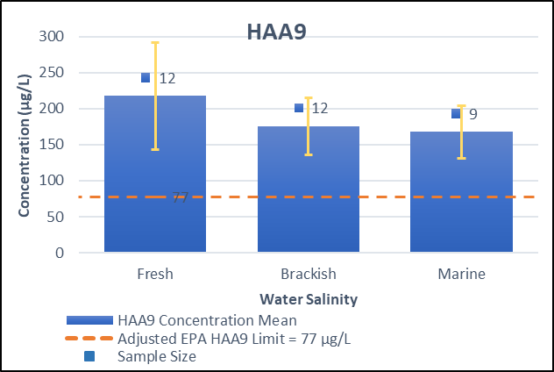
Results of Data Analysis

Slide 18
Visualization of DBP Results
 | Fresh | Brackish | Marine
Bromoform
Chlorodibromomethane
Chloroform
Dichlorobromomethane
HAA9
= BWMS data chemical concentration is significantly greater than EPA limit
= BWMS data chemical concentration is not significantly greater than EPA limit
Notes:
As you can see in this chart, 8/15 tests resulted in a rejection of the null hypothesis after adjustment for multiple comparisons. This means that 8/15 tests concluded that the chemical concentration was significantly higher than the EPA limit in that water salinity. Chloroform is the only chemical tested for that had no significant difference in any water salinity. Every other chemical was significantly higher than the EPA limit in at least one water salinity.

Slide 19
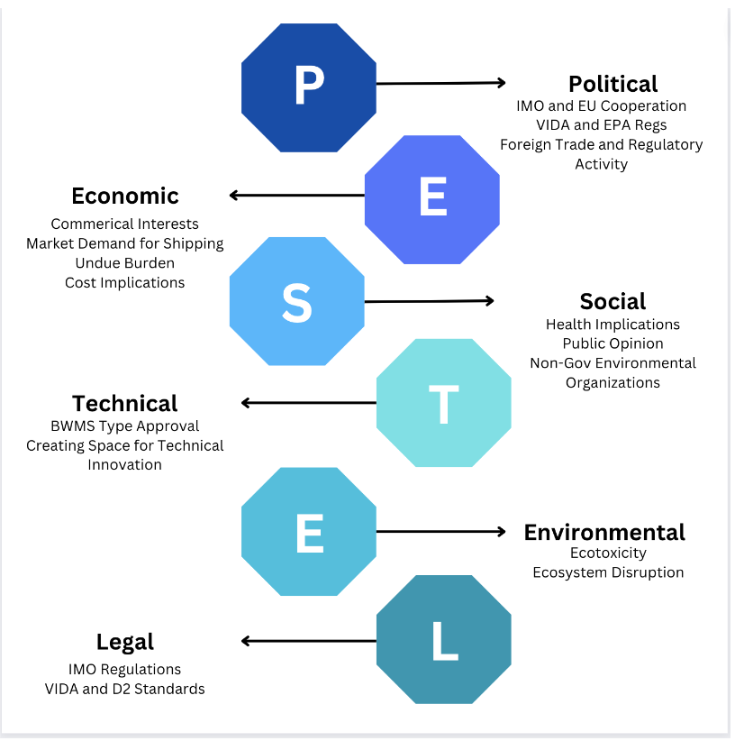
Method 3: Socioeconomic Analysis
An analysis on the political, economic, social, technical, environmental and legal aspects of this project was developed to predict the direct and indirect effects of changes to DBP regulation.
From this, we can understand the strengths, weaknesses, opportunities, and threats that should be considered when discussing DBP regulation
Notes:
Jadon

Slide 20
PESTEL Breakdown
PESTEL
Political:
IMO and EPA compatibility and crossover
Public awareness
Economic:
Risk of undue burden for vessel operators
Commercial interests
Technological:
BWMS Type Approval
Creating space for innovation
Social:
Population and demand increase
Global fleet size increase
Health implications
Environmental:
Ecotoxicity
Ecosystem disruption
Legal:
IMO regulations
VIDA and D2 standards

Slide 21
SWOT Analysis
S.W.O.T.
Strengths:
DBP data exceeds EPA recommended limits
Major chemicals of concern discharged at detectable levels
Weaknesses:
Little research on the long-term effects of DBPs
Lack of public attention
Opportunities:
VIDA and D2 standard development
Include testing for DBPs in BWMS tests
Threats:
Commercial interests
Difficulty enforcing new regulations

Slide 22
Results of Socioeconomic Analysis
Results based on framework from California’s interim performance standards for ballast water discharges.
Data shown for all BWMS types
(Wang and Corbett, 2020)
Notes:
[ADD] Traffic of US ports increase

Slide 23
Results of Socioeconomic Analysis Cont.
TEU: Twenty-foot Equivalent Unit
(UNCTADStat, n.d.)
Notes:
Growth of global fleet
Current growing market shipping demand
Average of 3.73% increase in throughput every year
From 2020 to 2021 there was a 14% increase in throughput
Maritime trade volumes are set to triple by 2050 (https://www.oecd.org/ocean/topics/ocean-shipping/)

Slide 24
Discussion and Recommendations
Discussion:
DBPs could pose a threat to human life and the environment.
The statistical significance of our data analysis suggests that DBPs are being discharged through ballast water in quantities that are potentially dangerous for human and wildlife health.
Data shows a growing market and growing concern in environmental conservation and protection, which could help propel the possibility of BWMS type approval regulation improvements in the government.
Recommendations:
We have concluded through statistical analysis that the concentrations of three out of four THMs, as well as HAA9, to be over an acceptable limit in deballasted water based on EPA recommendations. Chloroform did not show to be significantly higher in any salinity than its EPA limit.
We recommend significant further testing and research for the three significantly high THMs and HAA9s to determine if DBP regulations should be added to BWMS type approval. Any concentration limit should be determined based on continuous testing by the EPA and USCG.
Notes:
Jadon
Dicussion: Archival Research
Recommendation: We are not in a position to recommend specific concentrations limits for DBP regulation development, but would like to suggest that the high concentrations of THMs and HAA9s produced by BWMS be taken into account when writing BWMS type approval standards. We also recommend that further research be conducted concerning the harmful implications of these DBPs to determine where exactly the EPA should set DBP limits should be set.

Slide 25
Limitations
Lack of information available
Uncertain of the effects of DBPs after dilution
Data limitations
Small sample size
Only 16/24 chemical BWMS were included
Had to use DBP wastewater and drinking water suggestions
Had to use an estimation to get HAA9 standard
Estimation was adapted from HAA5 EPA drinking water standard by the American Water Works Association
Could lead to an overly critical analysis of BWMS DBP production
Notes:
Demi
In our archival research we found a lack of information concerning the health impacts of DBPs, and even less concerning the impacts of DBP production from
ballast water specifically.
In terms of data analysis we had very small sample sizes with some of the t-tests only containing 8 data points. We also only had 16 of the 24 TA chemical
BWMSs represented in our data. For our standards of comparison we had to use concentration suggestions that were not specific to the production of DBPs
by BWMS.
The biggest issue with this is our standard for HAA9s. We had to use an HAA5 EPA drinking water standard adapted to be applicable for HAA9s. This
estimation is based on drinking water standards which have much stricter limits than water being discharged into a general body of water would. We
understand that this might result in an overly critical analysis of BWMS DBP production.
We encourage the USCG to keep these limitation in mind when applying this data in future policy writing.

Slide 26
Acknowledgements
Our team would like to thank the following people for their contributions to the project:
Our primary point of contact Lieutenant Justus Martin, as well as Ms. Ann Kimrey, for their continuous guidance and feedback throughout the project. Lieutenant Commander Matthew Odom for his logistical assistance for our time at USCG headquarters.
Captain Butwid, Captain Cost, and Captain Compher for meeting with us and providing guidance on our project goals.
Our advisors from WPI, Professor Adrienne Hall-Phillips and Professor Lauren Mathews, for their continuous support and guidance in synthesizing this report and facilitating our research process. Dean Kent Rissmiller for his work in organizing this project and the Washington DC Project Center. Professor Carol Stimmel for her aid in creating our initial project proposal.
We would also like to thank Dr. June Mire and Ms. Ann Kimrey for allowing us to interview them for this project.
All the members of the United States Coast Guard that took time to be welcoming and hospitable during our time at Coast Guard Headquarters.
Thank you!
Notes:
Rachel

Slide 27
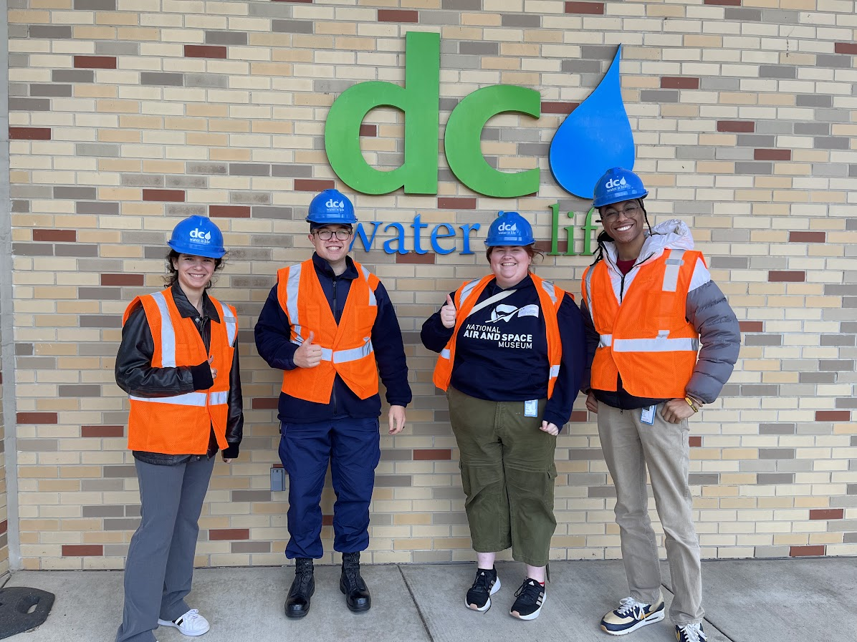
Our Experience
Getting to learn more about the Coast Guard!
Field Trips!
Exciting opportunity to contribute to future research and regulations

Slide 28
Thank You!
Do you have any questions?
gr-dc23-uscg@wpi.edu
Notes:
Rachel

Slide 29
Backup Slides

Slide 30
References
Bailey, S. A., Brydges, T., Casas-Monroy, O., Kydd, J., Linley, R. D., Rozon, R. M., & Darling, J. A. (2022). First evaluation of ballast water management systems on operational ships for minimizing introductions of nonindigenous zooplankton. Marine Pollution Bulletin, 182, 113947. https://doi.org/10.1016/j.marpolbul.2022.113947
Chloroform | Public Health Statement | ATSDR. (n.d.). Retrieved November 29, 2023, from https://wwwn.cdc.gov/TSP/PHS/PHS.aspx?phsid=51&toxid=16
Cui, H., Zhu, X., Zhu, Y., Huang, Y., & Chen, B. (2022). Ecotoxicological effects of DBPs on freshwater phytoplankton communities in co- culture systems. Journal of Hazardous Materials, 421, 126679. https://doi.org/10.1016/j.jhazmat.2021.126679
Duan, C., Yang, M., Wang, Q., Xue, J., Yuan, L., & Wu, H. (2023). Impacts of salinity stress caused by ballast water discharge on freshwater ecosystems. Regional Studies in Marine Science, 65. Scopus. https://doi.org/10.1016/j.rsma.2023.103079
Feng, W., Chen, Y., Zhang, T., Xue, J., & Wu, H. (2023). Evaluate the compliance of ballast water management system on various types of operational vessels based on the D-2 standard. Marine Pollution Bulletin, 194. Scopus. https://doi.org/10.1016/j.marpolbul.2023.115381
Kim, A.-R., Lee, S.-W., & Seo, Y.-J. (2022). How to control and manage vessels’ ballast water: The perspective of Korean shipping companies. Marine Policy, 138, 105007. https://doi.org/10.1016/j.marpol.2022.105007
Lodhi, A., Hashmi, I., Nasir, H., & Khan, R. (2017). Effect of trihalomethanes (chloroform and bromoform) on human haematological count. Journal of Water and Health, 15(3), 367–373. https://doi.org/10.2166/wh.2017.207
NBIC Online Database (2023). National Ballast Information Clearinghouse. Smithsonian Environmental Research Center & United States Coast Guard. http://dx.doi.org/10.5479/data.serc.nbic
PubChem. (n.d.). Chlorodibromomethane. Retrieved December 7, 2023, from https://pubchem.ncbi.nlm.nih.gov/compound/31296
Shah, A. D., Liu, Z.-Q., Salhi, E., Höfer, T., Werschkun, B., & Gunten, U. von. (2015). Formation of disinfection by-products during ballast water treatment with ozone, chlorine, and peracetic acid: Influence of water quality parameters. Environmental Science: Water Research & Technology, 1(4), 465–480. https://doi.org/10.1039/C5EW00061K
US EPA, O. (2019, March 11). The Vessel Incidental Discharge Act (VIDA) [Overviews and Factsheets]. https://www.epa.gov/vessels-marinas- and-ports/vessel-incidental-discharge-act-vida
Villanueva, C. M., Cordier, S., Font-Ribera, L., Salas, L. A., & Levallois, P. (2015). Overview of Disinfection By-products and Associated Health Effects. Current Environmental Health Reports, 2(1), 107–115. https://doi.org/10.1007/s40572-014-0032-x
Wang, Z., & Corbett, J. J. (2020). Scenario-based cost-effectiveness analysis of ballast water treatment strategies. Management of Biological Invasions, 12(1), 108–124. https://doi.org/10.3391/mbi.2021.12.1.08
UNCTAD. (2023). Review of Maritime Transport 2023. UNITED NATIONS CONFERENCE ON TRADE AND DEVELOPMENT, 30. https://unctad.org/system/files/official-document/rmt2023_en.pdf
UNCTADStat. (n.d.). https://unctadstat.unctad.org/datacentre/dataviewer/US.ContPortThroughput

Slide 31
More information on Data Analysis
Samples were organized in a table by chemical.
One right tailed T-test was done for each chemical in each water salinity, resulting in 15 total tests, 12 for THMs and 3 for total HAA concentrations.
The following formulas were used to calculate each step in the test.
Sample Size (N): =COUNT()
Sample Mean (SM): =AVERAGE()
Standard Deviation (STD): =STDEV()
Degrees of Freedom (DF): =N - 1
Test Statistic (T): =(SM – Hypothesized Mean)/(STD/SQRT(N))
P Value: =T.DIST.RT(T,DF)
The hypothesized mean for each sample is the EPA recommendation for acceptable concentration of that chemical in deballasted water.
Each test/P value was given an ID, to easier identify each sample when adjusting the p values for multiple comparisons.
Adjustment for Multiple Comparisons:
To adjust the P values for multiple comparisons to decrease likelihood of Type 1 Error, the Benjamini-Hochberg method was used.

Slide 32
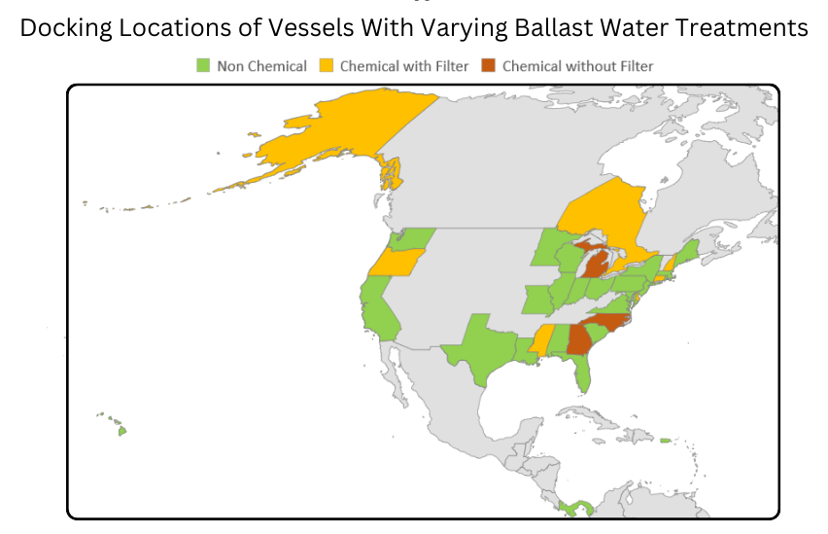
Data for vessels docking in the U.S. in 2023 provided by Smithsonian Environmental Research Center and National Ballast Information Clearinghouse
National Ballast Information Clearinghouse 2023. NBIC Online Database. Electronic publication, Smithsonian Environmental Research Center & United States Coast Guard. Available from http://dx.doi.org/10.5479/data.serc.nbic; searched on December 6, 2023.

Slide 33
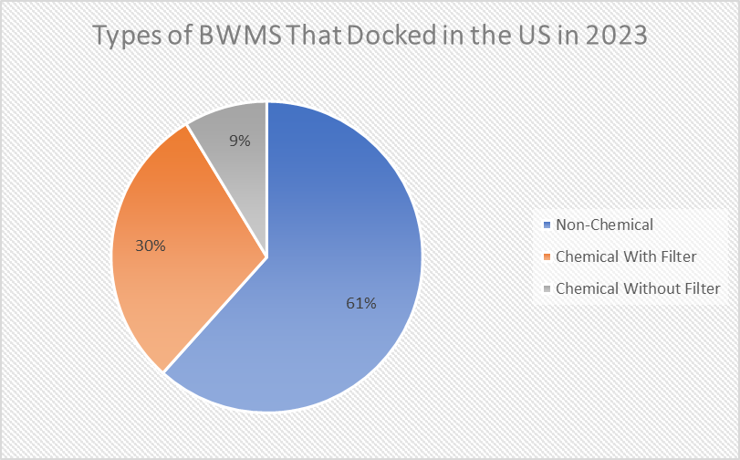
Data for vessels docking in the U.S. in 2023 provided by Smithsonian Environmental Research Center and National Ballast Information Clearinghouse
National Ballast Information Clearinghouse 2023. NBIC Online Database. Electronic publication, Smithsonian Environmental Research Center & United States Coast Guard. Available from http://dx.doi.org/10.5479/data.serc.nbic; searched on December 6, 2023.

Slide 34
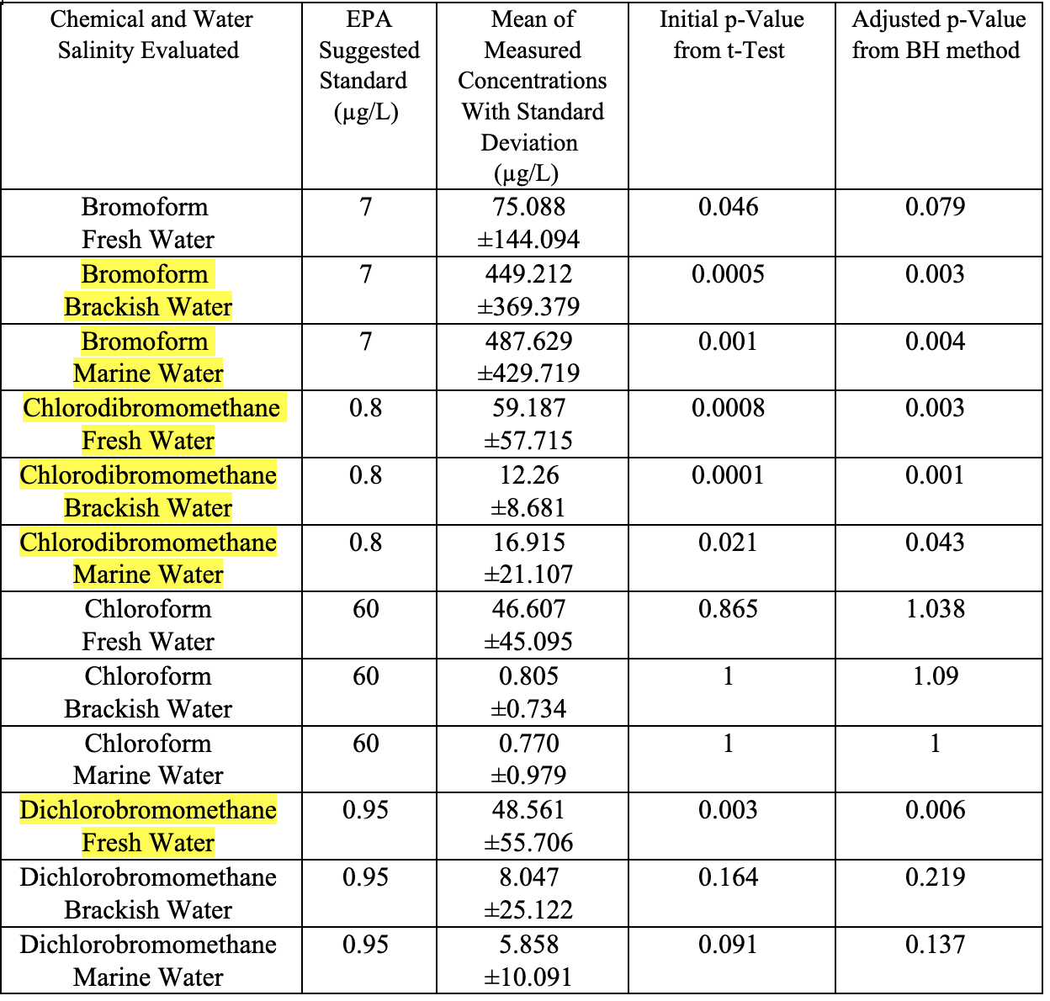

Slide 36
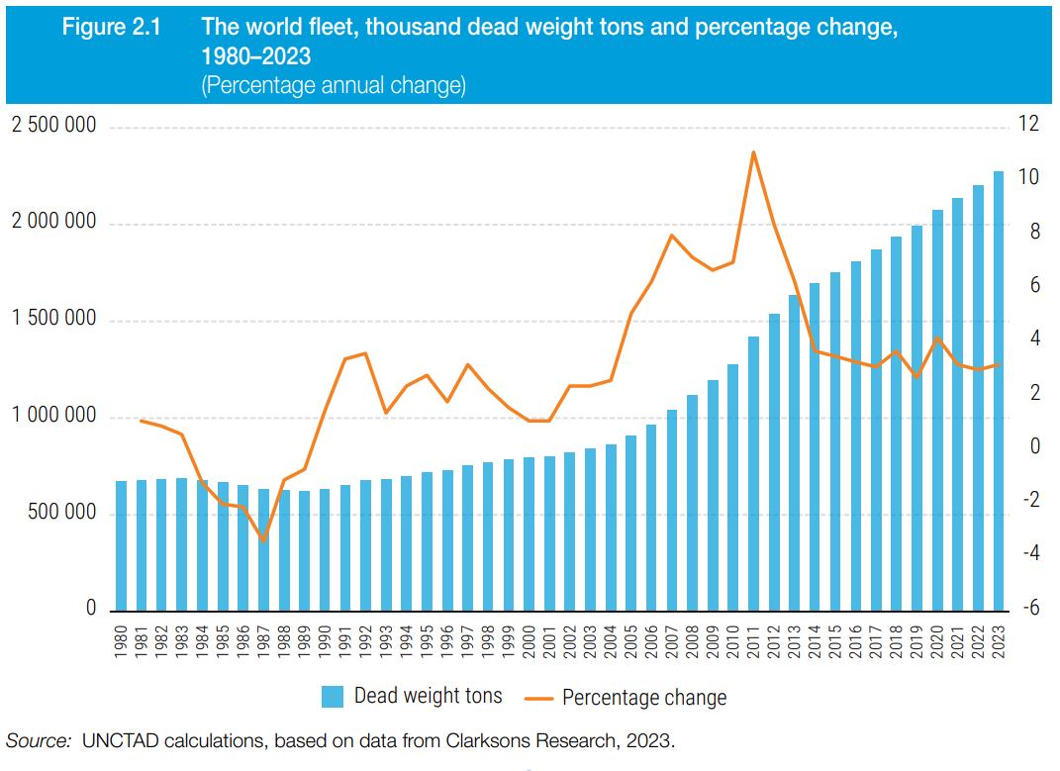
Used with permission from the United Nations and Clarksons Research
(UNCTAD, 2023)

Slide 37
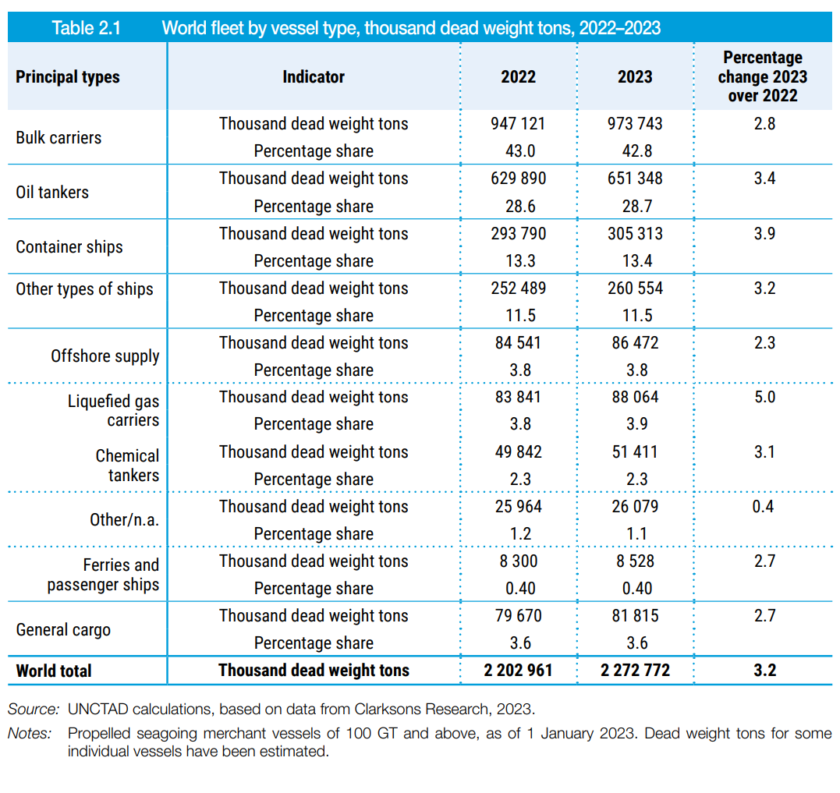
Used with permission from the United Nations and Clarksons Research
(UNCTAD, 2023)

Slide 38
Health Impacts
THM
In high concentrations in water, trihalomethanes like bromoform and chlorodibromomethane can cause harm to the liver and kidneys (ATSDR, 2015).
Bromoform and chloroform have the potential to change hematological count, which can be indicative of developing medical conditions (Lodhi, 2017).
Trihalomethanes are possibly carcinogenic in humans based on studies done on laboratory animals (Bureau of Water Resources Drinking Water Program, 2022).
Long term exposure to THMs like chloroform can lead to harmful effects on the human nervous system, causing symptoms such as depression and irritability (ATSDR, 2015).
Prolonged exposure to chlorodibromomethane has effects on the central nervous system, causing nausea, dizziness, headaches, and narcosis (National Center for Biotechnology Information, 2023).
HAA
A study tested the toxicity of 8 HAA concentrations found in wastewater on three species of freshwater organisms (Cui et al., 2021).
The tested chemicals were found to inhibit the growth and swimming ability of the organisms as well as induce abnormal development and mortality (Cui et al., 2021).
Phytoplankton, an organism essential to maintaining both marine and freshwater ecosystems, was found to be the most impacted by HAAs (Cui et al., 2021).
When placed under stress from low levels of HAAs, phytoplankton tends to bloom, or rapidly reproduce (Cui et al., 2022). This can deplete oxygen from the surrounding waters and release toxins into the ecosystem causing increased mortality and illness in larger organisms such as fish.
Because phytoplankton is the foundation of many aquatic food chains, when the organism is placed under stress from exotoxins the whole ecosystem is affected, as well as humans who rely on the fishing economy or eat seafood (Cui et al., 2021).
An increase in fish mortality is detrimental to the fishing industry, and humans can become sick from seafood that carries the toxins released by the algae blooms (Dai et al., 2023).

