Slide 1
Developing a Sequence Risk Score
Advisors: Jon Abraham and Barry Posterro
Alisha Anderson (MAC), Carina Kennedy(MAC), Haley Modelski (MAC)

Slide 2
Agenda
Project Introduction
Our Goal
Understanding Sequence Risk
Quantifying Sequence Risk
Future Work
2

Slide 3
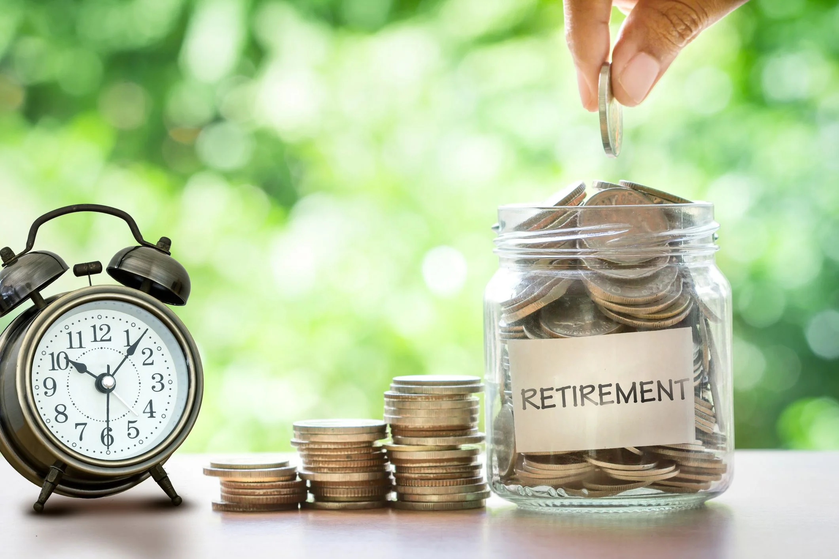
Project Introduction
Saving money for retirement
401(k)s
IRAs
Investing Risks
Poor Returns
Insufficient Deposits
Sequence Risk
3
Notes:
Poor returns(->lack diversifaction)
Sequence Risk
Developing a way to minimize it
Trend Following
There is no measure to quantify it

Slide 4
Sequence Risk
The risk associated with the final account balances attributable to the order of returns
4

Slide 5
Goals
Understand When Sequence Risk is Present
Develop a Measure of Sequence Risk
5

Slide 6
Retirement Phases
$
$
Age 25
Age 65
Age 85
Investment
Withdrawal
6

Slide 7
When is There Sequence Risk?
7

Slide 8
When is There No Sequence Risk?
$1,000 Deposits Yearly Subjected to 5.9% Constant Returns
8

Slide 9
When is There No Sequence Risk?
Single Cash Flows
Scenario | Return Year 1 | Return Year 2 | Return Year 3
1 | -10% | 10% | 20%
2 | -10% | 20% | 10%
3 | 10% | -10% | 20%
4 | 10% | 20% | -10%
5 | 20% | -10% | 10%
6 | 20% | 10% | -10%
9

Slide 10
Sequence Risk is Present When There Are:
Multiple cash flows
Varying returns
Unknown order of those returns
10

Slide 11
Quantifiable Attributes
Traditional Measures of Risk: Skewness, Kurtosis, Range
Modern Measures of Risk: TVaR, Sharpe Ratio, SemiVariance
11
Notes:
Carina
This Sequence Risk Score formula produces a positive number that has no units
These positive number solutions can be used as a comparative measure between different sets of returns to quantify the risk
A Sequence Risk Score of 0 always means that sequence risk is not present in the specific set of return
-Each component of the score above provides value. The range is indicating the spread of the returns. The larger the range of returns, the more potential risk that is present. The square root of semi-variance, or simply known as the semi-deviation, incorporates the component of risk for when a return is under-performing the average. Lastly, dividing by the geometric mean squared eliminates the units within the equation and scales the values of the score.
Since the score calculation does not have any units attached, this measure can easily be compared between different sets of returns. The score calculation is best used as a comparison measure, like the Sharpe Ratio, which is discussed in Section 4.3.2. For instance, if Set 1 has a sequence risk score of 2.0 and Set 2 has a sequence risk score of 10.0, then Set 1 has less sequence risk than Set 2, so Set 1 would be preferred since there is less risk associated with the returns. Another important characteristic of this sequence risk score calculation is that a set of returns with no variance, meaning the returns are the same each year, has a sequence risk score of 0.0, which was proven in the above sections. Overall, this score took trial and error and research to conclude upon, so in the next section describes our team’s methods to find this solution.

Slide 12
Sequence Risk Score Formula
$$Sequence Risk Score=\frac{Range×\sqrt{SemiVariance}}{{\left(Geometric Mean\right)}^{2}}$$
Pros | Cons
No negative values are possible | Not the most intuitive calculation
No units | SemiVariance does not work with the set of all the same returns
Matches visual ranking of sequence risk from a histogram
Looks at where risk is most important (i.e. everything below the mean)
12
Notes:
Carina
$$Range=the maximum return minus the minimum return$$
$$SemiVariance=the variance of the returns below the mean$$
$$Geometric Mean=the geometric average of the returns$$
-Each component of the score above provides value.
The range is indicating the spread of the returns. The larger the range of returns, the more potential risk that is present.
The square root of semi-variance, or simply known as the semi-deviation, incorporates the component of risk for when a return is under-performing the average.
Lastly, dividing by the geometric mean squared eliminates the units within the equation and scales the values of the score.

Slide 13
Developing a Sequence Risk Formula
Created retirement scenarios
25,000 permutations of returns
Depositing or withdrawing money for 30 years
Performed Calculations
Found the IRR that corresponds with final balance
Determined the year in which an account ran out of money
Figured out potential statistics to use for score
These statistics were calculated based only on the returns
Notes:
Poor returns(->lack diversifaction)
Sequence Risk
Developing a way to minimize it
Trend Following
There is no measure to quantify it

Slide 14
Example of S&P 500 Distribution
Sequence Risk Score: 7.98
14
Notes:
7.98
653089

Slide 15
Future Work
Explore Other Ways to Measure Sequence Risk
Find a relationship between simulation results and returns
Analyze our Proposed Sequence Risk Score for S&P 500 returns
Are there any trends? Could you predict future returns scores?
15
Notes:
Carina

Slide 16
Thank You!
Questions?
Notes:
Carina

