Slide 1
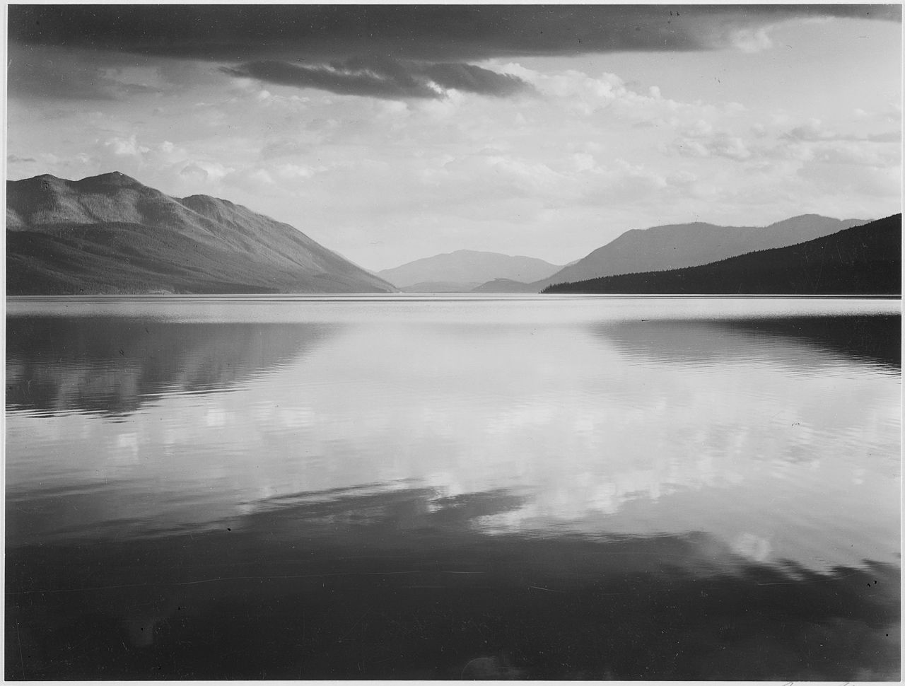
Proposing a New Digital Asset Management System for Glacier National Park
Lucia Bernard
Robert Dec
Calum Lehrach
Jacob Matthews
Notes:
Good afternoon everyone. For our project, we worked on proposing potential new digital asset management systems for Glacier National Park.
Montana Memory Project (16th Aug 2021). Main veranda at Going-to-the-Sun Chalets on Upper St. Mary Lake. In Website Montana Memory Project. Retrieved 9th Oct 2021 17:47, from https://www.mtmemory.org/nodes/view/5358

Slide 2
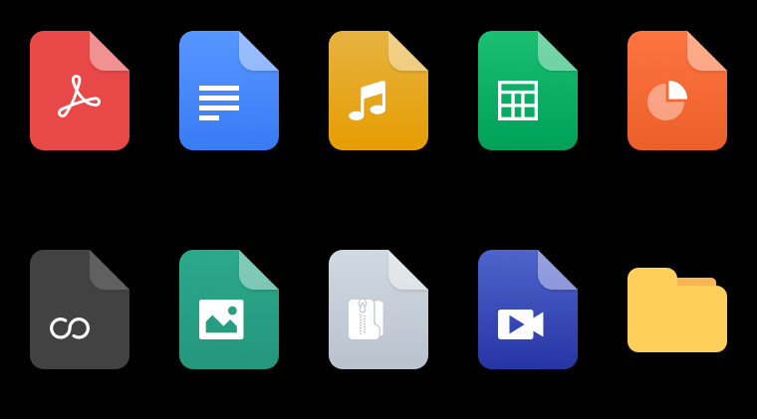
What are Digital Assets?
Notes:
So what is a digital asset? A digital asset is any content that’s stored digitally. Some common examples would be photos, videos, audio files, and pdfs. This slideshow itself is a digital asset. If you’ve ever used anything like a phone, a laptop, or a tablet, chances are you’re familiar with several types of digital assets.

Slide 3
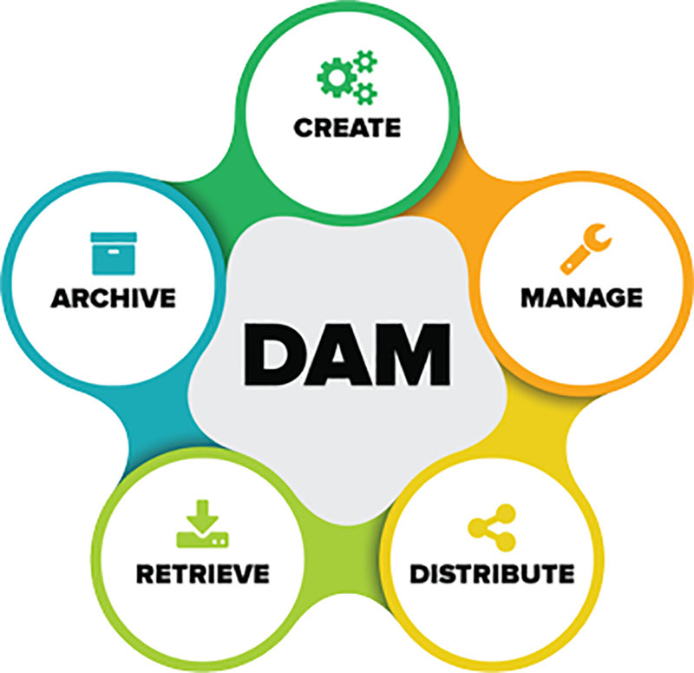
What is a Digital Asset Management System?
Notes:
Digital assets can be preserved using a digital asset management software system, or a DAM system for short. The majority of DAM systems have 5 basic functionalities.
First, assets are able to be created.
Second, assets are able to be managed.
Third, assets are able to be distributed.
Fourth, assets are able to be retrieved.
And fifth, assets are able to be archived.
DAM systems are also able to manage important information about assets, such as their author, date taken, and copyright holder.

Slide 4
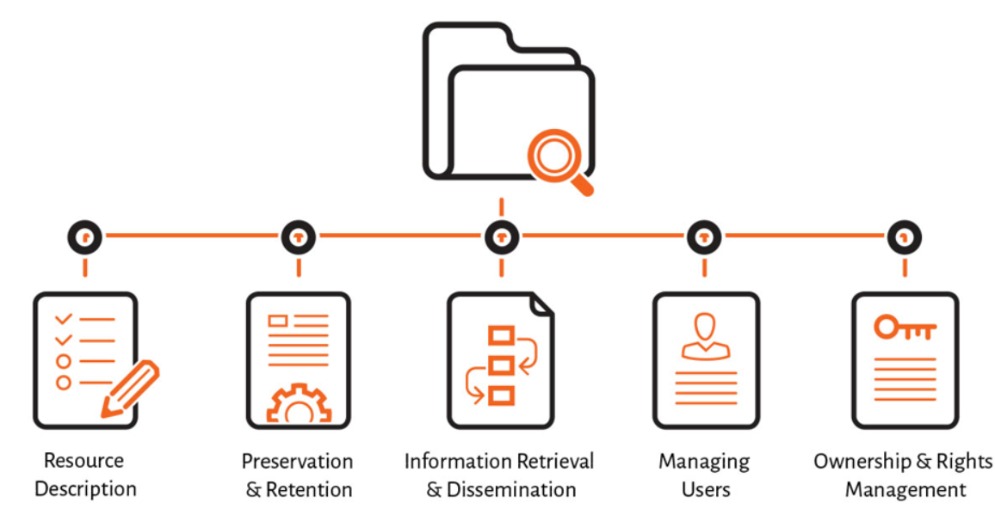
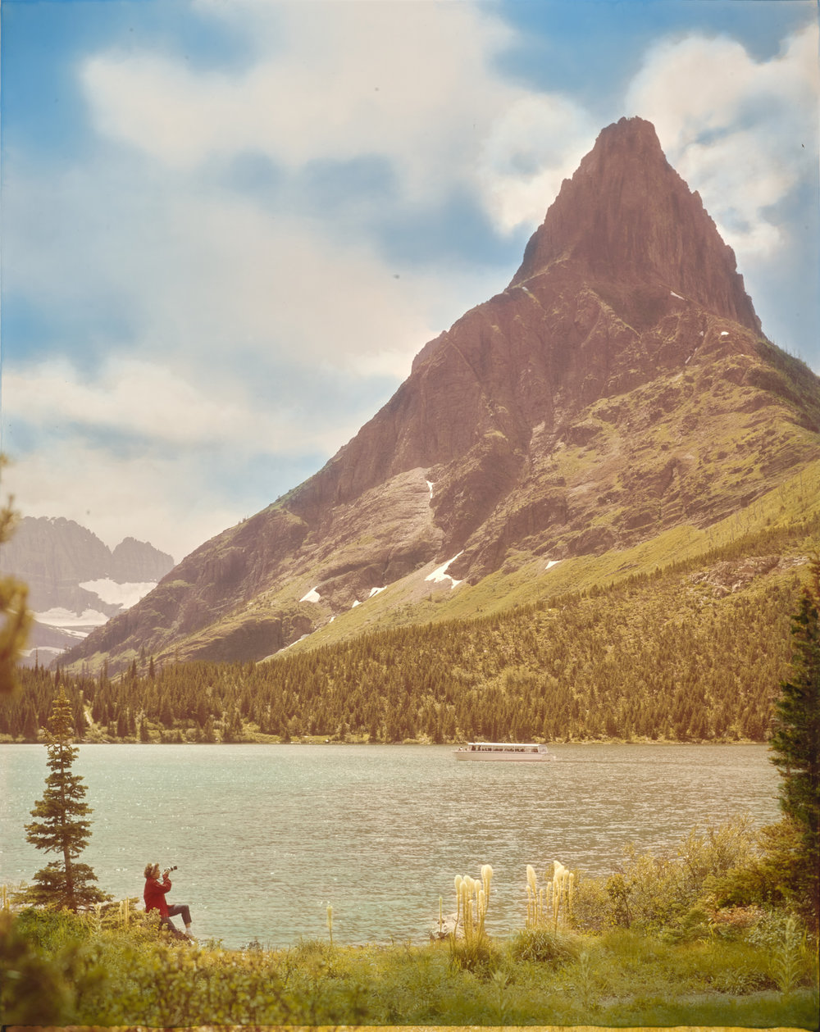
What is Metadata?
Notes:
Specifically more what does features does DAM systems do?
What does metadata accomplish?
What can DAMs do that excel sheets cannot?

Slide 5
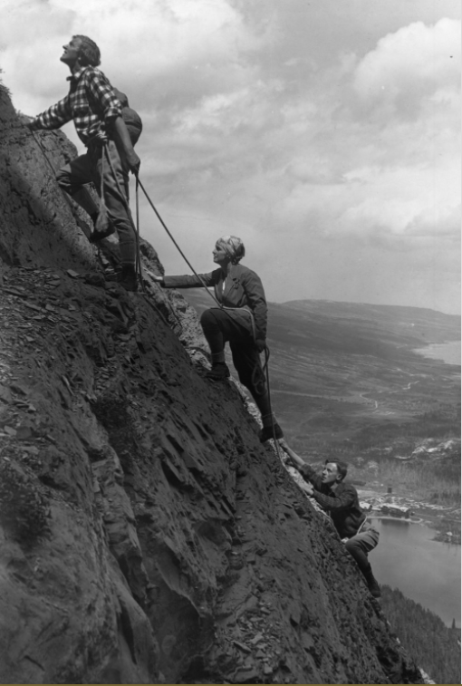
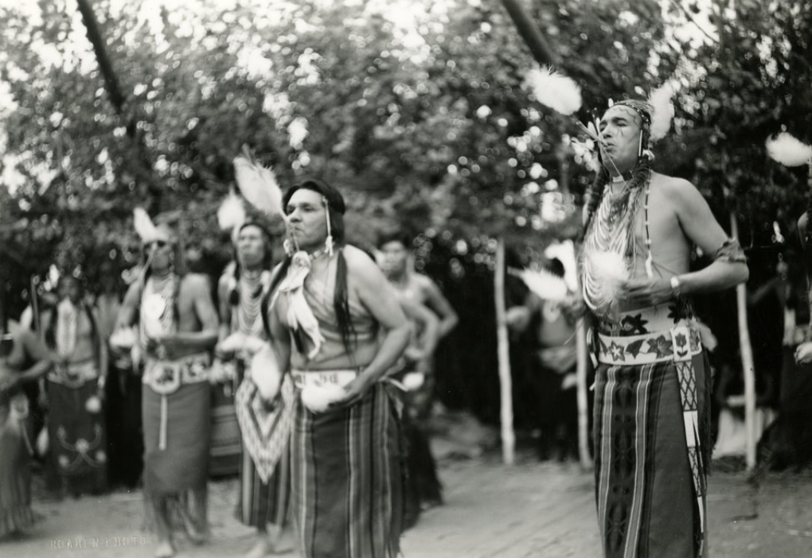
What is the Importance of Preserving Historic Archives?
Historical Education
Cultural Education
Research
Notes:
The preservation of digital archives and their metadata is important for many reasons, mainly:
Historical education
Cultural education
Research
Without an efficient DAM system, preserving digital archives can be tedious and difficult.

Slide 6
Current Process at Glacier National Park
Include screenshots from Jean to illustrate the feelings she has
Notes:
Here is a look into the current process GLAC archival and library staff use to locate digital images.
These are screenshots from excel spreadsheets that Jean and her team use to organize the metadata for digital images...(click) At the top of the spreadsheet is all the metadata field options...Image title, description, creator, genre etc…(click)
(click) These are sample metadata fields filled out for this specific image…(click)

Slide 7
Current Process at Glacier National Park
Include screenshots from Jean to illustrate the feelings she has
Notes:
Here are more metadata fields for the same image...Once you find the metadata that describes the image you are looking for you take the photo ID...In this case it’s HPF_4067…(click)

Slide 8
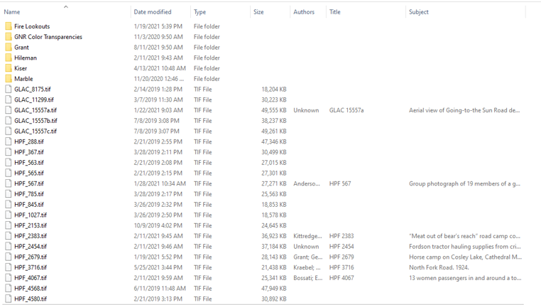
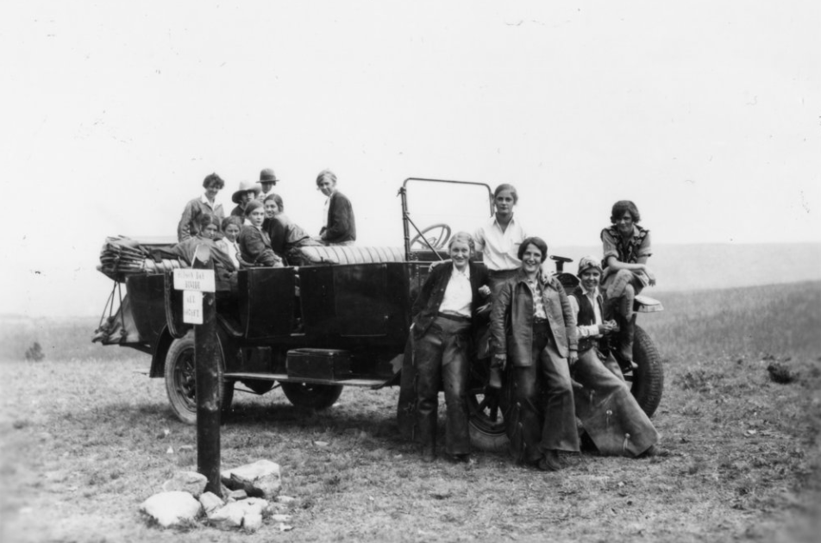
Current Process at Glacier National Park
Notes:
And here is the corresponding image file for that set of metadata…(click) That was a lot of time to locate a single image...if this wasn’t the image you were looking for you would have to go back to the metadata spreadsheet and try again. (Click)

Slide 9
Why is the Current Excel Process Ineffective
User interface is unfriendly
Error prone
Cannot directly attach assets
All manual, no automation
Not easily searchable
Labor intensive
Notes:
So why is this process ineffective?
(click)...the user interface of excel is difficult to navigate, especially with spreadsheets of 13,000 rows
(click)...Excel is error prone...there is no correction for wrongly entered fields in excel, whereas DAM software does not allow incomplete metadata fields for a particular asset...
(click)...Excel does not have the ability to attach metadata to the asset files themselves…which would allow the user to preview the image without going to file explorer...
(click) excel is not able to automatically match asset identifications with the asset files themselves in large batches...a crucial aspect of maintaining an archive of nearly 13,000 images.
(click) Excel can only be searched by the control F function, and does not compile the results...making searching very difficult...
(click) Using excel requires a lot of formatting on the back end...whereas a DAM software system would already have functionalities built in.

Slide 10
Proposing a DAM System for Glacier
1). Identified essential criteria for the new system.
2). Identified and evaluated potential DAM software systems.
3). Presented DAM software systems that met criteria to sponsor.
4). Developed recommendations for the new DAM software system.
Notes:
To find Glacier a new DAM system, we completed 4 objectives:
First, we identified essential criteria for the new system.
Second, we identified & evaluated potential DAM systems using the criteria we identified in objective 1.
Third, we presented the DAM systems from objective 2 that met the criteria to our project sponsor.
And fourth, we developed recommendations for the Park’s new DAM system.

Slide 11
Primary Criteria for Glacier's DAM System
Objective 1: Identify Criteria
Cost
Intuitive Navigability
Metadata Options
Troubleshooting Support
Batch Metadata Editing
User Roles
Notes:
Cost is of primary concern to the park and is necessary for completing an informed funding request.
We implemented a tiered cost structure ranging from least to most expensive.
Ensures ease of searchability Standard keywords controlled by admin users
Upload existing metadata for many images at the same time
Stored as a CSV file Allows overwriting old data or creation of new data
It is important sure to ensure that users can quickly and effectively find their way through the menus
The user interface of the system can help or hinder the ease of use.
There will inevitably be issues running the software, so having documentation and/or a help desk can assist users in troubleshooting problems.
Allows different people access to different assets
Admins can control the system
Other users can contribute or view selected assets

Slide 12
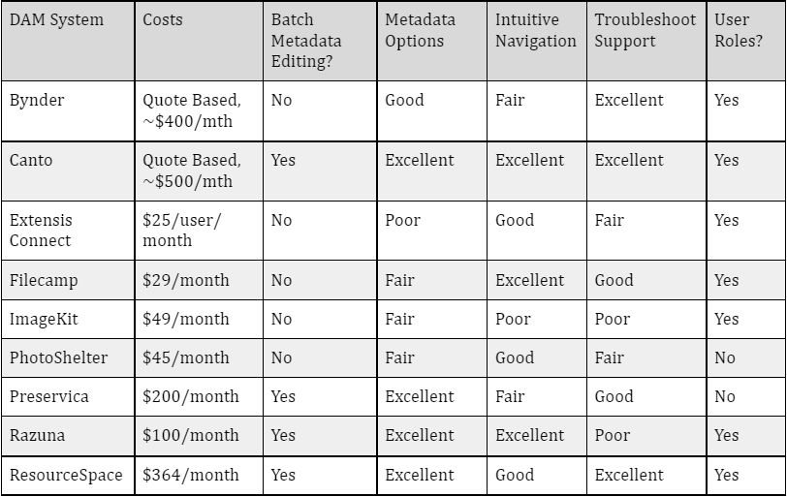
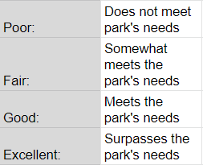
Objective 2: Identify and Evaluate Systems
Comparative Analysis of DAM Systems
Notes:
System names on the right side, criteria on the top
Costs – monthly cost
BME and UR have yes or no
Last 3 have a grade based on how well it accomplishes feature
Let’s us compare systems, see which ones are best, eliminate those that do not do well
Bynder
Canto / ResourceSpace
4 systems no bme
Leaves us with 3

Slide 13
Objective 3/4: Present and Recommend Systems
Recommendations
Razuna
Preservica
ResourceSpace

Slide 14
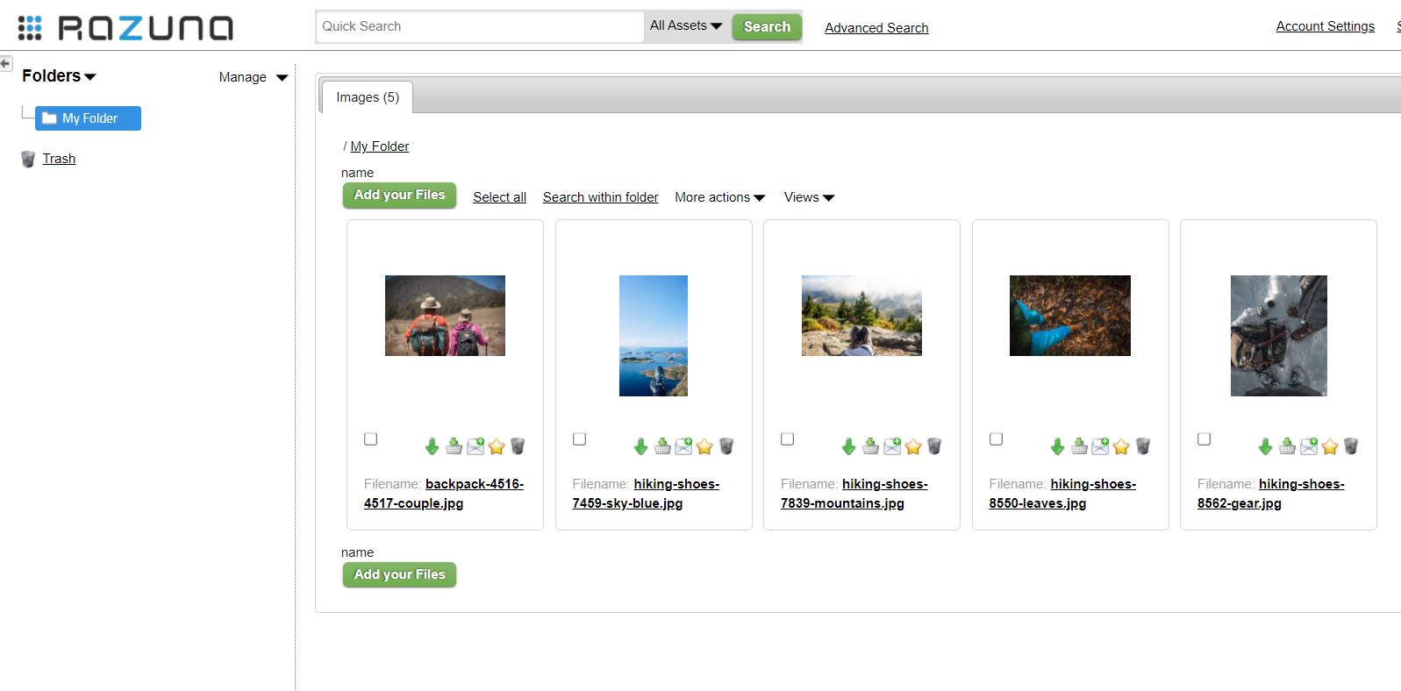
Objective 3/4: Present and Recommend Systems
Razuna - $99/month
Notes:
Exceptional at $99
Despite BME being a feature that comes with higher pricing packages
Auto convert file types and sizes – standardization and storage
Controlled searchable vocabulary with metadata options and user roles settings
Downside – tech support separate subscription, can go without

Slide 15
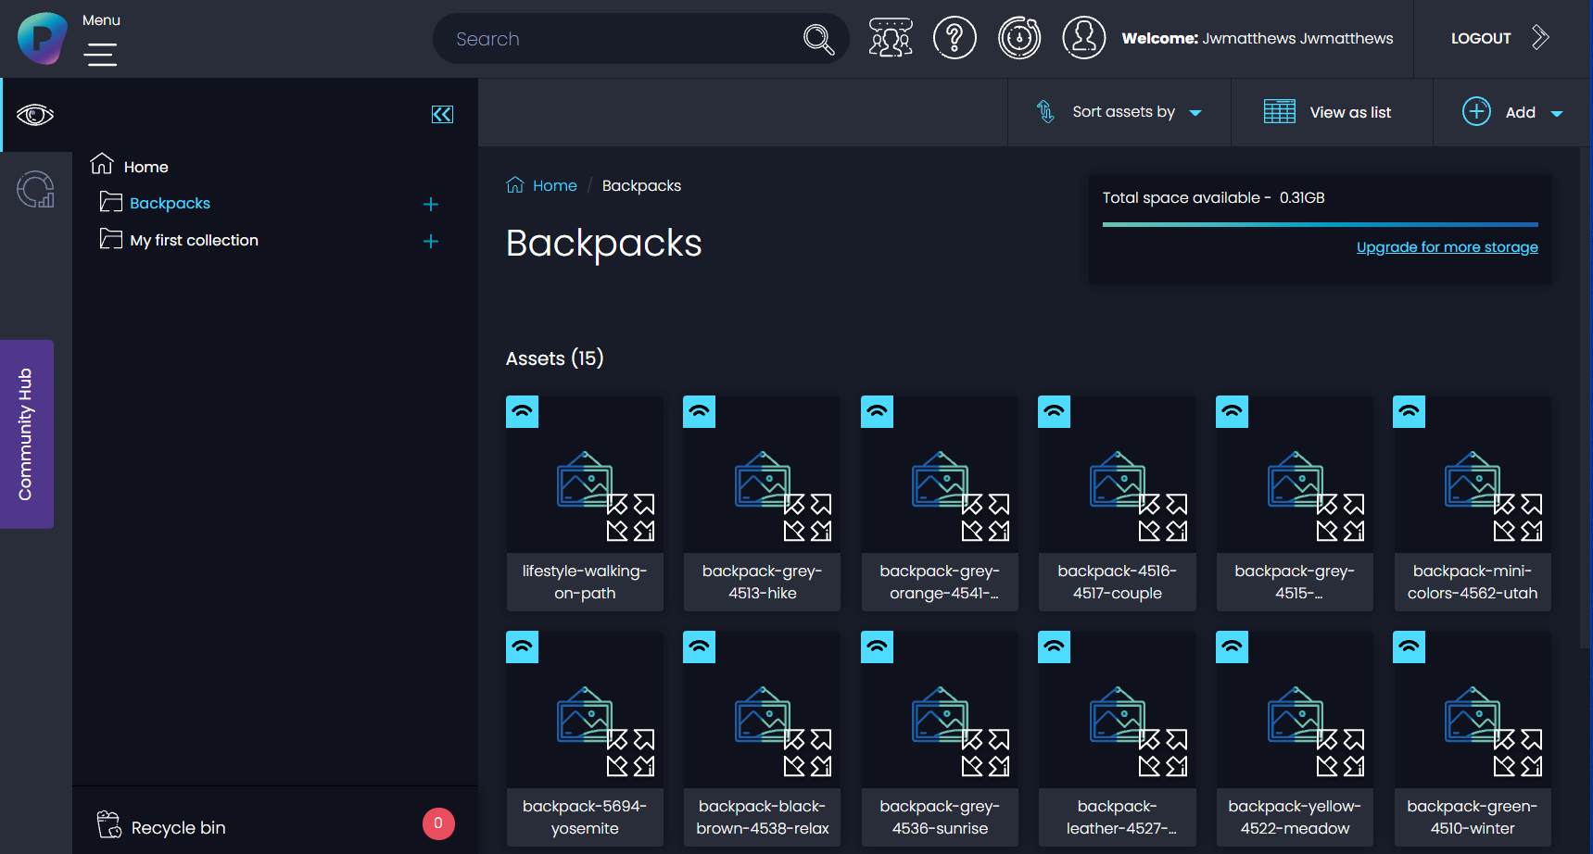
Objective 3/4: Present and Recommend Systems
Preservica - $199/month
Notes:
Next we recommend
Also straightforward, intuitive interface at $199
Allows users custom metadata fields and templates – any data desired
Plenty of space – 250GB, optional public access portals
However, only allows 3 users at a time, not many quality of life features in more expensive packages
Regardless, made for archival work and fits needs for a successful DAM for Glacier

Slide 16
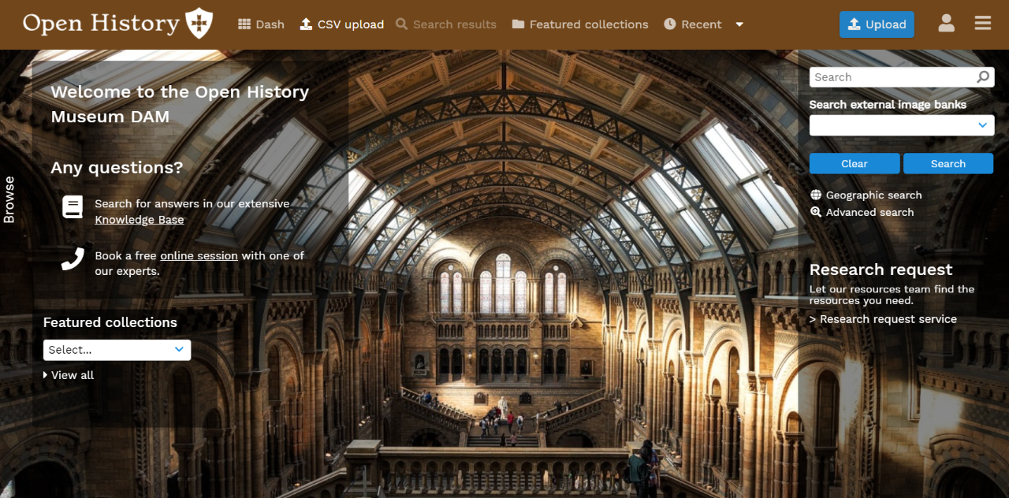
Objective 3/4: Present and Recommend Systems
ResourceSpace - $364/month
Notes:
Pros
Plentiful customization and organization options
Targeted towards archival use
Extra statistics and logs
Automatic file conversion, size and types
1 TB of storage
Comes with immediate support when setting up
Cons
Cost
Somewhat cluttered

Slide 17
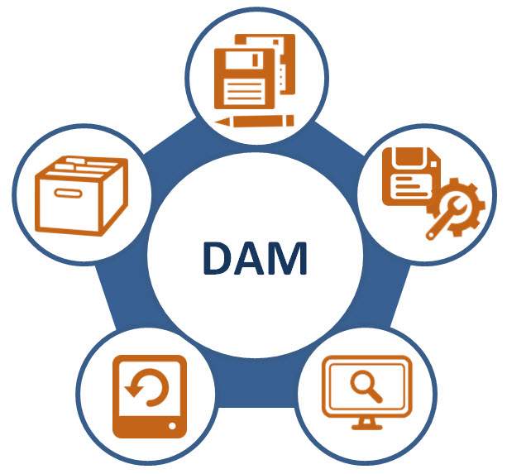
Why DAMs Are Beneficial
No redundancies
Consistent workflow
Permissioned access
Consolidated assets
Easy to retrieve assets
Accelerates digitization of images
Notes:
Glacier National Park's Museum and Archival Department needs a new DAM software system, and these three software systems satisfy their needs.
*The need for these systems is most important in non-profit organizations who often lack the necessary resources and funding to implement one. Therefore, our project may outline the process an organization takes to make digital assets accessible for climate change and cultural research.

Slide 18
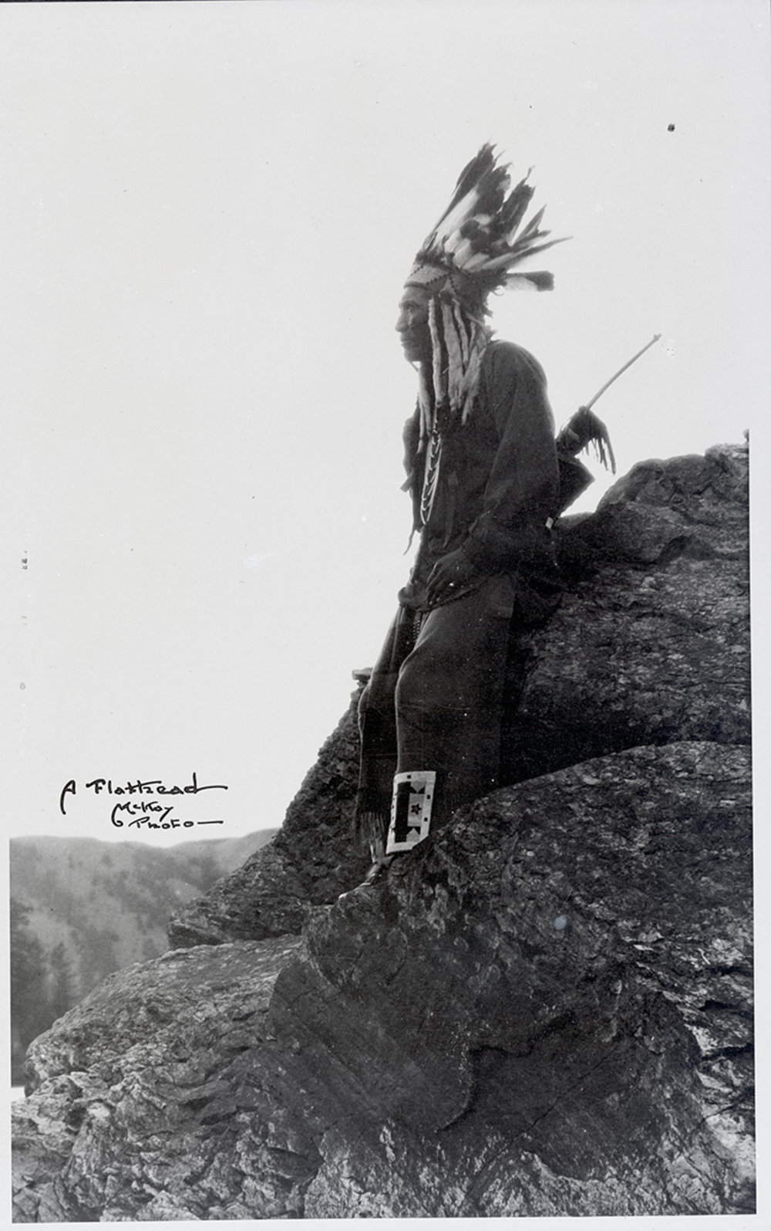
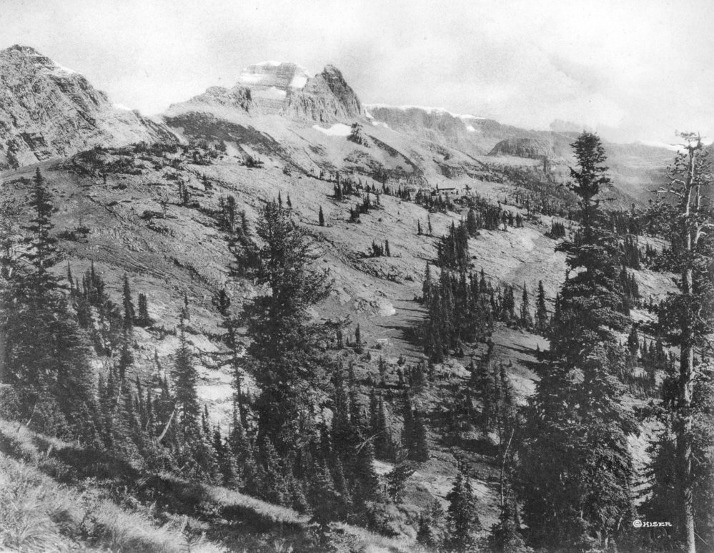
Notes:
Digital archives not only preserve physical assets from being damaged, they also allow for more accessibility to researchers and educators. Implementing these software systems to National Parks, museums, and libraries all over the world can preserve fragile assets of cultures, history, lands, and organizations. Glacier National Park’s museum and archive department needs a new DAM system to organize their images. It is our hope that using one of the DAM systems we recommended, that GLAC’s library team can save time and energy. More importantly, the photographs that GLAC handles are incredibly valuable. Their digitization prevents their physical deterioration, and thus having a new system sustains the preservation and management of these photographs. With a functional way of having these images safe and retrievable, the stories and events behind them can be shared to keep their historical and cultural importance for generations to come.

Slide 19
Thank you to our contacts:
Wendy Essery, Worcester Historical Museum Head Librarian
Anna K. Gold, WPI Head Librarian
Arthur C. Carlson, WPI Archivist and Assistant Director for Special Collections

Slide 20
Special Thanks to Our Sponsors Tara Carolin & Jean Tabbert And Our Advisors Professor Frederick Bianchi Professor Corey Dehner Professor Seth Tuler

Slide 21
Questions?
Thank you for listening!

