Slide 1
Developing a STEAM Strategy for the Boys & Girls Club of Worcester
Zach Bellion, Chris Ferreira, Lindsey Merrill, Justin Nguyen
April 26, 2018
Notes:
“We are the WPI IQP Team working towards…”

Slide 2
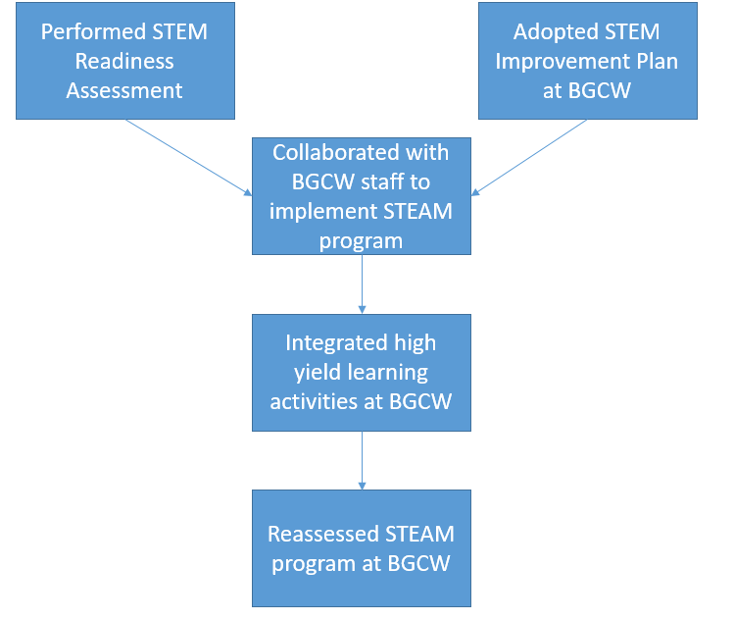
Mission Statement
Collaborated with the staff of the Boys & Girls Club of Worcester (BGCW) to develop a sustainable STEAM strategy and stimulate member interest in STEAM activities.
Notes:
Justin

Slide 3
STEM Readiness Pre-Assessment
STEM Improvement Plan
Resources
STEAM Activities
STEM Readiness Post-Assessment
Recommendations
Promotional Video
Notes:
Justin - Mention this is a national document
Chris take over at STEM Readiness Assessment Page

Slide 4
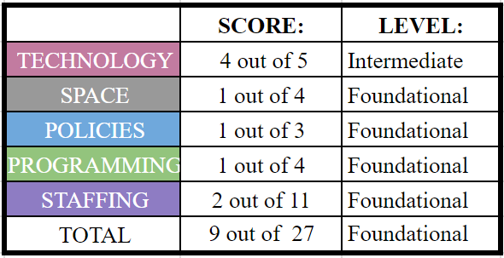
STEM Readiness Pre-Assessment
Notes:
Chris

Slide 5
STEM Readiness Pre-Assessment
Notes:
Chris

Slide 6
STEM Readiness Pre-Assessment
Notes:
Chris

Slide 7
STEM Readiness Pre-Assessment
Notes:
Chris

Slide 8
STEM Readiness Pre-Assessment
Notes:
Chris

Slide 9
STEM Readiness Pre-Assessment
Notes:
Chris

Slide 10
Immediate Improvements
Dedicate Learning Center to STEAM once a week
Create instructional videos for activities
Create Volunteer Guide to help run STEAM and Power Hour
Notes:
Zach - transition to guide
In our time here we were able to work with bolaji to….make immediate improvements and develop long term improvement
On right side outline next couple slides - immediate improvements
Make more appealing not graph form

Slide 11
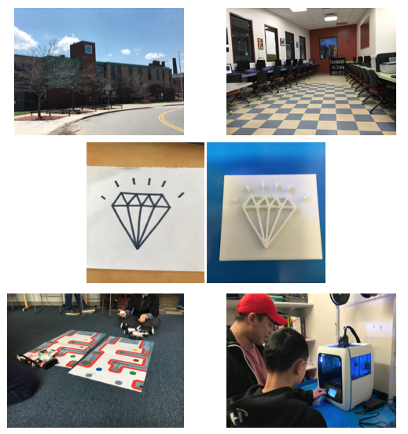
Volunteer Guide
How to manage Learning Center
STEAM Program Overview
3D Printer Instructions
Activity Plans
Notes:
Zach - Talk about volunteers being unsure how to help out around the club

Slide 12
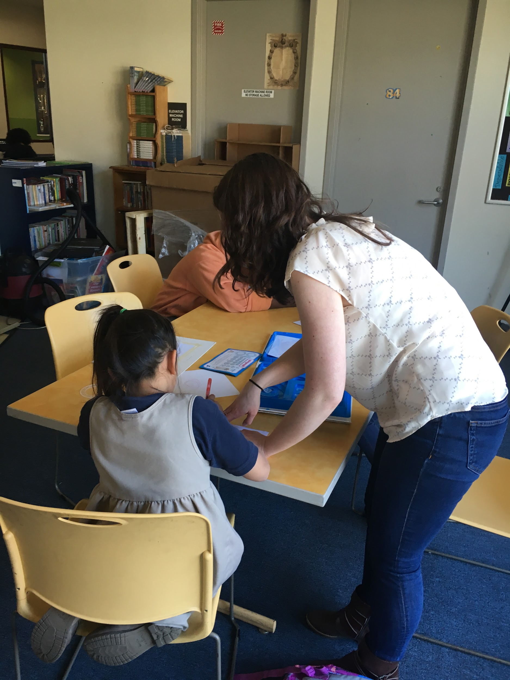
Pedagogy
Key Concepts for STEAM Activities
Activity Before Content (ABC)
Divergent Thinking
Cooperative Learning
Notes:
Lindsey
STEAM stands for science, technology, engineering, art, and mathematics. It is derived from STEM. Art was added to reinforce the importance of art in schools and utilizing creativity while doing STEM subjects. Also, the addition of art increase student engagement in science and math because it makes them more accessible. STEAM also allows for teachers to make the material more relevant to students which generally stimulates interest.
Pedagogy is the theory behind best teaching practices. There are three key concepts that can be utilized to teach STEAM effectively. The first is the concept of Activity Before Content, or ABC. This means that you engage students first with an interesting activity and follow it up with content about what was demonstrated through the activity. The second is divergent thinking which means deriving multiple solutions to a problem. The third is cooperative learning, which is a term that describes putting students in groups to work together to accomplish a task.
STEAM - change from STEM, strategy of making topics relevant to students and using art to increase creativity and student engagement,

Slide 13
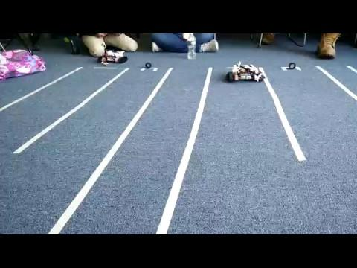
Lego Mindstorms
Organized Parts for Robots
Activity Plan
Race Track
Programming
Notes:
Justin
First Activity we used involved the Lego Mindstorms
Group organized parts for two kits so none would be lost
Two groups of members built robots
Conducted the Race Track Activity
Explain activity
Also conducted the programming activity
Short descrition of activity

Slide 14
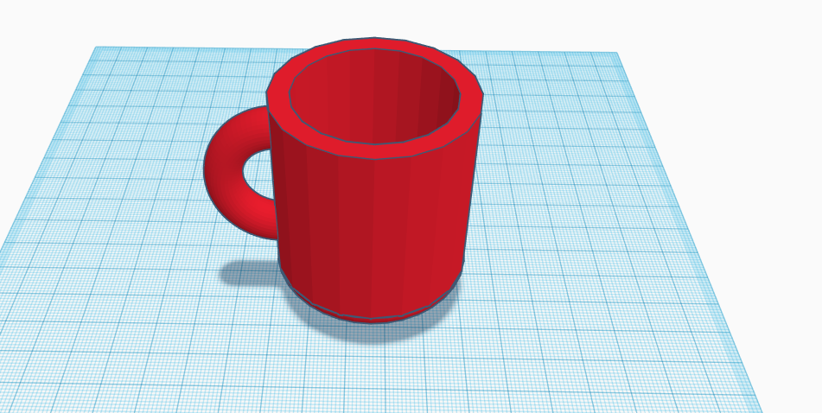
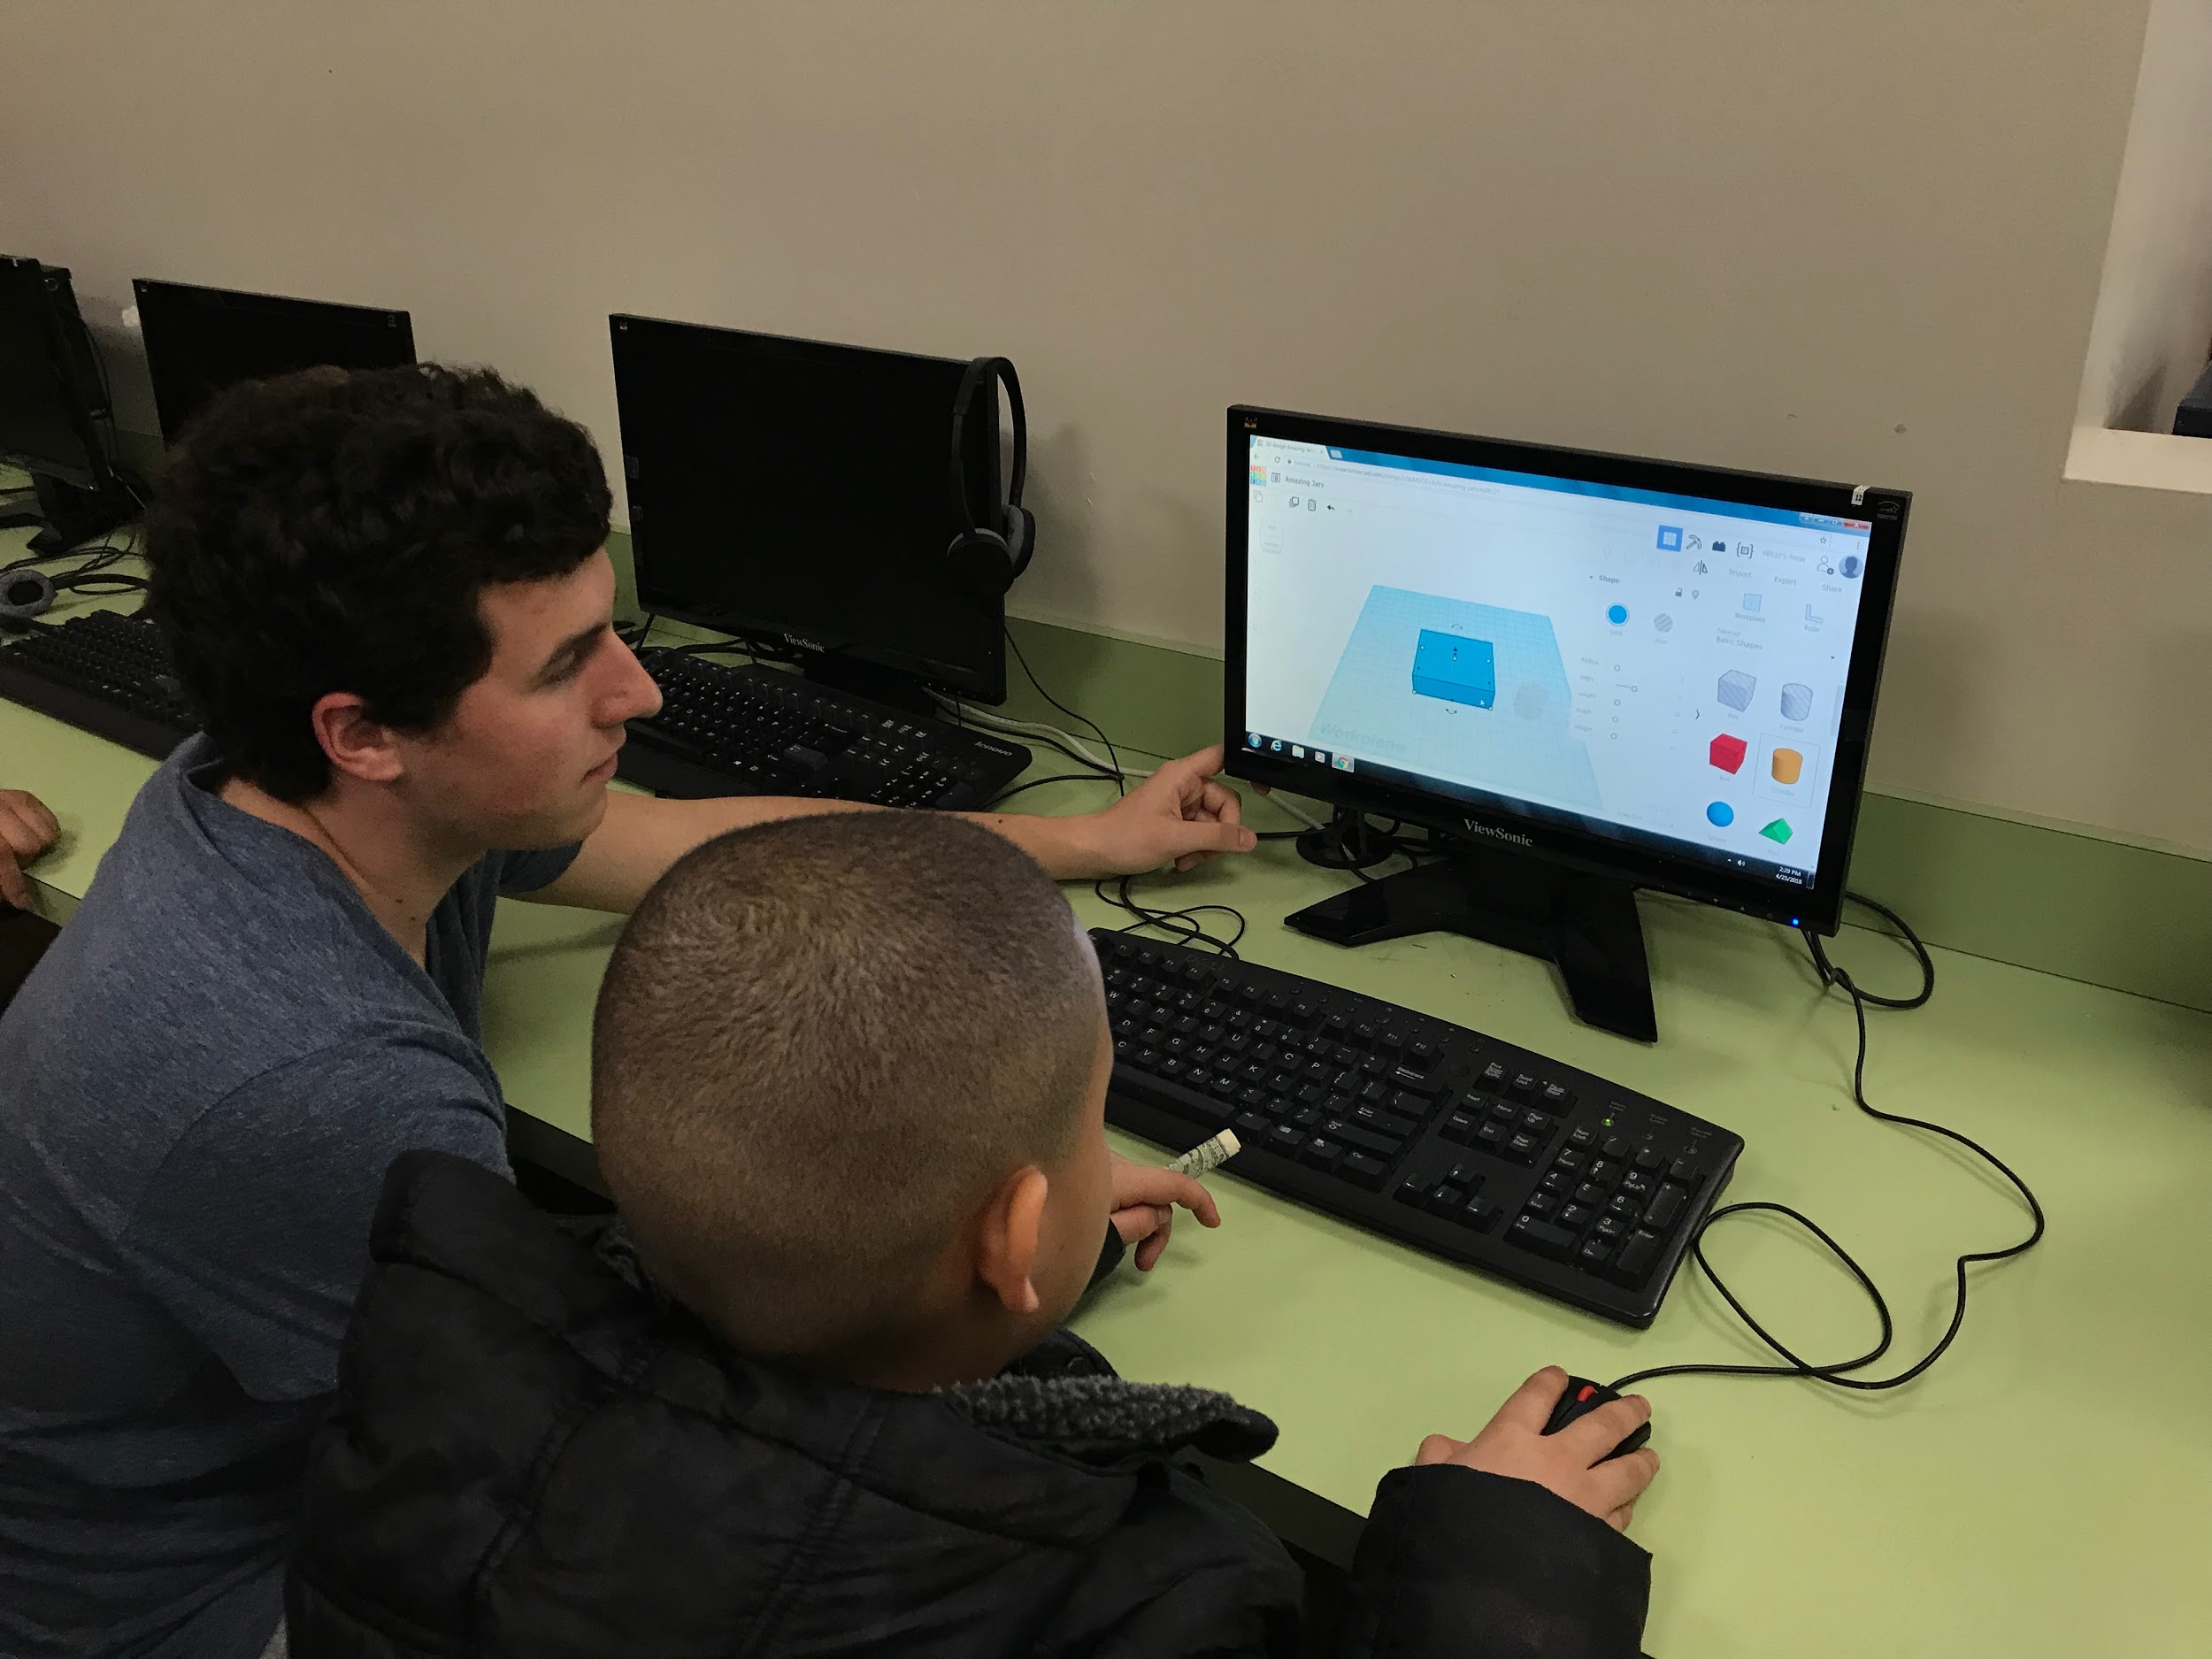
TinkerCAD
Instructional Videos for Tutorial
Name Tags
Activity Plans
Cup
Castle
Notes:
Justin
Start with explanation of TinkerCAD
Started tutorials/ playing around
Activity

Slide 15
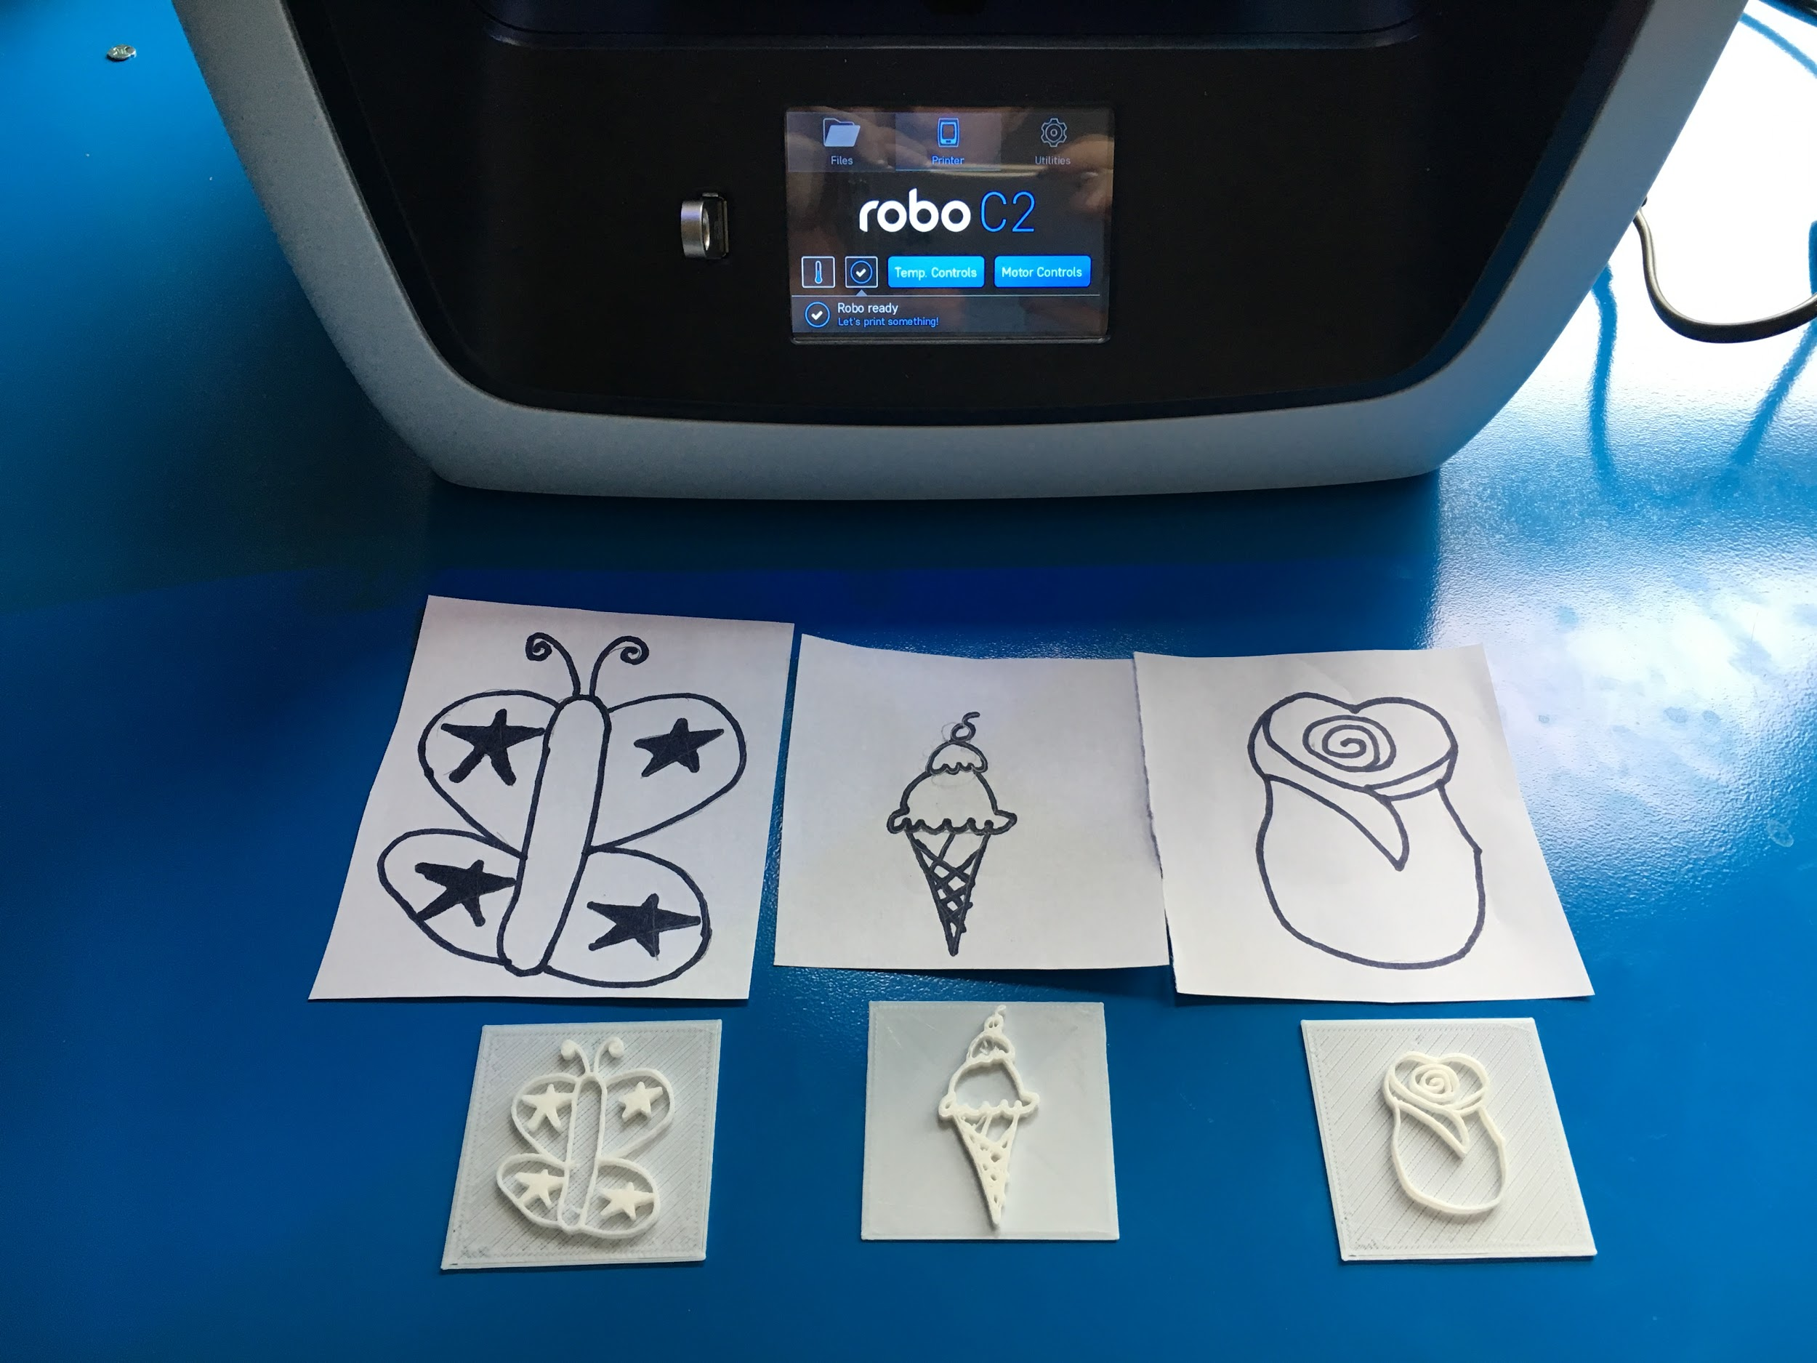
3D Printer
Volunteer Guide Instructions
3D Printer Drawing Activity
Notes:
Zach
Emphasize art element of STEAM

Slide 16
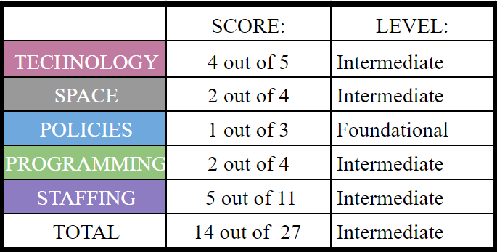
STEM Readiness Post-Assessment
Notes:
Chris

Slide 17
STEM Readiness Post-Assessment
Notes:
Chris

Slide 18
Hire Part-time Dedicated STEAM Staff Member
Connect with STEM Education Center at WPI
Volunteers’ Attendance Updates at Staff Meeting
Work Study Fair and Annual WPI Student Team
Recommendations for BGCW Staff
Structure STEAM Programming
Clarify Volunteers Expectations
Reaffirm Learning Center Structure with Members
Recommendations for the Learning Center
Notes:
Lindsey
There are two sets of recommendations. These are for the BGCW staff. We’d recommend hiring a part-time dedicated STEAM staff member. This staff member could be in charge of programming and handle technology support for the STEAM activities. However, we understand hiring someone new may be difficult since many organizations don’t want to give grants for salaries and the Club wants to stay service charge free to support all its members. Although, we do believe the STEAM program will be more successful and sustainable if another staff member is hired. Another option for grants is connecting with the STEM Education Center at WPI. The Center does outreach programs and goes to local schools to teach STEM lessons to students. They may now of an organization who would be willing to provide a grant to hire a staff member. We’d also recommend having volunteer updates at your weekly staff meetings. This could help with their accountability and everyone can be on the same page with what’s happening in the Club concerning volunteers. It also helps with open communication amongst the staff. Another recommendation is to attend the Work Study Fair at WPI in the fall. Many students attend the fair to find employment for the school year and they could be an option for helping with the STEAM program in the future. Also, it might be helpful to have WPI student teams do a similar project with the STEAM program on a yearly basis. They could come in with fresh eyes and new ideas to develop the program further.
The second set of recommendations are for the learning center. The first is to have a structure for the STEAM program. Joanne had the idea of starting with closing the LC from 4-5pm one day a week for STEAM activities and add on more days from there. The second recommendation is to clarify your expectations of the volunteers. We believe the volunteer guide will help with this and hopefully make the volunteers feel more comfortable when they are at the Club. The last recommendation is to reaffirm with the members that the LC should be a like a library where quiet activities are done, expect during the designated STEAM program time. This may decrease the number of members who try to run around the learning center.

Slide 19
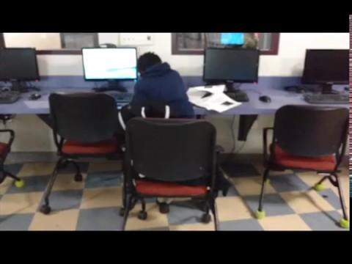
Promotional Video
Notes:
Chris

Slide 20
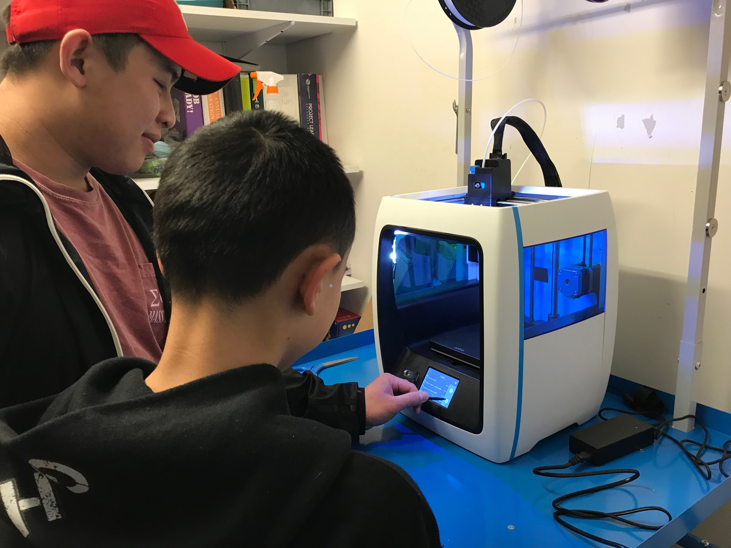
Acknowledgements
All Staff of the Boys & Girls Club
Bolaji Ojo
Teju Richardson
Scott Jiusto
Shari Weaver
All Members of the Boys & Girls Club
Joanne Fowling
Creighton Peet
Laura Robinson
Stephan Barthold

Slide 21
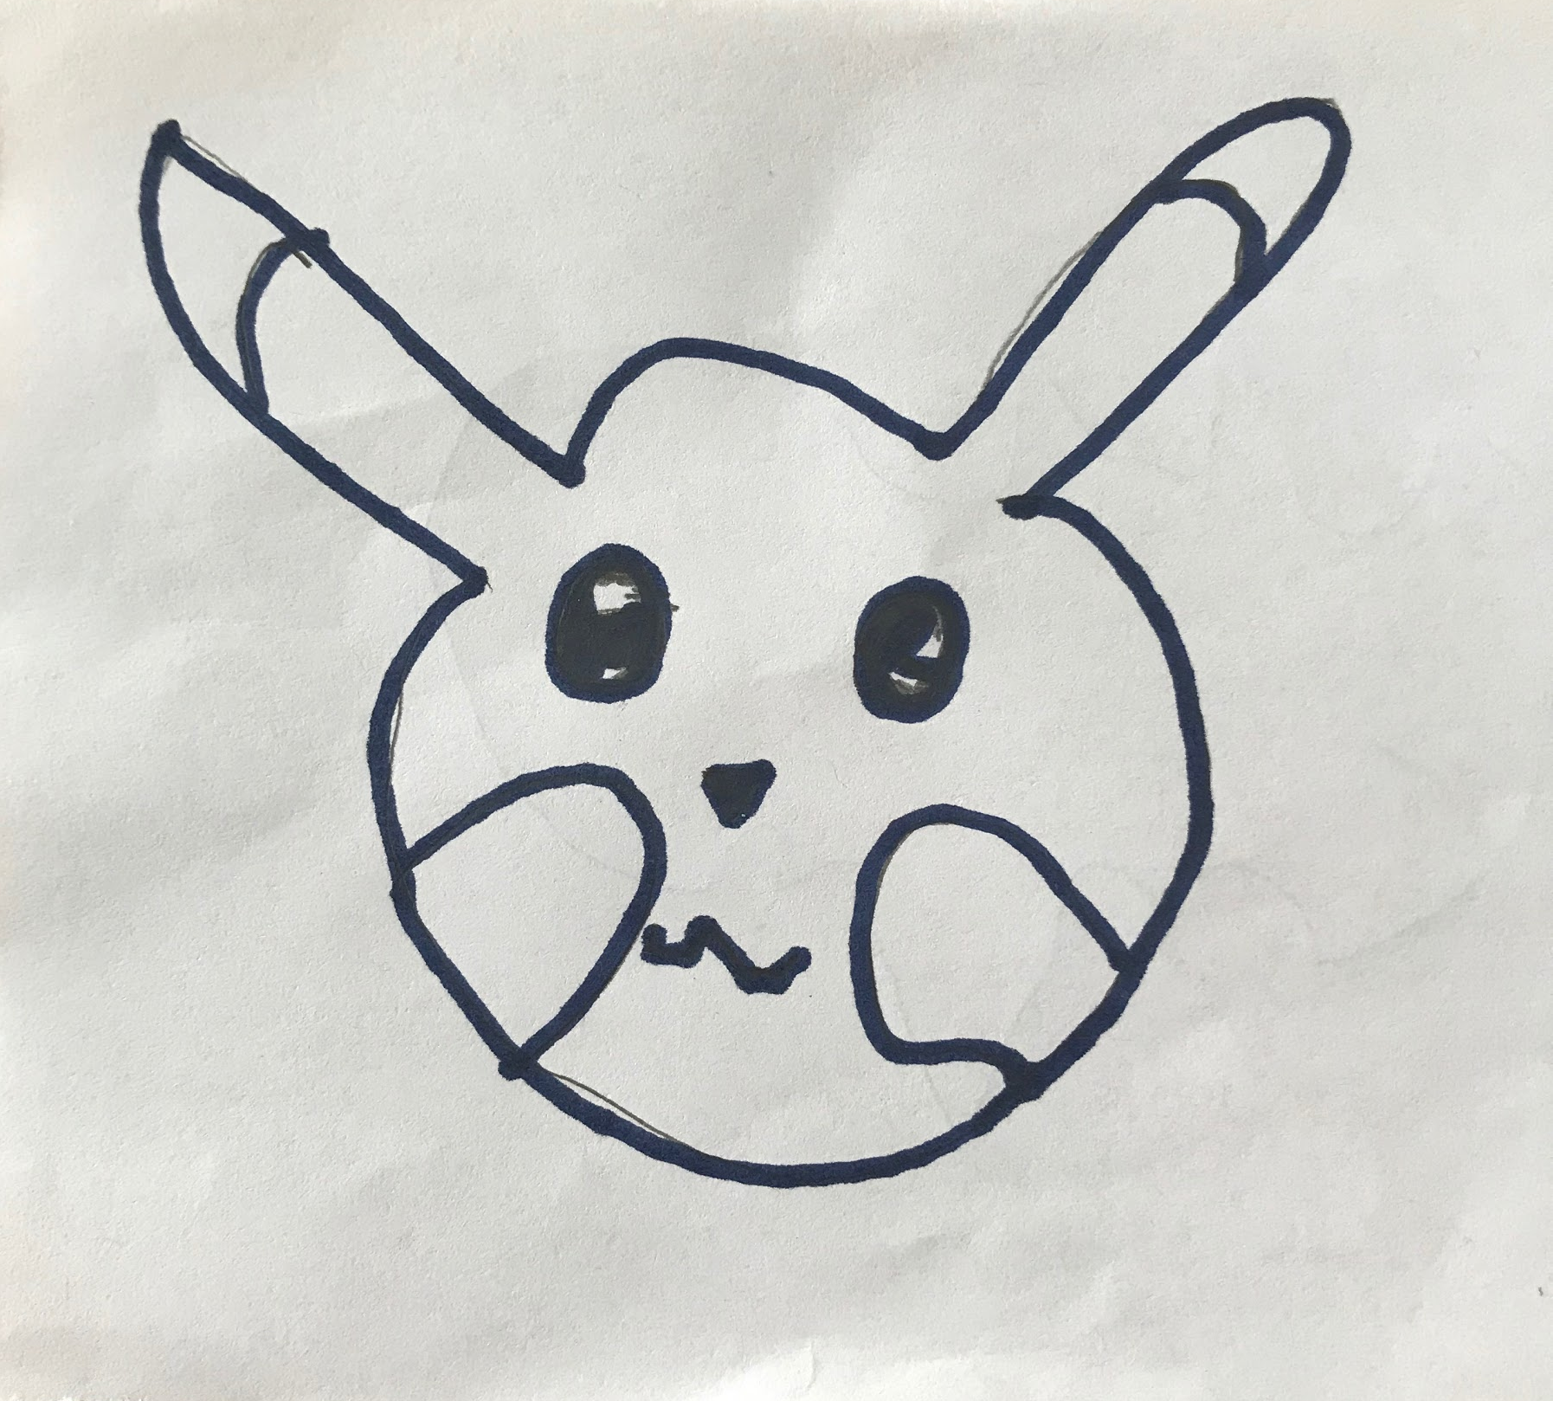
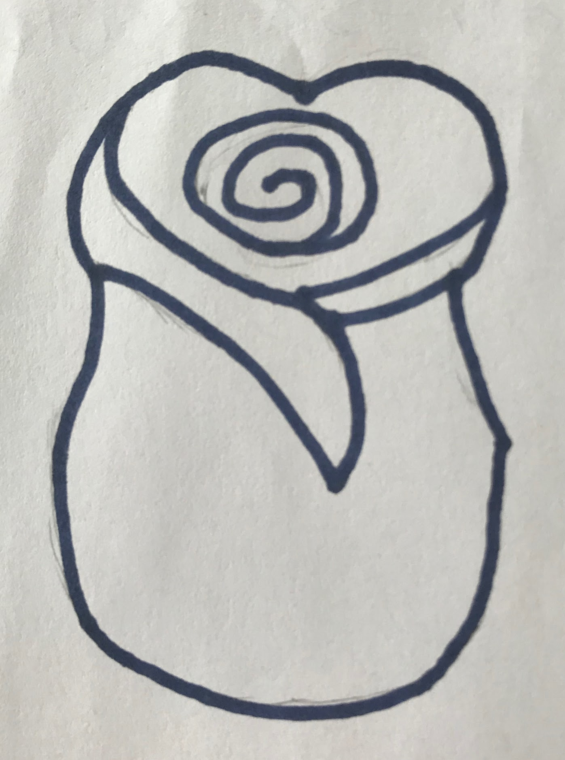
Questions/Suggestions?

