Slide 1
Sequence Risk
1
Jack Cascone, Matthew Letourneau, Zachary Pitts

Slide 2


What is Sequence Risk?
2
Deposit
Interest
Deposit
Interest
+$1000
5%
+$1000
20%
+$1000
10%
+$1000
15%
+$1000
15%
+$1000
10%
+$1000
20%
+$1000
5%
$5691.90
$5127.15

Slide 3
Avoiding Sequence Risk
3
Deposit
Interest
Deposit
Interest
+$4000
5%
+$4000
20%
10%
15%
15%
10%
20%
5%
$6375.60
$6375.60

Slide 4
Avoiding Sequence Risk
4
Deposit
Interest
Deposit
Interest
+$1000
11.1%
+$1000
11.1%
+$1000
11.1%
+$1000
11.1%
+$1000
11.1%
+$1000
11.1%
+$1000
11.1%
+$1000
11.1%
$5240.20
$5240.20

Slide 5
Product Concept
5
Notes:
A lump sum investment avoids sequence risk, but may not be financially practical
How can we mitigate the exposure to unfavorable sequences
Unpredictable growth factors means sequence risk

Slide 6
Product Concept (Example)
6
Example Account 1 Geometric Average
Deposit
Interest
Deposit
Interest
+$1000
20%
+$1000
12.36%
+$1000
15%
+$1000
12.36%
+$1000
10%
+$1000
12.36%
+$1000
5%
+$1000
12.36%
$5127.15
$5398.56
Payment: $271.41

Slide 7
Product Concept (Example)
7
Example Account 2 Geometric Average
Deposit
Interest
Deposit
Interest
+$1000
5%
+$1000
12.36%
+$1000
10%
+$1000
12.36%
+$1000
15%
+$1000
12.36%
+$1000
20%
+$1000
12.36%
$5691.90
$5398.56
Payment: $0

Slide 8
Product Concept
8
Deposit
Interest
+$1000
???%
+$1000
???%
Growth factors from
the S&P 500
30 annual deposits for $1000 each
+$1000
???%
+$1000
???%
+$1000
???%
Notes:
A lump sum investment avoids sequence risk, but may not be financially practical
How can we mitigate the exposure to unfavorable sequences
Unpredictable growth factors means sequence risk

Slide 9
Product Concept (Overview)
9
  Customer invests $1000 annually into the S&P500 for 30 years
  We promise a strike price calculated from the geometric average
  If they end up below this amount, we pay the difference

Slide 10
Simulating the Product
10
Notes:
Things we need
Data & simulations
Risk analysis
Pricing method

Slide 11
S&P 500 Data
11
(Shown in chronological order)
+14.0%
+12.2%
+13.1%
-5.7%
-11.2%
+8.9%
+16.1%
+3.1%
+16.6%
+62.0%
-8.4%
+1.1%
-9.9%
+11.0%
-6.1%
+15.6%
+52.2%
+11.6%
-32.0%
+14.0%
+11.4%
+2.8%
+12.7%
+9.8%
+13.9%
-20.6%
-11.3%
-2.8%
+20.1%
+61.0%
Geo Avg
+7.6%
Strike Price
$113,242
StDev
0.205

Slide 12
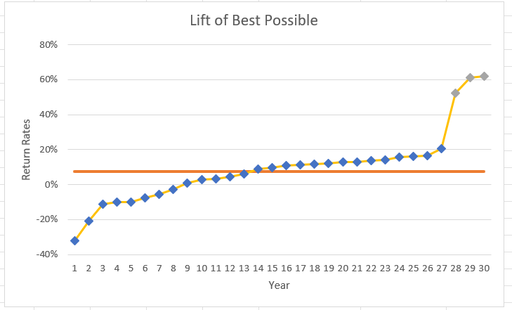
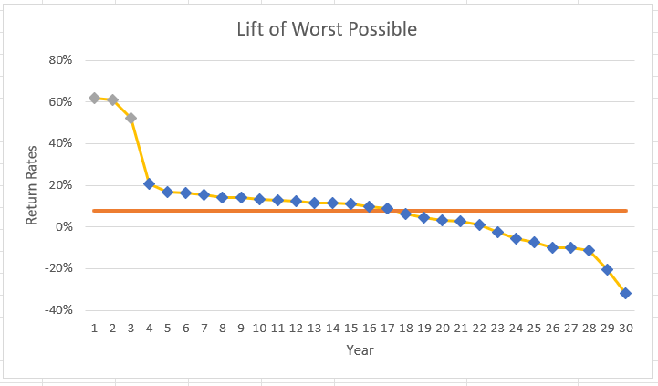
Best Possible vs Worst Possible
12
Strike Price
$113,242
Geo Avg 0.076
Final Account Balance
$467,891
Final Account Balance
$37,843
Ratio to Strike Price
4.13
Ratio to Strike Price
2.91
0.33

Slide 13
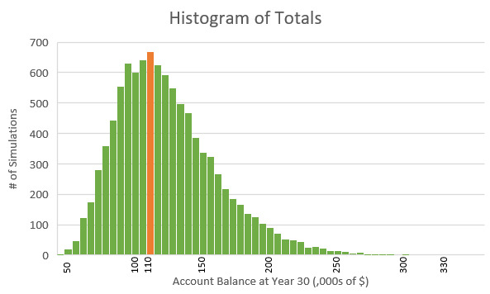
Simulated Account Balances
13
Strike Price
$113,242
Average Account Balance
$122,885
Average Payment
$8,477
Notes:
Discuss our excel simulation
% PiM: 44.3%
30yr x 10,000
Investment Pattern
With the 30 rates we took we created 10,000 permutations
LOGNORMAL

Slide 14
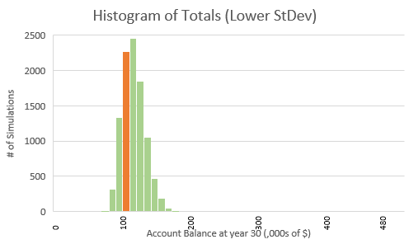
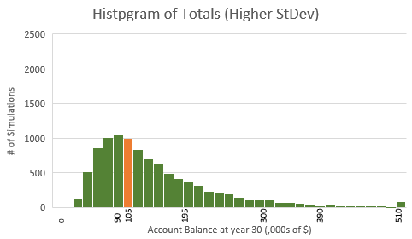
Lower vs Higher St. Deviation
14
Strike Price
$113,242
Avg Account Balance
$115,418
Avg Account Balance
$153,488
Avg Payment
$5,216
Avg Payment
2.91
$12,938
Notes:
NOTE: The DARK GREEN graph is way more spread out, it’s been condensed for viewing purposes.
Left PiM: 48.0%, right PiM: 40.9%

Slide 15
Pricing
15
Notes:
Things we need
Data & simulations
Risk analysis
Pricing method

Slide 16
Investing Premiums
16
The expected payment of all accounts is $8,477, which covers ~⅔ of sequences
Premium
$942
Invested into S&P500 as a lump sum
Final Value
$8,477
Notes:
We don’t want to just sit on premiums, cash has a negative yield considering inflation.
So, what do we do with our premiums to get the best output at the end of 30 years. Well, for us it is fairly simple. We need to provide coverage for sequence risk, so if we invest in something that has sequence risk, we are doubling down. Our best course of action is to invest all of our premiums into the S&P 500 all at once. This way we will have no sequence risk, and grow at the geometric average rate.
It does not matter that much if the S&P 500 performs well or poorly, because our policyholders will all be in the same boat.

Slide 17
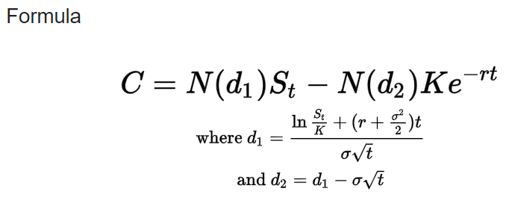
Pricing Method: Black-Scholes
17
Our product is like a European put option
Black-Scholes Formula is a formula for pricing stock options, including European Puts
Our variables aren’t one to one, we could not conclude on one final price from this method
C = call option price
N = CDF of the normal distribution
S_{t} = spot price
K =strike price
r = risk-free interest rate
t = time to maturity
σ = volatility
$2,518?
$416?
$4,673?

Slide 18

Pricing Method: Direct Simulation
18
30 random S&P 500 values
Simulate 30-year account
x50,000
Find unique guarantee / payment
Discount by 30 years
Premium
Notes:
Giant pool of S&P500 values from the last 100 years
Pick 30 random values
Run a policy through 30 years of those values, get a balance
Find the guarantee for that specific policy
Find the premium that pays the difference between balance & guarantee
Do this to get 50,000 unique policies
Order them all to get %iles

Slide 19
Pricing Method: Direct Simulation
19
Percentile
Premium
100%
$29,448
We ordered the payments from highest to lowest to calculate the premium at any percentile
99%
$6,707
95%
$4,166
90%
$3,145
85%
$2,490
50%
$0
Notes:
Giant pool of S&P500 values from the last 100 years
Pick 30 random values
Run a policy through 30 years of those values, get a balance
Find the guarantee for that specific policy
Find the premium that pays the difference between balance & guarantee
Do this to get 50,000 unique policies
Order them all to get %iles

Slide 20
Final Considerations
20
Diversification and hedging strategies are needed to have a more concrete pricing recommendation.
Researching these strategies would be a good follow up project.
This product is riskier since the law of large numbers does not apply, but this product is useful for insuring against sequence risk.
Notes:
Mention Diversification and Hedging and note that this is not something we had enough time for but would be good for another project in the future.

Slide 21
Thank You!
21
Notes:
A lump sum investment avoids sequence risk, but may not be financially practical
How can we mitigate the exposure to unfavorable sequences
Unpredictable growth factors means sequence risk

