Slide 1


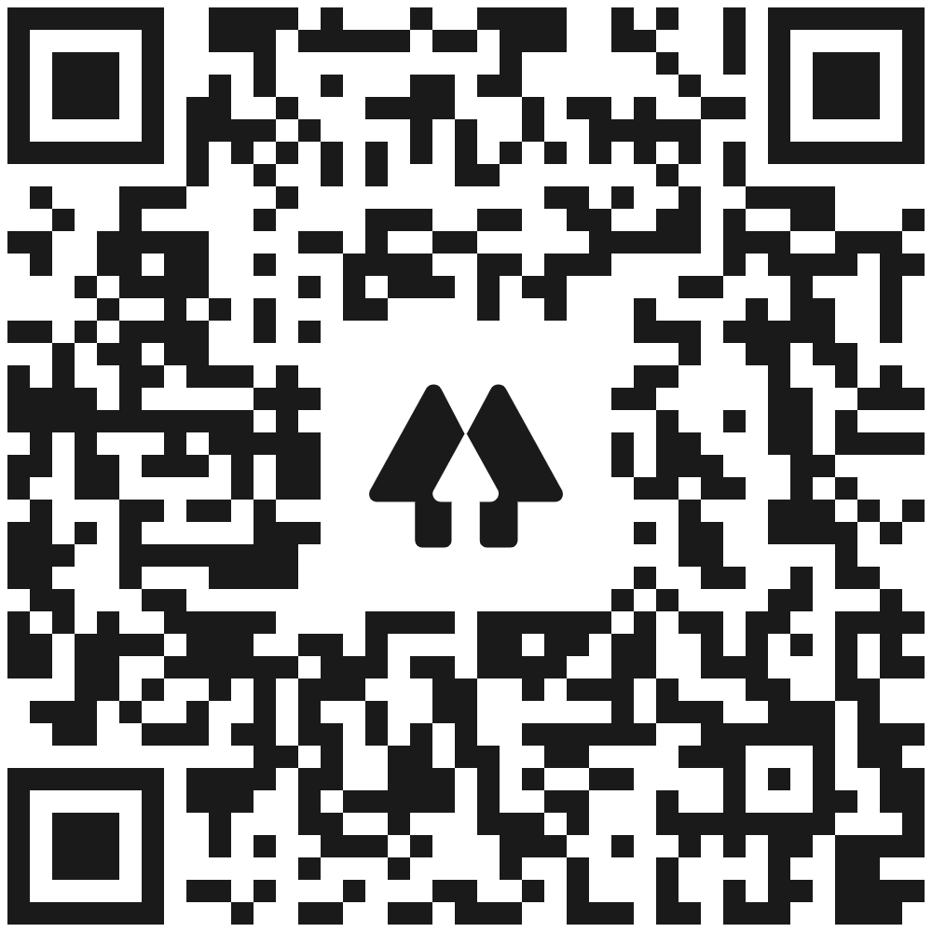
API Documentation for Users and Developers
Carley Gilmore (CS, PW)
Advisor: Professor Kevin Lewis
Qualitative Survey
Literature Review
21 developers were surveyed on their experiences with documentation and other resources for implementing technology.
Educational resources on documentation
Examples of API documentation
Best practices for SOPs
of developers use APIs
90%
”In theory, everything you need to know will be in one place…in practice, this isn’t always true.”
Well explained examples
Up-to-date, consistent, correct, and complete content
Well-organized, clear, and readable
Easy-to-follow project scope and abilities
Goal
To communicate best practices in API documentation, supported with research and a model documentation set of a Webhooks as a Service (WaaS) API platform created with 7Factor.
In a 2018 documentation study of 95 developers:
66%
rated sample code as very important
Deliverables
Using OxygenXML Editor and the DITA style guide, I created an initial user guide and SOP for the WaaS API.
Quantitative Survey
52 developers fully responded to the survey.
In a 2017 GitHub survey of 5,500 developers:
User Guide
Overview
Getting Started
Sample Code
SOP
Overview
Procedure
Supportive Media
46%
Rank Stack Overflow as a top resource, above API docs
Prefer forums because of more examples and tutorials
93%
reported incomplete or obsolete documentation
Sources
Geiger, Varoquaux, N., Mazel-Cabasse, C., & Holdgraf, C. (2018). The Types, Roles, and Practices of Documentation in Data Analytics Open Source Software Libraries: A Collaborative Ethnography of Documentation Work.
Inzunza, Sergio, Reyes Juárez-Ramírez, & Samantha Jiménez. (2018). “API Documentation: A Conceptual Evaluation Model.”
API User Guide and SOP Documents

