Slide 1
Nantucket’s path to solsmart status
Daniel Brower, Brendan Fainer, Grace Phillips, Alana Reid
Sponsor: Lauren Sinatra, Nantucket Energy Office
Notes:
Hello! My name is (etc.)… Our sponsor is Lauren Sinatra of the Nantucket Energy Office, and this is a presentation about Nantucket’s path to SolSmart status.

Slide 2
SolSmart is a national program that recognizes places that have demonstrated solar leadership.
BRONZE
SILVER
GOLD
PLATINUM
Image by SolSmart from Home | SolSmart under a CC0 (public domain) license
Notes:
SolSmart is a national program established by the US Department of Energy that recognizes municipalities with accessible pathways to installing solar panels on residential and commercial buildings. The program’s staff help interested communities adjust their solar installation process to conform to best practices and become solar leaders. Over 500 local governments have achieved SolSmart designation nationwide.
~click~
SolSmart designations come in four tiers, Bronze, Silver, Gold, and Platinum. No community has Platinum status yet and approximately 1/3 of the 500 designated communities have each of the other three.
~click~
With our help, the Town of Nantucket worked to achieve a Silver designation.

Slide 3
How To achieve a SolSmart Designation
1. Solar Statement
2. Zoning Review
Notes:
In general, a community’s process toward a SolSmart designation begins with them contacting representatives of SolSmart for a preliminary review of the community’s solar practices.
~click~
Then, the community submits a “Solar Statement” - a document that demonstrates their commitment to pursue SolSmart designation. (Nantucket’s Solar Statement was signed by town manager C. Elizabeth Gibson.)
~click~
Upon receiving this document, a SolSmart representative begins a “Zoning Review” - a review of the community’s bylaws to determine which of SolSmart’s criteria it has completed and which it could easily complete.

Slide 4
All Criteria
Award 0, 5, 10, or 20 points
Key:
Discretionary criteria
(all non-prerequisite criteria)
Platinum prerequisites
Gold prerequisites
Silver prerequisites
Bronze prerequisites
BRONZE
3 prerequisites
+
60 points
Discretionary Criteria
Prerequisite
Criteria
SILVER
Bronze status
+
4 prerequisites
+
100 points
Prerequisite criteria + sufficient points = SolSmart designation
Notes:
~click~
Criteria are specific tasks a community can complete in order to earn points. A certain number of points are required for any given designation tier. ~click~
Of all the criteria that exist, some criteria are prerequisites for certain tiers of designation, while the rest are discretionary criteria.
~click~
A community reaches a designation tier by completing all the prerequisite criteria for that tier and earning a certain number of points.
~click~
To obtain a Bronze designation, a community needs at least 60 points and 3 completed Bronze prerequisites. To obtain a Silver designation, not only must a community be eligible for Bronze status, but also it must have at least 100 points and 4 completed Silver prerequisites.

Slide 5
How To achieve a solsmart designation
3. Technical assistance
4. Designation
Notes:
After a community completes the zoning review baseline assessment and determines what criteria it has completed, it will work with its SolSmart representative toward completing additional criteria and verifying the criteria it completes.
~click~
Once it completes all the criteria for their desired tier, SolSmart awards the community a plaque and a designation! In the course of our project, we found that many municipalities applied for a SolSmart designation after significant effort toward solar installation stimulation.

Slide 6
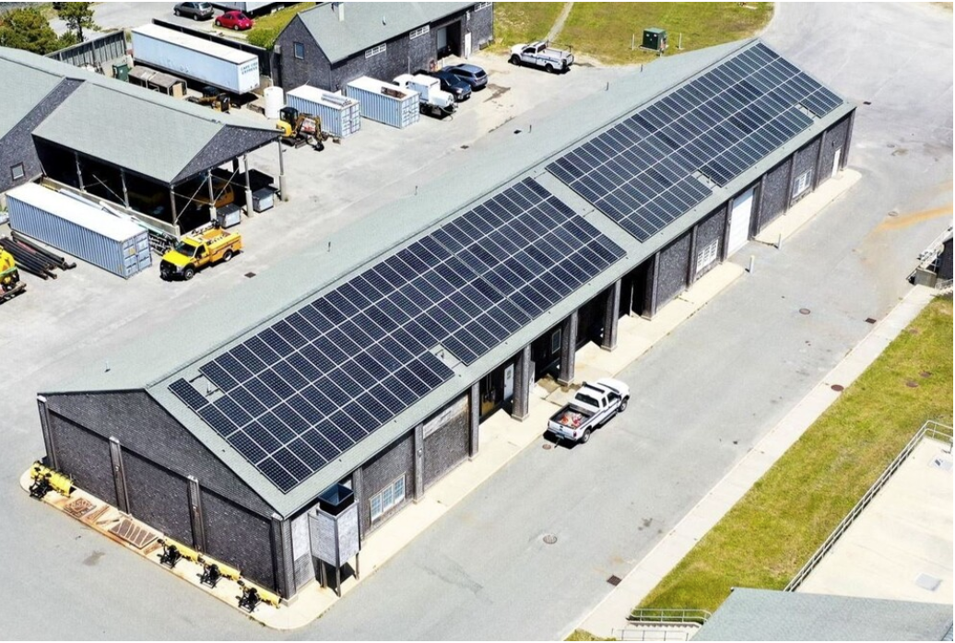
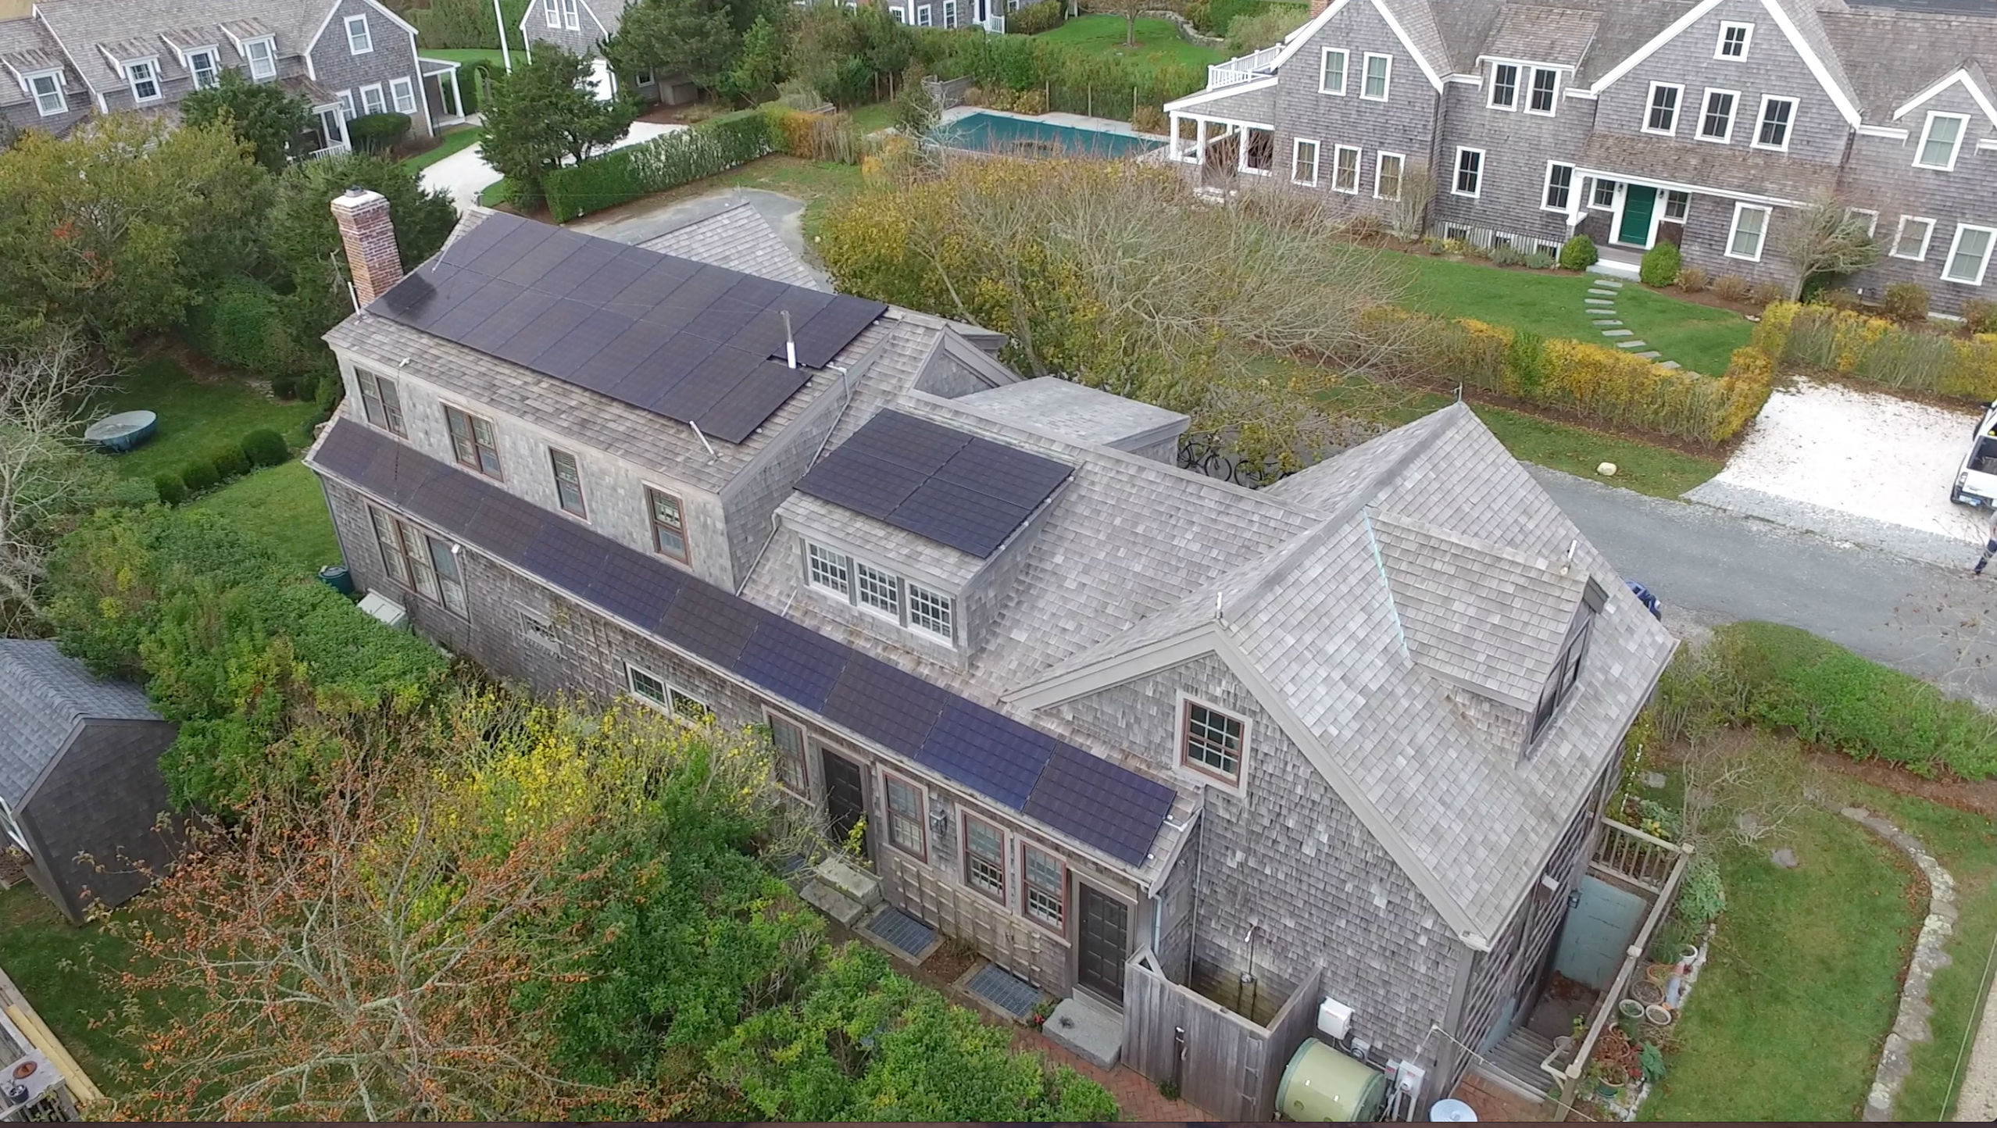
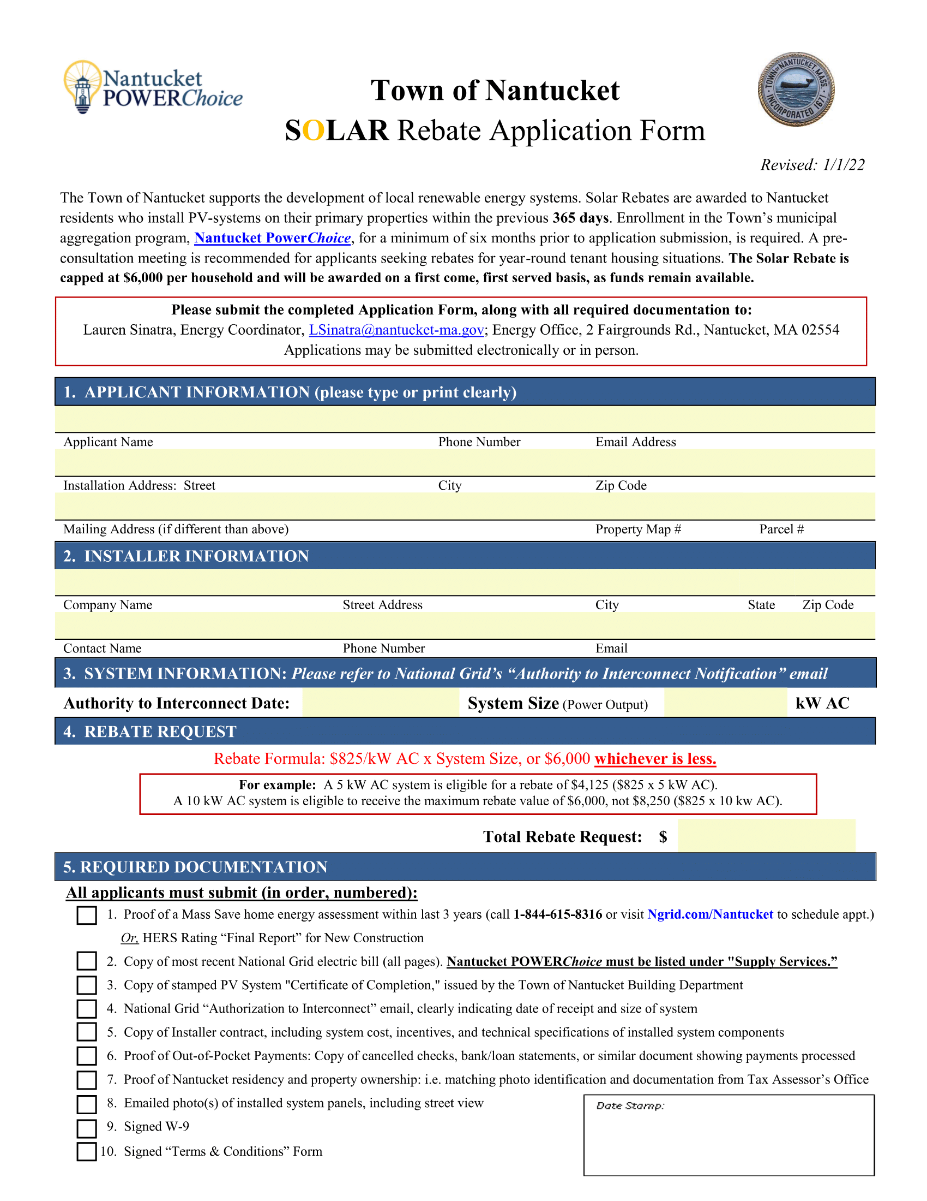
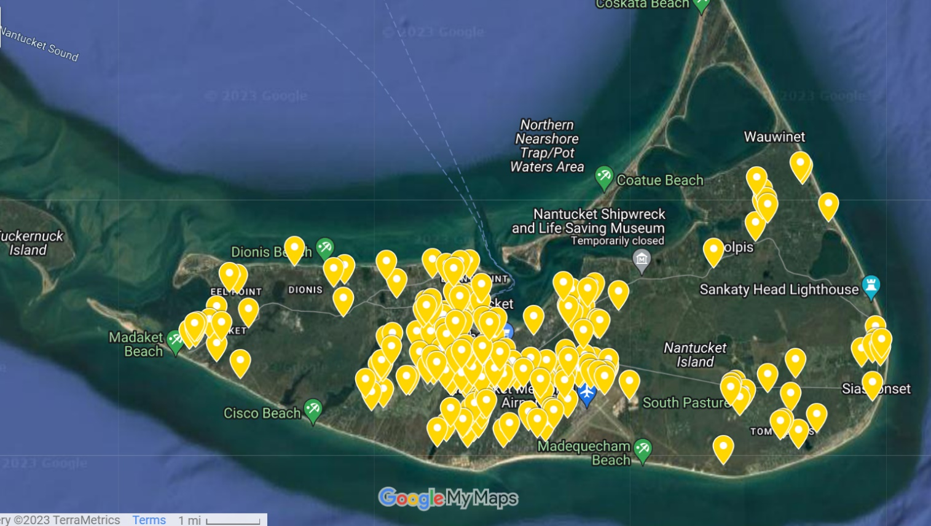
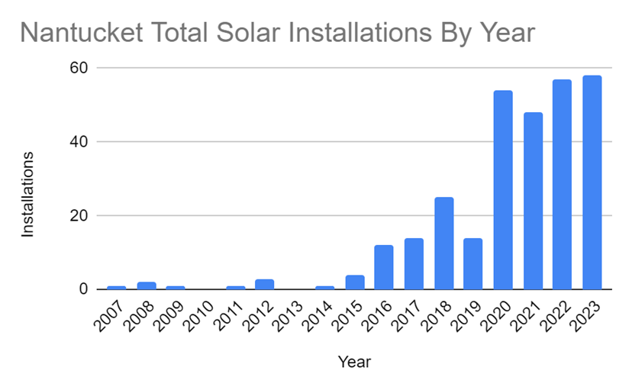
Nantucket is a Solar Leader
Image Credits:
Surfside: https://nantucket-ma.gov/DocumentCenter/View/45545/Town-Powers-Up-First-Municipal-Solar-Project-at-the-Surfside-Wastewater-Treatment-Plant-Press-Release-PDF; solar map: https://web.archive.org/web/20231208144413/https:/www.nantucket-ma.gov/1156/Solar-Map-Resources; Additional images provided by the Town of Nantucket Energy Office
Notes:
Fortunately, Nantucket is a solar leader. Even though it may seem like Nantucket’s status as a historic district and its protections around what can be constructed would prevent it from having a clear process to install solar panels, Nantucket has already implemented programs to facilitate solar development and completed numerous residential and commercial solar installations.
~click~
Depicted here are a few of the over 200 residential rooftop solar installations on the island.
~click~
The Historic District Commission, which oversees every publicly-visible construction on the island, wrote these Solar Guidelines in 2009 to clarify how to install solar panels without disrupting the historic character of the island.
~click~
And visible here are markers of every solar installation on Nantucket to date.
~click~
When a year-round resident of Nantucket installs solar on their residence, they can receive up to $6,000 in the form of a Local SOLAR Rebate (funded by an energy aggregation program called Nantucket PowerChoice). Since 2017, the Local Solar Rebate has given over $500,000 back to the community, with qualifying installations producing over a megawatt of power.
~click~
Nantucket has also completed a large commercial solar installation at Surfside Wastewater Treatment Plant in the summer of 2023. The installation consists of 232 solar panels, producing over 100 kilowatts of power, and it is expected to offset over 100 metric tons of greenhouse gas emissions per year.
~~click~~
Seen here is a graph we compiled of all solar installations on Nantucket since 2014.
~click~
As we can see, there is a clear upward trend over time.
All this admirable work that the Town of Nantucket has done put it in a prime position to obtain SolSmart Silver designation, so long as it could complete the prerequisite criteria for Bronze and Silver. Our team’s [task] was to help Nantucket achieve SolSmart Silver designation.

Slide 7
Objectives
Determine Silver Requirements
Develop and Execute Plan
Identify Potential Improvements
Update and Enhance Web Resources
Recommend Path to Gold Status
Notes:
As we approached this project, we developed 5 objectives:
~click~ Determine the requirements for SolSmart Silver status that the Town of Nantucket needs to complete.
~click~
Develop and execute a plan to fulfill the requirements for Silver.
~click~
Review and document the Town of Nantucket's permitting process for solar installations and identify ways it can be streamlined.
~click~
Update and enhance the Town of Nantucket's publicly accessible information related to solar panels and permitting by creating and revising online resources.
~click~
Recommend a path for Nantucket to achieve SolSmart Gold status in the future.

Slide 8
Results
Notes:
In completing our objectives, we [helped] the Town of Nantucket improve its solar installation process further, work toward obtaining a SolSmart Silver designation, and solidify its status as a solar leader.

Slide 9
SolSmart Points as of 12/12
50
165
215 of the 100 points required for SolSmart Silver status
Silver prerequisites
Solar Landing Page
9
Notes:
As of Today, We have 165 points approved by our technical assistant, and attempting to get an additional 50 points verified.
the Solar landing page prerequisite still needs to be completed. once these criteria are verified by the TA, Nantucket should have 215 completed points and be eligible for silver status

Slide 10
Solar Landing Page
Updated FAQs
Permitting Checklist
Bar Graphs
Updated Solar Map

Slide 11
Updated FAQs
More Questions
Updated Answers
Notes:
Daniel:
Some parts of the new ‘solar landing page’ were already online, including an old list of questions frequently asked to the energy department.
~click~
The old FAQs were difficult to locate and didn’t link to other resources and pages, which meant they could go out of date quickly if this page was not regularly updated. Additionally, they were not categorized by the types of questions included.
~click~
When we updated the FAQs, we added more questions, rewrote answers, and sorted the questions by category based on input from solar installers and permitting staff. Additionally, the new FAQs we developed are linked to other relevant resources. This featured section shows one of the new categories, Historic District Commission guidelines, where you can see that the Historic District Commission’s solar guidelines are linked as part of the answer to this top question.

Slide 12
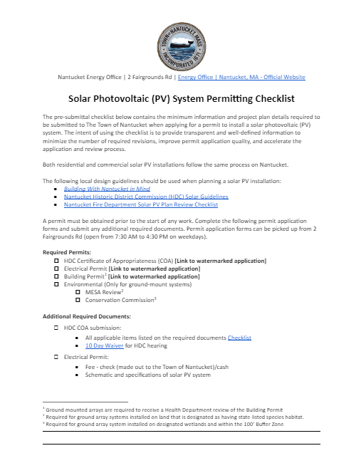
Permitting Checklist
Permitting Checklist shows:
Required Permits
Permit Fees
And more!

Slide 13
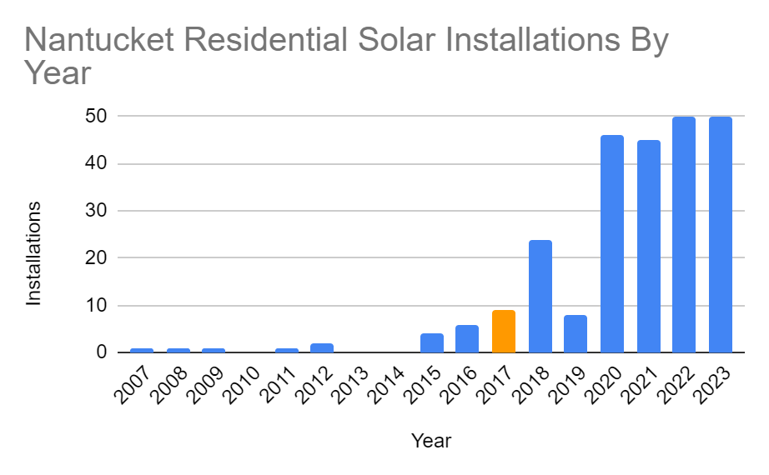
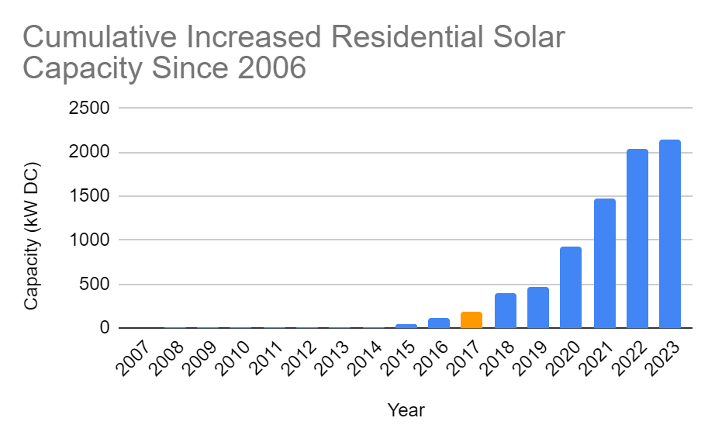
Residential Solar Installations
Cumulative Increase in Residential Kilowatt Capacity
Residential Installations
*
*
* The Local Solar Rebate Began in 2017
Notes:
Daniel:
Here, we have 2 bar graphs created from data on Nantucket’s solar installations.
On the left, we see the total number on residential installations on Nantucket, totaling over 200.
On the right, we can see the cumulative increase in the capacity of these residential installations, which now total over 2 megawatts.
In 2017, the local SOLAR Rebate Program was started, reimbursing up to $6000 to residential installers.
(SOLAR stands for Stimulating Ownership & Local Adoption of Renewables)

Slide 14
Solar Map
Image from updated Google My Map: https://www.google.com/maps/d/viewer?mid=1QPC0CkD1Mr7IVLUhXSssCZF-OnEzyBw&ll=41.301546720132116%2C-70.09520194520087&z=12
Notes:
The purpose of the Solar Map is to show prospective consumers that solar is common on the island (reword)
This is the first time the map has been updated since 2017
We are developing an app that will allow town staff to update the map automatically by inputting the most up-to-date permit data

Slide 15
RECOMMENDATIONs & Conclusion

Slide 16
Achieve Silver Status
Most of the work is complete
Nantucket has earned 165 of the 100 required points for Silver status
Prerequisites:
☑ Staff Training
☑ Zoning Determination letter
☐ Solar Landing Page
SILVER
January 2024
Notes:
Instead of saying at least on the slide, say has earned this amount so far and note this number will grow
(Updated Page coming soon) - say this rather than write it

Slide 17
Complete Gold Prerequisites
With completion of Silver,
215/200 Gold point requirement
Gold prerequisites:
Codify solar by right use
Zoning Barrier Removal
3-day Permit turnaround time
GOLD
TBD
Notes:
1. Good for the town to further enhance the solar permitting/installation process

Slide 18
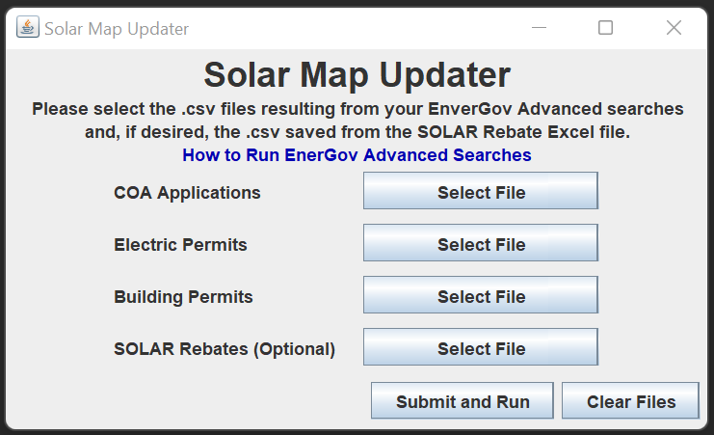
Maintain Solar Landing Page
Quarterly update the Solar Map
Creating instructions for sponsor
Update other resources:
Permitting Checklist
FAQs

Slide 19
Amendments to permitting Process
Digitize the permitting process
Develop "solar-only“ permits:
The Historic District Commission’s Certificate of Appropriateness
Building
Notes:
1.To enhance and streamline the solar permitting process even further,
Digitize the process, Nantucket has some of the permits online, staff is not rather just take current solar required permits and modify them to only include the relevant information for solar.
Go to example of COA next slide

Slide 20
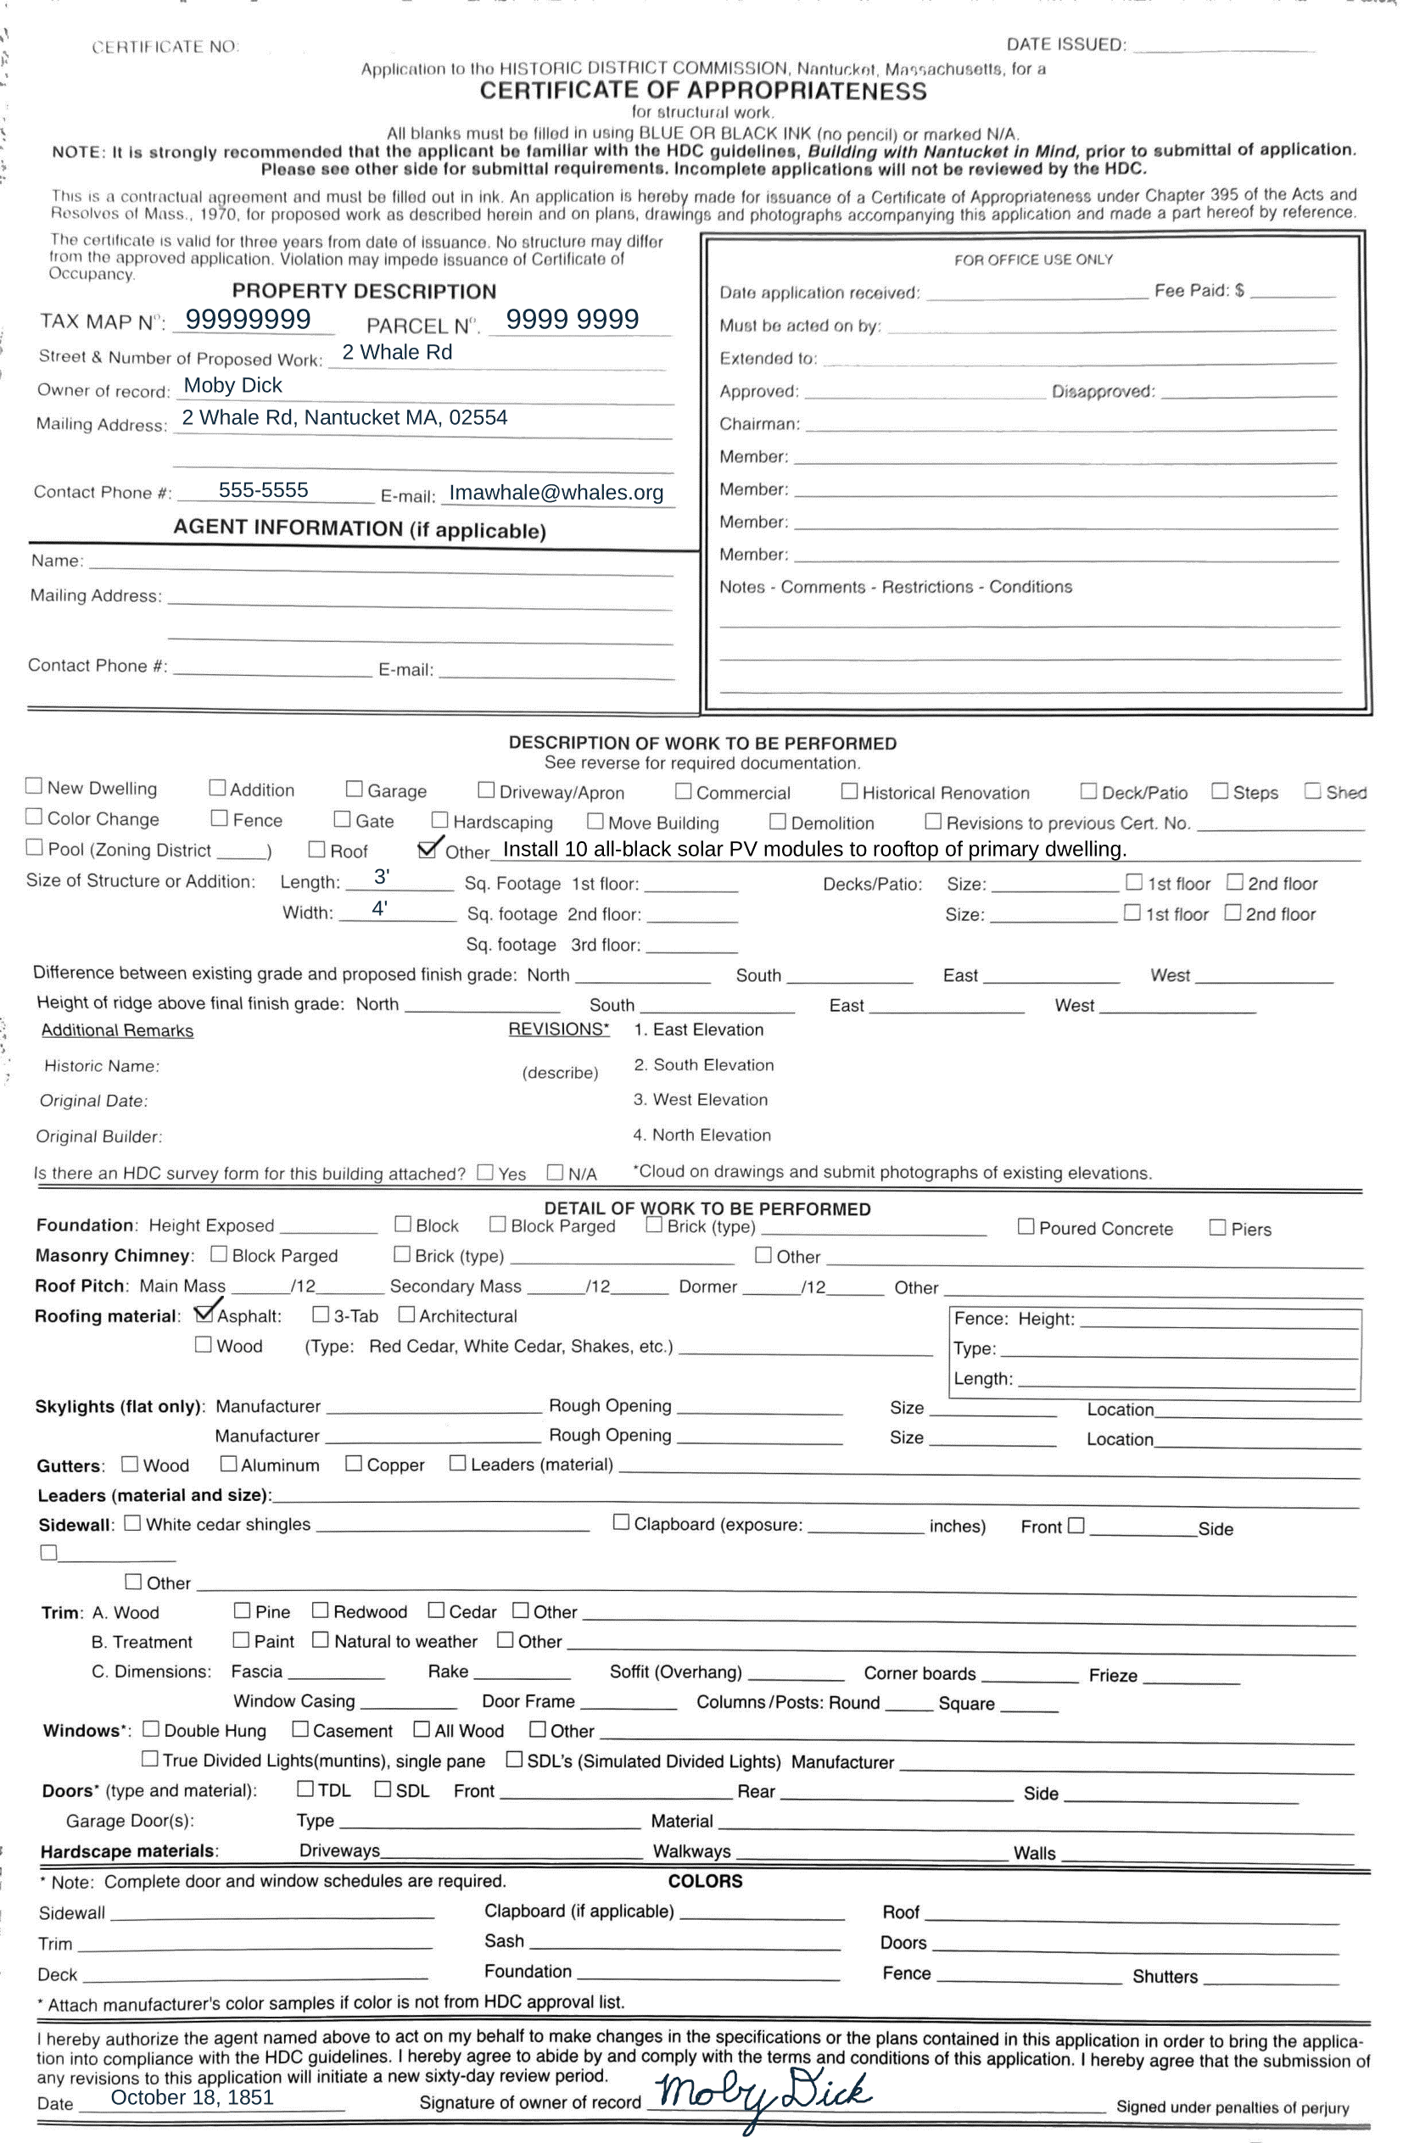
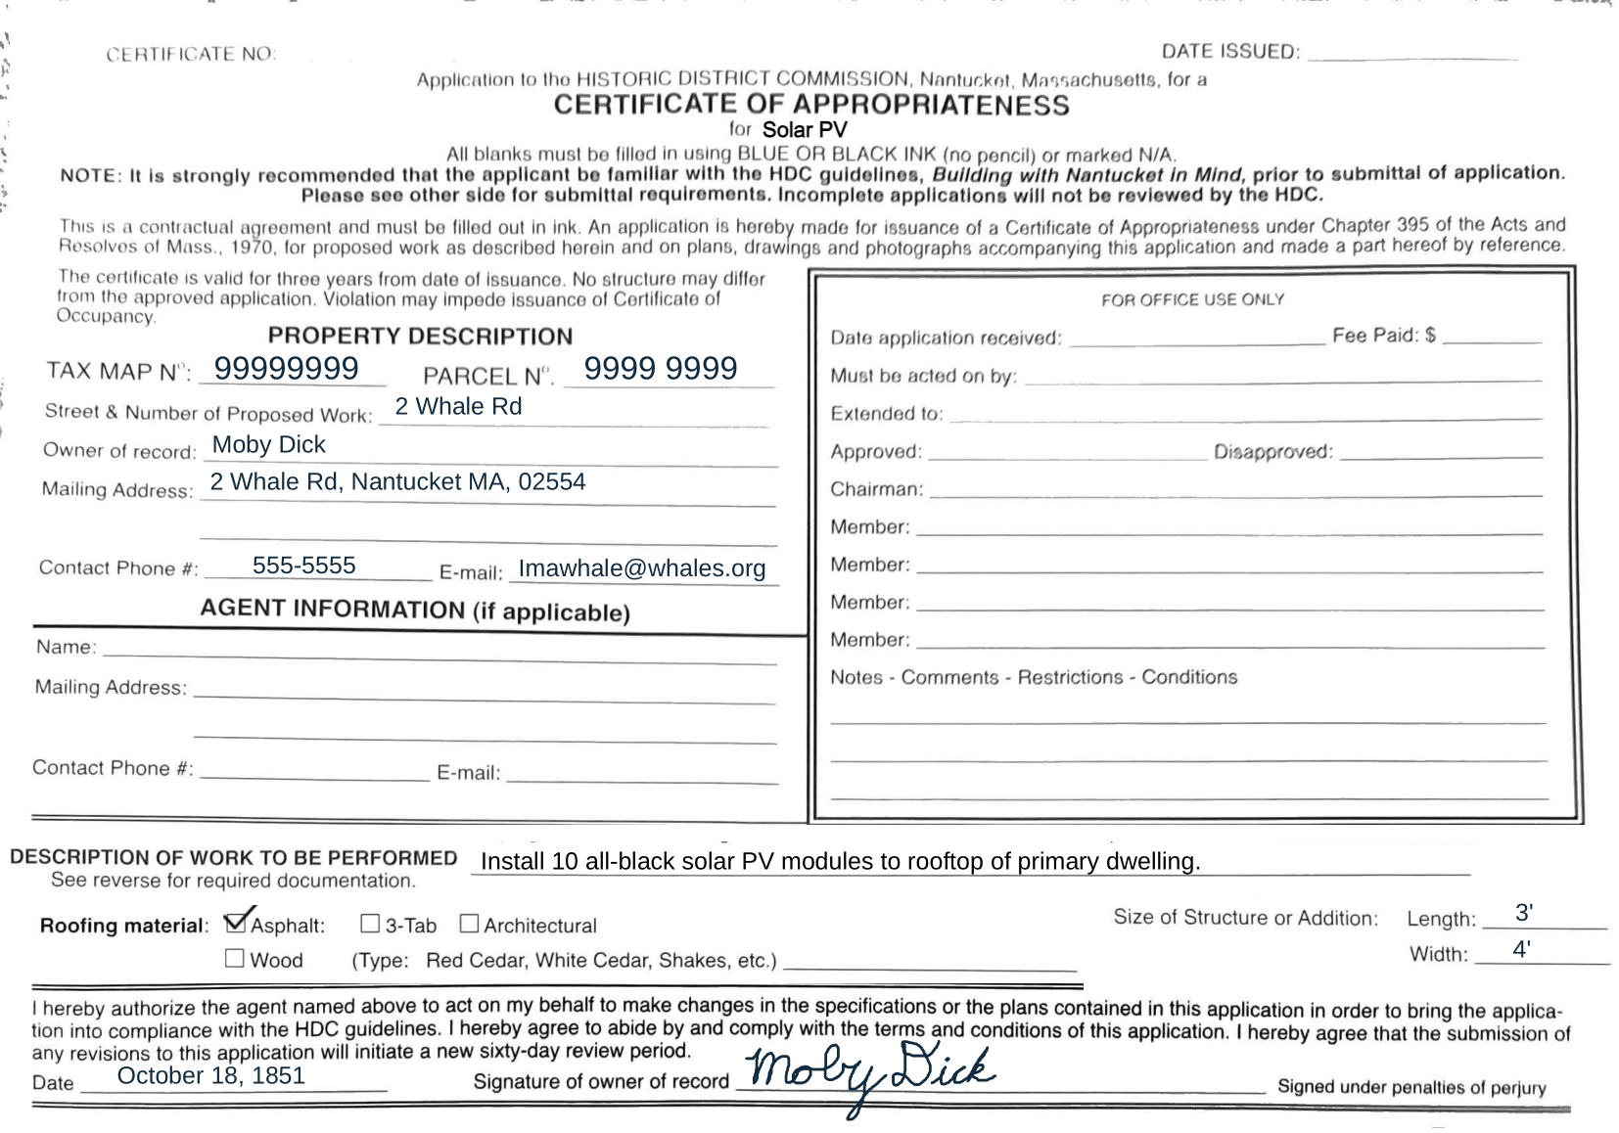

Slide 21
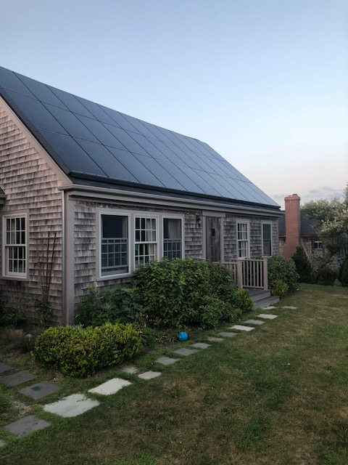
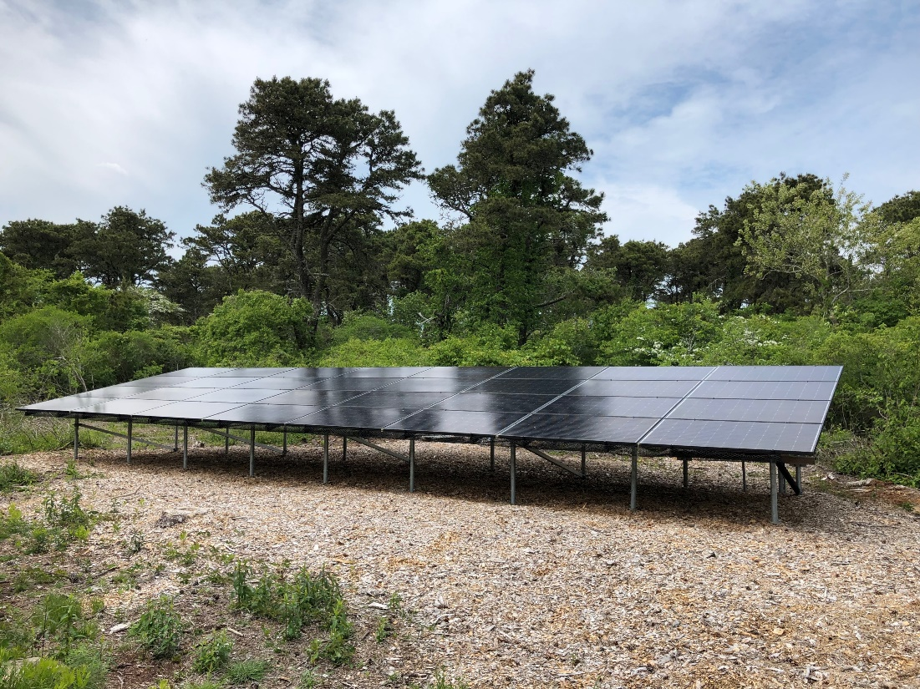
Nantucket is a solar leader
Images provided by the
Nantucket Energy Office
Notes:
We want to bring it back to this idea that Nantucket is a solar leader. The island has 207 residential solar installations and that number continues to grow. The energy office is constantly identifying ways to improve the solar permitting and installation process and earning SolSmart designation helps to promote and recognize their work.

Slide 22
Acknowledgements
Project Advisors, Dr. Fred Looft & Dr. Susan Jarvis
Sponsor, Lauren Sinatra
Town of Nantucket Staff
Local solar installers
SolSmart community interviewees
Nantucket Yacht Club
Young’s Bicycle Shop
Notes:
We would like to thank our advisors, Dr. Fred Looft and Dr. Susan Jarvis, for their expert guidance throughout the entire project. Their revision suggestions greatly improved the quality of our report.
We would like to thank our sponsor Lauren Sinatra for her leadership and her contributions to our deliverables. Her years of exemplary work facilitating solar development on Nantucket were a key factor in our project’s success.
We would like to thank the Town of Nantucket staff, including but not limited to Holly Backus, Molly Sprouse, George Hull, John Hedden, Florencia Rullo, and Nathan Porter, for their patience with our questions and for making us feel welcome.
We would like to thank the staff at local solar installation companies for helping us understand the permitting process.
We would like to thank our interviewees from Pepperell, Natick, Lowel, and Melrose for taking the time out of their day to participate in our interviews.
We would like to thank the Nantucket Yacht Club and its staff for providing us with clean, warm, and pleasant living arrangements during our stay on Nantucket.
We would like to thank Young’s Bicycle Shop for providing the bikes we rode to our workspace every day.

Slide 23
Thank you! Questions?

