Slide 1
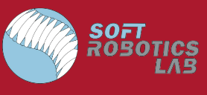
CLARA: Continuum Locomotive Alternative for Robotic Adaptive-exploration 2023
Presented by:
Derik Pignone (He/They) (RBE)
Blaise Schroeder (They/He) (RBE)
Advised by:
Prof. Çağdaş Önal

Slide 2
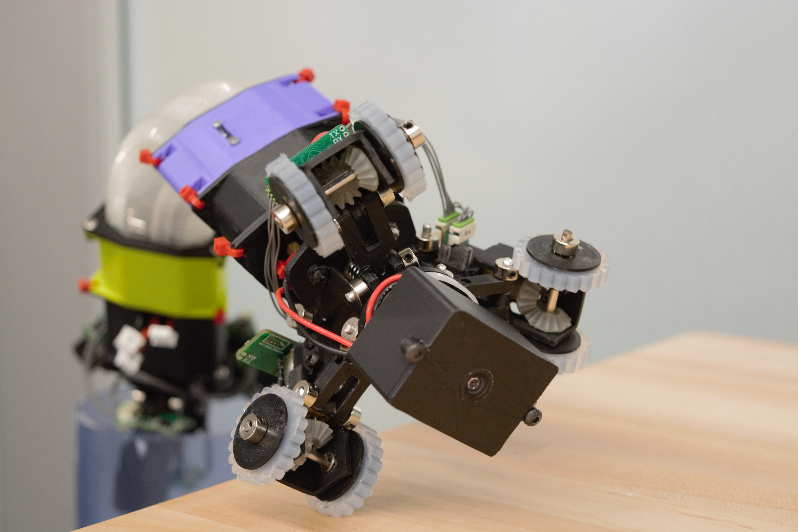
Presentation Outline
Background & Motivation
Objectives
Mechanical Changes
Electrical Changes
Sensors / Control Changes
Results and Conclusion
Acknowledgements
Notes:
Bwaise

Slide 3
Background and Motivation

Slide 4
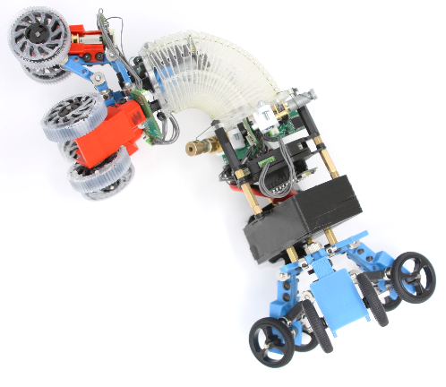
Background
Previous iteration served as POC
Scaled down version of Salamanderbot / OriSnake
Functional, but fragile
One side with active suspension/locomotion
Notes:
Bwaise

Slide 5
Motivation
Decrease frequency of repair and component replacement
Provide a strong platform for future work
Strong Physical Build -> Controls work
Move towards modularity
Addition of sensors
Notes:
Bwaise

Slide 6
Objectives

Slide 7
Project Objectives
Goal: To improve upon the work of the previous CLARA MQP group and further develop the robot as a platform for pipe network exploration.
Revisions/Improvements
Improved Casing Structure
Redesigned and relocated Flexure Winch
Explored Wheel Types
Changes to Wheel Linkage
Expansions & Addition​s
Camera/Live Feed
Dual Motorized Segments
Power Switch

Slide 8
Mechanical Updates

Slide 9
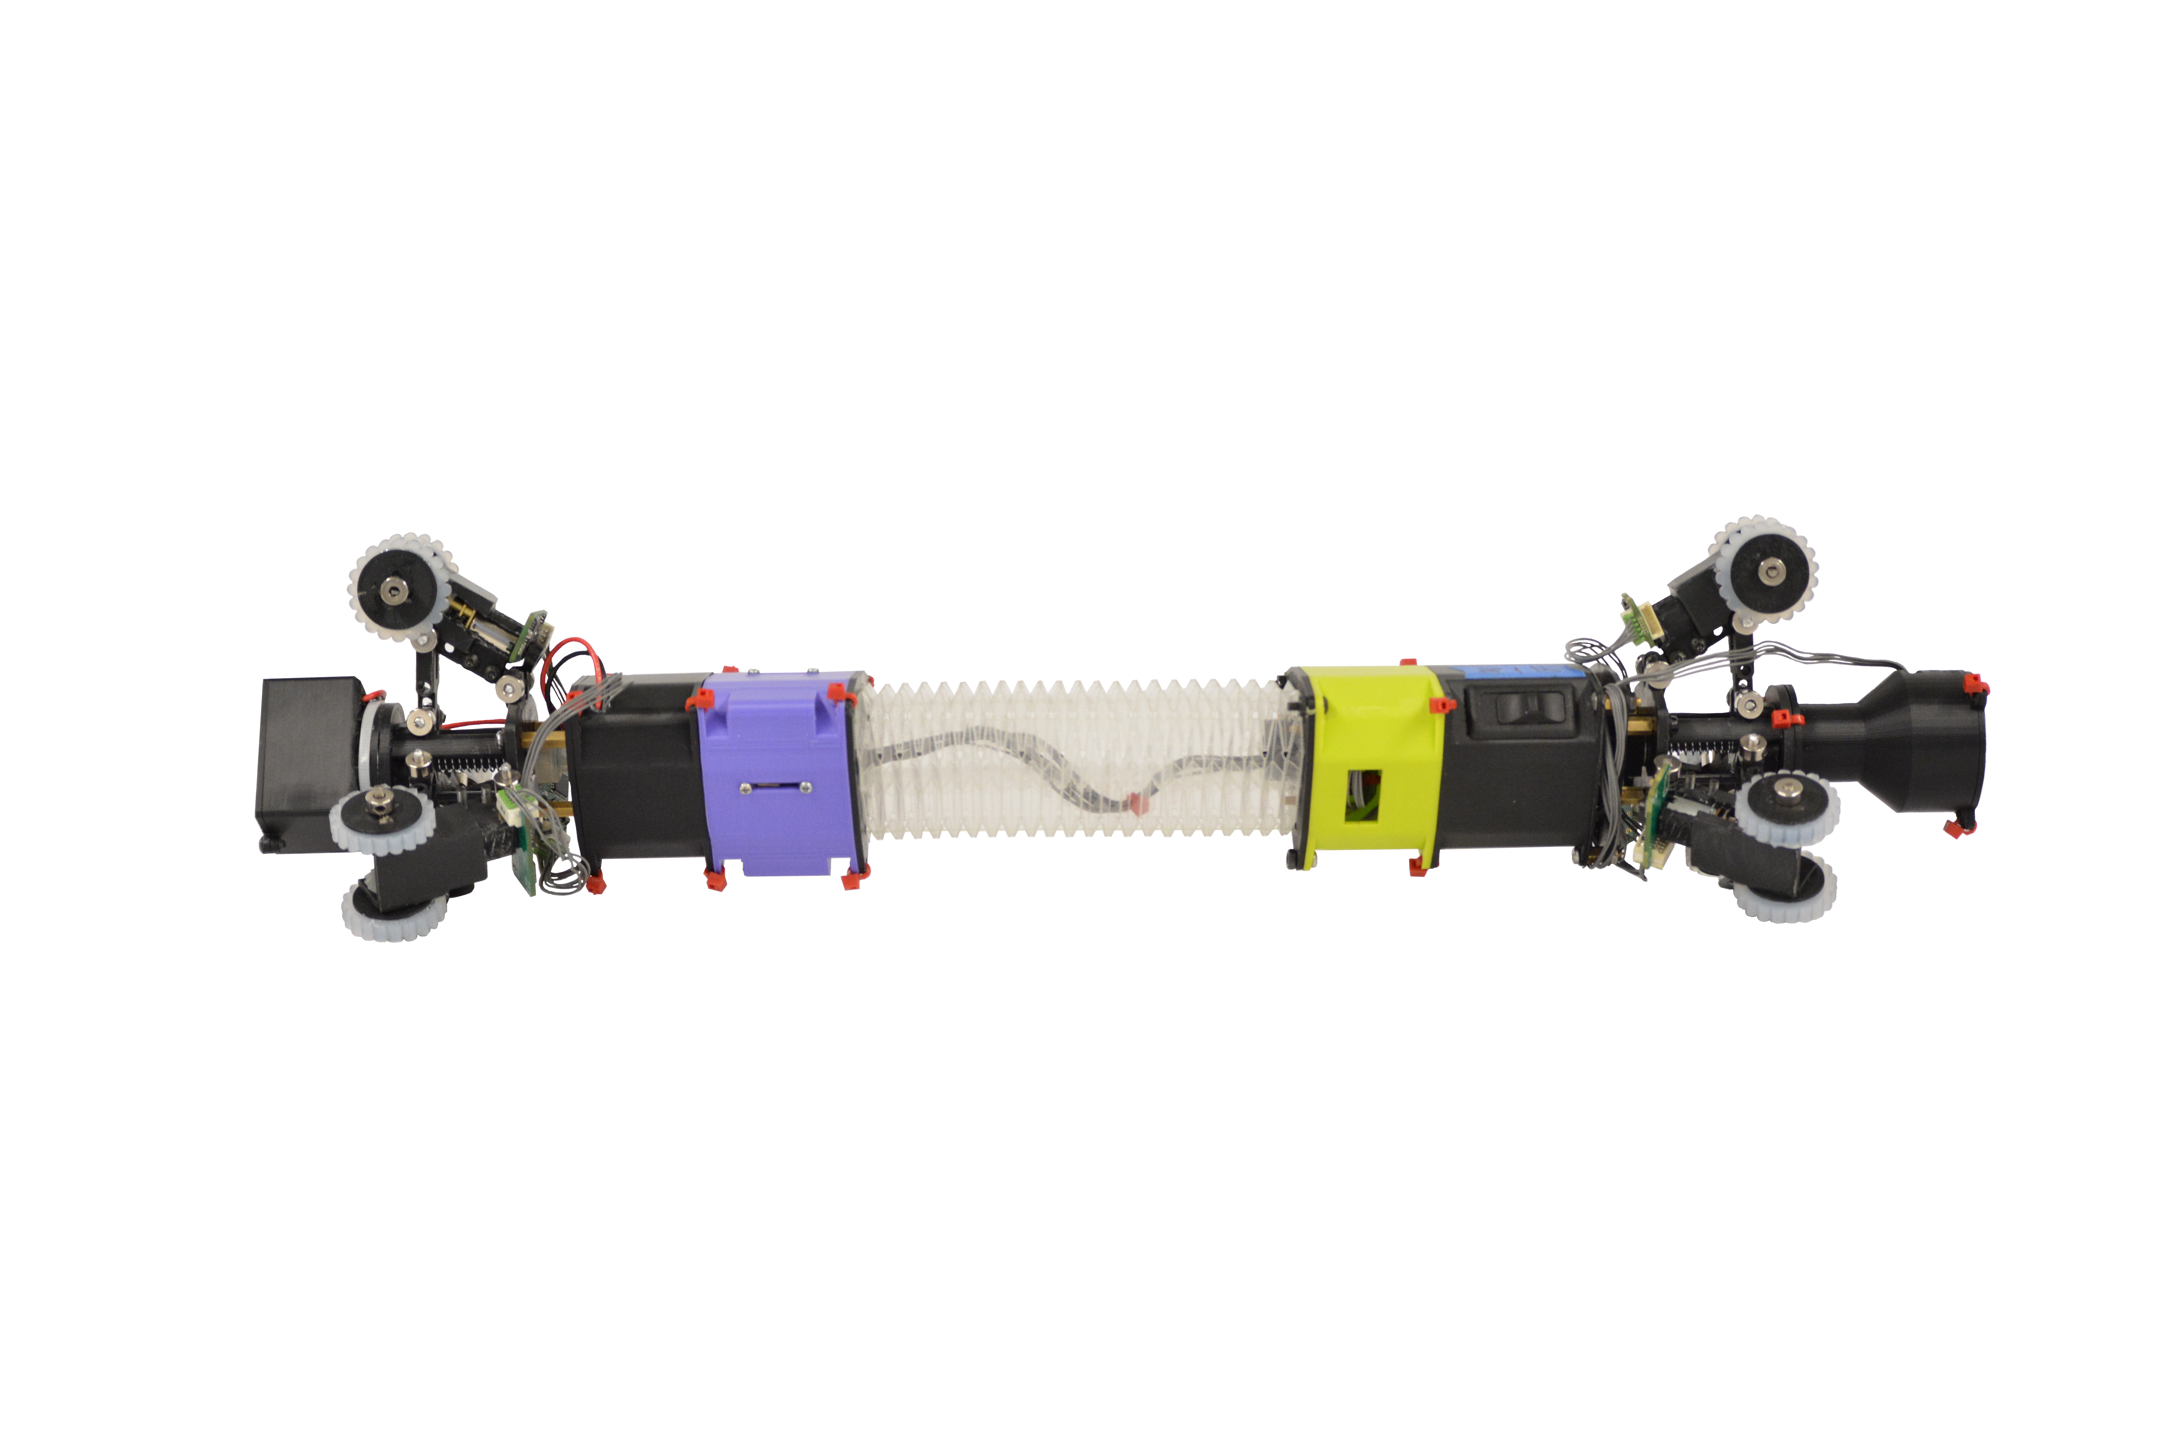
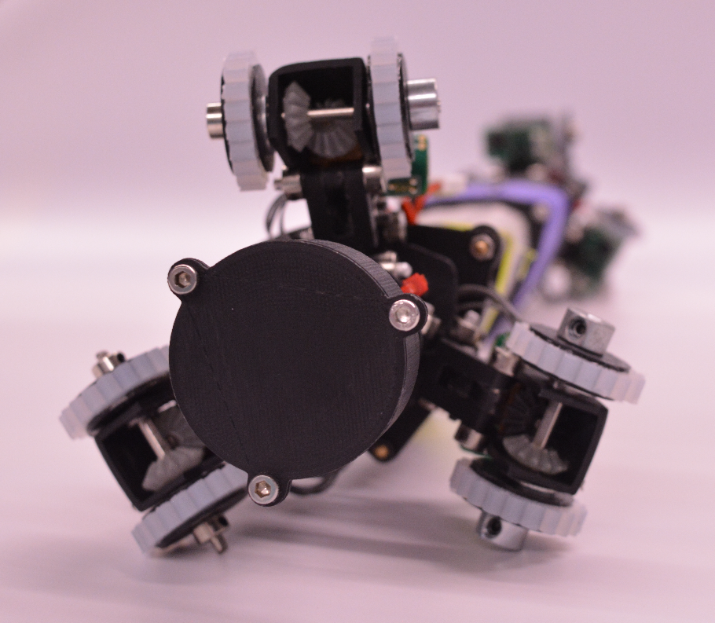
Casing / Body Profile Improvements
Key Benefits:
Consistent Slimmer profile
Improved appearance
Fewer exposed wires / boards
Increased bending angle
Better protection
Notes:
One of the largest and definitely the most noticeable mechanical change we made was to improve the casing.
This new casing helps to provide protection to essential robot components like the main microcontroller, wires, motors, etc, which previously stuck out from the core of the robot at awkward angles and distances.
This presented the potential for issues interfering with its environment, and potentially sustaining damage.
The new casing not only protects the components, but maintains a constant profile of the robot, barring the motorized ends. This not only improves bending angle, and offers consistency, but it also offers a new sleeker appearance.

Slide 10
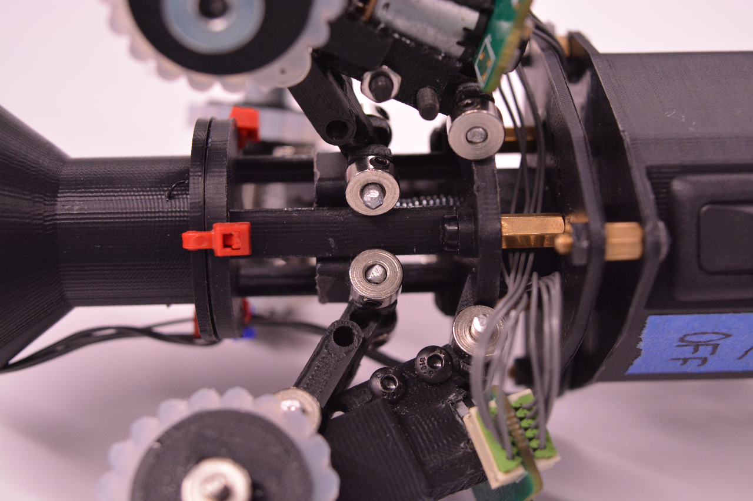
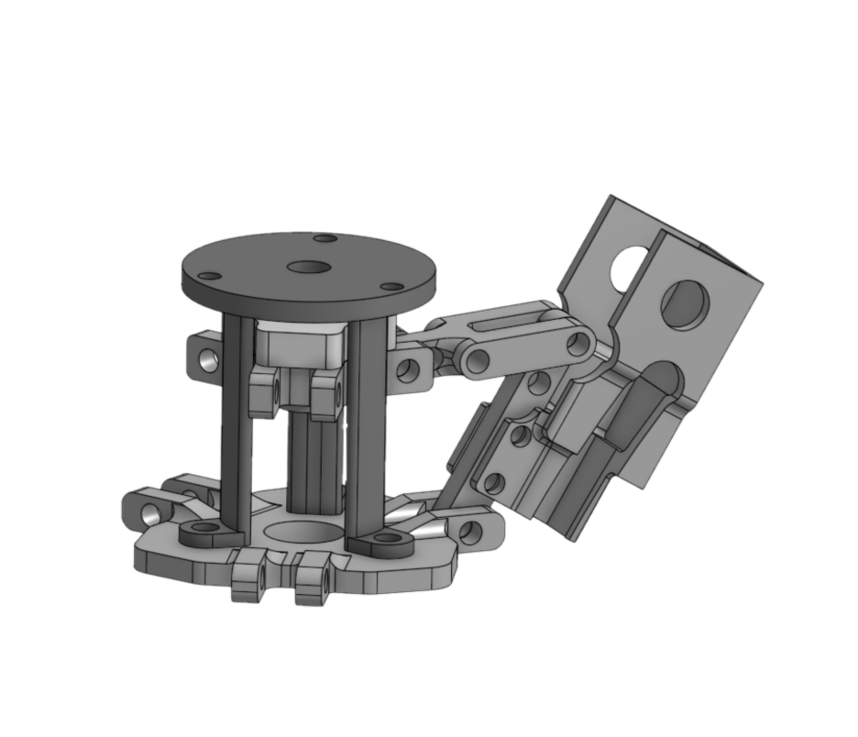
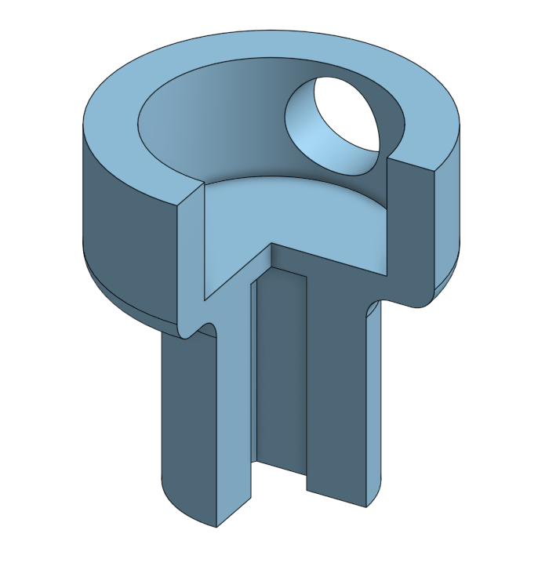
Wheel Linkage Changes
Passive Suspension with Compression Spring
Actively limited
Shroud to contain lead screw
Better motor – lead screw adapter
Notes:
The next major mechanical change was an improvement upon the wheel expansion / contraction linkage. The prior iteration of this module was actively driven to expand and contract.
To improve upon this, we modified this module to still be actively expanded and contracted, but to allow the wheels to always be passively compressed down to their minimum diameter.
The advantage of this is that the wheels can be retracted to fit into a pipe, then extended, and there will be constant pressure on the inner surface of the pipe. In addition, any unexpected changes in pipe diameter should not impede the motion of the robot.
Some other minor changes were made to improve the performance of this module, such as an added shroud to help stabilize the lead screw and provide a mount point for additional modules, and an improved adapter to translate rotational force from the motor to the lead screw to prevent slipping seen in prior models.

Slide 11
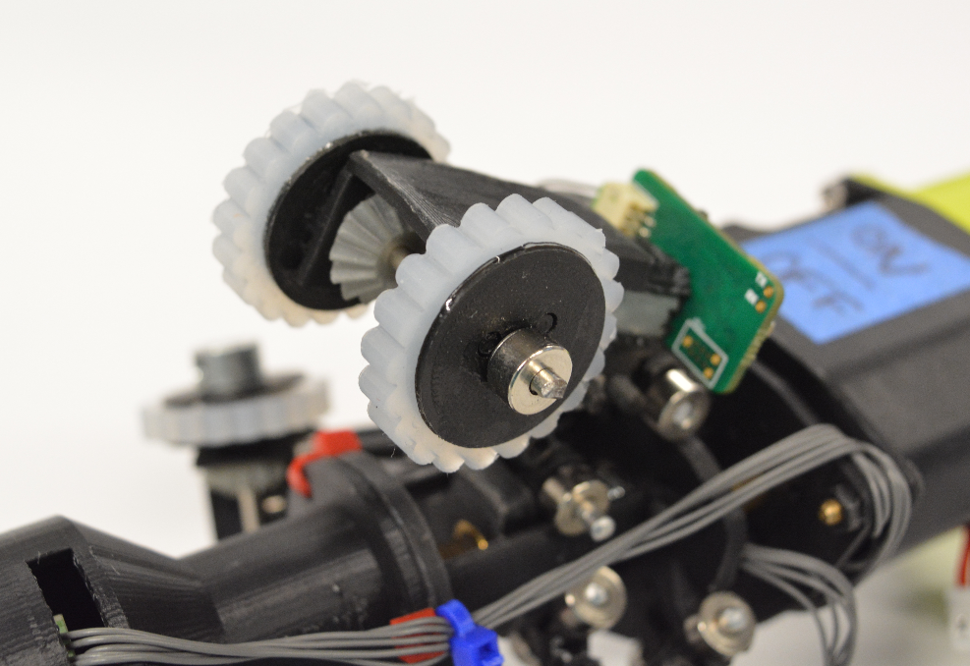
Silicone Wheels + Motorized End Duplication
Motorized End Duplication
Improved traction
Maintains control through junctions / gaps
Silicone Wheels
Cheap
Deformation
Grip
Notes:
In addition to the changes made to the linkage itself, the whole module was duplicated and placed on the rear of the robot as well.
In previous iterations, the robot had only a single driven end, and a passive follower which simply idled.
By duplicating this module and attaching it to the rear, we can improve traction and force applied.
Additionally, this helps to bridge any potential gaps in a pipe at a junction or otherwise where the previous iteration would have struggled.
More specifically, if one end of the robot loses contact with the pipe due to a junction, the other end should still be in contact, and allow the robot to maneuver the junction.
Additionally, custom silicone wheels were made from 3D printed PLA hubs and retention plates, and molded 'tires' made of Dragon-Skin silicone with a shore hardness of 30.
These wheels are cheap, allow for wheel deformation, and provide adequate grip to the inside surface of pipes for the robot to move and not slip, even when completely vertical.

Slide 12
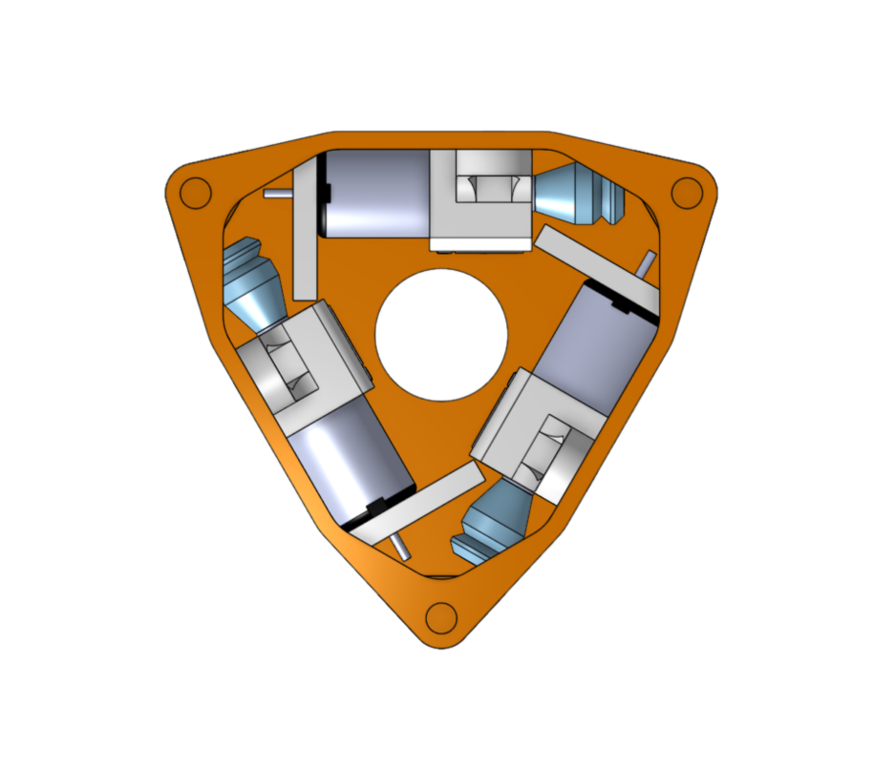
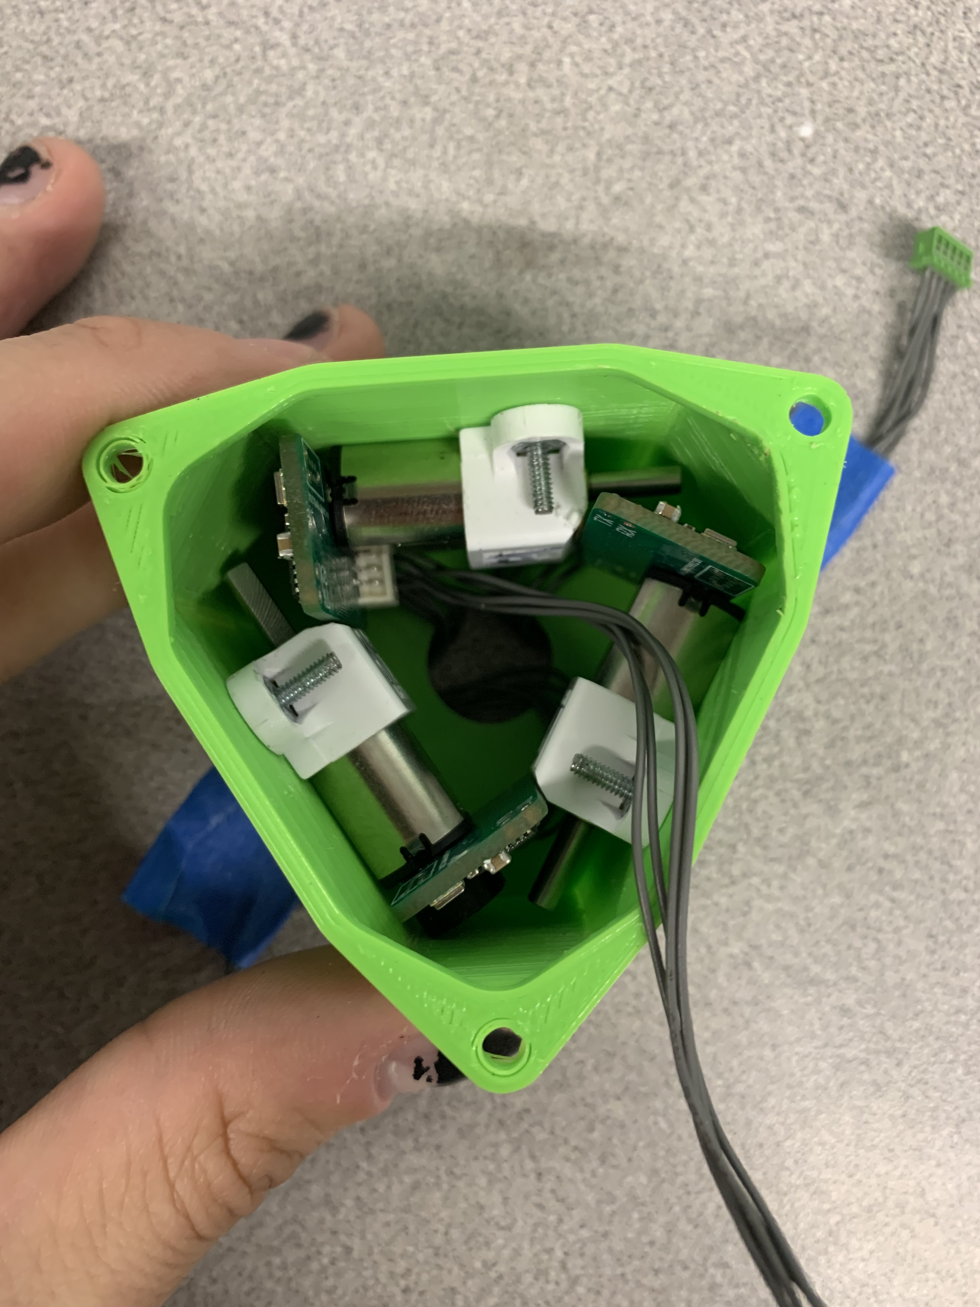
Winch Module Redesign
Reorientation to fit within profile
Smaller winch drum design
Better alignment with origami 'channels'
Reduced wear on cables / origami
Notes:
The final major mechanical change was the redesign of the winch module.
First, the motors were reoriented to fit within the newly established body profile.
Secondly, new winch drums were designed and printed from Tough 1500 resin to reduce size.
Both the reorientation and the new winch drums served another purpose, which was to better align with the channels in the origami module.
Previously, upon exiting the origami module, the winch cables took a sharp turn to get to the drums. This caused the cables to rub on the acrylic origami, creating friction and wear on the material that eventually broke it.
This new winch module design lines the cables up with the holes so that this wear is effectively eliminated.

Slide 13
Electrical Updates

Slide 14
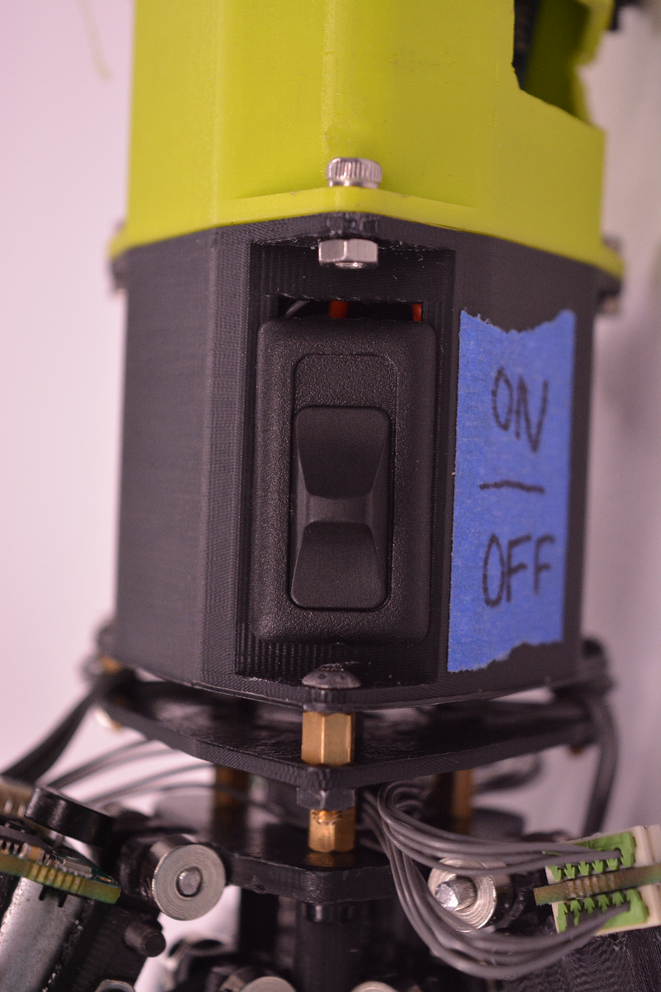
Power Changes
From 1x 7.4V 1000mAh battery to 3x 7.4V 250mAh batteries
Main breaker implementation to allow robot shutdown
Reorientation of 12V regulator on Main Board
Implementation of 5V regulator in parallel with main board to power camera
Notes:
The largest electrical change we made was to replace the single 7.4V 1000mAh battery with 3 smaller batteries of the same voltage.
This, again, was a change made to fit into the new body profile, as the previous iteration's battery was the widest part of the body and was quite awkward for maneuvering.
These batteries were wired in parallel to maintain the same 7.4V output, but achieve desired maximum current output.
Some other more minor electrical changed were implemented as well, including the addition of a main breaker, previously nonexistent. This, of course, allows the robot to be turned on and off without having to unplug the batteries, meaning that the batteries can be neatly tucked away and protected.

Slide 15
Wiring Diagram
Notes:
Derik

Slide 16
Software / Control Updates
Notes:
Big D

Slide 17
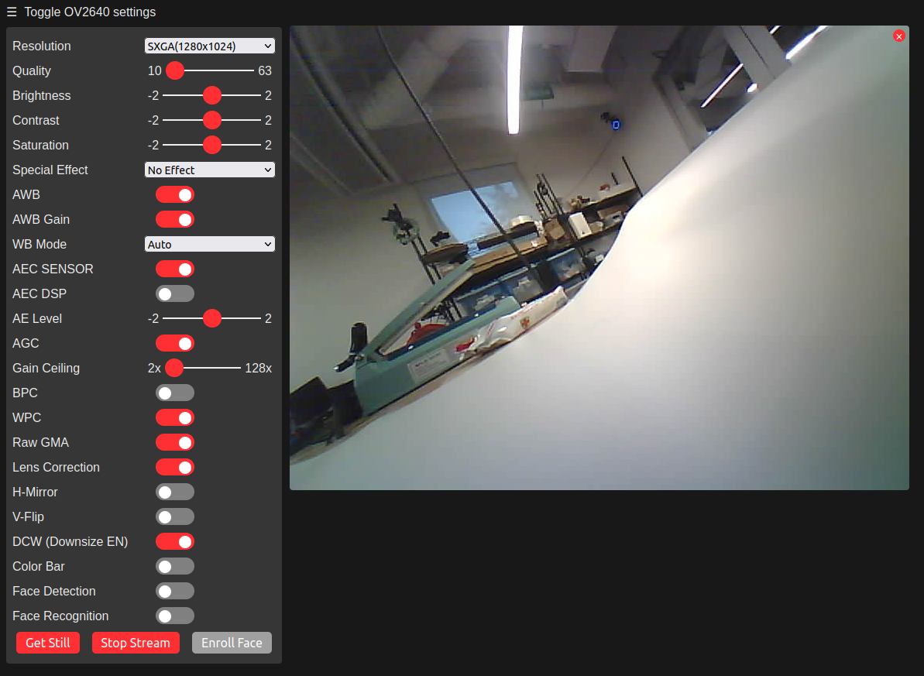
Camera Implementation
ESP32-Cam for live video feed
Streaming via Wi-Fi Web Server
Allows for usage for inspection
Notes:
One of the largest changes we made to the functionality of the robot was the implementation of a camera.
Previously, this robot had no sensors, meaning that its intended use in the exploration and inspection of pipe networks was essentially impossible.
Therefore, we implemented an ESP32-Cam module which provides a live video feed to the operator of the robot.
This means that the operator is able to see in front of the robot, inspecting pipes for damage, as well as helping navigate.

Slide 18
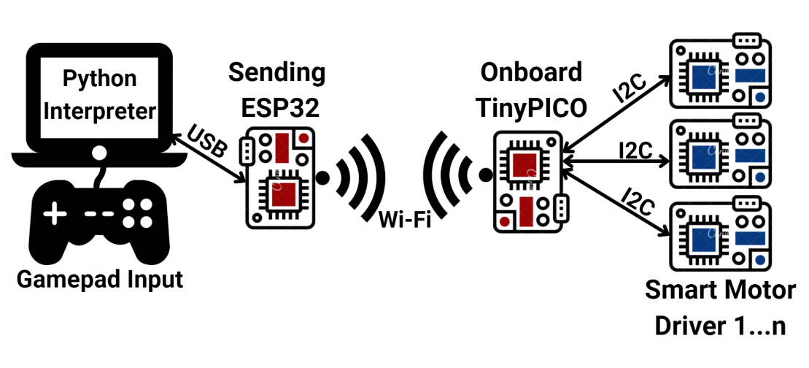
Updated Control Architecture
Wi-Fi
ESP32-Cam
CLARA: Continuum Locomotive Alternative for Robotic Adaptive-exploration (Katz & Wheeler, 2022) [1]
Notes:
This is the control architecture diagram created by the previous MQP team, adapted to include the newly implemented camera module.
The ESP32-Cam module is completely separate from the TinyPICO, as the TinyPICO is not powerful enough to transmit video.
Therefore, the ESP-32 cam acts as a wifi station which the operator laptop is connected to, and the live video feed is displayed in a browser.

Slide 19
Control Scheme Updates
Button | Command Code | Effect
Right Bumper | 8 | Drive Forwards
Left Bumper | 9 | Drive Backwards
D-Pad LEFT | 24 | Contract Cable 1
D-Pad DOWN | 25 | Contract Cable 2
D-Pad RIGHT | 26 | Contract Cable 3
'B' + D-Pad LEFT | 18 | Extend Cable 1
'B' + D-Pad DOWN | 19 | Extend Cable 2
'B' + D-Pad RIGHT | 20 | Extend Cable 3
'A' | 4 | Expand Front Wheels
'Y' | 1 | Contract Front Wheels
'B' + 'A' | 28 | Expand Rear Wheels
'B' + 'Y' | 27 | Contract Rear Wheels
Separate controls for front and rear lead screws
Removal of unnecessary controls which caused issues
Notes:
On the software side, some control changes were made to improve overall functionality and ease of use.
First, of course, the four new motors were implemented into the code and added to their respective control commands.
However, the front and rear lead screws were kept on separate controls. That way, if the front wheels need to be contracted to fit within a pipe, the operator can do so without losing grip on the rear wheels and potentially falling down.

Slide 20
Results

Slide 21
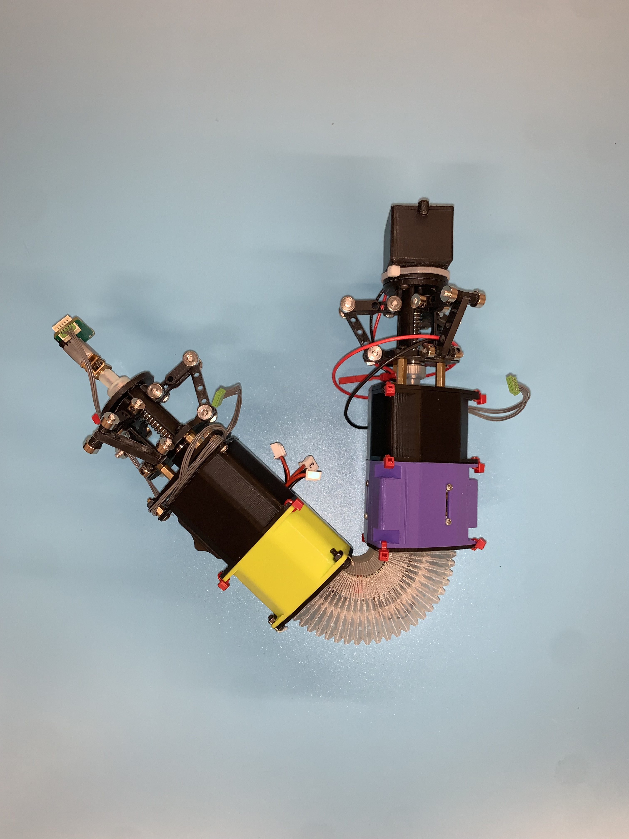
Results: Yoshimura Metrics
Maximum expansion / contraction did not change
Maximum bending angle increased from ~85.8 degrees to ~150 degrees
Notes:
Bwaise

Slide 22
Results: Weight
Payload Weight
Maximum recommended payload of around 500g
Above 550g, wheels slip (vertical orientation)
Payload could be water treatment / testing equipment
Robot Weight
Approx 670g or 1.48 lb.
~35% increase over previous iteration
Robot can tow nearly its own weight
Mass increase attributed to new components and casings
Notes:
Bwaise

Slide 23
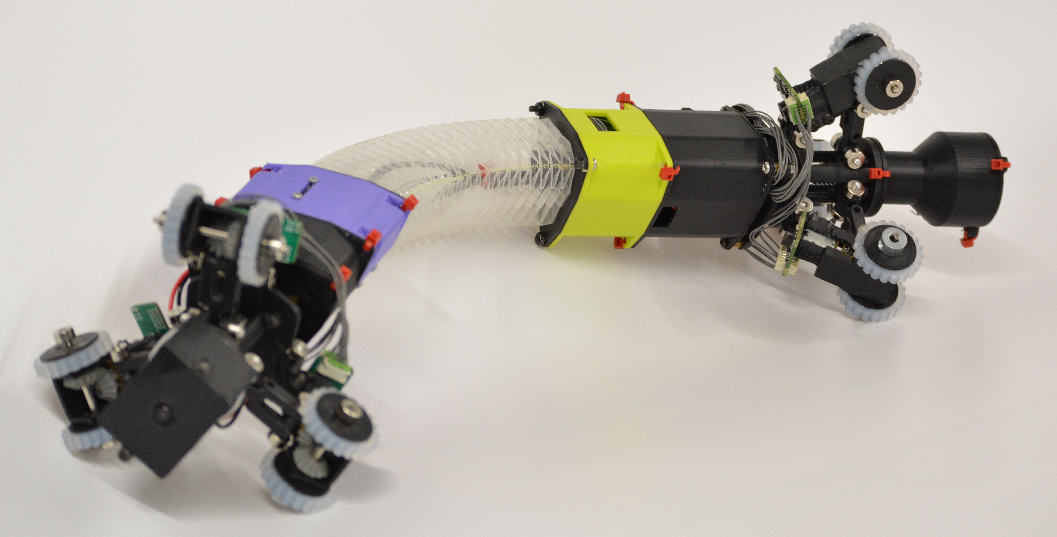
Fundamental Contributions
Goal: Improve the capabilities of a soft robotic origami module for the inspection and exploration of pipe networks that are unable to be explored by humans.
Robustness
Maneuverability
Vision
Protected Components
Notes:
Bwaise

Slide 24
Conclusion
Category | Value | Units
Weight | 1.48 | lbs.
Yoshimura Module Length | 1.5-6.0 | in
Maximum Bending Angle | ~150 | deg
Effective Diameter Range | ~3.5 - 5.1 | in
Wheel Compression | 0.2 | in
Maximum Horizontal Speed | 6 | in/s
Vertical Speed (Up/Down) | 3 / 6 | in/s
Notes:
Bwaise

Slide 25
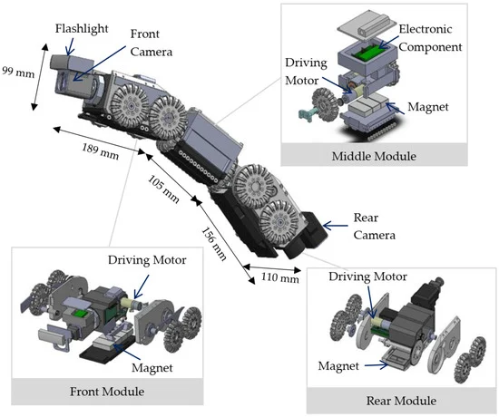
Future Work
Implementation of Payload
Improved control schemes
Motion tracking / live pipe network mapping
In-Pipe Inspection Robot (Thung-Od et al., 2022) [2]
Development of modular segments for repairability
Waterproofing for wet/damp pipes and environments
Notes:
Bwaise

Slide 26
Acknowledgements
Questions?
Special thanks to:
Professor Onal
Additional thanks to:
Gabby Conard
Robin Hall
Arnold Muralt
Dan Moyer
Shou-Shan Chiang
Notes:
brian

Slide 27
Citations
[1] B. Katz & K. Wheeler, "CLARA: Continuum Locomotive Alternative for Robotic Adaptive-exploration", Worcester Polytechnic Institute MQP project, July 2022.
[2] Thung-Od, K., Kanjanawanishkul, K., Maneewarn, T., Sethaput, T., & Boonyaprapasorn, A. (2022). An In-Pipe Inspection Robot with Permanent Magnets and Omnidirectional Wheels: Design and Implementation. Applied Sciences, 12(3), 1226. https://doi.org/10.3390/app12031226
[3] J. M. Aitken et al., "Simultaneous Localization and Mapping for Inspection Robots in Water and Sewer Pipe Networks: A Review," in IEEE Access, vol. 9, pp. 140173-140198, 2021, doi: 10.1109/ACCESS.2021.3115981.
[4] J. Santoso, E. H. Skorina, M. Luo, R. Yan and C. D. Onal, "Design and analysis of an origami continuum manipulation module with torsional strength," 2017 IEEE/RSJ International Conference on Intelligent Robots and Systems (IROS), Vancouver, BC, Canada, 2017, pp. 2098-2104, doi: 10.1109/IROS.2017.8206027.
[5] Y. Qin, Z. Wan, Y. Sun, E. H. Skorina, M. Luo and C. D. Onal, "Design, fabrication and experimental analysis of a 3-D soft robotic snake," 2018 IEEE International Conference on Soft Robotics (RoboSoft), Livorno, Italy, 2018, pp. 77-82, doi: 10.1109/ROBOSOFT.2018.8404900.

