Slide 1
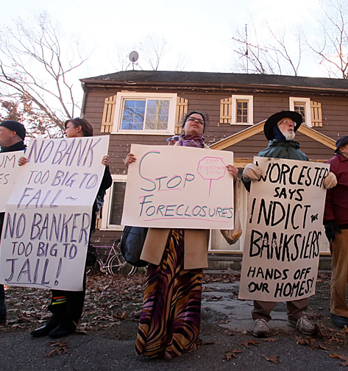



Developing a Data System to Address Foreclosures in Massachusetts
John Riley, John McCarthy, Natalie Dionne, Sophia Noel, and Theo Campbell
Notes:
JOHN RILEY
Hi my name is John Riley…
And we are the Data team working to Develop a Data System to Address Foreclosures in Massachusetts​. As mentioned previously by our fellow teammates there is an ever present housing crisis in Massecuites and Worcester and In order to act against these wrongful foreclosures, it is essential that MAAPL acquires specific data sets to prove that there is wrongdoing. By collecting these data sets from several publicly available locations, organizing it into a form that is analyzable, and demonstrating trends in illegal activities by banks, MAAPL can create cases against these wrongful foreclosures and work to prevent more from occurring in the future

Slide 2
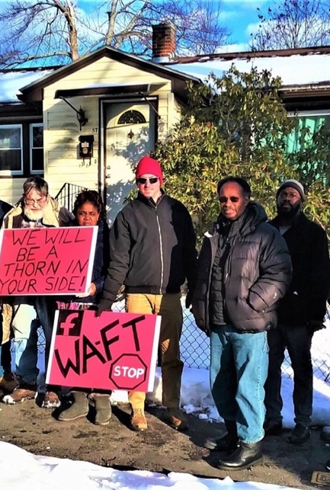
MAAPL and WAFT
Massachusetts Alliance Against Predatory Lending (MAAPL)
Worcester Anti-Foreclosure Team (WAFT)
Educate homeowners on how to fight their foreclosure status
Door knocking, brochures, and community meetings, court and policy action
By collecting data from public sources, we can help MAAPL analyze predatory lending practices
Notes:
JOHN RILEY
Spell out the names of the organizations explicitly on the slide. Possibly condense the bullet points. Less text. Get rid of questions?
Change title to better connect to changed title in last slide
Talk about the relationship between the two organizations

Slide 3
Foreclosure in Massachusetts
The Foreclosure Process
Foreclosure: defaulting on mortgage payment leads to loss of home ownership
Causes of foreclosure:
- catastrophic events (divorce, death, job loss)
- global events (COVID-19 and 2008 recession/housing crisis)
- unethical and/or illegal lending practices
1. Defaulted or missed payment for more than 3 months
2. Notice of foreclosure to homeowner, lender files petition
3. Foreclosure recorded in Registry of Deeds; affidavit recorded
4. Newspaper notices of auction (Massachusetts is auction state)
5. Auction or foreclosure by entry (unopposed entry by lender with witness)
Notes:
John McCarthy
A Foreclosure is when defaulting on a mortgage leads to loss of ownership of a home. By law in Massachusetts a Foreclosure begins when a person defaults on or misses payments for three months. A Notice of Foreclosure is then sent. From there an advertisement for the foreclosure auction is then sent out through a local newspaper and the house is then auctioned. There is another method of foreclosure where a representative makes a peaceable and unopposed entry onto the property and then the property is foreclosed after three years that is called a foreclosure by entry. The relevant documentation is stored in the registry of deeds.
There are many reasons why an individual may be foreclosed on such as death or job loss. However, a lesser-known cause of foreclosure is when a lender takes advantage of the borrower and forecloses on them illegally. This issue is widespread because the process of foreclosure is remarkably complex. As a result, there are numerous opportunities for lenders to cut corners in the foreclosure process. Access to the data will assist MAAPL in addressing these illegal foreclosures and help them to put a stop to illegal foreclosures in Massachusetts.
- Be quicker through process itself
- There is a legal process that has to/is supposed to be followed, there are requirements for both foreclosure and mortgage
- Are these legal requirements always met? What do people do if they get a notice of eviction?
- What can an individual do? Right to plead their case, may want to contest individual case and understand if the process has been legal.
- Also, how can getting a bunch of data potentially show trends in systemic abuses and is required for policy change. Often judges need evidence of repeated patterns to be convinced that there is a problem. Data is essential in order to do that.
- Sooo... there is a need for data to analyze trends in foreclosures and determine how well process works and whether anything illegal is happening
…..transition!!! to project goals

Slide 4
MAAPL’s Analysis Goals
Investigate illegalities and inconsistencies in the foreclosure process
Investigate whether mortgage companies intentionally provided mortgages that exceeded home values.
Investigate the legality of pooling mortgages.
Notes:
Sophia
Connect to process
These are some of MAAPL’s main goals for analysis and motivation for creating a data system. We developed our data system to collect and store data that can address these major goals, particularly goal 1: investigating illegalities and inconsistencies in the foreclosure process, in hopes of identifying systemic patterns that could halt foreclosures and evictions and end the most prevalent illegal foreclosure practices. This investigation is closely related to the process that John just described. By analyzing documentation in the Registry of Deeds we can determine if lenders cut corners during the process, especially during the home auction and foreclosure by entry phases. An examples of the illegalities we are looking for would be that the foreclosure auction is not propertly advertised in local newspapers, as mandated by law. Failure to do this unfairly benefits the lender because they could buy the house for an incredibly cheap price if no one else knows about the auction.
Places to store data for other data related to mortgages and securitized trusts were added to the data system to allow for MAAPL’s additional analysis goals.

Slide 5
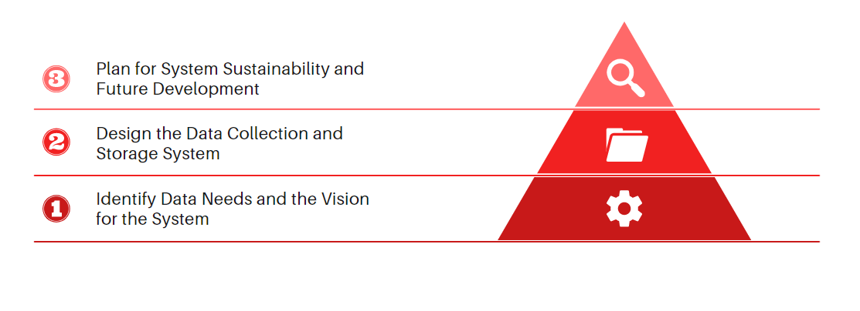
Project Goals and Objectives
Goal: Develop a data system to help MAAPL and WAFT collect and analyse data related to foreclosures in Massachusetts
Objectives:
Notes:
Natalie
- The main goal of our project this term was to develop a data system to help MAAPL and WAFT collect and analyse data related to foreclosures in Massachusetts
In order to address this goal, we focused on three main objectives. We based our objectives on this bottom up pyramid structure, which begins with Identifying the data needs and the vision for the system.
It was important that we started with this step to make sure that our vision for the system aligned with MAAPL’s vision for the system and that we understood which data values were the most useful for MAAPL in their work before we got too far into developing the system.
Next, we focused on designing the system, which included creating technical documentation, gathering data to put into the system, and creating code so the system functions
The final objective, Planning for System Sustainability and Future Development, included creating a future development guide and making recommendations for future project teams and individuals working on the system

Slide 6
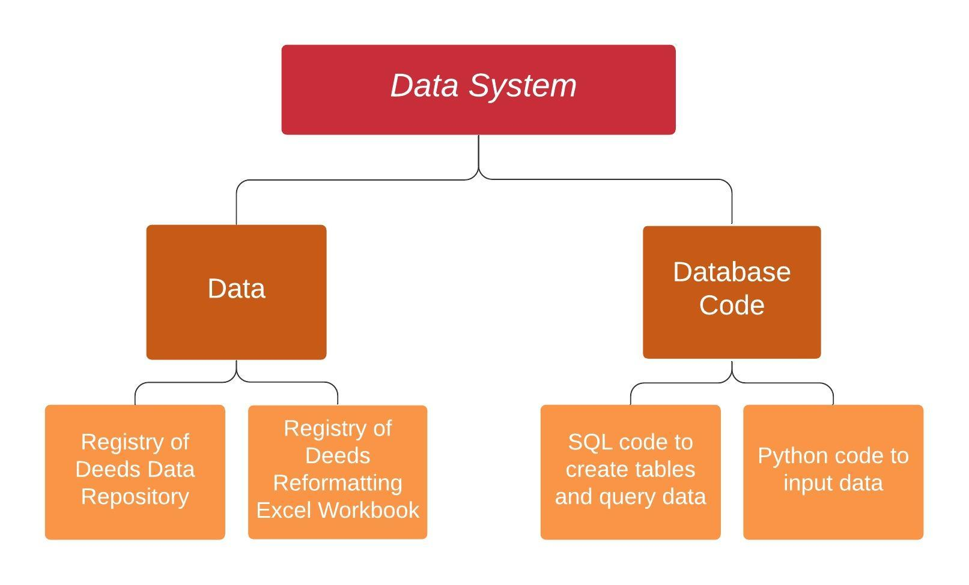
Project Outcomes
1
2
Notes:
Sophia
Is there a better way to visualize the system and all the components we successfully created? I tried my best but feel like there has to be a better way to do it

Slide 7
Data Sources and Data Needs
1
Sources | Data Available | Data Collection Method
Massachusetts Registries of Deeds | Foreclosure documentation Property history Indexed data and scanned documents | Indexed data from individual registries Optical Character Recognition
US Securities & Exchange Commission | Foundational documentation for bundled mortgages and securitized trusts | OCR Text scraping script
Massachusetts Public Notices | Newspaper ads for foreclosure auctions Foreclosure details | Text/web scraping script
CoreLogic/MLS real estate database | Property sales, foreclosure, and tax assessment history Property details Owner demographics | Text/web scraping script Some data may come in spreadsheets, but unknown
Notes:
Sophia
One of the first things that we did, is we interviewed our sponsor Grace to determine the most important sources and data values for her data analysis goals. We were able to both pursue her suggested data sources, as well as brainstorm ideas to get some of the other data she needed
- We have an alumni connection to CoreLogic, which sells real estate data, and were hoping to maybe pursue data through that company
We mapped out the most important data sources, and what kind of data each of those sources could offer us. We did this to help visualize and understand the many data sources needed to compile all data needed. We then were able to note the method required to collect data points from each of these sources, because those methods were what we were focusing on mainly.
We compared the public data sources using this table and were able to use it to plan our data collection, organization, and feasibility for database

Slide 8
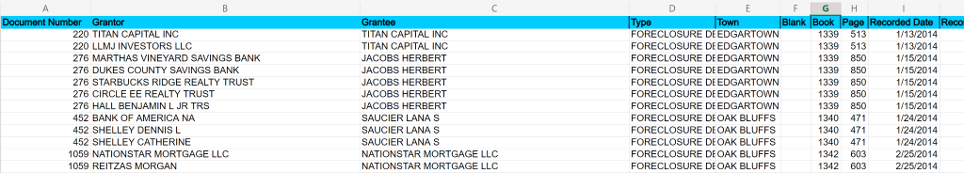
Indexed Publicly Available Data
1
Emailed Registry of Deeds for each county in Massachusetts asking for indexed data on foreclosures
Received indexed data from 7 counties
Reformatted and organized indexed data for easy uploading into database, created Excel workbook to streamline this process
Determined which additional data must be collected through web-scraping or OCR
Notes:
Sophia
To collect a large portion of the data, we turned to contacting each Registry of Deeds in Massachusetts. We contacted all 21 of the Registries requesting the three documents of most interest to MAAPL: Foreclosure deeds, certificates of entry, and powers of attorney. Although these documents are most often available online, we were requesting scans of the documents in bulk, as well as the basic data about each document that most registries collect electronically when recording documents. This electronic data is called indexed data and we were able to collect indexed data in the form of spreadsheets from 7 out of the 21 Registries of Deeds in Massachusetts. This was a giant step for MAAPL because they only had one solid indexed data sheet in the past. As student researchers, we were able to collect a lot of data that is relatively easy to input into a database and really reduces the amount of work needed to collect the data.
However, since nearly every registry has its own data storage and management system, we had to develop a way to reformat each Registry’s indexed data files into a standardized format so that the data can be more easily entered into the database. This was done by creating a master Excel workbook that was able to reformat the data sheets into this standardized format. This workbook will then be passed on to MAAPL volunteers to help them more easily standardize the data that the collect from the Registries in the future.
Finally, after getting the data points from the indexed data we were able to better map out how we could gather the data for the remaining other data fields.

Slide 9
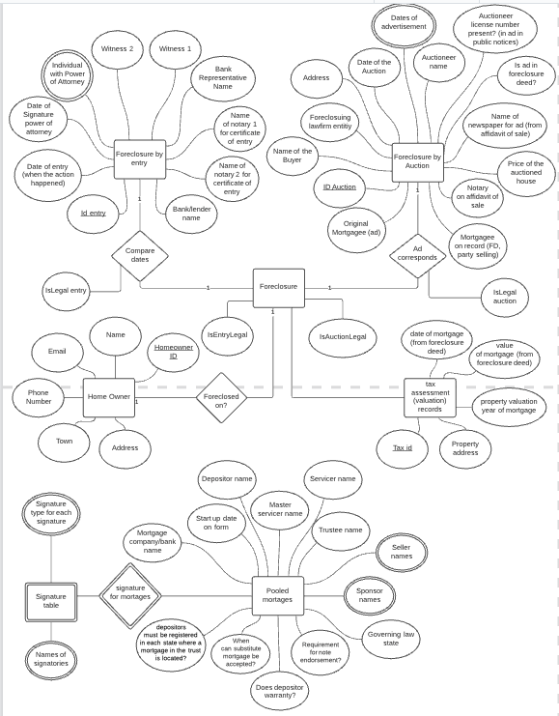
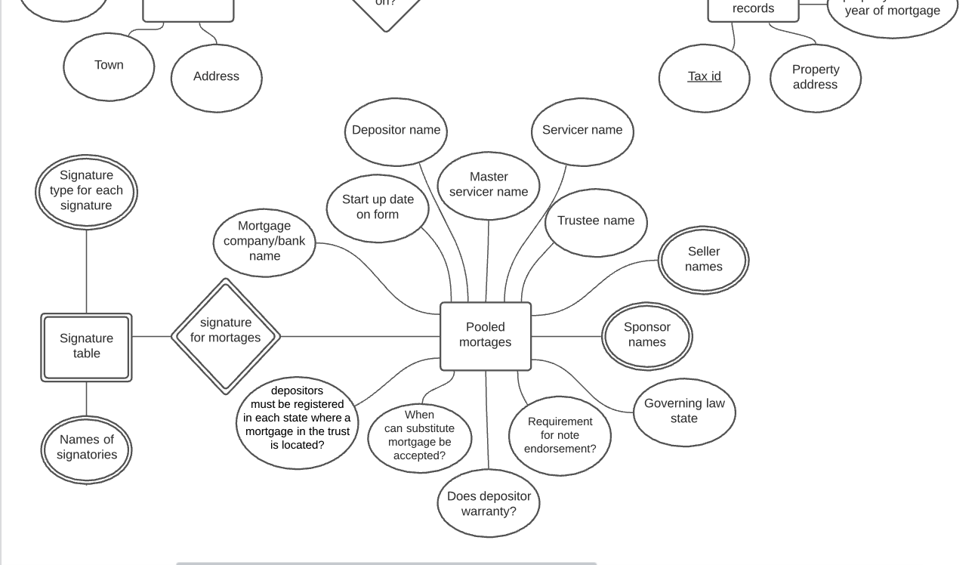
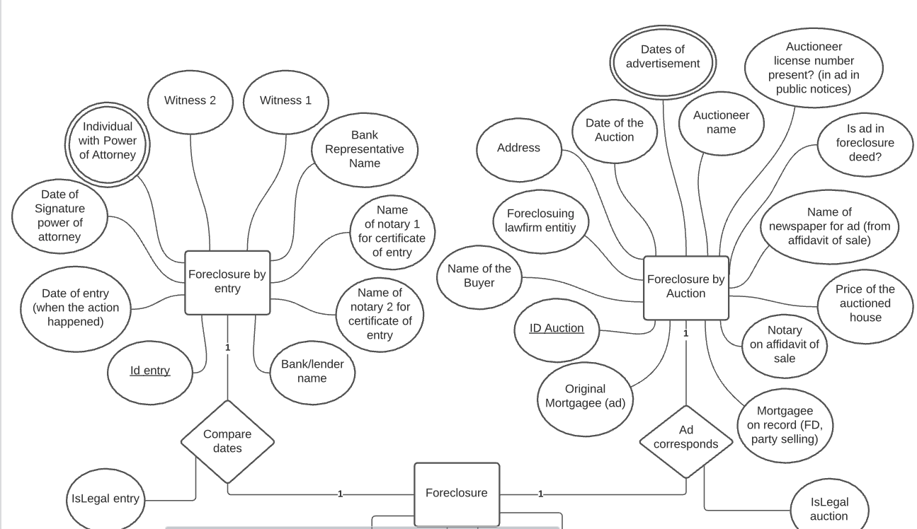
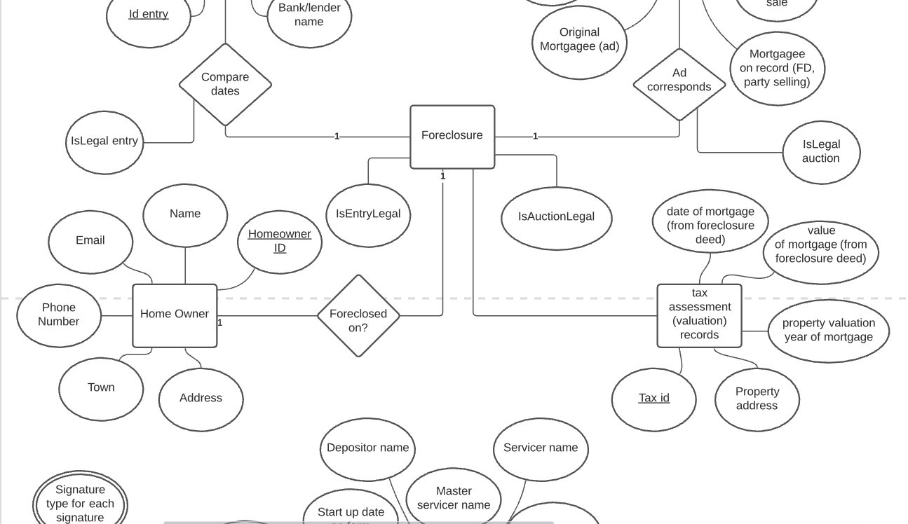
Technical Documentation
2
Notes:
Should we add a scrolling gif for the ERD? To zoom into specific sections to allow us to talk about the specific sections in the presentation?
Also I remember Scott suggesting putting ERD earlier in the presentation because it shows the data fields needed to be taken from data sources

Slide 10
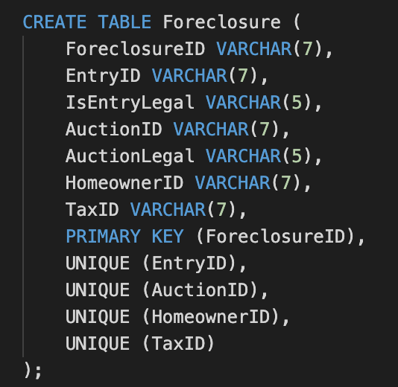

Database Code
2
Notes:
What about the code to input data into the database? I think we need to explain the difference between the different scripts (what each does and maybe use those descriptions to outline the entire process of inputting data into the database to querying data from the database)

Slide 11
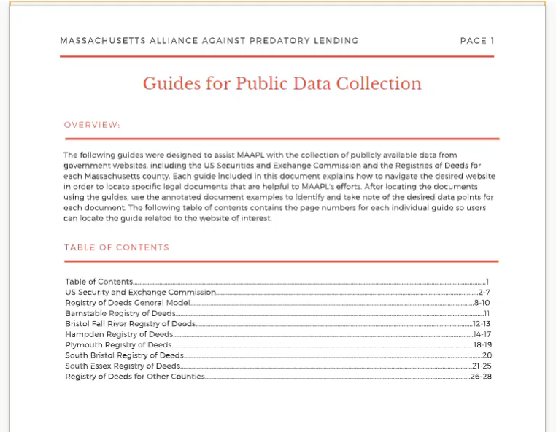
Volunteer Guides
Documentation for volunteers manually collecting important data
Notes:
John McCarthy
The documents relating to the foreclosures are stored in the various registries of deeds throughout Massachusetts. In addition, the Securities and exchange commission has information relating to the pooling of mortgages which is relevant to some foreclosures. As we noted previously, we created a database to store the information; so to streamline the process of gathering the information we created a set of instructional guides for volunteers. These guides are a set of step-by-step instructions detailing how to get to the legal documentation for each registry in the state. They will help MAAPL in the present by allowing any volunteer to gather documents from any registry. These instructions will also help any future group that wants to automate the data collection process because the documents will explain how each website works.

Slide 12
Future Development Guide
Guide for Future Work
System Functionality
Project Methods
How to Use System
Suggestions
Other Resources
Notes:
Natalie
-Another one of our main deliverables was a future development guide to be utilized by other project teams and individuals who will work to improve the data system going forward.
-This guide gives an overview how the system currently functions at the end of our project work. This includes information on any gaps in the system that the team was not able to address during the term, but would be beneficial to address in the future. This also includes asummary of the methods the team used to accomplish each step in creating the system, so future teams of individuals will understand the decisions we made and why we made them. It also includes informaiton on how to use the system in its current state and recommendations specifically for IQP groups, MQP groups, and general recommendations
- Finally, we have created a document that can be given to people working on the system in the future that would include contact information for everyone who we’ve been in contact with and who have helped us throughout the term. That way they can connect with them for more assistance if they need to

Slide 13
Recommendations for Future Work
Analyze and visualize
the collected data
Refine
the data intake form
Expand
the data system
Automate
the process of acquiring information form the Registry of Deeds
Create
case management and contact management systems
Notes:
Natalie

Slide 14
Potential Project Impacts
Improved MAAPL’s ability to advocate for new policy and homeowners
Helped establish a long-term partnership between MAAPL and WPI

Slide 15
Acknowledgements
We would like to extend our sincere gratitude to the following people who were instrumental in this project:
Our sponsor and MAAPL/WAFT Founder, Grace Ross
Our advisors, Dr. Gbetonmasse Somasse and Dr. Scott Jiusto
Steve Floridia, MAAPL IT expert
The many helpful individuals at Registries of Deeds throughout Massachusetts
Our fellow CTPC classmates

Slide 16
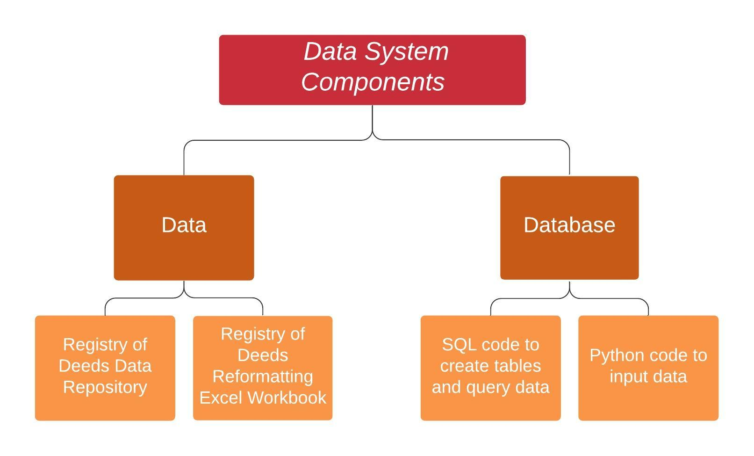
Thank you for listening!
Questions and Discussion
Notes:
Make less busy?

