Slide 1
Back to the Future
-- a guideline for annual WPI
Future of Higher Education workshop
By Cynthia Teng, Anqi Shen
Notes:
Perhaps the most important question I have is “Who is the audience for this proposal?” If it really is a “proposal” what are you proposing? To put it another way, what are you asking someone to do?
If you are thinking of this presentation as guidelines for a group planning to run a similar workshop next year, then you need some more concrete details such as
(1) materials created for this year’s workshop (like the description for the WinterSession brochure and any handouts or instructions)
(2) a calendar describing the work done leading up to the workshop (when does stuff need to happen?)
(3) mistakes you think you made.

Slide 2
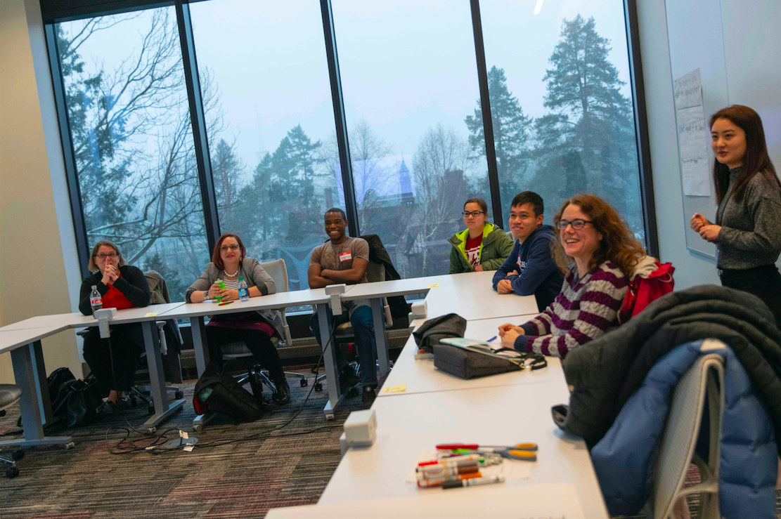
What is it
A student-lead program that gathers main stakeholders of higher education together to brainstorm & imagine the future of higher education at WPI.
Different topics each year
In the form of an active workshop

Slide 3
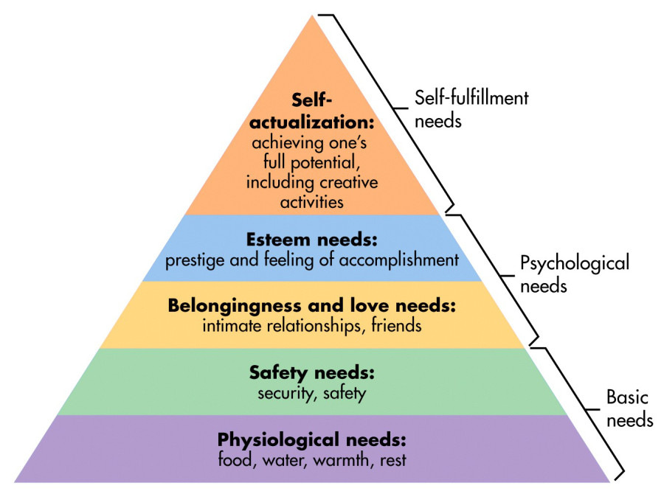
Why we are doing this
Self-actualization:
the individual is able to fully understand his or her own talents, core strengths, and development areas;
the individual has discovered his or her passion and a lifelong goal;
the individual feels motivated and willing to work toward the goal;
the individual feels connected to the outside community and feels comfortable communicating with that community.
Shape higher education in the future so it allows main stakeholders (students, faculty, staff, and community members) to empower each other to achieve self-actualization

Slide 4
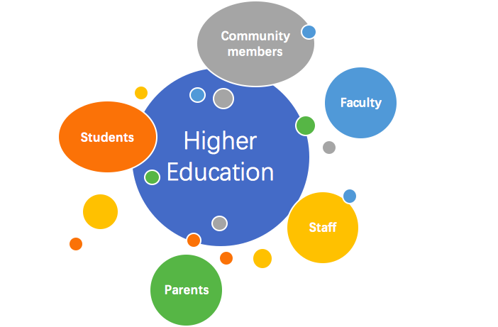
Objective
Have main stakeholders actively imagine possible futures for higher education and for WPI
Design programs that will adapt to the changing future or anticipate the changes
Programs that will help create a sustainable future for higher education
Benefits main stakeholders
Connections
WPI will survive
Notes:
Your stated objective seems to be to imagine futures for WPI and higher education. The focus on stakeholders makes an assumption that different people bring different perspectives on current needs and
What is the real objective?
(1)Imagine possible futures for higher education and for WPI.
(2)Design programs that will either adapt to this changing future or ANTICIPATE change and help create a future for higher education
You could add alumni to a stakeholders in your future plan. They have strong opinions (valuable opinions) about what worked well in their education at WPI.)

Slide 5
2019 Back to the Future workshop
What does WPI look like in 2050? You tell us.
WPI aims to prepare students through its Project-Based Learning (PBL) strategies, but how might we strive to make students become better engineers and global citizens in 2050? We believe students should be engaging in world-relevant experiences to become better global citizens.

Slide 6
Workshop Logistics
Time: Jan. 8th, 2019
Location: WPI Foisie Innovation Studio
Topic: Future of Higher Education and Community-based project-based Learning (CBL)
Platform: Winter Session
Attendees: 20 people signed up (through Winter Session); 7 people showed up
Facilitator: Anqi Shen, Cynthia Teng, Claire Long
Notes:
You need some more “practical details.” Give the date. Give the schedule and location. How many people signed up? How many people showed up?
How was the workshop advertised? How was it described in the WinterSession advertising?

Slide 7
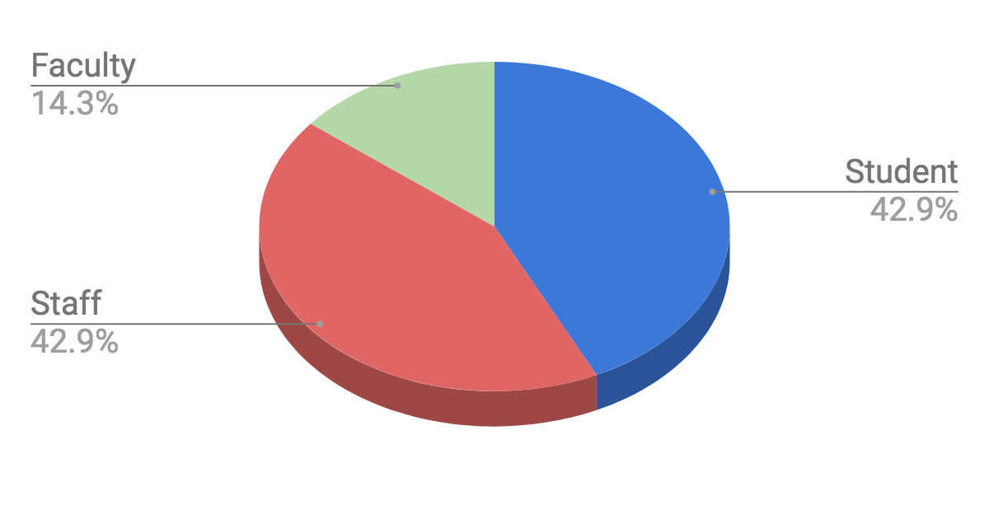
Workshop Attendees
Out of 7 attendees...
Stakeholder Representation
By using the Winter Session platform, we were able to obtain a fairly diverse group for the workshop
Diversity of the workshop attendees ensures that we could collect inputs from different perspectives
Different types of attendees will have different opinions towards higher education
1
3
3
Notes:
Percentages mean nothing hear without the total number of participants. How many people participated?
“Identity Ratio“ seems to be more about “Stakeholder Representation”
Why is gender important? Did you have different activities by gender? Did you analyze gender difference in the responses? (I don’t see why you reported it…)

Slide 8
Workshop Activity: Trivia
Activity Type | Warm up
Goal | To help attendees imagine what could happen in the future by looking back at WPI 50 years ago.
Duration | 15 min
Steps | The trivia consists of questions of history of WPI in the past 50 years The person who could answer the question right away gets 3 points If no one could answer the question after three tries. There will be multiple choices, the person who gets the right choice get 1 point
Notes:
You need some more “practical details.” Give the date. Give the schedule and location. How many people signed up? How many people showed up?
How was the workshop advertised? How was it described in the WinterSession advertising?
You just put the focus on CBL… but didn’t do anything earlier to explain why you would do that….

Slide 9
Workshop Activity: Trivia
Observations | With the focus on WPI history of learning curriculum, some attendees were able to answer more questions than others. If community members were involved, they will not be able to participant much.
Recommendations | Have trivia questions about higher education in general Other icebreaker activities People bingo Two truths and One Lie
Notes:
You need some more “practical details.” Give the date. Give the schedule and location. How many people signed up? How many people showed up?
How was the workshop advertised? How was it described in the WinterSession advertising?
You just put the focus on CBL… but didn’t do anything earlier to explain why you would do that….

Slide 10
Workshop Activity: Poster Making
Activity Type | Group discussion; brainstorm
Goal | To start attendees to think of what would happen for higher education in the future, specifically with the influence of community-based projects
Duration | 25 min
Steps | Assign attendees into groups of four Proposed topic: “In the year 2050, community-based projects will replace/change ___” Subtopic options: ‘nothing’, ‘project-based learning’, ‘traditional classroom’, ‘faculty’, and ‘four-year residential college’ Have teams fill out the blank and brainstorm follow-up questions: ‘what would it be like?, and ‘how to get there?’ Each group will present for 2 min
Notes:
You need some more “practical details.” Give the date. Give the schedule and location. How many people signed up? How many people showed up?
How was the workshop advertised? How was it described in the WinterSession advertising?
You just put the focus on CBL… but didn’t do anything earlier to explain why you would do that….

Slide 11
Workshop Activity: Poster Making
Observations | With a total of 6 attendees, we divided them into two groups of 3 Everyone were able to contribute to the discussion Facilitators sometimes need to help initiate/lead the conversation Some attendees were not very comfortable with presenting to a strange crowd
Recommendations | The activity works for smaller groups of 3-4 people Facilitators should Understand the objectives of the workshop as well as certain background knowledge of the topic (thorough literature review or methodology) to be able to initiate conversations Take notes during discussion Be prepared with facilitating skills (see following slides)
Notes:
You need some more “practical details.” Give the date. Give the schedule and location. How many people signed up? How many people showed up?
How was the workshop advertised? How was it described in the WinterSession advertising?
You just put the focus on CBL… but didn’t do anything earlier to explain why you would do that….

Slide 12
Workshop Activity: Role Play
Activity Type | Group discussion; role play
Goal | To have attendees think of higher education from other stakeholders’ perspectives, in order to develop empathy
Duration | 20 min each segment - 40 min in total
Steps | Assign roles/characters from different stakeholder groups to each attendee Half of the groups will be acting and discuss each poster based on the characters’ needs and concerns , while the other half stay with the poster to answer questions Comments & concerns will be added onto the poster with sticky notes Switch after 20 min
Notes:
You need some more “practical details.” Give the date. Give the schedule and location. How many people signed up? How many people showed up?
How was the workshop advertised? How was it described in the WinterSession advertising?
You just put the focus on CBL… but didn’t do anything earlier to explain why you would do that….

Slide 13
Workshop Activity: Role Play
Observations | People prefer having the discussion/role play within a larger group Both groups were interacting with each other at the same time Allows more comments from different perspectives and ideas to develop from each other The room was not large enough (too many chairs) for people to walk around People tend to focus on the character/stakeholder’s current needs rather than future needs
Recommendations | Stress the importance of empathy before the section; set up ground rules of judgment free Have the role play for only one whole section (40 min) when everyone could listen & participate Give attendees certain scenarios to play improv with their characters In year of 2050, everyone will study online instead of on campus
Notes:
You need some more “practical details.” Give the date. Give the schedule and location. How many people signed up? How many people showed up?
How was the workshop advertised? How was it described in the WinterSession advertising?
You just put the focus on CBL… but didn’t do anything earlier to explain why you would do that….

Slide 14
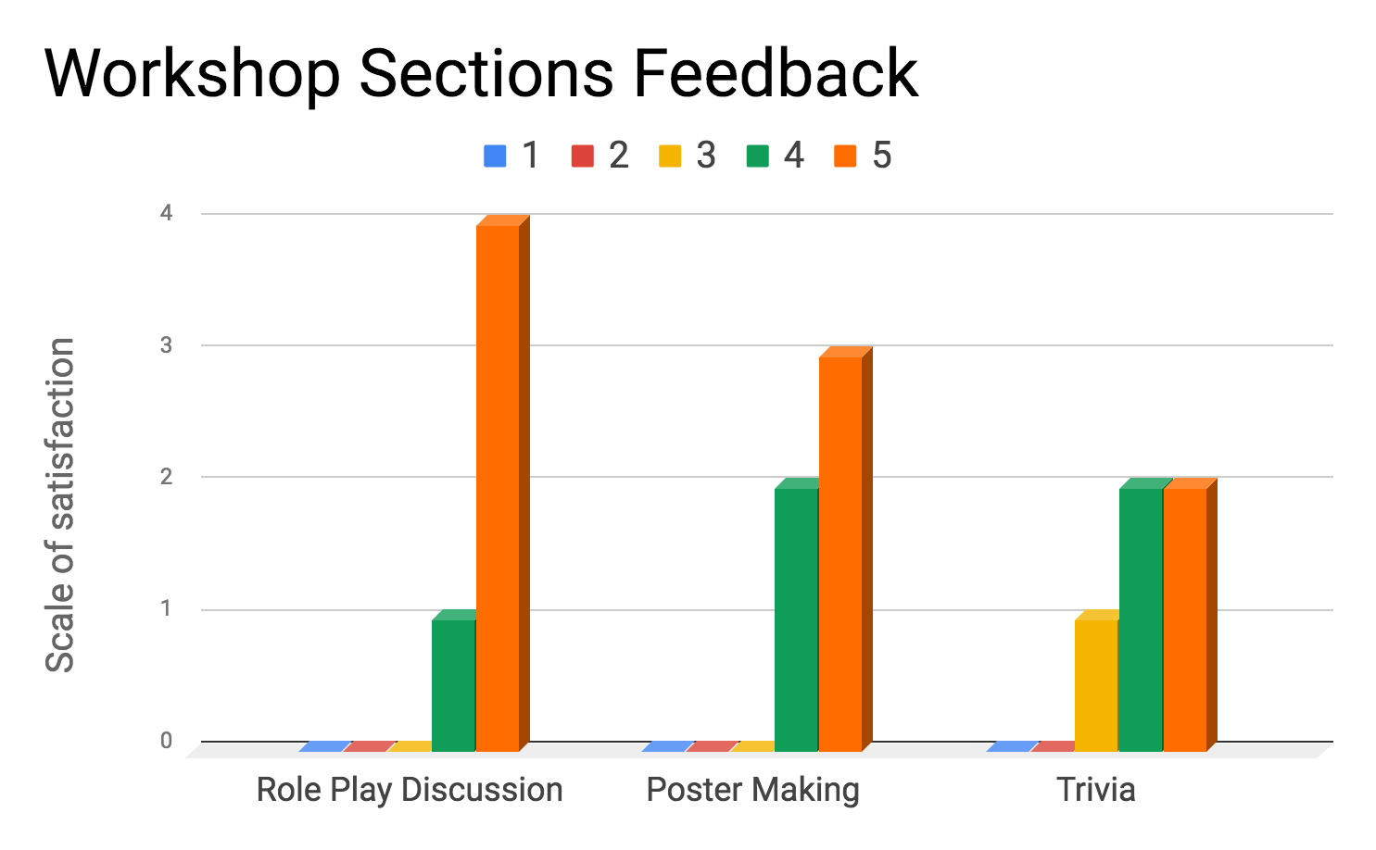
Feedback Analysis
After the workshop, attendees were asked to rate each section of the workshop on a scale of 1-5.
1 being not satisfied at all
5 being very satisfied
5 attendees filled out the survey
Notes:
The chart label (Scale of Satisfaction) is incorrect. I think this is “Number of responses” … in other words, you only got 5 responses to the survey?

Slide 15
Feedback Analysis continued
Interactive,
Engaging,
and Useful !
All participants of the workshop thought the program was very engaging, and they would like to attend similar workshops in this program
3 out of 5 attendees think the workshop was exceeding their expectations
Participants think the content was “useful”
Notes:
Did only five people fill out the survey? You need to present that data.
If you had 6 people at the workshop and got data from 5, that is pretty good. If you had 20 people at the workshop, then making any claims about the implications of responses from these 5 people is shaky.
I have no idea whether your first bullet means that they attendee liked the style of the workshop and did not like talking about the future of higher education OR liked working on the future of higher education but would want to focus on something different from CBL. Can you clarify this?

Slide 16
Recommendations
Future Topics
Grading criteria for PBL and CBL
Role of faculty/ mentorship
Online education
Forms of Discussion
Workshop
Conference
Unconference
Loosely structured conference emphasizing the exchange of information and ideas among participants, rather than following a conventionally structured program of events
Notes:
You did a bunch of research early in the project on significant challenges facing higher education (cost, equity and access, mistrust of universities and experts). You seem to be listing your personal favorite ideas of interesting future work. If not, then where did you get the future topics?
Are you making the assumption that there is still only one workshop and it is in WinterSession?
Can you describe in a few bullets what an Unconference is? This goes back to an earlier question about the audience for this presentation. If it is for Curtis, no need to explain. But you need to sell this to people who are not Curtis.

Slide 17
Recommendations continued
Recruitment
Facilitator:
Students who are interested in making an impact on WPI campus
Facilitation skills training
Goat Tank program (pitch/storytelling)
ACTIVATE program (conduct/design workshops)
Attend other conferences on higher education
Mentor:
A consistent faculty advisor
Avoid overlapped topics each year
Attendees:
Use Winter Session platform for recruiting, PR, and funding
Pro: Save time & energy; attendees will be more motivated since they express willingness to learn outside of school
Con: Time usually not available for faculty & community members
Notes:
How are you going to “Ensure a diverse board of attendees”?
Who are the facilitators? This list would seem to guarantee that no one would want that job! (See next slide comments also…)

Slide 18
Recommendations continued
Deliverables
Predictions for the future
Report
Presentation/poster
Video library
TedTalk
Assessment on the activities
Recipe book
“Train the trainer”
Notes:
This seems like a pretty trivial list of stuff you might add. (paper or online? Who cares?)
You have two interesting points hidden here:
Where to “well-prepared facilitators” come from? Should WPI actively try to promote and spread this skill among students and faculty?
What kind of video presentation? Are you arguing that one of the goals of each Future of Higher Ed workshop should be the creation of a brief video about some idea for the future of WPI?

Slide 19
Recommended Timeline #1
If work with Winter Session ...
Decide the topic, forms of discussion, facilitators, and form of final deliverable
Start gather information
Conduct workshop
Collect data
End of C term
Mid-B term
A/B term
Before C term: January
Modify/finaliza the activities
Sign up for Winter Session
Prepare materials
Analyze/evaluate results
Present

Slide 20
Recommended Timeline #2
Decide the topic, forms of discussion, facilitators, and form of final deliverable
Start gather information
Conduct workshop
Collect data
Mid-B term: November
A term
Summer break
(E term)
B term
Modify/finaliza the activities
Prepare materials
Start PR & advertising
Analyze/evaluate results
Present result
Audience: board of trustees

Slide 21
Resources
WPI Winter Session
Organized by LaunchPad
https://www.wpi.edu/academics/undergraduate/wintersession
2019 Back to The Future
Presentation https://docs.google.com/presentation/d/1D0z9TaRnmYCZkisNYCoNG3L5iF9TVonl32ARDXyazzw/edit?usp=sharing
Role play tages
https://drive.google.com/file/d/1hWyONdiKibsyUkZqckvw8hRfwHorgLNS/view?usp=sharing
IQP: Futures of Higher Education Report
https://drive.google.com/file/d/1lKZ6Q_583Yv7YypgB7fIj_Gz3gCm8x8C/view?usp=sharing
Notes:
(1) materials created for this year’s workshop (like the description for the WinterSession brochure and any handouts or instructions)
(2) a calendar describing the work done leading up to the workshop (when does stuff need to happen?)
(3) mistakes you think you made.

Slide 22
Thank you!

