Slide 1
Lambeth Business Intelligence
6/22
James Chen, Ben Sarkis, Rachel Whalen, Christopher Fernandez

Slide 2
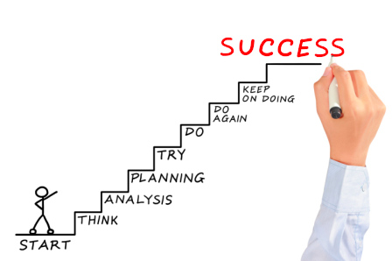
Project goal
Our goal is to encourage those who gather data, as well as those who utilize it, to incorporate a Business Intelligence system in Lambeth.

Slide 3
Presentation Outline
Background
Business Intelligence
Lambeth’s Profile
Methods and Results
Timeline
Objective 1:
Gather Information
Objective 2:
Implement a Plan
Conclusions and Recommendations

Slide 4
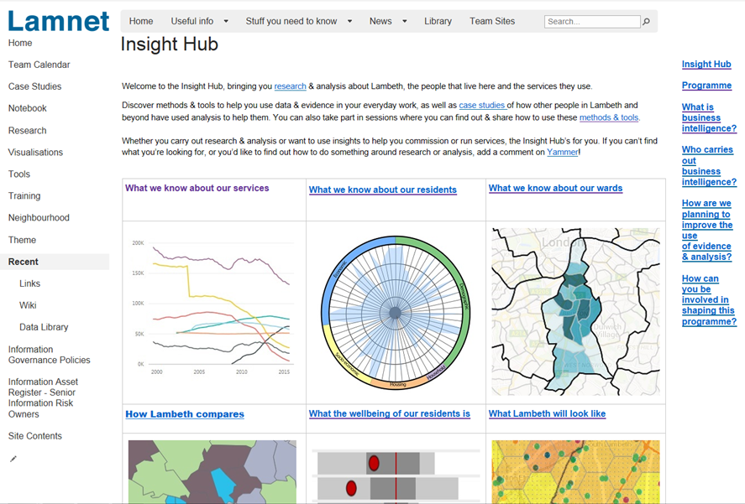
Business Intelligence (BI)
BI is a technology-driven process for analyzing data and converting it into useful information
Helps businesses, corporate executives, governments, councils, and many other people make informed decisions
Lambeth is beginning to use BI and has several databases and steps for how data is shared

Slide 5
Case Studies
Järfälla Kommun, a suburb of Stockholm, Sweden
Implemented BI in the contact center of the municipality
A hospital in Southern Taiwan
Used an SQL based BI system that improved clinical decision making
Success Factors of BI
Study of five organizations with common successes between each.
Empirical, as there is very little objective data on this.

Slide 6
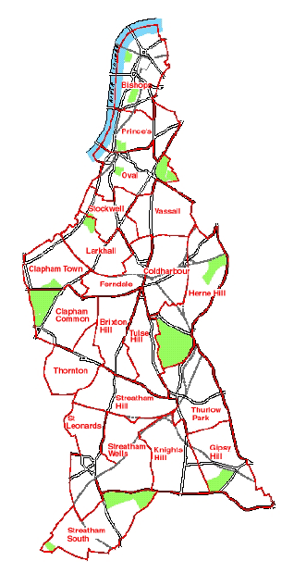
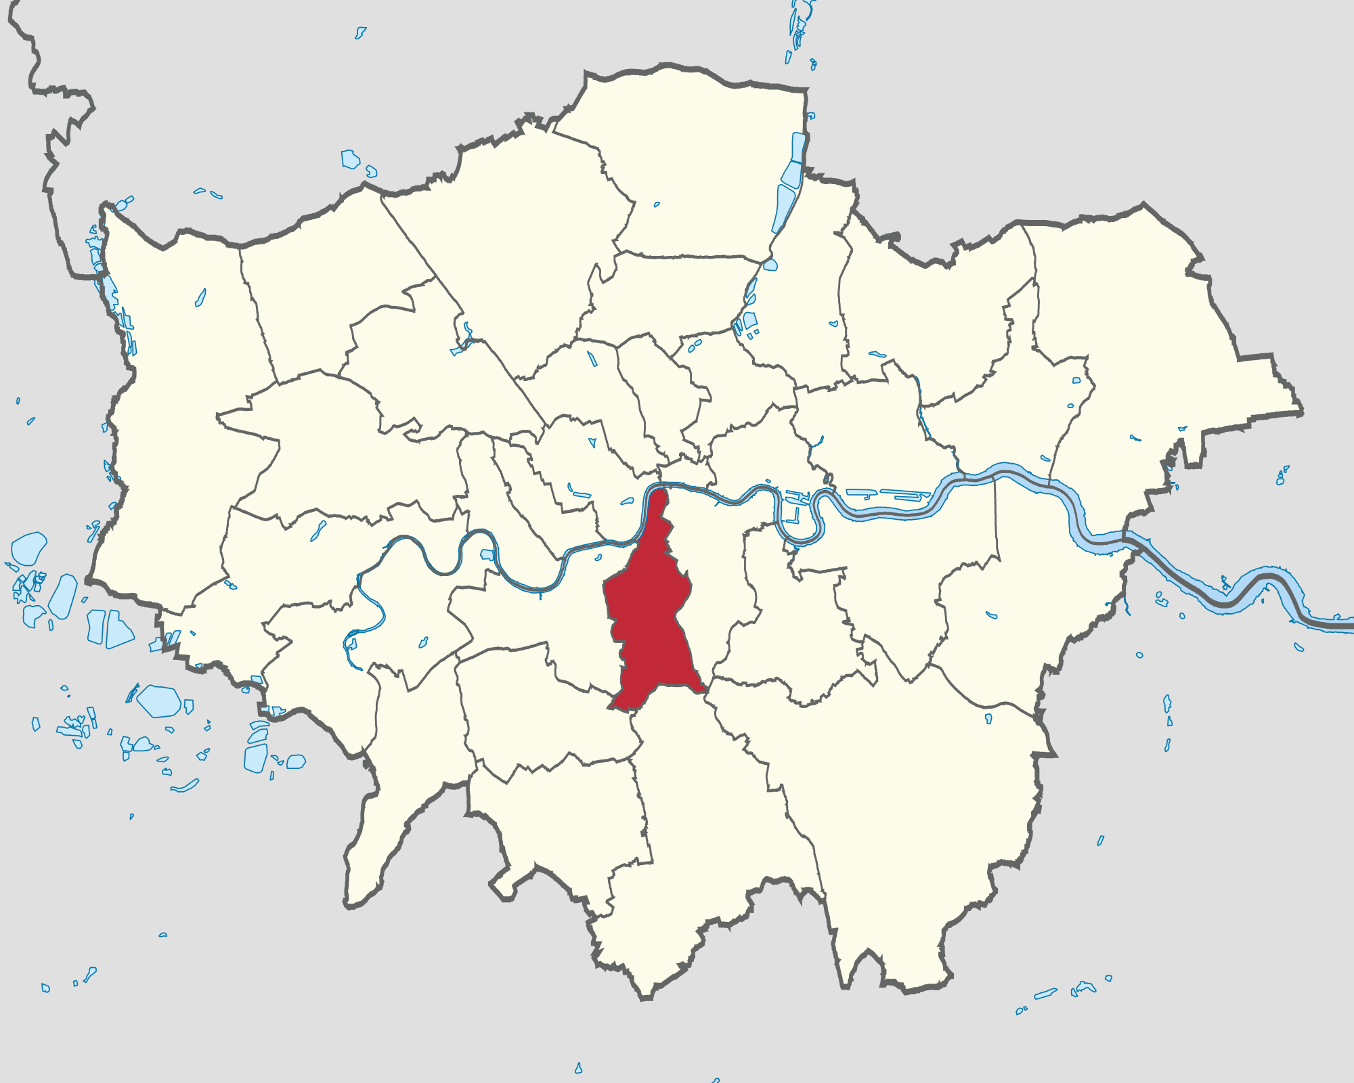
Lambeth’s Profile
The 8th poorest of the 32 boroughs in London
Young, poor population
High employment, but underpaid
Most densely populated area in London
About 310,000 people and growing

Slide 7
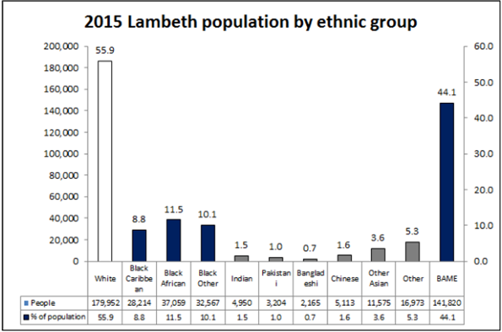
A Diverse Population

Slide 8
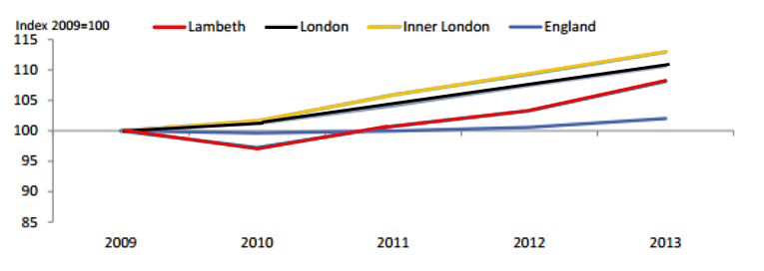
Employment
80% of the working age population is employed, but 20% are below the poverty line
Lambeth has been known as an “escalator borough”

Slide 9
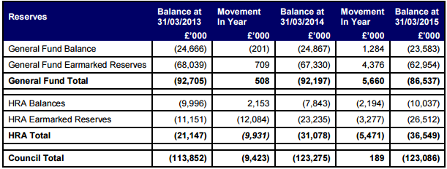
Budget
Budget cut by 56%, more cuts to come
£36.9 million cut in Lambeth’s 2015/2016 budget

Slide 10
Lambeth’s Administration
Lambeth Council
63 councillors with 3 from each of the 21 wards elected every 4 years
6 committees with 3 sub-committees
The Cabinet
10 councillors
Lambeth Council
Appointments Committee
Corporate Committee
Licensing Committee
Pensions Committee
Standards Committee
Planning Applications Committee
Appointments Sub-Committee
Licensing Sub-Committee
Standards (Hearings) Sub-Committee

Slide 11
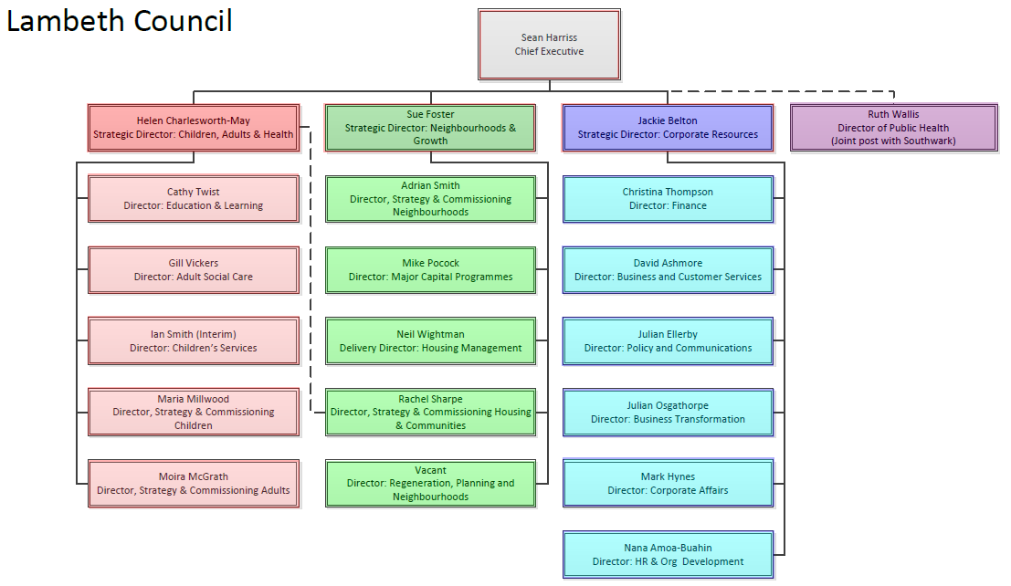
Services
Public Health
Children, Adults, and Health
Neighbourhoods and Growth
Corporate Resources

Slide 12
Commissioners and Service Managers
Commissioners plan long term strategies for the future
Service Managers plan short term for day to day functions

Slide 13
Methods and Results
Timeline
Objective 1
Objective 2

Slide 14
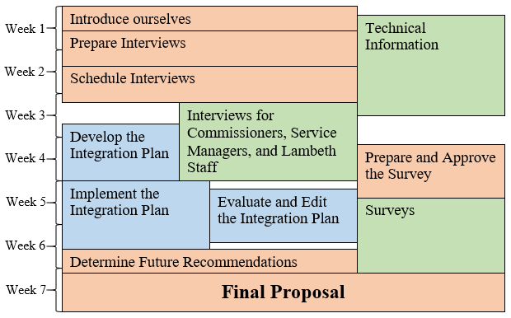
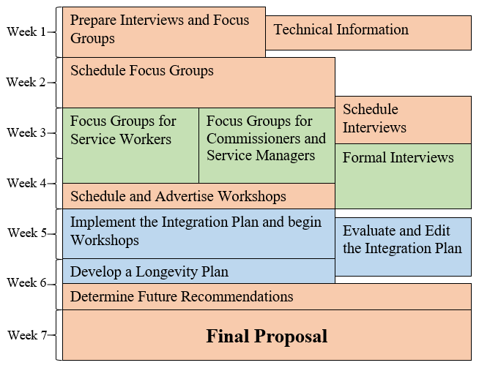
T
I
M
E
L
I
N
E

Slide 15
Objective 1:
Interviews
Survey
Research staff opinions on the use and analysis of data in Lambeth.

Slide 16
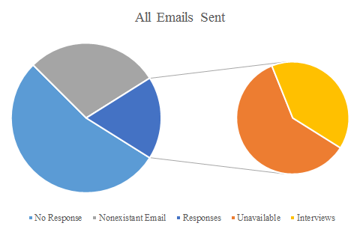
Attendance

Slide 17
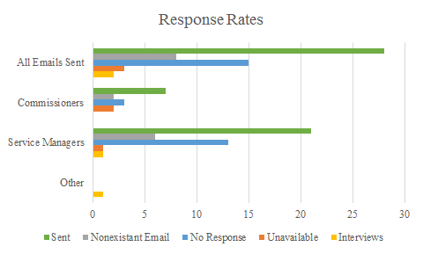

Slide 18
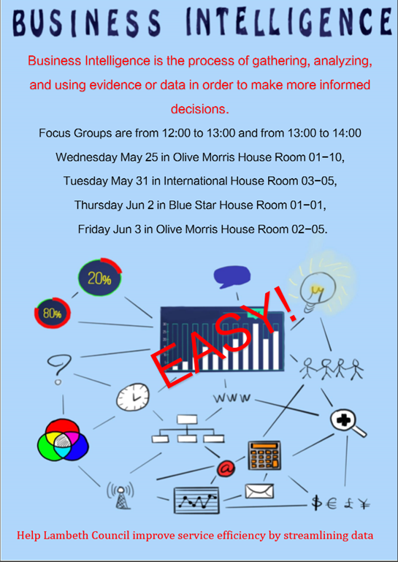
Interviews
Discussing how each position gathers and uses data.
About 45 minutes long.
Main qualitative method
Outcome
Got an outside perspective of the council
♦ Building Control: defined the limits of Insight Hub
♦ BI Analyst: knew about the Hub, but had not used it

Slide 19
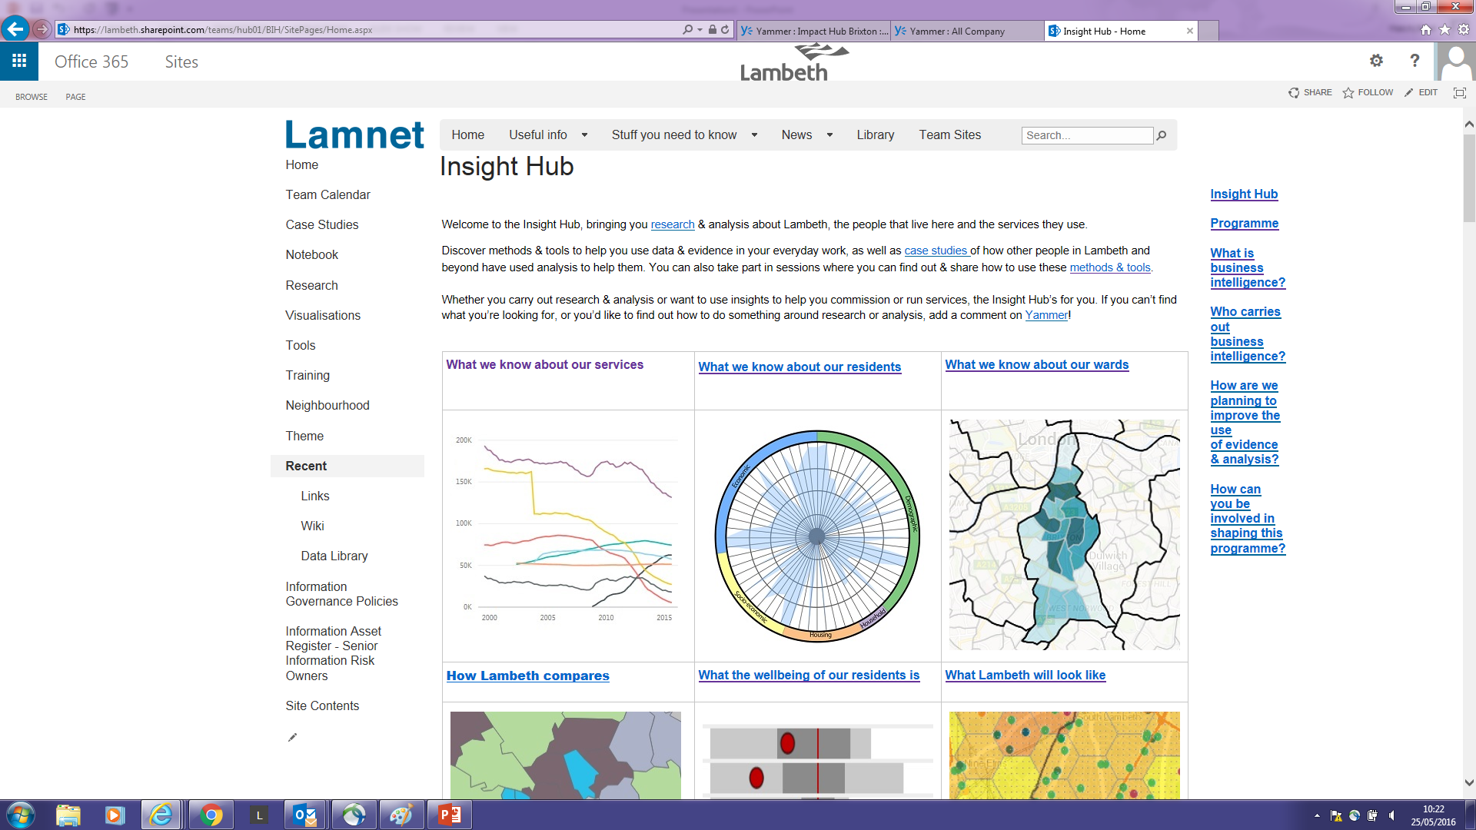
Technical Information

Slide 20
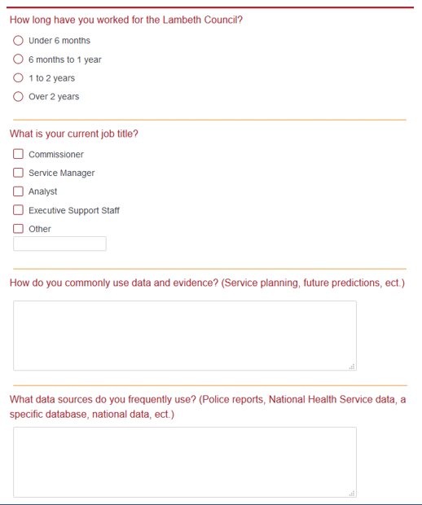
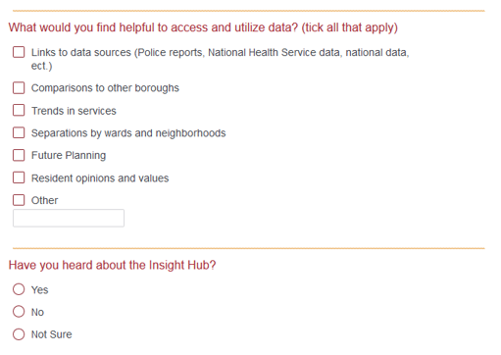
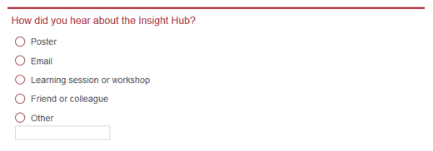
The Survey

Slide 21
The Survey Results Confirmed our other Data

Slide 22
Objective 2:
Workshops
Posters
Develop and implement an encouraging integration plan of BI in Lambeth.

Slide 23
Workshops
Understand what BI is
Discussion of BI
Experience of Insight Hub
Why Lambeth needs BI
Workshop Evaluations and future plan

Slide 24
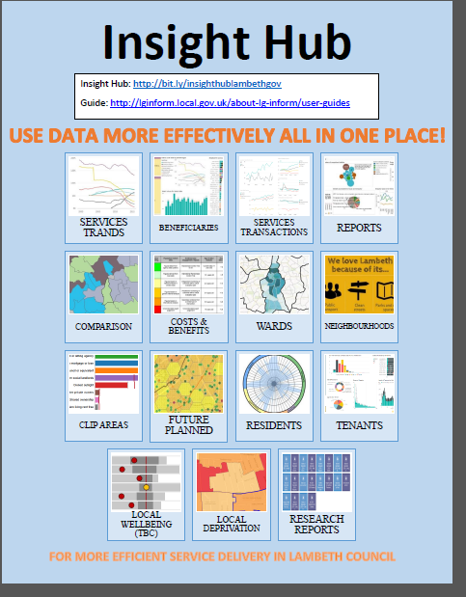
Workshop Plan
Greeting
Ask what already works
Talk about BI and Insight Hub
Show Insight Hub
Questions
Evaluation

Slide 25
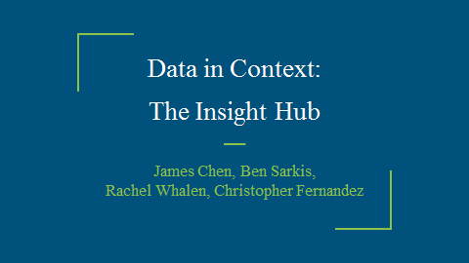
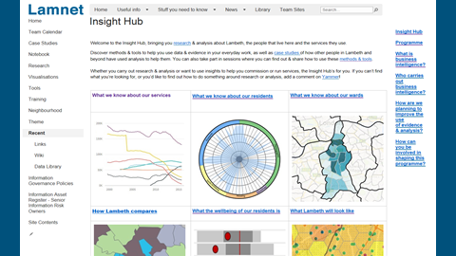
Workshop

Slide 26
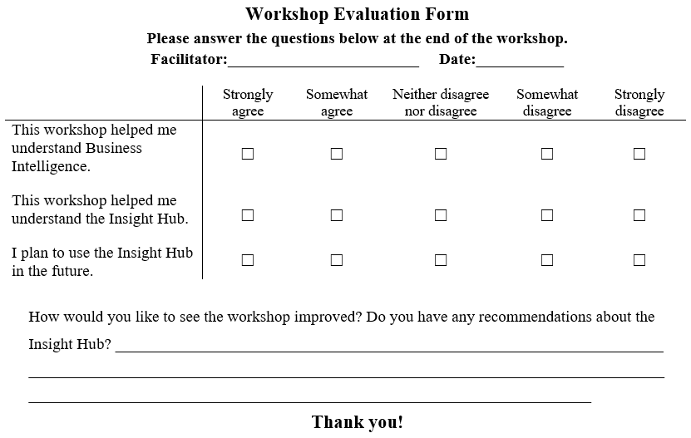
Workshop Evaluation

Slide 27
The Poster

Slide 28
Conclusions and Recommendations
Conclusions
Recommendations
Future Projects

Slide 29
Conclusions
Some staff do not understand that they use BI
They just see data as a part of their job
Few staff know about the Insight Hub
Many of the staff would find it useful
Over time the Insight Hub will likely become integrated in Lambeth

Slide 30
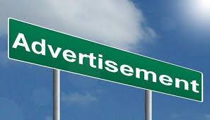
Recommendations
Insight Hub
♦ Create awareness
♦ Overcome perceived lack of need
Recommendations
♦ Media for insight hub
♦ More surveys and interviews
♦ Continue holding the workshops

Slide 31
Future Projects
Talk with a Human resources person
Data quality and standards
Continue with Lambeth as a sponsor
Better when council is done reorganizing

Slide 32
Acknowledgements
Our sponsor, Noel Hatch
Chris Guthrie
Lambeth Council
Professor Jianyu Liang and Professor Vincent J. Manzo

Slide 33
QUESTIONS?

Slide 34
References
Adelakun, Olawale. (2012 December 01). The Role of Business Intelligence in Government: A Case Study of a Swedish Municipality Contact Center [PDF]. University West. Retrieved April, 2016. https://www.diva-portal.org/smash/get/diva2:609244/FULLTEXT01.pdf
Baars, H., Kemper , H.-G. (2008) Management Support with Structured and Unstructured Data—An Integrated Business Intelligence Framework. Information
Systems Management, 25(2), 132-148, DOI: 10.1080/10580530801941058
Behaviours For The Cooperative Council. 1st ed. London: N.p., 2013. Web. 18 Mar. 2016.
Business Intelligence Uses. (n.d.). Retrieved April 01, 2016, from https://www.1keydata.com/datawarehousing/business-intelligence-uses.php
Campaigners protest at Lambeth council's cuts to its library service. (2016, March 21). Retrieved April 16, 2016, from http://www.slp.co.uk/article.cfm?id=116833
Chang, S. J., Hsiao, H. C., Huang, L. H., & Chang, H. (2011). Taiwan quality indicator project and hospital productivity growth. Omega, 39(1), 14-22. doi:doi:10.1016/j.omega.2010.01.006
Chen, H., Chiang, R. H., & Storey, V. C. (2012). Business Intelligence and Analytics: From Big Data to Big Impact. MIS Quarterly, 36(4), 1165-1188. Retrieved May 2, 2016, from http://hmchen.shidler.hawaii.edu/Chen_big_data_MISQ_2012.pdf
Chen, Y., Watson, E., Wohl, M., & Yao, Y. (2003). Customers’ Decision to Adopt Application Service Provider and Applications Service Providers’ Business Strategy in the Hospitality Industry: A Research Framework. Journal of Information Technology Case and Application Research, 5(3), 57-75. doi:10.1080/15228053.2003.10856026
Choi, T., Chan, H. K., & Yue, X. (2016). Recent Development in Big Data Analytics for Business Operations and Risk Management. IEEE Transactions on Cybernetics, PP (99), 1-12. doi:10.1109/TCYB.2015.2507599
Citizen's Advice. (2016). Welcome to Citizens Advice. Retrieved May 02, 2016, from https://www.citizensadvice.org.uk/ The website for Citizen's Advice Group in England.
Committee details - Committee. (n.d.). Retrieved March 18, 2016, from http://moderngov.lambeth.gov.uk/mgCommitteeDetails.aspx?ID=225
Committee details - Council. (n.d.). Retrieved March 18, 2016, from http://moderngov.lambeth.gov.uk/mgCommitteeDetails.aspx?ID=142
Committee meeting information. (n.d.). Retrieved March 18, 2016, from http://moderngov.lambeth.gov.uk/mgListCommittees.aspx?bcr=1
Constitution of the London Borough of Lambeth (2016)
A Cooperative Council. (2015) (1st ed.). London: N.p., 2013. Web. 18 Mar. 2016.
Creating Customer Contact Centres. (n.d.). Smart City. Retrieved April 1, 2016. http://www.smartcities.info/files/Creating%20Customer%20Contact%20Centres%20-%u20Smart%20Cities.pdf
Economist Intelligence Unit (EIU). (2007). Business Intelligence: Putting Enterprise Data to Work, EIU Oracle Sponsored Study, http://graphics.eiu.com/upload/portal/Oracle.BizIntel.pdf. Retrieved April 16, 2009.
Economist Intelligence Unit. (2016). The Economist Intelligence Unit. Retrieved May 13, 2016, from http://www.eiu.com/home.aspx
Elliott, D. (2011). Key stats. Retrieved April 10, 2016, from http://www.ageuk.org.uk/london/about-age-uk-london/media-centre/key-stats/
Fielding R. L. (2006). ‘Guide to The Top 5 Issues that Misguide Business Intelligence Decisions.’ freelance writer http://businessintelligencesoftware.blogspot.com/2008_03_01_archive.html. Retrieved April 16, 2009. Scroll down to the March 26th 2008 entries, this is the text of the article.

Slide 35
Foshay, N., & Kuziemsky, C. (2014). Towards an implementation framework for business intelligence in healthcare. International Journal of Information Managment, 34(1), 20-27. doi:doi:10.1016/j.ijinfomgt.2013.09.003
Golfarelli, M., Rizzi, S., & Cella, I. (2004). ACM international workshop on Data warehousing and OLAP (Vol. 7, pp. 1-6). Washington D. C.: ACM. doi:10.1145/1031763.1031765
Guy's Hospital, & St. Thomas Hospital. (2016). Our quality story. Retrieved May 02, 2016, from http://www.guysandstthomas.nhs.uk/about-us/quality-story/our-quality-story.aspx
Hill, D. (2015, February 23). London's poorest boroughs once again prepare to make the biggest cuts. Retrieved March 28, 2016, from http://www.theguardian.com/uk-news/davehillblog/2015/feb/23/londons-poorest-boroughs-once-again-prepare-to-make-the-biggest-cuts
HR-Survey. (2016). What is a Survey? from HR-Survey.com. Retrieved June 06, 2016, from http://www.hr-survey.com/WhatIs.htm
Information Governance Team. (2016). Strategic Management Framework(1st ed., pp. 1-32) (United Kingdom, Lambeth Council, Information Governance). Lambeth, London: Information Governance. Retrieved from file:///C:/Users/bgsarkis/Downloads/00%20Information%20Governance%20Framework%20v1.0%20(1).pdf
Introduction to the Insight Hub 0.2. (2016). Retrieved May 16, 2016, from http://www.slideshare.net/localinnovation/introduction-to-the-insight-hub-02
Jagielska, L., Darke, P., & Zagari, G. (2003). Business intelligence systems for decision support: Concepts, process and practice. In 7th International Conference of the International Society for Decision Support Systems (pp. 215-218). The Karol Adamiecki University of Economics. doi:http://arrow.monash.edu.au/hdl/1959.1/128961
Journal of Computer Information Systems, 50(3), 23-32. http://www.tandfonline.com.ezproxy.wpi.edu/doi/pdf/10.1080/08874417.2010.11645404
Kao, H., Yu, M., Masud, M., Wu, W., Chen, L., & Wu, Y. J. (2016). Design and evaluation of hospital-based business intelligence system (HBIS): A foundation for design science research methodology. Computers in Human Behavior, 62, 495-505. doi:doi:10.1016/j.chb.2016.04.021
Khan, A. M., Amin, N., & Lambrou, N. (2009, April 12). DRIVERS AND BARRIERS TO BUSINESS INTELLIGENCE ADOPTION: A CASE OF PAKISTAN. In Euopean and Mediterranean Conference on Information Systems. Retrieved April 16, 2016, from https://www.researchgate.net/profile/Nadia_Amin/publication/228439684_Drivers_and_Barriers_to_Business_Intelligence_Adoption_A_Case_of_Pakistan/links/0fcfd51128e2836923000000.pdf
Lambeth Borough Council is a co-operative council – but what does that actually mean? (2013, June 5). Retrieved April 1, 2016, from http://www.brixtonbuzz.com/2013/06/lambeth-borough-council-is-a-co-operative-council-but-what-does-that-actually-mean/
Lambeth Borough Guide. (n.d.). Retrieved March 18, 2016, from http://www.allinlondon.co.uk/boroughs/lambeth/
Lambeth Council. (n.d.). Retrieved March 18, 2016, from http://www.lambeth.gov.uk/
Lambeth First (2008). Our 2020 Vision: Lambeth’s sustainable Community Strategy. Retrieved from https://www.lambeth.gov.uk/sites/default/files/sc-our-2020-vision.pdf
Lambeth Growth Strategy Evidence Base. 1st ed. London: Shared Intelligence, (2014). Retrieved April 30, 2016. from http://www.walcotfoundation.org.uk/uploads/1/7/2/2/17226772/lambeth_growth_strategy_evidence_base.pdf
LG Inform. (n.d.). ESD standards. Retrieved May 16, 2016, from http://standards.esd.org.uk/?uri=group/metrics
Lowndes, V., & Gardner, A. (2016). Local governance under the Conservatives: Superausterity, devolution and the ‘smarter state’. Local Government Studies, 42(2), 1-15. doi:10.1080/03003930.2016.1150837
Marr, B. (n.d.). What is Business Intelligence (BI)? Retrieved April 2, 2016, from http://www.ap-institute.com/big-data-articles/what-is-business-intelligence-(bi).aspx

Slide 36
McGlone, P. (2015). London Borough of Lambeth Financial Resilience Strategy [PDF]. London: Cabinet of Finance and Investment. Retrieved April 1, 2016, from https://moderngov.lambeth.gov.uk/documents/s78812/FR%20Strategy%20Final.pdf
Negash, S. (2004). Business Intelligence. Communications of the Association for Information Systems, 13, 177-195. Retrieved April 16, 2016, from http://aisel.aisnet.org/cgi/viewcontent.cgi?article=3234&context=cais
OASIS ACADEMY JOHANNA Minutes of a Meeting of the Academy Council held at the School London:N.p.,2014 Web. 30 April, 2016 http://www.oasisacademyjohanna.org/sites/default/files/files/Minutes%20of%20Meeting%20-%2019_05_14%20Final.pdf
OLAP.com. (n.d.). What is the definition of OLAP? Retrieved May 13, 2016, from http://olap.com/olap-definition/
Olszak, C. M., & Ziemba, E. (2007). Approach to building and implementing business intelligence systems. Interdisciplinary Journal of Information, Knowledge and Management, 2, 135. Retrieved May 13, 2016, from http://go.galegroup.com.ezproxy.wpi.edu/ps/i.do?p=AONE&u=mlin_c_worpoly&id=GALE|A199195085&v=2.1&it=r&sid=summon&userGroup=mlin_c_worpoly&authCount=1#
Osborne, T. G., MP. (2016, March 16). Budget 2016. Retrieved March 28, 2016, from https://www.gov.uk/government/publications/budget-2016-documents/budget-2016#executive-summary
Piggott, G. (2105, July 30). [GLA Household Income Estimates]. Unpublished raw data
Popoviþ, A., Coelho, P. S., & Jakliþ, J. (2009). The impact of business intelligence system maturity on information quality. Information Research,14(4), 417-442. Retrieved April 12, 2016, from http://ssrn.com/abstract=1625573
Poster Tips. Retrieved from http://math.ca/Events/summer08/Poster_Tips.pdf
The Purposes of Government. (n.d.). Retrieved April 16, 2016, from http://www.ushistory.org/gov/1a.asp
Quality Nonsense Ltd. (2016). Database Administration - ANSI SQL Standards and Guidelines. Retrieved May 13, 2016, from http://www.whoishostingthis.com/resources/ansi-sql-standards/
Rossi, P. H., Wright, J. D., & Anderson, A. B. (Eds.). (2013). Handbook of survey research. Academic Press.
Sabin, L. (2015, July 14). Lambeth opts for gentrification on rotting estate. Retrieved April 01, 2016, from https://www.morningstaronline.co.uk/a-9ed3-Lambeth-opts-for-gentrification-on-rotting-estate#.Vv7UBqQrKhd
Schapira, M. M., MD, MPH, & VanRuiswyk, J., MD, MS. (2000, May). The Effect of an Illustrated Pamphlet Decision-Aid on the Use of Prostate Cancer Screening Tests. The Journal of Family Practice, 49(5), 418-424.
Schutt, R. K. (2015). Investigating the Social World: The Process and Practice of Research (8th ed.). Thousand Oaks, CA: SAGE Publications
Section 4. Conducting a Workshop. (n.d.). Retrieved April 21, 2016, from http://ctb.ku.edu/en/table-of-contents/structure/training-and-technical-assistance/workshops/main
Sedghi, A., & Butler, P. (2014, December 18). Local council cuts: Spending power by authority. Retrieved March 29, 2016, from http://www.theguardian.com/news/datablog/2014/dec/18/local-council-cuts-spending-power-by-authority
South London and Maudsley's Foundation Trust. (2009, February 4). Who we are. Retrieved May 02, 2016, from https://web.archive.org/web/20090204063918/http://slam.nhs.uk:80/about/who.aspx
State Of The Borough 2014. 1st ed. London: N.p., 2014. Web. 18 Mar. 2016.

Slide 37
State Of The Borough 2016. 1st ed. London: N.p., 2016. Web. 13 May. 2016.
Survey of London (Vol. 23, Lambeth: South Bank and Vauxhall). (1900). London: County Council. Retrieved March 22, 2016, from http://www.british-history.ac.uk/survey-london/vol23
The 4 Main Reasons to Conduct Surveys. (2012). Retrieved June 03, 2016, from http://www.snapsurveys.com/blog/4-main-reasons-conduct-surveys/
Tolliday, D. (2016). The Advantages of Posters. Smallbusiness.chron.com. Retrieved 2 June 2016, from http://smallbusiness.chron.com/advantages-posters-63269.html
Tremblay, M. C., Hevner, A. R., & Berndt, D. J. (2012). Design of an information volatility measure for health care decision making. Decision Support Systems, 52(2), 331-341. doi:doi:10.1016/j.dss.2011.08.009
Trust for London, & New Policy Institute. (2016). Education. Retrieved May 02, 2016, from http://www.londonspovertyprofile.org.uk/indicators/topics/low-educational-outcomes/
What is Business Intelligence (BI)? (n.d.). Retrieved April 1, 2016, from http://www.ap-institute.com/big-data-articles/what-is-business-intelligence-(bi).aspx
What Is Business Intelligence? (n.d.). Retrieved April 15, 2016, from http://business.tutsplus.com/tutorials/what-is-business-intelligence--cms-23412
Wyse, S. E. (2012, June 29). The 4 Main Reasons to Conduct Surveys. Retrieved June 06, 2016, from http://www.snapsurveys.com/blog/4-main-reasons-conduct-surveys/
Yeoh W. & Koronios A. (2010) Critical Success Factors for Business Intelligence Systems, Retrieved from http://www.tandfonline.com.ezproxy.wpi.edu/doi/pdf/10.1080/08874417.2010.11645404

