Slide 1
Closing the ‘W-Ever 6’ attainment gap
Yezi Chen, Jack Gerulskis, Siyuan (Claire) Li, Dieter Teirlinck
Advisors: John Orr, Paul Marrone
Notes:
Title Slide: sponsor, team name, member names. Explain the big context of your project, and take a minute to let your audience warm up to you.

Slide 2
Preface

Slide 3
Key Terms
‘Ever 6 student’ : A student who has ever received a free school meal in the past 6 years.
‘W-Ever 6 student’ : A white British student who has ever received a free school meal in the past 6 years.
Notes:
Linguistics : the ability to express oneself fluently and grammatically in speech ---- do we need this one?

Slide 4
Our Sponsor - Gospel Oak Primary and Nursery School
Located in Camden, ethnically and economically diverse
459 Students, Nursery, Reception, Years 1 - 6
~40% White British, ~26% Ever 6
“Outstanding School” according to Ofsted reports

Slide 5
The Problem

Slide 6
The ‘Ever 6’ group performs
24%
worse on General Certificate of Secondary Education exams than non ‘Ever 6’ students in the UK
Notes:
In UK!!

Slide 7
The ‘W-Ever 6’ group performs
38%
worse on General Certificate of Secondary Education exams than non ‘W-Ever 6’ students in the UK

Slide 8
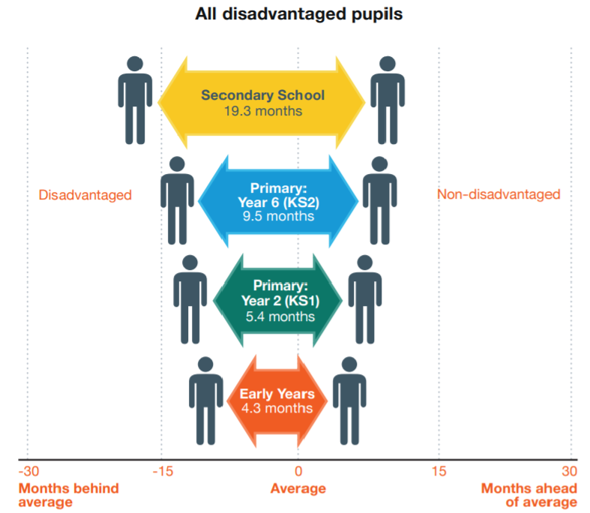
The attainment gap grows with age

Slide 9
What affects students’ attainment?
Economic Capital
Home Learning Environment
Aspiration
Aspiration
Socioeconomics
Reading
Child Directed Speech
Culture
English Level & Learning Progress
Student Oracy
Teaching Methods
Extracurriculars/Cultural Capital
Parental Engagement
Parents’ Education Achievement
School and Parent Collaboration
Notes:
Emphasis on wrapping up this ‘problem’ section with a brief summary of the complexity

Slide 10
Our Project

Slide 11
Mission Statement
The goal of this project is to collaborate with Gospel Oak Primary & Nursery School to analyse parental engagement and students’ linguistic skills and how those factors impact the educational attainment of W-Ever 6 students.
Notes:
Brief slide with information about your sponsor and their mission: (discuss it, rather than read it and figure out how to blend it into the flow) [NOTE: At times it will make sense to talk about #4 prior to talking about your sponsor]

Slide 12
Objectives
Linguistic Skills
#1 Analysis
#3 Improvement
Parental Engagement
#2 Analysis
#4 Improvement

Slide 13
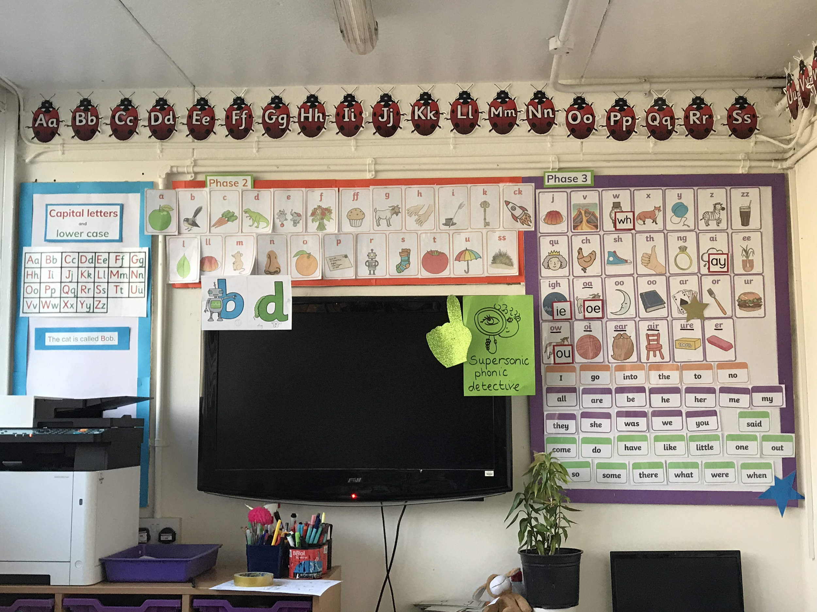
#1 To analyse students’ linguistic skills and the attainment gap
Attended classes
Held interviews
Analysed attainment
Held focus groups

Slide 14
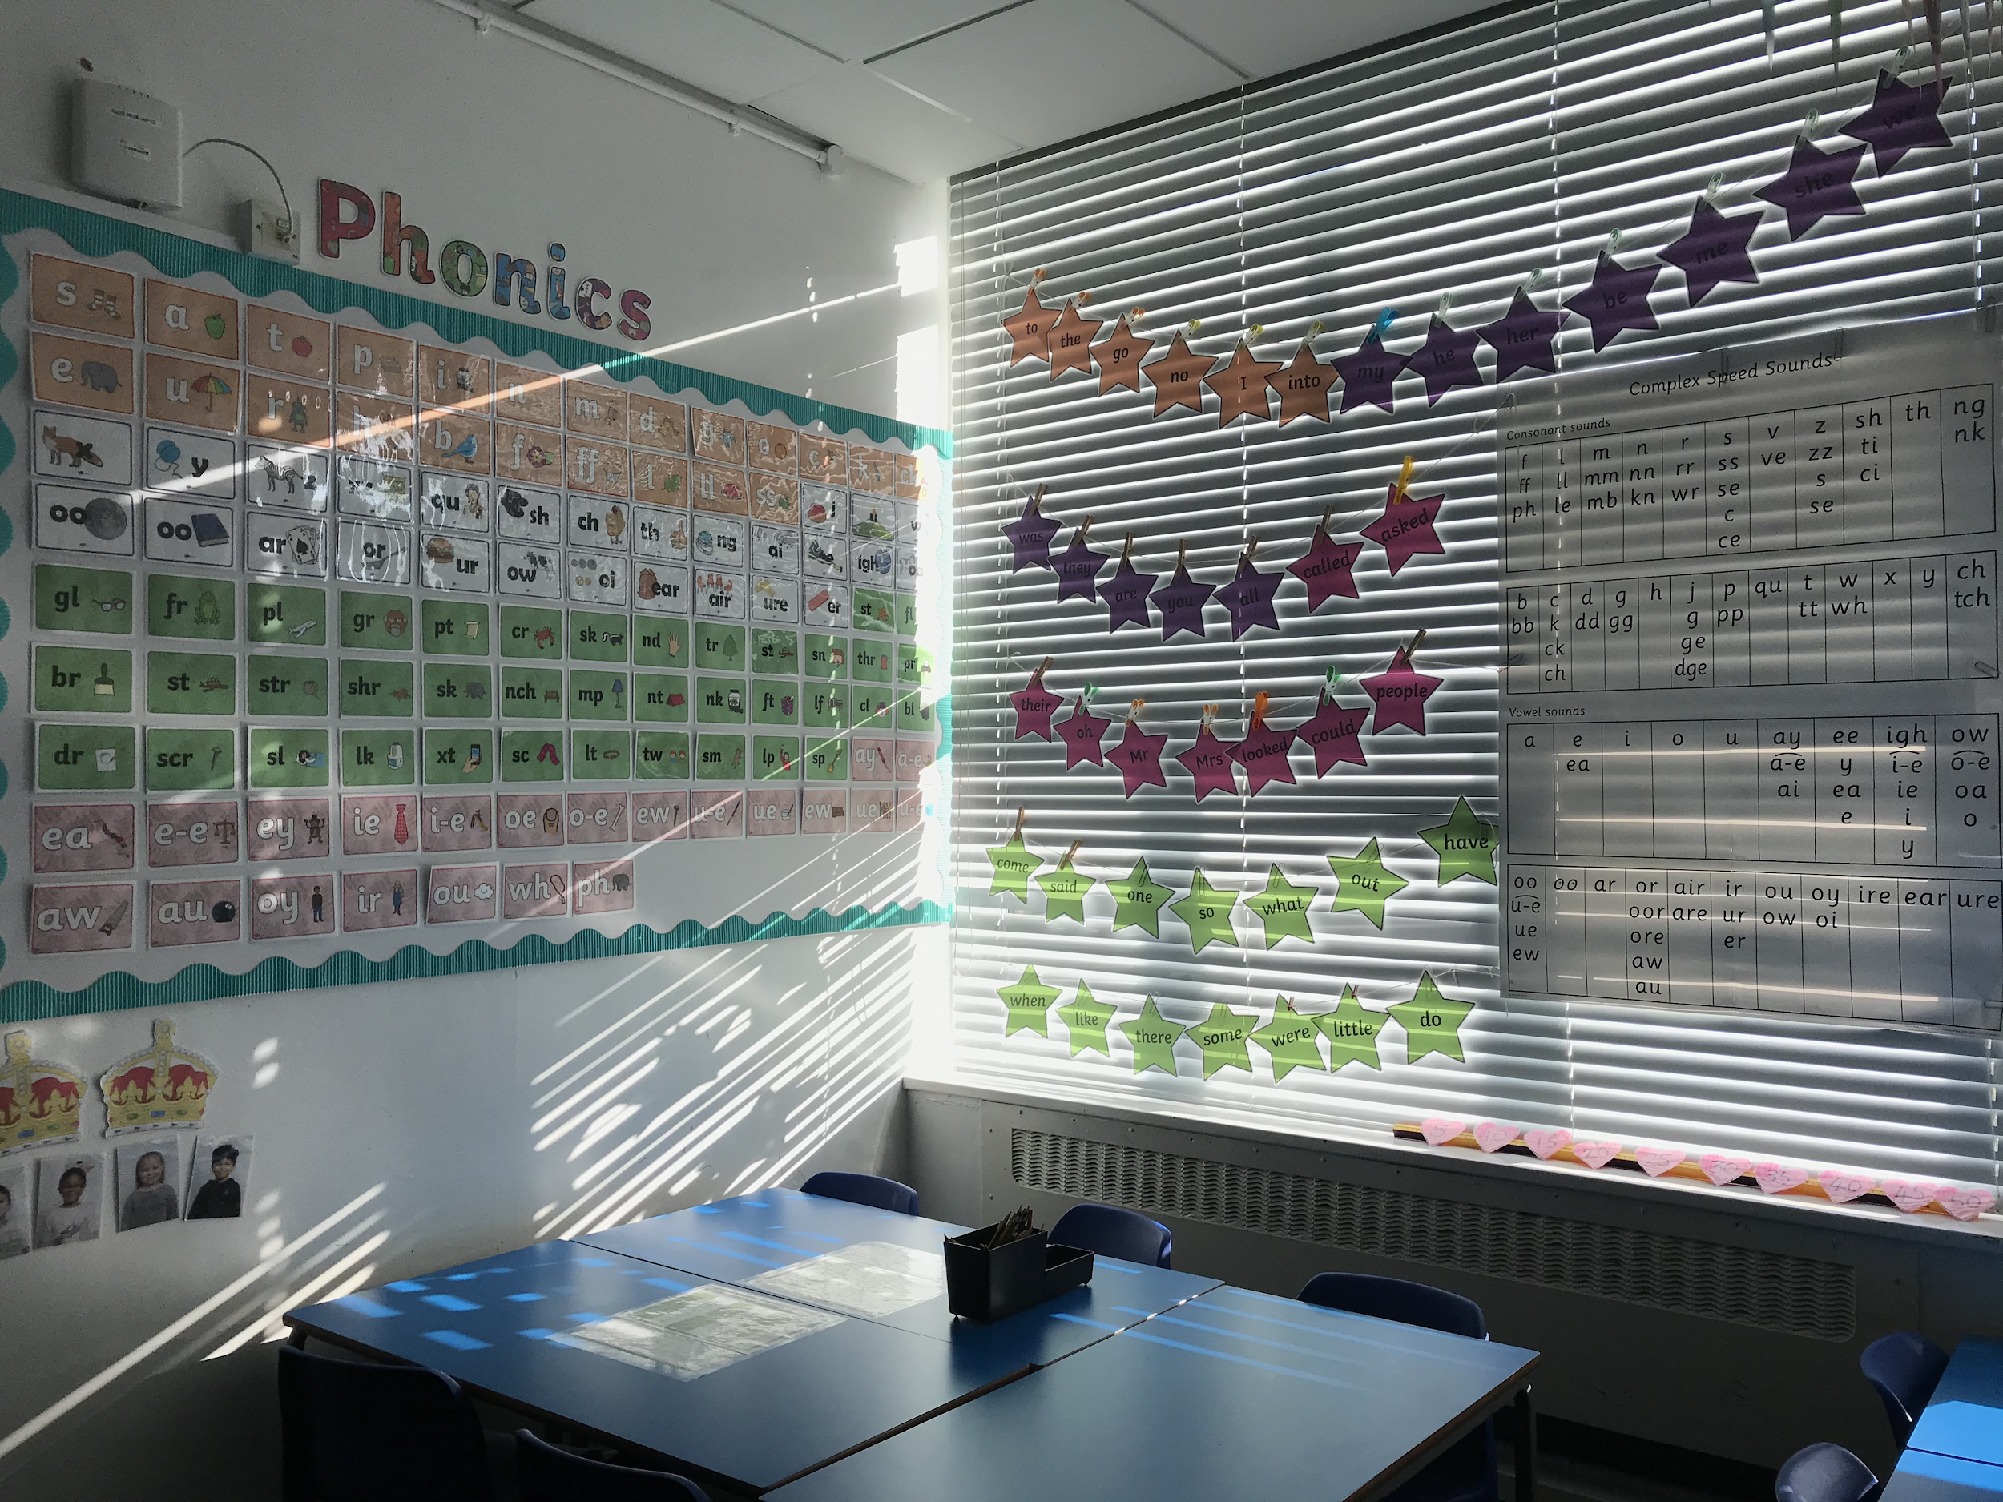
#1 To analyse students’ linguistic skills and the attainment gap
Attended classes at Gospel Oak Primary School from Nursery through Year 6
Engaging learning environment
Supportive teachers
Enough oracy strategies

Slide 15
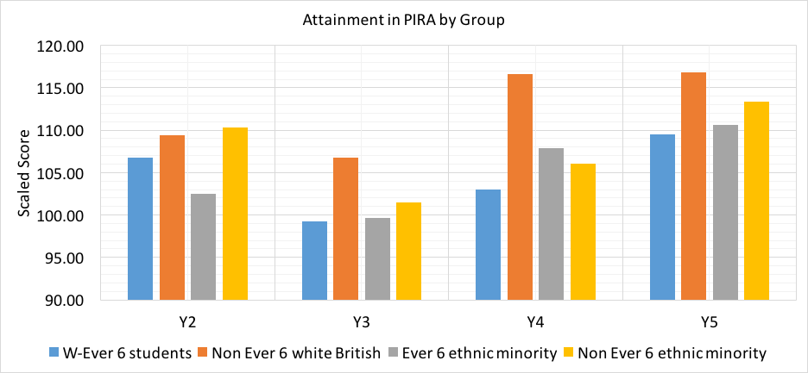
#1 To analyse students’ linguistic skills and the attainment gap
Analysis of existing scores
Progress In Reading Assessment (PIRA)
Full scaled score is 115 (Year 2)
Full scaled score is 120 (Year 3, 4, 5)
Grouping by ethnicity and eligibility for free school meal
W-Ever 6 students (Blue)
Non Ever 6 white British (Orange)
Ever 6 ethnic minority (Grey)
Non Ever 6 ethnic minority (Yellow)

Slide 16
Non Ever 6 White British is ahead of the other three groups.

Slide 17
7.30
13.63
2.66
7.55
Attainment gap widens in Year 3.

Slide 18
7.10
1.57
2.66
7.85
The attainment gap within ethnic minority groups almost closes in Year 5.

Slide 19
#1 To analyse students’ linguistic skills and the attainment gap
 | W-Ever 6 (Attaining well) |  | W-Ever 6 (Attaining poor) |  | Ever 6 (Attaining well) |  | Ever 6 (Attaining poor)
 | + | - | + | - | + | - | + | -
Comprehension | IIIIIIIIII |  | IIIIIIIIIII | II | IIIIIIIIIIIII |  | IIIIIIIIIIII | III
Complete Sentence | IIIIIIII | IIII | IIIII | IIIIIIIIII | IIIIIIIIIIII | III | IIIIIIIII | IIIIII
Proper Grammar | IIIII | II | III | IIIIIIIII | IIIIIIIII | IIIIIII | IIIIII | IIIIIIII
Formality | IIIIII | II | III | IIIIIIII | IIIIIIIII | IIIIII | IIIII | IIIIIIII
Vocabulary | IIIIII | III | III | IIIIII | IIIIIIIII | II | IIIII | IIIIII
Total responses | 46 |  | 60 |  | 70 |  | 68

Slide 20
#2 To analyse parental engagement with the school and at home with their children
Created survey for parents using Qualtrics
Some questions for parental engagement at home
Some questions for parental engagement with the school
Some questions about linguistics to help with Objective #1

Slide 21
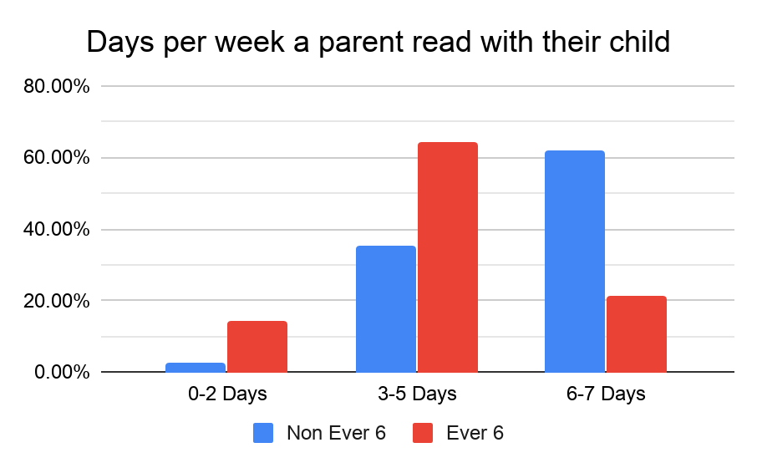
Notes:
Parents should read as much as possible with their children

Slide 22
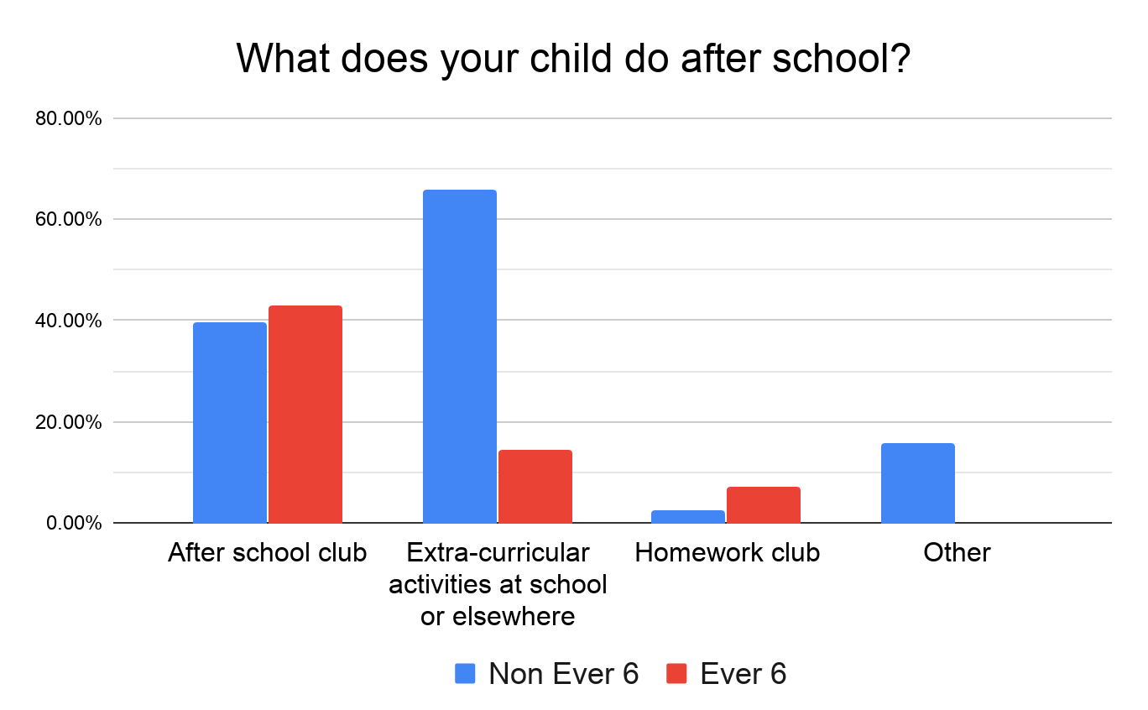

Slide 23
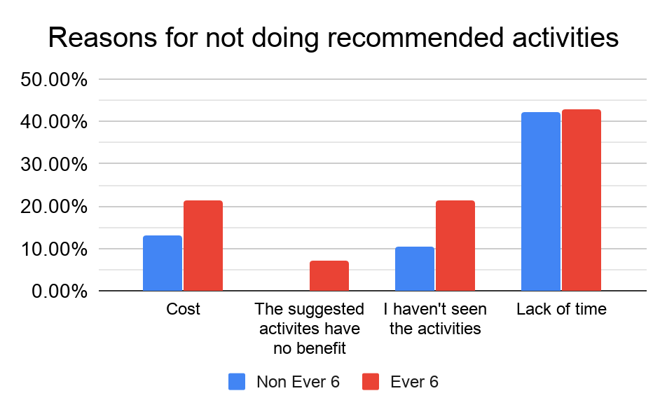

Slide 24
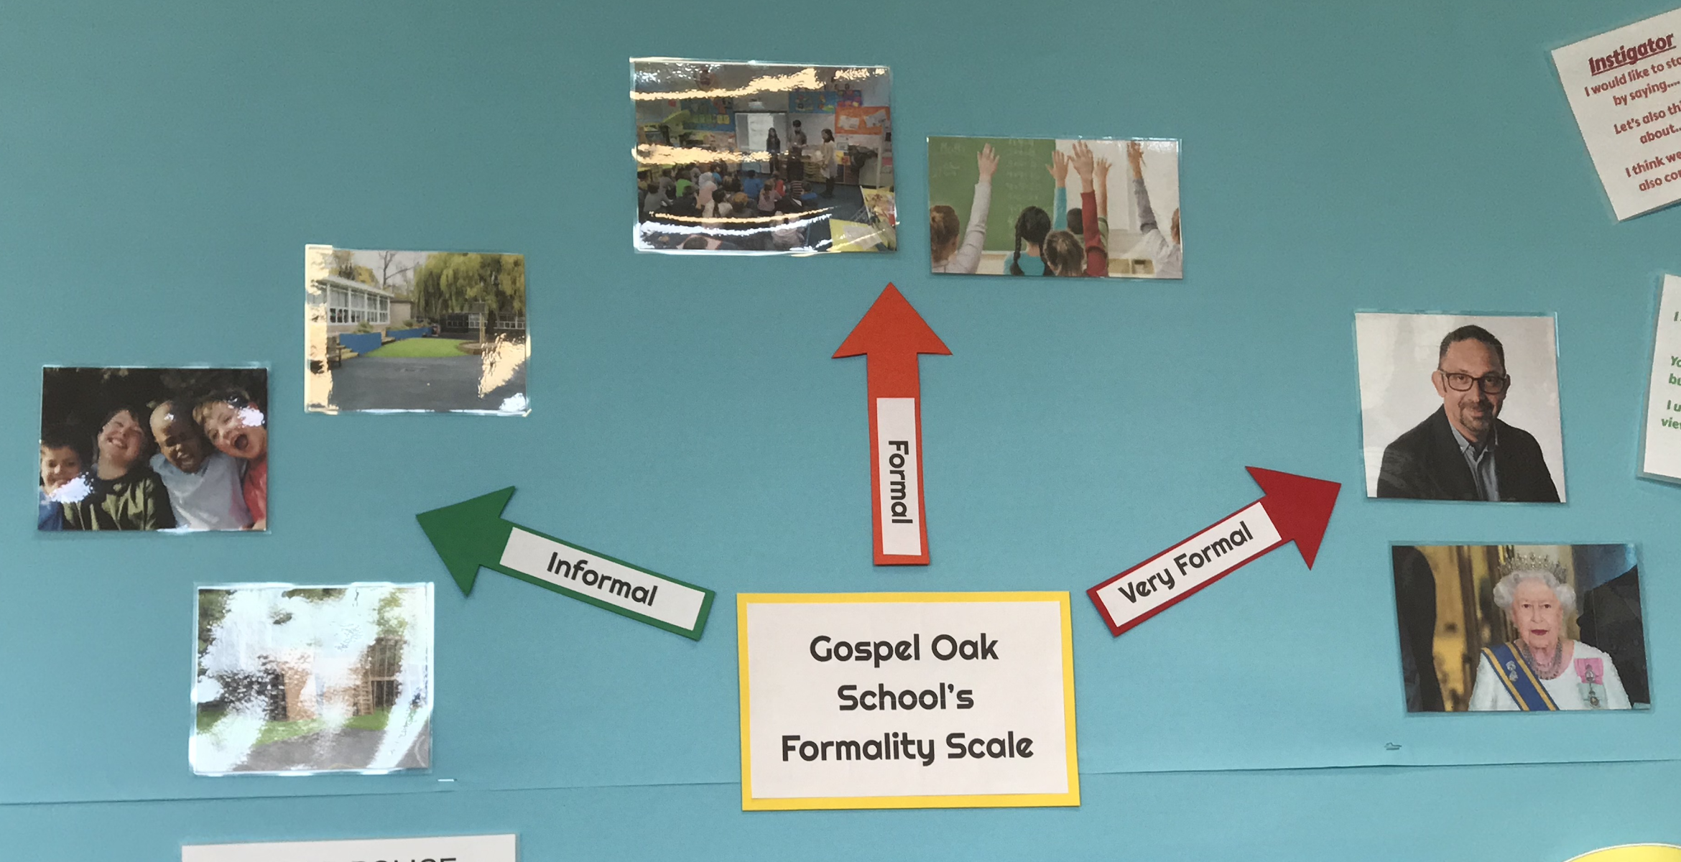
#3 To improve students’ linguistic skills by collaborating with senior faculty and parents
Practice, Practice, Practice
Reading homework
Language formality
Enforcing language formality
Awareness on Child Directed Speech
At home linguistics
Booklet on at-home-strategies

Slide 25
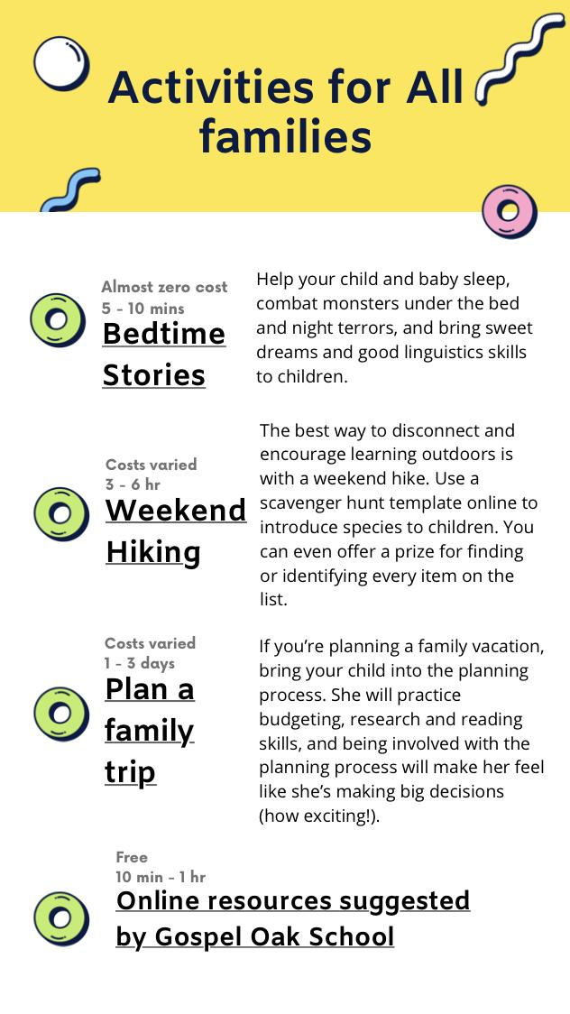
#3 To improve students’ linguistic skills by collaborating with senior faculty and parents
Booklet on at-home-strategies
Importance of home learning
Availability of educational resources
Flipped Learning
Educational games / activities
Recommended linguistics practice
All in one convenient location

Slide 26
#4 To improve parental engagement by introducing effective educational engagement based on existing research
Parent and student engagement
Created handbook for parents on Canva
Categorized by students’ passions
Digital copy with hyperlinks
Parent and school engagement
New communication platform to improve engagement

Slide 27
#4 To improve parental engagement by introducing effective educational
engagement based on existing research
Booklet on at-home-activities
Activities for parents of future Scientists/Artists/Athletes/Engineers…
With prices and estimated time
Suggested extracurricular locations
Online resources: Flipped learning
Parenting Tips:
Pause, Prompt, Praise
Parent by example
Encourage proper linguistics

Slide 28
#4 To improve parental engagement by introducing effective educational
engagement based on existing research
 | Newsletter | Website | WhatsApp | Slack | Class Dojo
Cost efficiency | 0 | +1 | +1 | +1 | +1
Instant communication | 0 | -1 | +1 | +1 | +1
Availability of sharing documents | 0 | +1 | +1 | +1 | +1
Group size | 0 | 0 | +1 | +1 | +1
Separate channels for parents | 0 | 0 | -1 | +1 | +1
Familiarity | 0 | 0 | +1 | -1 | -1
‘Quiet Hours’ | 0 | 0 | -1 | +1 | +1
Follow up function | 0 | 0 | -1 | +1 | +1
Follow each parent | 0 | -1 | 0 | 0 | +1
Even Weighted Total score | 0 | 0 | +2 | +6 | +7
Notes:
We evaluated different platforms by comparing all of them with the Newsletter, which Gospel Oak is currently using.

Slide 29
Conclusion

Slide 30
Acknowledgments
We would like to express our gratitude to …
Headteacher John Hayes
Dawn O’Driscoll
All Gospel Oak Primary School faculty
Professor John Orr
Professor Paul Marrone
Naomi Pollard
Camden Learning staff: Jon Abbey, Martin Cresswell

Slide 31
Thank you for listening, any questions?
Closing the ‘W-Ever 6’ attainment gap
Yezi Chen, Jack Gerulskis, Siyuan (Claire) Li, Dieter Teirlinck

