Slide 1

Storying Climate Change: London
By: Raul Arias Philippi, Ryan Carnemolla, Aidan Mayer, and Cameron Williams
Sponsor: Global Projects Program

Slide 2



The Global Projects Program
Responsible for coordinating off-campus projects and outreach
Prof. Shockey started the climate change Stories initiative in 2014
  Contextualizing climate change around individual experiences
Iceland
Japan
England
China
Albania
Australia
India
New Zealand

Slide 3
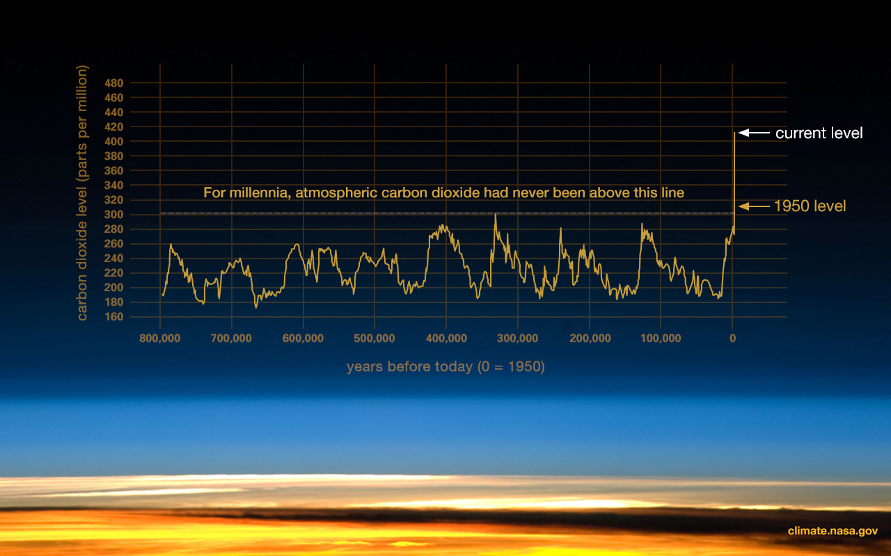
The Science of Climate Change

Slide 4
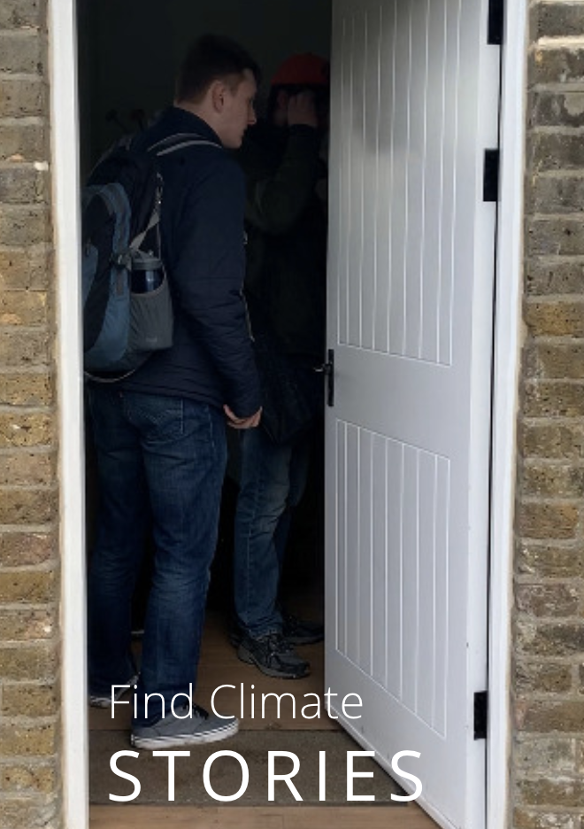
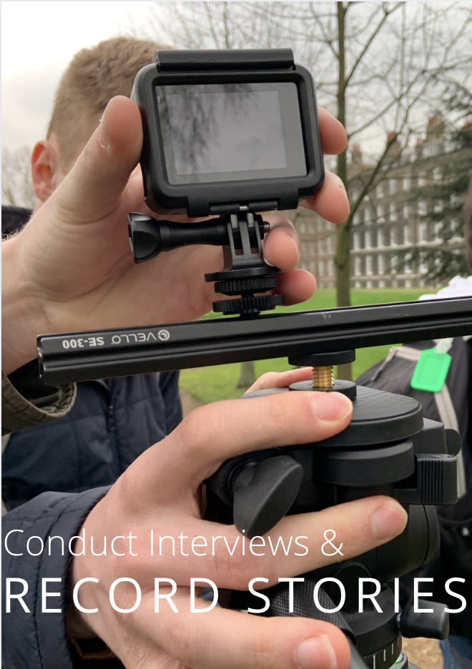
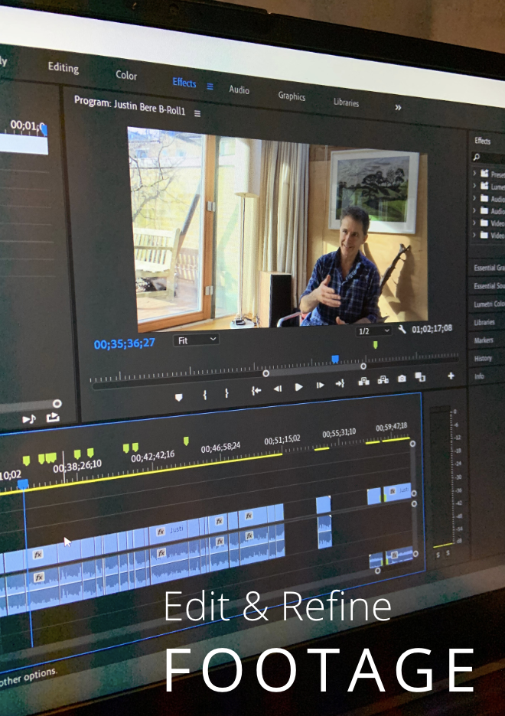
To document and present the experiences of Londoners as they relate to climate change

Slide 5
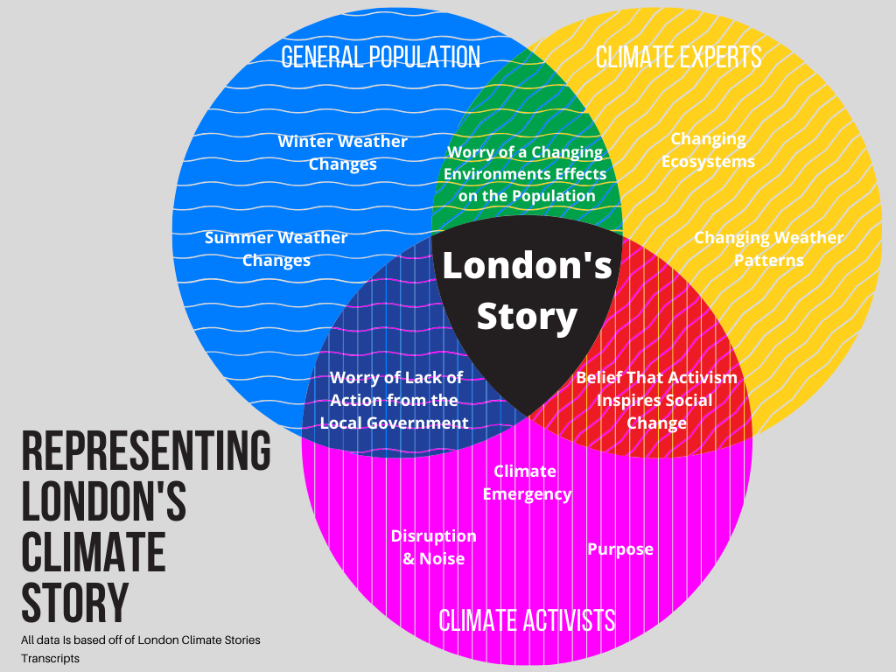
Findings

Slide 6
Acknowledgements
Prof. Dominic Golding
Prof. Paul Marrone
Prof. John Orr
Prof. Ingrid Shockey
Interviewees

Slide 7
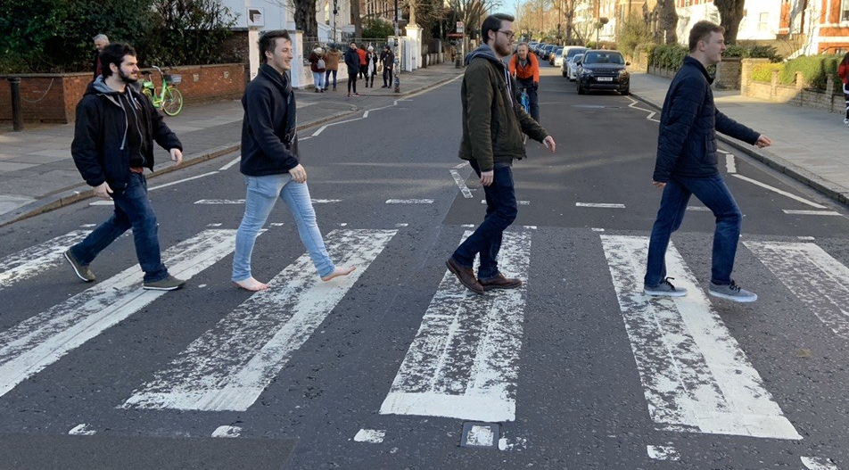
Thank You!
Questions?

