Slide 1
INCREASING COMMUNITY RESILIENCY THROUGH THE DEVELOPMENT OF MICROGRIDS
Worcester Polytechnic Institute
Sarah Chon, Amanda Mui, Samantha Yeung, Vincent Vu

Slide 2
TECHNICAL ADVISORS TO DEVELOPMENT OF MICROGRIDS
UNDERSTANDABLE AND ACTIONABLE CLIMATE SCIENCE AND CLEAN ENERGY FOR ALL

Slide 3
OUR PROJECT PROCESS
RESEARCH
EVALUATIONS
RECOMMENDATIONS
GOALS AND OBJECTIVES
INTERVIEWS

Slide 4
GOAL OF OUR IQP
IMPROVE MICROGRID OPPORTUNITIES FOR:
BY EXPLORING THE BARRIERS
PREVENTING IMPLEMENTATION
IN CAMBRIDGE, MA
UNDERSERVED COMMUNITIES
COMMUNITIES AFFECTED BY CLIMATE CHANGE

Slide 5
OBJECTIVES
Site Research
Understand Needs & Concerns
Analyze Barriers

Slide 6
CURRENT ENERGY PROBLEMS
CLIMATE CHANGE
INCREASED ENERGY DEMANDS
ENERGY RESILIENCY NEED
GROWING RELIANCE ON RENEWABLE ENERGY SOURCES

Slide 7
MICROGRID SOLUTION
Localized
Works Autonomously and with Main Grid
Lower Energy Bills
Load Management
Potential Benefits:
135 construction job-years over years 1 through 6
Total square footage of 1.75 million could be made resilient

Slide 8
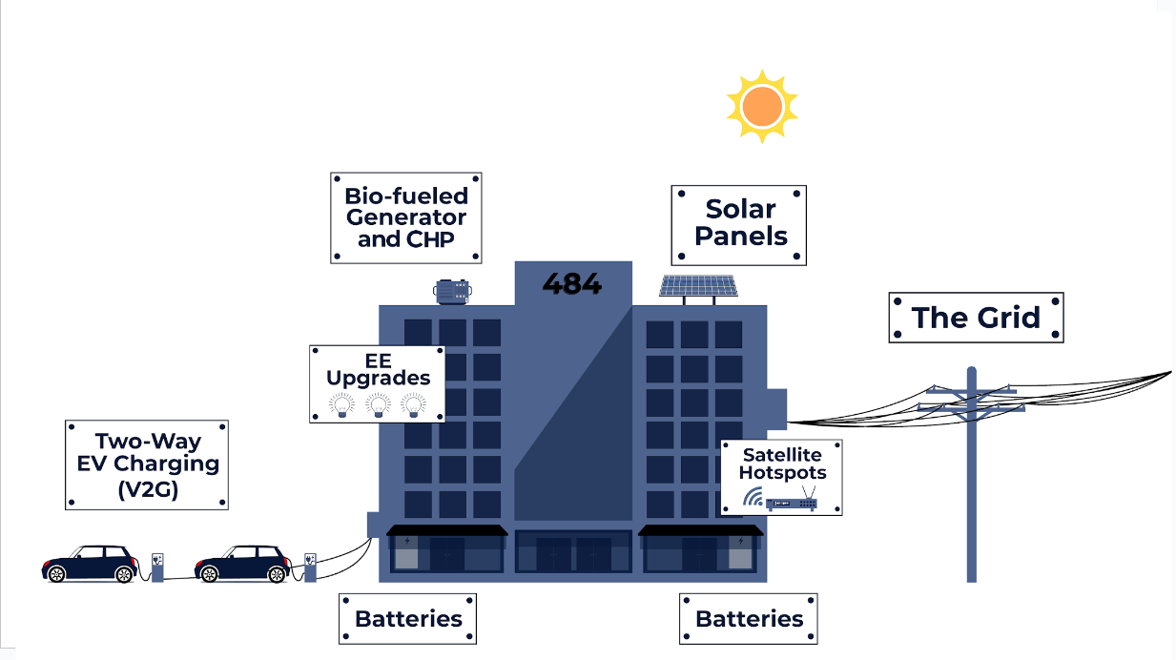
MICROGRID COMPONENTS
78% of rooftop capacity
83% of canopy capacity

Slide 9
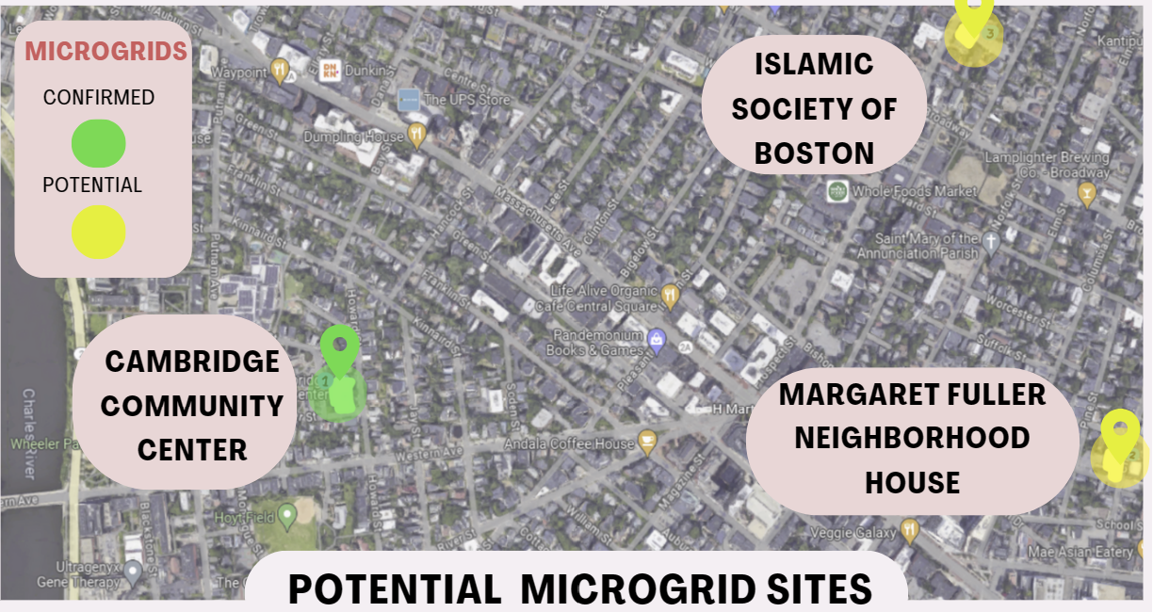
POTENTIAL MICROGRID SITES

Slide 10
INTERVIEWEES
ENVIRONMENTALISTS
COMMUNITY LEADERS
POLICY MAKERS
EXECUTIVE DIRECTOR OF CHINATOWN COMMUNITY LAND TRUST
REAL ESTATE ATTORNEY
CITY COUNCILOR
RETIRED ENVIRONMENTAL PLANNER FOR CAMBRIDGE
FORMER FIRE CHIEF & ADVOCATE OF PUBLIC SAFETY
MICROGRID COLLABORATION TEAMS
INTERVIEW STATS: 8 INTERVIEWS | 300 MINUTES | 29,708 WORDS

Slide 11
BARRIERS IDENTIFIED
PHYSICAL BARRIERS
POLICIES
FINANCIALS
BIASES AND MISUNDERSTANDINGS
SPACE: ROOFTOPS, PARKING(CANOPIES), FIELDS
REGULATIONS,
EXISTING INFRASTRUCTURE, DELAYS IN APPROVALS
GRANTS, PROJECT FINANCING, INCENTIVES
PAST UNDERSTANDINGS, UNAWARE OF NEW INCENTIVES

Slide 12
OUR RECOMMENDATIONS
COMMUNICATION
SOLAR
UTILITY COMPANIES NEED TO COMMUNICATE WITH THEIR CONSUMERS
SPREAD SOLAR POWER AWARENESS
MICROGRIDS
ADVOCATE
SPREAD MICROGRID AWARENESS
ADVOCATE FOR INCREASED MUNICIPALITY ENGAGEMENT

Slide 13
THANK YOU!
A special thank you to our sponsor Clean Energy Solutions Inc., Climable, and advisor Professor Paul Mathisen for all their time and support throughout our project!

