Slide 1



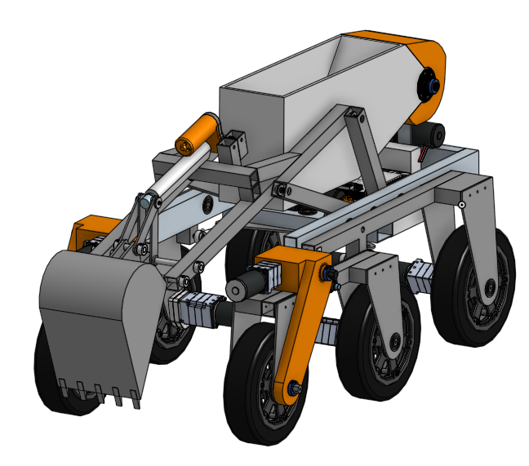
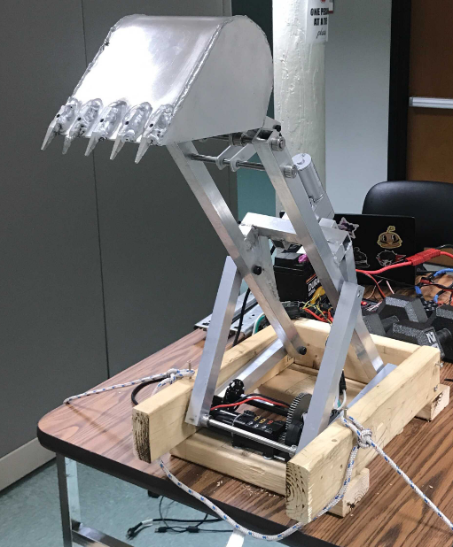
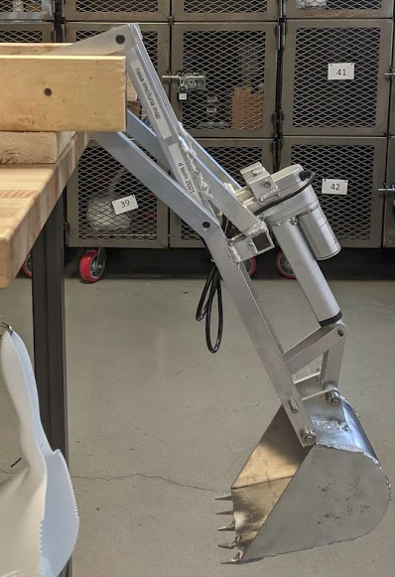
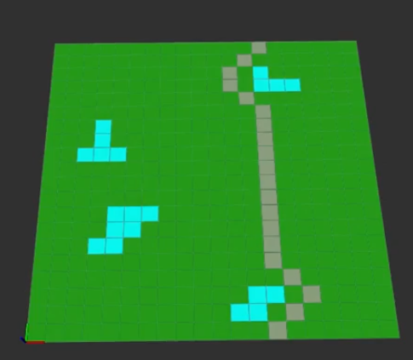
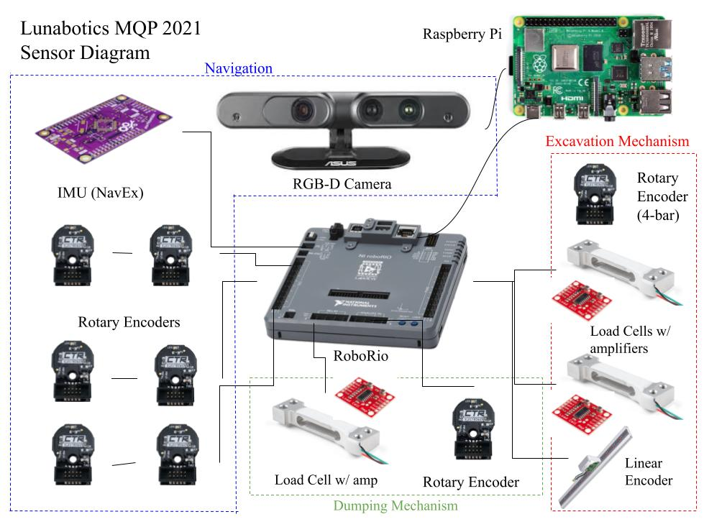
NASA Lunabotics 2021:
Robotic Mining Competition MQP
Students: David Houbre, John Mushatt, Lisa Spalding, Keming Wang, Shane Villafana
Advisors: Joshua Cuneo, Ken Stafford, Therese Smith, and Michael Ciaraldi
Abstract
Design
Build & Testing
The NASA Robotic Mining Challenge is a yearly competition in which university teams build a rover to navigate rough terrain and mine and deliver simulated icy regolith. With strict size constraints, additional challenges are to minimize the rover mass, energy used, and communication bandwidth, as well as achieve full autonomy. Our MQP developed an original design for an all-new rover with a rocker-bogie chassis and a novel, two degree of freedom, backhoe-style excavator. We were only able to build and test the excavator portion of this robot due to COVID and time constraints. We also programmed and tested the state machine and navigation system, creating a code base that can be used by future teams.
Excavator Mechanism:
1/8" and 1/16" aluminum square tubing
Custom aluminum plate
FRC Bag & Linear Actuator
Versaplanetary gearboxes
Welded to reduce weight
Base Construction:
2x4 wood
Stand-in for robot chassis
Testing:
Excavator connected to the RoboRio control system.
Teleoperation and autonomous test programs
Regolith approximated with sand and gravel past 30cm
Project Goals
6-wheel drive rocker-bogie system
Novel 2 DOF four bar digging mechanism
Angle amplifier (small four-bar) to control the angle of the excavator scoop mechanism
Custom 3-D printed dust protectors
Integrated sensor system for full autonomy
RoboRio control system Electronics
State machine to control overall robot status and allow for autonomous error recovery
RGB+Depth camera to enable simultaneous localization and mapping
Design and CAD full robot
Mine down to 45 cm
Fully autonomous navigation and digging
Build as much as possible
Meet or exceed all RMC requirements and specs
Navigation
Notable Features:
Raspberry Pi + ROS navigation and coms
Astar navigation algorithm running in a ROS node

