Slide 1
Investigating Whether A Social Media Presence Impacts Claim Severity
Elizabeth Beazley, Katherine Curran,
Anton Libsch, Robert Ronacher

Slide 2
Agenda
Goals & Objectives
Data Preparation
Exploratory Analysis
The Generalized Linear Model (GLM) Procedure
Key Results & Conclusions
Future Recommendations
Acknowledgements

Slide 3
Project Goal
Determine if social media data can be predictive of claim severity within workers’ compensation insurance in the restaurant and food services industry.
Claim Severity = $\frac{Total Claim Amount}{Number of Claims}$
Workers’ compensation insurance: offers a safety net for work-related accidents or illnesses, helping to pay for medical care, rehabilitation, & lost wages.

Slide 4
Potential Value of Social Media Data
Underwriting
A factor to consider when deciding to write a policy or not.
A rating factor to determine policy premium.
Marketing
Target groups who have the lowest predicted claim severity in order to minimize losses.
4

Slide 5
Agenda
Goals & Objectives
Data Preparation
Exploratory Analysis
The GLM Procedure
Key Results & Conclusions
Future Recommendations
Acknowledgements

Slide 6
Data Preparation
Original data set obtained from The Hanover
Total Data Points: 43,181
Removed policies effective before 2010
New Total: 29,925
Removed closed claims with loss amount $0
New total: 14,272
Removed claims without a
corresponding policy
New total: 12,769
Filtered data to claims from the restaurant industry & workers’ comp insurance & censored at the 98th percentile
New total: 4,890
Randomly sampled 75%
New total: 1,348
Compressed claims to one location point by policy year
New total: 1,797

Slide 7
Data Collection: Social Media Variables
Business Website
Consumer Generated Media
Company Generated Media
Does the company have a Yelp/TripAdvisor page?
How many reviews does the page have?
What is its 5 star rating?
Does the company have any Google Reviews?
Does the company have a Facebook page?
Does the company have its own website?
7

Slide 8
Collecting Online Information
Legalities:
Screen Scraping can be a violation of the Computer Fraud and Abuse Act
APIs are available, but are very restrictive.
Result:
We manually collected all social media data.

Slide 9
Agenda
Goals & Objectives
Data Preparation
Exploratory Analysis
The GLM Procedure
Key Results & Conclusions
Future Recommendations
Acknowledgements

Slide 10
Analysis Strategy
Familiarize ourselves with the data set and the social media fields that we gathered.
Observe the relationship between the variables and claim severity.
- Analyses of the social media variables vs. claim severity.
- Trend graphs of the claim severities of social media variables over time.
Identify changes to improve the data set.
- Censoring the data to cap large losses.

Slide 11
Claim Severity by Social Media Variable
Total Loss Amount | 32,057,222
Total # of Claims | 4,890
Overall Claim Severity | 6,556

Slide 12
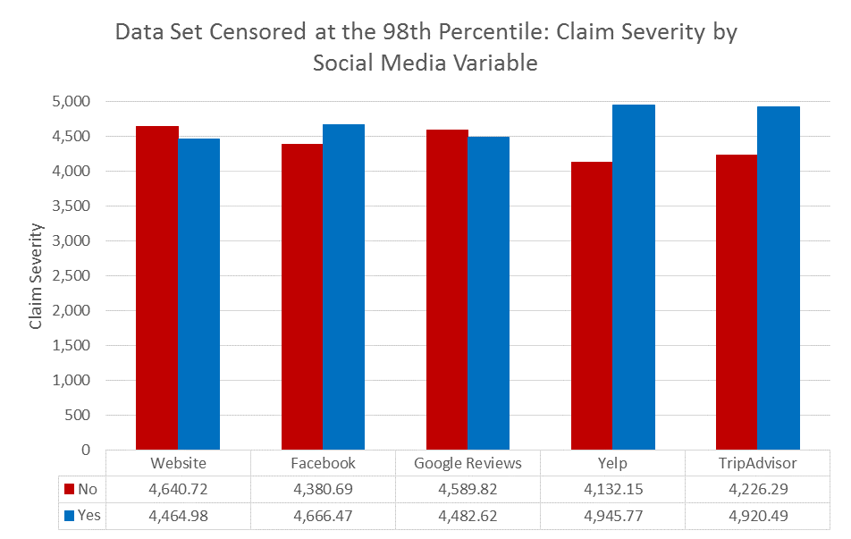
Claim Severity by Social Media Variable
Total Loss Amount | 22,122,300
Total # of Claims | 4,890
Overall Claim Severity | 4,524
*From this point forward, all analyses used the data set censored at the 98th percentile.

Slide 13
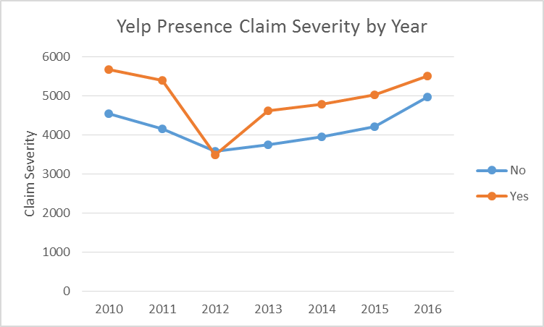
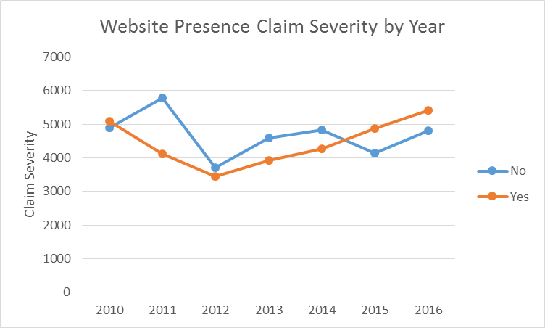
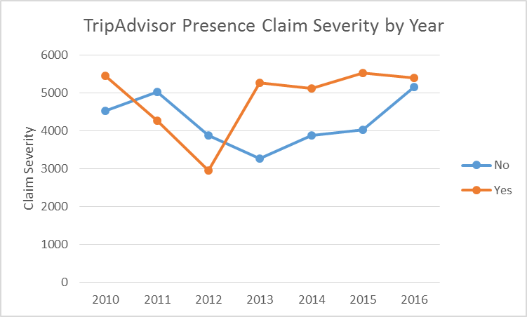
Trend Graphs

Slide 14
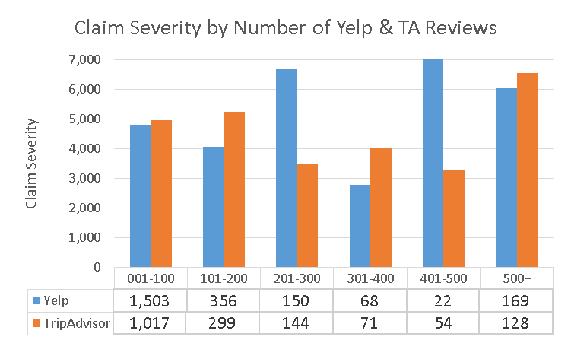
Claim Severity by Number of Reviews

Slide 15
Claim Severity by Rating

Slide 16
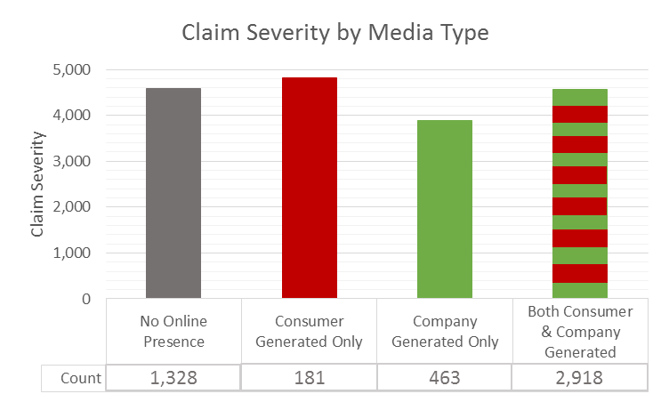
Claim Severity by Consumer vs. Company Generated Media
Consumer Generated Media
Company Generated Media
Business Website

Slide 17
Correlation of Social Media Variables
 | Website | Facebook | Google Reviews | Yelp | Trip Advisor
Website | 1 | ---- | ---- | ---- | ----
Facebook | 0.6751 | 1 | ---- | ---- | ----
Google Reviews | 0.7073 | 0.6901 | 1 | ---- | ----
Yelp | 0.6996 | 0.7570 | 0.7480 | 1 | ----
TripAdvisor | 0.6142 | 0.6941 | 0.6199 | 0.7537 | 1

Slide 18
Agenda
Introduction
Goals & Objectives
Data Preparation
Exploratory Analysis
The GLM Procedure
Key Results & Conclusions
Future Recommendations
Acknowledgements

Slide 19
Components of the Generalized Linear Model
Random Component
The distribution of the response variable
Systematic Component
Explanatory variables as a combination of linear predictors
Link Function
Relationship of the expected value to the linear predictors.

Slide 20
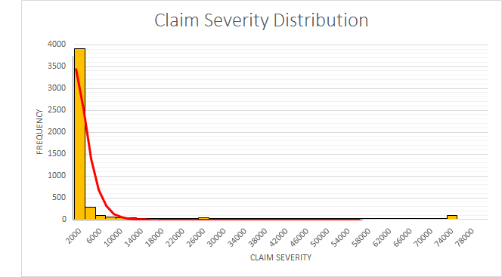
Claim Severity Distribution
Censoring Point

Slide 21
Model Strategy
1) Select a random sample.
We used 75% of our data as our build sample, and reserved the other 25% for validation testing.
2) Run the modeling procedure.
We used the GENMOD procedure within SAS.
3) Adjust and validate the model.
We used key outputs from SAS to adjust our model.

Slide 22
Model Design
Response variable: Claim Severity
Model distribution: Gamma with a log link
Model type: Generalized Linear Model (GLM)
Variables:
Social Media | Extra Information | Policy Information
Website Facebook GoogleReview YelpPage TripAdvisorPage | YelpRating NumYelpReviews TARating NumTAReviews | Policy Region/Subregion Policy Year

Slide 23
Adjusting the Model
The p-value of the significance test:
High p-values are removable.
AIC, AICC, BIC
Measurements of overall model fit.
Residual Plots
Want the residuals to be randomly scattered around 0.

Slide 24
Agenda
Goals & Objectives
Data Preparation
Exploratory Analysis
The GLM Procedure
Key Results & Conclusions
Future Recommendations
Acknowledgements

Slide 25
Model Parameters
Website
Yelp Page
Policy Sub-Region
Bucketed Policy Years (2010-2013, 2014-2016)
The claim severity can be modeled by the equation:
log(E[claim severity]) = β₀ + β₁×WebsiteNo + β₂×WebsiteYes + β₃×YelpPageNo + … + ε

Slide 26
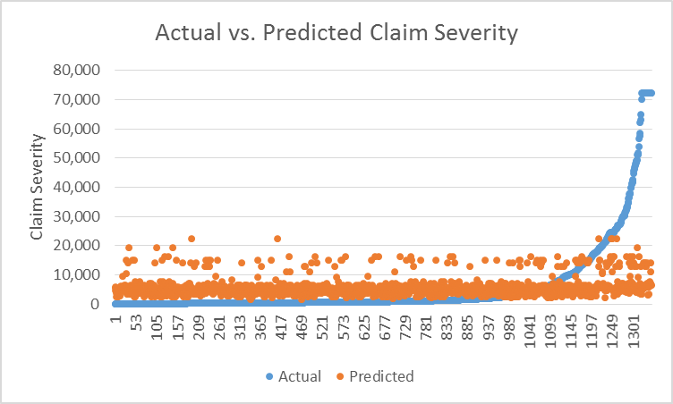
Actual vs. Predicted Claim Severity

Slide 27
Agenda
Goals & Objectives
Data Preparation
Exploratory Analysis
The GLM Procedure
Key Results & Conclusions
Future Recommendations
Acknowledgements
26

Slide 28
Future Recommendations
Expand original data set
Locations: Mailing address vs. business address
Claim Type: Medical vs. Indemnity
Gathering more information
Dates to track trends over time
Review rating distribution
Include other websites
Include employee websites
Use ‘Sentiment Analysis’ on written reviews
Categorizing opinions expressed in text to determine the writer’s attitude towards a topic
27

Slide 29
Acknowledgements
Our team would like to thank all those who invested their time and knowledge into our project:
Rick Burt
Jaris Wicklund
Isin Ozaksoy
Professor Jon Abraham
Professor Barry Posterro
Professor Randy Paffenroth
And everyone else who made this project possible!
28

Slide 30
Questions?

Slide 31
Examples of Link Functions
For link function f(x), $f\left(E\left(X\right)\right)= p_{1}e_{1}+p_{2}e_{2}…+p_{n}e_{n}$
Where p is 1 if the parameter is being estimated and 0 if not, and n is the number of parameters.
Log link:
$\ln{E\left(X\right)=p_{1}e_{1}+p_{2}e_{2}…+p_{n}e_{n}}$
$$E\left(X\right)= e^{p_{1}e_{1}+p_{2}e_{2}…+p_{n}e_{n}}$$

Slide 32
AIC, AICC and BIC
AIC - Akaike Information Criterion
AICC – Corrected Akaike Information Criterion
BIC – Sawa-Bayes Information Criterion
p = number of estimated parameters n = number of data points LogLikelihood is provided by SAS
$$AIC=−2∗LogLikelihood+2p$$
$$AICC=−2∗LogLikelihood+2∗\left(\frac{n}{n−p−1}\right)$$
$$BIC=−2∗LogLikelihood+p∗\ln{n}$$

Slide 33
Equation
log(E[claim severity]) = β0 + β1×WebsiteNo + β2×WebsiteYes + β3×YelpPageNo + … + ε
= 8.4422 + 0.3952*WebsiteNo + 0.0000*WebsiteYes
+ (-0.3146)*YelpPageNo + 0.0000*YelpPageYes
+ (-0.1641)*EastNorthCentral + (-0.5880)*EastSouthCentral +(.4225)*MiddleAtlantic
+ (-0.0941)*Mountain + (0.3293)*NewEngland + (1.1764)*Pacific + (0.2605)*SouthAtlantic
+ 0.0878*WestNorthCentral + (0.0000)*WestSouthCentral
+ (-0.1406)*BucketedYears2010-2013 + (0.0000)*BucketedYears2013-2016

Slide 34
Running the Model with the Test Sample

