Slide 1


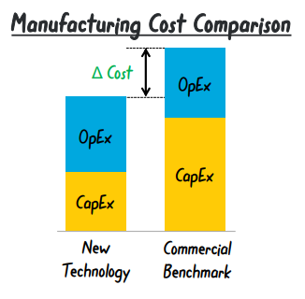
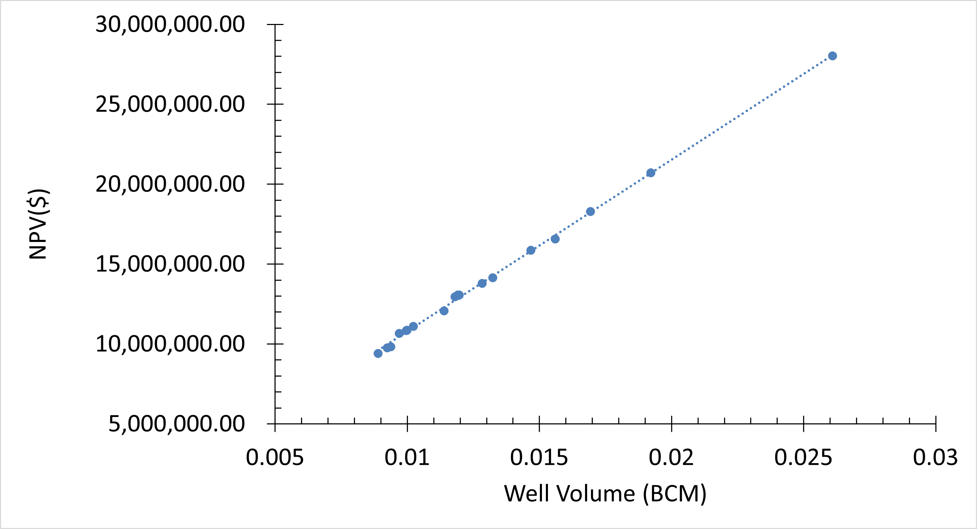
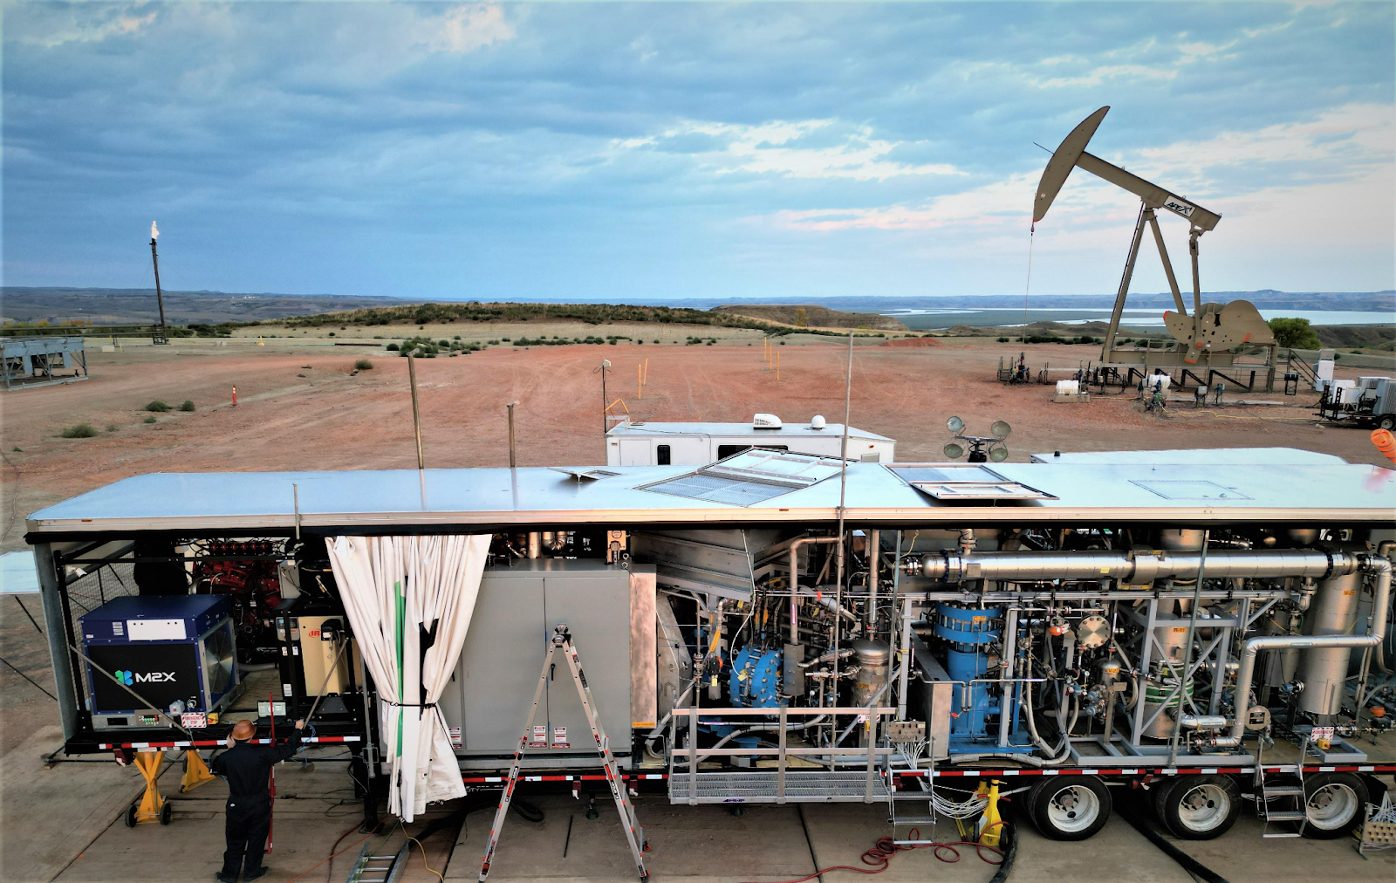
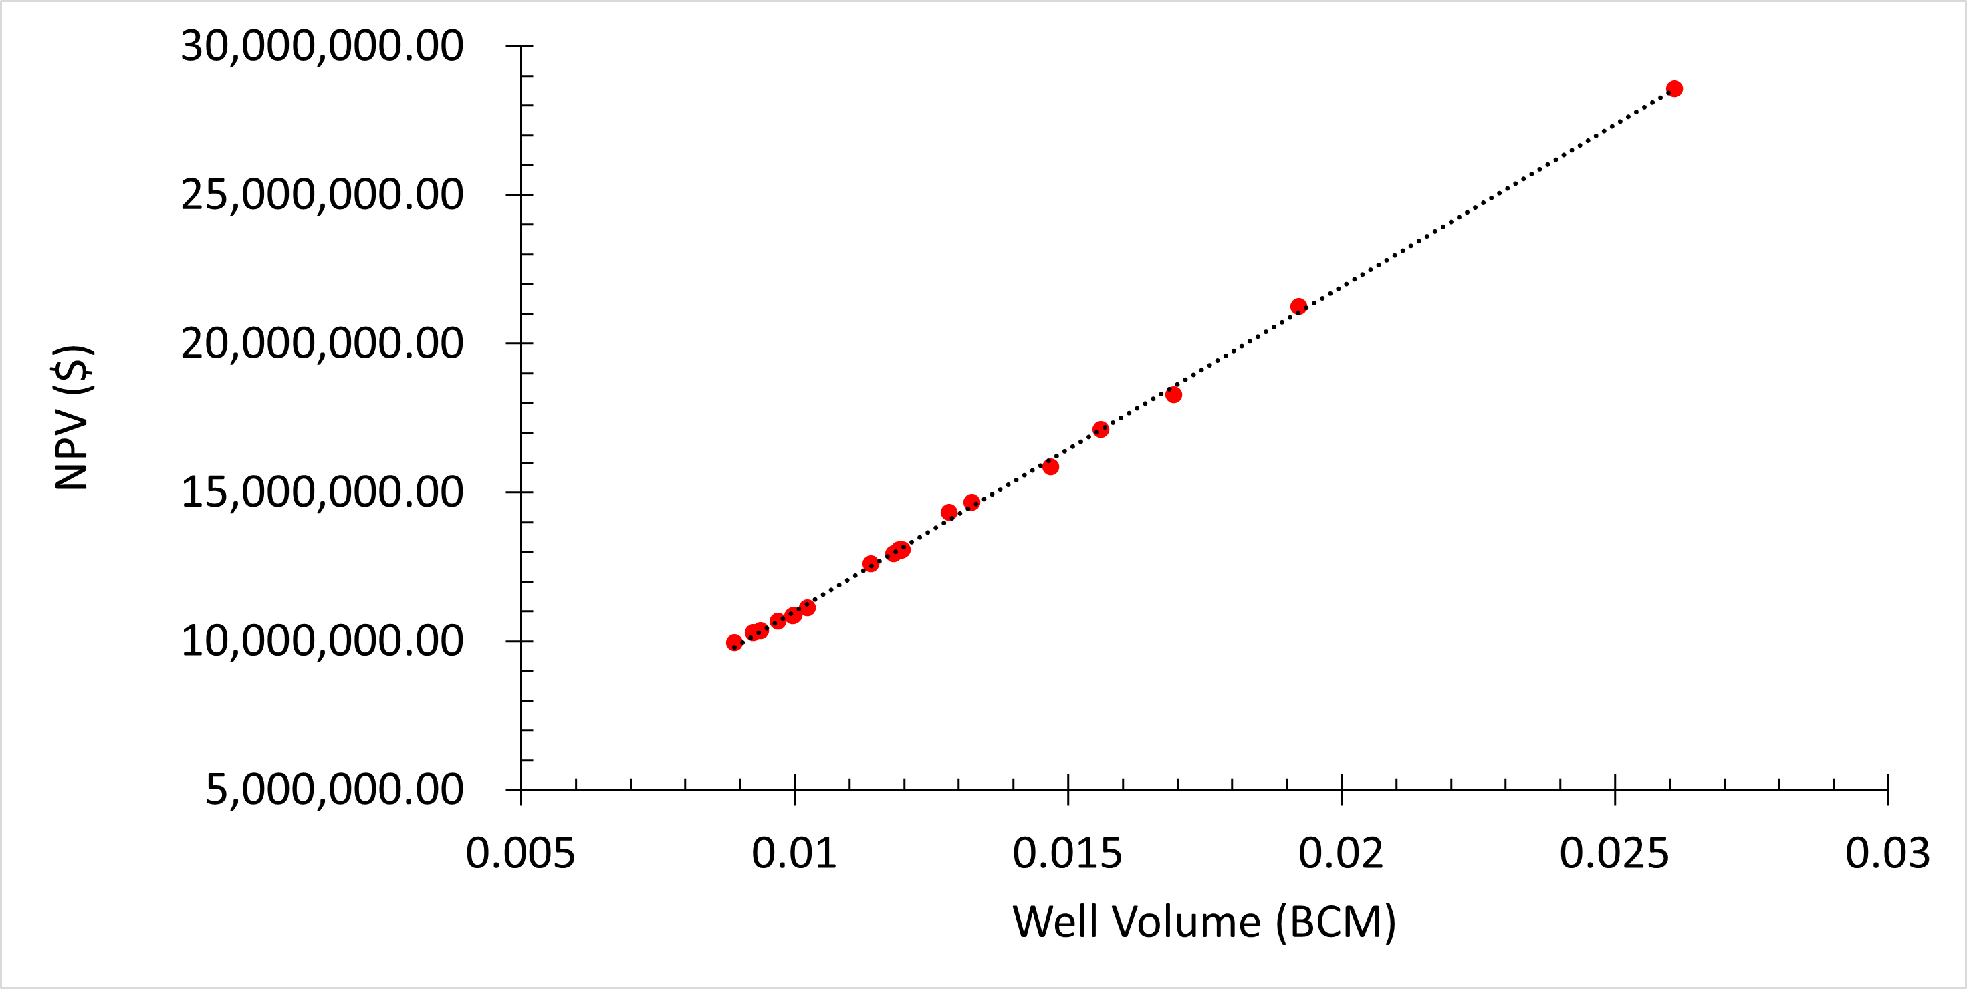
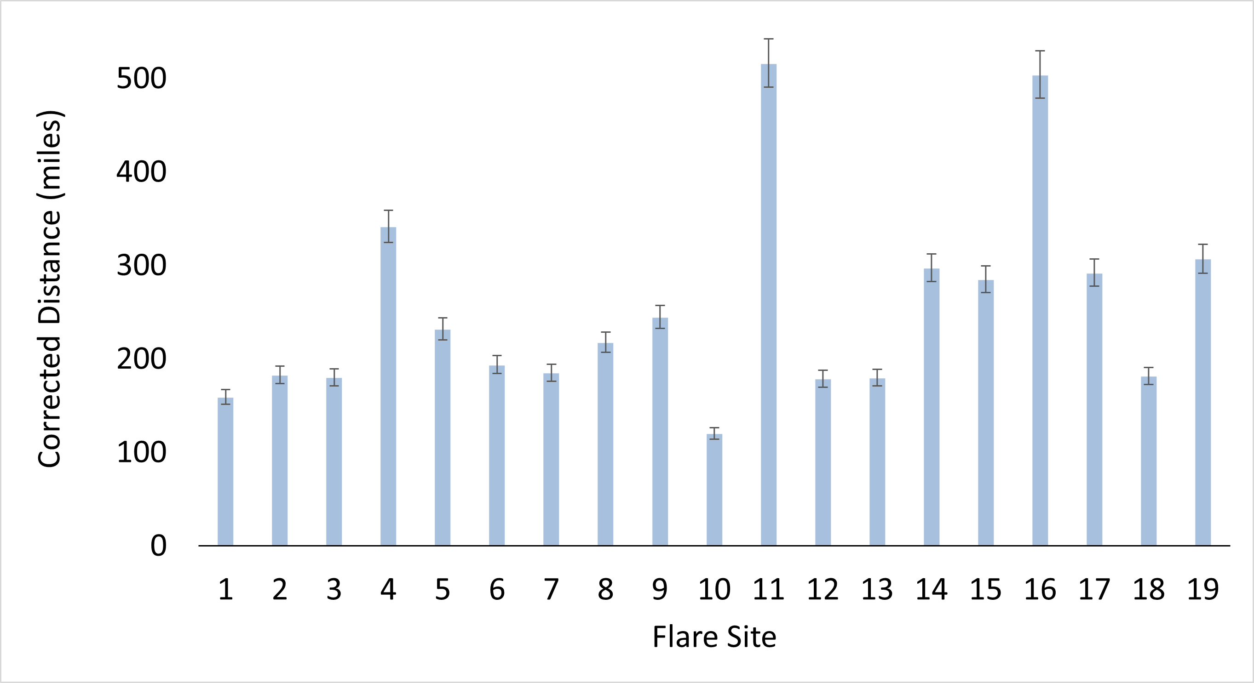
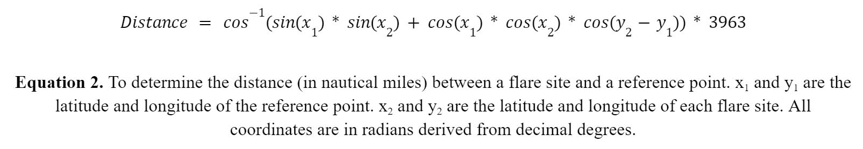
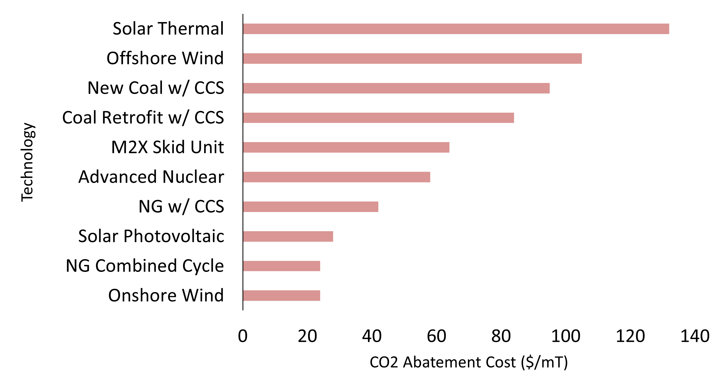


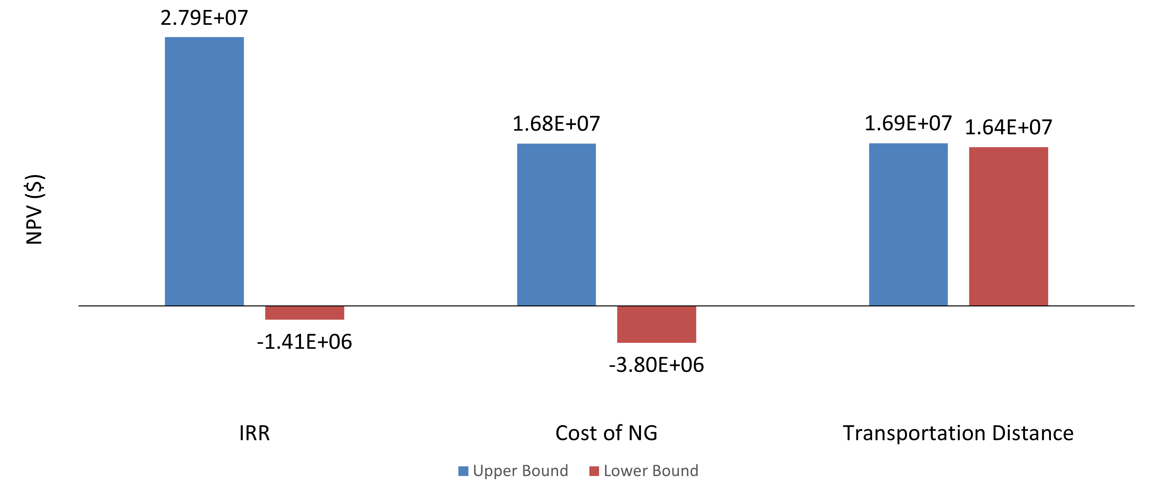
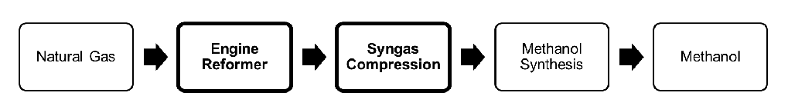
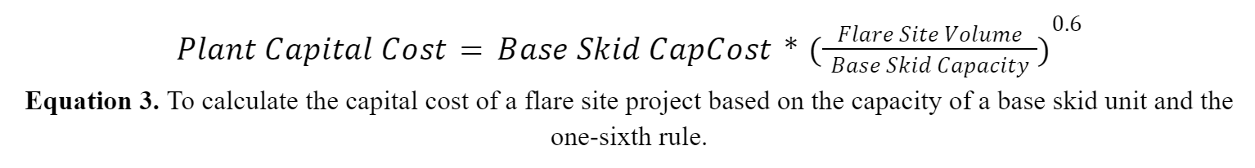
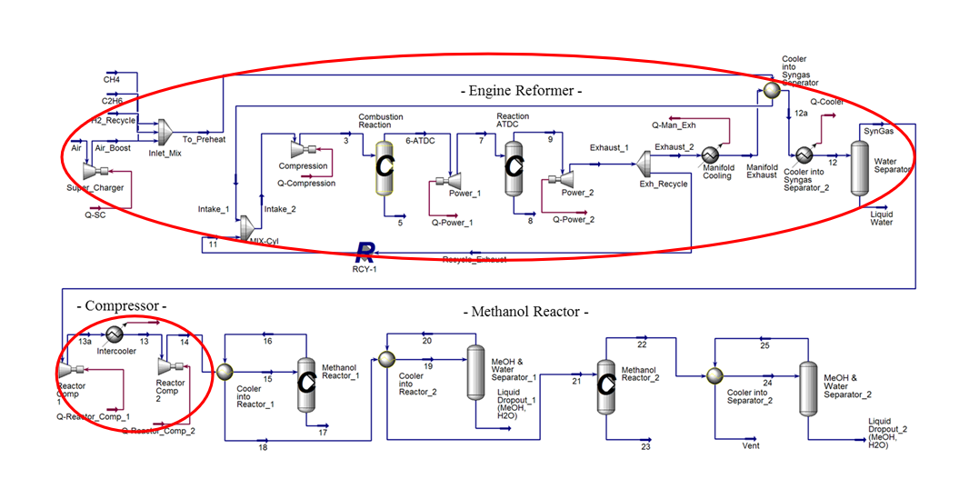
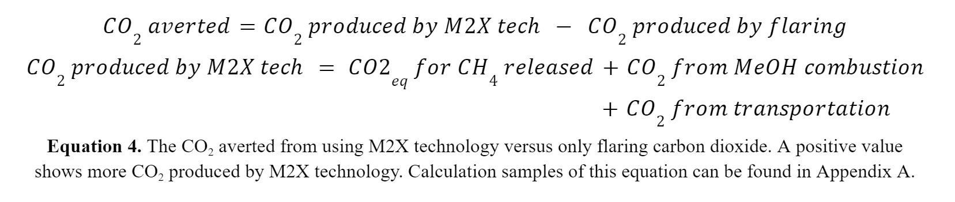
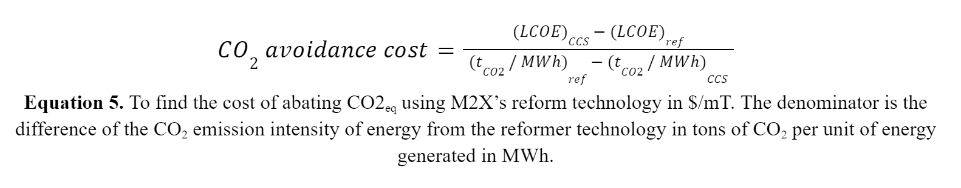
Stranded Gas Valorization
Ethan Fox (Chemical Engineering)
Advisors: Dr. Michael Timko (ChemE), Dr. Nikolaos Kazantzis (ChemE)
Purpose
TEA Basics
Results/Discussion
M2X Energy Inc. & Their Reformer Tech
Analysis of M2X Reformer Technology
  Technoeconomic
  Environmental
Feasibility of Technology Deployment
Transportation
Well Volume
Zero Maintenance
Min. Units Method
Strong Correlation
Methodology
Transportation Distance Calculations
- All U.S. Flare Sites & U.S. Oil/Gas Processing Facilities
- Min. Distance for All Flare Sites
Economic Impact Using NPV
Capital Cost Calculations
- Many Assumptions Listed
Sensitivity Analysis
- How do changes in IRR, NG Cost, and Distance affect NPV?
Carbon Emission Avoidance
Zero Flare Method
Strong Correlation
Corrected Distance
CF = 1.138
Low error
Small sample size
Case sensitive?
Background
Greenhouse Gases (GHG)
GHGs contribute to global warming primarily by CO2
Aggressive global warming has led to
  More severe storm systems
  Unpredictable seasonal weather patterns
  Rising sea levels
Natural Gas and Its Uses
NG is a fossil fuel mainly comprised of CH4
  Association Gas – NG when released from oil drilling
Association gas is commonly flared at well sites
  Processing plants are too far away
  Safest way to dispose this gas
M2X Energy and Their Reformer Technology
Utilizes a combustion engine to drive MeOH synthesis:
Dr. Joshua Browne (M2X CTO) authored a paper that
  Designed this GTL process
  Preformed a TEA
Why use this GTM tech?
  Runs autonomously → less labor cost
  Modular → easy deployment
  Scalability → adaptable to any flare site
Ethics of Deploying this Tech
Majority of people today want a shift to renewable energies
Would M2X’s tech prolong Big Oil’s focus on fossil fuels? NO
  At best, it would only increase global profits by 0.0000076% for Big Oil
Abatement Costs
In the middle
More than energy production
Justifies continued investment
Sensitivity Analysis
Careful w/ IRR
Distance = cheap
Generalization
Expenses
Transportation
Capital Cost
Revenue
Plant Availability
MeOH Market Price
Natural Gas Cost
MeOH Production
Conclusions
Min. Number of Units Method
--Round up and assume 1 unit is running below 100% efficiency
--Round down and flare the rest of the methane
Zero-methane Method
Use minimum number of units until all methane is consumed
A complete spreadsheet of Net Annual Profits for all flare sites with adjustable assumptions/conditions.
Well volume dictates profitability of a flare site according to this technoeconomic analysis model.
The preliminary correction factor 1.138 can be further refined for accuracy.
M2X Energy’s technology has a reasonable abatement cost to justify continued investment.
Sensitivity Analysis: Transportation distance has little effect on NPV; IRR has the most effect.
IRR
Operating Time
Market Price of MeOH
Lifetime of One Skid
MeOH Transportation Cost
Acknowledgements
This project would not be possible without the help from
Dr. Michael Timko – Advisor, WPI
Dr. Nikolaos Kazantzis – Advisor, WPI
Muntasir Shahabuddin – Ph.D. Student, WPI
Dr. Paul Yelvington – CSO, M2X Energy
PFD of M2X GTM Unit
Allison, E., and B. Mandler. “Oil Refining and Gas Processing.” American Geosciences Institute, 1 June 2018, https://www.americangeosciences.org/geoscience-currents/oil-refining-and-gas-processing.
Allison, E., and B. Mandler. “Transportation of Oil, Gas, and Refined Products.” American Geosciences Institute, 1 June 2018, https://www.americangeosciences.org/geoscience-currents/transportation-oil-gas-and-refined-products.
Artis, Zanagee. Oil Industry Netted Billions in Profits, Despite Global Price Dip. 10 Aug. 2023, https://www.nrdc.org/bio/zanagee-artis/oil-industry-netted-billions-profits-despite-global-price-dip.
Arutyunov, Vladimir. “Direct Methane to Methanol: Promising Technologies Based on the DMTM Process.” Methanol, Elsevier, 2018, pp. 211–38, https://doi.org/10.1016/B978-0-444-63903-5.00008-X.
Buis, Alan. “How Climate Change May Be Impacting Storms Over Earth’s Tropical Oceans.” Climate Change: Vital Signs of the Planet, https://climate.nasa.gov/explore/ask-nasa-climate/2956/how-climate-change-may-be-impacting-storms-over-earths-tropical-oceans/. Accessed 8 Nov. 2023.
Elvidge, Christopher, et al. “Methods for Global Survey of Natural Gas Flaring from Visible Infrared Imaging Radiometer Suite Data.” Energies, vol. 9, no. 1, Dec. 2015, p. 14, https://doi.org/10.3390/en9010014.
Gillingham, Kenneth, and James H. Stock. “The Cost of Reducing Greenhouse Gas Emissions.” Journal of Economic Perspectives, vol. 32, no. 4, Nov. 2018, pp. 53–72, https://doi.org/10.1257/jep.32.4.53.
Kennedy, Brian, et al. “1. What Americans Think about an Energy Transition from Fossil Fuels to Renewables.” Pew Research Center Science & Society, 28 June 2023, https://www.pewresearch.org/science/2023/06/28/what-americans-think-about-an-energy-transition-from-fossil-fuels-to-renewables/.
Roussanaly, Simon. “Calculating CO ₂ Avoidance Costs of Carbon Capture and Storage from Industry.” Carbon Management, vol. 10, no. 1, Jan. 2019, pp. 105–12, https://doi.org/10.1080/17583004.2018.1553435.
Salahudeen, N., et al. “Review on Technologies for Conversion of Natural Gas to Methanol.” Journal of Natural Gas Science and Engineering, vol. 108, 2022, p. 104845, https://doi.org/10.1016/j.jngse.2022.104845.
Speight, James G. Synthetic Fuels Handbook: Properties, Process, and Performance. McGraw-Hill, 2008.
Swai, Elitumaini. Valorization of Stranded Natural Gas. : Worcester Polytechnic Institute, 2023.
Weber, Robert S., and Lesley J. Snowden‐Swan. “The Economics of Numbering up a Chemical Process Enterprise.” Journal of Advanced Manufacturing and Processing, vol. 1, no. 1–2, Feb. 2019, p. e10011, https://doi.org/10.1002/amp2.10011.
Weller, Zachary D., et al. “A National Estimate of Methane Leakage from Pipeline Mains in Natural Gas Local Distribution Systems.” Environmental Science & Technology, vol. 54, no. 14, July 2020, pp. 8958–67, https://doi.org/10.1021/acs.est.0c00437.
Yelvington, Paul E., et al. “On Piston Engines as Hydrocarbon Gas Reformers for Modular, Distributed Chemical Production.” Applications in Energy and Combustion Science, vol. 13, Jan. 2023, p. 100117, https://doi.org/10.1016/j.jaecs.2023.100117.

