Slide 1
Mobile Poultry Processing on Nantucket
Katie Bowles, Trevor Drane, Adam LaBombard, & Charles Ritchie
Notes:
(Katie start) “Hi my name is katie. Im trevor. Im adam. I am charlie. And our project was mobile poultry processing on Nantucket”

Slide 2
Summary of Presentation
Mobile Poultry Processing on Nantucket
Project Overview
Objectives
MPPU Introduction
Interviews
Recommendations
Notes:
(Katie) so a quick summary of our presentation. We will be going over our project overview, an introduction to mobile poultry processing units, our objectives going into the project, the interviews we conducted and what we learned, and our recommendations for sustainable nantucket.

Slide 3
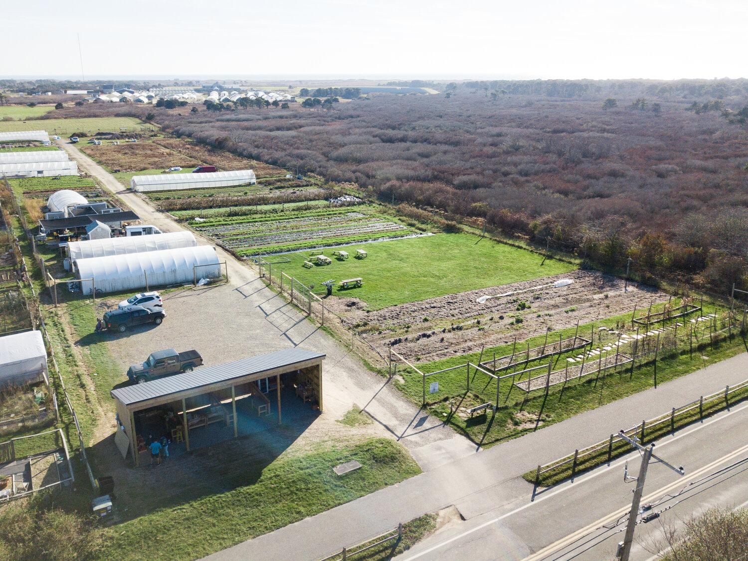
Sustainable Nantucket
Mobile Poultry Processing on Nantucket
NonProfit focused on promoting sustainable and locally sourced foods
Farm to School
Mentor Farmer Program
NantucketGrown™
Farmers & Artisans Market
Notes:
(Trevor) our sponsor for this project was sustainable nantucket- a nonprofit organization whose mission is to provide resources to local farmers to increase the amount of food grown locally, while promoting the benefits, including enhanced flavor and better health, of locally sourced foods. Their programs-the farm to school program, the mentor farmer program, NantucketGrown, and farmers market are each crucial to educating about and cross promoting the island’s agricultural history and the importance of increased local food production.

Slide 4
Mobile Poultry Processing on Nantucket
Project Overview
The goal of our project was to create a plan and set of materials that Sustainable Nantucket can use for the development and approval of a Mobile Poultry Processing Unit on Nantucket.
Notes:
(trevor) A part of SN’s mission to increase food production is to address a large gap in the availability of locally raised protein and provide the resources needed to empower growers to raise more poultry for egg laying and meat production. The lack of a humane and cost efficient means of local poultry slaughter on island is a barrier to more chicken production, thus our project goal was to create a plan and a set of materials that SN can use for the development of such a mobile poultry slaughter facility here- an MPPU.

Slide 5
Objectives
Mobile Poultry Processing on Nantucket
Evaluate and Determine MPPU Technology and Operational Guidelines
Evaluate Lessons Learned
Identify Applicable Regulations
Identify the Perspectives of Stakeholders
Develop Deliverables
Notes:
(Adam) Going into this project we had five objectives. First, to identify the applicable regulations regarding MPPUs at federal, state, and local levels. Second, to evaluate lessons learned from MPPUs operating in similar locations. Next was identifying perspectives of stakeholders such as farmers and local officials. Then, came determining mppu technologies and operational guidelines based on our research, and lastly was developing a set of deliverables for Sustainable Nantucket.

Slide 6
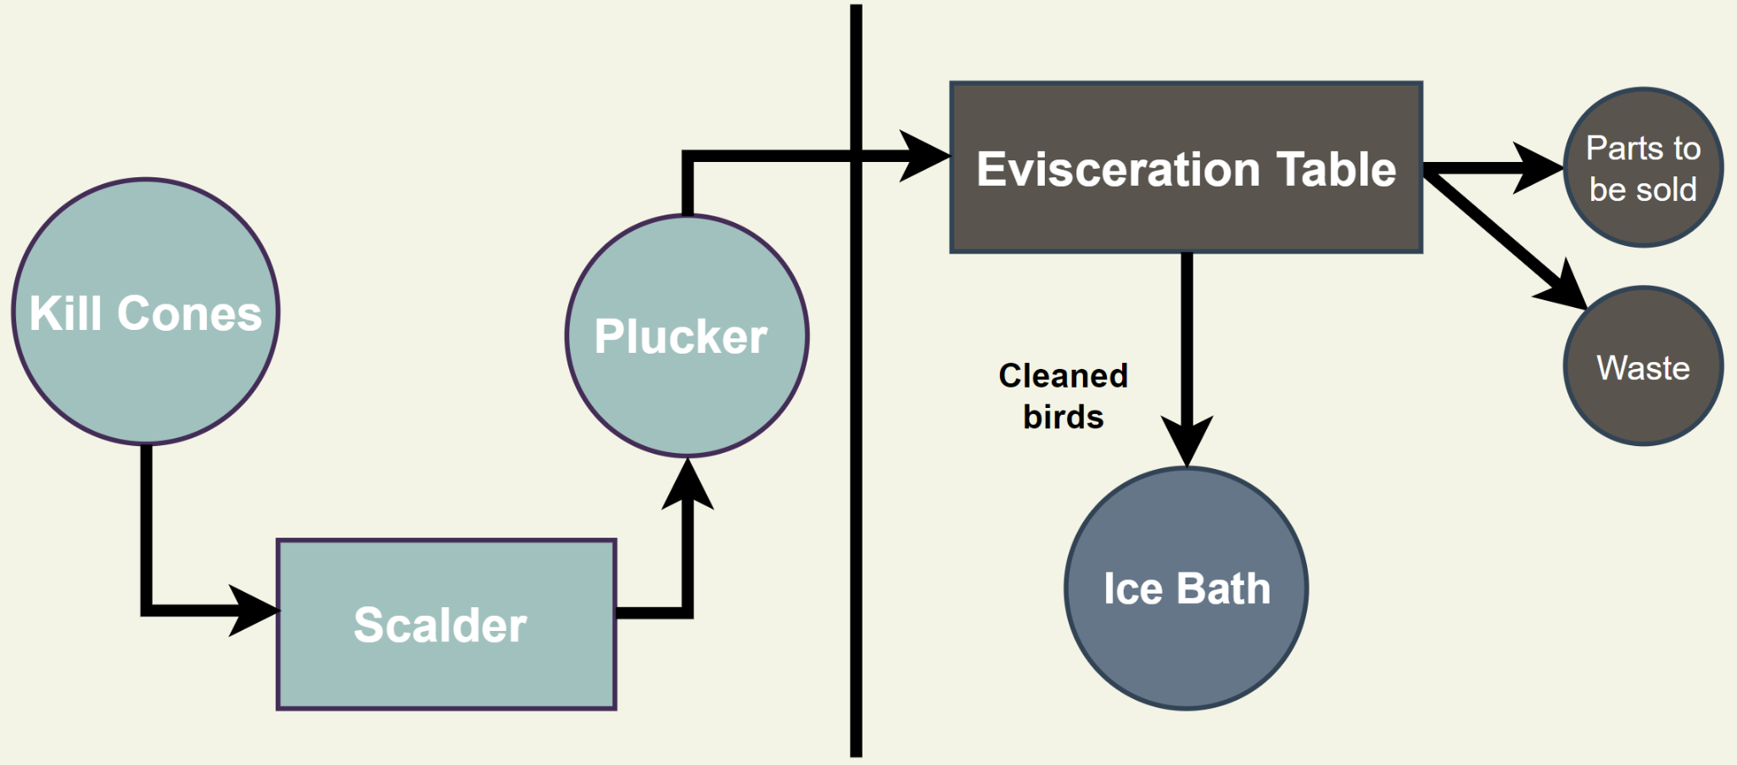
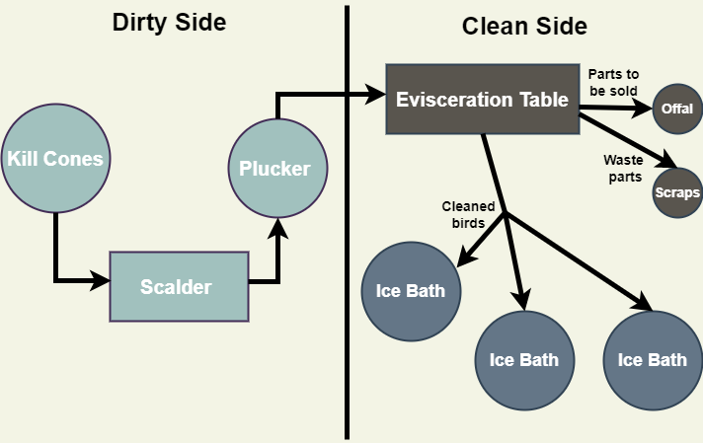
What is an MPPU?
Slaughter Side
Evisceration Side
Notes:
(Charlie) a mobile poultry processing unit is essentially a slaughter house on wheels that consists of two sides: one side for slaughter and the other for evisceration. On the first side birds are humanely slaughtered and bled in the kill cones before they are placed in a scalder, a bath of roughly 140 degree water,to loosen the feathers and then plucked in the plucker. After that they are moved to the evisceration side where they are cleaned and gutted, and the waste and offal are taken out of the carcass and separated. The cleaned, whole birds are placed in an ice bath to be brought to the required 40 degree temperature before packaging.

Slide 7
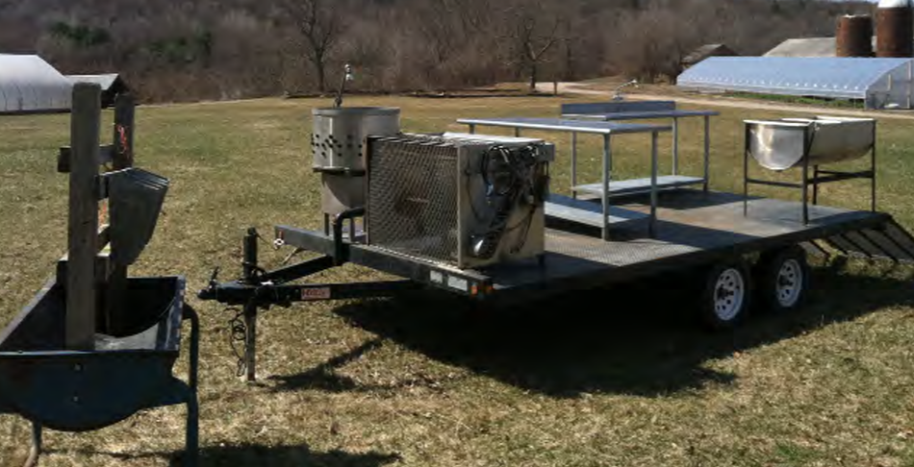
Mobile Poultry Processing on Nantucket
Notes:
(Charlie) This is an example of various equipment parts of the process on an open trailer that was previously used at Martha's Vineyard

Slide 8
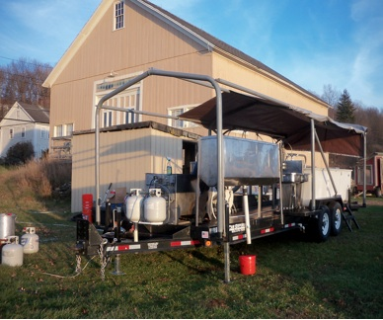
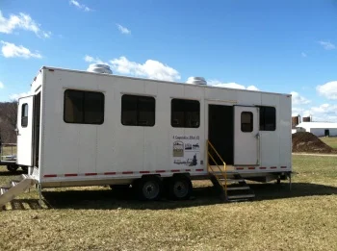
Mobile Poultry Processing on Nantucket
Why an MPPU?
On island processing and sale
Mobile
Cost effective
Notes:
(Trevor)So why is SN looking into An MPPU, it provides farmers with a way to process chickens on island for sale or home use on Nantucket as there are currently no permitted slaughter facilities here. It can be easily moved from location to location to allow for flexibility for the farmers and SN. And it is a cost effective way of processing poultry – other MPPUS we have looked at charge around $3-8 per chicken which is significantly cheaper for the farmer than sending the poultry off island to be slaughtered.

Slide 9
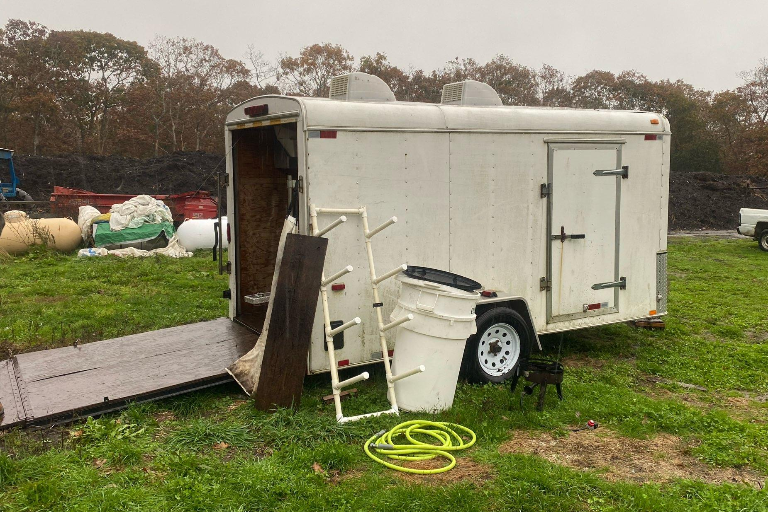
Types of MPPUs
Mobile Poultry Processing on Nantucket
Enclosed Storage, Open Air Unit
Processing in open air
Equipment storage out of the elements
Flexible design
$25,000
Open Air Mounted Unit
Open bed trailer
Cramped work space
Exposed to elements
$25,000-$35,000
Enclosed Unit
Four walls and ceiling
Climate controlled
Collects wastewater
$90,000
Notes:
(Katie) There are three main types of MPPUs. First, there is the enclosed unit. This unit has four walls, a floor and ceiling, is climate controlled, collects waste water and cleaning water through drainage in the floor, and costs approx $90,000 dollars and requires a substantial truck to haul it to different locations. Second is the open air mounted unit, which is mounted on an open bed trailer, has a bit of a cramped workspace, is more exposed to the elements than the enclosed unit, and costs around $25,000 to $35,000. The third type is an enclosed storage trailer, containing the equipment to be unloaded and used in the open air, processing under a pop-up canopy tent on wood chips or a non porous surface with drainage. This unit allows for more of a flexible operation, and costs around $25k.

Slide 10
Interviews
Mobile Poultry Processing on Nantucket
Notes:
(Trevor) so next we are going to talk about our interviews and what we learned. We conducted these interviews with the intent of gauging the current inventory of island raised chickens and the demand for an mppu from farmers, discussing waste disposal, and the processes and experiences of similar locations.

Slide 11
Farmer Perspectives
Mobile Poultry Processing on Nantucket
7
Farmers
Current Poultry:
200 layers
50 broilers
50 ducks
4
Yes
2
Potential Poultry:
600 layers
1000+ broilers
Some turkeys
Maybe
1
No
Notes:
(Trevor) we spoke with seven different farmers on nantucket to discuss their current farming operations, their interest in using an mppu should one be available what they are willing to increase their numbers too in that case. Of the seven farmers four said they would use the unit, two said they might use the unit, and one said they would not. There are currently 200 layers and 50 broilers and 50 ducks. The farmers interviewed said they would increase to around 600 layers and more than 1000 broilers with some farmers saying they would be interested in raising turkeys as well.

Slide 12
Local Official Interviews
Mobile Poultry Processing on Nantucket
Nantucket Waste Options
Nantucket Sewer Department
Nantucket Board of Health
Notes:
(Trevor) we spoke with jp caron with Waste Options about the disposal of solid waste in the digester. This could include woodchips, feathers and scraps from the evisceration process can be disposed of in the digester. David Gray at the Nantucket Sewer Department was enthusiastic and said that waste water from the processing and cleaning could be deposited into the sewer treatment plant and the possibility of using the land at the wwtp as a processing location. Lastly, we spoke with Roberto Santamaria, director of the Nantucket board of health, about the regulations sn will need follow.

Slide 13
MPPU Discussions
Mobile Poultry Processing on Nantucket
Martha’s Vineyard Agricultural Society
Island Grown Initiative of Martha’s Vineyard
New Entry Sustainable Farming Project
Notes:
(Trevor) we spoke with mvas, igi of MV, and new entry sustainable farming project about their experiences with an mppu. They were kind enough to share some of their processes and documentation. Mvas and igi provided us with the opportunity to see an mppu in action in person. Nesfp provided valuable information regarding the rules and regulations and provided sustainable nantucket with their documentation and logs

Slide 14
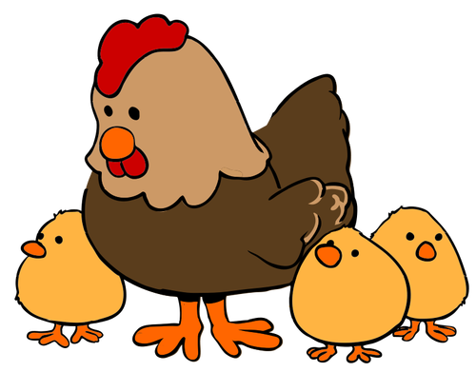
What Should Sustainable Nantucket Look for in an MPPU?
Mobile Poultry Processing on Nantucket
Flexibility
Easy processing
Ease of setup and cleanup
Safe to use
Notes:
(Katie)Flexibility – The unit should be able to handle chickens, turkey and other poultry. Ease of use – Slaughter should be quick and promote ease of training for new slaughterers. Easy set up and clean up – the MPPU should be quick to set up, clean, and take down to ensure that even smaller farmers can find using the MPPU “worth it.” Safe to use – Lastly the unit should ensure safe practices are used for safe food handling and general slaughter safety

Slide 15
Mobile Poultry Processing on Nantucket
Recommendations
Notes:
(Adam) Based on our research, our team made a series of recommendations to Sustainable Nantucket on what the best options for their future mppu would be.

Slide 16
Mobile Poultry Processing on Nantucket
MPPU Type Recommendation
Equipment is protected from elements
Purchase equipment separately
Flexibility in design
Easier to tow
Notes:
(Adam) The type of mppu that our team recommends is an enclosed trailer with removable equipment, like the one in the image here. The equipment such as the plucker, eviscerator, and kill cones would be stored inside this trailer, and removed and set up when it comes time to process. This will allow for more flexibility in the specific equipment used, and allows for the equipment to be purchased separately, making the mppu more customizable, and more lightweight for towing.

Slide 17
Mobile Poultry Processing on Nantucket
Slaughter Location
What Works
What Doesn't Work
Level ground w/ lots of space
Water and electric connection
Restroom facilities for processors
Being close to wetlands
Being close to biologically active fields
Federal, state and local land restrictions
Notes:
(Katie) the things that we and sustainable nantucket had to consider when thinking about locations for processing are water and electricity access, restrooms for those working the unit, level ground and enough space, the proximity to wetlands, if there is enough space between the location and biologically active fields, and any land restrictions.

Slide 18
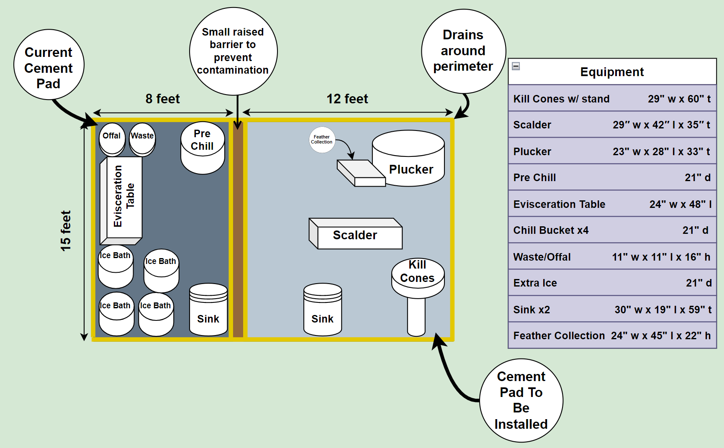
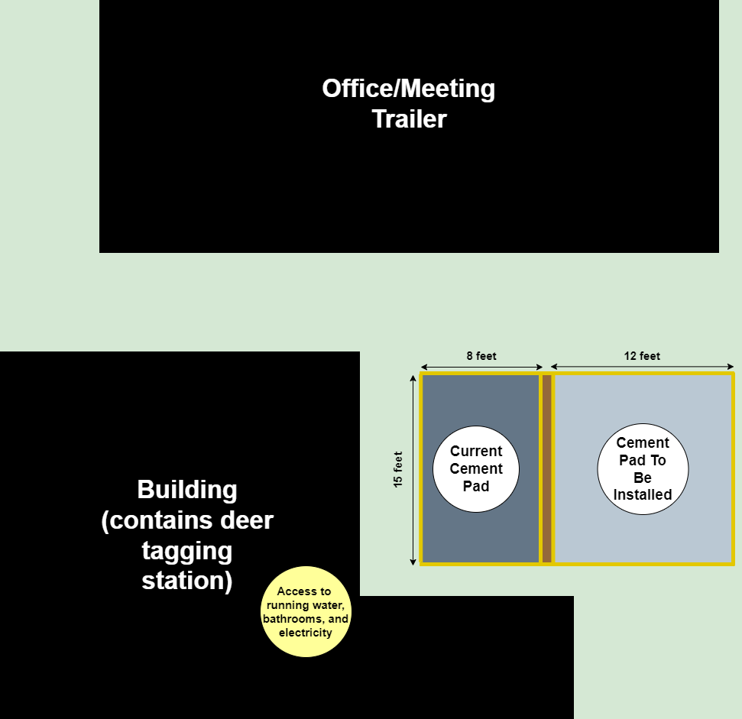
Mobile Poultry Processing on Nantucket
Location Example
Notes:
(Katie) one example of a location that we recommend sustainable nantucket continue exploring is an area at the wastewater treatment plant. This image provides a rough depiction of what the layout would be like.At this location there is an existing 8x15 foot cement pad that could be expanded. Around the pad there is a trailer and another building that is used for deer tagging during hunting season that has access to electricity, running water, and restrooms. Sustainable Nantucket could add another cement pad and cover both in epoxy, between these two pads would be a barrier to prevent contamination between the slaughter and the evisceration side and there would be drainage around the outside of the pads that would collect the liquid waste and allow it to flow directly into the sewer treatment facility. Having the mppu at the wastewater treatment plant would meet all of the criteria on the previous slide for slaughter location.

Slide 19
Mobile Poultry Processing on Nantucket
Waste Disposal
Solid Waste
Liquid
Woodchips
Feathers
Waste from evisceration
Water from cleaning
Water from ice
Water from scalder and plucker
Notes:
(Charlie) Main issue with waste is water production. Large amounts of water from ice, evisceration, scalding and sanitization. If SN uses our previously discussed recommendation, waste water will be piped directly into the treatment facility. Solid waste will be collected in a bucket and properly disposed of.

Slide 20
Operating Expenses
Mobile Poultry Processing on Nantucket
Major Costs
Labor - $5/bird
Ice - $3/bird
Propane - $0.50/bird
Minor Costs
Cleaning supplies
Bags
Water
Electricity
Gas
Wear and tear
Notes:
(Charlie) While Sn has a grant for purchasing the capital equipment and assembling the unit, during each slaughter the farmer will still have to pay for some recurring expenses. Assuming a farmer is slaughtering 75 birds Some expenses like labor will cost around 5 dollars per bird and ice which will cost around 3 dollars per bird. Prices for labor can change if the farmer is doing the slaughter themself. SInce so much water needs to be heated for the scalding process the propane usage works out to be about fifty cents per bird. Minor costs like wear and tear and cleaning supplies and electricity are a few cents per chicken total.

Slide 21
Mobile Poultry Processing on Nantucket
Operating Procedures and Manual
Model HACCP Plan
Recall Plan
Operations Manual
Notes:
(Charlie) Another aspect of research was on the regulations . For example each slaughtering facility needs to have a Hazard Analysis and Critical Control Points Plan. N HACCP is a document that outlines each step of the slaughter and the hazard that is most likely to happen during it. For example during the chilling process the chicken needs to be quickly brought from living temperature to refrigerator temperature. The recall plan is similar to what other chicken producers use. If some sort of contamination is discovered after the chicken has been sold there needs to be regulations in place to stop its consumption. We have also created an Operations manual. The manual is a detailed step by step instruction of all actions taken on slaughter day. It has everything from ordering ice to final clean up and sanitization of equipment.

Slide 22
Mobile Poultry Processing on Nantucket
Thank You!
Any Questions?
Notes:
Thank you, and thank you to our sponsor, advisors, and all of the people who gave us their time for interviews

Slide 23
Mobile Poultry Processing on Nantucket
References
Sustainable Nantucket. (n.d.). Sustainable Nantucket. Retrieved December 11, 2022, from https://sustainable-nantucket.org
Mobile Poultry Processing Unit Projects. (n.d.). New England Small Farm Institute. Retrieved December 10, 2022, from https://www.smallfarm.org/main/special_projects/mppu/
Tufts University. (n.d.). New Entry Sustainable Farming Project. Eastern Massachusetts Mobile Poultry Processing Unit (MPPU) | New Entry Sustainable Farming Project. Retrieved December 10, 2022, from https://nesfp.nutrition.tufts.edu/farmer-training/livestock-poultry/poultry-resources/eastern-massachusetts-mobile-poultry-processing
Poore, S. (2016, July 22). The cluck stops here: Mobile poultry processing unit geared toward family farms. Roanoke Times. https://roanoke.com/archive/the-cluck-stops-here-mobile-poultry-processing-unit-geared-toward-family-farms/article_e81dbdae-4f01-11e6-8570-3389ae916745.html

