Slide 1
Lecture Topic 4
Analogous Circuits (The Theory)

Slide 2
Why?
Topic 4 is meant to break down the use of analogous circuits, the theory behind them, and its possible uses.

Slide 3
Before we begin…
Electrical
Voltage
Mechanical
In order to understand the transition between electrical, mechanical, and acoustic domains you must understand the concept of impedance
Force
Acoustic
Pressure

Slide 4
Impedance
Simply put impedance is a measure of how much resistance a system presents to some kind of flow
Electrical: Resistance to electric current
Mechanical: Resistance to mechanical force
Acoustical: Resistance to acoustic volume flow
This concept is incredibly helpful in understanding how systems will react to inputs

Slide 5
Impedance
Take pushing a child on a swing as a basic example
Here, the person pushing acts as a high impedance driver to the child who is a low impedance load
If the person pushing matches their pushes to the resonant frequency of the child-swing system, they can maximize swinging amplitude

Slide 6
Impedance
In this scenario, the mechanical impedance is a function of input frequency
If the pushing frequency does not match that of the resonant frequency of the child-swing system, inefficient power transfer occurs
This results in a small swinging amplitude

Slide 7
Impedance
In audio equipment, electrical impedance matching plays a crucial role in ensuring that proper power transfer occurs
In this system, the audio amplifier acts as a high impedance source and the loudspeaker as a low impedance load
To ensure efficient power transfer, achieving the best audio quality, the output impedance of the amplifier must match that of the loudspeaker
D
D

Slide 8
Relating Domains
Electrical
Voltage
Mechanical
By understanding the relationship between impedance in different domains, you can relate quantities like voltage, force, and pressure to aid in modeling systems
Force
Acoustic
Pressure

Slide 9
What are we learning?
01
02
03
04
Electric Domain
Mechanical Domain
Cross and through variables in the electrical domain
Cross and through variables in the mechanical domain
Transformations
Acoustic Domain
Cross and through variables in the acoustic domain
Transforming through various domains

Slide 10
01
The Basics
Basic concepts and variables behind analogous circuits

Slide 11
Analogous Circuits – Acoustic Analogies
Electrical $→$ Mechanical $→$ Acoustical transition can be modeled easily!
Below is a model of a speaker ​you will make later in the course showing all three systems!

Slide 12
Analogous Circuits – Acoustic Analogies
Electrical $→$ Mechanical $→$ Acoustical transition can be modeled easily!​
First let’s look at their values…
Two types of variables - Each system has 1 cross and 1 through variable that will be transformed through each section of the circuit

Slide 13
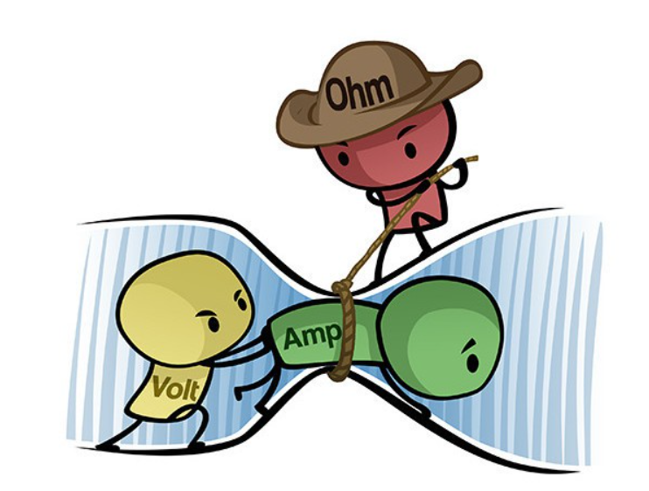
Analogous Circuits – Acoustic Analogies
Two types of variables:
Effort Variables (Cross)
Variables measured across a circuit
Voltage (V)
Flow Variables (Through)
Variables measured through a circuit
Current (I)
Notes:
https://www.build-electronic-circuits.com/ohms-law/

Slide 14
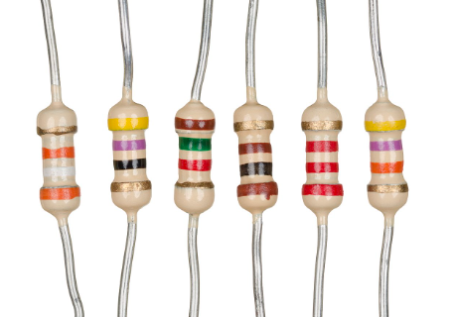
Acoustic Analogies – Electrical Domain
How do voltage and current correlate… Resistance!
$$R=\frac{V}{I}$$
$$V=I∗R$$
R = Resistance in Ohms [$Ω$]
V = Voltage in Volts [V]
I = Current in Amps [A]
Notes:
https://www.autodesk.com/products/fusion-360/blog/how-to-choose-the-right-resistor/

Slide 15
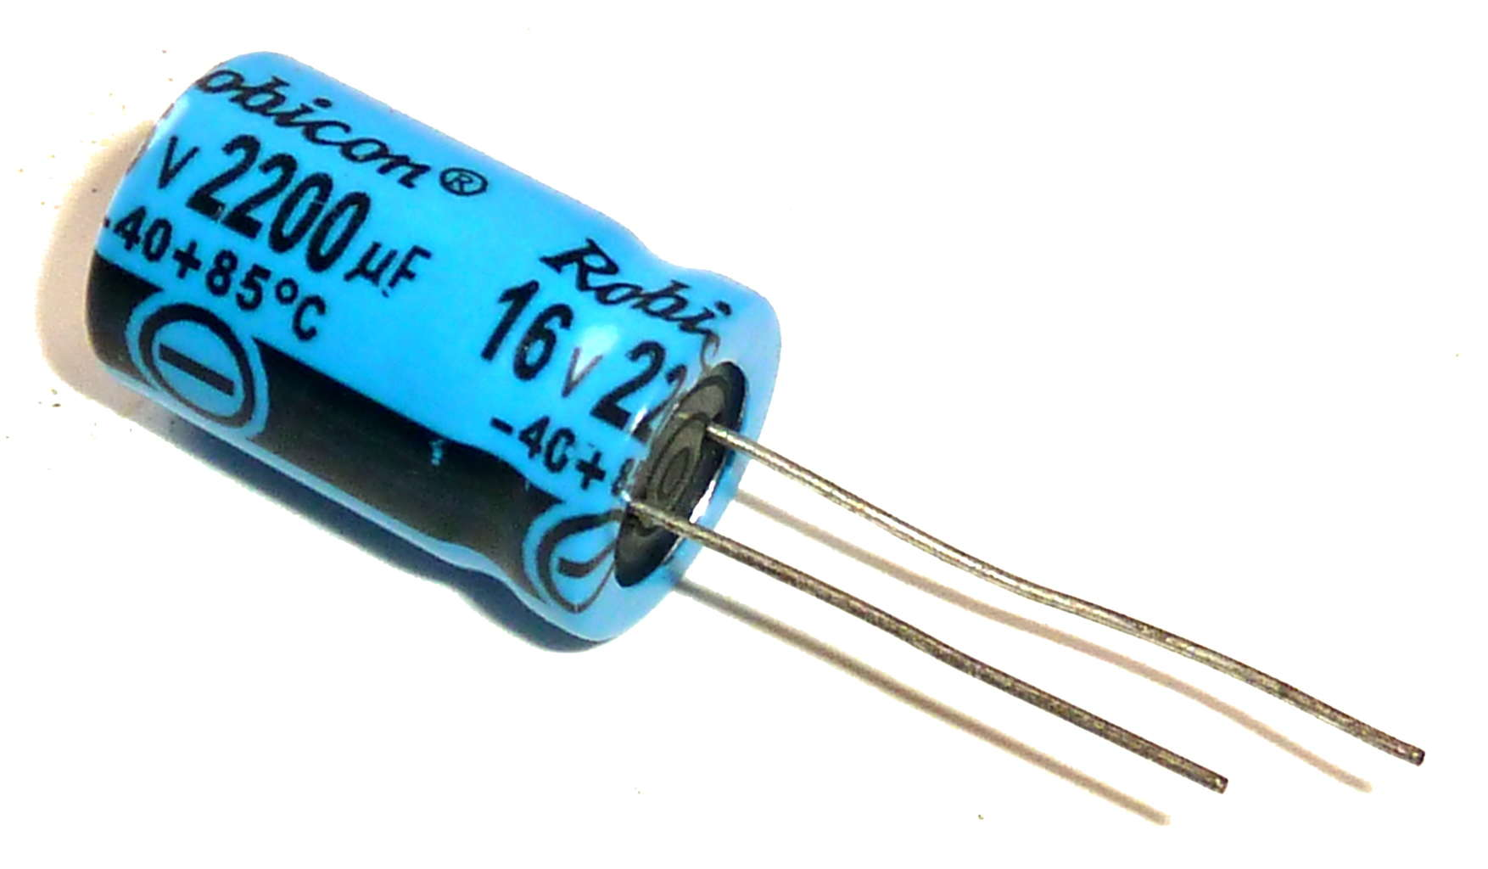
Acoustic Analogies – Electrical Domain
$$V=\frac{1}{c}\int_{0}^{t}{Idt}$$
How else do voltage and current correlate… Capacitance!
Capacitance – Ability of a circuit component to hold a charge for a duration of time
$t$ = Time in Seconds [$s$]
$V$ = Voltage in Volts [$V$]
$I$ = Current in Amps [$A$]
$C$ = Capacitance in Farads [$F$]
Notes:
https://www.build-electronic-circuits.com/wp-content/uploads/2013/05/electrolytic-capacitor.jpg

Slide 16
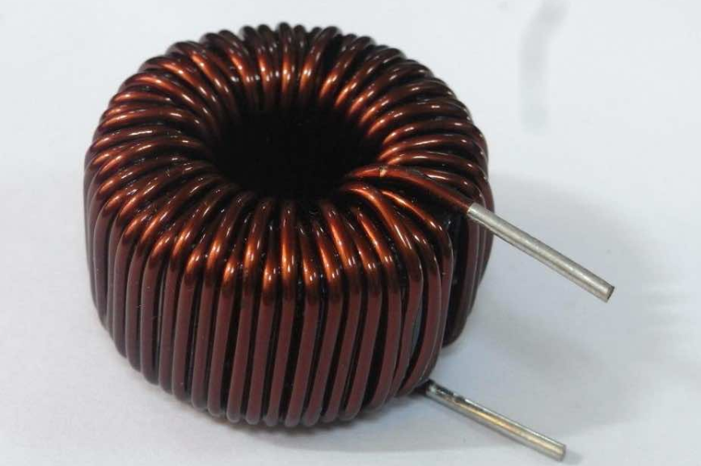
Acoustic Analogies – Electrical Domain
How else do voltage and current correlate… Inductance!
Inductance – Property that causes an electromotive force to be generated due to a rate of change in current
$$V=L\frac{1}{c}$$
L = Inductance in Henrys [$H$]
V = Voltage in Volts [V]
$\frac{dI}{dt}$ = Change in Current due to time [$\frac{Amps}{sec}$]

Slide 17
Acoustic Analogies – Mechanical Domain
How do velocity and force correlate… Mechanical Responsiveness!
$$\frac{v(t)}{r_{RMS}}=f\left(t\right)$$
$$v\left(t\right)=v\left(t\right)∗ r_{RMS}$$
$f(t)$ = Force [N]
$r_{RMS}$ = Mechanical Responsiveness [m/Ns]
$v(t)$ = Velocity [m/s]

Slide 18
Acoustic Analogies – Mechanical Domain
How else do velocity and force correlate… Mechanical Mass!
Mechanical Mass – Represents the inertia of the moving parts of the mechanical system
Wait… where did $τ$ come from???
$$v(t)=\frac{1}{m}\int_{−∞}^{t}{f(τ)dτ}$$
$f\left(τ\right)$= Force [N]m
$m$ = mass [kg]
$v(t)$= Velocity [m/s]

Slide 19
Relation to Newton’s 2nd Law
$$v(t)=\frac{1}{m}\int_{−∞}^{t}{f(τ)dτ}$$
$$m∗v(t)=\int_{−∞}^{t}{f(τ)dτ}$$
$$\frac{d}{dt}(m∗v\left(t\right))=\frac{d}{dt}\int_{−∞}^{t}{f(τ)dτ}$$
$$m∗a(t)=f(t)$$
$$F=ma$$
f($τ$) = Force [N]m
$m$ = mass [kg]
v(t) = Velocity [m/s]
Notes:
Script v for velocity

Slide 20
Acoustic Analogies – Mechanical Domain
$$v(t)=Comp\frac{df(t)}{dt}$$
How else do velocity and force correlate… Mechanical compliance!
Mechanical Compliance – The property that indicates the flexibility or elasticity of mechanical parts
Comp = Mechanical Compliance [m/N]
Comp $= \frac{1}{Stiffness}$
v(t) = Velocity [m/s]
f(t) = Force [N]
Notes:
Voltage – make it e

Slide 21
Acoustic Analogies – Acoustic Domain
How do pressure and volume correlate… Acoustic loss!
$$\frac{P(t)}{Loss}=U\left(t\right)$$
$$P\left(t\right)=U\left(t\right)∗Loss$$
P(t) = Acoustic Pressure [$μb$] (Micro Bar)
U(t) = Volume Velocity [$m^{3}$/s]
Loss = Acoustic Loss [dB] (decibels)

Slide 22
Acoustic Analogies – Acoustic Domain
$$p(t)=\frac{ρc^{2}}{Volume}\int_{−∞}^{t}{U\left(t\right)dt}$$
How else do pressure and volume correlate… Acoustic Volume!
Acoustic Volume – Elements of a system that act as compliances, used in finding acoustic compliance
p(t) = Acoustic Pressure [$μb$] (Micro Bar)
U(t) = Volume Velocity [$m^{3}$/s]
Volume = Acoustic Volume [$m^{3}$]
$ρ$ = Density [kg/ $m^{3}$]
c = speed of sound [m/s]

Slide 23
Acoustic Analogies – Acoustic Domain
$$p(t)=\frac{ρc^{2}}{Volume}\int_{−∞}^{t}{U\left(t\right)dt}$$
How else do pressure and volume correlate… Acoustic Port!
Acoustic Port – The lumped acoustic mass that models loudspeaker ports
p(t) = Acoustic Pressure [$μb$] (Micro Bar)
U(t) = Volume Velocity [$m^{3}$/s]
Volume = Acoustic Volume [$m^{3}$]
$ρ$ = Density [kg/ $m^{3}$]
c = speed of sound [m/s]

Slide 24
Analogous Circuits – Acoustic Analogies
$$R=\frac{V}{I} \frac{v(t)}{r_{RMS}}=f\left(t\right) \frac{P(t)}{Loss}=U\left(t\right)$$
(Electrical) (Mechanical) (Acoustic)
Did you notice all equations look similar?
Wait there’s more!

Slide 25
Analogous Circuits – Acoustic Analogies
$$V=\frac{1}{c}\int_{0}^{t}{Idt}$$
$$v(t)=\frac{1}{m}\int_{−∞}^{t}{f(τ)dτ}$$
$$p(t)=\frac{ρc^{2}}{Volume}\int_{−∞}^{t}{U\left(t\right)dt}$$
$$V=L\frac{1}{c}$$
$$v(t)=Comp\frac{df(t)}{dt}$$
$p(t)=\frac{ρLength}{Area}$* $\frac{dU(t)}{dt}$
(Electrical) (Mechanical) (Acoustic)

Slide 26
Analogous Circuits – Acoustic Analogies
How do you convert voltage/current (Electrical) to velocity/force (Mechanical) and
Velocity/force to pressure/volume (Acoustic)
All are dependent on the sensitivity of a transformer!

Slide 27
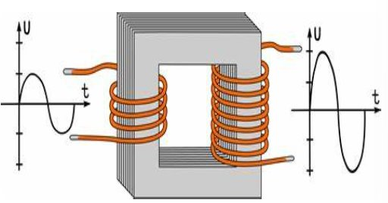
Basic Element - Transformer
The different number of coils can adjust the voltage!
Notes:
https://www.arrow.com/en/research-and-events/articles/step-up-and-step-down-transformers
N1 and n2 number of turns on the wires

Slide 28
Transformation of Variables
Transformation – changing of an Across variable either to a higher or lower magnitude between two systems.
Between two electrical systems it would look like this:
$V_{1}$ = incoming voltage [V]
$V_{2}$= outgoing voltage [V]
$I_{1}$ = incoming current [A]
$I_{2}$= outgoing current [A]
$$\frac{V_{1}}{V_{2}}=\frac{I_{2}}{I_{1}}$$
Notes:
TRANSFORMER SYMBOL HERE

Slide 29
Transformation of Variables – Electrical to Mechanical
Transformation – same principle as electrical transforming to change domains from electrical to mechanical
Between two electrical systems it would look like this:
$V$ = voltage [V] (electrical system)
F = Force [N] (mechanical system)
v(t) = velocity [m/s] (mechanical system)
I = current [A] (electrical system)
$$\frac{V}{F}=\frac{v(t)}{I}$$

Slide 30
Transformation of Variables – Mechanical to Acoustic
Transformation – Same principle as electrical transforming to change the mechanical domain to acoustic domain
Between two electrical systems it would look like this:
$P$ = pressure [Pa] (acoustic system)
F = Force [N] (mechanical system)
v(t) = velocity [m/s] (mechanical system)
U(t) = volume velocity [$m^{3}$/s] (acoustic system)
$$\frac{F}{P}=\frac{U(t)}{v(t)}$$
Notes:
VOLTAGE = CURRENT * RESISTANCE
CAPACITANCE -> RESISTANCE – INTEGRAL (ADD)

Slide 31
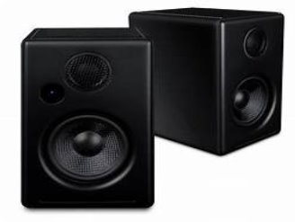
Analogous Circuits – Acoustic Analogies
Analogies and circuit theory are useful in studying complex systems
Ex. Loud Speakers
Transform electrical signals $→$ mechanical forces $→$ acoustical pressure
This can be modeled through equations and different simulators (MATLAB!)

