Slide 1
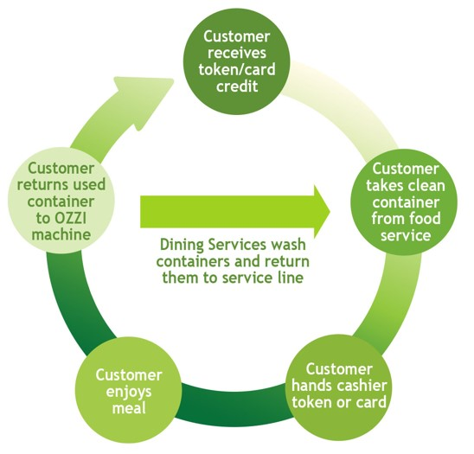
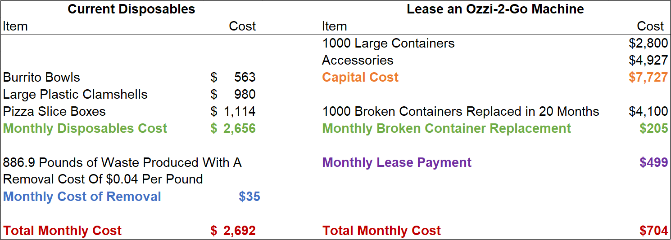
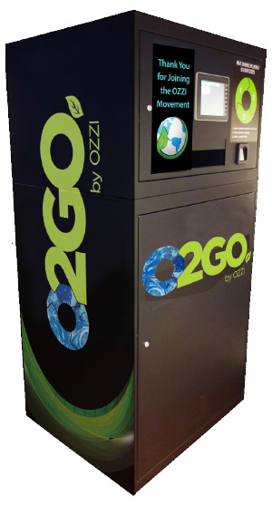
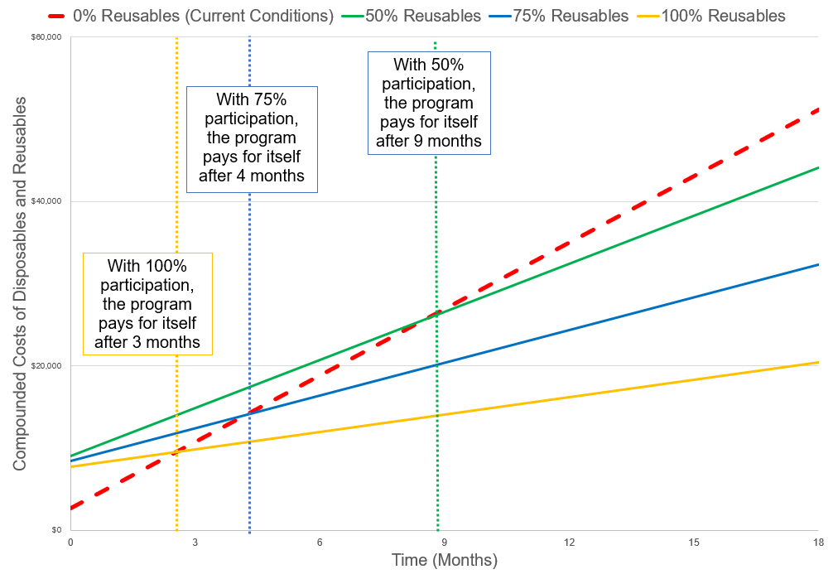
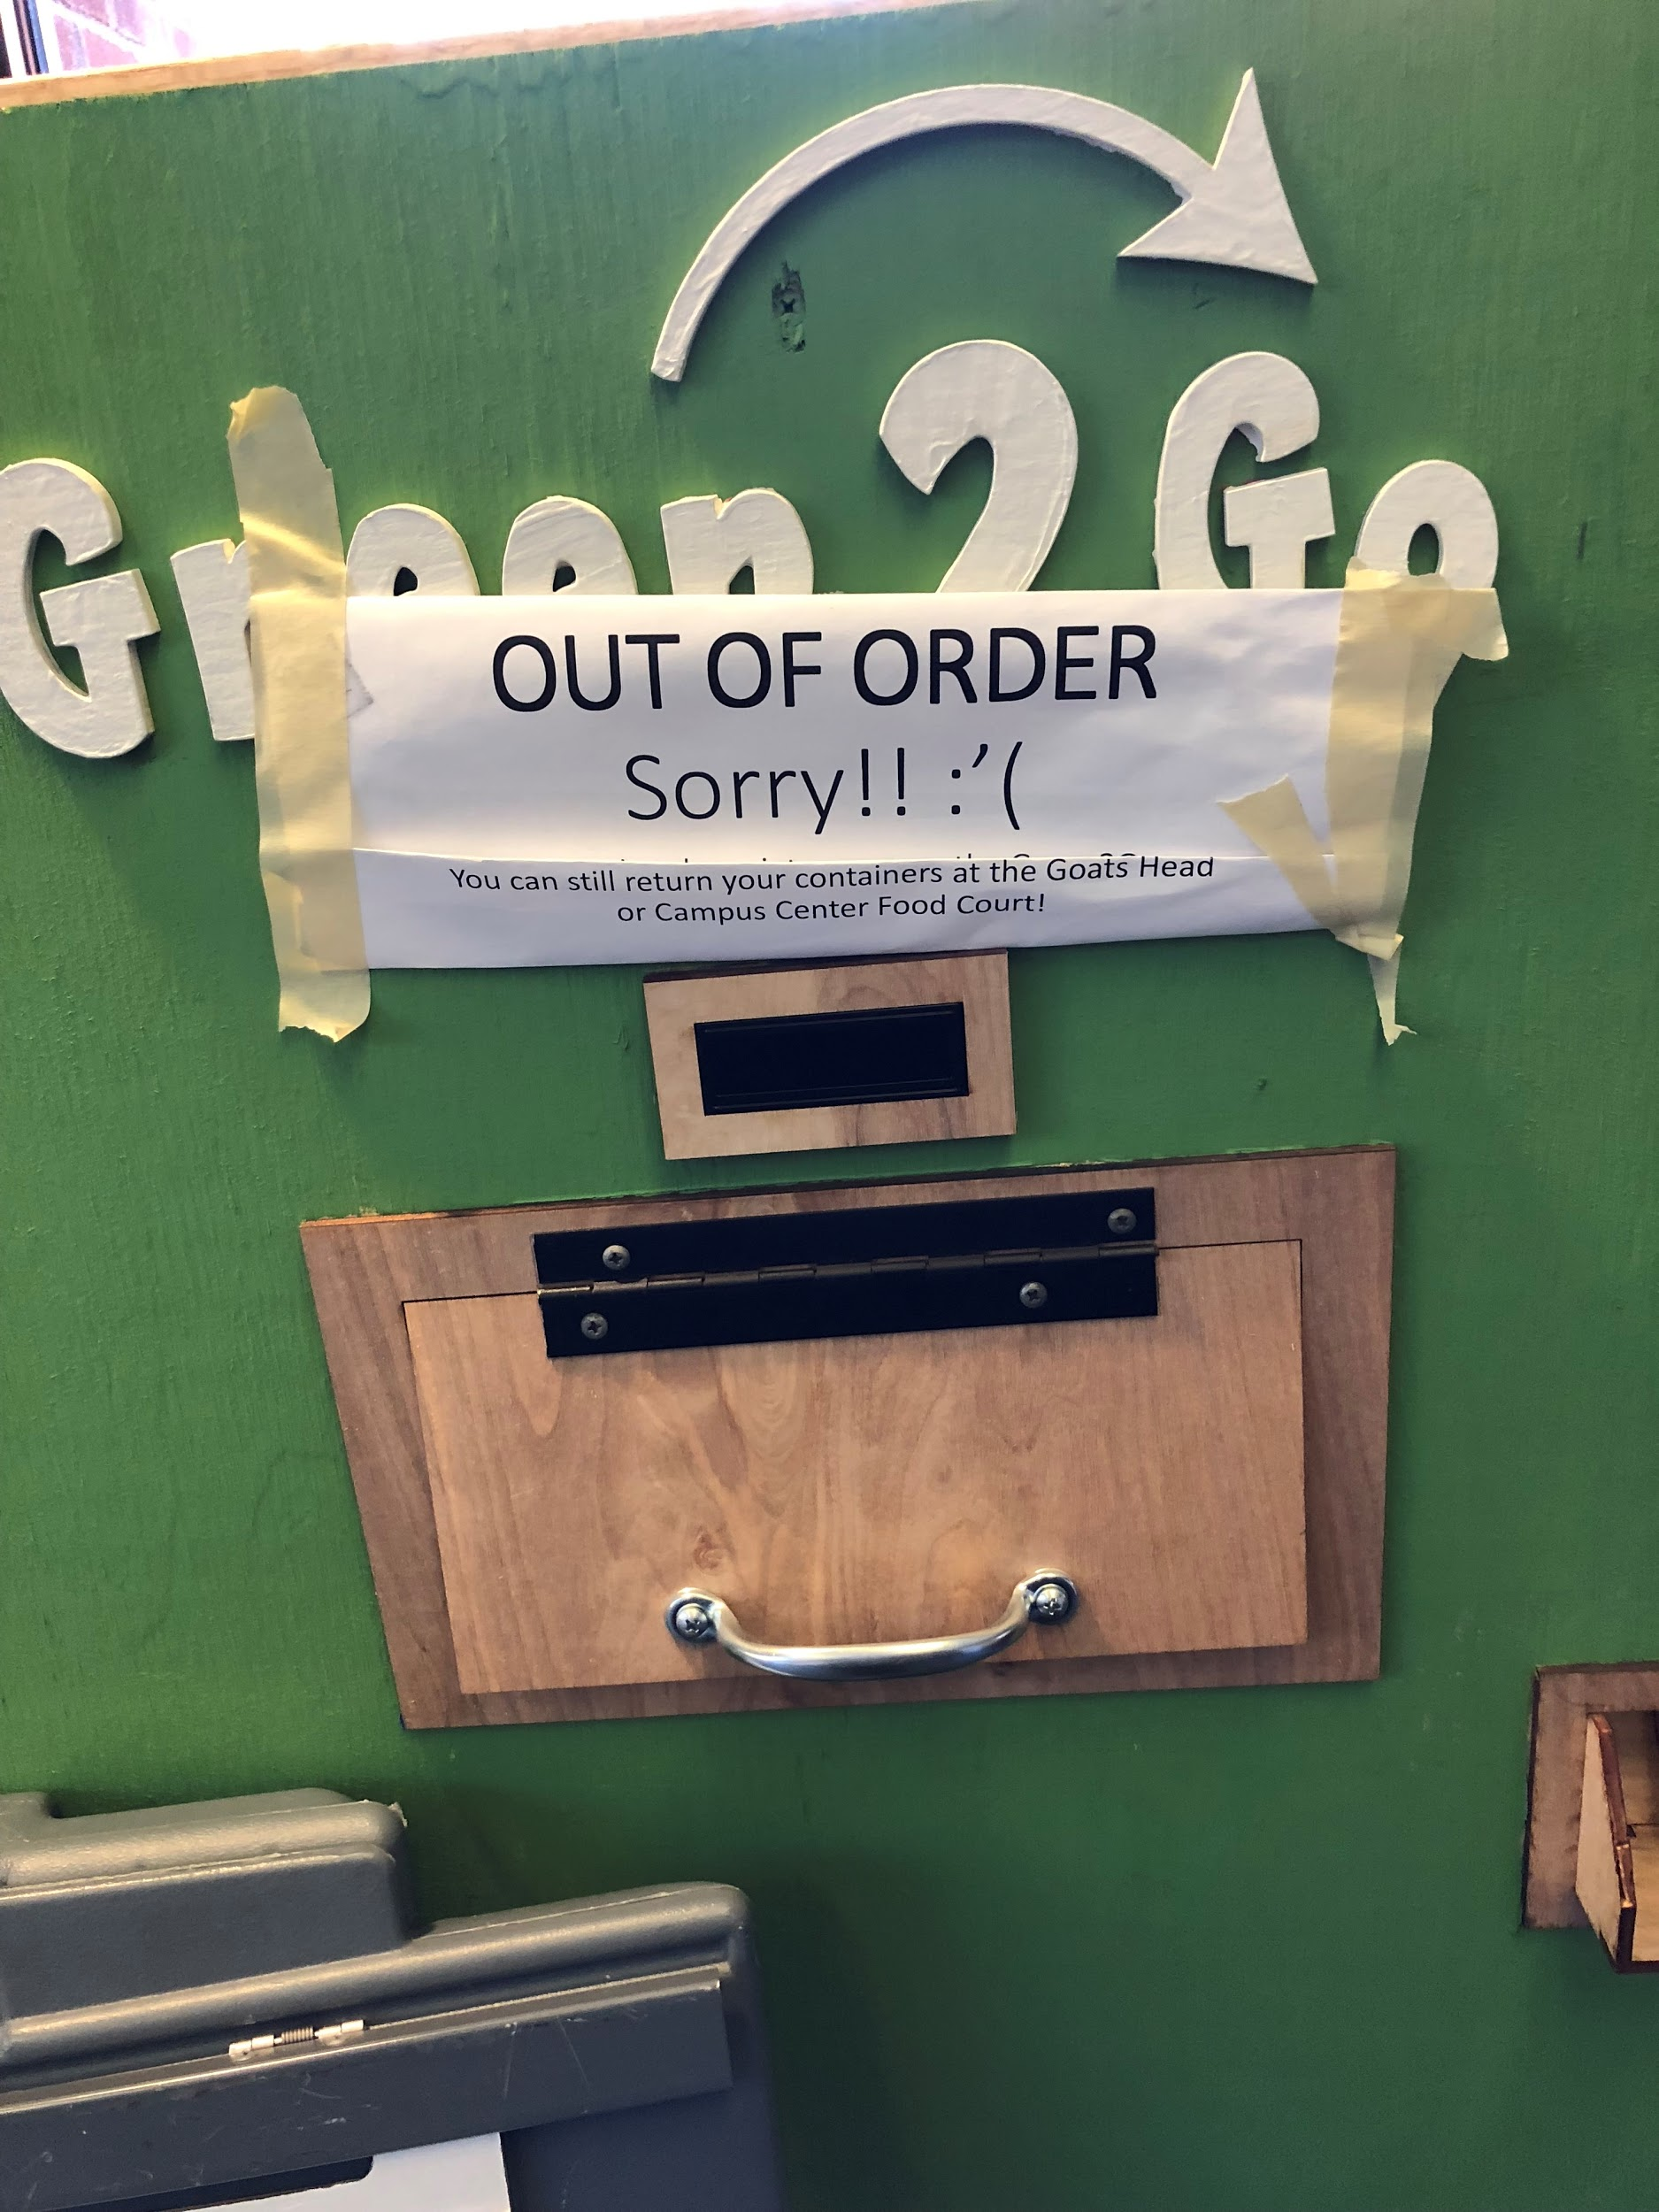
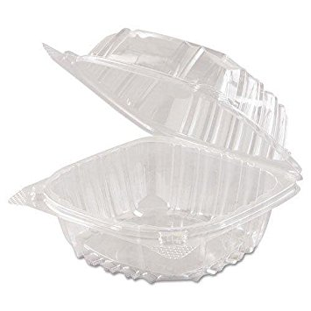
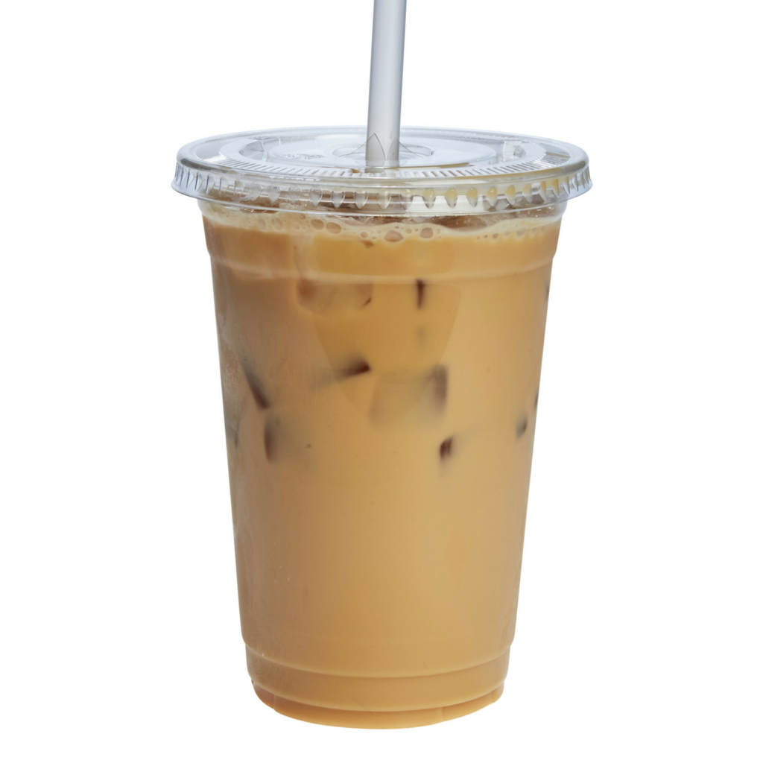
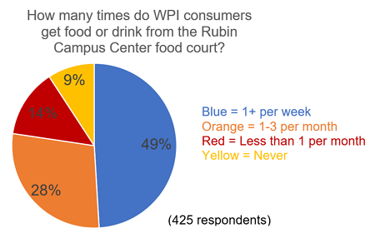
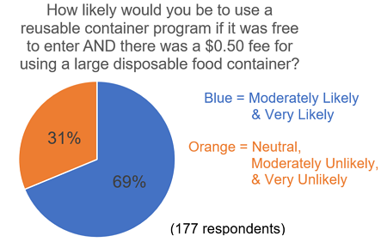
Waste Reduction Through A Reusable Container Program
Shea Mooney (CE), Stephen Peccerillo (AE) and James Curtin (CE)
Advisors: Professor Derren Rosbach (Dept. of Civil and Environmental Engineering)
and Professor Suzanne LePage (Dept. of Civil and Environmental Engineering)
Abstract
WPI waste generation rates are rising, a large portion from disposable food containers. This study’s purpose was to reduce disposable waste by assessing current waste management practices, researching new initiatives, and evaluating the feasibility of these initiatives. Students and faculty involved with sustainability initiatives were interviewed and the WPI community was surveyed. All relevant data was analyzed to develop recommendations related to the implementation of a campus-wide reusable container program.
Proposed Reusable Container Program
Is This Solution Cost Effective?
A program such as this could be funded in-part or entirely by the WPI Green Revolving Fund
Free entry into program with a $0.50 fee added to disposable containers to change consumer behavior
The Problems
Will Consumers Participate?
Half of those surveyed make up the majority of food court consumers
Of that half, 70%
said they were
likely to switch to a reusable container under conditions similar to the proposed program
With 50% participation, WPI would save $38,260 over the course of the Ozzi-2-Go 60-month lease.
Assessed the Current Waste Management Practices at WPI.
Researched New Initiatives and Practices at WPI.
Evaluated the Feasibility of the New Initiatives and Practices.
Recommended New Practices and Initiatives to Reduce Waste at WPI.
Objectives
Propose the funding of the Ozzi-2-Go program to the Green Revolving Fund board
As WPI dining culture changes, expand the program to include different types of containers
Future Goals
If 50% of all large disposable food containers were replaced with reusable ones, WPI would stop producing 444 pounds of waste every month, that’s equal to 8 tons over a typical undergraduate education.
References
http://agreenozzi.com/wp-content/uploads/2015/08/brochure.pdf
https://www.amazon.com/Clamshell-Container-Small-Clear-Hinged/dp/B00P99E9G8
https://forthemommas.com/wp-content/uploads/2012/05/Large-Iced-Coffee-Silo-2.jpg

