Slide 1
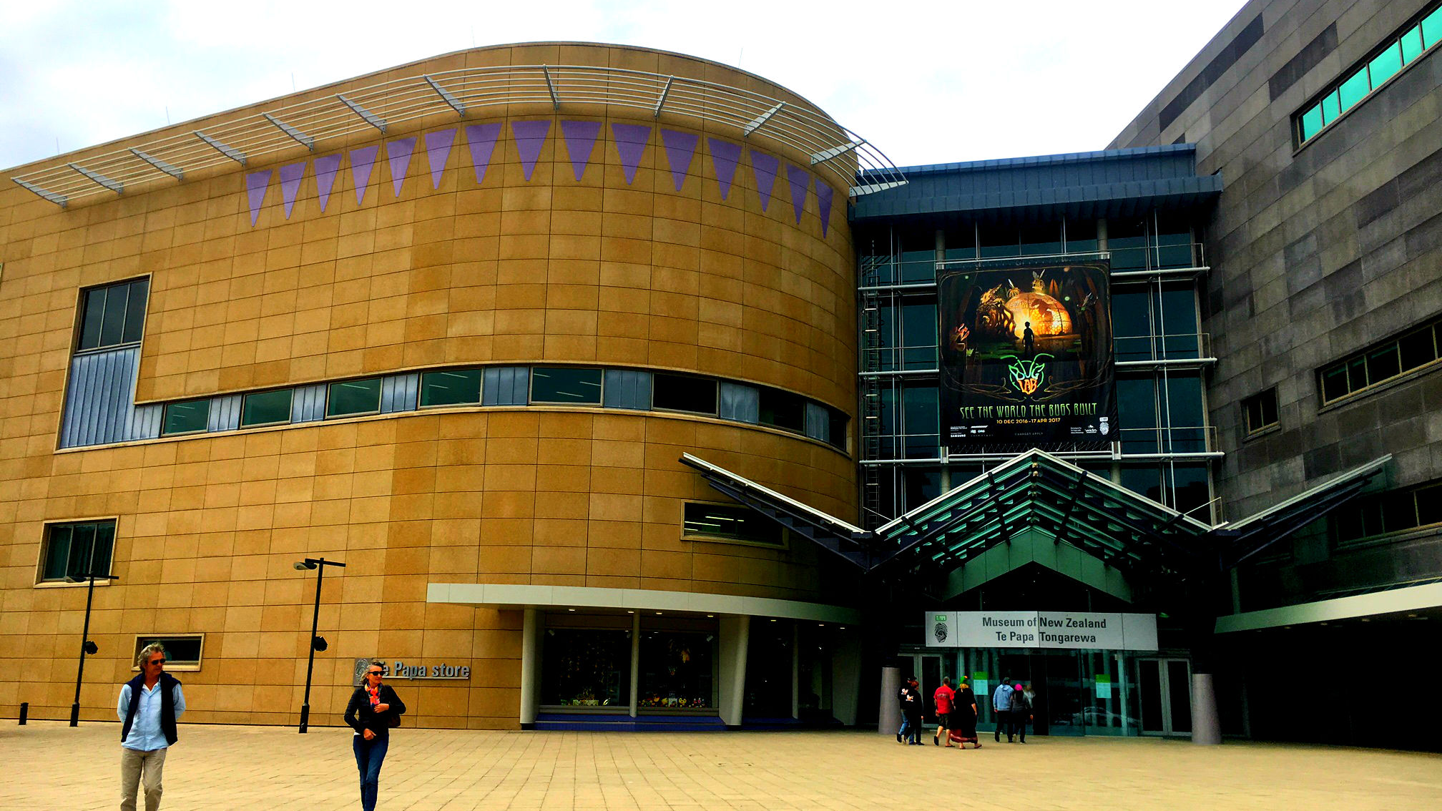
Assessing Visitor Experience
for the Te Papa Natural Environment Zone Renewal
Shannon Harrington
Brooke Klepper
Shannon Moffat
Kaylee Perron

Slide 2
The goal of this project was to provide Te Papa with recommendations for the renewal of the Natural Environment Zone.
Understand the mission and vision of Te Papa.
Evaluate visitor experience in the existing galleries.
Propose recommendations based on visitor feedback.

Slide 3
The goal of this project was to provide Te Papa with recommendations for the renewal of the Natural Environment Zone.
Understand the mission and vision of Te Papa.
Evaluate visitor experience in the existing galleries.
Propose recommendations based on visitor feedback.

Slide 4
Understand the mission and vision
Appreciate the unique biodiversity of New Zealand
Recognize the problems that the natural environment faces
Feel inspired to take action to preserve it

Slide 5
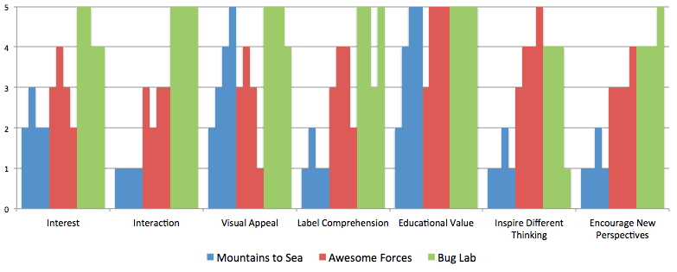
Distribution of Site Evaluation Scores

Slide 6
The goal of this project was to provide Te Papa with recommendations for the renewal of the Natural Environment Zone.
Understand the mission and vision of Te Papa.
Evaluate visitor experience in the existing galleries.
Propose recommendations based on visitor feedback.

Slide 7
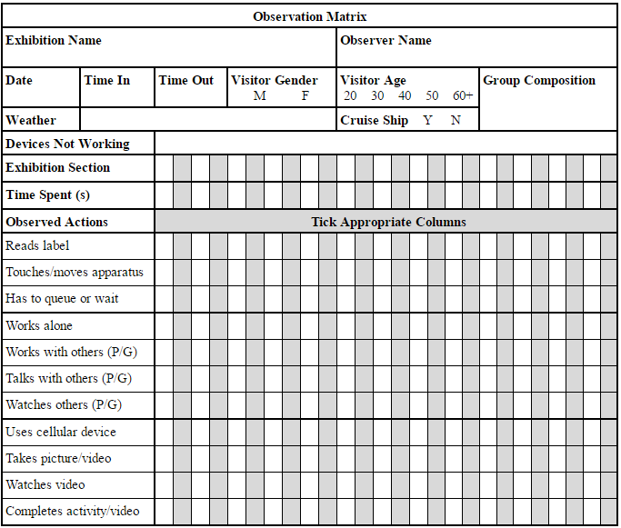
Measure visitor experience in the existing galleries

Slide 8
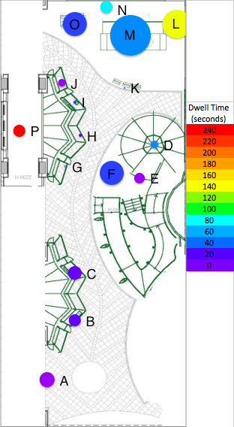
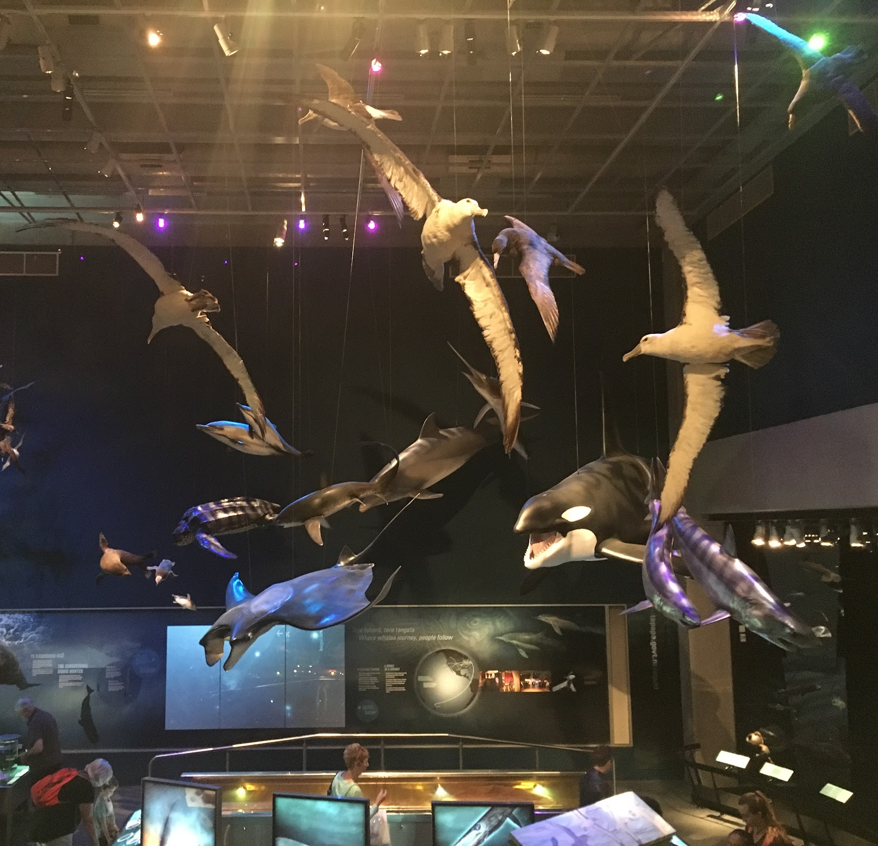
Mountains to Sea

Slide 9
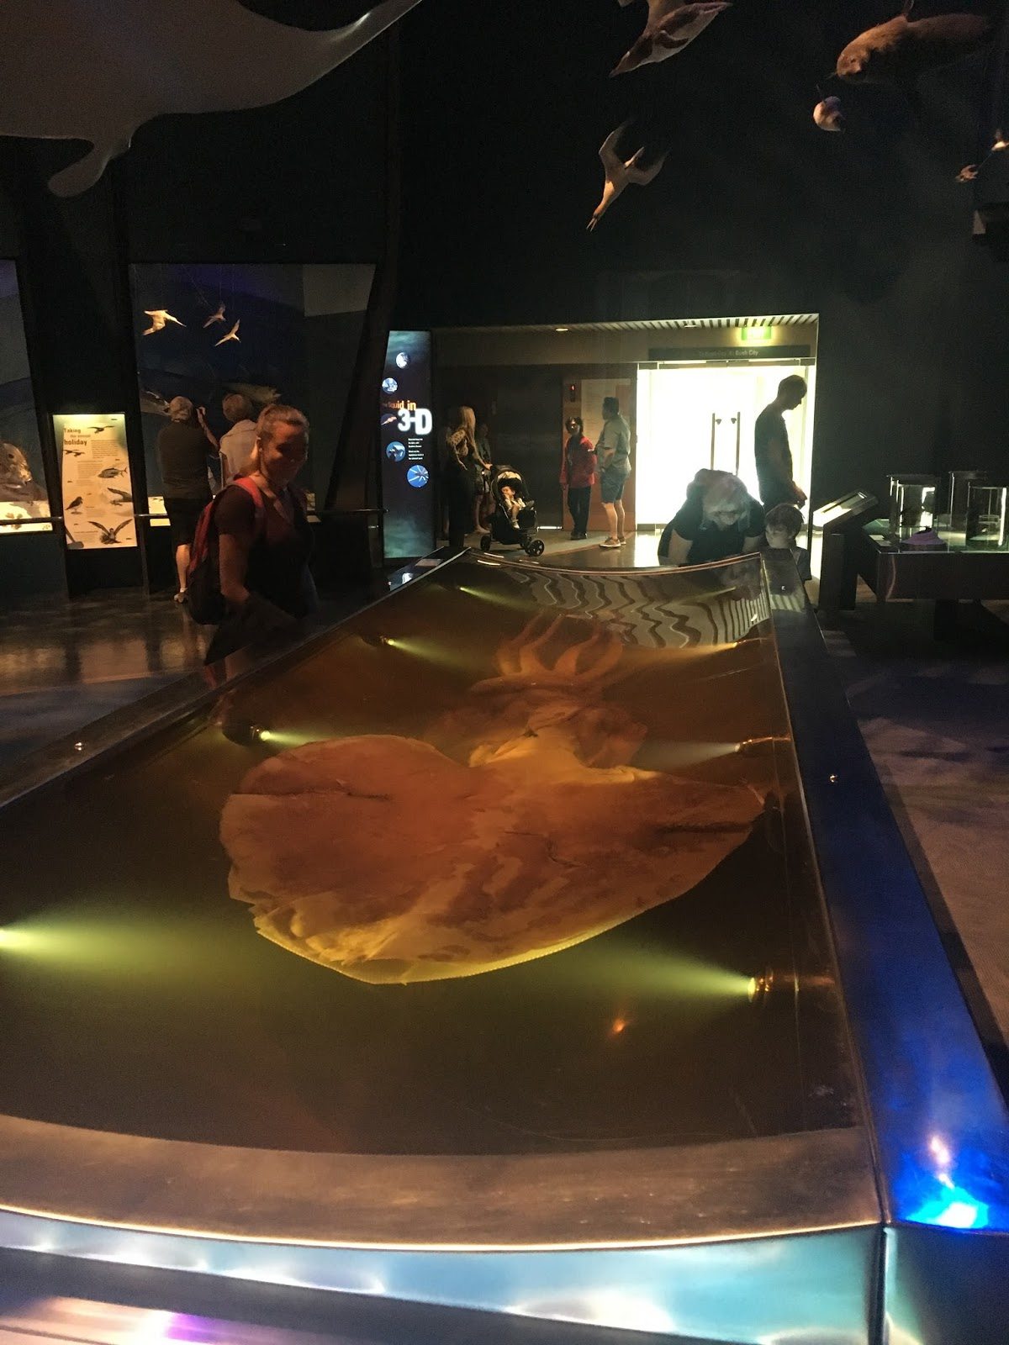
Colossal Squid
Visitors Stopped:
27 out of 31
Dwell Time:
1 minute
Comments:
“Alien-like”
“Its eye is the size of a soccer ball”

Slide 10
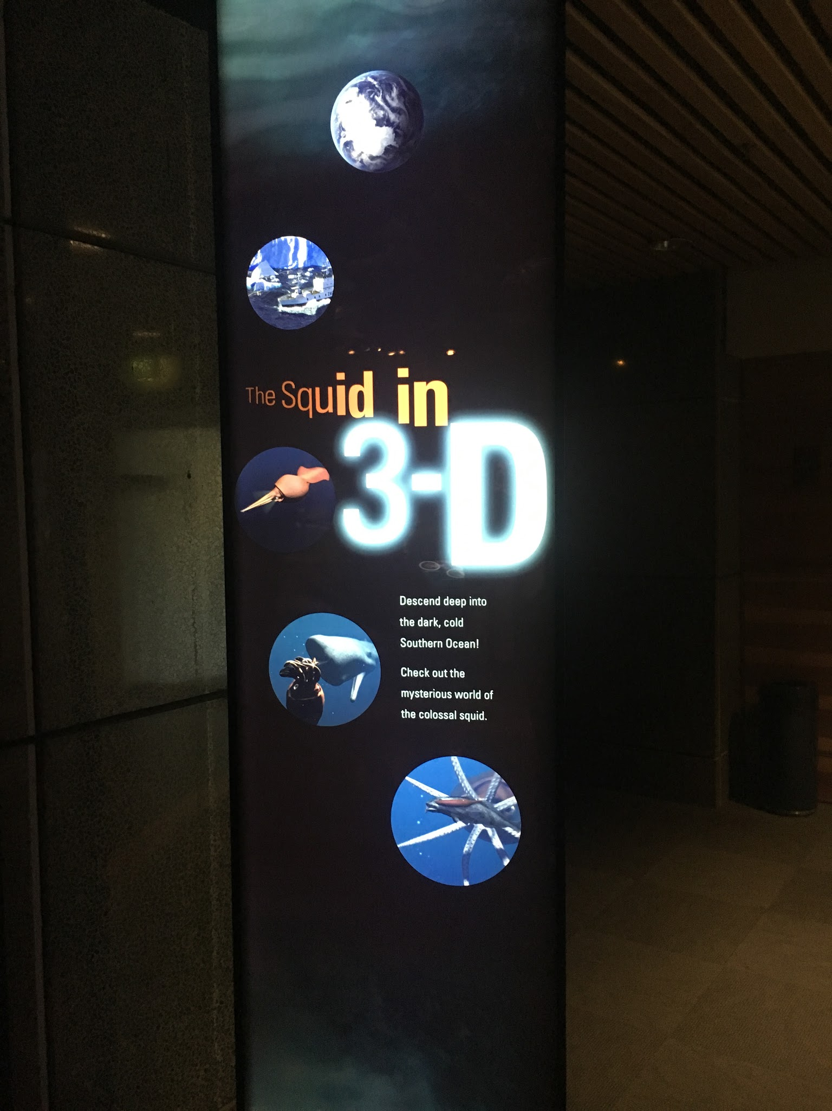
Squid in 3-D Video
Visitors Stopped:
8 out of 31
Dwell Time:
4 minutes
4 of the visitors completed the video
P

Slide 11
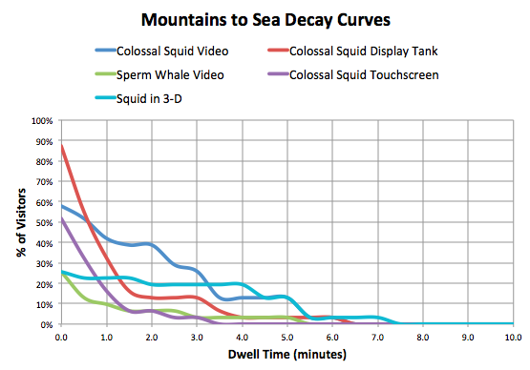

Slide 12
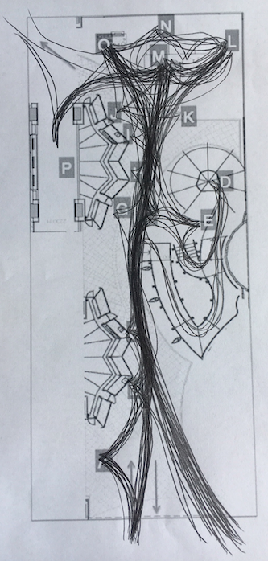
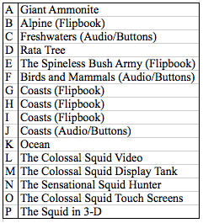

Slide 13
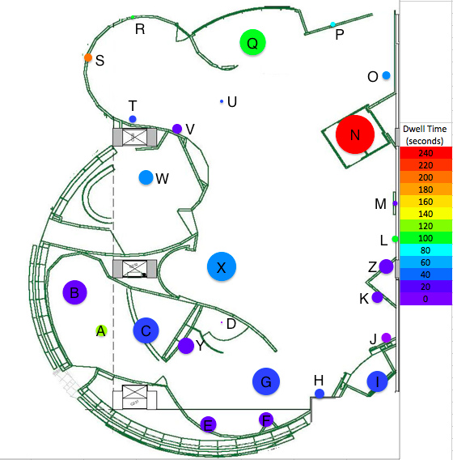
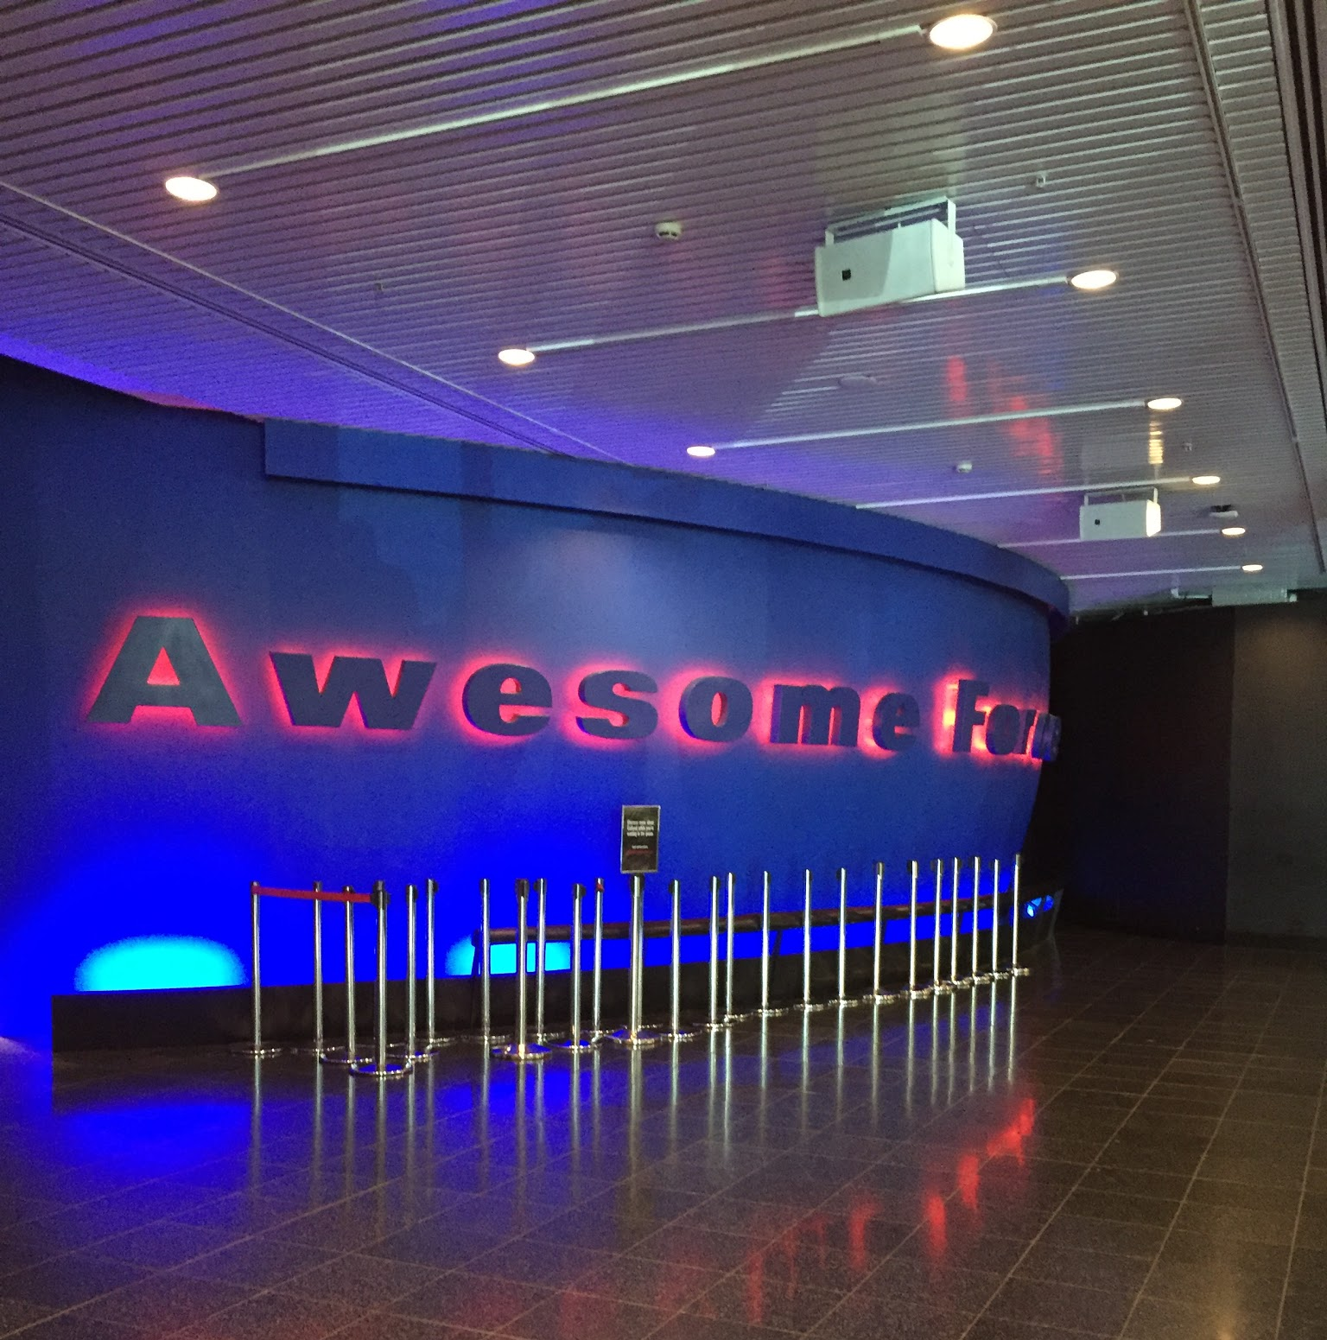
Awesome Forces

Slide 14
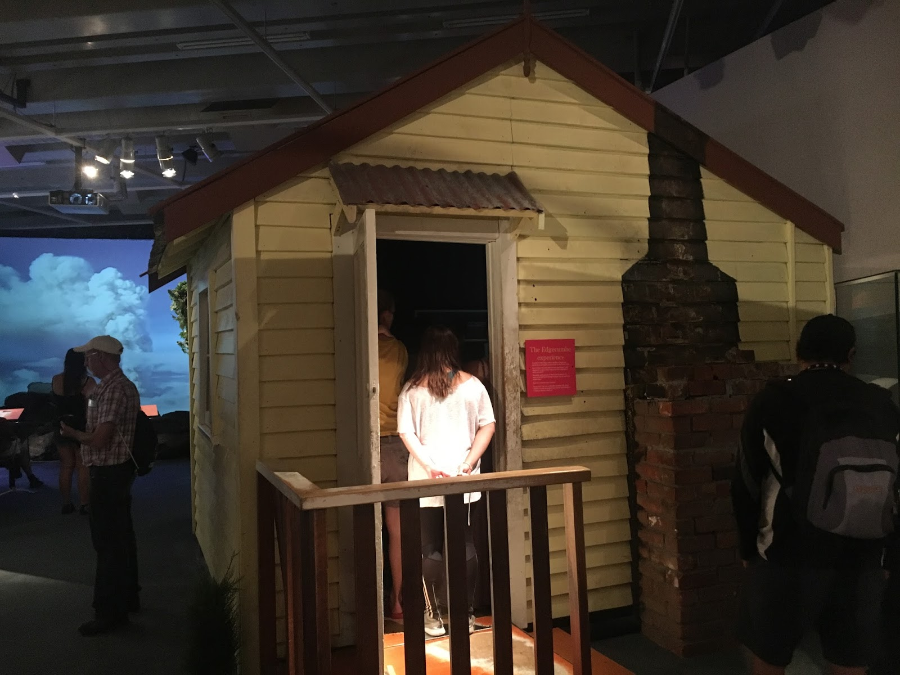
Earthquake House
Visitors Stopped:
24 out of 31
Dwell Time:
4 minutes
Took up 24% of average time in gallery
14 people had to wait in line

Slide 15
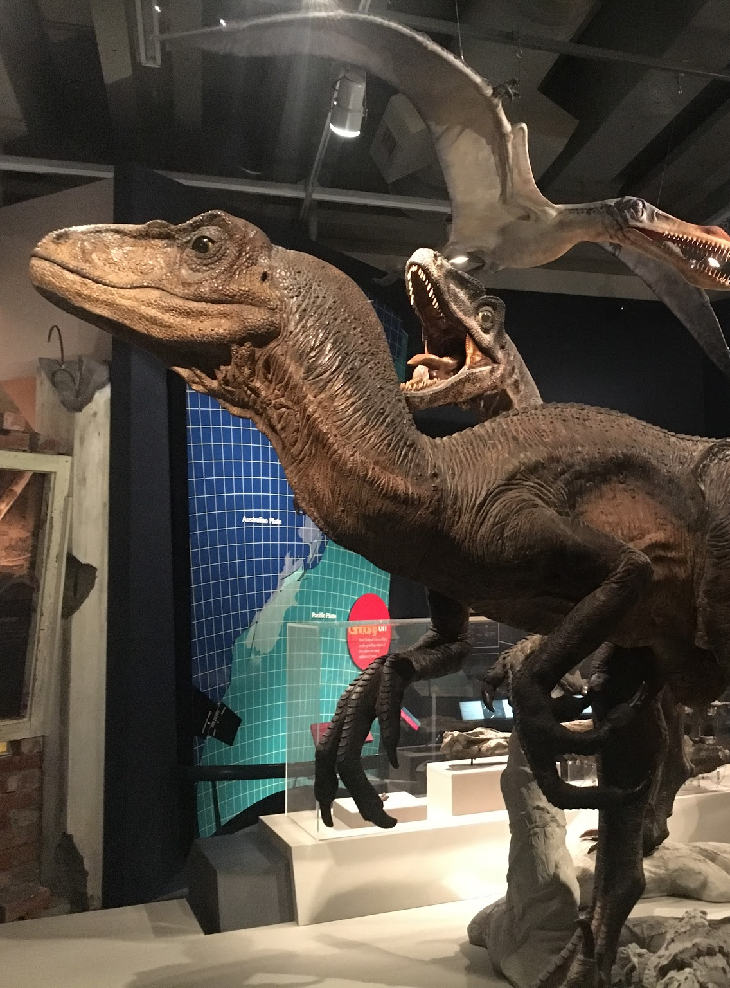
Zealandia Section
Visitors Stopped:
18 out of 31
Dwell Time:
1 minute

Slide 16
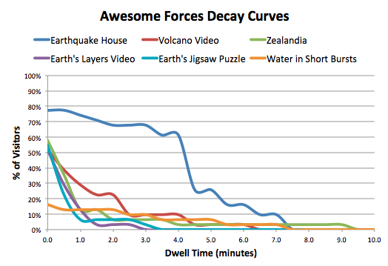

Slide 17
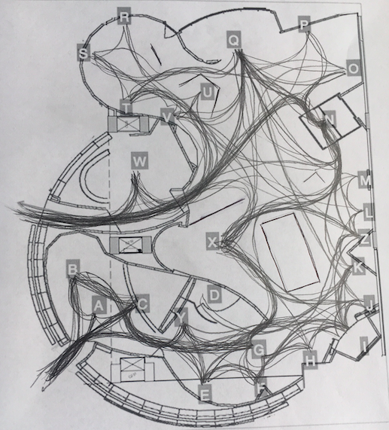
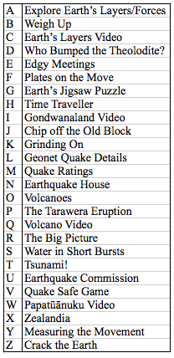

Slide 18
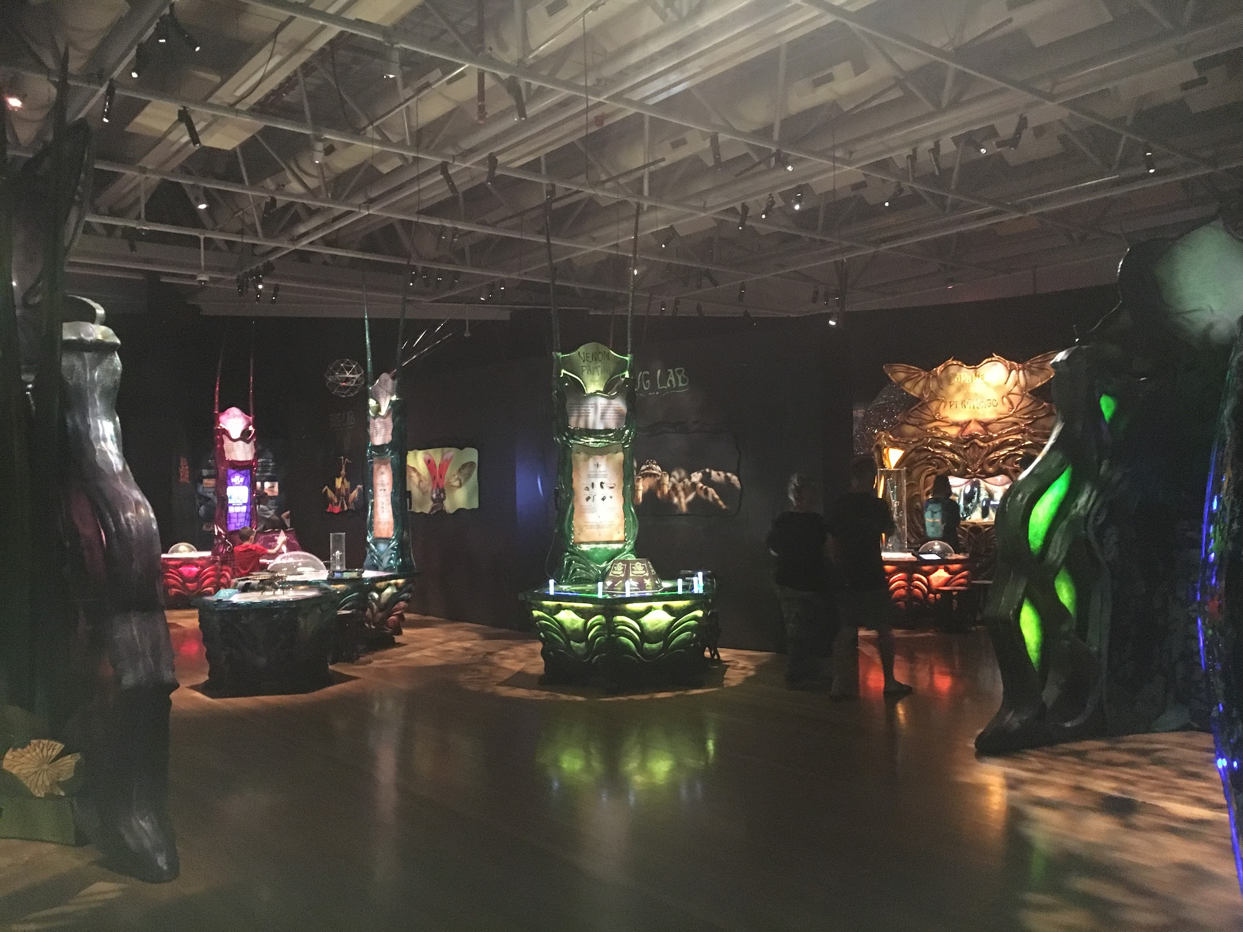
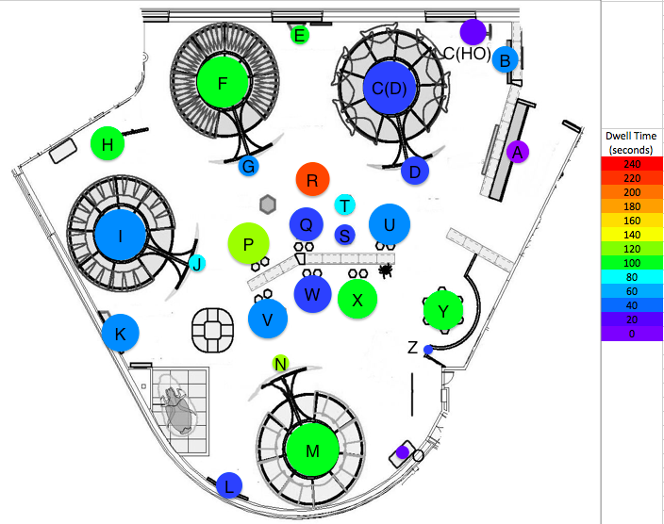
Bug Lab

Slide 19
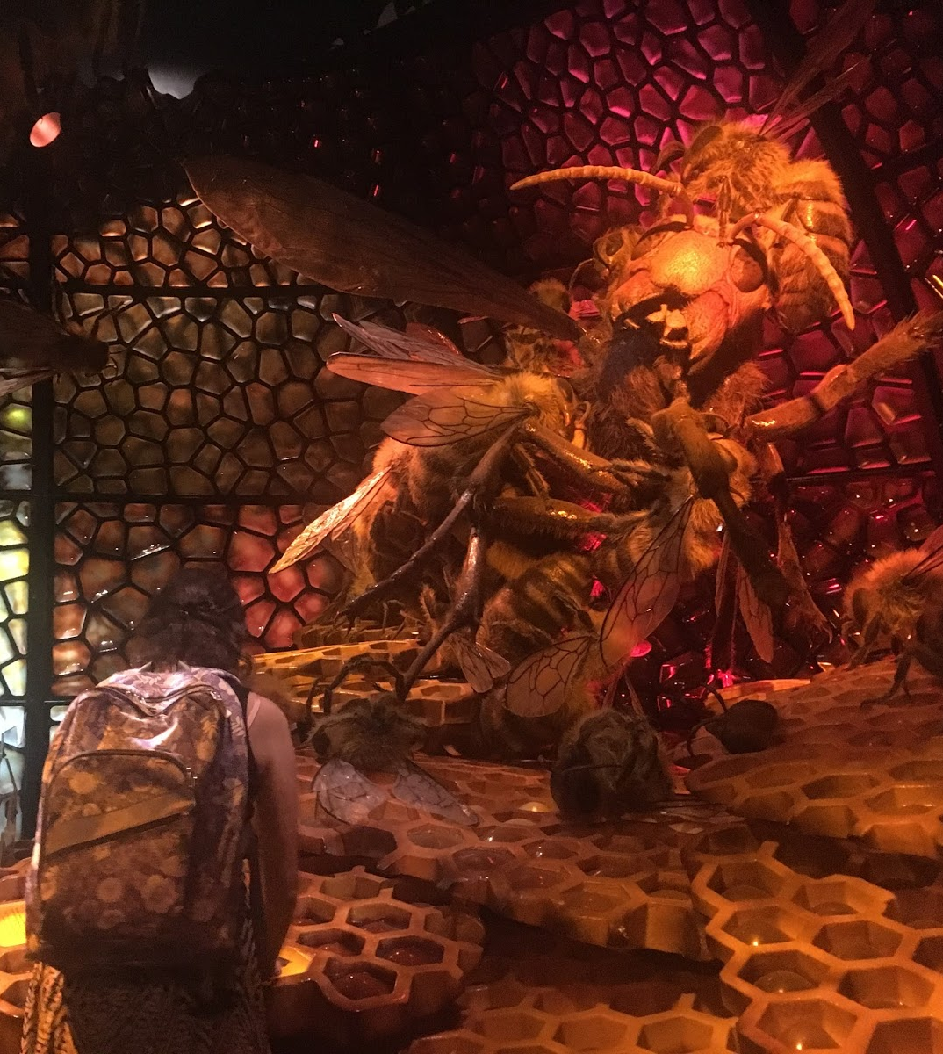
Swarm Lab: Japanese Honeybees
Visitors Stopped:
28 out of 30
Dwell Time:
2 minutes
15 of the tracked visitors engaged in the rubbing pad activity

Slide 20
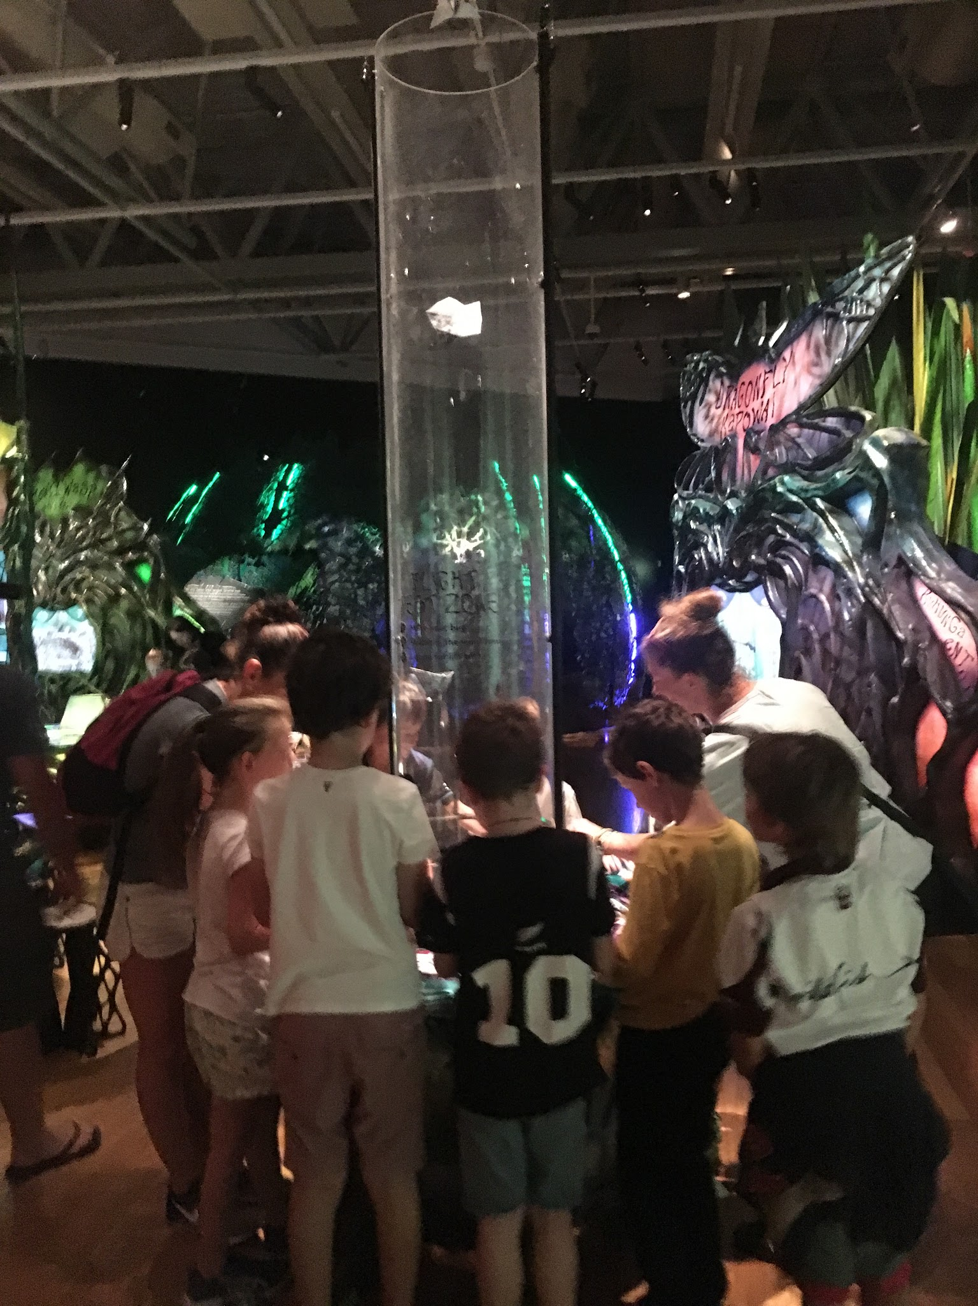
Flight Test Station
Visitors Stopped:
18 out of 30
Dwell Time:
4 minutes
Took up 11% of average time in gallery
17 of the tracked visitors conversed with others

Slide 21
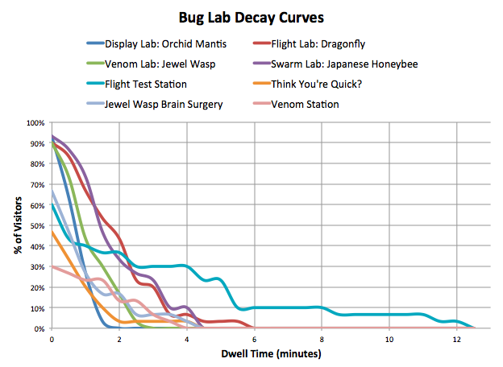

Slide 22
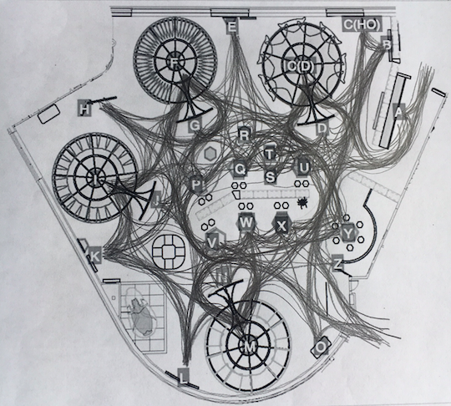
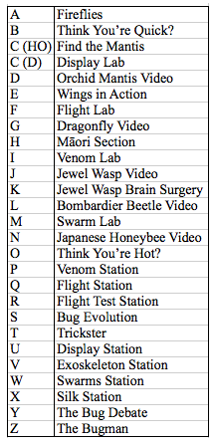

Slide 23
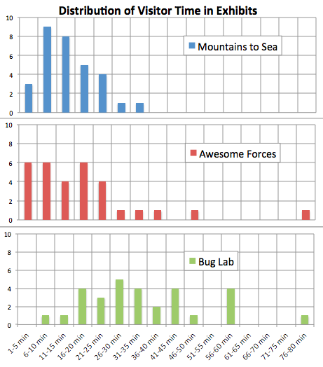
Distribution of Visitor Time in Exhibitions
Average = 14 minutes
Average = 18 minutes
Average = 35 minutes

Slide 24
The goal of this project was to provide Te Papa with recommendations for the renewal of the Natural Environment Zone.
Understand the mission and vision of Te Papa.
Evaluate visitor experience in the existing galleries.
Propose recommendations based on visitor feedback.

Slide 25
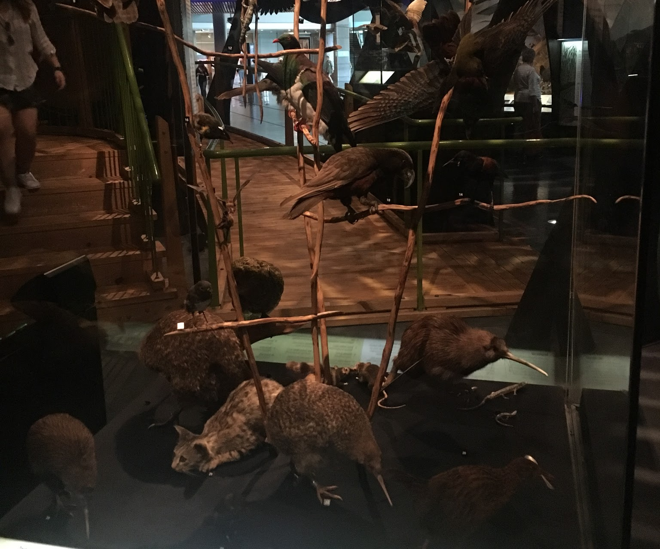
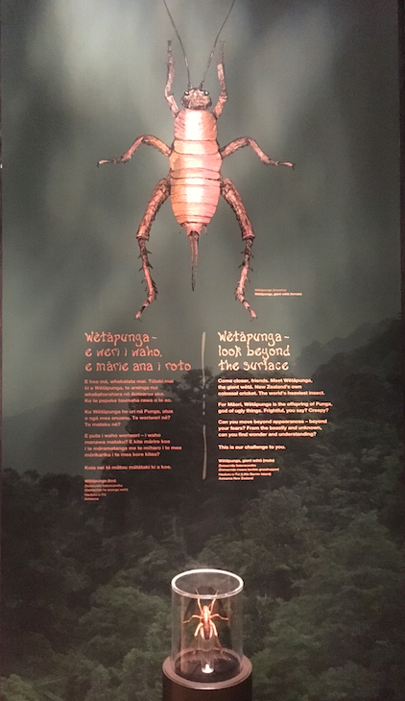
Focus on topics that are unique and native to New Zealand

Slide 26
Maintain a connection between humans and the natural environment

Slide 27
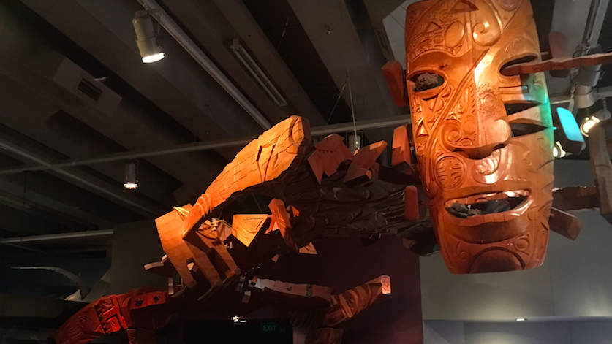
Explore ways to integrate mātauranga Māori from the start of development

Slide 28
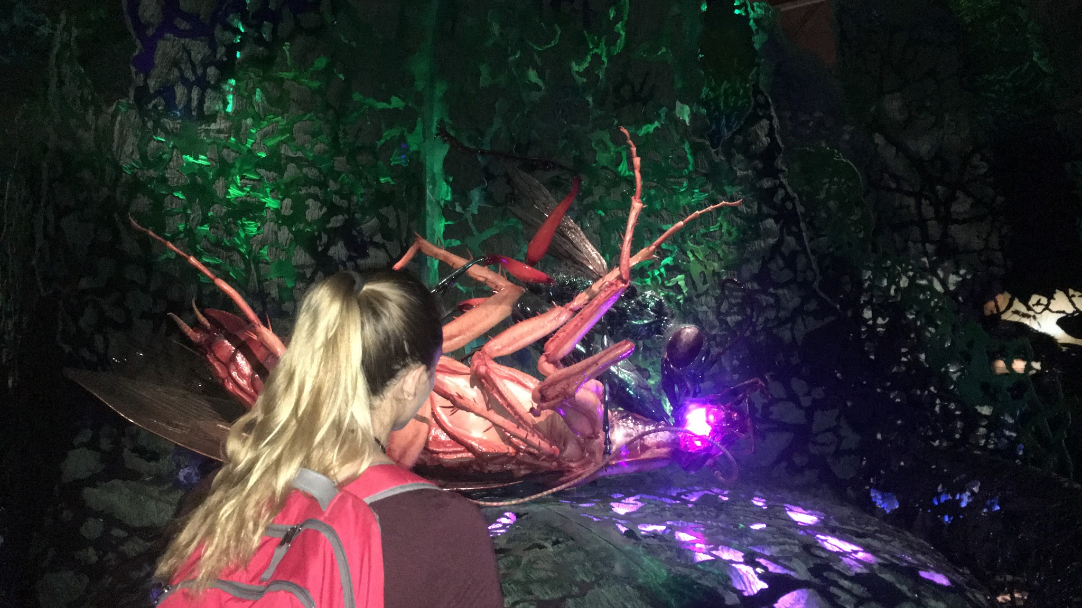
Embrace the peculiar and bizarre aspects of the natural environment

Slide 29
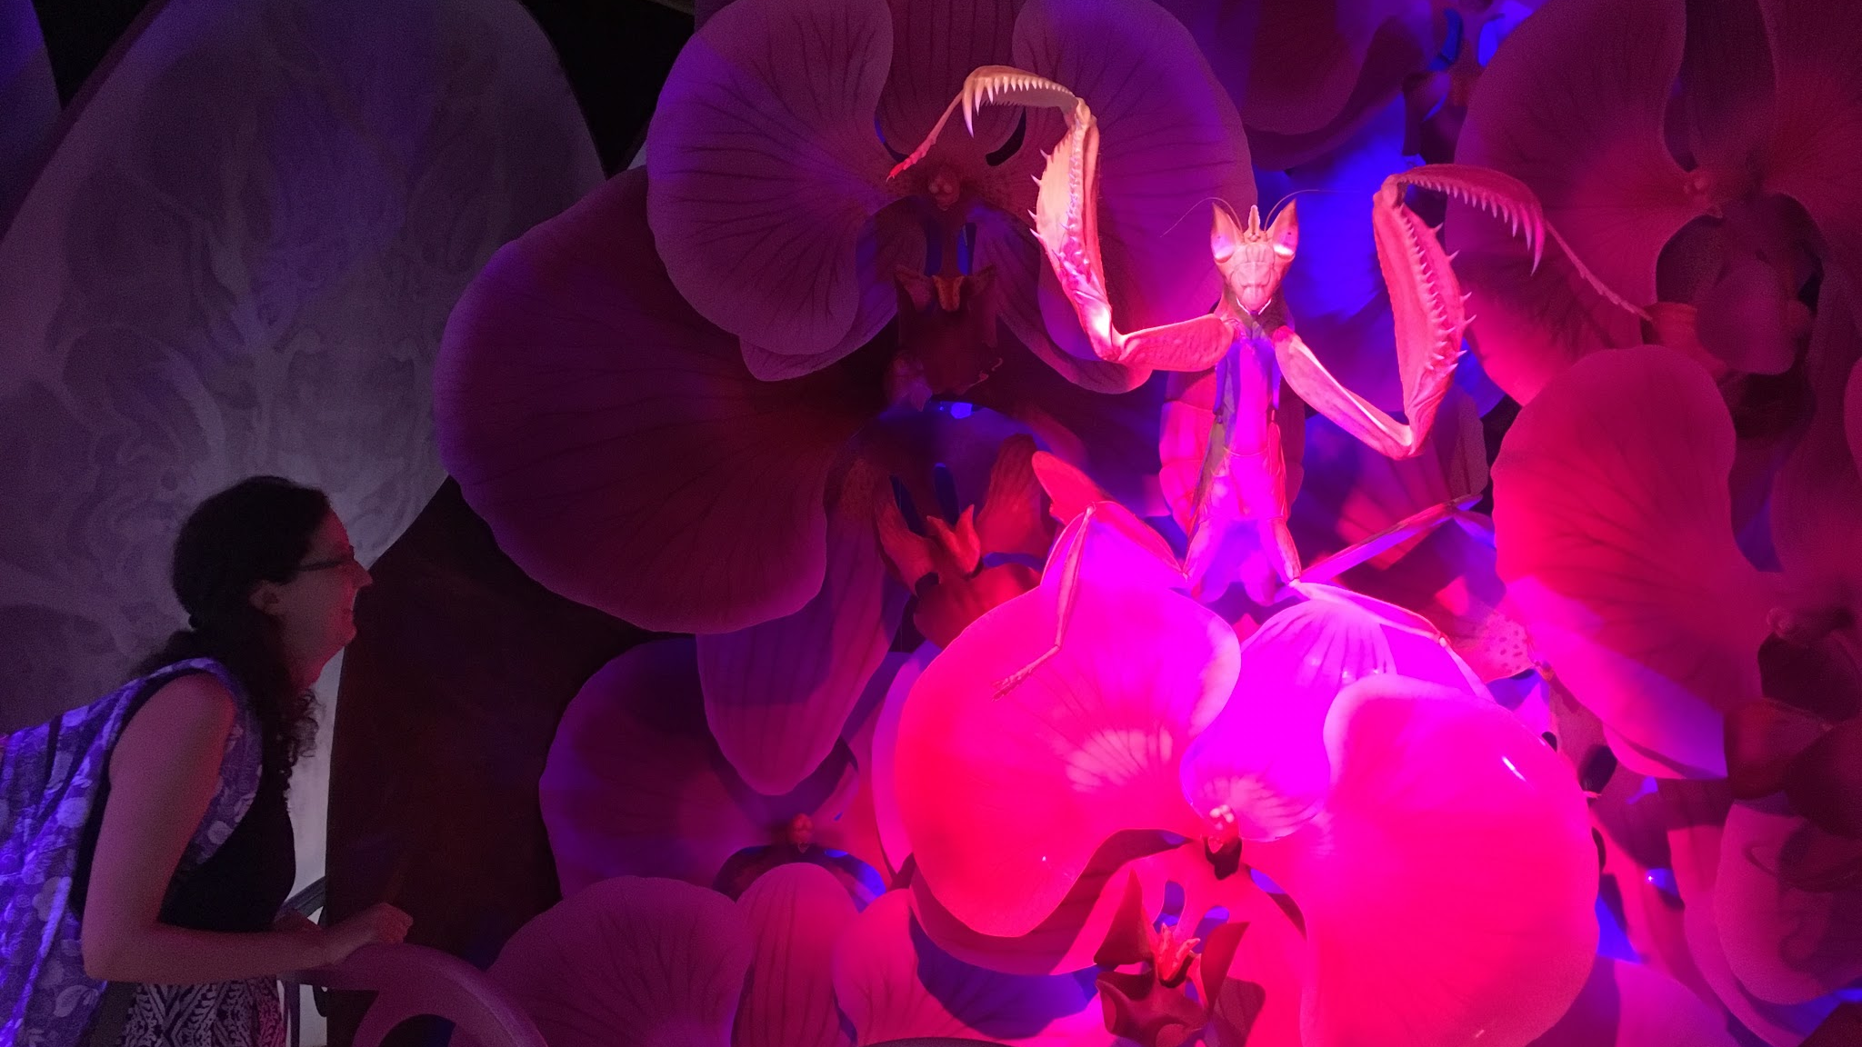
Create detailed and eye-catching displays; consider more partnerships with Weta Workshop

Slide 30
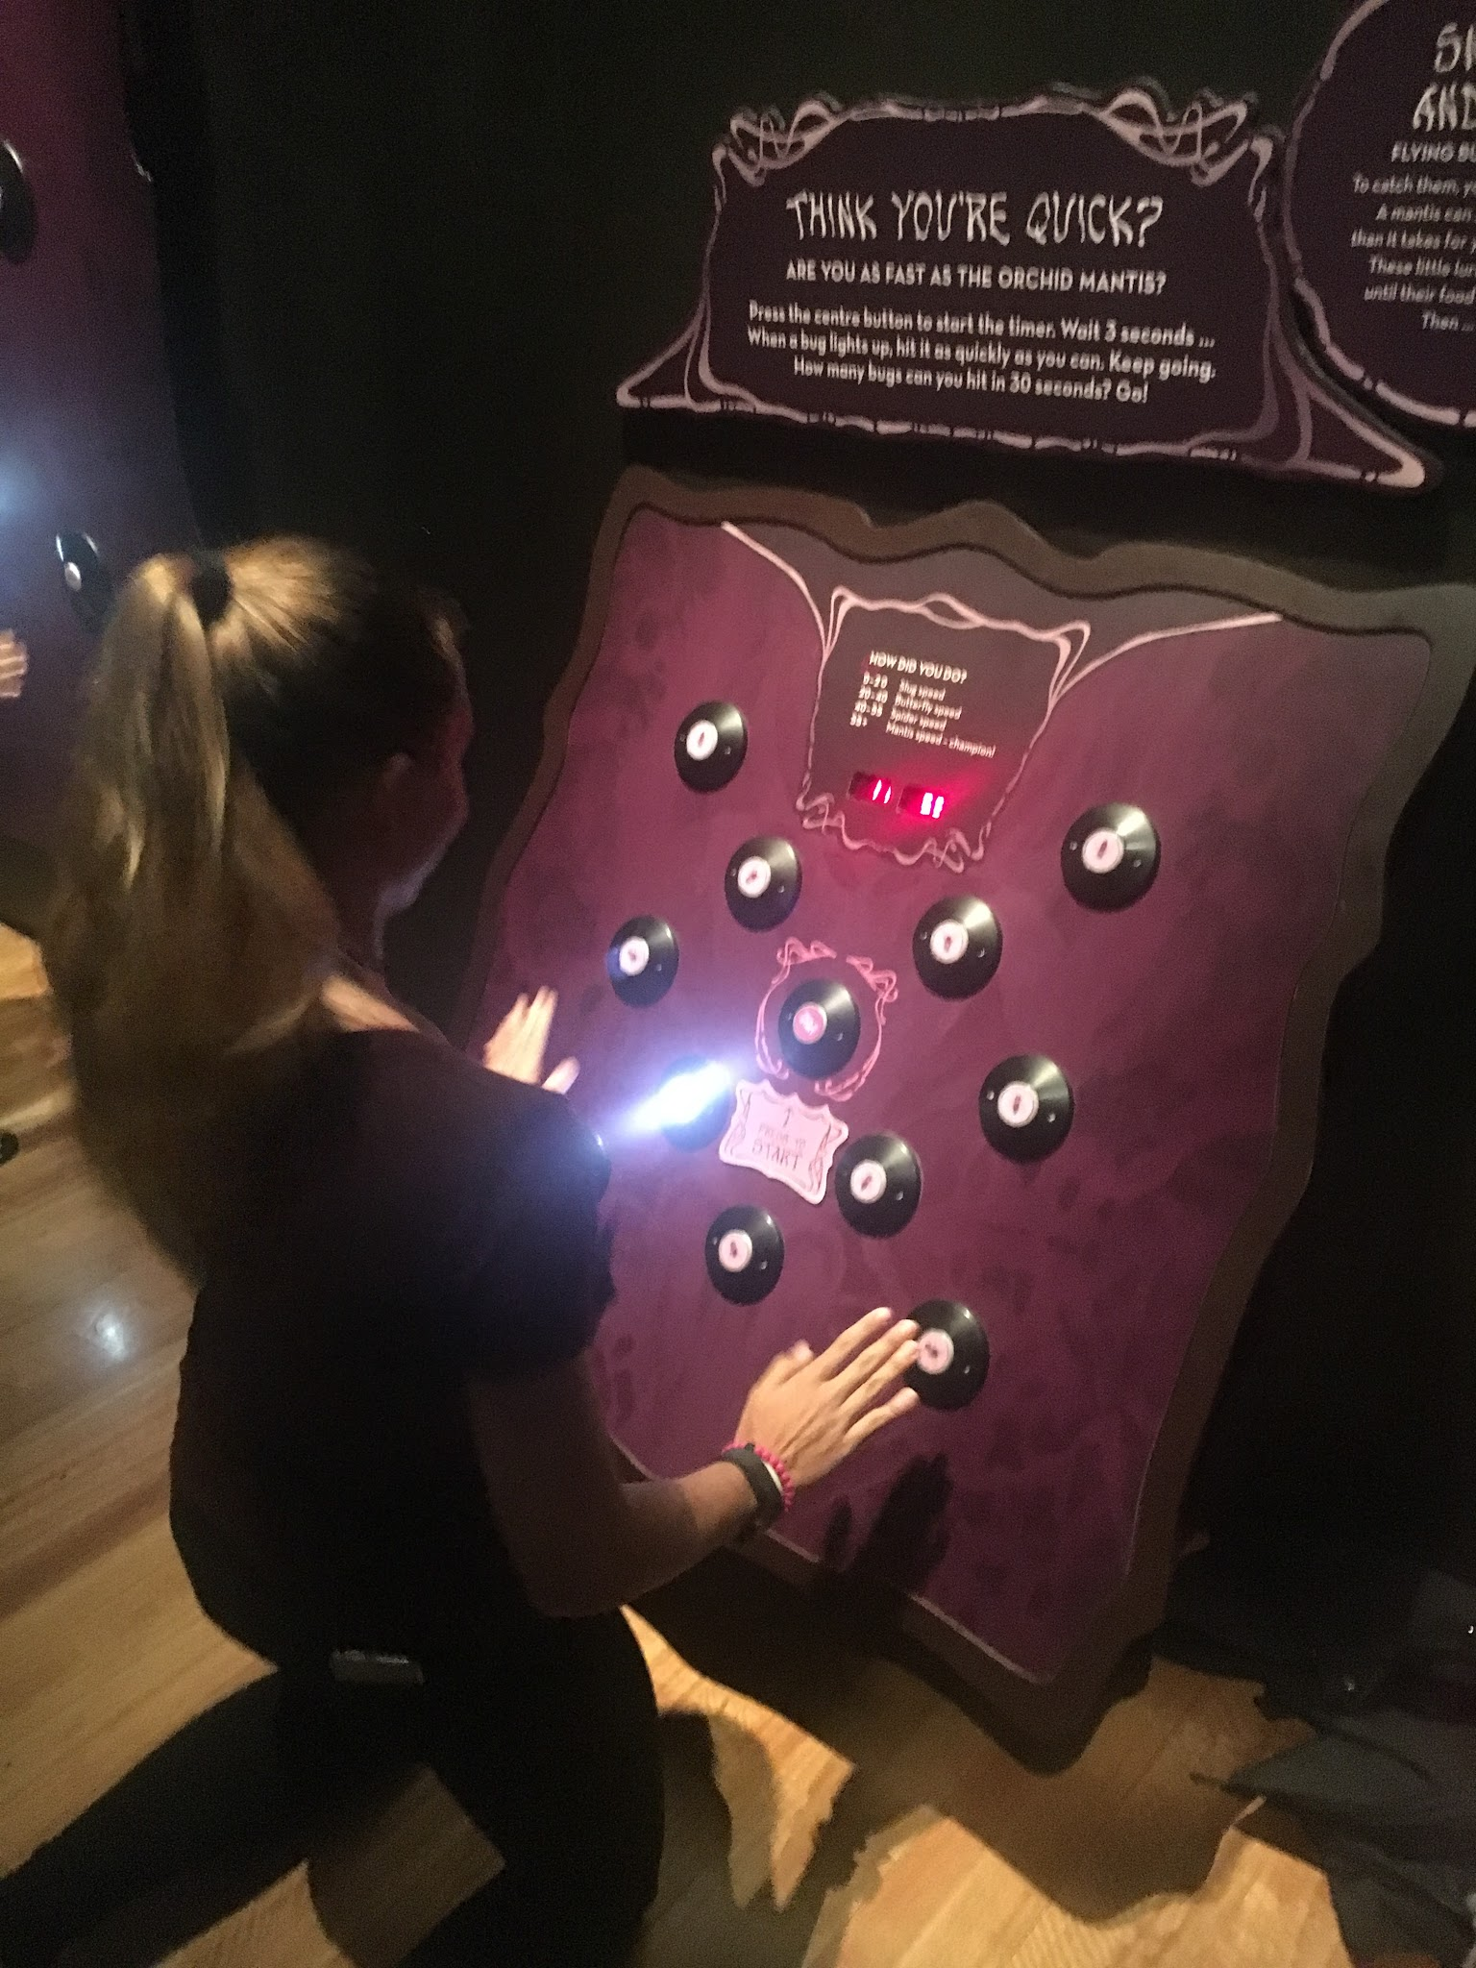
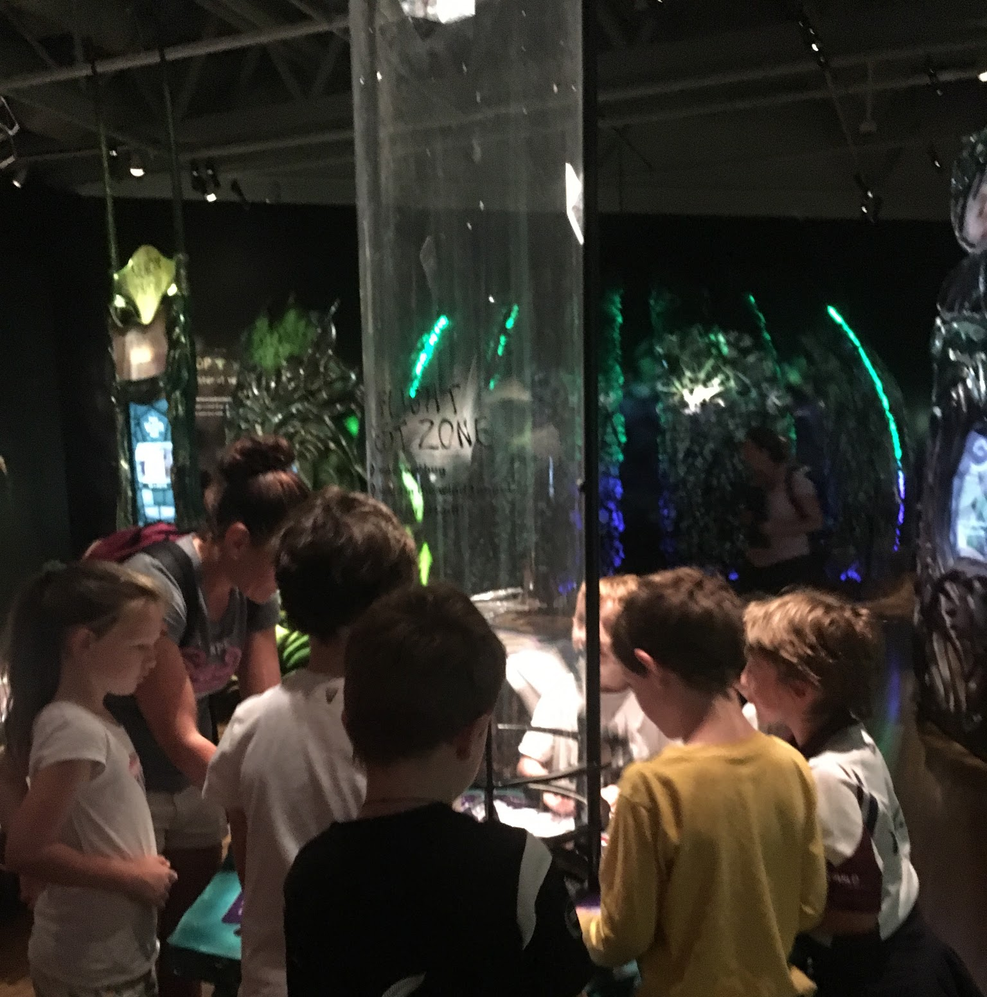
Incorporate hands-on games and activities for engagement with both children and adults

Slide 31
Arrange the layout of the gallery so that valuable or costly exhibits are front and center

Slide 32
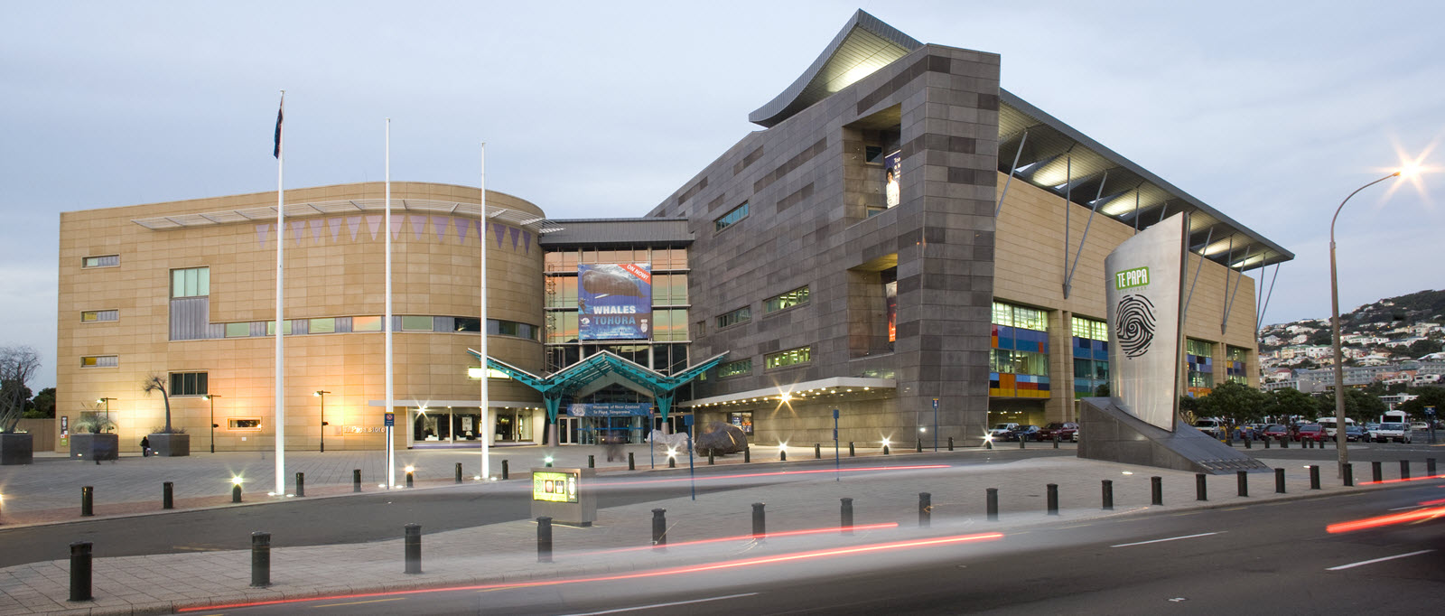
Kia Ora!

Slide 33
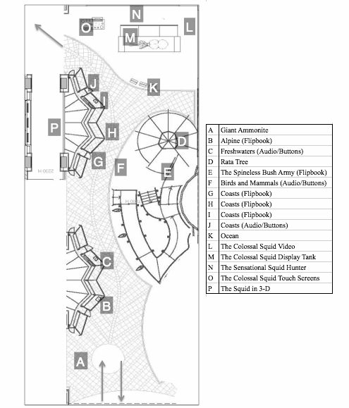

Slide 34
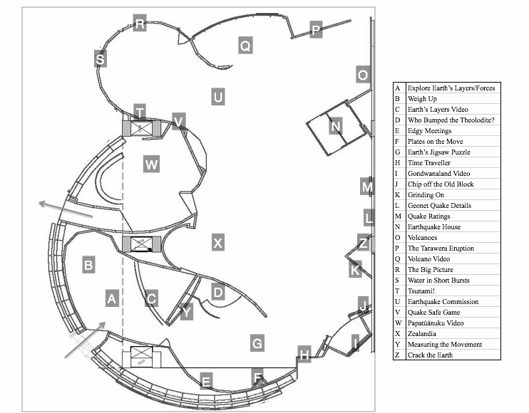

Slide 35
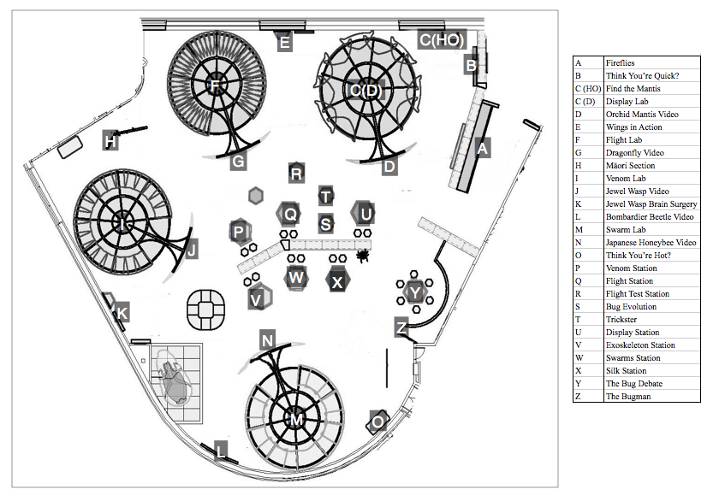

Slide 36
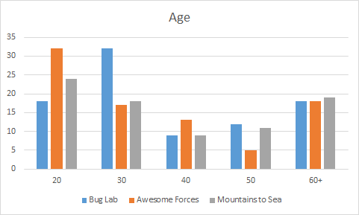

Slide 37
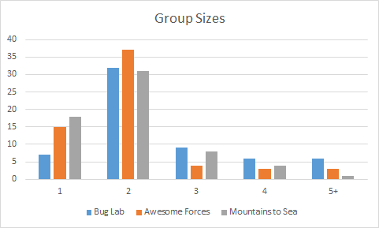

Slide 38
Gender Distribution

