Slide 1
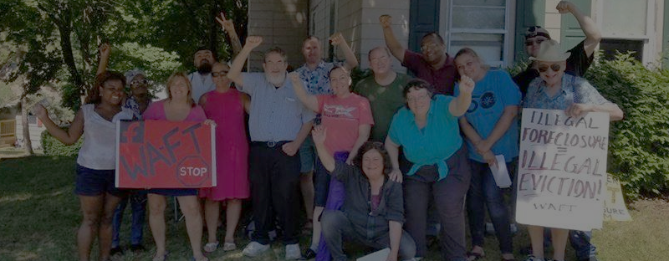



IMPROVING OUTREACH TO INDIVIDUALS AT RISK OF EVICTION AND FORECLOSURE IN MASSACHUSETTS
Sydney Borrello​
Sid Damle​
Kat Tarantino​
Dylan Turetsky​
Dan Wrona
December 8, 2020

Slide 2
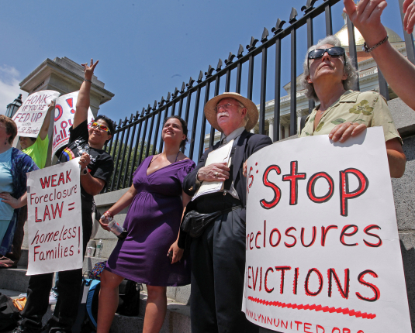
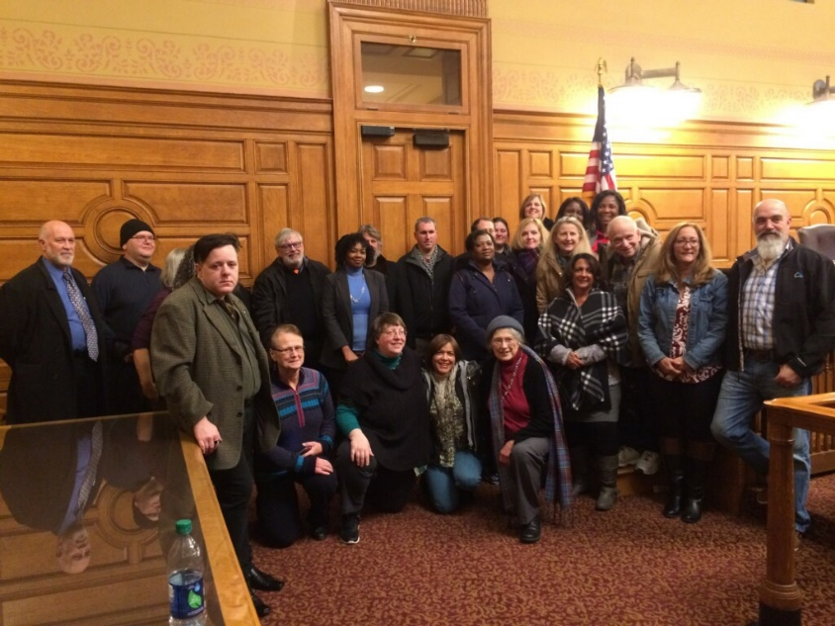
Introduction
Project Sponsors
The Massachusetts Alliance Against Predatory Lending “MAAPL”
Coalition of 70+ partner organizations
Legislation: push for changes in laws and policies (ex: moratorium)
The Worcester Anti-Foreclosure Team “WAFT”
Grassroots activist organization
Education: homeowner rights and fighting evictions/foreclosures
2

Slide 3
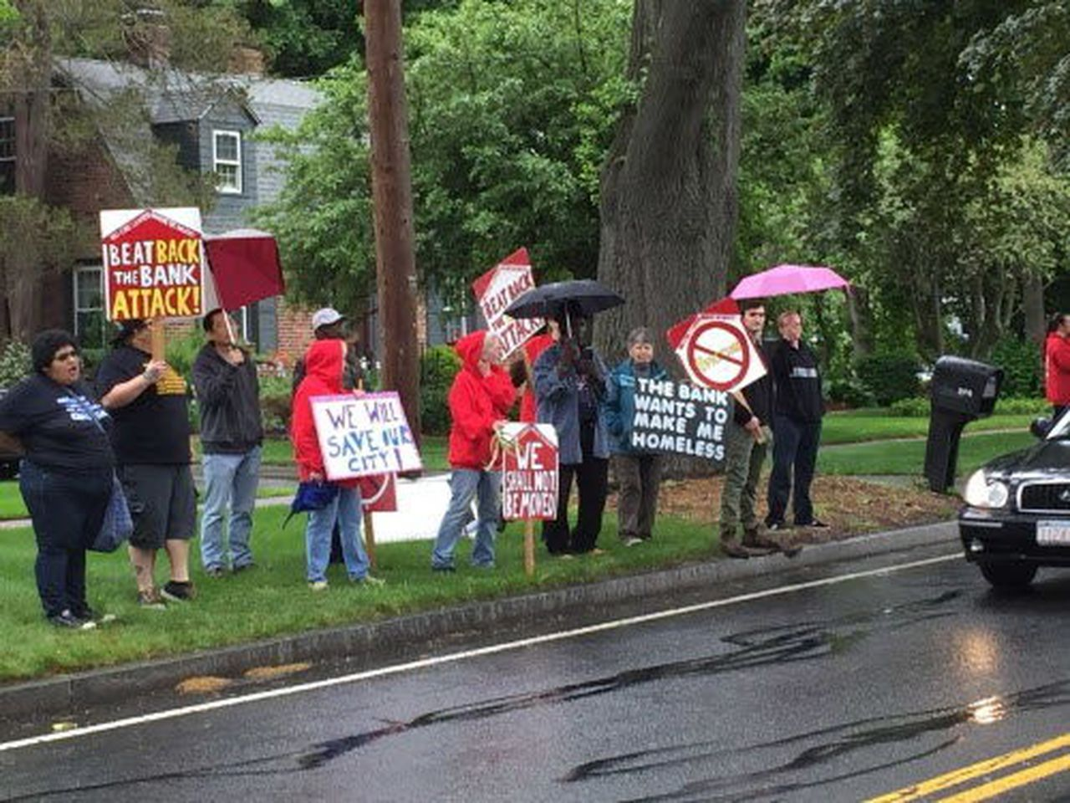





Introduction
The Problem
Project Goal
Develop effective outreach strategies to provide assistance and information to homeowners and renters facing housing insecurity.
3

Slide 4
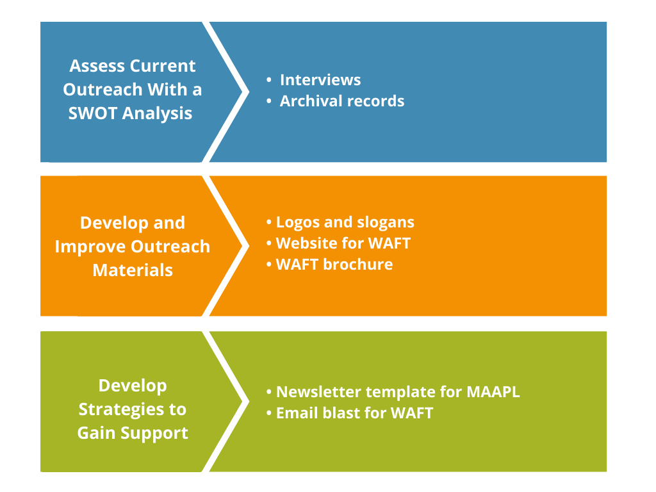
Objectives
1
2
3
4

Slide 5

Findings
MAAPL and WAFT SWOT Analyses
Interviews
Grant Proposals
News Articles
5

Slide 6
STRENGTHS
WEAKNESSES
Mutual aid philosophy
Safe and open meeting space
Responsiveness to auctions
Supporting people of color
Door knocking
Limited full-time staff and funding
Organization of volunteers to take part in outreach
Limited delegation for
outreach activities
S
W
SWOT Analysis: WAFT
WAFT
OPPORTUNITIES
O
T
THREATS
New partnerships
with local organizations
Establishing partnerships for translation
Using a software to organize outreach materials
Impact of COVID-19
Personal shame and
hesitation to receive help
Not reaching people soon enough
6

Slide 7
STRENGTHS
WEAKNESSES
Legal and policy connections and initiatives
Diversity of organization
Educational resources
Influence on policy
Need to effectively reach
people across the state
Committing to tasks outlined
in grant proposals
Limited organization and
explanation of outreach plans
S
W
MAAPL
SWOT Analysis: MAAPL
OPPORTUNITIES
O
T
THREATS
Improving web presence and communication
Case specific intake form
Data mining opportunities
Impact of COVID-19
Personal shame
7

Slide 8

1
Logos and slogans for WAFT and MAAPL
2
WAFT Website & Web Maintenance Guide
3
Updated WAFT Brochure
Deliverables
4
MAAPL Newsletter & Canva Usage Guide
Shaped by results of SWOT analyses.
8

Slide 9
Logos and Slogans
1
9

Slide 10
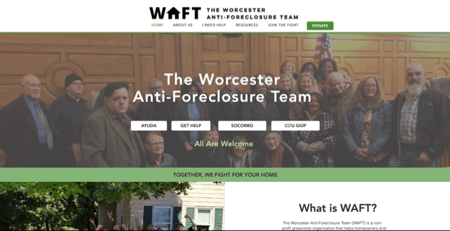

WAFT Website
2
& Maintenance Guide
Goals
Improve web presence and increase audience
Convey WAFT’s mission and share resources
Features
Accessibility: alternative text, multiple languages, etc.
Web maintenance guide
10

Slide 11

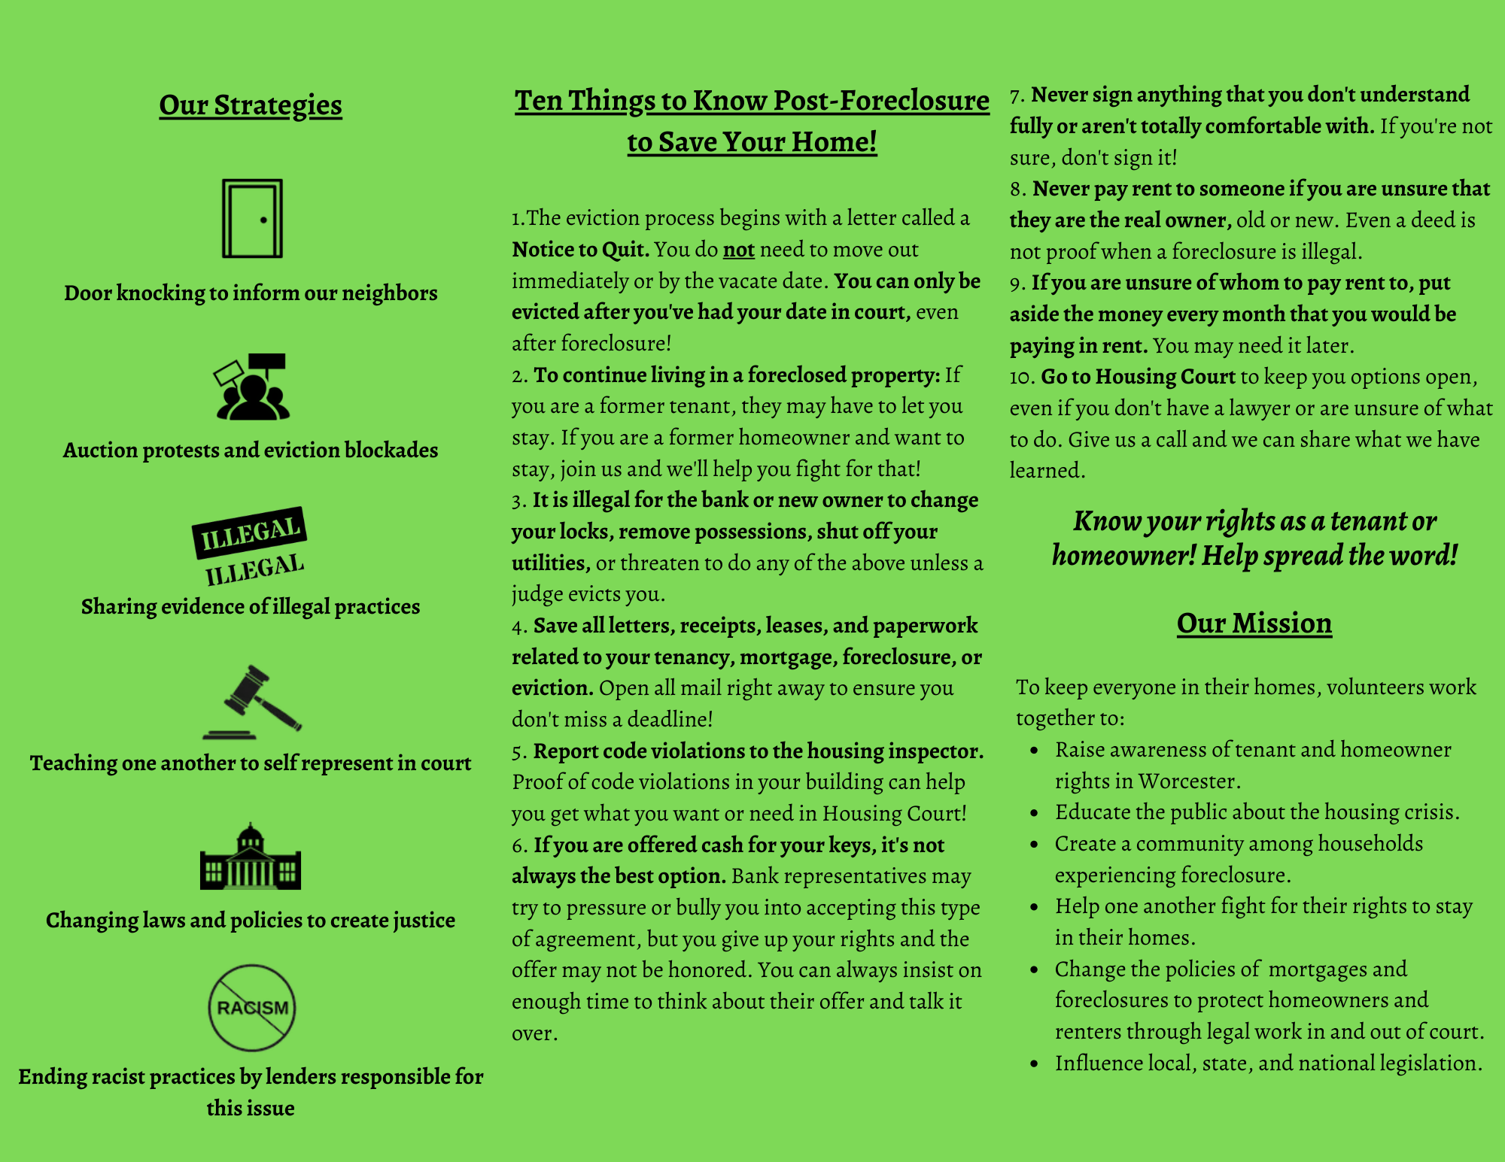

Updated WAFT Brochure
3
Spanish
Portuguese
Vietnamese
English
11

Slide 12







5
WAFT Email Blast
Organization Types
Food banks
Religious organizations & cultural groups
Community organizations
12

Slide 13
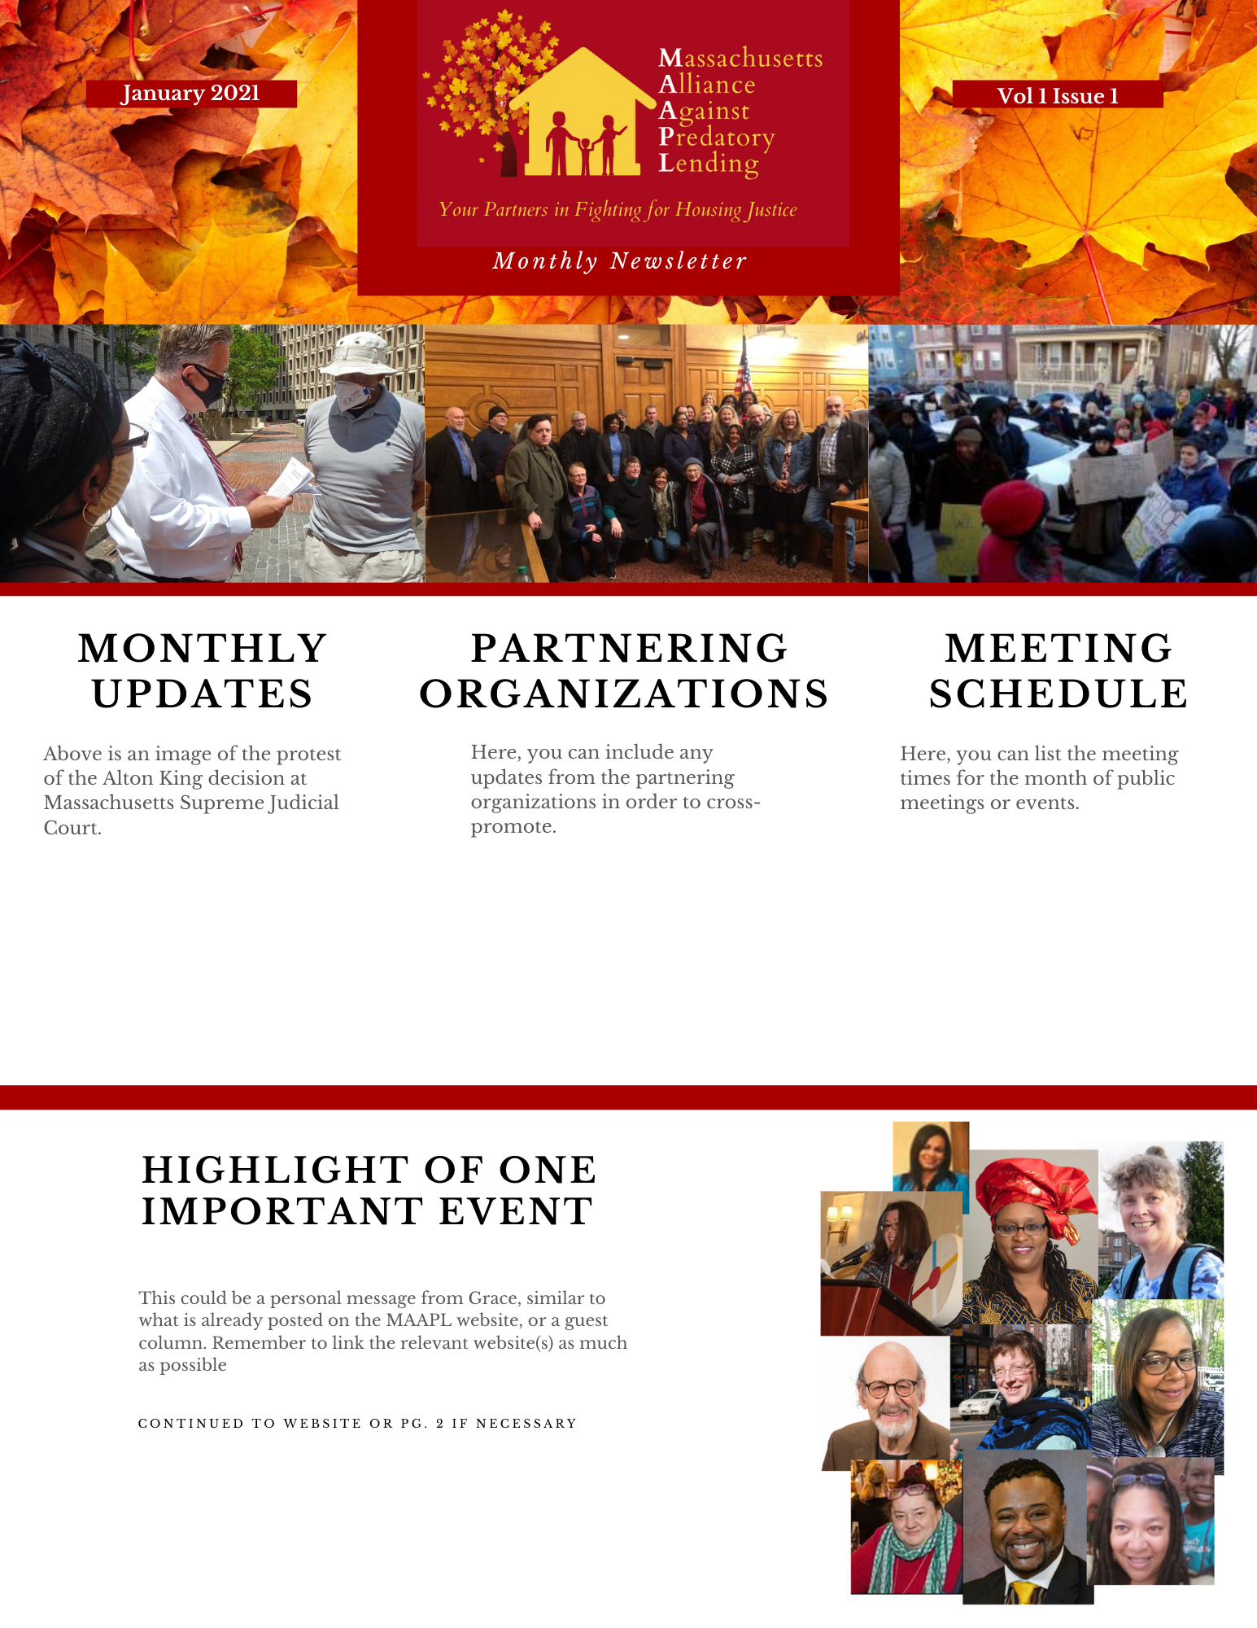

MAAPL Newsletter Template
4
& Usage Guide
Goals
Strengthen the relationship and communication between MAAPL and its partnering organizations
Features
Sections for updates, schedules, and highlights
Canva usage guide
13

Slide 14
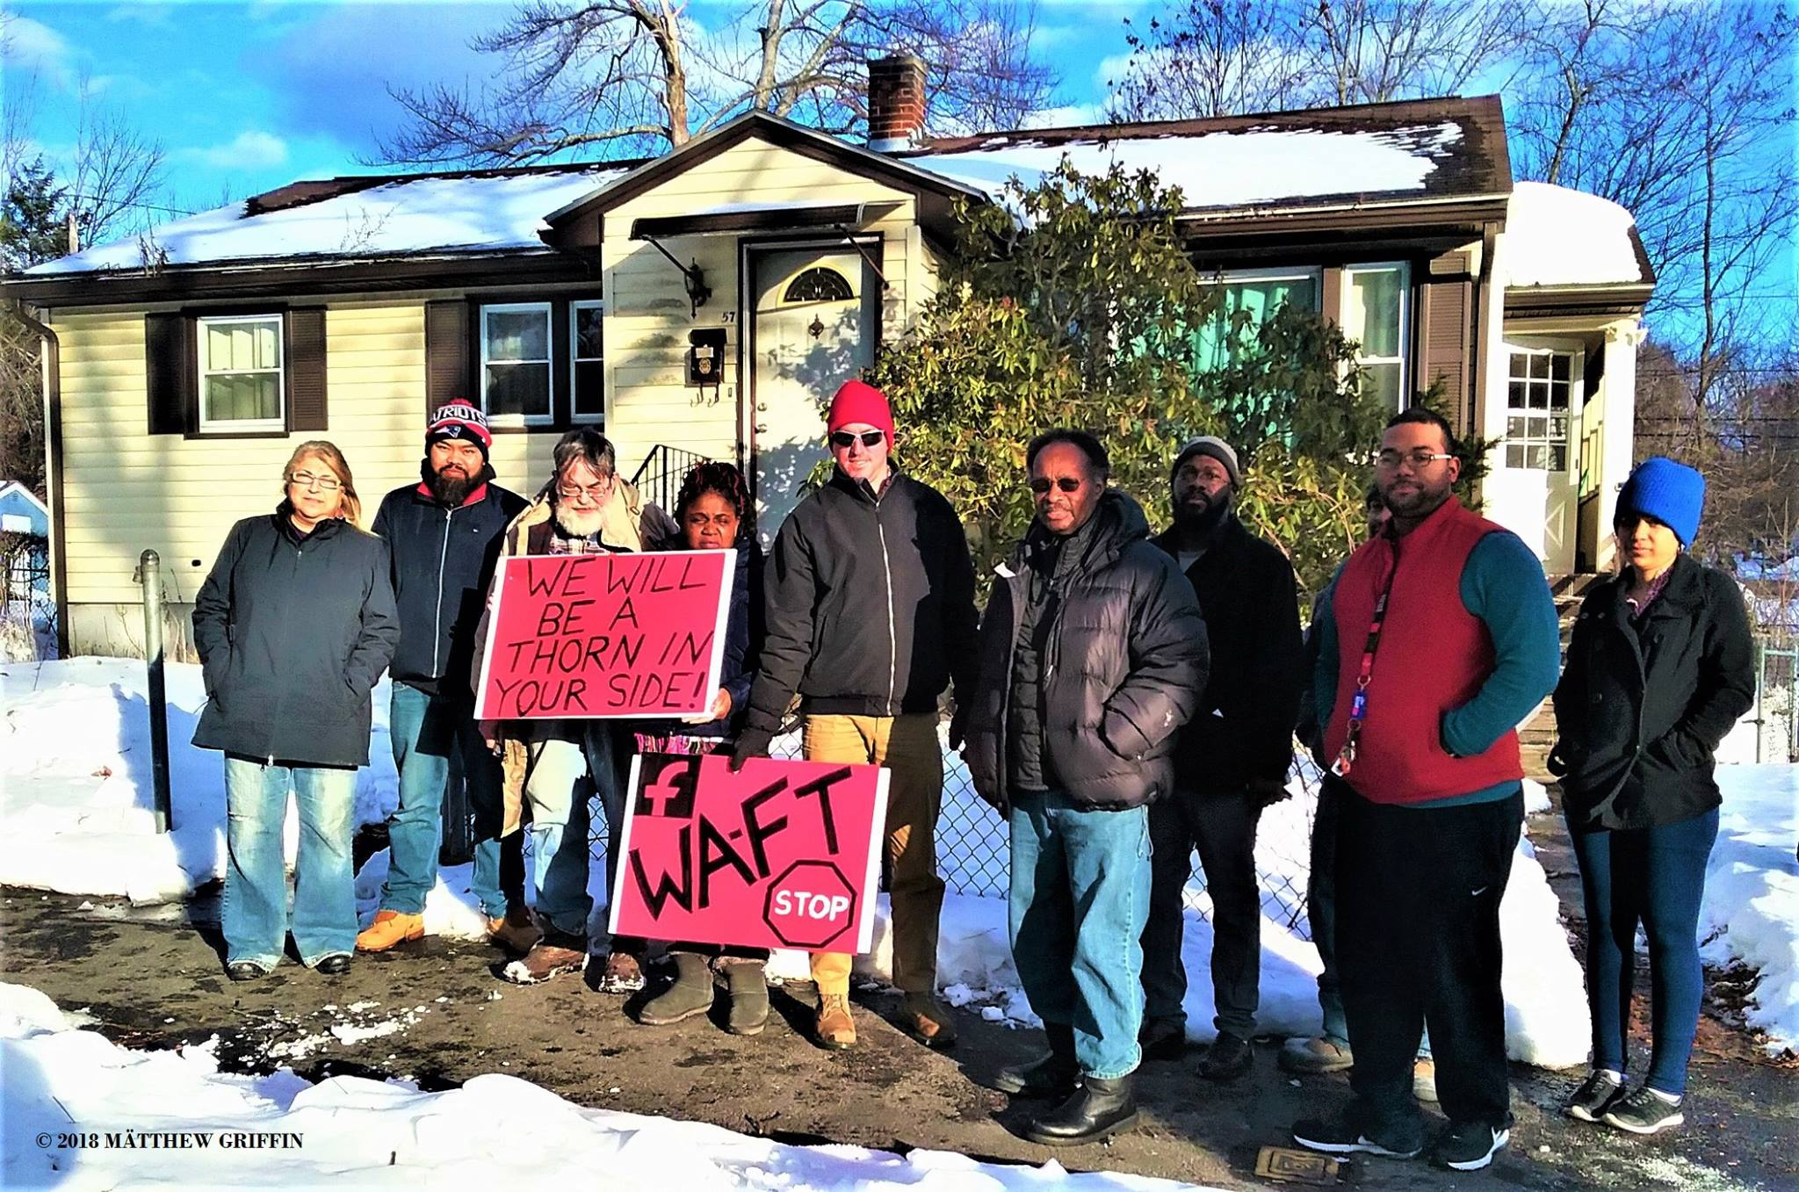

What The Project Can Do
Provide greater accessibility to information regarding housing insecurity.
1
Allow more people to learn about WAFT and get involved.
2
Impact
Help MAAPL stay in contact and strengthen their relationships with partnering organizations.
Of This Work
3
WAFT can apply for 501(c)(3) status
14
Notes:
Dylan
Housing Insecurity: high housing costs in proportion to income, poor housing quality, unstable neighborhoods, overcrowding or homelessness.
Foreclosure: the process that mortgage holders, such as banks, use to take back property from the borrowers who fail to make their payments.
Eviction: the process where tenants are removed from their rental property by the landlord when the fail to pay the scheduled rent.
Predatory Lending: any lending practice that imposes unfair or abusive loan terms on a borrower

Slide 15
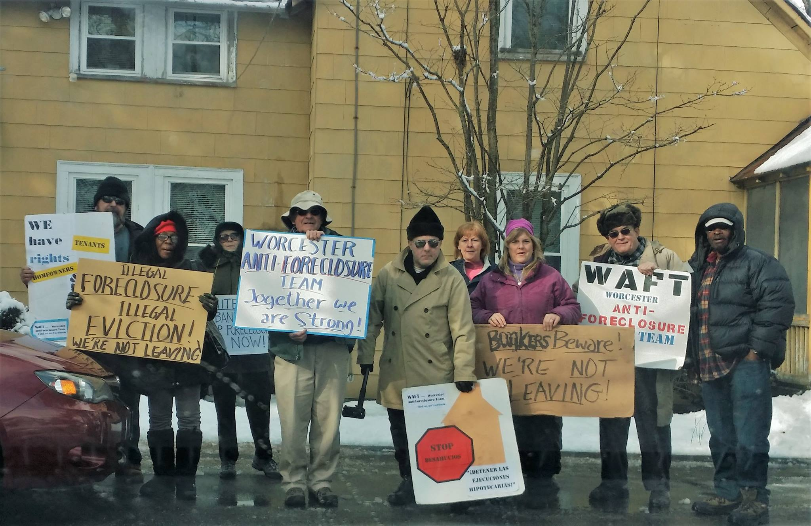

MAAPL
1
Create phone bank to organize contact information of individuals at risk
Opportunities
Opportunities
WAFT
2
Form new organizational partnerships
1
Create member intake form for specific cases and needs
And Recommendations
And Recommendations
3
Make improvements to current website
2
Hold subcommittee meetings
3
Implement software to aid in organization of material
15
Notes:
Dylan
Housing Insecurity: high housing costs in proportion to income, poor housing quality, unstable neighborhoods, overcrowding or homelessness.
Foreclosure: the process that mortgage holders, such as banks, use to take back property from the borrowers who fail to make their payments.
Eviction: the process where tenants are removed from their rental property by the landlord when the fail to pay the scheduled rent.
Predatory Lending: any lending practice that imposes unfair or abusive loan terms on a borrower

Slide 16
Thank You to
Grace Ross, Project Liaison
Scott and Gbeton, IQP Advisors

Slide 17
Visit Our Website!
Questions or Comments?
https://waft2008.wixsite.com/waft
16

