Slide 1
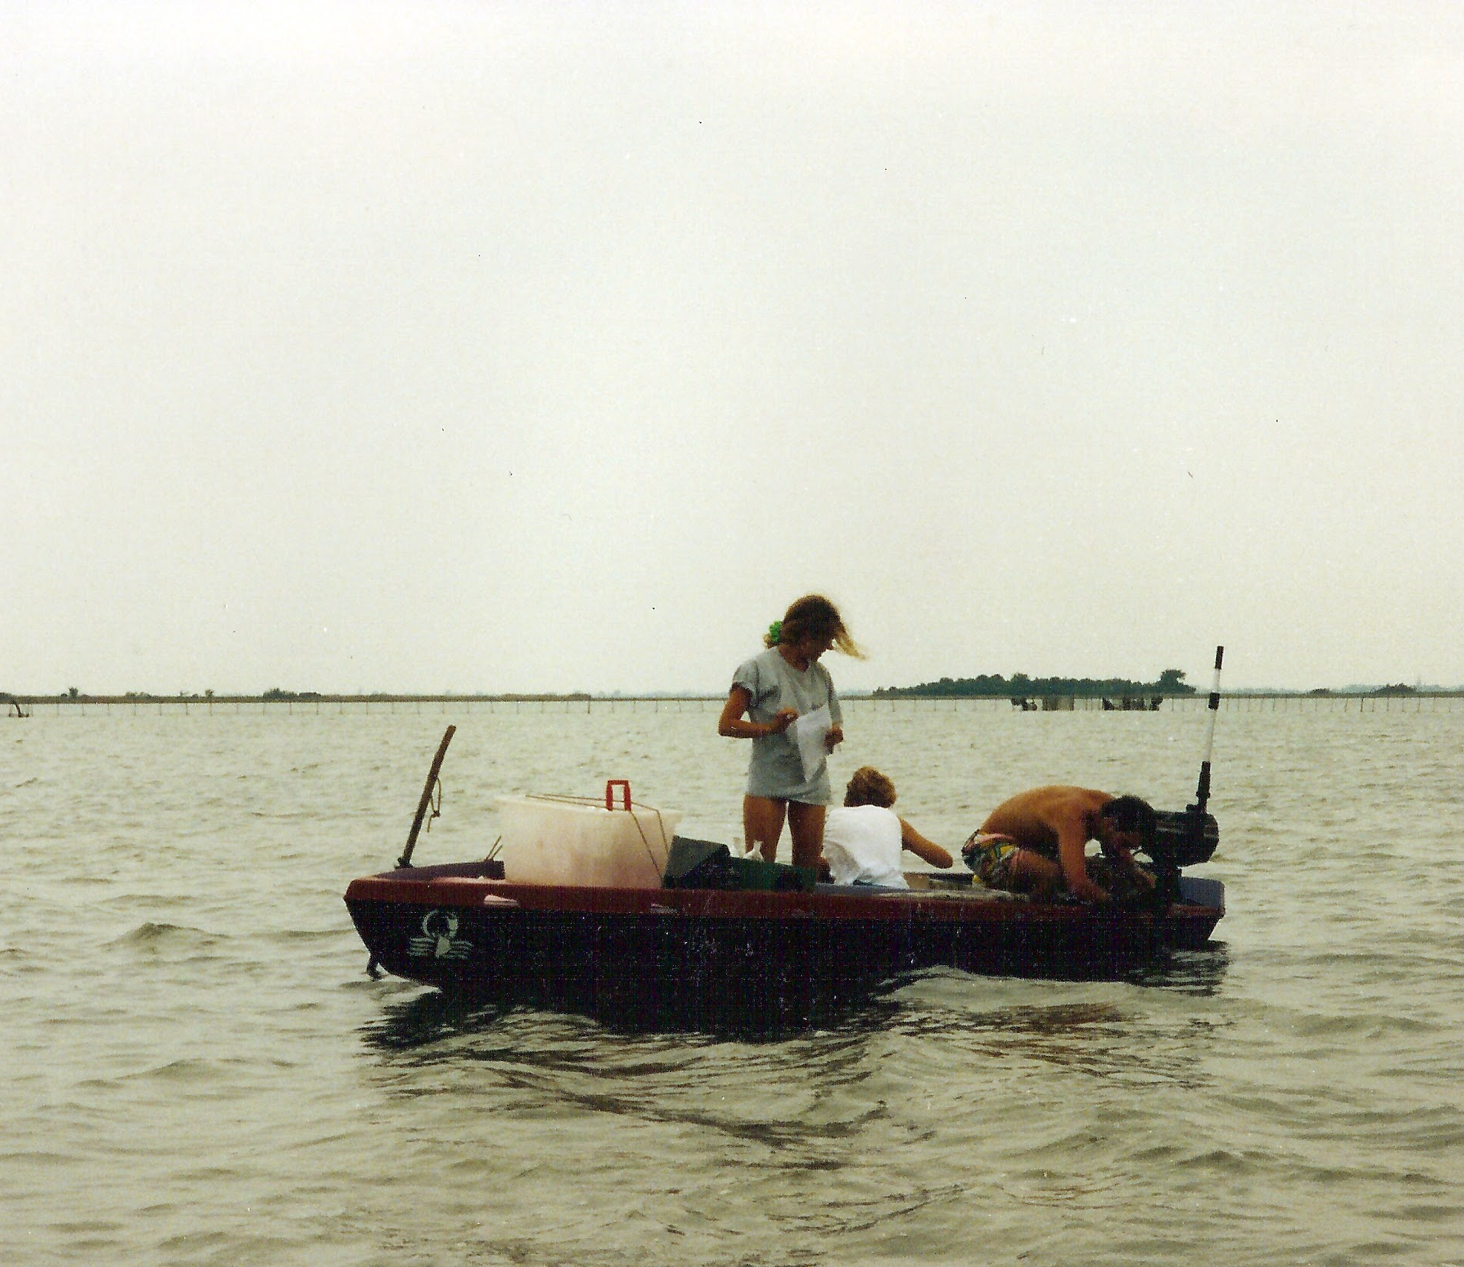
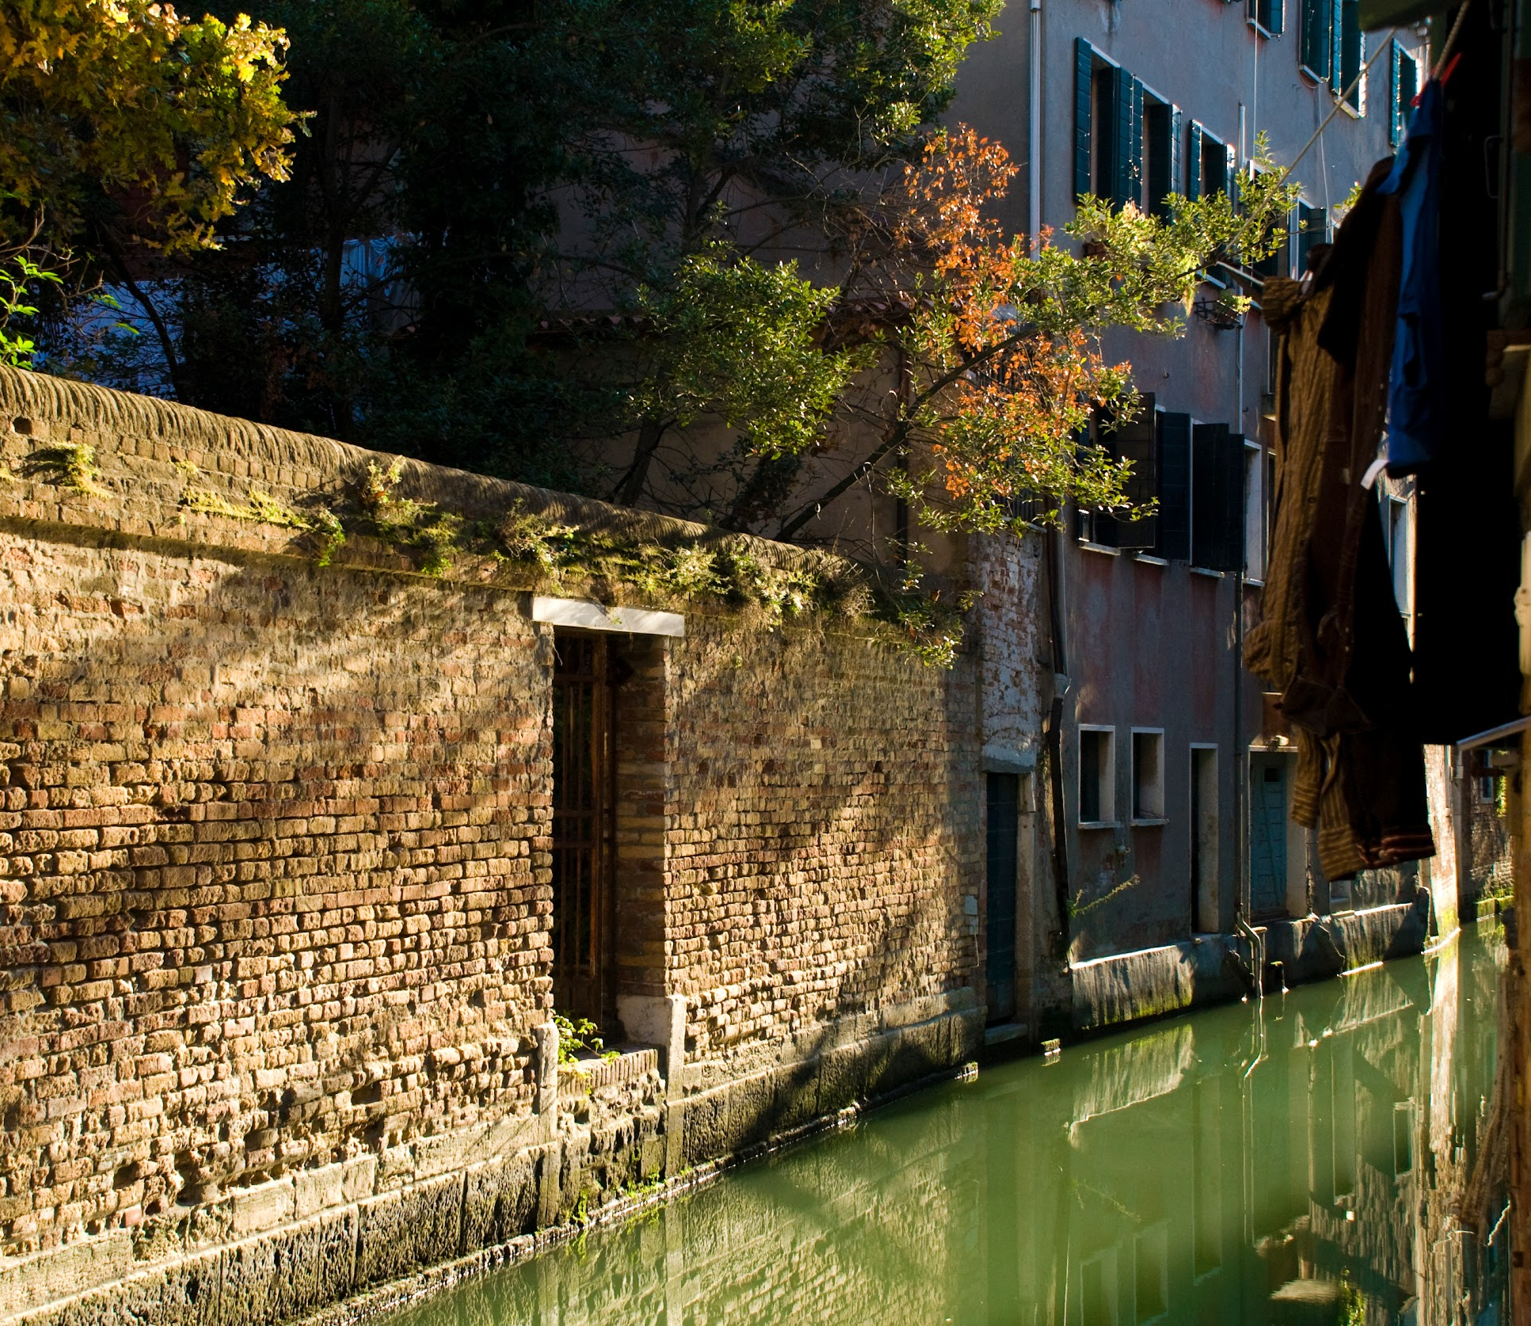
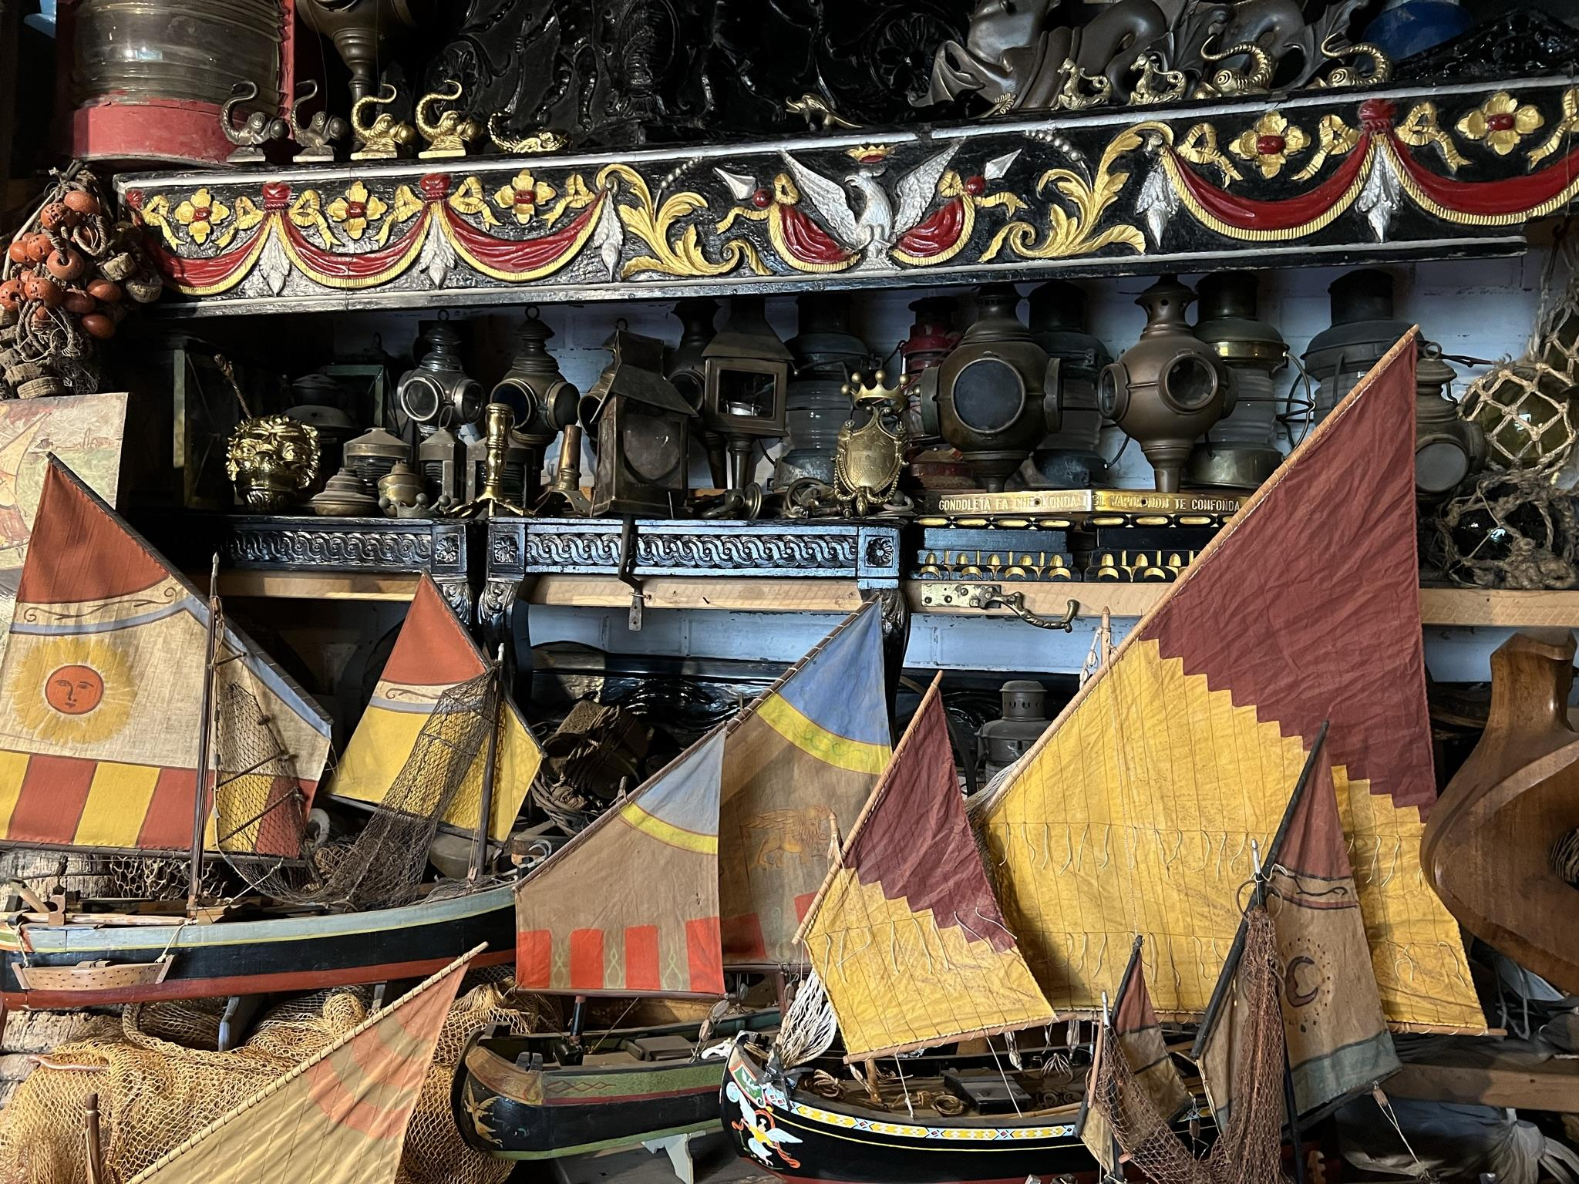

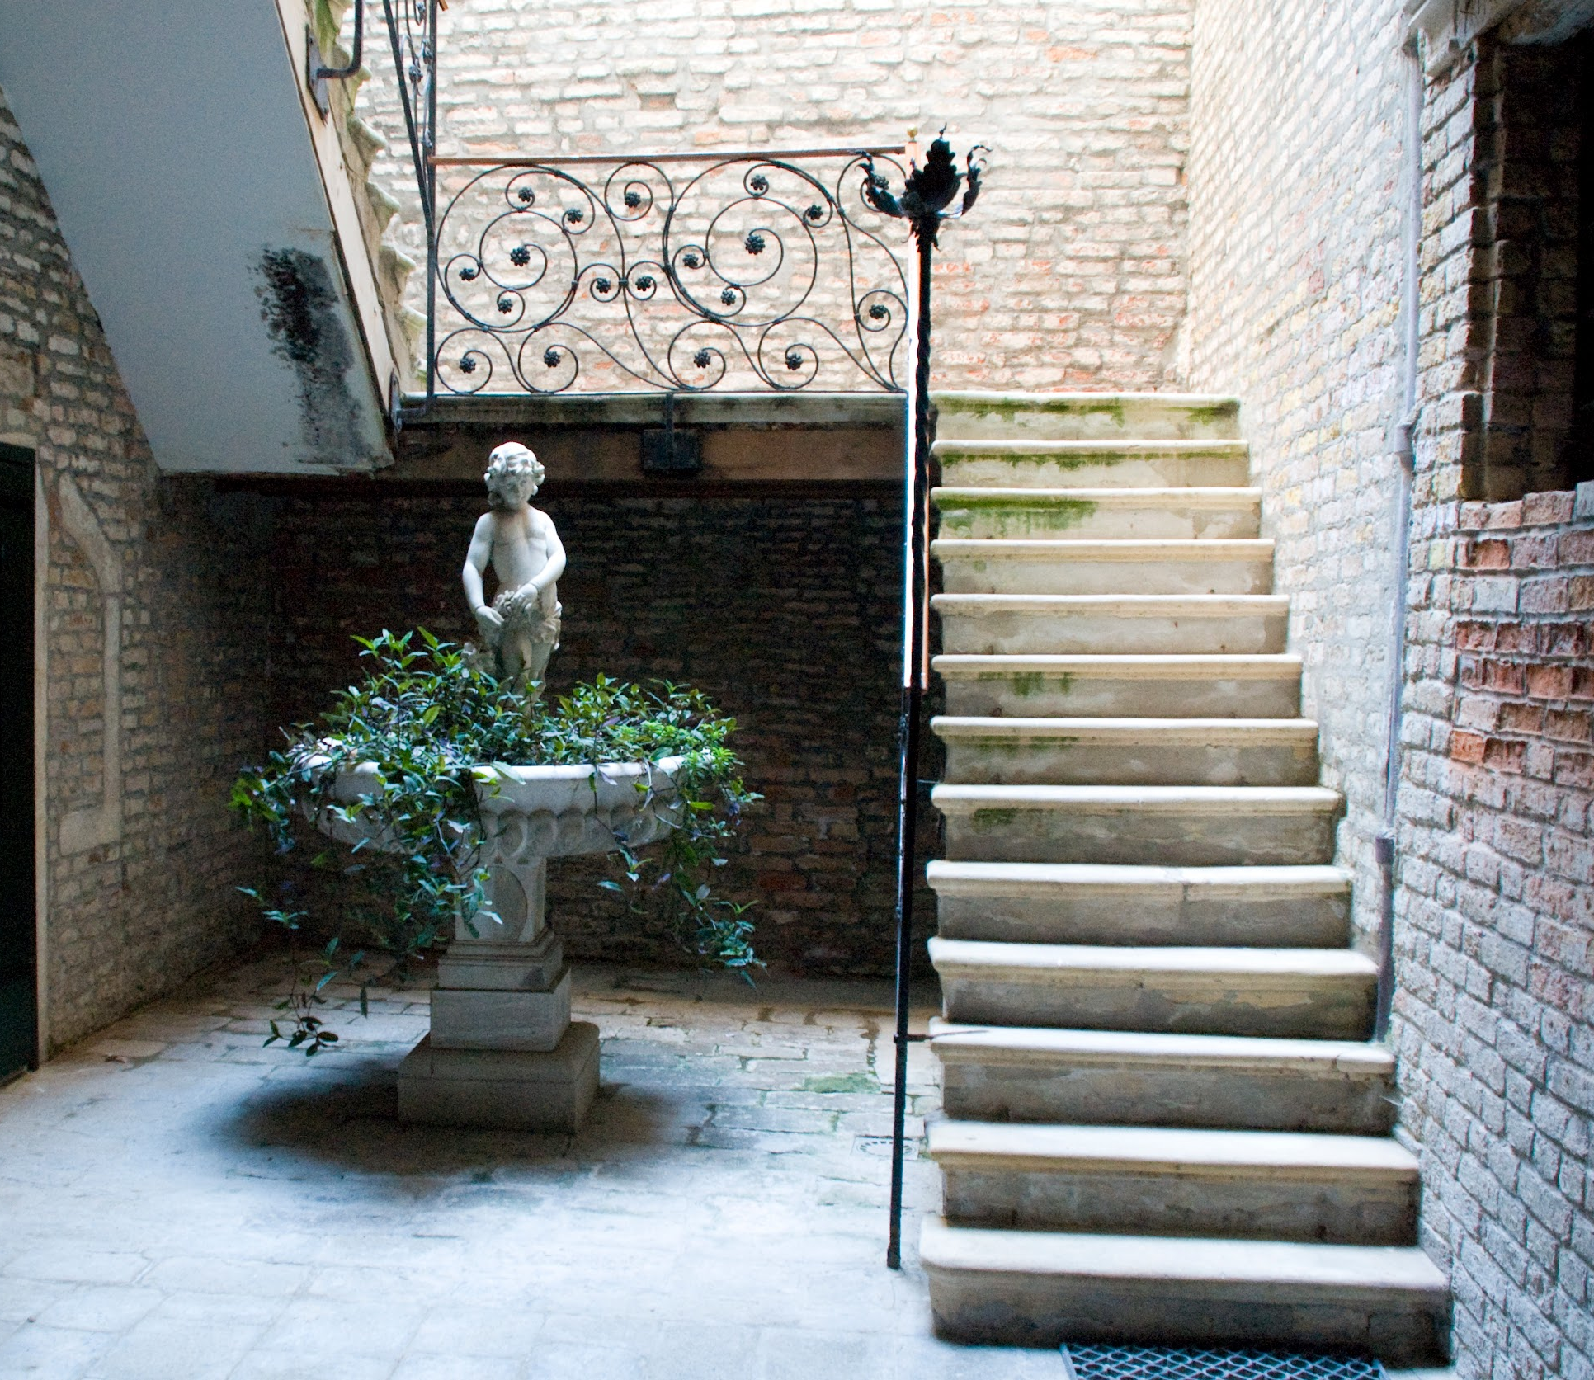

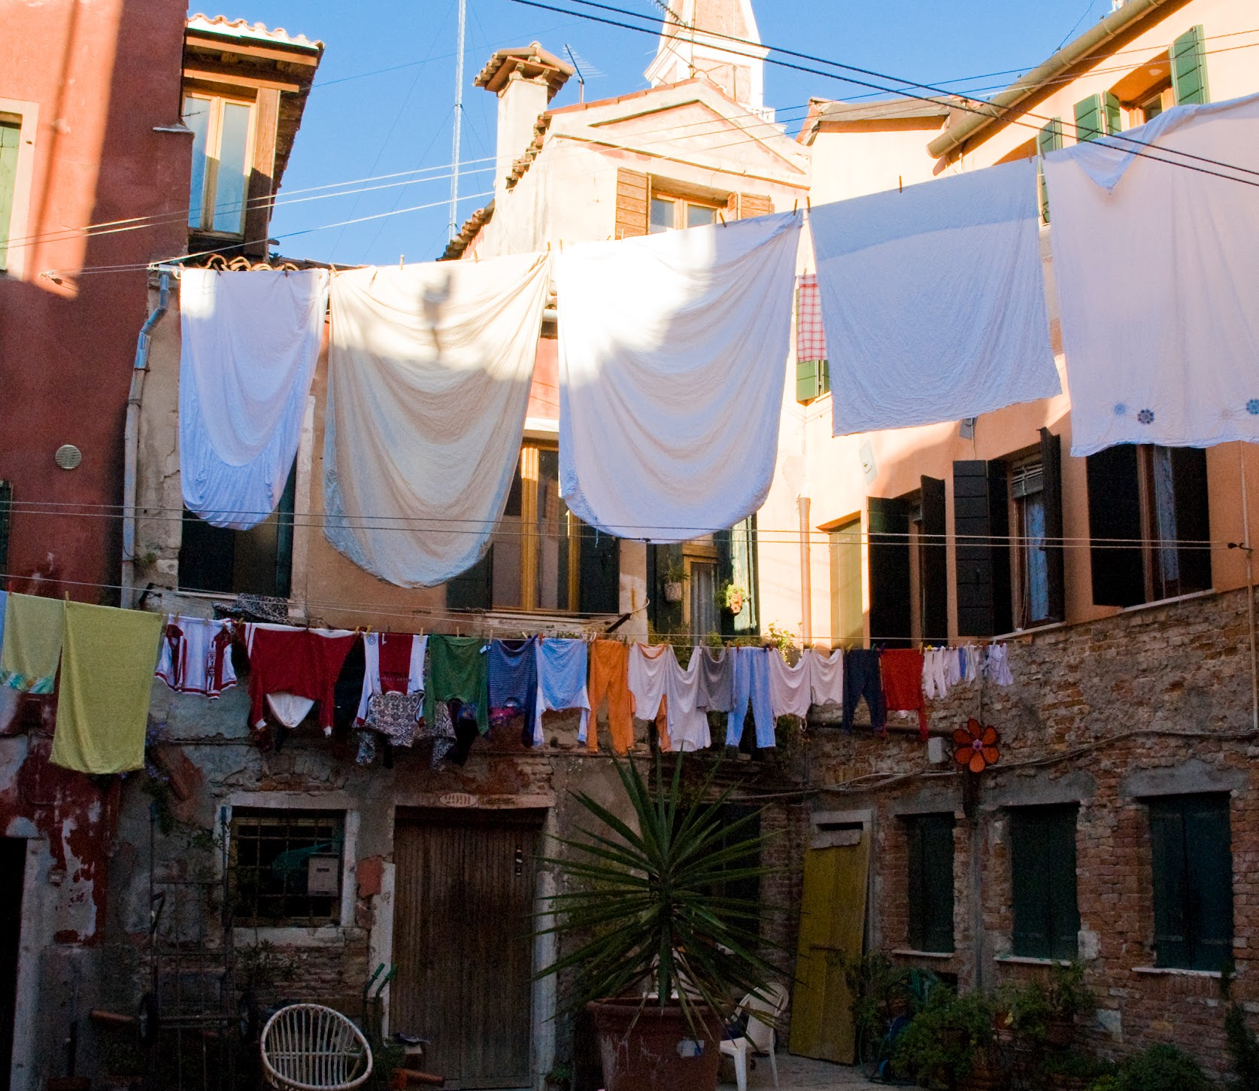
A Multimedia
Showcase for 35 Years
at the Venice Project Center
Jared Bailey, Jillian Crandall, Sam David, Nick Leslie, Hayden Padula
10 July 2023
Notes:
JILLIAN - My name is Jillian,

Slide 2
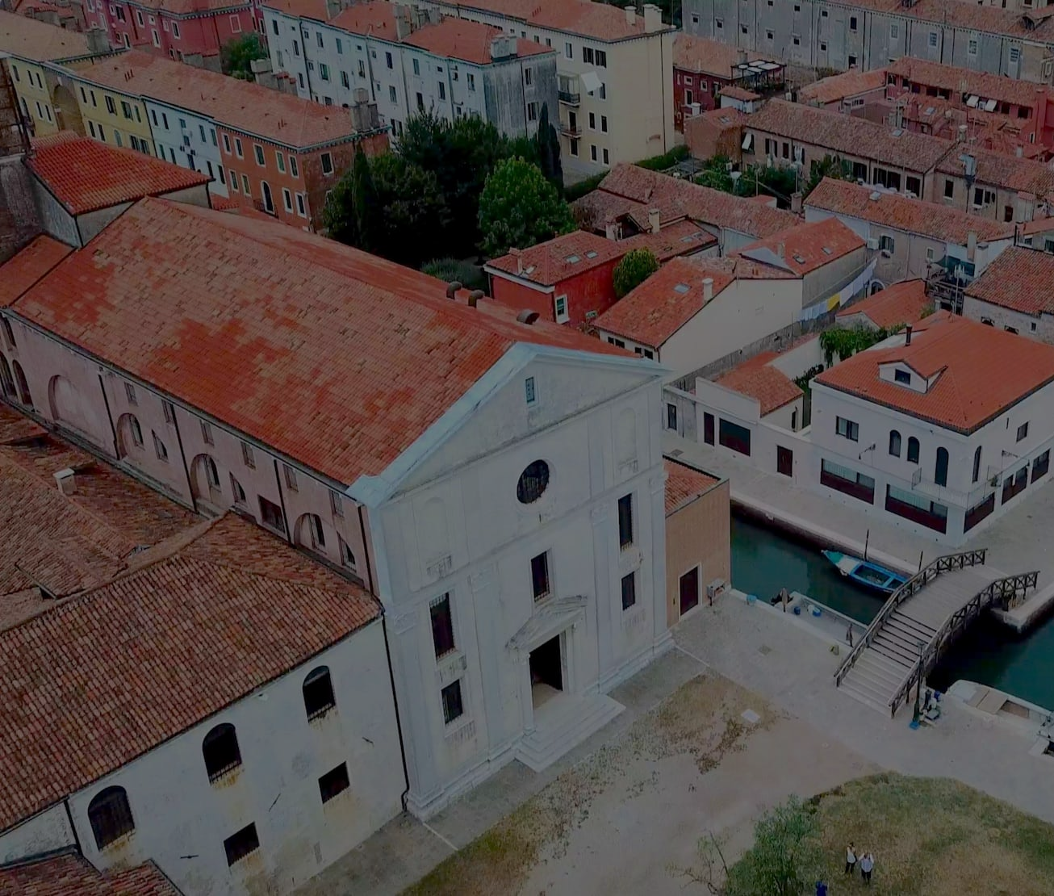
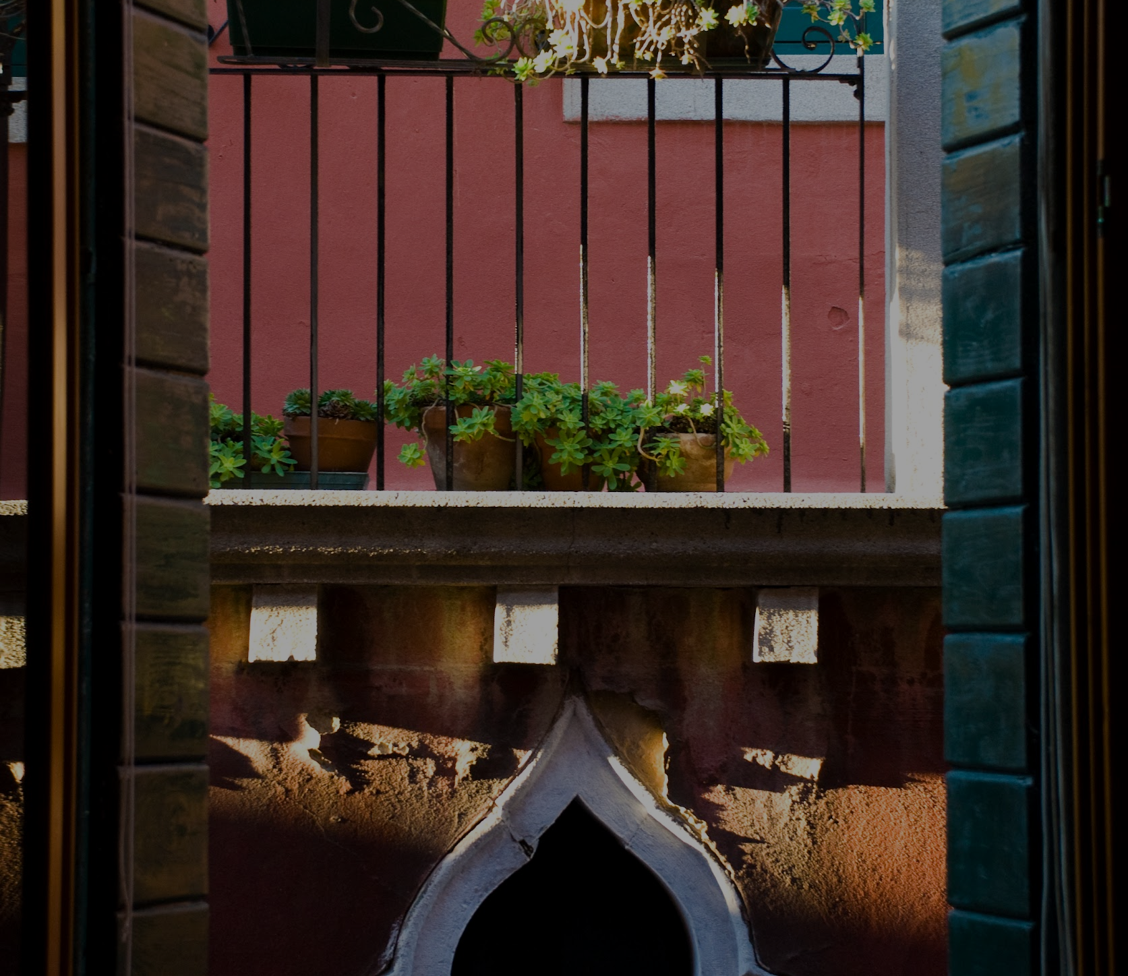
What is the Venice Project Center?
Founded in 1988 by Prof. Fabio Carrera
239 Research Projects
800 Students
100 Local Sponsors
Notes:
Jillian The Venice Project Center was founded in 1988 by Professor Fabio Carrera in collaboration with Worcester Polytechnic Institute. Over the past 35 years, WPI Students and faculty have travelled to Venice to work on over 200 research projects that aim to collect data on problems within the city with the assistance of local sponsor companies.

Slide 3
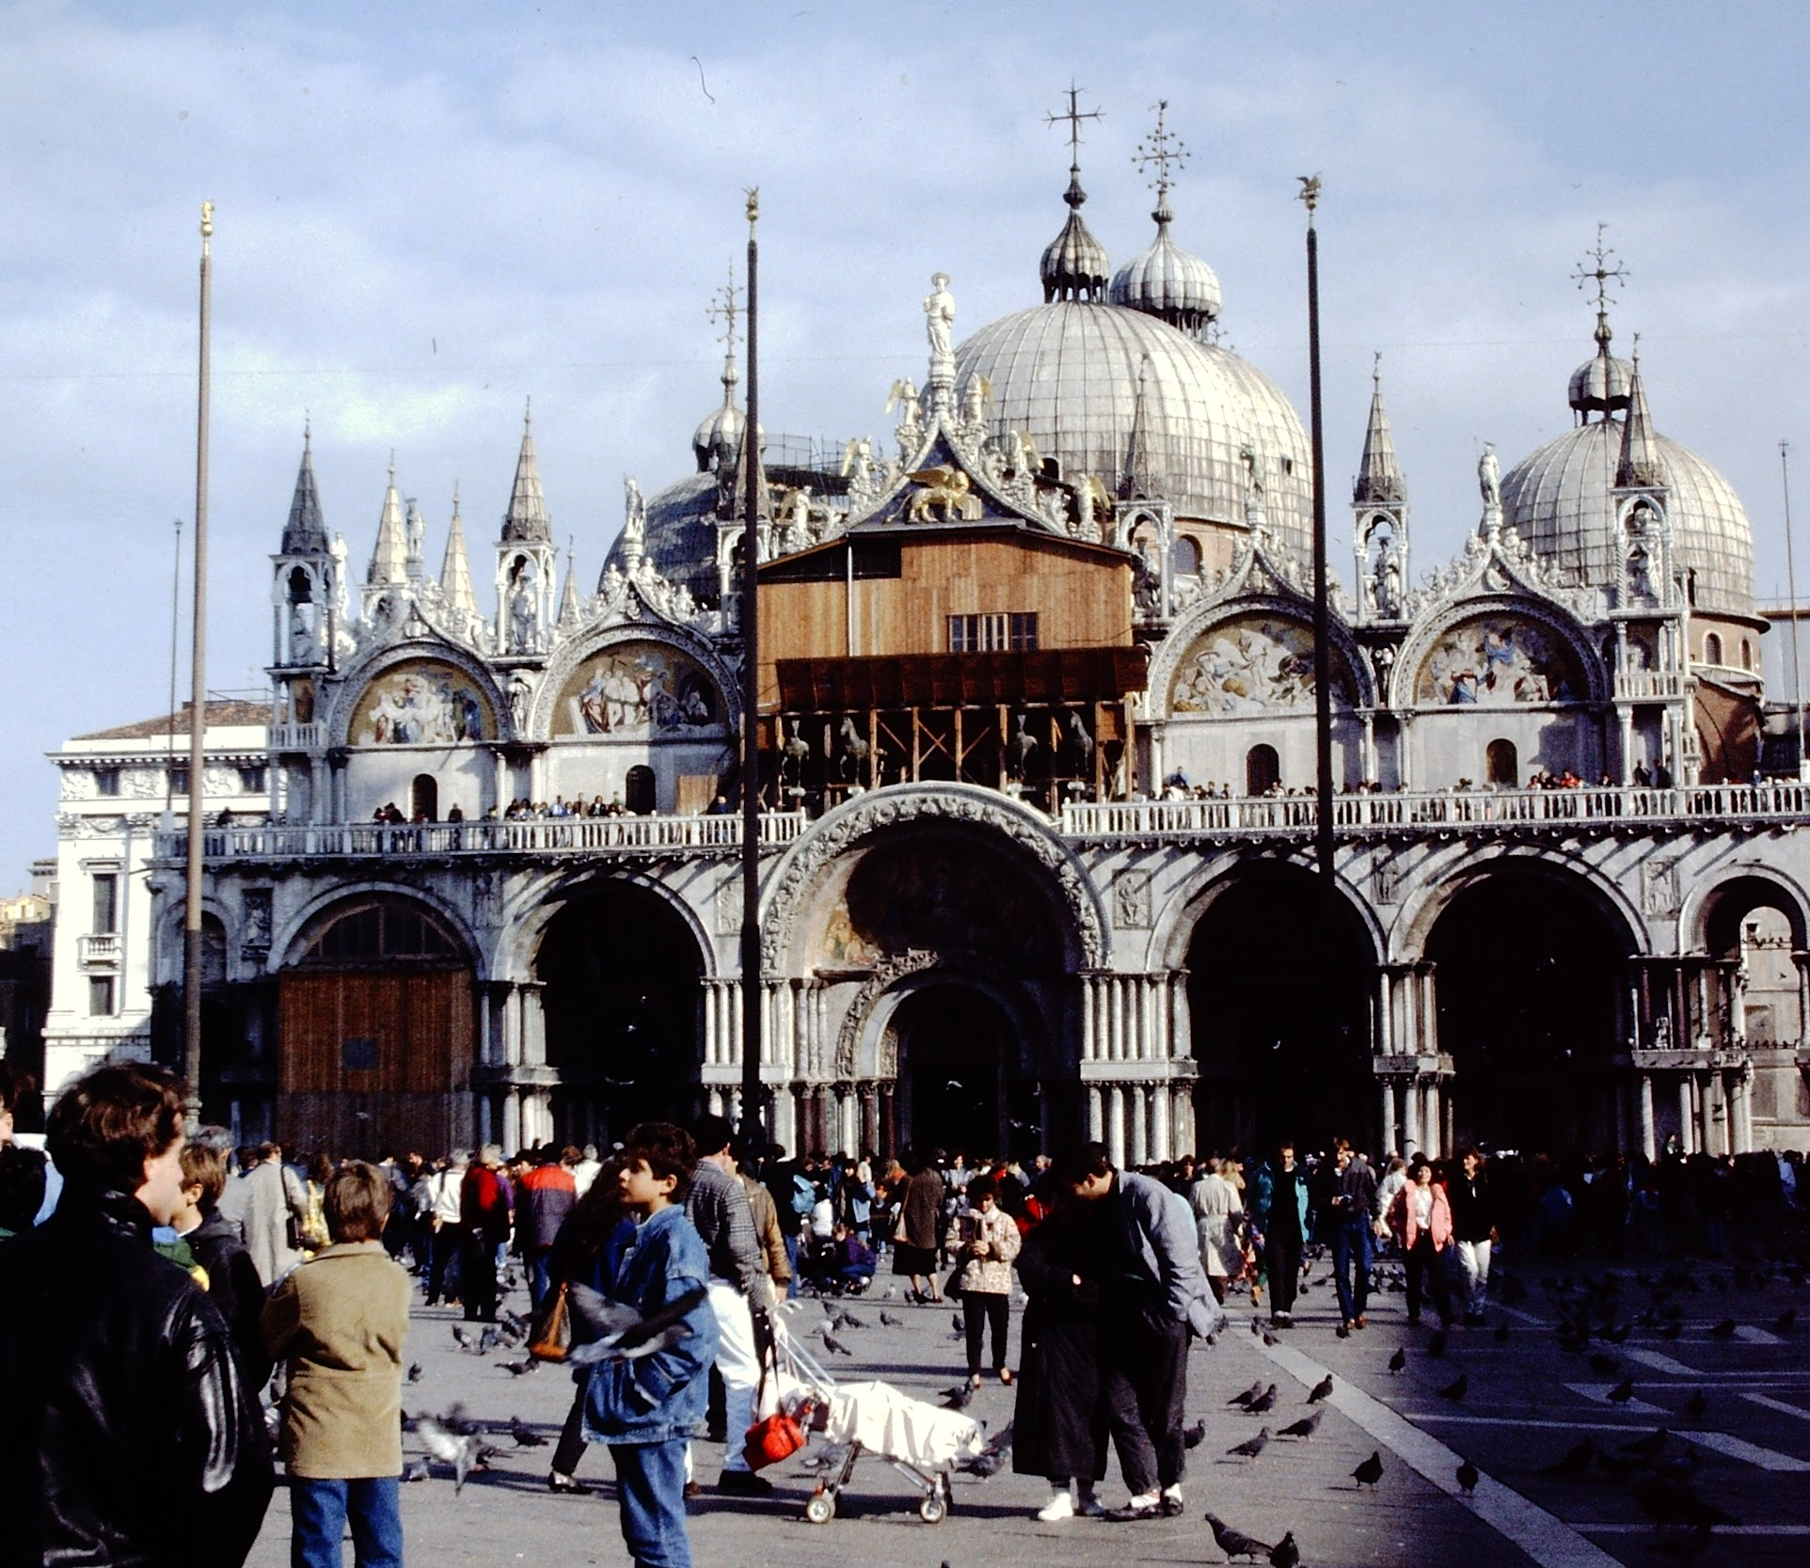
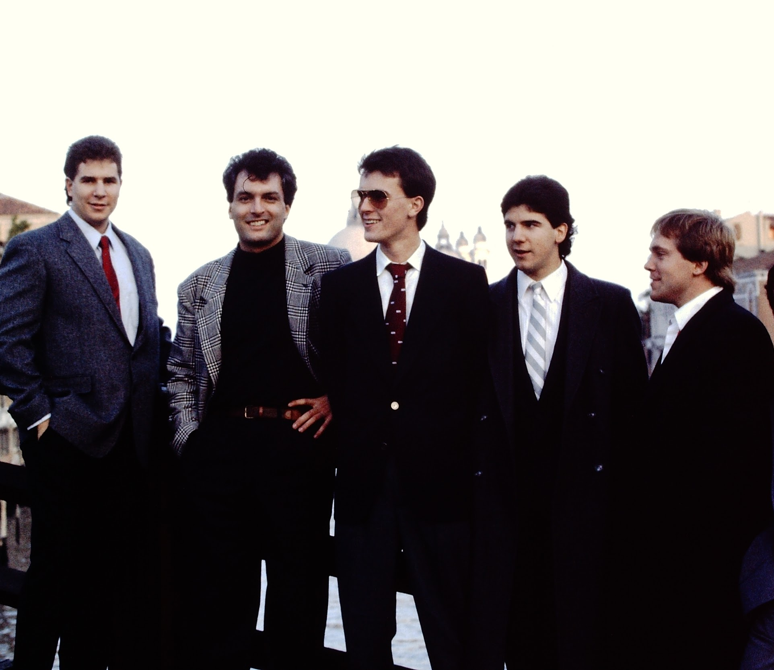
Anniversary Projects
Every 5 years there is an Anniversary Project
30th made the previous VPC website
Winter 2022 team provided the foundation
Our project is next in a line of many to come over the next few years.
Notes:
Jillian The VPC creates anniversary projects every 5 years to celebrate the accomplishments made in the past. These projects typically involve the creation of an overview of the center as a whole. The previous anniversary projected conducted in 2018 to celebrate the 30th anniversary created the previous VPC site, which we have improved upon. In B term of 2022, a 35th anniversary project was created that gave us the foundation for our own project.

Slide 4

Our Project
We’ve created a multimedia storytelling campaign to publicize the history and research conducted by the Venice Project Center in the past 35 years.
Notes:
Jillian - To Tell the Story of the Venice Project Center through a Modern and Sustainable Social Media Approach

Slide 5
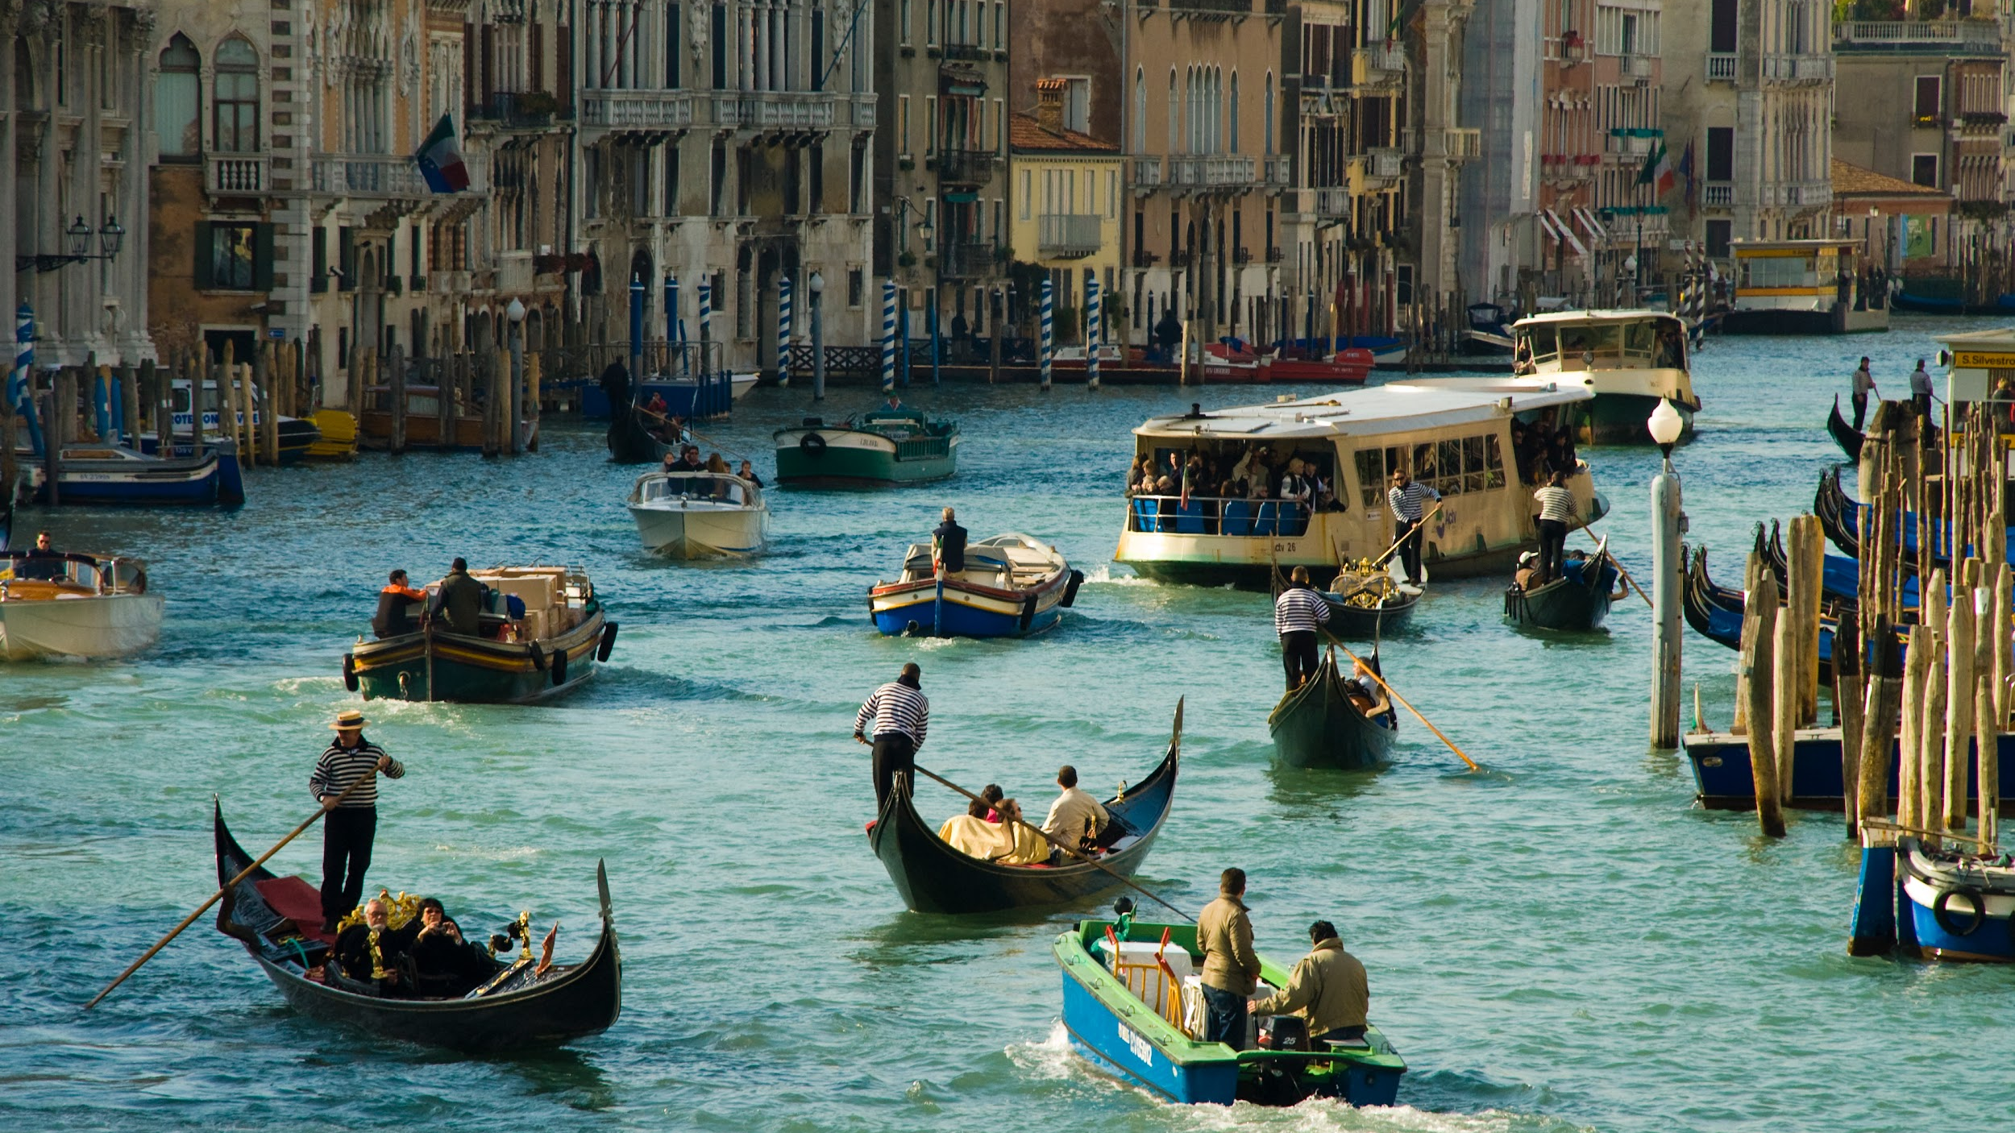
Our Results
Created a Storytelling Strategy
1
2
Implemented the Strategy
Planned the 35th Anniversary Celebration
3
Notes:
Jillian We have 3 main objective for speaker notes: outline project, use these as a road map, explain them a little more
Create a story telling plan to preserve the heritage of the vpc
Implement this story telling strategy through a multimedia approach including documentaries,websites, and documentation
finally laying the ground work for planing the 35th anniversary celebration

Slide 6
Created a Storytelling Strategy
1
2
Implemented the Strategy
Planned the 35th Anniversary Celebration
3
Notes:
SAM - Our first result is our creation of a storytelling strategy

Slide 7
1
Our Strategy
Plan
for the Future
Using Present-Day Tools
Celebrate the
Past
Digital Media
Website
Videos
Notes:
Sam - Our Strategy is to Celebrate the past, as well as Plan for the future, by using present-day tools such as digital media, a website, and videos

Slide 8
1
The Tools
Digital Media | Website | Videos
Social Media Campaign StoryMap | New Website Infrastructure Overhaul | Youtube Docu-Series
Why? | Why? | Why?
Modern Popular Convenient | Maintainable Accessible Informative | Versatile Large Audience Entertaining Educational
Notes:
Sam
We started a social media campaign to increase public outreach of the VPC, and utilized story map software such as ArcGIS for storyboarding strategies. We have chosen these platforms because they are modern, popular, and convenient.

Slide 9
1
The Tools
Digital Media | Website | Videos
Social Media Campaign StoryMap | New Website Infrastructure Overhaul | Youtube Docu-Series
Why? | Why? | Why?
Modern Popular Convenient | Maintainable Accessible Informative | Versatile Large Audience Entertaining Educational
Notes:
Sam
In order to create our storytelling strategy, we utilized these digital tools.
In addition to the digital media, we also created a new website for the VPC and overhauled previous project data onto it. We did this because we wanted the website to be more maintainable, accessible, and informative than the one created by the 30th anniversary project

Slide 10
1
The Tools
Digital Media | Website | Videos
Social Media Campaign StoryMap | New Website Infrastructure Overhaul | Youtube Docu-Series
Why? | Why? | Why?
Modern Popular Convenient | Maintainable Accessible Informative | Versatile Large Audience Entertaining Educational
Notes:
Sam
In order to create our storytelling strategy, we utilized these digital tools.
We began a youtube docu-series about the history of the VPC, because videos are a versatile way of storytelling, and we needed versatility for the wide range of projects conducted by the VPC. Also, youtube has a very large audience which will help with publicity.

Slide 11
Created a Storytelling Strategy
1
2
Implemented the Strategy
Planned the 35th Anniversary Celebration
3
Notes:
Nick

Slide 12
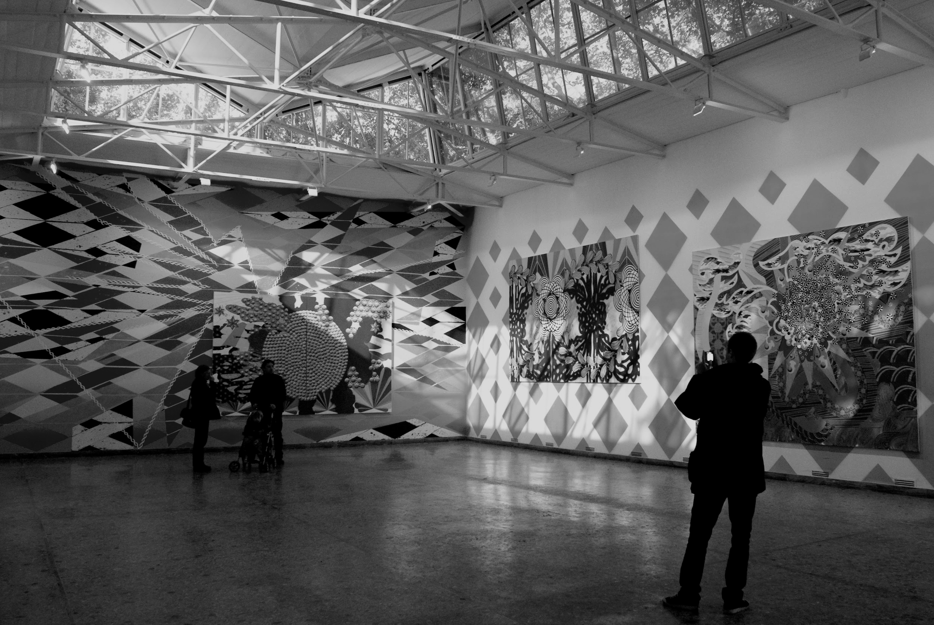
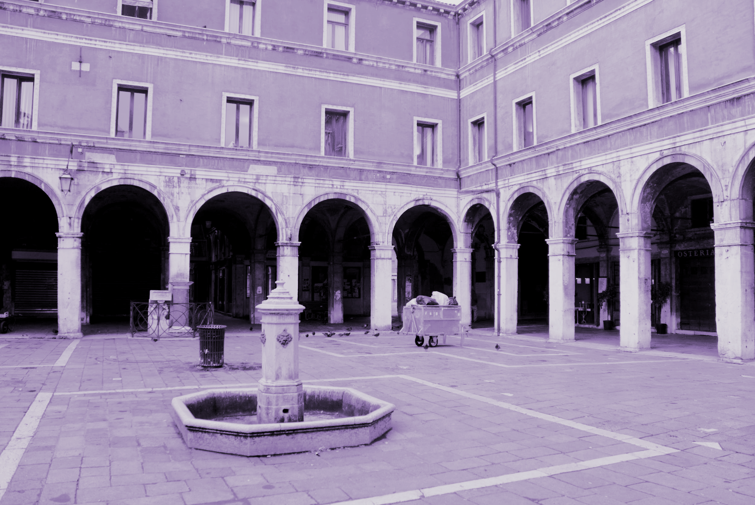
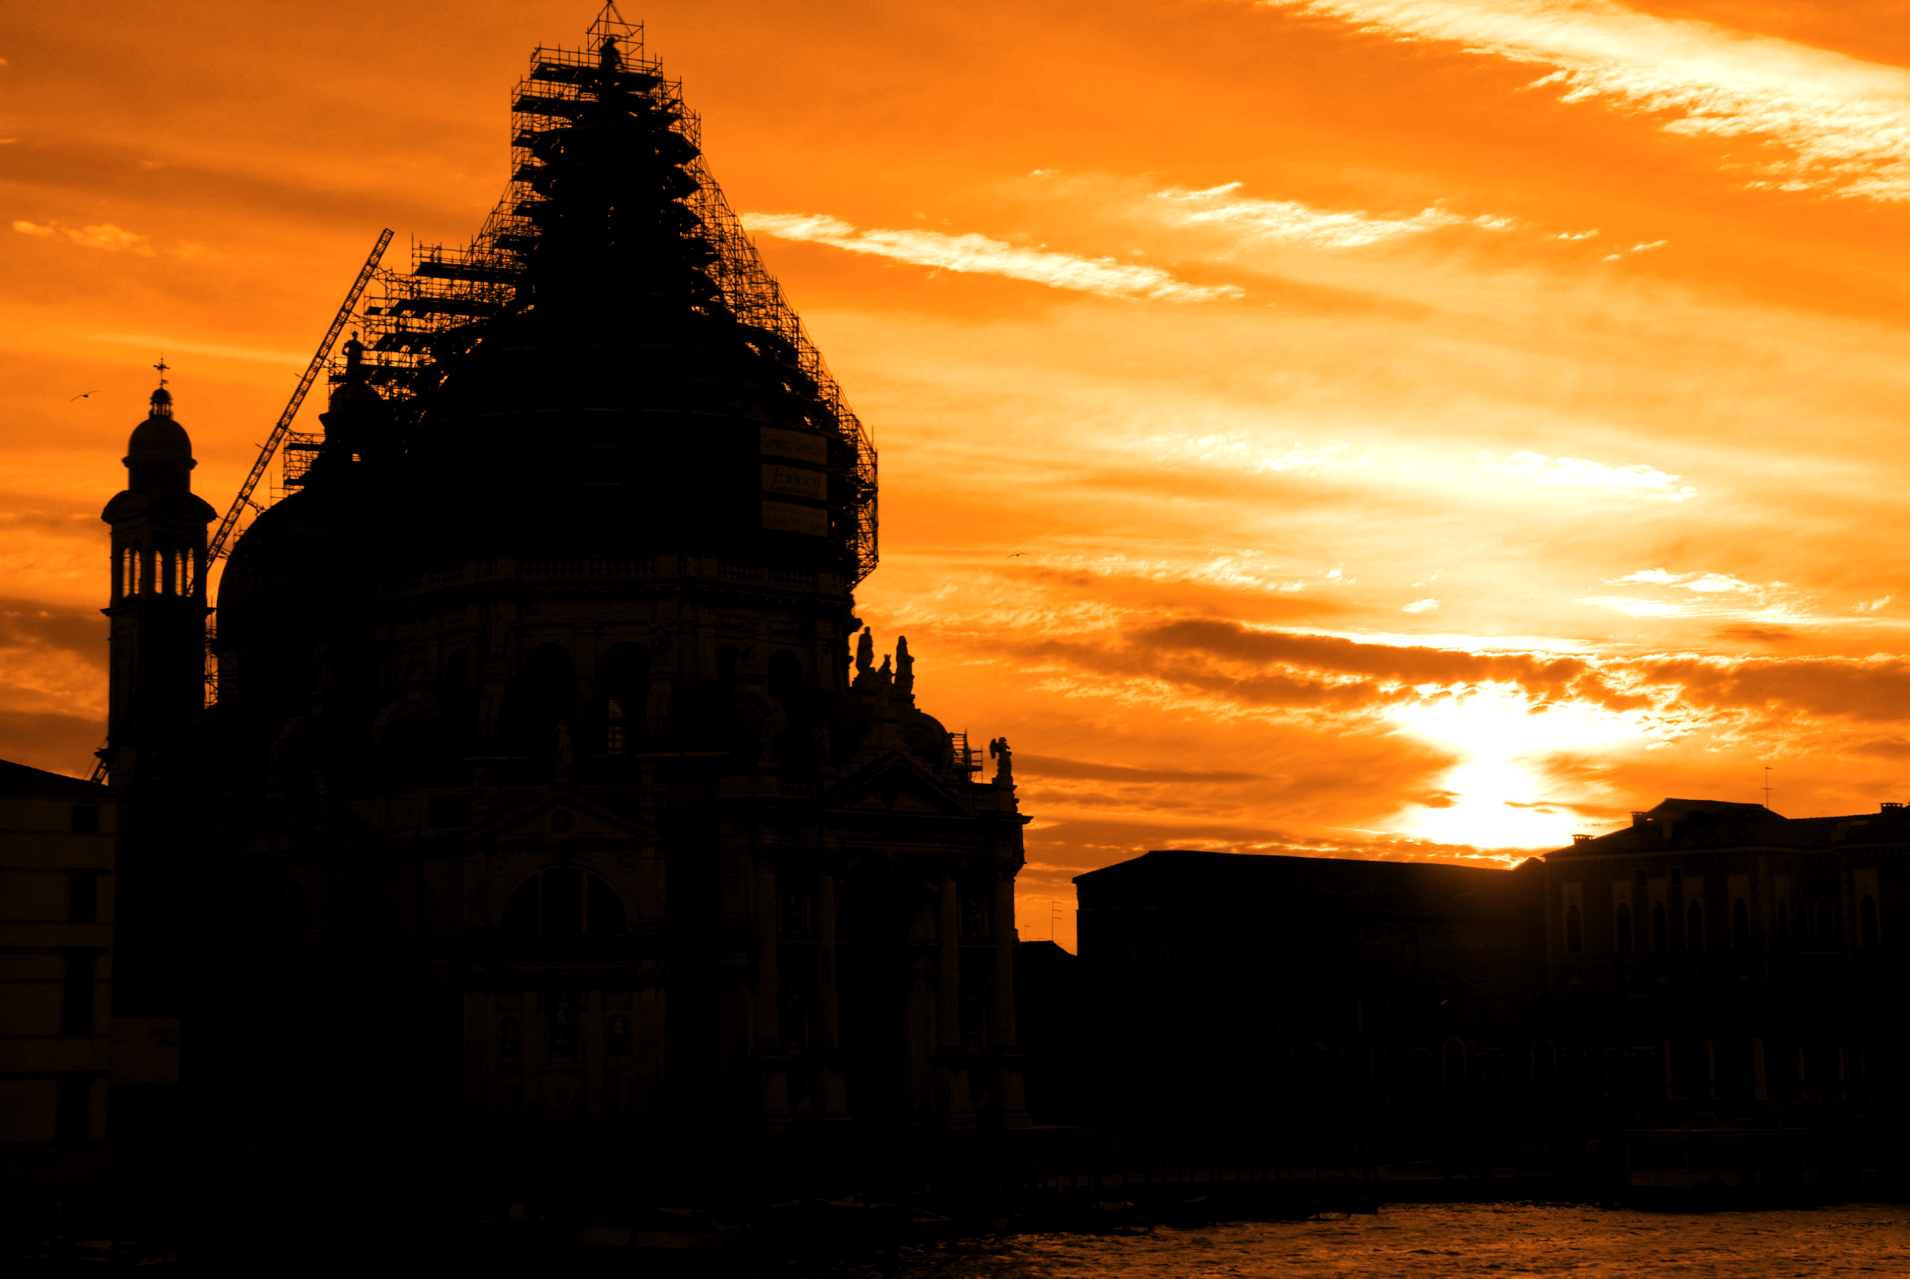
2
Implemented the Strategy
2.1 Content Organization | 2.2 Production Management | 2.3 Final Products
Notes:
Nick - We split implementing the strategy into 3 parts, those being Content Organization, Production Management, and the creation of our Final Products

Slide 13
2.1
Content Organization
Notes:
Nick

Slide 14
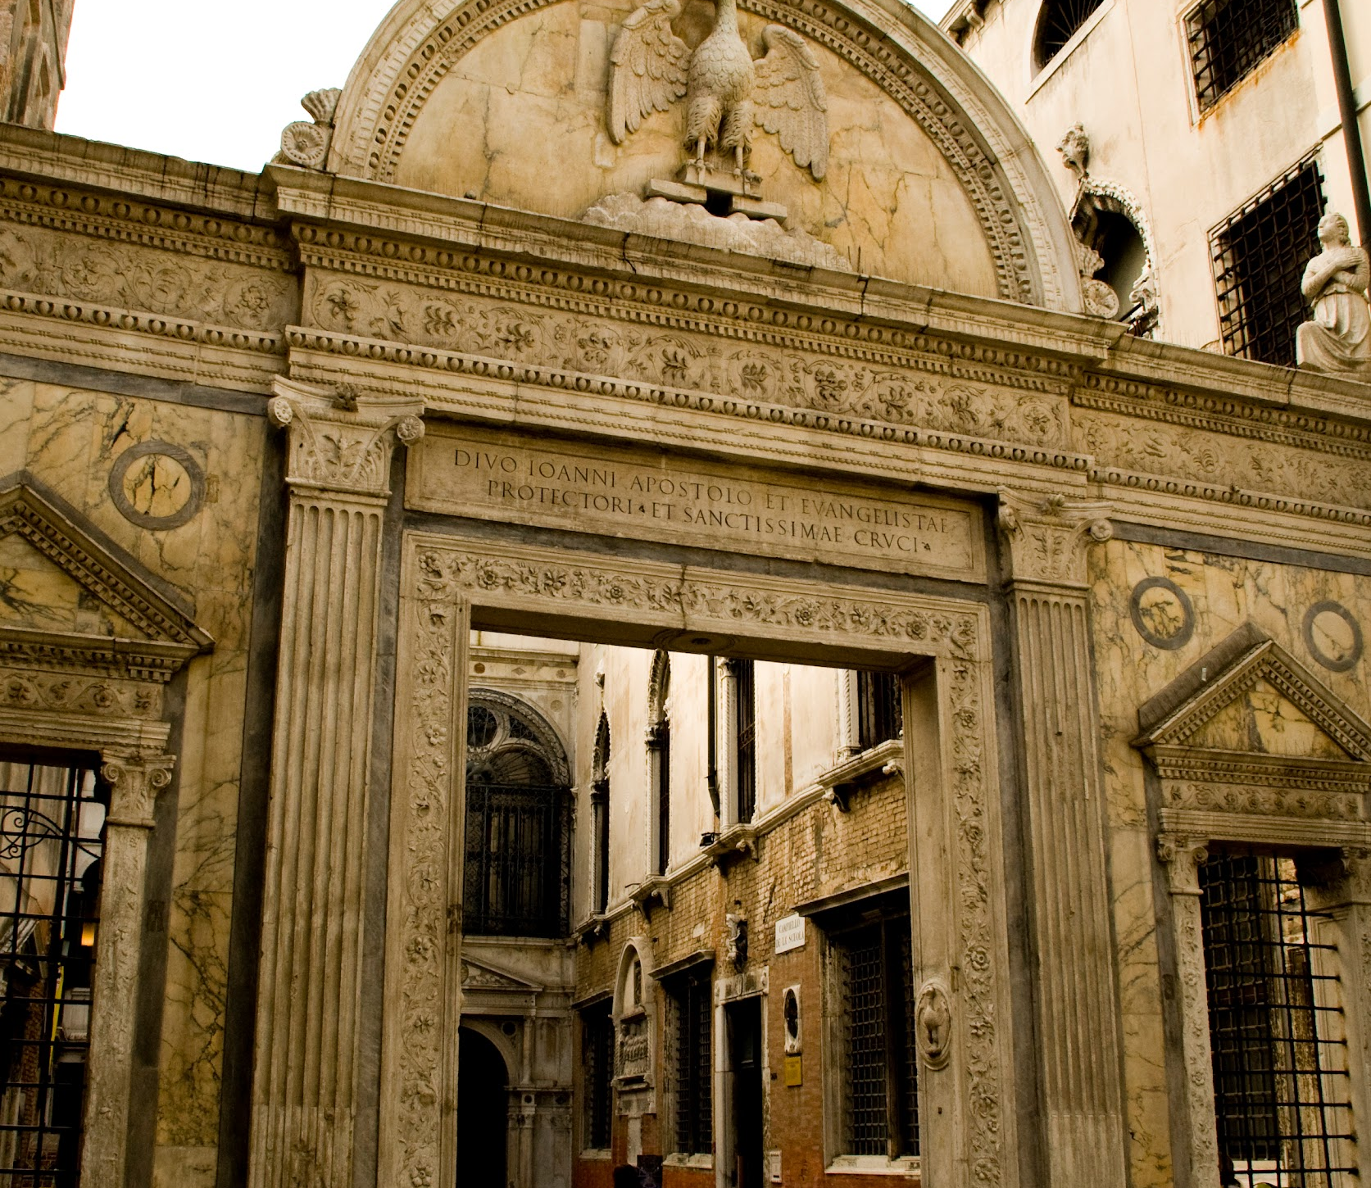

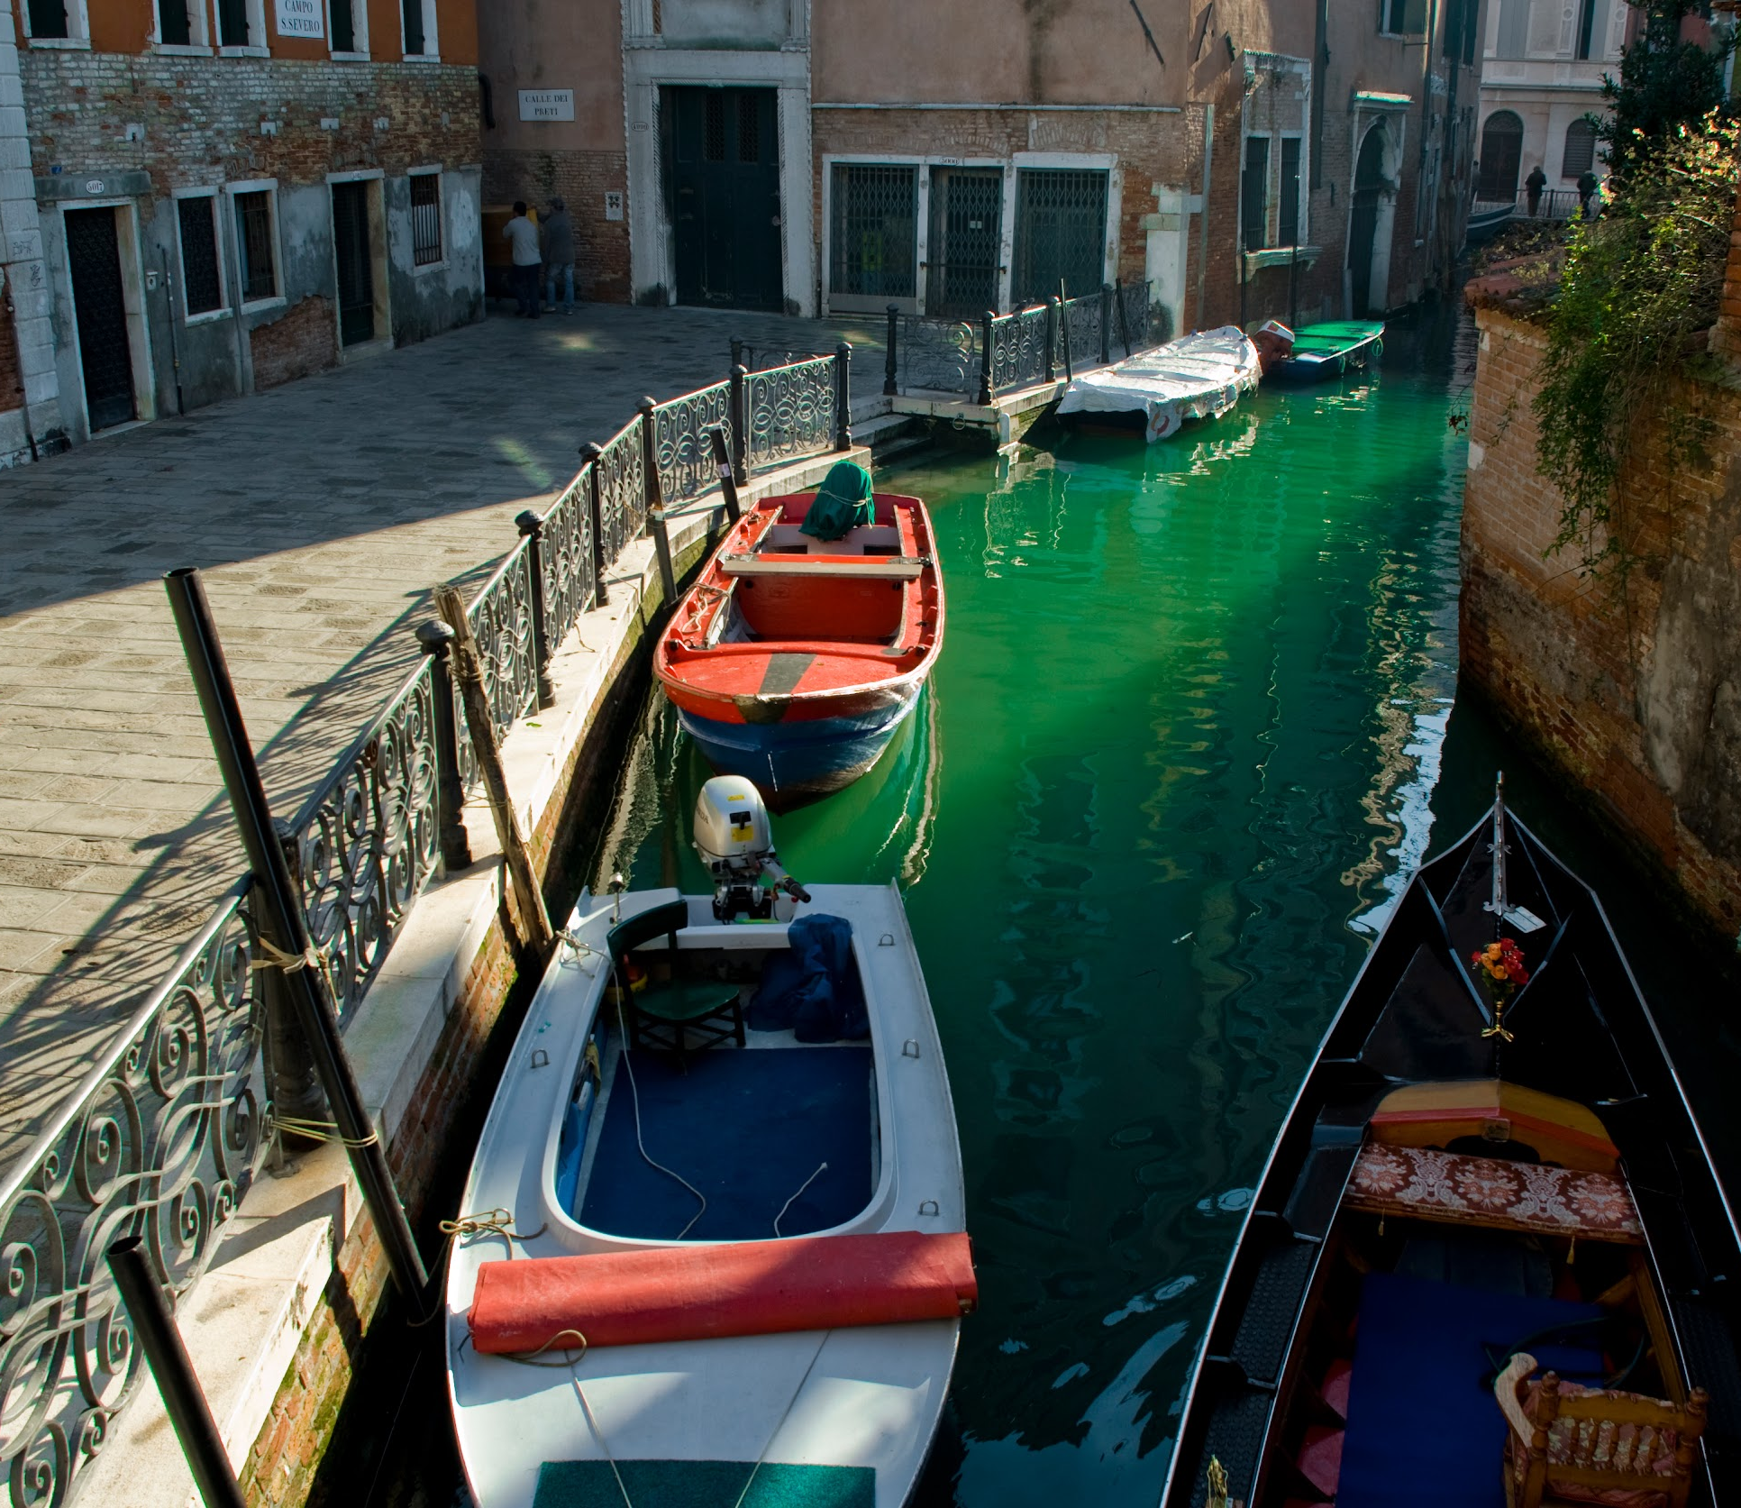
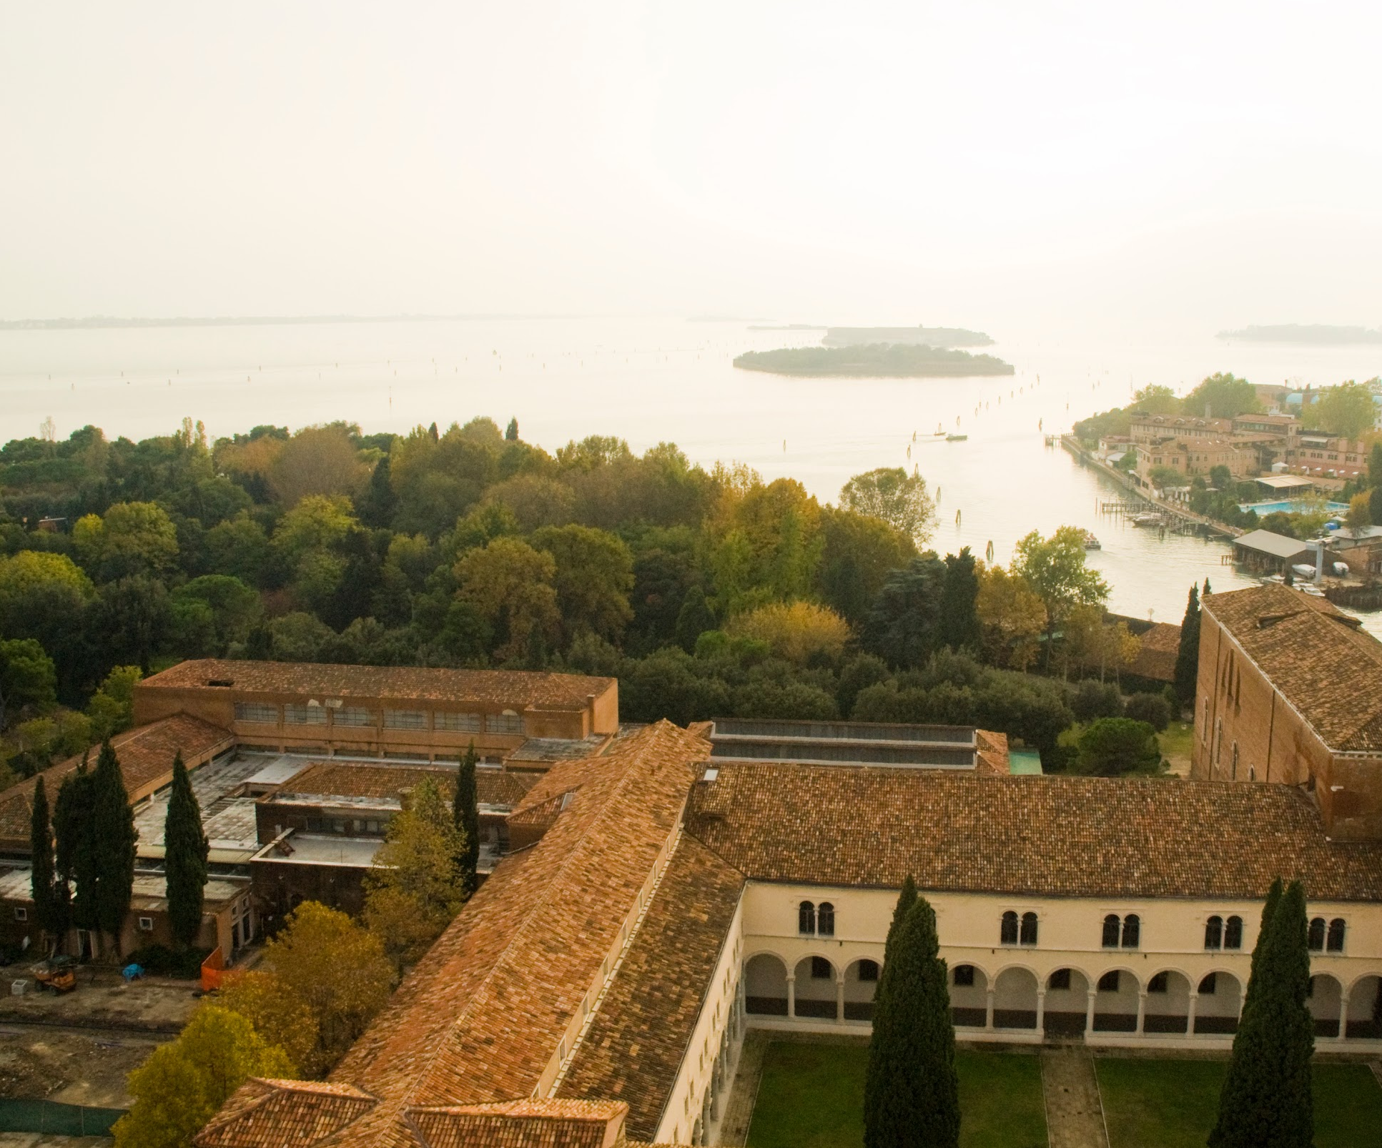
2.1 Content Organization
Content Organization
Created a structure for documentary storytelling.
Heritage
Tourism and Demographics
Read through all past VPC projects.
Sorted into small categories based on topics.
Urban Infrastructure
Environment
Grouped topics into larger theme categories.
Notes:
Nick - To begin creating a structure. We started by reading all of the previous vpc research projects and grouping them into 4 main categories. Those being heritage, Tourism and demographics, urban infrastructure, and environment. This was an essential step in creating a storytelling structure for our documentary

Slide 15
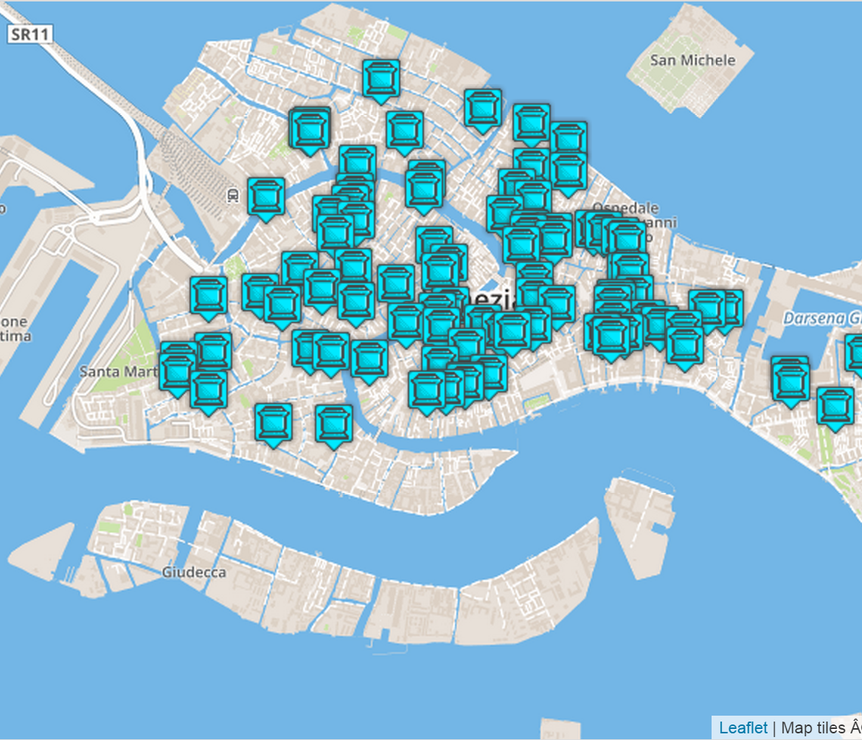
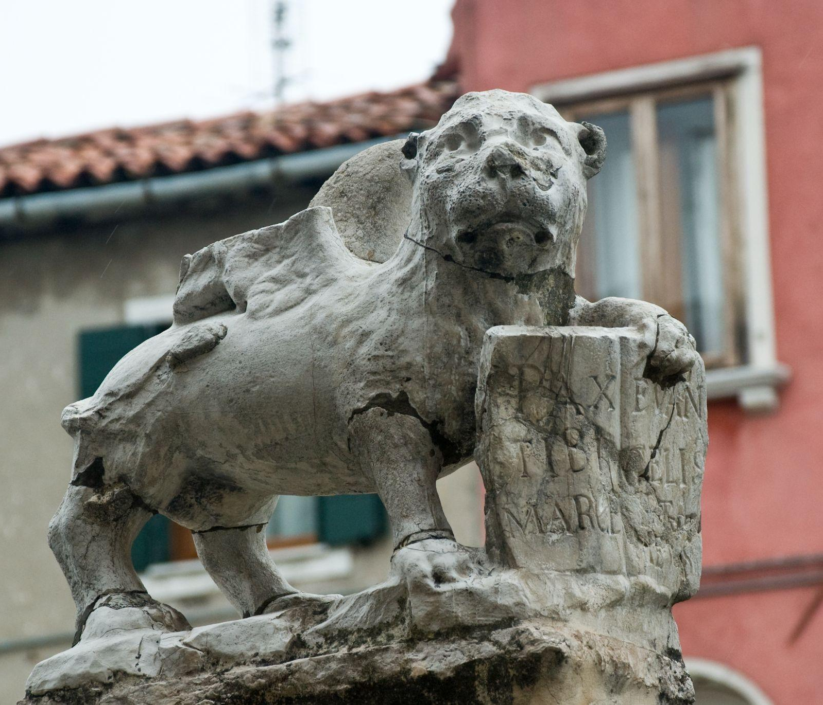
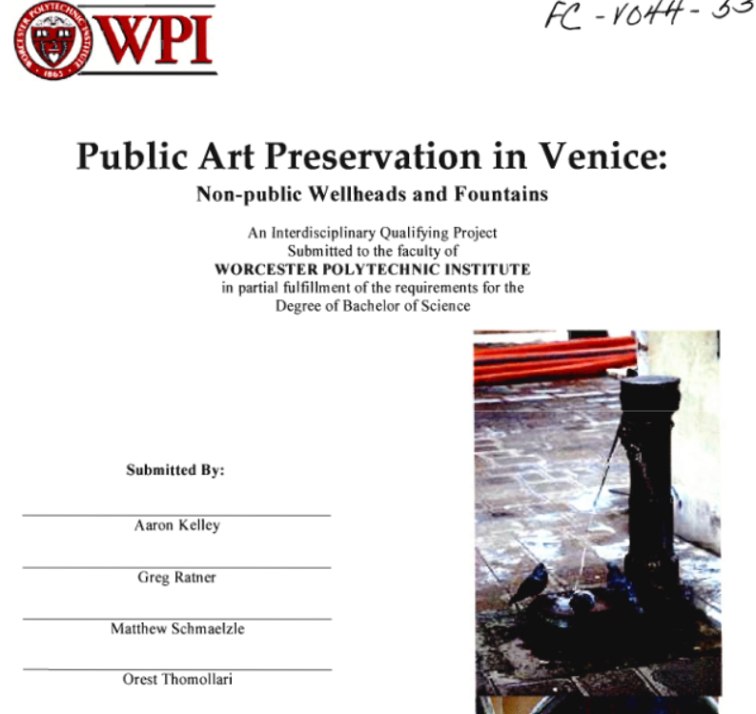
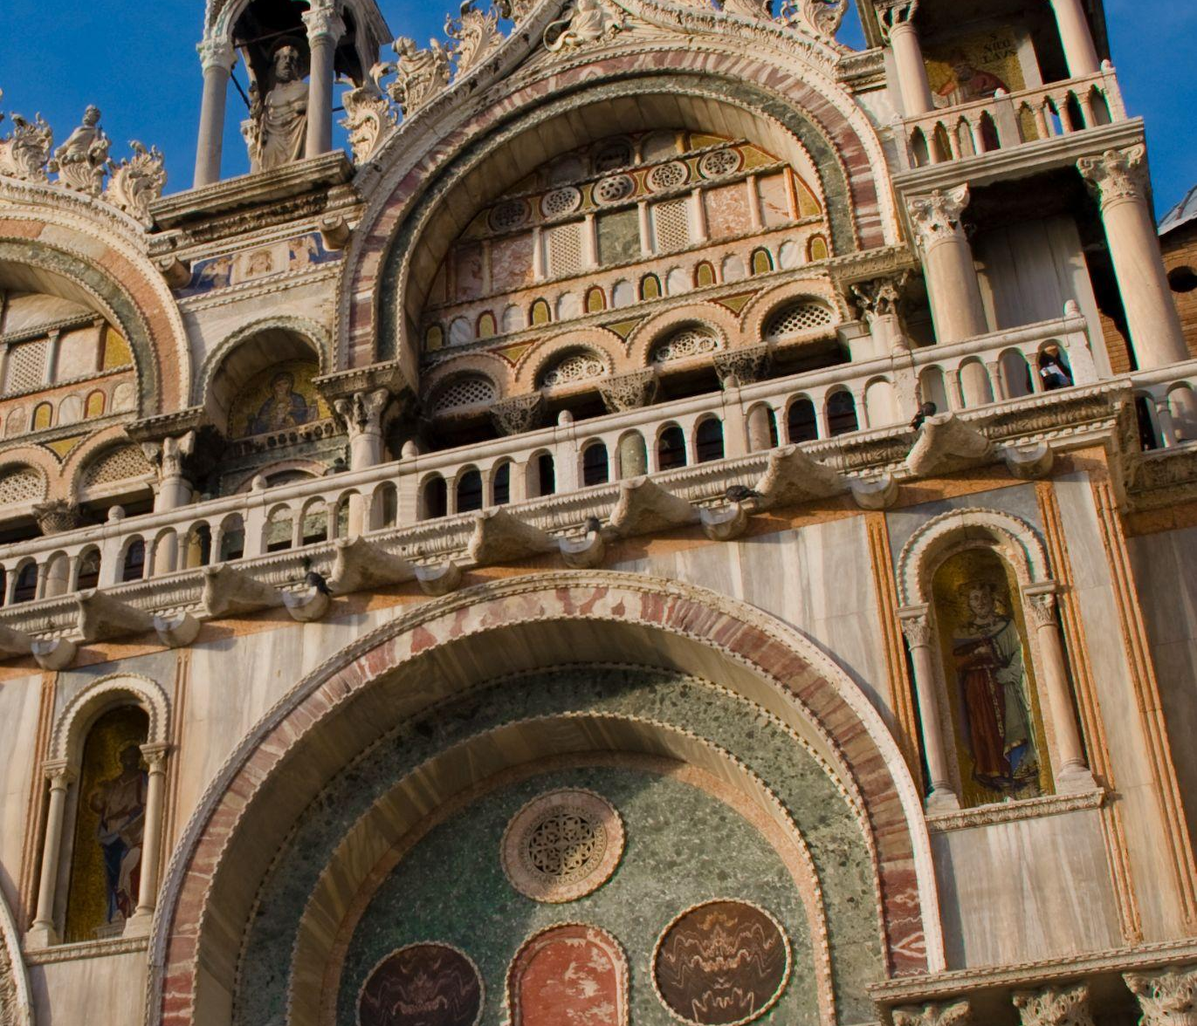
Heritage Topics
2.1 Content Organization
Architecture
Outdoor Art
Heritage
Churches
Notes:
Hayden-
Photos:
Map: IQP that mapped wellheads in venice overtime
Church: church
text: example IQP about public art preservation
statue: example of outdoor art

Slide 16
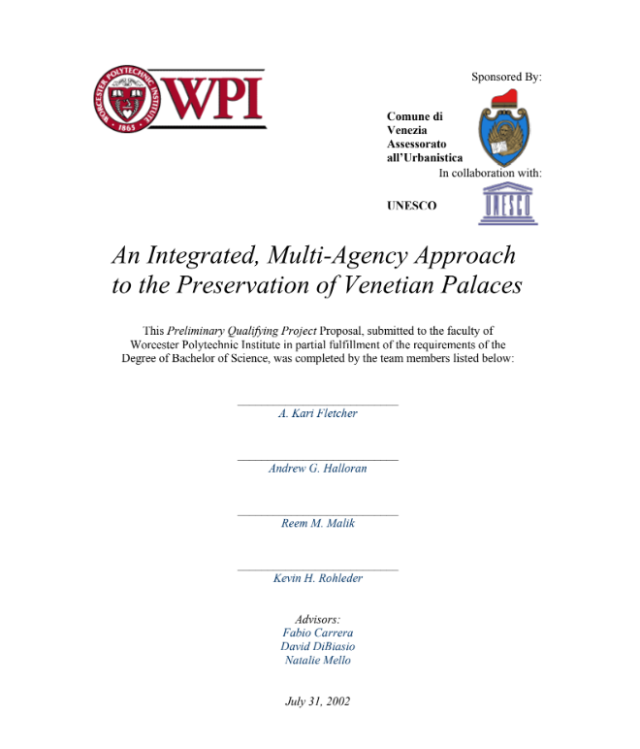
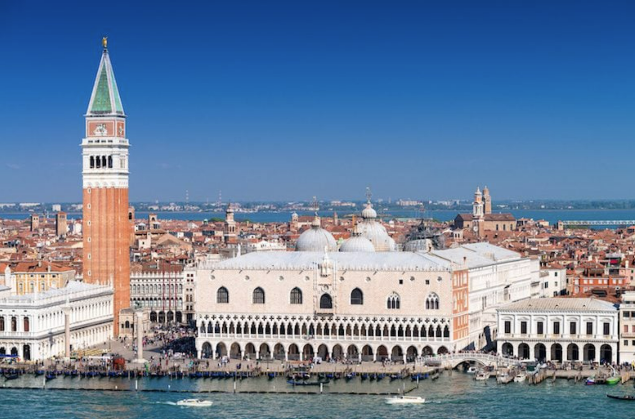
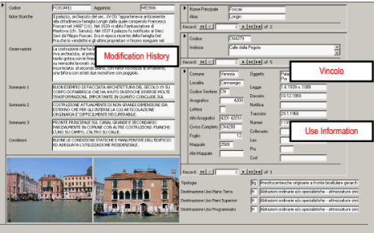
2.1 Content Organization
Heritage
Architecture
Entrances
Bell Towers
Palazzos
Notes:
Hayden - outdoor art, projects involve mapping and creating preservation guides

Slide 17
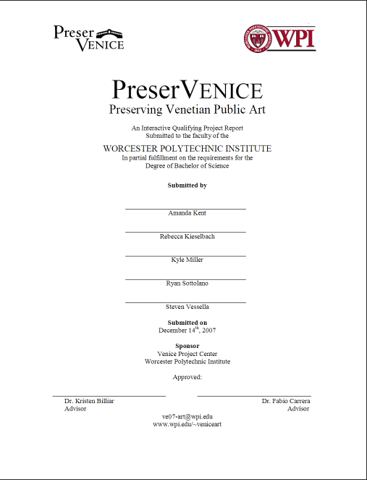

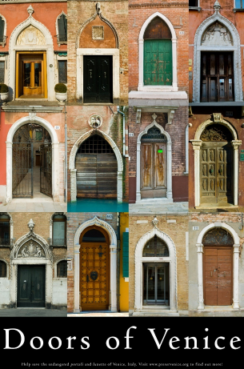
2.1 Content Organization
Heritage
Outdoor Art
Public Art
Coat of Arms
Sculptures
Notes:
Hayden

Slide 18
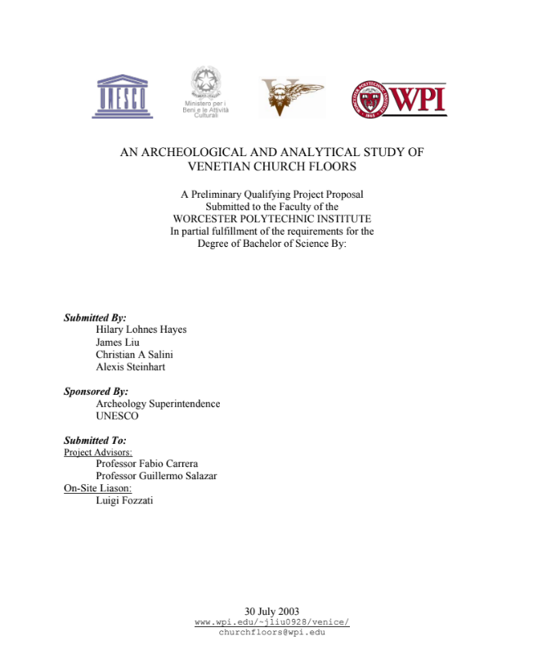
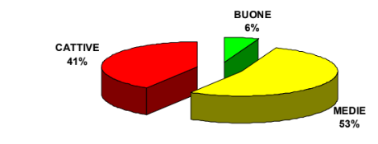
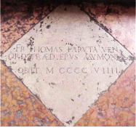
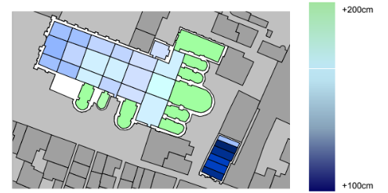
2.1 Content Organization
Heritage
Churches
Floors
Repurposing
Notes:
Hayden

Slide 19
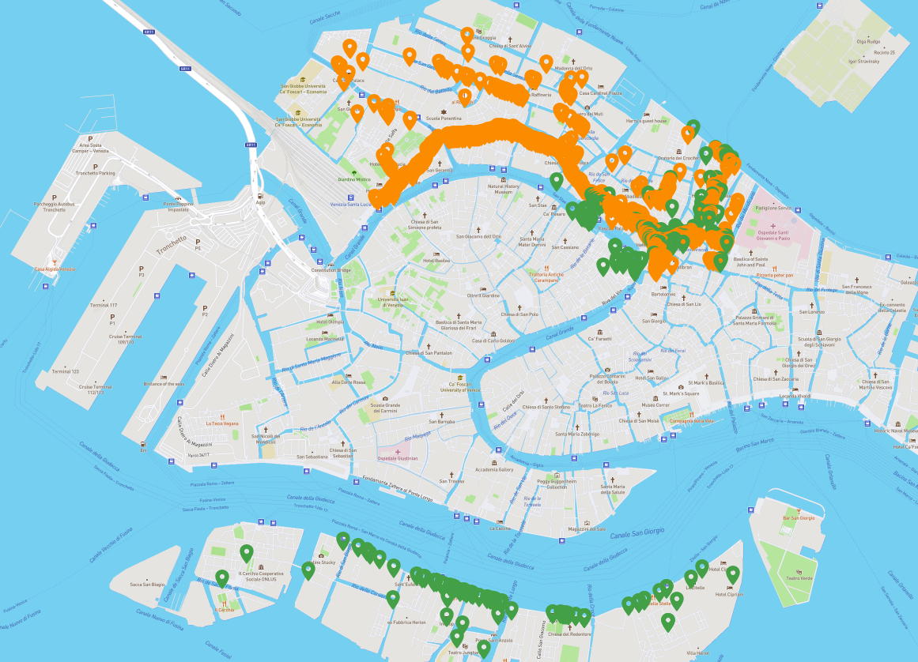
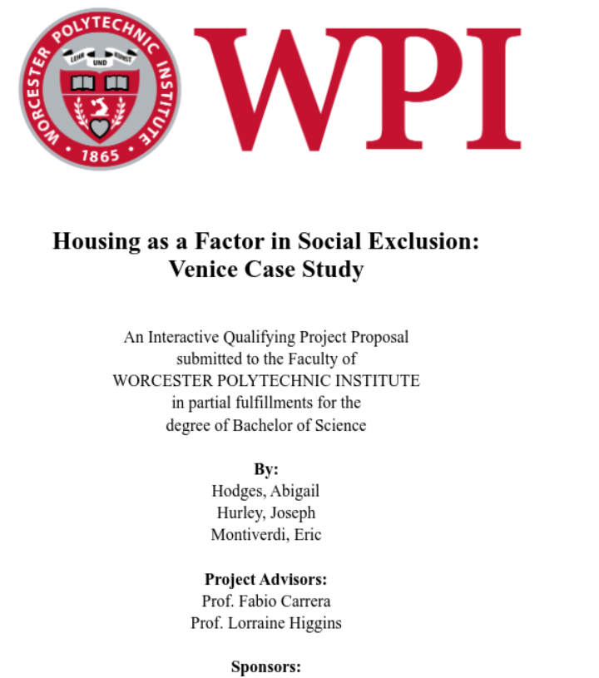
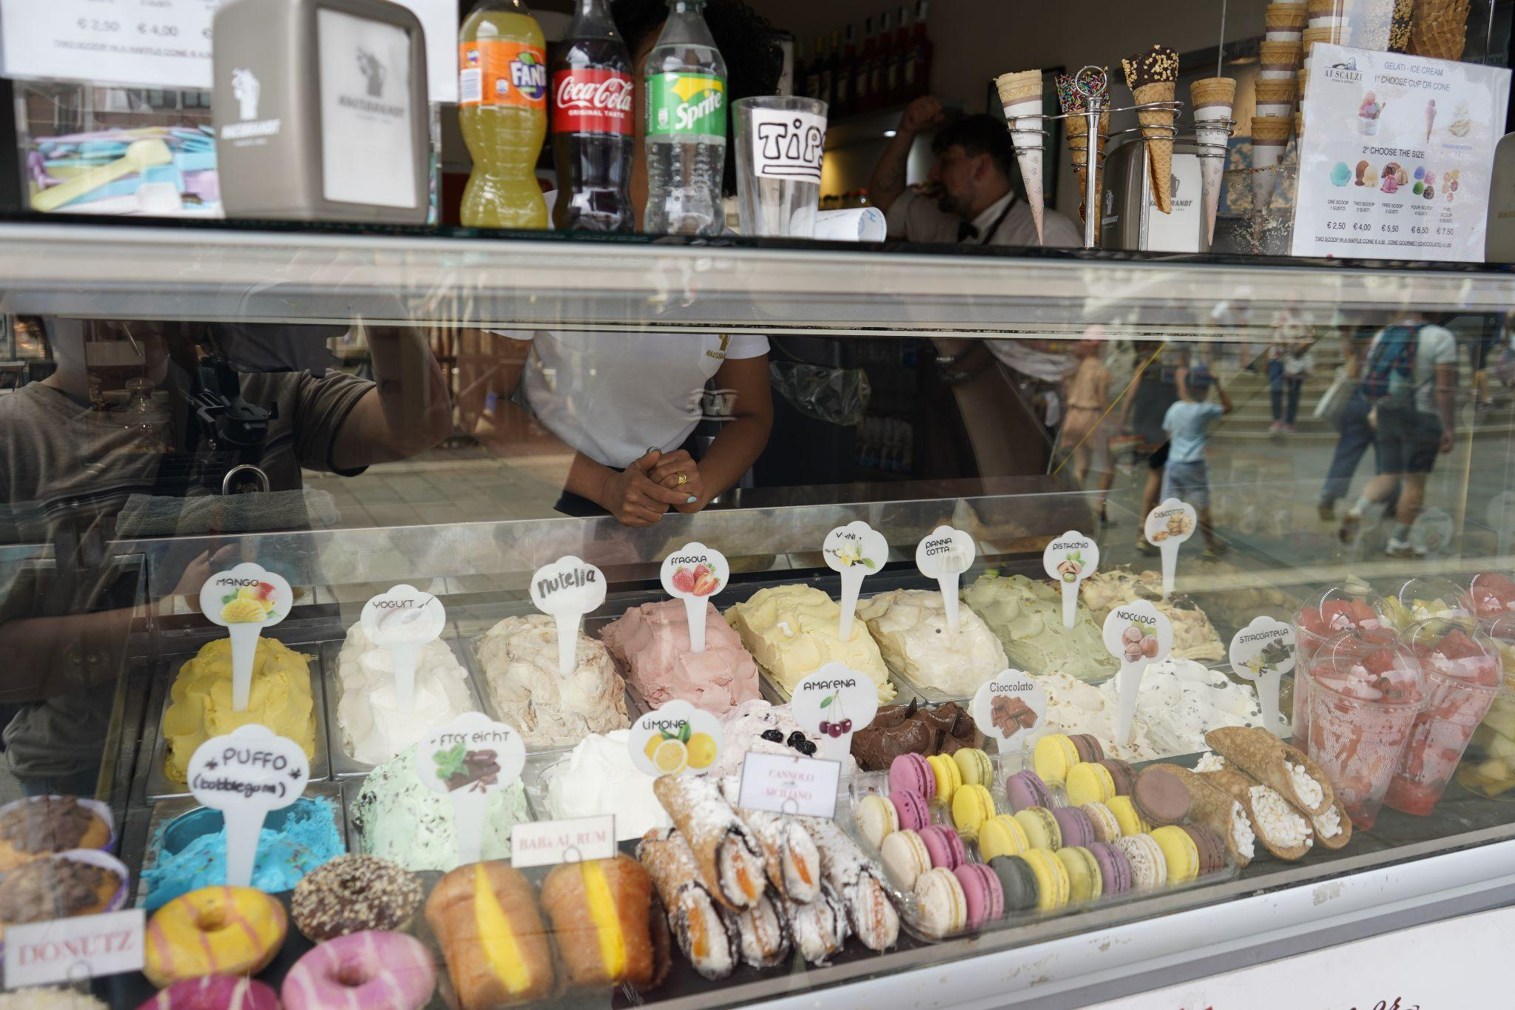
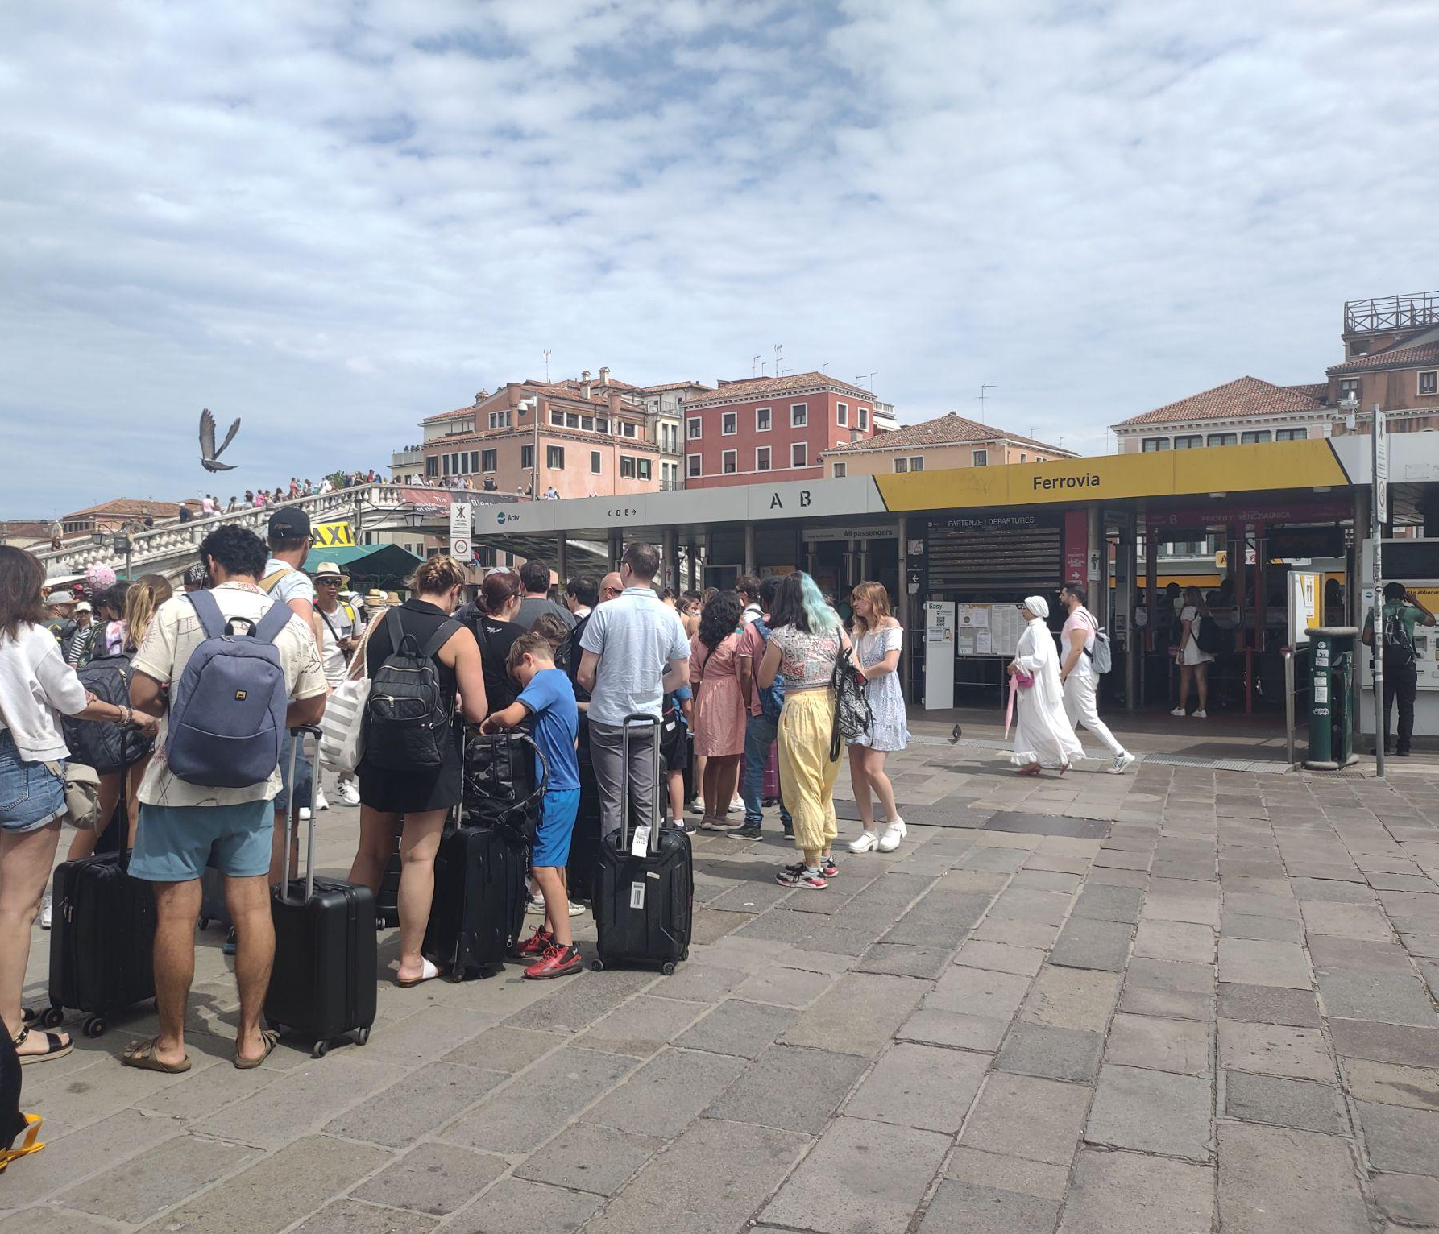
Tourism and Demographics Topics
2.1 Content Organization
Population
Tourism and Demographics
Tourism
Economics
Notes:
JARED- Our next theme is tourism and demographics. We have broken this into three topics: population, tourism, and economics

Slide 20
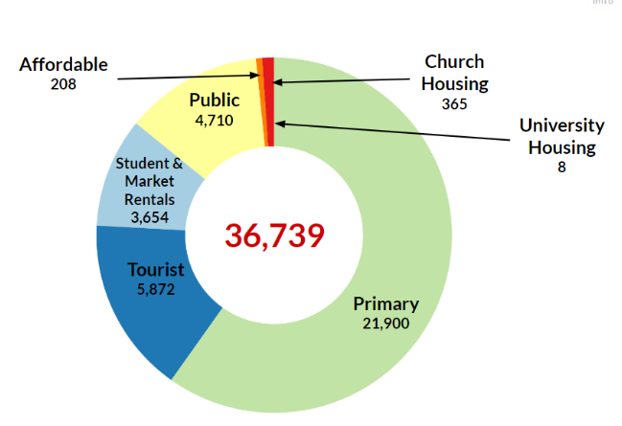
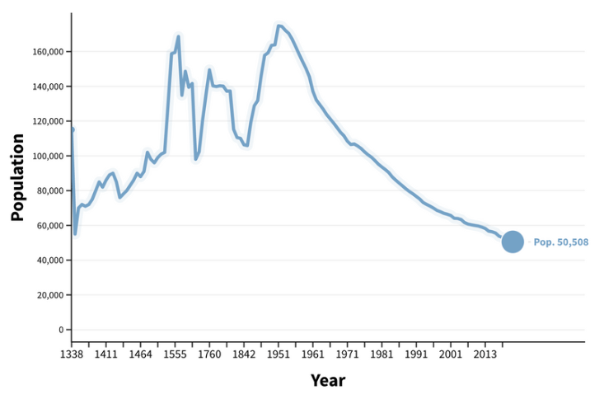
2.1 Content Organization
Tourism and Demographics
Population
Residents
Quality of Life
Notes:
jared: Projects within the topic of population study the quality of life of the residents of Venice, to understand why the population is declining and how this can be reversed.

Slide 21
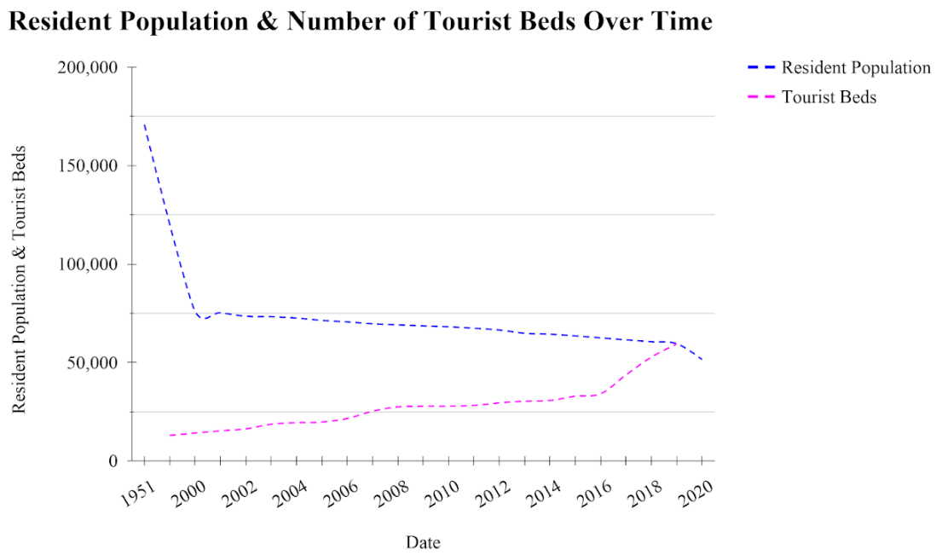
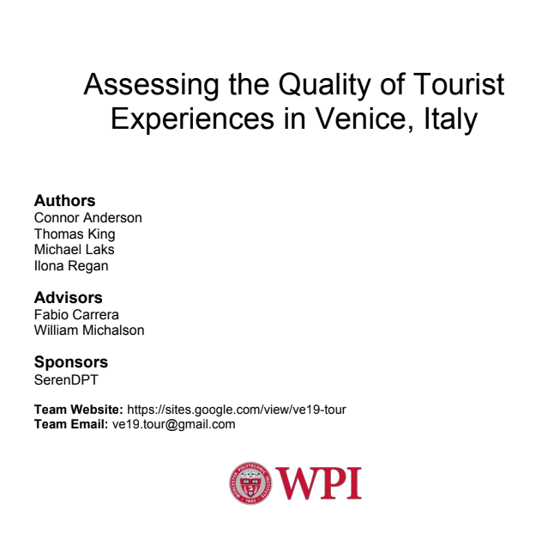
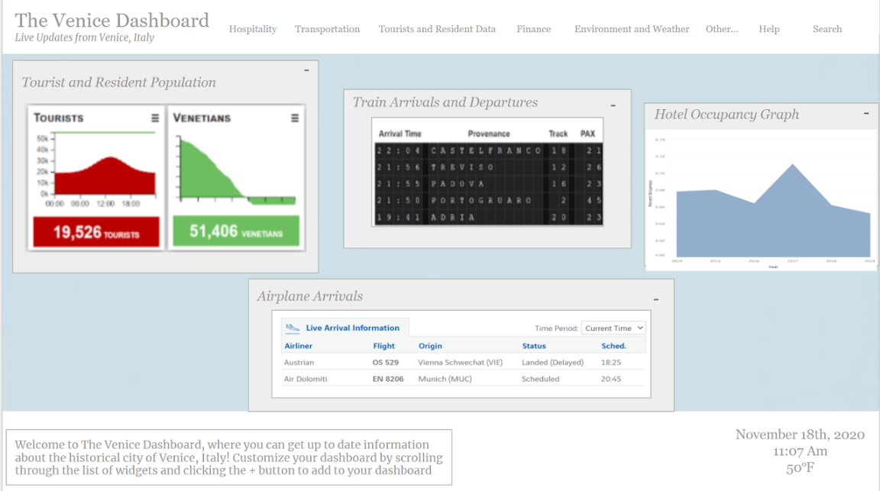
2.1 Content Organization
Tourism and Demographics
Tourism
Excursionists
Impacts
Notes:
jared: The next topic, tourism, relates to projects that have researched the impacts of tourists on the city of Venice, including understanding the different types of tourists, such as excursionists who are tourists that only stay in Venice for a day-trip without staying overnight in the city.

Slide 22
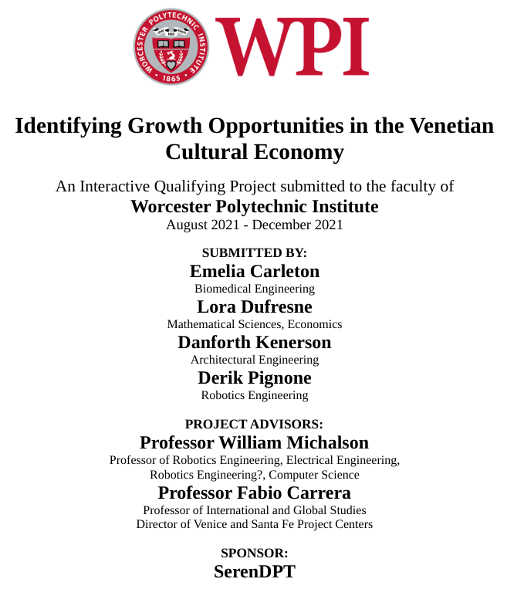
2.1 Content Organization
Tourism and Demographics
Economics
Job Market
Local Businesses
Notes:
jared: The final topic within tourism and demographics is economics. Specifically, projects in this area research the job market and availability of jobs for locals in Venice, and the decline of local businesses in the city due to the takeover of tourist-catered buildings.

Slide 23
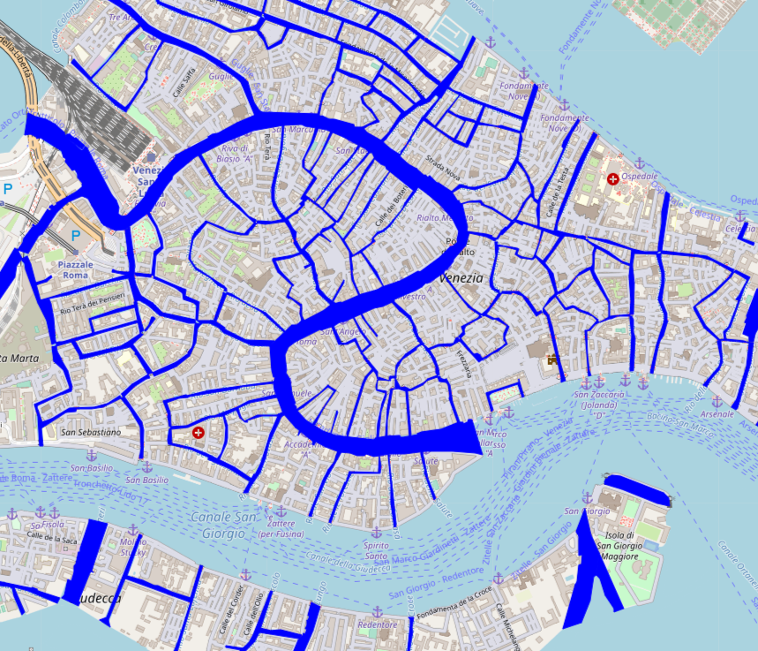
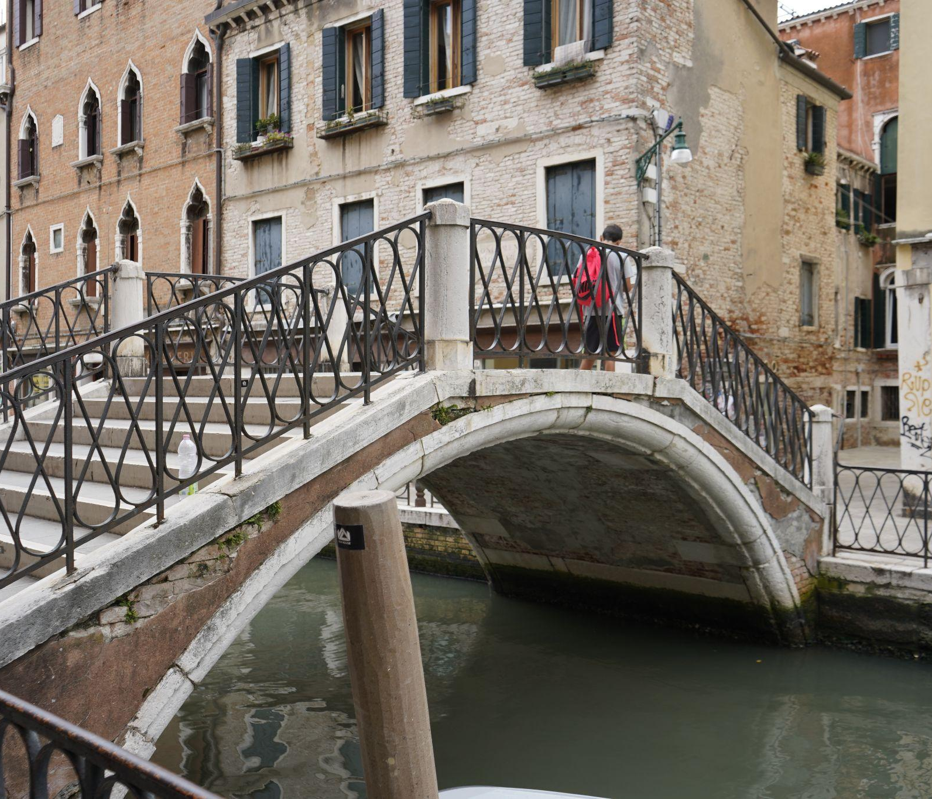
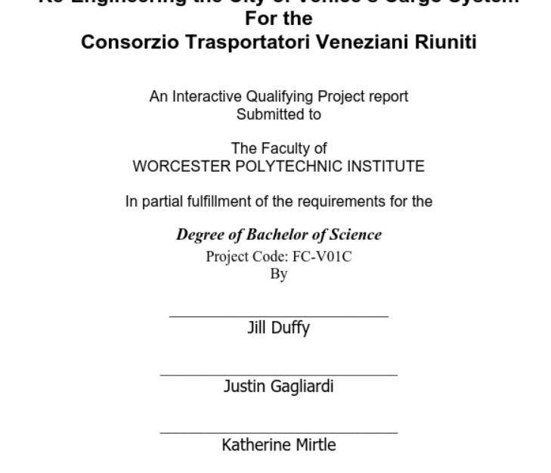
Urban Infrastructure Topics
2.1 Content Organization
Canals
Bridges
Urban Infrastructure
Docks
Mobilities
Notes:
jillian
Photos
Map: Canal mapping IQP project
Text: Cover page of project involving cargo systems in Venice
Bridge: Bridge

Slide 24
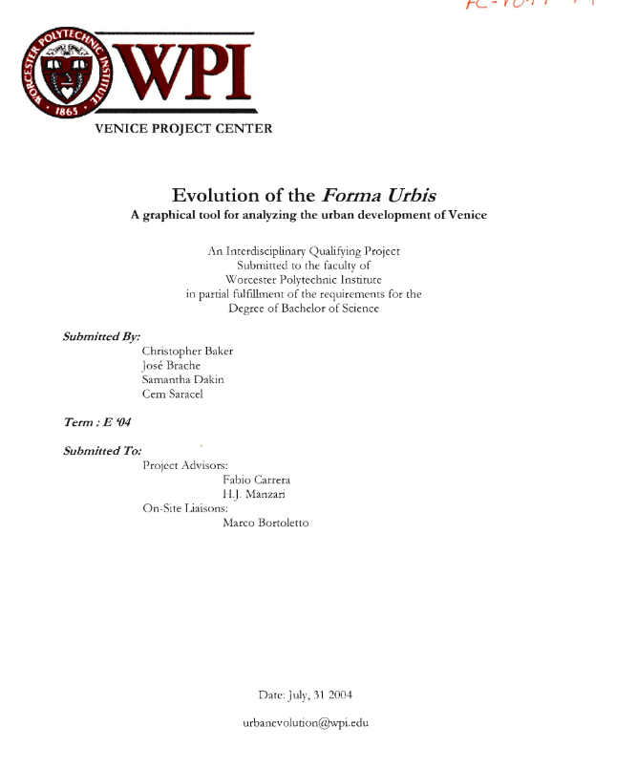
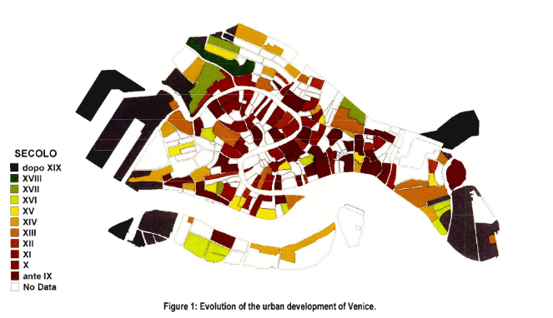
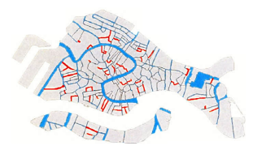
2.1 Content Organization
Urban Infrastructure
Canals
Hydrodynamics
Wall Damage
Notes:
jillian - study the causes of moto ondoso and the properties of the canal

Slide 25
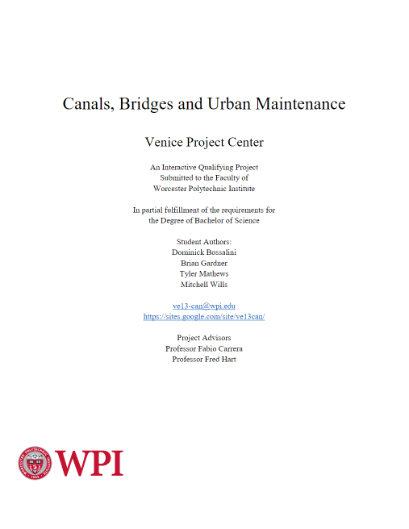
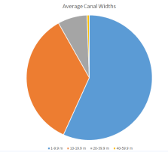
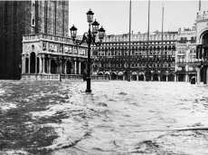
2.1 Content Organization
Urban Infrastructure
Bridges
History
Utilization
Inventory
Notes:
jillian - track locations and utilsation of bridges

Slide 26
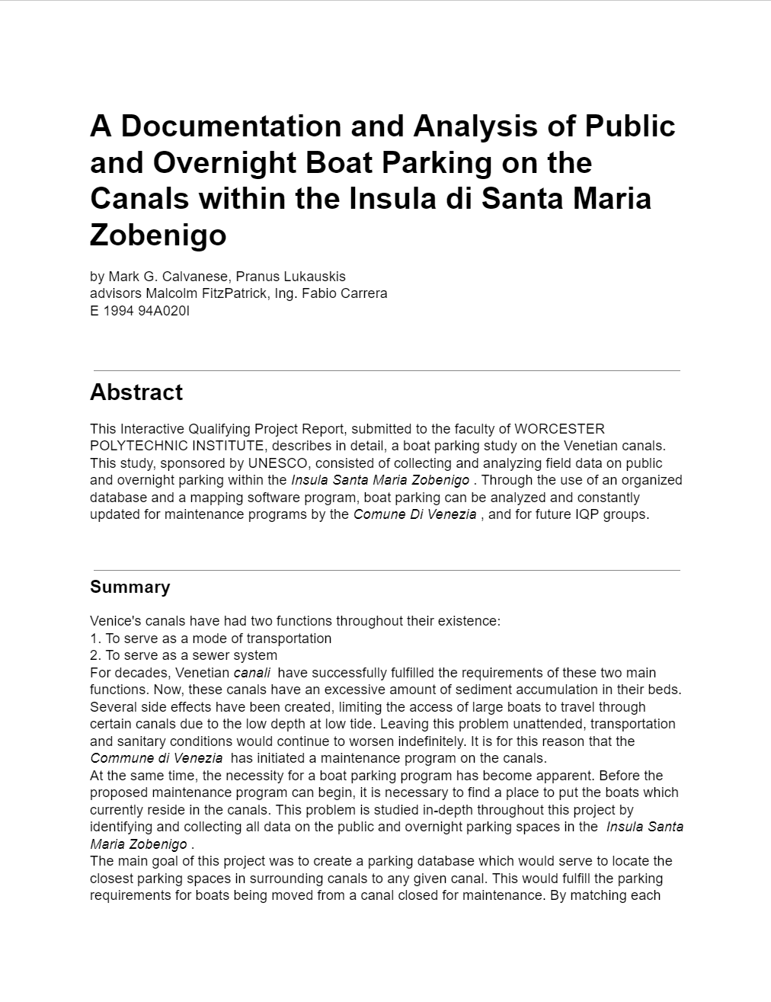
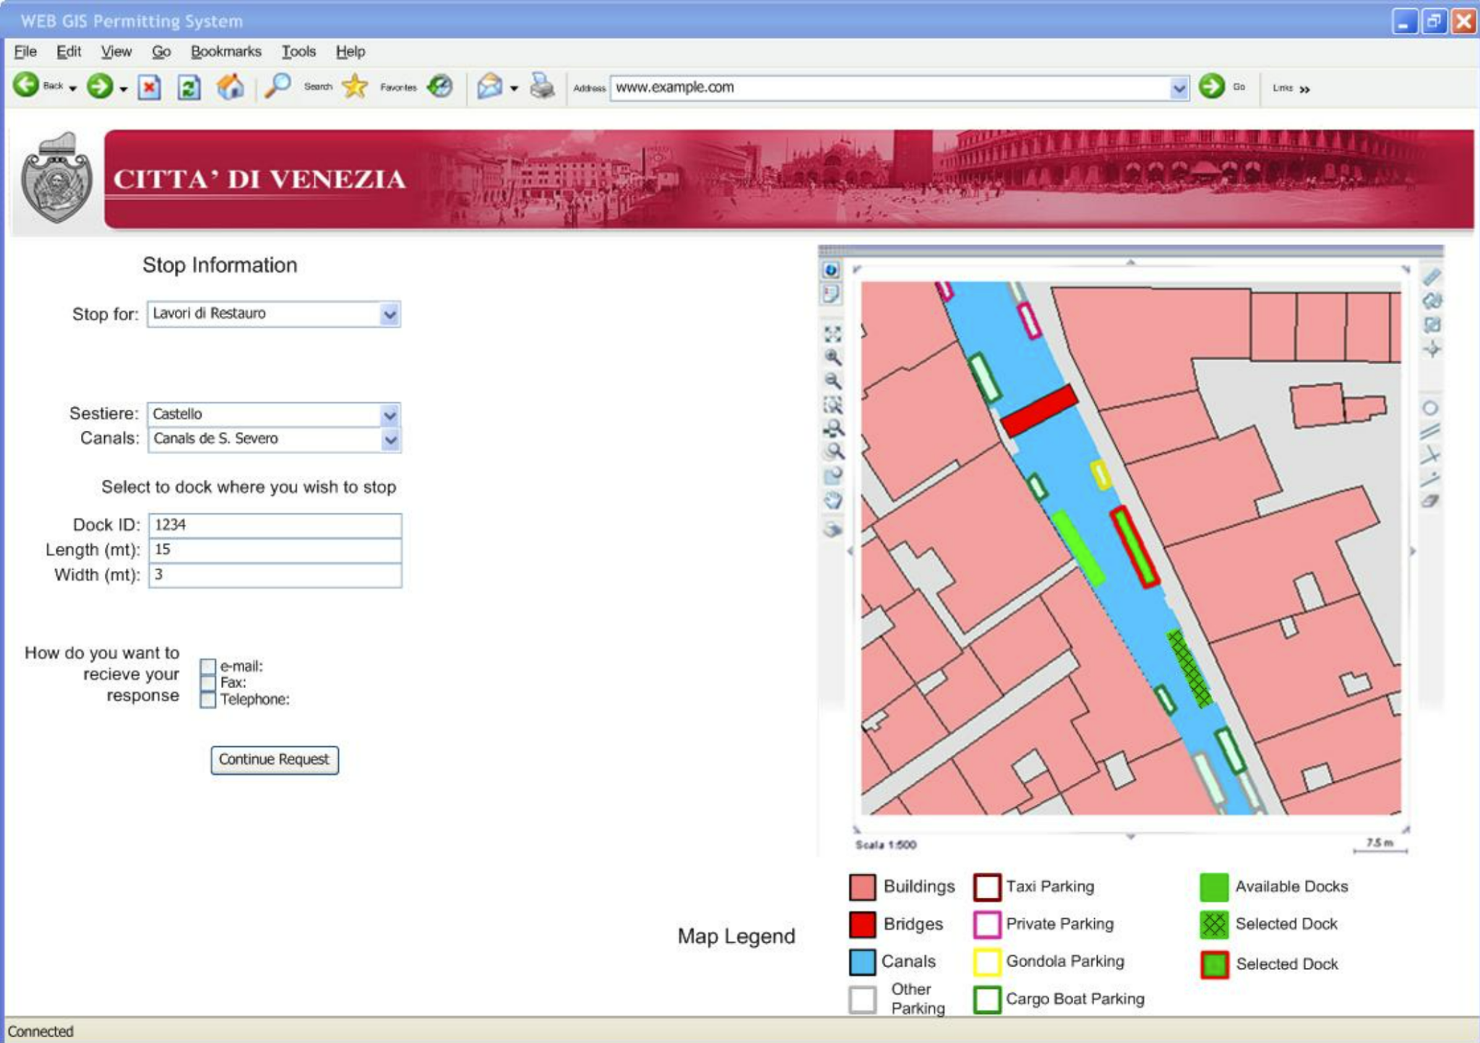

2.1 Content Organization
Urban Infrastructure
Docks
Uses
Inventory
Notes:
jilian

Slide 27




2.1 Content Organization
Urban Infrastructure
Mobilities
Accessibility
Pedestrian Traffic
Boat Traffic
Notes:
jilian

Slide 28



2.1 Content Organization
Environmental Topics
Ecosystem
Energy
Environment
Agriculture & Greenery
Pollution
Notes:
sam
The theme of Environment had the 4 topics of Ecosystem, Energy, Agriculture & Greenery, and Pollution
Photos:
Text: IQP promoting sustainable stewardship of green space in venice
photo: green space in venice
map: project that involved creating database of plastic pollution on the island and mapping points of interest for plastic buildup

Slide 29



2.1 Content Organization
Environment
Ecosystem
Lagoon
Native Species
Conservation
Notes:
Sam - Examples of content about the Venetian ecosystem include material about the Venetian Lagoon, Native Species of Venice, and the conservation of the Venetian ecosystem

Slide 30


2.1 Content Organization
Environment
Energy
Clean Energy
Solar Power
Notes:
Sam - Environmental Energy is about the manufacture of clean energy systems in Venice, such as Solar Power

Slide 31



2.1 Content Organization
Environment
Agriculture & Greenery
Organic Farming
Reviving Plant Life
Notes:
Sam - Even though Venice is a city, there have been researchers dedicated to practicing Organic Farming and the revival of plant life to preserve the Agriculture and Greenery of Venice

Slide 32


2.1 Content Organization
Environment
Pollution
Acid Rain
Air Pollution
Recycling
Notes:
Sam - As Venice has become more developed throughout the centuries, there have been pollution problems arising such as the effects of the Murano glass factory and acid rain, as well as research into ways to combat these, such as recycling and utilization of alternative materials

Slide 33
2
Implemented the Strategy
2.1 Content Organization | 2.2 Production Management | 2.3 Final Products
Notes:
hayden -

Slide 34
2.2
Production Management
Notes:
HAYDEN

Slide 35
2
Production Plan
Equipment Management | Production Guidelines | How to Collection
Testing Organization Guides | Guides Timelines Organization | StoryMap Davinci
Notes:
HAYDEN:
In order to create our storytelling strategy, we utilized these digital tools.

Slide 36
2
Production Plan
Equipment Management | Production Guidelines | How to Collection
Testing Organization Guides | Guides Timelines Organization | StoryMap Davinci
Notes:
HAYDEN:
In order to create our storytelling strategy, we utilized these digital tools.

Slide 37
2
Production Plan
Equipment Management | Production Guidelines | “How-To” Guides
Testing Organization Guides | Guides Timelines Organization | StoryMap Davinci
Notes:
HAYDEN:
In order to create our storytelling strategy, we utilized these digital tools.

Slide 38

2.2 Production Management
Equipment Management
Tested each piece of equipment at the VPC.
Made a spreadsheet of the equipment for easy check outs in the future.
Created info guides on how to use the equipment.
Notes:
jared:

Slide 39

2.2 Production Management
Equipment Management
Tested each piece of equipment at the VPC.
Made a spreadsheet of the equipment for easy check outs in the future.
Created info guides on how to use the equipment.
Notes:
jared

Slide 40

2.2 Production Management
Production Guidelines
Experimented with editing software to familiarize ourselves with it.
Created guides and timelines for future teams on how to produce content.
Filmed and edited b-roll for future teams to utilize.
Organized content into folders.
Notes:
JILLIAN - writing filming organizing

Slide 41





“How-To” Guides
2.2 Production Management
5 Types of Guides Created:
Production
Equipment
Interview
Editing
StoryMap
Notes:
Jillian
5 Different guides: story map, how to edit, how to produce the podcast, how to interview, guides for various equipment

Slide 42



Production Guide
2.2 Production Management
Notes:
Jllian
5 Different guides: story map, how to edit, how to produce the podcast, how to interview, guides for various equipment

Slide 43


Equipment Guides
2.2 Production Management
Notes:
Jillian
5 Different guides: story map, how to edit, how to produce the podcast, how to interview, guides for various equipment

Slide 44


Interview Guide
2.2 Production Management
Notes:
Jillian
5 Different guides: story map, how to edit, how to produce the podcast, how to interview, guides for various equipment

Slide 45


Editing Guide
2.2 Production Management
Notes:
Jillian
davinci how to edit

Slide 46



StoryMap Guide
2.2 Production Management
Notes:
Jillian
5 Different guides: story map, how to edit, how to produce the podcast, how to interview, guides for various equipment

Slide 47
2
Implement the Strategy
2.1 Content Organization | 2.2 Production Management | 2.3 Final Products
Notes:
Nick - Content organization and Production management all culminated in the creation of our final products

Slide 48
2.3
Final Products
Notes:
Nick-

Slide 49




2.3 Final Products
Website Overhaul
Old
New
Created an easily maintainable and editable site
Built on top of React and Next js
New page to host documentary episodes
Gives access to all the data, applications, research projects and documentaries
Notes:
SAM - We created a new, maintainable site using a React/NextJS framework. Now future project groups will be able to add their projects easily, and the future story groups will be able to add their episodes to the website as well, in a brand new page. The previous website had a few unaccessible links, but the new one has far more accessibility to previous project data.

Slide 50



2.3 Final Products
Web Hosting infrastructure
Everything can be Rebuilt with a single command
Created a data backup strategy
Vercel is free and Supports advanced next js features
Notes:
NICK - To organise the existing web elements we adopted an infrastructure as code approach to development. infrastructure as code enables us to store all of our web infrastructure in a set of config files. this enables us to create and destroy all of our web infrastructure with a single command.
We used terraform to make our website reproducible with a single command
we picked vercel as our hosting platform for there easy integration with Next js
additionally we worked on creating backups of our data to keep it resilient into the ages

Slide 51

2.3 Final Products
Bridges StoryMap
Useful visual storytelling tool.
Utilized the software as a storyboarding technique.
Can be used as a condensed version of the videos.
Our Map
Interactive mapping features.
Notes:
JARED Our next product that we created was a StoryMap. StoryMaps is an interactive software made by ArcGIS that is able to combine the visual aspects of maps with narrative storytelling. For our project this was used as both a story-boarding technique for our videos, and as a concise and visually appealing way to relay information to a viewer. We will now visit the storymap that we have created on the bridges of Venice.

Slide 52
2.3 Final Products
StoryMap Demonstration
Notes:
JARED

Slide 53



2.3 Final Products
Documentary Filming
Filmed B-roll of many subjects
Recorded multiple shots from multiple cameras and angles
Uploaded to the cloud for use by future teams and to edit
Notes:
JILLIAN The final aspect of our project was putting all of the work and research we have done together into a pilot episode. For this episode, we focused on the traditional boats of venice and how they are being replaced by modern-day motorized boats. To do this, we read through several projects pertaining to this topic to write a script, recorded audio and b-roll footage, then edited it all together into one final product.

Slide 54


2.3 Final Products
Documentary Pilot
We focused on traditional boats of Venice.
Read through VPC research papers to create a script.
Recorded audio and b-roll footage.
Edited footage together to create a full length video.
Notes:
jillian The final aspect of our project was putting all of the work and research we have done together into a pilot episode. For this episode, we focused on the traditional boats of venice and how they are being replaced by modern-day motorized boats. To do this, we read through several projects pertaining to this topic to write a script, recorded audio and b-roll footage, then edited it all together into one final product.

Slide 55

2.3 Final Products
Completed Documentary
Notes:
jillian The final aspect of our project was putting all of the work and research we have done together into a pilot episode. For this episode, we focused on the traditional boats of venice and how they are being replaced by modern-day motorized boats. To do this, we read through several projects pertaining to this topic to write a script, recorded audio and b-roll footage, then edited it all together into one final product.

Slide 56
Created a Storytelling Strategy
1
2
Implemented the Strategy
Planned the 35th Anniversary Celebration
3
Notes:
hayden Finally we reach our plans and recommendations for future teams

Slide 57
3 Anniversary
Planning
Future Production
Preparation Period
Decide on Topic
Research Related Projects
Additional Research
Organize Research
Schedule Interviews
Create Script and Shot List
Any questions or missing information should be supplemented with additional research
Organize research according to the Episode Outline, then put it in a StoryMap
Plan out more specific Interview questions in addition the general ones
Execution Period
Record Initial Narration
Record Interviews
Record Shots from Shot List
Edit
Re Record Anything Missing
Save to Hard Drive and Post According to Schedule
Notes:
hayden

Slide 58


Future Possibilities
3 Anniversary
Planning
The VPC has hosted exhibits in the past
Future projects will create an exhibit celebration of the last 35 years at the VPC.
Exhibits
Future teams will work to host an exhibit featuring the research conducted by the VPC.
Organize Content
Planning
  Location, food etc
Notes:
HAYDEN

Slide 59
Notes:
jared “we hope that we we did can help out future teams” “we look forward to coming back and possibly seeing the 40th anniversary celebration some day” put gallery photos of our deliverables

Slide 60
Thank you!
Notes:
Thank you all for your time, here’s our team :

Slide 61






Contact Information
Email: v23e.story@gmail.com
Jared Bailey
Industrial Engineering
Jillian Crandall
Biochemistry and Biotechnology
Nick Leslie
Computer Science
Hayden Padula
Interactive Media and Game Development
Sam David
Computer Science and Electrical Engineering
Notes:
Contact Slide

