Slide 1
Communicating
A Project on the Multisensory Panels Located within
the Churches of Venice
29 April 2024
Benjamin Coe, Brian Leverock, Brett Marelli, Jake Olsen
Notes:
Benjy

Slide 2
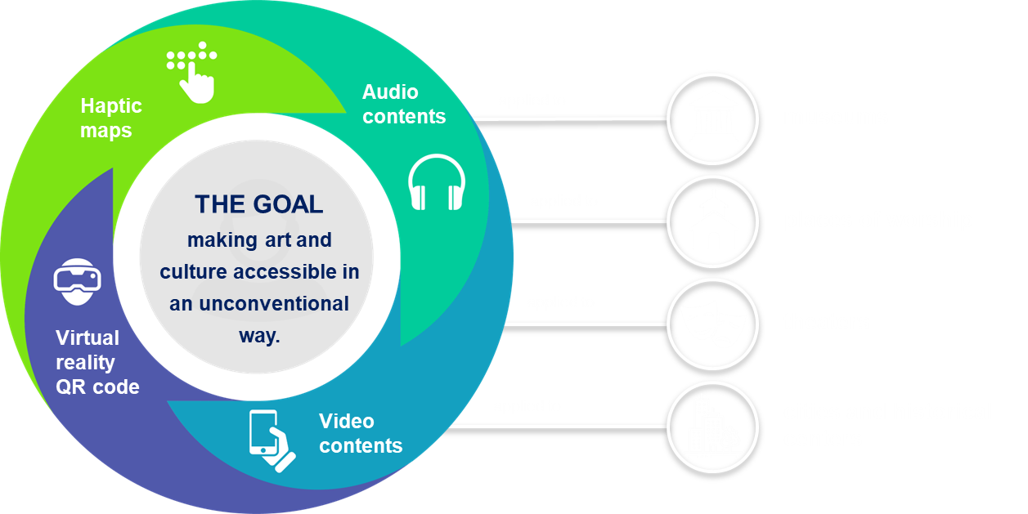
The Rotary Club’s CulturALL Initiative
Notes:
Benjy

Slide 3
CulturALL’s Long Term Vision
Notes:
Benjy

Slide 4
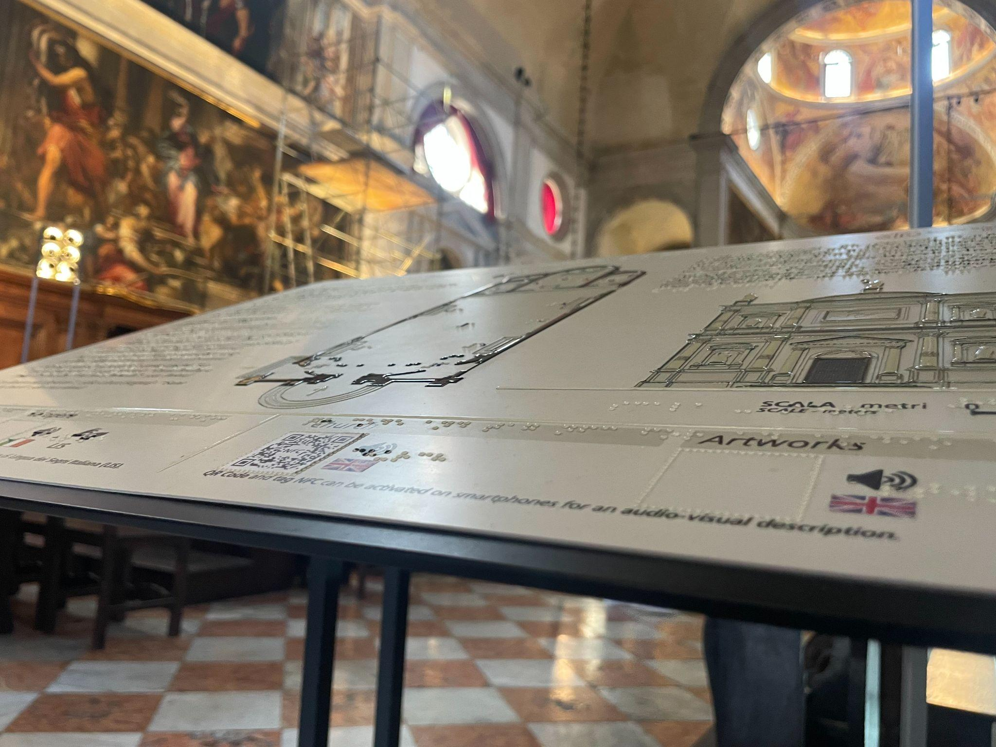
Multisensory Panels
Notes:
Brian

Slide 5
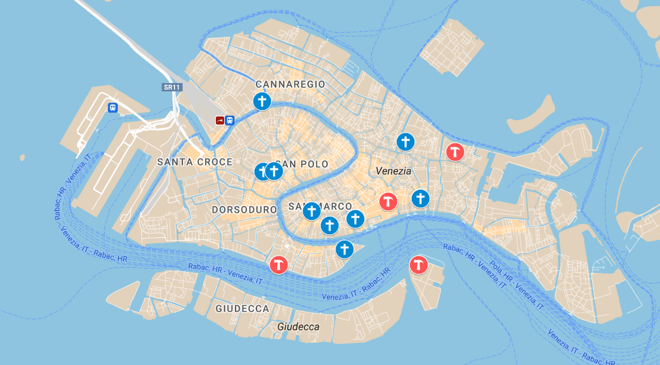
Where are the panels installed?
Notes:
Brian

Slide 6
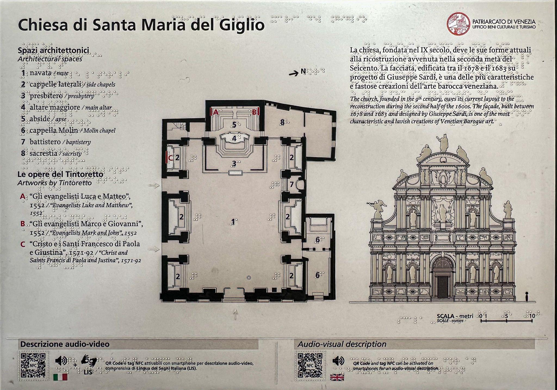
What is a Multisensory Panel?
Notes:
Brian

Slide 7
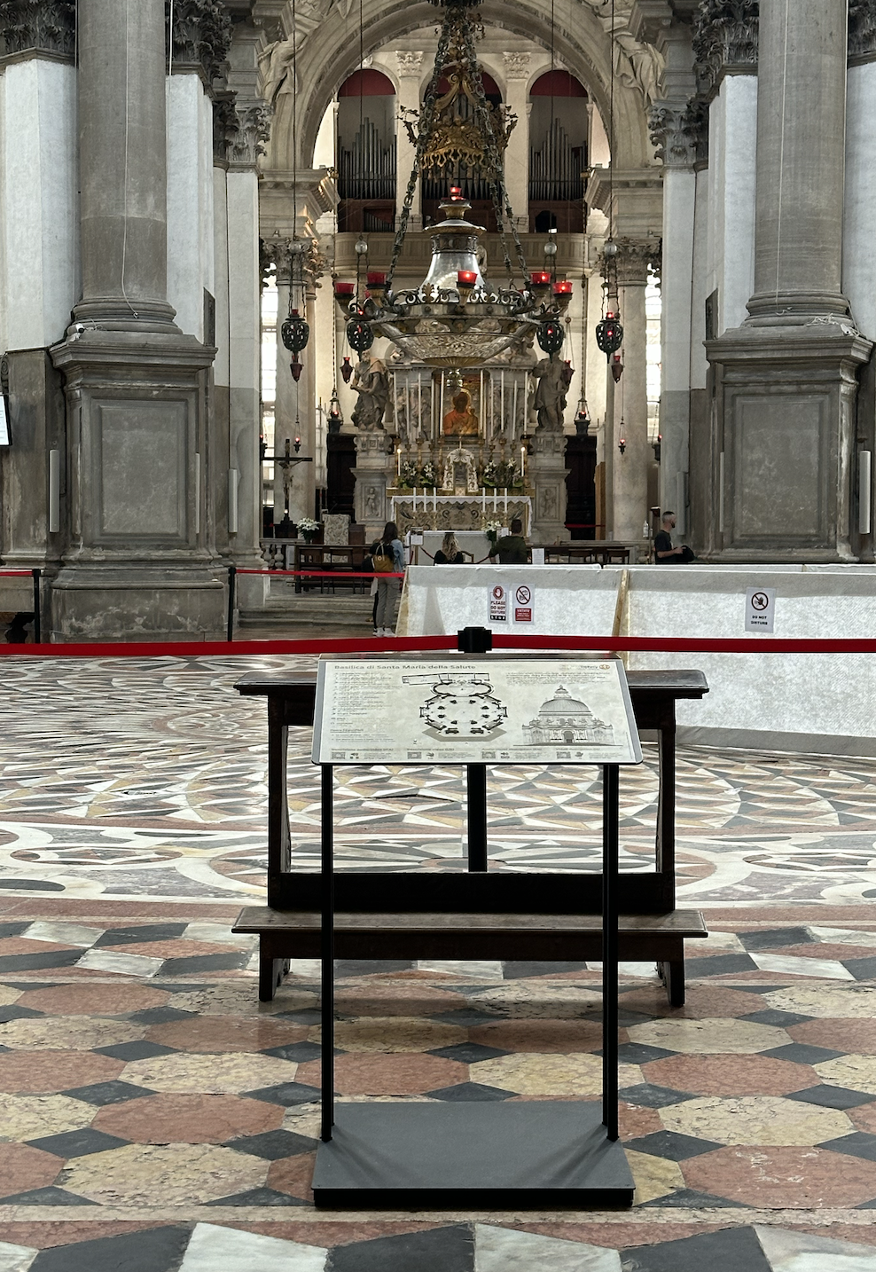
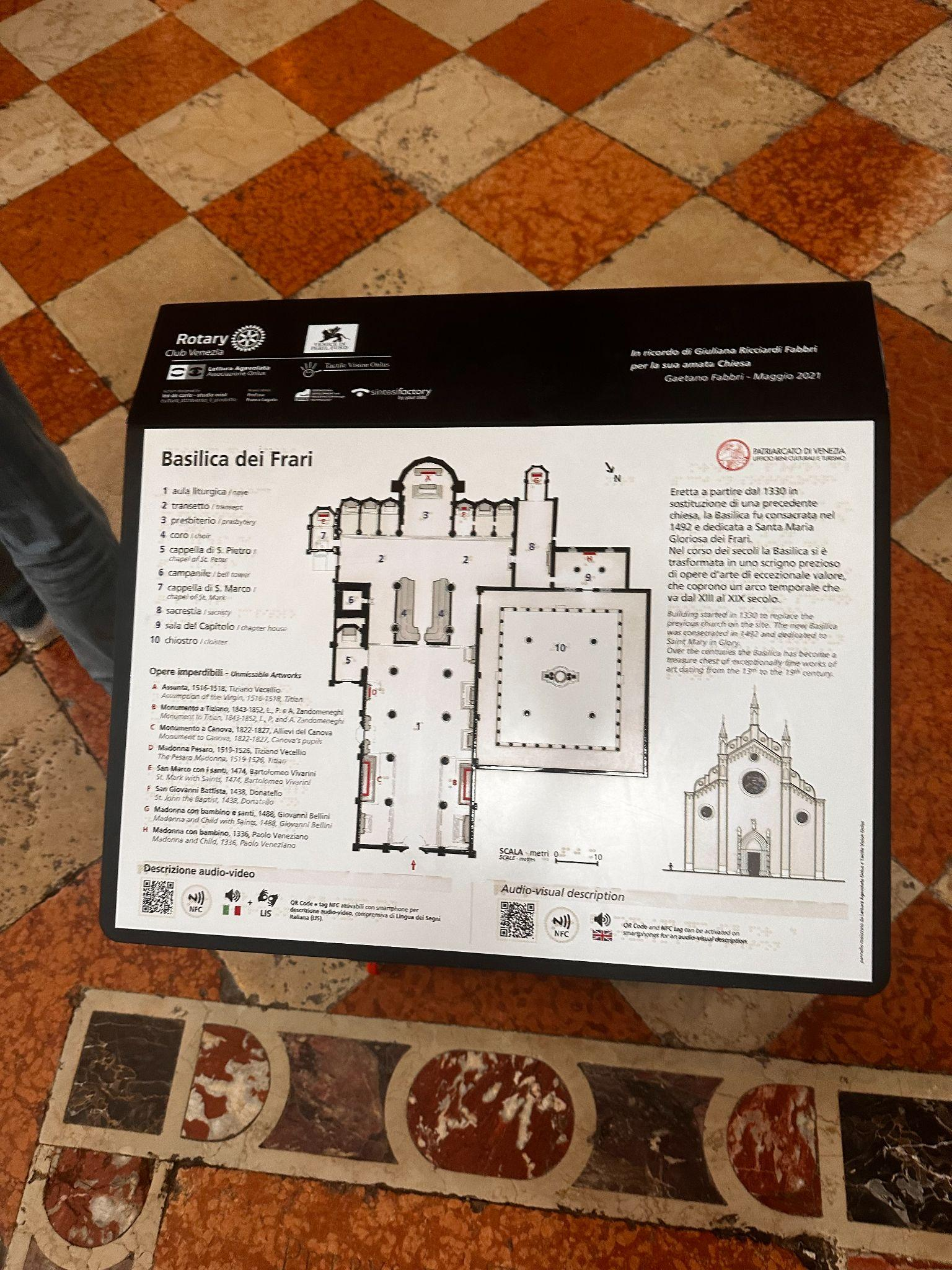
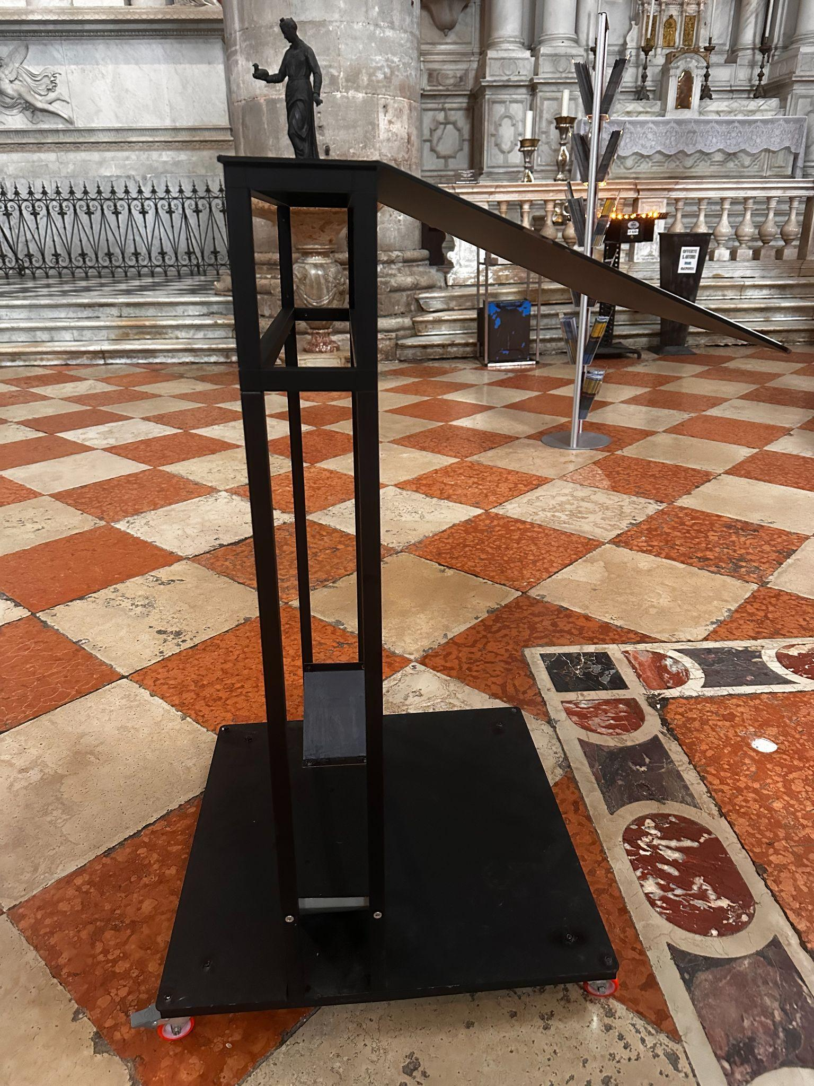
What Does it Look Like in a Church?
Notes:
Brian

Slide 8
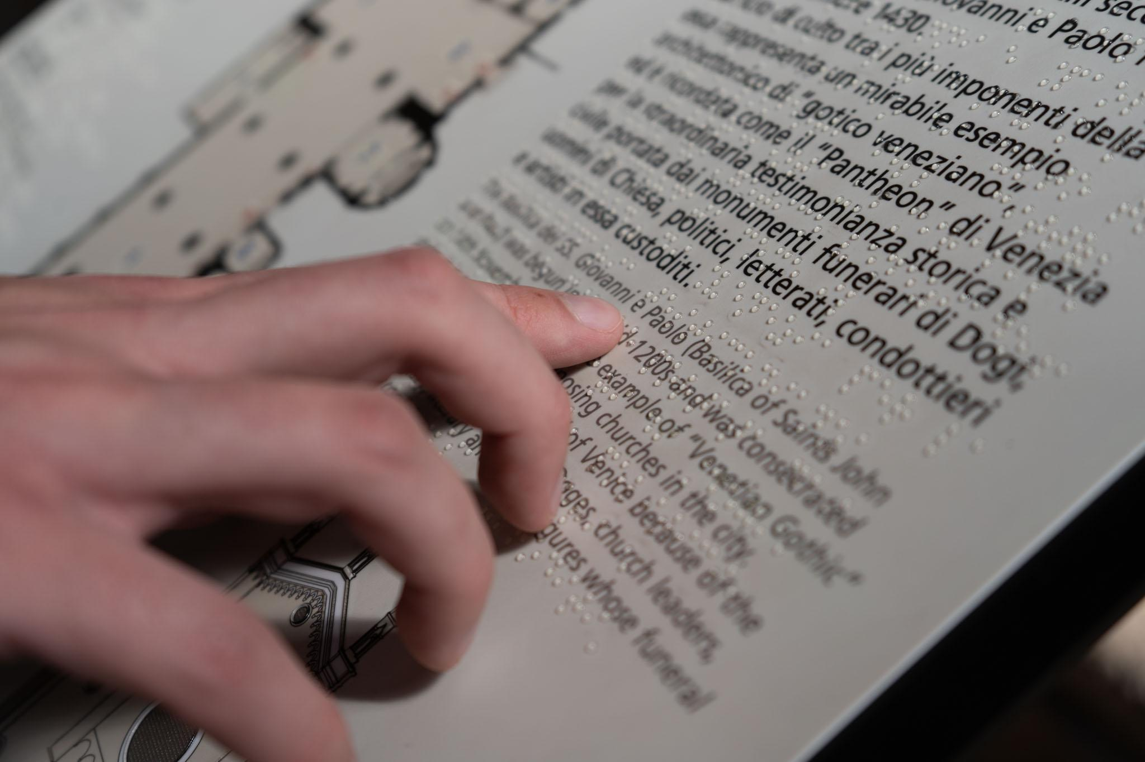
Where Can CulturALL Improve?
Lack of Usage Data
Condition of Installations
Digital Impact
Notes:
Brett

Slide 9
To further the CulturALL initiative of Venice’s Rotary Club by recommending improvements for existing and future multisensory panel installations and providing greater access to the information the panels present.
Project Goal
Notes:
Brett

Slide 10
CulturALL will be furthered by:
Recommending improvements to past and present multisensory panel installations.
Providing greater access to the information on the multisensory panels.
Project Goal
Notes:
Brett

Slide 11
CulturALL will be furthered by:
Recommending improvements to past and present multisensory panel installations.
Providing greater access to the information on the multisensory panels.
Project Goal
Notes:
Brett

Slide 12
Recommending Improvements
Usage
Cleanliness
Structure
Notes:
Brett

Slide 13
Recommending Improvements
Usage
Cleanliness
Structure
Notes:
Brian

Slide 14
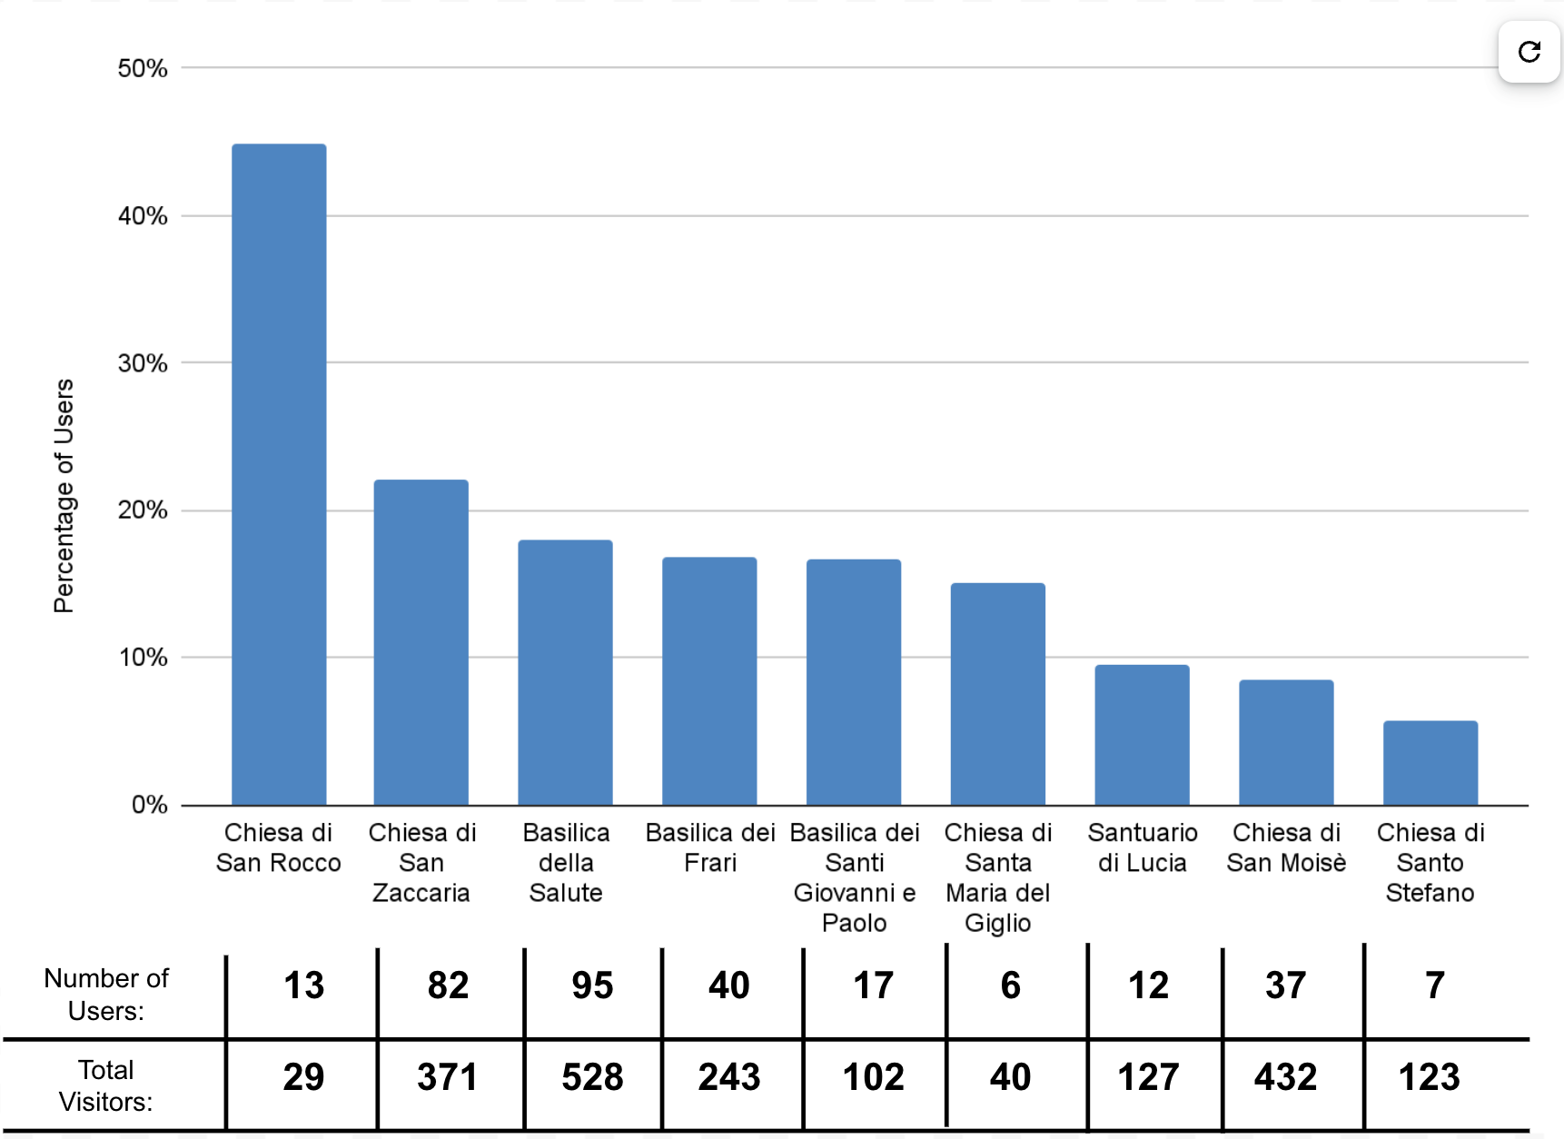
On Average 18% Of Visitors Interacted With The Panel.
Notes:
Brian

Slide 15
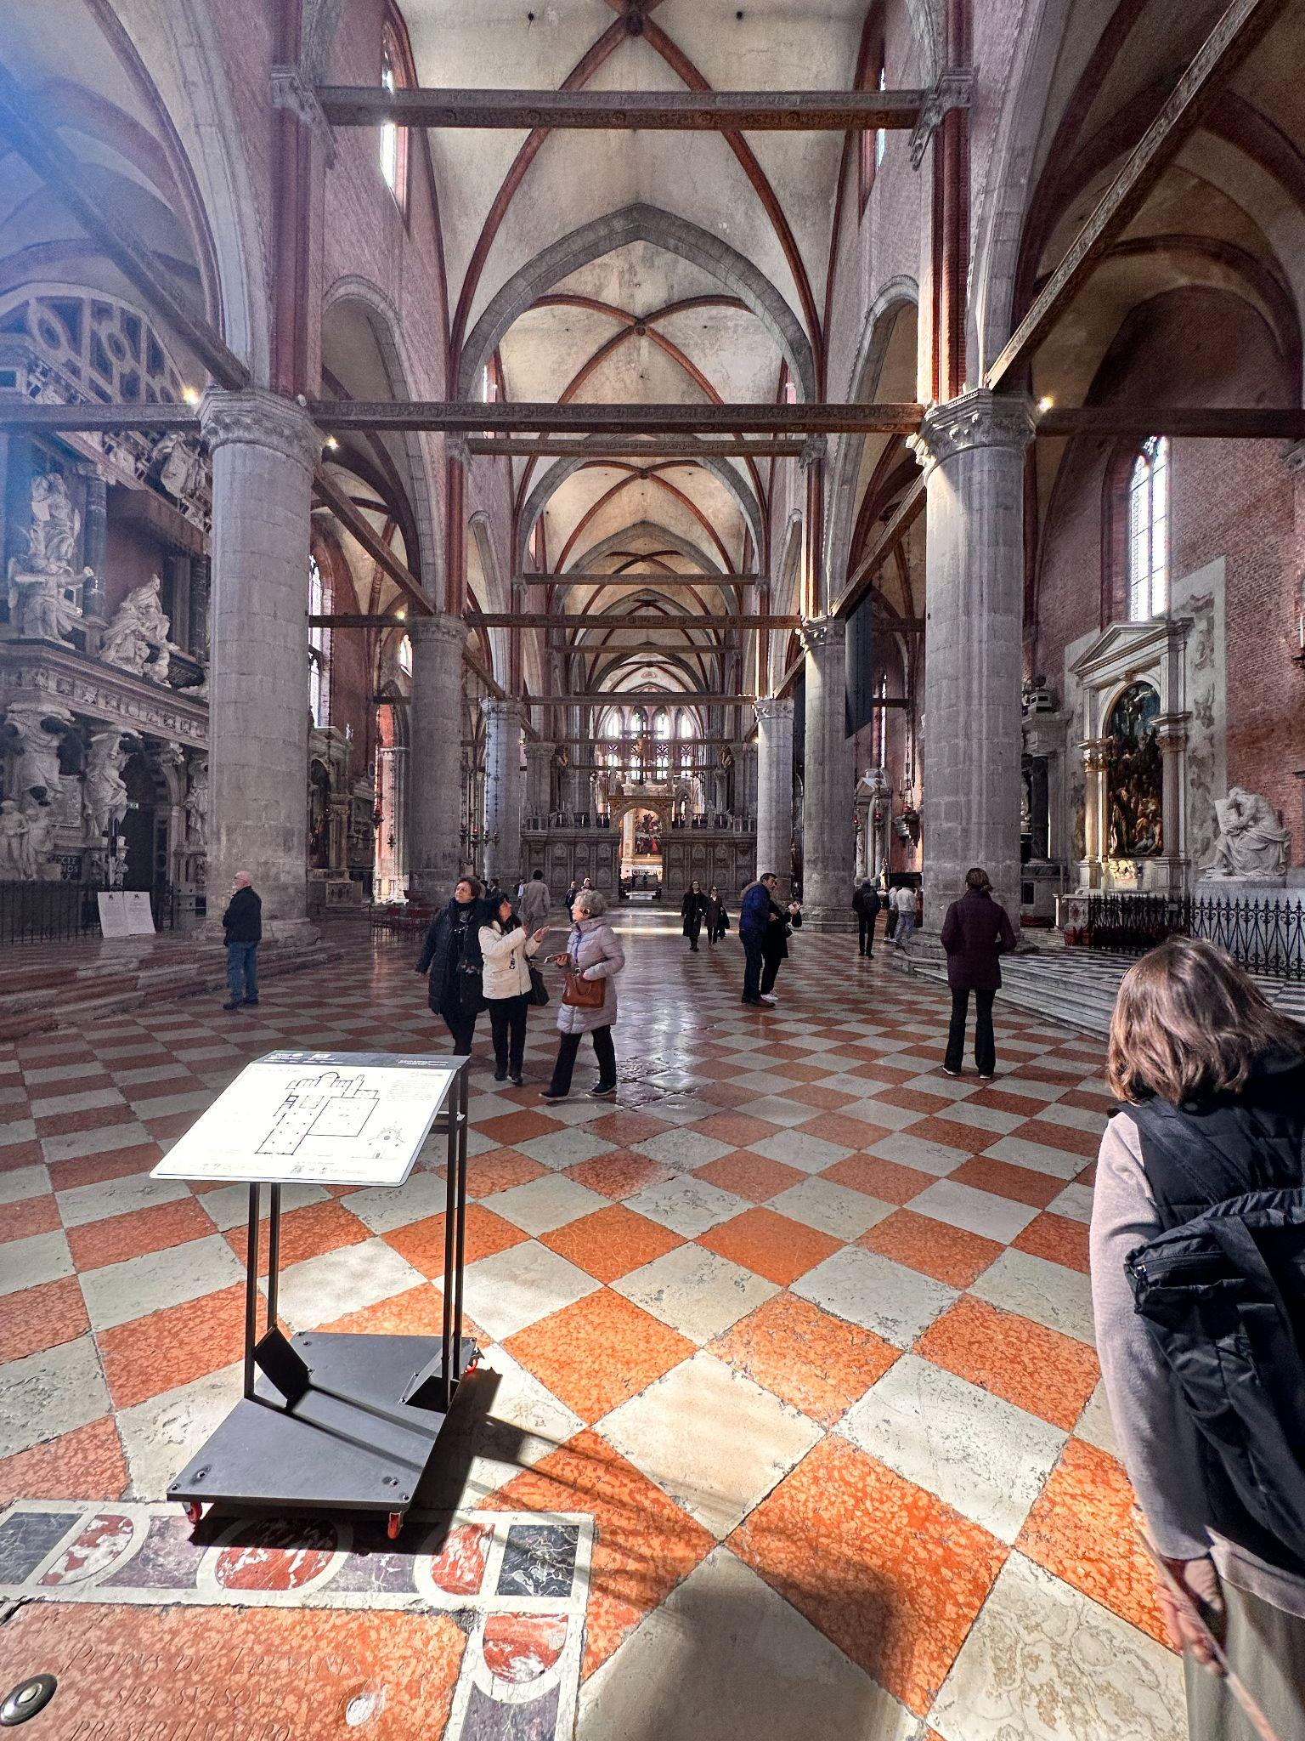
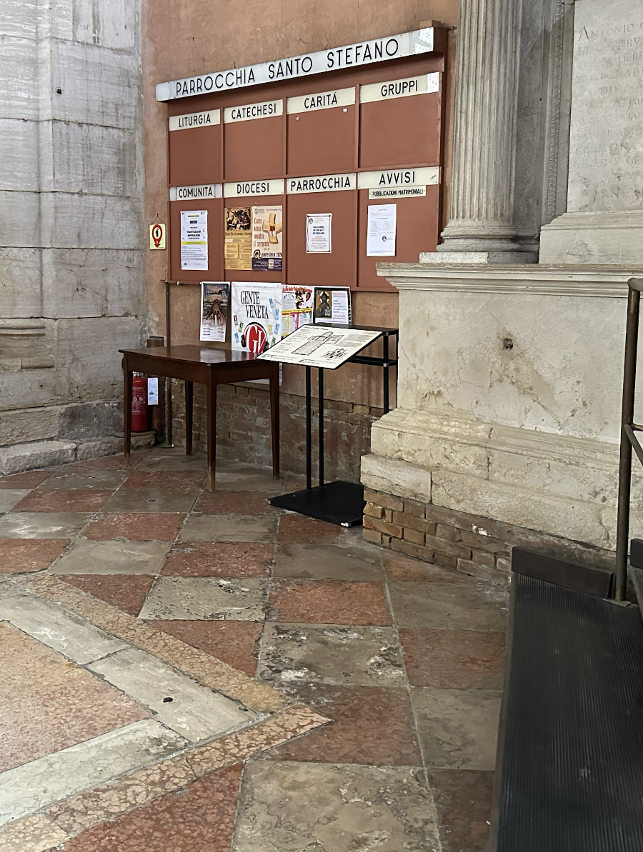
Location Matters as a Predictor of Use
Basilica dei Frari
17% of visitors used the panel.
35% of users interacted with the tactile features.
Chiesa di Santo Stefano
6% of visitors used the panel.
14% of users interacted with the tactile features.
Notes:
Brian

Slide 16
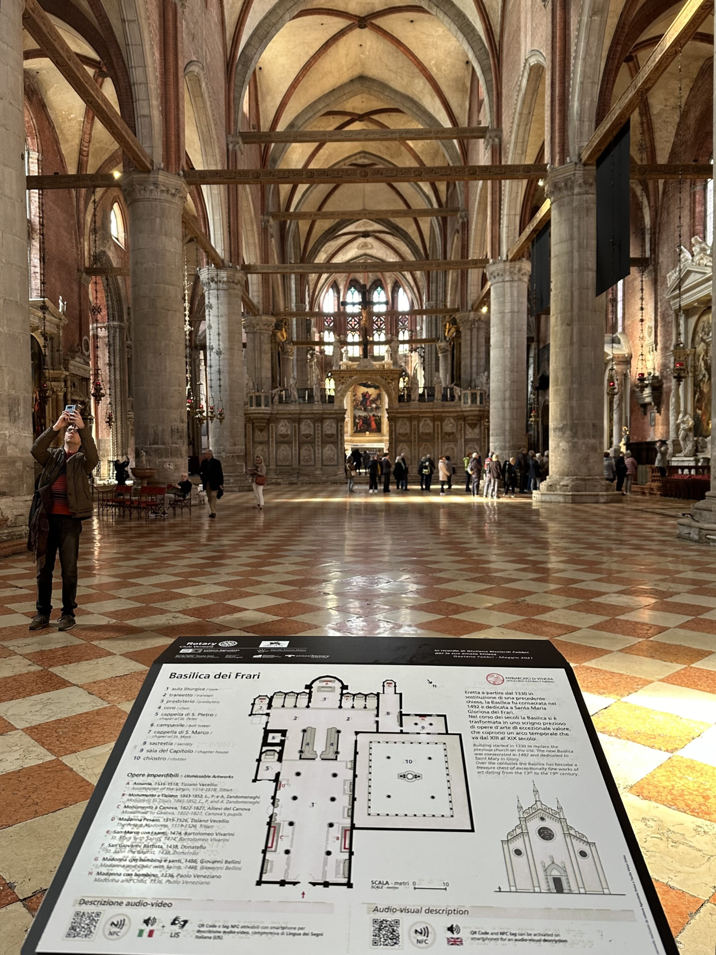
Ensure the Panel is in a Prominent Location
Lectern should be centered if possible.
Installation should be located on main path.
Middle Ground
Location of lectern should be marked on map.
Basilica dei Frari
Notes:
Brian

Slide 17
Recommending Improvements
Usage
Cleanliness
Structure
Notes:
Brett

Slide 18
Recommending Improvements
Usage
Cleanliness
Structure
Notes:
Brett

Slide 19
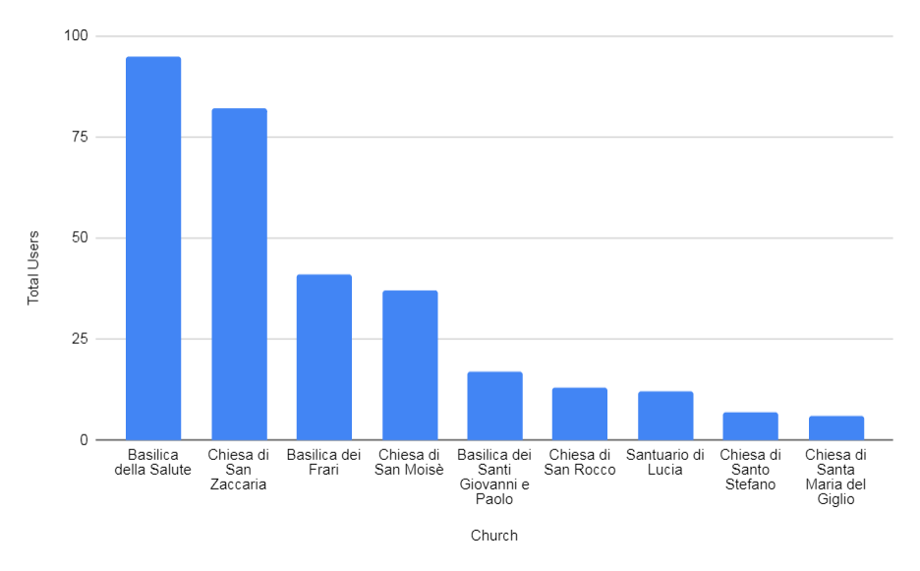
Higher Use Correlates with Dirtiness.

Slide 20
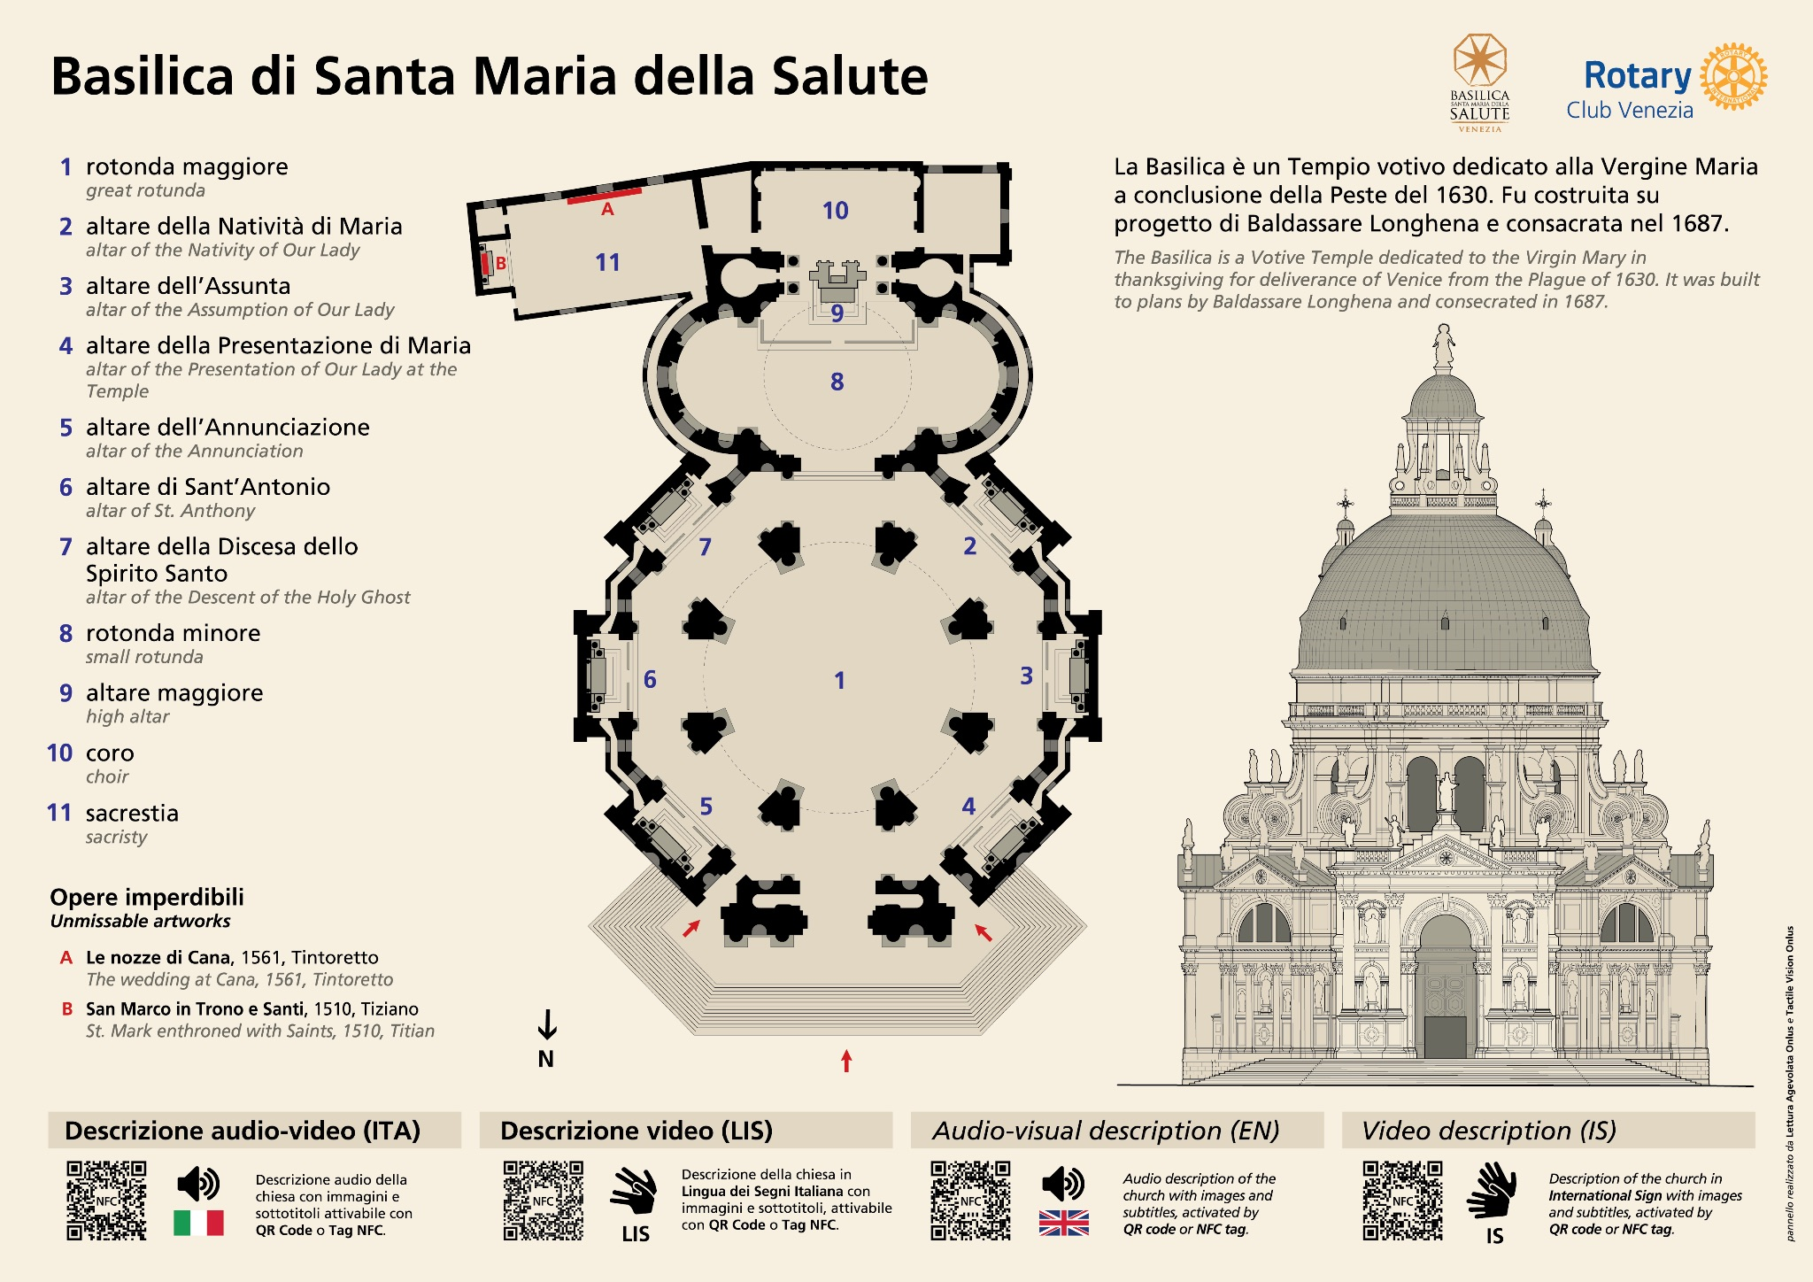
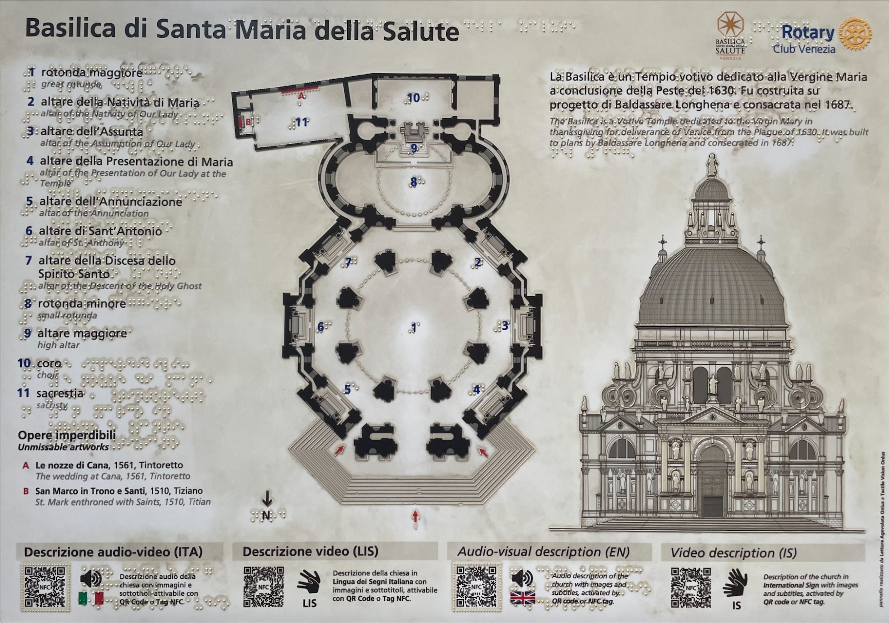
Majority of Panels are Falling into Disrepair.
2022
2024
Notes:
Brett

Slide 21
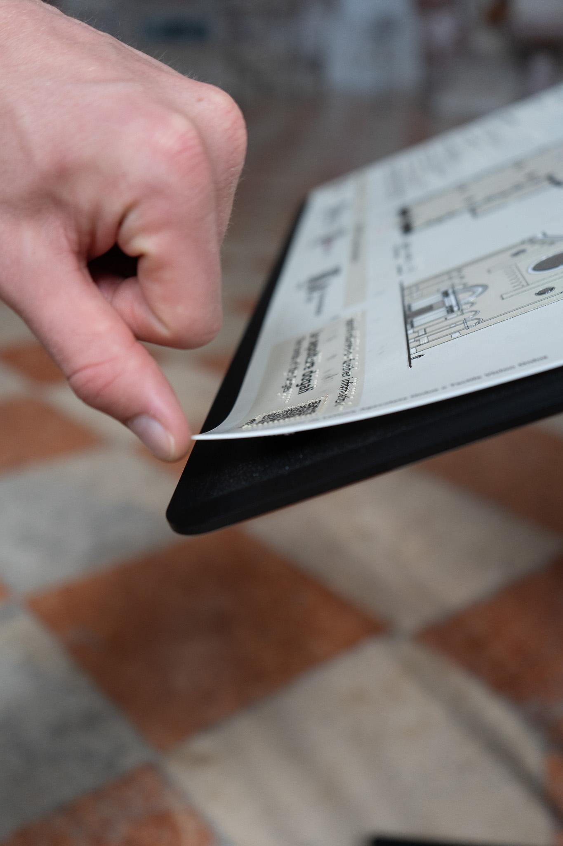
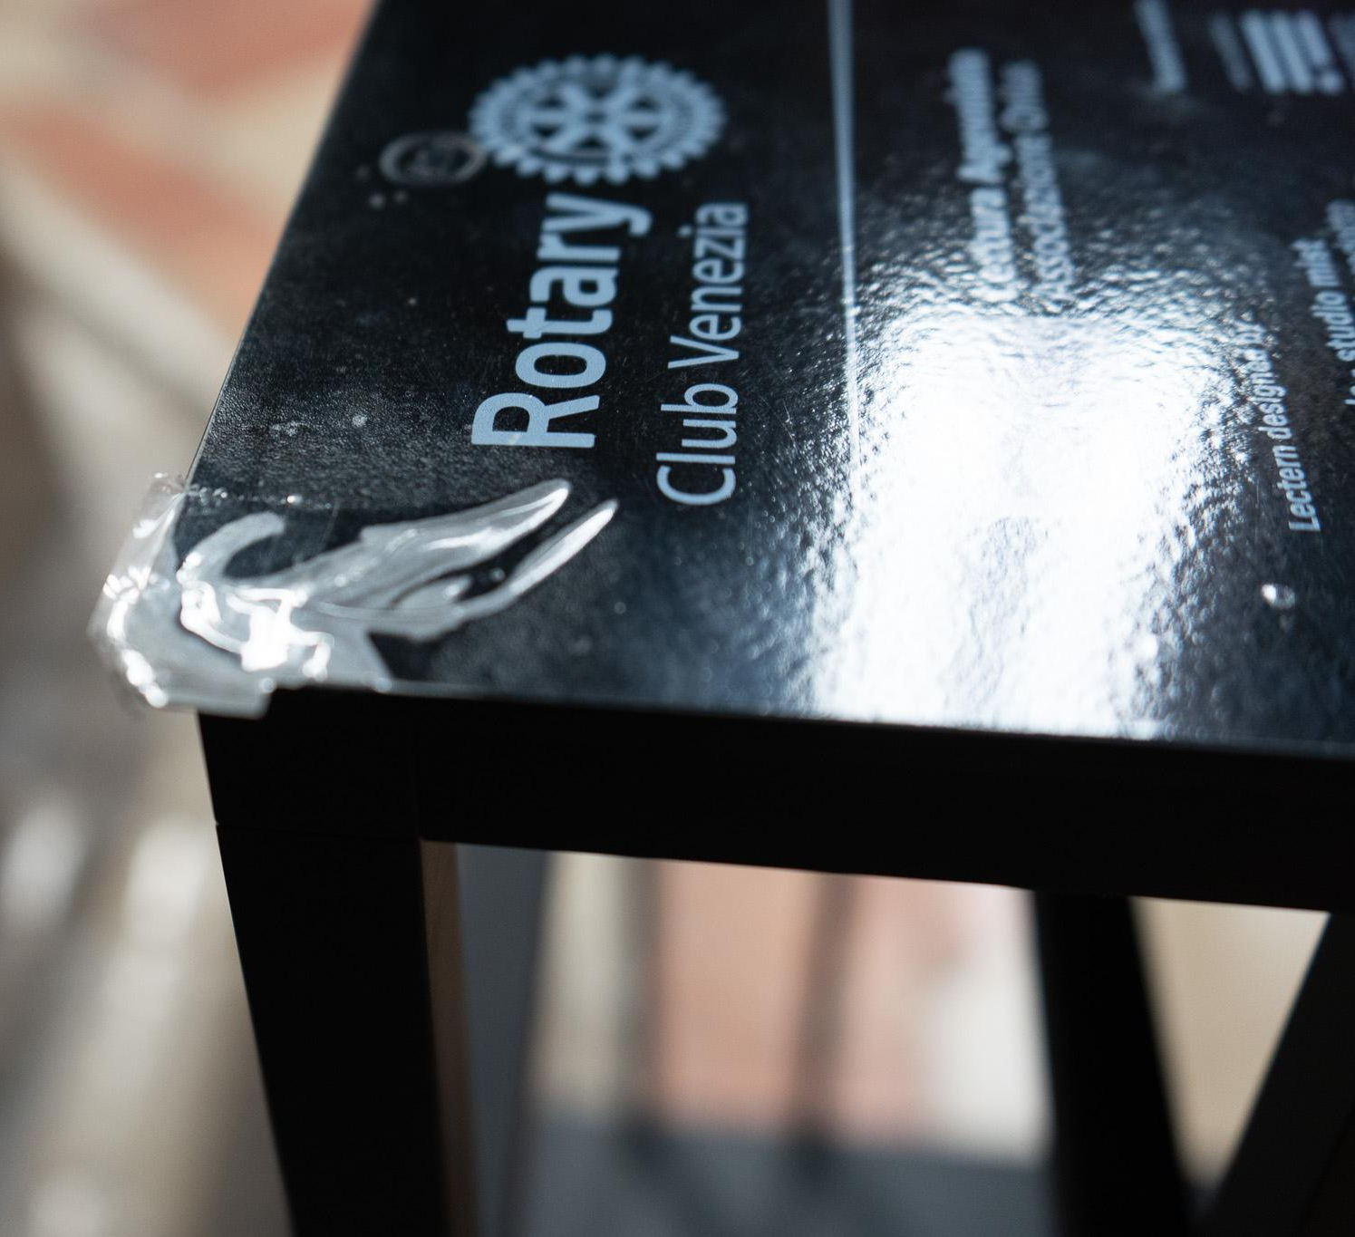
Adhesion is Weak on Several Panels.
Basilica dei Santi Giovanni e Paolo
Notes:
Brett

Slide 22
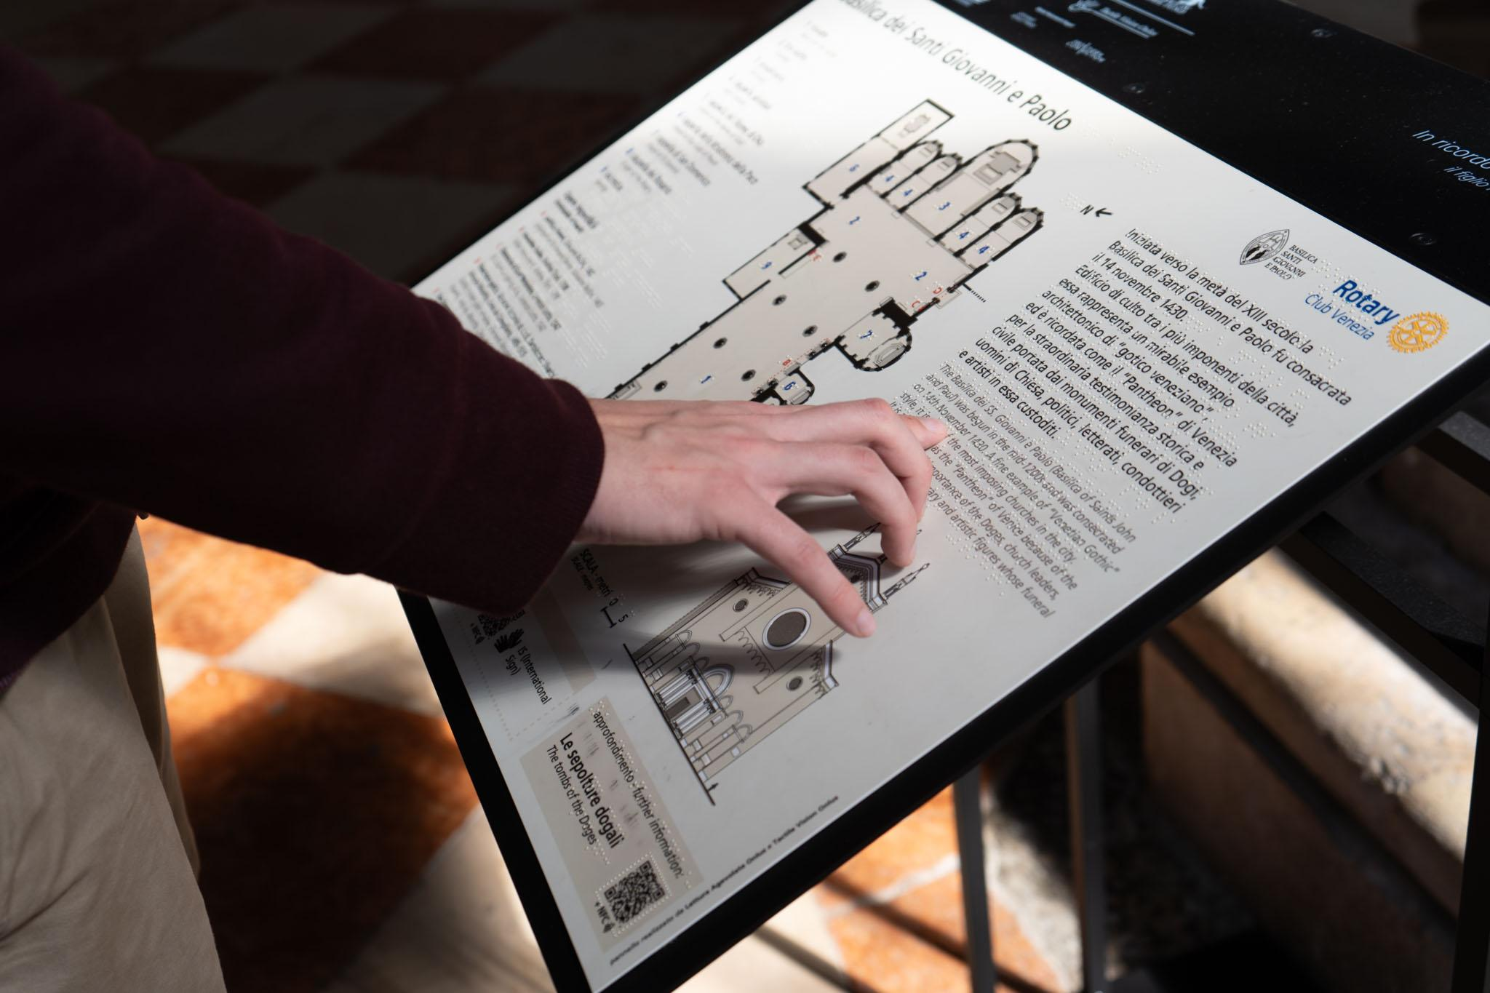
Instate a Cleaning and Maintenance Plan.
Wiped down consistently for disinfection
Spray plastic cleaner wiped with soft cloth
Middle Ground
Consider Repairing/Reinstallation
Notes:
Jake

Slide 23
Recommending Improvements
Usage
Cleanliness
Structure
Notes:
Benjy

Slide 24
Recommending Improvements
Usage
Cleanliness
Structure
Notes:
Benjy

Slide 25
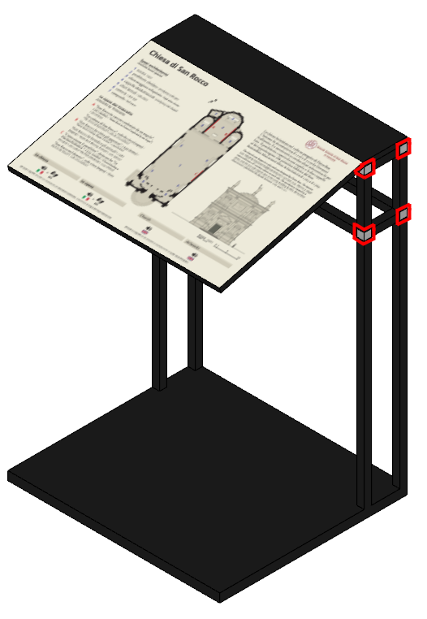
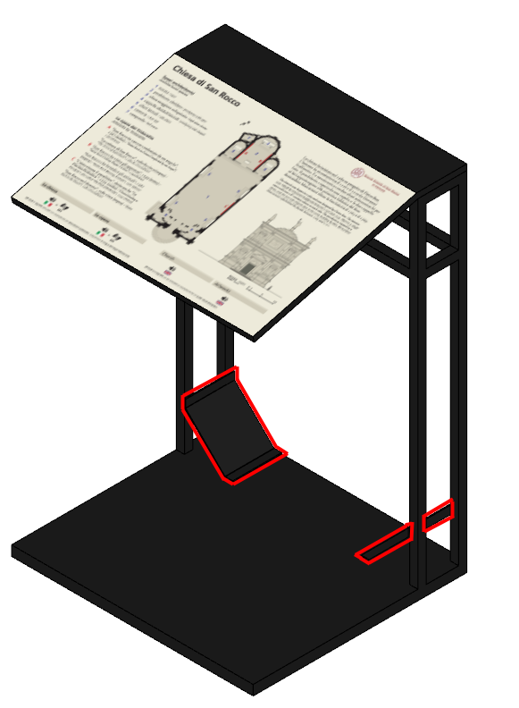
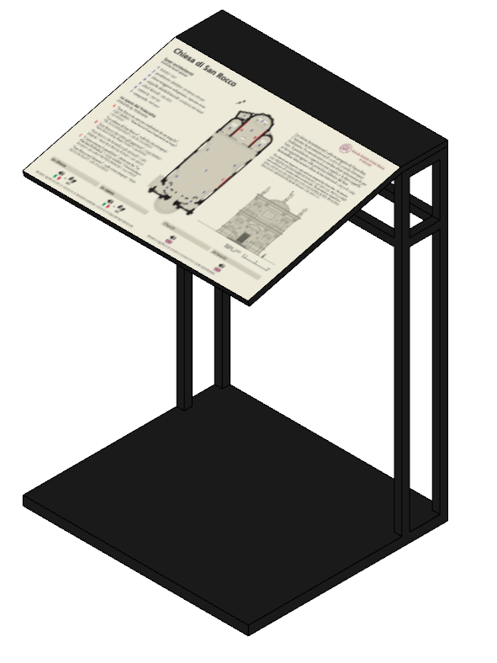
There are Three Types of Structure for the Lectern.
Design 1
Design 2
Design 3
Notes:
Benjy

Slide 26
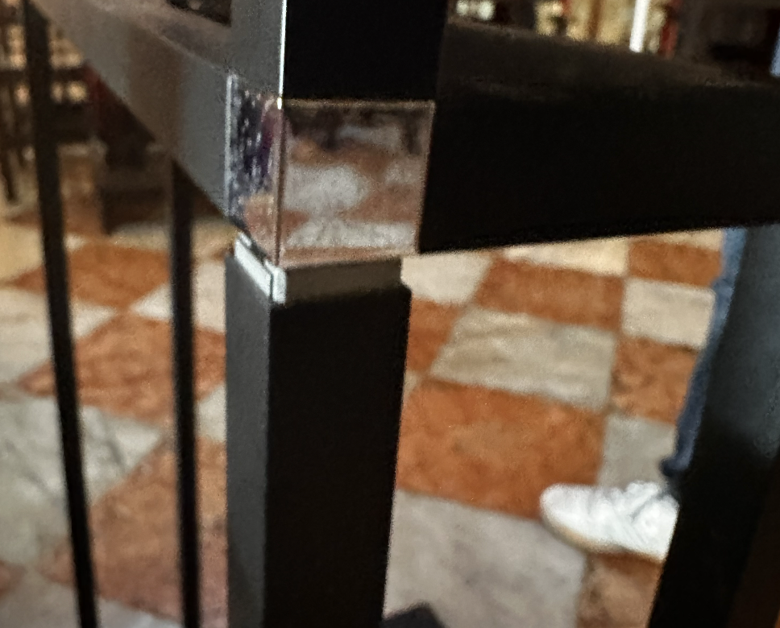
Design 1 Can Resist Sway, But…
Design 1
Chiesa di San Rocco
Notes:
Benjy

Slide 27
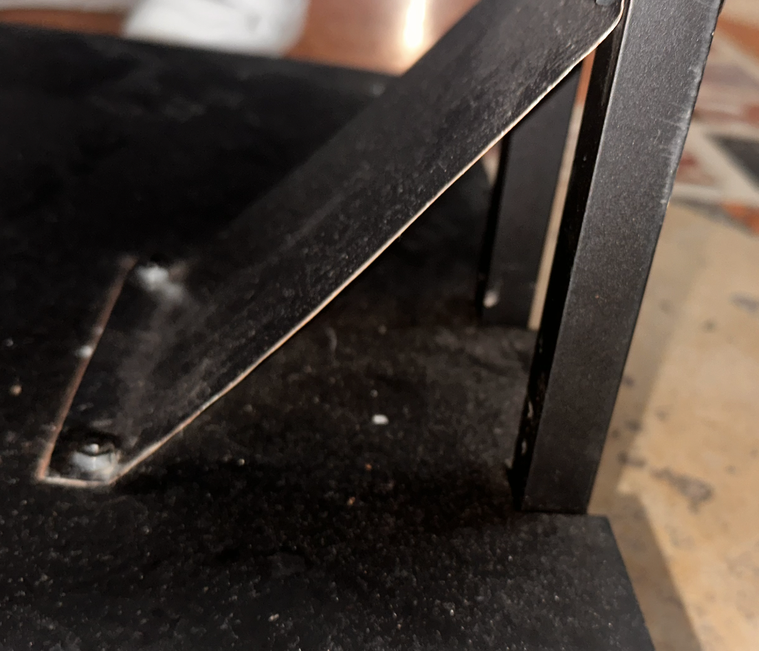
Reinforcement on Design 2 is Essential to Resist Sway.
Design 2
Design 3
Basilica dei Frari
Notes:
Benjy

Slide 28
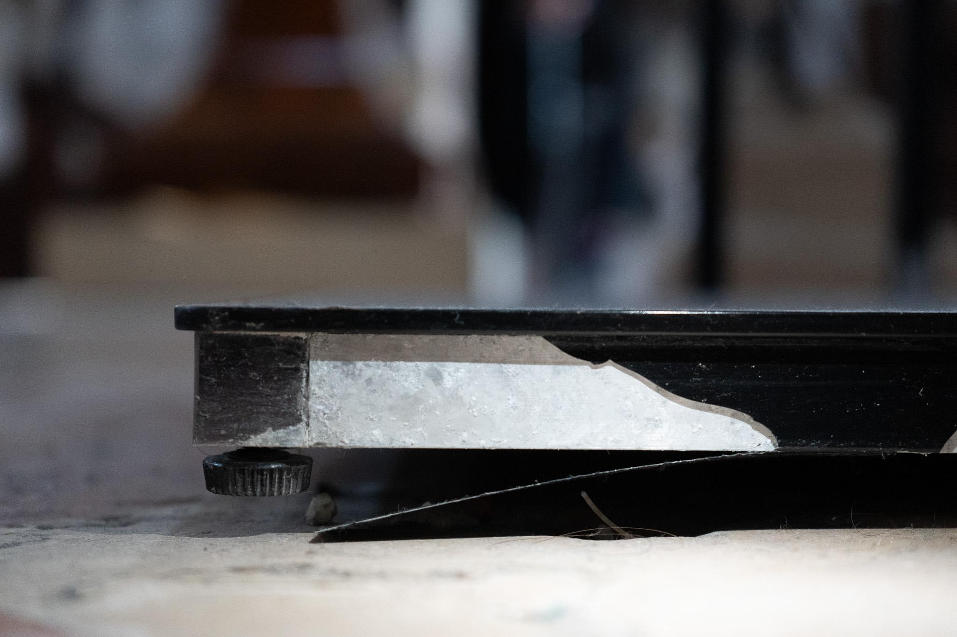
All Lecterns Are Subject to Base Degradation.
Lack of resistance to forward and backward motion causes base to warp.
Chiesa di San Moisè
Notes:
Benjy

Slide 29
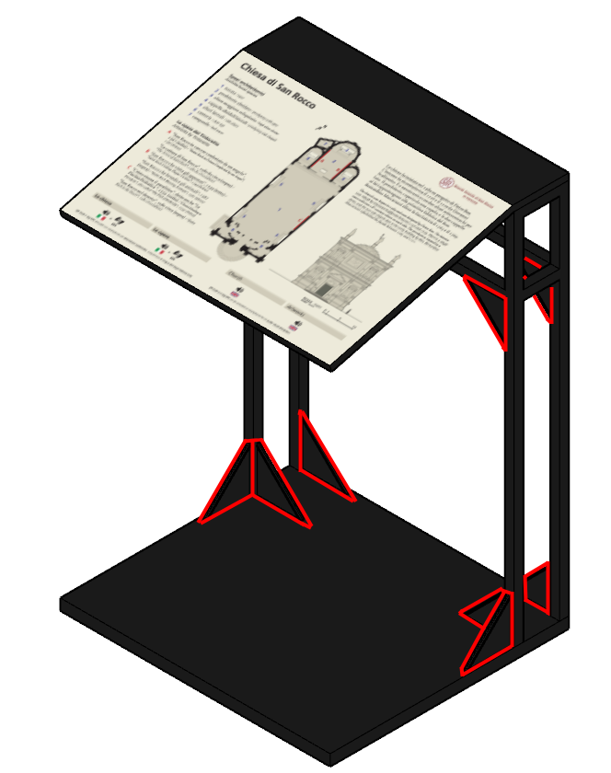
Reinforce Lectern Structure (Short Term)
Lectern Retrofit
Aluminum Gusset Plates
Welded to existing structure
Applied to corners for stabilization
Reinforces directly with base
Balances strength with architectural vision of “invisibility.”
Notes:
Benjy

Slide 30
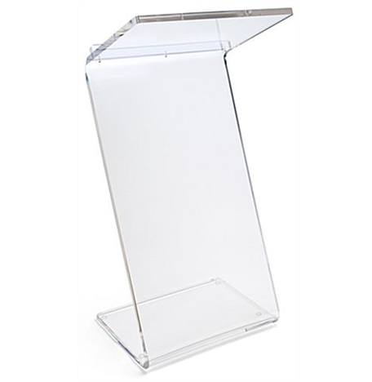
Replace Lectern Structure (Long Term)
New Lectern
Plastic-based replacement
Rust-resistant
Lightweight
Enhances original architectural vision of invisibility.
Notes:
Benjy

Slide 31
CulturALL will be furthered by:
Recommending improvements to past and present multisensory panel installations.
Providing greater access to the information on the multisensory panels.
Project Goal
Notes:
Jake

Slide 32
CulturALL will be furthered by:
Recommending improvements to past and present multisensory panel installations.
Providing greater access to the information on the multisensory panels.
Project Goal
Notes:
Jake

Slide 33
Rotary Club of Venice
How can we make the website easily maintainable?
Create Website
Who are the stakeholders?
Develop Design
Criteria
Users
How can we make the information accessible to all?
Notes:
Brett

Slide 34
The Website:
A Library of Information
1. Digitize
RCV’s Multisensory Panels
2. Inspire
other organizations
3. Uphold
accessibility guidelines
Notes:
Jake

Slide 35
The
Website
Notes:
Jake

Slide 36
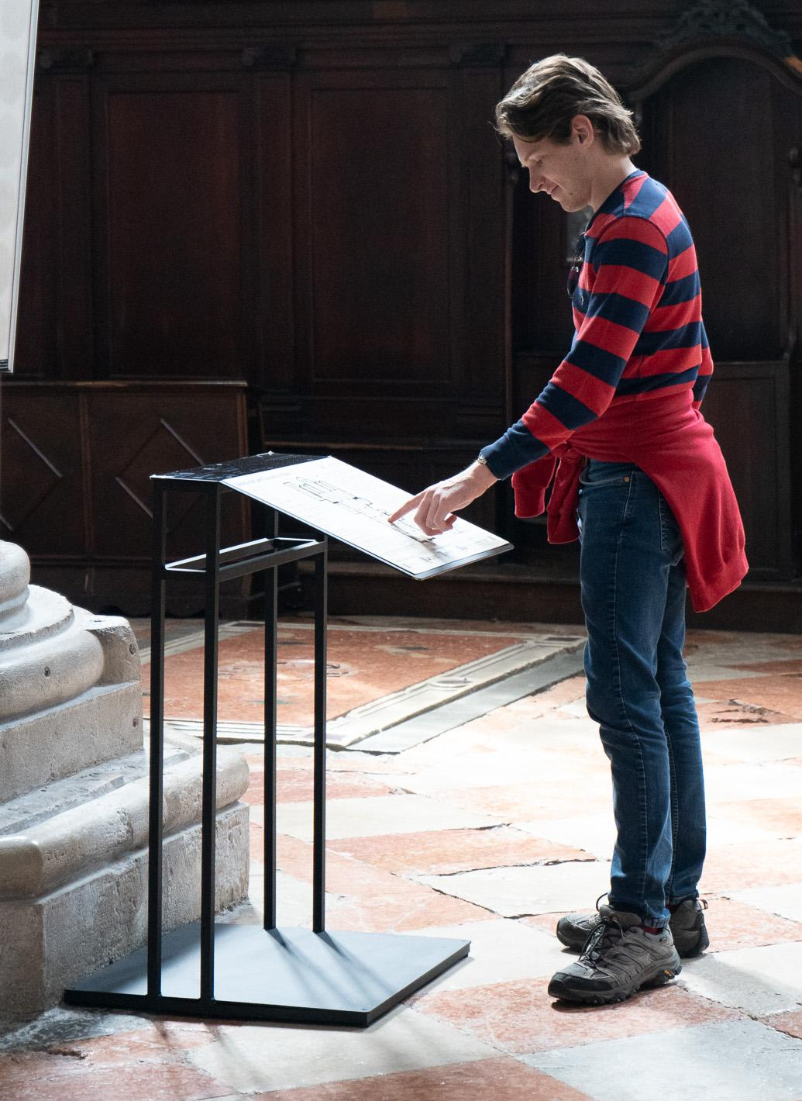
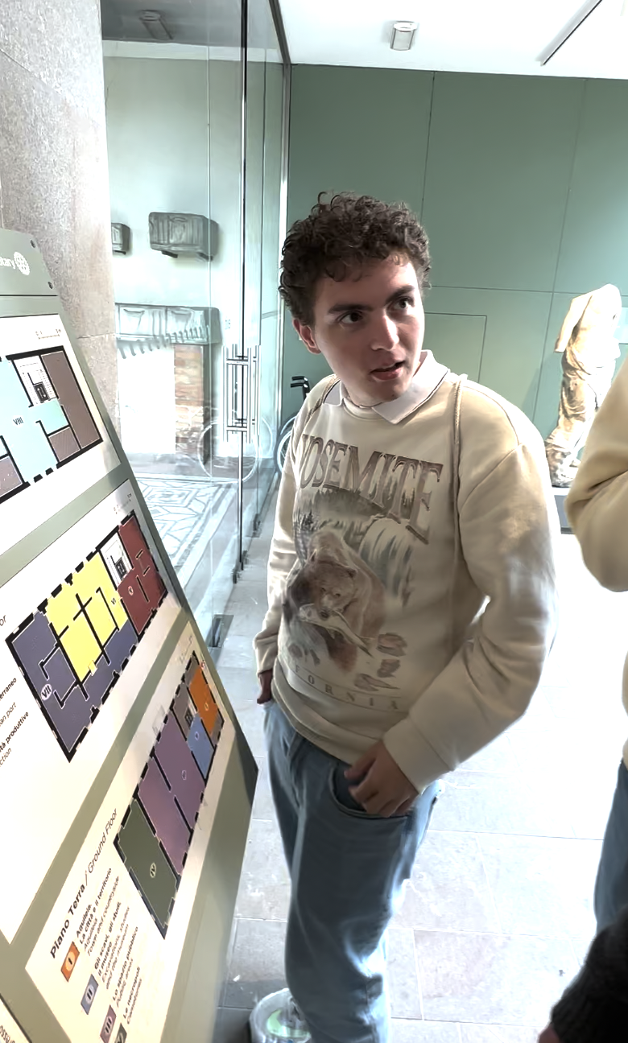
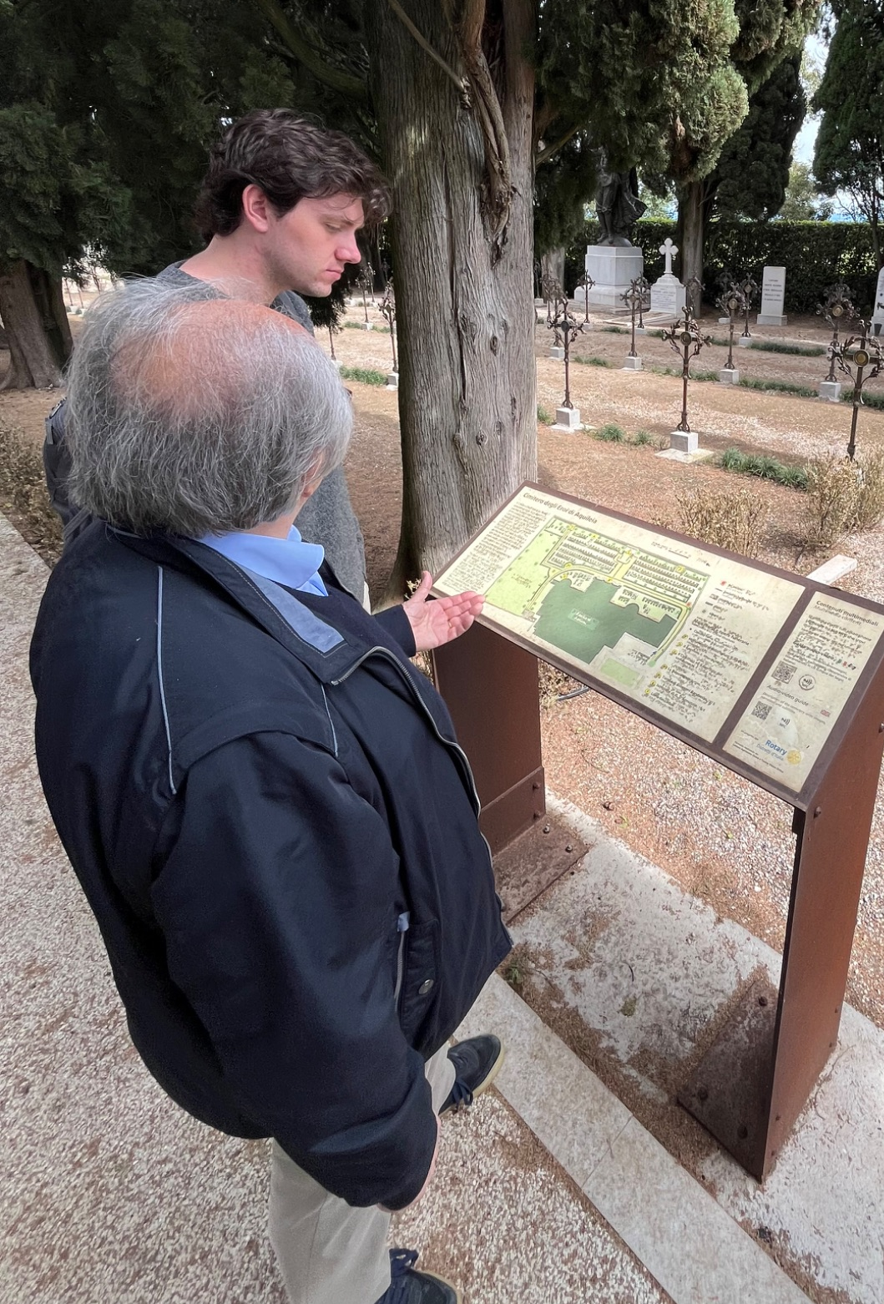
Final Takeaways

Slide 37
Thank you to:
The Rotary Club of Venice
Elisabetta Fabbri
Fabio Carrera
Raffaele Caltabiano
Leonardo De Carlo
Lettura Agevolata/Tactile Vision Onlus
SerenDPT
Chrys Demetry and Rick Vaz
Notes:
Brett

Slide 38
Thank you!

