Slide 1
SME Sustainability Guide
Lily Beals
Edward Dang
Nick DeMasi
John Michienzi

Slide 2
Worcester Polytechnic Institute
Project-based learning is a main focus at WPI. Our Interactive Qualifying Project (IQP) counts towards our undergraduate graduation requirement.

Slide 3
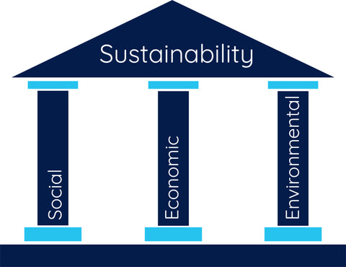
Our Project
Goal: to create a guide for the CICR that helps Costa Rican SMEs increase their environmental, social, and economic sustainability

Slide 4
Objectives
Categorize CICR’s SME Affiliates to Aid in Data Analysis
1
Learn How Businesses Develop Profitable Sustainability
2
Analyze Profitable Sustainability Practices to Define Common Trends
3
Develop the Sustainability Guide
4

Slide 5
Objective 1: Categorize CICR’s Business Affiliates to Aid in Data Analysis
Differentiate between companies of different sizes
Differentiate between companies in varying industries

Slide 6
Objective 2: Learn How Businesses Develop Profitable Sustainability

Slide 7
Objective 3: Analyze Profitable Sustainability Practices to Define Common Trends
Identify common profitable practices among companies
Determine trends among large companies that translate to small businesses

Slide 8
Objective 4: Develop the Sustainability Guide for SMEs
Supplement data with research
Map each common sustainable practice to its economic benefit

Slide 9
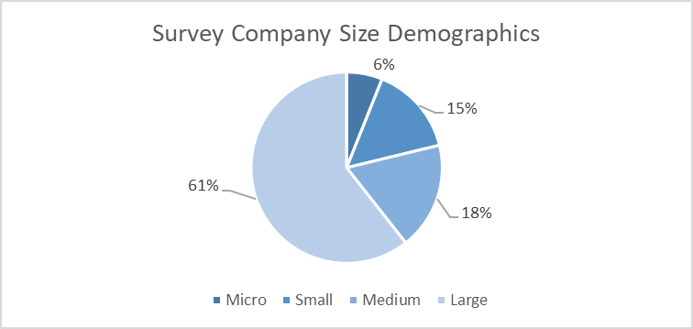
Survey Responses
n = 33 respondents

Slide 10
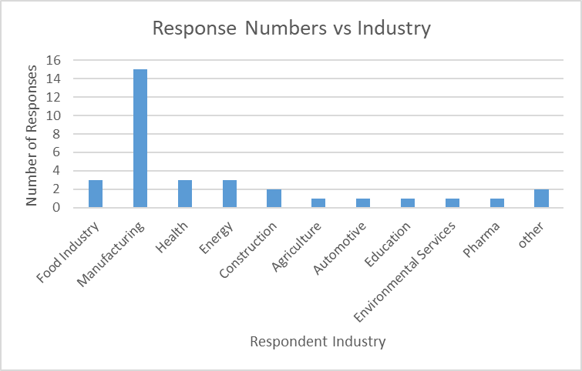
Industry Representation
n = 33 respondents

Slide 11
Findings

Slide 12
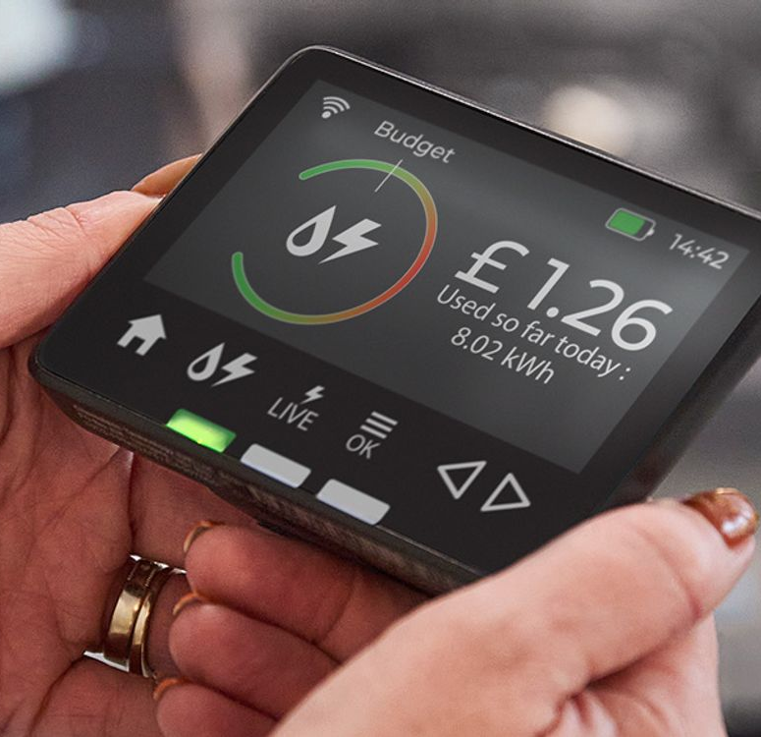
Monitoring energy and water consumption is an integral part of small business sustainability
85% of surveyed SMEs monitor energy consumption
77% of surveyed SMEs monitor water consumption
Notes:
Add smart meter image

Slide 13
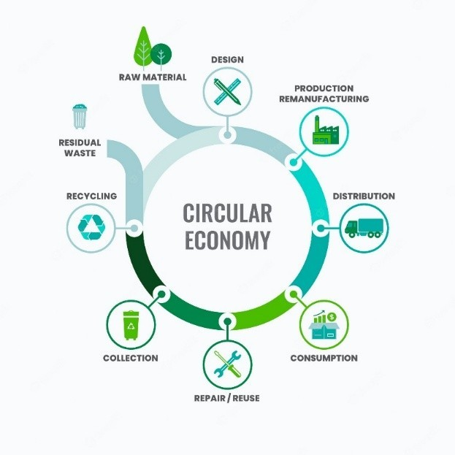
Participation in the circular economy helps SMEs reduce energy consumption
Notes:
Find better graphic (hume) melbourne fall 22 or 23

Slide 14
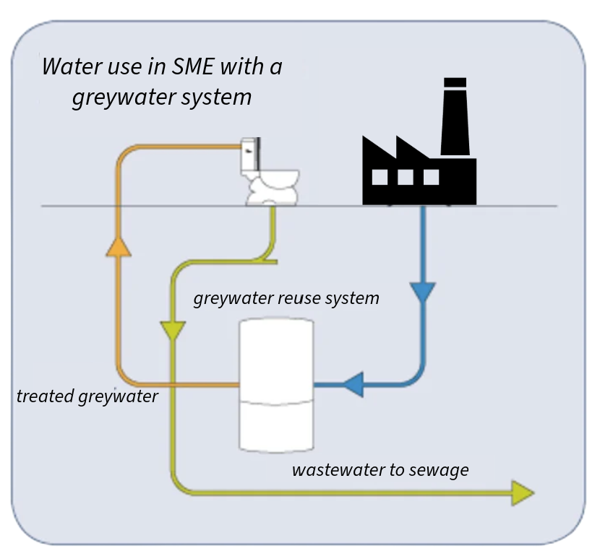
Repurposing water helps SMEs decrease water consumption
Notes:
Graywater uses

Slide 15
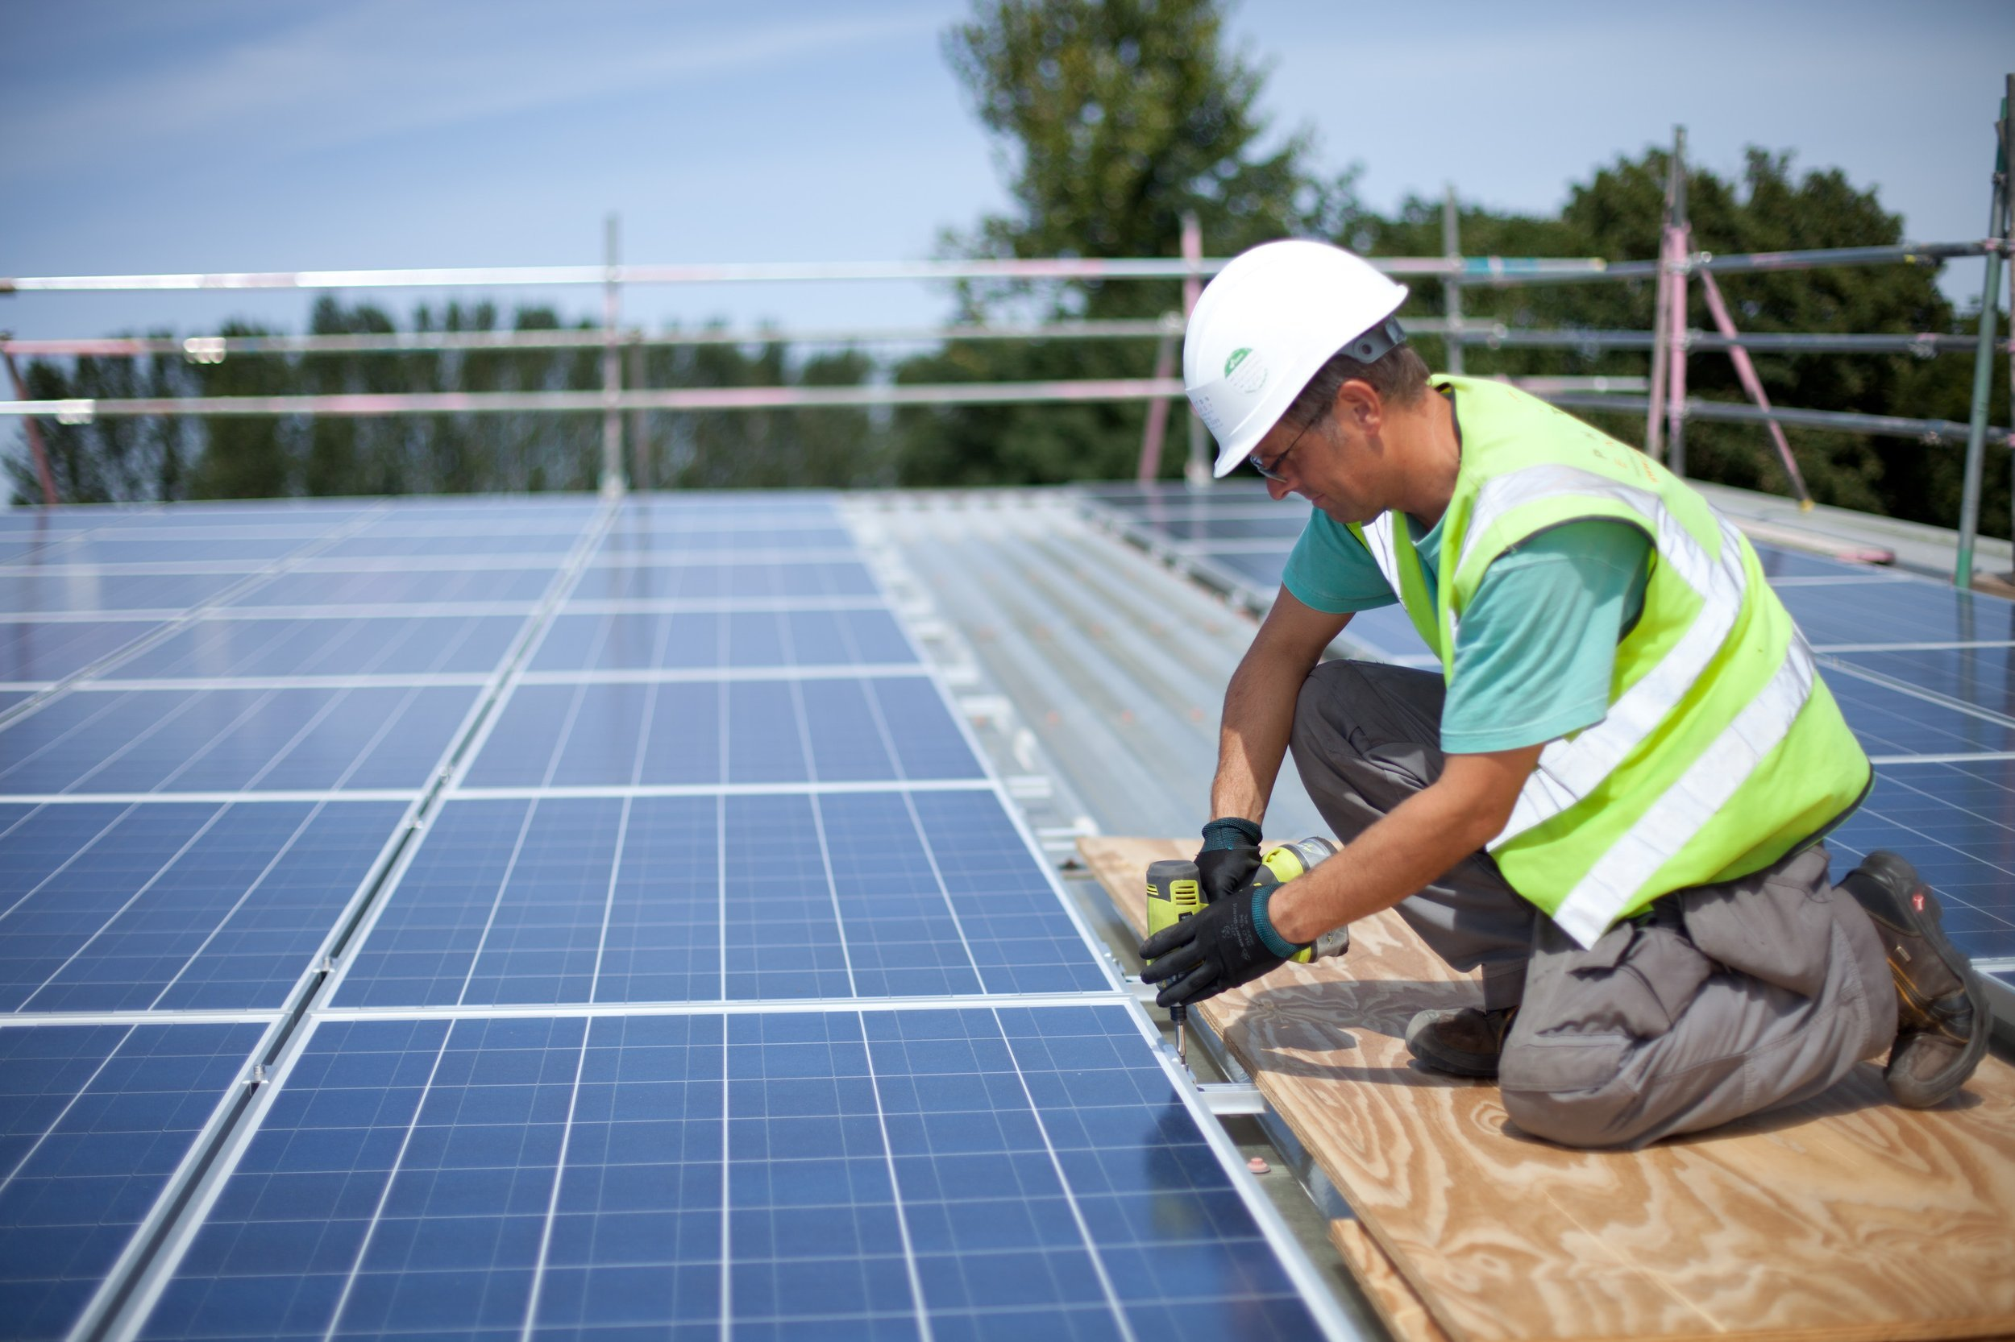
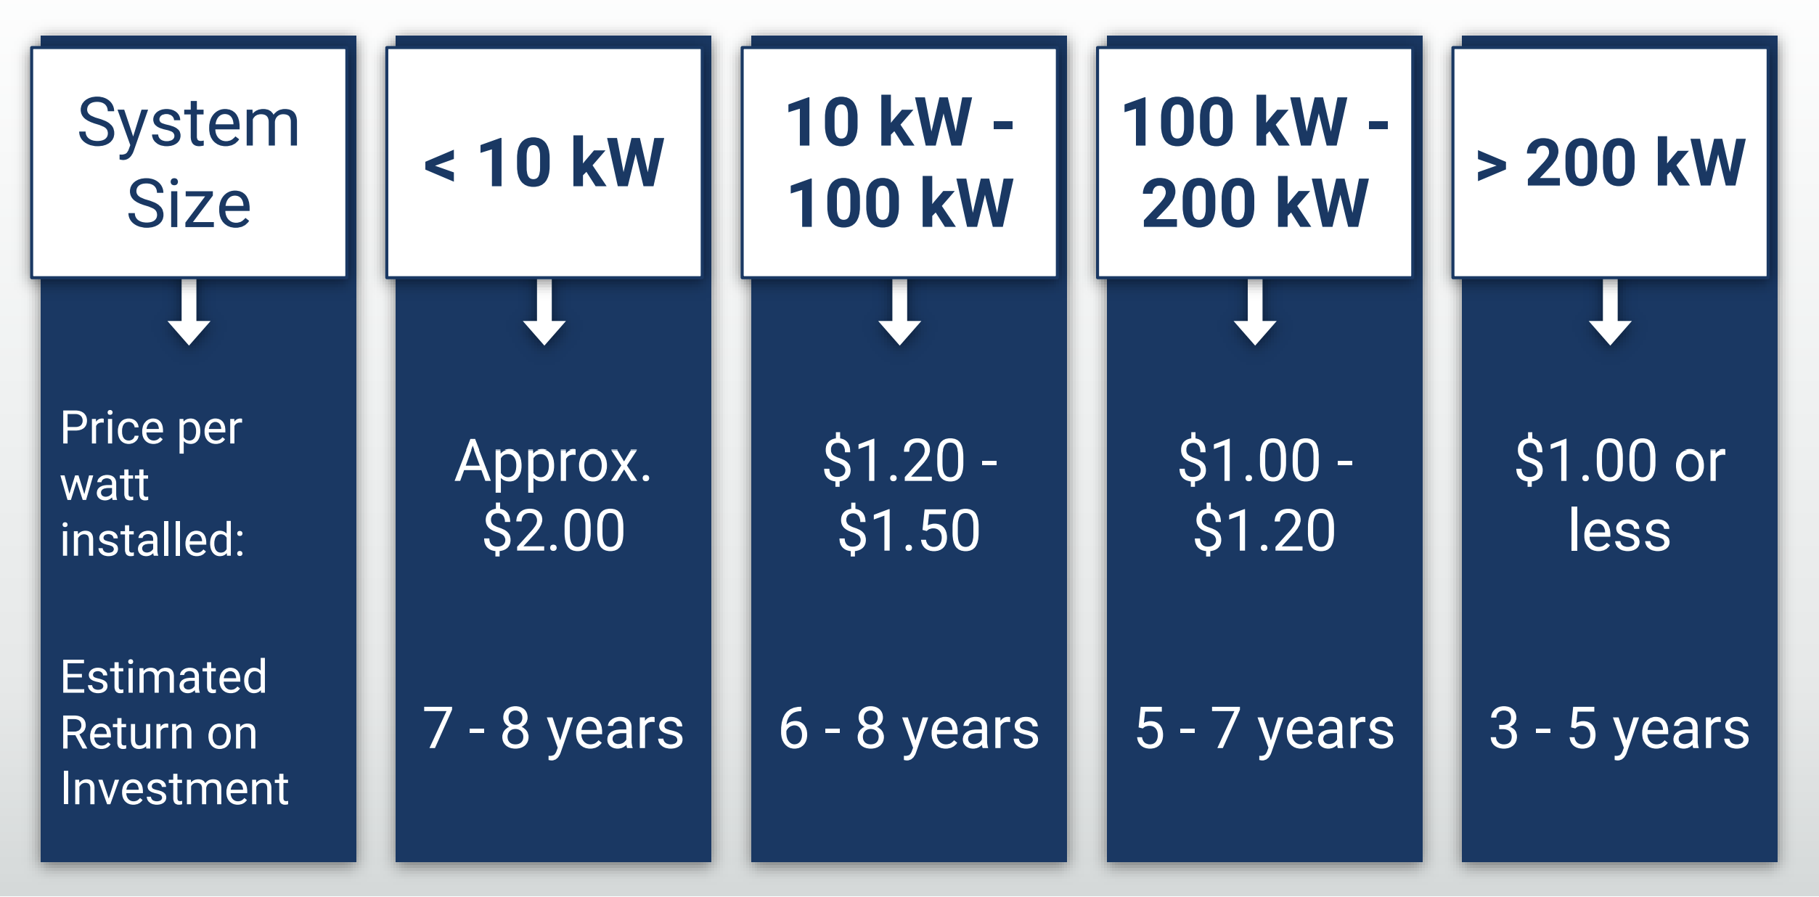
The switch to solar saves money in Costa Rica
Notes:
"Most businesses see a ROI in 4-7 years" - Greenenergy Costa Rica (2018).
"As low as 2.7 Years" - Avolta Energy CR (2023).

Slide 16
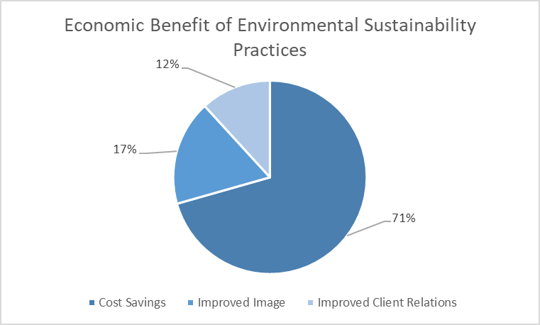
Most businesses see cost savings as the greatest economic benefit of environmental sustainability
n = 33 respondents
Notes:
Maybe explain more about grouping in writing

Slide 17
SMEs struggle to quantify social sustainability
Eleven out of thirteen SMEs do not have a budget towards social sustainability projects
Notes:
Little people but different color

Slide 18
We have outlined a way for SMEs to quantify the benefits of social projects

Slide 19
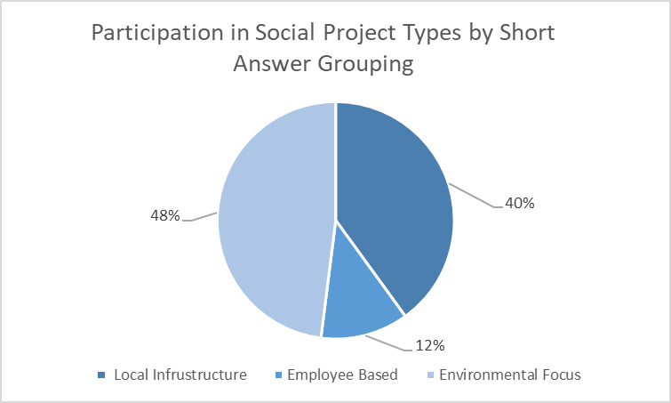
Identifying business social projects participation in Costa Rica
n = 33 respondents

Slide 20
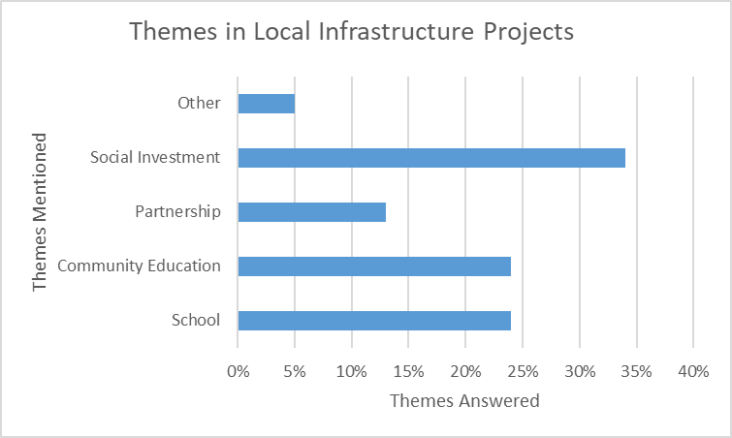
Local infrastructure projects have taken diverse actions to better the community
n = 33 respondents
Notes:
BIg Small Colors

Slide 21
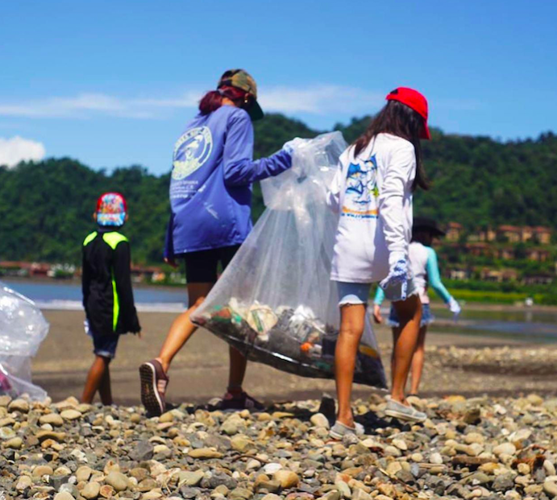
Costa Rican businesses value social projects involved with park/land beautification
Notes:
Put Jaco clean up

Slide 22
Conclusions

Slide 23
Environmental sustainability is engrained into Costa Rican Businesses
Notes:
Enviromental sustianaiblity is engrained into their culture, clean energy,
Clean Energy
Circular Economy
Better to reuse than recycle the whole process
Sense of pride over environment
Can see the effects of their actions
More and more laws about environmental sustainability

Slide 24
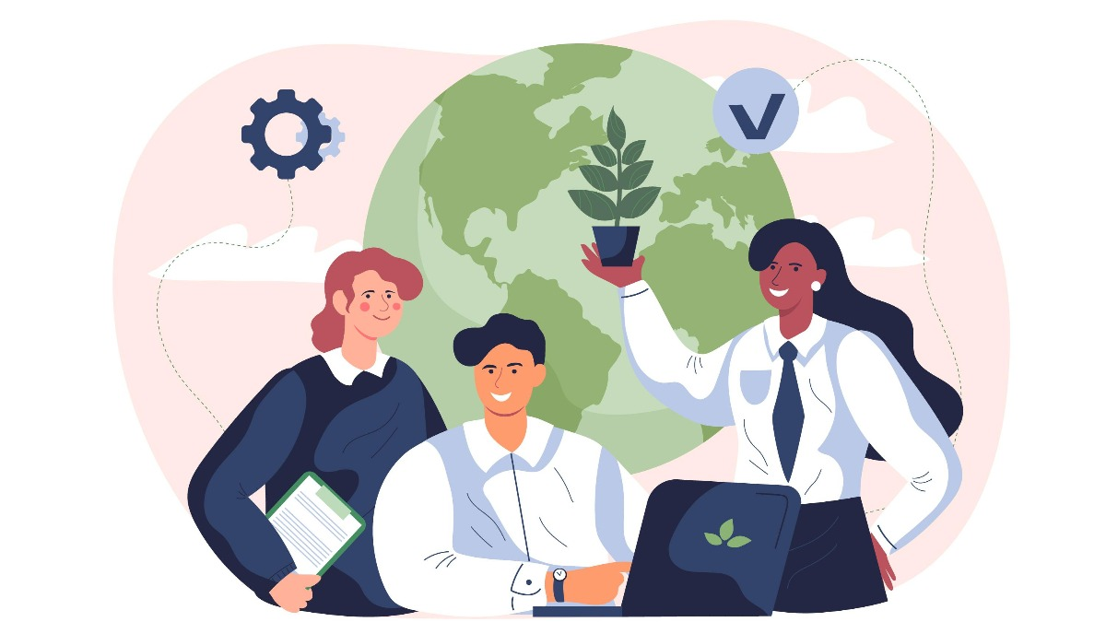
Quantifying social projects helps SMEs make social sustainability profitable.
Notes:
Educating clients to be more sustainable helps sell sustainablility.
Participating with community
Improved image
Improved client relations
Helping Employees
Makes them feel sense of belonging -> more productivity

Slide 25
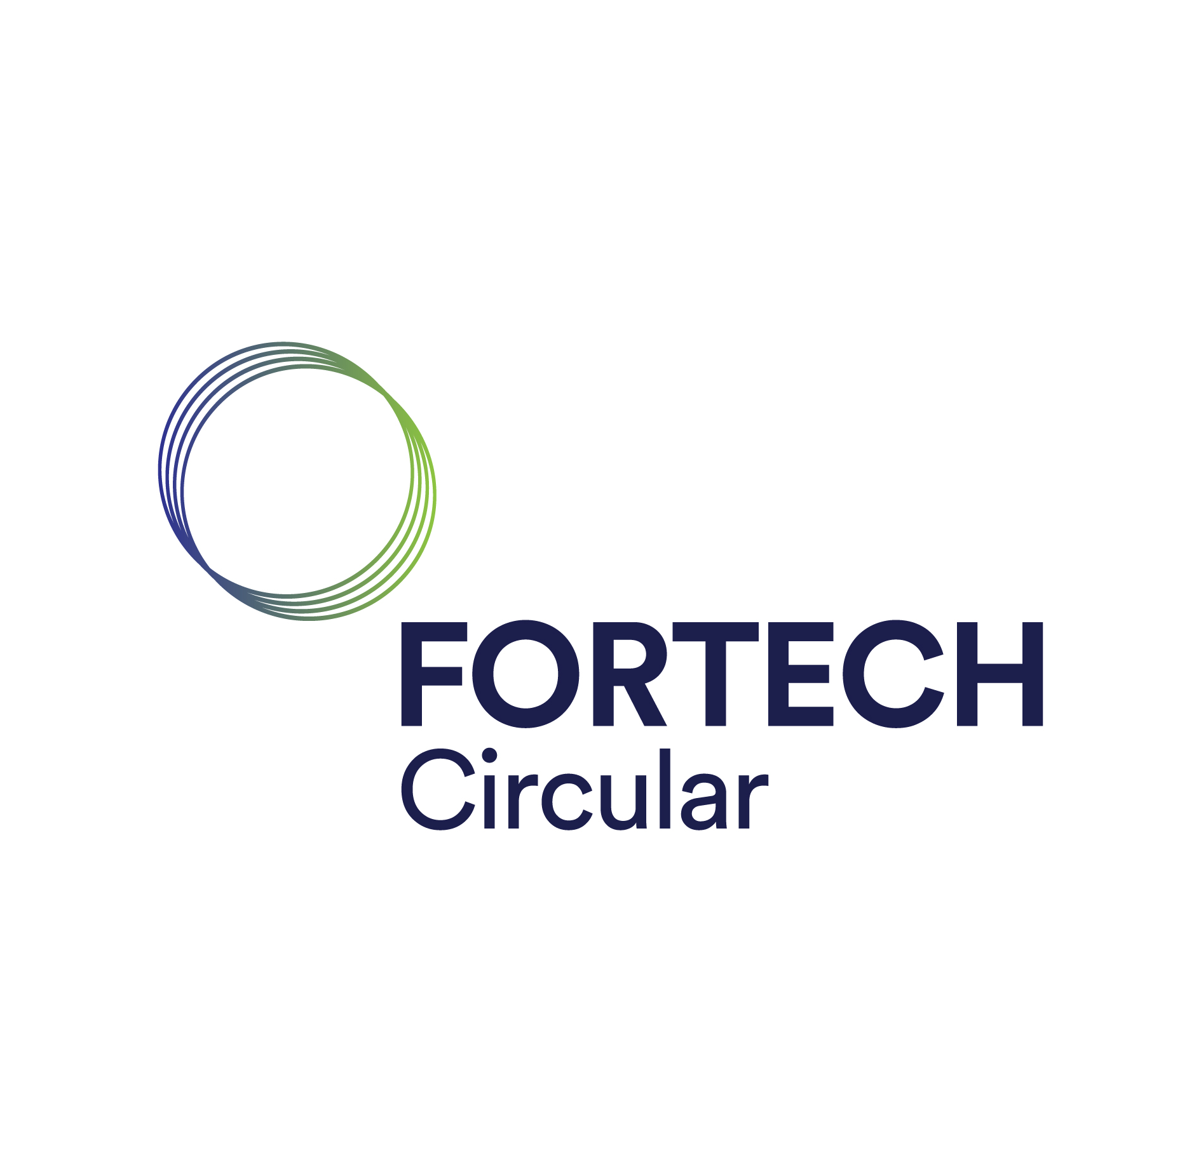
Thank you for the interviews!

Slide 26
Special Thanks!
To Our Advisors and Sponsors
Advisors:
Holly K. Ault
James Chiarelli
Sponsors:
Andrei Gaggion
Akira Hidalgo

Slide 27
References
https://www.northmist.com/blogs/news/understanding-the-concept-the-three-pillars-of-sustainability
https://www.which.co.uk/reviews/smart-meters/article/smart-meters-explained/what-is-a-smart-meter-artlW8n6atdo
https://www.linkedin.com/pulse/circular-economy-sustainable-solution-effective-waste-management/
https://www.photonenergy.co.uk/photon-energy-news/2022/11/28/does-the-installation-of-solar-panels-damage-your-roof
https://www.epa.gov/waterreuse/basic-information-about-water-reuse
https://greenenergy.cr/en/solar-panel-return-of-investment/
https://www.younginflux.com/social-sustainability-the-pillar-of-sustainable-development/

