Slide 1
Community Events Program Evaluation
Team Members: Matt Farah, Manuel Freile, Matthew Outama & Faris Shaikh
Advisors: Katherine Foo & Stephan Sturm
Sponsor Contact: Linn Kaldinski
April 29th, 2019
Notes:
Talk about project briefly & slide overviews

Slide 2
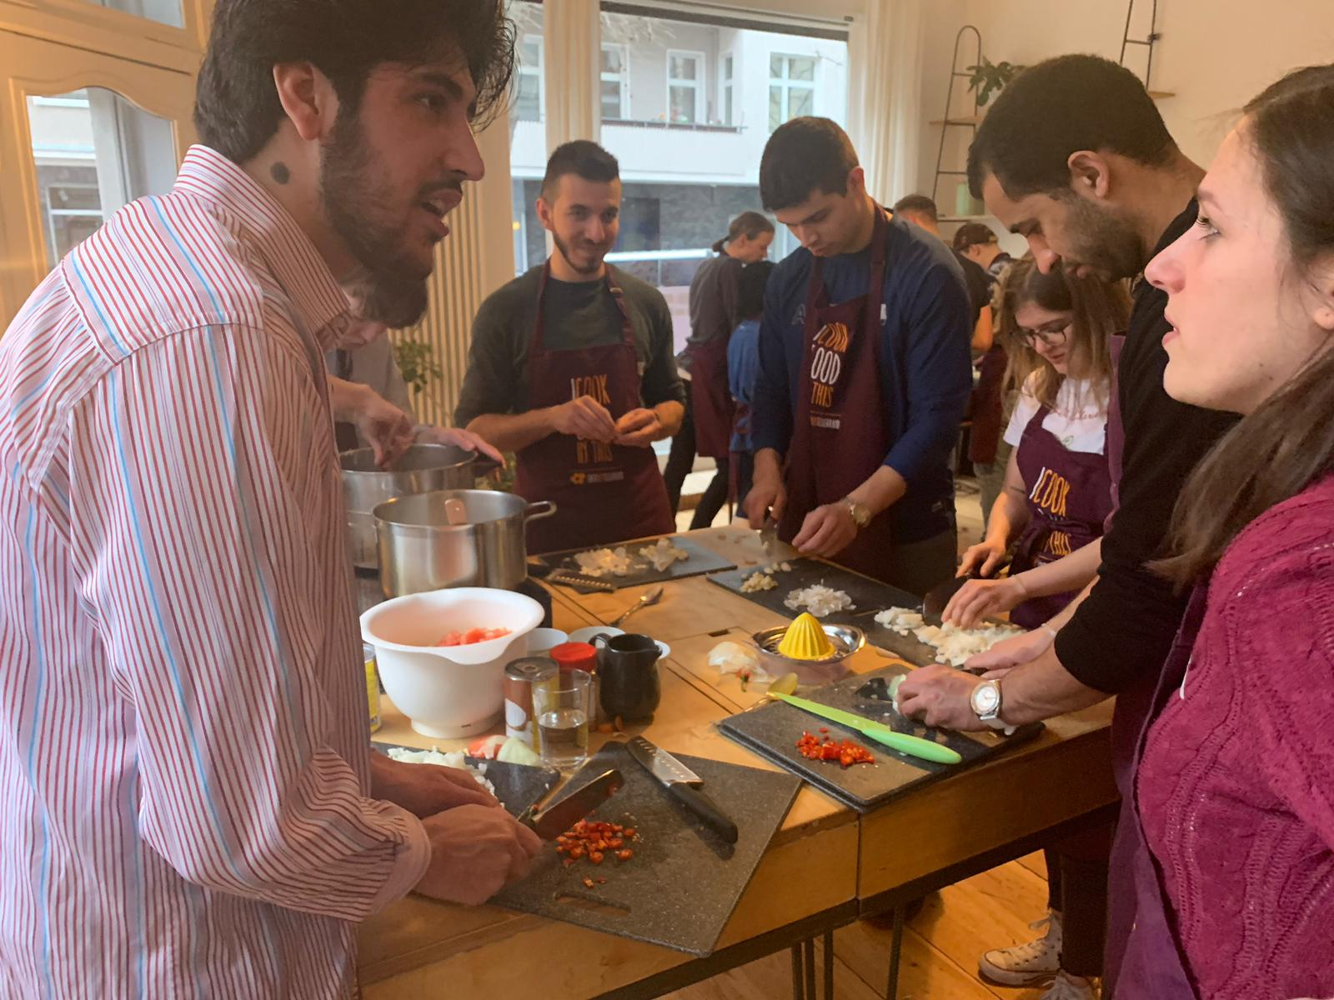
Overall Project Goal
To evaluate the impact of Über den Tellerrand’s community events on the target groups including both immigrants and locals.
Notes:
Matt O. (1)
Notes: Our project started by contextualizing the issues faced in the integration of immigrants, specifically the presence of racial discrimination and prejudices. To help resolve this problem, organizations such as Uber den Tellerand have stepped in -- they’ve developed the goal of creating an encounter space for locals and immigrants to meet and feel comfortable interacting with one another. In order to understand how well the organization is in achieving that goal, it was important to perform a program evaluation. Our team was tasked with evaluating the impact of the community events on both immigrants and locals.

Slide 3
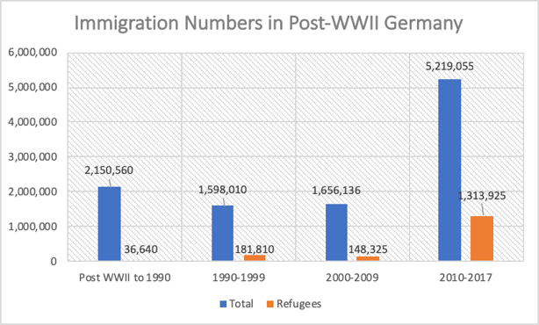
Migrant Refugees and Immigration at a Glance
[1]
Notes:
Matt F (2) - overall (no need to talk about why Udt exists)
Because of the increase in immigrants Germany has become a more multicultural society but there has also increase in social pressure against immigrants

Slide 4
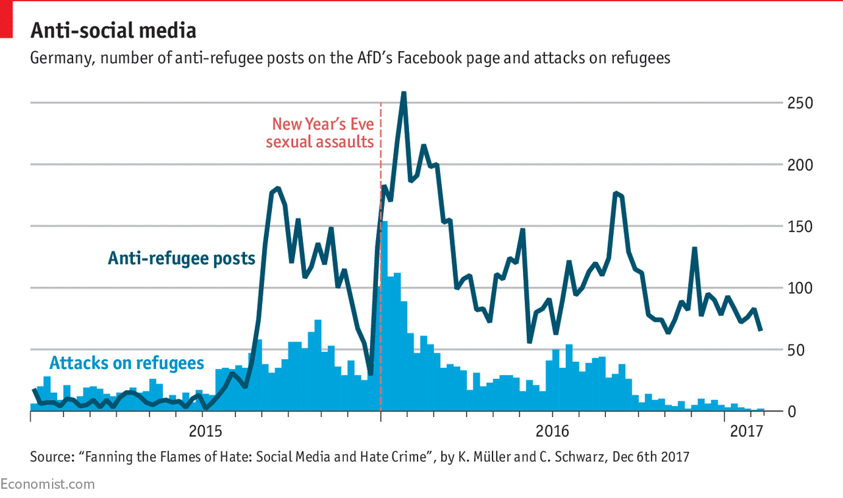
The Shattered Myth of a Post-Racial Germany
[2]
Notes:
Faris (1)
until the early 1990s and the somewhat recent migrant crisis many Germans had believed that they had their country had moved past race driven politics and racial violence; however, the european union's report on minorities and discrimination found that almost half of the migrant refugees surveyed felt that they had been discriminated against based on their ethnicity or religion, the religion often being Islam
The graphic on the board depicts the rate of violent attacks against migrant refugees

Slide 5
German Policy Attempts to Promote Integration
[3]
Notes:
Faris (2) (at the end - because Ger is multicultural there is racism Thera are a need for organizations like UdT. Funnel Background)
Before 2005 all Government efforts went to social welfare
600 hours of language courses and 100 hours of history, culture and legal system courses
The main objective of the summit was to attempt integration in the employment market.
2.1 GIC co-introduced the summit and achieved introduction of Islamic religious instruction in schools and creation of five centers (so far) for Islamic theology
3. Although to the day critics of this law argue that it lack standardization and remains non-transparent.
-> Despite the German government’s efforts to integrate immigrants and migrant refugees their programs left a lot to be desired and were not extensive enough to cover the the needs of the immigrants, as a result non-profit organizations such as UdT have arisen to meet that need.

Slide 6
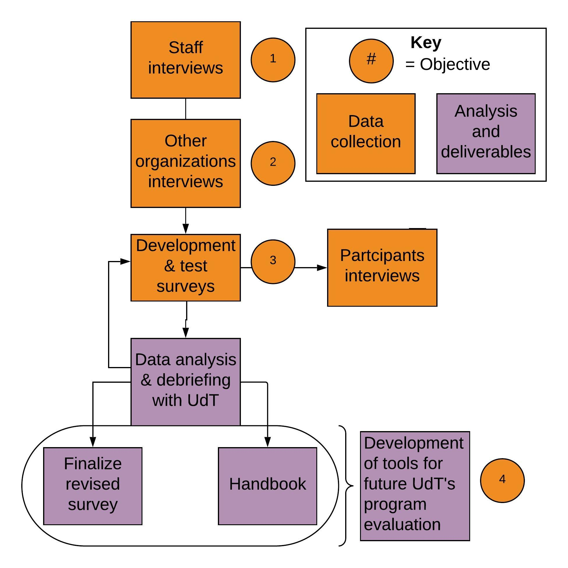
Methodology Flow Chart
1
Goals
2
Assessment
3
Survey
4
Deliverables
Notes:
Manny (1) In order to evaluate organizations like UdT we designed our methodology in the following way
As you can see in the key the orange circles represent each objective and that is evident throughout the presentation
Clarify goals and find out what UdT wanted to find out about their participants
Tools and protocols of evaluation
Quantify the impact UdT has on its participants
We came up with two tools for UdT to use for future evaluations

Slide 7
Staff Interviews
1
Sharing
Socializing
Demographics
Demographics
Support
Notes:
Faris (3)
Based on the set of goals we obtained from the UdT staff while completing Objective 1 we developed three interconnected themes And ultimately we also investigated the demographics of the community events

Slide 8
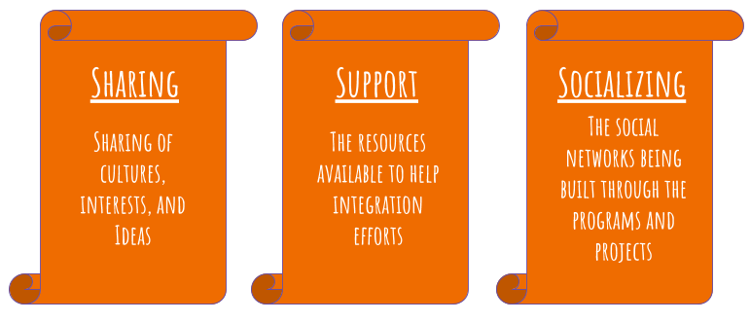
Theme Definitions
1
Notes:
Faris (4)
Sharing, Sharing of the participants’ cultures, interests, and ideas
Support or the resources that UdT provides that can help participants sustain their networks or that help them integrate better into German society
Socializing or the series of networks, built and maintained by UdT and its participants, that carry the stories and cultural values of the participants in order to break down prejudices

Slide 9
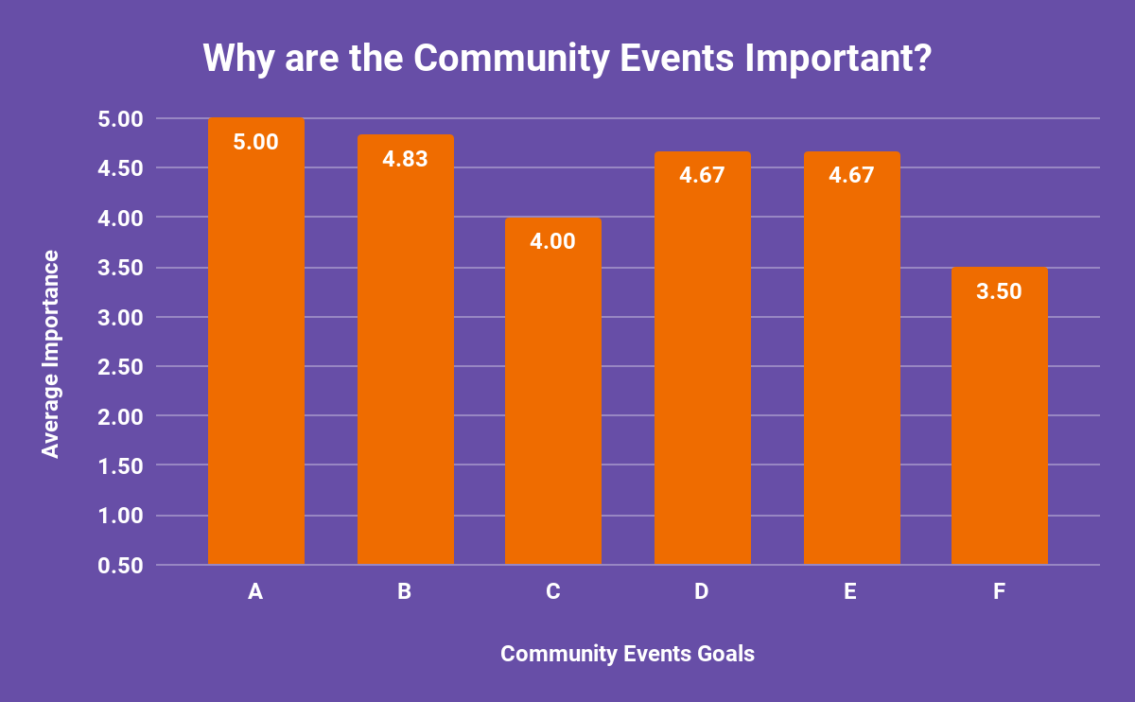
Importance of Community Event Goals
1
Highest Rated Goals:
A - Creating encounter spaces
B - Sharing culture, interests, and ideas
D - Reducing prejudices
E - Creating sustainable relationships
Notes:
Matty O (2)
Notes: We then gathered data to help us determine the most important goals of the community events. This was done through a google form sent to the UdT staff. Understanding which goals were important helped us develop our survey questions, and confirm the relevance of our themes. The highest rated goal was - creating encounter spaces. The next was for the sharing of culture, interests, and ideas. The other highest rated goals were to reduce prejudices and help participants create sustainable relationships.

Slide 10
Interviews with Similar Organizations
2
“...the topic of refugees. Too many people talk about it, and the refugees themselves should be talking...they have stories to tell” - Dustin, Media Residents
Notes:
Matty O (3)
Notes: To further help us design our evaluation tool, we interviewed other refugee organizations in Berlin. We interviewed two organizations, Media Residents and Be an Angel.
Dustin, a staff member at Media Residents states that …… this was important to note because it shows the relevance in speaking to these other organizations. They share a similar goal in integrating immigrants and offering a space for them to share their stories with others.

Slide 11
Factors for Successful Integration
2
“...Employment opportunities”
“...key to integration is Language”
“...all factors being fulfilled makes good integration”
Notes:
Matt O. (4)
Notes: In building our understanding of successful integration, we identified what the organizations believed to be the most important factor for it. For Media Residents it was employment. Employment allows for social interactions to happen naturally. And with those interactions, immigrants start to learn the German language more easily….For Be an Angel, the key to integration is language. They believe having immigrants share their stories is important, and this can be done more easily if they are able to speak German.
You, UdT, had a different view on successful integration. Instead of one factor being more important than another, you presented the idea that the process is multifaceted. That factors like employment and language are both equally important in successful integration.

Slide 12
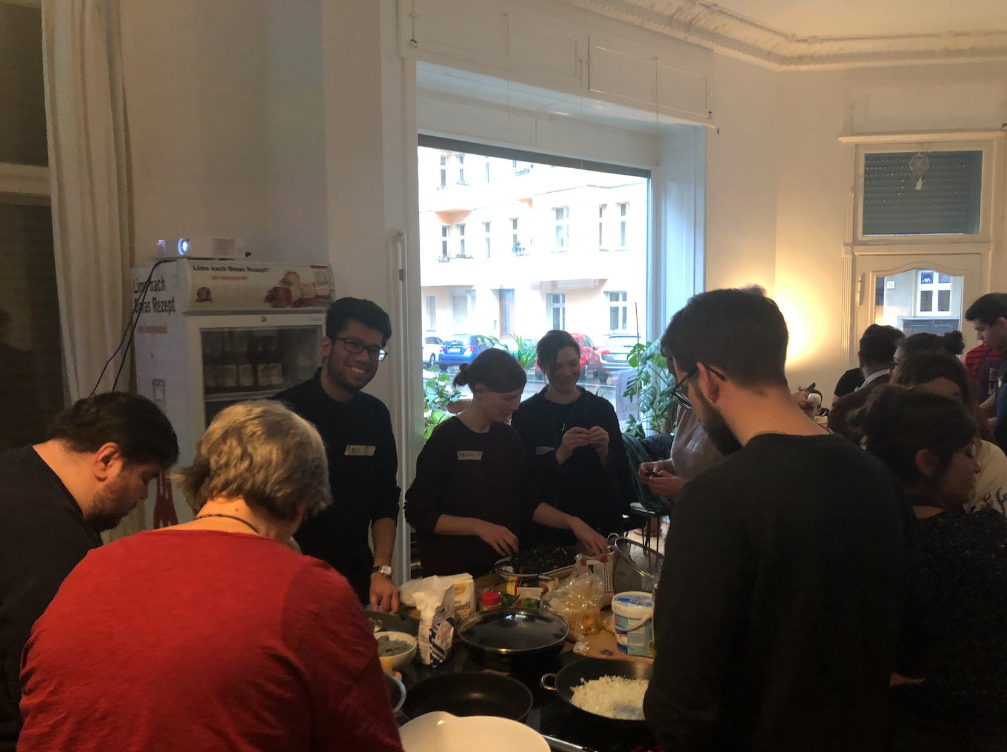
Preliminary Survey Distribution
3
50 Plates of Lentils
Persian Night
50 Plates of Desserts
38 respondents
Notes:
Matt F (2)
these are the 1st three events we… the goal of these events was to first get a feel of how the events are run, and to test the survey questions. we wanted to verify that the responses and our data collection techniques made sense. for ex: we were only doing mean (does not tell us much)

Slide 13
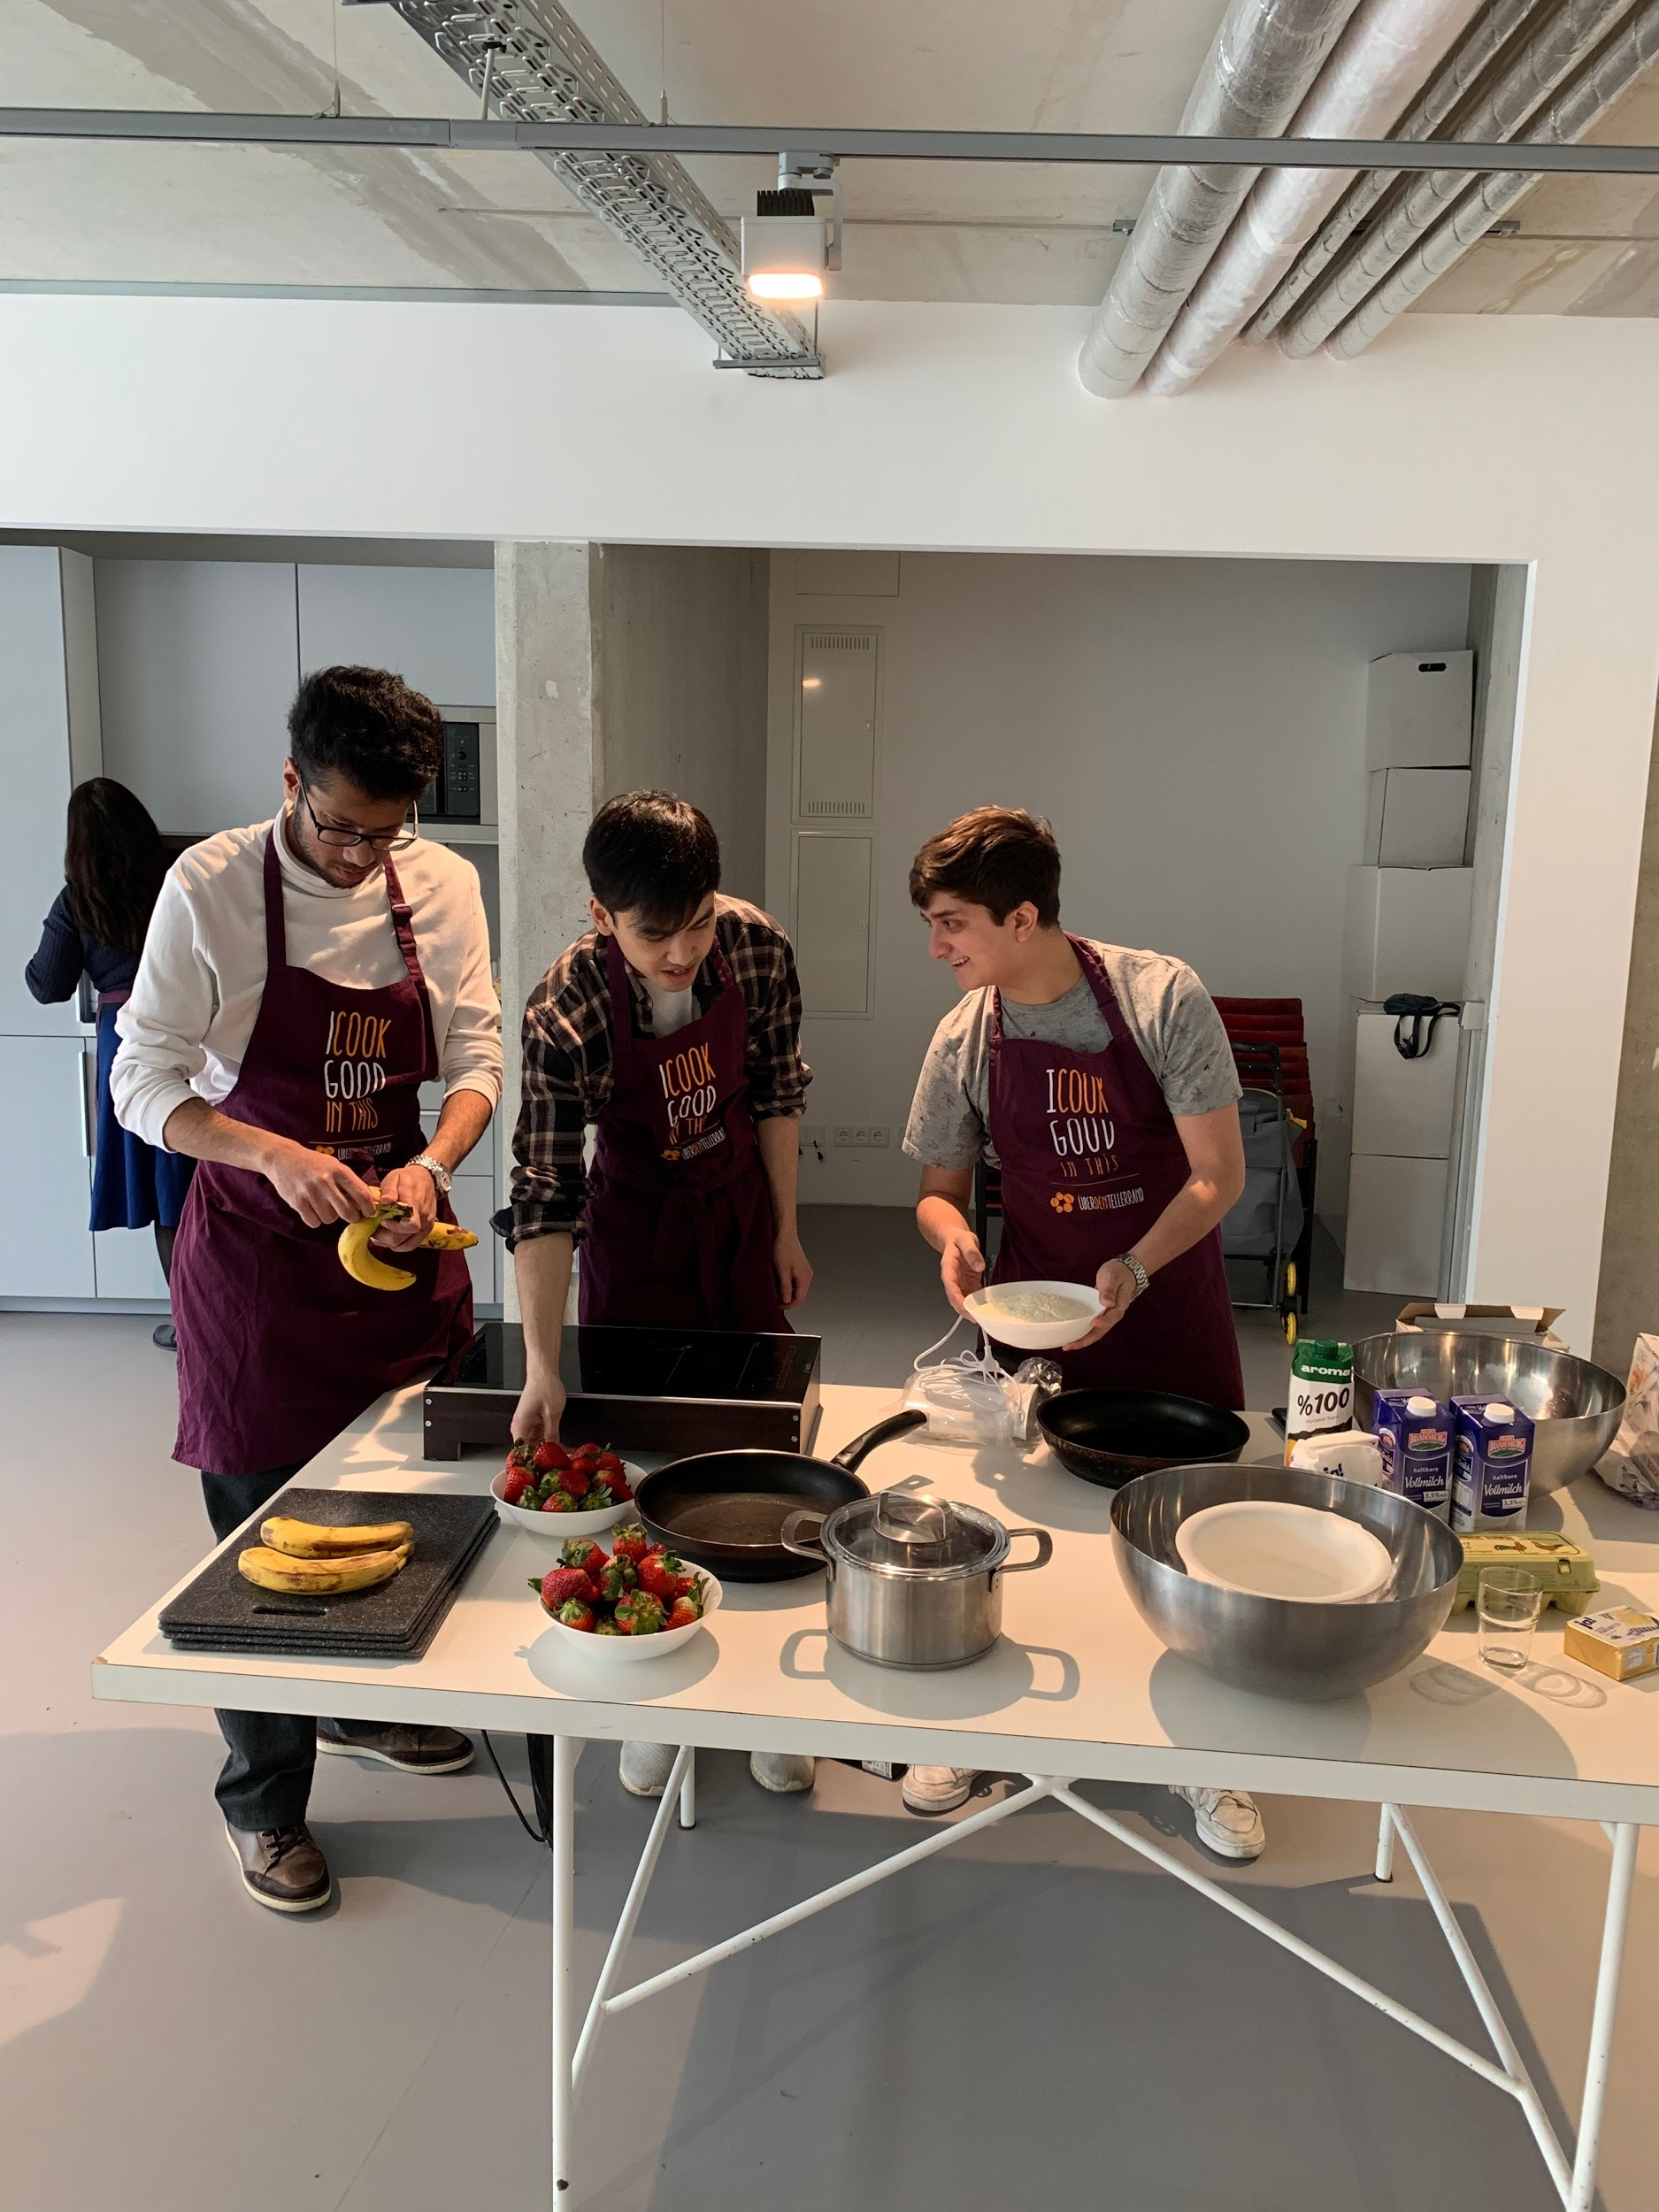
Final Survey Distribution
3
Women Cooking
Music Night
50 Plates of Eggs
50 Plates of Pasta
Sprach Café
Ostern bei Tellerrand
86 respondents
Notes:
Manuel (2)
Used paper because of: higher response rate and it’s less intrusive

Slide 14
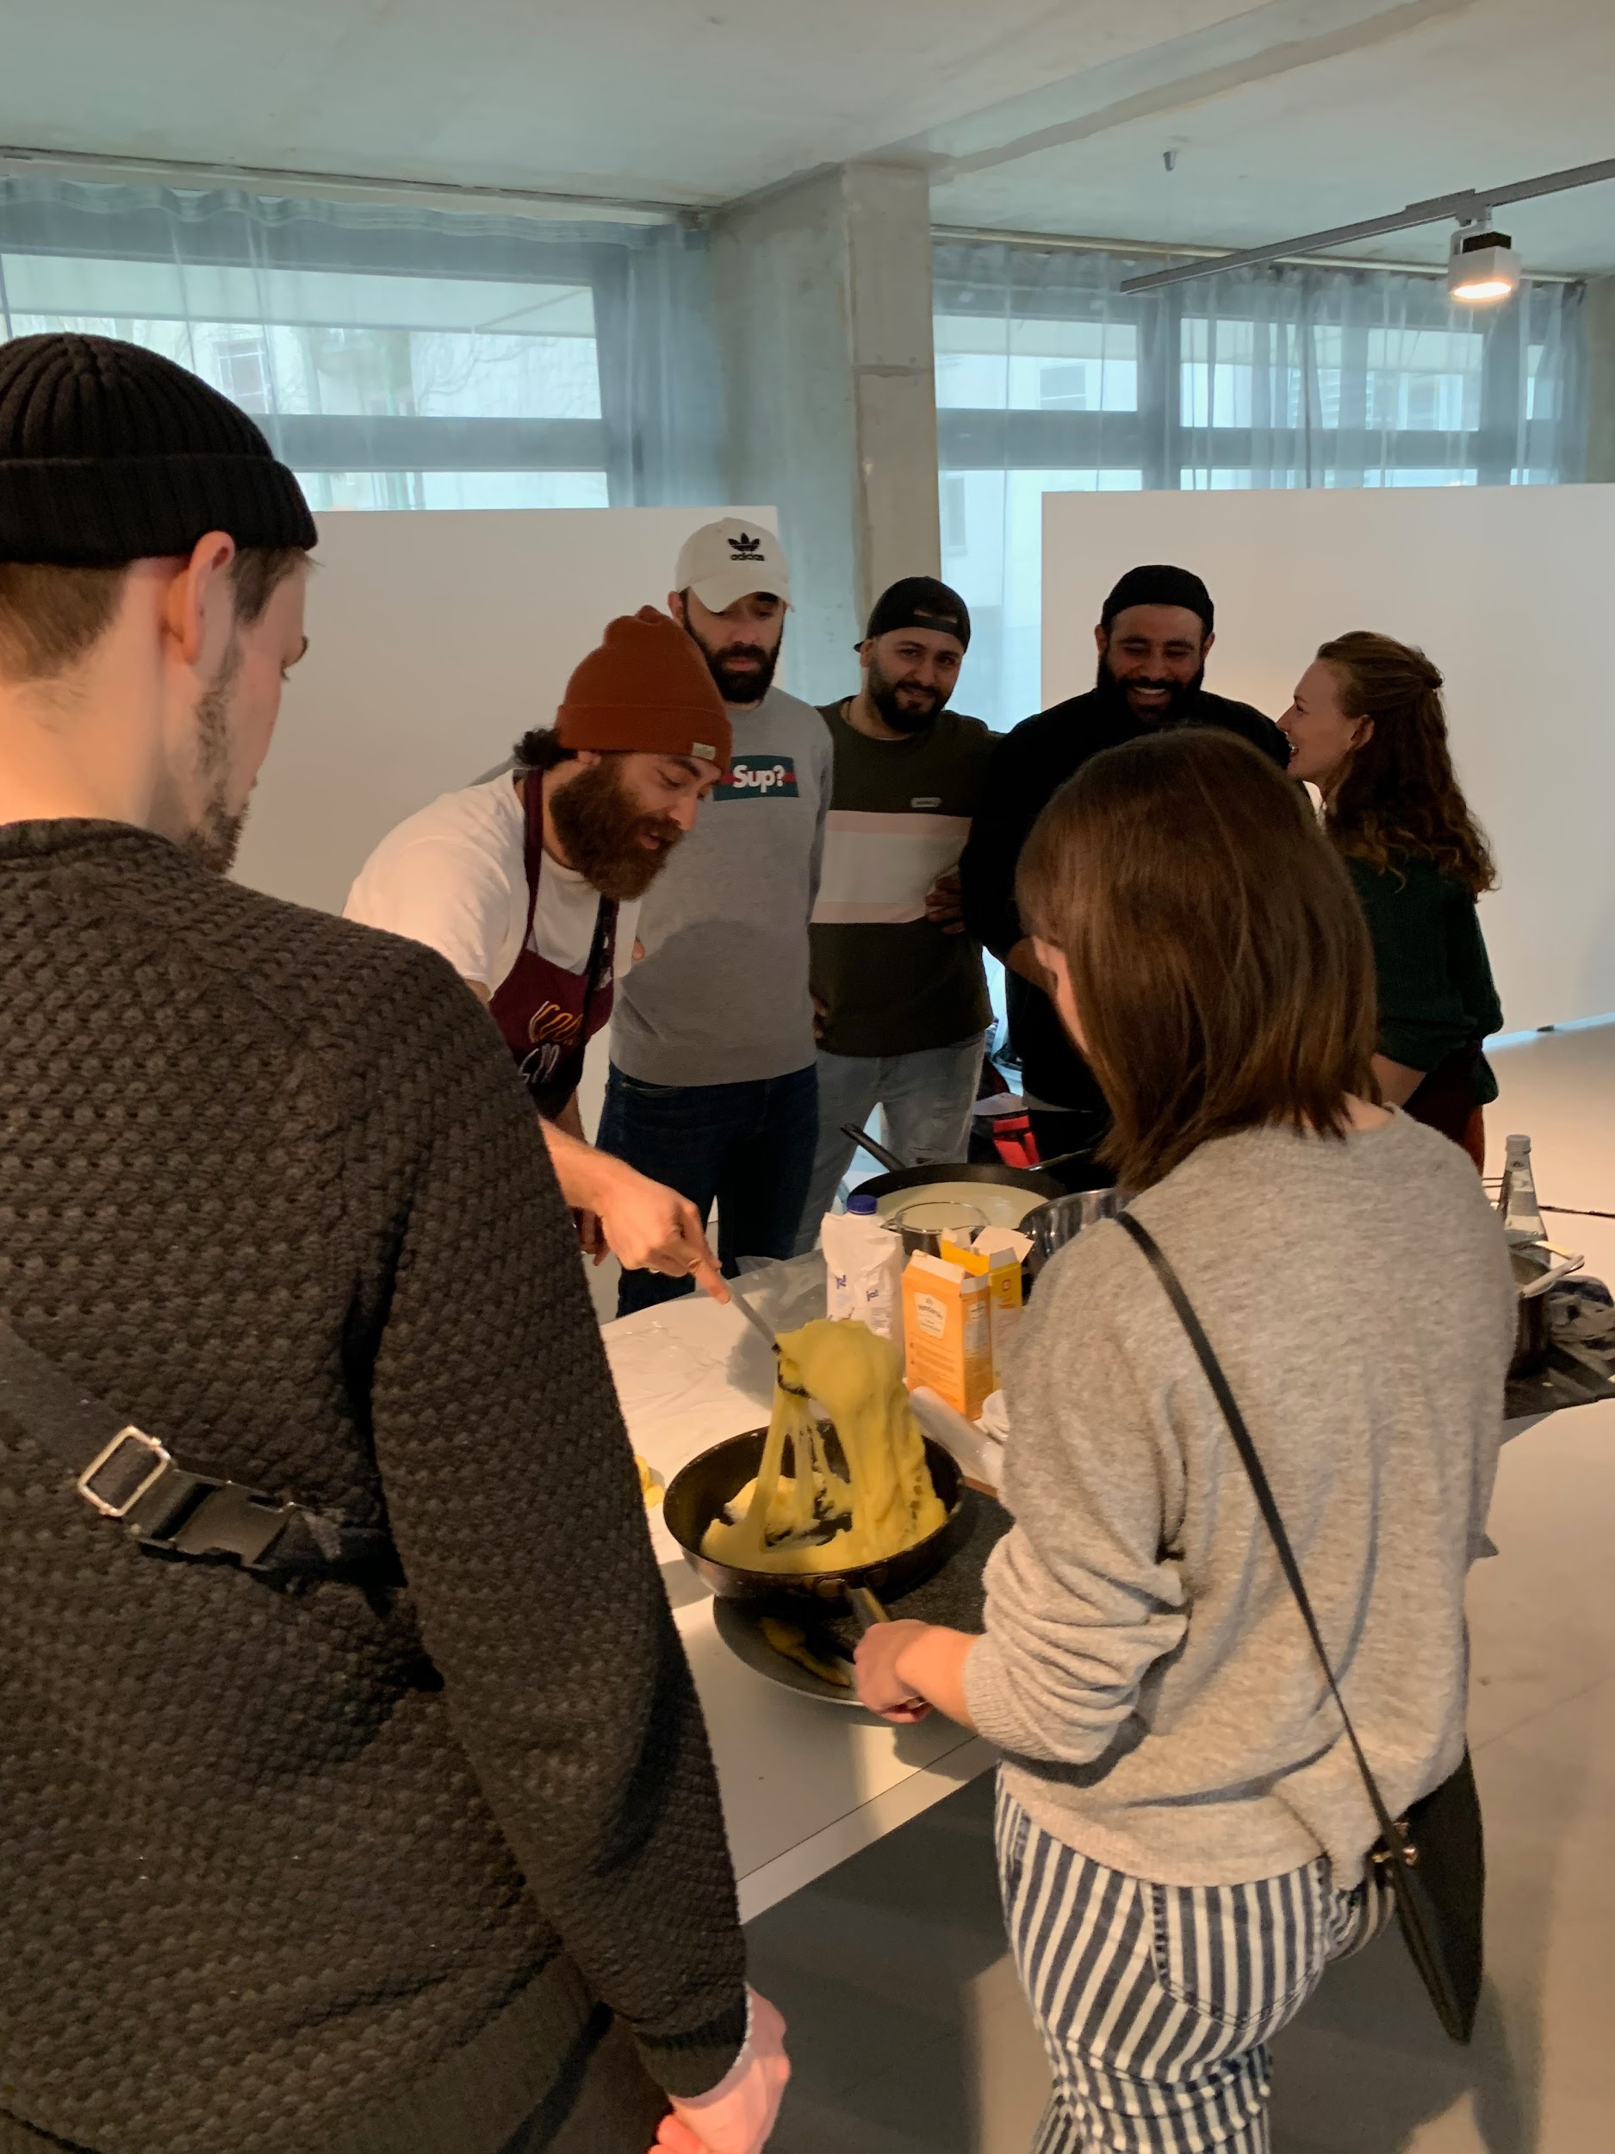
Reducing Prejudices through Sharing
3
56% of participants feel that events help to reduce personal prejudices
60% of participants feel more comfortable talking to people w/ different ethnicities at Über den Tellerrand than in public
From follow-up interview: personal level
Notes:
Faris (5)
Notes from report:
UdT is reducing personal prejudice, we know this because 56% of participants believe so, and this is why 60% of participants feel more comfortable at these events.
It is important to take into account that not everyone attending these events believed they have any prejudices to begin with. This notion could explain why 12% of participants think Über den Tellerrand is not helping to reduce prejudices
To better develop an understanding of what the participants thought about UdT’s efforts we conducted a series of participant interviews where we collected information, stories, and recommendations on a more personal level

Slide 15
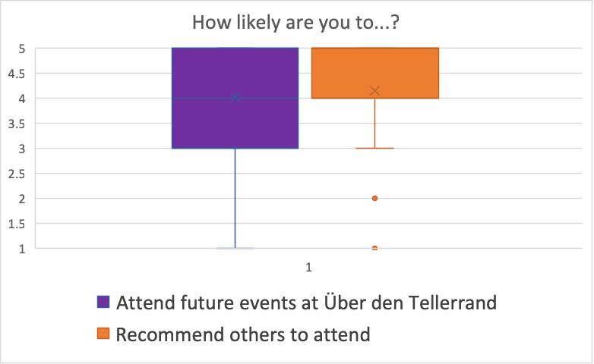
Building a Social Network
3
55% of participants found out about community events from personal recommendations
Follow-up dinner
Notes:
Matt F (3)
Udt is doing an excellent job of building a social network between its participants
Notes from report
From our survey slider question where respondents had to choose from 1-5 (where 1 means that the participants are not willing to attend future events, and 5 means that they are very likely to attend future events), the median response was a 4.
This means that the participants are finding great interest in the community events and are willing to come back to future events
For example, from one of our participant interviews we were told that the respondent actually had dinner on the next day with some of the other participants who attended the community event. This indicates that people are socializing and making new friends at community events.
According to our data, 55% of the survey respondents had learned about Über den Tellerrand from personal recommendations. This knowledge further suggests that participants value the events and the social network Über den Tellerrand has built
Participants come to make new friends and find other people who come from a similar background to them in order to “feel more at home.”
showed a high emphasis on the importance of socializing and the social network.

Slide 16
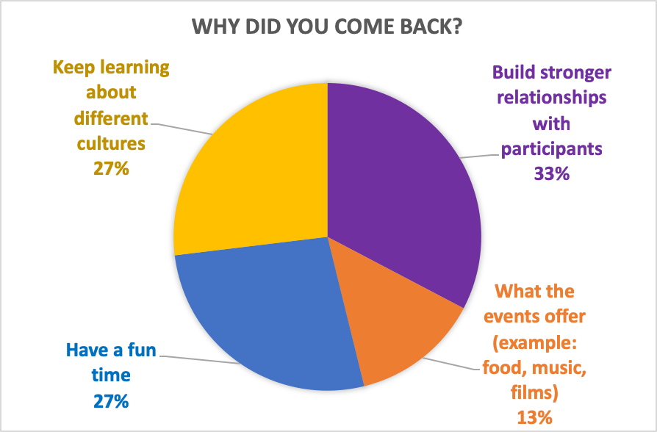
Offering Resources for Support
3
82% of participants say Über den Tellerand is a safe space (14% say maybe)
Helping to improve language skills, assistance in getting around the city
Notes:
Matt F. (4)
Two of the main goals of Über den Tellerrand is to develop a space that can support its participants’ interactions, while also helping them to live more comfortably in their local communities.
practicing a language (i.e. German) is a major reason why many immigrants decide to partake in the community events. So Über den Tellerrand, by creating a space where immigrants can improve their German, are supporting the establishment of a bridge to improve communication between different cultures.
Graphic: All of this is being accomplished through the support of the Über den Tellerrand staff and volunteers, and the resource provided by Über den Tellerrand.
In fact, one interviewee mentioned how refugees from Syria come to Germany with no knowledge about the country. It was not until they were introduced to an organization like Über den Tellerrand that they found needed support.
Without any knowledge about resources in Germany, immigrants face the many social and bureaucratic barriers alone and this can have lasting financial consequences. Specifically, that support was coming from the participants of the community events. They also mentioned how the other participants at the events are always willing and happy to help solve issues anyone might have.
82% of the participants feel that Über den Tellerrand is a safe space → the Über den Tellerrand staff have done an excellent job at establishing a friendly environment

Slide 17
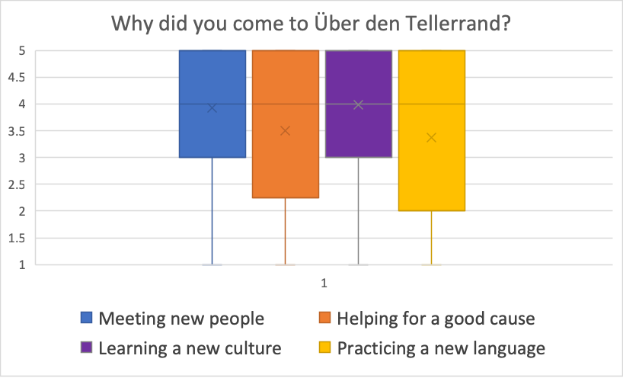
Participant Demographics
3
Majority of participants: 26-35 years old
73% of participants are not German (only 27% are German)
50% of non-Germans have lived in Germany 1-3 years before hearing about Über den Tellerrand
Notes:
Mattyo (4)
Notes: In addition to the conclusions we have made with our thematic framework, we also looked at participant demographics. We found that …. Finally the graph depicts the reasons why participants are coming to the community events. The two main reasons were meeting new people, and learning a new culture.

Slide 18
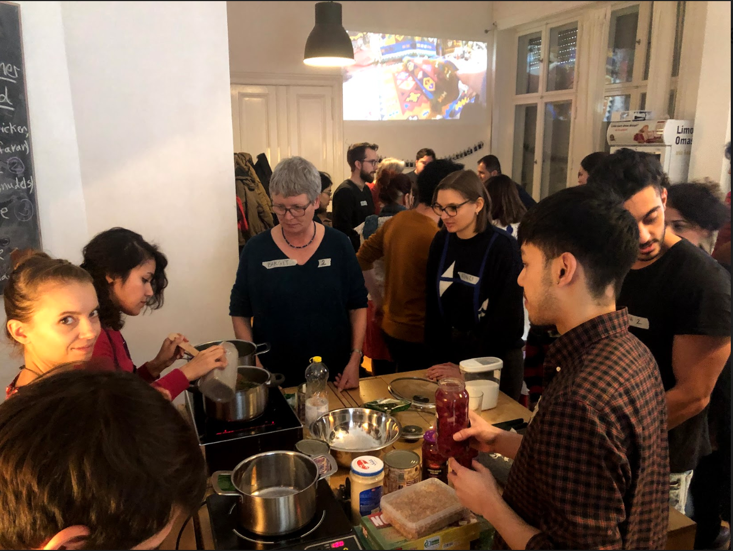
Final Deliverables
4
1. Revised survey
2. Guidelines handbook
Notes:
Manny (3)
debriefed with linn. To find out what questions gathered useful data based on our results. Electronic and Paper
Guidelines on how to do an evaluation based on research & experience. Include guidelines on how to enter and interpret data

Slide 19
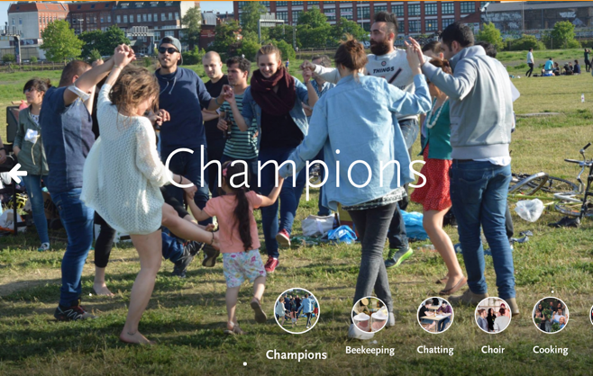
Increase german participation
Staff would like more of a 1:1 ratio of Germans to Immigrants
Bring a friend
Notes:
Matt F (5)
Goal--> reduce prejudices amongst german society, germans need to get to know the foreign culture and immigrants should socialize with germans to build connections

Slide 20
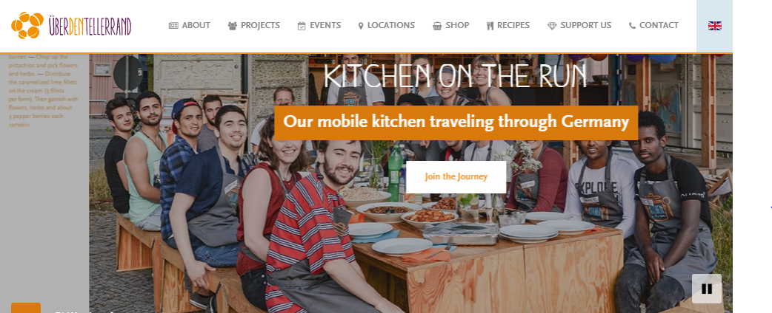
Personal stories blog
Notes:
Manny (4)
Easier access for more people to find about the refugees stories (book & paid classes). Updated in more consistent basis by the immigrants themselves
This can generate more empathy and help with the first recommendation as well as grow the awareness of the problem

Slide 21
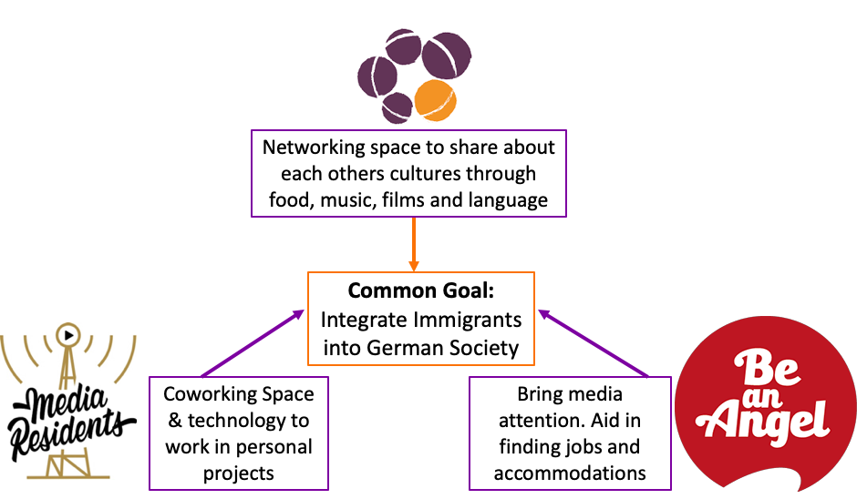
Improving the Refugee Organization Network
Notes:
Manny (5)
Help each other increase the amount of people they can help and complement each others with what they have to offer to immigrants.

Slide 22
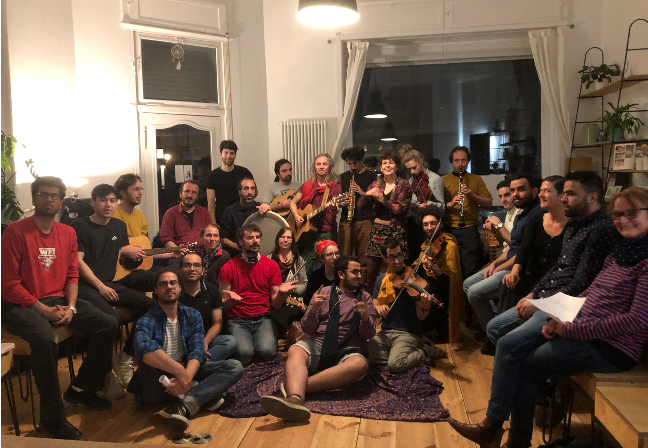
Final Conclusion
Notes:
Faris (6)
Overall, our result data points out, in UdT’s first program evaluation, that Über den Tellerrand’s community events program is meeting the goals it set out to with. Its participants are sustaining and expanding the UdT networks for cultural exchange and support and their interactions are fostering better understanding between native-born Germans and immigrants.

Slide 23
Acknowledgements
Our project was conducted in Berlin, Germany. Our project team would like to thank Über den Tellerrand, the Über den Tellerrand staff members, the volunteers, and the participants for their time and assistance.
We would like to acknowledge our Sponsor Linn Kaldinski from Über den Tellerrand for her time, resources and dedication to our project. We would also like to acknowledge: Katja Elsner, Dustin of Media Residents, and Andreas of Be an Angel
Additionally, we would like to thank Professor Katherine Foo and Professor Stephan Sturm for advising us throughout our project, and our ID2050 advisor, Dominic Golding, for his support and feedback.
Special thanks to the Kiezburo coworking space, for letting us work in their space.

Slide 24
Thank You!
Questions?
Notes:
Anybody

Slide 25
References
[1] Destatis (2017). Navigation and service. Retrieved from
https://www.destatis.de/EN/FactsFigures/SocietyState/Population/MigrationIntegration/MigrationIntegration.html
[2] Müller, Karsten and Schwarz, Carlo (2018), Fanning the Flames of Hate: Social Media and Hate Crime. Retrieved from: https://ssrn.com/abstract=3082972 or http://dx.doi.org/10.2139/ssrn.3082972
[3] Hanewinkel, V., & Oltmer, J. (2018, January 11). Integration and Integration Policies in
Germany | bpb. Retrieved from:
http://www.bpb.de/gesellschaft/migration/laenderprofile/262812/integration-and-integrat on-policies-in-germany

