Slide 1
Feasibility of a Mushroom Farm in the Bunkers in El Buey
Sarah Muse, Serena Soltero, Matthew Suarez

Slide 2
Introduction
The economy in Vieques and Puerto Rico in general is in a crisis. One of the biggest problems is high levels of unemployment. The goal of our project is to bring a source of employment to the residents of the Vieques.
Notes:
Serena

Slide 3
Background
History
Economy
Mushroom Farming
Notes:
Matt

Slide 4
A Brief History and its Impact
Navy arrived in the early 1940's
Acquired two thirds of the land
Economy shifts away from agriculture
Still plenty of jobs in hotels, restaurants, bars, and construction.
Focus of WWII moves out of the Caribbean
Navy leaves with it
No longer construction or entertainment jobs
Land has remained restricted
Navy used it for target practice
They left in 2003 but gave the land to Fish and Wildlife who made it a nature reserve
Because of this the island cannot return to agriculture for its economy
http://www.puertorico-herald.org/images/49-VqsmapNEW-es.jpg
Notes:
Sarah

Slide 5
http://www.puertorico-herald.org/images/49-VqsmapNEW-es.jpg

Slide 6
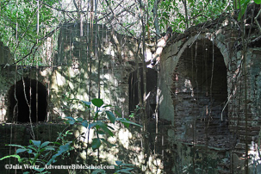
Economy
Sugar industry
Minimal agriculture today
Local businesses
Employment
Median household income in 2013
Vieques: $17,000
Puerto Rico: $27,000
https://encrypted-tbn1.gstatic.com/images?q=tbn:ANd9GcRaoXOOLggEm5DwVNxCspgWytW8t9Tq7B6AZAsC_jjtsmmhDsSx
Notes:
Matt

Slide 7
Household Income in Vieques Comunidad, Puerto Rico
http://www.citymelt.com/city/Puerto-Rico/Vieques+Comunidad-PR/Housing.html
Notes:
Matt

Slide 8
Mushroom Growing and Community Farming
Producer
Community Farming
Increase collaboration leads to higher sense of community
Good source of income
Agriculture and forestry cooperatives
Traders and Mushrooms Growers Club
Auction Market
Wholesaler
Mushrooms
Easy to cultivate
High yield each cycle
Retailer
Exporter
Domestic comsumers
Export market
Notes:
Serena

Slide 9
Methods
Three major areas of research
Engineering – Electricity, Water, and Infrastructure
Economic Feasibility - Cost, Profit, and Employment
Community Interest - Would people support the farm?
Notes:
Matt

Slide 10
Solar Panels
Why we chose solar energy:
There is an abundance of sunlight
Case studies of solar energy on Vieques
Aesthetically pleasing (more so than wind)
PR, people like solar energy
http://butlerrural.coopwebbuilder.com/sites/butlerrural.coopwebbuilder.com/files/page-images/solar_panels_edited.png
Notes:
Serena

Slide 11
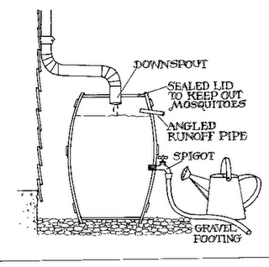
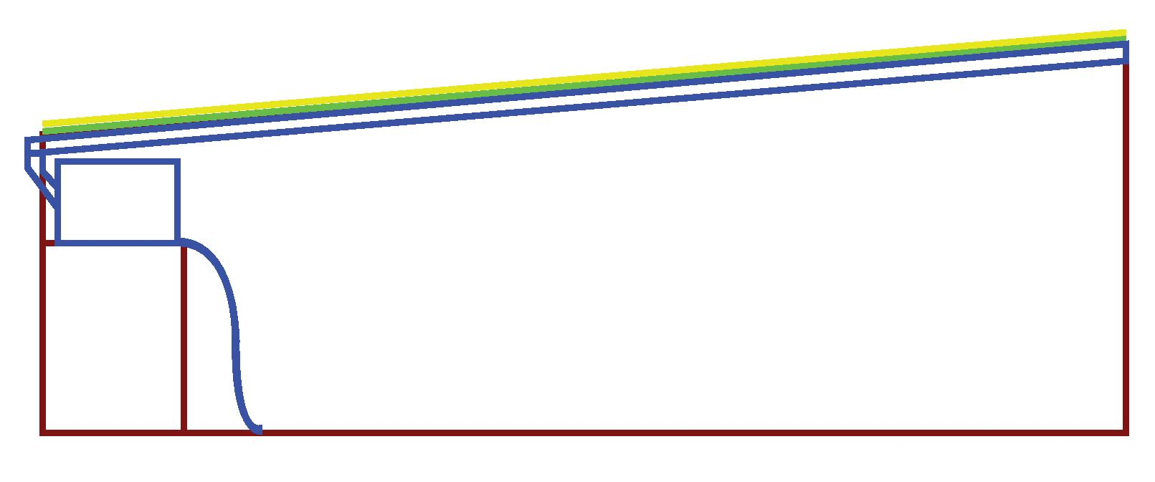
Engineering - Water Collection
Cistern
Water
Solar Panels
Plexiglass
Bunker Walls
Side View of Bunker
How much water could be collected in a year
How much water is needed to grow the mushrooms
Rainfall per month
Calculated how much water storage would be required
Notes:
Matt

Slide 12
Economic Feasibility
Cost
Revenue
Online queries to find prices of the required materials such as tools, growing medium, etc.
Researched average cost of projects and fit them to our project (i.e. solar panels)
Average price for a house
How much more do we need
Scaling up price as necessary
Research how many pounds of mushrooms per square foot
Create floor plan to determine amount of trays we can have
Total sqft of growing area
Research selling price of mushrooms
Multiply unit price by area to determine revenue
Notes:
Sarah

Slide 13
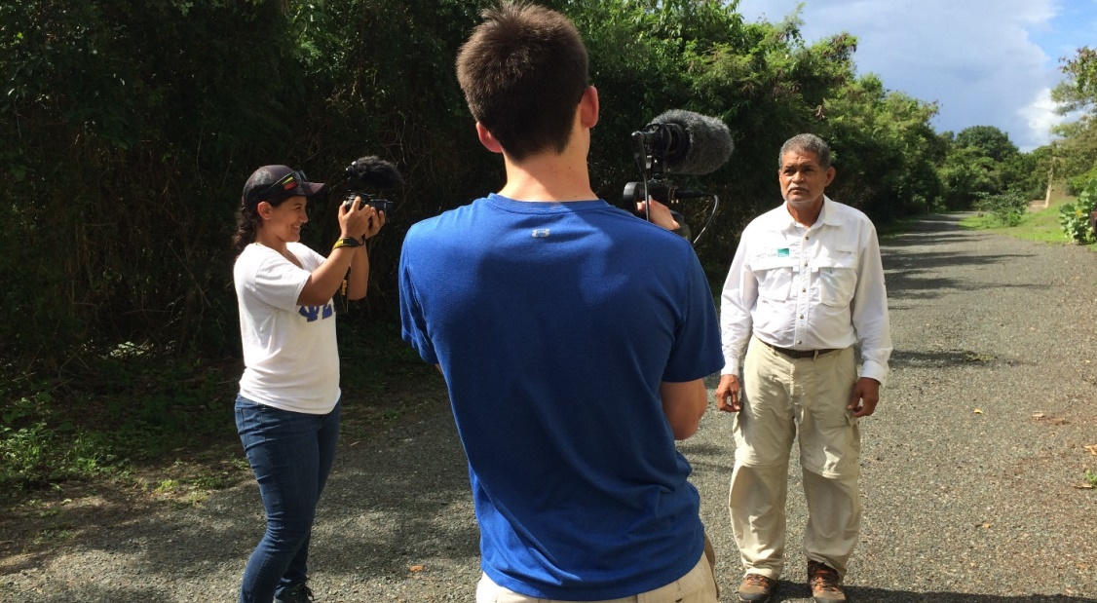
Community Support
Surveys
Content
General opinion of farm
Employment interest
Locally grown agriculture interest
Interviews with government and Para la Naturaleza
Purpose
Know support from government
Understand the ideas from Para la Naturaleza
Notes:
Serena

Slide 14
Results
Engineering
Economic
Social
Notes:
sarah

Slide 15
Water Collection and Energy
Water Collection
Solar Panels and Electricity
102,401.49 kWh of solar energy can be collected per year
Rainwater potentially collected on a 100.5’x49.5’ bunker roof
http://jeffrey.darofamily.com/wp-content/uploads/2014/06/iStock_000016988110WEB.jpg
Notes:
Serena

Slide 16
Calculations
Water (mushroom kit)
Scaling up to bunker
12’ wide x 10’ long x 8’ deep
5 cups to set up casing / compost
1 cup spraying for applying casing
Daily (10-12 or 17-21 days):
Moderate spray mist or sprinkling of water on casing once a day
Keep surface moist at all times without overwatering
80% moisture in peat layer
½ cup water to replenish water after picking
Walked through mushroom growing process and scaled numbers up to fit the square footage of the bunker
Estimate for the water needed: ~104,000 gallons per year
Notes:
Matt

Slide 17
Mushroom Infrastructure and Layout
Challenge: Transportation and disposal of materials like compost and peat moss
142 cubic yards per cycle
Beds: 4' x 4'4 "x 1'
Beds per Layer: 120
Layers: 3
Total Number of beds: 360
Total growing area: 5,760 sq feet
https://2ecffd01e1ab3e9383f0-07db7b9624bbdf022e3b5395236d5cf8.ssl.cf4.rackcdn.com/Product-800x800/93377668-430d-4f16-b687-ffda6bf51b5b.jpg
Notes:
Matt

Slide 18
Economic Feasibility (cost)
Investment Costs:
Cleaning Bunkers: 276.00
Painting Interior: 1120.00
Install Solar Panels: 297,000.00
Install Electrical System: 9,700.00
Water Collection System: 19,165.00
Mushroom Infrastructure: 34,800.00
Ventilation System: 1,800.00
Install Climate System: 2921.00
Operation Costs:
Fixed Costs:
Tools: 642.00
Wages: 234,000.00
Variable Costs
Growing medium: 44,031.00
Spores: 28,108.00
Fungicide/Insecticide: 371.00
Total investment: $366,782
Total operational: $307,154
Notes:
Sarah

Slide 19
Economic Feasibility (revenue)
Example Calculation: $5760 {ft}^{2}∗\frac{48 lb}{1 {ft}^{2}}∗\frac{\$6.00}{1 lb}=\$1,658,880$
*A pilot study is needed to gain an accurate number for how many mushrooms can be grown, and a market study is needed for accurate profit
 | Surface Area of Mushroom Growing | Amount of Mushrooms Produced Each Year | Unit Price of Mushroom | Revenue Generated Each Year
Pessimistically | 5760 ft² | 25 lb per ft² | $3.00 per lb | $483,840
Average | 5760 ft² | 36.5 lb per ft² | $4.50 per lb | $946,080
Optimistically | 5760 ft² | 48 lb per ft² | $6.00 per lb | $1,658,880
Notes:
Sarah

Slide 20
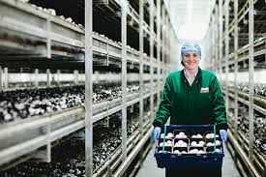
Jobs Created
Our assumption:
10 workers
5 full time (40 hrs/week)
5 part time (20 hours/week)
$15.00/hour wages
Total Cost: $234,000.00
Yearly income (before tax)
Full time: $31,200.00
Part time: $15,600.00
Avg on Vieques: 17,355.00
http://www.monaghan-mushrooms.com/work-with-us/
*A pilot study would help determine how many people the farm needs to operate
Notes:
Sarah

Slide 21
Community Support
n=34
Strong desire to participate in farm
High desire for locally grown agriculture
Need a more diverse demographic
Notes:
Serena

Slide 22
Suggestions
Pilot Study
Market Study
Different Crops
Notes:
Serena

Slide 23
Pilot Study
Study may be potentially expensive
Many unknowns
Electricity consumed
Water needed
Pounds of sellable mushrooms produced per cycle
How many employees are required
Notes:
Serena

Slide 24
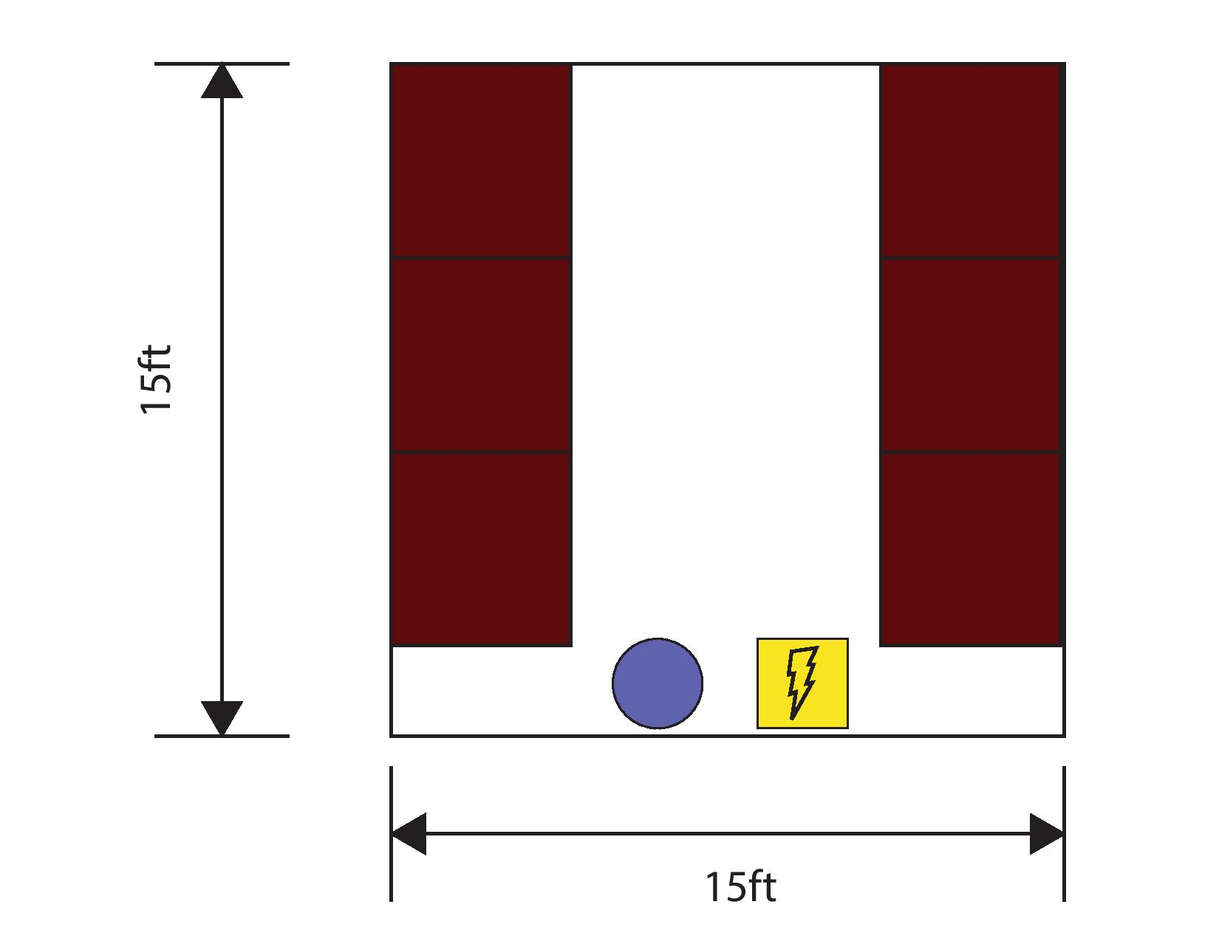
Pilot Study (cont.)
Basic Floor Plan for Pilot study
Notes:
Matt

Slide 25
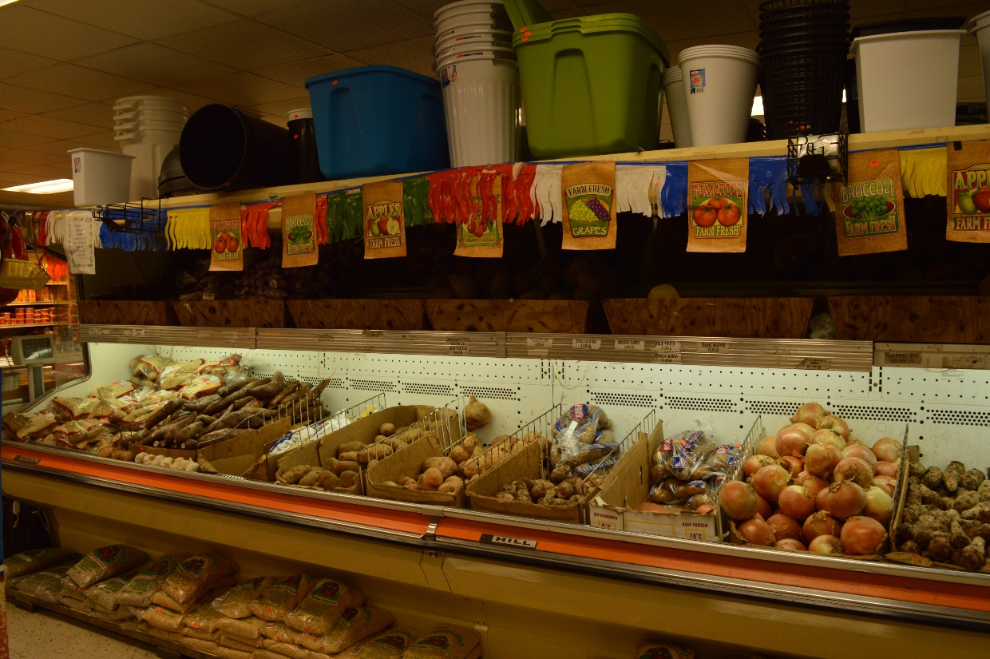
Market Study
Interviews with restaurants and chefs
Establish collaboration between farm and business
Export to nearby islands
Available produce at Supermercado Morales in Vieques
Notes:
Sarah

Slide 26
Different Crops
Pro:
Strong support from community
High demand from markets
Slightly more feasible for engineering
Con:
More expensive
Requires more training?
“Esto programeas deberia implantar mas producto como mas plantas ajies, recao, pimiento verde, lechuga y otros.”
–Anonymous survey response
https://2ecffd01e1ab3e9383f0-07db7b9624bbdf022e3b5395236d5cf8.ssl.cf4.rackcdn.com/Product-800x800/93377668-430d-4f16-b687-ffda6bf51b5b.jpg
Notes:
Serena

Slide 27
Conclusion
Project is potentially feasible with our assumptions
Challenges:
Water usage
Transportation/disposal of materials
Recommendations:
Pilot Study
Market Study
Alternative crops
Notes:
Sarah

Slide 28
Acknowledgements
PLN Educational Project Advisor: Elizabeth Padilla
Auxiliary Superintendent: Julian Garcia
Secretary of Municipality of Vieques: Fabian Martinez
Superintendent of the East Region: Carlos Morales
IQP Advisors
Fred Hart
Karla Mendoza-Abarca

